Slide 1
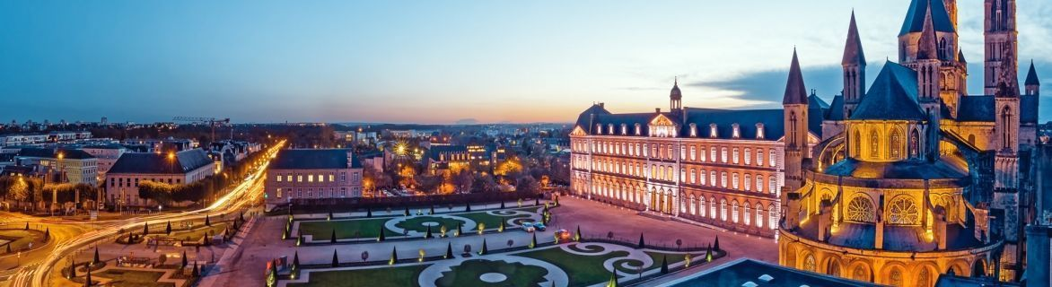
PARIS gamma calorimeter: idea, status and perspectives
European Nuclear Physics Conference 2025
Michał Ciemała
IFJ PAN Kraków, 23/09/2025
for the PARIS Collaboration
http://paris.ifj.edu.pl

Slide 2
Presentation plan
The concept of the PARIS array and initial tests
Physics done with PARIS
Future and summary

Slide 3
The concept of the PARIS array and initial tests

Slide 4
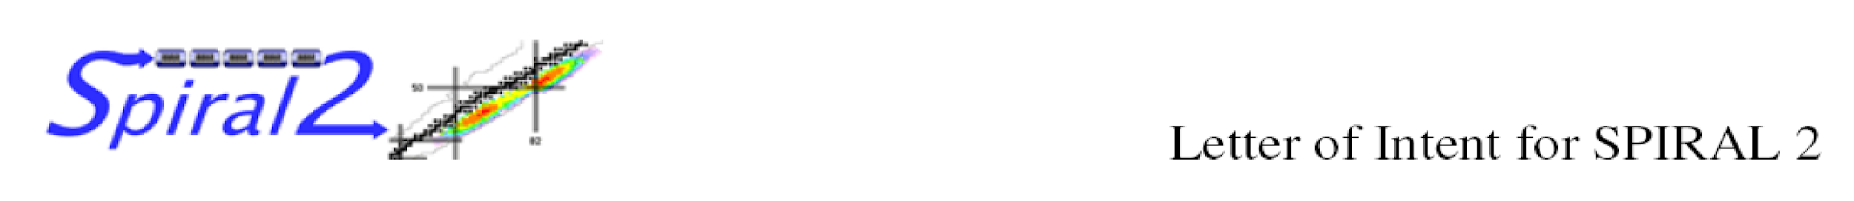
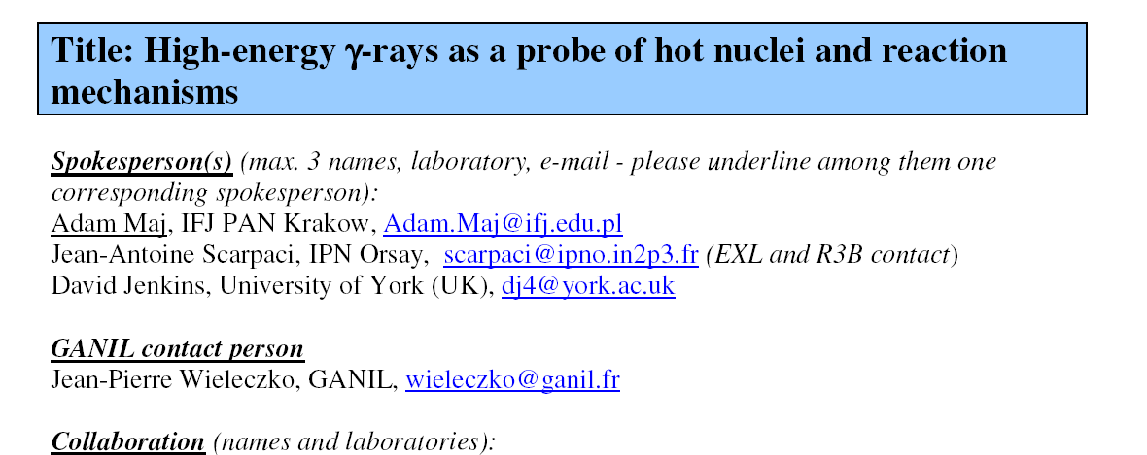
4-5-6th October, 2005 „Future prospects for high resolution gamma spectroscopy at GANIL”
Convenors : Bob Wadsworth and Wolfram Korten
WG „Collective modes in continuum” – convenors: Silvia Leoni and Adam Maj;
M. Kmiecik: talk on possible Jacobi shapes in exotic nuclei
GANIL
SAC open session
October 19th, 2006

Slide 5
PARIS main physics cases
HOT ROTATING NUCLEI
Jacobi and Poincare shape transitions
Studies of shape phase diagrams of hot nuclei
Hot GDR in neutron-rich nuclei
Isospin mixing at finite temperatures
Links between GDR emission and SD/HD structure
GDR and PDR built on isomeric states
Onset of chaotic regime (+AGATA)
A.Maj, J. Dudek, K. Mazurek, M. Kmiecik, M. Ciemała
A. Bracco, F. Camera, S. Leoni, I. Mazumdar, D.R. Chakrabarty, V. Nanal, M. Kicinska-Habior, M. Harakeh, P. Bednarczyk
REACTION MECHANISMS
Onset of multifragmentation and GDR
Reaction mechanism studied via gamma-rays
Heavy ion radiative capture
Nuclear astrophysics
Fission of SHE nuclei
J.P. Wieleczko, S. Santonocito, Ch. Schmitt, O. Dorvaux, S. Courting, D.G. Jenkins, S. Harissopulos, A. Maj
SHELL STRUCTURE
Multiple Coulex of SD bands in light nuclei
Relativistic coulex
Shell structure at intermediate energies
Near barrier resonances
3-body force
F. Azaiez, J. Stephan, B. Fornal, S. Leoni, P. Napiorkowski,
P. Bednarczyk, A. Maj, Z. Dombradi, M. Ploszajczak, S. Leoni, B. Fornal, M. Ciemała, M. Lewitowicz
COLLECTIVE MODES
PDR in neutron-rich and proton-rich nuclei
Gamma-decay of GDR and GQR built on ground states
GDR built on isomeric states
A.Bracco, A. Maj, D. Beaumel, I. Matea, F. Crespi,
M. Kmiecik, M. Lewitowicz, M. Harakeh, M. Kmiecik

Slide 6
General assumptions
The new gamma calorimeter shall:
be transportable (between different facilities: SPIRAL2, ALTO, Legnaro, Kraków, Warsaw,
Mumbai,...)
be modular (to be connected with other detectors: AGATA, EXOGAM, GRIT, NEDA, FAZIA,
ACTAR, VAMOS, …)
have high granulation (multiplicity measurement, Doppler correction,...)
have very high efficiency for high-energy γ-rays
have good timing resolution (<600 ps) – to resolve gamma’s from neutrons by ToF
have energy resolution as good as possible
have some position sensitivity
be readout by digital electronics.

Slide 7

PARIS collaboration
10 PARTNERS:
IN2P3 (France), COPIN (Poland), GANIL/SPIRAL2 (France), TIFR/BARC/VECC (India), IFIN HH (Romania),
INFN (Italy), UK, Turkey, GSI/FAIR Darmstadt
PARIS Steering Committee
Angela Bracco (INFN, Italy)
Wilton Catford (UK)
Oliver Dorvaux (IN2P3, France)
Sefa Ertuerk (Turkey)
Bogdan Fornal (COPIN, Poland) - Vice-Chair
Juergen Gerl (GSI/FAIR, Germany)
Marek Lewitowicz (GANIL, France) - Chair
Vandana Nanal (India)
Mihai Stanoiu (Romania)
PARIS Project Manager
Adam Maj (Krakow)
Working Groups and their Coordinators
Piotr Bednarczyk (Krakow) - Online user interface integration
Sergio Brambilla (Milano) - Electronic and DAQ integration
Michał Ciemała (Krakow) - Physics event generators, off-line data analysis and data management
Oliver Dorvaux (Strasbourg) - Detectors
Iolanda Matea (Orsay) - Mechanical integrations
Oliver Stezowski (Lyon) - Simulations and characterization
PARIS Collaboration Council (21 institutions)
F. Camera (INFN and U. Milano) - chair and PARIS spokesman
C. Bhattacharya (VECC Kolkata), W. Catford (U. Surrey), M. Cinausero (LNL Legnaro), S. Courtin (IPHC Strasbourg),
Zs. Dombradi (ATOMKI Debrecen), C. Ducoin (IPN Lyon), S. Ertuerk (U. Nigde), N. Gelli (U. Florence), J. Gerl (GSI),
A.K. Gourishetty (IIT Roorkee), D. Jenkins (U. York), M. Kmiecik (IFJ PAN Krakow),
B. Kumar Nayak (BARC Mumbai), M. Labiche (STFC Daresbury), V. Nanal (TIFR Mumbai), P. Napiorkowski (HIL Warsaw), M. Ploszajczak (GANIL), M. Stanoiu (IFIN-HH Bucharest), J. Wilson (IPN Orsay)

Slide 8
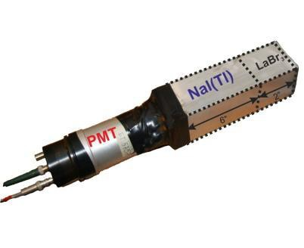
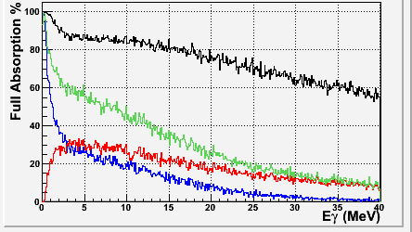
Simulations: O. Stezowski, M.C., M. Labiche et al.
Extensive simulation studies have been performed to understand how γ–rays with energies from few keV up to 50 MeV are absorbed and recovered.
All the considerations drive the design of the basic element of PARIS as composed of
a phoswich 2”x2”x2” LaBr3 (or CeBr3) followed by 2”x2”x6” NaI.
placed at a reasonable distance (ca. 20 cm) from the target position it gives a 4π array composed of ca. 200 of elements
for optimal characteristics in non-relativistic domain (β < 10%).
Phoswich 2” LaBr3 + 6”NaI

Slide 9
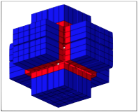
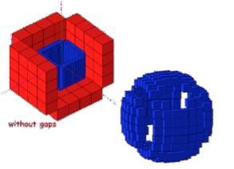
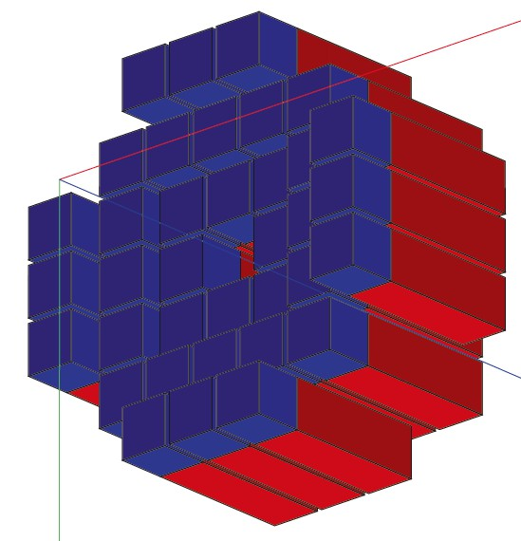
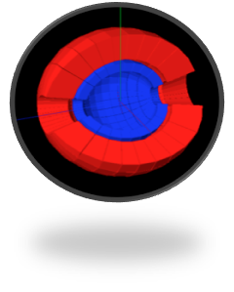
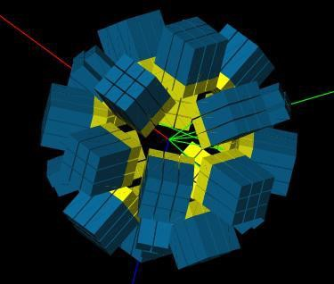
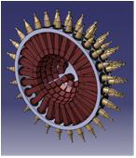
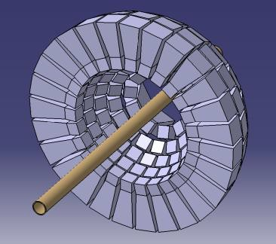
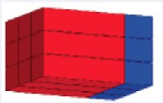
Several geometries studied
‘cubic’-like
‘Ideal’ - spherical
‘radial’-like
PARIS to be made of rectangular phoswiches
Arranged in clusters (9 phoswiches each)
This allows cubic, wall or semi-spherical geometry
with 24 clusters (216 phoswiches)

Slide 10
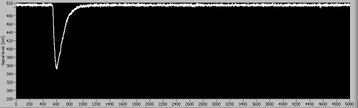

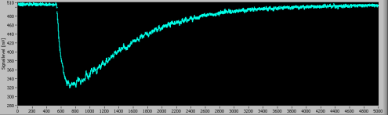


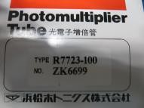
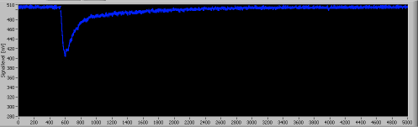
Phoswich tests
10 ns risetime
LaBr₃ or CeBr₃
Single pulses
The PARIS PHOSWICH at work
HAMAMATSU
Mixed signal

Slide 11
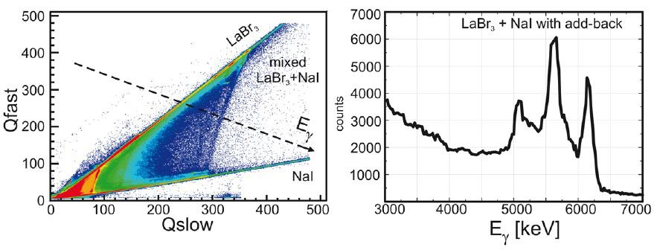
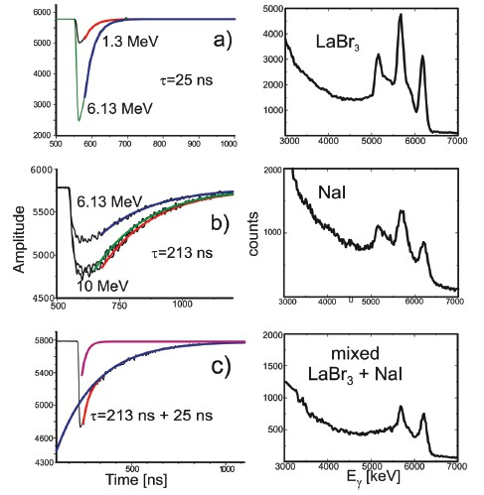
6.13 MeV γ source
A test measurement at IFJ PAN, Kraków (2011) with BaFPro module from Milano
Sources
proton beam
LaBr₃ resolution
(seen through 6” long NaI): ca. 4%
The phoswich concept works !
Other tests: Strasbourg, Orsay, Milano, Warsaw, Mumbai
M. Zieblinski et al.,
Acta Phys.Pol. B44, 651 (2013)

Slide 12
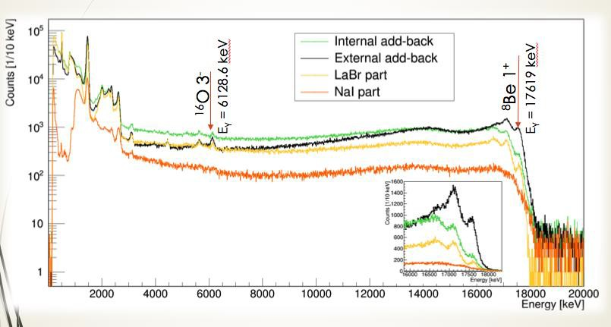
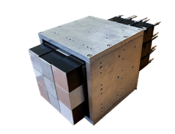
Test experiment in ATOMKI Debrecen – March 2017
(p,gamma) – reaction on LiBO target
Testing PARIS cluster add-back with high-energy gamma-rays
B. Wasilewska et al.,

Slide 13
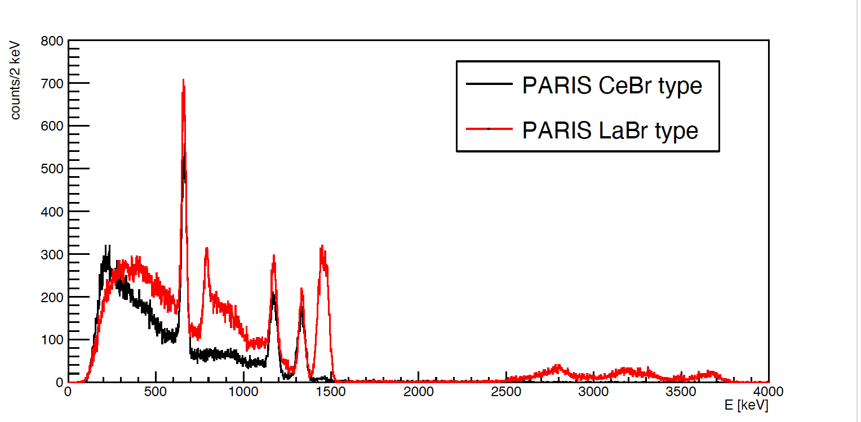
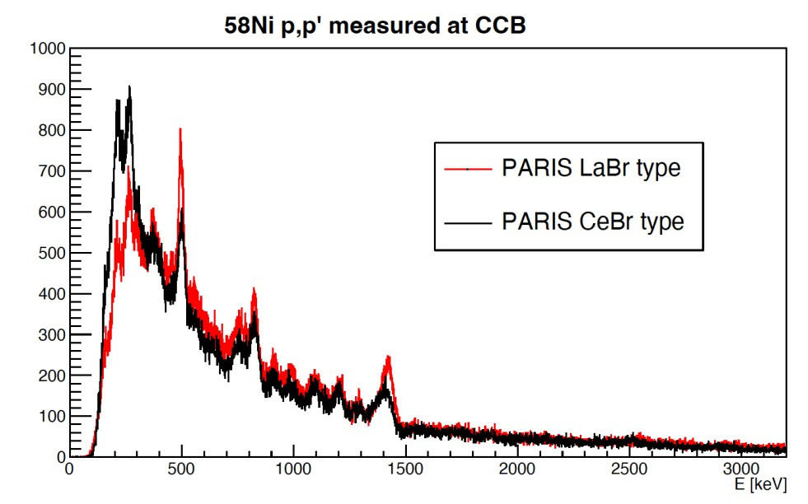
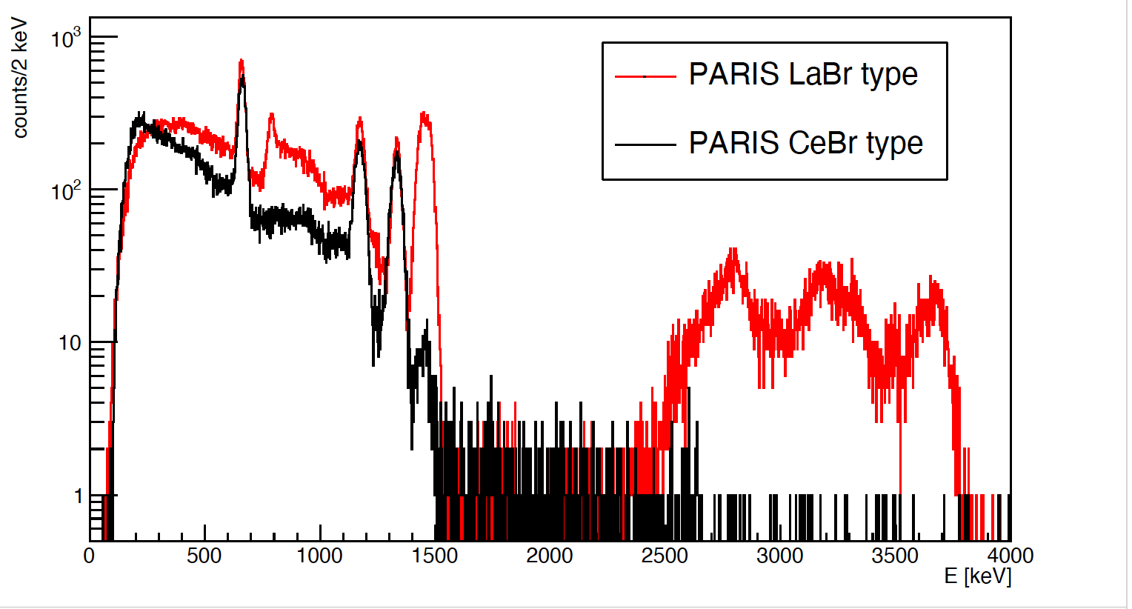
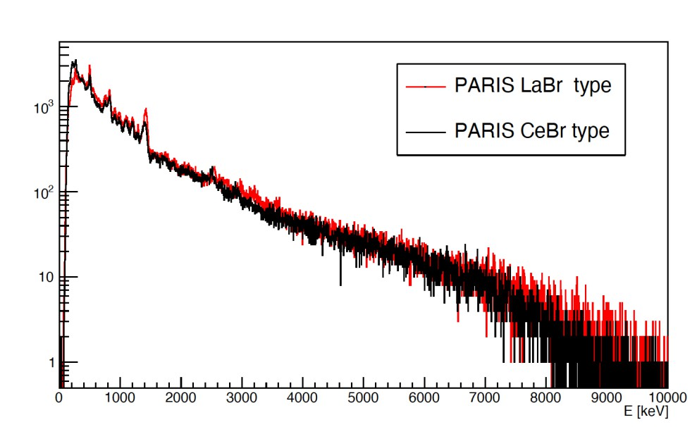
Two types of PARIS phoswiches:
LaBr₃+NaI (from SaintGobain) and CeBr₃+NaI (from Scionix)
Source: ¹³⁷Cs + ⁶⁰Co
in-beam

Slide 14
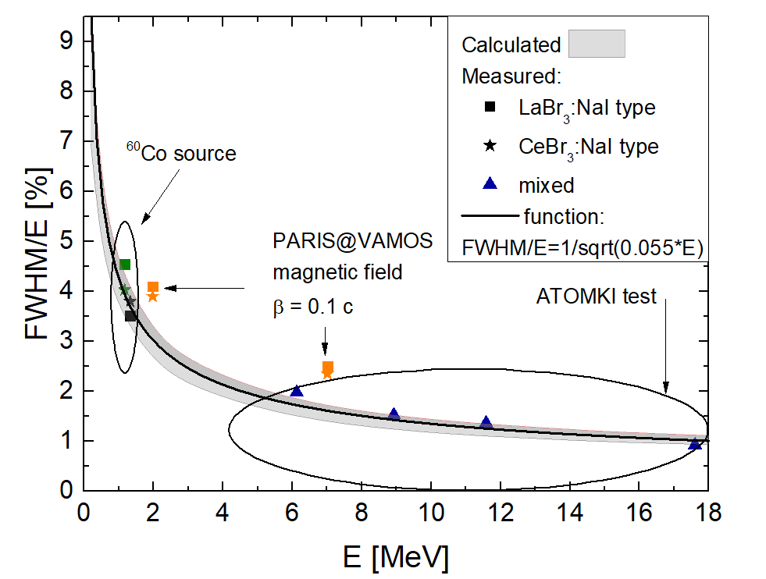
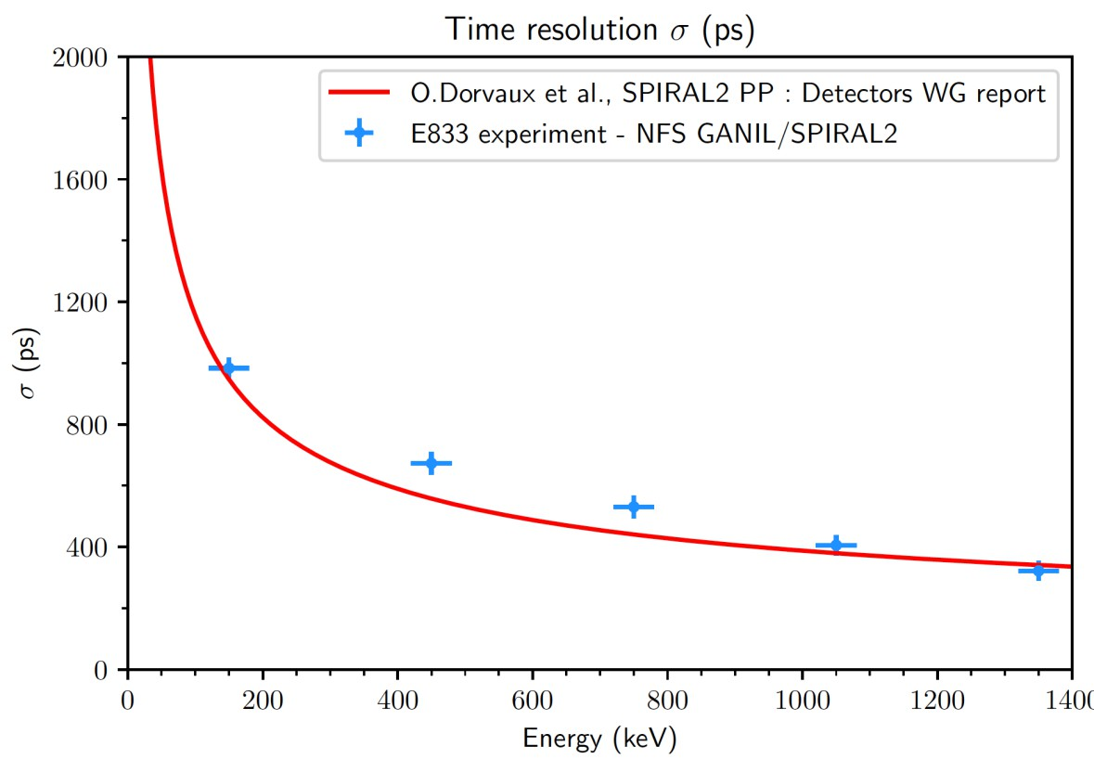
PARIS Energy/Time resolution
PARIS cluster energy resolution as a function of gamma-ray energy: simulation and experimental results.
The continuum line indicates the 1/sqrt(E) energy dependence of the FWHM.
Time resolution (sigma) in the PARIS@NFS experiment.
Courtesy of Perine Miriot-Jaubert.

Slide 15
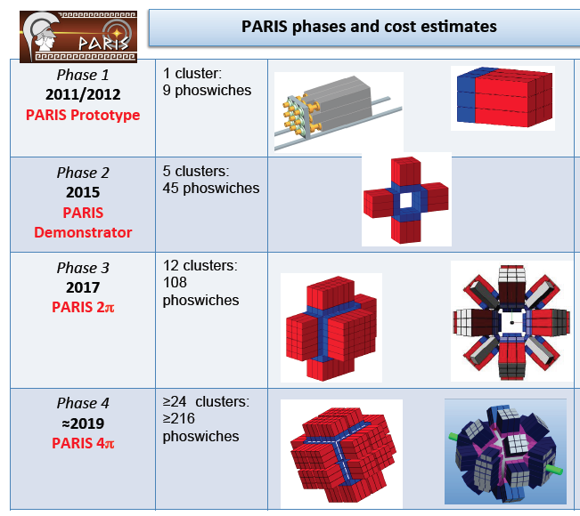
Photon Array for studies with Radioactive Ion and Stable Beam - PARIS (travelling detector)
PARIS Project Manager: A. Maj (IFJ PAN Kraków)
PARIS is a collaborative project between France, Poland, Italy, India, Romania, Germany, UK and Turkey
PARIS cluster
8 clusters
72 phoswiches
2021
IPN Orsay
.
AGATA@GANIL
.
.
S3@GANIL
.
CCB Krakow
.
.
LNL/SPES
.
.
SPIRAL2 phase2
.
PARIS is made of clusters:
Cluster = 9 phoswiches of LaBr₃:NaI or CeBr₃:NaI
Digital electronic basing on V1730 digitizer, which can be coupled to NUMEXO2 boards.
Also other electronic used, by example FASTER digitizers (NFS exp. and @IJCLab)
2025?
2025?
Today we have ~ 10 clusters (90 detectors)
after2025
after2025

Slide 16
Physics done with PARIS

Slide 17
PARIS detectors in experiments
So far PARIS was used in a number of experiments performed at
GANIL 2017:
@VAMOS,AGATA: Lifetime measurements of excited states in neutron-rich C and O isotopes : a stringent test of the three body forces, S. Leoni, B. Fornal, M. Cieamła et al.
b) GANIL 2022:
@VAMOS: Insight into fission from the gamma probe: Going beyond current status with PARIS@VAMOS, Ch. Schmitt, A. Lemassson, M. Cieamła et al.,
@LISE: Study of deformed and spherical 2⁺ states via Coulomb excitation and first time measurement of PDR in ³⁴Si, R. Lica, S. Calinescu, O. Sorlin, et al.
Study of Proton/Neutron contribution along Silicium isotopic chain, S. Grévy, R. Thomas, O. Sorlin, et al.
@NFS:Nuclear structure studies using neutron inelastic scattering reactions, example of the pygmy resonance in ¹⁴⁰Ce, M. Vandebrouck, I. Matea et al.,

Slide 18

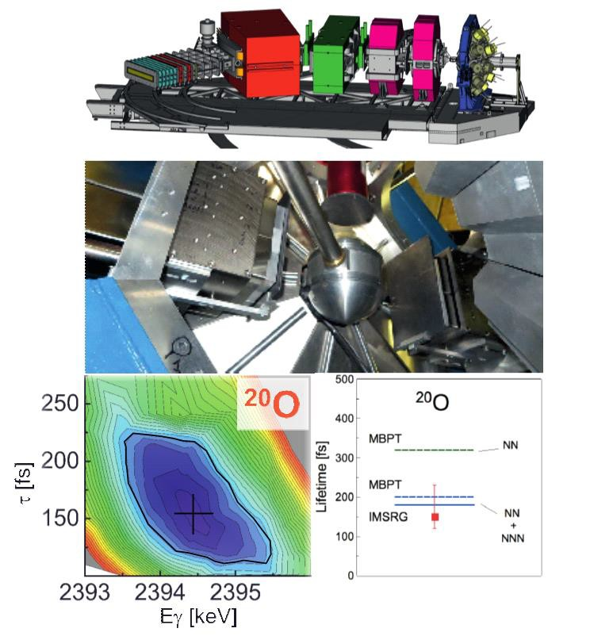
GANIL (France)
Performed:
S. Leoni, B. Fornal, M. C. et al., “Lifetimes in A=18 region – verifying theory predictions (NN or NNN)”
(PARIS: 2 clusters + 2 large LaBr3), AGATA, VAMOS, Plunger (July 2017)
Results published:
M. C. et al. Phys. Rev. C101, 021303(R) (2020)
M. C. et al., EPJ A57, 156 (2021)
S. Ziliani et al., Phys. Rev. C104, L041301 (2021)
The achieved results on transition probabilities in neutron-rich ²⁰O (for the second 2⁺ state) agree well with predictions from theories assuming
3-body interactions.
For the first time information about 3-body forces came from the gamma-spectrocopy studies.
In addition, in the same experiment, were measured lifetimes for the low-lying states in other neutron-rich nuclei: ¹⁷N, ¹⁸N, ¹⁶C, ¹⁷O, ¹⁹O, ¹⁴C

Slide 19
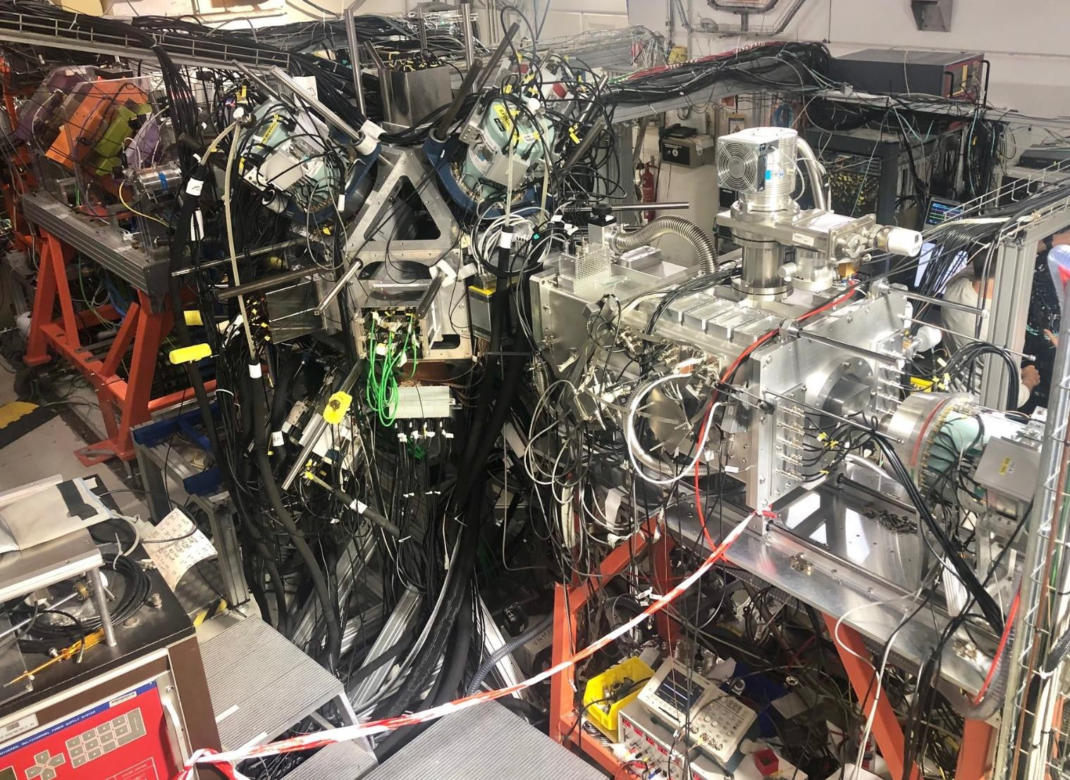


Brochette mode at LISE2022, GANIL
1) Nuclear, 2) Coulomb excitation, 3) isomer and beta-decays
ACTAR TPC
S. Grevy, "Study of proton and neutron contributions to the excitation of the 2+ states in Si isotopes between N=20 and N=28", talk on Monday, 15:05
ZDD
”Study of deformed and spherical 2+ states via Coulomb excitation and first time measurement of PDR in 34Si,” R. Lica, S. Calinescu, O. Sorlin, et al.
„Study of Proton/Neutron
contribution along Silicium isotopic chain” S. Grévy, R. Thomas, O. Sorlin et al.
CATS
EXOGAM 0°
8 PARIS
8 EXOGAM
Annular Si
22
Data are being analyzed
LISE 20
Photo: V. Morel

Slide 20
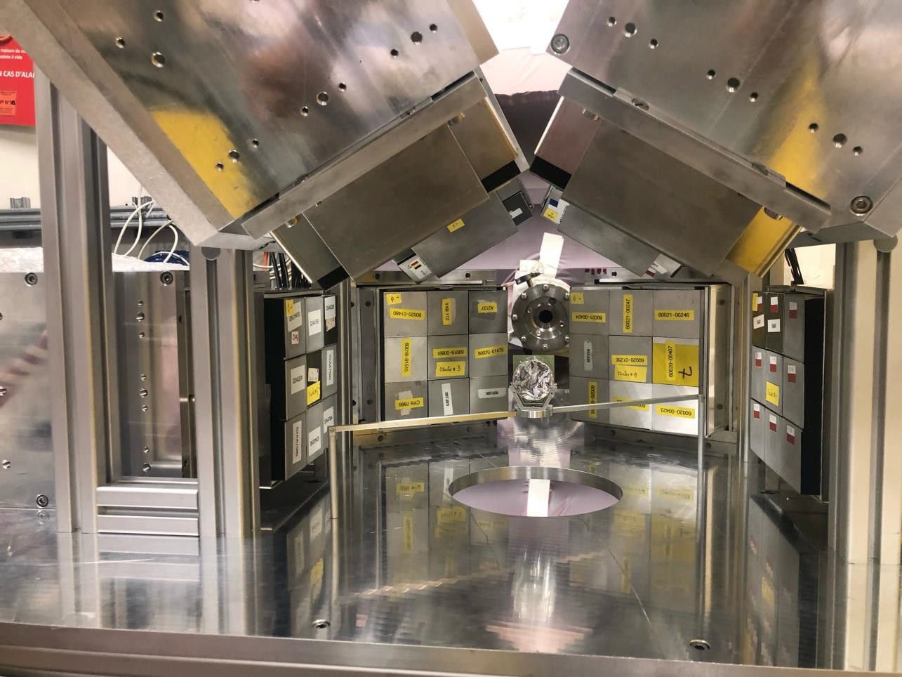
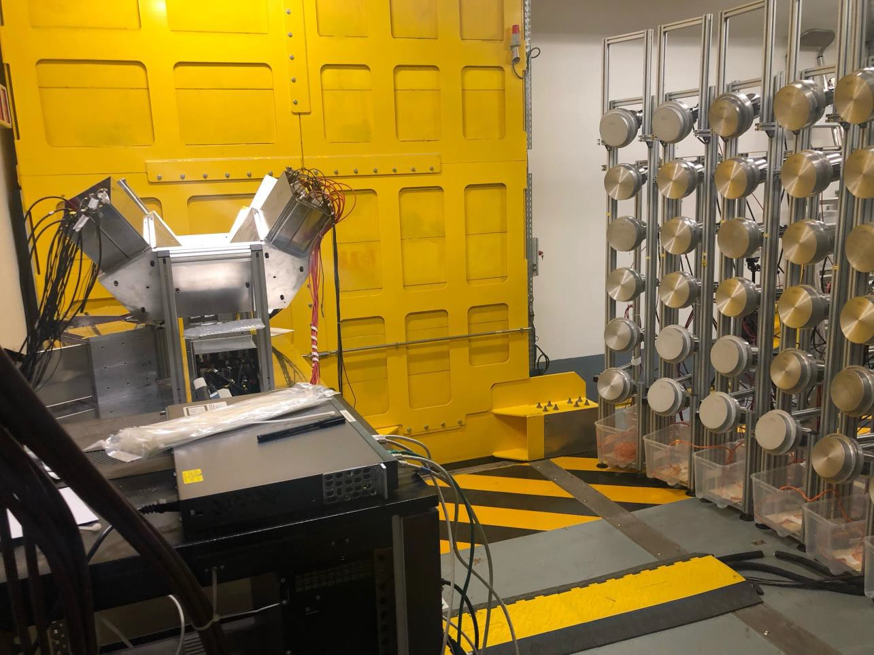
NFS: Nuclear structure studies using neutron inelastic scattering reactions, example of the pygmy resonance in ¹⁴⁰Ce
P. Miriot-Jaubert, " First study of the PDR via neutron inelastic scattering at GANIL-SPIRAL2/NFS ", talk on Tuesday, 18:05

Slide 21
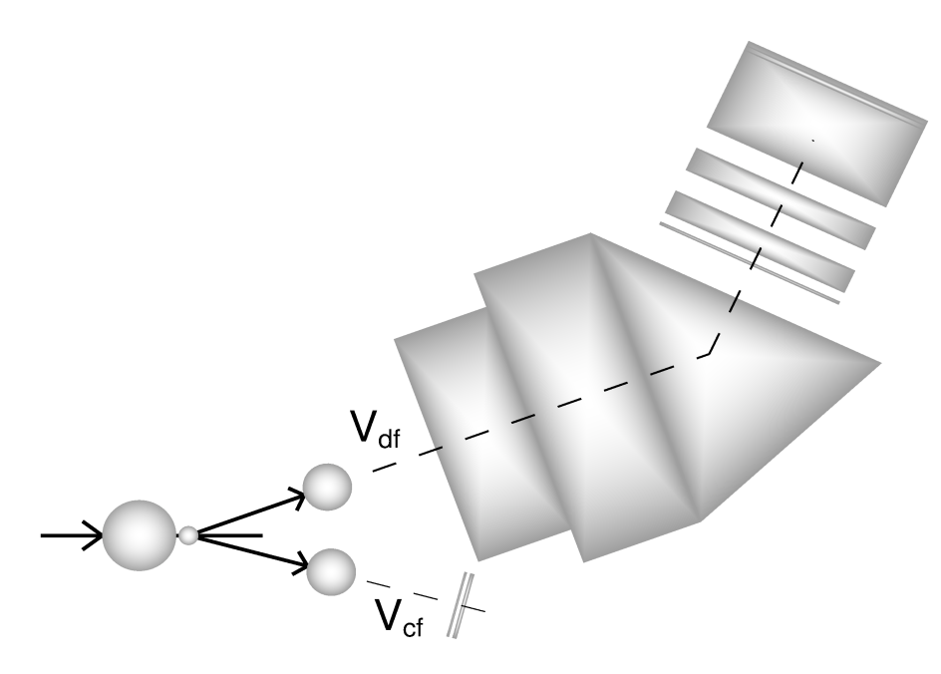
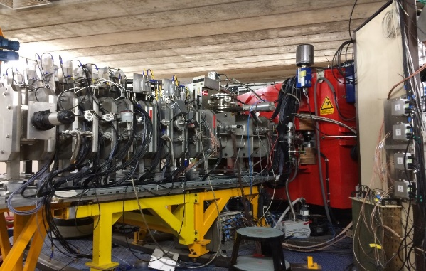

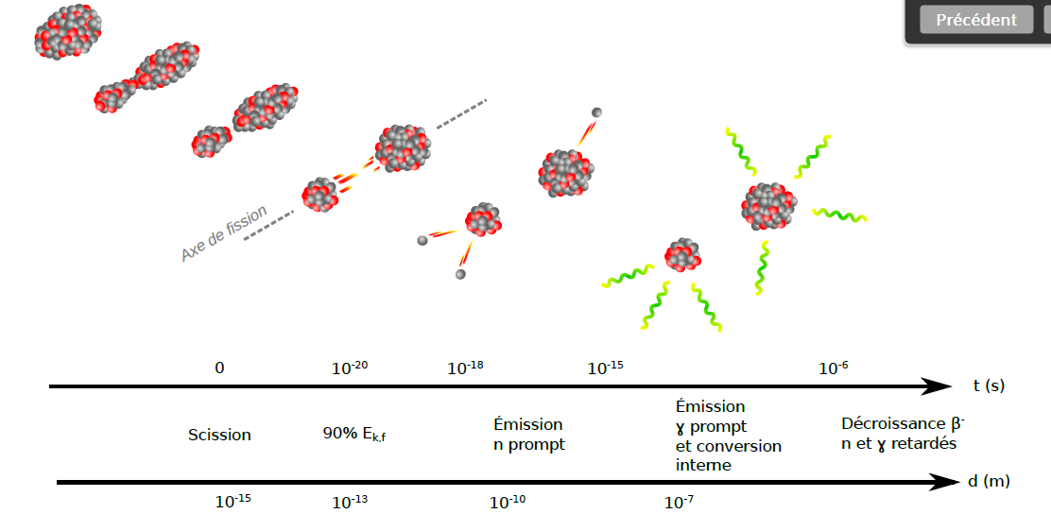
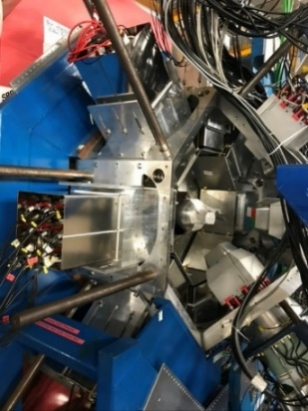
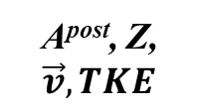
Insight into fission from the gamma probe: Going beyond current status with PARIS@VAMOS
A^{post}, Z,
$$\vec{v}, TKE$$
Fusion-fission in inverse kinematics
²³⁸U + ⁹Be →²⁴⁷Cm* (E*~ 43MeV)
^{(5.88MeV/u) (500μg/cm2)}
Ff1
Ff2 Ff2
γ
Ff1
^{target}
γ
^{beam}
10 days of the beam time
1.5 pnA of the beam current
Ff2
VAMOS++
ϑ=21°, Bρ=1.1Tm
 Ff’s uniquely resolved / characterized
in (A, Z, $\vec{v}$)
 PFGS and properties (E_{γ} , E_{γ}^{sum}, M_{γ})
 Neutrons (E_{n} , M_{n})
PFGS
E_{γ} , E_{γ}^{sum}, M_{γ} , M_{n}
event
by
event
PARIS
Exogam

Slide 22
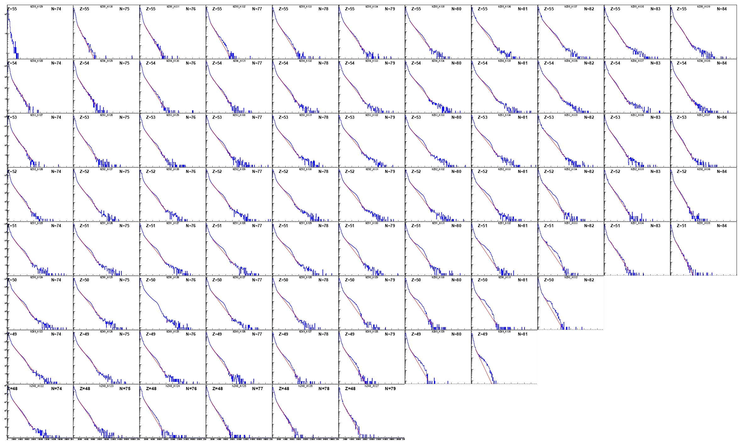
N,Z gated γ properties - PFGS
Z = 55
Z = 54
Z = 53
Z = 52
Z = 51
Z = 50
N = 83
Z = 49
N = 82
Z = 48

Slide 23
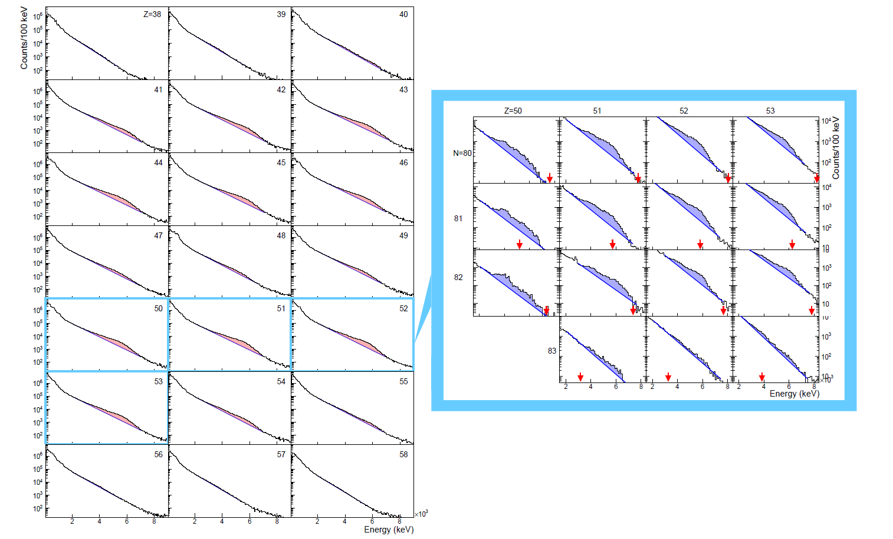
Ch. Schmitt, "Fission: review of recent major advances and selected results", plenary talk on Tuesday, 11:30
N,Z gated γ properties - PFGS

Slide 24
3-4 clusters of PARIS in CCB @ IFJ PAN Krakow for 2024/2026 campaign (beam time only during weekends)
M. Kmiecik, "Studying collective excitations at CCB of IFJ PAN Krakow", talk on Tuesday, 18:25
PDR in ⁵⁸Ni and ⁶²Ni (O. Wieland, M. Kmiecik)
PDR in ⁶⁴Ni (A. Giaz, M. Ciemała)
M4 stretched states in ¹⁶O and ¹²C (N. Cieplicka, G. Corbari)
Evolution of prompt fission gamma-ray emission with excitation energy and the
Thorium anomalies (Ch. Schmitt, M. Ciemała, J. Wilson)
Gamma decay study of the Double Isobaric Analog State in ⁴⁸Ti (D. Stramaccioni)
Search for the PDR in the deformed isotope ⁶⁴Zn as a continuation of the systematic study of PDR in the A=60 mass region (A. Giaz, M. Ciemała)

Slide 25

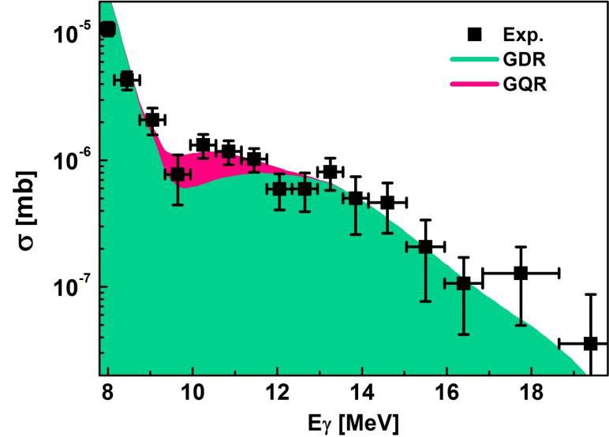
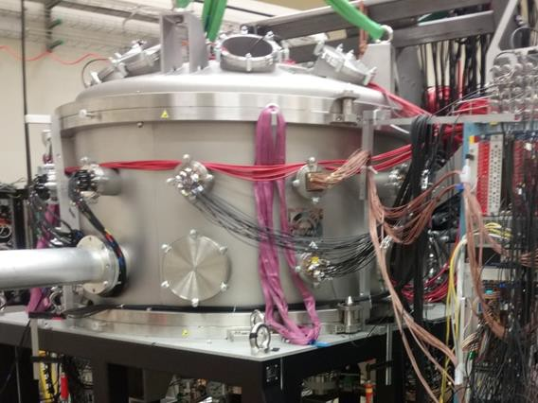
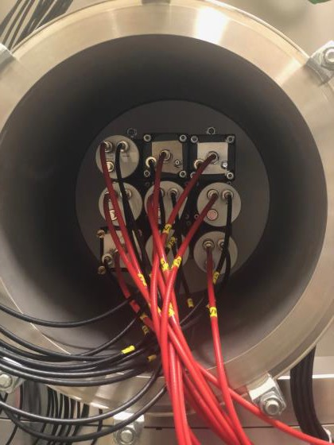
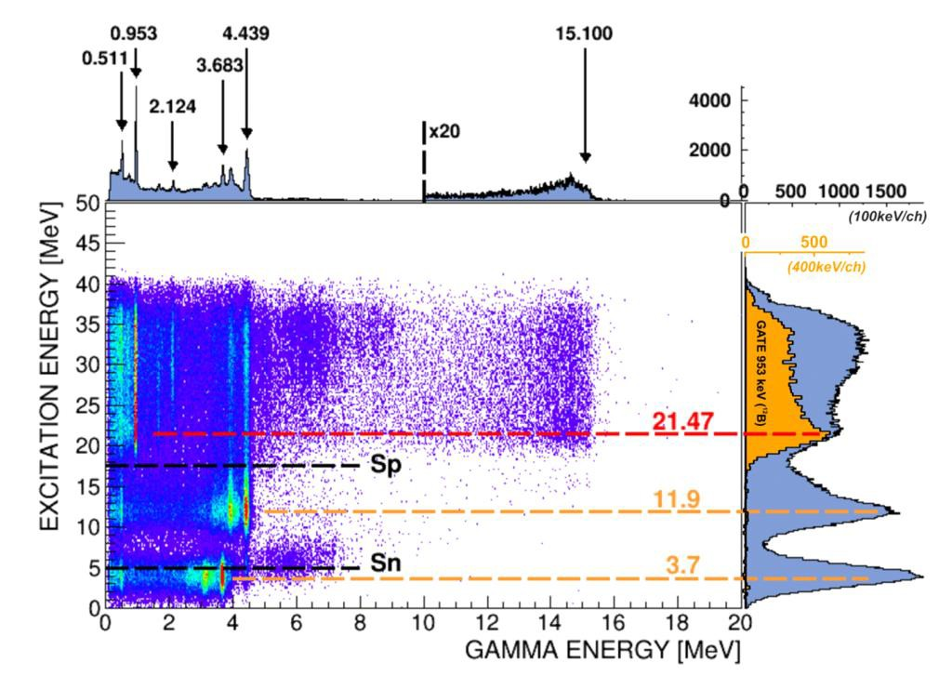
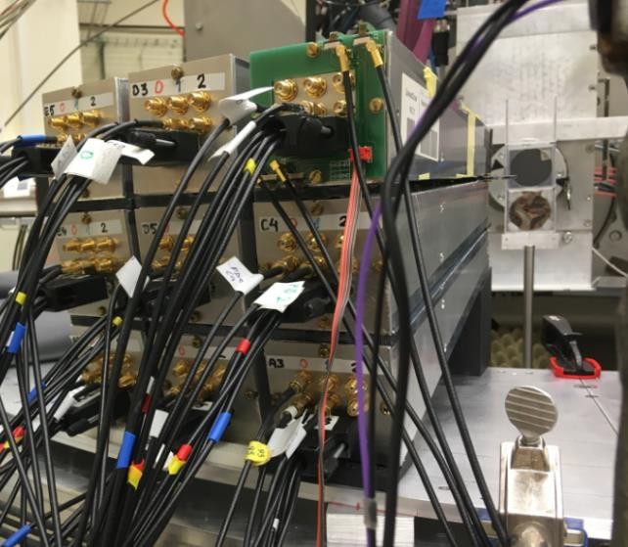
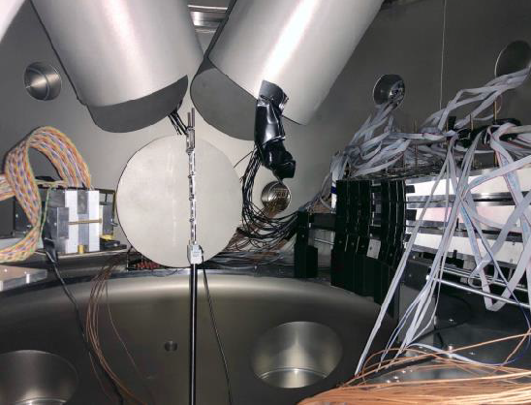
CCB@IFJ-PAN Krakow (Poland) (2 PARIS clusters) - „Studies of resonances in nuclei using
high-energy proton beam in p,p’ reactions at forward angles”
B. Wasilewska, M. Kmiecik, M. Ciemała, et al., Phys. Rev. C 105, 014310 (2022)
Gamma-decay of GQR in ²⁰⁸Pb and ¹²⁴Sn (M. Kmiecik, F. Crespi)
N. Cieplicka-Oryńczak, Y. Jaganathen, B. Fornal, et al., Phys Lett B 834, 137398 (2022)
N. Cieplicka-Oryńczak, "Decay of the stretched resonance at 19.6 MeV in 12C investigated via (p,p’) reactions", talk on Tuesday, 18:45
Decay of the M4 resonance (21.5 MeV) in ¹³C nucleus has been identified (N. Cieplicka, S. Leoni, B. Fornal)

Slide 26
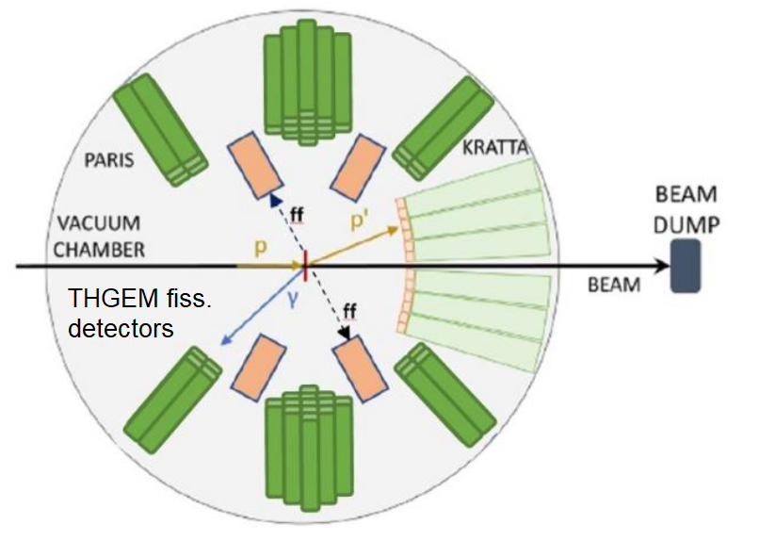
Upgrade of the setup: Evolution of prompt fission gamma-ray emission with excitation energy and the Thorium anomalies
Inelastic scattering
p + ²³²Th → p’ + ²³²Th* (E* up to ~ 30MeV)
^{(160Mev) (400μg/cm2)}
Event-by-event
 E* - tagged fission of ²³²Th
 Ff’s (A, TKE)
 PFGS and PFNS
^{p’}
^{n}
²³²Th
^{p}
^{γ}
Ff1
²³²Th*
Ff2
KRATTA
32 triple telescopes
40cm from target
from 6° to 18°
E_{p’} , ϑ_{p’}
PARIS
42 phoswiches
27cm from target
@ ±45, 90, 135°
PFGS, E_{γ}^{sum}, M_{γ} ,
PFNS, M_{n}
Fission detectors
20cm from target
@ ±30° and ±150°
A_{ff} ^{pre}, $\vec{v}\text{ff} , TKE$_{ff}

Slide 27

IJCLab Orsay (France)
Early years (2017-2019) experiments:
E. Kozulin, I. Harca, E. Vardaci et al. “Prompt γ-rays as a probe of nuclear dynamics” (2017)
I. Matea, J. Wilson, M. Ciemala et al. „PARIS cluster response to fast neutrons” (2017)
M. Lebois, Q. Liqiang et al. “Prompt gamma and neutron emission for ²³⁸U fast neutron
induced fission as a function of incident neutron energy” (2017)
I. Matea et al., „PDR studies in very neutron rich nuclei around N=50 shell closure through
beta-decay” (2019)
M. Babo, A. Gottardo et al., “⁸¹Zn ground-state spin determination from pandemonium
free beta-delayed spectroscopy of ⁸¹Ga” (2019)
A. Oberstedt, “Measurement of prompt gamma ray spectra from the reaction ²³³U(n,f)”
(2019)

Slide 28



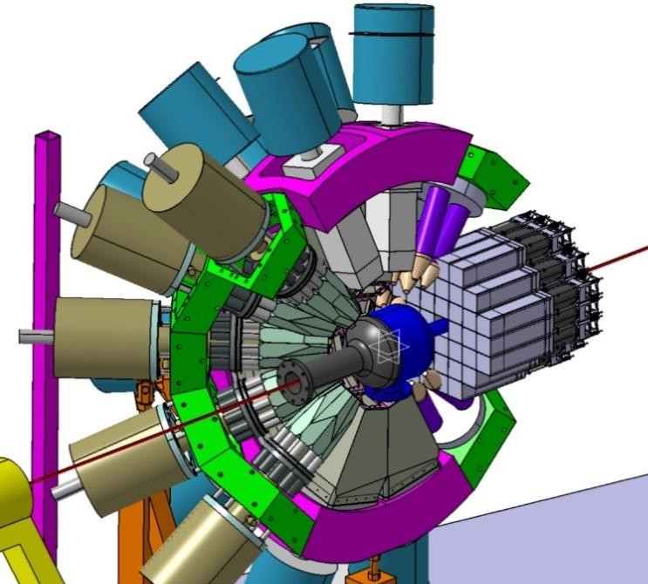
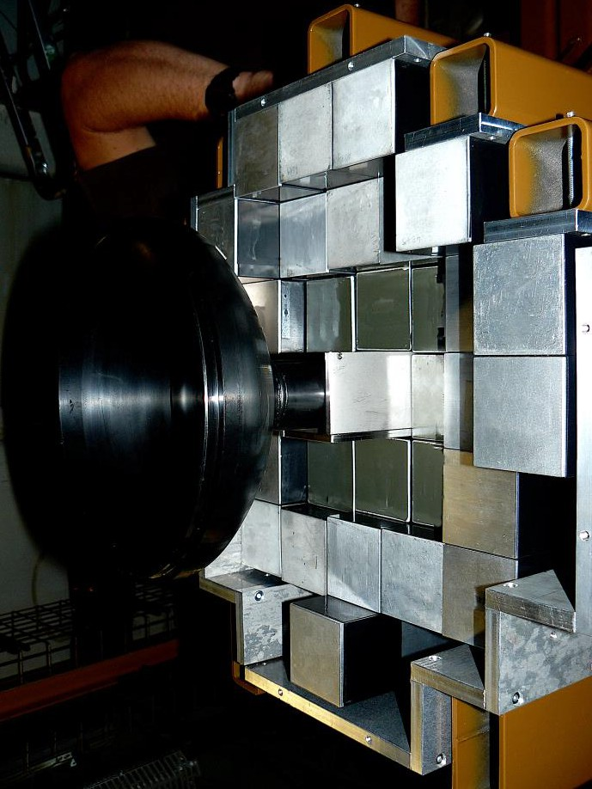
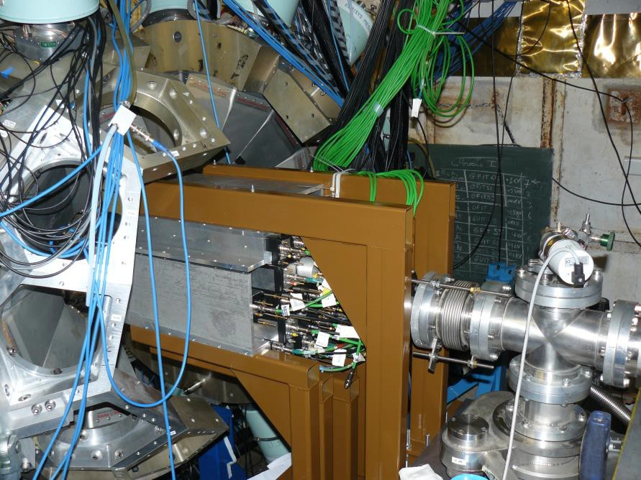
IJCLab Orsay (France) - nuBall 1 campaign
nuBall (24 clover HPGe detectors, 10 coaxial Ge detectors)
4 PARIS clusters (34 phoswich LaBr₃/CaBr₃+NaI detectors - „wall”

Slide 29
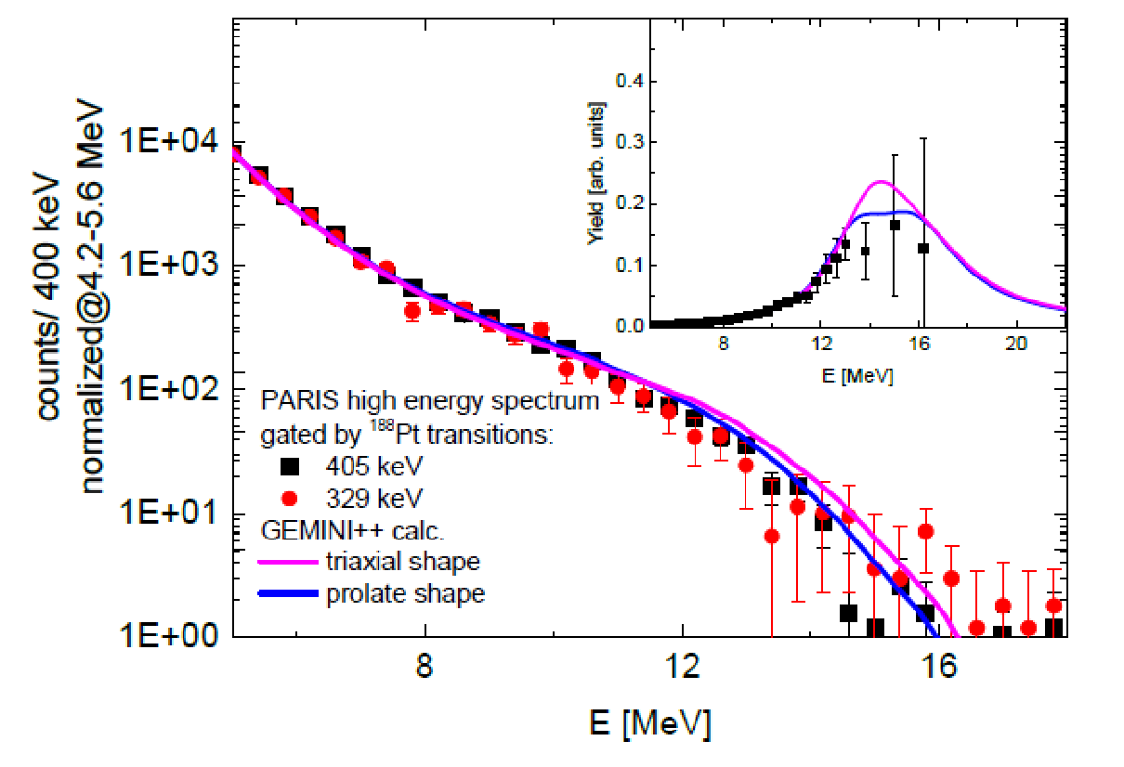
“Feeding of low-energy structures of different deformations by the GDR decay: the nuBall array coupled to PARIS”
¹⁸O + ¹⁷⁴Yb → ¹⁹²Pt
Better agreement to experimental data is seen for the calculations assuming prolate-like shape of the nucleus.
Suggestion that either:
the assignment of the triaxial deformation for 12+ isomer is wrong
or
the nucleus does not preserve the shape during the decay.
M.C. et al., Acta Phys. Pol B Proc. Suppl. 16, 4-A3 (2023)

Slide 30
PARIS + NuBall2 experiments at IJCLab, France
2022 List of experiments:
N-SI-122, November 2022: M. Ciemała et al. “Links between ⁸⁰Sr compound nucleus’ shape and its residue’s deformation studied with the GDR”
2023 List of experiments:
N-SI-129, January 2023: J. Wilson et al. “Detailed spectroscopy of fission isomers in Uranium isotopes”
N-SI-131, January 2023: G. Pasqualato et al., “Evidence for enhanced collectivity in ⁵⁸Fe examined through Coulomb excitation”
N-SI-85, March/April 2023: P.J. Napiorkowski et al., „Coulomb excitation of super-deformed band in ⁴⁰Ca”
N-SI-125, March 2023: M. Lebois et al., “Neutron-gamma de-excitation of fission fragments level lifetimes in exotic neutron-rich nuclei “
N-SI-136, May 2023: J. Wilson et al. “Search for the fission shape isomer in ²³²Th”
N-SI-128, June 2023: M. Matejska-Minda et al. „Investigation of high spin structures in ⁴⁴Ti and ⁴²Ca via discrete and continuum gamma spectroscopy”
N-SI-137, June 2023: K. Hadyńska-Klęk et al, “- Emergence of the collectivity near magic nuclei: Coulomb excitation of ⁶²Ni”
J. Wilson, "Fission studies with the nu-Ball2 array", talk on Tuesday, 14:40

Slide 31
Future and Summary

Slide 32

PARIS Whitebook
(concept, physics case, outlook)
Editorial Board:
F. Camera (chair), A. Maj (co-chair),
S. Leoni, Ch. Schmidt, I. Mazumdar
M. Lewitowicz (GANIL)
I. Matea, J. Wilson (IPN Orsay)
M. Kmiecik (IFJ PAN Krakow)
M. Cinausero, F. Crespi (LNL Legnaro)
V. Nanal (TIFR Mumbai)
http://rifj.ifj.edu.pl/handle/item/333
ISBN 978-83-63542-22-1

Slide 33
Presently PARIS collaboration possesses 106 phoswich detectors
which means ~12 clusters:
4 LaBr3:NaI clusters (produced by Saint Gobain)
6 CeBr3:NaI cluster (produced by Scionix)
1 mixed LaBr:NaI and CeBr3_NaI
Detectors are normally in the owners laboratories
(for example: 3 clusters are presently in IFJ PAN Krakow, 2 in Mumbai, rest in
Orsay, Milano, …)
According to the MoU the partners should make them available for the experimental campaigns in the host laboratories: GANIL, IJCLaB Orsay, LNL Legnaro, IFJ PAN, Mumbai, …

Slide 34



The PARIS Collaboration proposes to bring the PARIS calorimeter in its present stage (10 clusters) to LNL
Legnaro, and couple it to the AGATA array for the experiments during the
AGATA Zero Degree Campaign (2027-28 ?)
Ongoin work for the details of the mechanical coupling by
IJCLab Orsay (I. Matea, Ch. le Galliard), IFJ PAN Krakow (B. Sowicki, A. Maj, M. C.),
LNL Legnaro (S. Pigliapoco, M. Rampazzo, J.J. Valiente-Dobon), Milano (F. Camera, G. Benzoni, B. Million)

Slide 35
The concepts of PARIS phoswich (LaBr₃+NaI, CeBr₃+NaI) and PARIS cluster of 9 phoswiches, were proved to work according to expectations based on simulations
Results from the first PARIS experiments done in GANIL, IPN Orsay and CCB at IFJ
PAN Krakow, are coming and are promising
PARIS, either standalone or coupled to other detectors, performs well
At present PARIS possesses ~12 clusters (100 phoswich detectors)
PARIS campaigns are planned
in IFJ PAN Krakow, 3 clusters (2025-2026)
LNL Legnaro (10 clusters, as an acillary detector to AGATA, 2027-28?)
Possibly at other facilities like HIL Warsaw, TIFR India, HiSpec/DeSpec@GSI/FAIR (2026-> ?)
New MoU till 2026 (ca. 16 clusters – a compact 4π geometry of the PARIS Calorimeter) is signed
paris.ifj.edu.pl

Slide 36
Acknowledgements
A. Maj, M. Kmiecik, B. Fornal, P. Bednarczyk, M. Ziębliński, J. Grębosz, B. Sowicki et al. (IFJ PAN Kraków)
M. Lewitowicz, E. Clement, A. Lemasson et al.. (GANIL)
O. Dorvaux, C. Schmitt et al.. (IHPC Strasbourg)
J. Wilson, I. Matea, Ch. le Galliard et al. (IPN Orsay)
A. Bracco, S. Leoni, F. Camera, S. Brambilla, F. Crespi et al. (University of Milano)
P. Napiorkowski, K. Hadyńska-Klęk et al. (HIL Warsaw)
V. Nanal, C. Gosh, B. Dey, I. Mazumdar et al. (India)
M. Stanoiu et al. (Bucharest)
D. Jenkins et al. (York), W. Catford (U. Surrey)
J. Gerl (GSI),
PARIS, AGATA, VAMOS, nuBall and LICORNE collaborations
Technical staff of IJCLab Orsay, IFJ PAN Krakow, GANIL Caen, ATOMKI Debrecen
Saint Gobain and Scionix
ENSAR2 and EURO-LABS (TNA support), COPIGAL and POLITA collaboration projects, Polish NCN grants

