Slide 1






DIAMMONI: diamond-detector for beam monitoring at ultra-high dose rate
Molle Robin
molle@lpsc.in2p3.fr

Slide 2
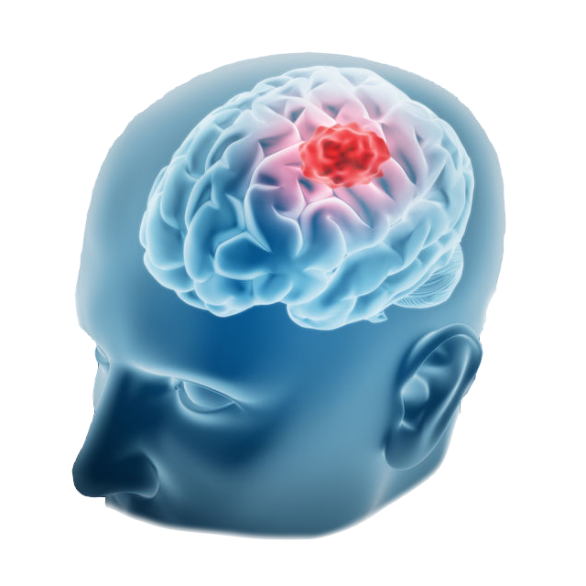

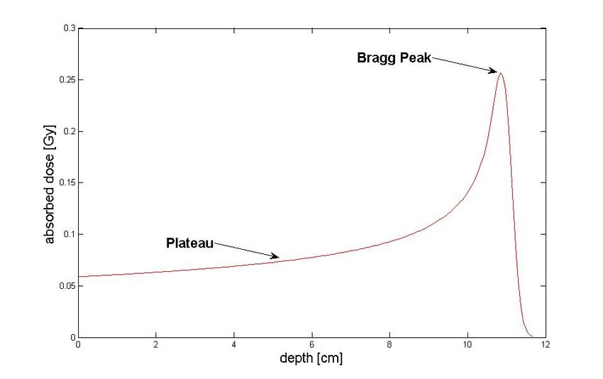
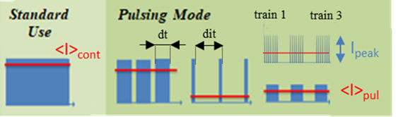
Why beam monitoring?
Diamond detector
Secondary particle emissions
Beam monitoring
Ion beam
Number of particles
50 MeV – 150 MeV for protons
Time tagging for particles
Time stamps for trains
Beam structure:
Microstructure : ~30 ns bunch
(4 ns ON – 29 ns OFF for ARRONAX cyclotron)
Macrostructure : few µs to 1 ms train
train made of bunches
tunable duration dt
tunable duration between trains dit
Source: The pulsing chopper-based system of the ARRONAX C70XP Cyclotron, Poirier et al., International Particle Accelerator Conference, 2019. URL https://doi.org/10.18429/JACoW-IPAC2019-TUPTS008
Source : Experimental determination of absorbed dose to water in a scanned proton beam using a water calorimeter and an ionization chamber, S. Gagnebin,2010. URL : https://www.researchgate.net/publication/272623275_Experimental_determination_of_absorbed_dose_to_water_in_a_scanned_proton_beam_using_a_water_calorimeter_and_an_ionization_chamber

Slide 3
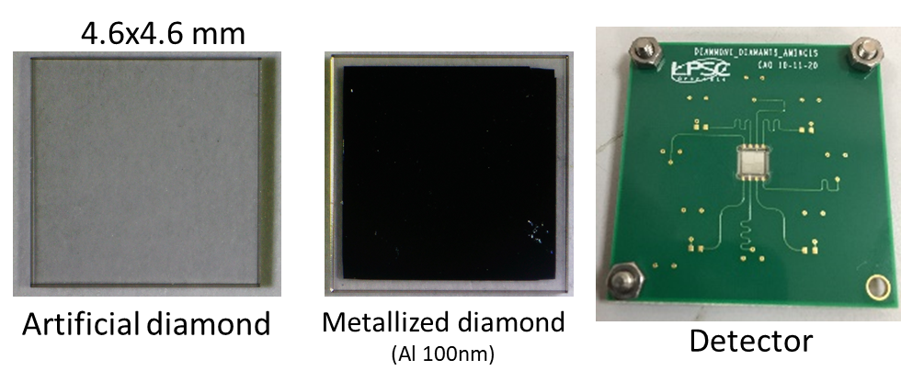



Flash therapy vs conventional?
➔ high doses in a very short time: diamond beam monitoring!
Conventional X-rays
or hadrontherapy → Gy/mn
Flash therapies → 100 Gy/s
Short pulses to be monitored at high beam intensity !
High particle couting rate capabilities to be demonstrated
Bunch or train of bunches time stamps
Ionizing particle
Diamond compared to other semiconductors
Diamond Assets :
Intrinsic radiation hardness
Fast signal risetime enables timing precision of a few tens of ps
Low noise
Issues :
Cost
Availability of large area
d = 150-500 µm
$$\vec{E}\sim 1 V/µm$$
$$V_{bias}$$

Slide 4
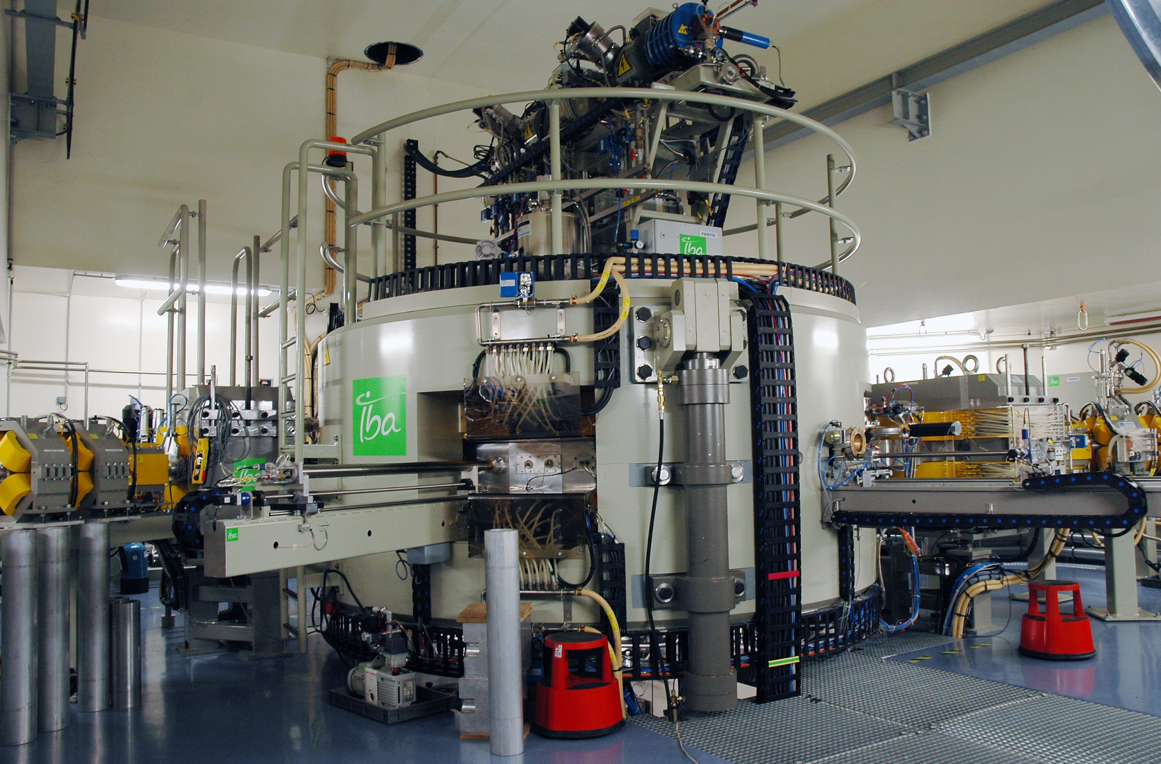
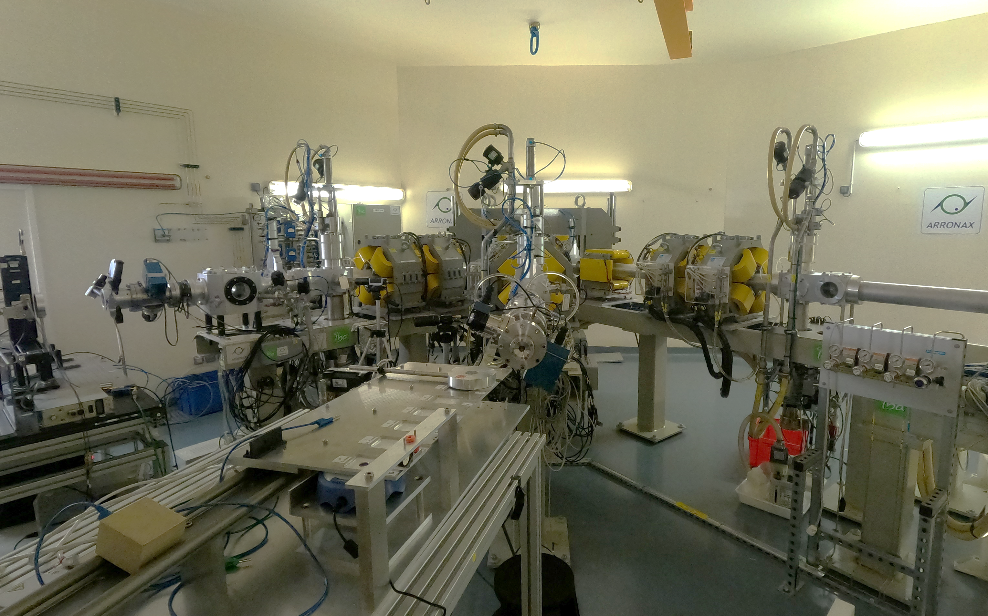
ARRONAX cyclotron (France)
68 MeV proton / 70 MeV alpha particles cyclotron
Beam intensity up to 20 µA
Continuous or pulse mode beam delivery with tunable dt and dit time duration
Bunch : 4ns ON, 29ns OFF (f = 30,45 MHz)
Source: The pulsing chopper-based system of the ARRONAX C70XP Cyclotron, Poirier et al., International Particle Accelerator Conference, 2019. URL https://doi.org/10.18429/JACoW-IPAC2019-TUPTS008

Slide 5
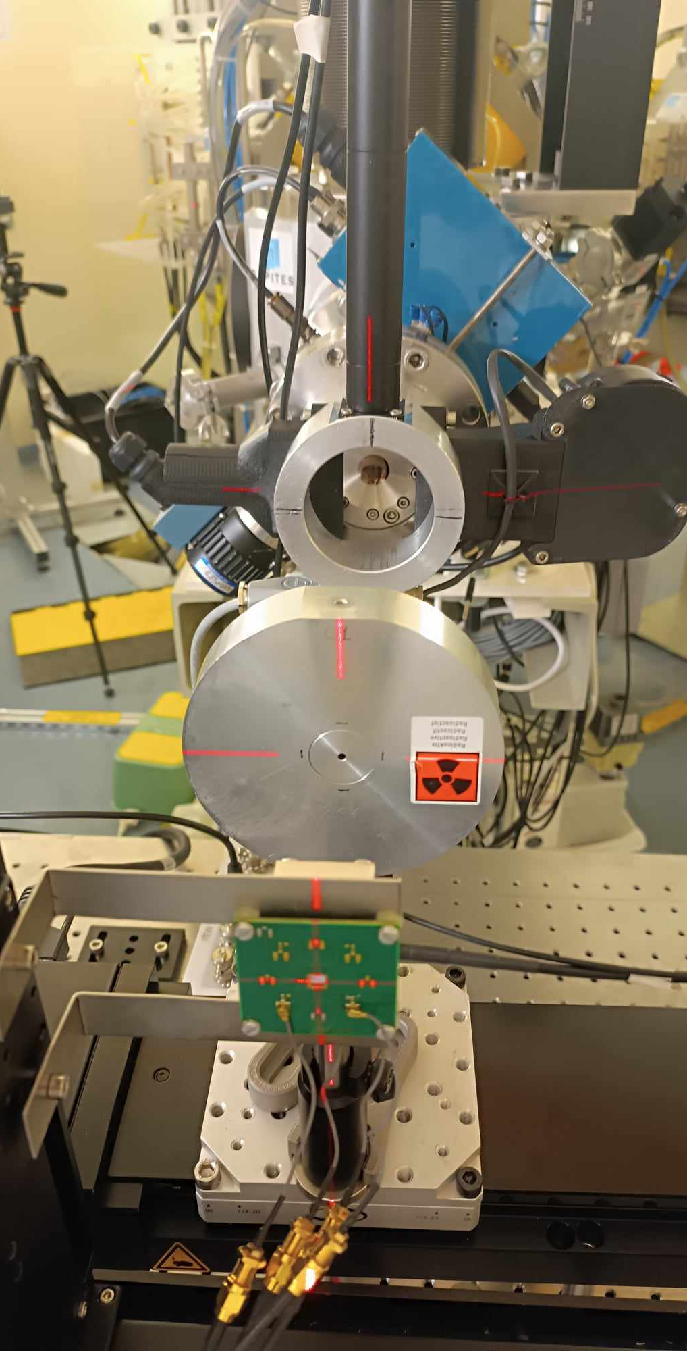
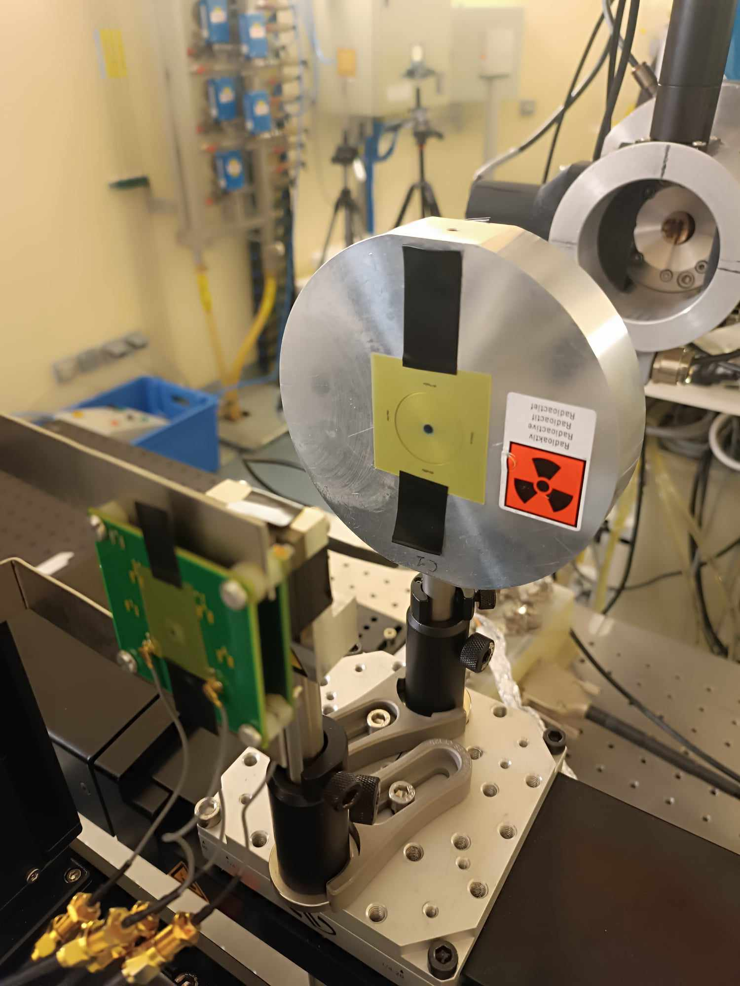
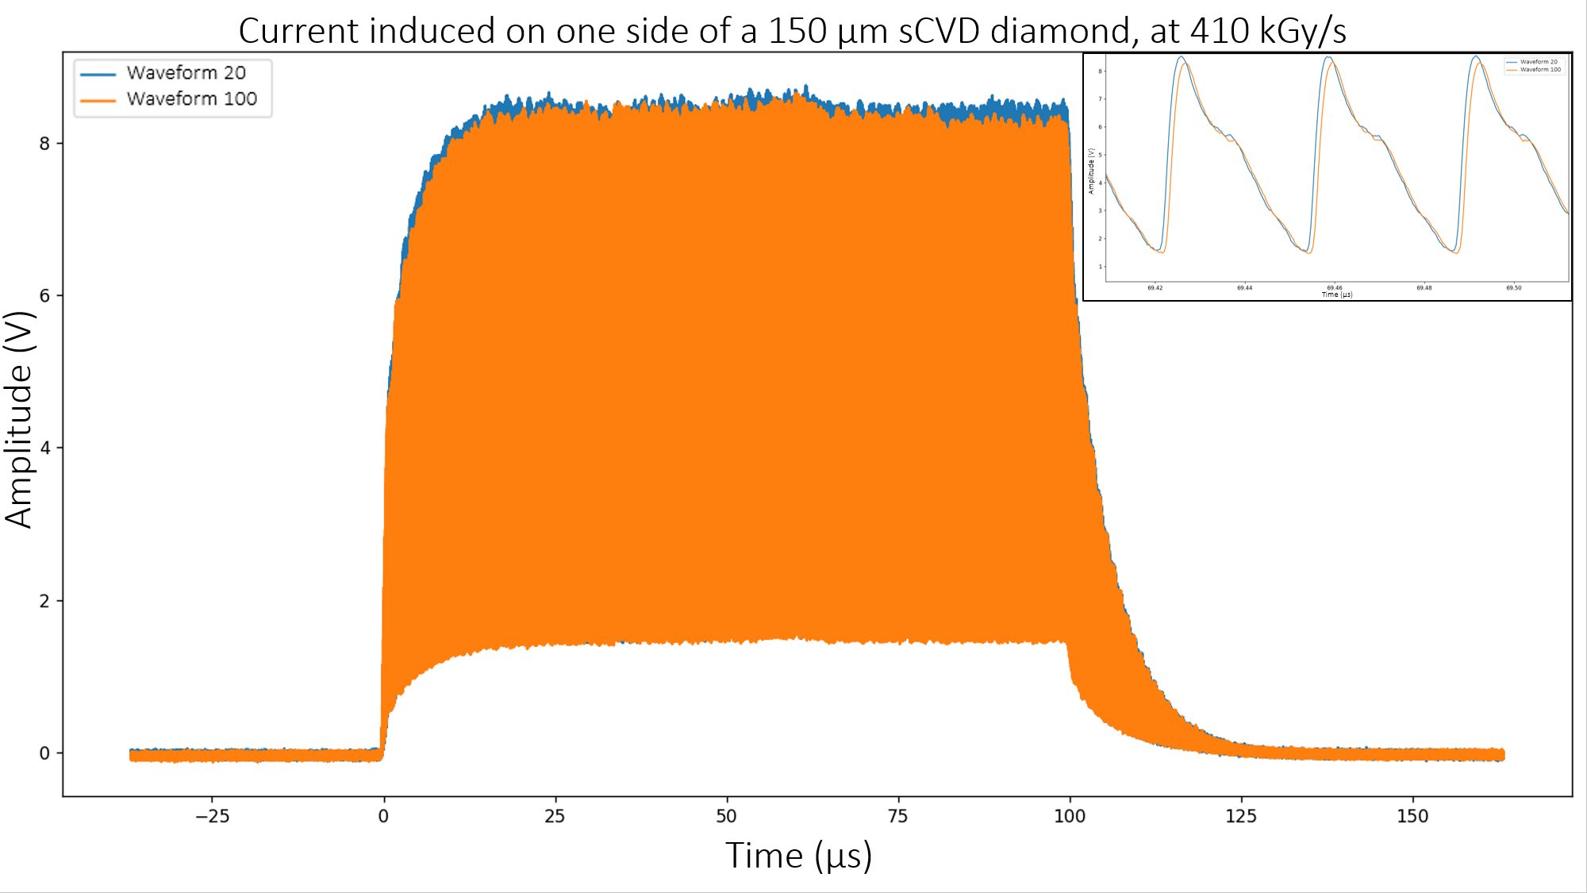
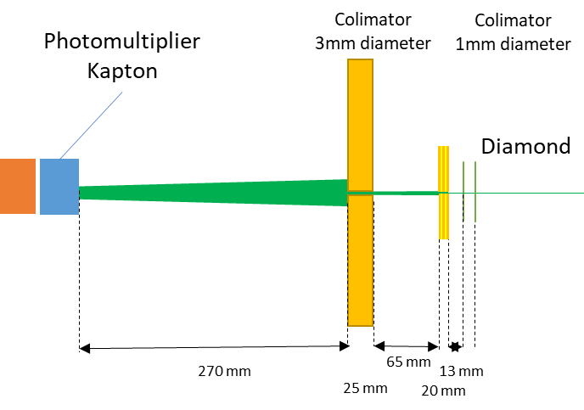
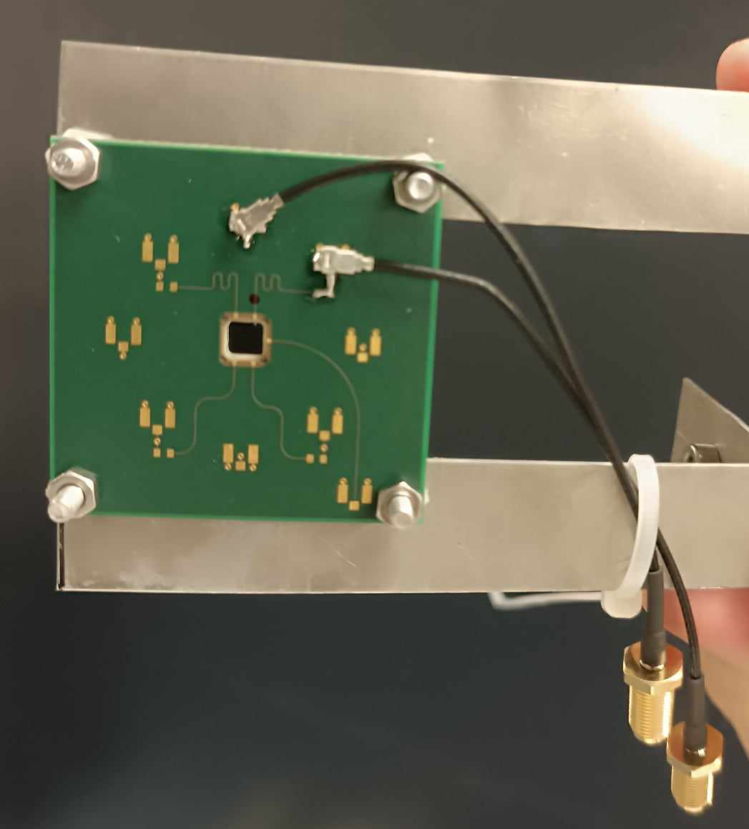
Experimental set-up
Diamants
Collimateur 3 mm
Collimateur 1 mm
Oscilloscope
Voltage bias

Slide 6
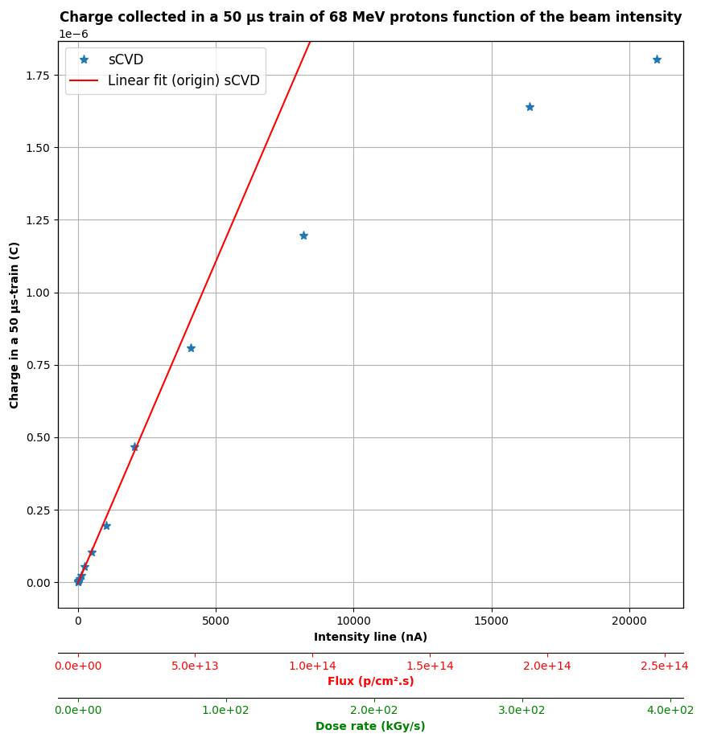
Diamond response with proton flux
For each beam intensity:
1 train of 50 µs of 68 MeV protons
Linearity of sCVD diamond until a flux of ~2.5E13 p/cm²
Saturation effect for higher fluxes :
at high flux, an amount of e-h pairs created
can disturb the electric field applied
lifetime of e-h in diamond longer
➔ more risk of trapping and recombination
➔ saturation effect
Flash : >100 Gy/s
Simulation work on doing
for beam monitoring in FLASH conditions
What about lifetime of the detector?
  ➔ towards aging studies in extreme conditions in terms of flux and fluence

Slide 7

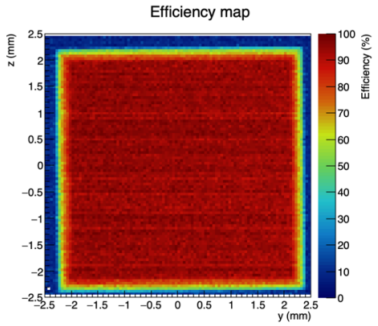
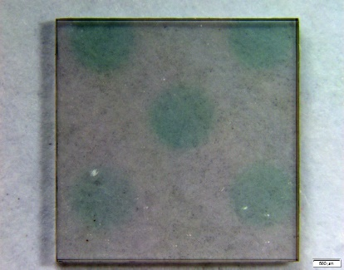
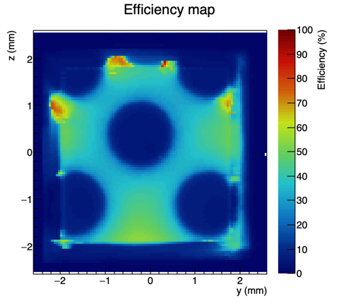
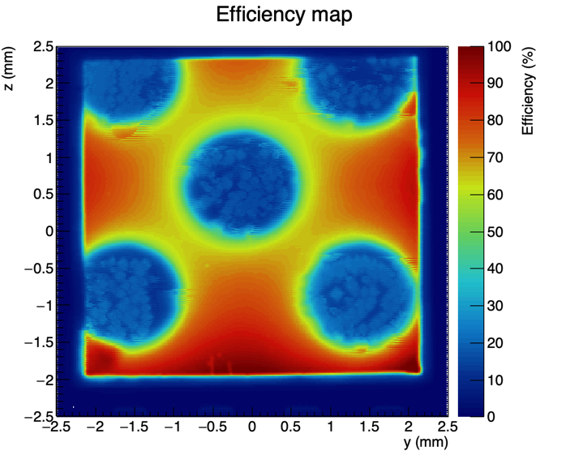


High fluences : diamond aging studies with 68 MeV alpha particles
Fluence experiment
ANR - DIAMMONI
Single-crystal CVD diamond chosen for the experiment
Irradiated diamond by 68-MeV alpha particles at ARRONAX. Total fluence: 10¹⁵ ions/cm²
Homogeneous response of the active surface before irradiation
F. Laffont, TN , Tran – Thi XBIC setup BM05 ESRF
sCVD 500µm E6
XBIC mapping at ESRF
Before irradiation
The diamond is colored in green typical of GR1 type defects
XBIC mapping at ESRF
After irradiation
In blue the areas of less effective charge collection
XBIC mapping at ESRF
After annealing
(1000 °C for 6 hours)
Diamond has recovered
Bragg diffraction imaging was performed
→No irradiation-related structural defects are visible
➔ Vacancy density is to low to have an impact on the crystal mesh
From simple calculations, we estimated the displacements per atom to be of the order of few p.p.m

Slide 8

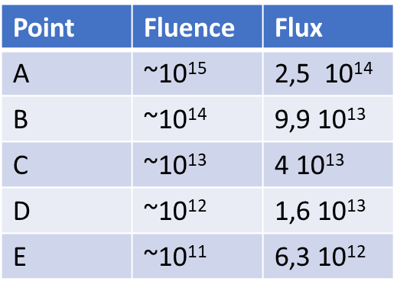
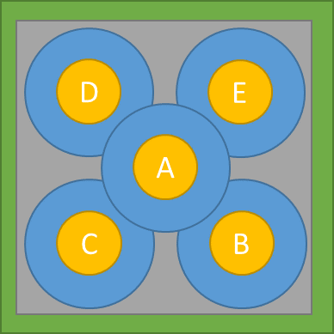
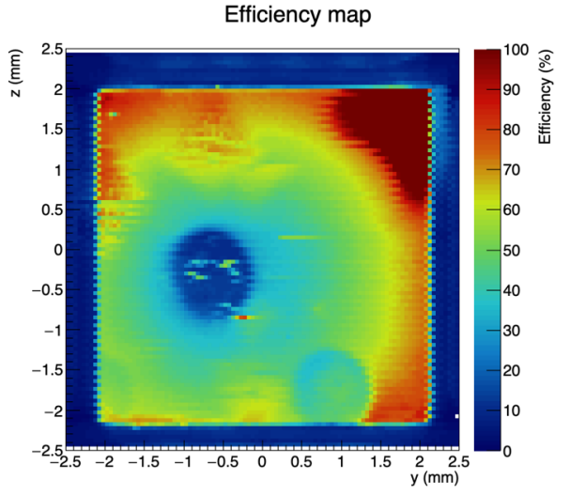
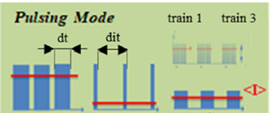
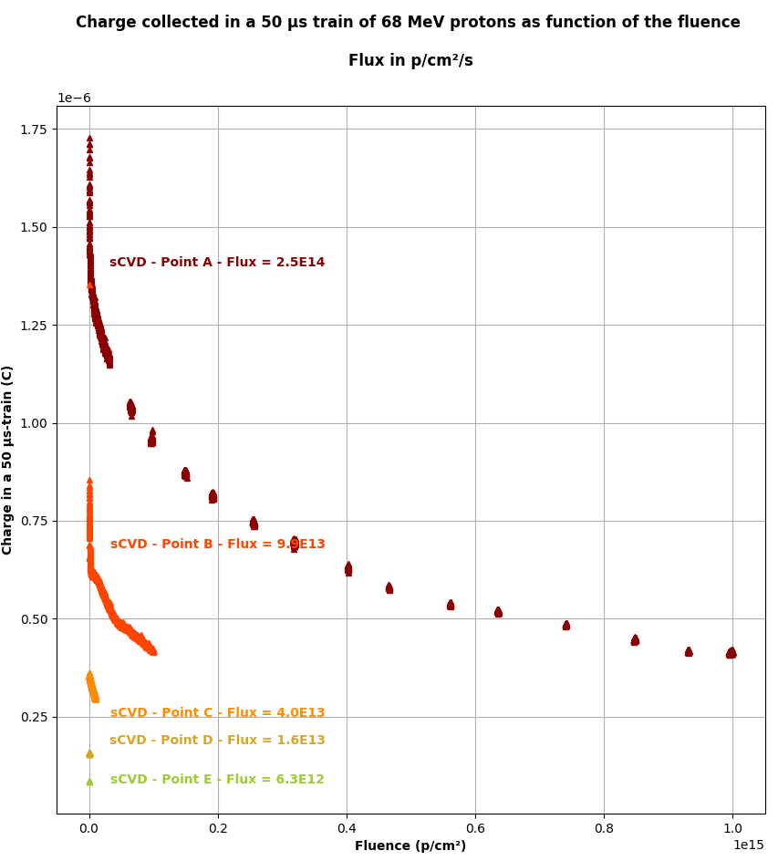
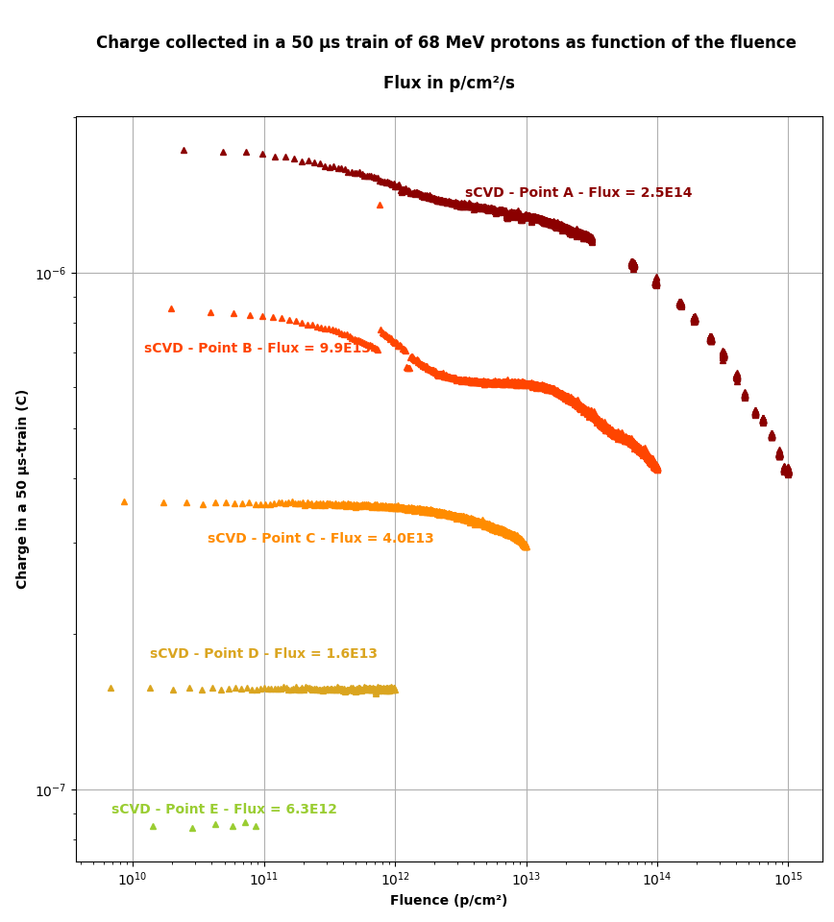
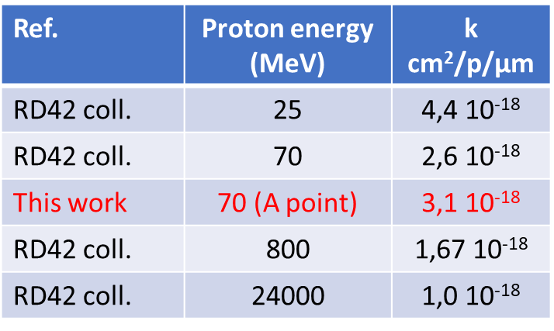




PRELIMINARY
Aging studies (flux and fluence)
70-MeV protons
sCVD results
dt = 50µs
dit : variable => <I> = cste
(lin,lin)
(log,log)
RD42 CERN coll. results**:
→k is decreasing with proton energy
Question to be answered:
→k = k (𝜑) with 𝜑 = flux?
Ongoing studies!
Literature * and **:
$$Q=\frac{Q_{0}}{1+kφ}$$
* A. Bhattacharya et al, « Degradation of single crystal diamond detectors in swift heavy ion beams, Diamond and related Materials 70 (2016) 124-131
**L. Bäni et al, RD42 coll. , « A study of the radiation tolerance of CVD diamond to 70 MeV protons, fast neutrons and 300 MeV pions », Sensors 2020, 20, 6648
Remind proton therapy:
~10¹⁰ protons/cm²/treatment
~20 patient/day
~10¹³ proton/cm²/year
$$Q=charge$$
$φ$ = fluence
$Q_{0}$, $k$ = Cste = fit parameters

Slide 9
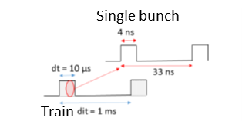
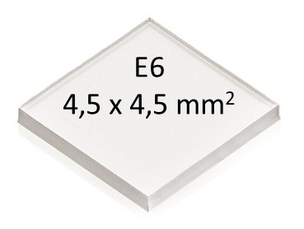
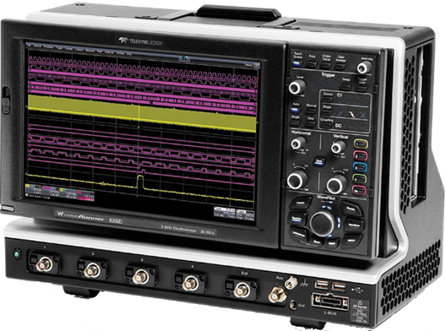
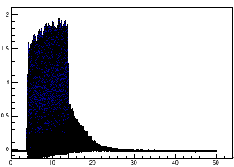
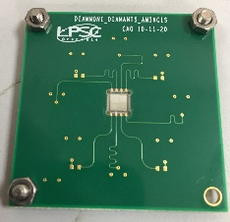
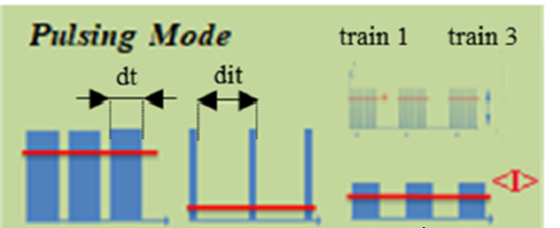
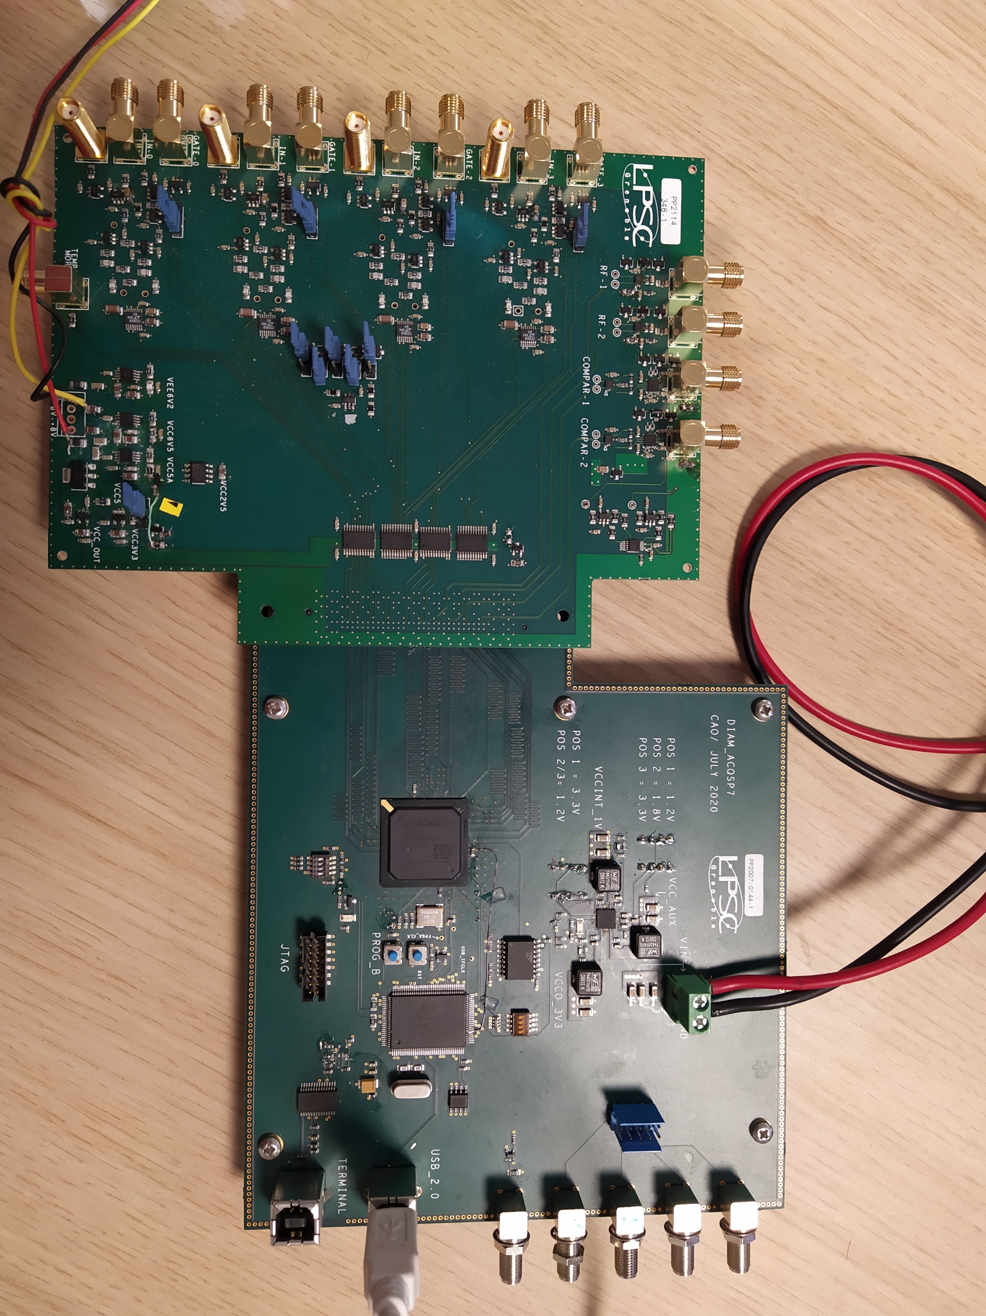
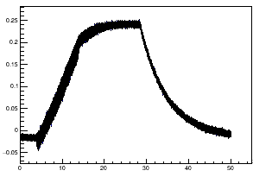
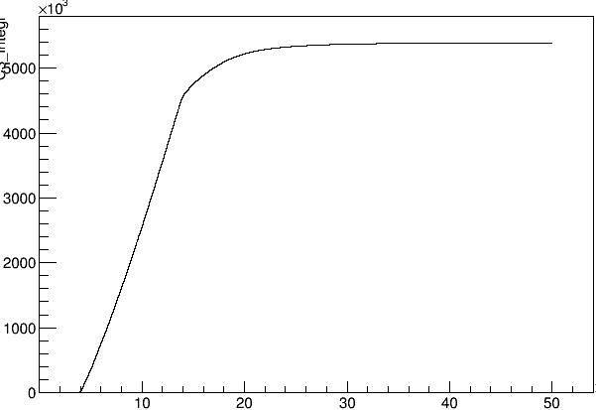
DIAMMONI detector development
DSO Lecroy
2 GHz; 10 or 20 GS/s
Signal of 10µs train of protons
Tension(en V)
68 MeV Proton beam
Amplitude (V)
I = 10nA, dt = 10µs, dit = 1s
Temps (µs)
Time ( µs)
Train integral = on line measurement with LPSC QDC
Train integral = DSO post analysis
QDC board
developped @ LPSC
A.U
V.s
DAQ
developped @ LPSC
Time ( µs)
Time ( µs)

Slide 10

Conclusion
DIAMMONI: Diamond detector for pulsed beam monitoring in FLASH conditions
diamond used as solid-state ionizing chamber
  studies function of
    flux (up to very high dose rate beyond FLASH conditions)
    fluence (lifetime of the detector under extreme radiation conditions)
front-end and back-end electronic developments (current integration
in proton train) → instrumentation of diamond as beam monitor
Further studies function of
ionizing particle type
signal formation (simulation)
Ultimate goal : integration on the beam line (summer 2024)

Slide 11


Thank you for your attention !
A. Guertin, F. Haddad, C. Koumeir,
V. Métivier, R. Molle*, Q. Mouchard, F. Poirier, N. Servagent
R. Molle*, Y. Arnoud, A. Bes,
JL Bouly, J. Collot, D. Dauvergne,
P. Everaere, L. Gallin-Martel, ML Gallin-Martel,
O. Guillaudin, C. Hoarau, F. Lafont, A. Lacoste,
E. Lagorio, S. Marcatili, M. Marton, JF Muraz, N. Ponchant, F. Rarbi, M. Reynaud, O. Rossetto, J. Waquet
F. Lafont, TN. Tran – Thi
* molle@lpsc.in2p3.fr

Slide 12
BACK-UP slides

Slide 13
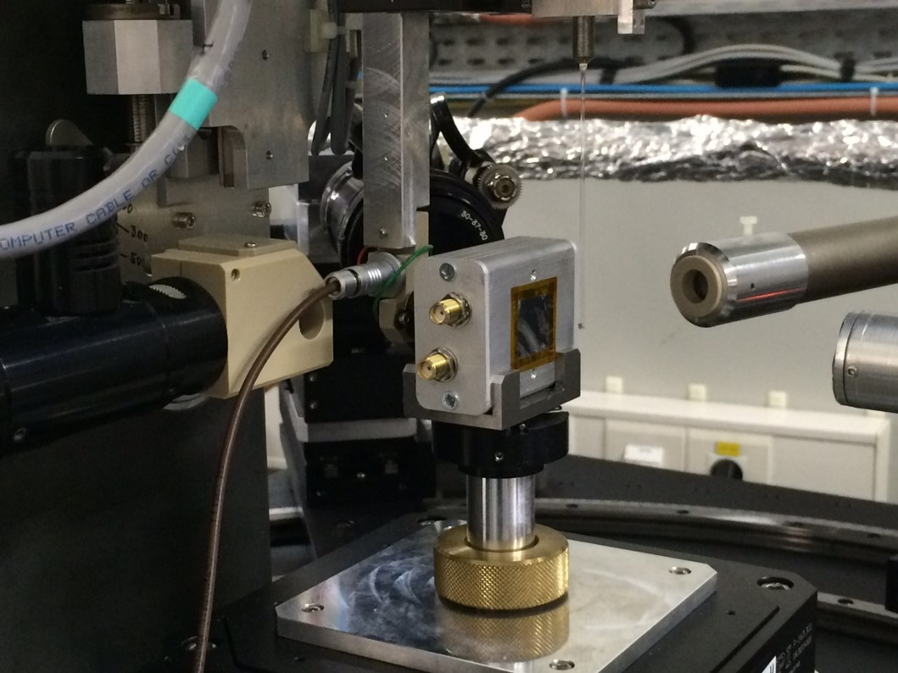
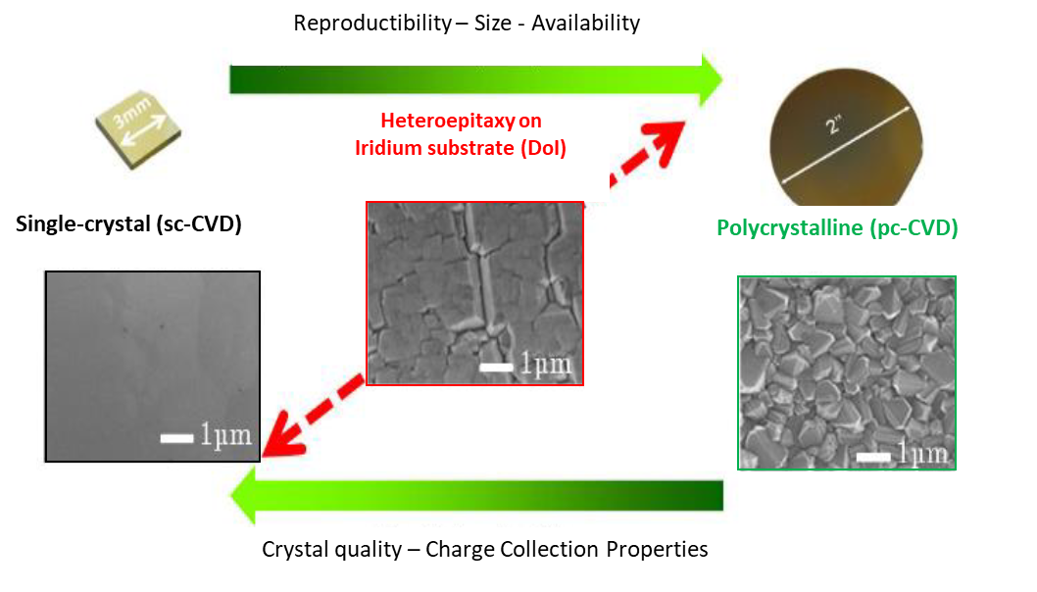
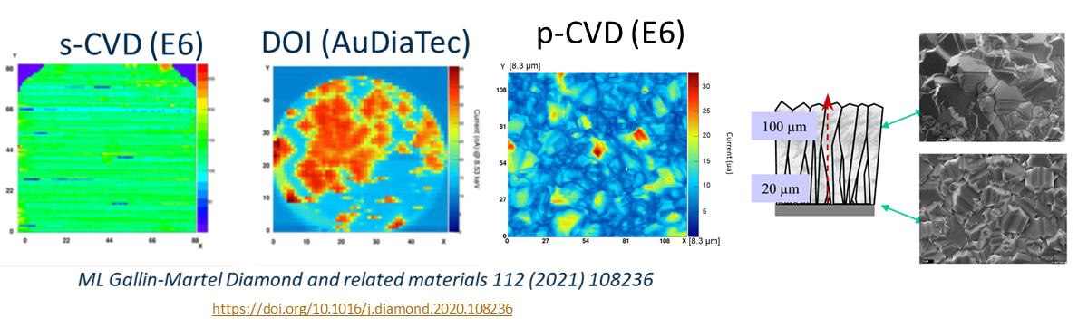
Diamond detector for beam monitoring:
quality of the diamond?
XBIC = X rays Beam Induced Current
@ ESRF (France) : Photons 8.5 keV
2D « current maps » with CVD diamonds
N. Vaissiere PhD thesis https://tel.archives-ouvertes.fr/tel-01022652

