Slide 1
Dosimetric environment of preclinical FLASH hadrontherapy studies at the ARRONAX cyclotron
Manon Evin, Charbel Koumeir, Quentin Mouchard, Gregory Delpon, Ferid Haddad, Vincent Potiron, Gaëlle Saade, Mathieu Chocry, Noël Servagent, Stéphane Supiot,
Vincent Métivier, Sophie Chiavassa

Slide 2
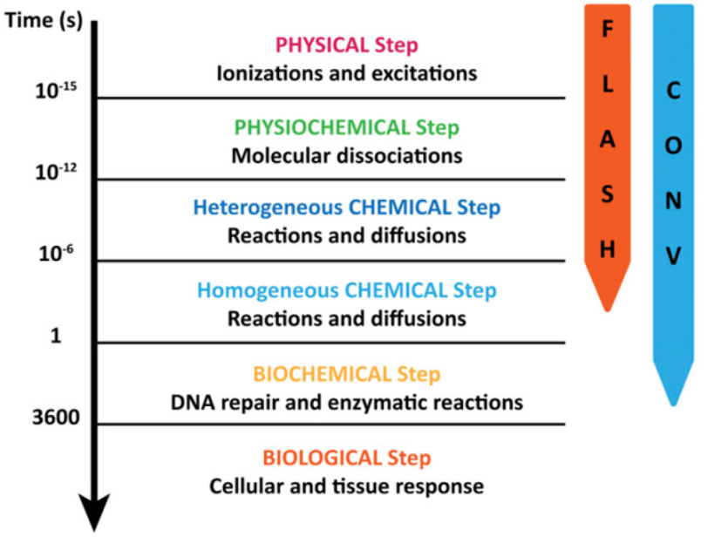
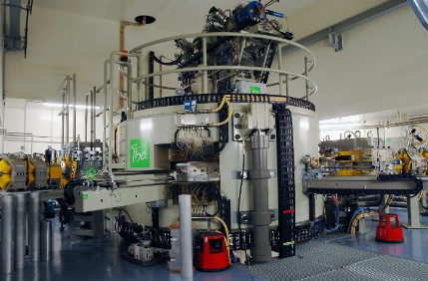
FLASHMOD project
Context Beam control Set-up & methodology for preclinical irradiations In vivo dosimetry Conclusion
Development of FLASH external radiotherapy
FLASH effect
Irradiation time (s)
Increase in dose rate from 0.1 Gy/s (CONV)
to at least 40 Gy/s (UHDR):
Reduced toxicity to healthy tissue
Same anti-tumoral efficiency
Enlargement of the therapeutic window
Main goals
Understand the FLASH effect mechanisms
Facing the technical challenges of UHDR
Montay-Gruel,P., et al. (2019). DOI: 10.1073/pnas.1901777116
Multidisciplinary team around the ARRONAX cyclotron
Accélérateur pour la Recherche en Radiochimie et Oncologie à Nantes-Atlantique
Dose rates
CONV : ~ 0.1 Gy/s
UHDR :
Up to several hundred of kGy/s
Cyclotron C70XP

Slide 3
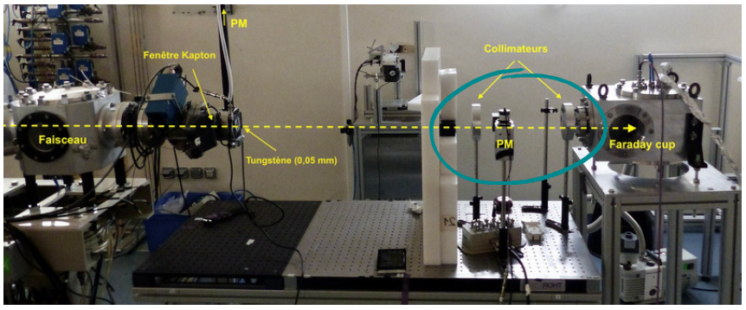
ARRONAX preclinical irradiation platform
Context Beam control Set-up & methodology for preclinical irradiations In vivo dosimetry Conclusion
Beam creation
Energy and temporal structure
Beam monitoring
Sample or animal
positioning and targeting
Beam shaping
Lateral and distal homogeneity, field size and geometry
In vivo dosimetry
Cyclotron
Kapton
exit window
Ionization chamber
Ridge filter for SOPB (optional)
Photomultipliers
Opaque cavities
Radiochromic
film
Applications
100 µm Tungsten foil
Collimator
Innovative dosimetry
through radiations emitted by
the irradiated medium
Poirier F et al., “The injection and chopper-based system at ARRONAX C70XP cyclotron”, cyc19, sept. 2019, doi:10.18429/jacow-cyclotrons2019-tup006

Slide 4
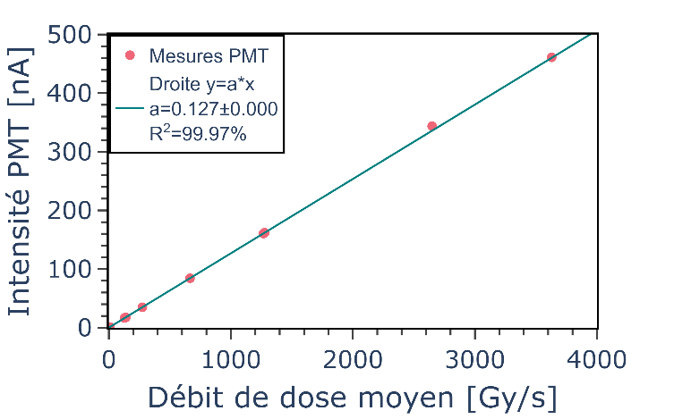
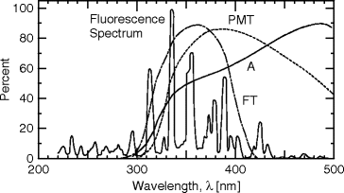
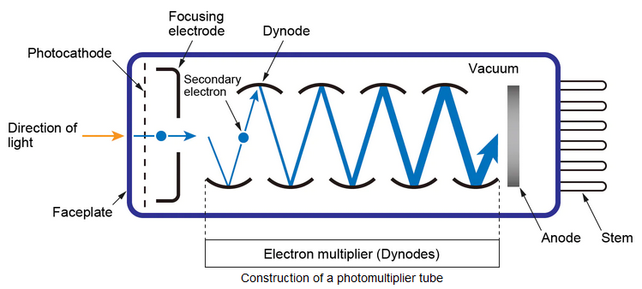
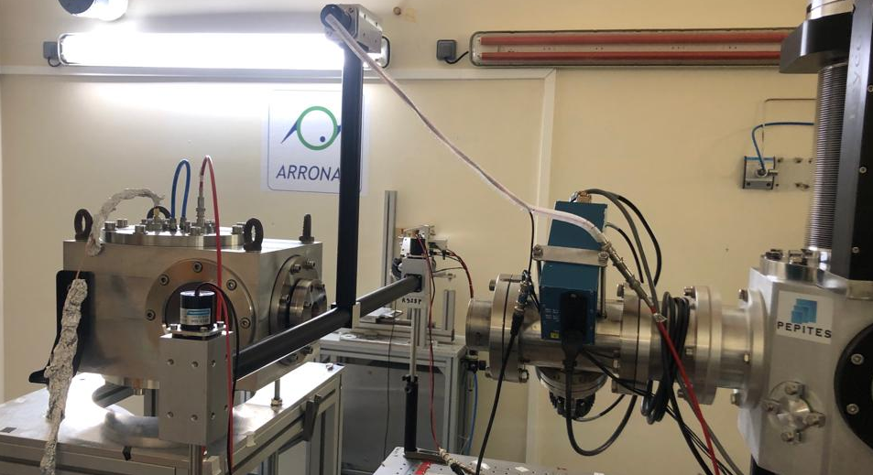
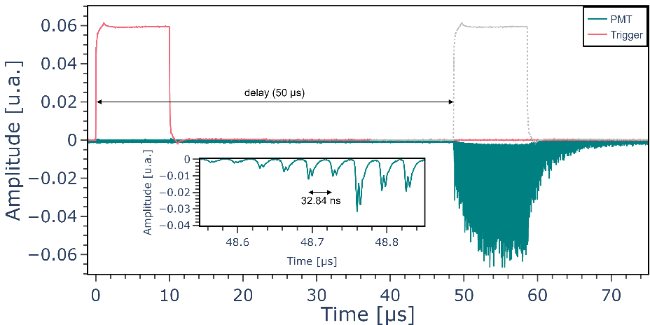
UHDD and CONV beam monitoring
Context Beam control Set-up & methodology for preclinical irradiations In vivo dosimetry Conclusion
Quentin Mouchard
Linearity with dose rate
Fluorescence of the air dinitrogen: peak at 337 nm (UV) Photomultiplier tube (PMT)
PMT intensity (nA)
Matsuada website, « Photomultiplier Tube (PMT) ». [31/05/2023].
Mean dose rate (Gy/s)
Temporal structures of beams
Selection of the best PMT candidates
Feasibility of UHDR and CONV monitoring
Feasibility of temporal monitoring
Feasibility of a geometric profile
Charaterization of the method
Beam
Vacuum faraday cage with guard ring
PMT
Mouchard Q., et al.. Upgrade of the flash beam monitoring system at ARRONAX cyclotron. (FRPT 2022). ⟨hal-03885576⟩

Slide 5
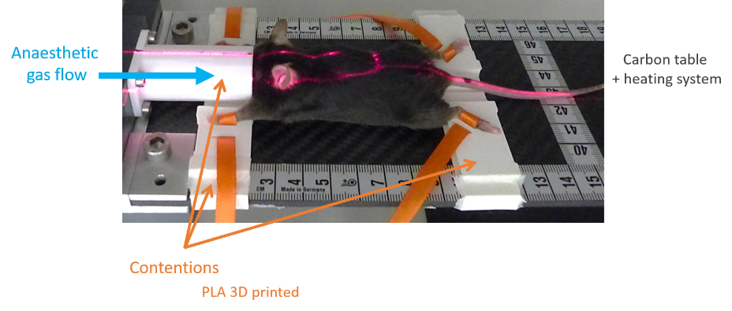
Preclinical irradiations at ARRONAX
Context Beam control Set-up & methodology for preclinical irradiations In vivo dosimetry Conclusion
Workflow and methodology for:
Internal organs targeting without online imaging
Fixed collimators
H⁺
ARRONAX
ICO
3D printed bed
Preclinical irradiator

Slide 6
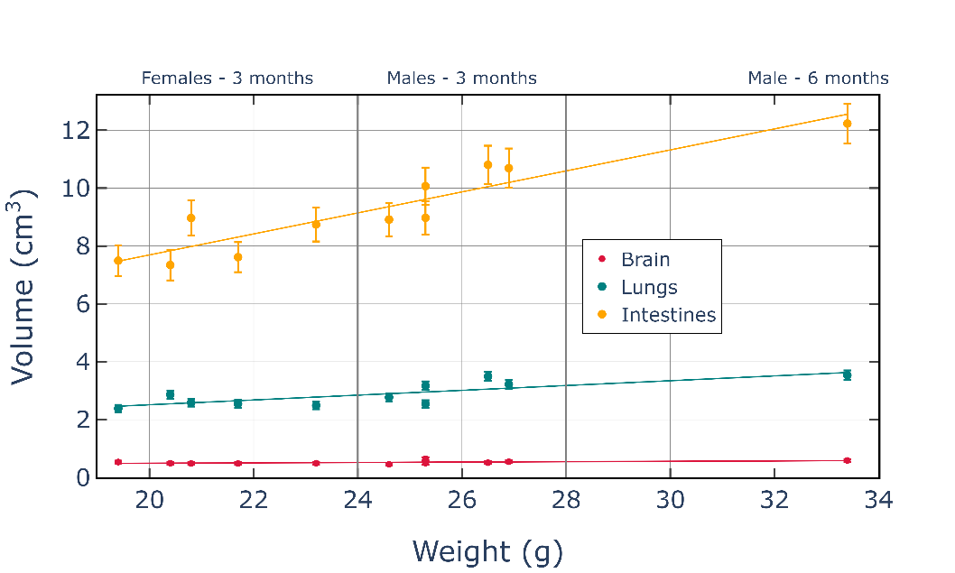
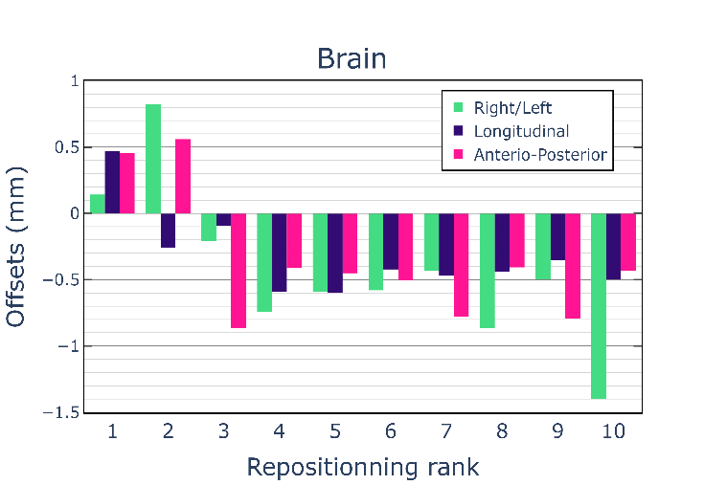
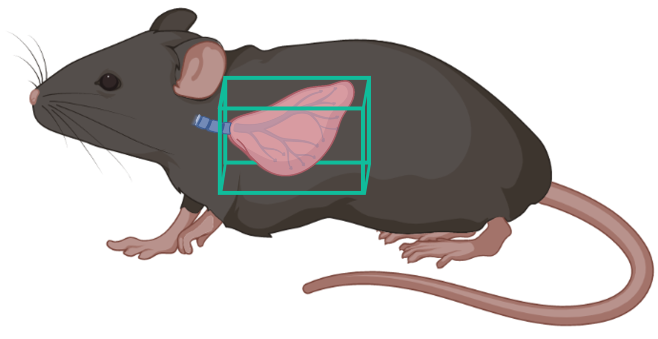
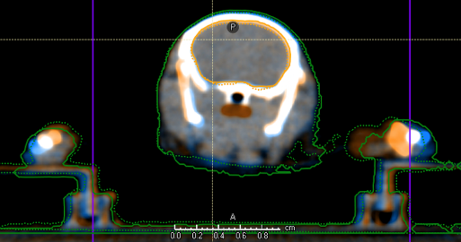
Irradiation field sizes and margins
Context Beam control Set-up & methodology for preclinical irradiations In vivo dosimetry Conclusion
Study with 11 mice using the XRAD225Cx
R²=0.88
R²=0.78
Reference image (orange)
Repositionning image (blue)
Before
registration
Selection of a cohort based on the weight enables the use of a unique field size
After
registration

Slide 7
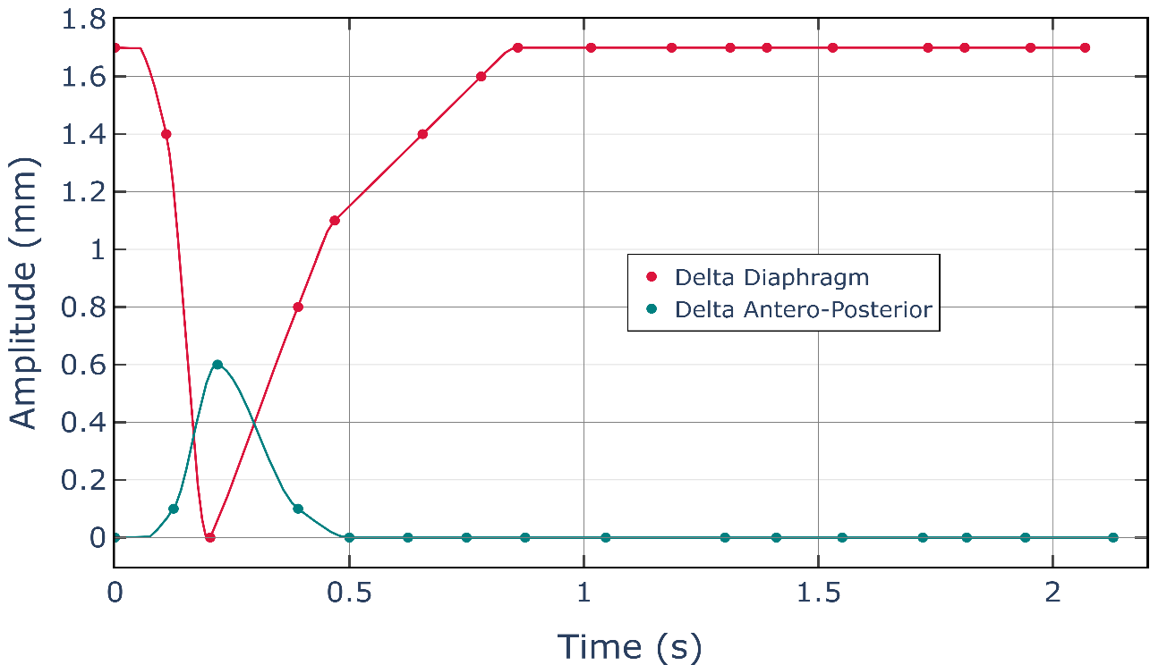
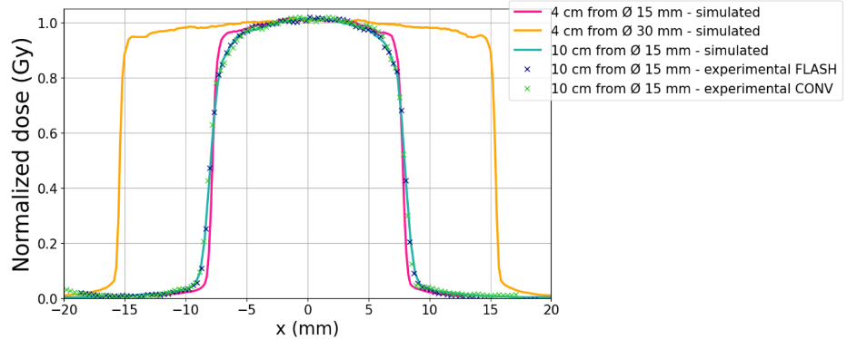
Irradiation field sizes and margins
Context Beam control Set-up & methodology for preclinical irradiations In vivo dosimetry Conclusion
Fluoroscopy mode XRAD225Cx (8 images/s)
Delta Antero-Posterior
Maximal amplitudes over 10 cycles of an anaesthetized mouse
Delta Diaphragm
6

Slide 8
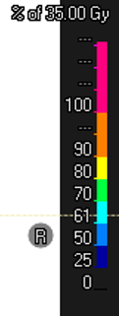
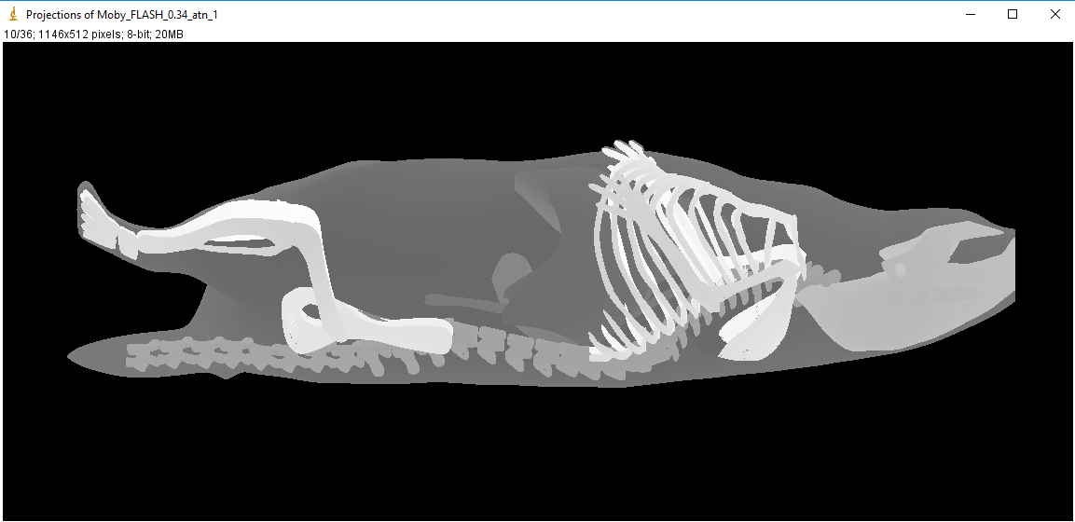
Impact of respiratory cycle under FLASH-RT
Context Beam control Set-up & methodology for preclinical irradiations In vivo dosimetry Conclusion
Vertical irradiation
Full expiration
(d=0,45 g/cm³, volume 0,56 cm³)
Full inspiration
(d=0,26 g/cm³, volume 0,79 cm³)
FLASH-RT irradiation time ˜ ms
H⁺
H⁺
Dosimetric impact ?
MOBY (Mouse Whole Body 4D Digital Fantom) V.2
Right
Left
Delta Antero-Posterior
Cumulative Dose-Volume Histogram
Delta Diaphragm
Differences in
homogeneity and
mean dose < 1 %
Full expiration and full inspiration
(density, composition ICRU and volume)
Heyden, Brent van der, et al.. « The Influence of Respiratory Motion on Dose Delivery in a Mouse Lung Tumour Irradiation Using the 4D MOBY Phantom ». The British Journal of Radiology 90, nº 1069 (janvier 2017): 20160419.

Slide 9
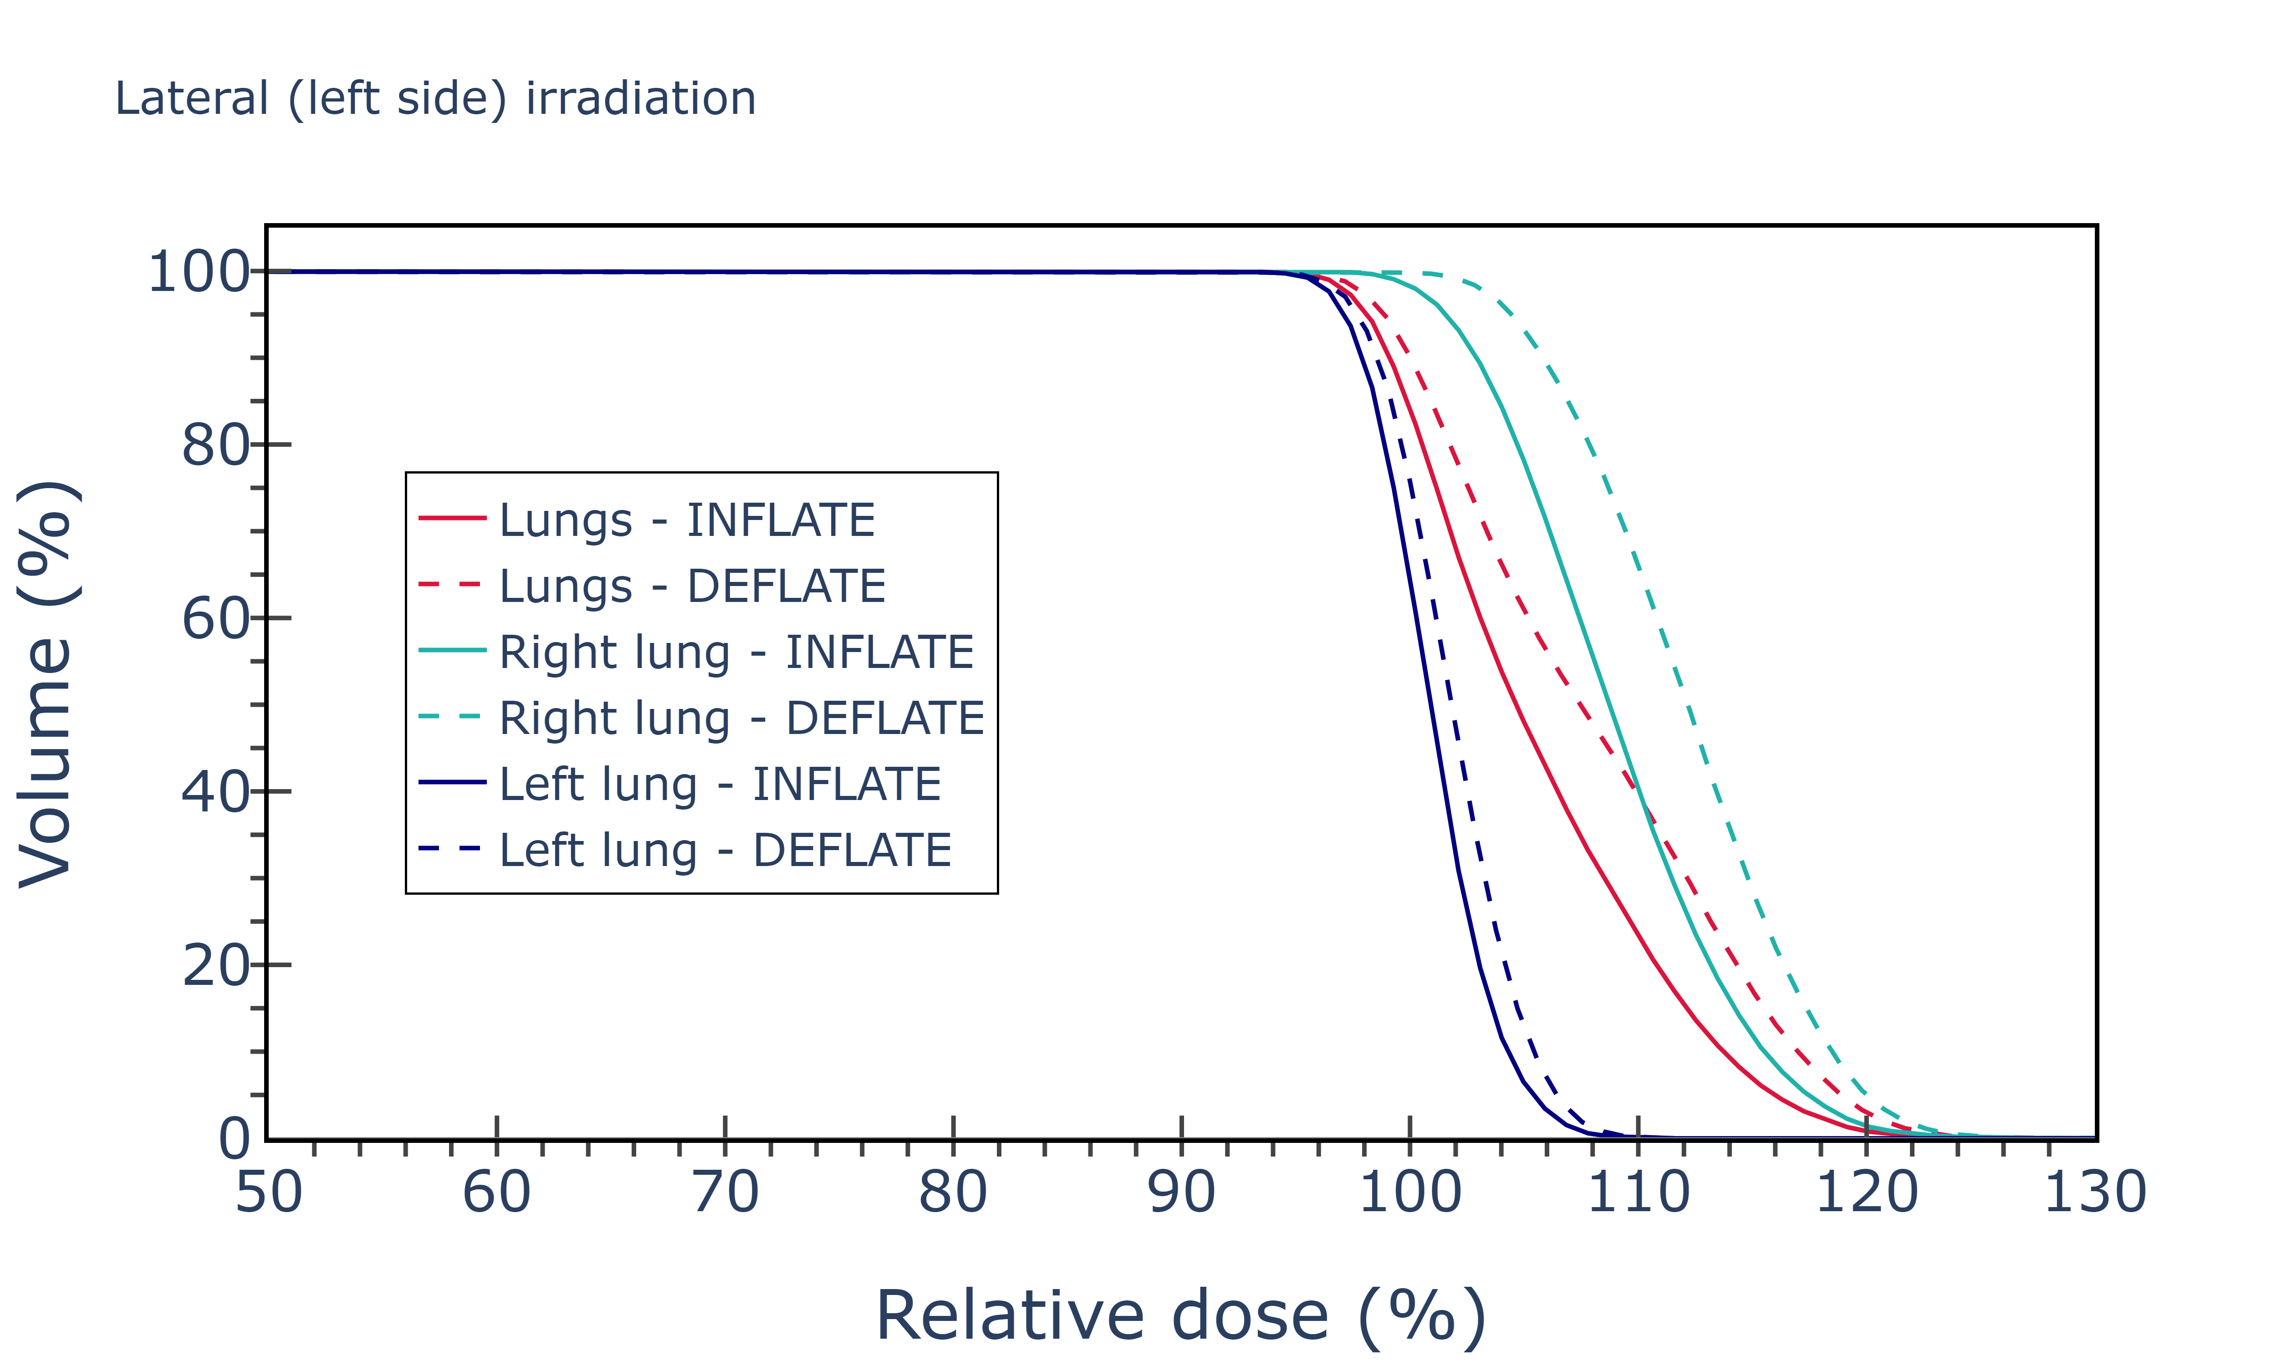
Context Beam control Set-up & methodology for preclinical irradiations In vivo dosimetry Conclusion
Impact of respiratory cycle under FLASH-RT
Lateral irradiation
Full expiration (Deflate)
(d=0,45 g/cm³, volume 0,56 cm³)
Full inspiration (Inflate)
(d=0,26 g/cm³, volume 0,79 cm³)
Cumulative Dose-Volume Histogram
H⁺
H⁺
Right
Left
Right
Left
Top view
Top view
H⁺
H⁺
Differences in homogeneity and mean dose:
< 1 % for entrance lung
[1-3] % for exit lung and both lungs
the one to be considered for biological analyses

Slide 10
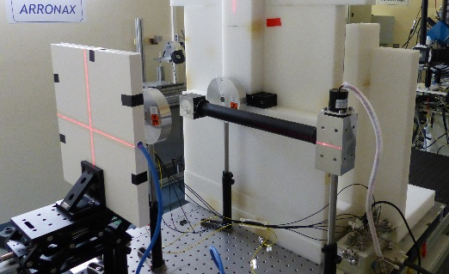
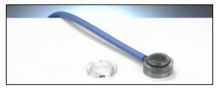
In vivo dosimetry with radiochromic films
Context Beam control Set-up & methodology for preclinical irradiations In vivo dosimetry Conclusion
LET (Linear Energy Transfert) dependency
OrthoChromic Films OC-1
Chamber
Advanced Markus
- 12 %
Absorbed dose (2, 5, 10, 20, 30 Gy)
Independent of dose rate
Calibration for proton in CONV with TRS-398 formalism (PTW Advanced Markus)
Villoing,et al. « Proton Beam Dosimetry at Ultra-High Dose Rates (FLASH): Evaluation of GAFchromicTM (EBT3, EBT-XD) and OrthoChromic (OC-1) Film Performances ». Medical Physics, 2022. https://doi.org/10.1002/mp.15526.
Gate simulation
Villoing., et al., « Response characterization of a new radiochromic film to ultra high dose rates for light ions beams. » (ESTRO 2022). ⟨hal-03680039⟩
Determination of the correction factor f(LET)

Slide 11
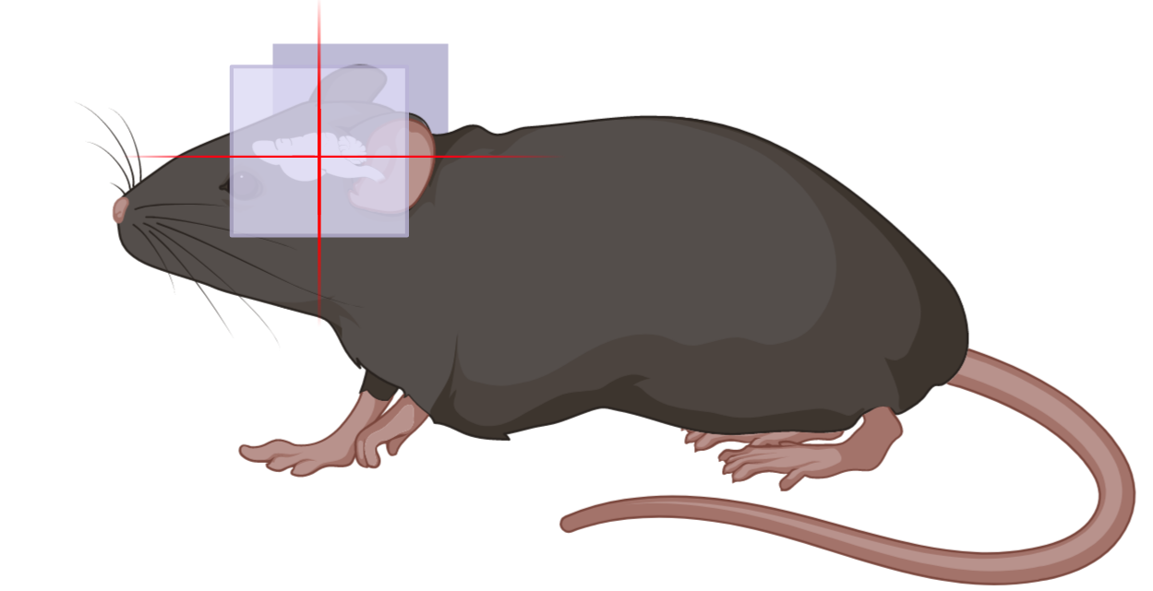
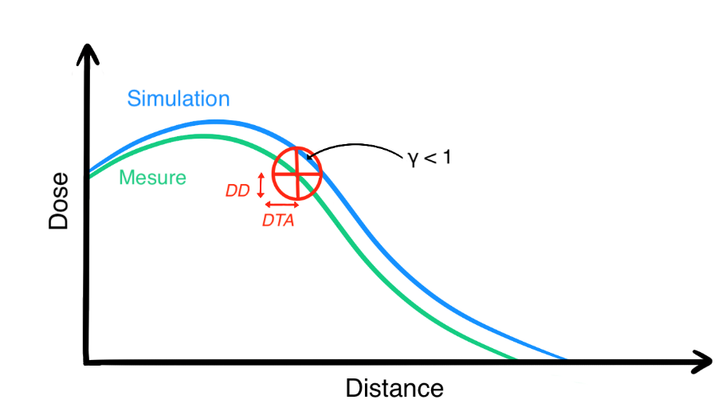
In vivo dosimetry with radiochromic films
Context Beam control Set-up & methodology for preclinical irradiations In vivo dosimetry Conclusion
Mouse whole brain irradiation: GATE simulation from XRAD225Cx µCBCT and targeting without image guidance at ARRONAX
Experimental
Simulated
OC-1 films
H⁺
Local gamma index 2D (DD 1% - DTA 1 mm): pass rate 98,2 %
Measure
Front
Back
1D illustration of the gamma index metric
Verisoft software

Slide 12
Conclusion and perspective
Context Beam control Set-up & methodology for preclinical irradiations In vivo dosimetry Conclusion
PMT for beam control through light emitted by air
In vivo dosimetry
with OC-1 films
Methodology for internal organs targeting without image guidance
Dosimetric environment of preclinical FLASH hadrontherapy at ARRONAX
Ready for irradiation of small animals (tumors and healthy tissues)
Other main perspective:
Design of a ridge filter for Spread Out Bragg Peak irradiations (SOPB)
as for clinical irradiation
Patriarca A, et al. « Experimental Set-up for FLASH Proton Irradiation of Small Animals Using a Clinical System »,
International Journal of Radiation Oncology*Biology*Physics, DOI: 10.1016/j.ijrobp.2018.06.403.

Slide 13
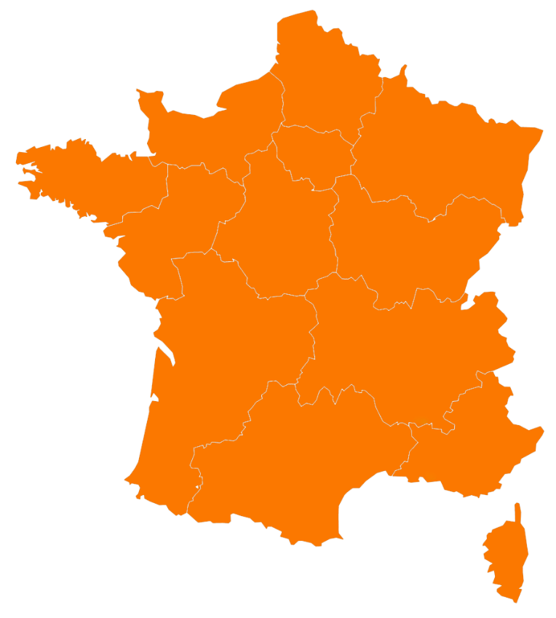
Thank you for your attention
FLASHMOD project
Collaboration with:
Université de Namur
Université de Louvain
Société IBA
Nantes
Saint-Herblain
PRISMA team (Physics of Radiation
Interactions with Matter and Applications)
Manon EVIN
Arnaud GUERTIN
Vincent METIVIER
Quentin MOUCHARD
Noël SERVAGENT
Radiochemistry team
Guillaume BLAIN
Émeline CRAFF
Sarra TERFAS
Johan VANDENBORRE
Clermont-Ferrand
Bordeaux
Ferid HADDAD
Charbel KOUMEIR
Freddy POIRIER
Simulation GATE/Geant4-DNA
Lydia MAIGNE
Giovanna FOIS
Hoang Tran
Medical physics
Sophie CHIAVASSA (PRISMA)
Grégory DELPON (PRISMA)
Radiobiology
Mathieu CHOCRY Vincent POTIRON
Gaëlle SAADE
Stéphane SUPIOT

