Slide 1
OSSR: Application for
SciCodes Membership
Kay GRAF
ECAP, Erlangen Centre for Astroparticle Physics, Friedrich-Alexander-Universität Erlangen-Nürnberg
on behalf of the OSSR Group

Slide 2
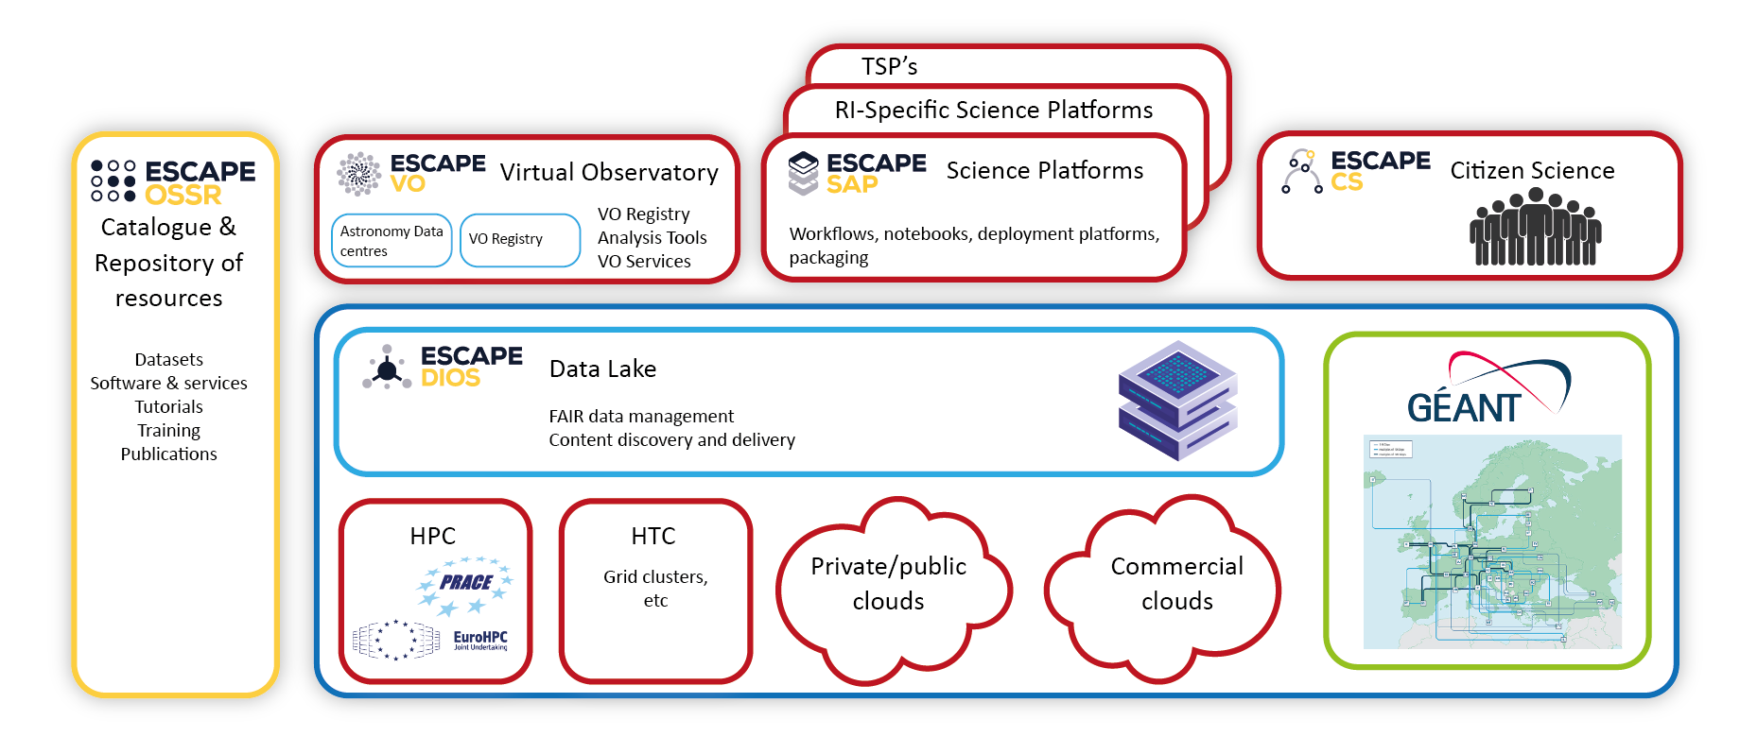

ESCAPE EOSC cell
OSSR was developed as part of the ESCAPE project
(Astro/particle, Particle Physics and Astronomy Research Infrastructures)
in the EOSC (European Open Science Cloud)
servicing the needs of the RIS
Since 03/2023: ESCAPE is an Open Collaboration
Notes:
Data Lake:
Build a scalable, federated, data infrastructure as the basis of open science for the ESFRI projects within ESCAPE. Enable connection to compute and storage resources.
Software Repository:
Repository of "scientific software" as a major component of the “data” to be curated in EOSC. Implementation of a community-based approach for the continuous development of shared software and for training of researchers and data scientists.
Virtual Observatory:
Extend the VO FAIR standards, methods and to a broader scientific context; prepare the VO to interface the large data volumes of next facilities.
Science Platforms:
Flexible science platforms to enable the open data analysis tailored by and for each facility as well as a global one for transversal workflows.
Citizen Science:
Open gateway for citizen science on ESCAPE data archives and ESFRI community

Slide 3

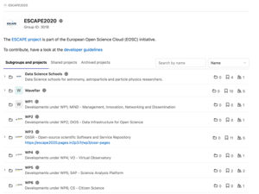
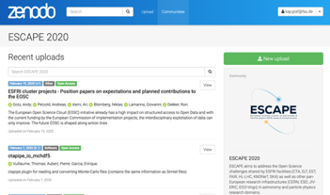
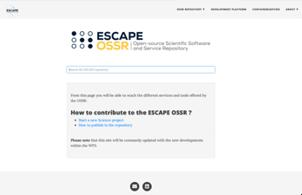
OSSR Aims and Structure
Development Platform
Software Development
Integration & Automation
The ESCAPE Open-source Scientific Software and Service Repository (OSSR) is a sustainable open-access repository to share scientific software, services to the astro-particle-physics-related communities and enable open science. It is built as a curated Zenodo community integrated with dedicated tools to enable a complete software life-cycle. The OSSR is fully onboarded into the EOSC explorer.
Repository
Service Aggregation
Preservation / Archive
(link to EOSC)
Landing Page
Entry point,
Link Aggregation
Search

Slide 4
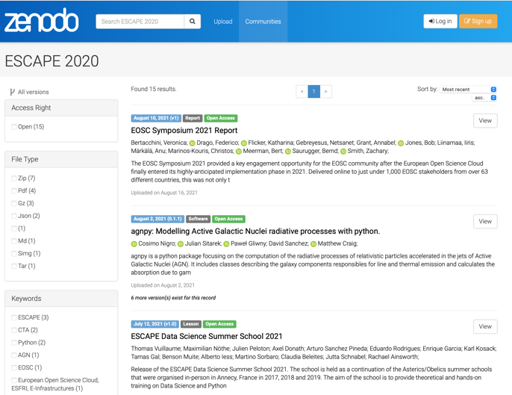
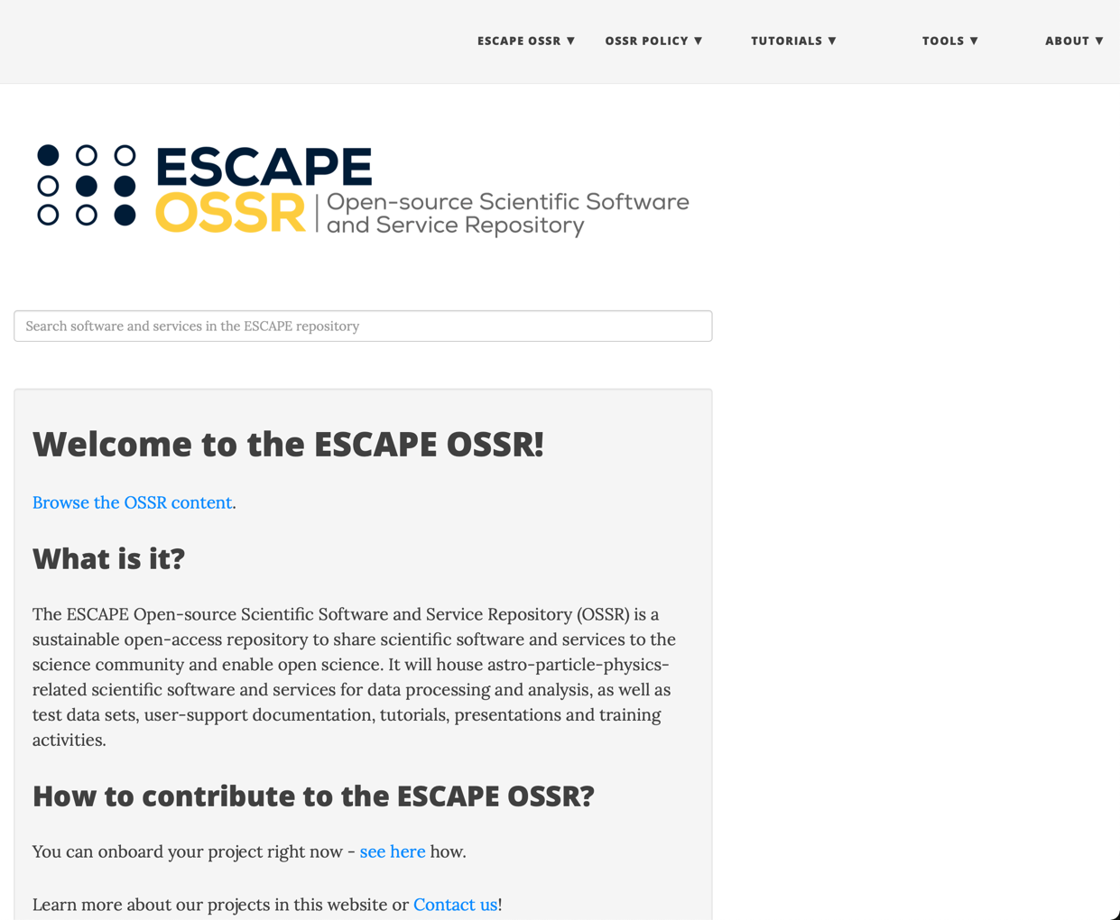

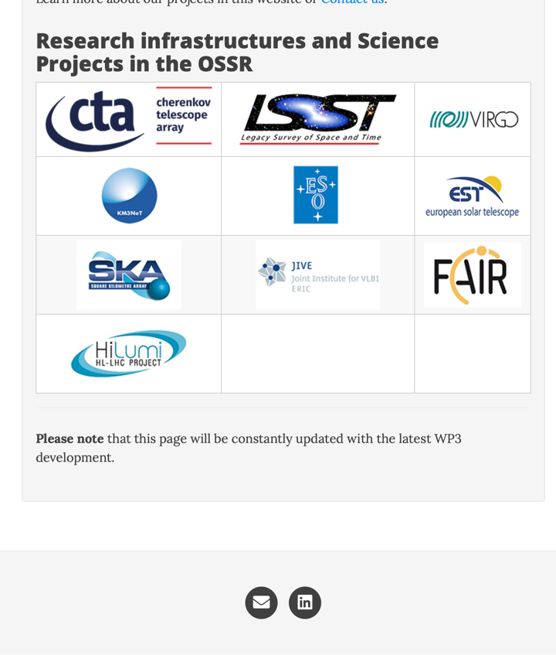
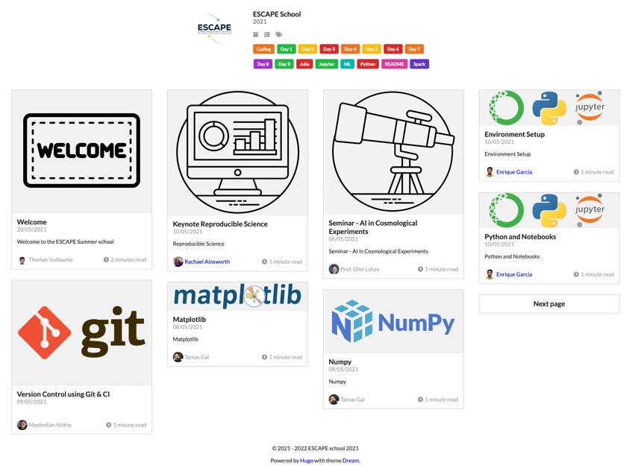
OSSR – User’s View
http://purl.org/escape/ossr
Long-term
Entry
EOSC Integration
Federation
openAIRE
Training
+ related projects / collections
ESCAPE Software Schools

Slide 5







OSSR – Provider Workflow
Long-term
publishes source code
(updates your existing record with new versions)
long term archived
findable
citable
Integration
FAIR
Open-source
publishes
image
develop/maintain software
tag a version(release)
add metadata (CodeMeta)
let the CI do the rest
registers
image
integrates into ESCAPE EOSC cell
builds a
container image
Reprocessing
implemented in eOSSR library
Container Registry

Slide 6
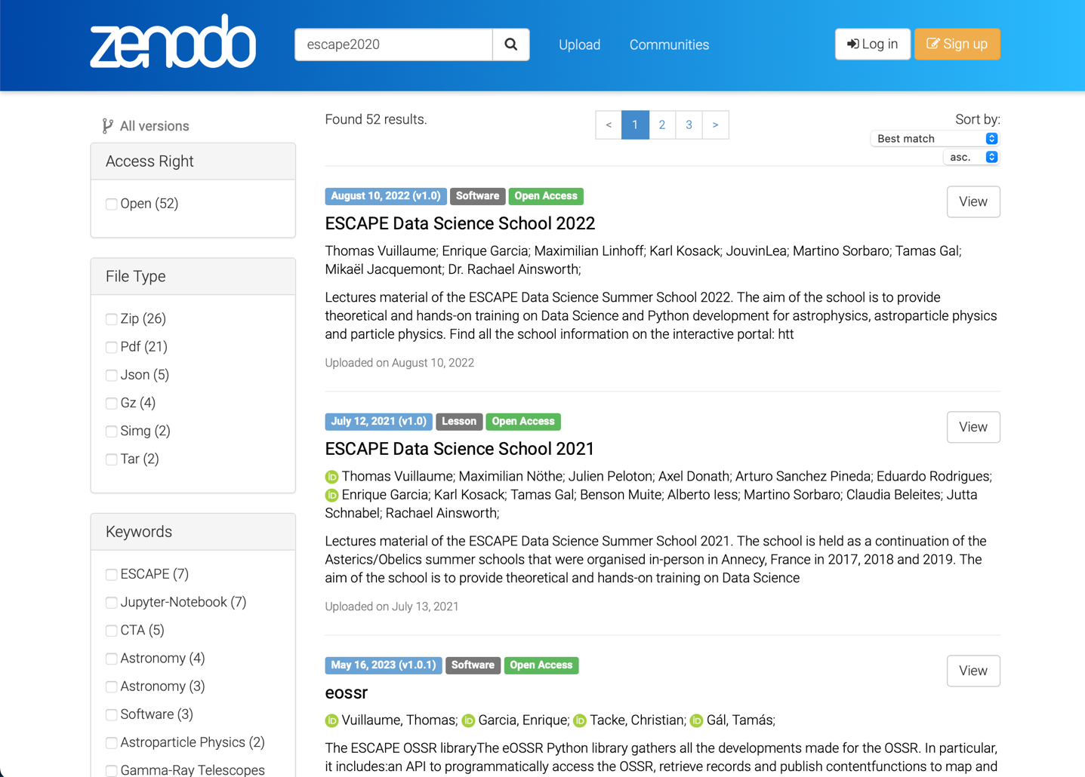
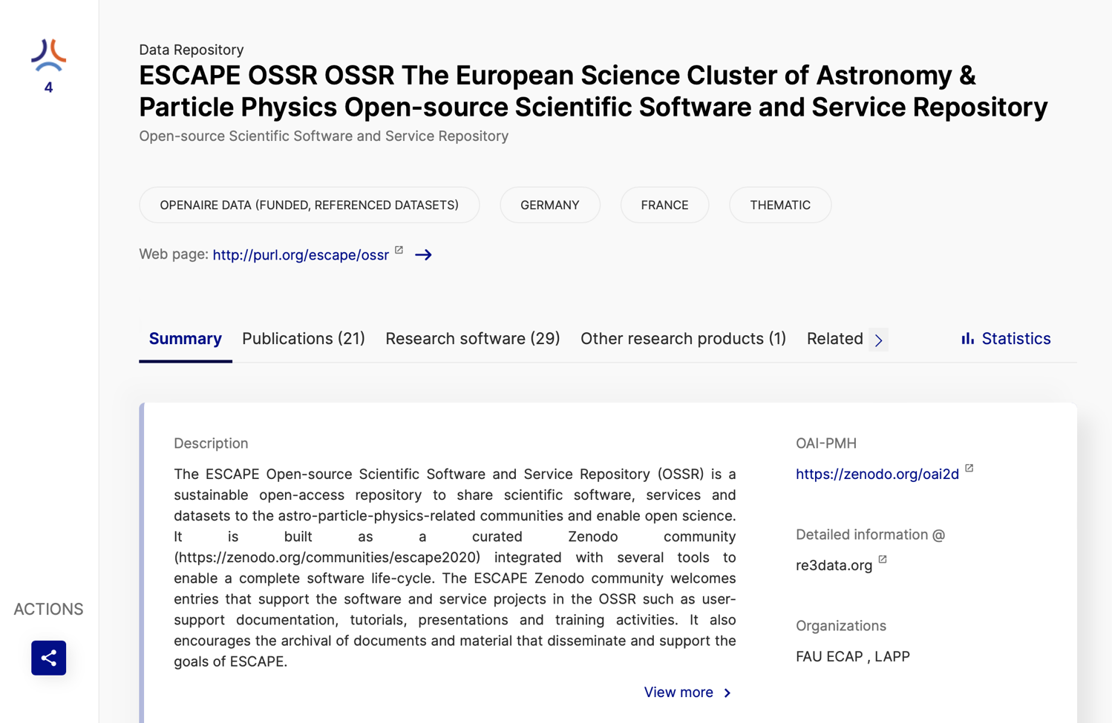
OSSR Onboarded Entries
Direct: Zenodo
Aggregated: EOSC Portal via OpenAIRE
Repository registered at re3data.org; http://doi.org/10.17616/R31NJN5V

Slide 7
OSSR in the Open Collaboration Area
Transition from project organisation into
open collaboration under an MoU
Three main areas of collaboration:
  Policy, Strategy and Collaboration
  Onboarding → Curated Repository!
  Technical Developments
  (further sub-groups under discussion)
Aims:
  Collect software to provide additional visibility and cite-ability
  for RSEs; strengthen software competence with quality in focus
  Use of OSSR as forum to foster publications/opportunities
  Offer standards for new communities to join
By software curation & standards
Enable sustainability by encouraging open source software
Sharing best practices
Foster co-development of software

Slide 8
Onboarding
Type of projects to onboard:
  Software/Services/Projects from the ESCAPE & EOSC-future (Astro/Particle/Physics) context
  Any open software from the scientific field beneficial for the community
  Analyses and workflows
How to onboard:
  Register at the OSSR: https://purl.org/escape/ossr/onboarding
  Present your work at an OSSR onboarding session (several per year)
  Add your project to zenodo and get it curated

Slide 9
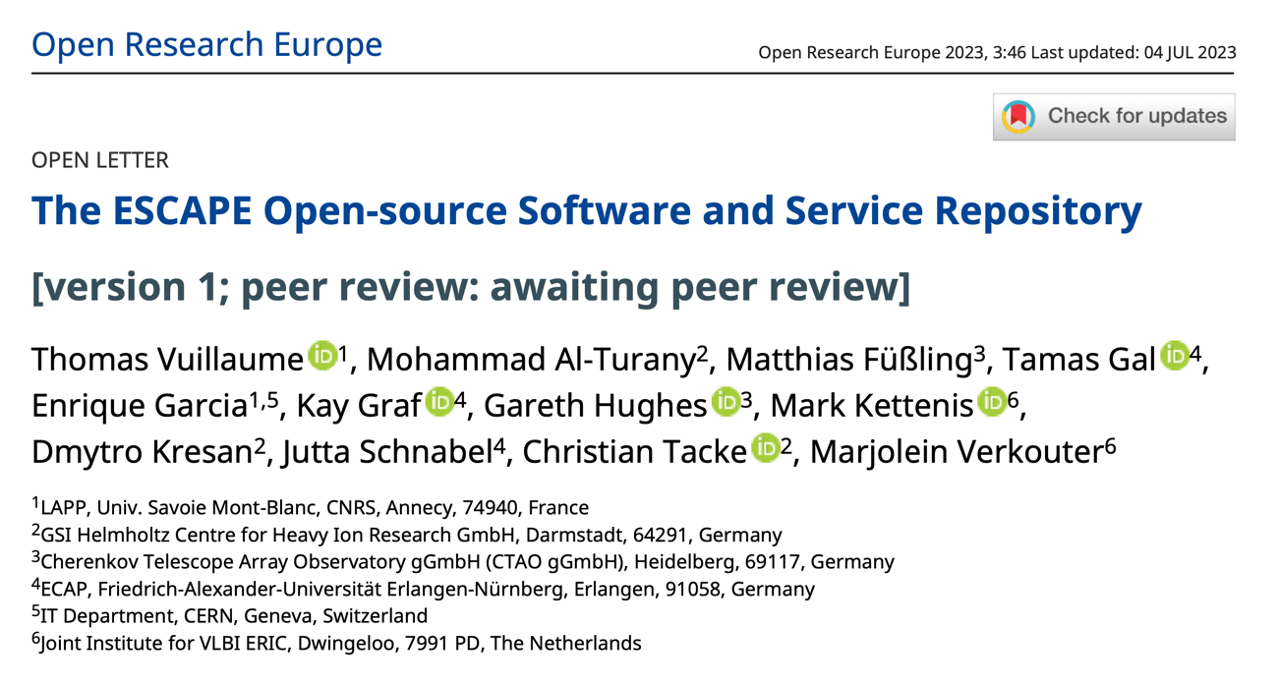
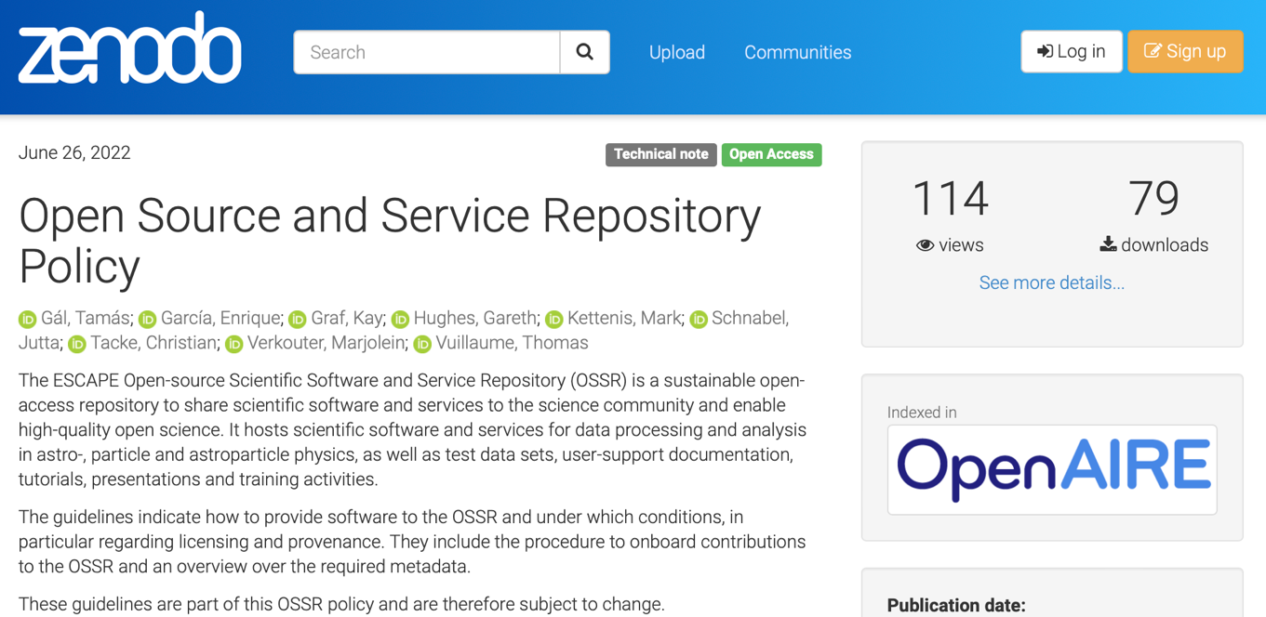
Further Reading: OSSR Publications
OSSR White Paper:
ESCAPE Work Package 3 (OSSR): Achievements and Future Prospects
Scientific paper:
The ESCAPE Open-source Software and Service Repository
ORE 2023, 3:46 (under review)
Policy Paper:
Open Source and Service Repository Policy
DOI: 10.5281/zenodo.6757112

Slide 10
OSSR started as EOSC Project and became an
Open Collaboration lately
Many overlapping topics with SciCodes
Thank you for your attention!

