Slide 1
How alert packets are received ?
The vhf channel enables packets to be retrieved in near-real time, but the link with a station can fail...
To overcome this difficulty, the packets are repeated in order of priority
However the Beidou channel provides a secure link with a delay of around 1 minute, but bandwidth is limited.
A subset of packets is duplicated via Beidou. These are:
the first ECLAIRs alert packet
the last ECLAIRs alert packet (in fact Alert descriptors)
MXT positions each time the QF is improved (maximum 4 packets)
PDPU packets that give slew information
The VT attitude chart for the red channel

Slide 2
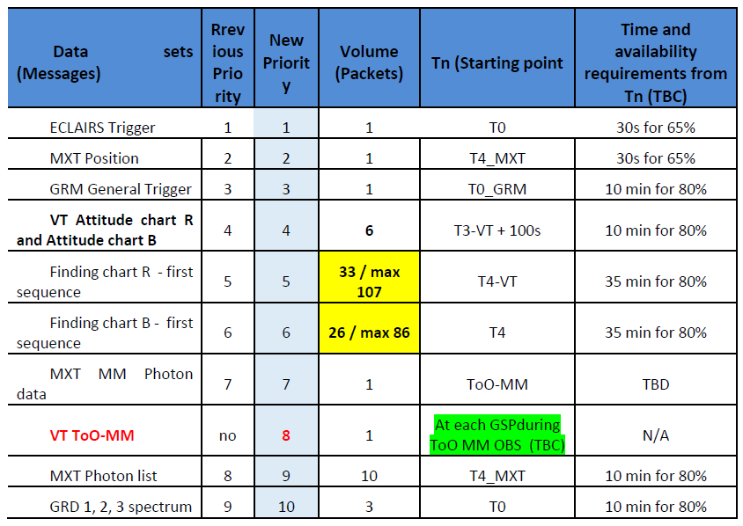
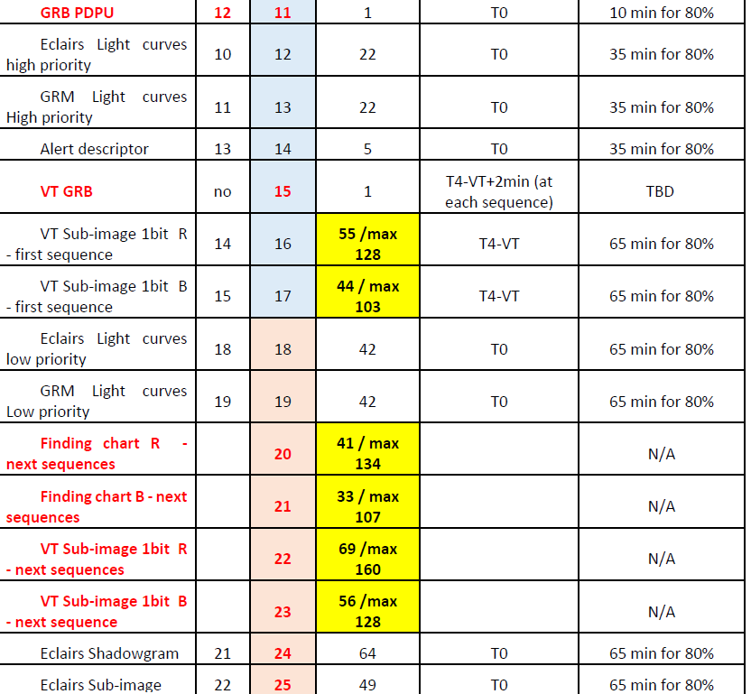
SVOM System Requirements Document
VHF MESSAGE MANAGEMENT BY PDPU

Slide 3
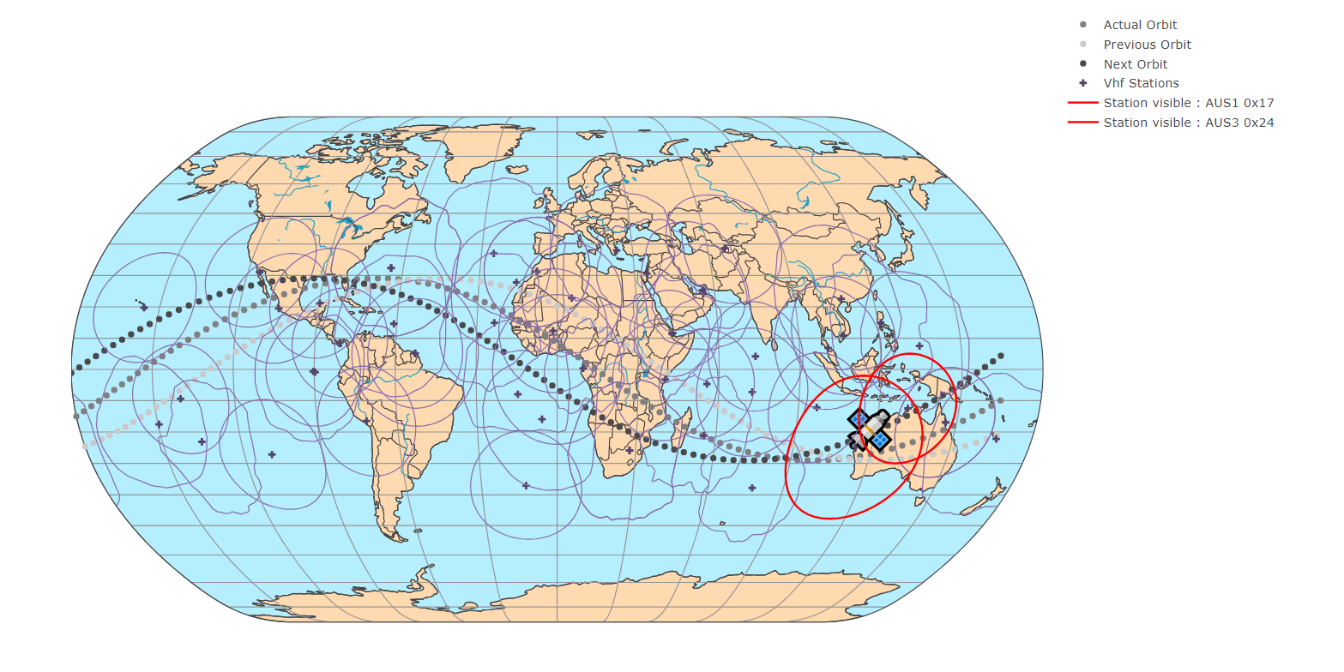
For the hands-on, we will remove two crutial stations at the begining of the alert sequence

