Slide 1
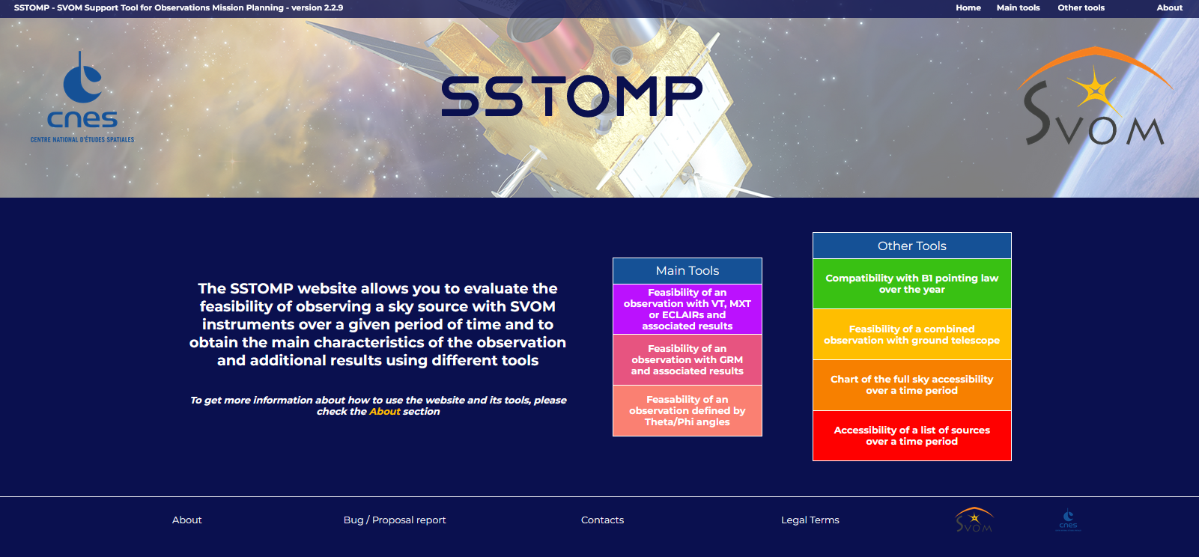
SVOM Presentation of SSTOMP web tool
(SVOM Support Tool for Observation Mission Planning)
Burst Advocate Workshop – APC Paris – 20th September 2023
J. Jaubert CNES

Slide 2
SSTOMP : General points
What SSTOMP is :
SSTOMP = SVOM Support Tool for Observation Mission Planning
Objective :
Help any potential user of the SVOM system (scientific, system, operation teams) to define or analyze an observation request while being provided with assessment of feasibility of the observation, status of applicable constraints and several associated features for the observation sequence.
Globally representative of the SVOM system (requirements, methods, conventions, …).
Can be used before launch (preparation of tests scenarios, commissioning, …) and after launch, to help for the elaboration and tuning of observation requests to be sent to the operational SVOM system (e.g. submission of a request to CSC) or to analyze an event occurred during flight (e.g. condition of a GRB detection).
Tool accessible through internet (free access) : https://sstomp.cnes.fr/sstomp/home
Interactive tool - Default / Custom inputs - Downloadable results
Stand-alone and independent
Internal development at CNES (internships, internal support) – Hosted and maintained at CNES.

Slide 3
SSTOMP : General points
What SSTOMP is not :
Not an operational tool (i.e. not managed as a component of the operational system)
No connections with the real SVOM system (no direct use of interfaces, data, software, …)
Results provided by SSTOMP are indicative and give some representative and reliable trends (as precise as possible) but have in the end to be defined, processed and checked using the operational means and programming chains.

Slide 4
SSTOMP : General points
Current status of SSTOMP :
Current version on line : 2.2.9
Many functions have already been developed and released, but other ones in progress or intended
Good level of validation (functional results, mainly tested with Firefox for web interface)
Possible evolutions derived from users’ feedback
On-line help for each function available
Open access to www https://sstomp.cnes.fr/sstomp/home
Contacts :
Dedicated @ : svom-sstomp@cnes.fr
Jean Jaubert : jean.jaubert@cnes.fr

Slide 5
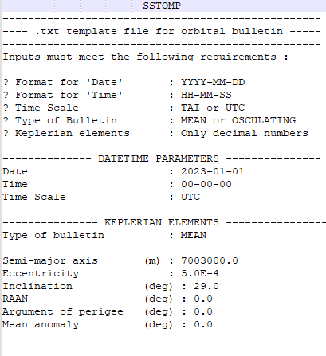
SSTOMP : Main functions
Orbit initialisation and propagation :
Mode automatic :
Orbit initialized automatically from Two-Line Elements (TLE) downloaded from Spacetrack.org website. TLE are usually refreshed every day.
(Warning : currently, simulated by retrieval of TLE for SWIFT satellite)
Mode manual :
Orbit initialized from external data being either “Keplerian bulletin” or “TLE”
Propagation :
Analytical model (Eckstein-Hechler) for keplerian bulletin → long term propagation (days, monthes, year) Dedicated model (SGP) for TLE → short term propagation (days, week)
Note : Backward propagation is possible → analyze of event in the past

Slide 6
SSTOMP : Main functions
Observation with VT / MXT / ECLAIRs :
Assess the feasibility and characteristics of an observation of a chosen sky source (RA, Dec) at a given date or over a given period.
Source pointed to with satellite X-axis (supposed = LoS of VT / MXT / ECL)
Choice of the instrument (VT / MXT / ECL) → applicable constraints (Sun, Moon, SAA, Earth occultations, …)
Results :
Feasability of observation / constraints
Computation of slots and duration for effective observation over the period
Production of associated data (PVT, GSP, quaternion, sampled status for constraints with angles, …)
Graphic representations (ground tracks on Earth map, sky charts with pointings, FoV instruments, other predefined sources, …)
Additional pointings associated (for GRM/GRD, theta/phi or other RA/Dec direction)
Downloadable (formated / raw)

Slide 7
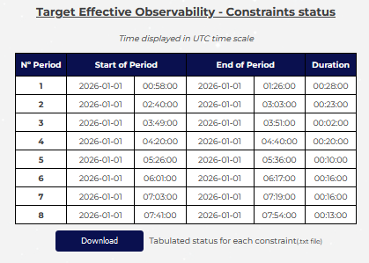
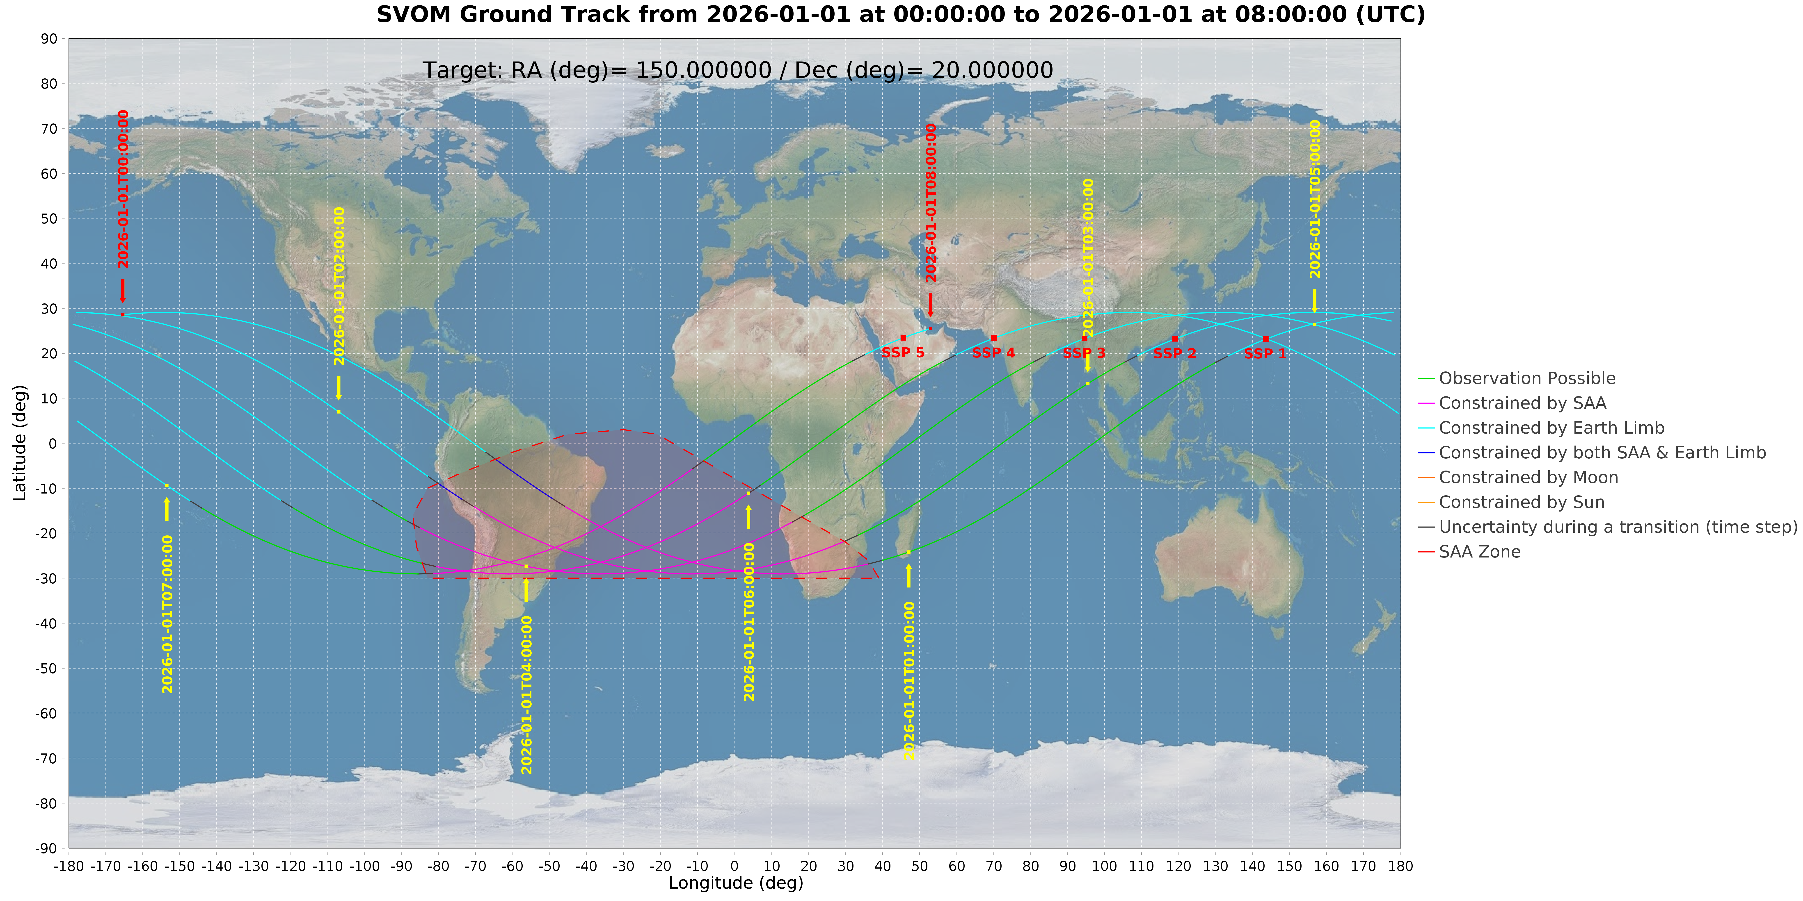
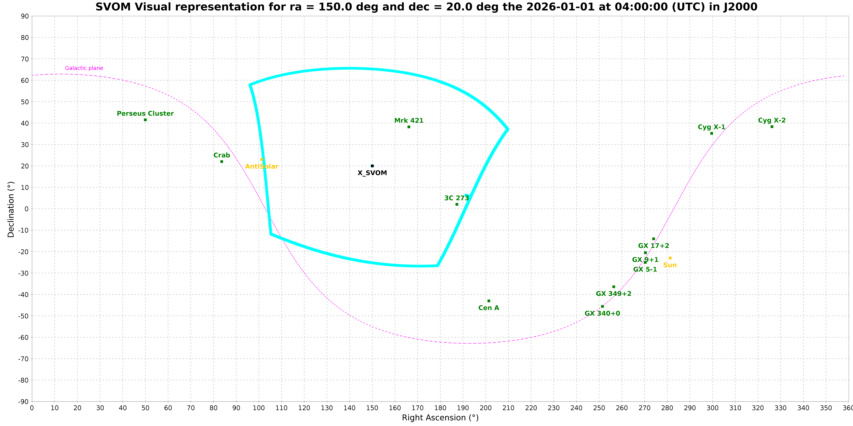
SSTOMP : Main functions
Observation with VT / MXT / ECLAIRs :

Slide 8
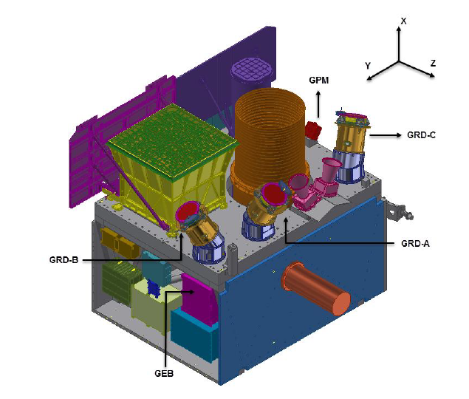
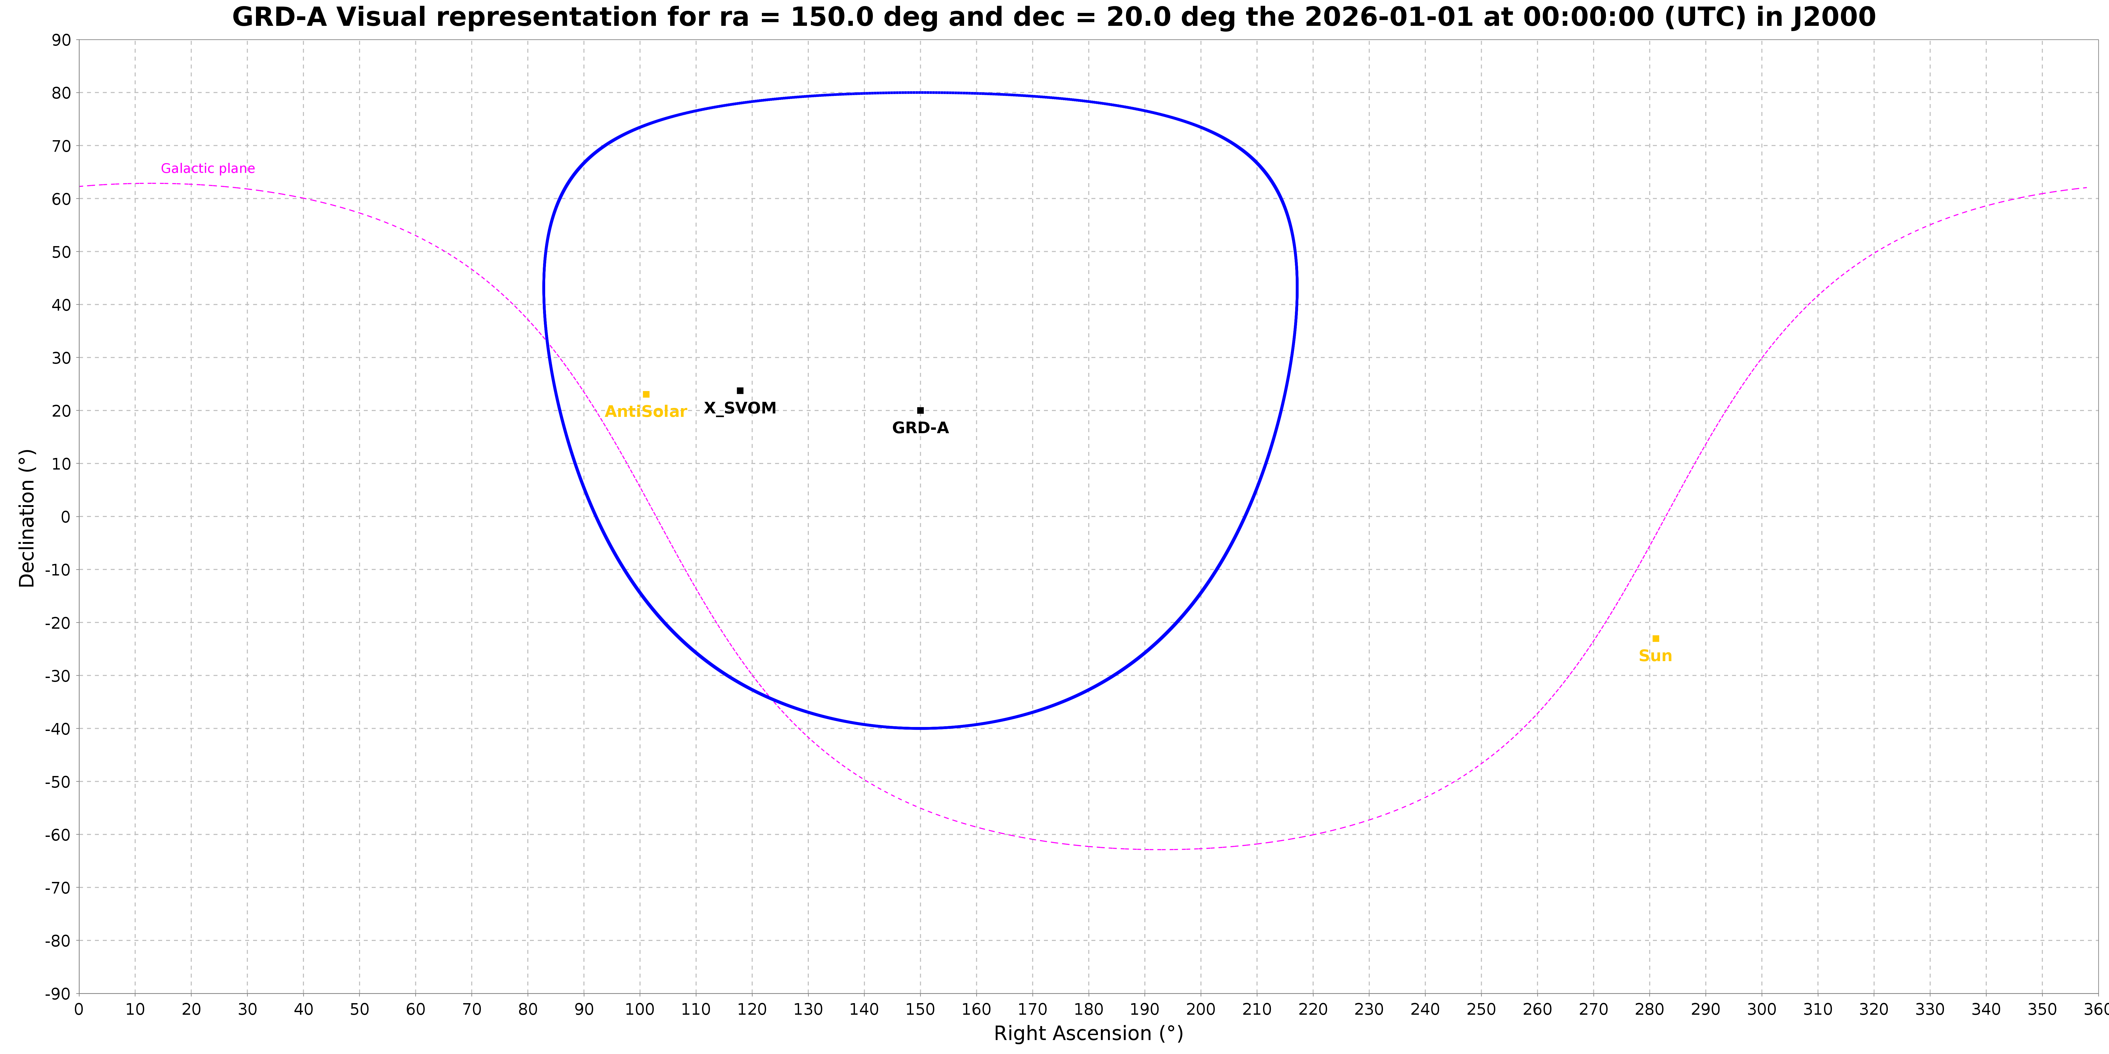
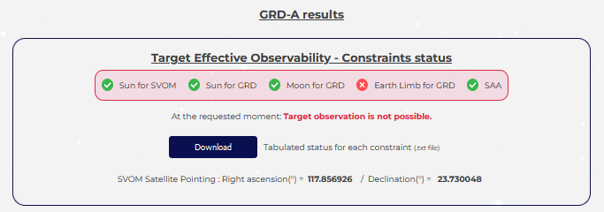
SSTOMP : Main functions
Observation with GRM :
Assess the feasibility and characteristics of an observation of a chosen sky source (RA, Dec) at a given date or over a given period.
Source pointed to with LoS of one of the 3 GRD heads
Choice of the GRD head → applicable constraints (Sun, Moon, SAA, Earth occultations, …)
Results :
Feasability of observation / constraints
Computation of slots and duration for effective observation by GRD over the period
Pointing quaternion and RA,Dec for the satellite (if feasible wrt satellite Sun constraint)
Graphic representation (sky charts with pointings, FoV GRD, other predefined sources,…)
Downloadable (formated / raw)

Slide 9
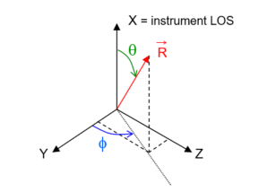
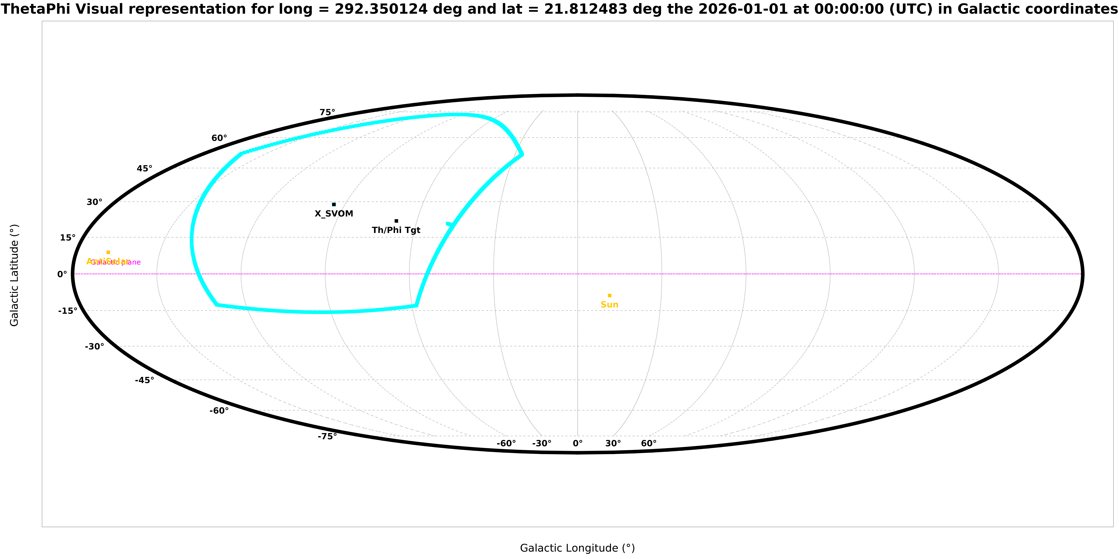
SSTOMP : Main functions
Observation towards direction defined by theta / phi angles :
Assess the feasibility and characteristics of an observation of a chosen sky source (RA, Dec) at a given date or over a given period.
Source pointed to with direction defined by chosen theta / phi angles (wrt to statellite frame)
Choice of the instrument (VT/MXT/ECL) → applicable constraints (Sun, Moon, SAA, Earth occultations, …)
Results :
Feasability of observation / constraints
Computation of slots and duration for effective observation towards theta / phi direction
Pointing quaternion and RA,Dec for the satellite (if feasible wrt satellite Sun constraint)
Graphic representation (sky charts with pointings, theta / phi direction, other predefined sources,…)
Downloadable (formated / raw)

Slide 10
SSTOMP : Additional functions
Compatibility with B1 law reference pointing :
Gives the days in the year when a chosen sky source (RA, Dec) direction is compatible (= within 10 deg) from the B1 reference pointing of each day.
Charts of full sky availability :
Production of sky charts showing if any direction is accessible (= valid pointing wrt Sun and Moon constraints) over a given period with indication of average ratio for effective observation duration per orbit.
Combined observation with a ground telescope :
Compute the time slots over a period when a chosen sky source (RA, Dec) is accessible by both SVOM and a ground telescope (predefined or custom) considering all applicable constraints for each one of them.
Accessibility of a list of sky sources :
Batch computing of the accessibility (= feasibility of pointing wrt Sun and Moon constraints) for a whole list of sky sources (predefined or external input) over a period.

Slide 11
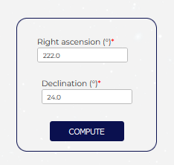
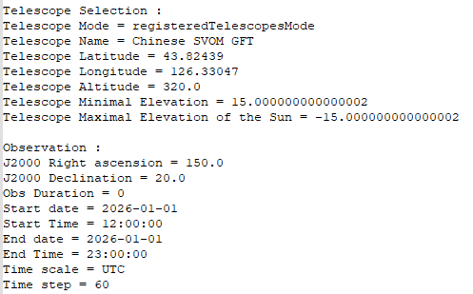
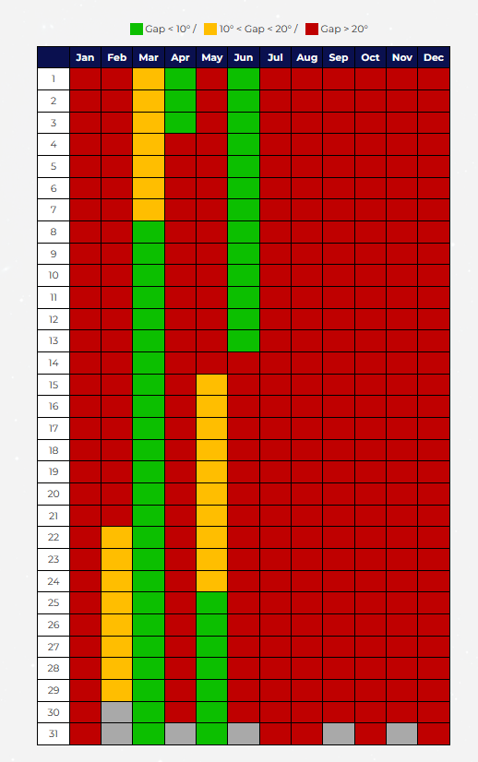
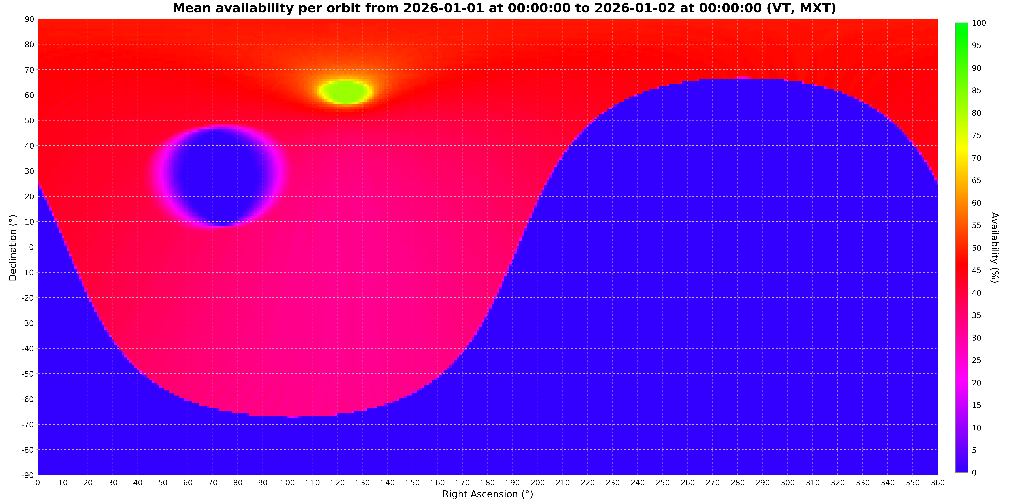
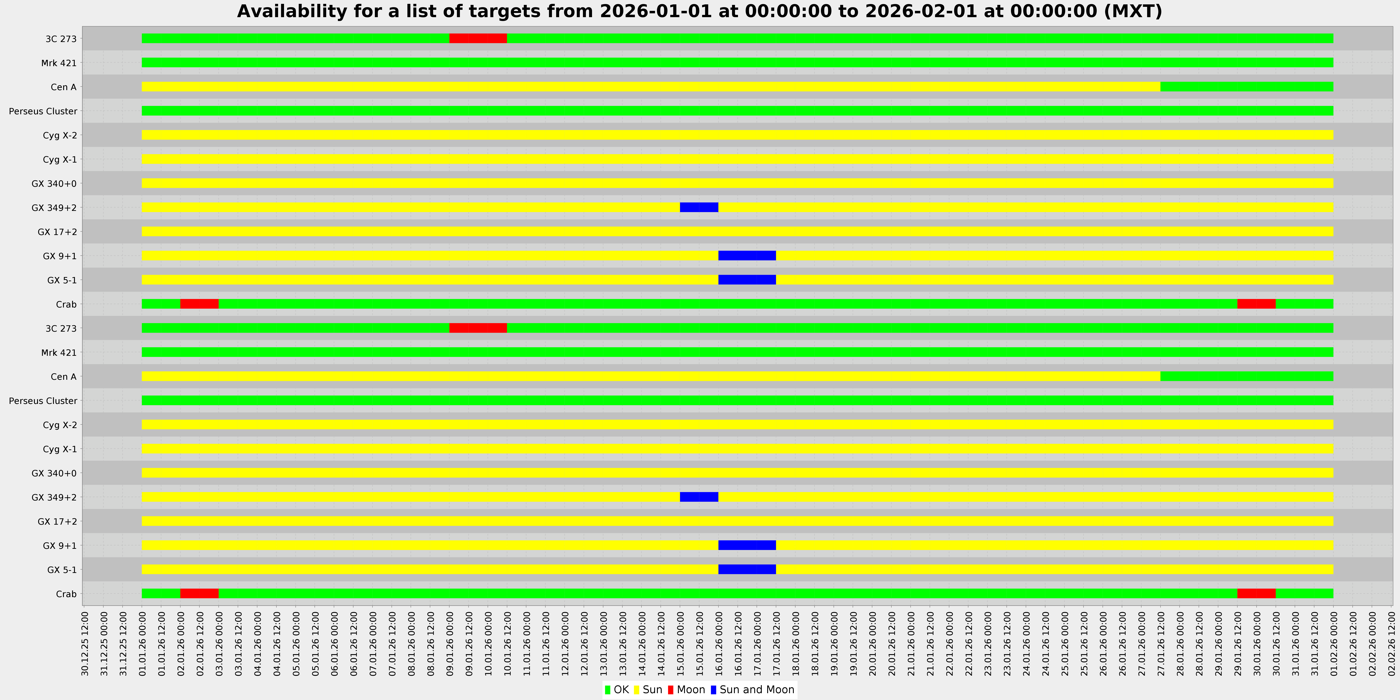
SSTOMP : Additional functions

Slide 12
SSTOMP : Future work
New functions : → In progress
Combined observation with other satellites (Fermi, Integral, JWST, …)
Representation of Moon position
Dynamic tuning of mission parameters
Maintenance :
Various improvements for existing functions (additional results, …)
Consideration of users’ feedback

Slide 13
谢谢
Thank you

