Slide 1
GRM performance
Requirements & Validation
SHI Haoli,HUANG Yue,HE Jiang
2023.09.18

Slide 2
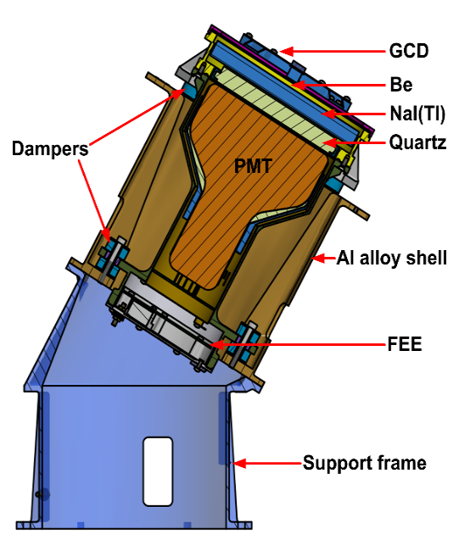
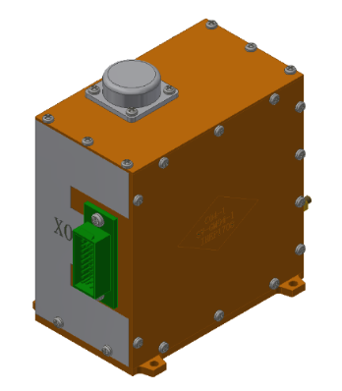
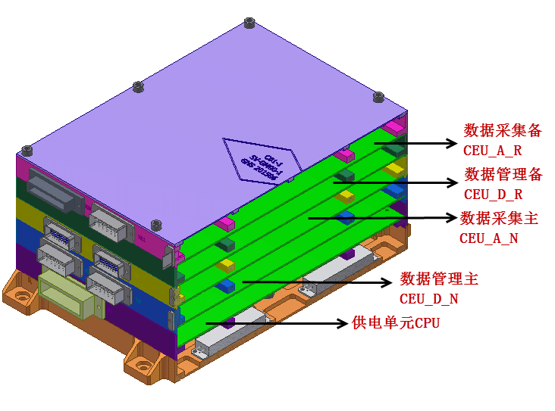
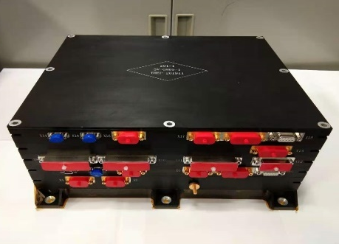
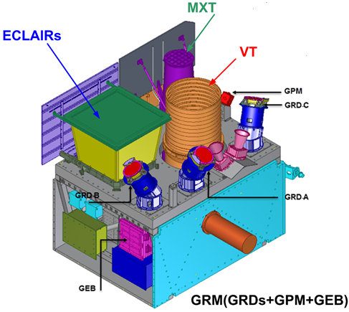
GRM introduction
GRD(GCD)
GPM
GEB
GRD (Gamma Ray Detector)：3GRDs (NaI + PMT)，used for GRB trigger, spectrum measurement and rough localization.
GCD (GRM Calibration Detector)：²⁴¹Am+PS+SiPM，used for on-orbit calibration.
GPM (GRM Particle Monitor)：PS+PMT，monitor the electrons and judge the SAR.
GEB (GRM Electronic Box)：to generate GRM packets.

Slide 3
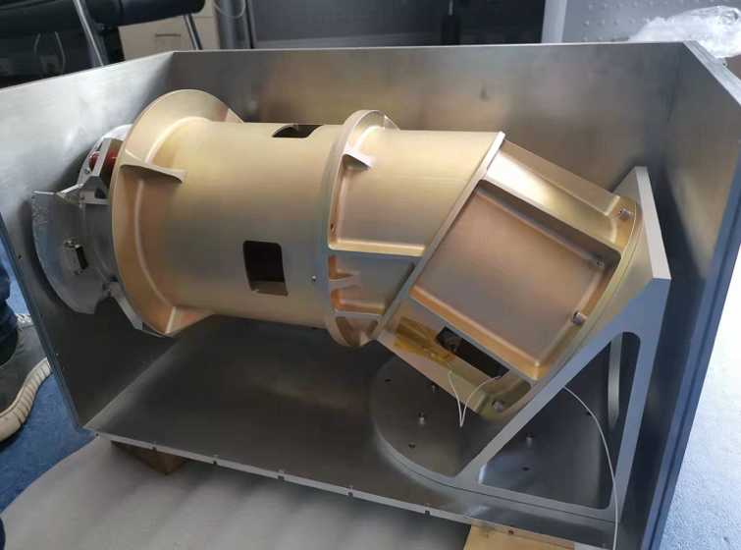
FM calibration experiment introduction
items | GRD used
Energy response, detection efficiency, angular response calibrations and HV effect with radioactive sources | GRD01-05
Energy response, detection efficiency calibrations with x-ray beam (10-160keV) | GRD01-05
GPM threshold and x-ray efficiency calibrations (electron: 1MeV, proton: 20MeV, x-ray beam for efficiency ranging from 10keV-130keV) | GPM01-02
GRD threshold and HV research (threshold:0x21, 15keV detectable, 0x0d to check the lowest detectable energy) (HV: E-C, resolution, ratio of high gain and low gain) | GRD01-03
Temperature response (5-35℃, ²⁴¹Am, ⁵⁷Co, ¹³³Ba…, full-energy peak, energy resolution) | GRD05
Dead time test | GRD01-05
Performance variation test for a long term (Energy response, detection efficiency, energy resolution) | GRD01-05，GCD01-05，GPM01-02
GRD01-05:
GRD04 & 05 as spares
GPM01-02:
GPM02 as a spare

Slide 4
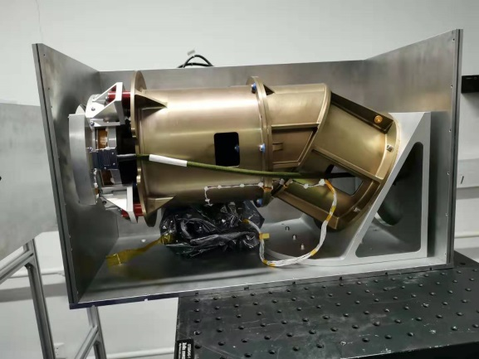
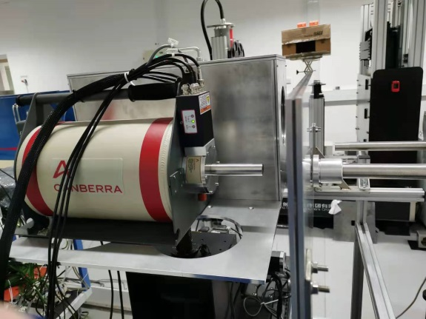
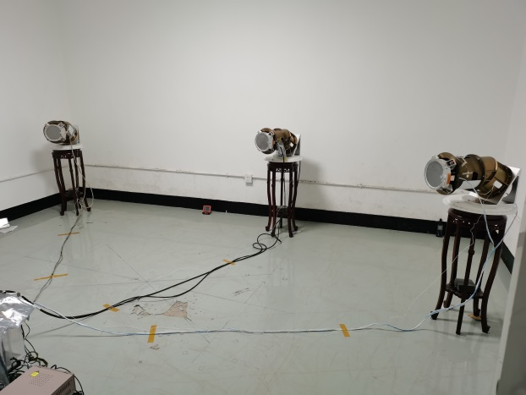
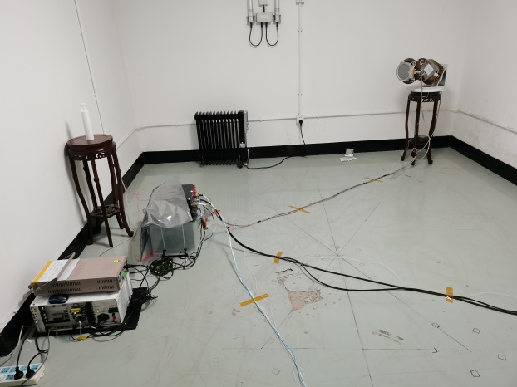
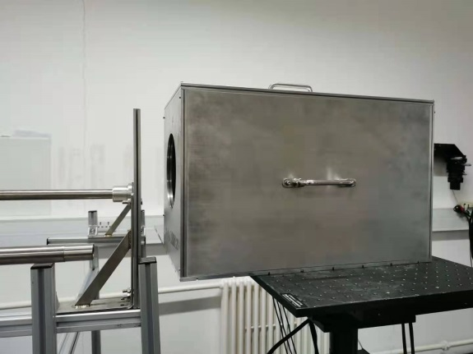
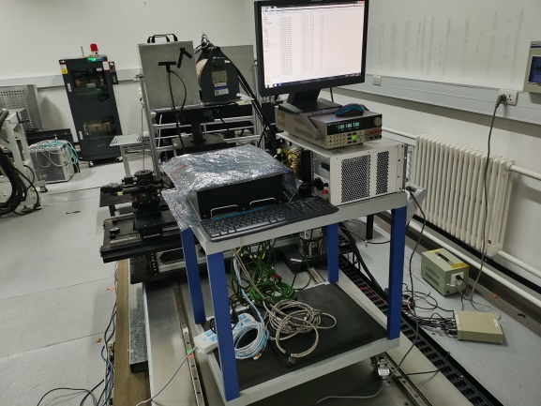
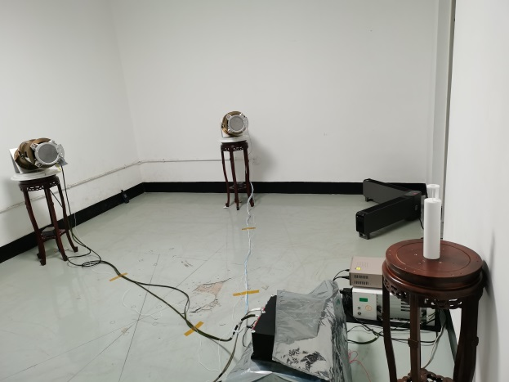
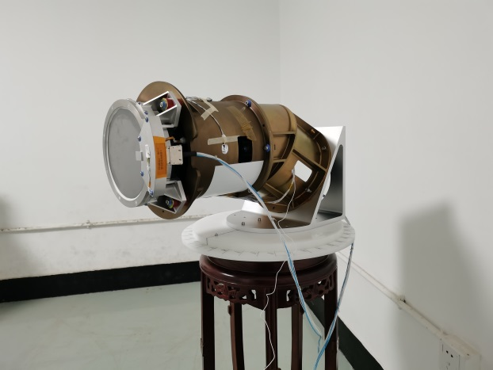
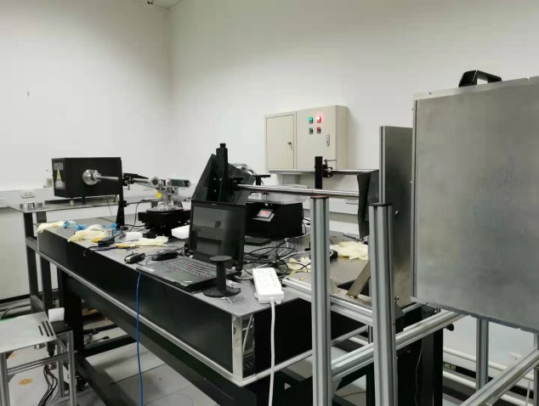
Equipment assembly
for X-ray beam
for sources

Slide 5
X-ray beam setting and sources selection
Energy(keV)
(8、9)10
11-12
13-15
16-20、22、24
26、28、30-31
32-40
41-44
45-51
55/65/75/80/
110、120、130、140、150、160
No. | Source type | energy(keV) | 活度(Bq)
1 | ¹³⁷Cs | 661.657 | 1.993E+06
2 |  | 32.194
3 | ¹¹³Sn | 391.698 | 2.457E+06
4 | ⁶⁰Co | 1173.228 | 3.504E+06
5 |  | 1332.492
6 | ⁸⁸Y | 14.958 | 1.518E+06
7 |  | 898.042
8 |  | 1836.063
9 | ⁵⁷Co | 14.41 | /
10 |  | 122.06
11 | ²²Na | 511.0 | /
12 |  | 1274.537
13 | ²⁴¹Am | 59.5 | /
Energy test points
Non-linearity of NaI crystal in low energy
The absorption edge of Iodine element on 33keV
We do the test with more energy points under 20keV and near 33keV
Sources list

Slide 6
Performance requirements
Item | Specification | Verification method
Energy range | 15 - 5000 keV | test & analysis
Field of View | ± 60° (for one GRD) | Simulation
Sensitive area | > 200 cm² (for one GRD) | test
Dead time | < 8 μs | test
Temporal resolution | < 20 μs | review of Design
Energy resolution | ≤ 19%@60 keV | test
Burst observation rate | >90/year | simulation & analysis
GRB localization error | <5 degrees (fluence > 1e-6 ergcm⁻²@1-1000 keV, 1s) | simulation & analysis

Slide 7
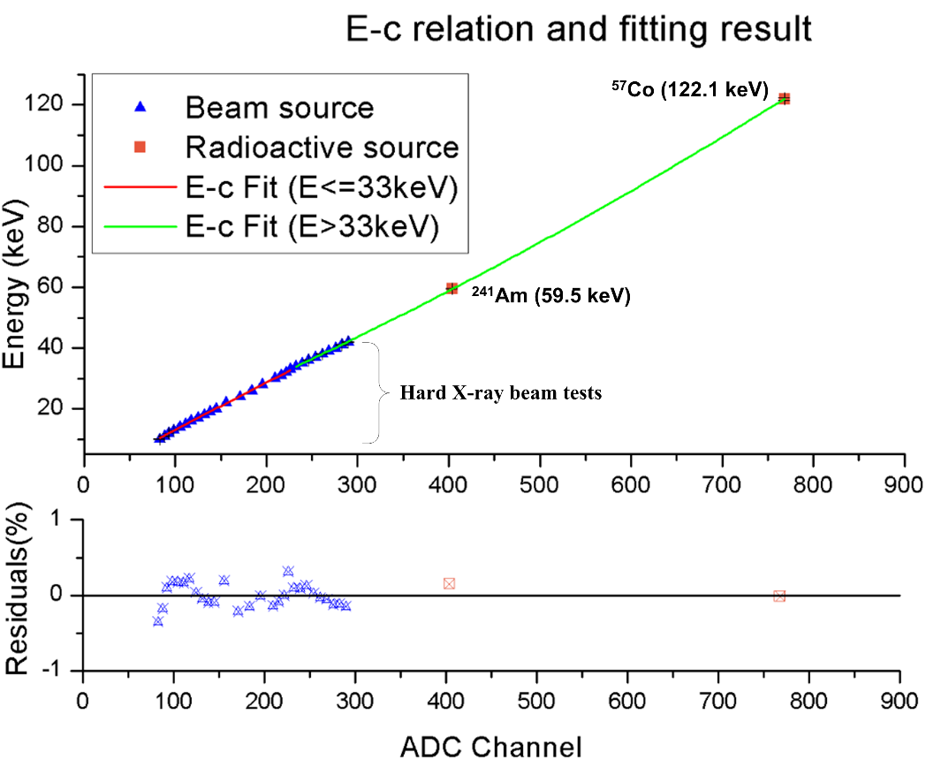
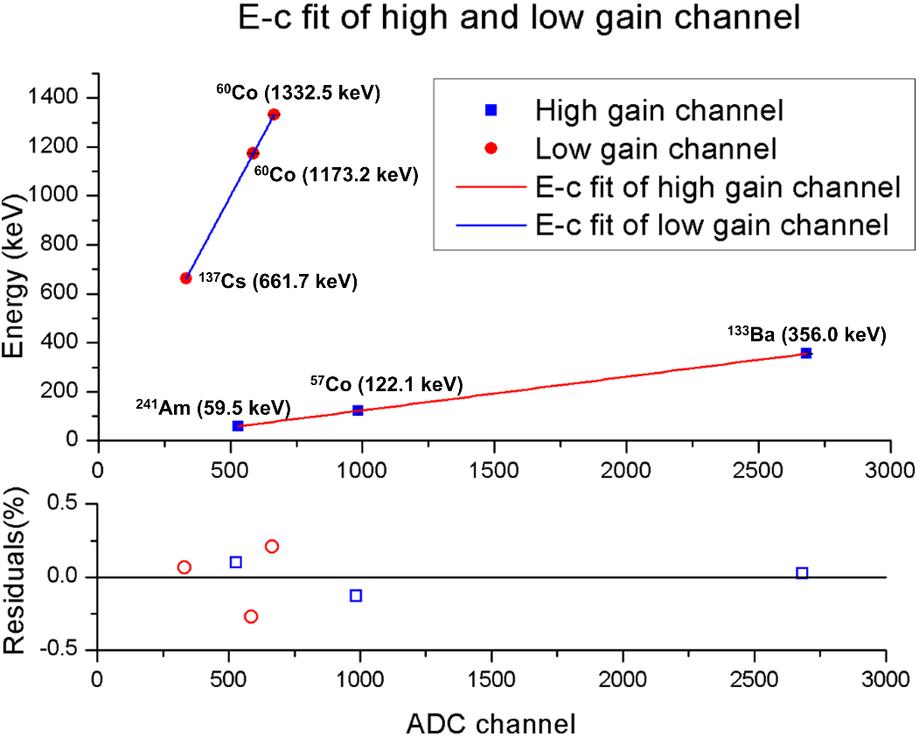
Energy range
E-C relation calibrations
E-C relation of GRD with hard X-ray beam and sources
E-C relation of GRD with radioactive sources

Slide 8
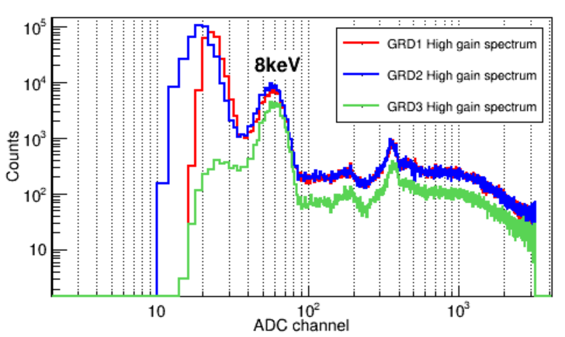
Energy range
According to the EC for low gain, one can get:
channel | detector
 | GRD1 | GRD2 | GRD3
3200 | 6109keV | 5861keV | 5763keV
8kev spectrum measurement
with x-ray calibration (threshold:0x0d)
Energy range calculation of low gain

Slide 9
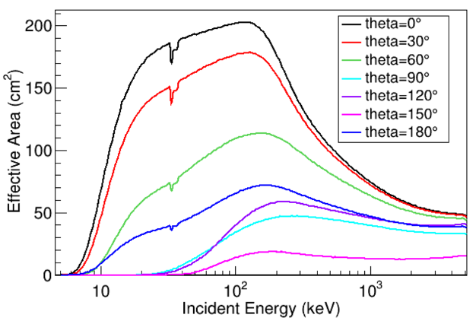
Field of View
The FOV of GRD is defined as the solid angle with the incident polar angle where the effective area of GRD drops half.
simulation (angular response)
Theta=60°: effective area is more than half of the sensitive area.
Meet the requirement of FOV (±60°)

Slide 10
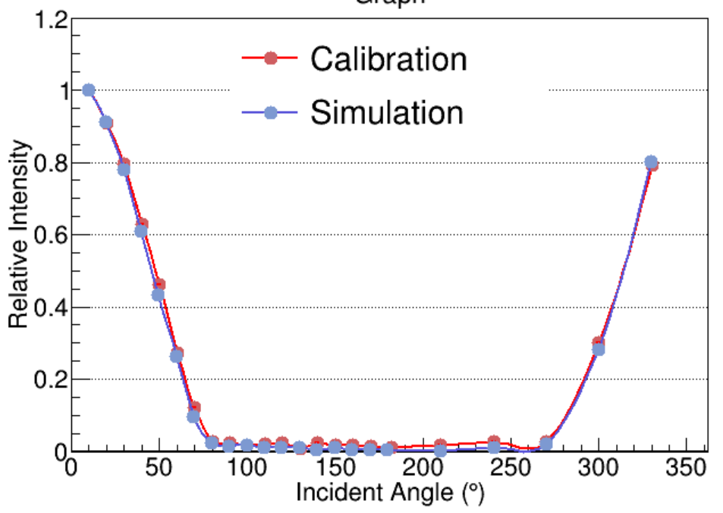
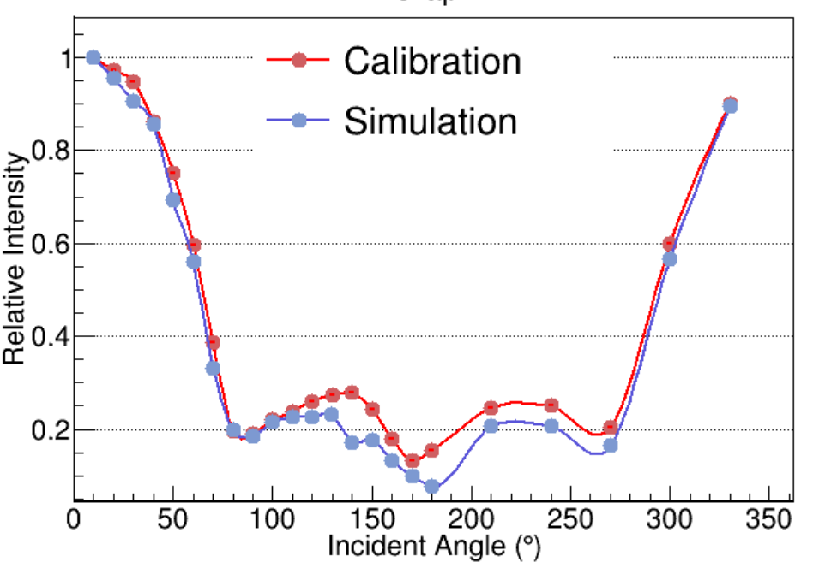
Field of View
¹¹³Sn的24keV全能峰相对效率变化
¹¹³Sn的392keV全能峰相对效率变化

Slide 11
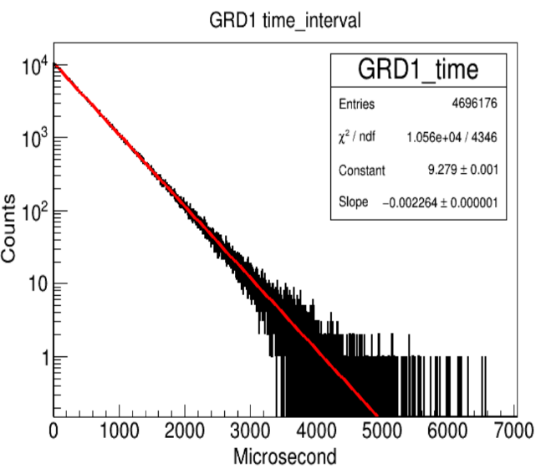
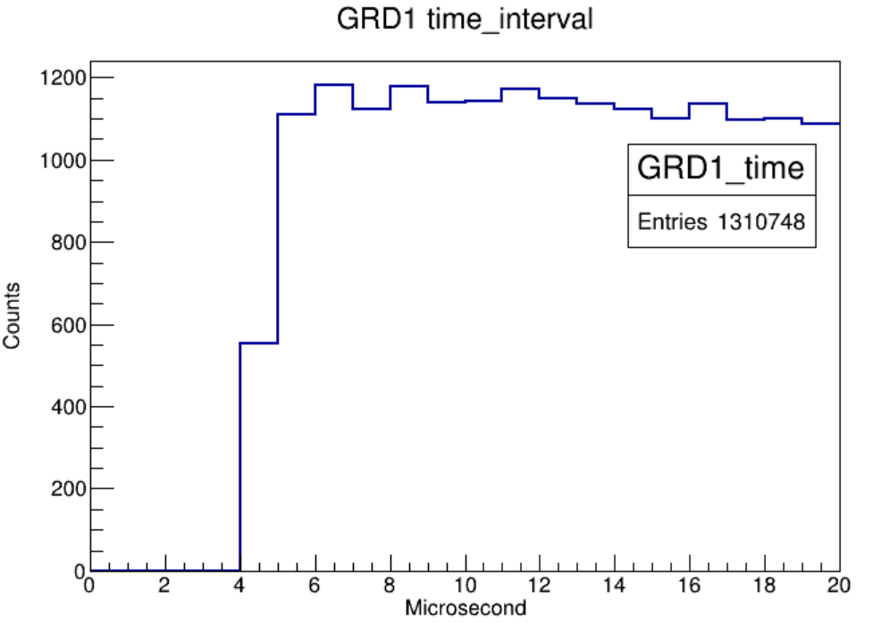
Sensitive area and dead time
Sensitive area of GRD
The diameter of NaI crystal is 16 cm, thus the sensitive area of each GRD is 201.06 cm²
Dead time
The test result on GRD FM is about 4us.
⁶⁰Co time interval spectrum

Slide 12
Sensitive area and dead time
Temporal resolution
The temporal resolution is the accuracy of arrival time of each event, which is designed to be 1μs. Crystal frequency 30MHz, for events, its time precision is 1us in the raw data.
Byte No. | contents
 | D7 | D6 | D5 | D4 | D3 | D2 | D1 | D0
byte 1 | Packet type (‘1’) | CH(1 to 0): “00”invalid,“01”GRD1,“10”GRD2, “11”GRD3 |  | ‘0’single gain event | Coincide flag： 0 non-coincide event 1 coincide event | Gain falg： 0 low gain，1 high gain | Packet sequence number
 |  |  |  | ‘1’double gain event
byte 2 | ptime(19 to 12)：microsecond counts(19 to 12)
byte 3 | ptime(11 to 4) ：microsecond counts(11 to 4)
byte 4 | ptime(3 to 0) & energy(11to 8)：microsecond counts(3 to 0) &channel(11to 8)
byte 5 | energy(7 to 0)：channel(7to 0)
GRM x-band event packet definition

Slide 13
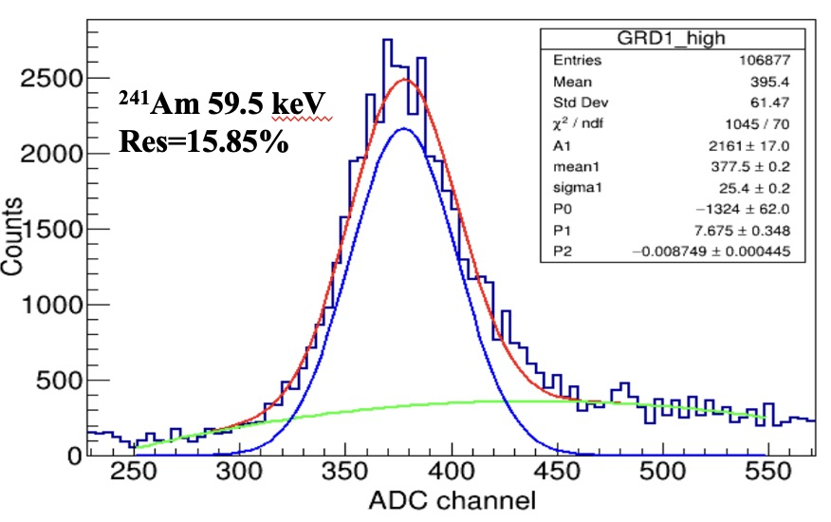
energy resolution
 | GRD1 | GRD2 | GRD3
Energy Resolution @60keV | 15.85% | 16.2% | 16.5%
Energy resolution of GRD FM.
Measured with ²⁴¹AM.

Slide 14
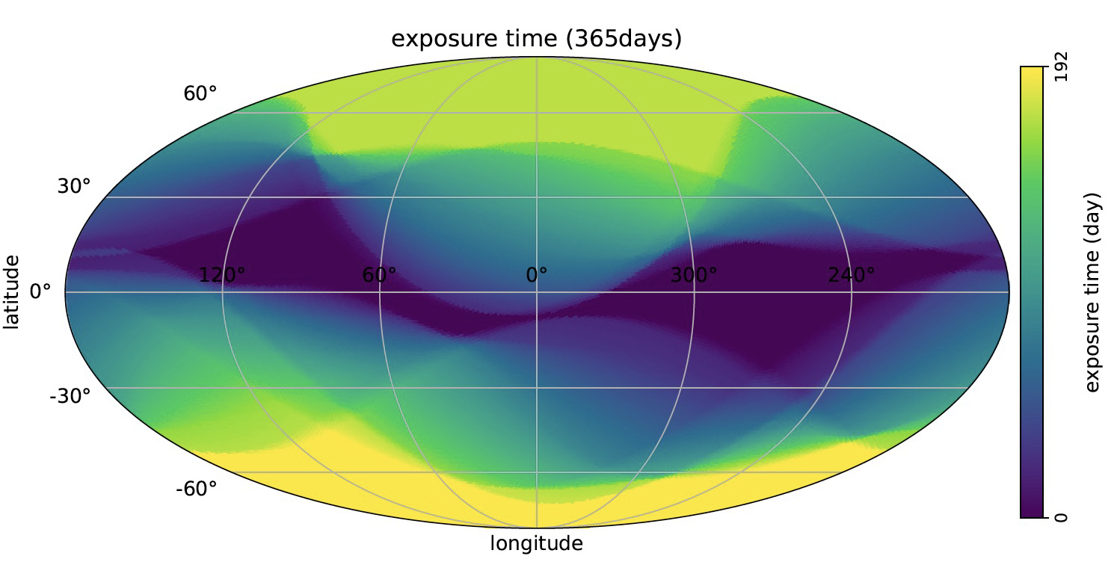
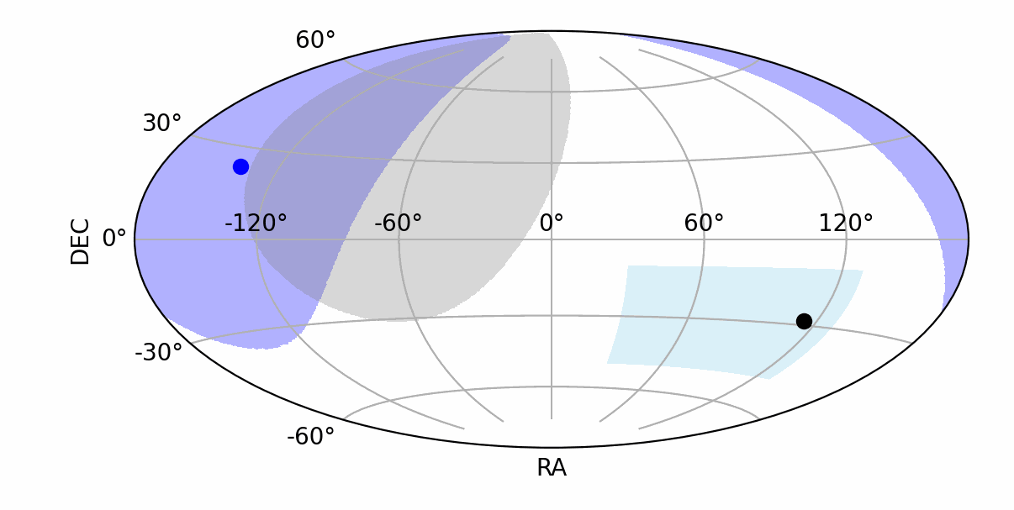
Burst observation rate
Fig.1 B1 law operational strategy
Fig.2 The exposure time in one year(FOV=$±60°$).
We assume that there are ~550 gamma-ray bursts with peak flux greater than 0.3 ph/cm2/s within one year. Therefore, within three years of operation, there will be approximately 1650 gamma-ray bursts. These bursts will be uniformly sampled in time and space. The energy spectrum and peak flux of GRBs are derived from the results of BATSE. if at least two detectors are required for triggering(>5$σ$), then ~330 GRBs can be triggered within three years, with an average of approximately ~110 triggers per year.

Slide 15
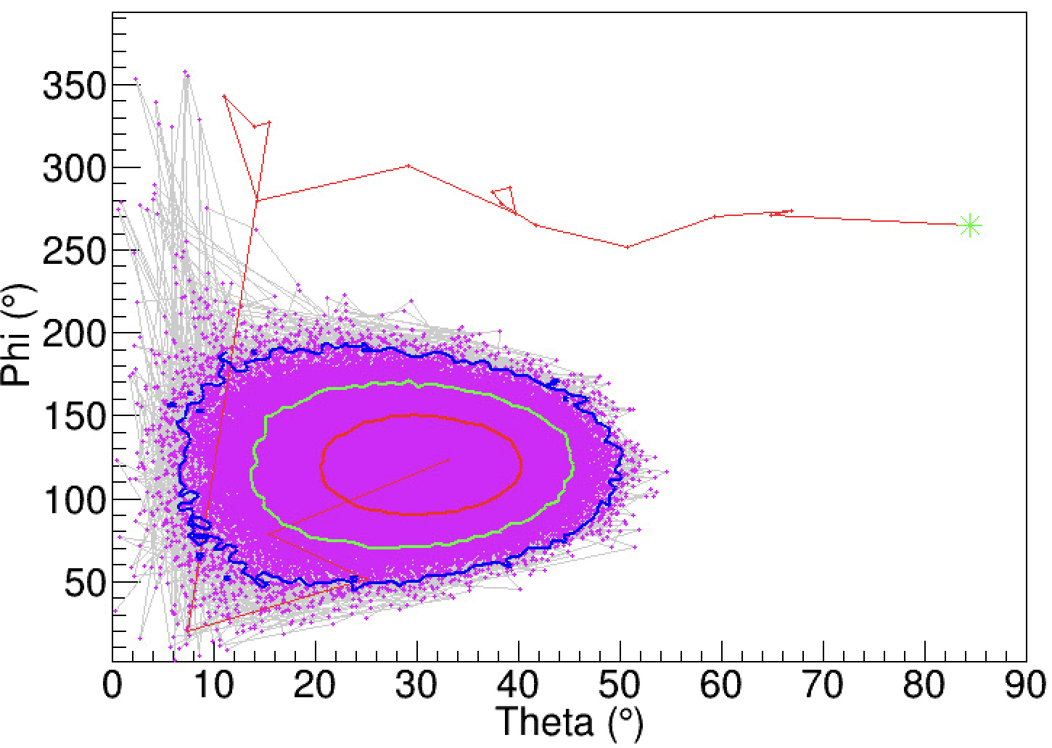
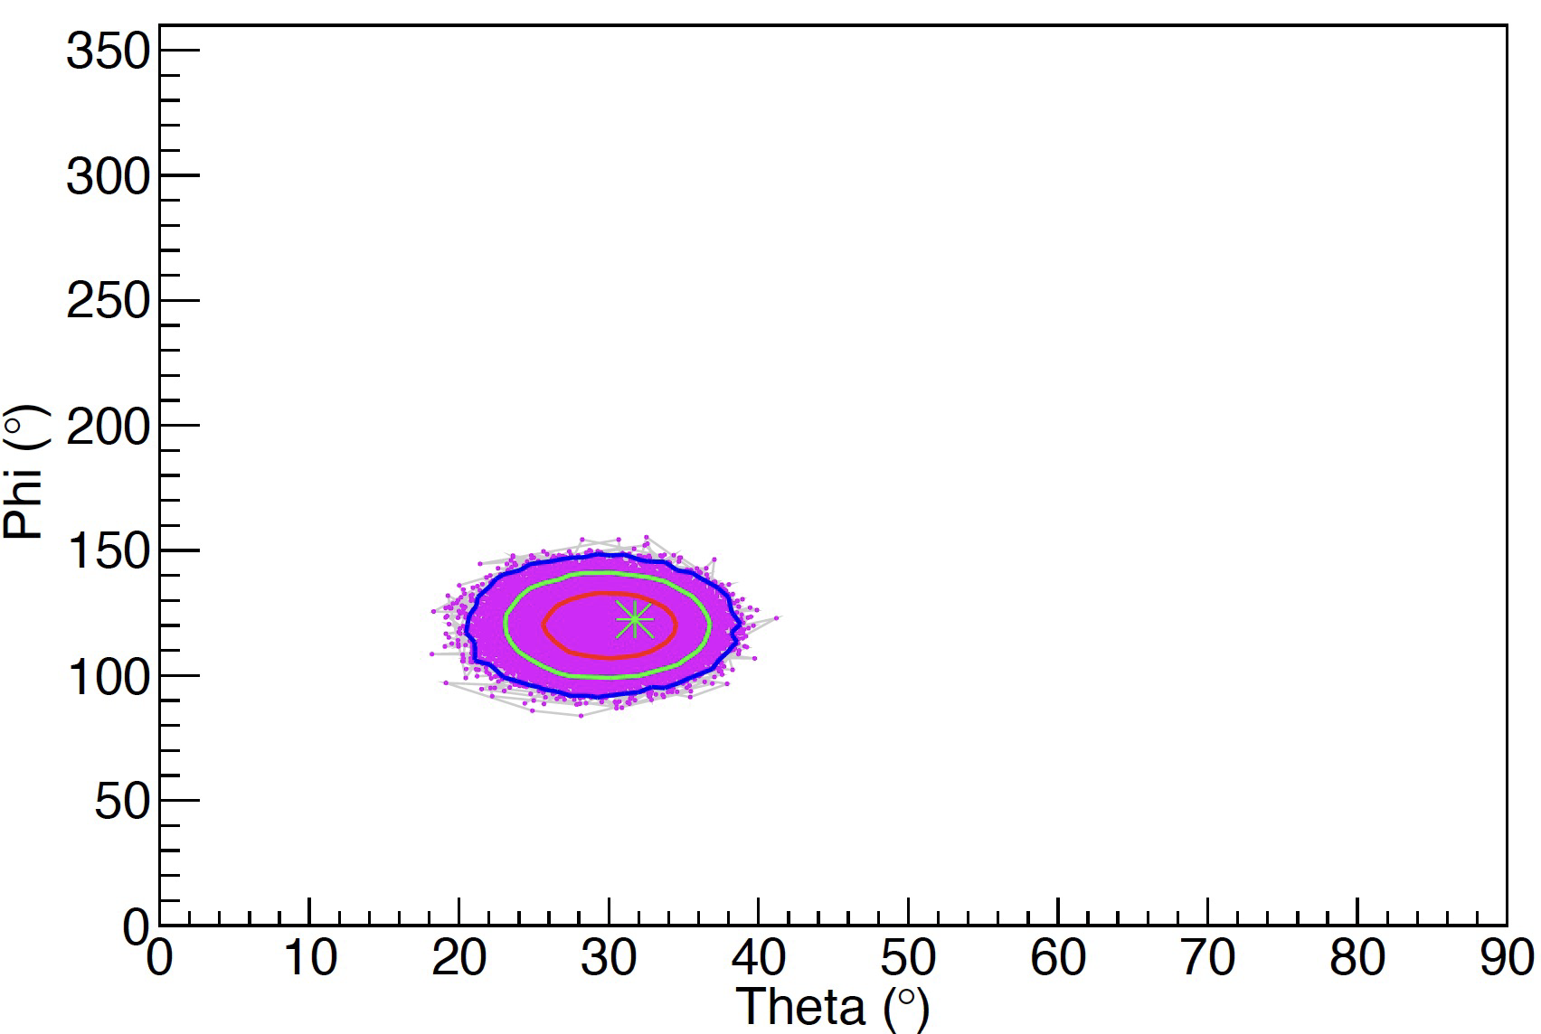
localization error
Incident direction(30,120)
$$Band\left(α=−1,β=−2.3,Epeak=230 keV\right)，$$
$$Fluence=1×{10}^{−7} erg {cm}^{−2}{ s}^{−1}，duration=10 s.$$
$$Band\left(α=−1,β=−2.3,Epeak=230 keV\right)，$$
$$Fluence=1{×10}^{−6} erg {cm}^{−2}{ s}^{−1}，duration=1 s.$$
68% confidence interval（1$σ$）：
68% confidence interval（1$σ$）：
$$θ\left(21.15°，40.05°\right)$$
$$φ(91.8°，149.4°)$$
$$θ(25.65°，33.75°)$$
$$φ(109.8°，131.4°)$$
Local error ~10°
Local error ~5°

Slide 16
conclusion
All the performances of GRM meet the requirements, and validated by tests, simulation, calculation or analysis for GRM FM.
Merci!
Thank you!

