Slide 1
The performance of Visible Telescope --- in the view of scientists
Yulei QIU Liping XIN
NAOC

Slide 2
Outline
General specifications and functions
Detection capability
Two major modifications for VT FM
Calibrations
Data Processing Pipelines

Slide 3
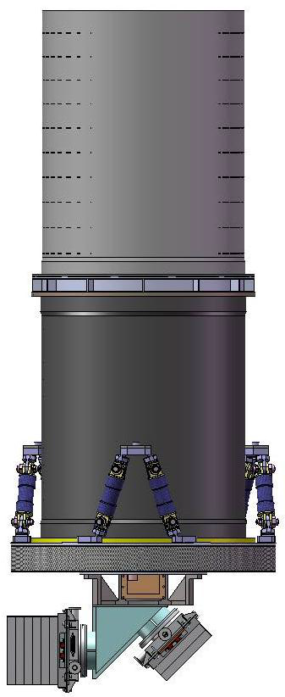
General Specifications of VT
Diameter : 44cm ; Focal Length: 360cm
FOV: 26‘x26’ Sensitivity : 22.5 Mv in 300s
Encircled energy : 80% and 70% within the radius of 0.77aresec in blue and red channels, respectively.
Two channels: 400 – 650 nm(blue); 650 – 1000 nm(red)
CCDs for two channels :
2kx2k, 13.5 μm for both CCDs
Cooling temperatures: -65C （blue） and -75C （red ）
blue : thinned CCD, QE ~90% at 600nm cooling
Red : deep depletion CCD, QE > 50% at 900nm)
Readout noise for both CCDs:
< 8e-/pix （for 15s exp.) ; <6e-/pix （for >=100s exp.）

Slide 4
General functions of VT
Supports all of the SVOM tasks (CP ,GP , ToO)
Calibrations : photometry, astrometry and alignments
Data processing : onboard and on-ground
Data link (VHF, Beidou, X-band, S-band)
Data budgets : maximum of 30Gbit per day.

Slide 5
Detection capability
SNR=
R* : derived from throughput of the telescope:
CCDs : calibration of FM
Optics: calirbration of FM
whole system: direct measurements and indirect measurements
Rsky : derived from brightness of sky background the throughput
Npix : dirived from Encircled energy performace(measurements)
RN and Dark : noise of the detector (measurements)
Estimated detection capability : For a GRB with magnitude of 22.5 and spectrum of index of -1 for a 3*100s exposure, SNR:
Blue band: 4.56
Red band: 6.20
The performance of the detection capability meets the requirement in MRR (>3sigma)

Slide 6
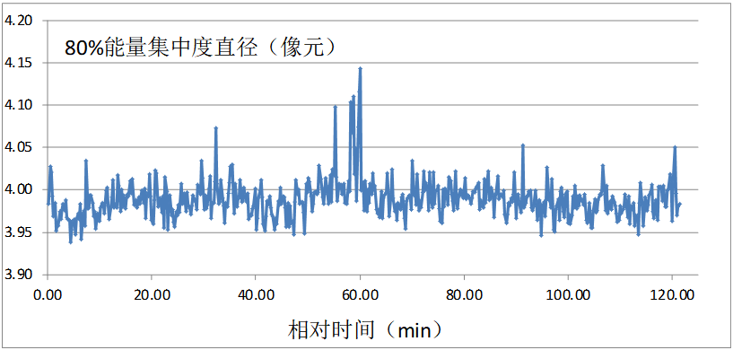
New thermo design one of two major modification of FM
E
E
(pix)
Old thermo design
new thermo design

Slide 7
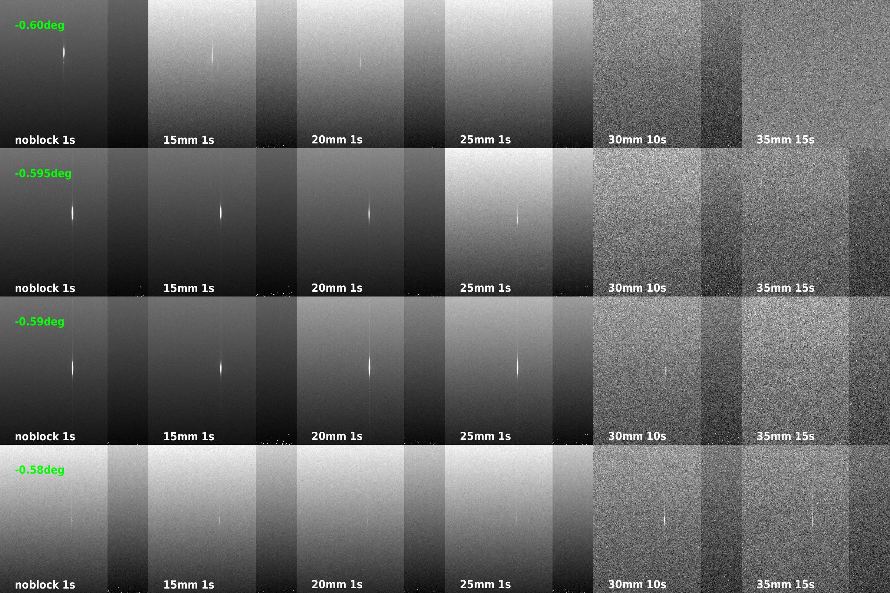
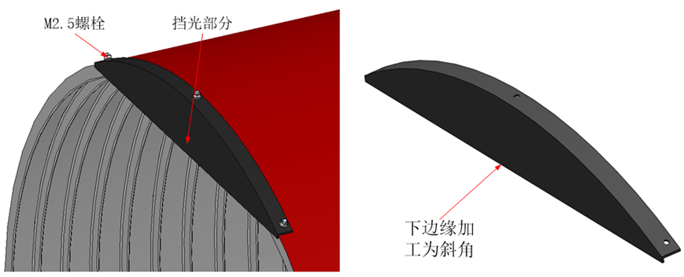
New design of VT to avoid ghost images: one of two major modifications of FM
New baffle design can effectively remove the ghost-images and have no significant impact on the detection capability.

Slide 8
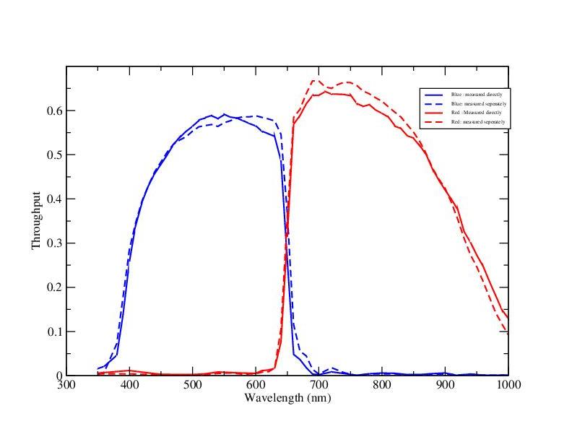
Calibration :throughput
Before launch:
Two different method
: Directly
CCD and optics were measured separately
In orbit :
validation and zero point Correction by observing standard stars

Slide 9
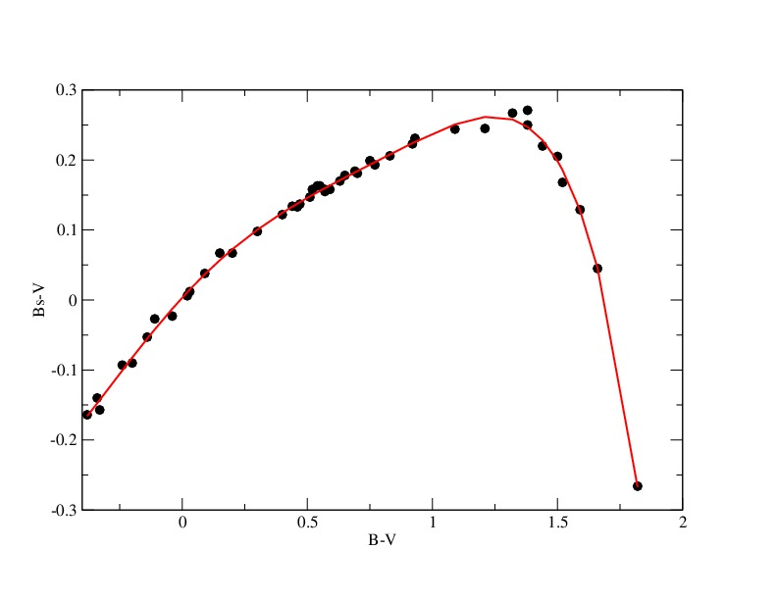
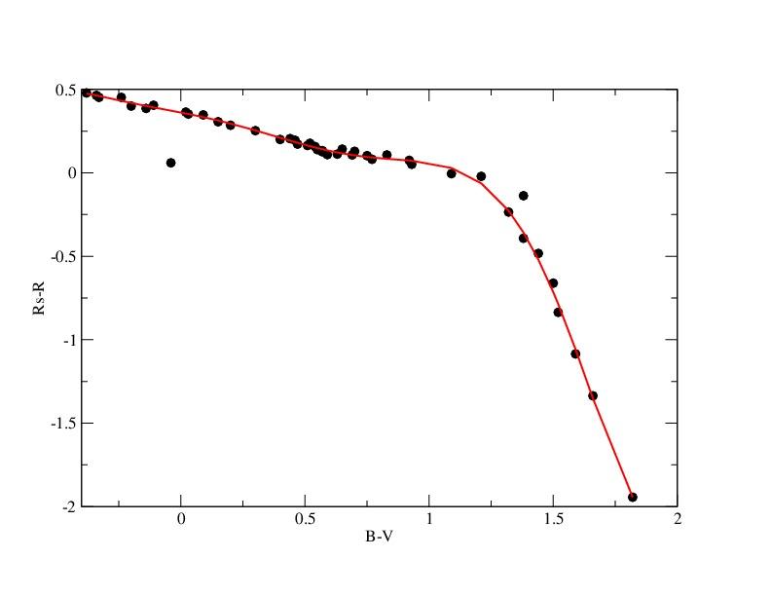
Calibration: SVOM AB magnitudes to Johnson System

Slide 10
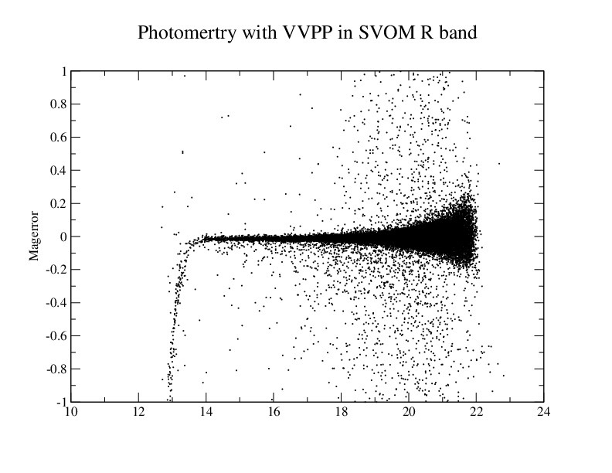
Photometric accuracy
Short term calibration
Psf correction
psf is measured for each frame.
Longterm calibration
Before launch : Throughput test
In orbit: validation and re-calibration with standard stars
Monitor GAIN of detectors
Internal calibration (LED lamps)
Systematic photometric calibration accuracy can be
better than 1%--meets the requirements in MRR

Slide 11
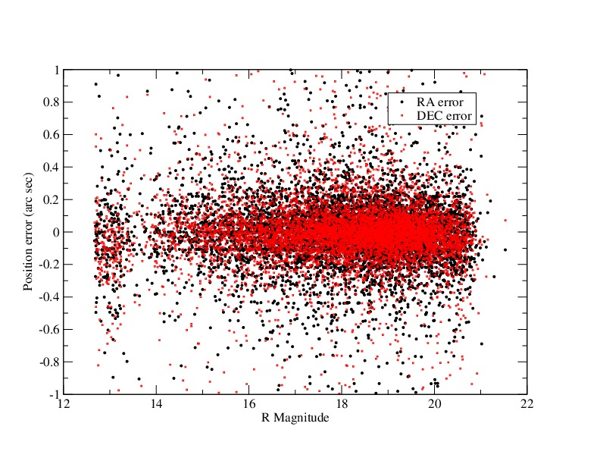
Astrometric accuracy
Simulations show that
Systematic calibration accuracy can be
better than 0.1 pixel

Slide 12
Alignment calibrations
VT and Star-trackers
VT and Eclairs
VT and MXT

Slide 13
Data Processing Pipelines
VOPP (VT Onbarod Processing Pipeline)
NAOC and SCEM teams are testing software
VT Beidou packets will be optimized
VVPP(VT VHF data Processing Pipeline)
CALDB: astrometric and photometric calibrations
Participate in the NMS test in April 2023
Qsourcelist_VT, Qsky_VT, 1 bit images with WCS
VTAC(VT VHF Afterglow Candidate)
GRB candidate search by crossmatch of VT source lists and archived data
Science products:
Qsourcelist_VT
Qsky_VT
QCANDI_VT
QIM1B
VXPP(VT X-band data Processing Pipeline)
CP:
CP01: in the case that the optical counterpart has not been identified.
Optimize the strategy of image-combination
Find variable objects in error box of MXT
CP02: photometry for identified GRBs.
ToO-MM
find transients in the nearby galaxies with the algorithm of image-subtraction .
Science products : CANDI_VT
Candidates list or counterpart
Positions
Light curves,
Finding charts

Slide 14
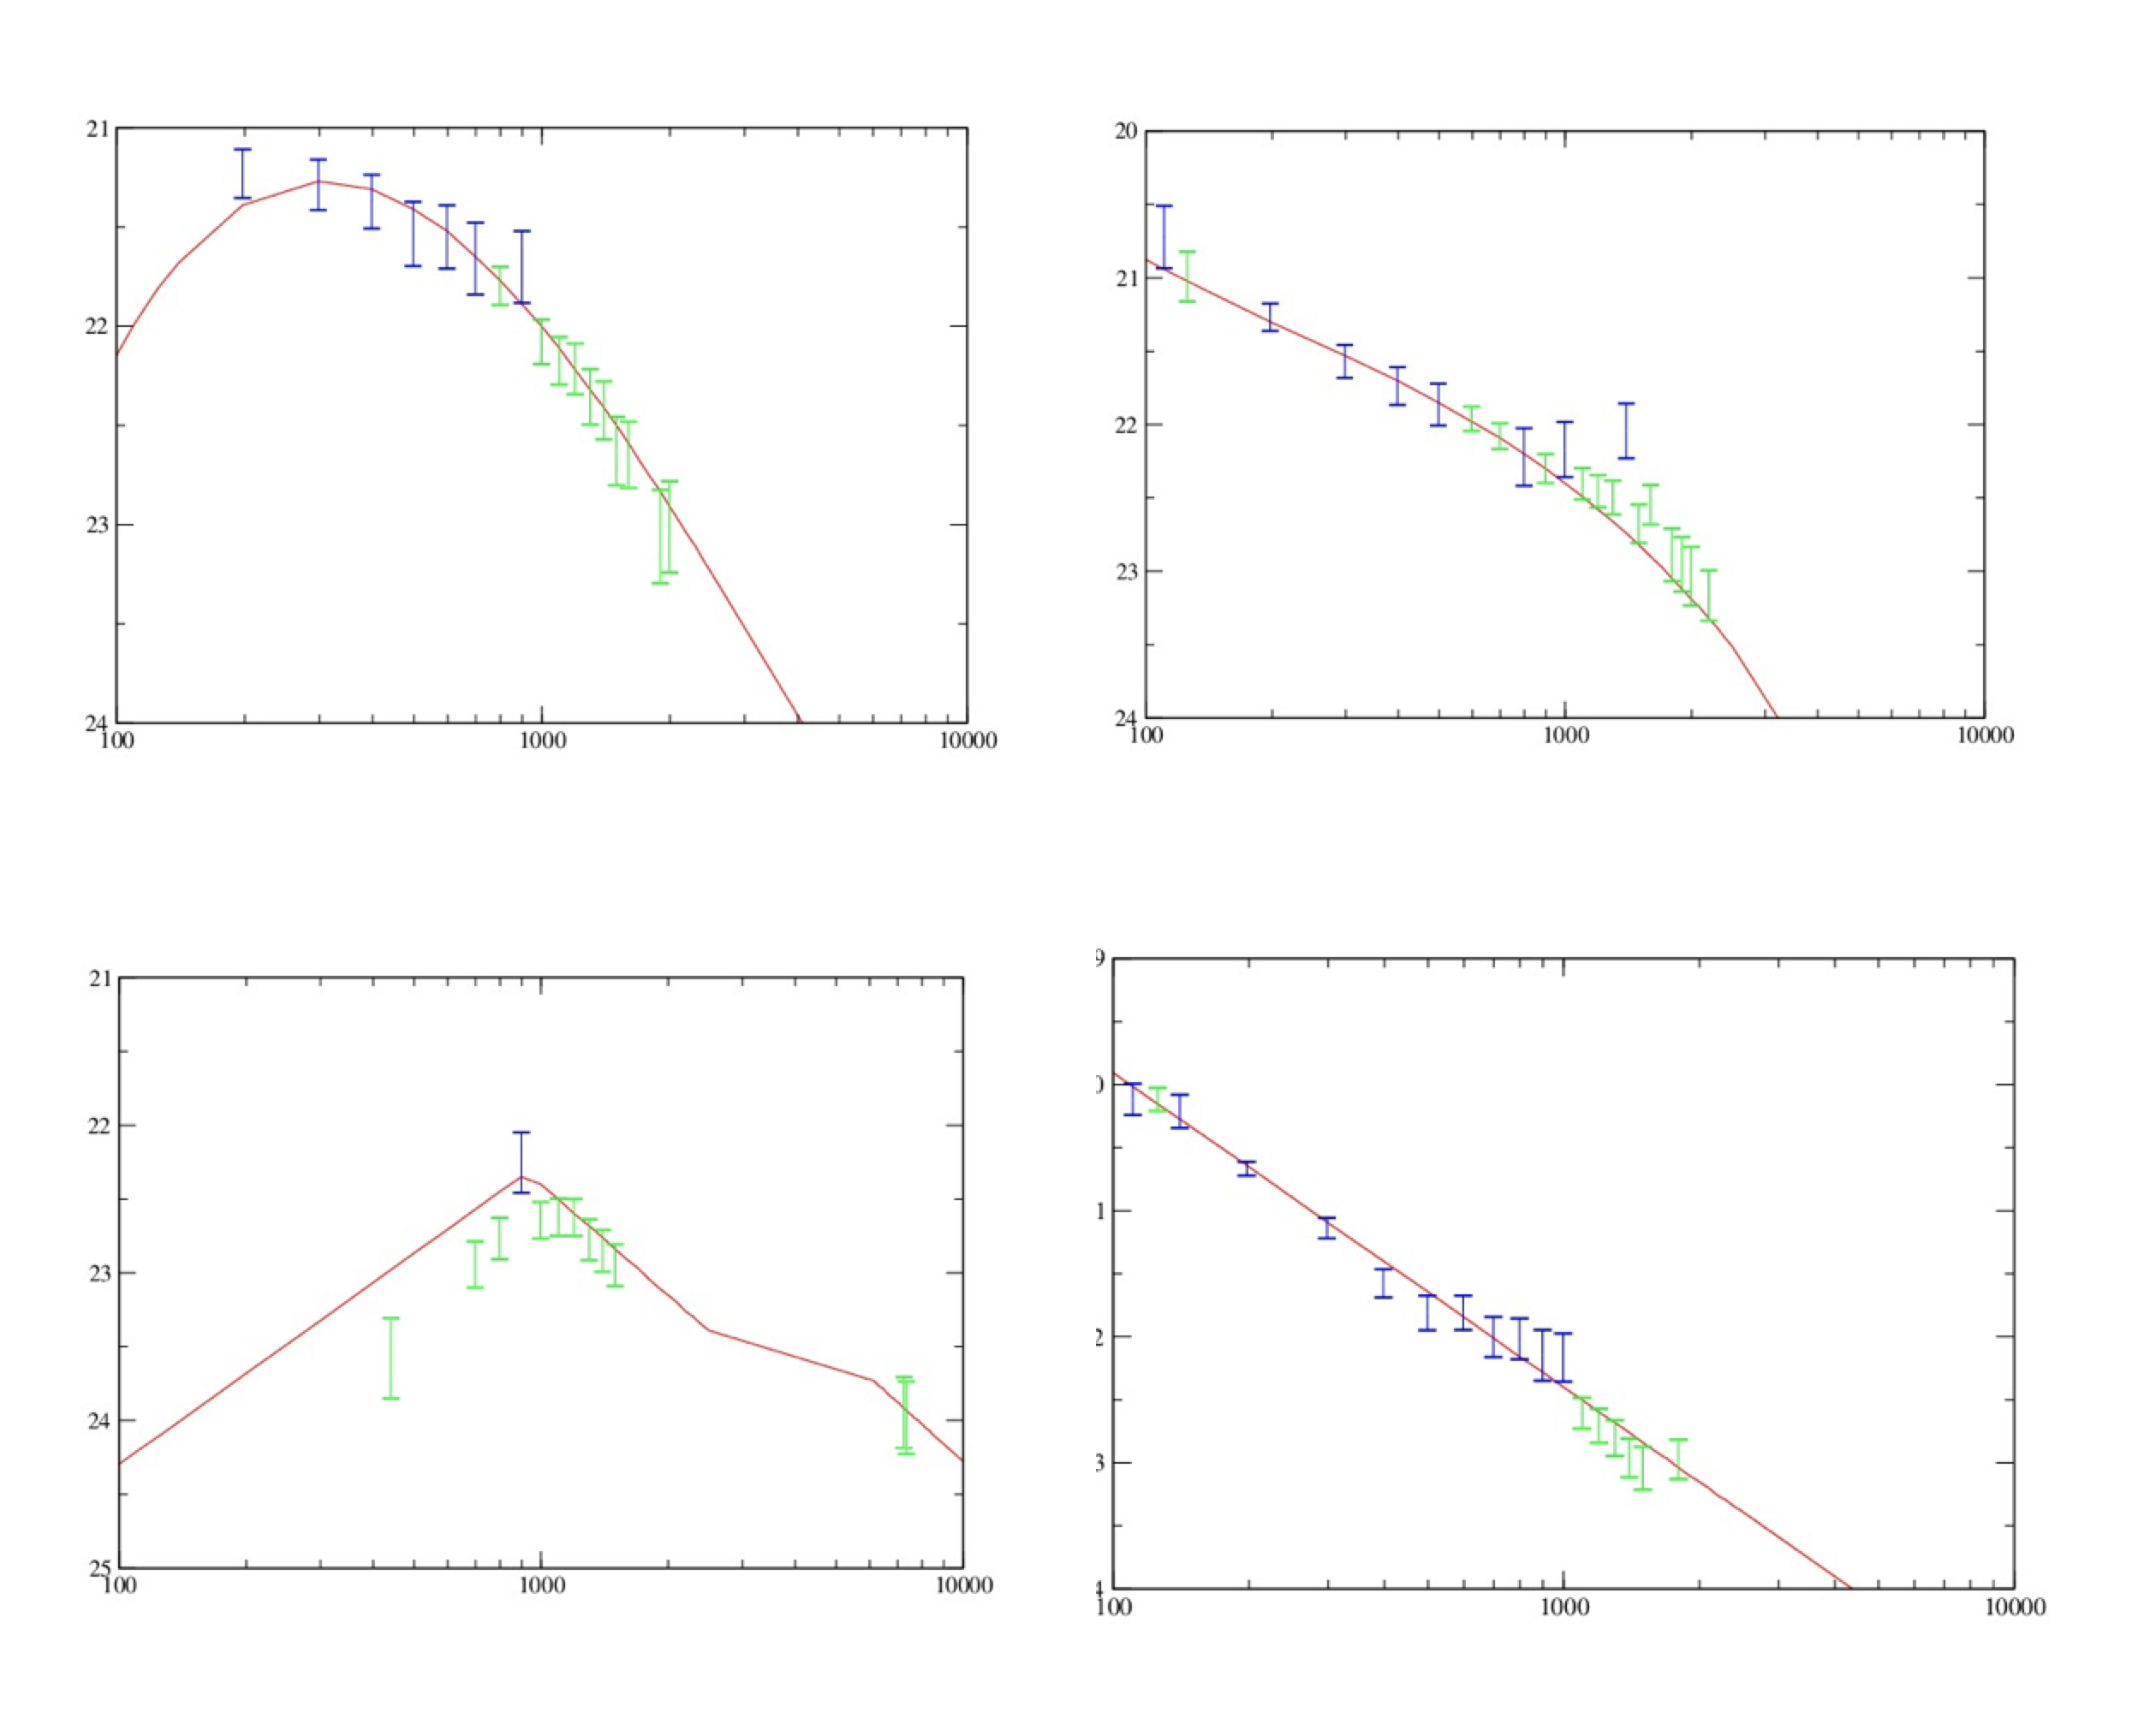
VXPP-p01: photometry for optical counterparts of GRB
For faint GRBs

Slide 15
VXPP-p02: automatically search for candidates of optical afterglows in VT images

Slide 16
Merci beaucoup!
谢谢！

