Slide 1
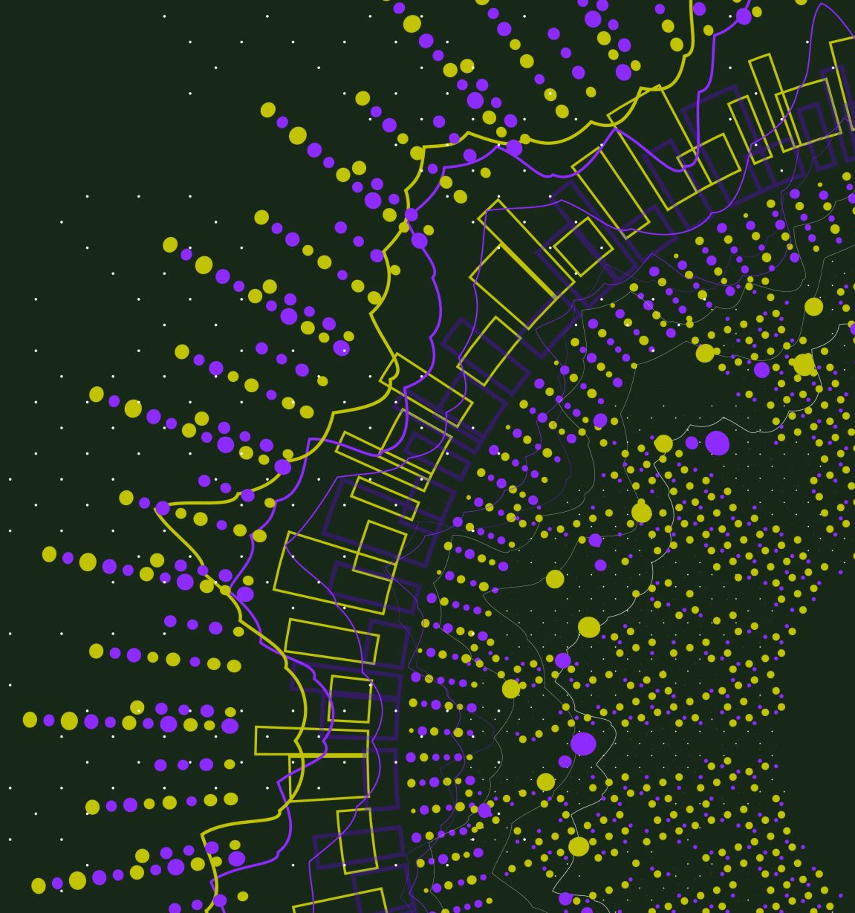
Study of cosmic neutrinos with Hyper Kamiokande detector
Enzo Forestier, Ecole Polytechnique

Slide 2
Personal introduction
3 year student in Polytechnique engineering school
Studied physics, space science and meteorology, and japanese !
Student research projects : building rocket engines, implementing a complete simulator for a satellite mission

Slide 3
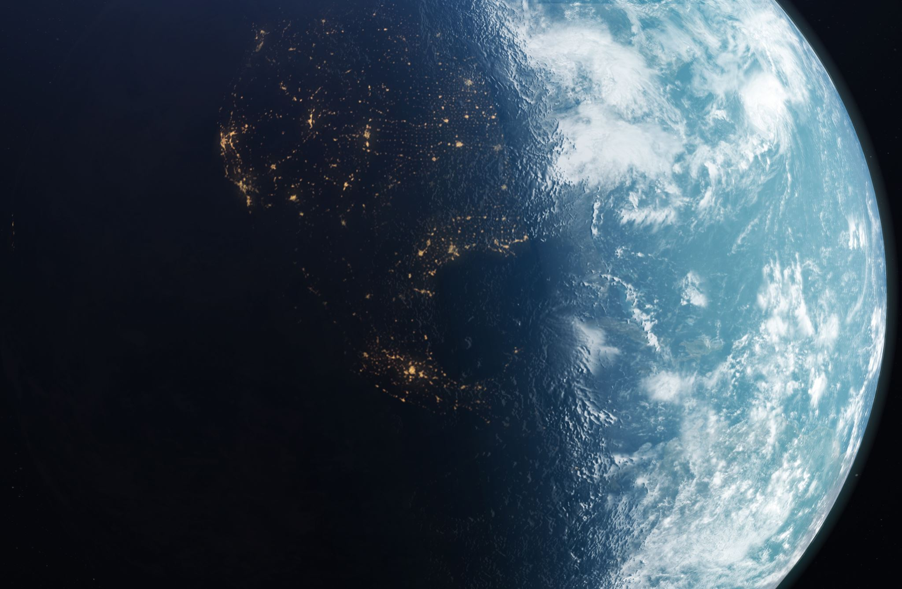
Personal introduction
Flaming interest for both climate and space
Career plan: studying global warming, and working on fluid dynamics for the simulation of the atmosphere

Slide 4
internship in UT
discovering machine learning, acquire valuable coding skills
study the detection of solar neutrinos with machine learning in Hyper-Kamiokande

Slide 5
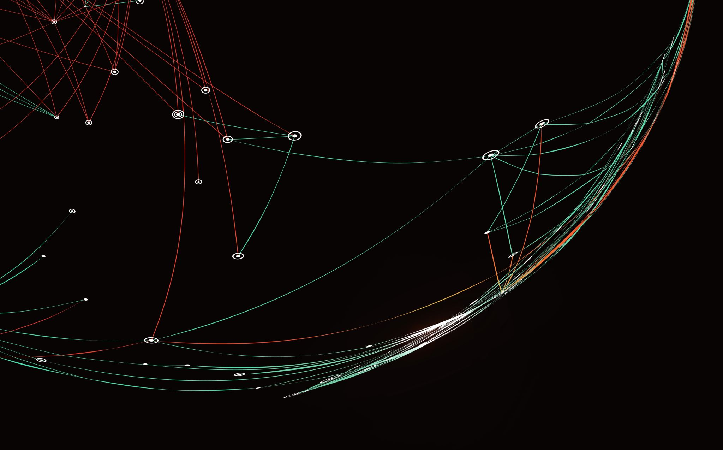
Realisations
Built a dynamic graph-analysis method to filter neutrinos signal from noise

Slide 6
Realisations : graph analysis
‘Agents’ circulate in the graph and propagate ‘wealth’
Circulation from node to node is probabilistic
P3
P3
P2
P2
P1
P1

Slide 7
After a certain number of epochs, agents circulation makes signal patterns emerge from noise
The most visited points gain a greater wealth

Slide 8
Result of filtering on a ~10 MeV event

Slide 9
Filtering…

Slide 10
Filtering…

Slide 11
Eventually we can filter all noise

Slide 12
Realisations
Currently building a GNN that aims at reconstructing the vertex of a neutrino event from the detected signal

Slide 13
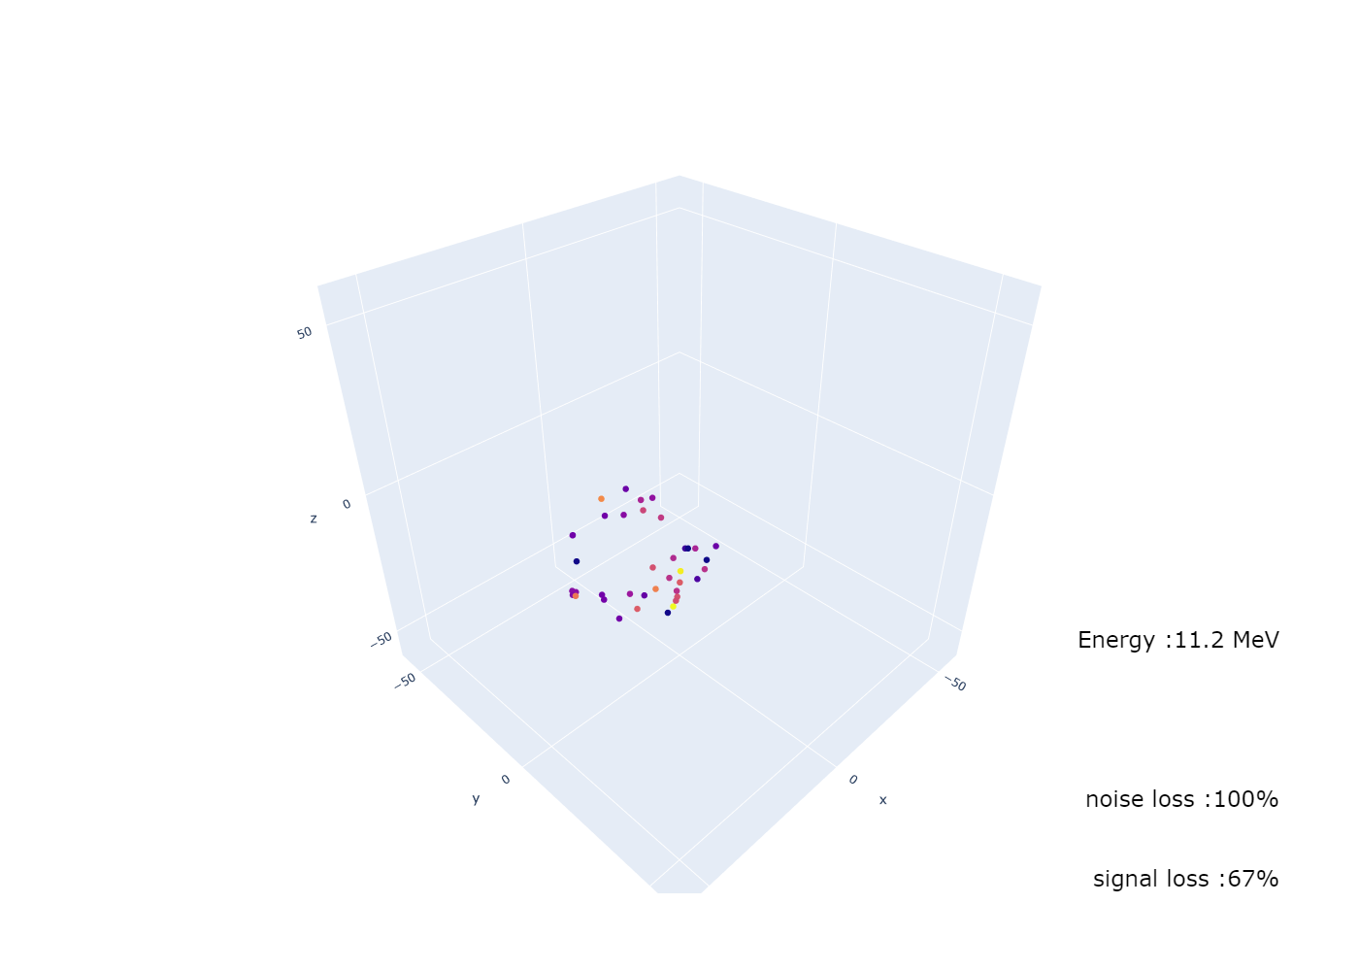
Vertex reconstruction

Slide 14
Vertex reconstruction
Model : Graph Analysis with GNN
Current results : ~10m accuracy, for ~2m accuracy in pre-existing models…
But it is just the beginning of the project, enhanced versions coming soon !
GRAPH CONVOLUTION
RECONSTRUCTION LAYERS
Graph Input
3D VECTOR

