Slide 1
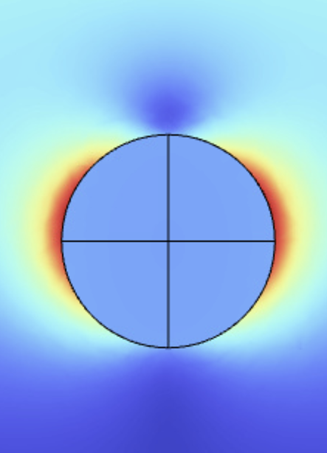
Plasmon-enhanced light absorption in 2D MoS₂ solar cell
Paul Jacquet
ILANCE student fest, June 12th 2023

Slide 2
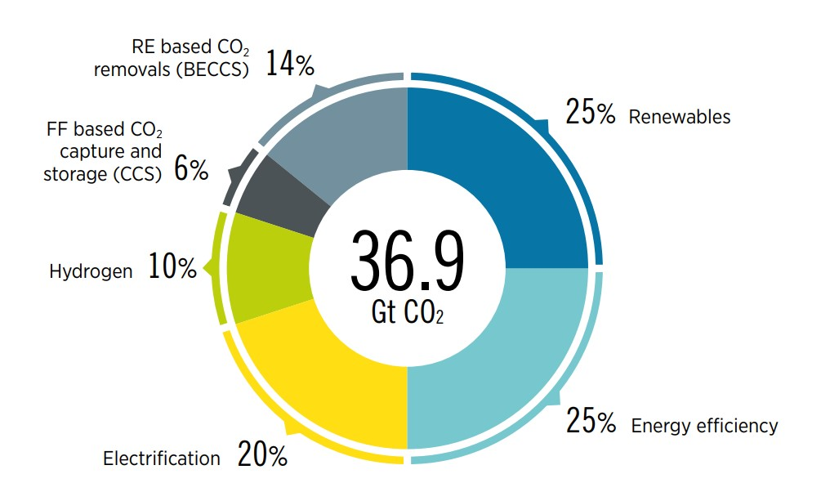
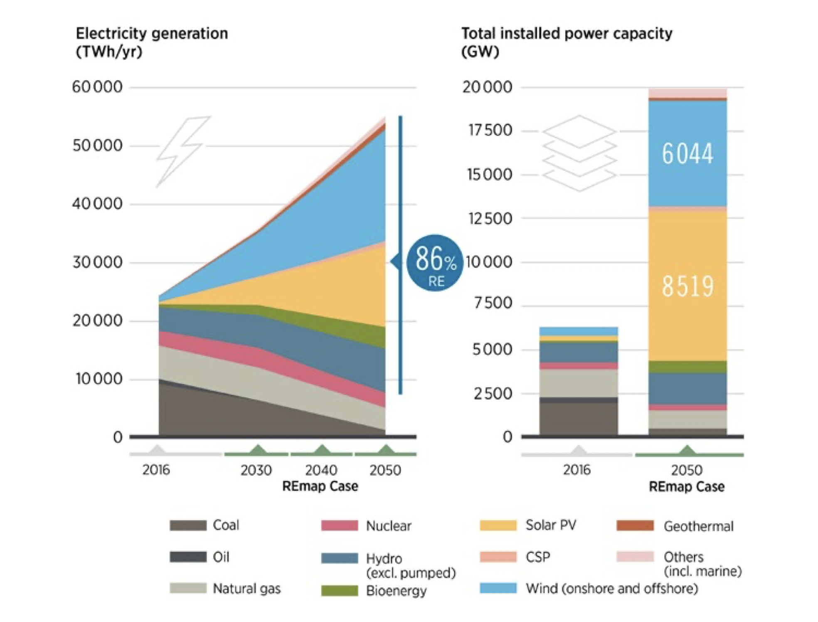
INTEREST IN THE ENERGY TRANSITON
Innovative R&D on next-generation high-efficiency solar cells and low-cost production technologies : intermediate band, multi-junction solar cells, ...

Slide 3
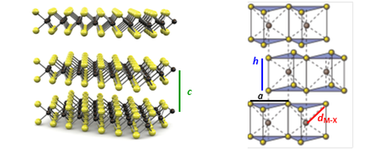
TRANSITION METAL DICHALCOGENIDES (TMDC)

Slide 4
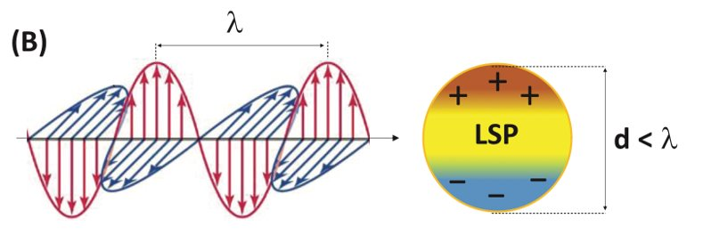
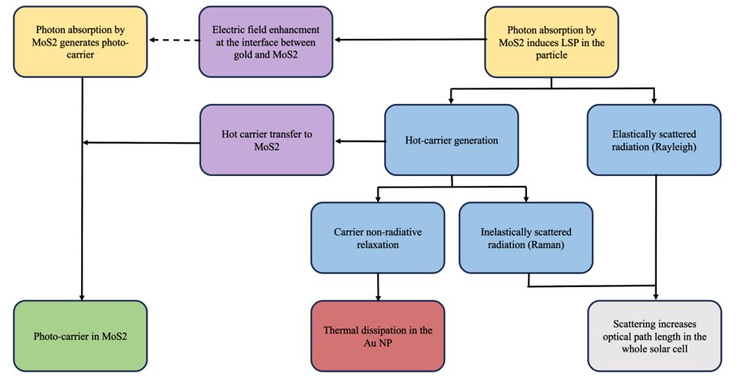
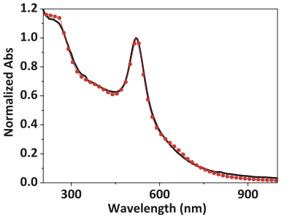
PLASMONIC GOLD NAOPARTICLES (AuNP)

Slide 5
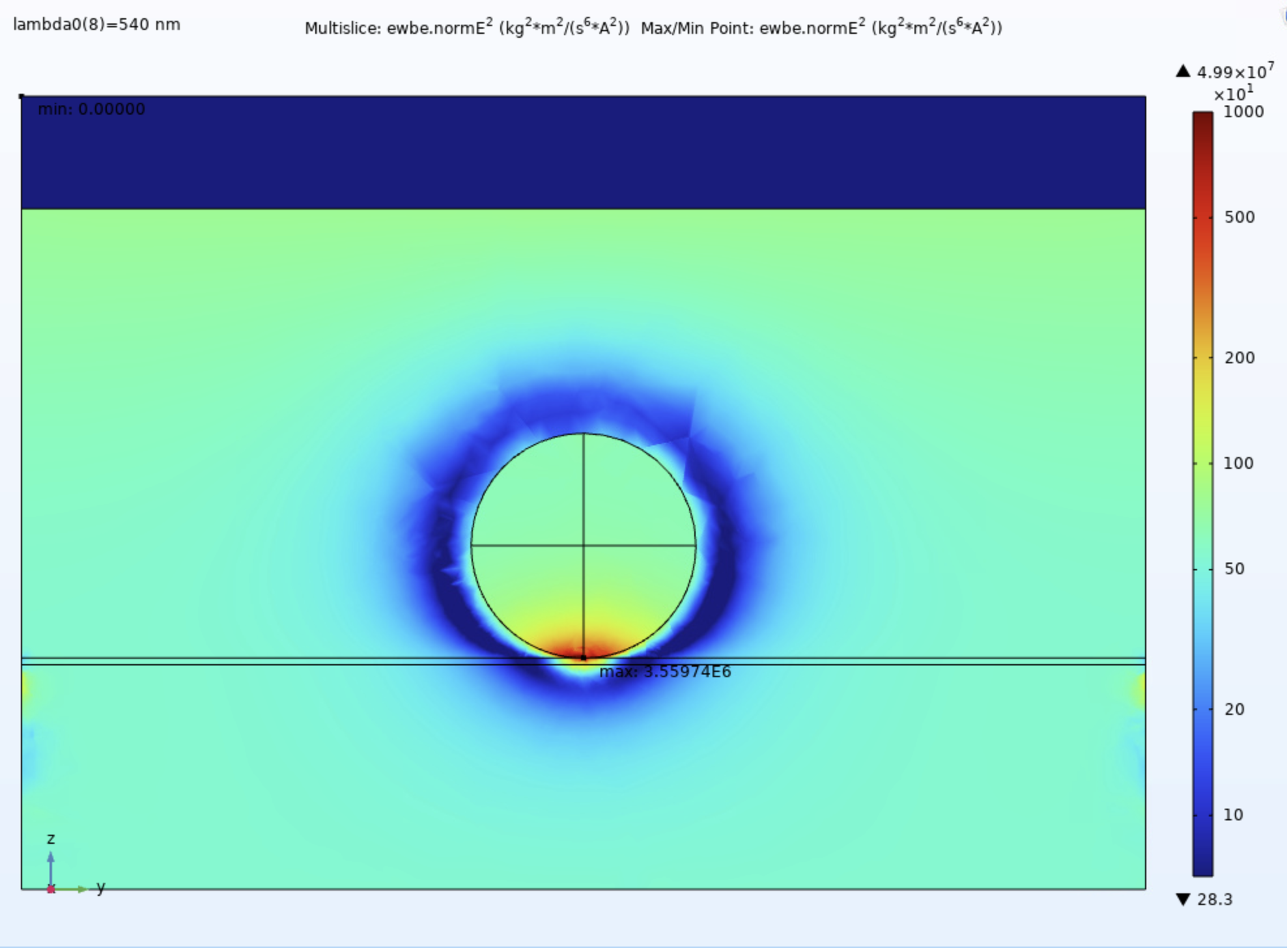
SIMULATIONS STUDIES

Slide 6
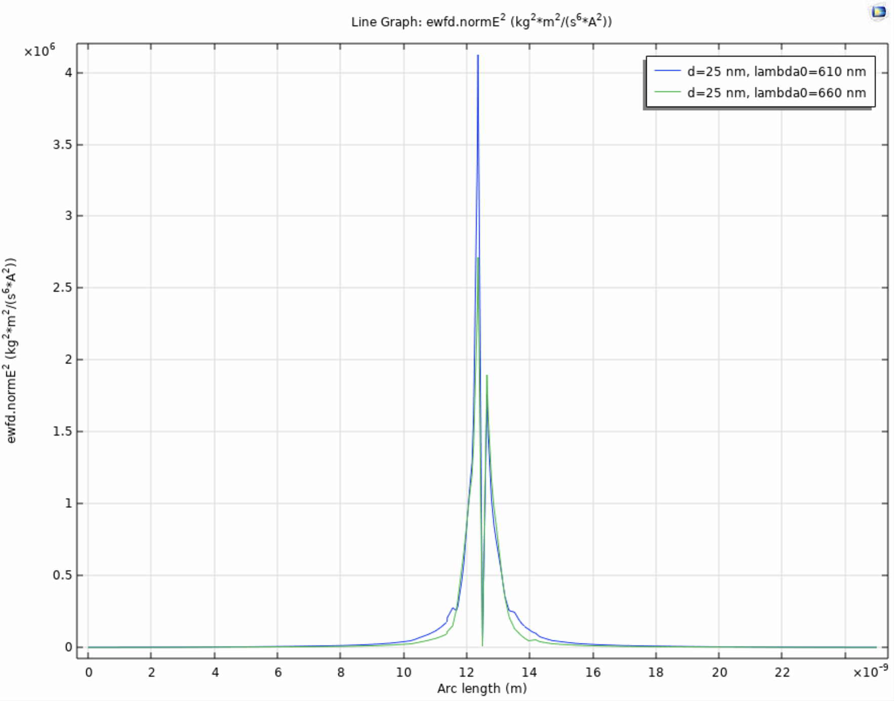
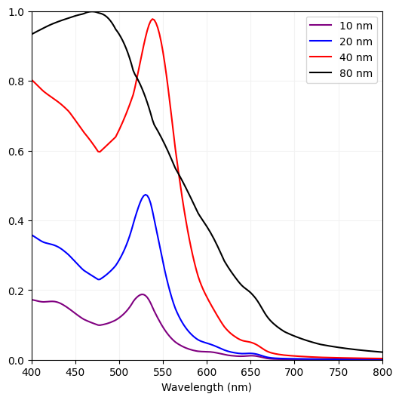
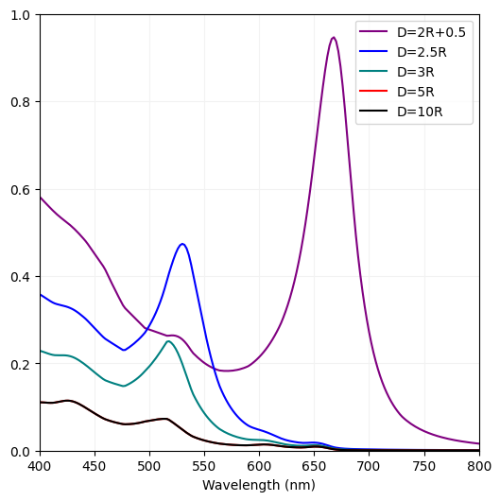
FIRST RESULTS
Strong localization of EF enhancement
Au NPs coupling with a strong redshift
Absoption is size and coverage dependent

Slide 7
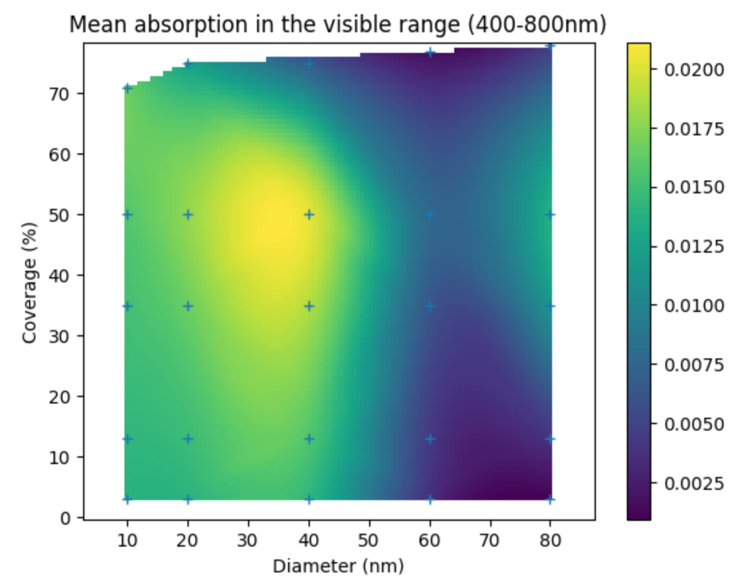
NEXT STEPS
Similar study with AuNPs below the TMDC
Experimental validation

Slide 8
Any question ?

