Slide 1
Deep Generative Bayesian Network

Slide 2
Summary
Neural Networks vs Bayesian Neural Networks
Advantages of Bayesian Neural Networks
Bayesian Theory
Preliminary Results

Slide 3
Neural Networks
vs
Bayesian Neural Networks

Slide 4
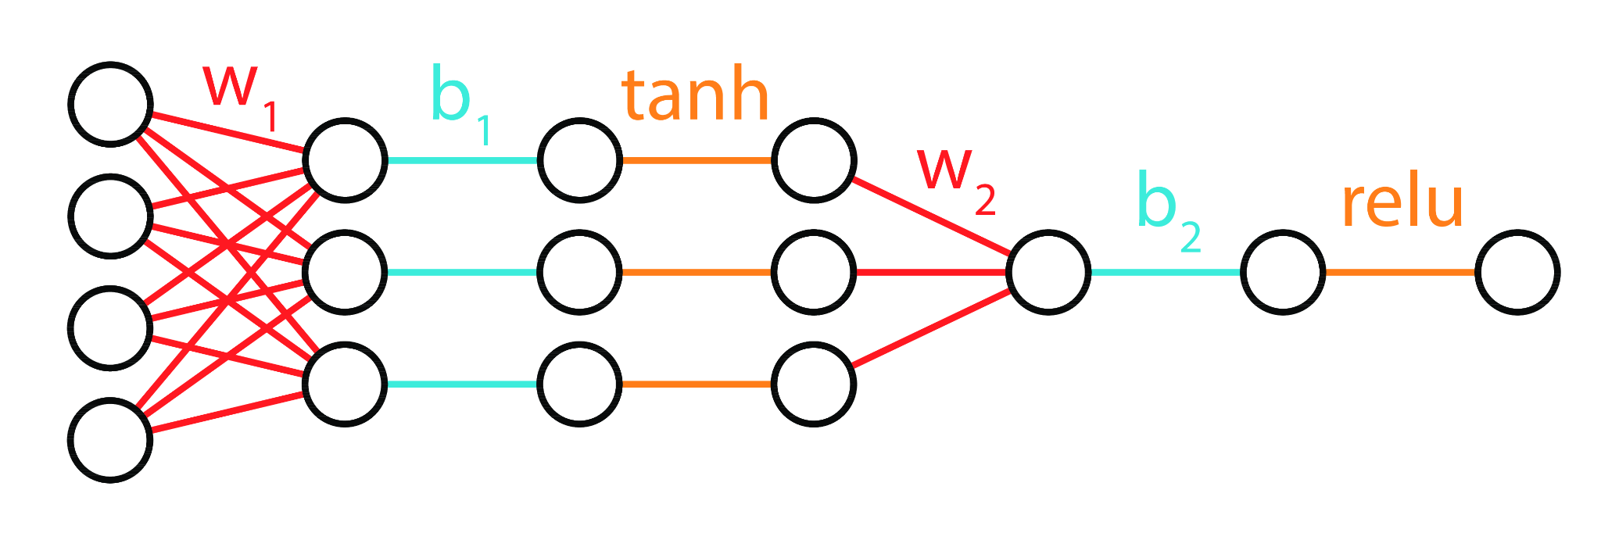
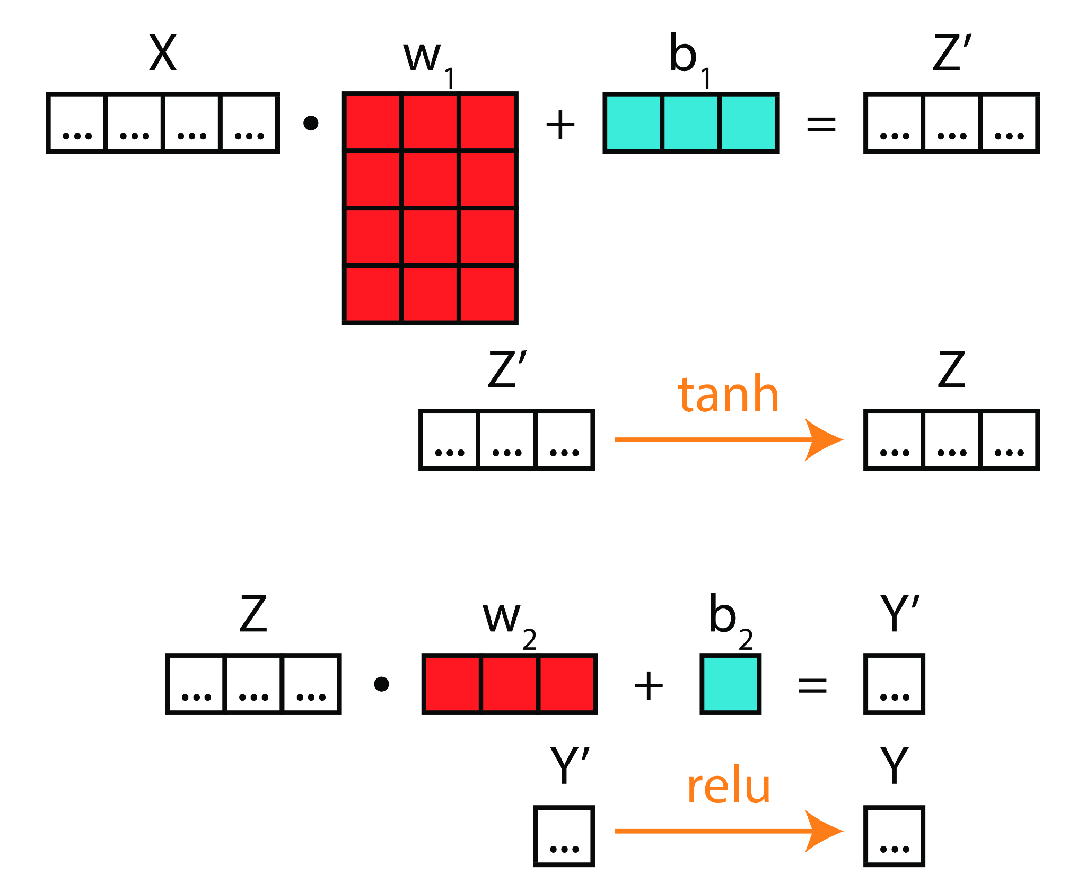
Regular Neural Networks
Fixed weights and biases
Kinda boring
One set of features: one result

Slide 5
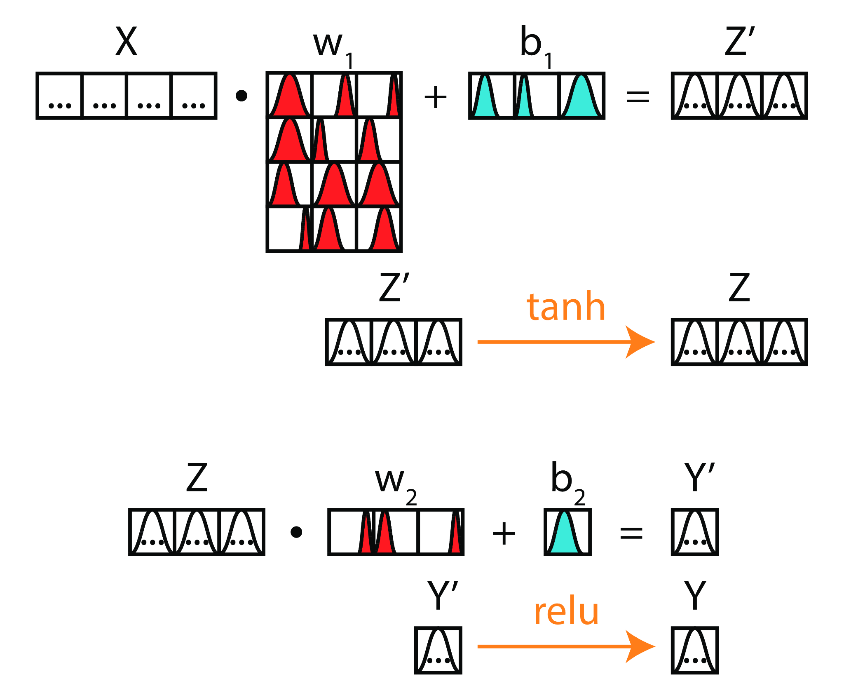
Bayesian Neural Network
Gaussian distributions
Awesome Monte Carlo sampling
The weights and biases are drawn following these distributions
One set of features: different results possible

Slide 6
Advantages of Bayesian Neural Networks

Slide 7
Advantages vs Disadvantages
Robust to small datasets (less prone to overfitting)
“Conscious” of its uncertainties
Gives a probability distribution as an output
Can adapt easily to regular neural networks architectures
More computer demanding
Implementation more difficult
More complexe theory

Slide 8
Bayesian Theory

Slide 9
Comparison to Regular Neural Network Theory
Minimize the loss:
Equivalent to maximizing the likelihood:
Regular theory
Calculate the posterior distribution:
Bayesian theory
Baye’s rules (exact inference):

Slide 10
Approximation
Posterior distribution
Parametrized distribution
Kullbach-Liebler divergence:

Slide 11
Loss function
Evidence Lower BOund (ELBO):

Slide 12
Custom dataset

Slide 13
Building custom rings
True ring
Adding noise to the dataset
The goal is to reproduce this noise
Noised ring

Slide 14
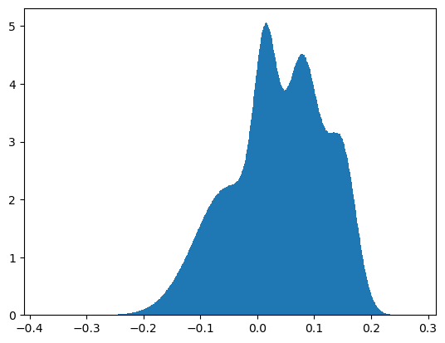
The noise distribution
Depends on the features:
mean, width, position, angles
Make the model fit to this distribution

Slide 15
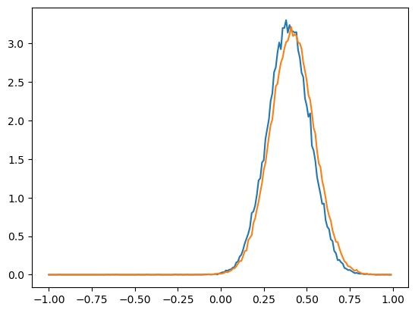
Fitting the noise distribution
Working first on a simpler distribution
By minimizing the ELBO loss we can fit the distribution
blue = predicted distribution
orange = true distribution

Slide 16
Updates

Slide 17
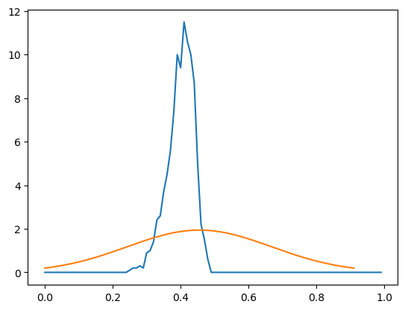
No convergence
blue = predicted distribution
orange = true distribution

Slide 18
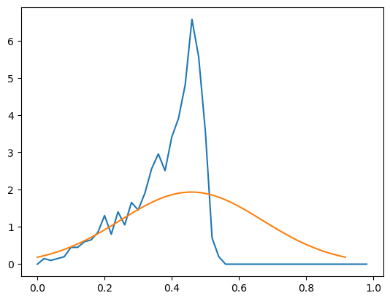
Partial convergence
blue = predicted distribution
orange = true distribution

Slide 19
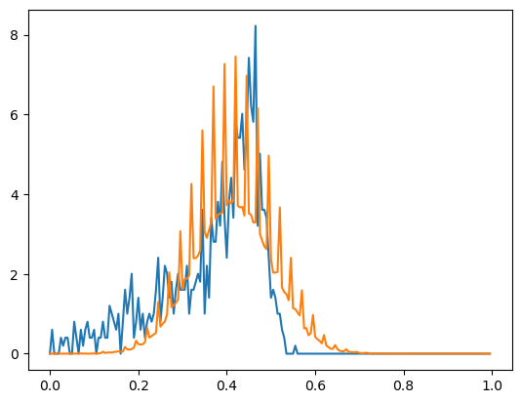
Real distribution
Discrete probability distribution
blue = predicted distribution
orange = true distribution

Slide 20
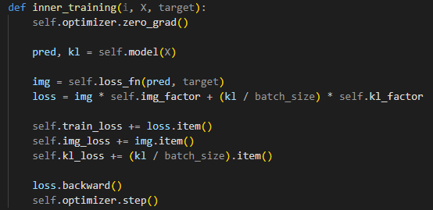
The CODE

Slide 21
The CODE

Slide 22
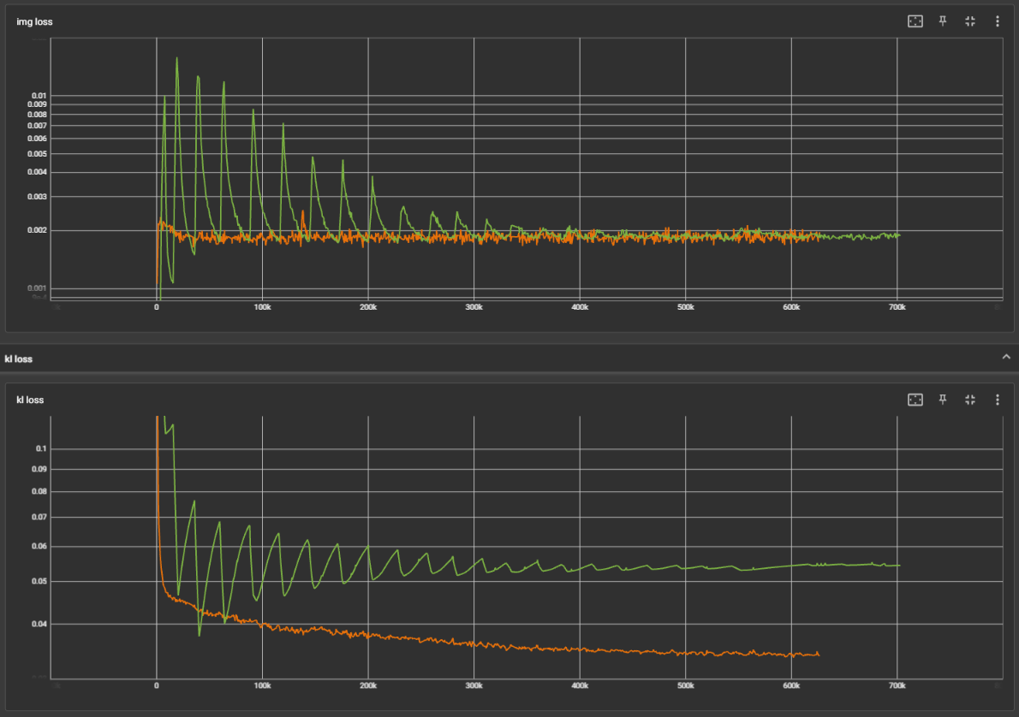
Image loss and KL loss
blue = factor switch
orange = kl_factor adjust

