Slide 1
STUDENT FEST, France-Japan, UTokyo & Grandes Ecoles Assessment of Tsunami Evacuation Plan in Small Declining Cities: Study Case of Tosashimizu, Japan Auriane Laurent (M1)

Slide 2
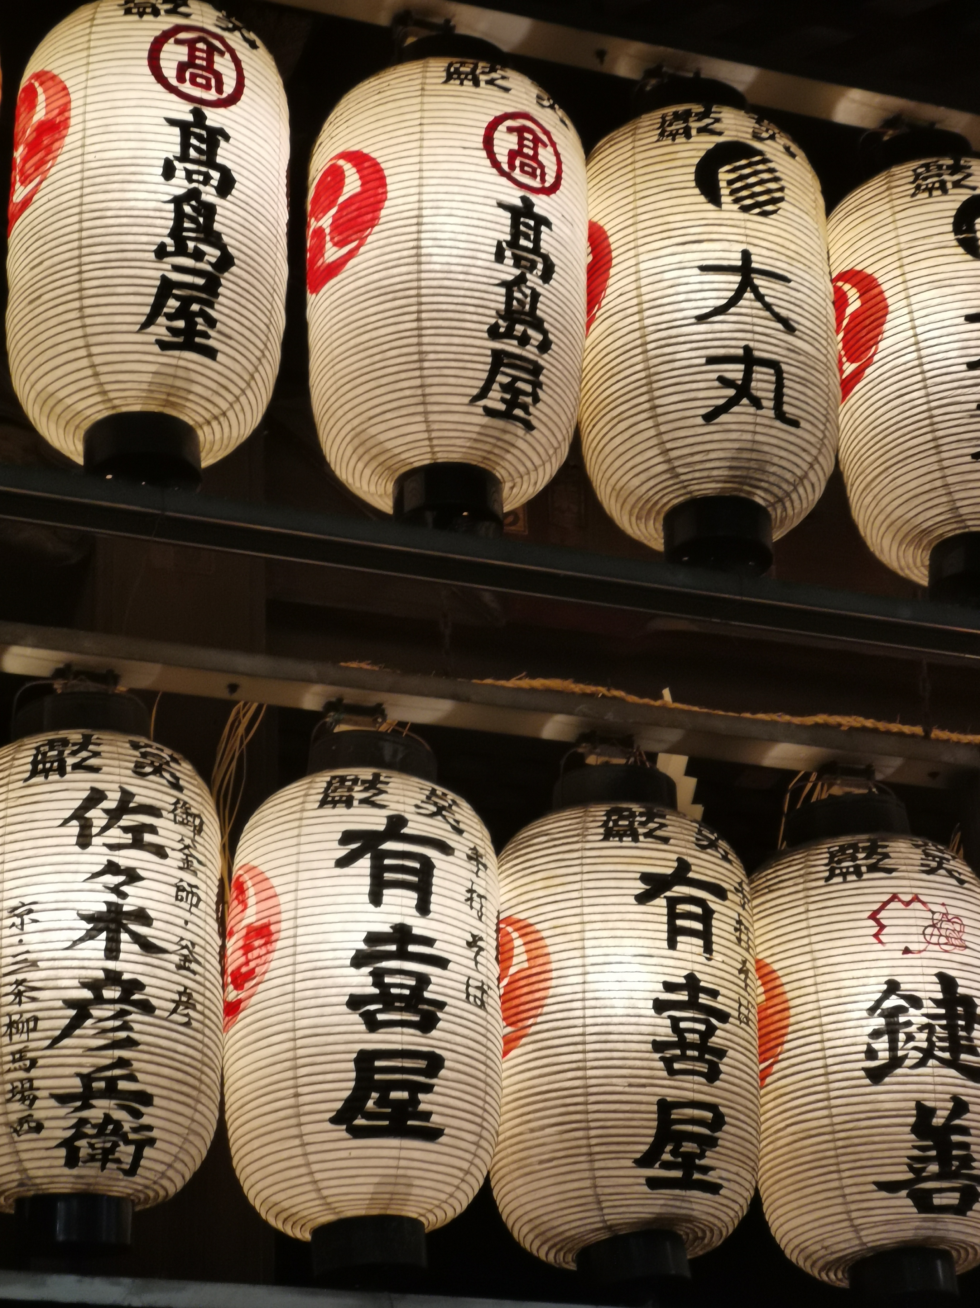
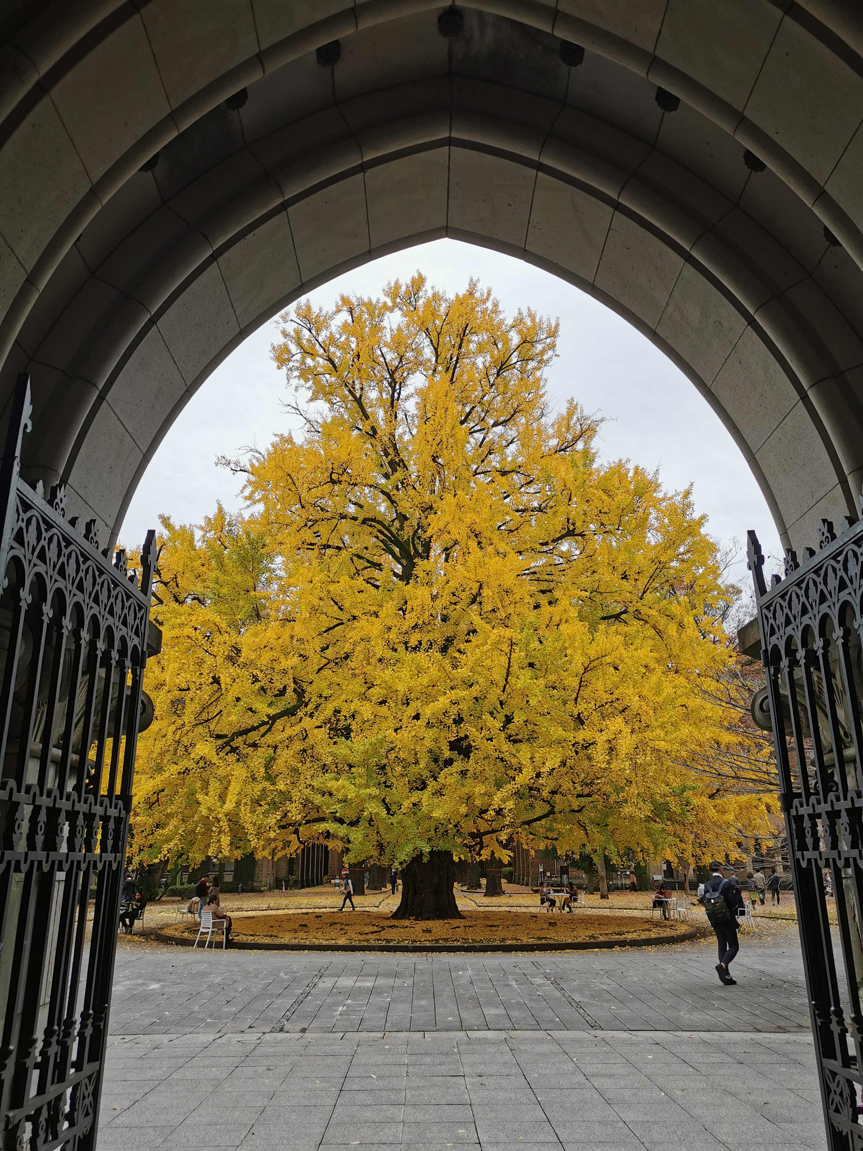
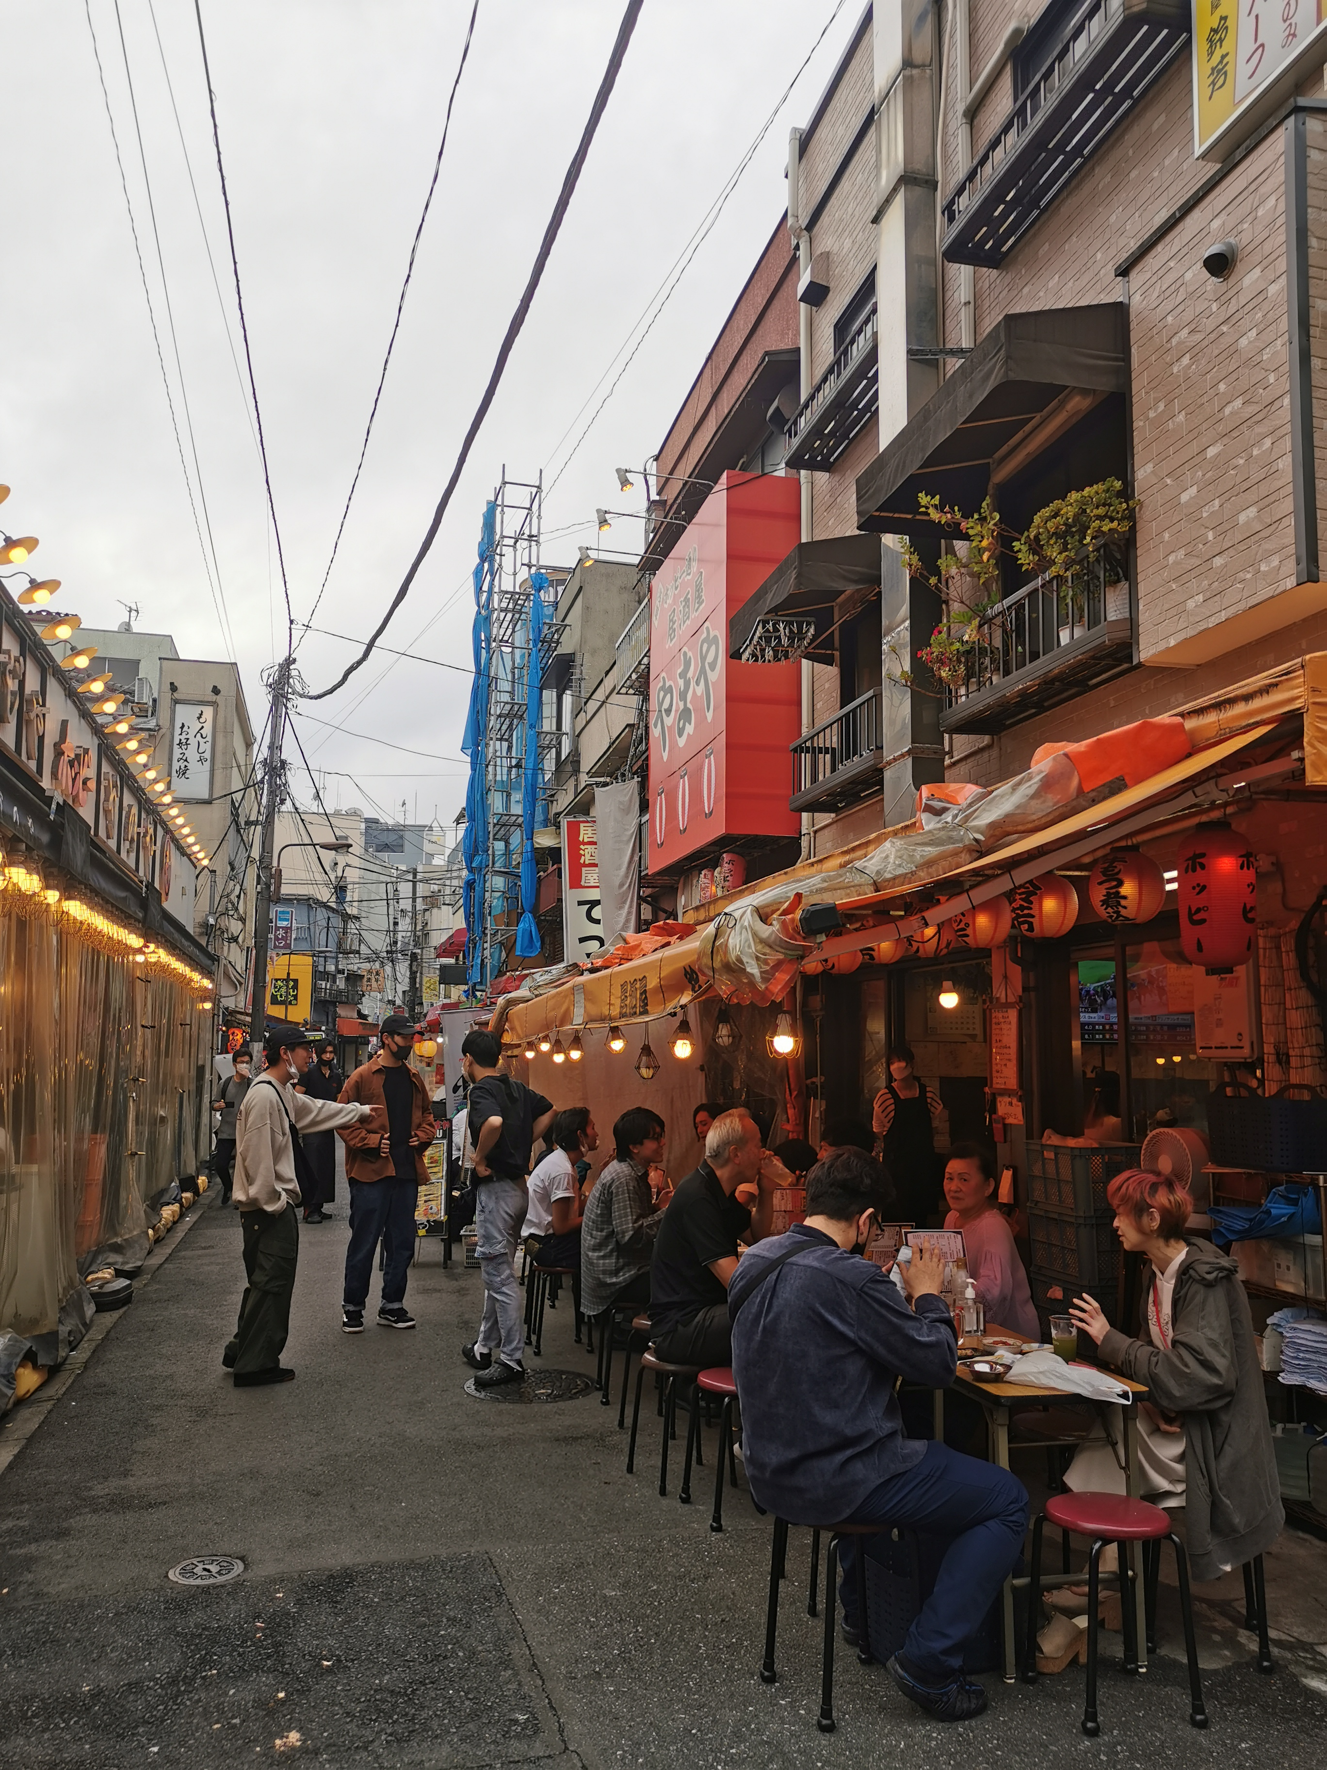
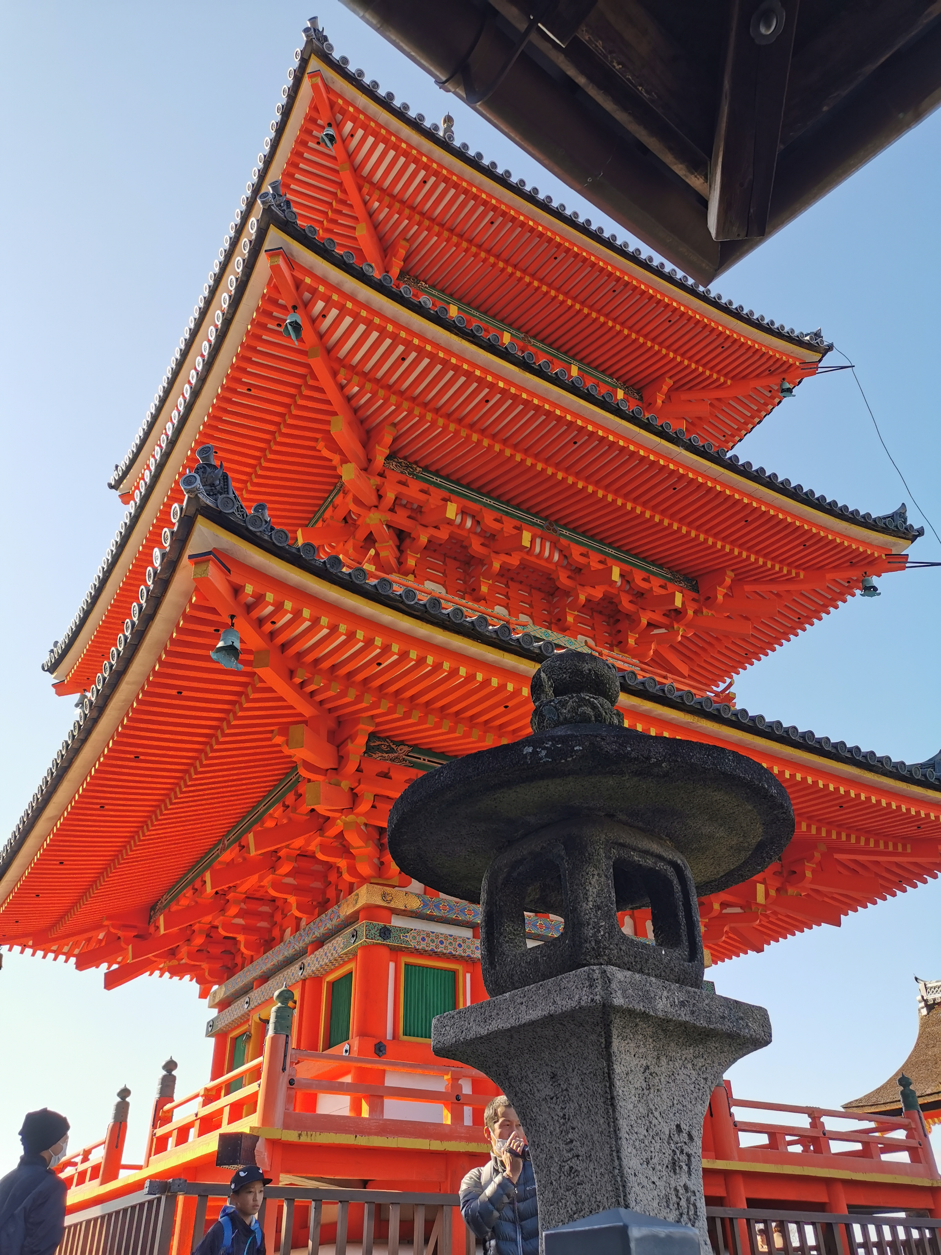
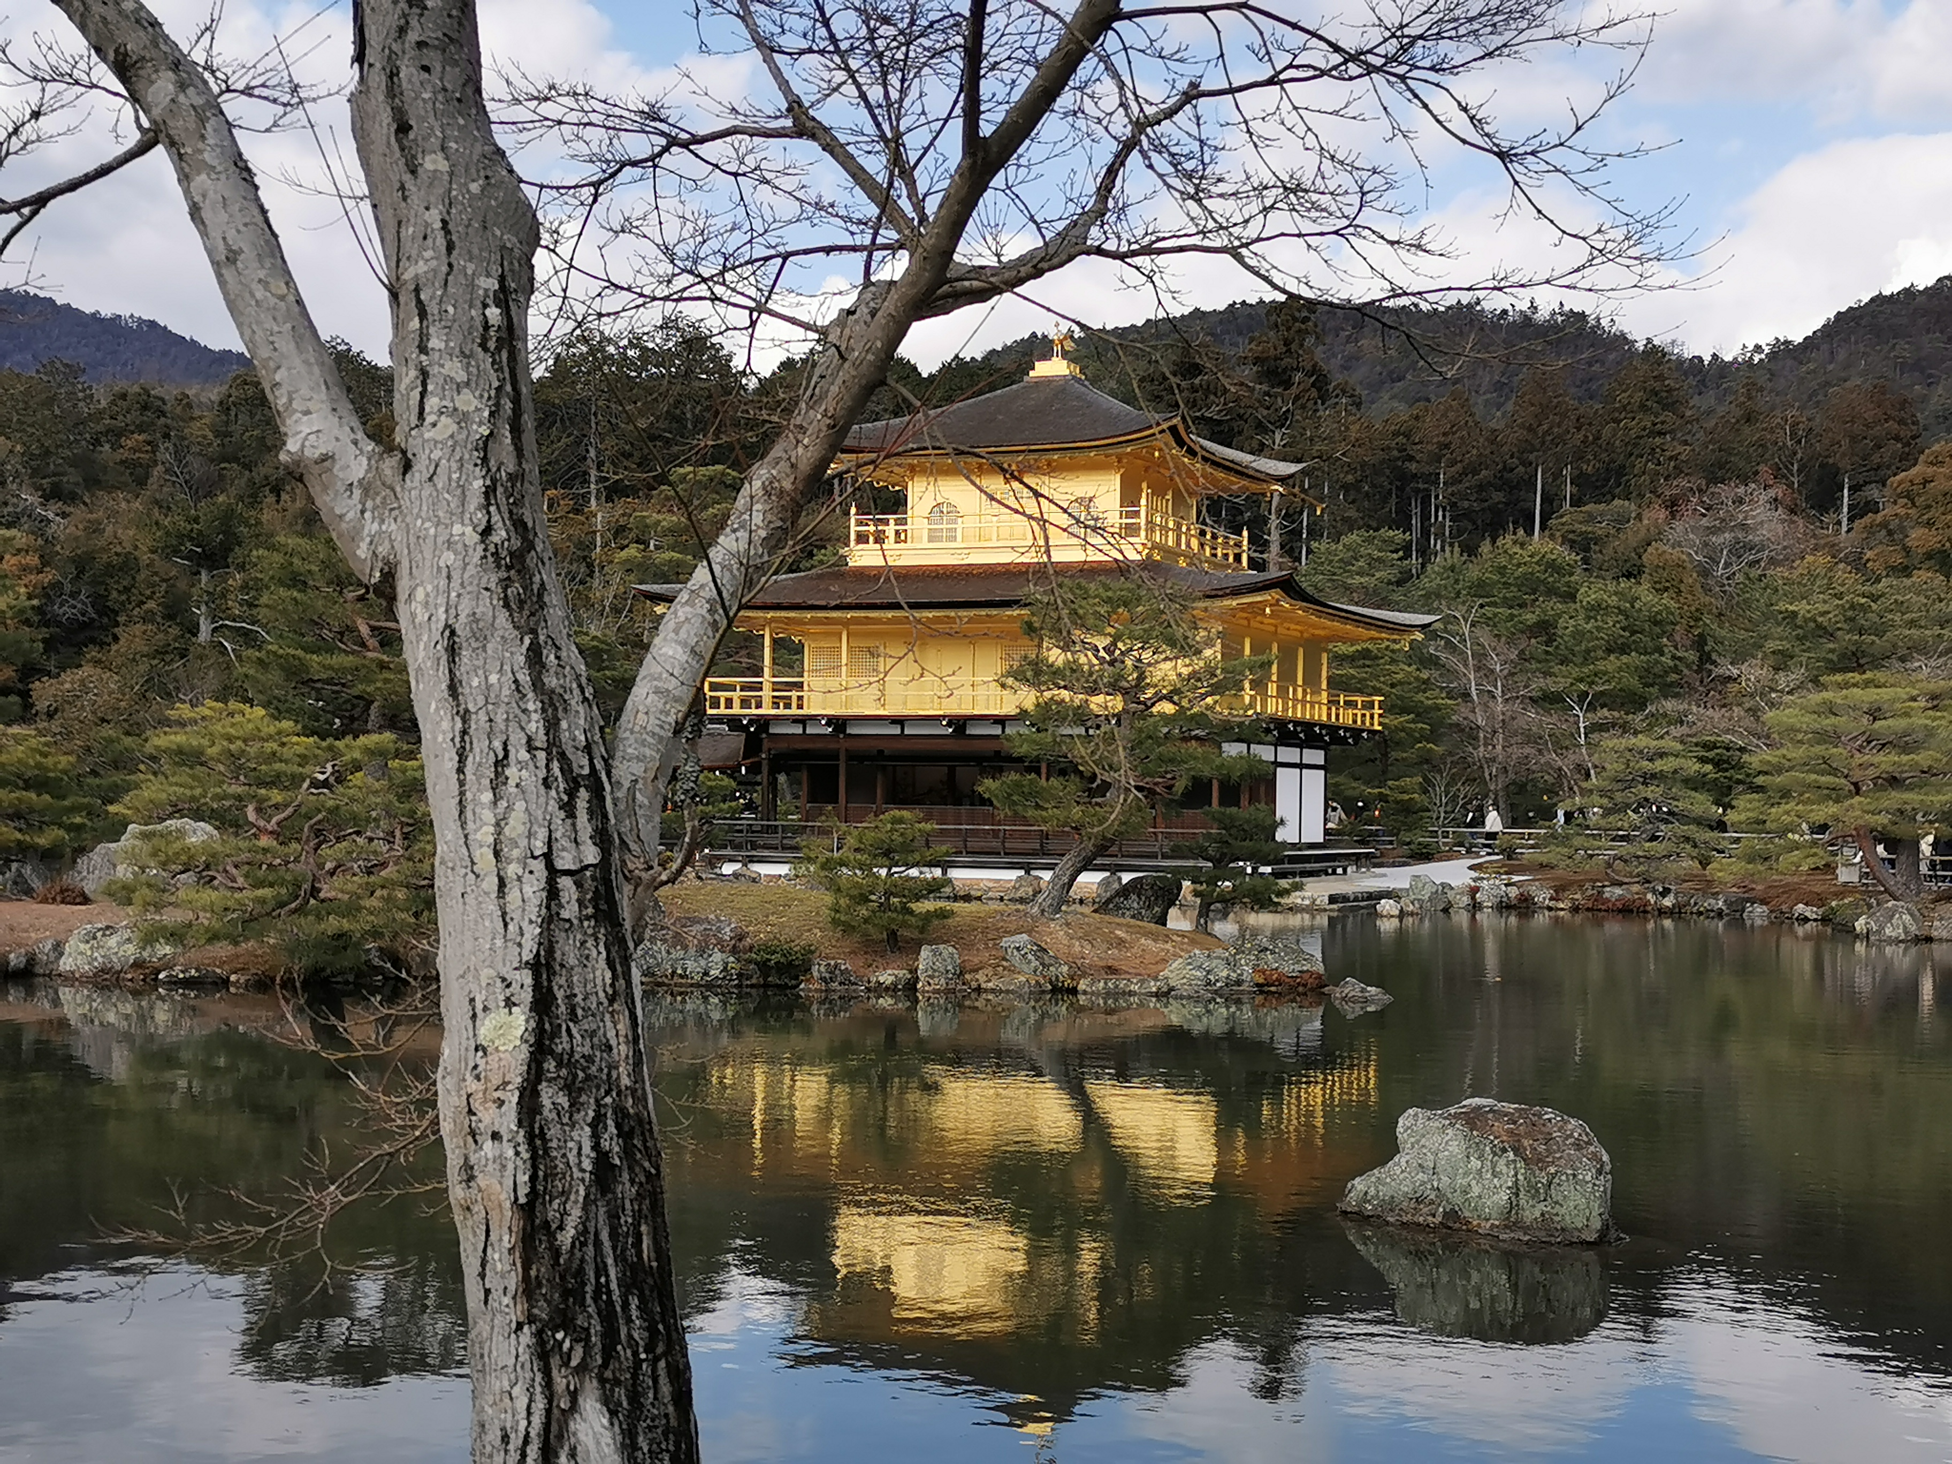
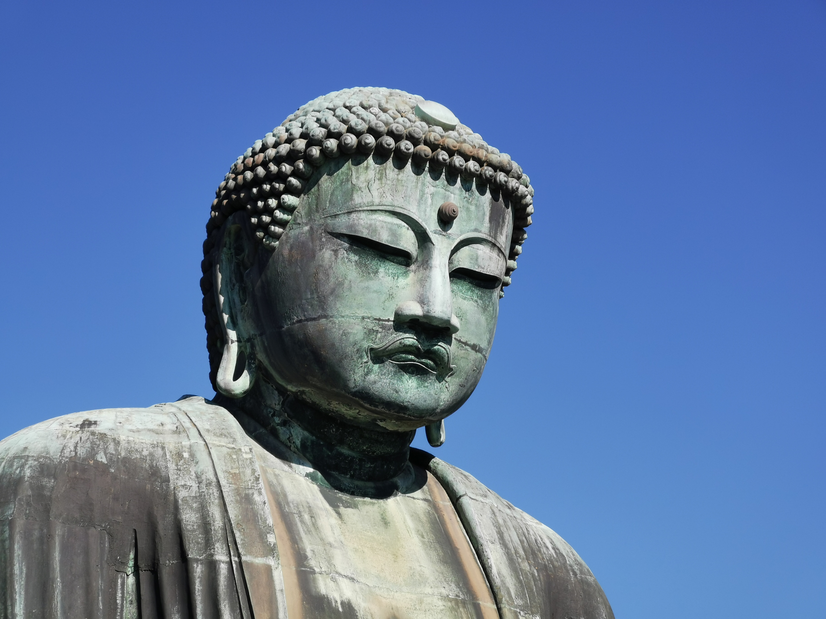
About my school career
Preparatory classes in France (MP)
Ecole Polytechnique (class X2019)
Specialization in Mechanics + strong interest for Civil Engineering and Construction
Enrollment as a Master Student in the University of Tokyo in Oct 2022 (expected graduation: Sep 2024)
Department of Civil Engineering, Coastal Engineering, Pr. Tajima
Personal hobbies here in Japan:
Judo, Karaoke, Hiking and Traveling, helping younger class of Polytechnique students to come to Japan
Today: introduction on one of Japanese expertise field:
➔ how to mitigate natural disasters and especially tsunamis

Slide 3
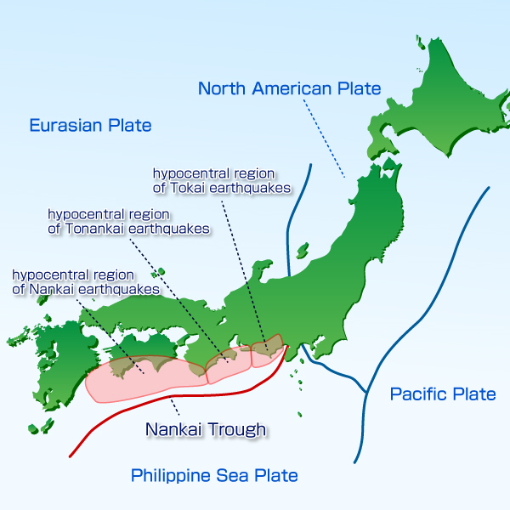
Nankai Trough
Japan :
Coastal country: almost all its population and economic activities are located on coasts
Convergence point of 4 tectonic plate ➔ lots of mountains, volcanoes and earthquakes
Earthquakes in sea can provoke tsunamis
Nankai trough: south of Japan, quake of 8M every 100 years (last in 1946)
➔ estimated 70-80% probably of occurrence in the next 30 years
Tosashimizu :
Very vulnerable to Nankai earthquake and tsunami
(15-20m high tsunami expected to reach in less than 15min)

Slide 4
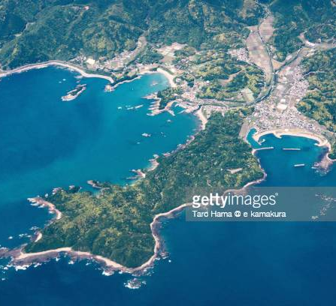
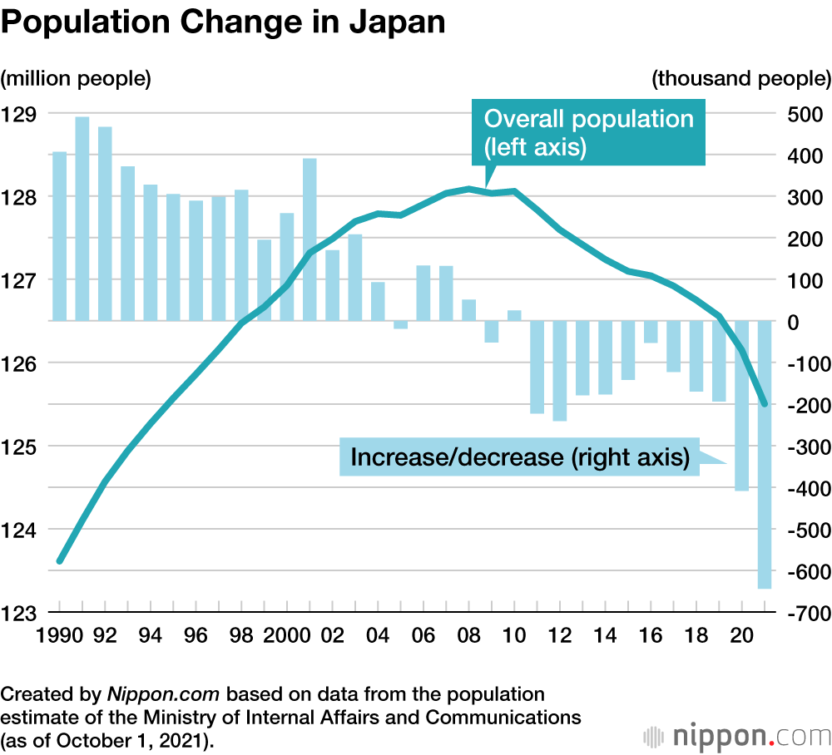
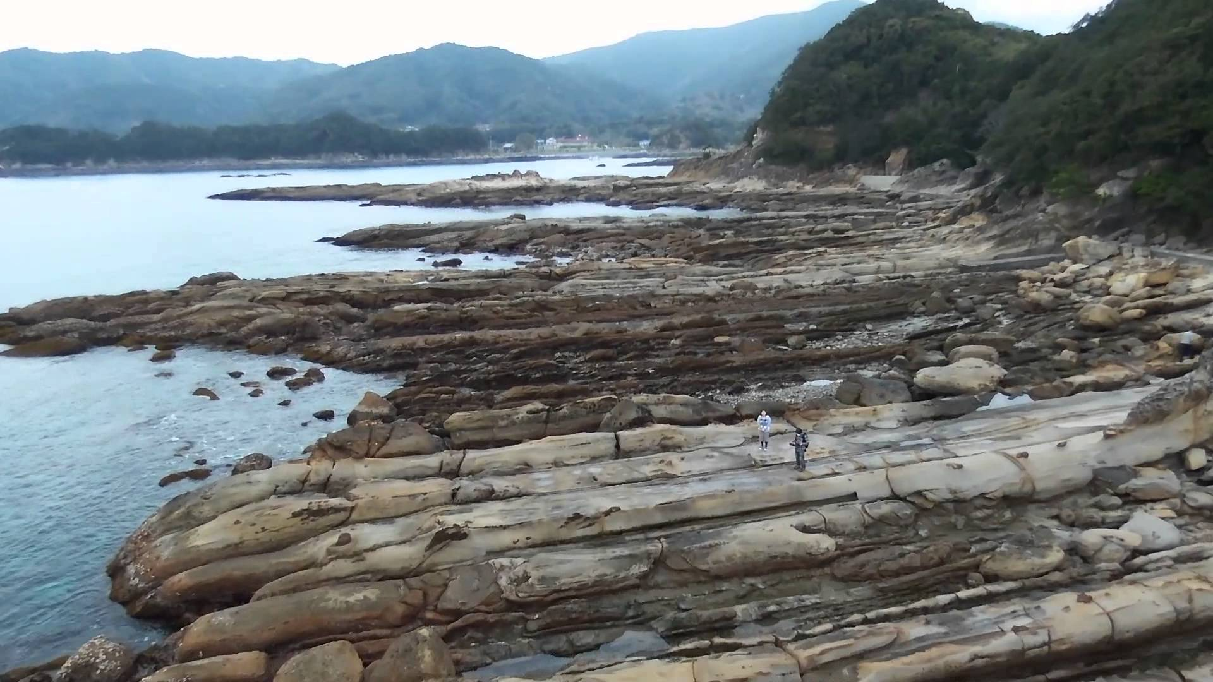
Tosashimizu and Misaki Demographics
Tosashimizu: 12161 inhabitants; Misaki: 1510
Aging population
More than 50% of locals are >65 years old
Population decline: disappearing in 2070?
Lots of tourism: 600 000 visitors a year. Estimated 1000 visitors a day in August in Misaki
Population concentrated on the shores
Misaki
A representative case for many rural Japanese town

Slide 5
Current risk analysis
Financial capacities of the locality
Tsunami mitigation process
Tsunami propagation model
(hydrodynamic model)
➔
Evacuation
Model
(modeling of people’s behavior: by foot or car? choice of evacuation place?...)
People’s repartition on shores
Earthquake rupture scenario
(rupture location and slip)
Number of potential death, estimation of material damages…
Choice of mitigation measures:
Structural (seawalls…)
Non-structural (evacuation plan, move away from dangerous zones
➔
➔
Tsunami scenario
(tide, land subsidence on the shores)
Current analysis
Non-Linear Shallow Water Equations
2m tide (high tide)
People go to the nearest evacuation spot (on hills)
Distance to the evacuation spot: distance by road
Speed and reaction time from the 2011 Tohoku earthquake reports
2 groups : the elderly and the able-bodied
➔
No hard zones to evacuate
Declining city
➔ no funds for further structural measures + maintenance issues
➔ Relies strongly on evacuation plan

Slide 6
Current risk analysis
Current analysis
Non-Linear Shallow Water Equations
2m tide (high tide)
People go to the nearest evacuation spot (on hills)
Distance to the evacuation spot: distance by road
Speed and reaction time from the 2011 Tohoku earthquake reports
2 groups : the elderly and the able-bodied
➔
No hard zones to evacuate
Declining city
➔ no funds for further structural measures + maintenance issues
➔ Relies strongly on evacuation plan
Our aim
What might miss
Land subsidence? Higher tide? (Relative Sea Level Rise : RSLR)
Tsunami propagation in rivers
Inclusion of the ~1000 tourists a day Misaki hosts in August
Effect of slope on the evacuation speed
➔
No hard zones to evacuate ?

Slide 7
Tsunami propagation model
Tsunami propagation model
2D Shallow water equations
Nested model (mesh size 810,270,90,30,10)
Initial conditions: References scenarios for Nankai tsunamis (CDMC, 2012)
Non linearity and tide : Considered in N4
Coupled with 1D-river model
WHY?
Rivers’ width < 10m
HOW?
1D waterway model using NLSWE
Water discharge rate imposed
Empirical overflow formula to compute exchanges betwen river and inundated land
No levee breach

Slide 8
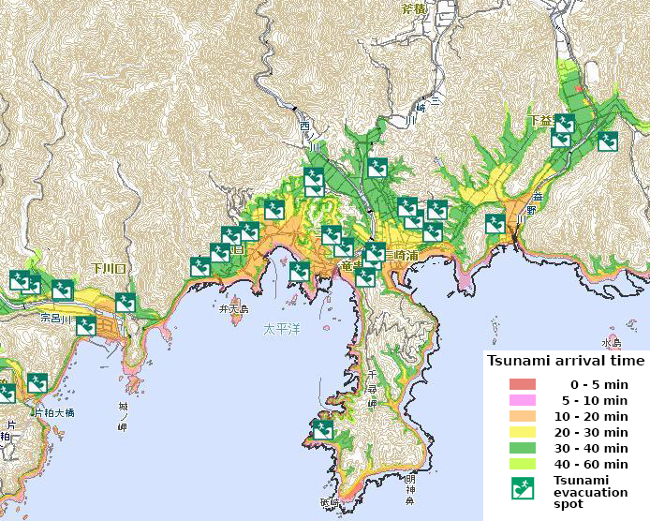
Scenario 4
Government map
Our computation
Reaching time
Reference simulation (same settings the government used)
Scenario 4, 90 min, tide = 0m and without waterways
maximum inundation depth in Misaki of ~25m, (government obtained an inundation height of 34m maximum over all Tosashimizu)
No significant difference between the governmental computation and ours in the Reaching Time or inundation depth

Slide 9
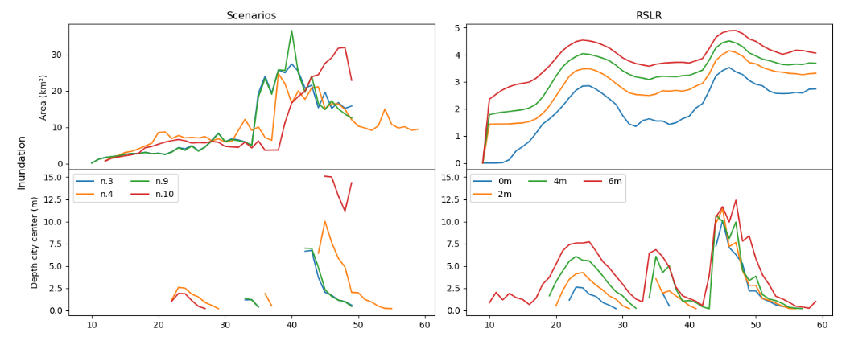
wATERWAYs model: Inundation Height
4 ,10 & 5th : reach city center within similar times, the quickest
3,9, 11th : arrives later
➔ (less serious for evacuation)
Higher RSLR causes the higher inundation
RSLR effect mostly during 1st wave

Slide 10
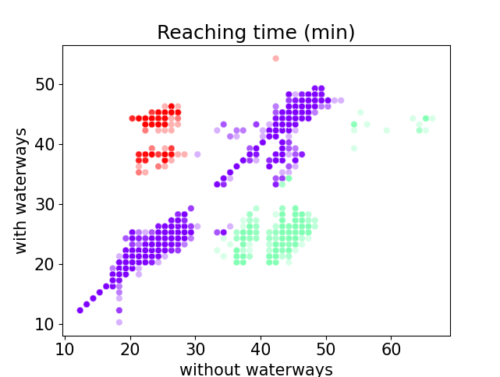
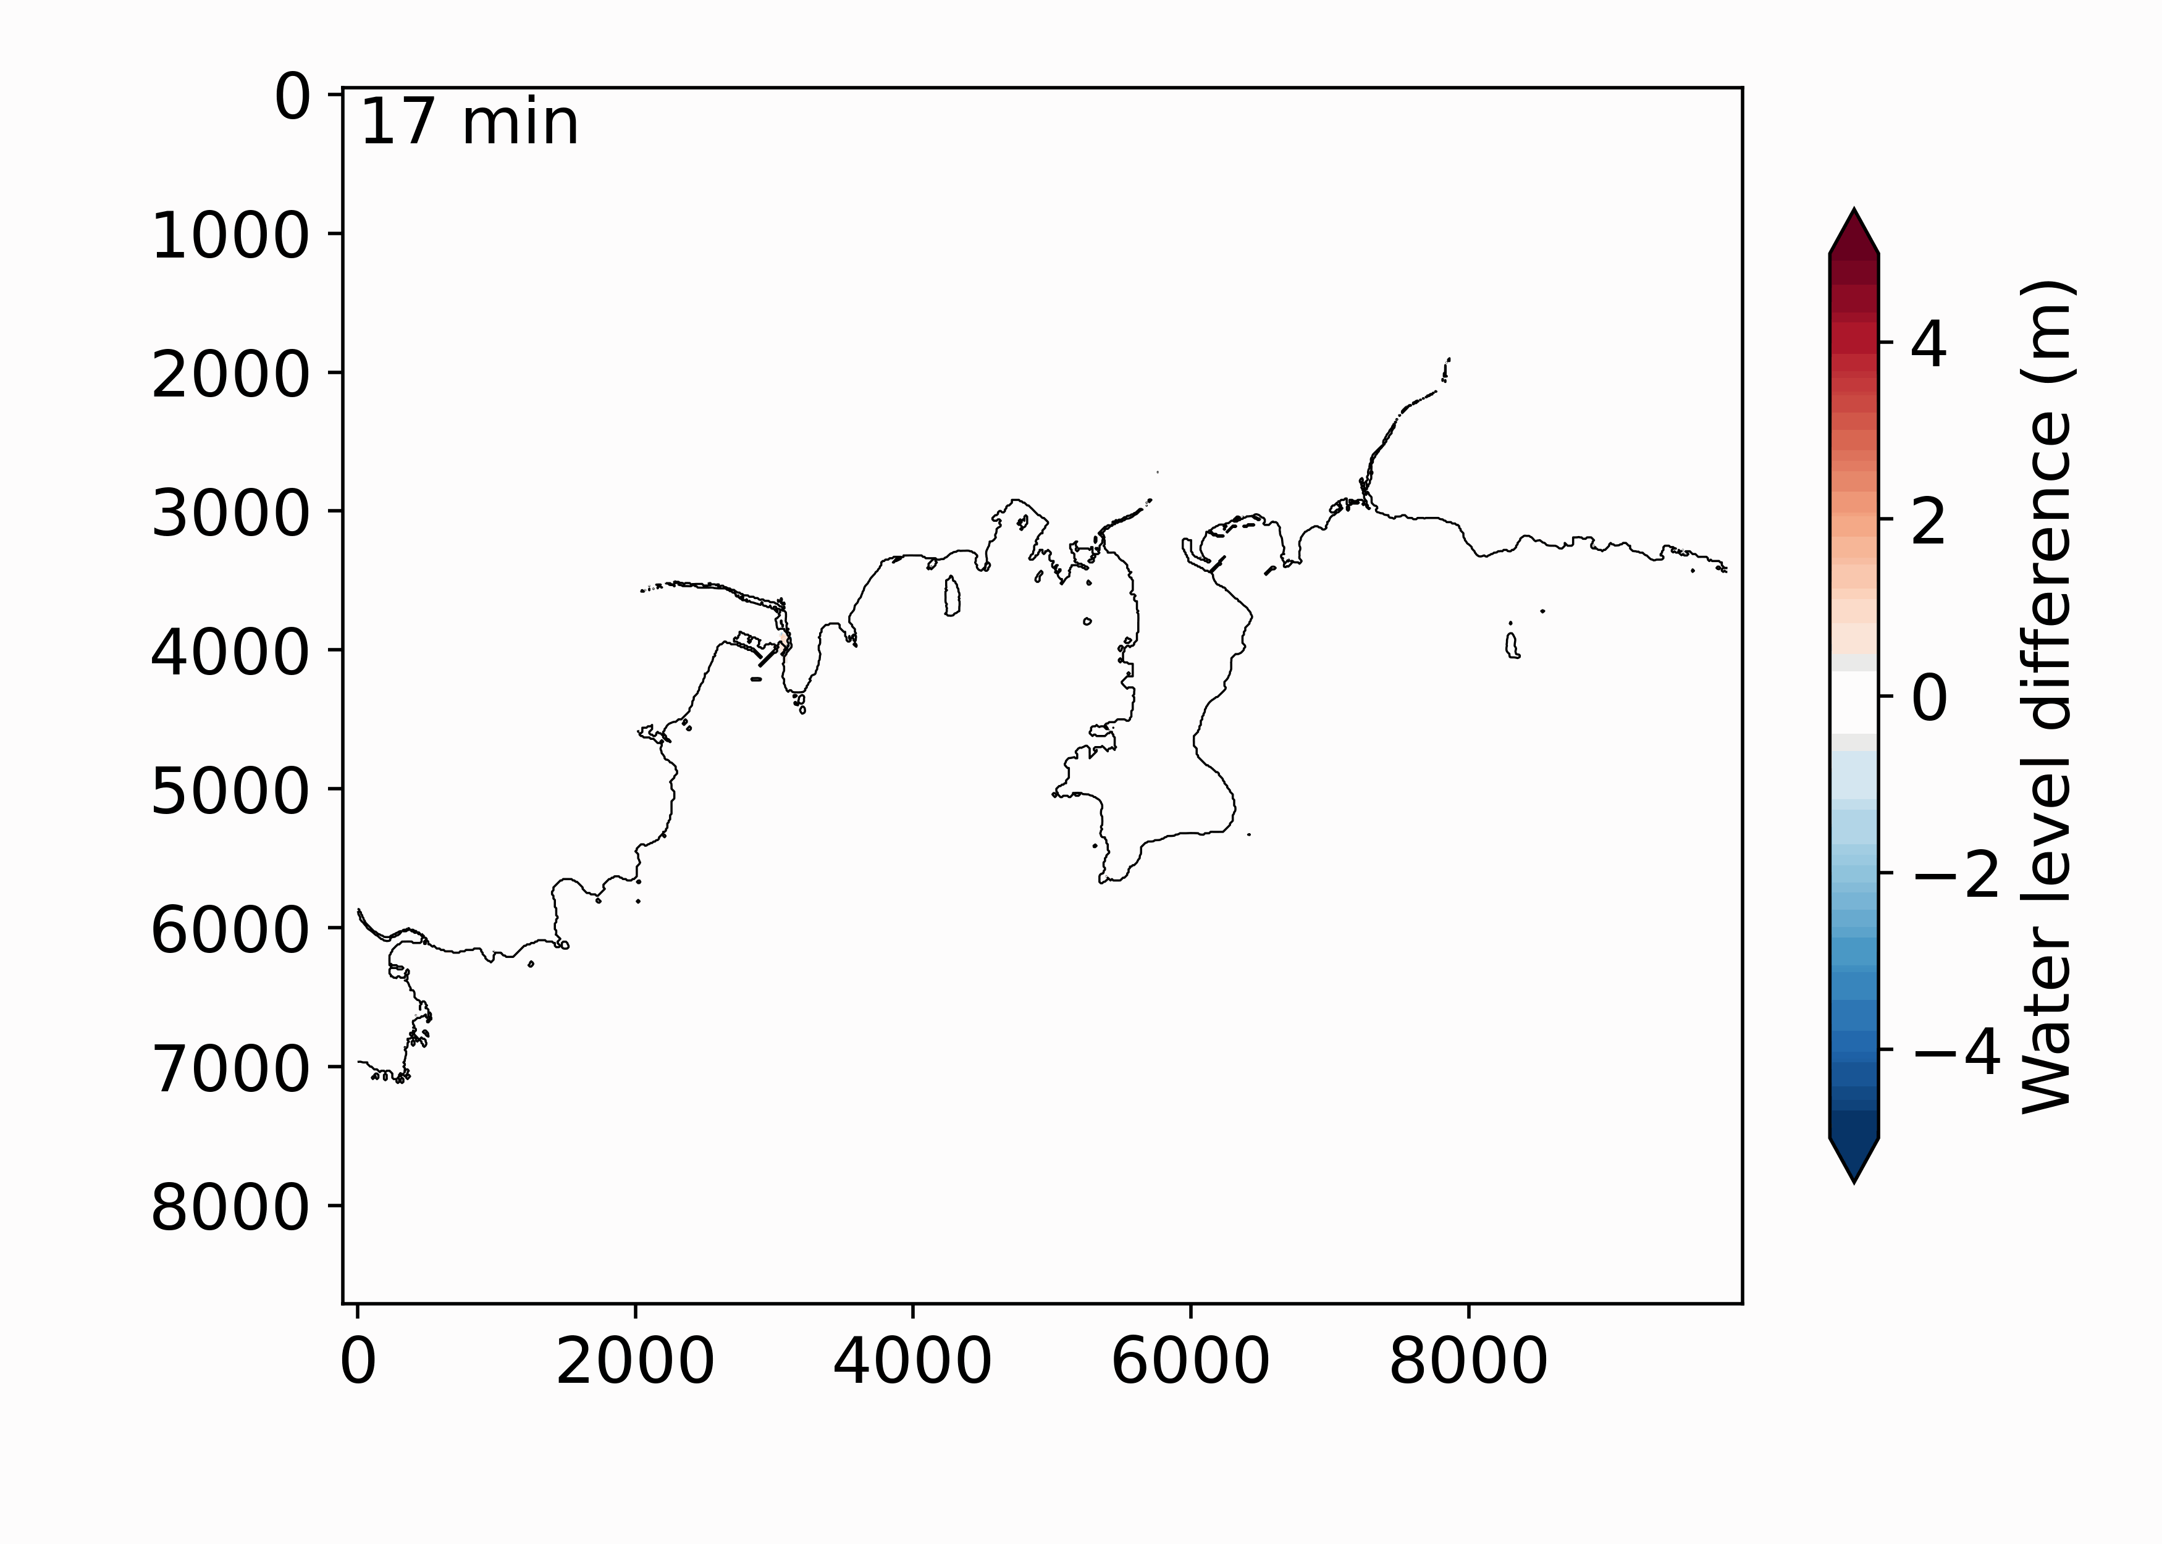
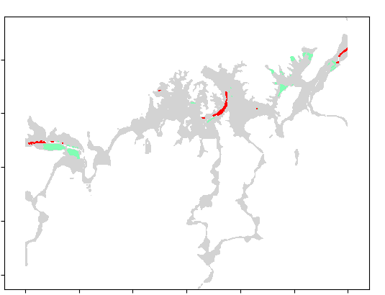
waterways model: TSUNAMI ARRIVAL TIME
Model with waterway predicts higher inundation around waterway mouth
Model with waterway predict slightly higher maximum inundation depth.
Most of the time the two models predicts similar inundation arrival time
Model with water in advance around the river mouth
Model without in advance in upper parts of the river
➔ Role of the water discharge?
Both models have the same reaching time
Model without waterways is in advance
Model with waterways is in advance

Slide 11
Evacuation simulation
 |  | People trapped by the tsunami. (Governmental evacuation simulation / Our evacuation model) (Scenario 4 only)
Rivers | RSLR | Able | Disabled | Tourists
No | 0 | 0/0 | 1/17 | -/7
 | 4 | 0/0 | 20/66 | -/94
 | 6 | 0/0 | 30/101 | -/151
Yes | 0 | 0/0 | 1/17 | -/7
 | 4 | 0/0 | 27/68 | -/162
 | 6 | 0/12 | 45/146 | -/504
People
Able, Tourists and Disabled (3 different walking speed)
Slop reduces speed
Locals start evacuating 5min after the earthquake
Tourists 10 min after (Maps check)
Reach the nearest evacuation spot
Evacuate by foot
Able people are a low risk of being trapped by the tsunami
The death toll rises strongly when the relative sea level rise is high
Tourists are high risk because their departure is delayed
~Government tsunami simulation

Slide 12
Conclusion and next step
Conclusion:
4th scenario: the worst
RSLR worsen the inundation: might consider a 2 or 4m RLSR
New evacuation simulation: high risk for disabled people and tourists
End of the simulation work and analysis on the current situation
Next:
Scientific questions on model, incertainties,…
Economic, political, and ethical consideration:
How much can we afford to spend to protect the population, knowing the city might dispear ?
How much do we have to protect the population?
To which level of risk to we have to protect?
Real estate regulations, evacuation plan and drills, cost-benefits analysis, ….

Slide 13
CEL 05.10 Tsunami simulation in Tosashimizu Auriane Laurent (M1)
Thank you for your listening

