Slide 1
On Brane Inflation after Litebird
Valentin (バレンティン)
Carpintero Pérez (カルピンテロ・ペレス)
ILANCE Student Fest
Notes:
Hello, my name is Valentin Carpintero Pérez. I am a master student at Ecole Polytechnic specializing in Theoretical Physics and I’m currently a visitor at Kavli IPMU, institute for the Physics and Mathematics of the Universe.
First, I would like to thank the organizers for this opportunity to present my project.
On top of that, I’d like to thanks my supervisors for being here, and especially for their huge support in my work.
After introducing you a bit about cosmic history, I’ll try to give you a glimpse on what the theory of inflation is, and finally present you my current project, which is the study of the Brane Inflation model, in regards to the upcoming mission LiteBIRD.

Slide 2
Cosmic history
ESA, Planck Collaboration
Notes:
We have strong evidence that our universe is expanding, at an accelerating rate. For instance, we observe that galaxies are moving away, and the further they are, the faster.
The universe was therefore denser and hotter in the past.
We believe that, in the Big Bang cosmological models, during the earliest periods, the universe was filled with an opaque fog of dense, hot plasma of subatomic particles (protons, neutrons, electrons) and very-high energetic photons that prevented any heavier nuclei from forming. (E>E_liaison)
As the universe expanded, this plasma cooled to the point where protons and electrons combined to form neutral atoms of mostly hydrogen. Unlike the plasma, these atoms could not scatter thermal radiation by Thomson scattering, and so the universe became transparent.
Known as the recombination epoch, this decoupling (between light and matter) event released photons to travel freely through space. However, the photons have grown less energetic, since the expansion of space causes their wavelength to increase.
The surface of last scattering refers to a shell at the right distance in space so photons are now received that were originally emitted at the time of decoupling.
Later in the cosmic history, atoms and ordinary matter started to feel the gravity field created by dark matter. We call this era dark ages.
Later, the first starts and galaxies formed in the knots of this cosmic web created by dark matter. Bigger cluster of galaxies formed billions of years later.
Back up on scales:
Scale factor a(t) and redshift z = (lambda0-lambda_1)/lambda_1 related by 1+z = 1/a(t1)

Slide 3
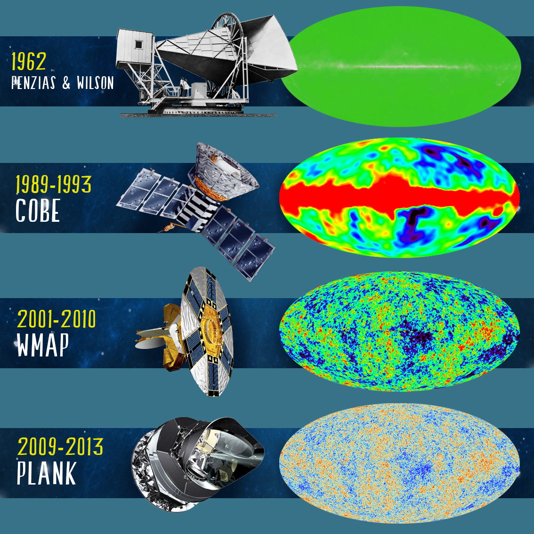
The Cosmic Microwave Background
The Cosmic Microwave Background (CMB) is an emission of light coming from all directions of the sky.
Universe is on large scales homogeneous and isotropic
Universe presents inhomogeneities and anisotropies
The CMB has a thermal black body spectrum at temperature
$$T=2.72548±0.00057 K$$
ETH Zürich
Notes:
This is a nice story, but what can we actually infer from the observation of the universe ?
It was discovered in 1962 (by accident?) by Penzias and Wilson that measured a mysterious noise in radio signal. This noise was evenly spread over the universe sky and constant.
This is the CMB, also known as fossil radiation, is the cooled remnant of the first light that could ever travel freely throughout the Universe. It was released soon after the 'Big Bang’.
The CMB is not completely smooth and uniform, showing a faint anisotropy that can be mapped by sensitive detectors. Ground and space-based experiments such as COBE, WMAP and PLANK have been used to measure these temperature inhomogeneities.

Slide 4
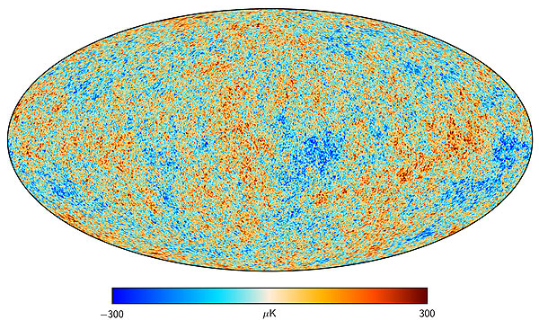
The Cosmic Microwave Background
Planck’s map of the temperature of the CMB
Observations :
Universe is on large scales homogeneous and isotropic
Universe presents anisotropies
The CMB has a thermal black body spectrum at temperature
$$T=2.72548±0.00057 K$$
Notes:
The anisotropy (or directional dependency) structure is determined by various interactions of matter and photons up to the point of decoupling, which results in a characteristic lumpy pattern that varies with angular scale.
The anisotropy is divided into two types:
primary anisotropy, due to effects that occur at the surface of last scattering and before. For instance, acoustic oscillations in the photon-baryon plasma.
secondary anisotropy, due to effects such as interactions of the background radiation with intervening hot gas or gravitational potentials, which occur between the last scattering surface and the observer

Slide 5
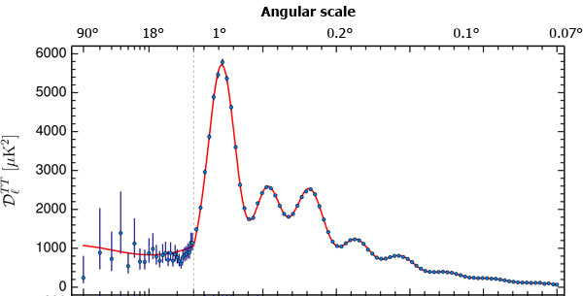
The Cosmic Microwave Background
Planck’s angular power spectrum of the CMB
(size of the temperature fluctuations as a function of the angular separation)
Planck’s map of the temperature of the CMB
Observations :
Universe is on large scales homogeneous and isotropic
Universe presents anisotropies
From the angular power spectrum, scales in the early universe can be determined, and six parameters of the Lambda-CDM model can be checked for consistency with the CMB.
The CMB has a thermal black body spectrum at temperature
$$T=2.72548±0.00057 K$$
Notes:
The distribution of the anisotropy across the sky has frequency components that can be represented by a power spectrum displaying a sequence of peaks and valleys.
A power spectrum of a function on a sphere is a function that captures how much difference there is between the function values at different points as a function of the angular separation.
The peak values of this spectrum hold important information about the physical properties of the early universe (and especially constants of the Lambda-CDM model):
the 1st peak determines the overall curvature of the universe
the 2nd peak gives information on the baryon density
the 3rd pick details the density of dark matter
Extracting fine details from the CMB data can be challenging, since the emission has undergone modification by foreground features such as galaxy clusters, dust, gravitational lensing.
All in all, CMB is one of our greatest tools to study cosmology and the early universe. It is particularly one of our best ways to probe inflation.

Slide 6
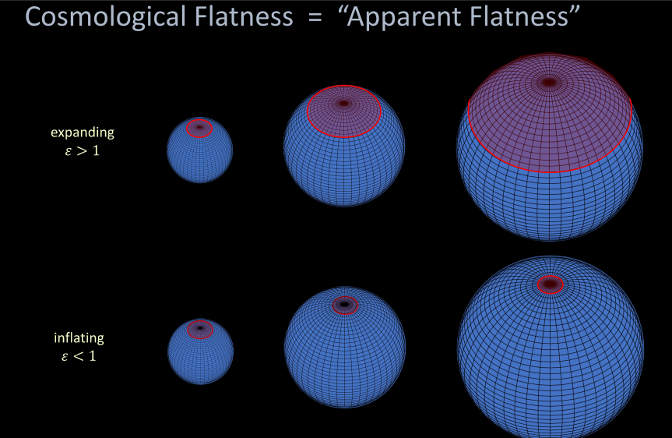
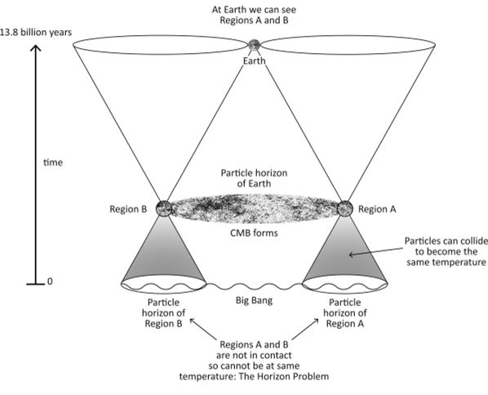
Inflation
Horizon problem : why is our universe so homogeneous?
Flatness problem : why is our universe flat?
P. Steinhardt and A. Ijjas
C. Devereux and P. Farrell.
Notes:
Key features of the observed universe, notably with the CMB, such as its large-scale homogeneity and flatness, seem to require that the universe started with very special and fined tuned conditions. These problems, called horizon and flatness problems can be explained by inflation.
Inflation, is an early period of accelerated expansion. This theory explains how the primordial universe drove towards its special state, even if it started from more generic initial conditions.
The horizon problem is the problem of determining why the Universe appears statistically homogeneous and isotropic (in accordance with the cosmological principle).
Similar to a gas reaching thermal equilibrium, we could build a big bang model without inflation. The problem is that gravitational expansion does not give the early universe enough time to equilibrate and dissipate inhomogeneities and anisotropies. On the other hand, inflation smoothens out initial inhomogeneities.
The flatness problem is the problem of determining why the cosmic density appears to be fairly close the critical value. In terms of space-time curvature, the Universe is remarkably close to being flat. The pb is that there is no obvious reason why our universe should have the exact critical density. Especially since, if it starts out near, it quickly deviates.
One of the greatest features of inflation is that it contains a mechanism to produce the primordial density fluctuations. Small quantum fluctuations get stretched by the inflationary expansion and become the seeds for the formation of the large-scale structure of the universe.

Slide 7
Polarization of the CMB – probing inflation
Detecting primordial gravitational waves’ footprint on B-mode polarization is very difficult
LiteBIRD
Light Satellite for the study of B-mode polarization and Inflation from cosmic background Radiation Detection
Expected launch in late 2029
The CMB presents 2 types of polarization :
E-modes (Thomson scattering of photons on early-universe plasma)
and B-modes (gravitational lensing + primordial gravitational waves)
Notes:
The cosmic microwave background is polarized at the level of a few microkelvin. There are two types of polarization, called E-modes and B-modes (in analogy to electrostatics). The E-modes arise naturally from Thomson scattering in a heterogeneous plasma. The B-modes are not produced by standard scalar type perturbations.
Instead, they can be created by two mechanisms:
the 1st one is by gravitational lensing of E-modes, which has been measured by the South Pole Telescope in 2013
the 2nd one is from gravitational waves arising from cosmic inflation.
Detecting the B-modes is extremely difficult, particularly as the degree of foreground contamination is unknown, and the weak gravitational lensing signal mixes the relatively strong E-mode signal with the B-mode signal. (massive bodies curve space time and bend the path of light)
So, a B-mode search allows us to target gravitational waves that are the signal of inflation at very high sensitivity without being swamped by the larger E-modes. (smoking gun :) )
This is precisely the objective of the LiteBIRD collaboration (Japan+Europe) that aims to detect B-modes, again which are the footprints of the primordial gravitational waves on the CMB.

Slide 8
Brane Inflation
$$V\left(φ\right)=V_{0} \frac{φ^{p}}{φ^{p}+μ^{p}}$$
Brane Inflation is a scenario within the brane world framework in string theory (4+6-dimensions space-time)
$$V(φ)$$
$$δφ$$
$$\dot{φ}$$
Predictions of BI almost cover completely Planck’s data
reheating
inflation
$$φ$$
📖 Vennin+2020
$$φ_{CMB}$$
$$φ_{end}$$
$$Δφ$$
Brane Inflation potential
Notes:
Inflation is hypothesized to have been driven by a so-called primordial inflationary field φ called the inflaton, that governs the density of early-stage universe.
I have been studying a particular potential, presented in this graph, which is called Brane Inflation.
It is an inflationary universe scenario within the brane world framework in string theory.
What’s worth noting about this potential is its very flat plateau (on the gauche).
Why would be study this potential. Actually, the predictions of Brane Inflation match quite accurately Planck’s data, so it could be a great candidate for inflation models.
BACK UP : BI
We present a novel inflationary scenario in theories with low scale (TeV) quantum gravity, in which the standard model particles are localized on the branes whereas gravity propagates in the bulk of large extra dimensions. This inflationary scenario is natural in the brane world picture. In the lowest energy state, a number of branes sit on top of each other (or at an orientifold plane), so the vacuum energy cancels out. In the cosmological setting, some of the branes "start out" relatively displaced in the extra dimensions and the resulting vacuum energy triggers the exponential growth of the 3 non-compact dimensions. The number of e-foldings can be very large due to the very weak brane-brane interaction at large distances. In the effective four-dimensional field theory, the brane motion is described by a slowly rolling scalar field with an extremely flat plateau potential. When branes approach each other to a critical distance, the potential becomes steep and inflation ends rapidly. Then the branes "collide" and oscillate about the equilibrium point, releasing energy mostly into radiation on the branes. arXiv:hep-ph/9812483

Slide 9
Brane Inflation
Brane Inflation models
Notes:
This is what highlights this paper by Vincent Vennin.
He studies a bunch of inflation potentials and classifies them according to their fit with Planck’s and other missions' data. (here are some of the potentials, but there are more than a 100 studied)
The potential in green are the ones that fit the actual data and cannot be excluded. On the contrary, the pink and purple ones are inflationary models that are most likely to be excluded by our current data.
All Brane Inflation models, in the orange circle, are good candidates for a single-scalar-field inflation model.
Thus, it is interesting and worth studying this particular potential!

Slide 10
Slow-roll study of Brane Inflation
$$V\left(φ\right)=V_{0} \frac{φ^{p}}{φ^{p}+μ^{p}}$$
Brane Inflation is a scenario within the brane world framework in string theory (4+6-dimensions space-time)
$$V(φ)$$
$$δφ$$
$$\dot{φ}$$
Hubble rate $H=\frac{\dot{a}}{a}$
$$\ddot{φ}+3H \dot{φ}=−\frac{dV}{dφ}≈3H \dot{φ}$$
Klein-Gordon equation in the slow-roll approximation
reheating
$$H^{2}=\frac{8πG}{3}\left(\frac{1}{2}{\dot{φ}}^{2}+ V\left(φ\right)\right)≈\frac{8πG}{3}V(φ)$$
Friedmann equation in the slow-roll approximation
inflation
$$φ$$
$$φ_{CMB}$$
$$φ_{end}$$
$$Δφ$$
Brane Inflation potential
Notes:
Slow-roll is a model of inflation where inflation occured by a scalar field rolling down a potential energy hill. When the fields rolls very slowly compared to the expansion of the universe, inflation occurs.
Most of the energy density during inflation is in the form of the inflaton potential $V(φ)$.
Inflation is a period of supercooled expansion, when the temperature drops by a factor of 10⁵. This relatively low temperature is maintained during the inflationary phase.
When inflation ends the temperature returns to the pre-inflationary temperature; this is called reheating because the large potential energy of the inflaton field decays into particles and fills the Universe with Standard Model particles.
The theory of inflation can make predictions on the power spectrum that would be produced after inflation.
Fluctuations of different wavelengths are produced at different times in the inflationary evolution and therefore probe different parts of the inflationary potentials.
The scales observed in the CMB probe the conditions roughly 50 e-folds before the end of inflation. (represented by the $Δφ$)
What is interesting noting is that the observations of the CMB lie into a zone in the potential where it is very flat and verifies the slow-roll condition.
The advantage of the slow-roll approximation, is that it lets us express inflationary predictions in terms of the shape of the potential, and not anymore in terms of the Hubble rate $H=\frac{\dot{a}}{a}$, which is the speed at which the universe is expanding.
I’ve been working on this potential, one of my objectives is to produce the theoretical power spectrum that this potential would create.

Slide 11
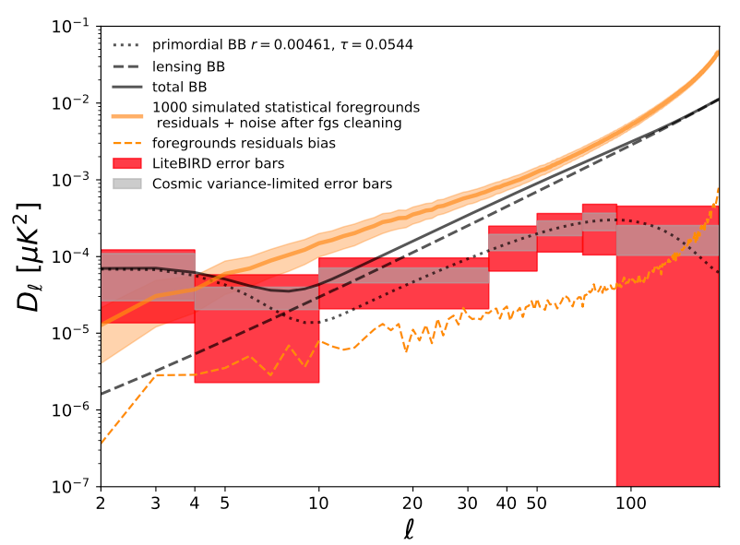
My missions
C. Leloup
Compute theoretical power spectrum from the slow-roll study of the Brane Inflation potential
Considering noise and variance due to systematics effects in instruments and cosmic variance, can we constraint parameters of the Brane Inflation model ?
Notes:
Here are some plots that I did not do but come from other studies of other potential.
My mission is to run similar work on this potential.
1st, I have to compute theoretical power spectrum produced by the Brane Inflation potential
2nd, I’ll try to take into account the noise and variance in the power spectrum that are due to systematics effects in the observational instruments, in the separation algorithms (as will explain my colleague Julien) and also cosmic variance
Finally, this could lead to constraining cosmological parameters that charactherize this inflation potential.

Slide 12
Summary
Inflation is cool !
Brane Inflation is a cool inflation potential!
Studying the Cosmological Background is one of our best tools to study inflation and physics in the early universe
The discovery of CMB B-mode polarization would be a smoking gun of Universe’s inflation
Notes:
After going to lunch, let be give you a brief recap.
I really enjoy studying inflation, this is why I think it’s a very interesting theory that is worth studying. So you should give it a try.
Besides that, the CMB is currently one of our best tools to probe inflation. The various telescope missions that arise emphasize.

Slide 13
Credits:
ESA and Planck Collaboration
BICEP2 Collaboration

