Slide 1
Studying High redshift Quiescent Galaxies
Mouad Gnaoui, June 12th
Notes:
* Self-introduction
* What Is redshift ?

Slide 2
Summary
Introduction
The high redshift universe
Photometry probes
My research : searching for red objects
NIR-dark Galaxies
SED fitting and it’s parameters
Case in point : Quiescent Galaxies
What are they and why are they special ?
Candidate and characteristics
Notes:
1 – Why it is important to understand far away galaxies
2 – The methods we use to study them
3 – One specific population : QG, what why how ?

Slide 3
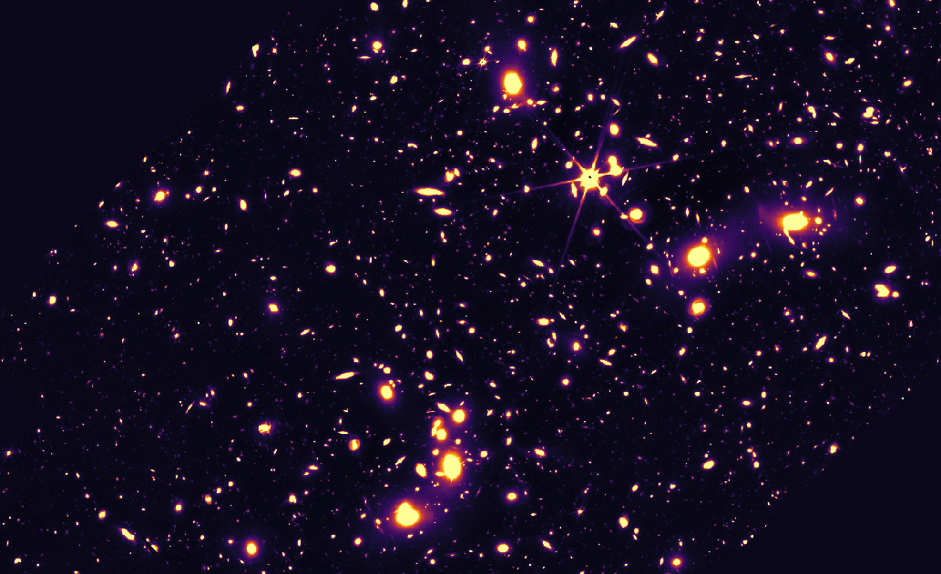
The High Redshift Universe
We study objects at cosmological distances because they are a window to the past.
They tell us about :
The Big Bang
Precursors of present-day objects
Galaxy formation / evolution
Matter, dark matter…
1 arcmin
Figure 1 : Deep observation by the James Webb Space Telescope (Abell2744 lensing field)

Slide 4
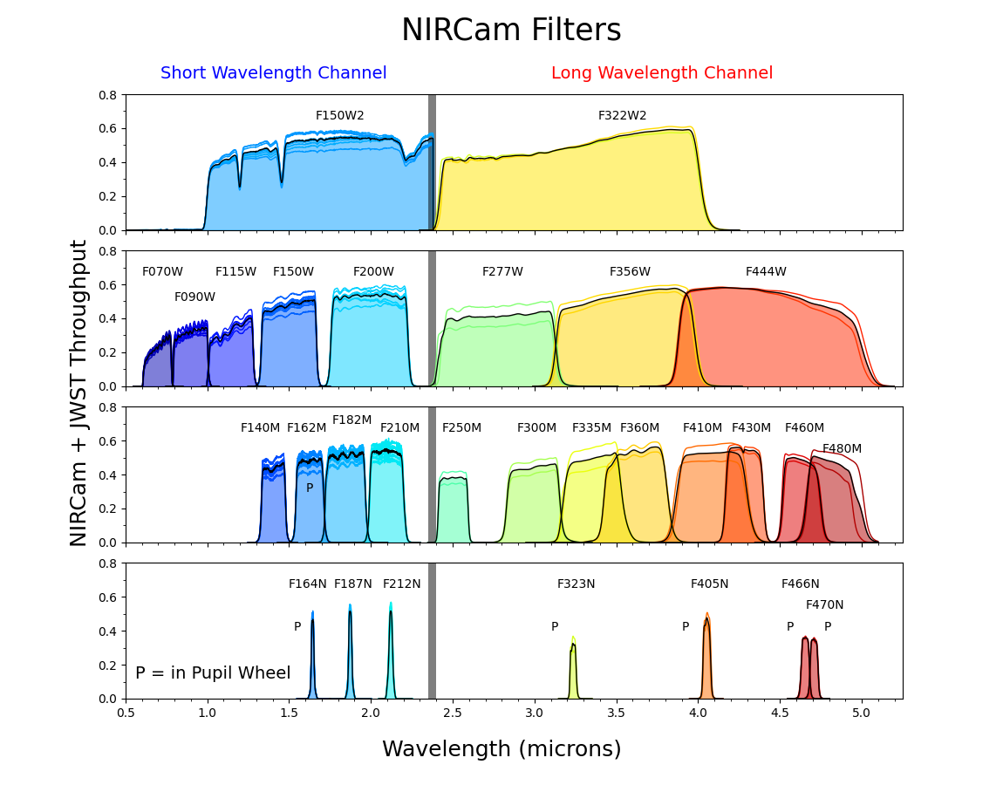
Photometry probes
Figure 2 : The same region at 4.4µm and 1.15µm
Photometry = measuring fluxes
Different objects are bright in different regions
Filter Bands to select light
From X-ray to Far infrared spectrometry
Shape, Spectrum and time evolution
Today, we can see
Galaxies ~0.1 Gyr (vs 13.8 Gyr)
Hours upon hours of integration time
It’s the data I work with.
Figure 3 : Throughput of various JWST bands

Slide 5
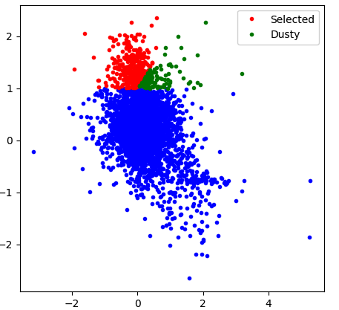
My research : NIR-dark “red” Galaxies
brighter
in longer
wavelength
1.15μm vs 1.50μm
magnitude
difference
Near-infrared dark objects are invisible in optical wavelengths. They suddenly appear in farther infrared :
Unnoticed for a while, leading to underestimated densities
Harder to pinpoint, still under debate
Many possible reasons, high redshift, degeneracy :
Lyman break
Dust obscuration, emission lines, growing black holes (AGN)
Old stars (balmer break)
How to know what we’re looking at ?
fainter
in longer
wavelength
fainter
in longer
wavelength
1.50μm vs 2.77μm
magnitude
difference
brighter
in longer
wavelength
1.15 µm
1.5 µm
2.7 µm
3.6 µm
4.4 µm
Figure 4 : Some candidate images and
Initial selection criteria.
Higher magnitude = fainter object

Slide 6
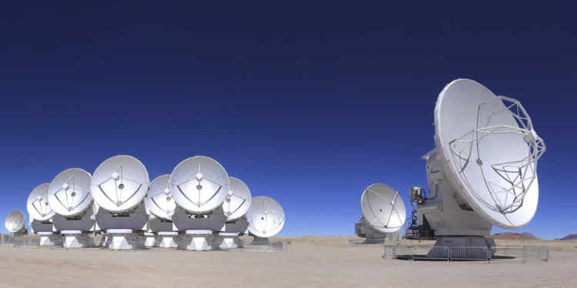
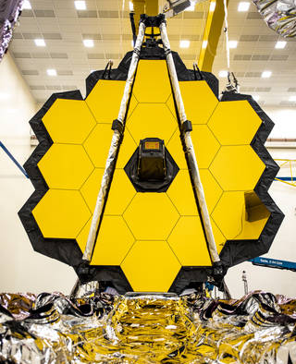
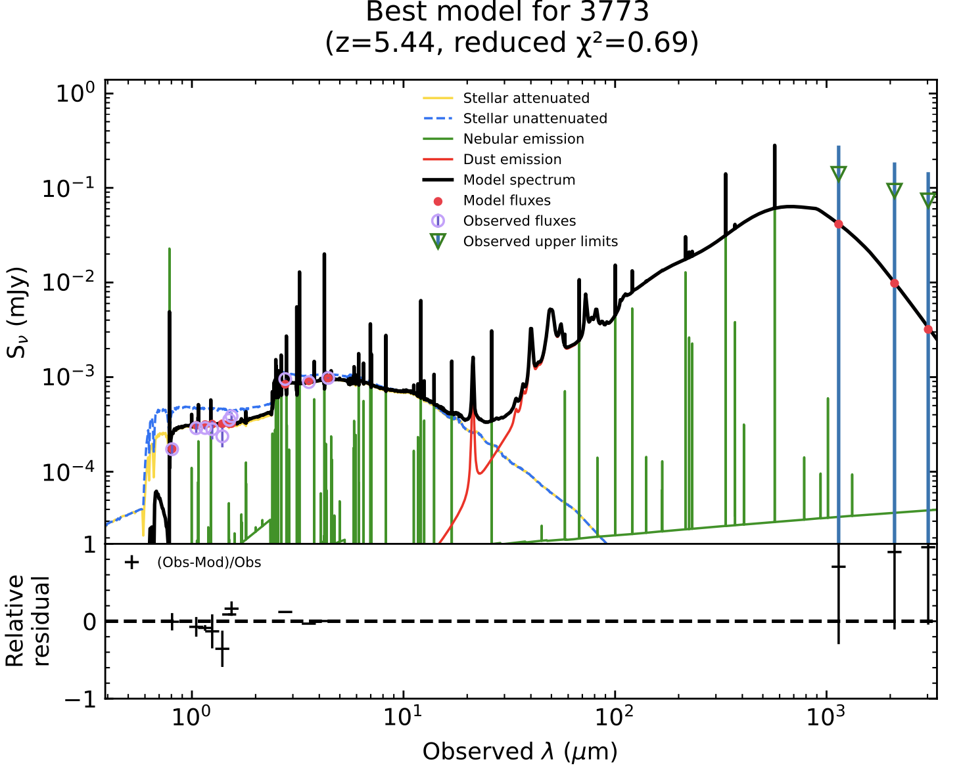
SED fitting and it’s parameters
ALMA
SED (Spectral Energy Distribution) contains most of the accessible information.
From available photometry, derive object characteristics :
Age, mass, redshift
Presence and amouts of gaz, dust, black holes (spectral lines…)
Star formation history : massive blue stars die fast (few Myr) while old, red stars last longer than the universe (14 Gyr)
–> effect on SED shape
We fit these parameters using a set of templates
Dust emission
JWST
Stellar light
Flux density (mJy)
800 nm
Figure 5 : Example of an SED. Best fit model based on ~10 photometric data points

Slide 7
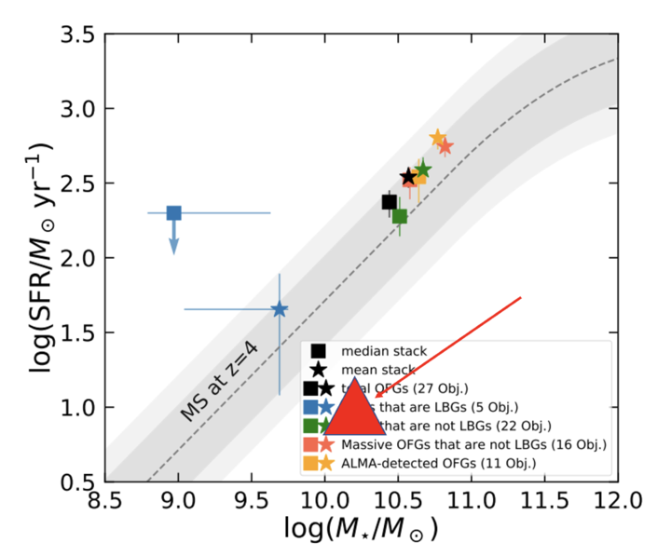
Case in point: Quiescent Galaxies
1.15 µm
1.5 µm
2.7 µm
3.6 µm
4.4 µm
Quenched (extinguished) galaxies with only old stars left, and therefore very red. They are remnants of inaccessible steps of massive galaxy evolution and formation.
Understanding the causes of quenching
Put constraints on inaccessible very early star/galaxy formation
Rare, still unknown density (Weak constraints)
recent discoveries reveal tensions with Lambda-CDM ?)
This object :
Lensed by a factor of 5 => 25 less needed integration time
An order of magnitude below the “main sequence” (between starbursts and quiescent galaxies)
Figure 5 : Star formation rate against Mass and Galaxy main sequence
https://arxiv.org/PS_cache/astro-ph/ps/9807/9807287v1.fig2.gif

Slide 8
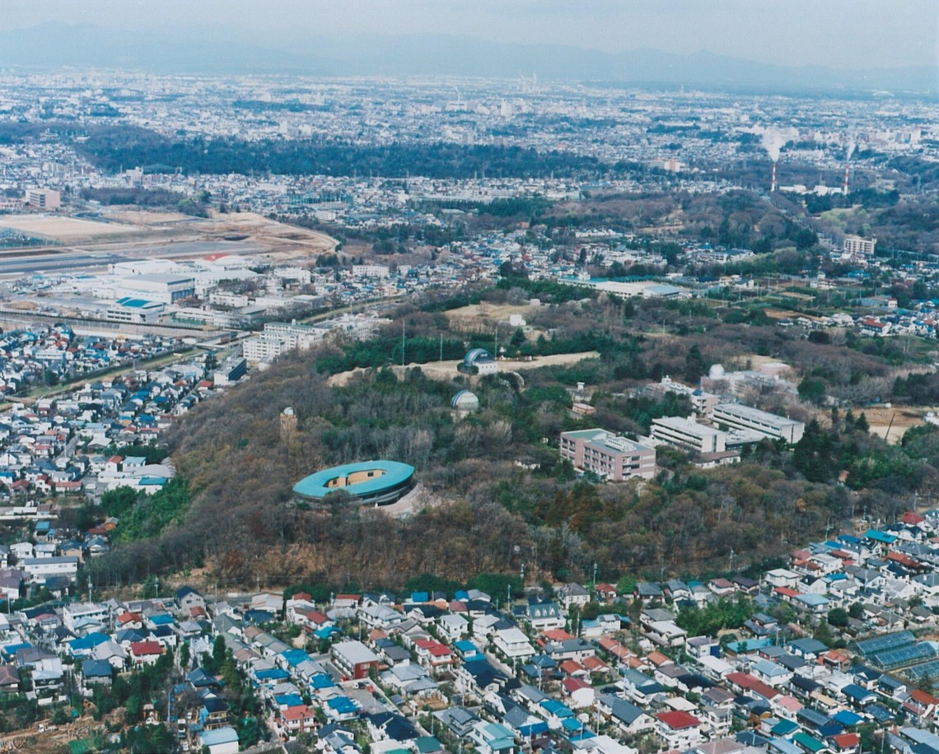
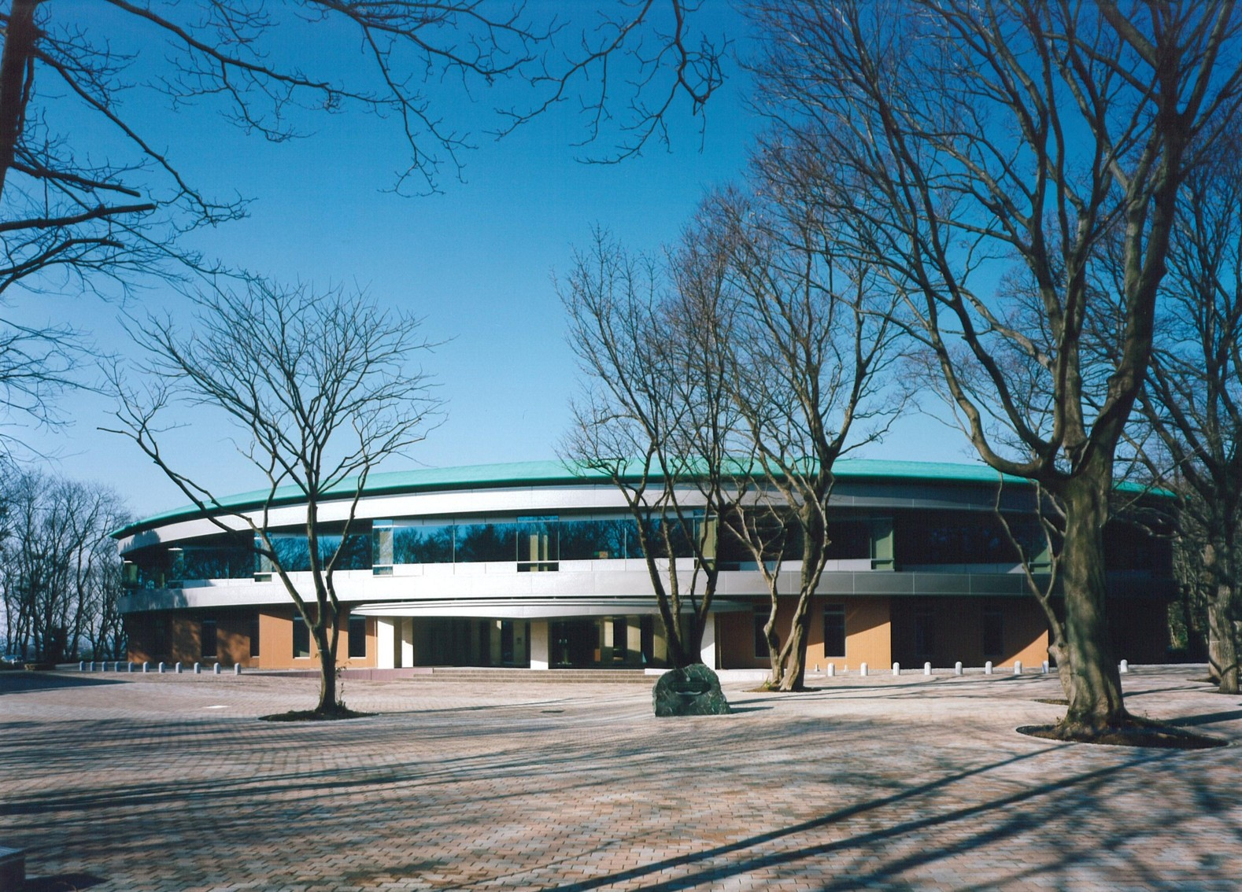
That’s it for me !

