Slide 1
Deep learning for the characterization of neutrino events in Hyper Kamiokande
Lucas JACQUIER – Ecole polytechnique

Slide 2
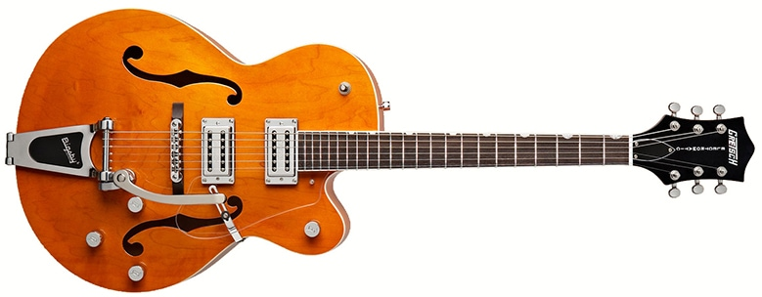
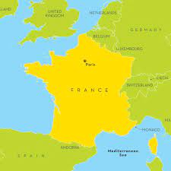
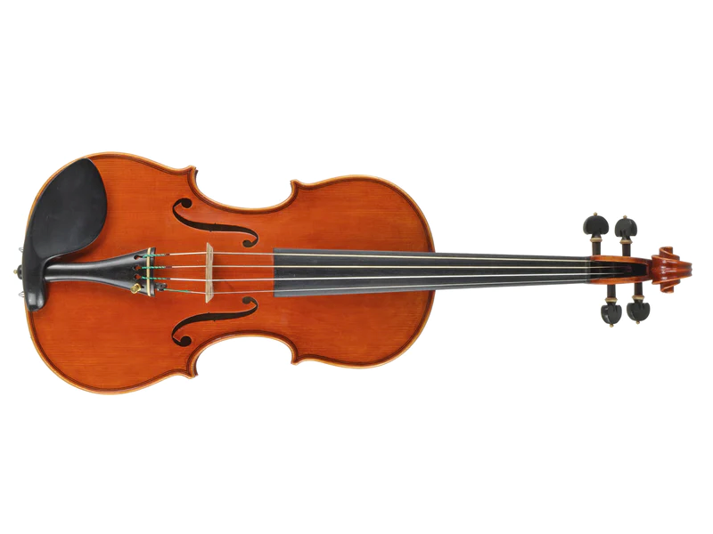
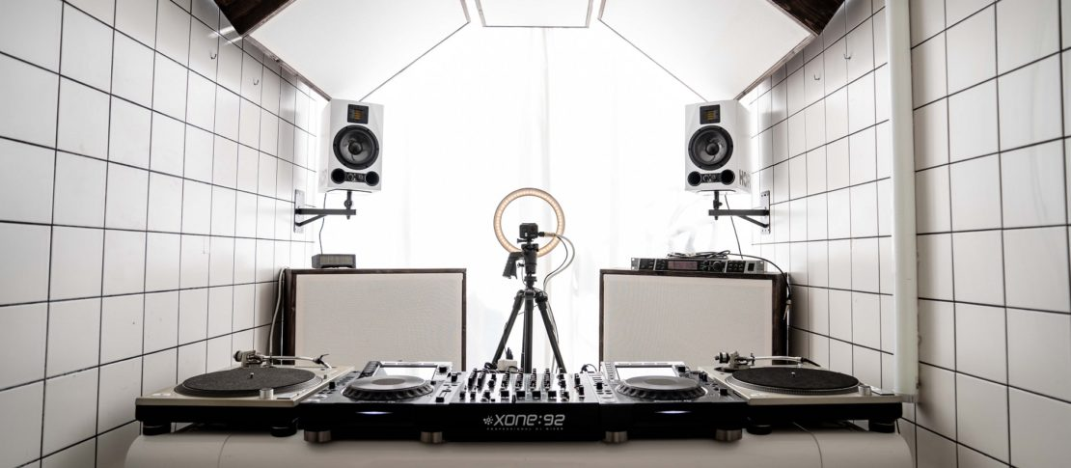
A little about me
From
Studying
Love
Career plan
Fundamental Physics Major

Slide 3
Neutrinos
Only interact through the weak interaction and gravity → It makes them very difficult to detect
The mean free path of a solar neutrino in lead is about 1 light year !

Slide 4
How do we detect neutrinos?

Slide 5
How do we detect neutrinos?
By analyzing the cherenkov ring, we can infer
The type of neutrino
Its energy
Its direction
Etc..

Slide 6
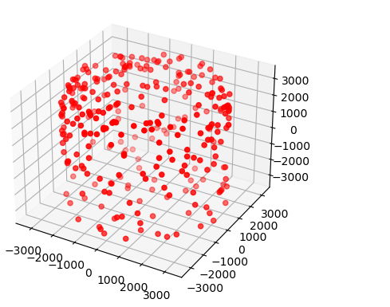
Not always easy
At low energies (below 10Mev), the signal can be hard to distinguish from the noise

Slide 8
Problem: the detector is not flat
How can we do convolution on a 4D point cloud?
Our data:
$$\left[\begin{aligned}x \\ y \\ z \\ t\end{aligned}\right]$$
Each node is the postion vector in space time of an activated PMT in the detector

Slide 9
First step: create a graph
Each node is connected to its k nearest neighbors

Slide 10
Step two: compute edge features
e_{ij}
i
j
i
j
x_{i}
x_{j}
x_{i}
x_{j}
$$e_{ij}=h_{θ}(x_{i },x_{j})$$
With $h_{θ}$ a learnable function

Slide 11
Step three: aggregate
e₁₄
x₁
4
e₁₂
1
2
$$x_{1}′=mean⁡(e_{12},e_{13},e_{14})$$
e₁₃
3

Slide 12
Summary: one convolution layer
Create a graph based on nearest neighbors
Calculate edge features
Aggregate to generate a new point cloud

Slide 13
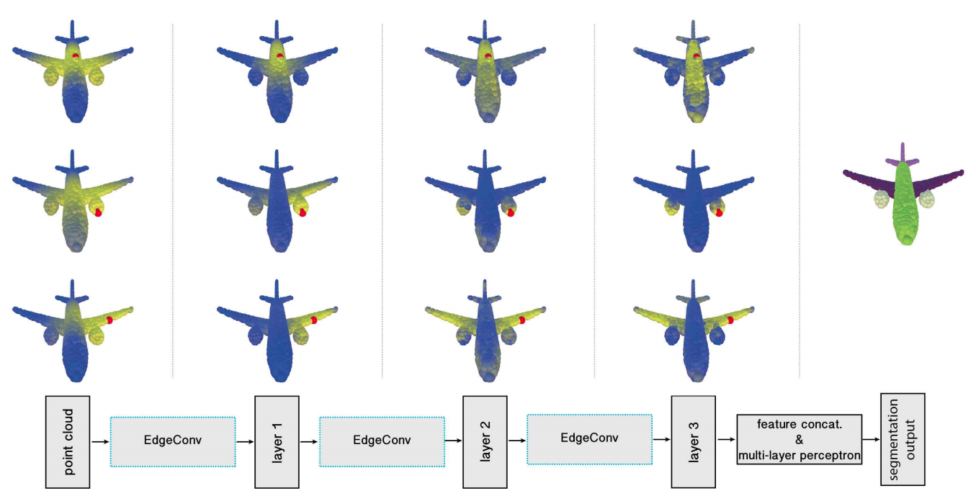
Points that are originally far away can end up being neighbors. It allows for the recognition of global scale patterns, like cherenkov rings!

Slide 14
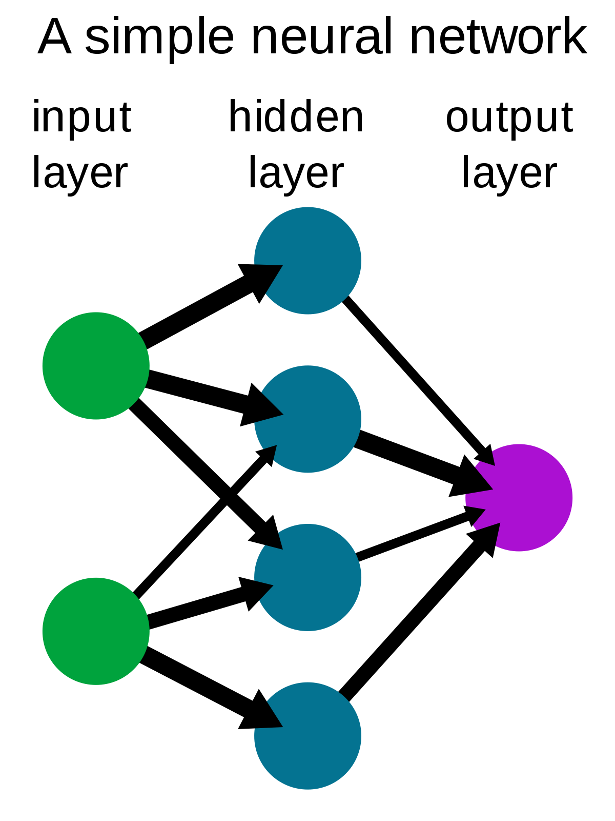
We can now use convolution layers to build a network
Convolution
Convolution
Pooling
Pooling

Slide 15
Does it work?

Slide 16
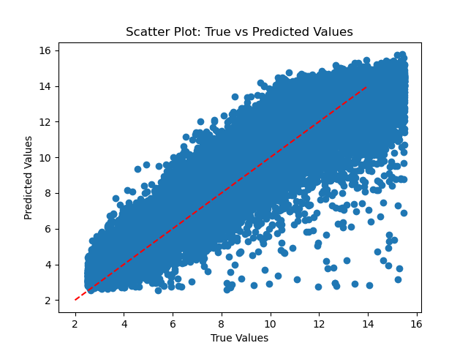
Energy regression
Mean absolute error: 1Mev

Slide 17
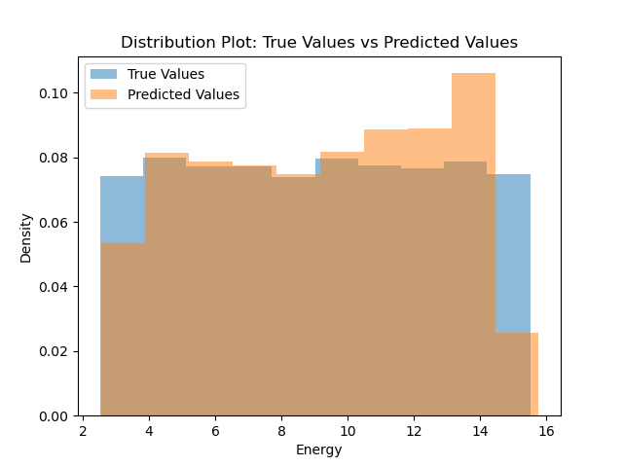
Deficit on the border of the energy spectrum to be expected

Slide 18
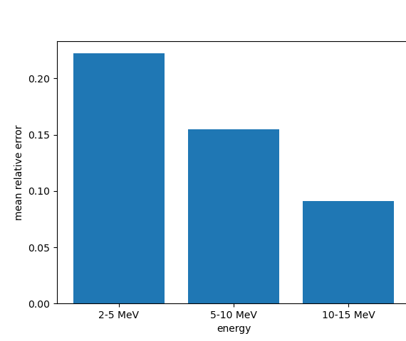
Mean relative error at different energies

Slide 19
What is next?
Tune the model for better reconstruction
1
Compare to other architectures
2
Try to reconstruct other features (position, direction,…)
3

