Slide 1
DarkMachines data challenge and anomaly scores
Sascha Caron (Radboud University and Nikhef)
Roberto Ruiz de Austri (IFIC Valencia)
Pietro Vischia (Oviedo and ICTEA)
for the DarkMachines-unsupervised working group

Slide 2
Anomaly score definitions…
Pick no “new physics model”
Learn the background model (simulation and/or data)
Train ML model to test the prediction (is event background or not?)
Hypothesis test with data|background model on classifier output
Exclude the background model?

Slide 3
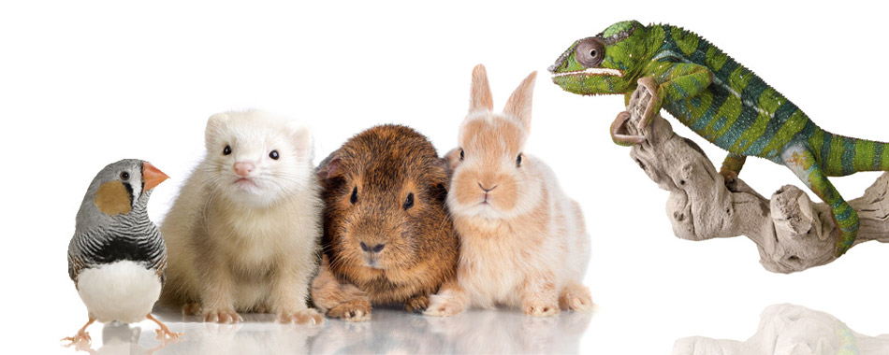
Which features “flag” the outlier?
How would you define an ”outlier” ?

Slide 4
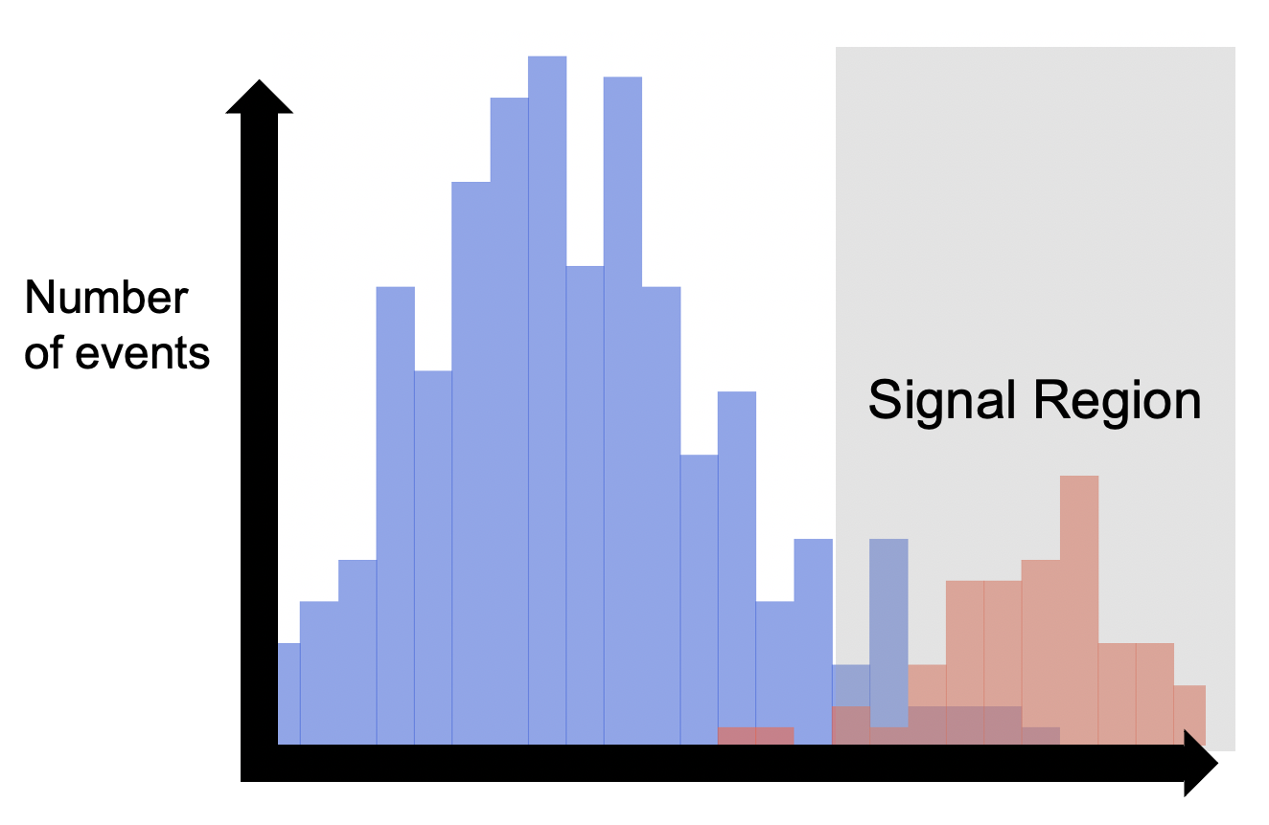
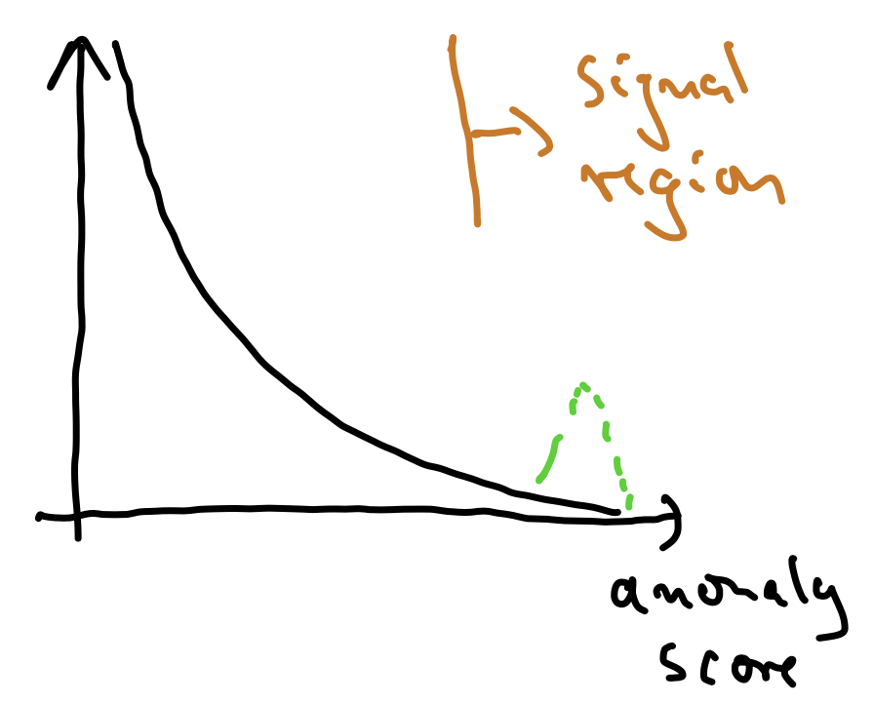
How to detect…
…“Expected” signal events
…“Unexpected” anomalous events
Control regions to predict background in signal region
Control regions to predict background in signal region
ML classifier score
(or physics-motivated discriminating quantity)
Anomaly score

Slide 5
Advantages
Do I really have to convince you?
Minimal changes to traditional signal region approach
You could just “add” a new signal region to your analysis
Background prediction via transfer functions, control regions etc.
No *extra* Look-elsewhere effect (Why ? → only 1 more statistical test in the new “anomaly SR”)
No training of NN data vs SM prediction needed
(I don’t really believe this)

Slide 6
How to define anomalies ? ML approaches
Approaches being described all around you ;)

Slide 7
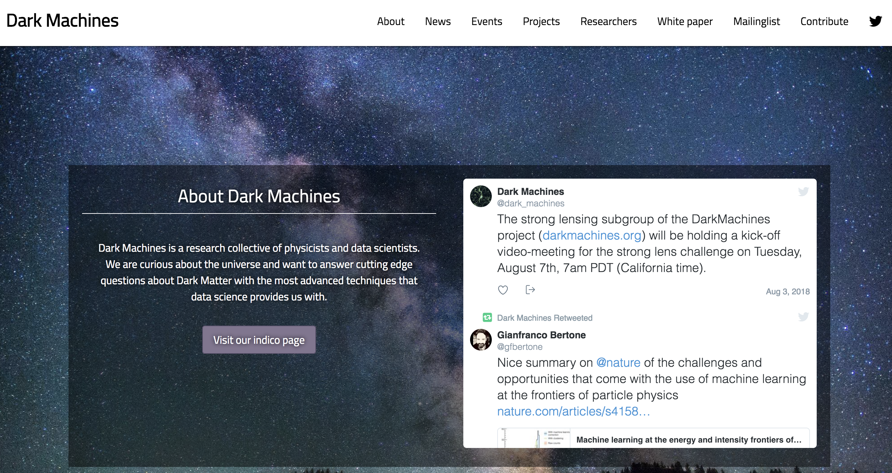
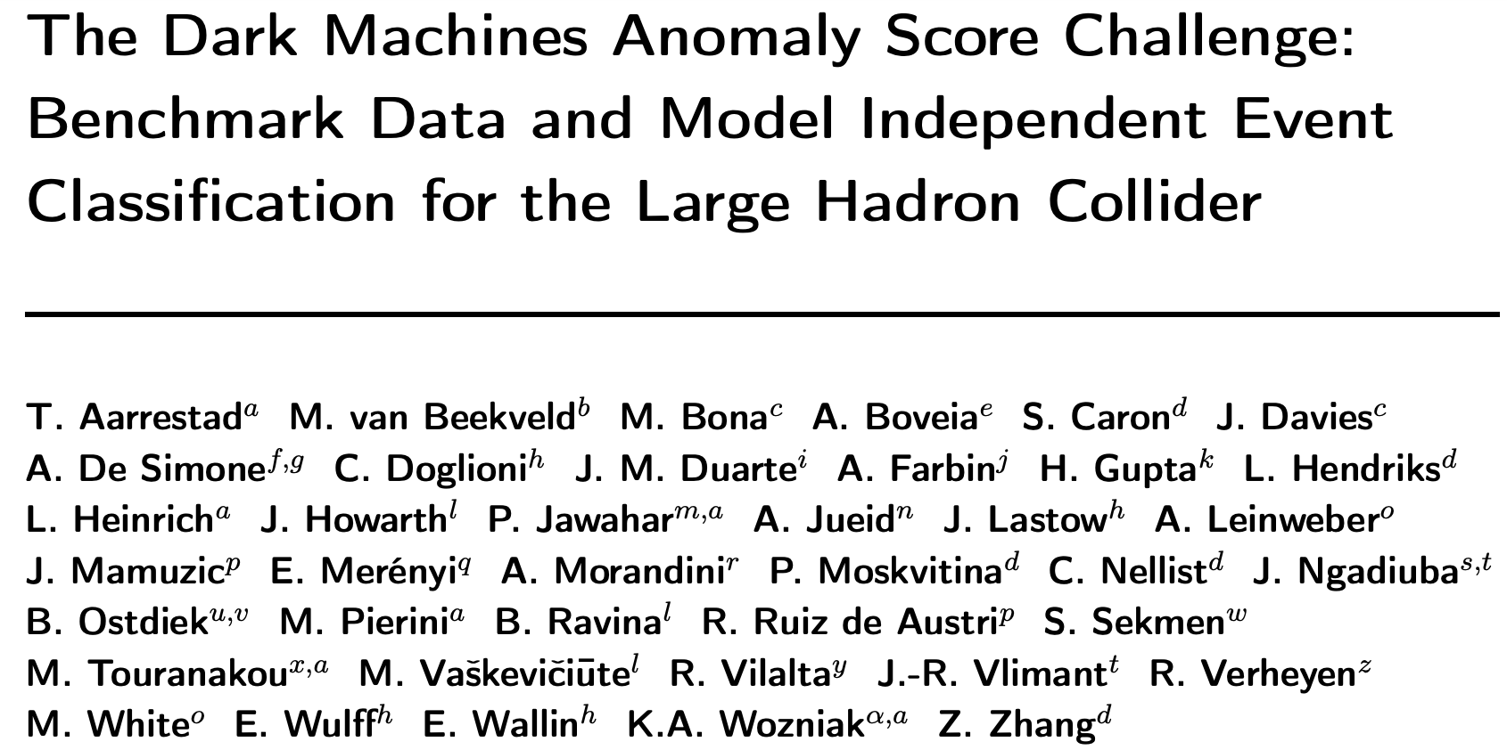
Can (should!) compare approaches
(whenever it makes sense)
Define an “event-by-event” anomaly score (AS)
AS threshold defines “signal region
Statistical test of the background model
in the signal region
Run this for every algorithm, on a benchmark
dataset
www.darkmachines.org
Different from
LHC Olympics (full signal and bump hunting / density comparisons with a few signals + background expectation)
(assuming bkg expectation are well modelled)
(since you are at it: check again the excellent tutorial given yesterday by Gregor using the LHC Olympics dataset!)

Slide 8
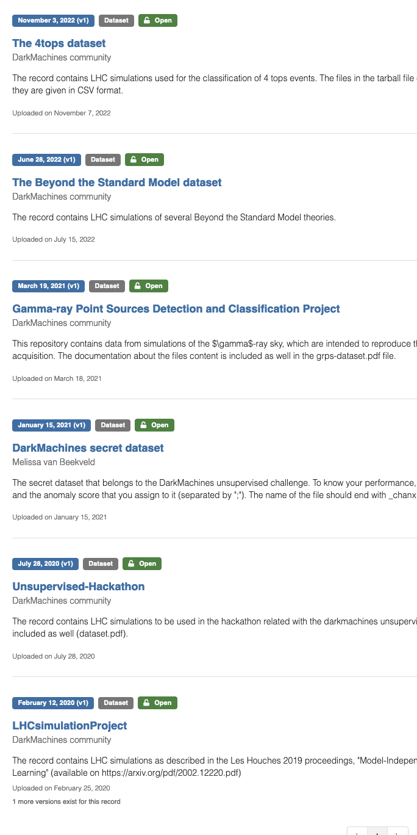
Data publicly available on zenodo!
https://zenodo.org/communities/darkmachines/records
More than 1 billion events produced, for various scenarios
Unsupervised learning hackathon:
performance computed on a “secret” (unlabelled) data set
LHC data set e.g. stores four-vectors of: jets, leptons, charge, photons, missing transverse momentum

Slide 9
Results on the LHC data set https://arxiv.org/abs/2105.14027
Contact persons: Comparisons: B. Ostdiek (bostdiek@g.harvard.edu)
Datasets: M. van Beekveld (melissa.vanbeekveld@physics.ox.ac.uk)
Compared performance of >20 methods to define anomalies
> 1000 hyperparameter settings (i.e. algorithms to define anomalies)
> 20 signals
>1 Billion simulated LHC events
A secret dataset (labels are still blind, only Melissa van Beekveld (Oxford) knows)
Task: Classify 100000s of events as standard-model-like or not by assigning a score between 0 and 1…
Figure of merit: By how much can we improve the significance for that signal
i.e. Significance Improvement SI per signal
Organizers:
C. Doglioni, M. Pierini, S.C
For a reasoned comparison of figures of merit:
Vischia (2019) https://doi.org/10.22323/1.336.0249

Slide 10
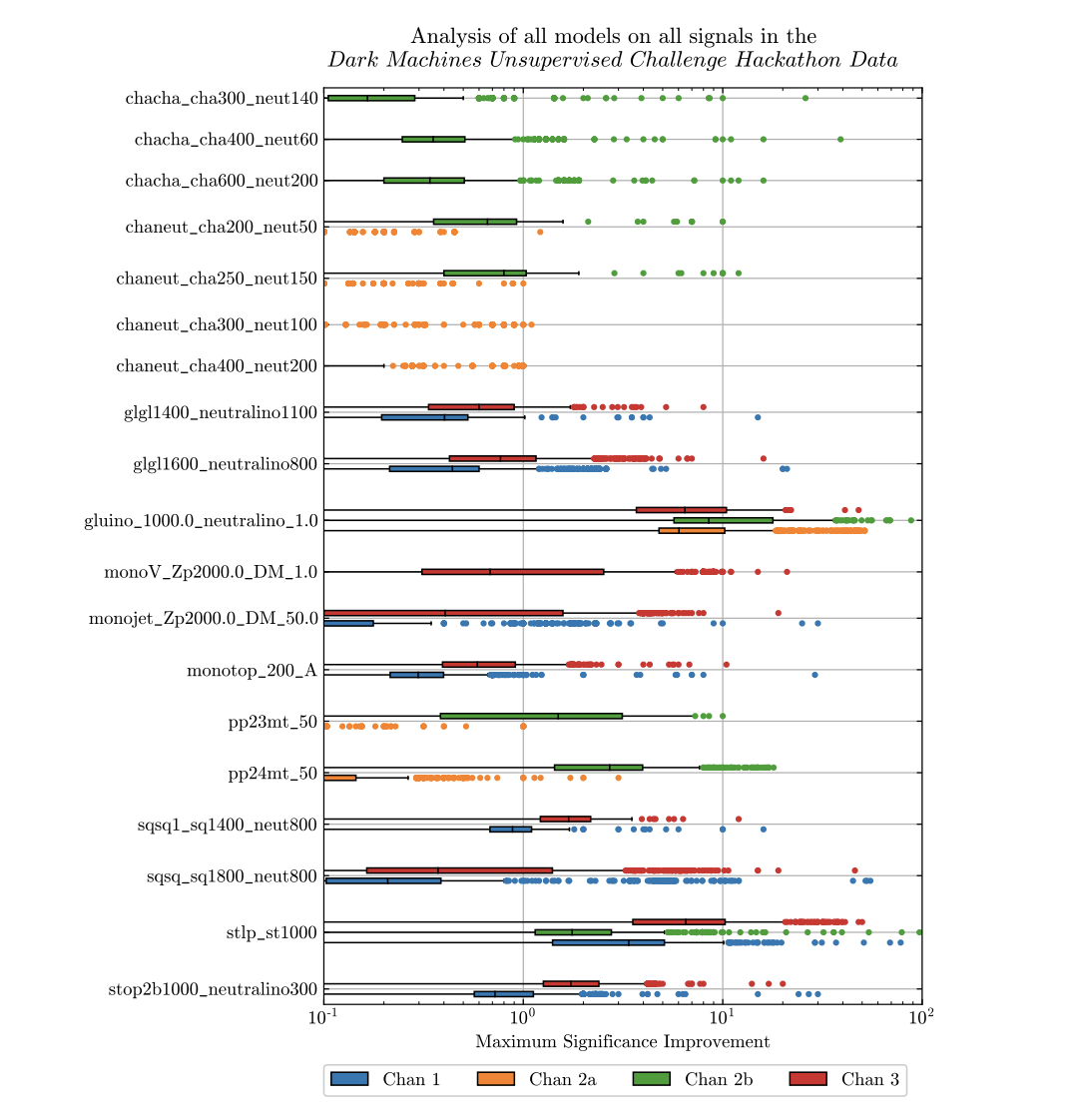
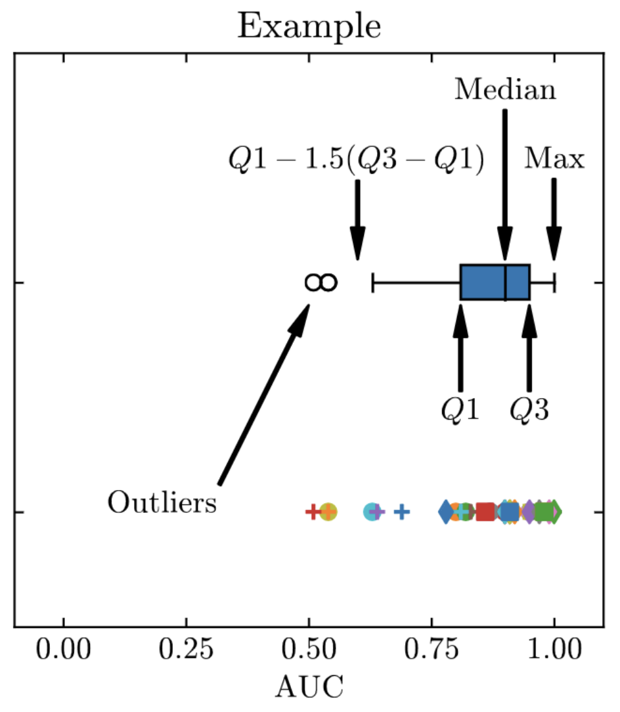
Many signals many algorithms many channels
chacha cha
Which algorithm is the best for most of the signals?
Charginos
Gluinos
Zprime
Monotop
Squarks
Stops
….
Whiskers plots as summaries

Slide 11
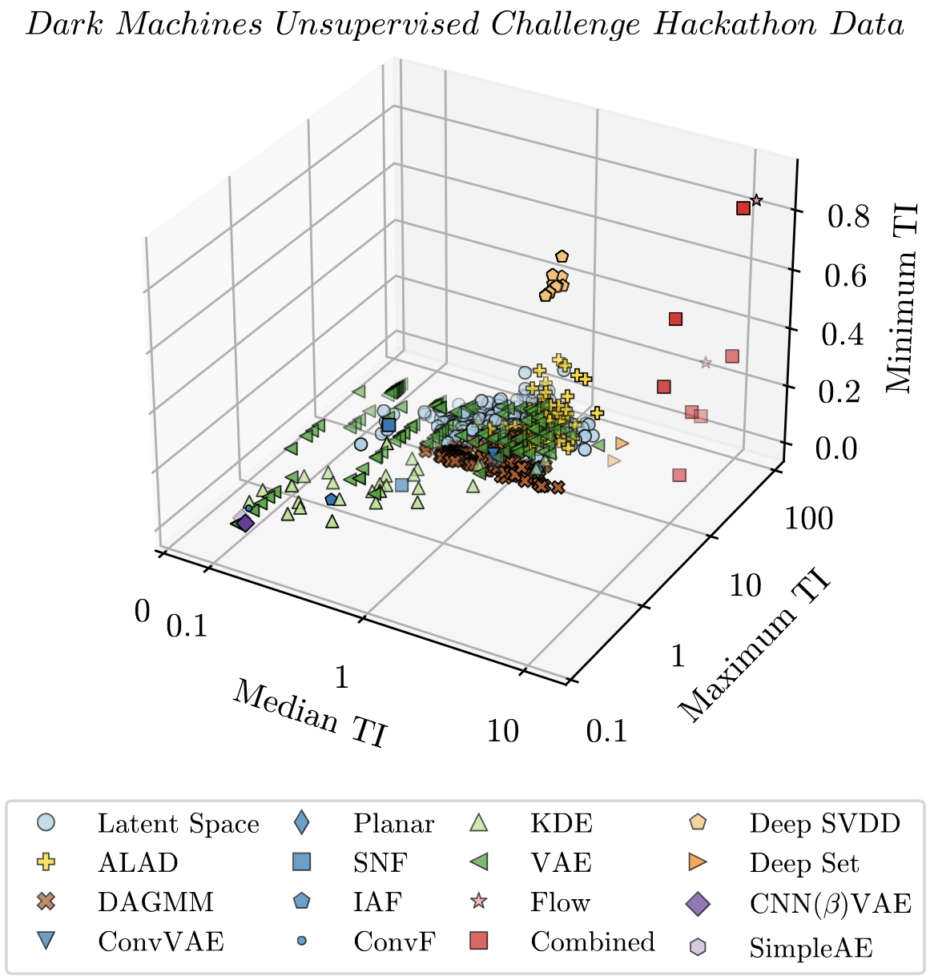
Summary plot
TI =
Total Improvement. (over many signals)
(median, max and min
Improvement of many
toy signals)
Lessons learned
Good algorithms have large max, min and mean TI
DeepSVDD, Flow , Combined, DeepSets
largely outperform traditional approaches (e.g. KDE),
but also all autoencoder and VAEs
Caveats
Generalization sometimes bad (e.g., results on secret
dataset often differ from hackathon one,
when hyperpar scans are involved)
Must not overgeneralize these results
https://arxiv.org/abs/2105.14027

Slide 12
Follow-up: unsupervised vs supervised vs mixtures-of-theories
Supervised approaches (100s trained on different individual signals)
➔ Orange on the next slide
Mixture of Theory approach ➔ M on the next slide, see 10.1007/JHEP03%282023%29004
Unsupervised approaches ➔ All other colours
A mixture model made of theories, formally the output is the ratio of the density of the mixture of BSM models and the SM density.
Who will win?

Slide 13
Mixtures seem to work pretty well
Modern DL outperforms traditional
techniques
AE not the optimal tools (no decoder needed)
Flow models work very well
Combined (rare+different) works even better,
(2106.10164)
Supervised approaches outperform
many AE’s etc.
Mixture-of theories approach outperform
all supervised approaches

Slide 14
Take away message
Performance of anomaly detection models can be compared
Generalization not always possible, but useful hints emerge
Public data sets provide useful benchmarks for comparing algorithms
Benchmark your favourite algorithm against the DarkMachines Challenge Data Set!
https://zenodo.org/communities/darkmachines/records

