Slide 1


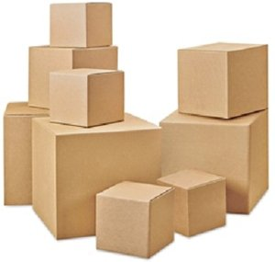


Anomaly Detection
with
RanBox
Tommaso Dorigo
INFN-Padova
Lulea Technical University
Universal Scientific Education and Research Network

Slide 2
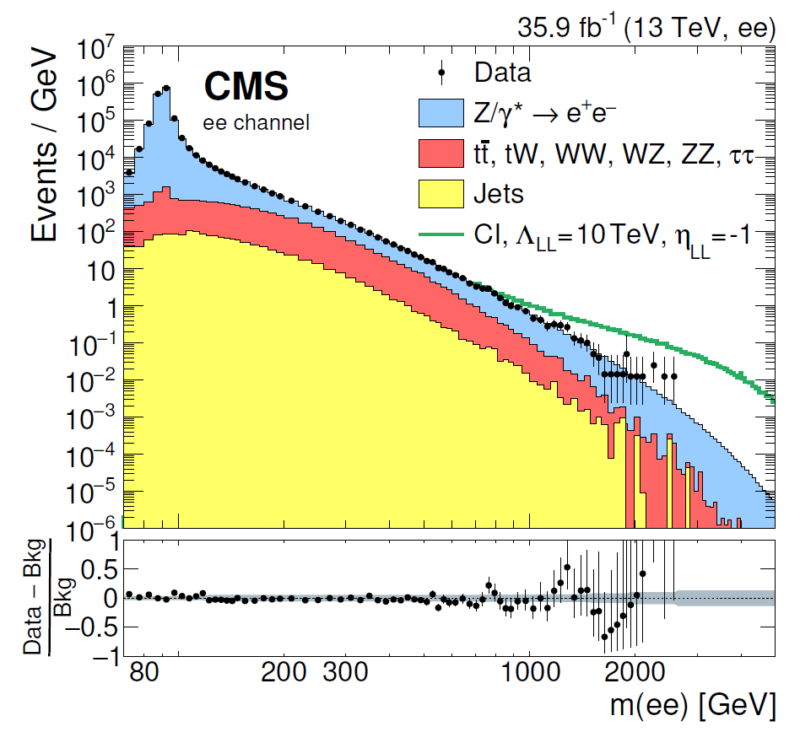
Uneven marginals
Looking for overdensities in HEP is complicated
… or maybe too easy!

Slide 3
Our data is messy
Hadron collider data are both"tall" and "wide", but after suitable distillation of high-level objects it is only "tall": millions of events, each of which is characterized by a few tens of relevant features
Our choice of which features are those relevant is critical, but we are confident we know how to make it
  I will not argue on this point, although it deserves to be kept on the table at all times
  We sometimes do consider "unlikely" observables in our searches – whether that is enough is a question for a different talk
Standardization is a generally helpful practice as a preprocessing step for many ML algorithms and in particular for a generalized, unpreconceived search in multi-D
  I start from there

Slide 4
Our data is messy
Hadron collider data are both"tall" and "wide", but after suitable distillation of high-level objects it is only "tall": millions of events, each of which is characterized by a few tens of relevant features
Our choice of which features are those relevant is critical, but we are confident we know how to make it
  I will not argue on this point, although it deserves to be kept on the table at all times
  We sometimes do consider "unlikely" observables in our searches – whether that is enough is a question for a different talk
Standardization is a generally helpful practice as a preprocessing step for many ML algorithms and in particular for a generalized, unpreconceived search in multi-D
  I start from there

Slide 5
Our data is messy
Hadron collider data are both"tall" and "wide", but after suitable distillation of high-level objects it is only "tall": millions of events, each of which is characterized by a few tens of relevant features
Our choice of which features are those relevant is critical, but we are confident we know how to make it
  I will not argue on this point, although it deserves to be kept on the table at all times
  We sometimes do consider "unlikely" observables in our searches – whether that is enough is a question for a different talk
Standardization is a generally helpful practice as a preprocessing step for many ML algorithms and in particular for a generalized, unpreconceived search in multi-D
  I start from there

Slide 6
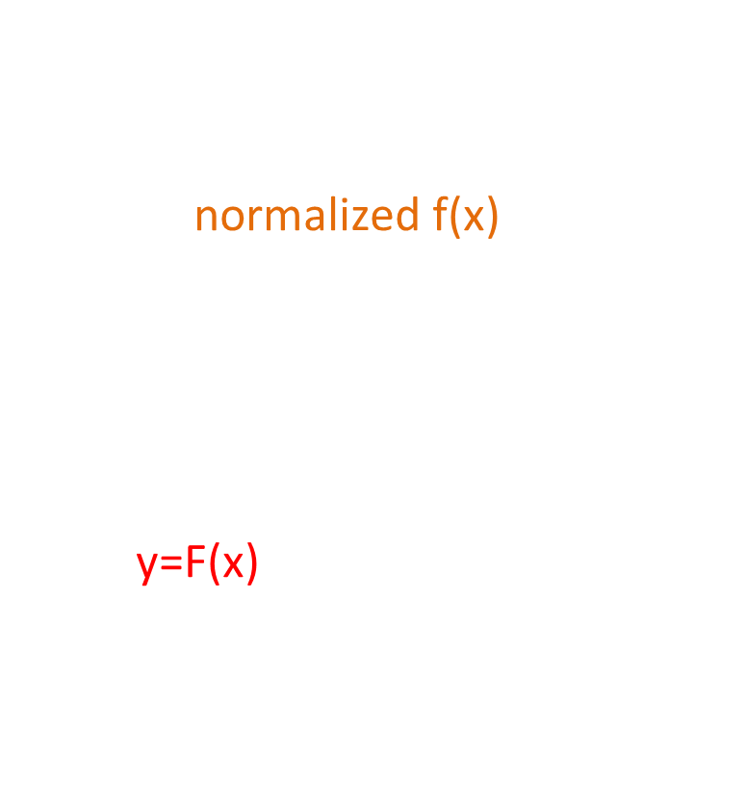
The probability integral transform
If your data are bumpy, don't get grumpy...
Given a normalized f(x), compute the cumulative distribution function of f:
$$F\left(x\right)=\int_{−∞}^{x}{f\left(t\right)dt}$$
Now y=F(x) is uniformly distributed in [0,1]. There is a 1-to-1 map connecting x and y, so the transformation is invertible.
f(x)
F(x)
y
p(y)
x

Slide 7
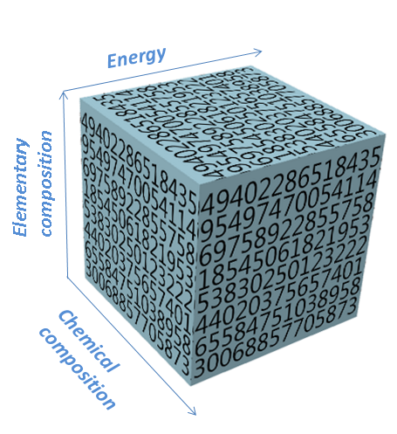
The Copula
From Sklar's theorem, any multivariate joint distribution is decomposable in univariate marginals and a uniquely defined copula which describes the interdependence of the features
If one also forces the boundaries of each feature to fit within a [0,1] interval, one gets a handy D-dimensional data cube
Watched from each side, the cube has flat marginals

Slide 8
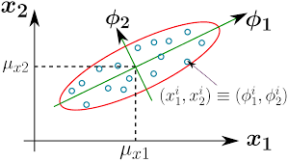
One more ingredient: PCA
If our data are very high-dimensional, but many of the features are not very informative (low variance) we may consider the first D'<D principal components, killing two birds with one stone:
  dimensionality reduction
  the new variables are (linearly) uncorrelated, so they simplify the problem of finding pockets of overdensity in the copula

Slide 9
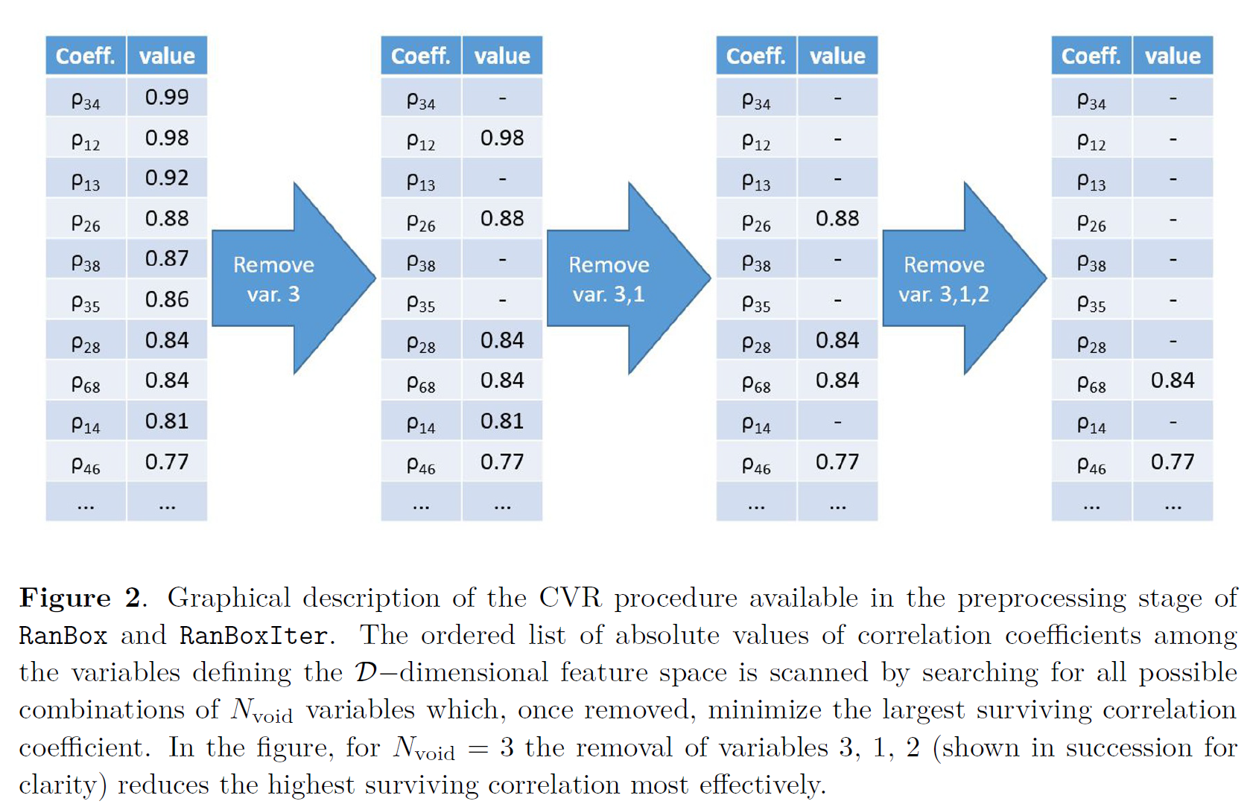
CVR: An alternative to PCA
We designed an alternative to PCA, iteratively searching and removing variables highly correlated with others

Slide 10

Standardization recipe
The standardization recipe we need for anomaly detection emerges as follows:
Flatten and rescale features x to [0,1]
Apply PCA or CVR, select the first D'<D components x'
Compute cumulative distributions of marginals of new x' features; create new variables x'' =$\int_{−∞}^{x^{′}}{f\left(t\right)dt}$
Then we are ready to scan the space of x’’ with D’-dimensional intervals (random boxes)!

Slide 11
But how?
We now have our data in a nice, unit-volume D'-dim cube, and none of the features have a linear correlation with any other. Any disuniformity in this space is now potentially interesting
Physics (old and new) creates disuniformities in this space. An unsupervised anomaly detection algorithm may spot them and assess their departure from a uniform density hypothesis
  It may be able to find surprising structures, or only stick to completely predictable ones
  eventually human intervention is required to assess the results
But let's not put the cart before the horse. We still have to understand how overdense regions of discrete data sparsely populating a high-D' space can be found effectively

Slide 12
RanBox
The curse of dimensionality affects any discrete set of data in large-D' spaces.
Our task is to identify interesting overdense regions in subspaces of D'
  we have the preconception that some, if not most, of the features of NP events will not be "anomalous" → hence we need to focus on subspaces
We approach this problem by stochastic means
  we randomly pick a subset of the features
  we scan the resulting space with a D"<D'-dim parallelepiped (a "box"), looking for box boundaries which maximize the "pseudo-significance" of the clustering of data captured within the box
Since our full data (N points) are contained in a space of volume=1, it is very simple to compute how many data points are expected (in the fully uniform hypothesis) in an arbitrary box:
  N_{exp} = (N * box volume)

Slide 13
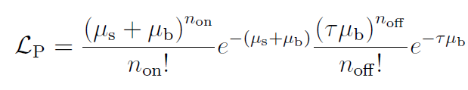
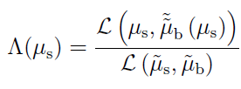

Z_{PL} definition
  We need to define a measure of the "pseudo-significance" of observing N_{box} data inside a box, out of a total N populating the unit cube.
  This is the so-called "on-off" problem often encountered in astrophysics searches
  A handy definition was proposed by Li and Ma [T. Li, Y. Ma, Astrophysical Journal 272 (1983) 317] in the form of the "Profile Likelihood" Z_{PL} obtained from:
  whence one gets
and
which is
(τ is ratio of
time spent looking
off and on source)

Slide 14
Z_{PL} definition
  We need to define a measure of the "pseudo-significance" of observing N_{box} data inside a box, out of a total N populating the unit cube.
  This is the so-called "on-off" problem often encountered in astrophysics searches
  A handy definition was proposed by Li and Ma [T. Li, Y. Ma, Astrophysical Journal 272 (1983) 317] in the form of the "Profile Likelihood" Z_{PL} obtained from:
  whence one gets
and
which is
(τ is ratio of
time spent looking
off and on source)

Slide 15
Z_{PL} definition
  We need to define a measure of the "pseudo-significance" of observing N_{box} data inside a box, out of a total N populating the unit cube.
  This is the so-called "on-off" problem often encountered in astrophysics searches
  A handy definition was proposed by Li and Ma [T. Li, Y. Ma, Astrophysical Journal 272 (1983) 317] in the form of the "Profile Likelihood" Z_{PL} obtained from:
  whence one gets
and
which is
(τ is ratio of
time spent looking
off and on source)

Slide 16
Clustering for seeding
We are searching for a local overdensity, so it looks reasonable to seed the box search with the point where several data events are close in space.
Routine:
for each data event i, find list of other data events j₁...j_{N} that have i as closest (relatives); identify event i* which has maximum number of relatives
for each relative of i* j₁...j_{N}, find list of data events that have j_{k} as closest (relatives of j_{k})
Draw minimum box in multi-D which includes all second-order relatives of i*
Many variants investigated – some perform similarly to this one

Slide 17
The full RanBox routine
Standardize data boundaries in D-dim space
Do PCA, select D' principal components
Apply integral transform to all features
Loop on subspaces - repeat many times:
  Choose at random subspace D" of D' of workable dimensionality (e.g. D"=6-10)
  Find seed box in D"
  Maximize Z_{PL} (or other figure of merit, see later) by accelerated gradient descent
The procedure produces an ordered list of the boxes of best approximated pseudo-significance Z_{PL} in the corresponding most promising subspaces

Slide 18
Maximization: greedy ascent
Boundaries of box are varied to search for highest point density/volume ratio
- can also maximize expected ratio of density to sidebands in D’ dimensions ← useful for highly structured data
Discreteness and sparsity of data in multi-D create large number of maxima → noisy convergence, hard to find best point
  useful to schedule periodic variation of learning rate
we are not interested in generalization, as we want to minimize on data at hand
  stochastic GD useless

Slide 19

Tests and exercises
Can we spot a Gaussian overdensity amidst a flatly distributed dataset?
  Try a D'=15-dim Gaussian injected in a D=20-dim flat space, sample subspaces of D"=6, see if we capture signal, as a function of injected fraction
  Details for these tests:
    N = 10,000 events
    1000 subspaces scanned (comb. is 5005); random initial box
      every subspace has 18.1% chance of being studied
    Gaussian components have random sigmas in 0.01-0.1 range
    PCA is performed on 20-D space, and D'=15 principal components are chosen
Background fraction | N_{s}/N_{b} | % signal in box | Z_{PL} | Total N_{in} | N_{exp} | Box volume
0.99 | 100/9900 | 71.0 | 13.3 | 83 | 12.0 | 0.00120
0.991 | 90/9910 | 36.6 | 9.2 | 80 | 22.9 | 0.00229
0.992 | 80/9920 | 57.5 | 8.8 | 98 | 34.6 | 0.00346
0.993 | 70/9930 | 41.4 | 8.7 | 64 | 16.8 | 0.00168
0.994 | 60/9940 | 41.6 | 9.4 | 59 | 12.7 | 0.00127
0.995 | 50/9950 | 44.0 | 8.0 | 47 | 10.9 | 0.00109
0.996 | 40/9960 | 0.0 | 7.5 | 9 | 0.14 | 0.00001

Slide 20
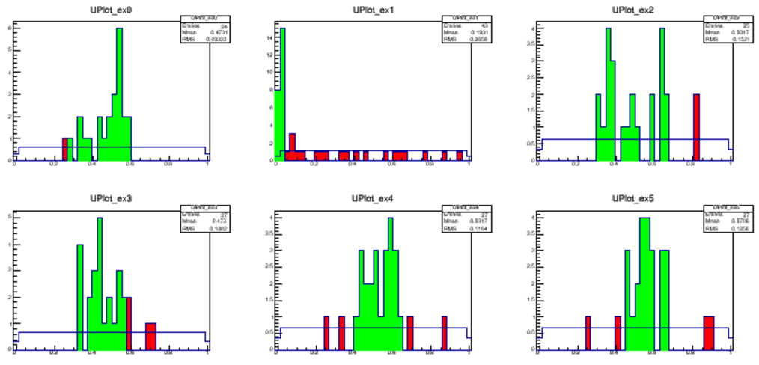
Sample distributions
Marginal distributions of the six variables where RanBox carves the box of highest local density, for a sample with signal fraction 0.01
In green are the selected events
In red are shown events that fail only a cut on the displayed variable

Slide 21
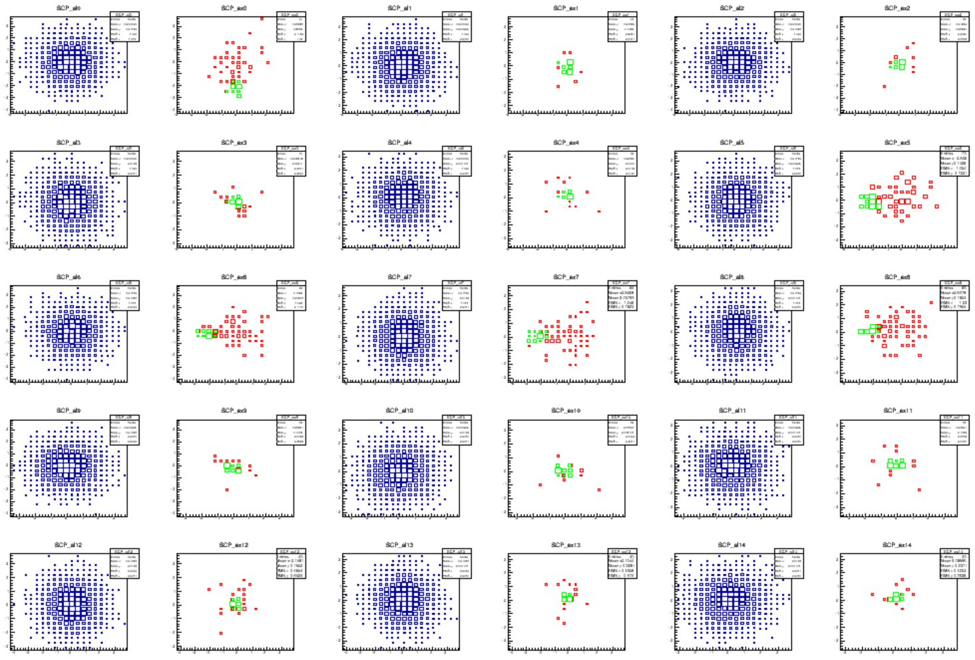
PCA view of the 6 subspace features
Left to right, top to bottom:
v1:v2, v1:v3, v1:v4, v1:v5, v1:v6, v2:v3, v2:v4, v2:v5, v2:v6, v3:v4, v3:v5, v3:v6,
v4:v5, v4:v6, v5:v6
for each combination, there are two distributions:
1) Blue=all data;
2) Green= data in best box; Red= data failing cut only on two shown variables

Slide 22
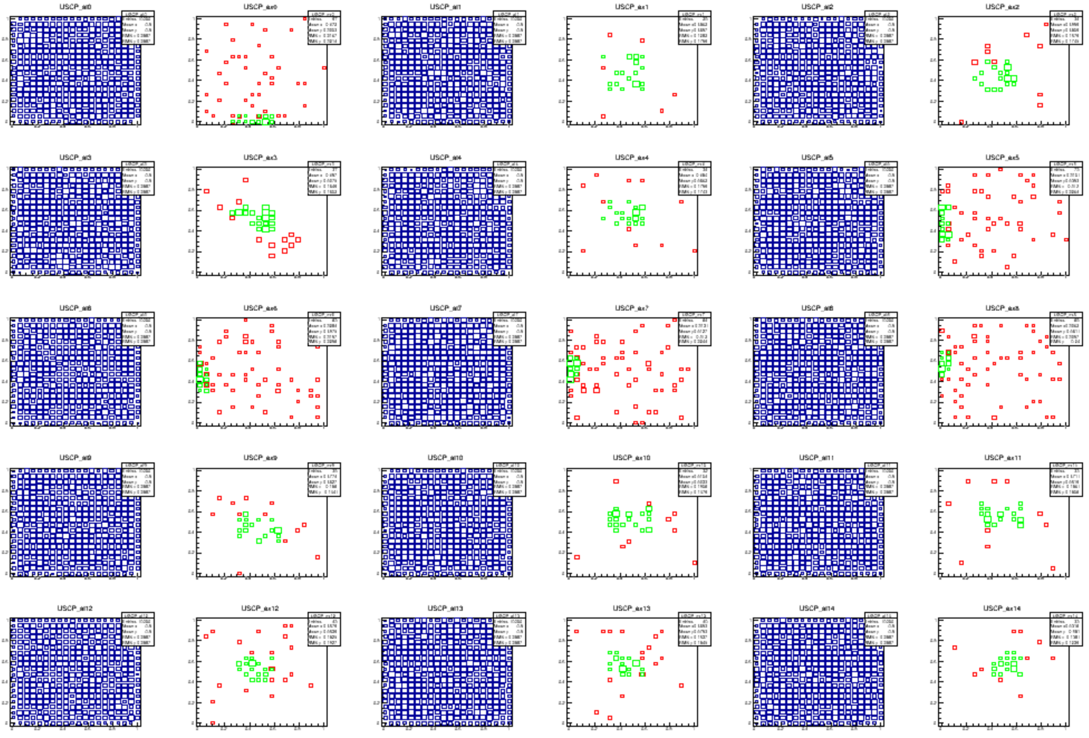
View in the algorithm space
Left to right, top to bottom:
v1:v2, v1:v3, v1:v4, v1:v5, v1:v6, v2:v3, v2:v4, v2:v5, v2:v6, v3:v4, v3:v5, v3:v6,
v4:v5, v4:v6, v5:v6
for each combination, there are two distributions:
1) Blue=all data;
2) Green= data in best box; Red= data failing cut only on two shown variables

Slide 23
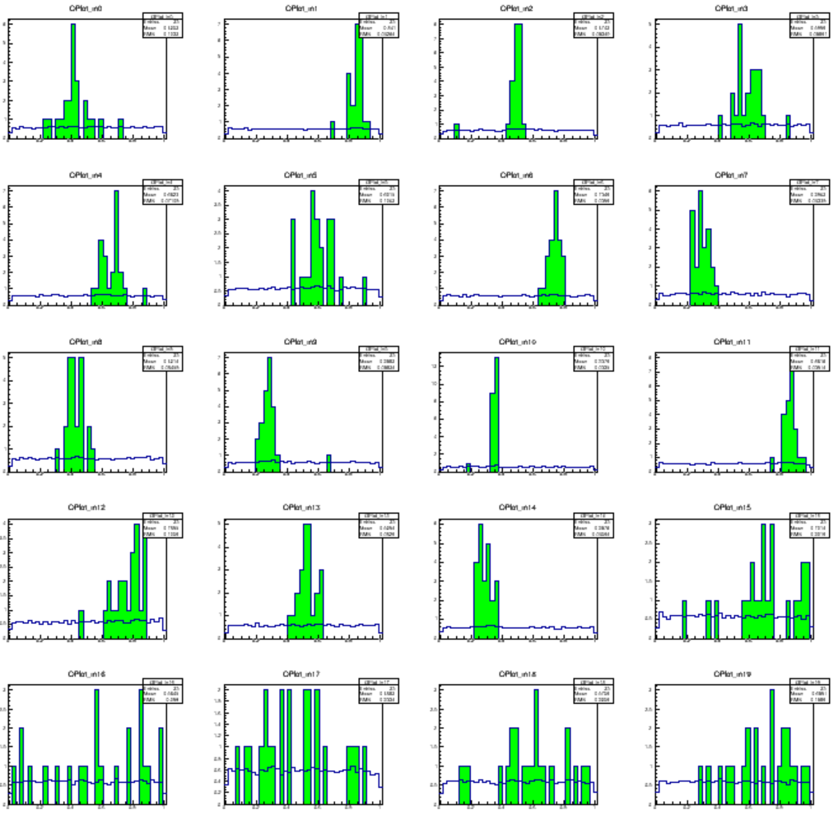
A PCA-back-transformed view of the 20 original
variables, the first
15 of which (top to bottom, left to right)
have a 1% Gaussian
component on top of a 99% flat background
The blue histogram shows the marginal for all data
All/selected data distributions are normalized to one another
The few events contained in the best box are 100% signal pure!

Slide 24
Power tests
The idealized setup of gaussian signal and flat background features allows us to probe the power of hypothesis test (significant signal in best box) with varying signal fraction or number of gaussian features

Slide 25
Power tests
The idealized setup of gaussian signal and flat background features allows us to probe the power of hypothesis test (significant signal in best box) with varying signal fraction or number of gaussian features

Slide 26
A different test statistic: R
To increase further the sensitivity to small signals, one may want to change the test statistic, as when signal significance decreases the algorithm tends to focus more on "wide" regions (typically high ME regions of PS)
use R=N_{in}/(1+τ*N_{tot}), the ratio between observed and (1+expected data) in the box.
This favors small clusters over large ones
The added 1 regularizes the denominator and avoids preference for arbitrarily small boxes

Slide 27
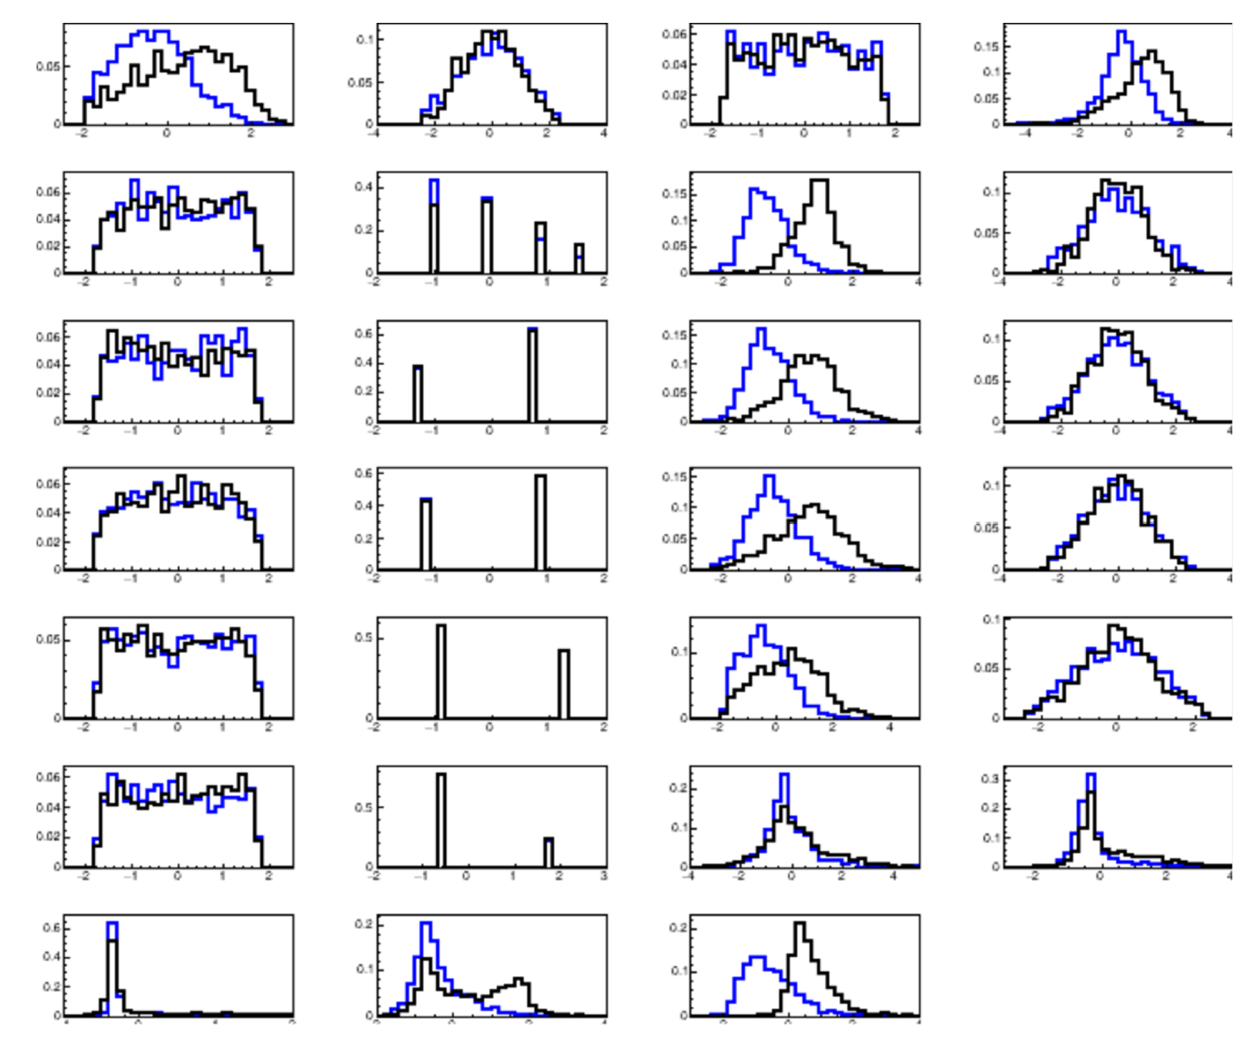
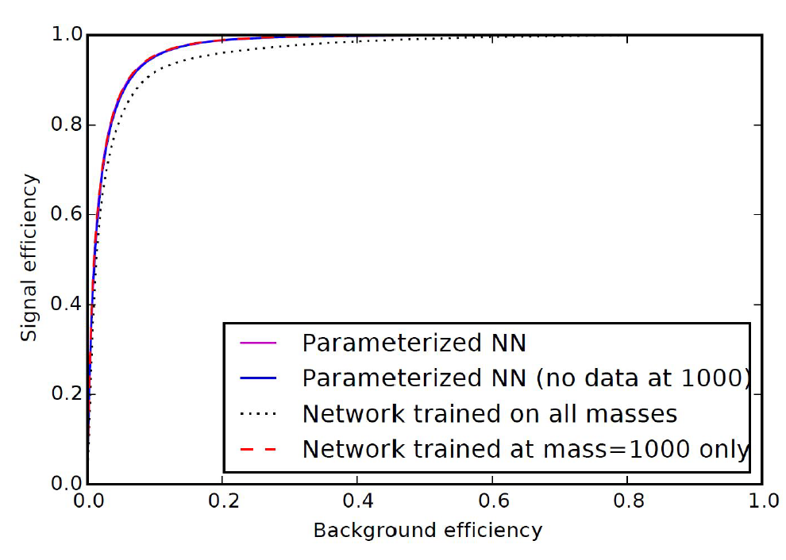
Test on X→ttbar Delphes data
We use a dataset produced by UC Irvine (“HEPMASS”) for a test on HEP-like data
  27 kinematic features
  Can compare to NN results…

Slide 28
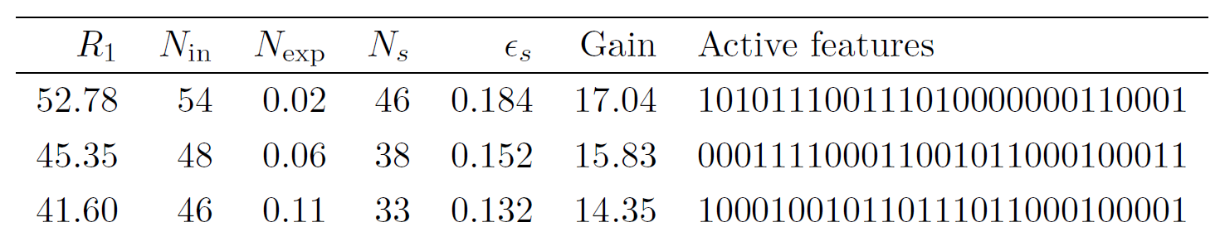
HEPMASS - Results
Best identified boxes in 250/4750 evt mixture have S/N properties comparable to those of dedicated NN, while using far fewer events (100k training of NN)
- a bit unfair comparison as of course RanBox interval may have poorer generalization power, as the problem setup is different
- but RanBox is completely unsupervised, AND it only saw 250 signal events!
Efficiency of best box: 18.4%, acceptance: 0.2%

Slide 29
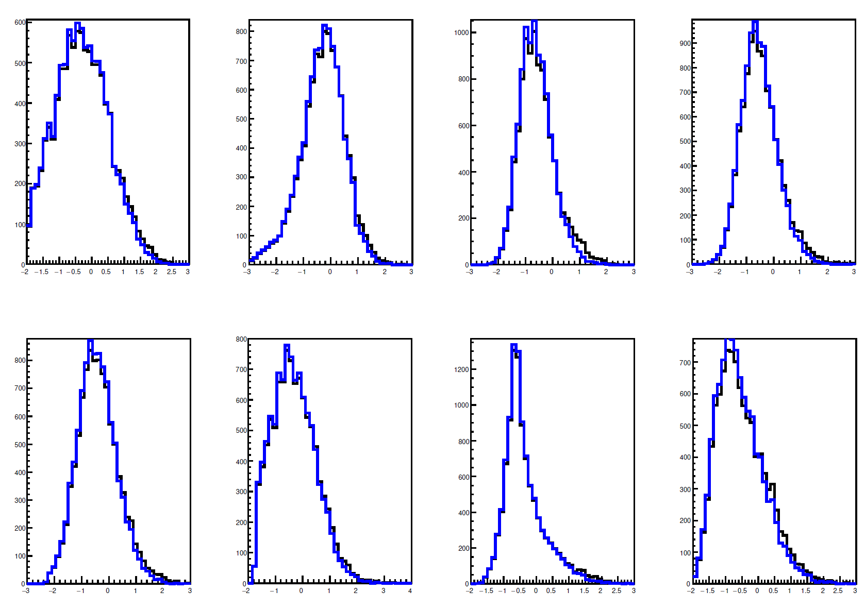
What does a 5% do
5% might seem like a lot, but in this HEPMASS example it would be a small effect on the tails, hardly convincing unless treated by multiD analysis

Slide 30
Additional studies
The random search in the D’-dimensional subspace becomes ineffective for D’>20-30
A different approach consists in iteratively increase the dimensionality of the problem, scanning only the progressively most promising subspaces:
Look for best box in all possible 2-dim spaces
Only consider 2D spaces giving best results and add one dimension
Repeat procedure
→ RanBoxIter
Better performance per invested CPU in high-dimensionality cases
As with any GoF measure, no guarantee of optimality…

Slide 31
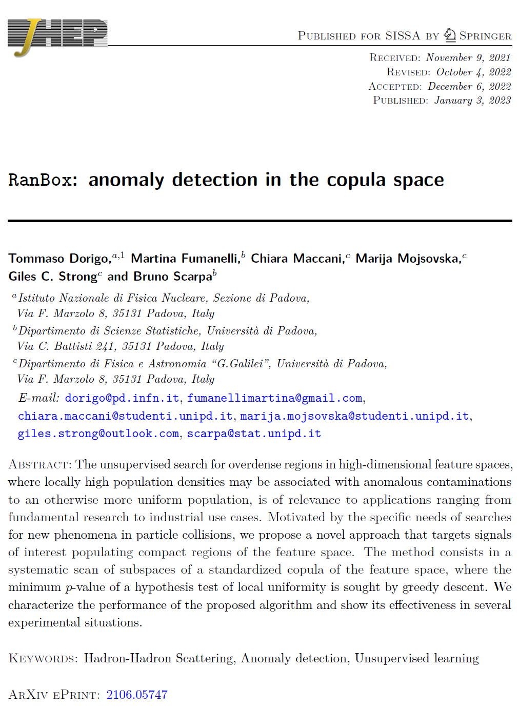
A paper
The code for RanBox and RanBoxIter is available on GitHub
A JHEP article contains detailed discussion, tests on different datasets (MiniBooNE, CC fraud detection)

Slide 32
Future work
Improve search of minimum
Calibrate Z with Bonferroni correction
Investigate semi-supervised approach (partial MC input for background)
  Idea: know background (SM), use it for density estimate in boxes
    Developed in context of CMS B_{s}→ττ search, but work not completed yet
Optimize code
More tests on interesting use cases

Slide 33
Thank you for your interest !

Slide 34
Backup

Slide 35
Other nuts and bolts
The search for the highest-significance box is complicated, because data are sparse. There are a huge number of local maxima where a Z_{PL} maximization routine can get stuck.
One thus needs a smart seeding to inform the choice of initial box boundaries, easing the convergence task
Three strategies considered:
  random initial box boundaries
    fastest but, er, random
  window around region of maximum kernel density
    Slow; good unless high-D sparsity makes it ineffective
  area containing cluster of close points
    best for high-D search, slowest
EF
FE
CT
IV
E
F
A
S
T
E
R

Slide 36
RanBox parameters
Number of PC retained as "restricted feature space" where the search is made, N_{PC}
Number of variables N_{v} of subspaces searched for best box
Number of subspaces scanned
  if large (>1/3) compared with combinatorial N_{PC}!/[(N_{v}!)(N_{PC}-N_{v})!], a full scan is instead made
Box initialization method
  (0 – random, 1:4 – various clustering choices, 5 – kernel density)
Mode "real data": amount of data / kind of data to read / whether to inject a toy signal, and fraction of latter
Mode "toy": number of Gaussian dimensions, fraction of non-flat data
Other control variables, currently values hardwired in code:
Max number of GD loops in minimization (100 – typical convergence takes 40-50 steps)
Whether to produce plots (default = true)
Whether to do PCA or not (default = true)
Number of total considered variables on which PCA is made (default=20)
whether in toys narrow or fat gaussians are used in signal generation (default=narrow)
coarseness of box sides (default = 0.01)
debug mode on/off (default = false)

Slide 37
Bonferroni correction?
Of course, we are looking for excesses of events in a gazillion places → saying that Z is overestimated is a understatement
The ordering by Z_{PL} that RanBox performs does imply that what we are looking for are interesting regions of phase space, not a quantitative assessment of the "significance" of an excess
However, the actual value of max(Z_{PL}) might be useful, to inform on how interesting the region is. One then needs to calibrate it.
One may define a procedure to determine a Bonferroni correction (aka a way to account for the look-elsewhere effect)
This is work in progress. It will require:
  finding a proper way to create a space with as much information as the one examined
  finding a way to give toy data a "similar" correlation structure
Ultimately, an absolute evaluation of a trial-factor-corrected Z value remains unnecessary for the algorithm to be meaningful

Slide 38
Introduction
Searches for NP at the LHC often involve the testing of theories that extend the SM: one then has a background model (MC or data-driven) as well as a signal model (MC)
  In ML terms these are called "supervised learning" tasks
  This leaves a lot of ground uncovered
One may also take a walk on the wild side, and leave the signal model unspecified
  By focusing in turn on different "potentially interesting" signatures, one becomes sensitive to unknown NP
  In ML terms these are "semi-supervised learning" tasks
    in HEP parlance these are called instead "signature-based searches"

Slide 39
But What If...?
Our capability to model known physics processes (SM) is terrific, so supervised and semi-supervised modi operandi might be all we need, but...
We still do not trust our models in extreme regions of the phase space – tails of the distributions, corners of phase space not well lit up by previous studies
→ in those cases we go data-driven, or just throw our hands up
Unfortunately, and obviously, those regions have large overlap with the place where NP can still hide
The above is motivation for making one further step in the unknown: go fully unsupervised
→ Anomaly detection
→ Cluster search
→ Variational autoencoders
In this talk, I will consider a simple approach to anomaly detection: the search for overdensities in a standardized space

Slide 40


Anomaly!
A sideline:
Your speaker is not at all an expert in anomaly detection...
Which is a great opportunity to have a unbiased view of the problem!
OTOH he wrote a book on anomalies in collider data
An account of the complex sociology of a particle physics experiment and the controversies around anomalous findings
  Ed Witten: "a fascinating look"
  Gordy Kane: "charming and irreverent"
  Peter Woit: "clear-eyed view... compelling"
  Sean Carroll: "entertaining and provocative"
  GF Giudice: "a captivating narrative"
  Times HE: "a guilty pleasure"
  Physics World: "engaging and insightful"
In case you are interested:
More info at World Scientific site,
https://www.worldscientific.com/worldscibooks/10.1142/q0032
Get a copy at https://tinyurl.com/y69h7jpm
(or at the CERN bookstore)
Or email me for a free pdf if you're broke
shameless self-promotion censored

Slide 41

Seeding recipe
random box: choose two numbers in [0,1] per each dimension → initial volume is V=(1/3)^{N}
Kernel density: Substitute each data point with a multi-D Gaussian density, compute sum of densities, get
$\arg{\max_{x_{j}}\sum_{i=1}^{N}{G(x_{j}−x_{i})}}$
then pick initial box boundaries as [x_{j}-k, x_{j}+k]
  - k=0.2 reasonable choice for the cases explored so far
3) Find box boundaries with clustering routine
→next slide

Slide 42
Variants of metric in cluster definition
The clustering described in previous slide works by finding "closest" points
  Given that one wants high density and maybe only a fraction of the subspace features are significant to isolate a signal, several possible variants come to mind to define the distance of x and y in D"-dimensional subspace
  Euclidean, but only consider the half of coordinates where points are closest
  1b) Same, but use all D" dimensions
  Linear sum of the smallest half of absolute values of coordinate differences
  2b) Same, but use all D" dimensions
  3) Minimum volume of box containing x,y points in half of subspace dimensions
  3b) Same, but using all D" dimensions
  4) Largest among the D" absolute values of x-y coordinate differences
Although the choice is certainly application-specific, in my studied use cases I found that consistently 3 > 1 > 3b > 1b > 2 > 2b > 4
→ use recipe 3

Slide 43
Uses and future developments
The algorithm produces a list of interesting regions of the feature space (in the standardized principal components), with corresponding Z values
The list can be scanned to understand whether the regions involve potential NP signatures
A different use mode (not yet investigated, WIP) is to morph the technique into a partially semi-supervised one. E.g., if a NNLL prediction for the spectrum of some of the features exists, one can rely on that in the calculation of the predicted density, by applying to those features the integral transform computed on the simulation
This way, the algorithm gets less distracted by overdensities due to SM ME
Or decide for full semi-supervision, allowing MEM or MC to inform the full expected SM density in the space
  The transition can thus enable to tune how much preconception we inject in the search, for what concerns the multi-D behaviour of "known" physics

Slide 44
Improving sensitivity
Can we get more sensitivity by increasing the # of scanned subspaces?
  Take F_{s}=0.996 (40 signal events in 10000), which failed on random search of 1000 subspaces; search in 5000 (which means any 6D combination has 64% chance of being looked at)
    This results in 37.5% of signal caught in best box (N_{in}=34 / N_{exp}=4.2), Z_{PL}=9.0
  Take F_{s}=0.997 (30 signal in 10000), random search 5000 subspaces
    No detected signal in best box
We can go further if we change seeding, at CPU expense:
  Take F_{s}=0.997, now try highest-kernel-density point as seed for box search
    A scan of only 100 iterations already converges to a signal rich region (N_{in}= 26 / N_{exp}=3.7), Z_{PL}=7.5
  Going below 0.3% signal fraction looks silly, as <30 events will never make a very large significance spot, so fluctuations elsewhere are bound to be picked instead

Slide 45
Tests and exercises – cont'd
What if the signal has wider Gaussians?
  Larger widths make the signal less prominent, thus harder to spot. Here we double the average sigma, so in 15 dimensions the peak density of a 15D Gaussian reduces by a factor of 30 thousand
    Try again the previous setup: 15-D Gaussian injected in a 20-D flat space, sample subspaces of D"=6 out of D'=15 principal components, see if we capture a signal contamination as a function of its fraction
    Details: N = 10000 events; Gaussian components have random sigmas in 0.1-0.2 range (G(x) are truncated so x is in [0,1]; μ random in [2σ,1-2σ])
Background fraction | N_{s}/N_{b} | % signal in box | Z_{PL} | Total N_{in} | N_{exp} | Box volume
0.9 | 1000/9000 | 40.2 | 16.7 | 599 | 281.9 | 0.0282
0.95 | 500/9500 | 31.0 | 13.5 | 241 | 87.1 | 0.0087
0.96 | 400/9600 | 31.5 | 11.2 | 226 | 97.1 | 0.0097
0.97 | 300/9700 | 22.3 | 9.9 | 132 | 48.4 | 0.0048
0.98 | 200/9800 | 37.5 | 7.6 | 262 | 158.1 | 0.0158
→ Not bad. Not meaningful to study smaller signal fractions, as Z_{PL} is already "low"

Slide 46
Fewer Gaussians
If the signal is characterized by fewer features, it also becomes harder to spot, for two distinct reasons:
1) a random subspace has fewer chances to contain those features
2) the peak density is overall smaller by a factor F=σ^{N} if N is the lost dimensionality of the multi-D Gaussian
To study this, we fix background fraction to 0.99, and decrease number of Gaussian components from 15 down
  Details: as before, Gaussians have sigmas in [0.01,0.1] range; 20D space, 15-D PCA components chosen, 6-D scan, 1000 iterations with random initial box
N Gaussian dimensions | N_{s}/N_{b} | % signal in box | Z_{PL} | Total N_{in} | N_{exp} | Box volume
15 | 100/9900 | 71.0 | 13.3 | 83 | 12.0 | 0.00120
14 | 100/9900 | 38.0 | 8.9 | 95 | 32.1 | 0.00321
13 | 100/9900 | 0.0 | 7.5 | 16 | 1.1 | 0.00011
12 | 100/9900 | 0.0 | 7.6 | 10 | 0.2 | 0.00002
11 | 100/9900 | 0.0 | 7.8 | 3 | 0.0 | 0.00000

Slide 47
More sensitivity with optimal seeding
So far, our tests used random initial box boundaries before gradient descent.
A more informed seeding might do much better, at higher CPU cost
Below are results of an attempt to study this.
Seeding with max kernel density produces negative results on toys with <14 Gaussian dimensions (out of 20 as before); seeding with the clustering technique instead gives sensitivity down to 12
→ Over 2 orders of magnitude higher sensitivity to peak density
N Gaussian dimensions | N_{s}/N_{b} | % signal in box | Z_{PL} | Total N_{in} | N_{exp} | Box volume
15 | 100/9900 | 71.0 | 13.3 | 83 | 12.0 | 0.00120
14 | 100/9900 | 38.0 | 8.9 | 95 | 32.1 | 0.00321
13 | 100/9900 | 27.0 | 8.8 | 70 | 19.3 | 0.00193
12 | 100/9900 | 36.0 | 8.2 | 90 | 32.7 | 0.00327
11 | 100/9900 | 0.0 | 7.8 | 3 | 0.0 | 0.00000

