Slide 1



Weak-interaction studies
with nuclear beta decay
Bertram Blank for the NEX group
LP2i Bordeaux
Super-allowed 0⁺ - 0⁺ β decay
  Determination of V_{ud}
  Search for scalar currents: ¹⁰C decay
Angular correlation measurements: WISArD
  Search for scalar and tensor currents
Conseil scientifique du LP2i Bordeaux
23 mai 2023

Slide 2
• • • Standard model of weak interaction
Hamiltonian: Lorentz invariance
J.D. Jackson et al, Nucl. Phys. 4 (1957) 206
M. González-Alonso et al.,
Prog. Part. Nucl. Phys. 104, 165 (2019)
hadronic terms
leptonic terms
vector
axial-vector
scalar
tensor
pseudo-scalar
omitted
Herm. conj.
Coupling
constant
Initial
w.f.
Cur-
rent
final
w.f.
Standard model: V-A theory
  C_{S} = C_{S}’ = C_{T} = C_{T}’ = C_{P} = C_{P}’ = 0
  Maximal violation of parity: C_{V} = C_{V}’ and C_{A} = C_{A}’
  Time-reversal symmetry: C_{V} , C_{V}’ , C_{A} , C_{A}’ real
Beyond standard model physics (new physics “NP”)
  search for new particles (HEP), deviation from theory in nuclear β decay

Slide 3

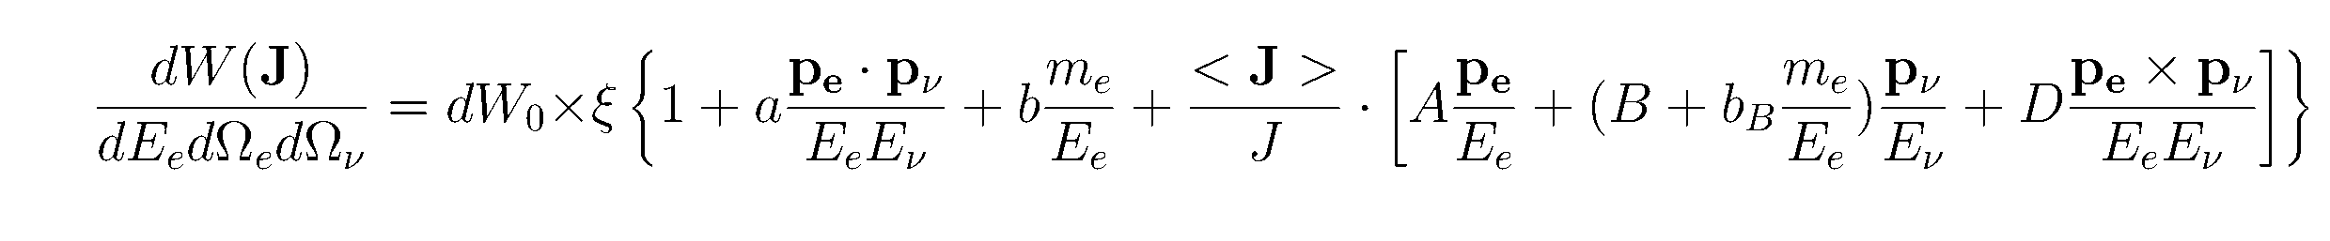

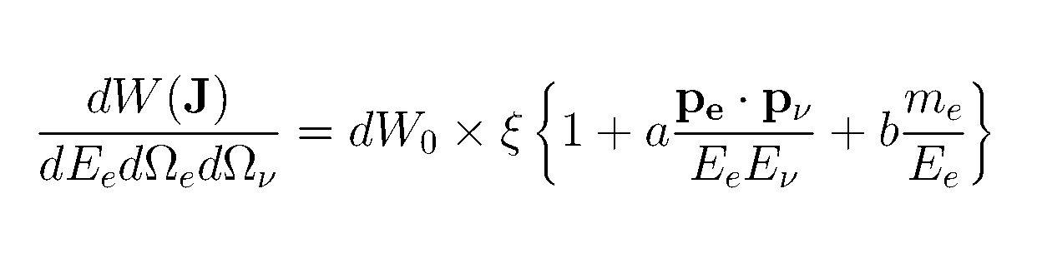
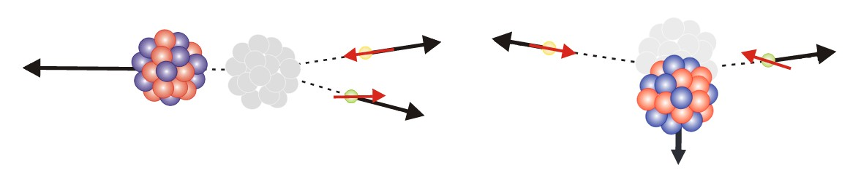




• • • The nuclear laboratory
β-decay probability
+….
a: β−ν correlation coefficient
CP conserving
Access to C_{S} and C_{T} quadratically
b: Fierz interference term
CP conserving
Access to C_{S} and C_{T} linearly
« D » coefficient
CP violating
Acces to C_{A}, C_{A}’, C_{V}, C_{V}’ linearly
➔
non-polarized nuclei
for aligned spins only
pure Fermi transitions ΔJ=0
➭ S=0 : spin of leptons anti-parallel
pure Gamow-Teller transitions
➭ S=1 : spin of leptons parallel
$$a_{\text{bn}}^{F}≅1 − \frac{\left|CS\right|2+ {|C}_{S}^{′}|2}{C_{V}^{2}}$$
$$b_{\text{bn}}^{F}≅± Re ( \frac{CS + C_{S}^{′}}{CV})$$
$a_{\text{bn}}^{GT}$ $≅−\frac{1}{3}[1−\frac{\left|CT\right|2+ |C^{′}T|2}{C2A}$]
$$b_{\text{bn}}^{GT}≅± Re ( \frac{CT + C_{T}^{′}}{CA})$$
SM: vector current
Preferred emission angle: θ = 0°
Maximum recoil energy
NP: scalar current
Preferred emission angle: θ = 180°
Minimum recoil energy
NP: tensor current
Preferred emission angle: θ = 0°
Maximum recoil energy
SM: axial-vector current
Preferred emission angle: θ = 180°
Minimum recoil
energy

Slide 4

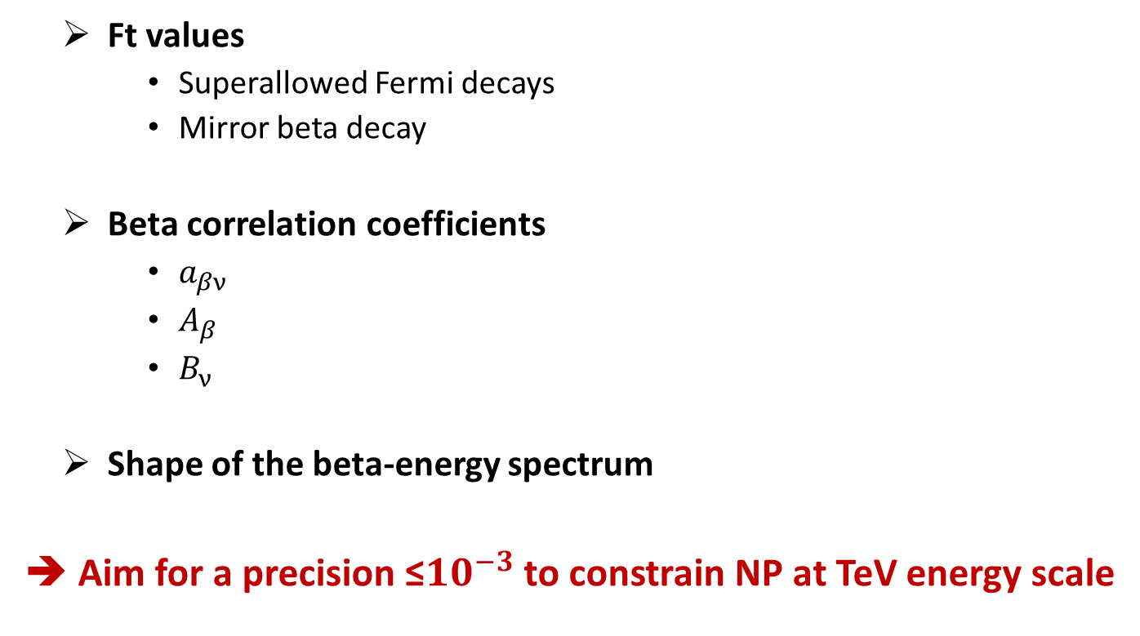







• • • Weak-interaction studies with nuclear beta decay
$${\overline{ν}}_{e}$$
  Ft values
    Superallowed Fermi decays
    Mirror beta decay
  Beta correlation coefficients
    $a_{βν}$
    $A_{β}$
    $B_{ν}$
  Shape of the beta-energy spectrum
➔ Aim for a precision ≤${10}^{−3}$ to constrain NP at TeV energy scale
$$p$$
x
x
$$n$$
$$e^{−}$$
X
X
$$n$$
X
X
$$p$$
$$ν_{e}$$
$$e^{+}$$

Slide 5
• • •
0⁺ - 0⁺ super-allowed β-decay probability
-
Ft values

Slide 6
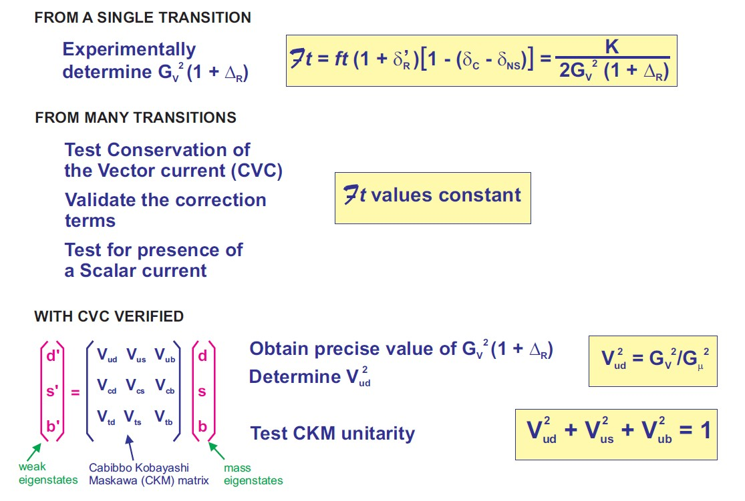
• • • Nuclear beta decay: 0⁺ - 0⁺
0⁺
0⁺ → 0⁺ :
ft =
K
2
M
2
T_{1/2}
G
V
F
Ft = ft (1 + δ_{R}’ ) (1 – δ_{c} + δ_{NS} ) = = cnst
K
2
(1 + Δ_{R})
2
Q_{EC}
G
M
f(Z, Q_{EC}) ~ 1.5%
V
F
BR
f(nucl. structure) ~ 0.3-1.5%
0⁺
f(weak interaction) ~ 2.4%
➔ 1 – 3 σ tension
Precision measurements required: 10⁻³
Q_{EC} → mass measurements: f ~ Q_{EC}⁵
T_{1/2} , BR → β-decay studies: t = T_{1/2} / BR

Slide 7
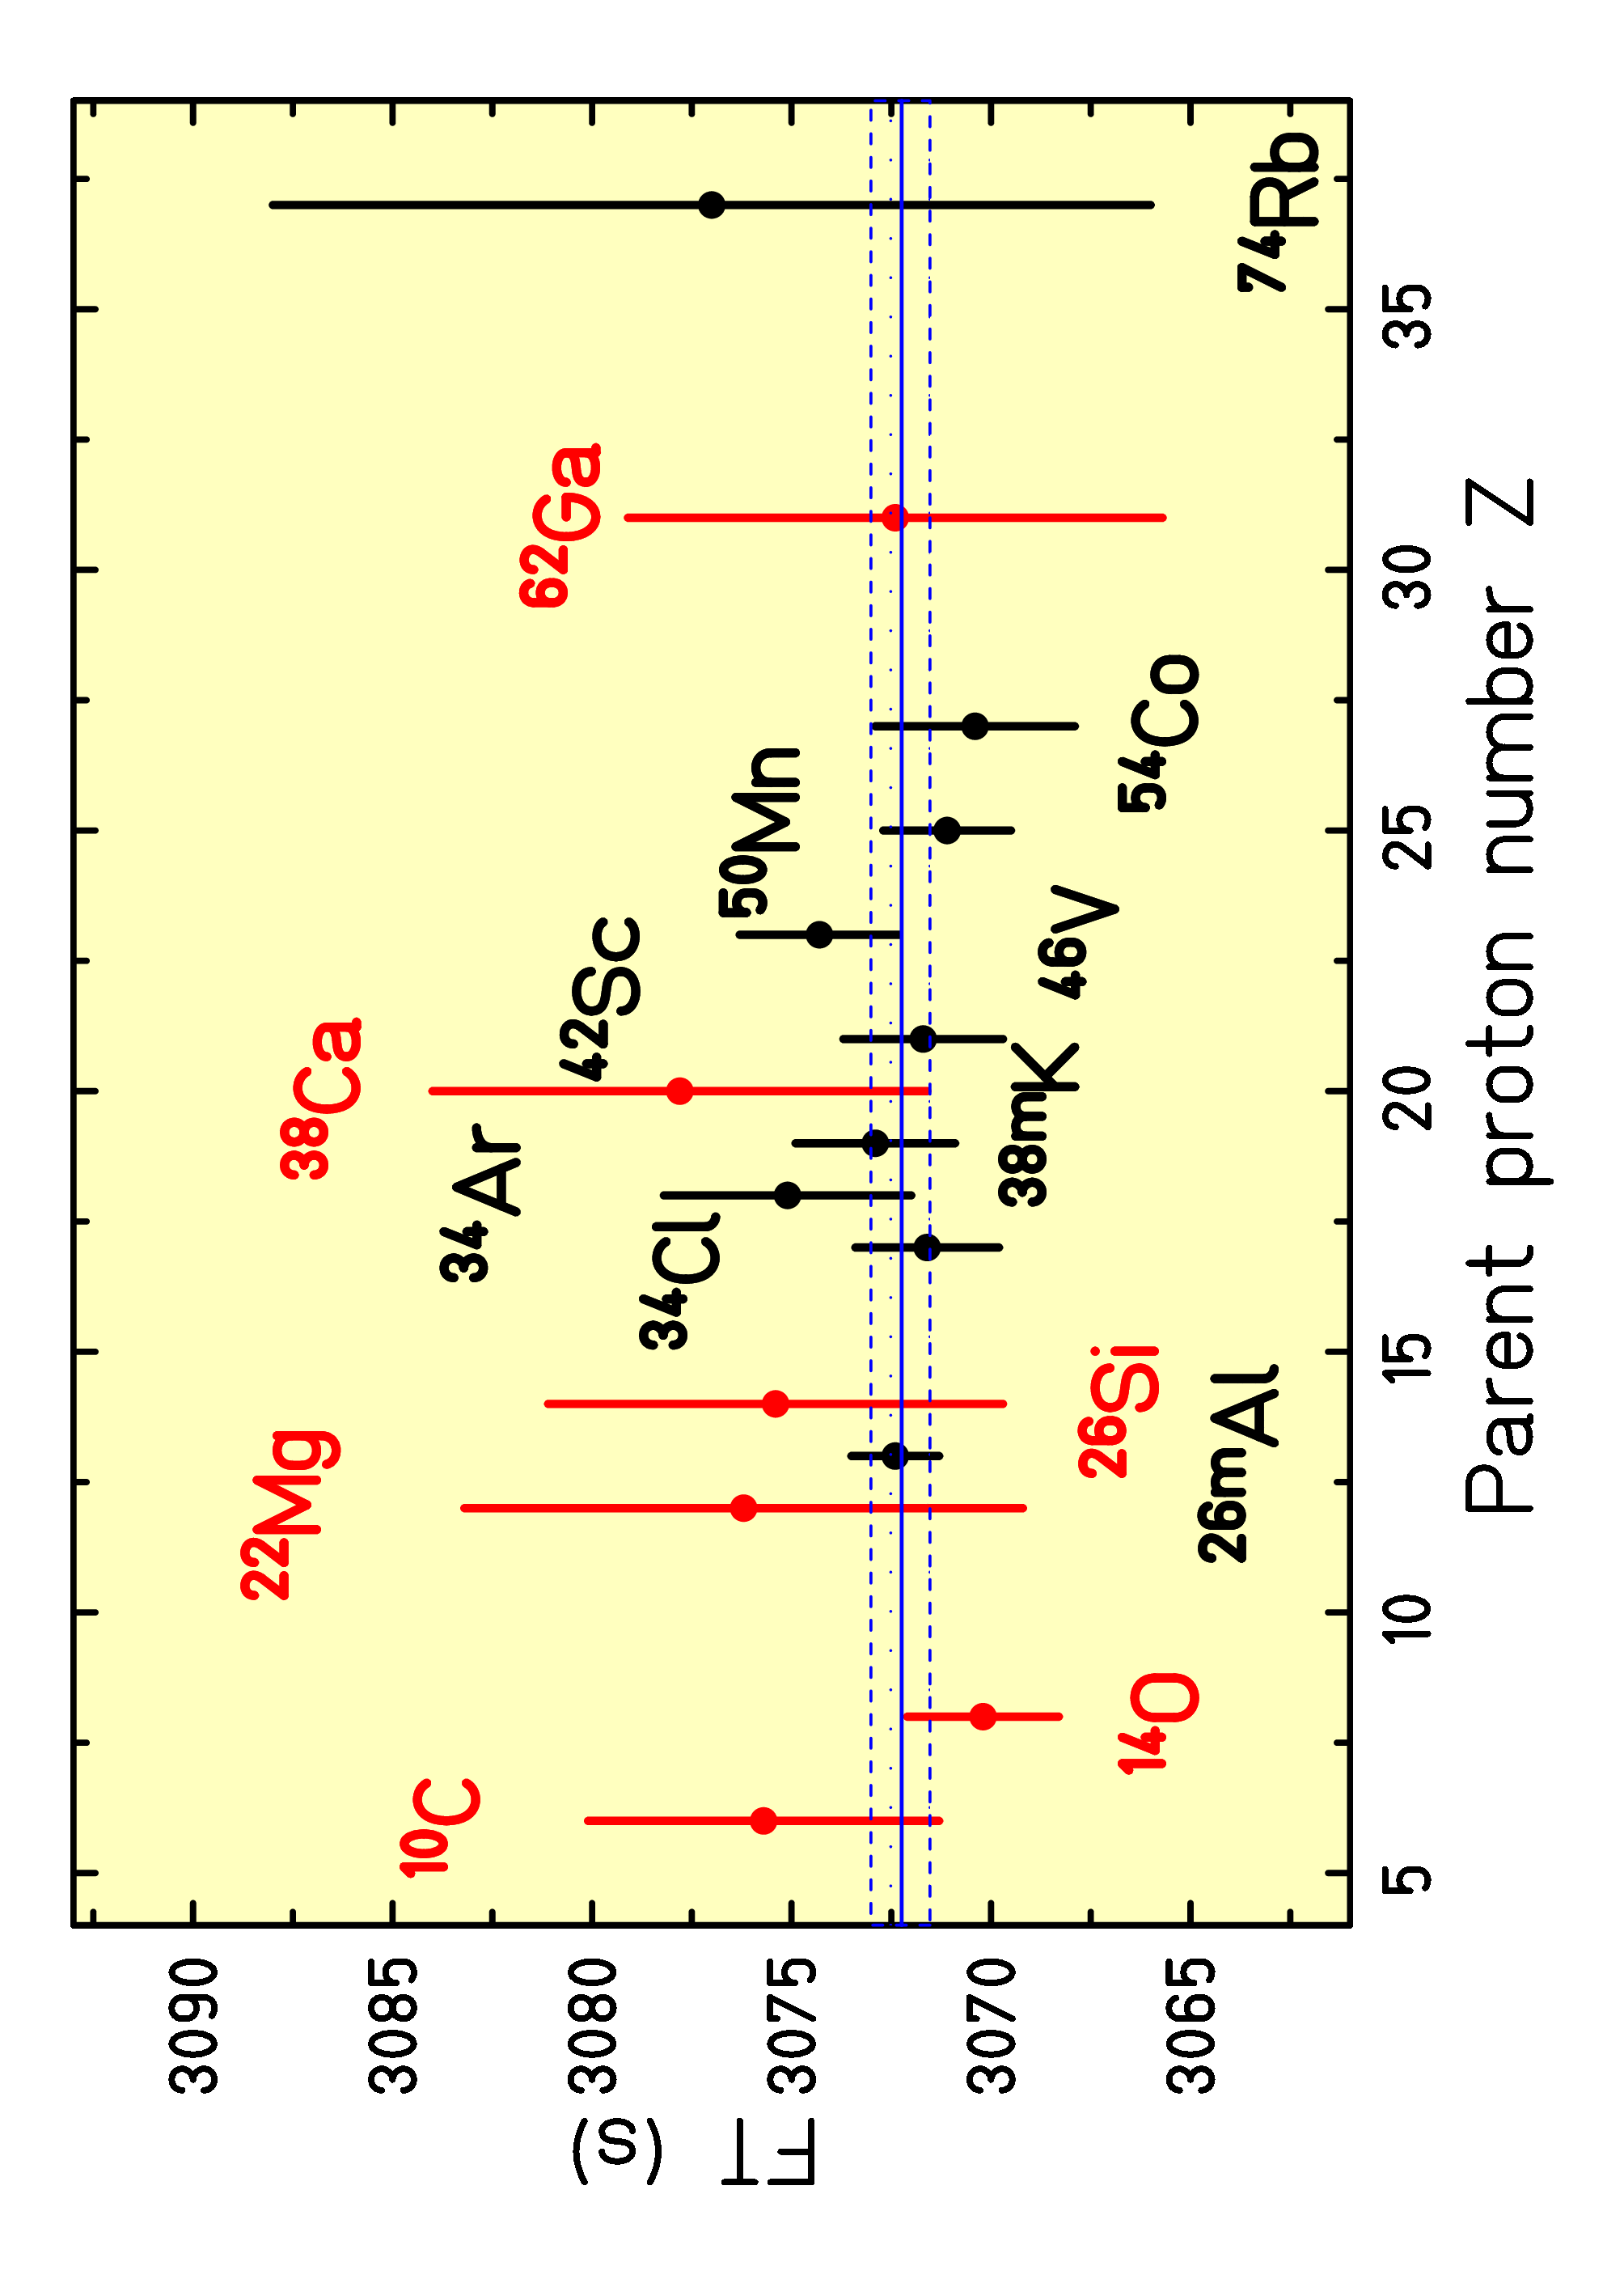
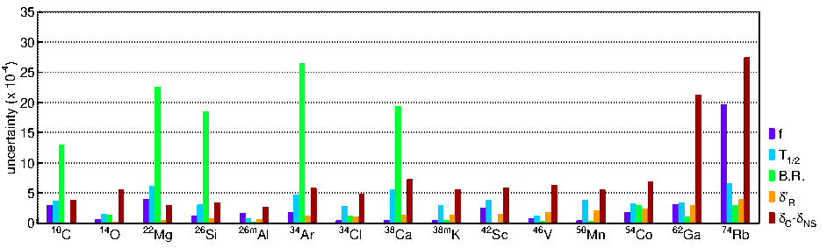
• • • 0⁺ → 0⁺ decays: present status
Contribution NEX
➔ Ft = (3072.24 ± 1.85)s
15 nuclei
other nuclei under study:
  ¹⁸Ne
  ³⁰S
  + heavier to come
V_{ud} = 0.9740 ± 0.0005
Errors:
exp: 0.0001
δ_{R}’: 0.0001
δ_{C}’, δ_{NS} : 0.0003
Δ_{R}: 0.0004
Error budget:

Slide 8
0⁺ - 0⁺ β decay: our recent work on
³⁸Ca, ³⁰S and ²²Mg

Slide 9
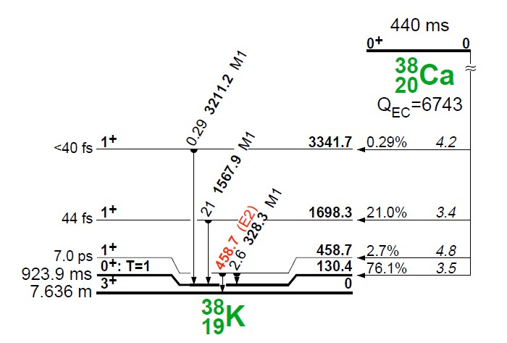
Super-allowed Fermi transitions for T_{z} = -1
many decay channels open
strong non-analog transitions
high precision of γ efficiency needed ➔ 0.1%

Slide 10
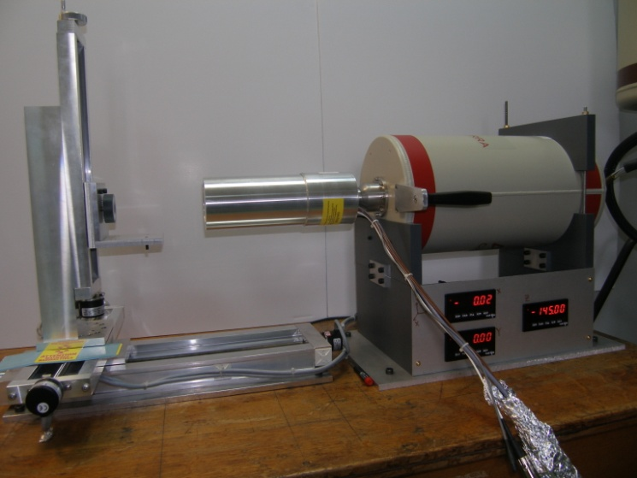
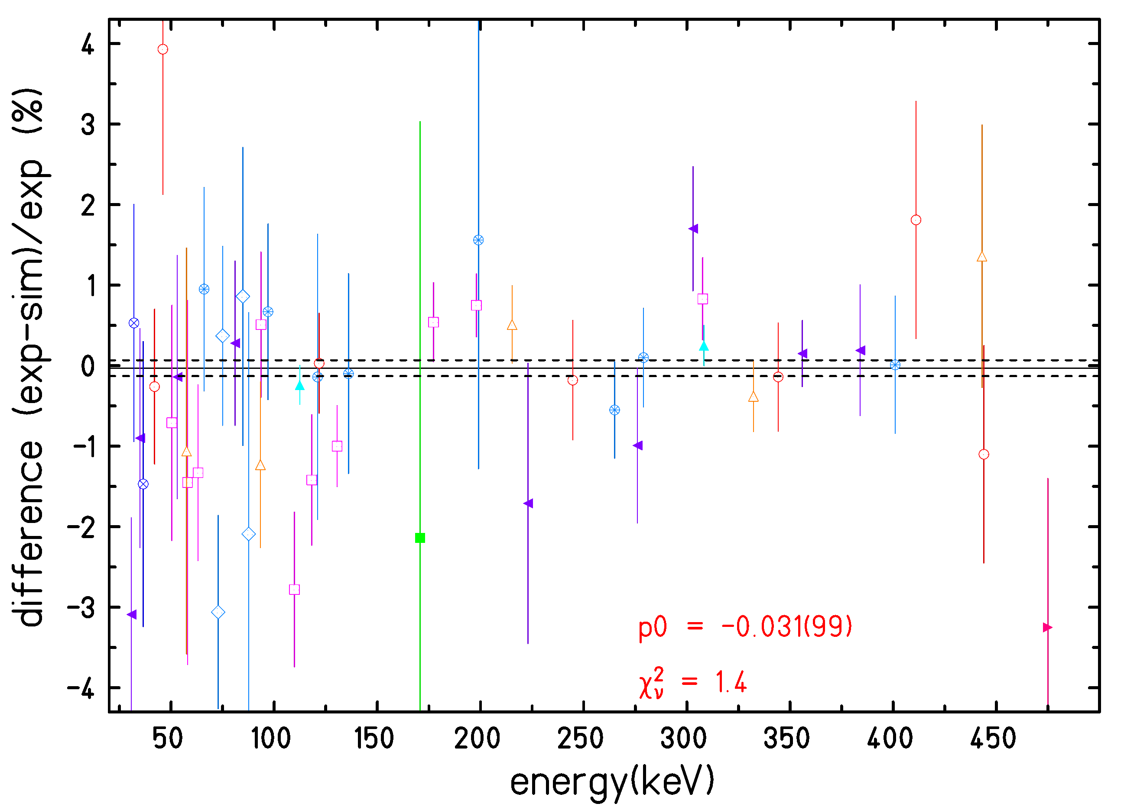
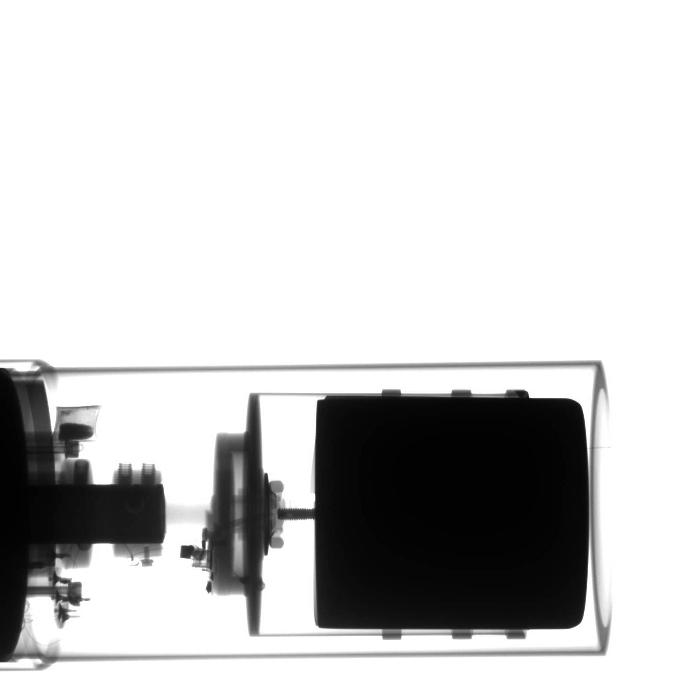
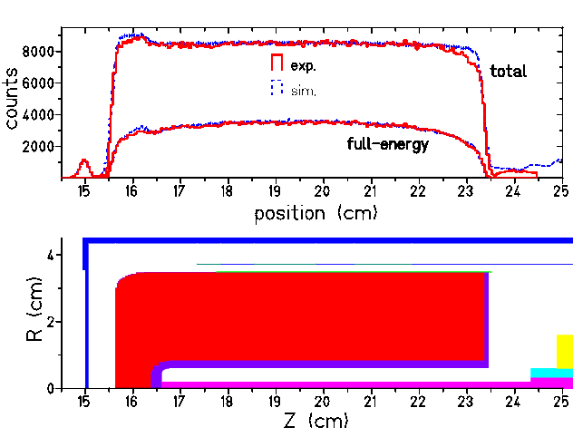
• • • Calibration of germanium detector
Δε_{rel} = 0.1%, Δε_{abs} = 0.15%
calibration programme of a
HP Ge detector:
- x-ray photography of detector
- scan of the crystal at CSNSM Orsay
- source measurements at CENBG, IPNO, ISOLDE
- MC simulations: CYLTRAN, GEANT4
X-ray
photography
B. Blank et al., NIMA776 (2015) 34, NIMA 984 (2020) 164631
Scan at
CSNSM:
¹³⁷Cs
strongly
collimated
Relative detection efficiency:
²⁴Na, ²⁷Mg, ⁴⁸Cr, ⁵⁶Co, ⁶⁰Co, ⁶⁶Ga, ⁷⁵Se, ⁸⁸Y,
¹³³Ba, ¹³⁴Cs, ¹³⁷Ce, ¹⁵²Eu, ¹⁶⁹Yb, ¹⁸⁰Hf, ²⁰⁷Bi
Peak/total: ²²Na, ³⁸K, ⁴¹Ar, ⁵¹Cr, ⁵⁴Mn, ⁵⁷Co, ⁵⁸Co, ⁶⁰Co,
⁶⁵Zn, ⁸⁵Sr, ¹³⁷Cs …ISOLDE, IPNO sources

Slide 11
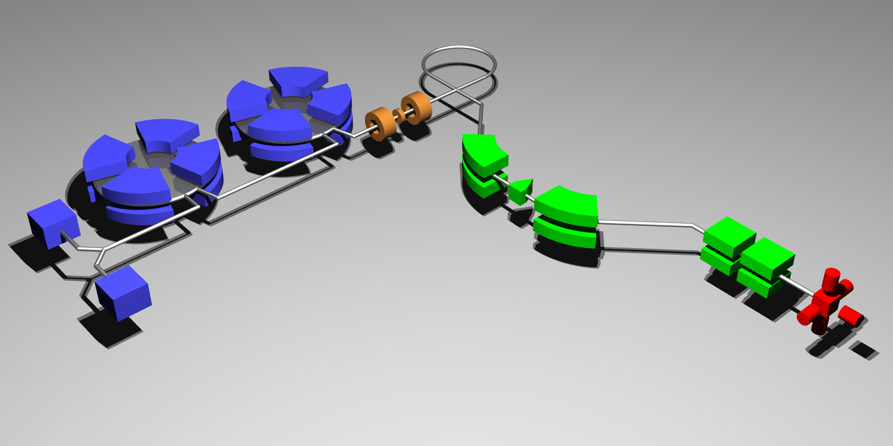
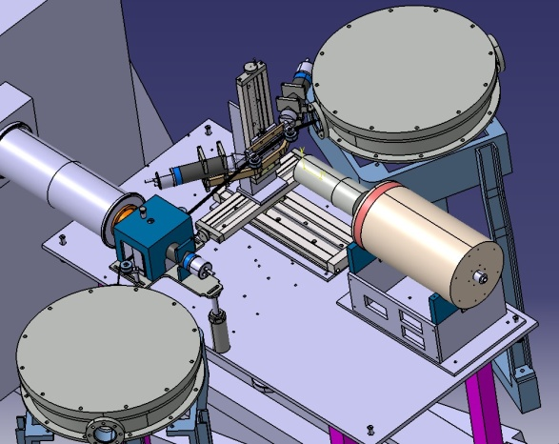
• • • ³⁸Ca production at GANIL/LISE3
Primary Beam:
⁴⁰Ca @ 50 MeV/A
GANIL / LISE3 experiments
Production Target :
^{nat}Ni 90 μm
LISE3 Spectrometer
Detection
Set-up
10⁴ ³⁸Ca / s
99.5 % purity
Contaminants:
  ³⁷K: 0.12 %
  ³⁶Ar (stable): 0.11 %
  ³⁵Cl (stable): 0.09 %
  ³⁴S (stable): 0.14 %

Slide 12
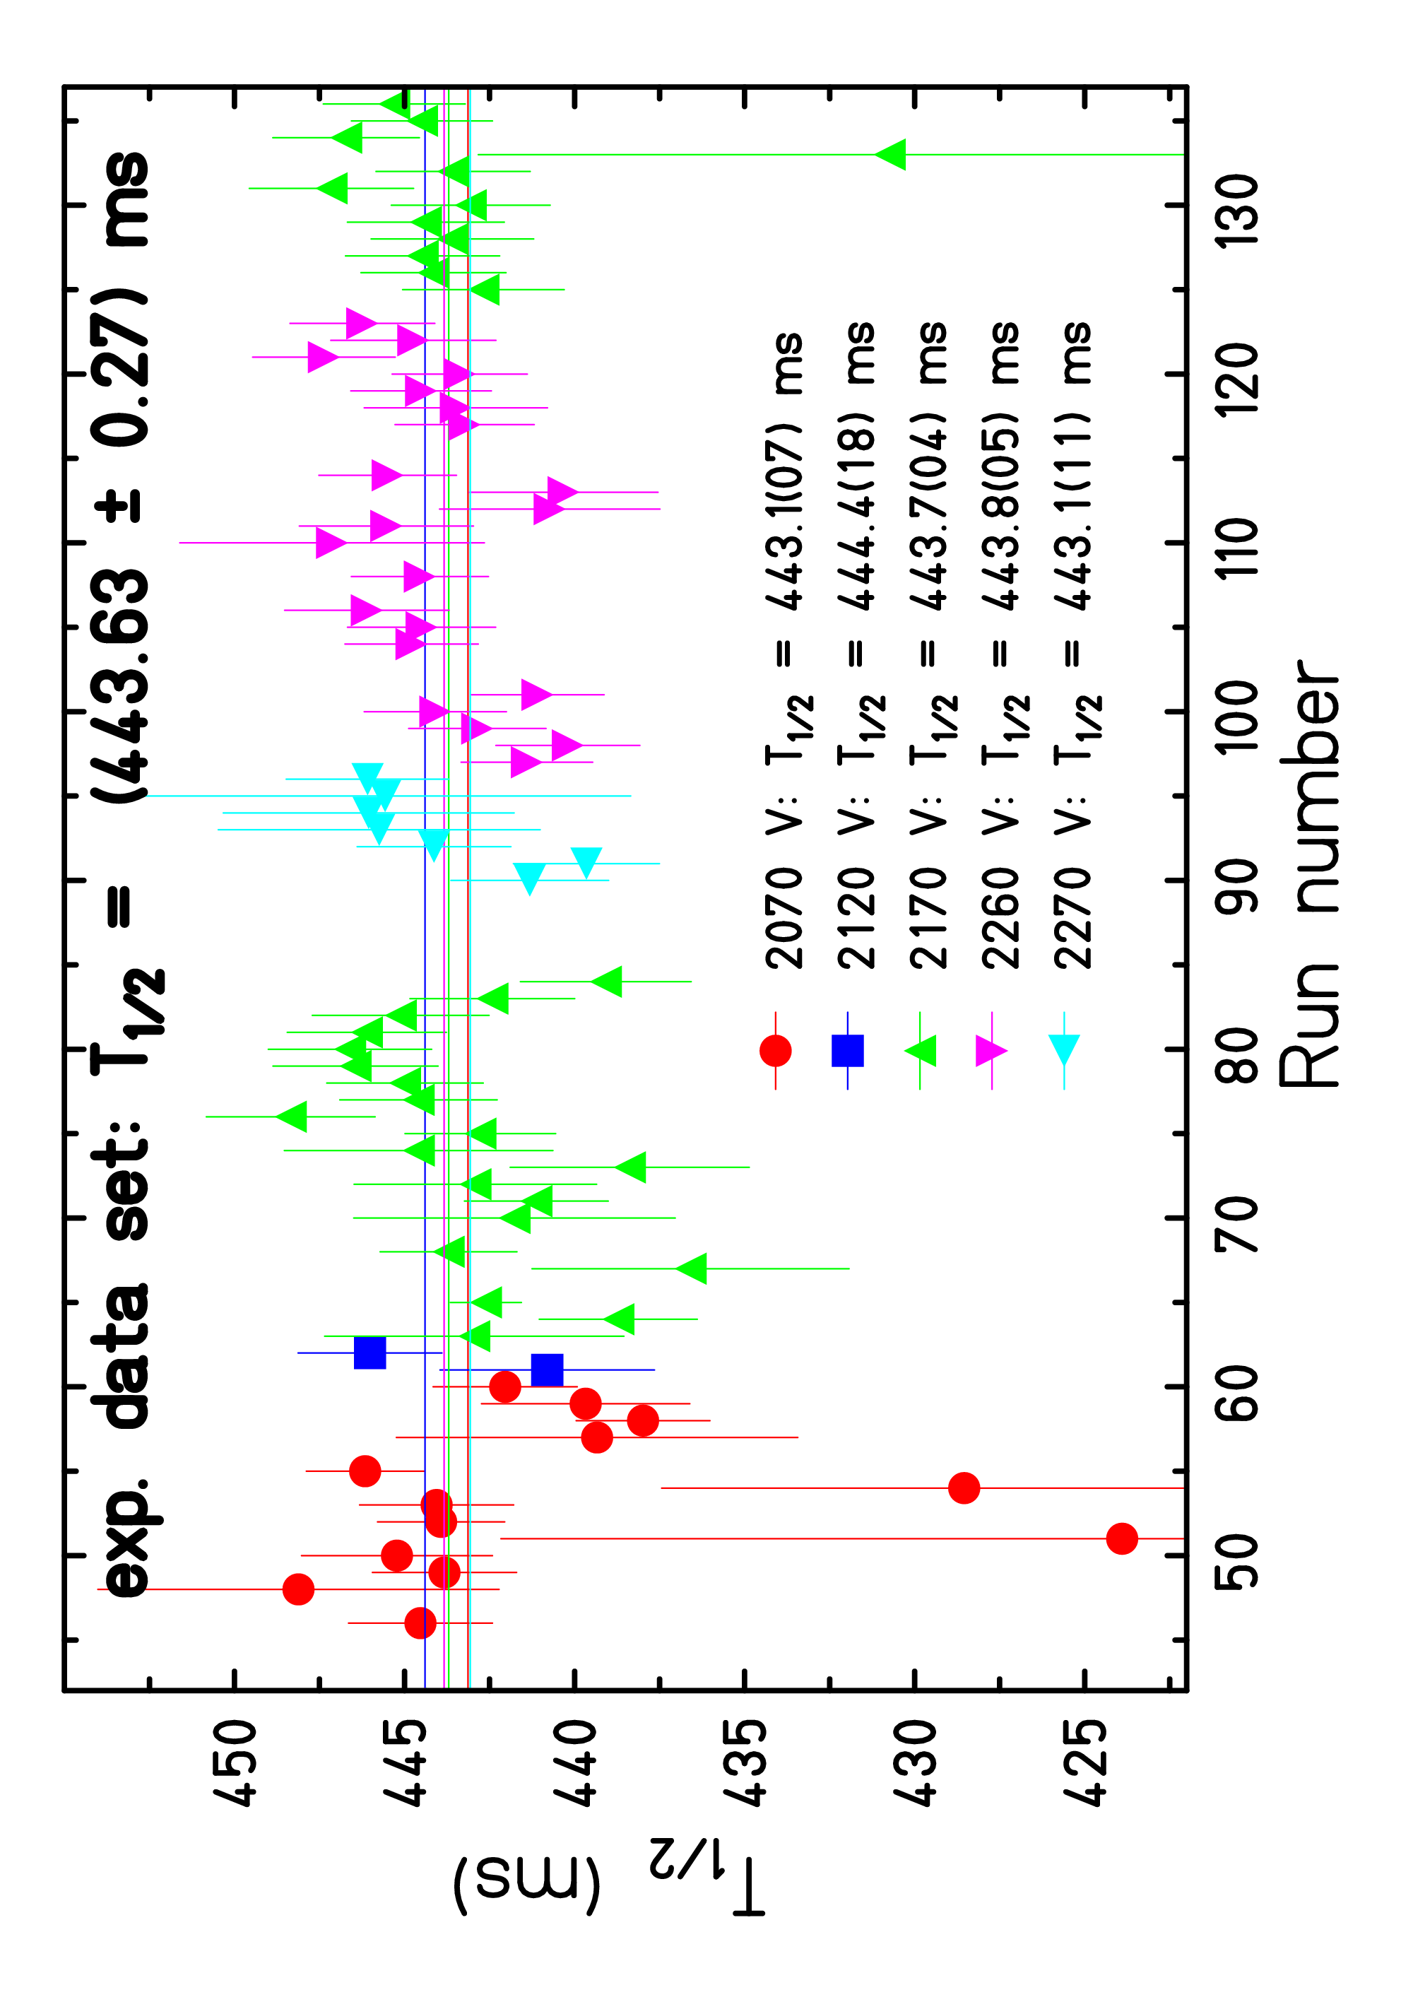
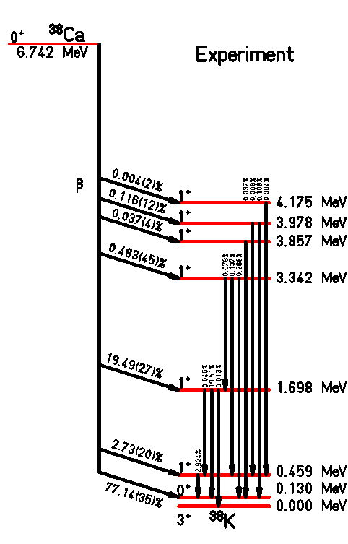
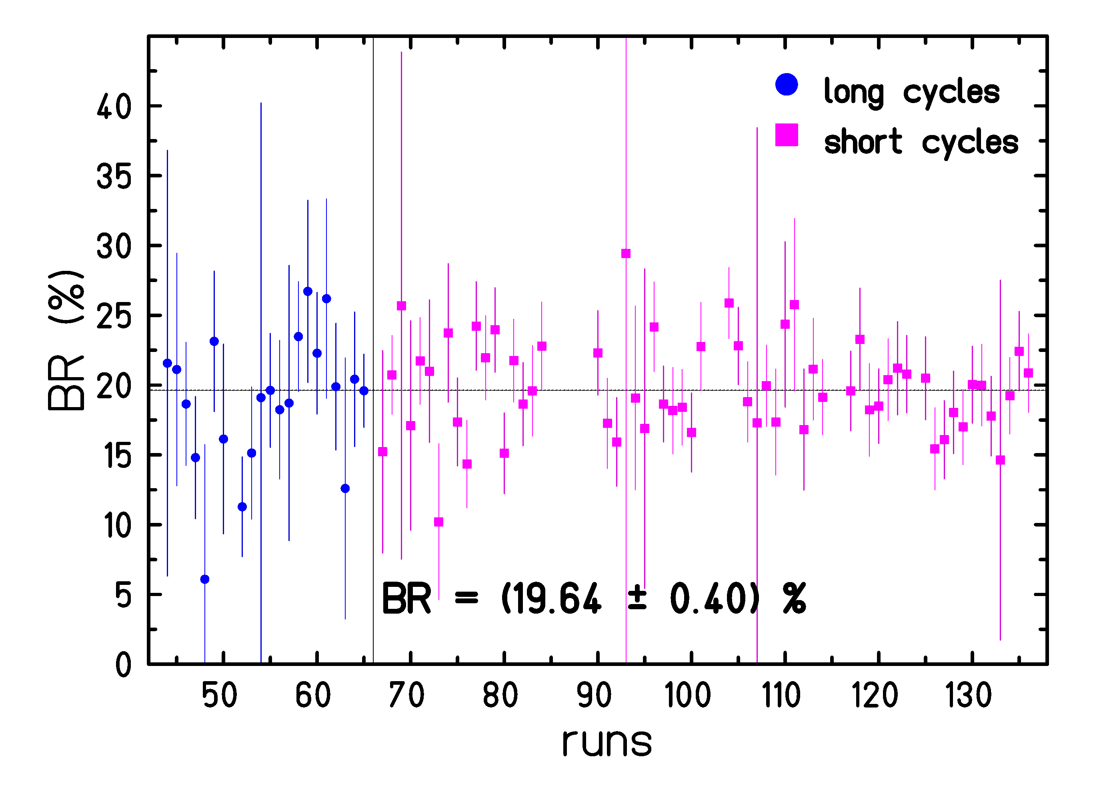
• • • ³⁸Ca branching ratios and half-life
(443.63 ± 0.35)
Present work and Anderson et al.
B. Blank et al., EPJA 51 (2015) 8

Slide 13
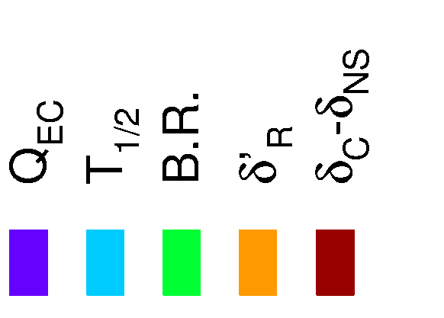
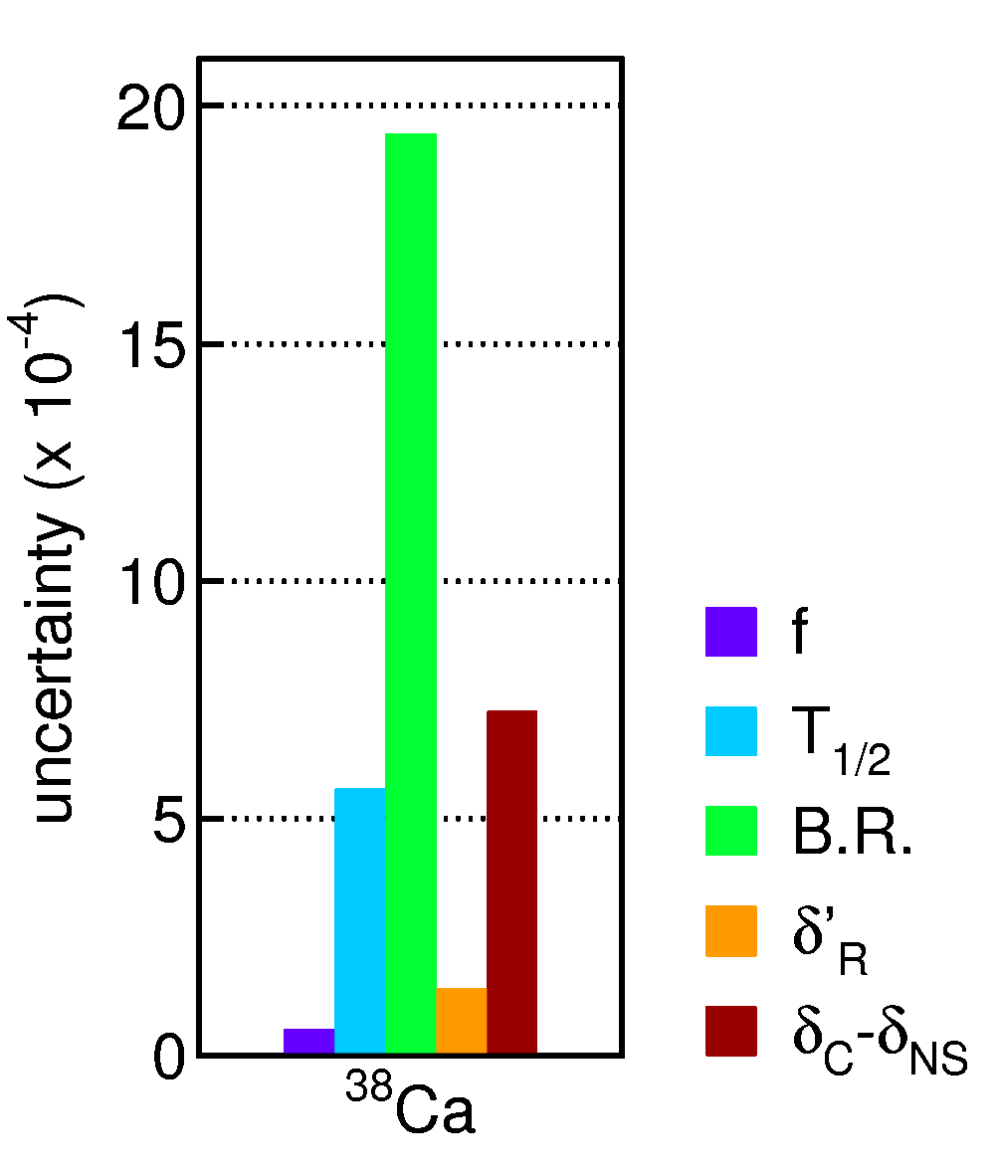
• • • ³⁸Ca: result
half-life:
BR (0⁺ — 0⁺): present: 77.09(35) %
Park et al.: 77.28(16) %
Q value: Eronen et al.: 6612.11(7) keV
ft = 3063.3(62) s
Ft = 3077.5(67) s
➔➔ 443.70(25) ms
➔➔ 77.25(15) %
B. Blank et al., EPJA 51 (2015) 8

Slide 14
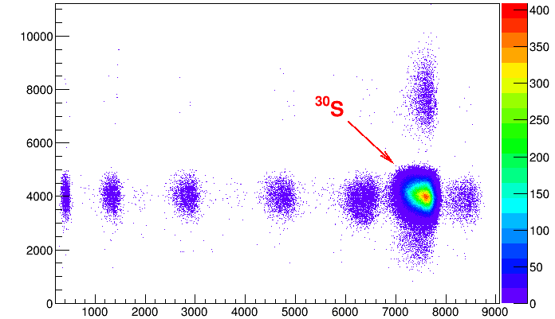
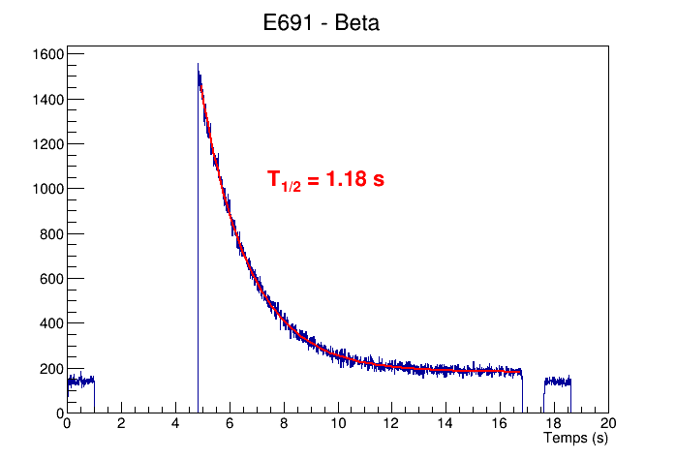
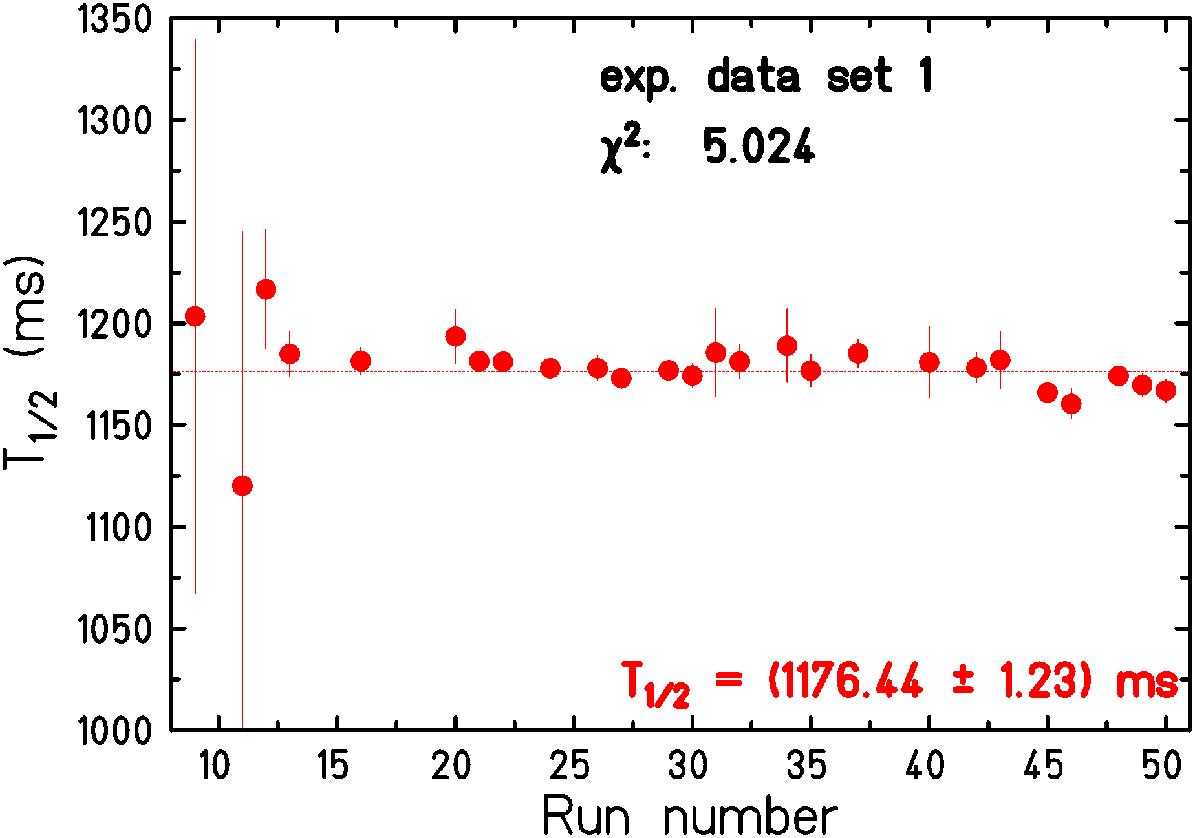
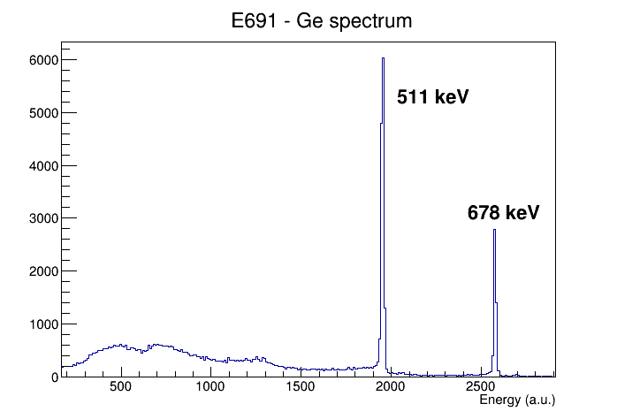
• • • ³⁰S at GANIL: very preliminary result
analysis in progress

Slide 15
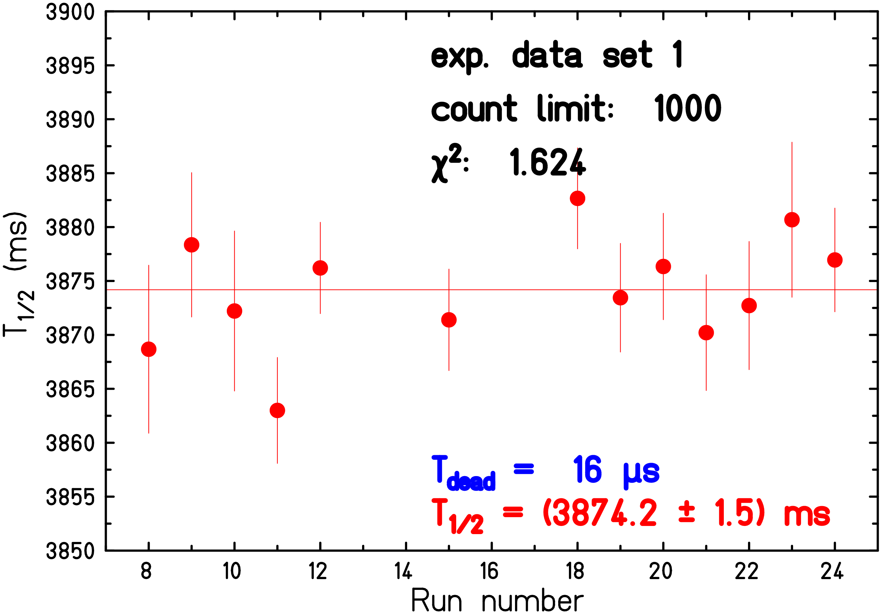
• • • ²²Mg at ISOLDE: very preliminary result
analysis in progress
Large amounts of ²²Na in beam
Use of LIST technique to remove it
➔ Loss of factor 50 for ²²Mg
…also data on branching ratios
…to be analysed

Slide 16
• • • V_{ud} from different source and unitarity of CKM matrix
0⁺ - 0⁺ decays: V_{ud} = 0.9740 ± 0.0005
mirror decays: V_{ud} = 0.9742 ± 0.0009
neutron decay: V_{ud} = 0.9743 ± 0.0006
➔ V_{ud} = 0.9741 ± 0.0004
V_{us} = 0.2243 ± 0.0005
V_{ub} = (3.94 ± 0.36) x 10⁻³
V_{ud}² + V_{us}² + V_{ub}² = 0.9992 ± 0.0007 ➔ 1.1σ
but also 3.1σ (see Hardy & Towner 2020)

Slide 17
Future measurements at GANIL

Slide 18
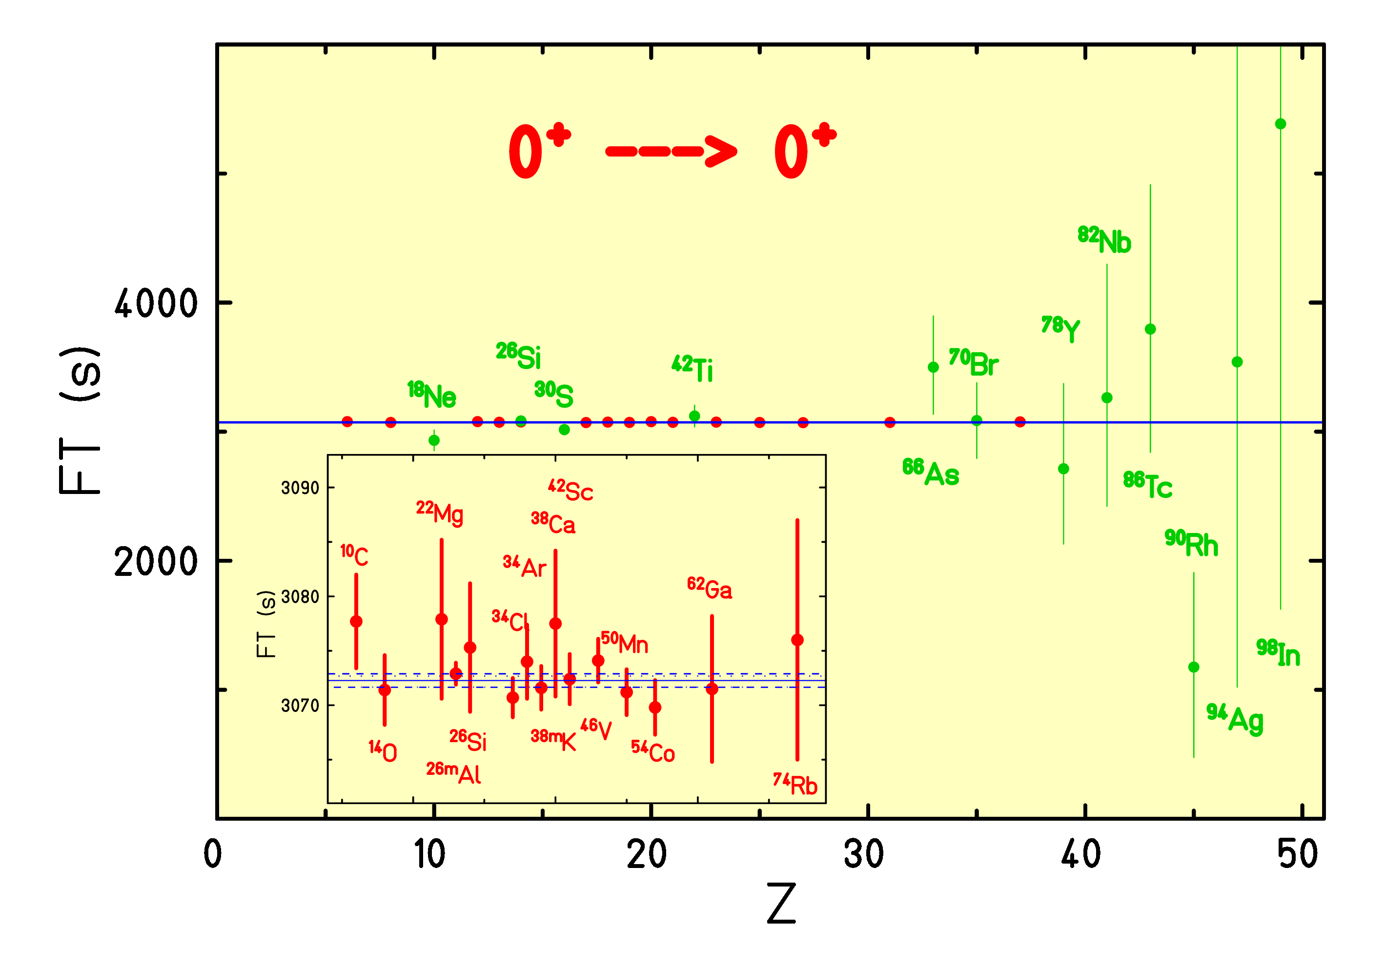
• • • Heavy T_{z} = 0 nuclei
test of CVC on a much larger basis
test of different models for corrections

Slide 19
• • • Heavy T_{z} = 0 nuclei: production at S3-LEB
 | isotope | half-life (ms) | rate day I (pps) | rate day II (pps) | rate A/Q=7 (pps) | rate A/Q=7 fast cell (20ms) (pps)
 | ⁶⁶As | 95.77(23) | 75 | 450 | 750 | 4000
 | ⁷⁰Br | 79 .1(8) | 200 | 400 | 400 | 3000
 | ⁷⁴Rb | 64.78(3) | 100 | 150 | 150 | 2000
 | ⁷⁸Y | 54(5) | 10 | 10 | 15 | 300
 | ⁸²Nb | 50(5) | 1.5 | 1.5 | 3 | 70
 | ⁸⁶Tc | 55(6) | 1.5 | 1.5 | 3 | 50
 | ⁹⁰Rh | 15(7) | 3e-4 | 4e-4 | 7e-4 | 30
 | ⁹⁴Ag | 37(18) | 0.6 | 0.7 | 1 | 90
 | ⁹⁸In | 37(5) | 5e-4 | 6e-4 | 1e-3 | 7e-2
➔ test CVC over a larger range of Z

Slide 20
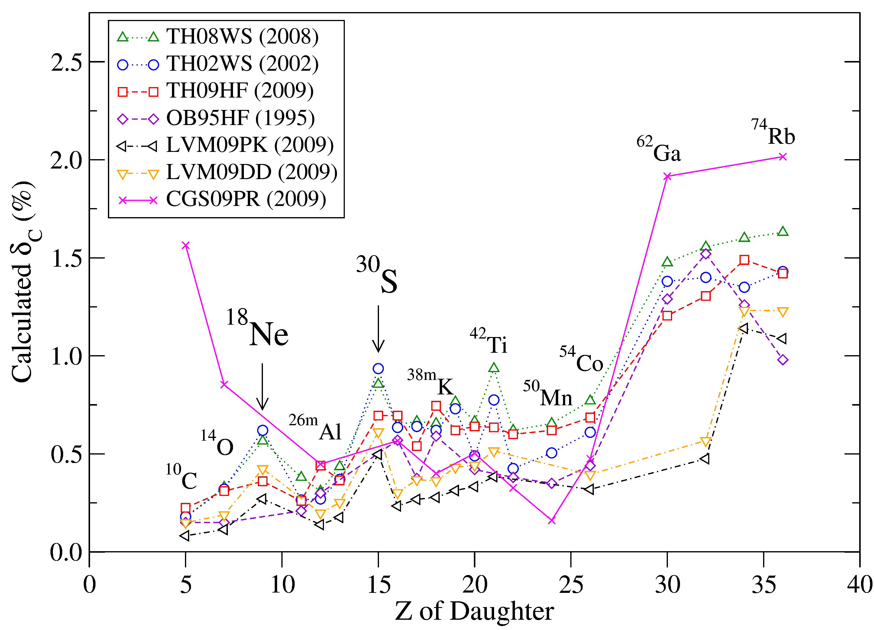
• • • ¹⁸Ne, ³⁰S, ⁴²Ti
T_{z} = -1 nucleus accessible with high statistics:
BR is difficult
up to factor of 3 difference in δ_{C}
feasible at GANIL

Slide 21
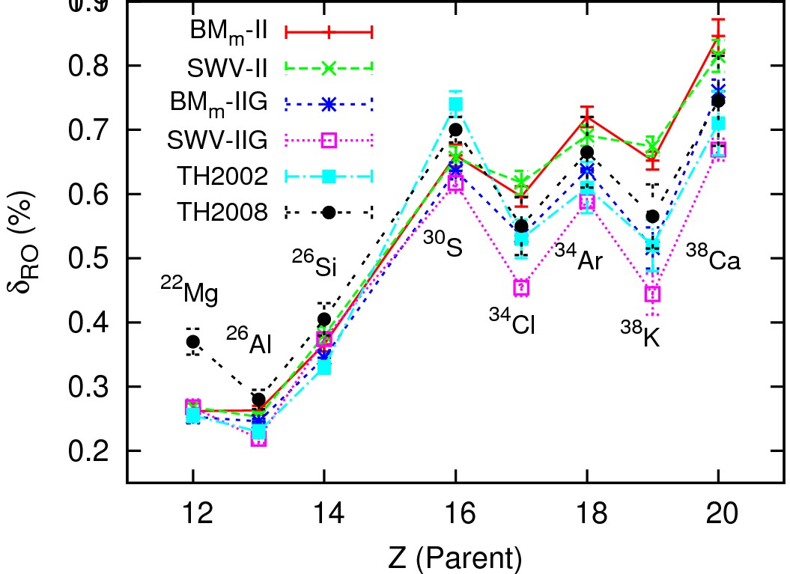
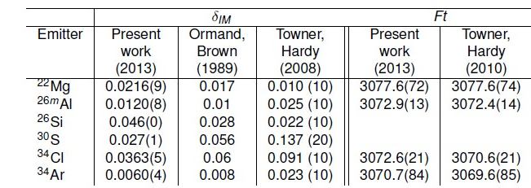
• • • Theoretical corrections (sd shell)
N. Smirnova, Y. Lam, L. Xayavong et al.

Slide 22
• • •
β−ν angular correlations
WISArD

Slide 23

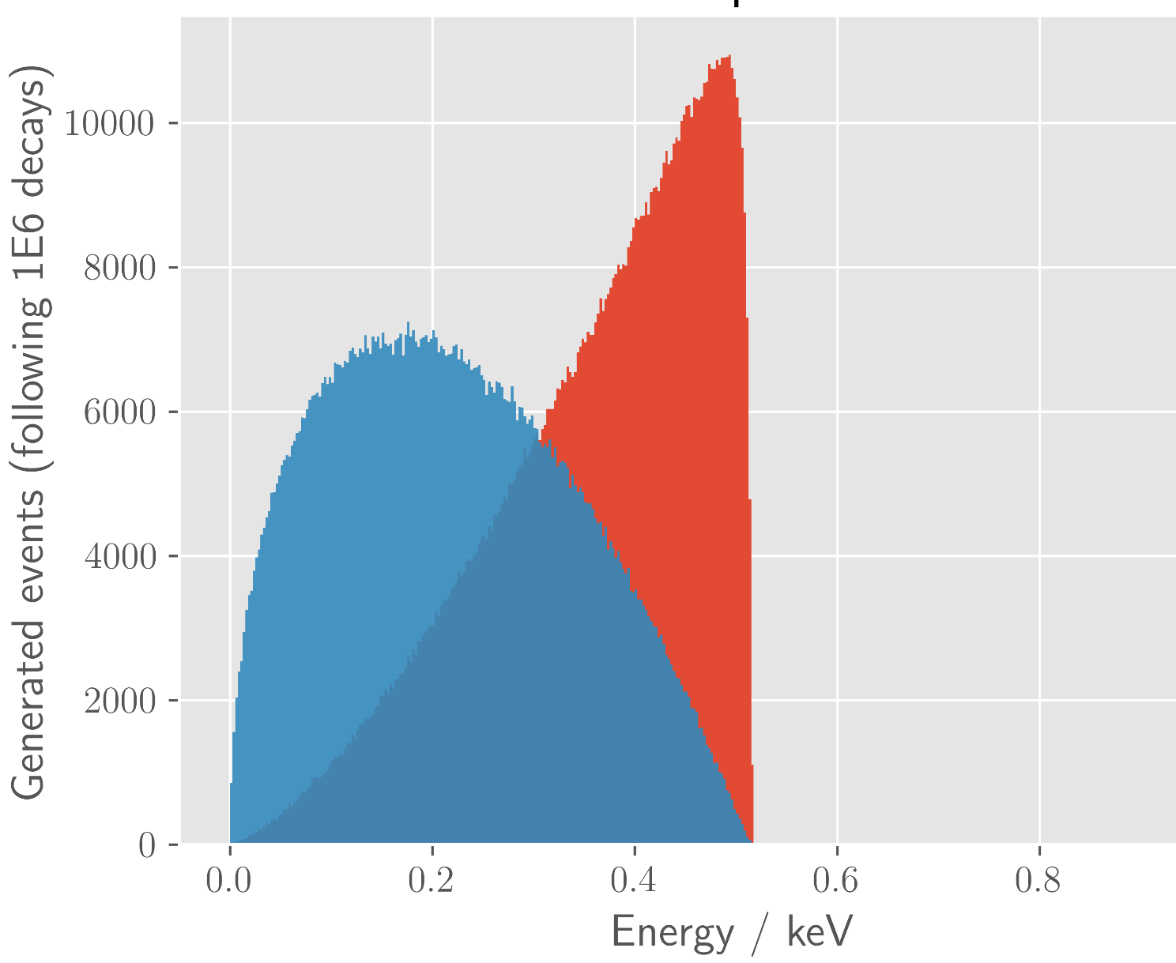
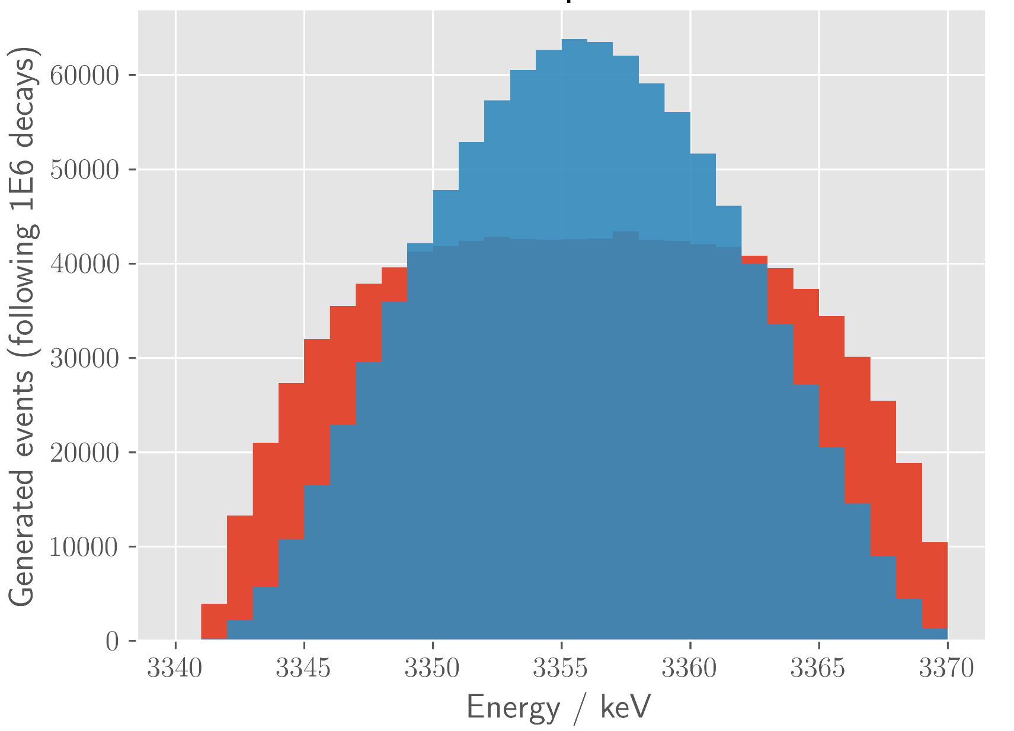
• • • The WISArD experiment
e⁺
nucleus
access to:
θ
ν_{e}
kinematic shift of proton: recoil of nucleus ³²Cl
β
Pure Fermi transition (ΔJ=0, S=0):
³²Ar
p
= 1
³¹S+p
³²Cl
= 0
scalar
vector
nuclear
recoil:
scalar
emitted
proton:
vector
ion traps: LPCTrap (⁶He), TRINAT (^{38m}K)
WISArD experiment at ISOLDE

Slide 24
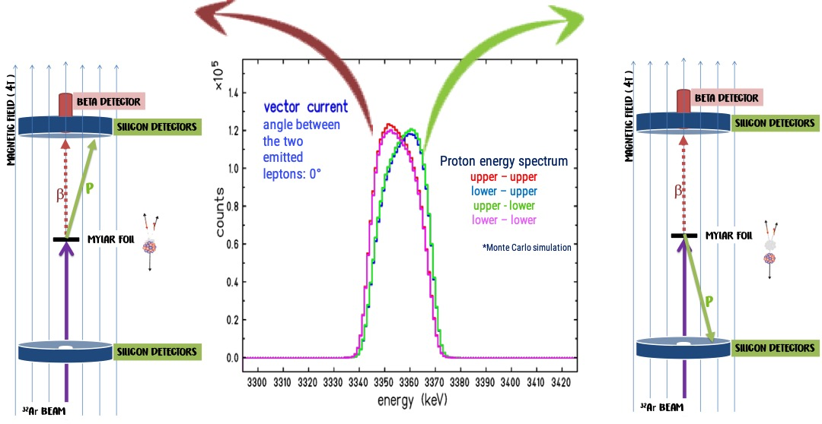
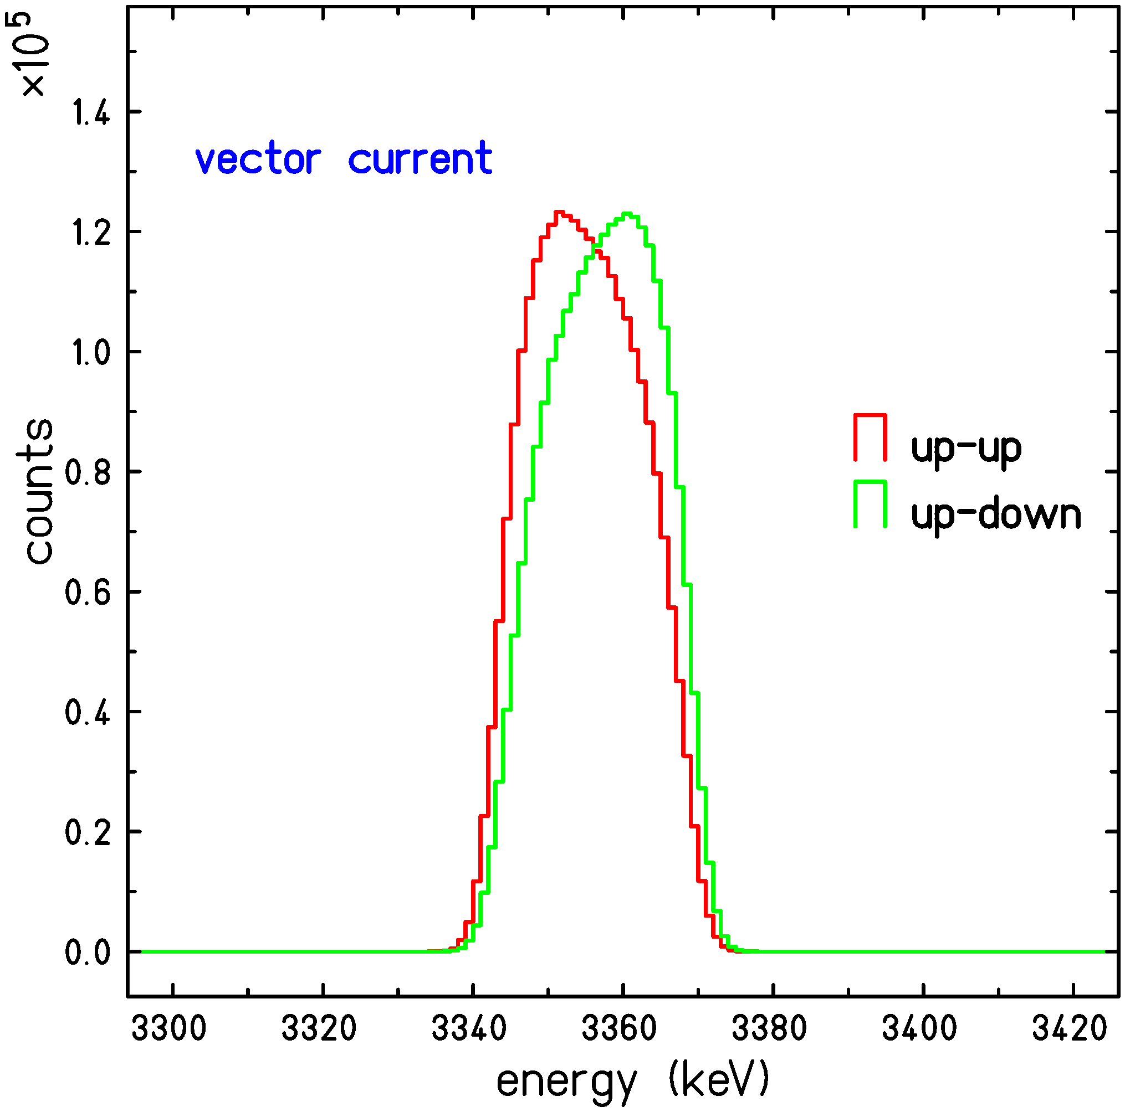
• • • The WISArD experiment
Principle: measurement of the recoil of nucleus
via an indirect measurement: β-delayed proton
in a magnetic field to guide the positrons
kinematical cuts by measuring or not the emitted positrons
increased sensitivity
Detection of proton: recoil of nucleus ³²Cl (“Doppler” effect)
β
³²Ar
p
³¹S+p
³²Cl

Slide 25
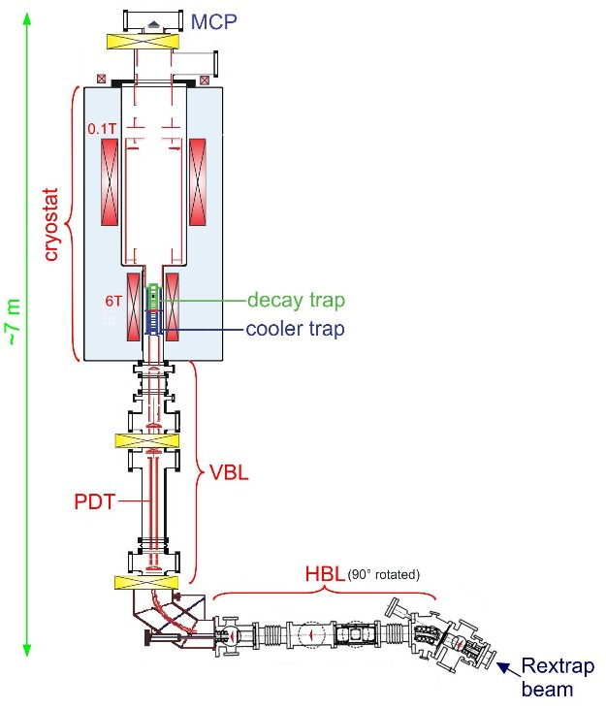
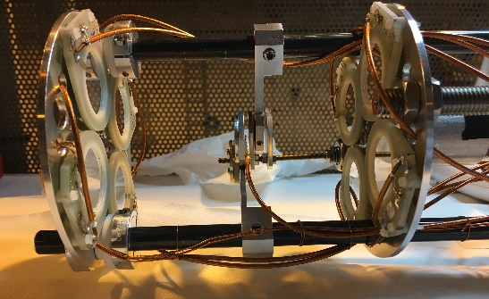
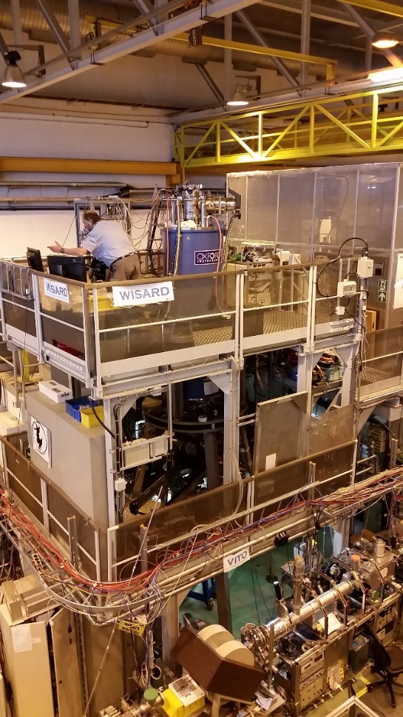
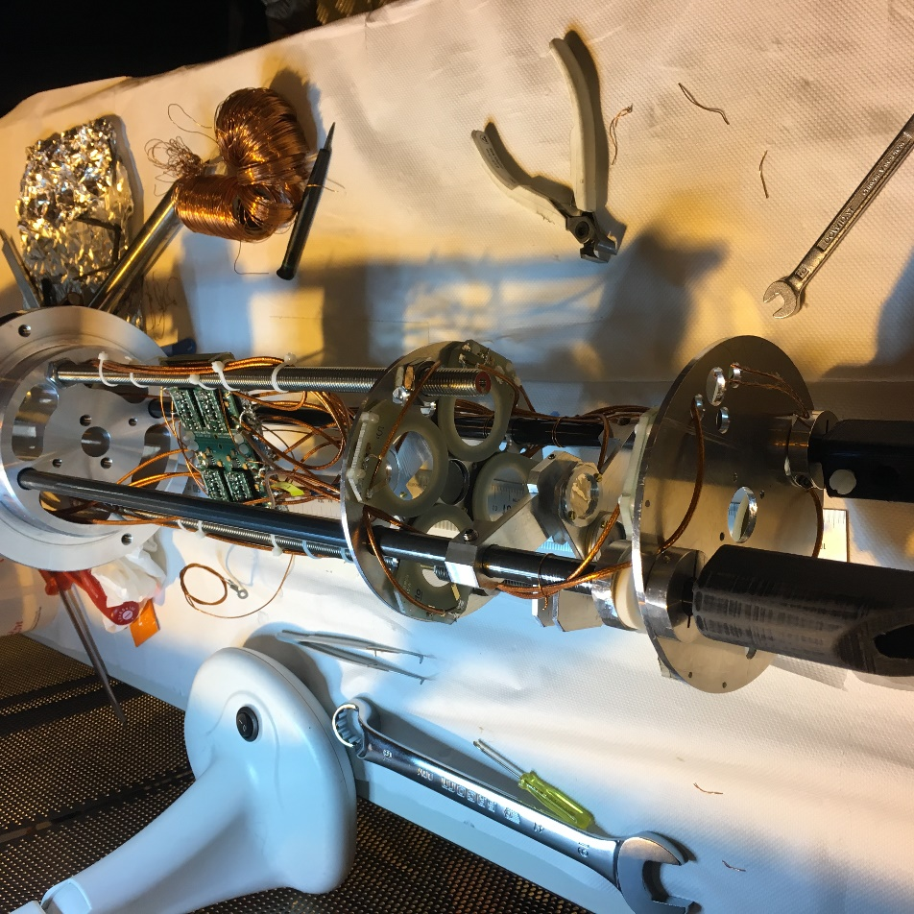
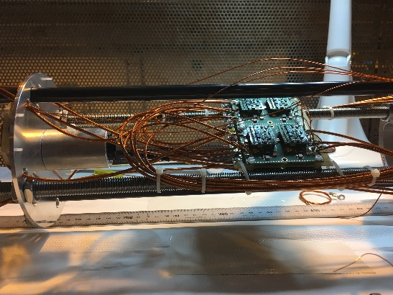
• • • The WISArD experiment: Set-up at ISOLDE
Experimental hall of ISOLDE
- former WITCH magnet
Catcher + detector planes
detection
setup
β detector: plastic scintillator and SiPM
2018

Slide 26
• • • The WISArD experiment: proof-of- principle
first results (nov. 2018):
GT IAS: Fermi transition
proton spectra:
E shift -> p detector
dead layer
E shift -> mylar foil + dead layer
« shadow » peaks
V. Araujo-Escalona et al, PRC 101 (2020) 055501

Slide 27
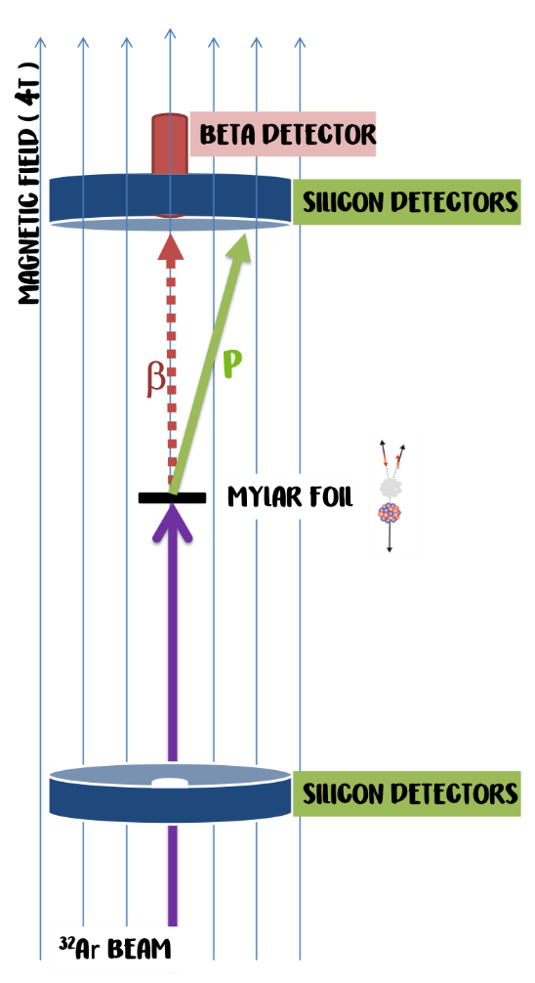
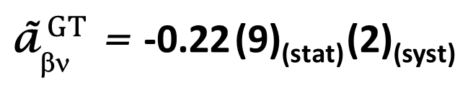
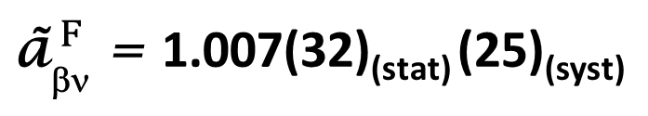
• • • The WISArD experiment
first results: (nov. 2018)
Typical resolution:
35 keV FWHM
Average shift:
Δ = 4.49(3) keV
by means of GEANT4 MC calculations:
${\text{ã}}_{\text{bn}}^{ F}$ = 1.007(32)_{(stat)} (25)_{(syst)}
${\text{ã}}_{\text{bn}}^{ GT}$ = -0.22 (9)_{(stat)} (2)_{(syst)}
V. Araujo-Escalona et al, PRC 101 (2020) 055501

Slide 28
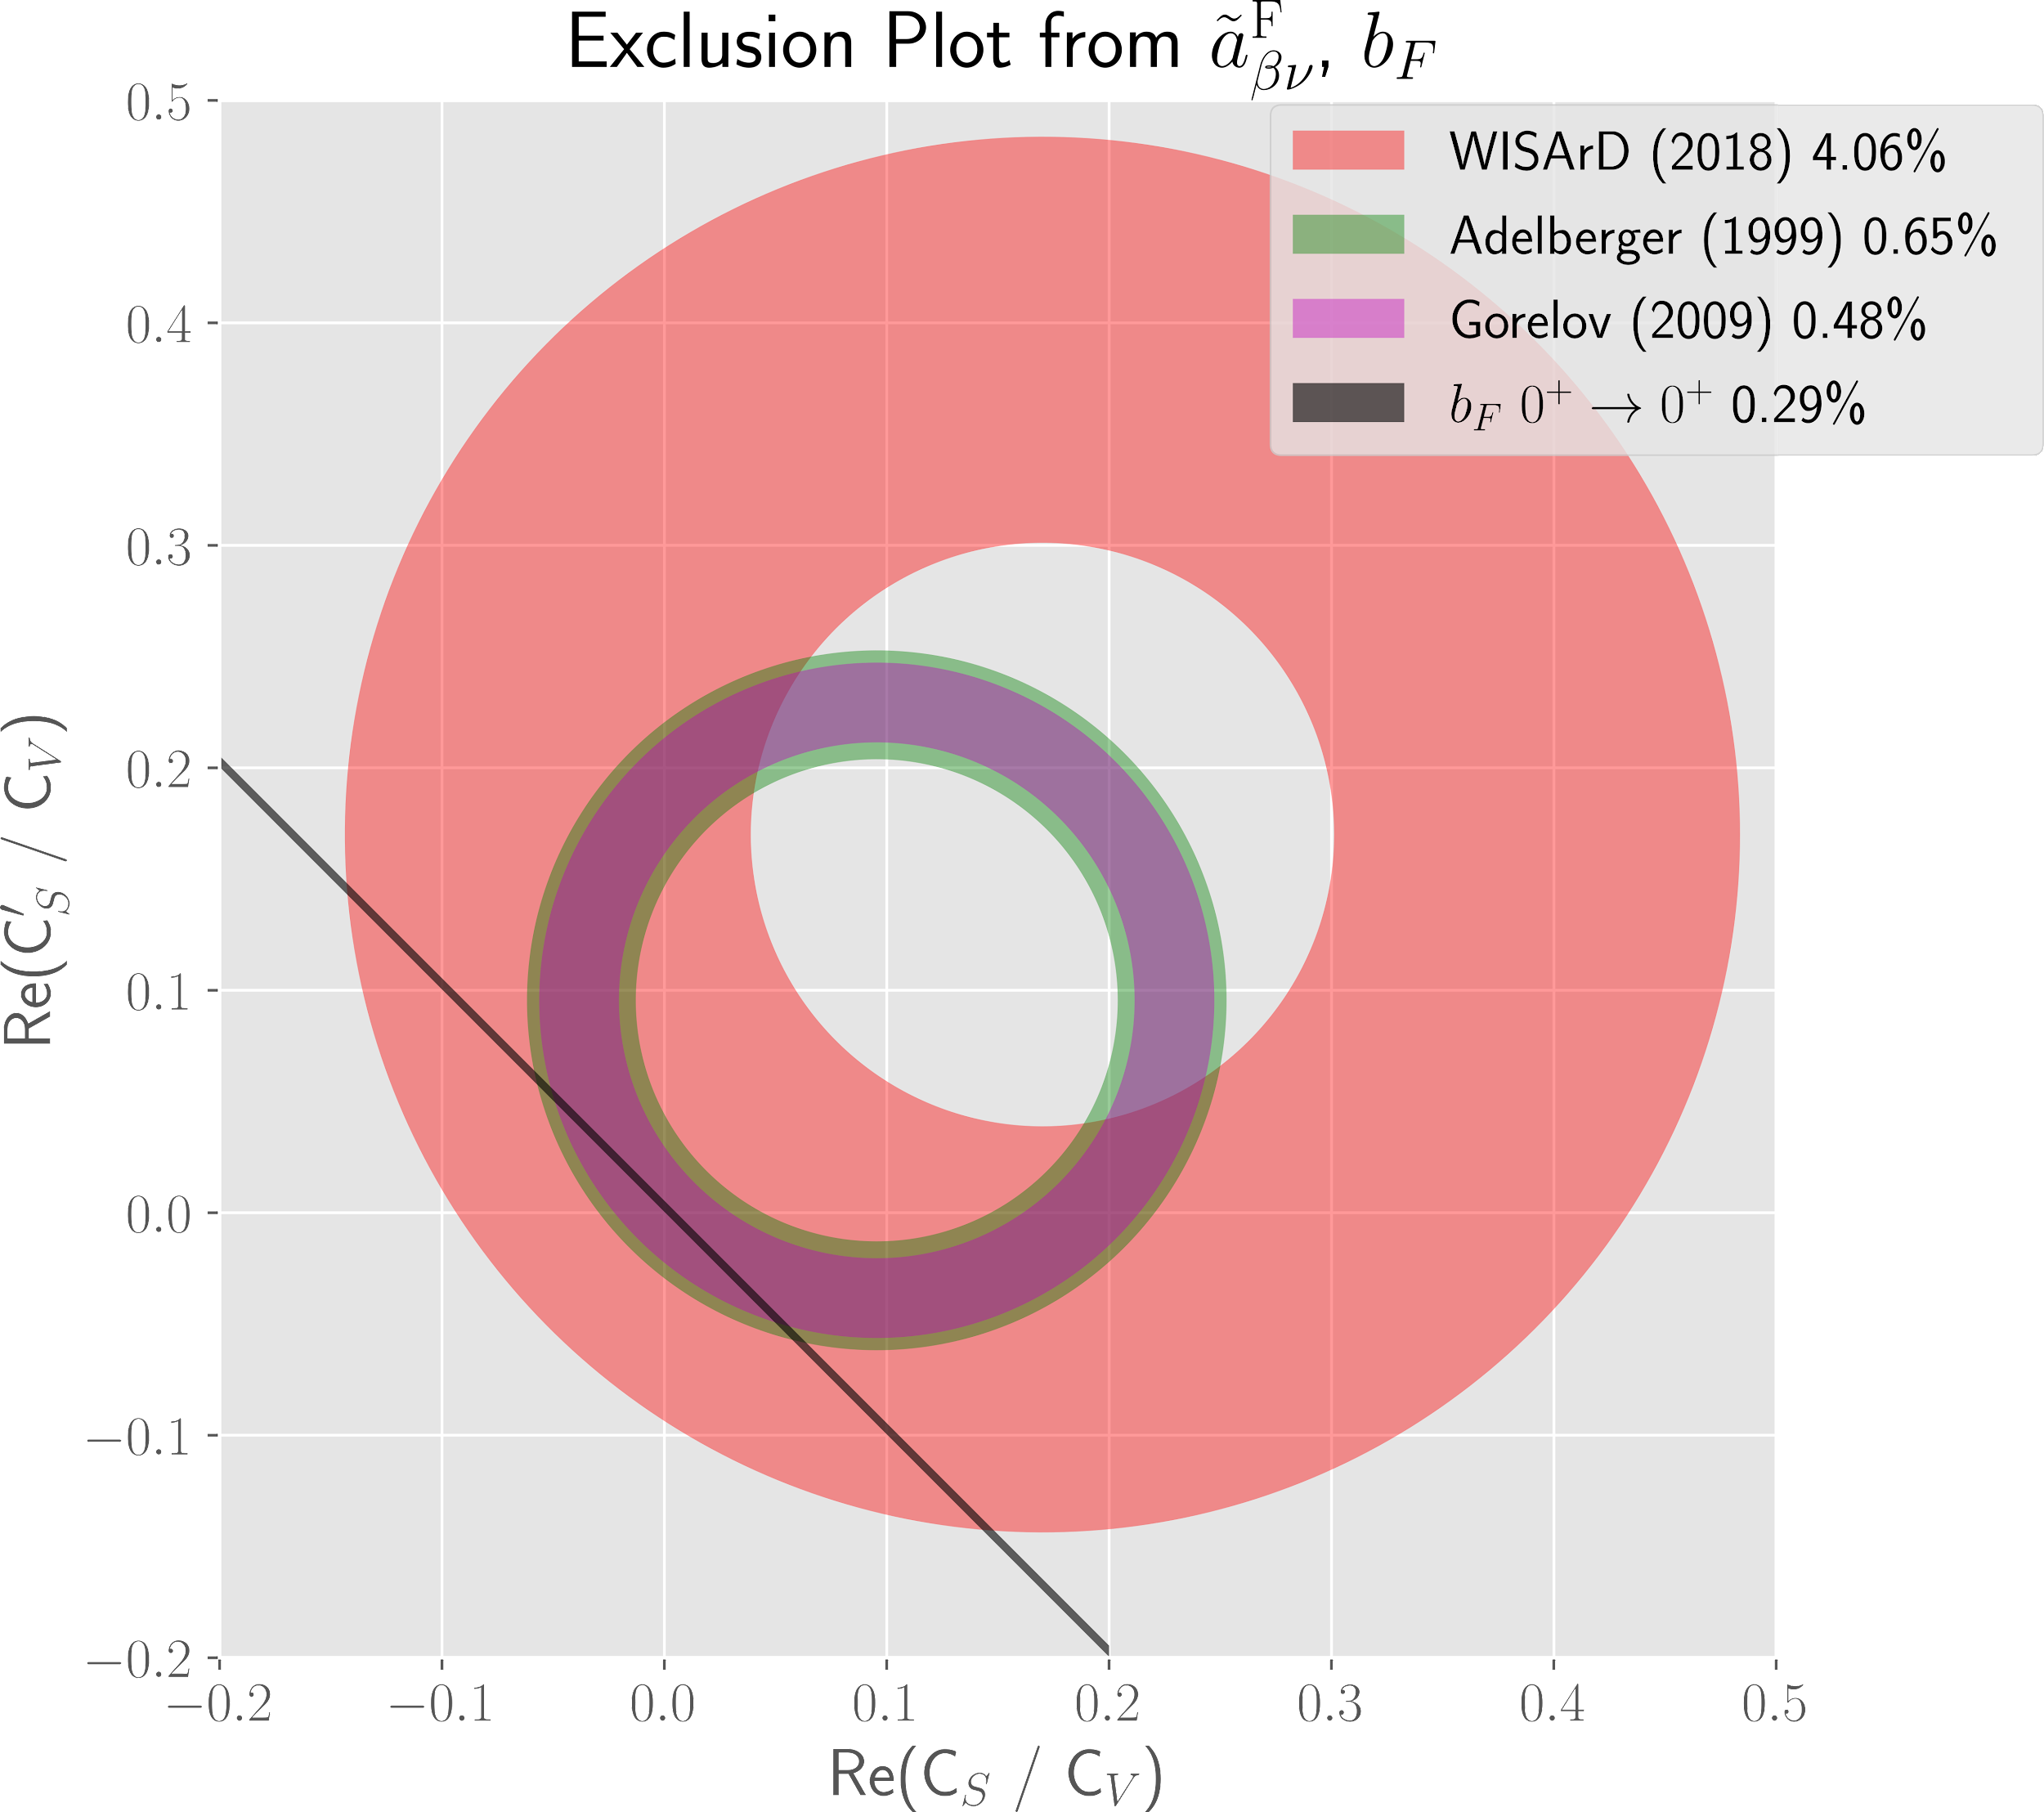
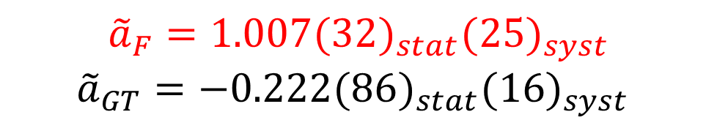
• • • Limits on scalar currents: 2018
after 35h collection
N_{coinc} ≈ 1e5
3rd best result
V. Araujo-Escalona et al. Phys. Rev. C101, 055501 (2020)

Slide 29
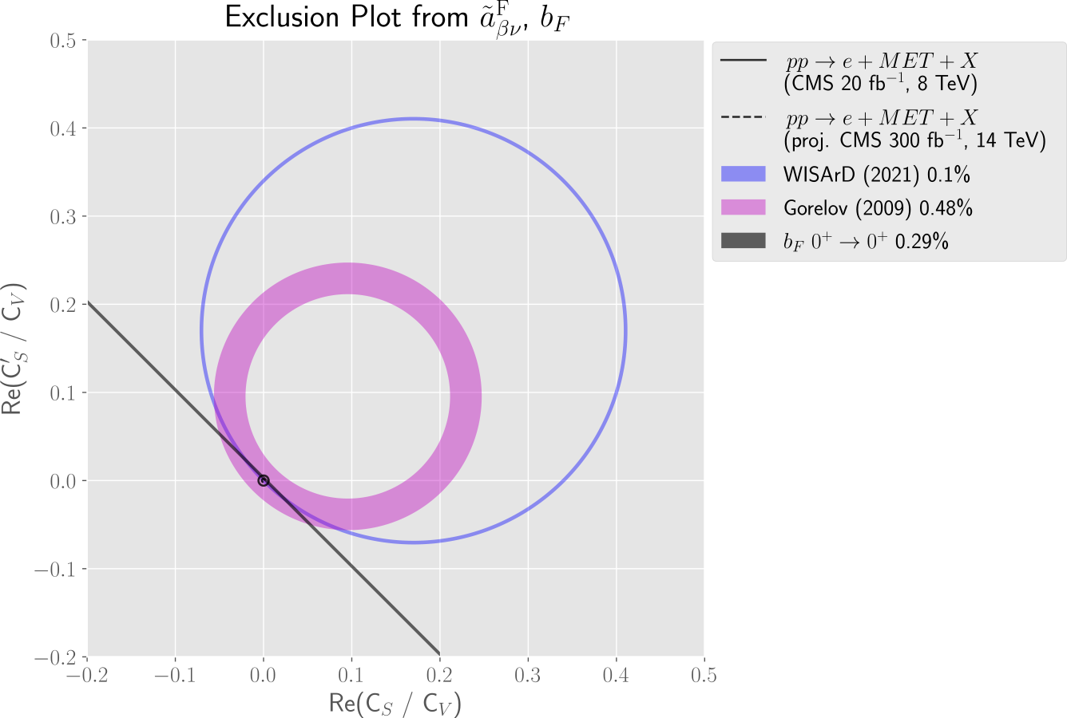
• • • Limits on scalar currents: 2023-4
Precision ≤ 0.1% needed to complement LHC searches!
(2023) 0.1%

Slide 30
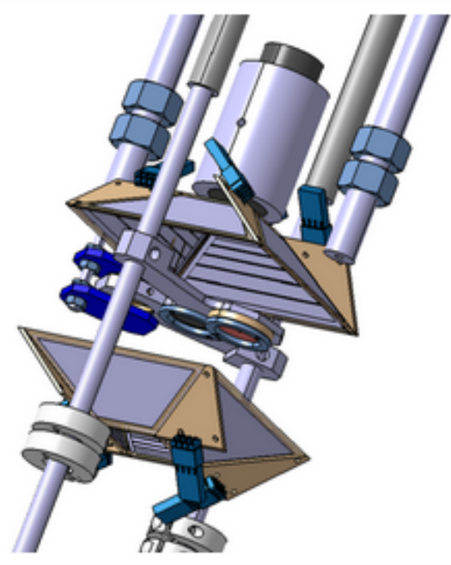
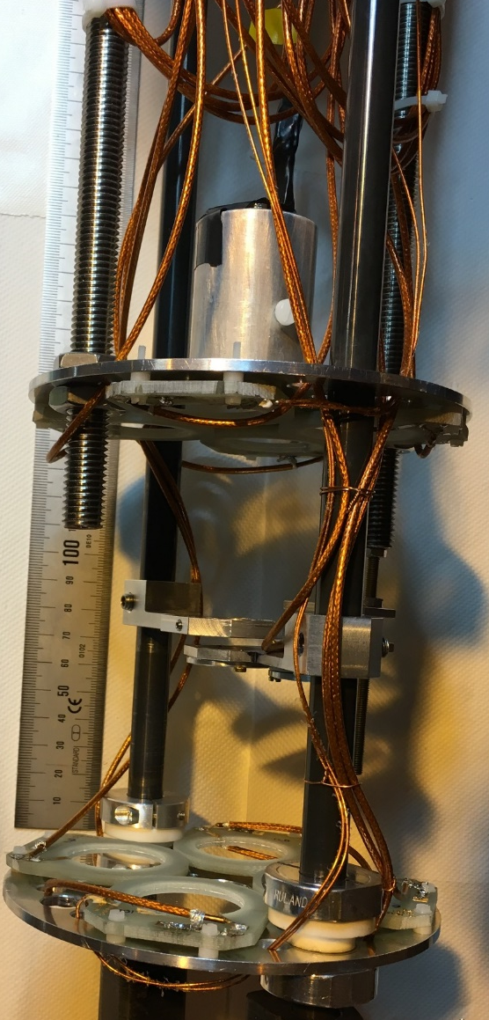
• • • WISArD upgrades 2019 - 2021
2018
Beta detector* + SiPM
2021
9 SiPMs instead of 1
characterisation with 2 e- spectrometers
lower thresholds
Catcher***
➔ two catchers (0.5 and 1 μm)
proton detectors planes**
beam transport line
* Plastic scintillator;
** Silicon surface-barrier (thickness = 300 μm);
*** Aluminized Mylar (thickness = 6.7 μm)
* Plastic scintillator – EJ200;
** MICRON single-sided silicon-strip (thickness = 300 μm);
*** Aluminized Mylar (thickness = 0.5 + 1.0 μm)

Slide 31
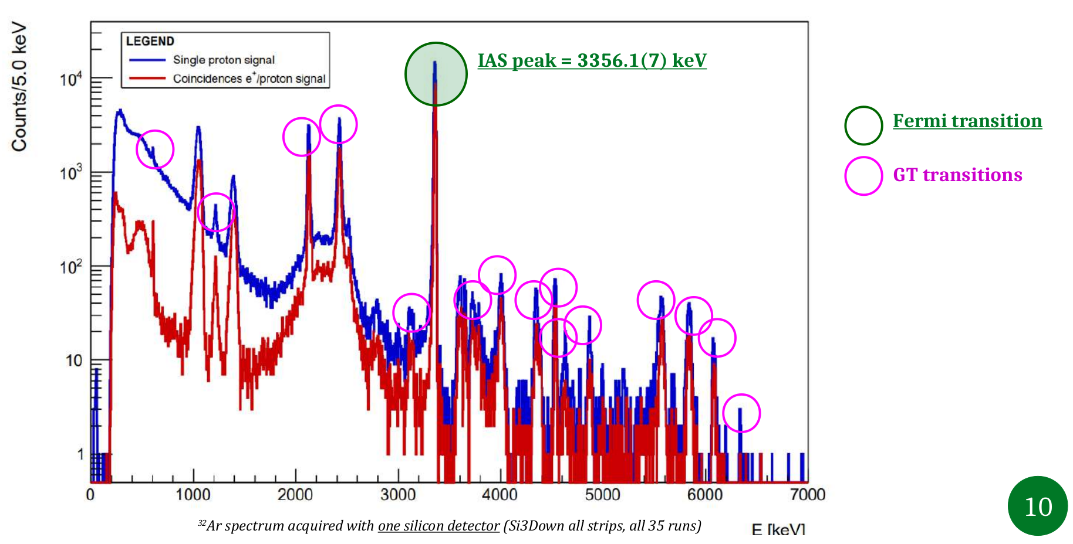
• • • WISArD 2021 test experiment
ã^{F}_{βν} = 1.002(17)_{stat}
all components work, but not yet always together…
3 WWW (WISArD Working Weeks) since then
new data taking expected in late 2023 or beginning 2024
➔ aim of 0.1 - 0.2% precision on a_{βν} and b

Slide 32
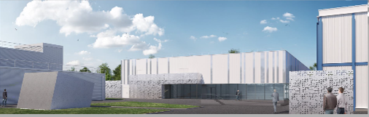
• • • WISArD: possible longer-term future
after the end of the ³²Ar measurements:
possibility with ²⁰Mg βp decay
➔ higher sensitivity, but lower production and purity
possibility with ⁸B and/or ⁸Li βαα decay
➔ sensitivity estimates underway
possible long-term future: DESIR facility at GANIL
➔ higher production rates, pure beams ➔ 2027 onwards
Artist’s view of DESIR facility

Slide 33









• • •
Thanks to Instrumentation
and Mechanics Services
Thanks for your attention

Slide 34
• • •
Search for scalar contributions

Slide 35

• • • 0⁺ → 0⁺ decays: limits on exotic currents from Fierz term
standard model assumption: only vector current
if scalar currants, we obtain for F t
F t ➔ F t * (1 + $\frac{y bF}{<W>}$), y ²= 1 – Z²α²
limit on scalar current from term in F t function: (1 + b_{F} y / <W>)

Slide 36
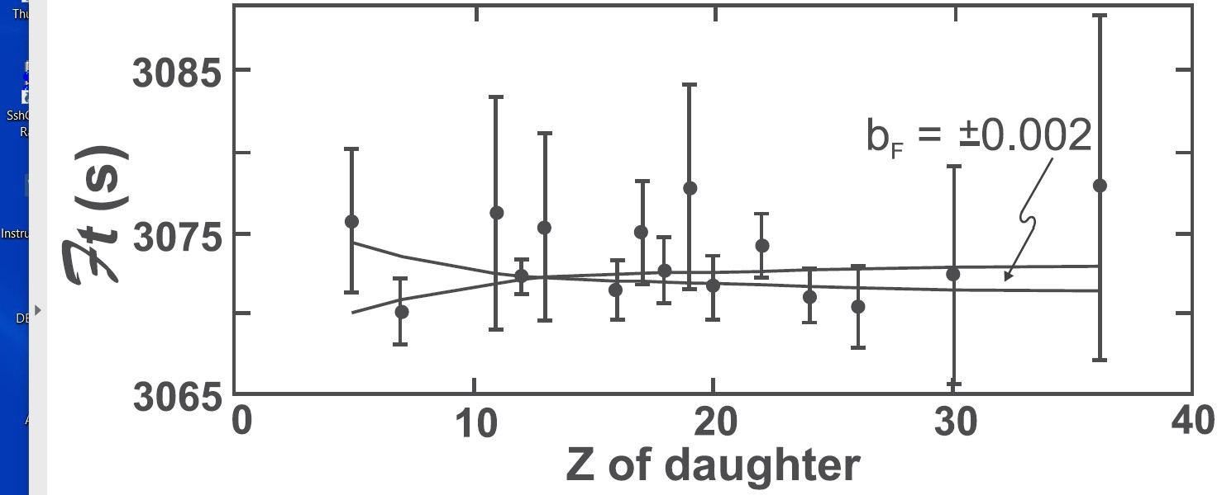
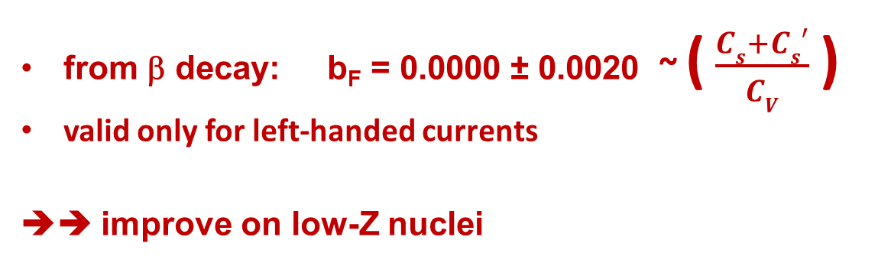
• • • 0⁺ → 0⁺ decays: limits on exotic currents
Hardy & Towner, 2020
from β decay: b_{F} = 0.0000 ± 0.0020 ~ ( $\frac{Cs+Cs′}{CV}$ )
valid only for left-handed currents
➔➔ improve on low-Z nuclei
Hardy & Towner

Slide 37


• • • 0⁺ → 0⁺ decays: ¹⁰C error budget
BR by far largest error
two precise measurements:
  Savard et al.: 1.4625(25)%
  (PRL 74 (1995) 1521)
  Fujikawa et al.: 1.4665(38)%
  (PLB 449 (1999) 6)
  measurements with Ge
  multi-detector array
our approach:
re-measuring the BR of ¹⁰C
with out precisely calibrated
Germanium detector
¹⁰C

Slide 38




• • • ¹⁰C measurement at ISOLDE
Proton beam at 1.4 GeV and 2μA
Target: CaO
Source: VADIS
catcher
profiler

Slide 39




• • • ¹⁰C experimental set-up and analysis procedure
¹⁹Ne:
similar T_{1/2}
similar Q_{EC}
no 1022 keV peak, only 511-511 pile-up
¹⁰C: 1022 keV line + 511+511 pile-up
N(1022) =
N(511)² * τ
pile-up shape
and intensity adjusted with 511keV peak,
¹⁹Ne + sim.

Slide 40

• • • Super-allowed ranching ratio of ¹⁰C
Blank et al., EPJA56 (2020) 156
next attempt:
higher statistics: difficult…
higher purity: MR-ToF selection
Final result: 1.4638(50) %
Literature: 1.4646(19) %
main errors: statistics: 0.0039 %
pile-up: 0.0030 %

