Slide 1

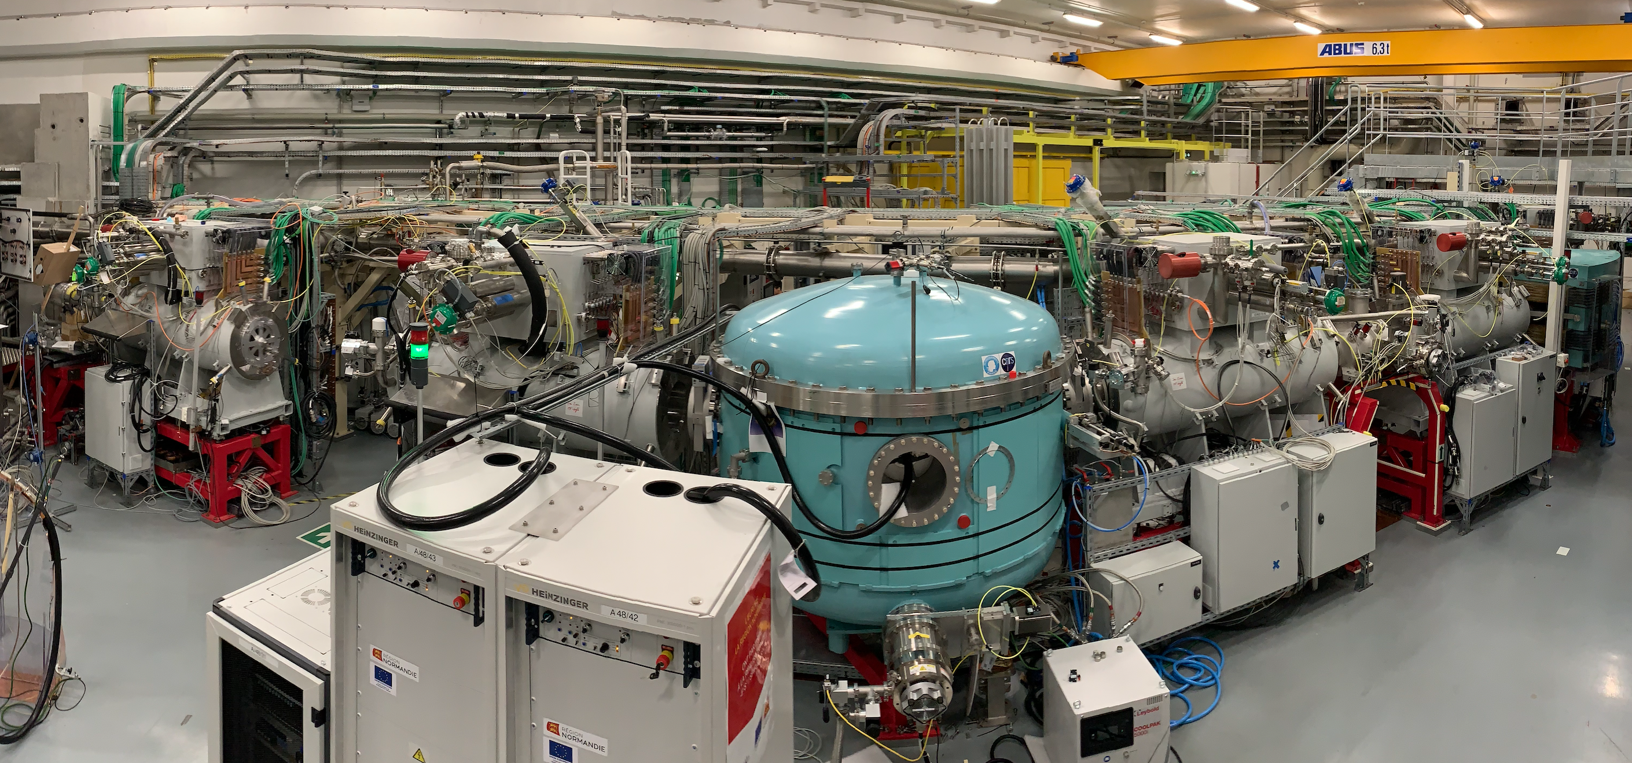



Super Separator Spectrometer S³
Opportunities for UK Physicists at GANIL/SPIRAL2
H. Savajols on behalf of the S³ collaboration
S3 has been funded by the French Research Ministry, National Research Agency (ANR), through the EQUIPEX (EQUIPment of EXcellence) reference ANR-10EQPX- 46, the FEDER (Fonds Européen de Développement Economique et Régional), the CPER (Contrat Plan Etat Région), and supported by the U.S. Department of Energy, Office of Nuclear Physics, under contract No. DE-AC02-06CH11357 and by the E.C.FP7-INFRASTRUCTURES 2007, SPIRAL2 Preparatory Phase, Grant agreement No.: 212692.
1
http://pro.ganil-spiral2.eu/spiral2/instrumentation/s3

Slide 2
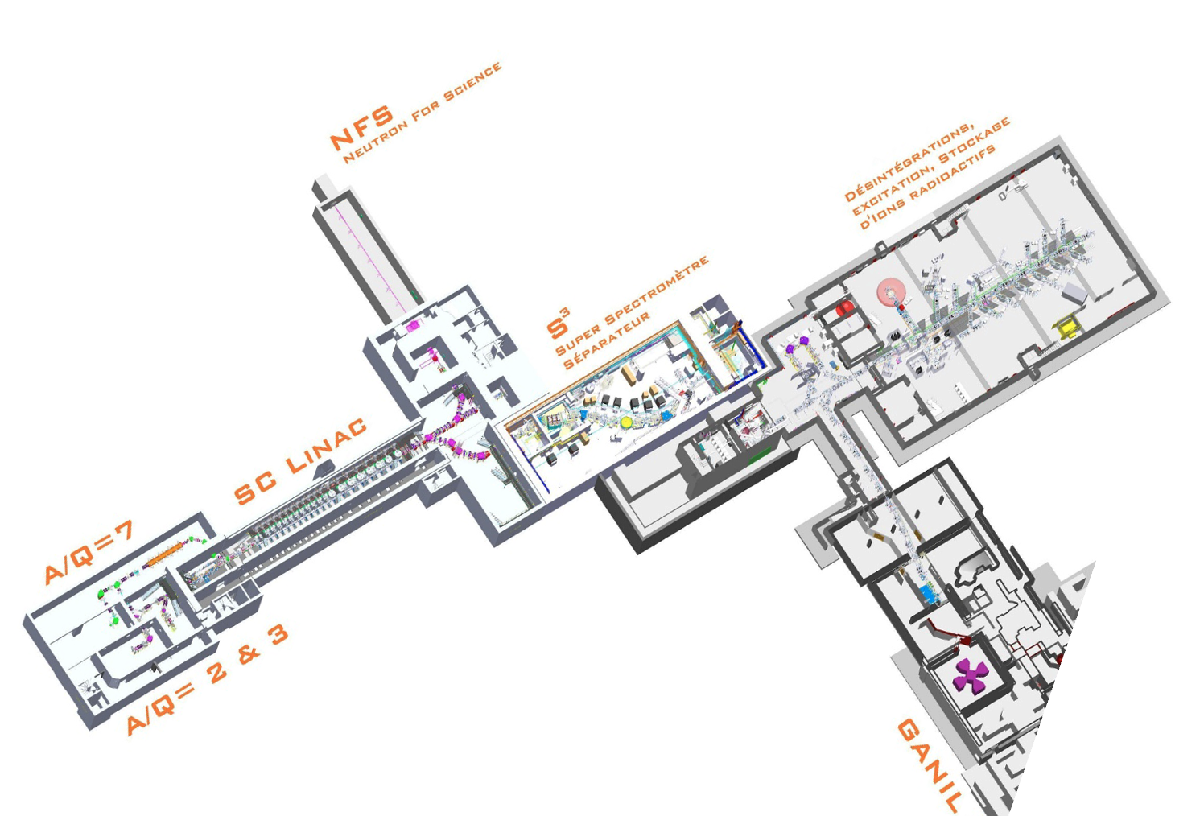




Super Separator Spectrometer
Projet :
Budget ≈ 23.3 M€
FTE ≈ 450 (32,8 FTE 2022)
8 partner laboratories
Commissioning 2025
LINAC beams : He to U
1 mA, < 14,5 MeV/A (A/Q=3)
1 mA, < 7,5 MeV/A (A/Q=7)
Ions | Intensity (pµA) Phoenix V3 RFQ A/Q≤3 | Intensity (pµA) Phoenix V3 RFQ A/Q≤7 | Intensity (pµA) SC Ion Source RFQ A/Q≤7
¹⁸O | 80 | * | 375
¹⁹F | >15 | >40 | >40
³⁶Ar | 16 | 70 | 45
⁴⁰Ar | 3.6 | 70 | 45
³⁶S | 2.3 | * | *
⁴⁰Ca | 2.9 | 10 | 20
⁴⁸Ca | 1.2 | 10 | 20
⁵⁸Ni | 1.1 | 4 | 8
⁸⁴Kr | 0.1 | 10 | 20
Scientific collaboration:
27 Laboratories
11 countries : France, Finland, Germany, Hungary, Italy, Poland, Slovakia, Spain, Sweden, U.K., USA
2

Slide 3
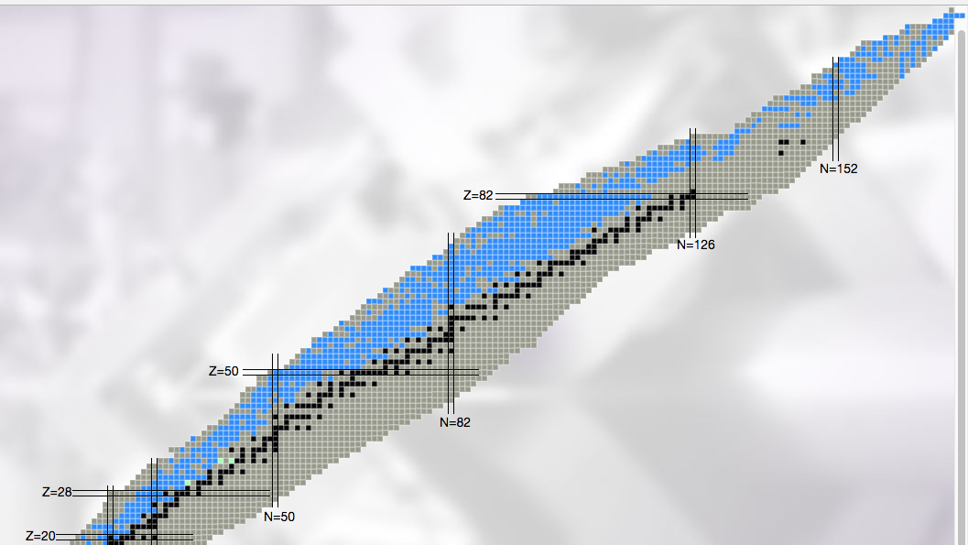
Physics goals
Study of rare events in nuclear and atomic physics
Proton Dripline & N=Z nuclei
Nuclear structure
Study the role of π-ν correlations
Deformation – shape coexistence
Exotic decay
Astrophysics rp-process
Fundamental interaction
Nuclei produced by
Fusion-Evaporation
(with refractory elements)
Heavy and Superheavy
Elements
Limit of the nuclear existence
Nuclear structure
Reaction mechanisms
Atomic properties
⁵⁸Ni+⁴⁶Ti→¹⁰⁰Sn +4n
I=10pµA ➔ 10/s
RIBF : 0.7/s
FAIR : 2/s & FRIB : 8/s
⁴⁸Ca+²³⁸U→²⁸²⁻²⁸³Cn+3,4n
(I=10pµA) ➔40evt/week
Develop a comprehensive model of atomic nuclei – How do we understand the structure and stability of atomic nuclei?
Understand the origin of elements
Use of atomic nuclei to test fundamental symmetries and properties
http://u.ganil-spiral2.eu/chartbeams/
3
Notes:
How deformation emerge from microscopic configuration

Slide 4
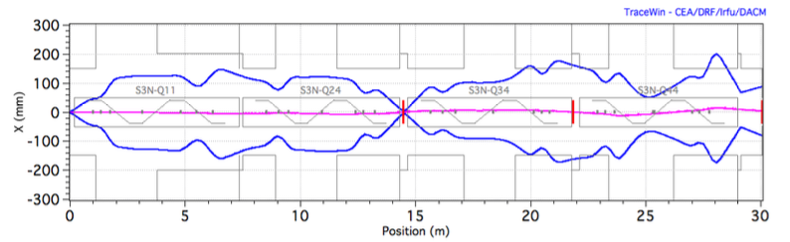
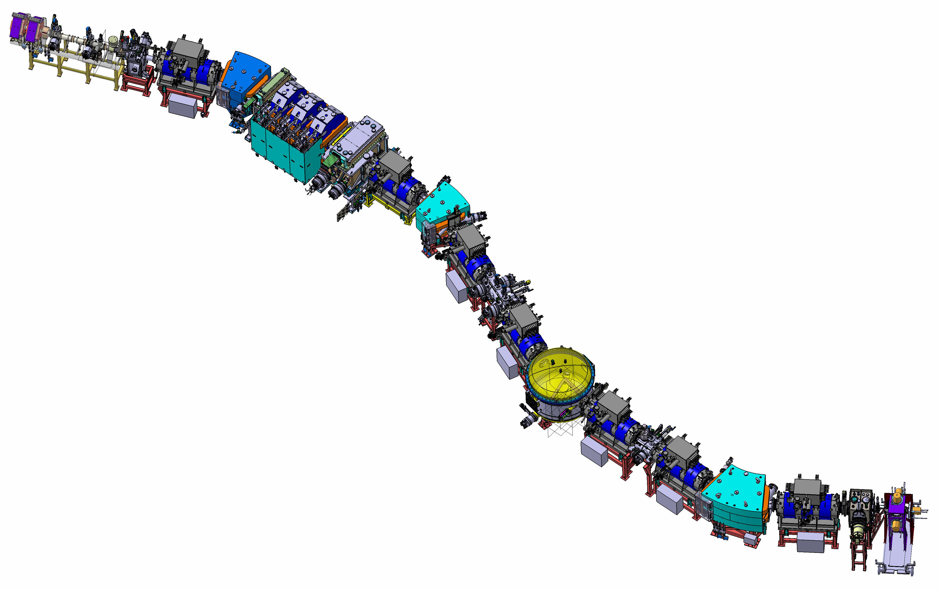
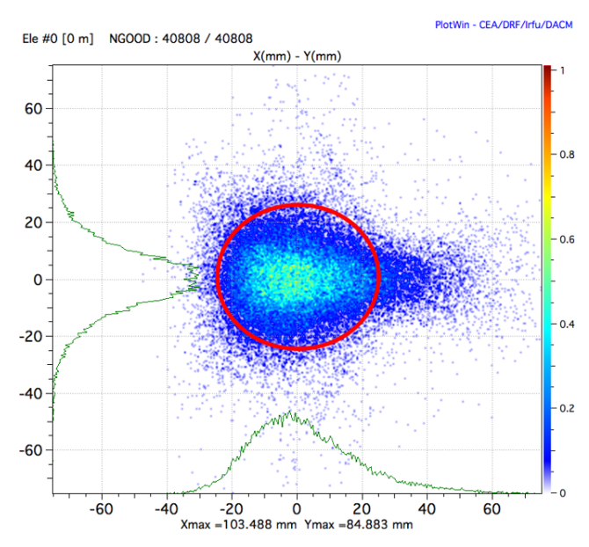
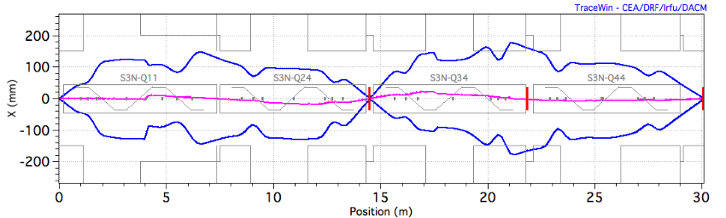
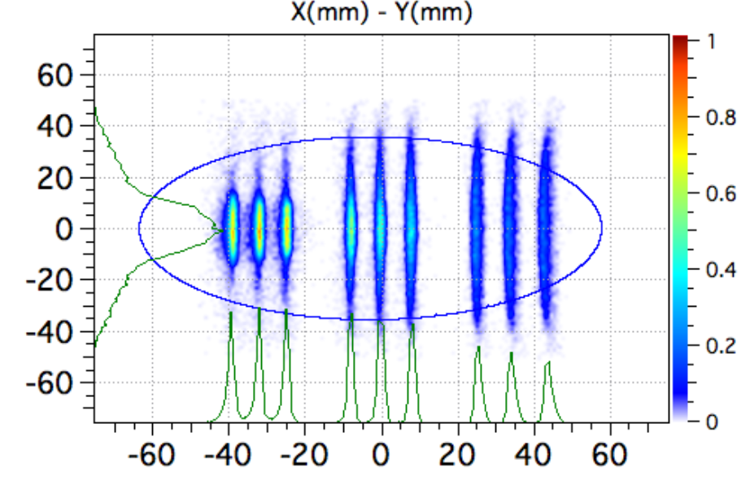
Optics and performances
Reference beam :
A=100, Q=24+, 𝛔_{p} = 3.7%, 𝛔 _{θ} = 18mrad
Basic properties and functionalities
Convergent Mode (CM)
No mass resolution
6 charge states
𝚫dp/p=20%,
𝚫𝝦=90mrad,
𝚫𝛗=140mrad,
¹⁰⁰Sn transmissions 65%
(10x10cm)
High beam intensity
  High power target: >> 1pµA (= 6.10¹²p/s)
F1
Achromatic point
F0
Target position
Final focal plane
Primary beam dump
F2
  Versatile multistep separator
  Momentum achromat + Mass separator
  Ion optics configuration: Q³DQ³Q³DQ³Q³EQ³Q³DQ³
  F1 : R16=1.15cm/%
  F2/F4 : R16 = R26 = 0
  F3 : R16 = -1.73 cm/% / -1.59 cm/%
Secondary beam dump
F3
F4
High Resolution Mode (HRM)
m/q dispersion = 8 mm/%
3 charge states & M/𝚫M = 500
𝚫dp/p=16%
𝚫𝝦=45mrad
𝚫𝛗=140mrad)
¹⁰⁰Sn transmissions 40%
(10x10cm)
Two basic optical modes of operation:
High transmission vs high mass resolution
→ The momentum achromat (MA) optic is common to all modes
4

Slide 5
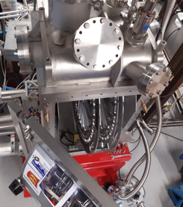

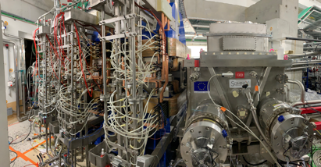

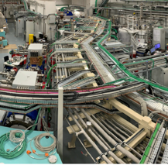
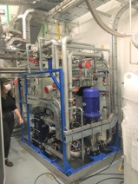
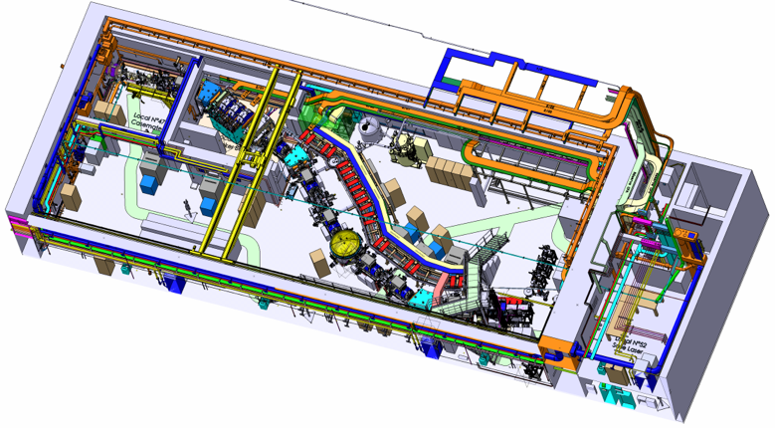

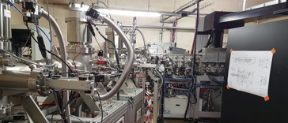
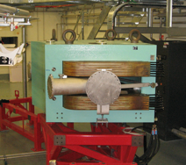


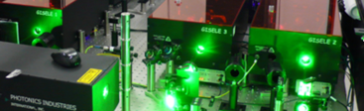


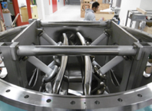
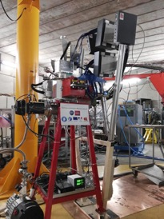
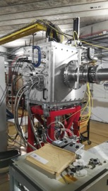
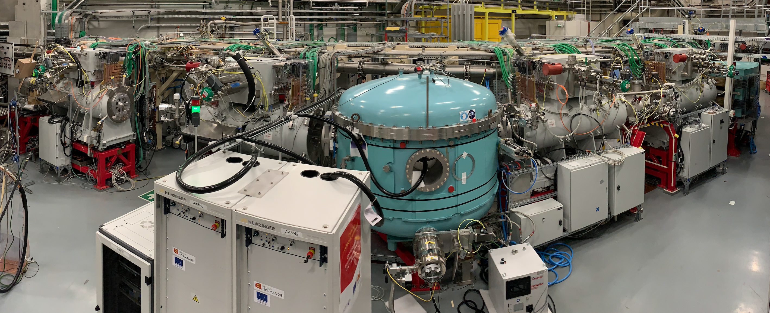


Super Separator Spectrometer
Main equipment and detection setups
Open RT magnet & beam dump & Movable fingers
Lot C68, Cooling system, Laser room …
Dispersive zone
Infra / Interface
Target system
High power rotating targets
LEB @ LPC & GISELE Laser Lab
LEB
3 × M-dipoles
Large H & V gaps
DSSD, SSD, FEE/BEE, DAQ & Diagbox
SMT, PSS, Coldbox & LTC
E-Dipole
SC Multipoles
SIRIUS
20 cm gap & +/- 300 kV
Open slit in the anode
High selectivity > 10¹³ - High efficiency 50% - In flight mass separation > 1/450
Versatility & unique instrumentation (SIRIUS – LEB)
5

Slide 6
Status of the beamline
Target station
  → on-line commissioning at GANIL in 2023 / on-line commissioning at LINAC planned end 2024
Room temperature magnets (3 magnetic dipoles & open multipole triplet)
  → power-up tests done 2023
Electric dipole (chamber, electrodes and 300kV power supplies installed)
  → first successful test (75 kV) 2023 & final conditioning beginning 2024
SMT, PSS & Cryogenics (7 PSS & 7 SMT delivered & cryo line installed and tested)
  → SMT1-4 tested, SMT5 misunderstood quenches/fast discharges to be investigated in 2023
  Many crashes of the cold box turbines since May 2022 (New cooling down sequence October 2023 !)
  → Finalised SMT tests in 2023-2024
  → Finalise 3D magnetic field measurement & alignment in 2023-2024
  → All SMT in final position, tested and connected Q3 2024
Beam dump (2 chambers, translation mechanisms, fingers and shielding delivered)
  → dump plates / cooling pipes assemblies installed end 2024
6

Slide 7
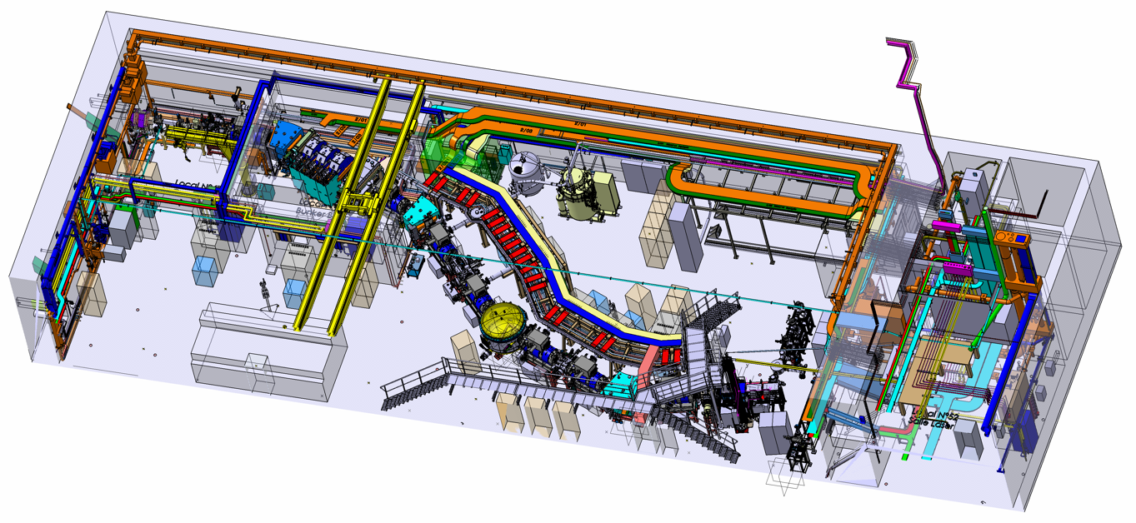
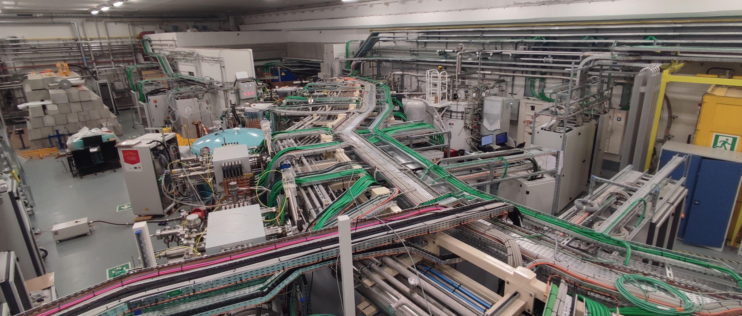
Status of the beamline
Level of completion
Target station
Beam Dump
Superconducting Multipole Triplets
and Power-Supply Systems (x7)
Cryogenics
Dipole 1
Dipole 2
Ready for beam commissioning 2025
Open RT Triplet
Electric Dipole
Dipoles 3
Level of completion ≈ 85 %
7

Slide 8
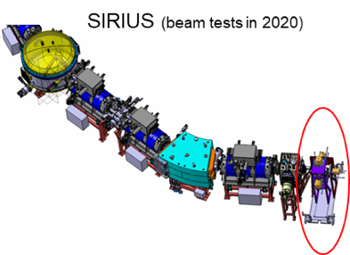




Detections systems
Spectroscopy
S³-SIRIUS
(Spectroscopy & Indentification
of Rare Ions Using S³)
Evolution of shell structure
Collective vs single-particle degrees of freedom
Deformation & shape coexistence
MQ & Z identification
$α$, SF, e⁻, $γ$ decay spectroscopy
Limits of the nuclear chart
New isotopes
Fission branches & half lives, properties of fission fragments
Fission hindrances of single-particle and high-K states
Reaction mechanism
Systematic measurement of cross sections & excitation
functions
8

Slide 9
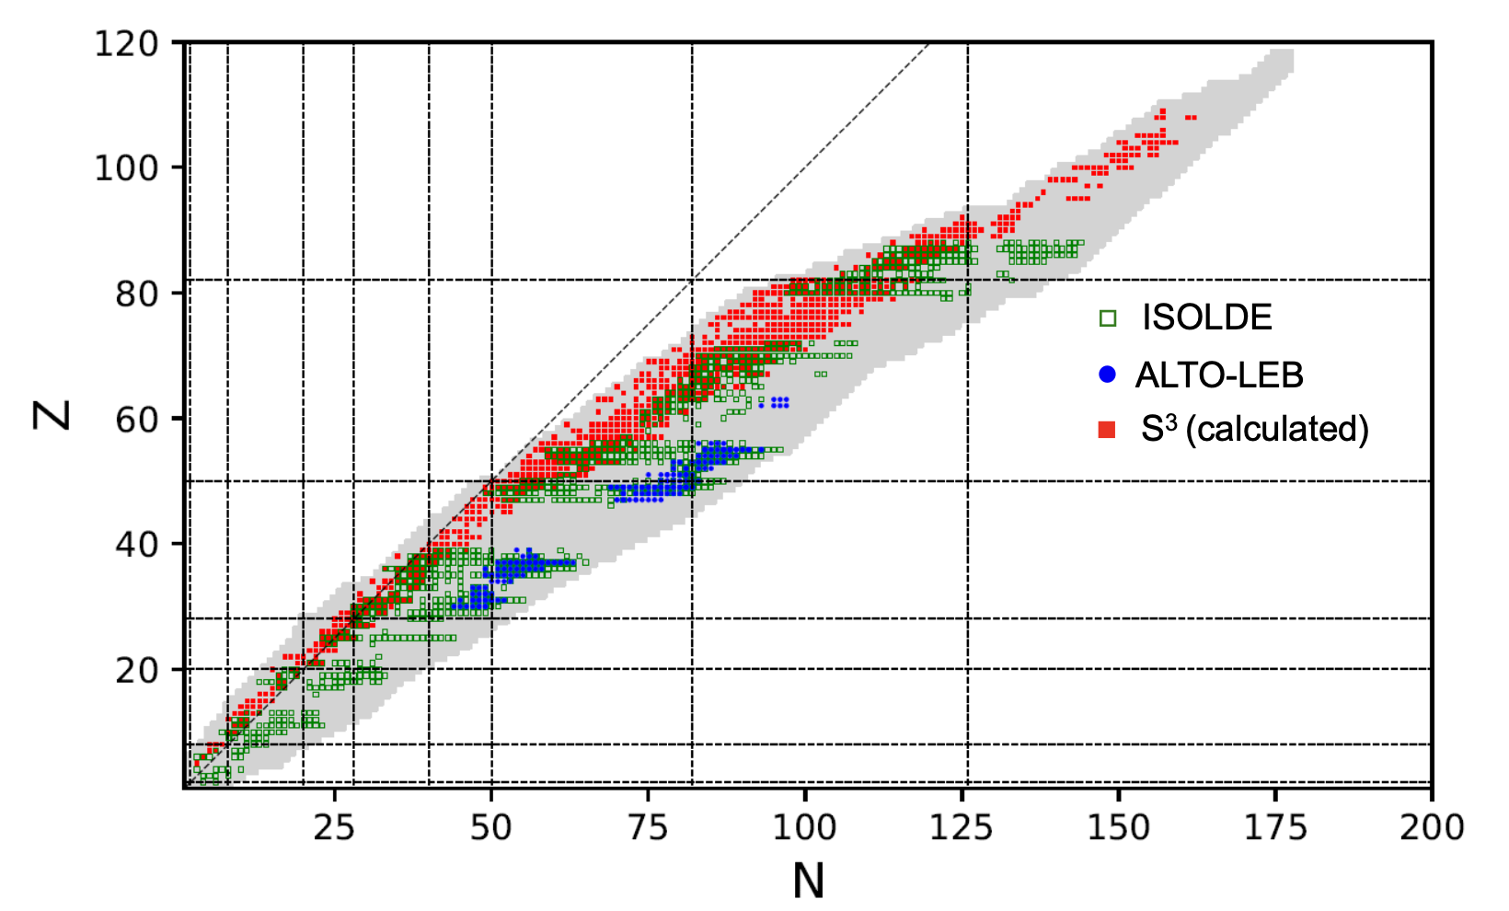
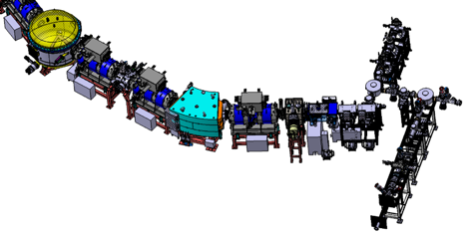



Detections systems
S³-LEB
(Low Energy Branch)
Tasks
Provide pure & low energy beams
Provide access to species not available by other techniques
Laser & decay spectroscopy
Mass measurement
Fundamental properties
Nuclear Moments / Charge radii / Spin
Mass
Decay spectroscopy
9

Slide 10
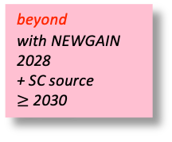
Science program ”day1” & beyond
2018 LoIs
Study of heavy nuclei
beyond
with NEWGAIN
2028
+ SC source
$≥$ 2030
”day1 ” - preproposals
152
162
184
SIRIUS
Isomers
²⁵⁴Rf, ²⁶⁰Sg
120
S³ LEB
114
Search for new isotopes
²⁵²Rf
relativistic effects and the architecture of the periodic table
rutherfordium/dubnium isotopes
108
Limits of stability/isomers
^{250,249,…}No
E_{shell}
Atomic spectroscopy
(isomers, shapes and moments)
fermium isotopes
Odd Z isotopes – nuclear structure
fermium region
Calc.: A. Sobiszewski
“day 1”
with injector1
Octupole deformation
uranium region
N = 126 shell closure
Ac - Th region
Courtesy of D. Ackermann (GANIL)
10

Slide 11
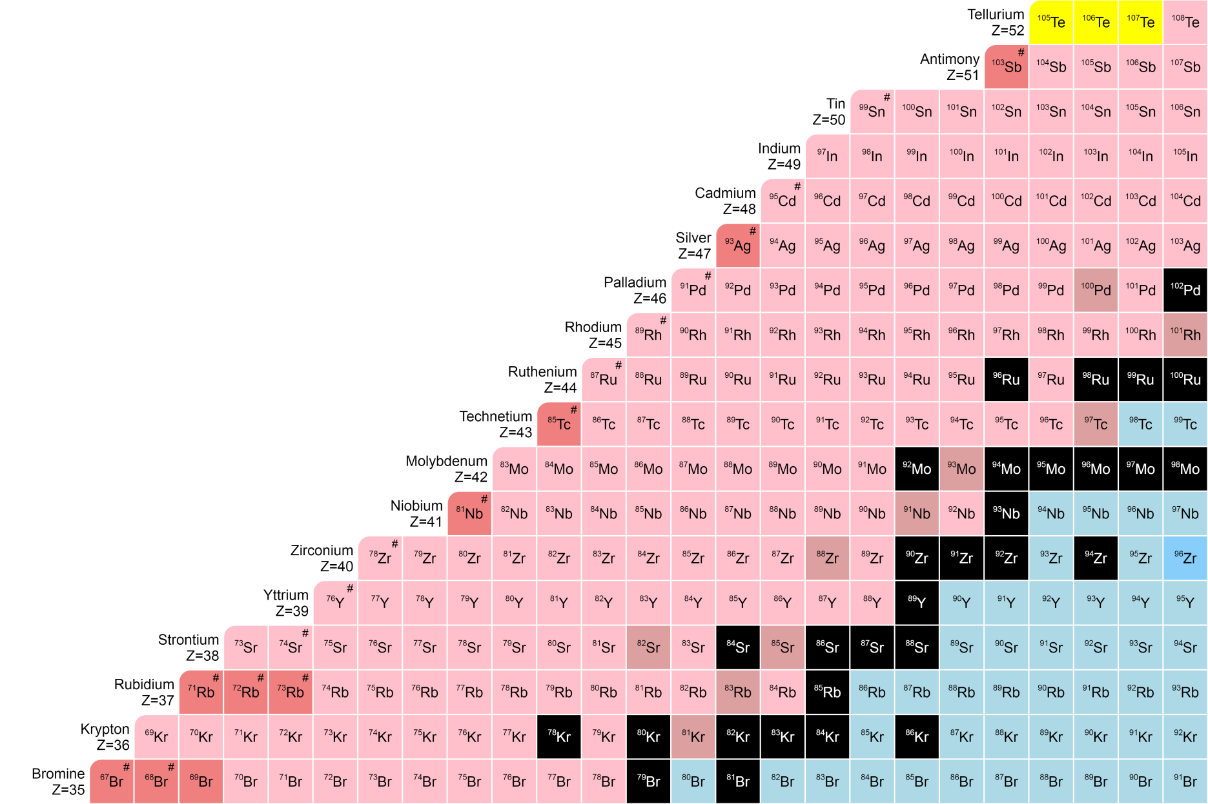
Science program ”day1” & beyond
2018 LoIs
Study of N=Z nuclei
N = Z
”day1 ” - preproposals
S³ LEB
SIRIUS
Known masses
Nucleon-Nucleon interaction around ¹⁰⁰Sn?
Effective Single particle energy levels: ¹⁰¹Sn, ⁹⁹In
T = 0 T = 1 Pairing interaction: ⁹⁸In
Spin-aligned coupling scheme: ⁹⁴Ag, ⁹⁰Rh
How deformation emerge from microscopic
configuration ?
Q in Sn chain
Evolution of deformation around ⁸⁰Zr (refractory elements)
Binding energies and Wigner term ?
From ⁸⁰Zr-¹⁰⁰Sn
rp-process
New decay modes ?
Super-allowed α decay: ¹¹²Ba-¹⁰⁸Xe-¹⁰⁴Te
Cluster radioactivity: ¹¹⁴Ba, ¹¹²Ba
Courtesy of L. Caceres (GANIL)
11

Slide 12
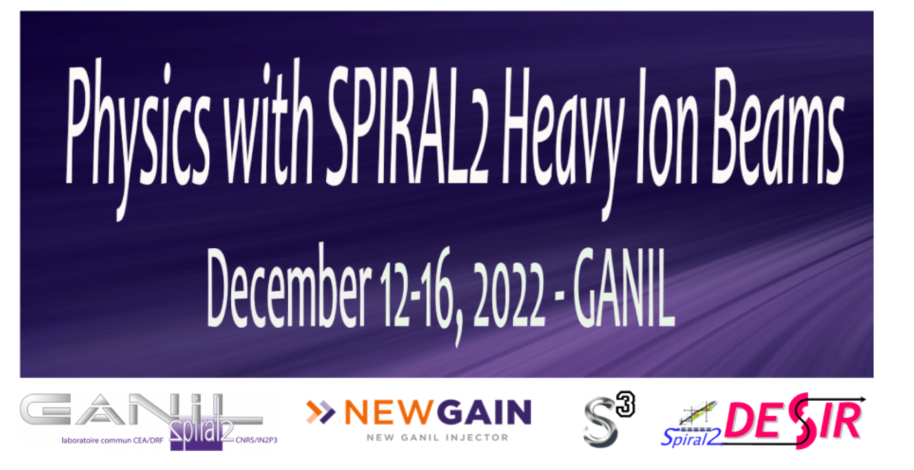
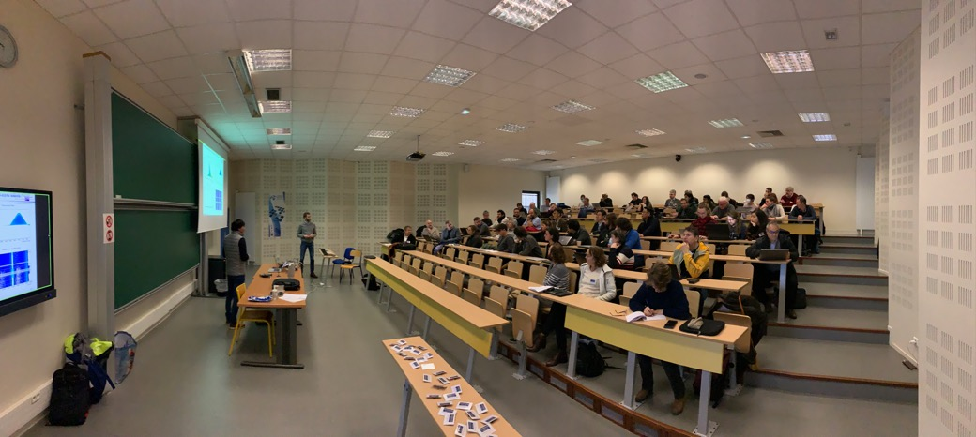
Collaboration & Scientific program
Belgium
CERN-Isolde
Germany
Slovaquia
Finland
France
UK
Italia
Japan
Corean
Poland
Romania
United States
105 registered participants (13 countries)
Strong & diverse community ∼ 70 talks
Revised S³ LoIs 2018
  SIRIUS : Some experiments have been performed but have open new questions / some of the program are
  still relevant (K-isomers, XS, fission, alpha-decay) / ⁴⁸Ca shortage is an issue
  LEB : Scientific program is still relevant with high scientific impact
New idea and further developments
  Molecular laser spectroscopy at S³-LEB (start with stable Lanthanide molecule)
  New proposal to install a tape station for beta decay spectroscopy in ¹⁰⁰Sn region at S³-LEB
  X-rays measurement with SIRIUS / Faster gas cell is needed in future (ANR FRIENDS3: V. Manéa IJCLAB)
General remarks
  S³ has a very strong and diverse community → Full synchronisation among all team is essential
  Important to identify our “starting niche” for select impactful results
12

Slide 13
Separator Spectrometer commissioning
Global strategy
Optical commissioning :
  Progressive tuning of the elements with direct and scattering/stripped beams (Momentum achromat + Mass spectrometer)
  Tools : all diagnostics along the spectrometer + additional diagnostics at the focal plane (SIRIUS & LEB can be connected but not used)
Scientific commissioning :
  Optimize the rejection and the transmission for relevant kinematics to reach the required performances
    Converging Mode (CM)
    High Resolution Mode (HRM) important for the SIRIUS scientific program
  Setup : Diagnostic box in LEB mode + LEB / SIRIUS
SIRIUS and LEB commissioning with S³ beams in parallel with the 2 steps.
  Reference reactions with easy beams and targets to produce nuclei which large XS that are alpha emitters and easy to identify (asymmetric / very asymmetric / symmetric reactions)
  Direct comparison of spectrum quality and various other performances with cases that have also been studied elsewhere (e.g. using the gas-filled separator RITU at JYFL, the VASSILISA at JINR)
  Possibility of scientific data taking during the so-called commissioning for SIRIUS and LEB.
Given the complexity of S³ the commissioning and the associated focal plane detection, two years will be necessary to reach adequate performances to start day1 campaigns with experiments selected by the PAC (SIRIUS / LEB)
13

Slide 14
Commissionning plan endorsed by S³ UCC (20 Juin)
Milestone J6a : LINAC beam delivery up to the S³ target end 2024
  LHS3N accelerator beam line test up to LHS3N-CF24
  Beam spot optimisation on the target (S3N-CF12) and beam synchronisation
Block 4 (Converging mode) : LEB
Reaction 4: asymmetric reaction ⁴⁰Ar + ¹⁷⁵Lu to produce actinium (N=126)
Reaction 5: symmetric reaction ⁵⁰Cr + ⁵⁸Ni to produce N = Z nuclei
Reaction 6: very asymmetric reaction ²⁰Ne + ¹⁹⁷Au to produce actinium (N=126)
Block 5 (Converging/ High Resolution modes) : SIRIUS
Reaction 7: very asymmetric reaction ²²Ne + ²⁰⁶Pb to produce thorium
Reaction 8: repeat asymmetric reaction ⁴⁰Ar + ¹¹⁶Sn to produce ¹⁵¹⁻¹⁵²Er
Reaction 9: repeat asymmetric reaction ⁴⁰Ar + ¹⁷⁴Yb
Reaction 10: ⁴⁰Ar + ²⁰⁹Bi to populate mendelevium isotopes ²⁴⁴⁻²⁴⁷Md
Block 1 : Spectrometer optical commissioning
Block 2 (Converging Mode) : LEB
Reaction 1: asymmetric reaction ⁴⁰Ar + ¹¹⁶Sn to produce erbium (N=82)
Block 3 (Coverging mode) : SIRIUS
Reaction 2: asymmetric reaction ⁴⁰Ar + ¹⁷⁴Yb to produce known actinides
Reaction 3: asymmetric reaction ⁴⁰Ar + ¹⁸⁰Hf to produce thorium (N=126)
14

Slide 15
Conclusion
Development of the S³ project is progressing well
  Spectrometer : ready for beam commissioning in 2025
  LEB : off-line tests at LPC completed / installation at S³ in 2024 for commissioning
  SIRIUS : in beam test at GANIL in 2023 / installation at S³ (room 51) in 2024 for source tests
Scientific program and campaigns setting
  Commissioning plan defined
  3 months day1 campaign selected for each set-up (SIRIUS & LEB) in 2018
  U.K. scientists involvement (6 LoIs)
    Decay Spectroscopy of ²⁵³Rf and ²⁵⁷Sg (Universities of Liverpool & York )
    Alpha-decay spectroscopy of odd-Z isotopes in fermium region (University of York)
    Search for new isotopes: ²⁵²Rf and ²⁵⁶Sg (University of Liverpool)
    Search for octupole deformation in ²²⁵⁻²²⁸U (University of Liverpool)
    Single-particle states and proton-neutron interaction in the ¹⁰⁰Sn region studied through the neutron-deficient In nuclei (University of Manchester)
    Beta-delayed fission of neutron-deficient isotopes (University of York)
S³ will strongly benefit of NEWGAIN (Injector A/Q=7)
15
Notes:
Question to the management/evaluation commitee :need for an official channel to submit proposals/LoIs – a clear time plan for the management

