Slide 1
Physics at NFS using neutrons
X. Ledoux on behalf of the NFS collaboration
The NFS facility
Neutron beam characteristics
First experiments
Notes:
Dlfktgmgr

Slide 2






The Neutrons For Science facility
NFS is one of the experimental areas of SPIRAL-2 at GANIL (Caen)
Physics case
Fundamental physics
Astrophysics
New generation of reactor
Fusion technology
Radioisotopes production for medical applications
Biology (cells irradiation..)
Development and characterization of new detectors
Study of the single-event upsets
International collaboration
50 physicists
15 laboratories
8 partners

Slide 3
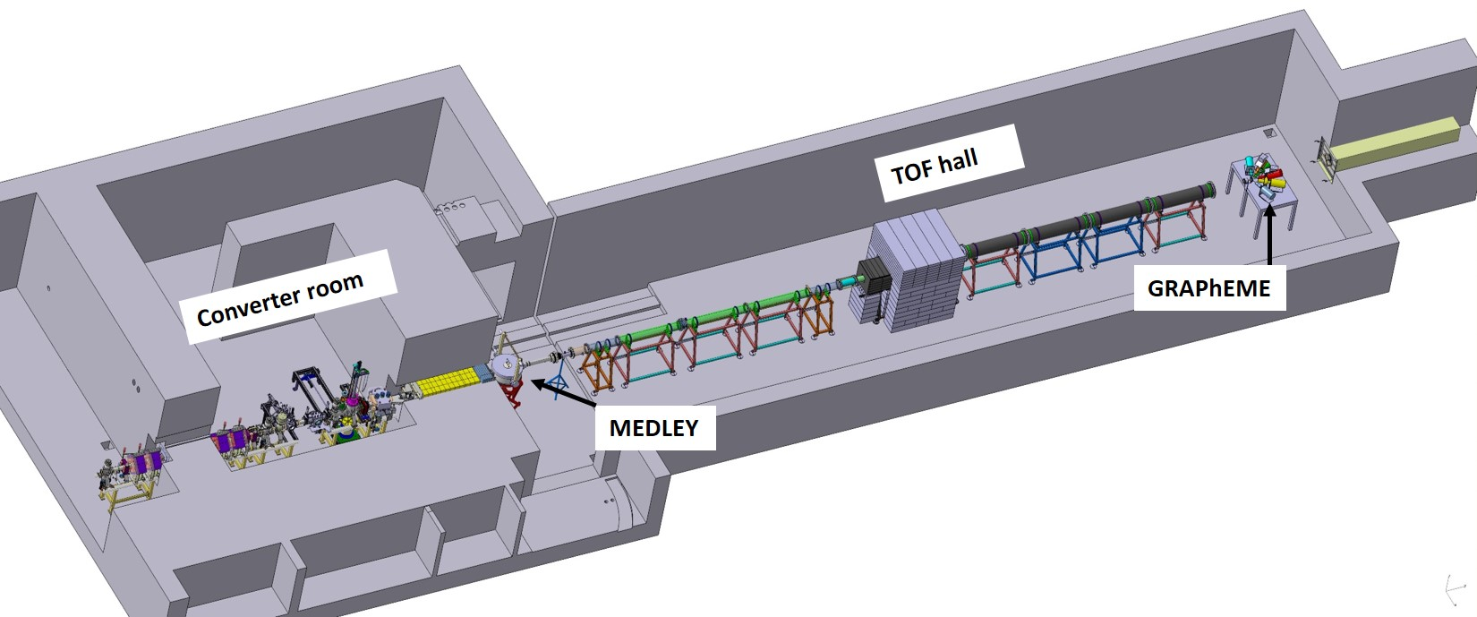
NFS layout
Collimator
LINAC
Beam
● Neutron Beam at 0°
● Collimator ↔ beam quality
● Size (Lⅹl) ≃ (28m ⅹ 6m)
- TOF measurements
- free flight path
● Ion and neutron induced reactions
● Beam line extension
● Irradiation station (n, p, d)

Slide 4
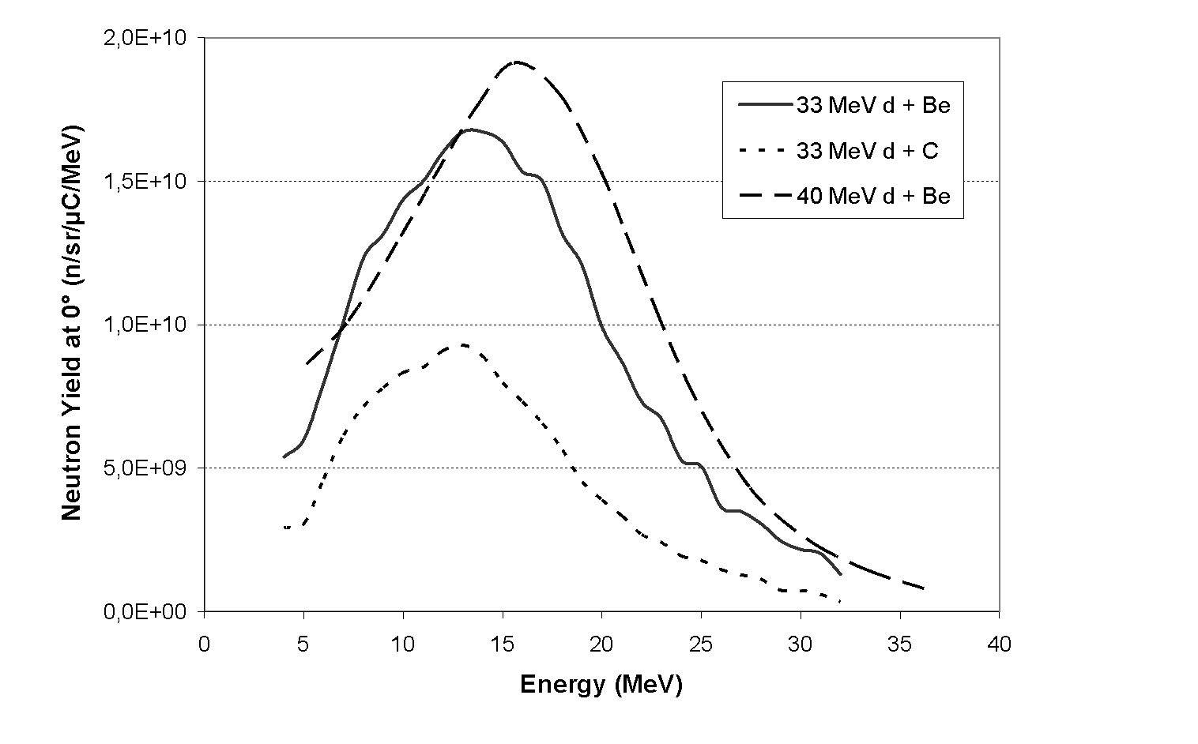
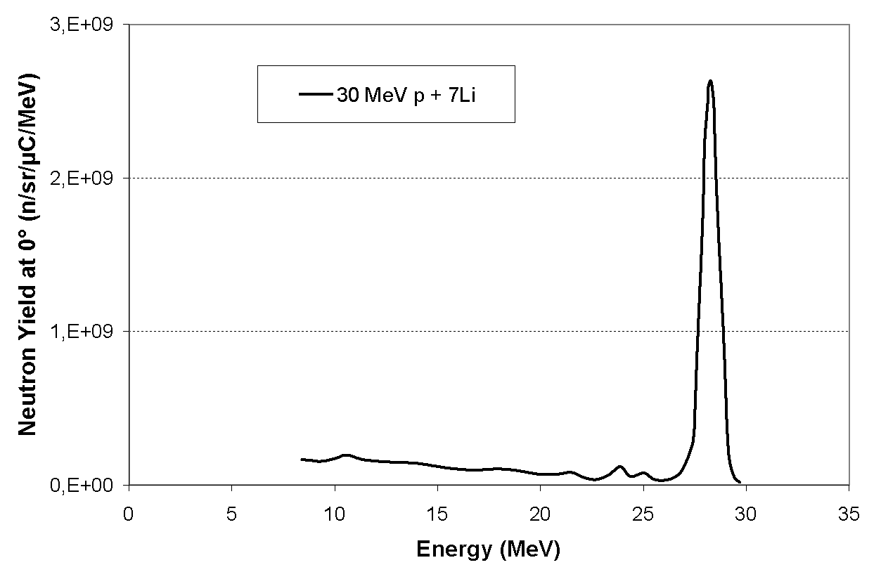
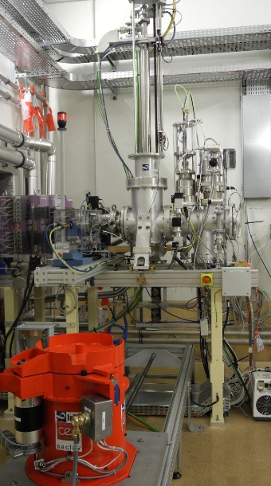
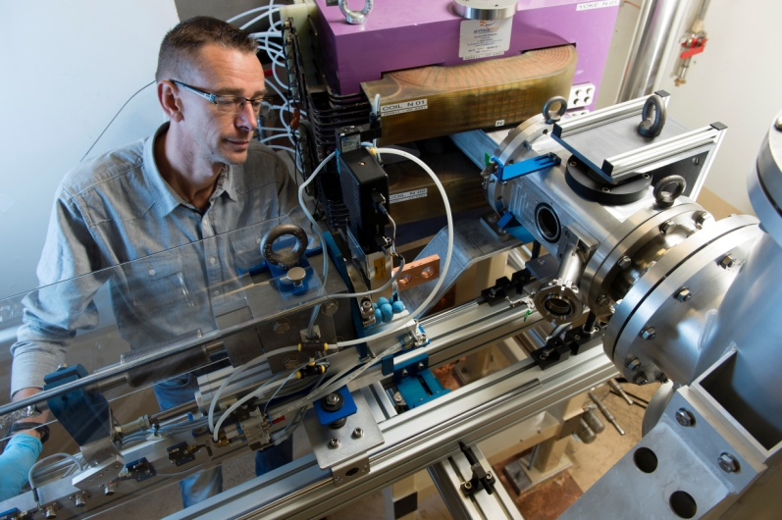
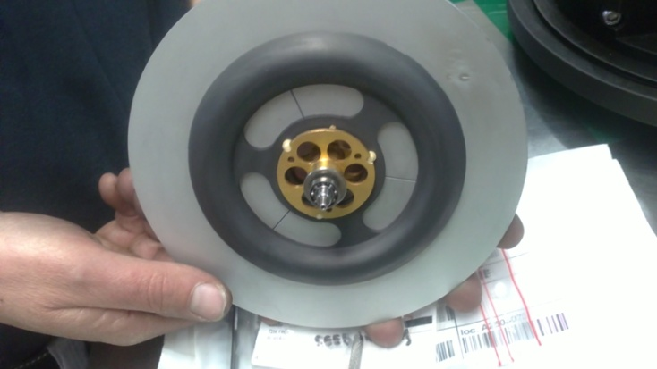

Neutron production reaction
Continuous spectrum
E_{max} = 40 MeV , <E> = 14 MeV
Quasi-monoenergetic spectrum
E_{n} = up to 31 MeV
40 MeV d + Be at 50 µA
p + Li (1mm) at 20 µA
Rotating converter
thick target C or B (8mm)
P< 2 kW

Slide 5
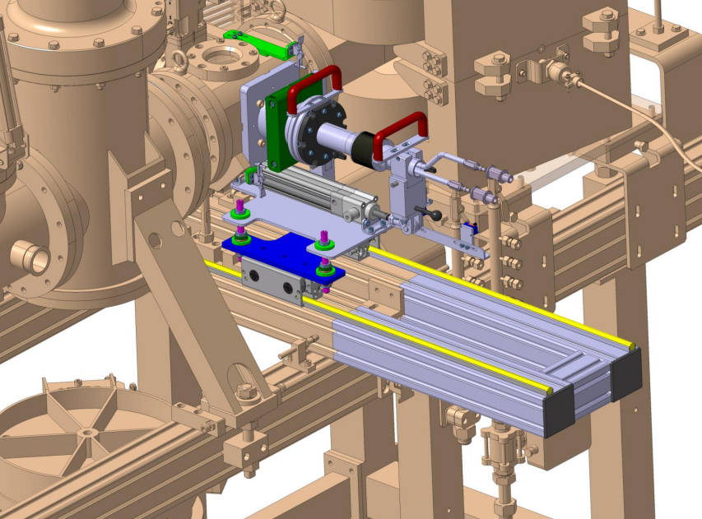
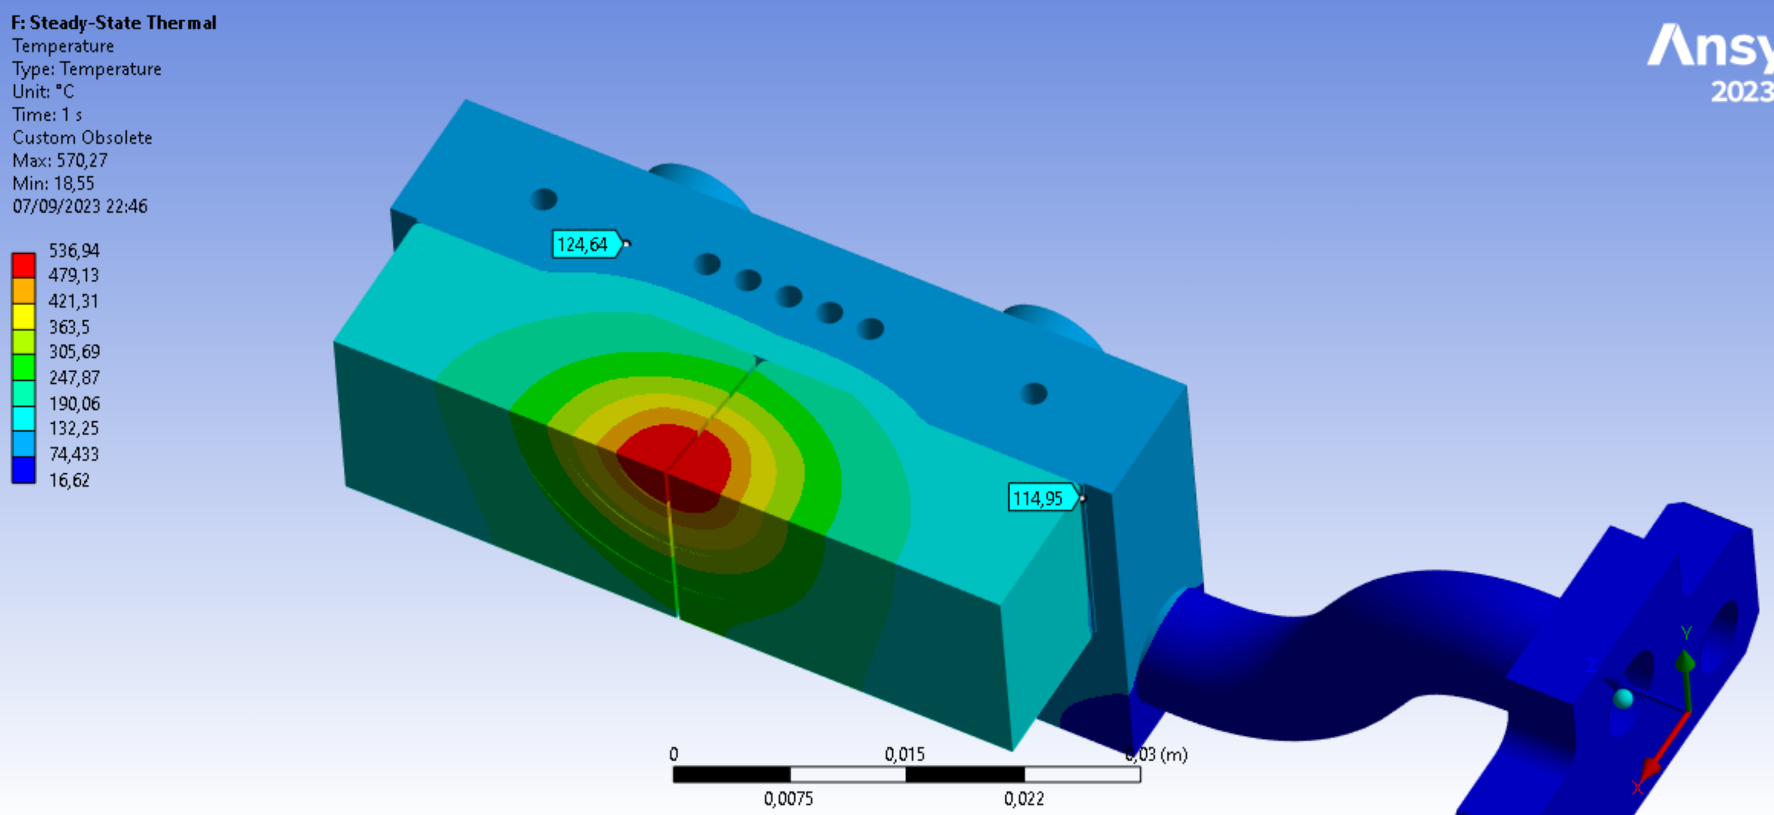
New beryllium converter
After the failure of the rotating converter in 2021, a new static converter was build
Water cooled copper bracket
Beryllium

Slide 6
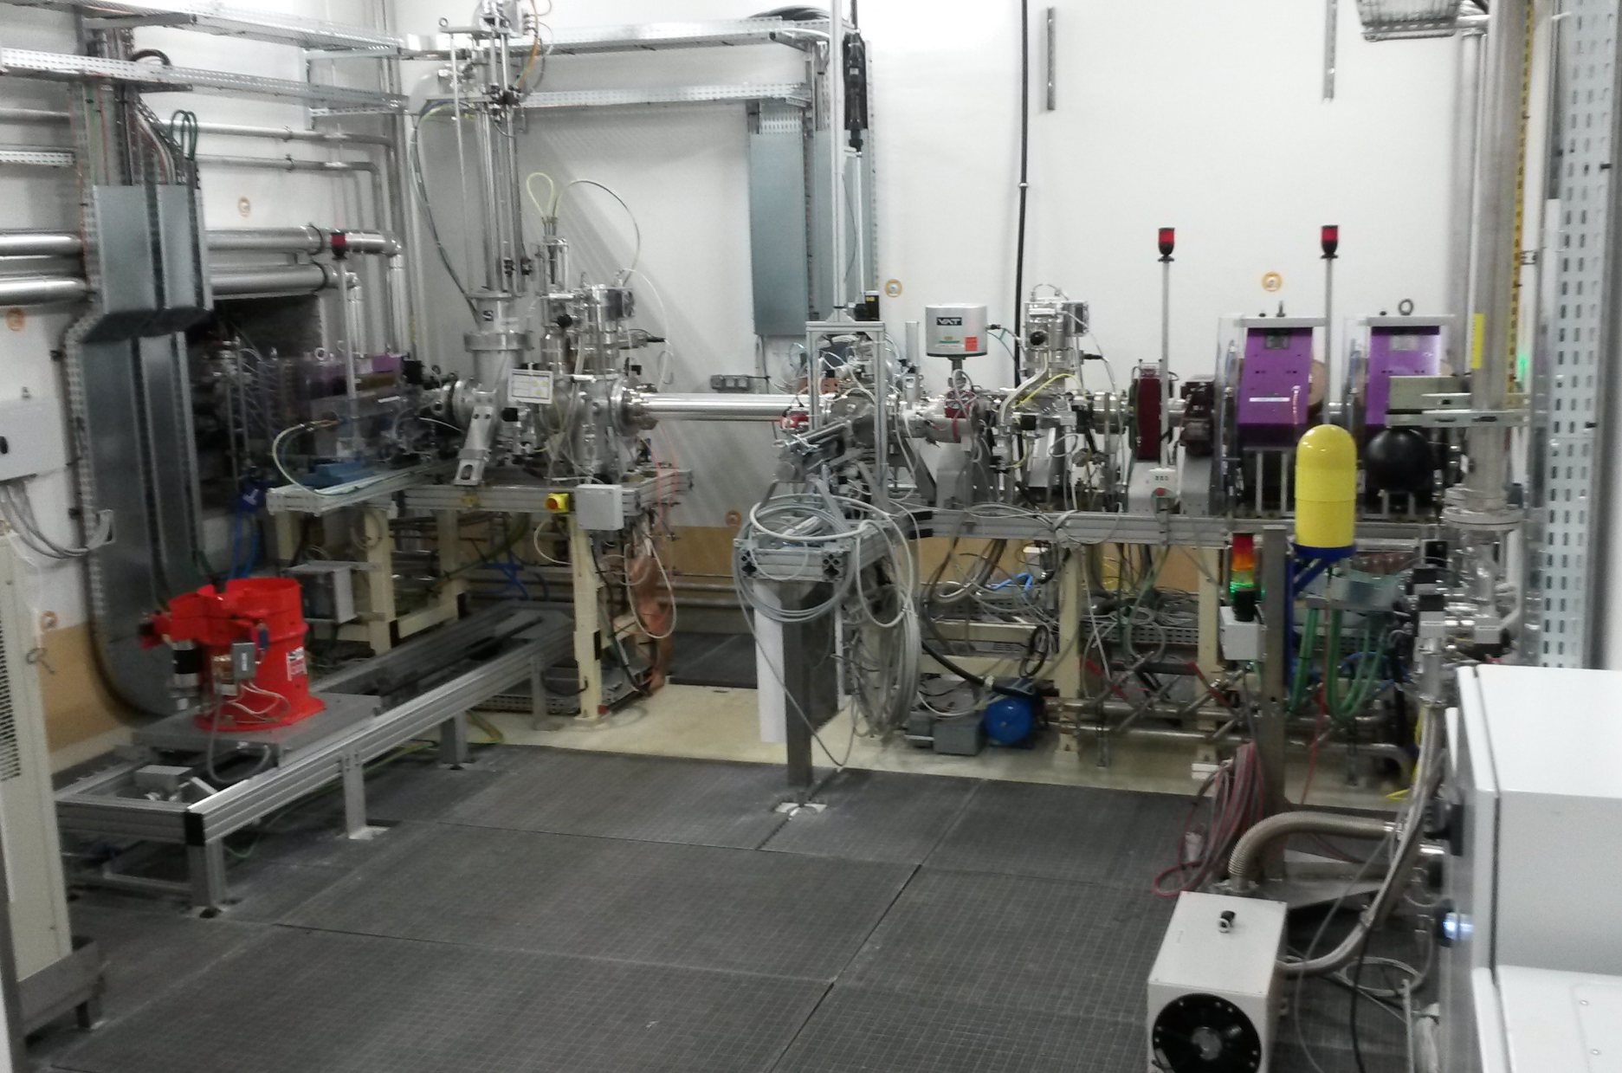
NFS: The converter room
Rotating
converter
Pneumatic transfer system
Li converter
Irradiation station

Slide 7
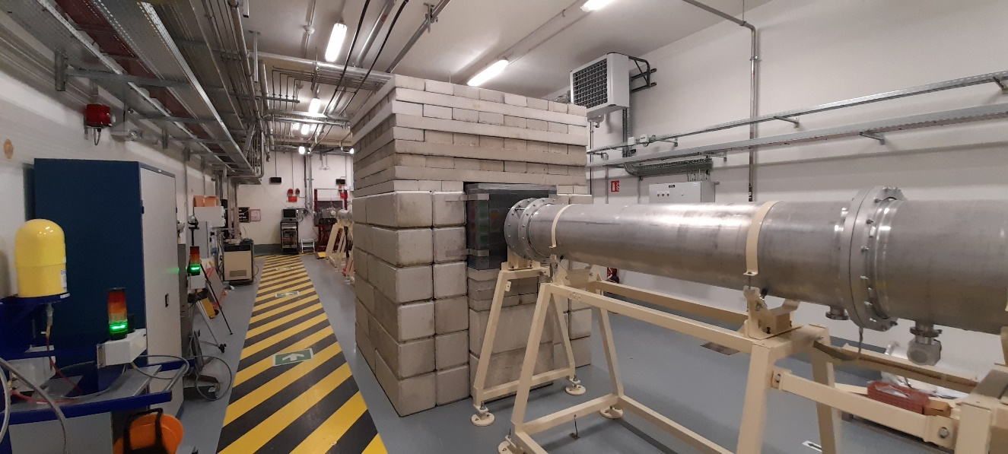
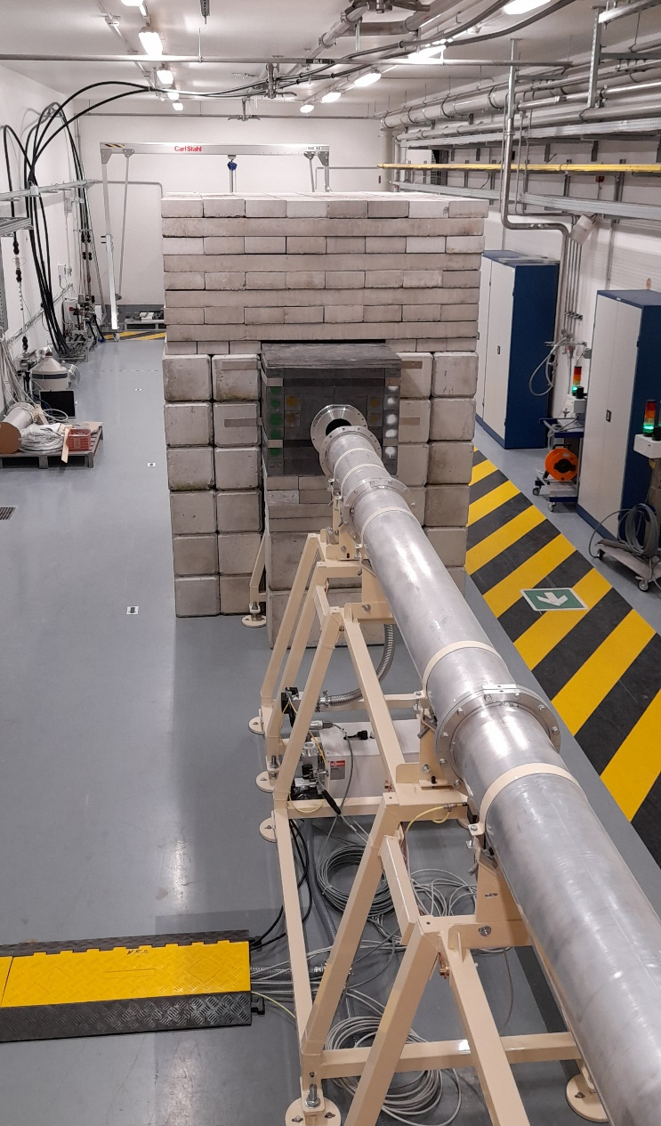
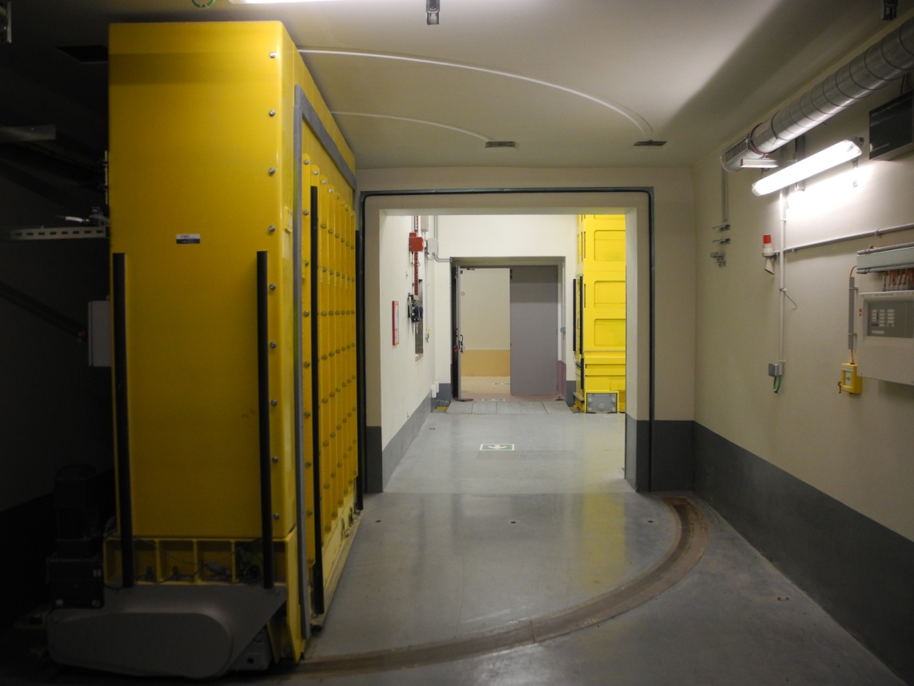
NFS: The TOF area

Slide 8
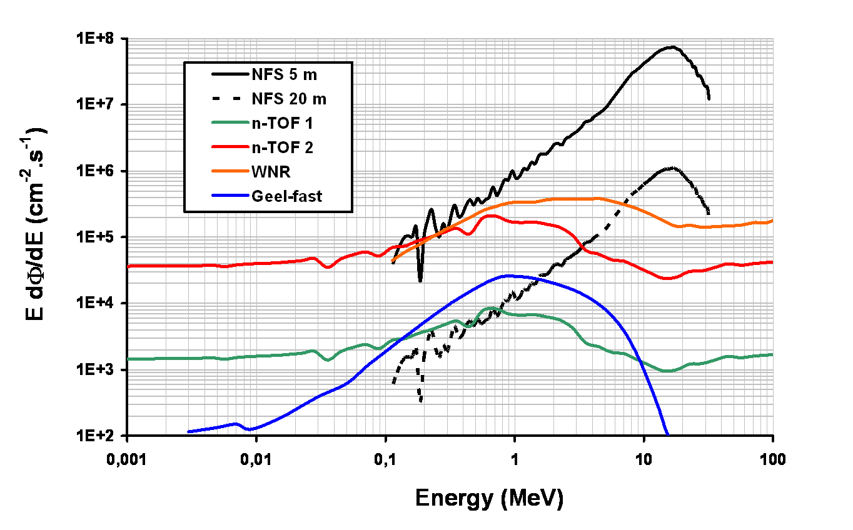
Comparison with other Neutron TOF facilities
NFS : 40 MeV d + Be
WNR : Los Alamos
n-TOF 2 : CERN
n-TOF 1 : CERN
GELINA : Geel
E_{n}: from 0,1 MeV to 40 MeV
Good energy resolution
Reduced γ flash
Low instantaneous flux
Complementary to the existing facilities

Slide 9
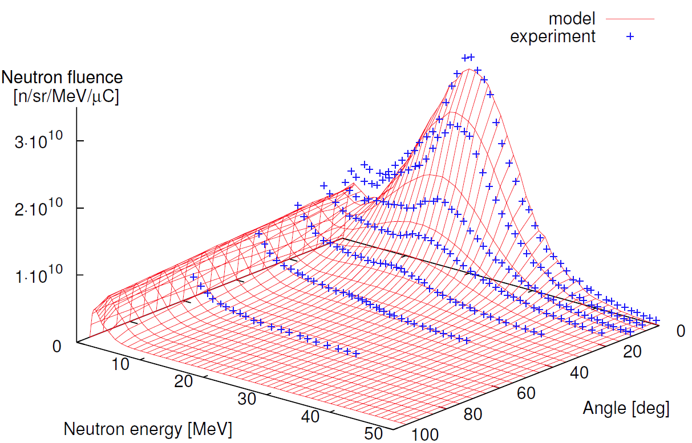
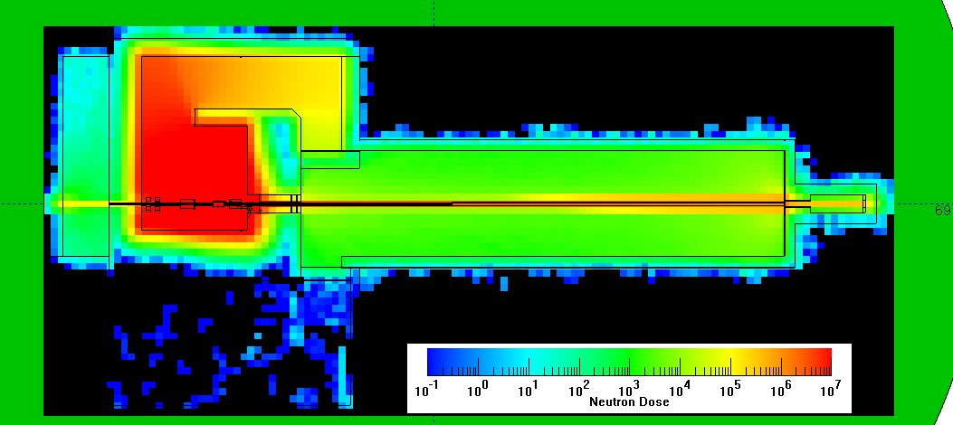
Neutron transport simulations
Neutron transport simulations are needed for :
  Safety purpose (biological protection, activation,
  waste management…)
  Background evaluation
Simulations characteristics :
  MCNPX neutron code
  Neutron source d+Be and p+⁷Li
  Faithful geometry of the buildings
Neutron dose
50µA (40MeV) d + Be

Slide 10
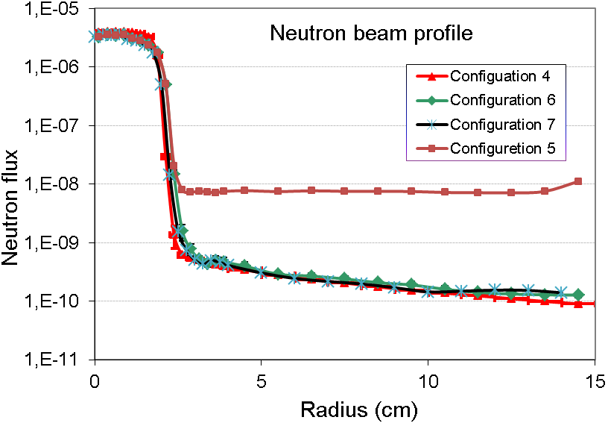
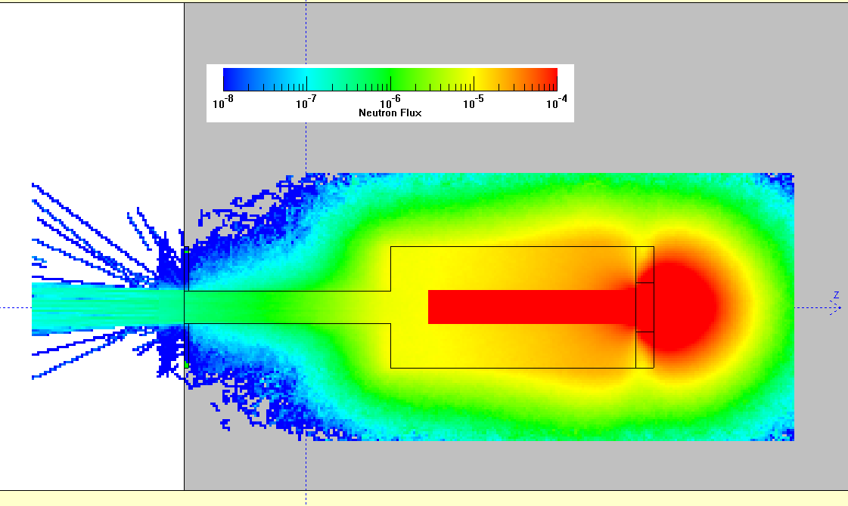
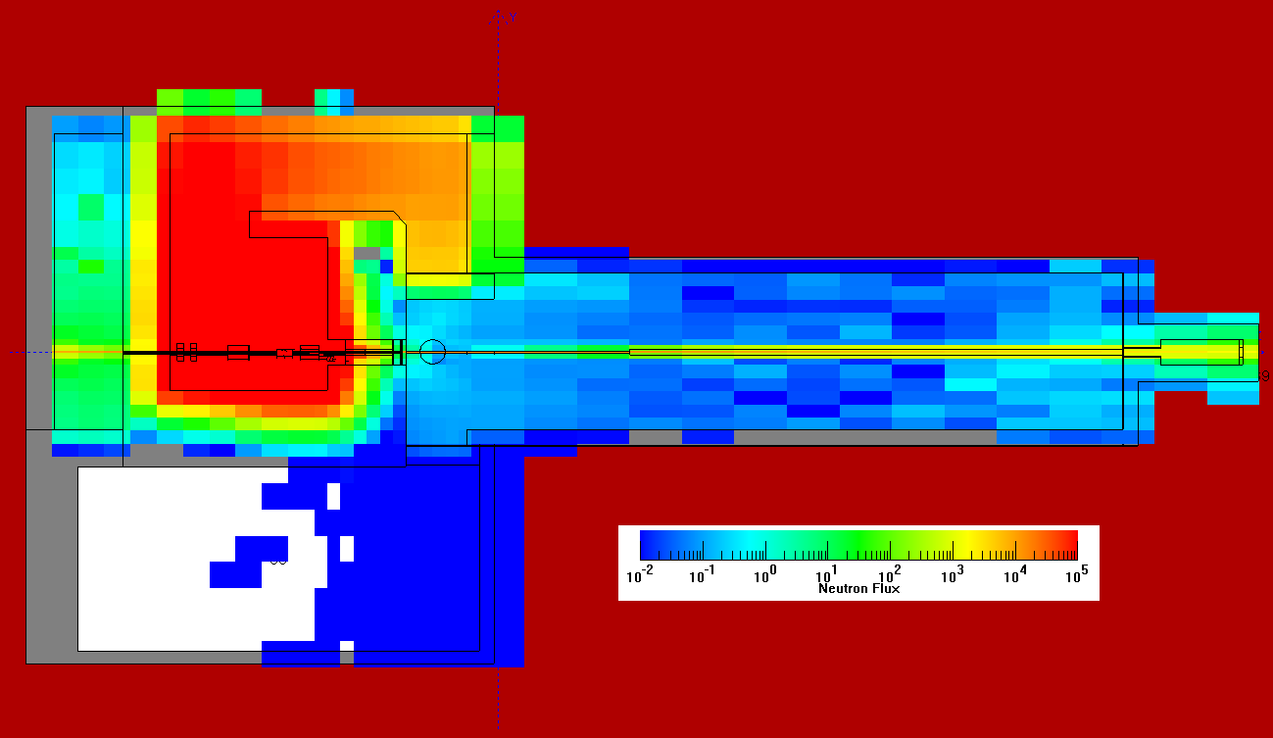
Calculation for beam profile and neutron background
Neutron beam dump
Neutron flux in NFS
MCNPX calculations

Slide 11
The NFS facility
Neutron beam characteristics
First experiments

Slide 12
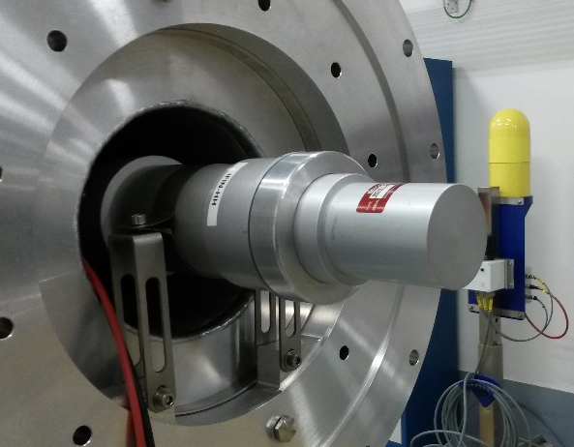
Neutron spectra measurements: E> 2 MeV
Detectors based on liquid scintillator EJ309
Neutron spectrum and flux measurement by the TOF technique
n-γ discrimination by pulse shape analysis
EJ309 cell (2 inches in diameter, 3 inches in length)
Placed in the beam pipe downstream of the rotating converter (15 to 30 m)
Adaptation of the SCINFUL code:
    Light response of EJ309 included
    Efficiency determination

Slide 13
PPAC
Neutron beam characterization based on neutron induced fission
The monitor is composed of :
  two U238 samples
  3 Parallel Plates Avalanche Counters
Neutron beam spot visualization thanks the PPAC localization
Neutron energy distribution by TOF
Neutron yield determination
D. Ramos et al, to be published

Slide 14
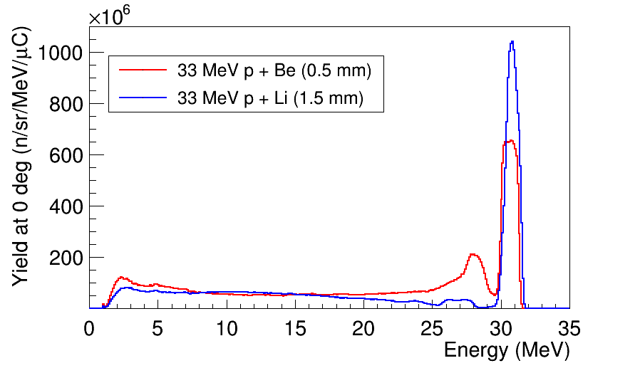
Quasi-mono-energetic spectra
33 MeV p + Li (1,5 mm)
Neutron yield in the mono-energetic peak 1,2 10⁹ n/sr/µC
at 20 µA and d=500cm → Φ = 10⁵ n/s/cm²

Slide 15
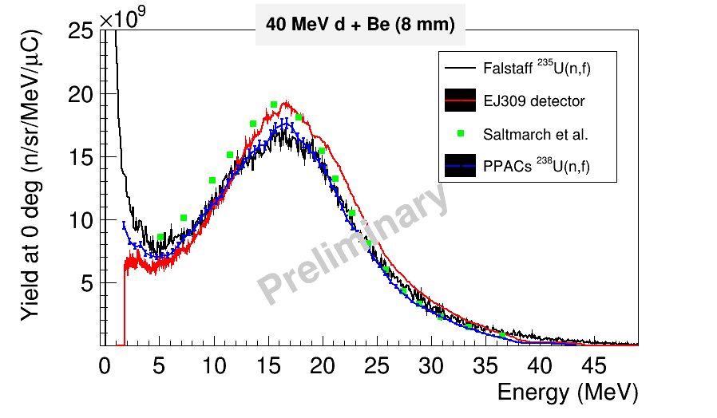
Continuous spectrum

Slide 16
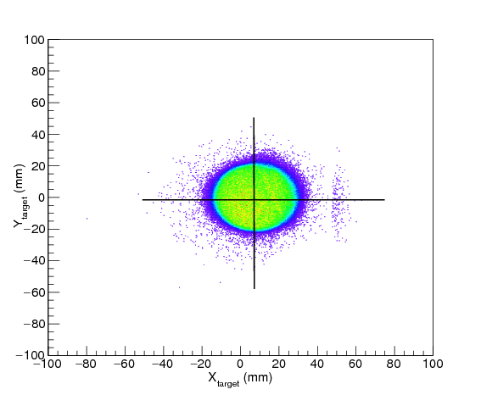
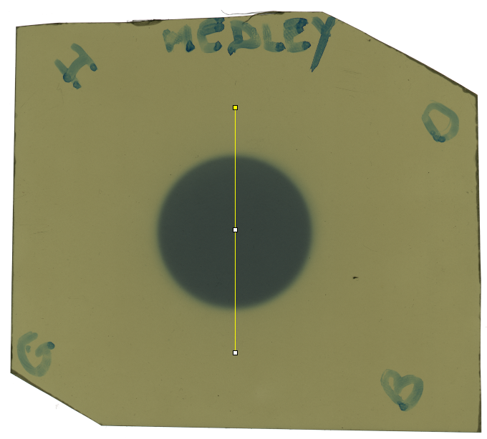
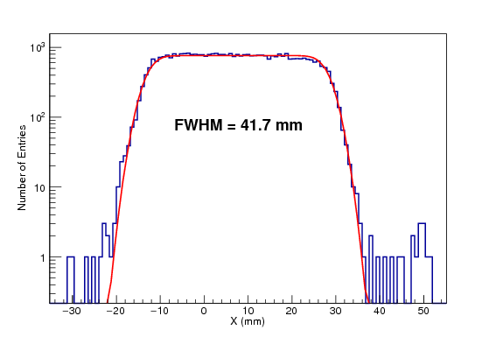
Neutron beam profile
The beam has a conical shape :
  r=21 mm at 5 m downstream from the collimator
  r=28 mm at 29 m
PPAC measurement
Graphchromic film
Beam spot at 536 cm from the converter
X (mm)

Slide 17
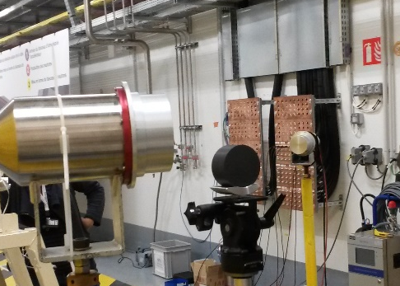
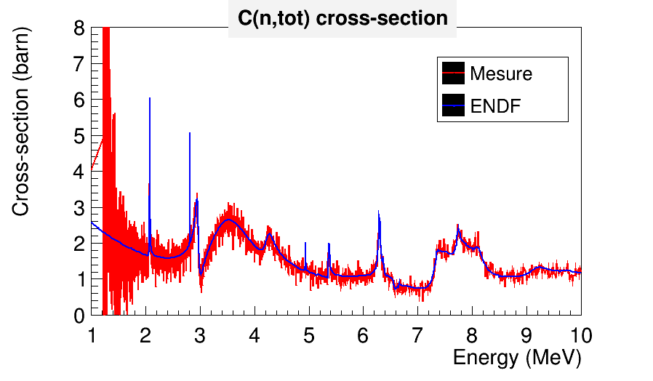
Transmission measurement
Transmission measurement with Carbon samples (2, 4 and 6 cm thick)
Total cross-section reaction measurement
NFS Energy resolution estimation

Slide 18
The NFS facility
Neutron beam characteristics
First experiments

Slide 19
PAC 2020 to 2022 NFS accepted experiments
NUM | Title | Spokesperson | UT Allocated
E799 | Excitation functions of short-lived isotopes in proton induced reactions on ^{nat}Fe | E. Simeckova, NPI, Rez | 5
E800 | LIONS - Light-Ion Production Studies with Medley at the NFS facility | A.V. Prokofiev, Uppsala University | 17
E802 | GARIC - Gas pRoduction In Chromium by neutrons | A.V. Prokofiev, Uppsala University | 21
E804 | Measurement of fission cross sections standards relative to elastic n-p scattering at neutron energies 1- 40 MeV | D. Tarrio, Uppsala University | 31
E807 | Study of the (n,xn) and (n,f) reaction for U238 | G. Bélier, CEA-DAM | 12
E811 | Study of the (n,alpha) reactions of interest for nuclear reactors - the SCALP Project | F. R. Lecolley, lpc Caen | 12
E814 | 235U Fission fragment study with FALSTAFF at NFS | D. Doré, CEA/IRFU/DPhN | 11
E832 | Deuteron activation of natMo - focus on short-lived products | E. Simeckova, NPI, Rez | 4
E833 | Pygmy dipole resonance in 140Ce using the (n,n'g) reaction at NFS | M. Vandebrouck, CEA Saclay | 23
E835 | Measurement of the neutron induced activation in materials | V. Blieanu, CEA Saclay | 3
E838 | Shedding new light on the structure of 56Ni using (n,3n) reaction at NFS | E. Clément, Ganil | 22
E856 | Study of neutron induced reactions on 239Pu | G. Bélier, CEA-DAM | 42
E858 | GARROS - Gas production in iron by neutrons | A. Prokofiev, Uppsala University | 22
E859 | 238U(n, 2ng) and (n, 3ng) reaction cross sections measurements | M. Kerveno, IPHC, Strasbourg | 31
Performed in 2021
Performed in 2022
Scheduled in 2023
1 UT = 8h

Slide 20
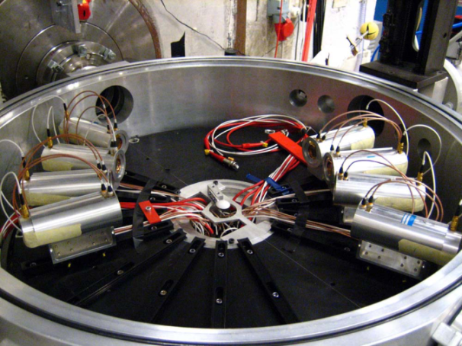
Ion Production Studies with Medley at the NFS facility
Spokesperson : D. Tario, Uppsala University
Neutron-Induced Light charged particles emission with MEDLEY
  8 Si-Si-CsI telescopes
  Double-differential cross sections :
  Cancer therapy and dosimetry (H,C,O, Ca...)
  Radiation effects in microelectronics (Si, O)
  Energy applications: Gen-IV or fusion reactors (building materials, fuel, coolants, etc)
Setup tested in fall 2020 and September 2021
  High particle-identification capability
  Simultaneous measurement of charged-particles energy and neutron ToF (digital
Identification E-∆E technique
Experiments :
E800, E802, E858
Participation of physicists and students
From UKEA

Slide 21

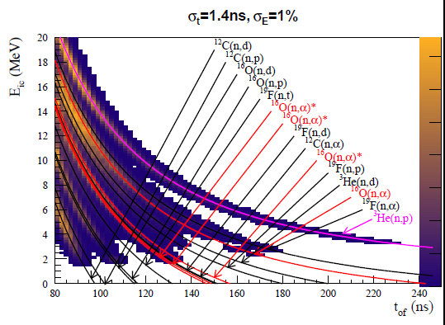
E811: Study of the (n,α) reactions of interest for nuclear reactors - the SCALP Project
Spokesperson : J. F. Lecolley, LPC Caen
Goals : XS measurement in 7MeV-20MeV range with an uncertainty better than 5%
Active target
Scintillating Ionization chamber
Continuous energy
Target composition :
Oxygen → CO₂
Scintillation → CF₄
Normalization → ³He
A lot of Channels
to distinguish
Experiment performed in Oct 2021
A. Chevalier et al, ANIMA 2023 proceeding

Slide 22

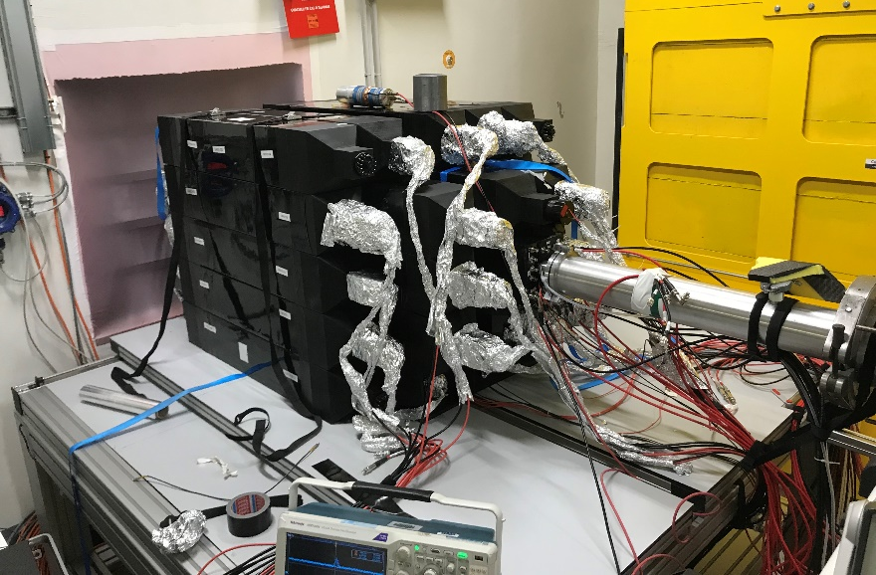
E807: Study of the (n,xn) and (n,f) reaction for U238
Spokesperson : G. Bélier, CEA-DAM-DIF
(n,xn) reaction are important channels in the 5-50 MeV range
(n,xn) cross-section measurement of actinide is very difficult:
  radioactive sample
  prompt neutron fission
Experimental technique :
  Veto fission (fission chamber)
  4π neutron detector SCONE
  6 MeV<En< 20 MeV

Slide 23
E814: ²³⁵U Fission fragment study with FALSTAFF at NFS
Perform experiments in the fast domain to characterize actinide fission fragments
Neutron Sawtooth Curve
Important piece of information about scission
  Excitation energy sharing
  Shell effects
  Energy balance

Slide 24
Residual energy as function of neutron energy

Slide 25
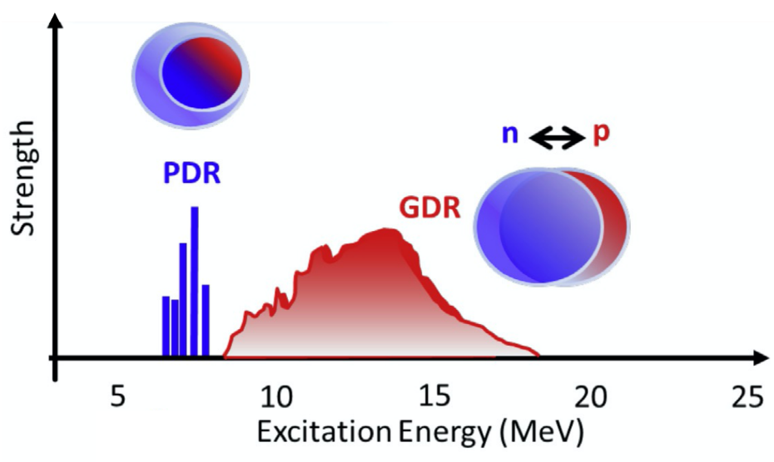
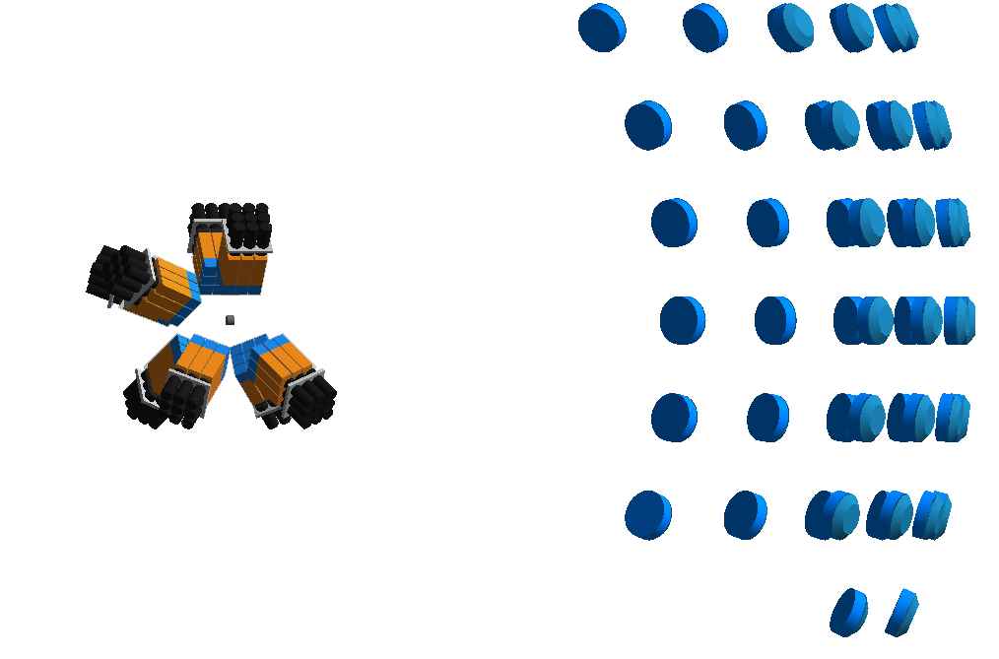
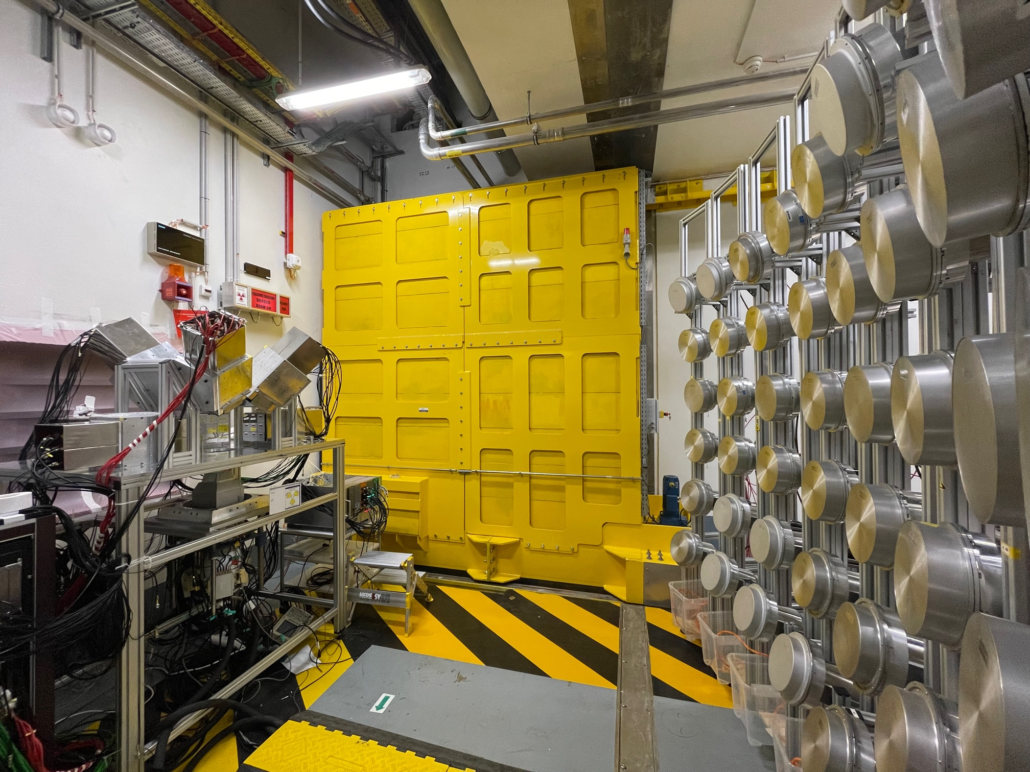
E833 : Pygmy dipole resonance (PDR) in 140Ce using the (n,n’γ) reaction at SPIRAL2-NFS
Spokespersons: Marine VANDEBROUCK (CEA Saclay Irfu/DPhN) and Iolanda MATEA (IJCLab)
The use of different reactions to excite the PDR showed different responses, not always compatible with the neutron skin picture
New probes are necessary to resolve the complexity of the PDR structure
We propose to use neutron inelastic scattering reaction at SPIRAL2-NFS as a new probe
48 MONSTER modules
Experiment in September
8 PARIS clusters
n’
Figure extracted from A. Bracco et al. Prog. Part. Nucl. Phys. 106 (2019)
n
γ
GDR (Giant Dipole Resonance)
oscillation of neutrons against protons
exhausts ~ 100% of the dipole strength
PDR (Pygmy Dipole Resonance)
oscillation of a neutron skin against a symmetric proton/neutron core
small additional dipole strength at lower energy
¹⁴⁰Ce(n,n’)¹⁴⁰Ce*(γ)¹⁴⁰Ce @NFS

Slide 26
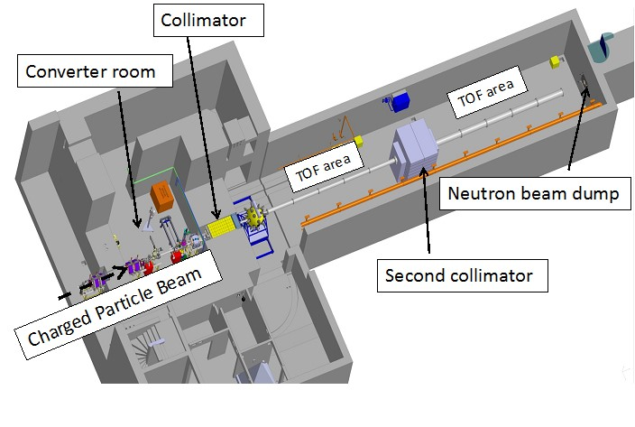
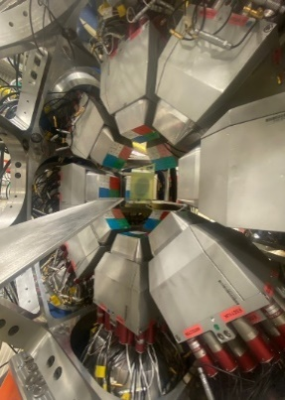
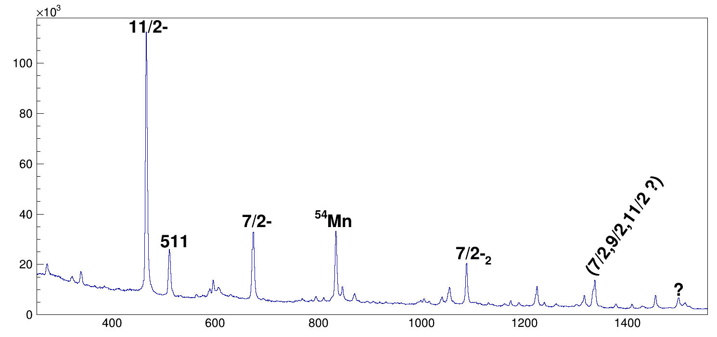
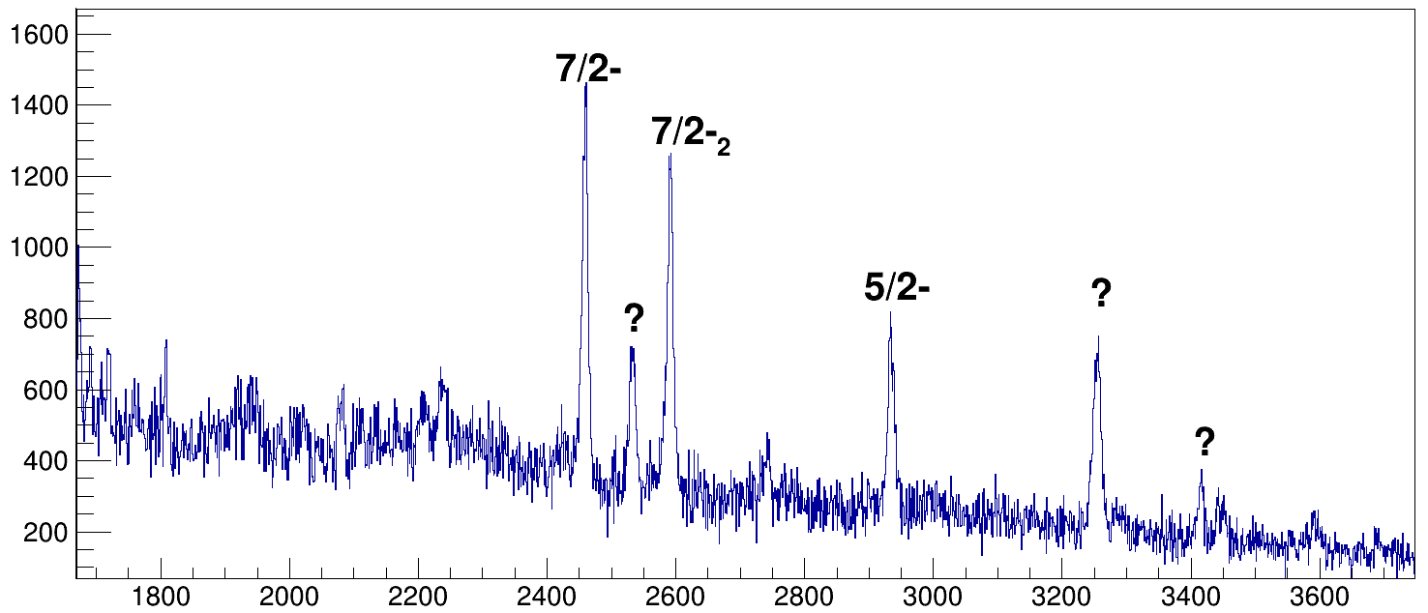
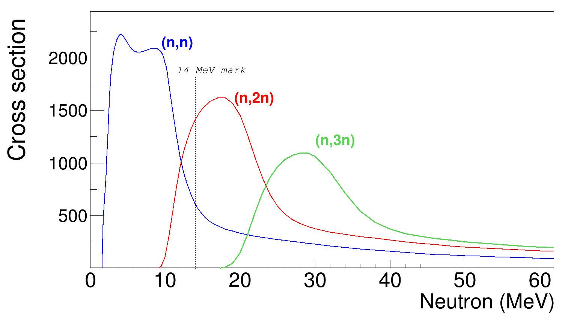
E838 : Shedding new light on the structure of 56Ni using 58Ni(n,3n) reaction at NFS
Preliminary
⁵⁸Ni(n,d)⁵⁷Co
Steel activation
12 exogam clover at NFS
EXOGAM clovers placed at 8.6 meters from the production target
Using 10 μA of 40 MeV deuteron beam on the thick Be target
→100 Hz of ⁵⁶Ni with a 1mm target
Triggered in γγ in coincidence with the fastest neutrons (> 25 MeV)
Preliminary
⁵⁸Ni(n,2n)⁵⁷Ni
New states probably observed in ⁵⁷Ni
⁵⁶Ni decay was observed
From the easiest (n,d/t) channels, it seems that different states than β-decay, fusion of heavy ions or direct transfer reaction using protons beam are populated with high cross section (?)

Slide 27
Summary
Neutrons for Science is now operational
10 Experiments have already been performed (4 scheduled in 2023)
  Lcp particle production
  Fission process
  n,xnγ reactions
  Nuclear structure
Everyone can propose an experiment
  1 PAC session per year; next PAC in November
  GANIL web site “proposing an experiment” and contact me
  One proposal submitted by UKEA in PAC 2023: E875 “Gas production study in copper”
NFS is in the European Projects (Transnational Access):
  ARIEL
  RADNEXT
  EUROLABS

Slide 29
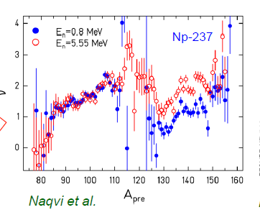
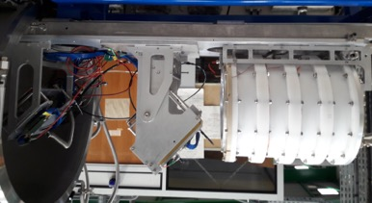
E814: ²³⁵U Fission fragment study with FALSTAFF at NFS
Spokesperson: D. Doré (CEA/IRFU)
Perform experiments in the fast domain to characterize actinide fission fragments
Neutron Sawtooth Curve
Important piece of information about scission
  Excitation energy sharing
  Shell effects
  Energy balance
Many models exist but not predictive enough
Actinides to study:
^{235,238}U,²³⁹Pu,²³⁷Np, ²³²Th, ²³³U
Detection of fragments in coincidence
Kinetic energy
Post-masses (after n evap) → EV method good energy resolution 1 %
Pre-masses (before n evap) → 2V method TOF measurement time resolution < 150ps
Each arm is composed of Ionization chamber (E) and SED detector (v)

Slide 30
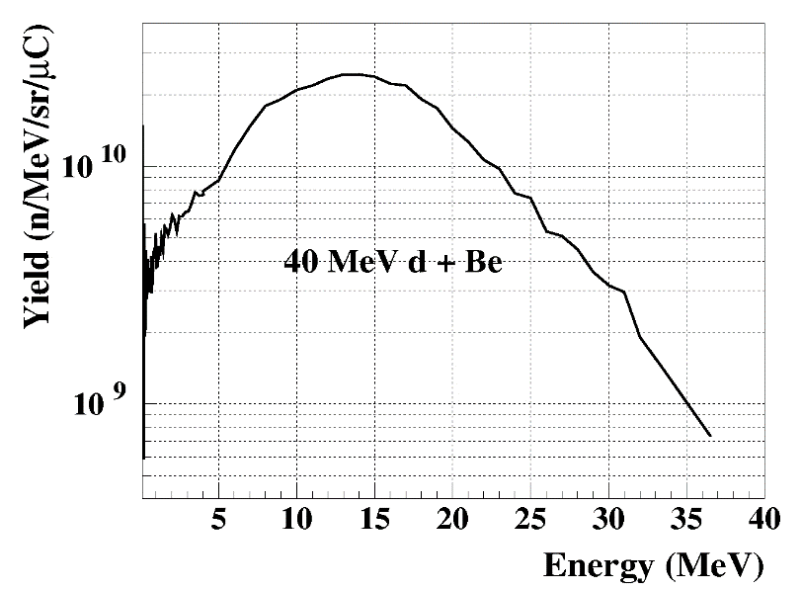
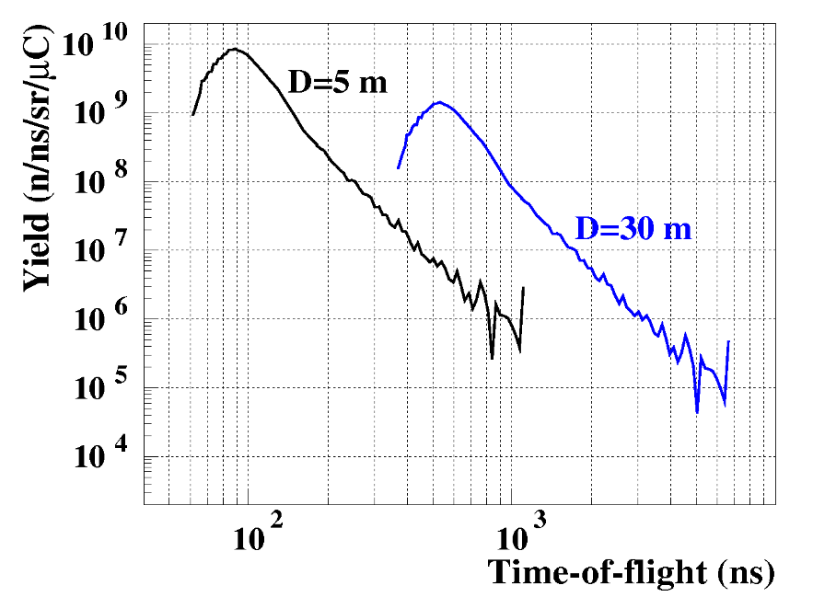
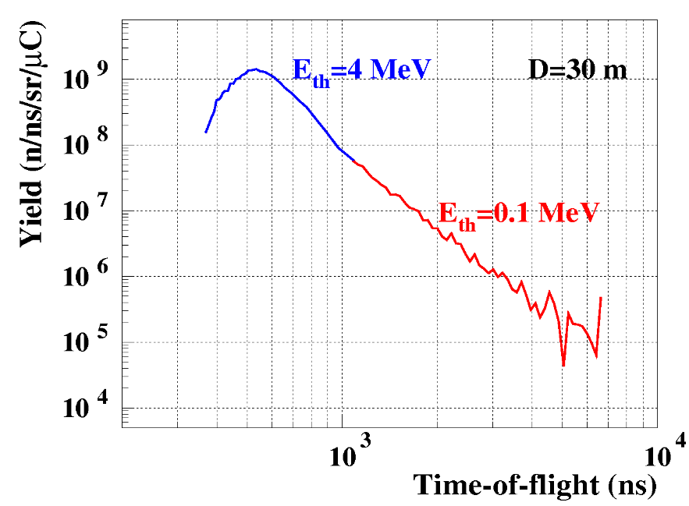
Beam repetition rate
Identification between 2 neutrons with time of flight t et t+T
T_{LINAG} = 11 ns
T ≃ 1 μs
T ≃ 6 μs
1 bunch over N (f = F₀/N)
- “fast chopper”
- I = I_{max} / N, I_{max}=5mA
T ≃ 1 μs
L(m) | E_{th} (MeV) | T(μs) | N | I_{max}(μA)
5 | 0.1 | 1 | 100 | 50
20 | 0.1 | 4 | 400 | 12
30 | 0.1 | 6 | 600 | 8
T ≃ 6 μs

