Slide 1
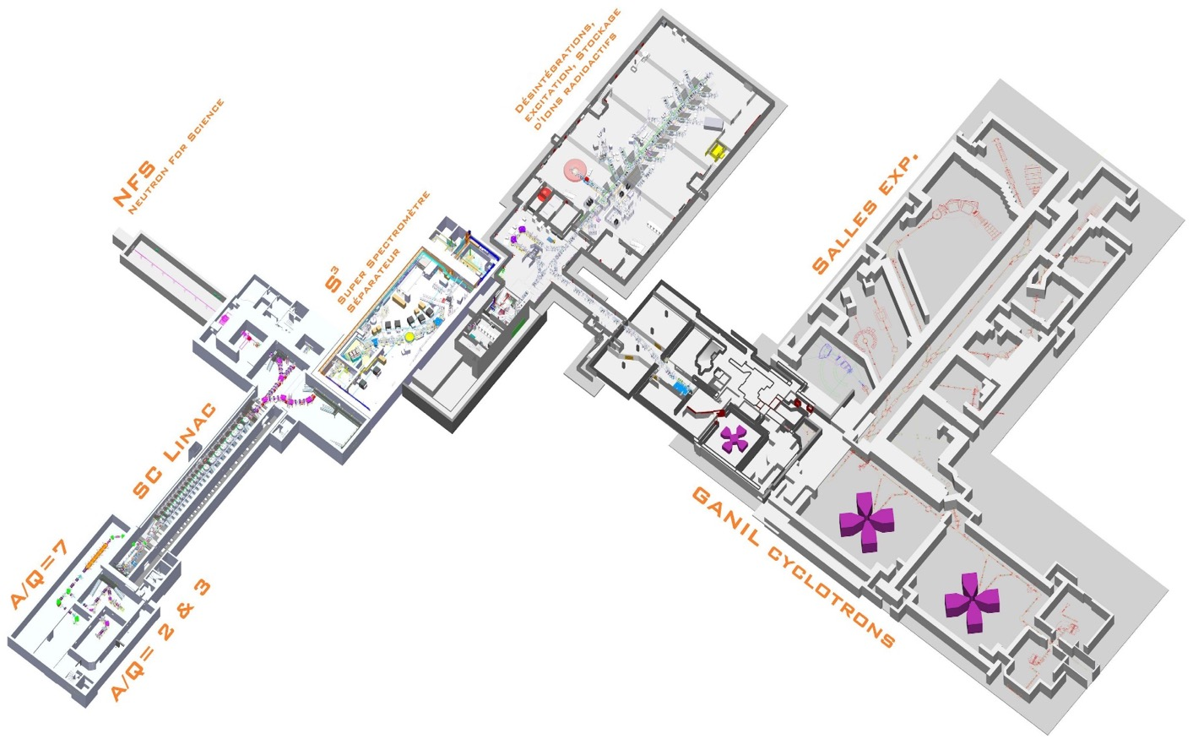
Welcome to
GANIL-UK
2023 Workshop

Slide 2
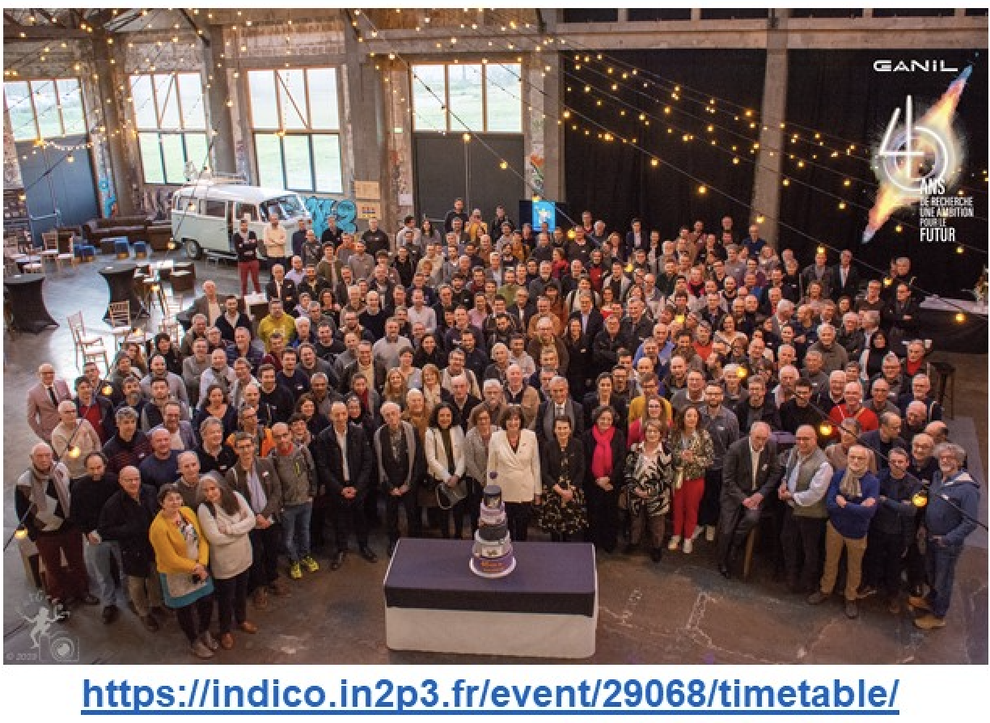
GANIL-SPIRAL2
232 permanent staff members CEA and CNRS
(researchers, engineers, tech.)
+ 55 temporary staff
(22, Tech.,22 PhD, 11 postdocs)
Researchers : 59
Administration : 28
Accelerators and Instrumentation : 200
4040th Anniversary of first GANIL experiment

Slide 3
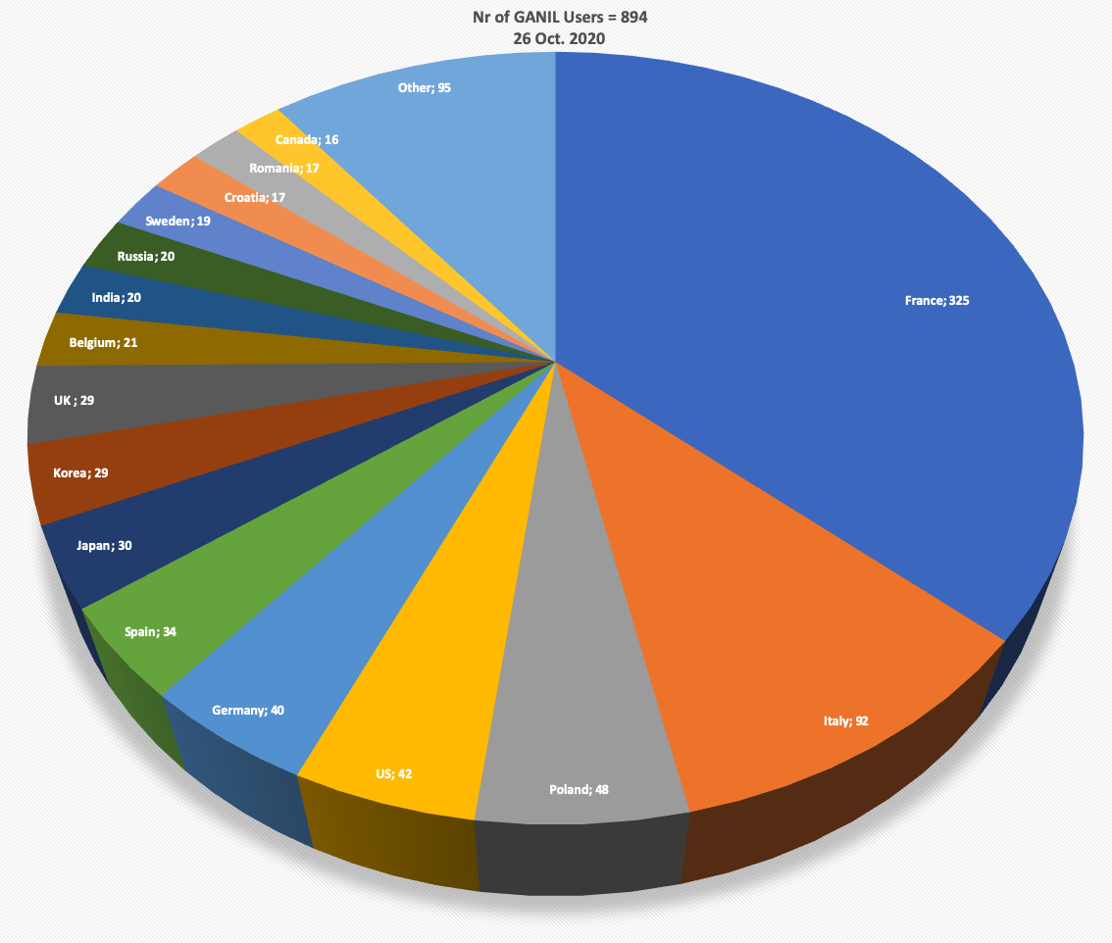
Users community
An international scientific community of ≈ 1000 members
France
Italie
Pologne
USA
Allemagne
Espagne
Japon
Corée
Royaume Uni
Belgique
Inde
Russie
Suède
Roumanie
Canada
A major facility for heavy ions in the world
with GSI/FAIR (Germany), RIBF/RIKEN (Japan), FRIB/MSU (USA), ISOLDE (CERN)…

Slide 4
Strategy for
GANIL/SPIRAL2
in the coming years

Slide 5

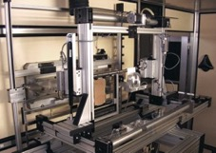
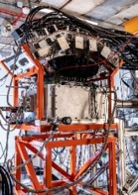
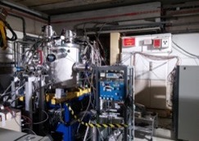
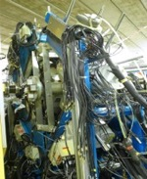
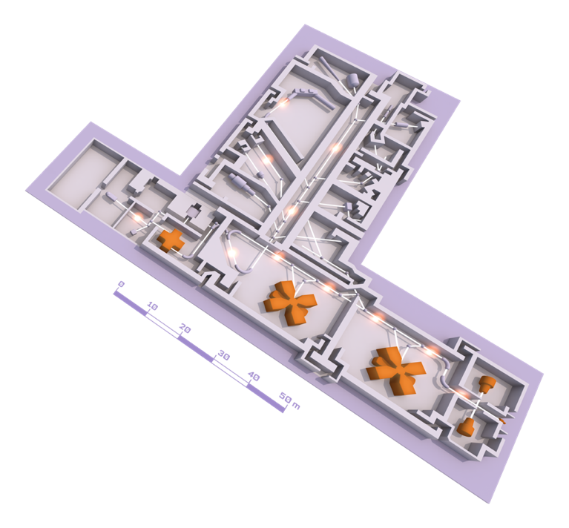
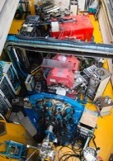
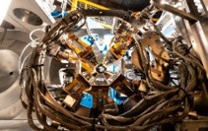
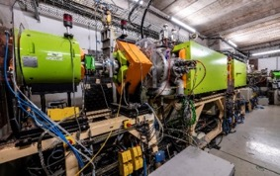
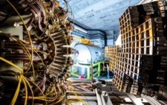
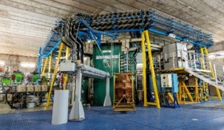
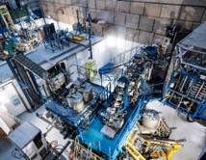
GANIL cyclotrons and their experimental equipment
ACTAR TPC
A strong program for the next years with upgraded spectrometers and detectors:
-VAMOS++ and the fission revival
Talk by Pierre Morfouace
-LISE2022 and the « tandem » mode
-MUST2/MUGAST campaign 2023-?
Talk by Valérian Girard-Alcindor
-ACTAR active target
Talk by Thomas Roger
-INDRA+FAZIA
-AGATA@GANIL.2 ?
Talk by Emmanuel Clément
-many new SPIRAL1 beams
Talk by Pierre Chauveau
But an increase of accelerator failures
=>Cyclotron refurbishing program CYREN
EXOGAM
Porte échantillon pour irradiation
MUGAST
Experimental rooms
AGATA
LISE SPECTROMETER
VAMOS
Beams : ¹²C à U
Energy : from <1 MeV up to 95MeV/nucleon
Up to 4 parallel experiments
GANIL CYCLOTRONS
INDRA + FAZIA
CYCLOTRON
SOURCES

Slide 6

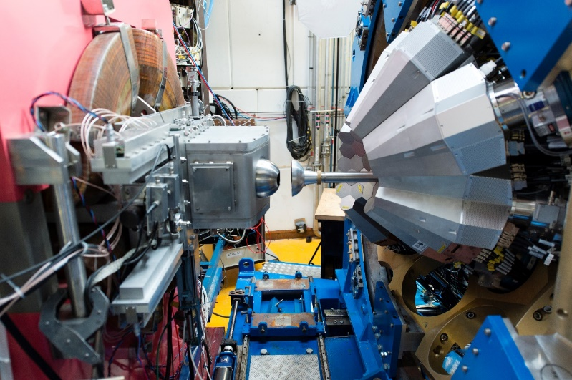
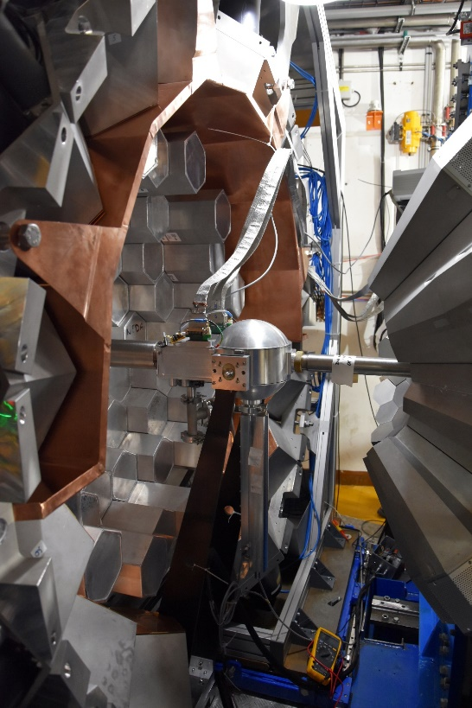
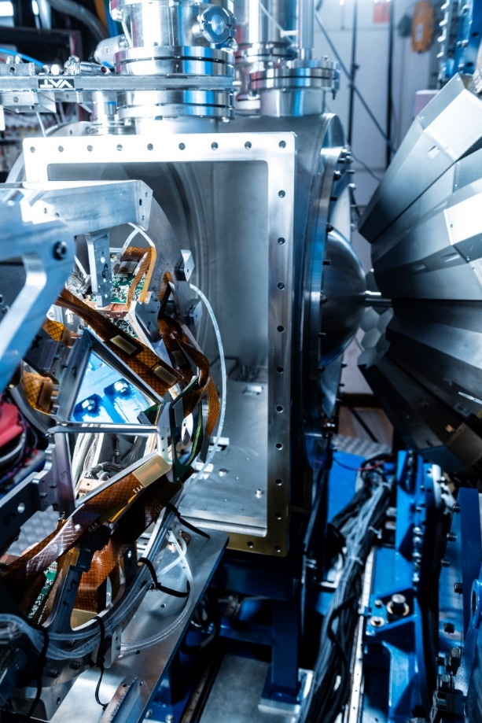
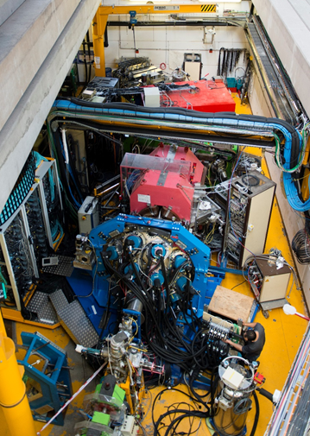
AGATA@GANIL
2015-2017
2018
2019-2021
2021
24-34 capsules
AGATA coupled to VAMOS, FATIMA, PARIS
Exotic nuclei spectroscopy by MNT transfer and fission reaction
36 capsules
40-41 capsules
AGATA coupled to NEDA- DIAMANT
N~Z nuclei spectroscopy by fusion evaporation
AGATA coupled to VAMOS MUGAST
40-41 capsules
AGATA coupled to VAMOS, EXOGAM, 2nd Arm, LEPS
Each GANIL PAC had a “PrePac” workshop (8 in total) with a specific call without filters : AGATA Collaboration Meeting
40-41 capsules
Exotic nuclei spectroscopy by transfer reaction using RIB
Exotic nuclei spectroscopy by MNT transfer
821 UT have been performed over 29 experiments

Slide 7
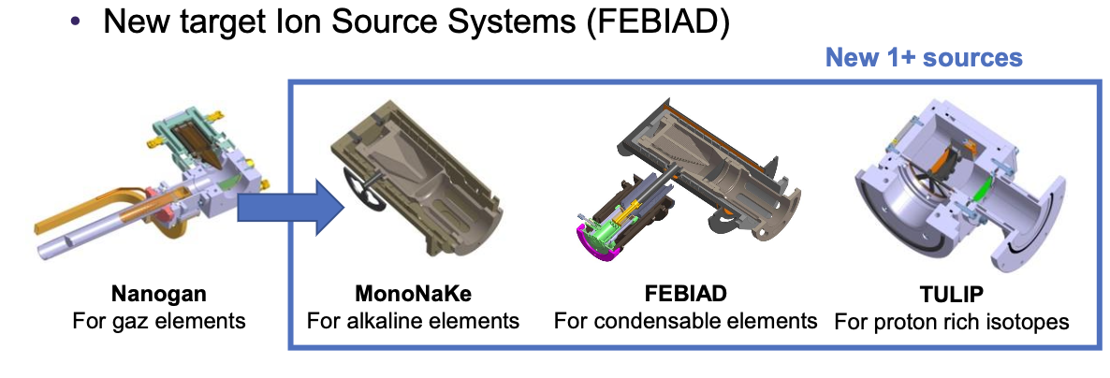
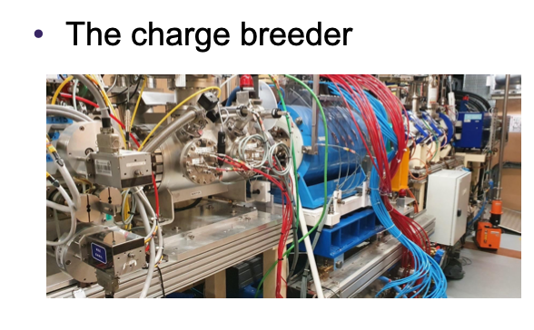
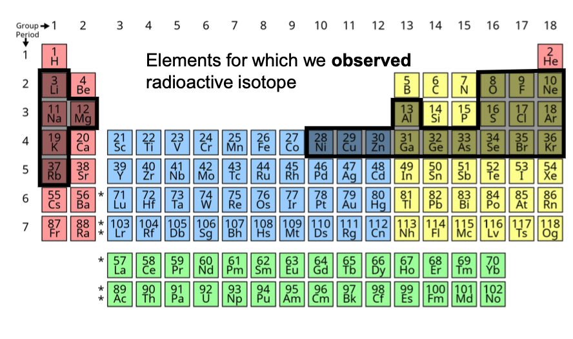
SPIRAL1 upgrade
50 new isomers/isotopes
With intensities suitable for acceleration
See PAC call for
further details
Presentation of Pierre Chauveau

Slide 8
LISE2022
« Tandem » mode with ACTAR-TPC and EXOGAM-PARIS-ZDD: a world premiere with heavy ions
Simultaneous measurement of Coulomb and nuclear excitation for neutron-rich isotopes of Si and S
First cible (H)
ACTAR-TPC
Nuclear Excitation
Second target (Au)
8 EXOGAM2 + 8 PARIS
Coulomb Excitation

Slide 9
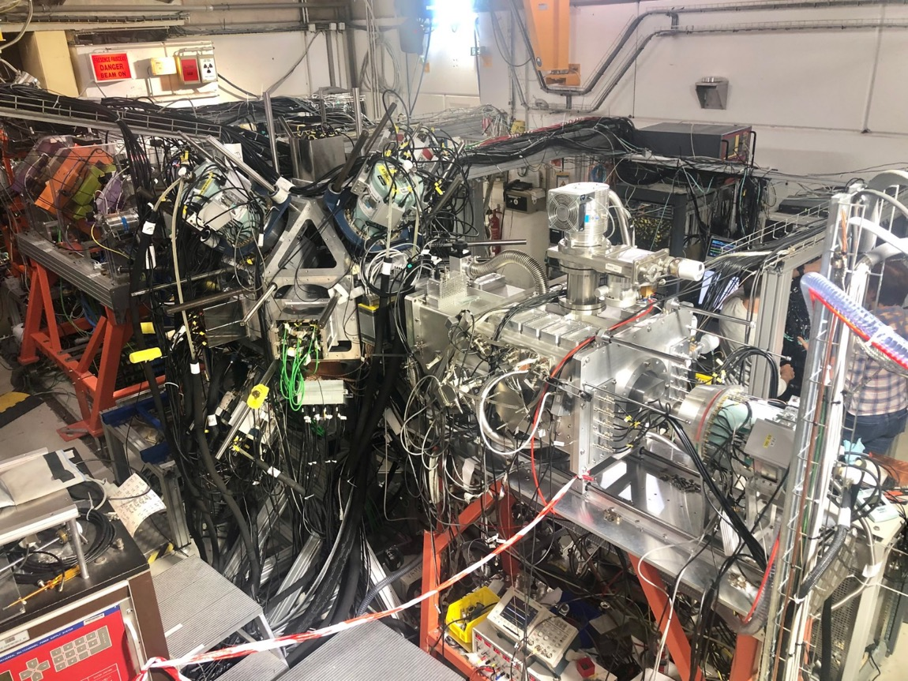
LISE2022
Zero
Degree
Detection
ACTAR TPC
CATS
EXOGAM 0°
8 PARIS
8 EXOGAM
Annular
Silicon detectors
S. Grévy et al. E823
R. Lica et al. E 798

Slide 10
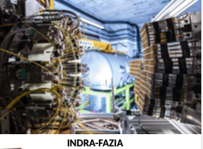
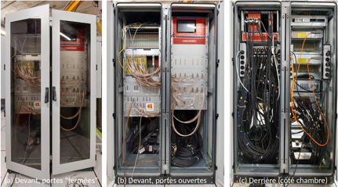
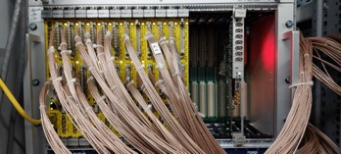
INDRA/FAZIA : hot nuclear matter
N. Le Neindre et al, E818
Notes:
10

Slide 11
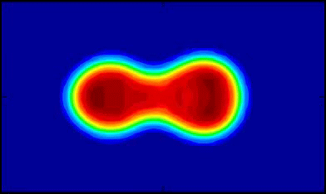

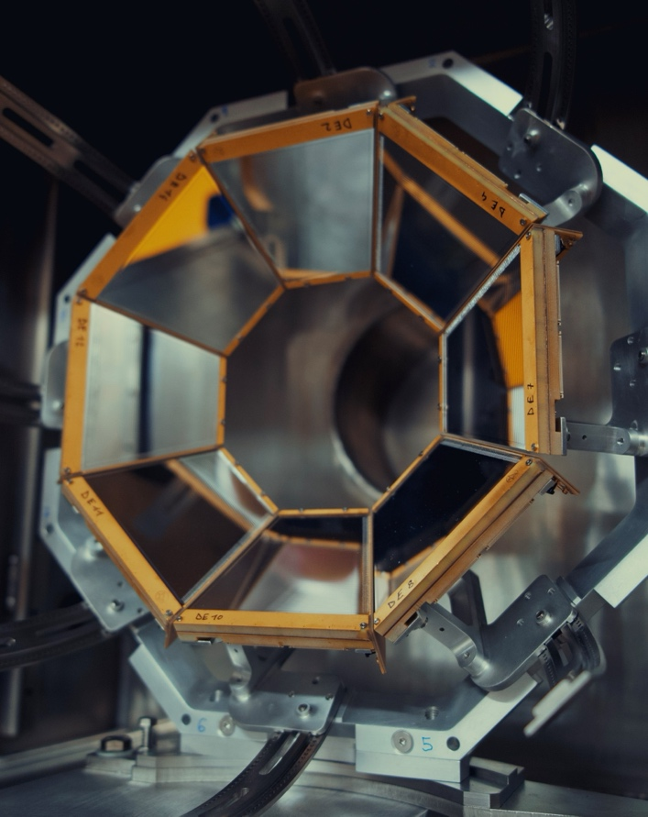
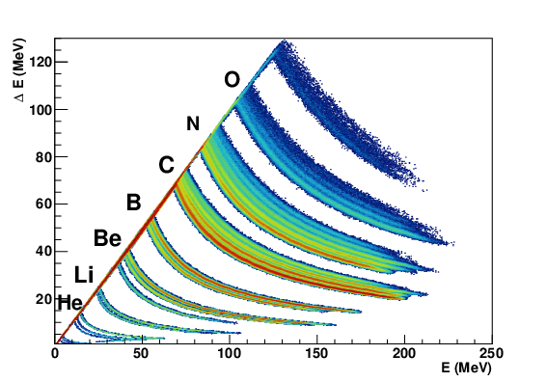
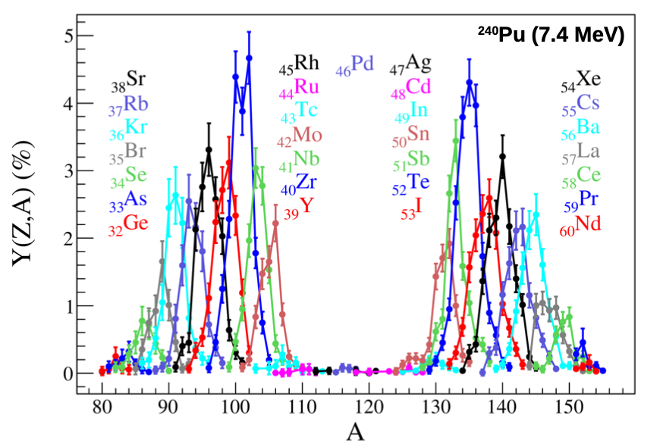
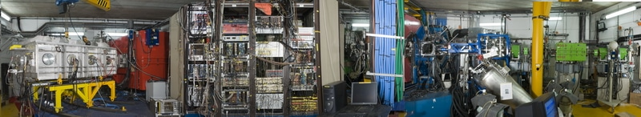
Fission studies at VAMOS
inverse kinematics : ²³⁸U +¹²C
Fissioning system identified at the target
Measurement of isotopic yields as a function of E* with the new PISTA array Damping of shell effects in nuclear fission
Spokesperson: J. Taieb, CEA/DAM
Courtesy Antoine Lemasson, GANIL
11

Slide 12
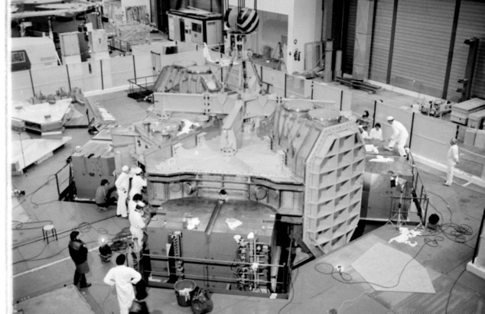
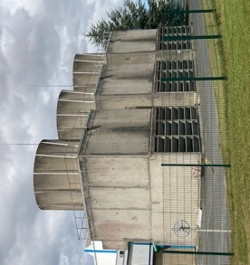
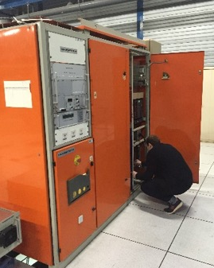
CYREN – Cyclotron Renovation
Last 10 years : Cyclotrons maintenance and refurbishment reduced to the strict minimum. GANIL manpower dedicated to SPIRAL2 building then commissioning.
Aging ↗ Reliability ↘ Manpower for curative maintenance ↗
Launch of the pre project CYREN : march 2022
1: keep the facility in operational conditions for at least 20 years
2 : optimize manpower needed for maintenance after refurbishment
Scope : full installation
Cyclotrons and experimental areas, infrastructure and utilities, safety, security, radioprotection
Implementation:
Funding under discussion, 2024-2030, facility available during renovations with
possible shutdowns during some phases
Cyclotrons et experimental rooms
Power Supplies and Magnets
RF cavities and systems
Remote control
PLCs
Vacuum systems
Diagnostics
Production targets
Ions Sources
Infrastructures and utilities
Electricity Distribution
Cooling systems
HVAC
Buildings
Various networks (water, air, gas)
Computer Infrastructures
Safety / Security / Radioprotection Systems
Radioprotection devices (radiation detectors, active dosimeters, gamma spectrometers, …)
Access Management System
Fire Safety System

Slide 13

The main topic : rf cavities
Risk : cooling circuit leak, unreachable for repairing
        At least, manufacturing of a new cavity and keeping an old one as a spare : REFERENCE scenario
        Replace the 4 SSC RF cavities : HIGH scenario
hypotheses
  Extended shutdown only for RF cavities
  Other works during 2nd semester of each year, to minimise impact on the community
  Start of the preparatory phase as soon as 2024 and start of refurbishment program in 2025
« As soon as possible » schedule
  REFERENCE scenario in 5 years : 2025 to 2029 (light residual in 2030)
  First cavity delivery, installation and RF characterization :
  Sep 2028-Nov2029
  HIGH scenario in 8 years : 2025 to 2032
  Three next cavities in 2030, 2031, 2032

Slide 14
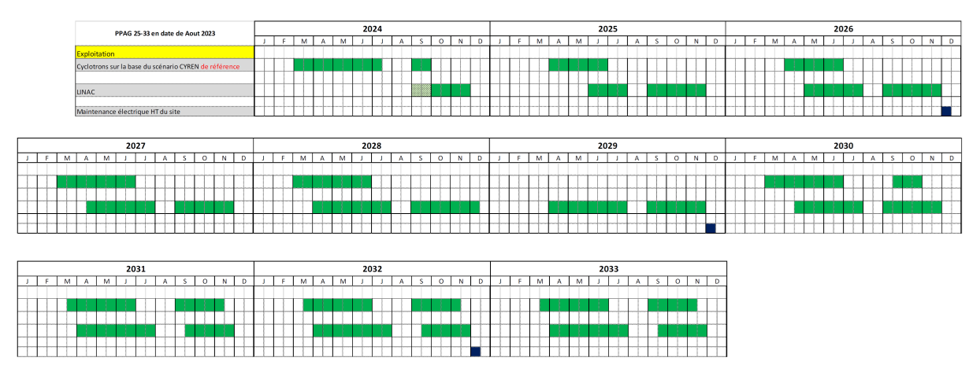
Impact of CYREN on CYCLOTRON operation
Operation time 2024-2033 : Cyclotrons and Linac

Slide 15
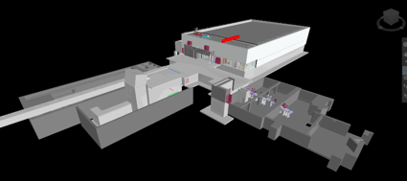
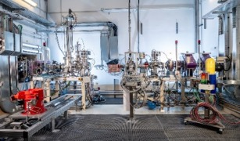
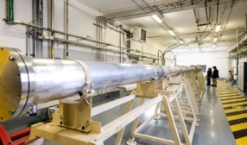
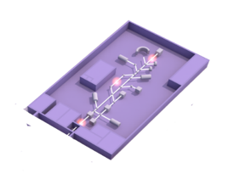

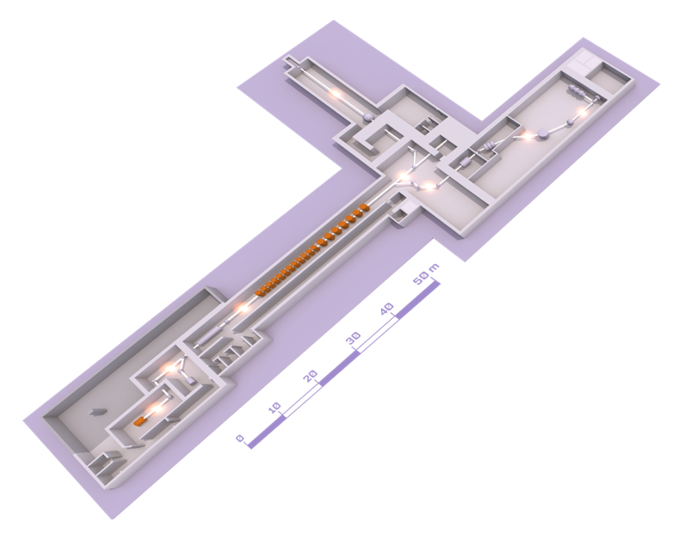


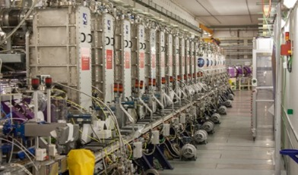
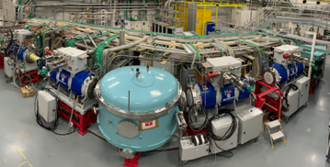
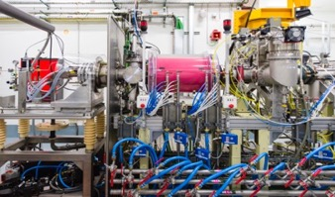
SPIRAL2 and the new experimental rooms
DESIR
(Decay,
Excitation and
storage of radioactive ions)
A new accelerator ramping up:
-Beam developments
Talk by Guillaume Normand
-First operation experimental area and the first neutrons at GANIL/SPIRAL2: NFS first campaigns and results
Talks by Xavier Ledoux and Anne-Marie Frelin
-Super Separator Spectrometer
Talks by Hervé Savajols, Julien Piot and Vladimir Manea
-DESIR project
Talk by Jean-Charles Thomas
NFS (NEUTRONS FOR SCIENCE)
Salle convertisseur
Salle Temps de vol
Accélérateur linéaire (LINAC)
S3 (SUPER SEPARATOR SPECTROMETER)
Beams :
33 MeV protons
40 MeV deutons
<14,5 MeV/nucleon ions lourds
ION SOURCE

Slide 16






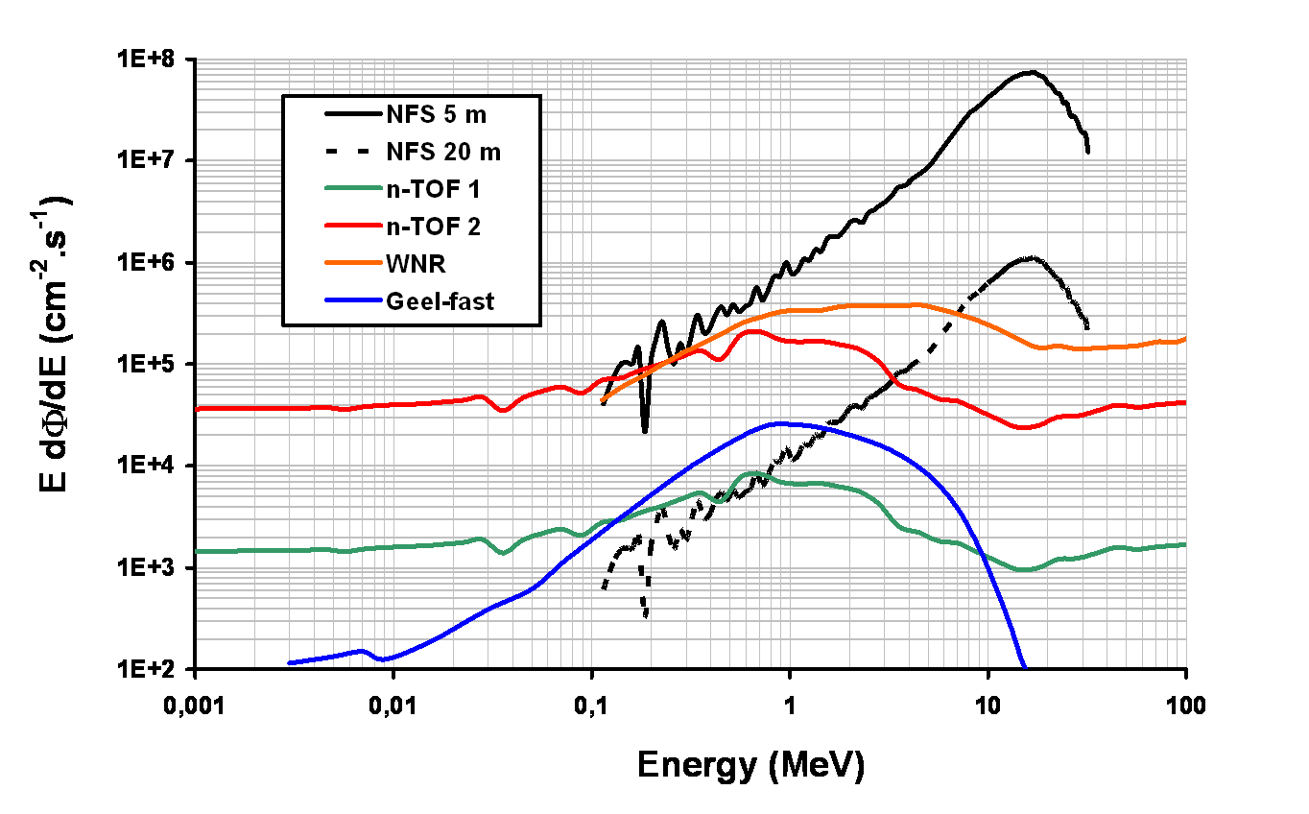
The Neutrons For Science facility
NFS is the first operational experimental area of SPIRAL2 at GANIL
International collaboration
50 physicists
15 laboratories
6 partners
Physics case
Fundamental physics
Astrophysics
New generation of reactor
Fusion technology
Radioisotopes production for medical applications
Biology (cells irradiation..)
Development and characterization of new detectors
Study of the single-event upsets
High neutron flux and good complementarity with other facilities

Slide 17





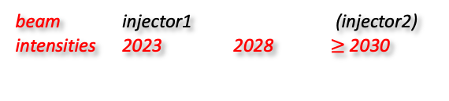
New injector for SPIRAL2: NEWGAIN
Floorplan, design intensities and time line
beam injector1 (injector2)
intensities 2023 2028 $≥$ 2030
Ions | Intensity (pµA) Phoenix V3 RFQ A/Q≤3 | Intensity (pµA) Phoenix V3 RFQ A/Q≤7 | Intensity (pµA) SC Ion Source RFQ A/Q≤7
¹⁸O | 80 | * | 375
¹⁹F | >15 | >40 | >40
³⁶Ar | 16 | 70 | 45
⁴⁰Ar | 3.6 | 70 | 45
³⁶S | 2.3 | * | *
⁴⁰Ca | 2.9 | 10 | 20
⁴⁸Ca | 1.2 | 10 | 20
⁵⁸Ni | 1.1 | 4 | 8
⁸⁴Kr | 0.1 | 10 | 20
¹³⁹Xe | 0.001 | 7 | >10
²³⁸U | <<0.001 | 0.1 | 6
Measured
Estimated
* -> no estimation
White Book
https://www.ganil-spiral2.eu/scientists/ganil-spiral-2-facilities/accelerators/newgain/
time line
2020 | 2021 | 2022 | 2023 | 2024 | 2025 | 2026 | 2027 | 2028
Study Phase
Construction Phase
first
beam
Courtesy of MH Moscatello, D. Ackermann

Slide 18
Scientific motivation
Consolidation and reinforcement of the S3, LEB & DESIR heavy-ion existing physics program
N=Z and SHE
Relevant beams:
^{12,13,14}C, ^{16,17,18}O, ^{20,21,22}Ne, ²³Na, ^{24,25,26}Mg, ²⁷Al, ^{28,29,30}Si, ^{32,34}S, ^{35,37}Cl, ^{38,40}Ar, ^{38,39,40}K, ^{40,42,43,44,46,48}Ca, ^{46,47,48,49,50}Ti, ⁵¹V, ^{50,52,53,54}Cr, ⁵⁵Mn, ^{54,56,57,58}Fe, ⁵⁹Co, ^{58,60,61,62,64}Ni, ^{63,65}Cu, ^{64,66,67,68,70}Zn, ^{74,76}Ge, ^{78,86}Kr, ^{84,86}Sr, ⁹⁰Zr, ⁹²Mo
Inj 1
NEWGAIN
Ions | Intensity (pµA) Phoenix V3 A/Q≤3 | Intensity (pµA) Phoenix V3 A/Q≤6* | Intensity (pµA) SC Ion Source A/Q≤7 | Intensity (pµA) SC Ion Source RFQ A/Q≤6
¹⁸O | 80 | * | 375 | 375
¹⁹F | >15 | >40 | >40 | >40
³⁶Ar | 16 | 70 | 45 | 45
⁴⁰Ar | 3.6 | 70 | 45 | 45
³⁶S | 2.3 | * | * | *
⁴⁰Ca | 2.9 | 10 | 20 | 20
⁴⁸Ca | 1.2 | 10 | 20 | 20
⁵⁸Ni | 1.1 | 4 | 8 | 8
⁸⁴Kr | 0.1 | 10 | 20 | 20
¹³⁹Xe | 0.001 | 7 | >10 | >10
²³⁸U | <<0.001 | 0.1 | 10 | 0.5
Future Opportunities
Multi-nucleon transfer + fusion-fission:
-> neutron-rich nuclei
Based on:
heavy beams (Pb, U)
New experimental facility (S³ not adapted)
Incipient phase!
Useful beams: heavy beams – ⁸⁴Kr, ¹³⁶Xe, ¹⁹⁷Au,²⁰⁸Pb,Bi,Th,²³⁸U up to 10 puA
*: limite HT Phoenix V3
Emittance and intensity measurement with Ca beams in October 2023
Neutron rich nuclei
I.Stefan

Slide 19
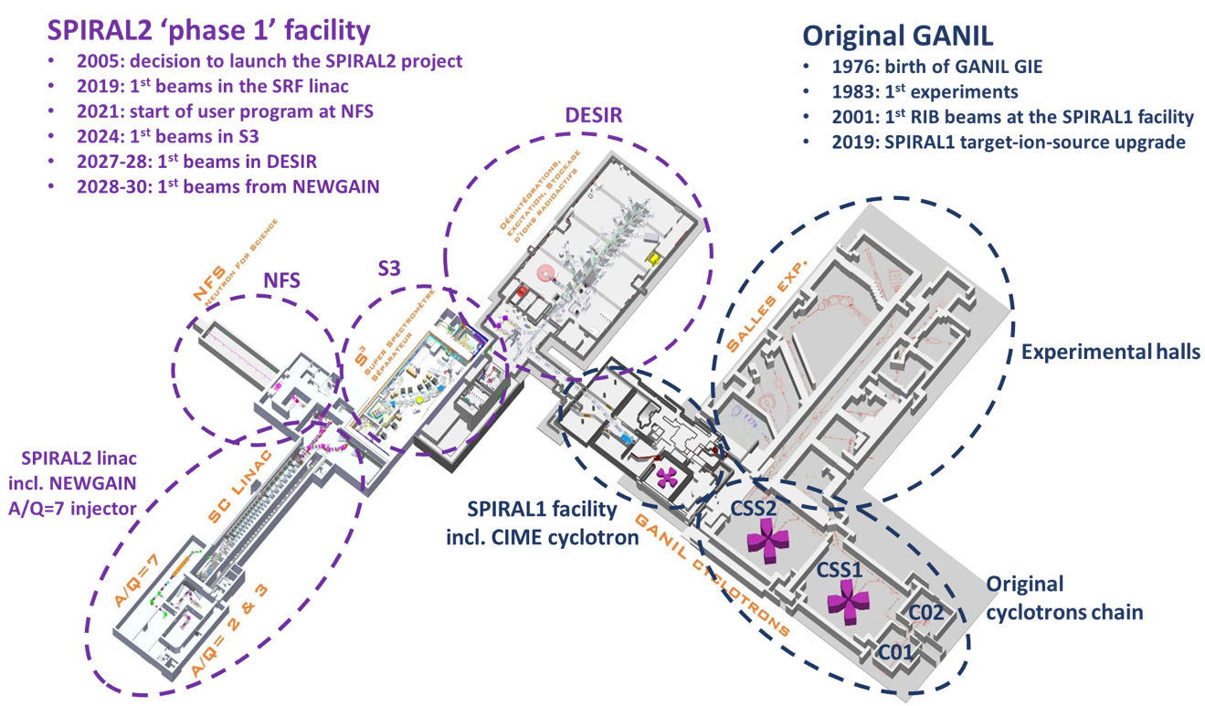
Before 2030
Neutrons for Science (NFS) started to work in 2021 (first exp). Neutrons produced from protons and deuterons accelerated from the LINAC: mainly fission, but also low-energy excitations, …
Commissioning of the Super
Separator Spectrometer (S3) planned in 2024: nuclei with very low cross sections, such as superheavy elements or neutron deficient nuclei close to the limit of stability
DESIR in 2027-2028
unique opportunities in terms of selection of exotic nuclei and/or beam purity.
masses, laser spectroscopy, beta-decay spectroscopy, … building construction starts in 2023.
First stone ceremony on November 10, 2023
NEWGAIN, Injector 2: A/Q =3-7 Increasing beam intensities of heavy (A > 40) and very heavy (Xe, Pb, U) nuclei
Refurbishment of the cyclotrons – by the end of the decade
Recently commissioned LINAC
Courtesy M. Grasso

Slide 20
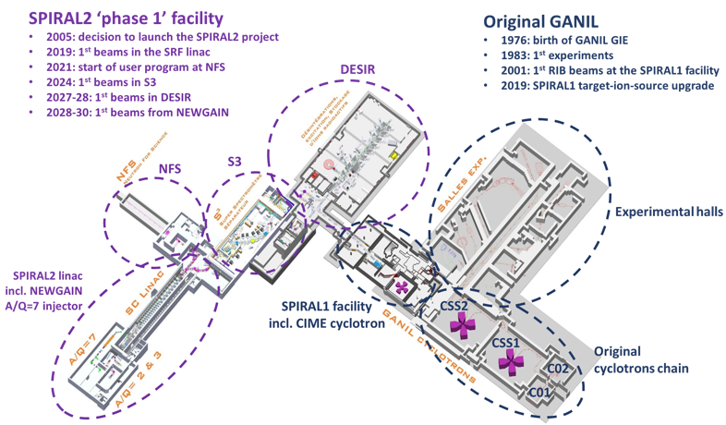
Beyond 2030
International expert committee, chaired by Michel Spiro: vision for the future of GANIL (report provided to CNRS and CEA in December 2021)
Strategy to be defined based on different recommendations and options suggested by the expert committee: new building for production of neutron-rich exotic nuclei, production of radioisotopes, new reacceleration system -> from Coulomb barrier up to 100 MeV/nucleon, ….
On this basis, GANIL direction asked Hanna Franberg and Stéphane Grevy to prepare a document where a few possible scenarios are identified, with:
-the description of the physics cases associated with each step
-a budget estimation
GANIL members, CEA/DRF and CNRS/IN2P3, will use this document to establish a strategy
Courtesy M. Grasso

Slide 21
Take home messages
Ambitious scientific program for the next years, on both accelerators
Stepwise completion of the different projects: S³, DESIR, NEWGAIN, CYREN
First steps towards long term future based on the recommendations of the international expert committee….…with partners
  Visiting scientists program: for stays between 2 and 9 months of scientific or technical experts with employment at another lab, GANIL covers lodging and living costs up flat rate of 2700€/month
  Increased number of scientific and technical post-docs
  « Scientific partners »: international legal entities which develop ion-beam based research and related technologies, which are not members of the GIE GANIL and which are committed under bilateral agreements signed with the GIE GANIL to (i) making significant financial and/or in-kind contributions to the design, construction, and/or operation of GANIL, and (ii) promoting GANIL scientific activities.

Slide 22
Thank you for your attention

