Slide 1

Development of timing system
Thanks to a successful R&D project (also supported by the TYL/FJPPL as NU08) a proposal for a timing system to be deployed at the Hyper-Kamiokande site has been developed
A strong collaboration with the SYRTE laboratory at the Paris Observatory has been established
Some equipment (Rb and PHM atomic clocks as well as GNSS receiver and antenna) has already been purchased, calibrated at SYRTE, then installed and extensively tested at LPNHE in Paris

Slide 2
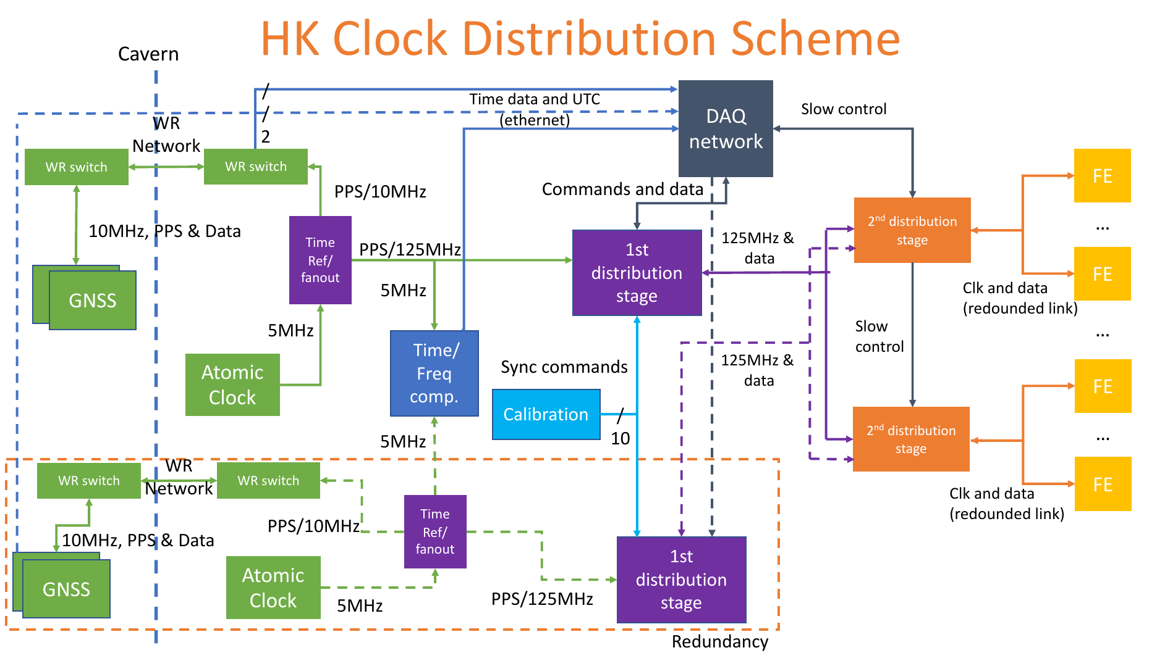

Slide 3
Development of timing system at J-PARC
Based on this success, a new TYL/FJPPL project has been launched for the development and implementation of a similar timing system on the J-PARC site
This system is crucial for the synchronization of events registered in Hyper-Kamiokande with the J-PARC neutrino spills

Slide 4


