Slide 1

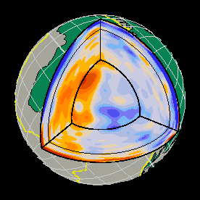

Whole Earth oscillations:
Thé key to imaging density in Earth’s deep interior using seismic data
Arwen Deuss
Runa van Tent, Ashim Rijal, Laura Cobden
Universiteit Utrecht
blue=fast
red=slow
Model S40RTS
Ritsema, Deuss et al., 2011
Notes:
The majority of tomographic models are made using either body waves or surface waves. What I am going to show in my presentation, is that normal modes or whole Earth oscillations are also a very important data set that may even be the key if you are interested in certain properties, such as density or attenuation, that you not be able to get from other data, or not so easily get from other data set. They are also very useful for imaging the lower mante, where we do not have any surface wave sensitivity and body waves are limited by restricted earthquake and receiver locations.

Slide 2
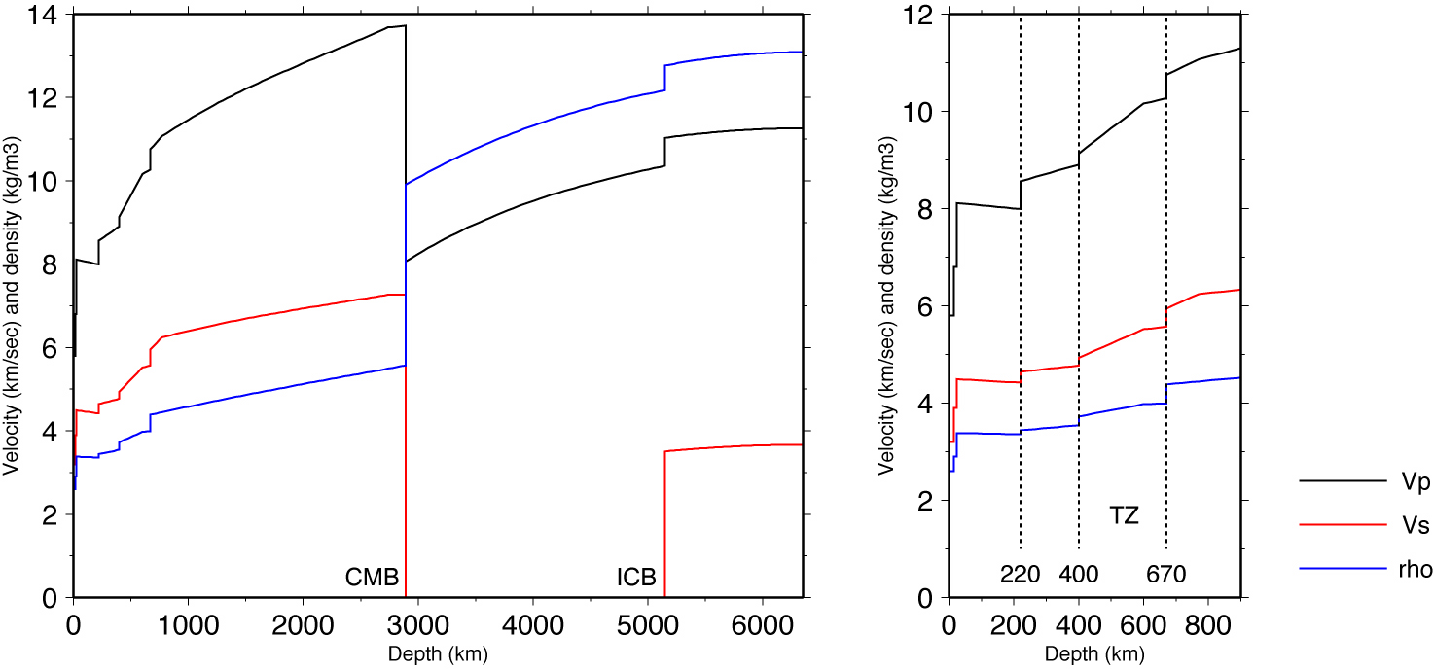
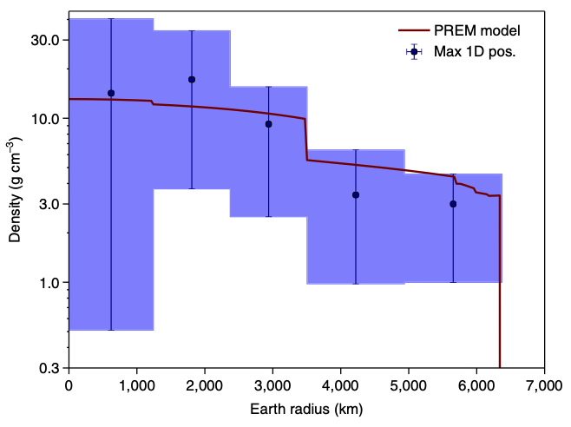
1D density profile
Seismic tomography
Neutrino tomography
PREM, Dziewonski & Anderson (1981)
Donini et al (2019)

Slide 3
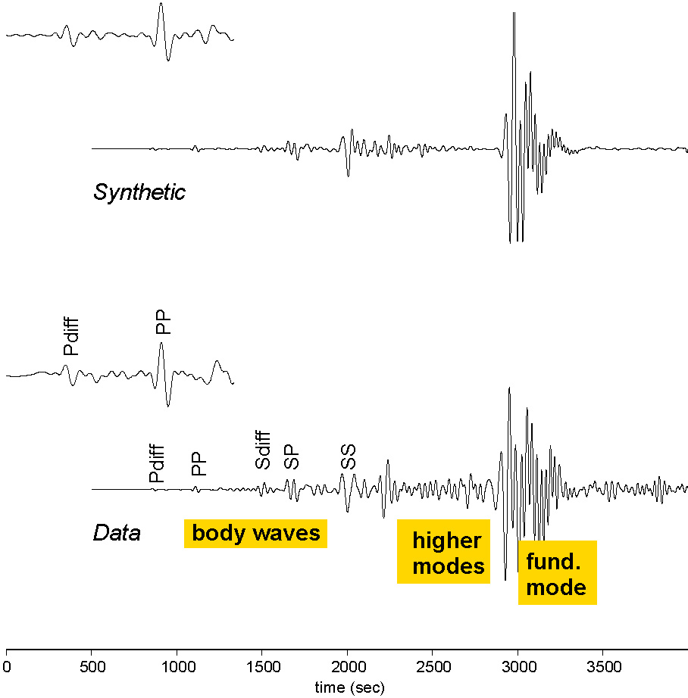
Seismological Data
Synthetics computed using
normal mode summation
up to 6 seconds for PREM
Event 21 May 1998 (Indonesia)
at TSUM (Tsumeb, Namibia)
Depth = 28km,
Mw= 6.6, Mb=6.3,
Δ =101.5
Notes:
What seismologists usually do, we measure seismograms for real earthquakes and compare those to calculated seismograms for a model of the Earth. And we see that there are differences, and by improving the model we better fit the data and so we learn about the interior of the Earth.

Slide 4
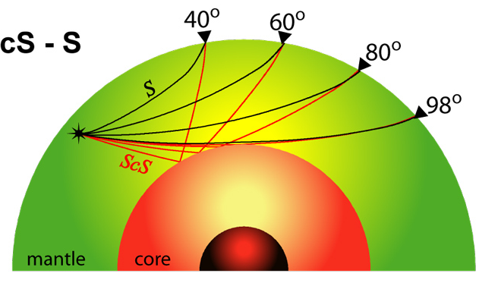
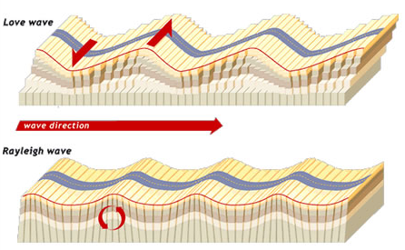
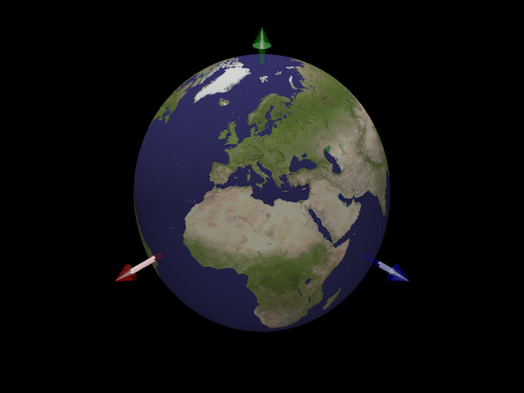
(1) Body waves
Imaging small scale structure
and discontinuities
Only velocity information
Ray theoretical approximations
Short period
(~ 0.05-1Hz)
(2) Surface waves
Imaging upper mantle only
Mainly velocity information
(limited density)
(0.3-40 mHz)
(3) Whole Earth oscillations
Density and velocity information
Only large scale structure
Complete theory
Long period
(0.2-10 mHz)
Notes:
There are three data types that we can use to `see through’ the Earth. These are generated by earthquakes and the waves travel through the Earth’s crust, mantle and core. Only short period body waves and surface waves have so far been used for measuring attenuation, for which it is really difficutl to separate attenuation from scattering.
We will have a look at the three different data types we use in seismology, going from short period to long period.

Slide 5
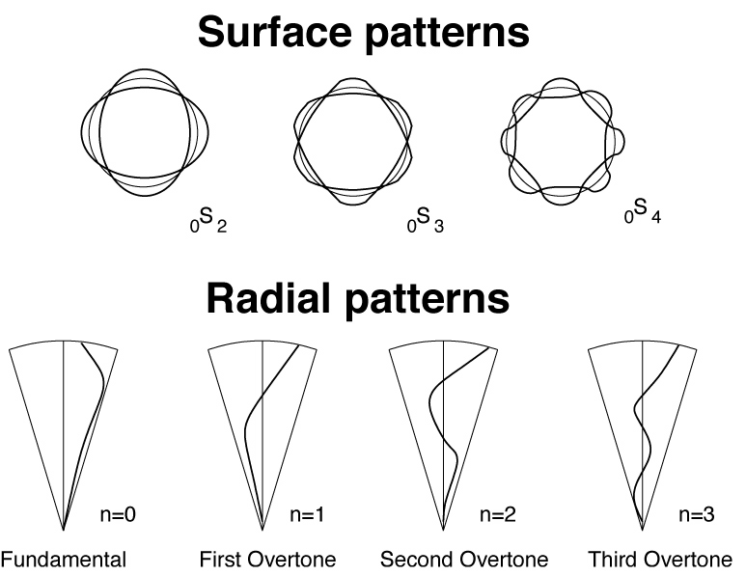
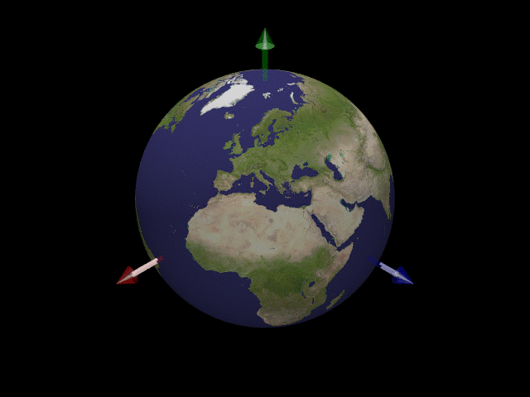
Whole Earth oscillations
Spheroidal modes _{n}S_{l}
n = radial order, l = angular order
₀S₂: 54 minutes
“football mode”
₀S₀: 20 minutes
“breathing mode”
http://lucien.saviot.free.fr/terre/index.en.html
Notes:
Normal modes are whole Earth oscillations, and are standing waves along the radius and surface of our planet.

Slide 6
Normal mode data
Data spectrum
Sumatra earthquake
26/12/2004
Data
Synthetics
1.0 1.1 1.2 1.3 1.4 1.5 1.6 1.7
Frequency (mHz)
Deuss et al (2013)
Notes:
… to make the modes visible in a frequency spectrum.

Slide 7
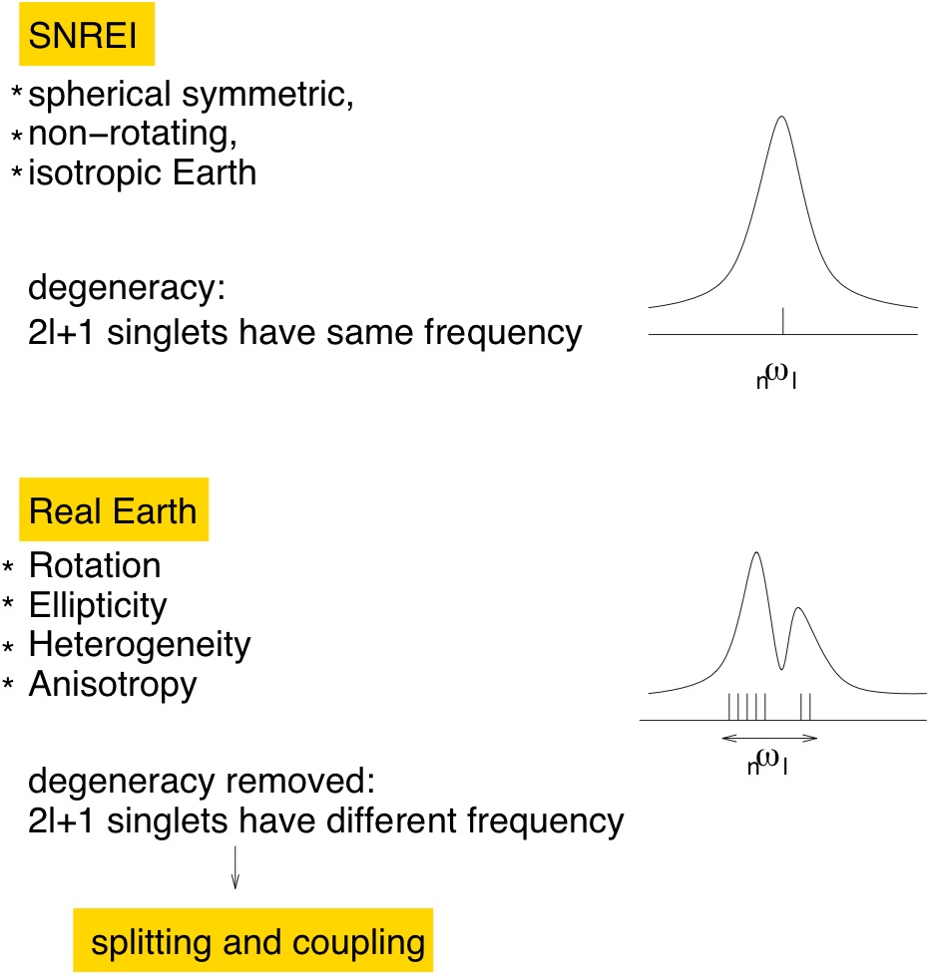
Notes:
What does this mean in practise?

Slide 8
Normal mode observations
Data set of 93 events with Mw>7.4 since 1978
Select frequency window for specific normal mode
Combine all spectra for one splitting function
Start from PREM predictions
Iterative least squares spectral fitting
Including:
2004 Sumatra (Mw=9.0)
2010 Chile (Mw=8.8)
2011 Japan (Mw=9.0)
(Deuss et al., GJI, 2013)
Notes:
Our aim is to observe the CMB stoneley modes.
For this purpose, we have a large data set of earthquakes from the last 40 years
with magnitudes larger than 7.4 of which the locations are shown here.
This data set includes the Sumatra and Japan megathrust earthquakes and
a lot deep events as well as events in continental regions.

Slide 9
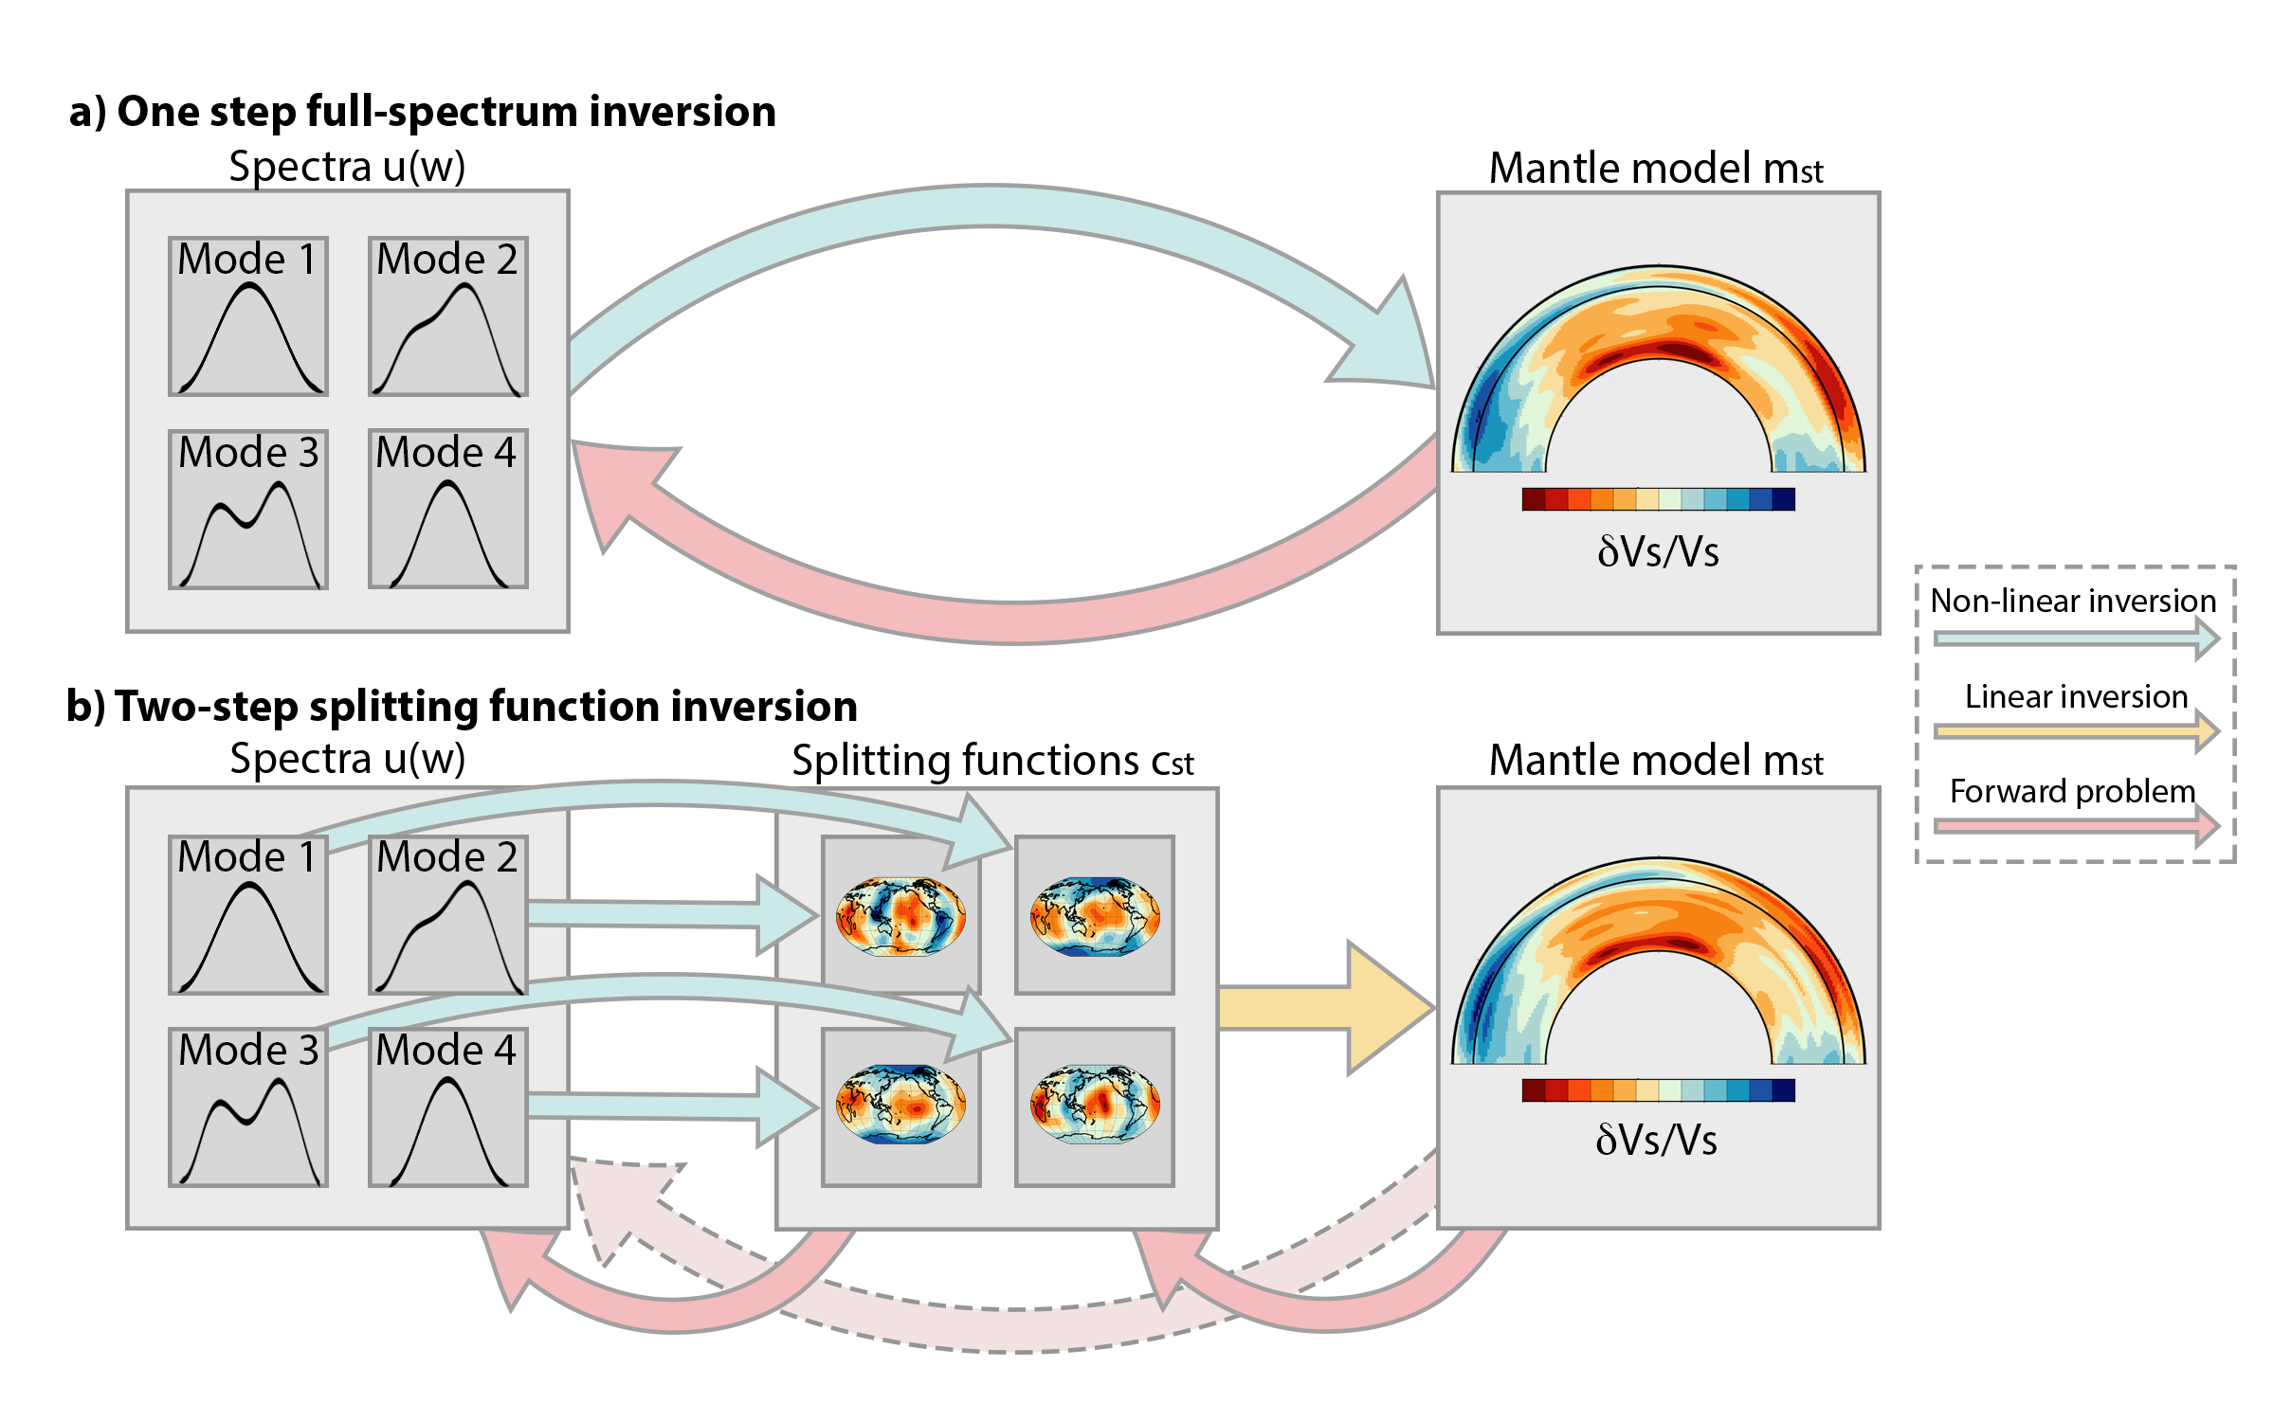
Notes:
There are two different ways to use normal modes in making tomographic models. Ideally, you directly invert the spectra for, in this case, velocity. That is a non-linear inversion and therefore requires iteration. Cross-oupling or resonance between modes can easily be included.

Slide 10
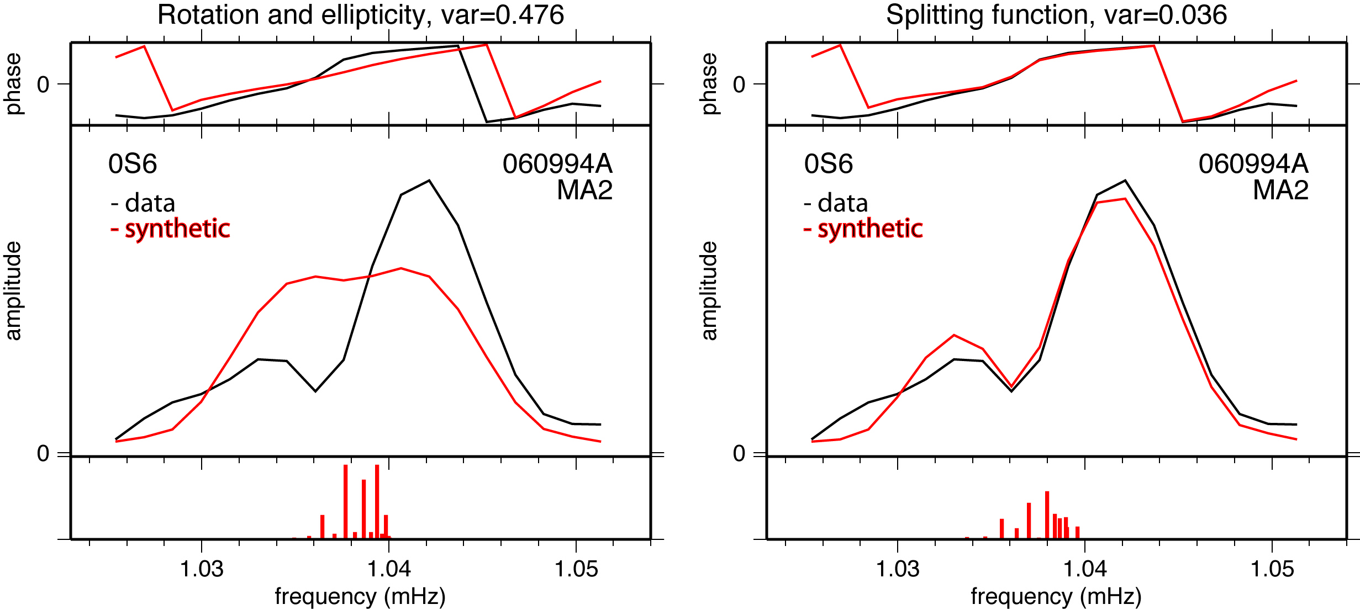
Normal mode spectra
Before splitting function
measurement:
After splitting function
measurement:
Woodhouse & Deuss, Treatise on Geophysics, 2015
Notes:
We measure splitting functions, by comparing observed spectra with calculated spectra.

Slide 11
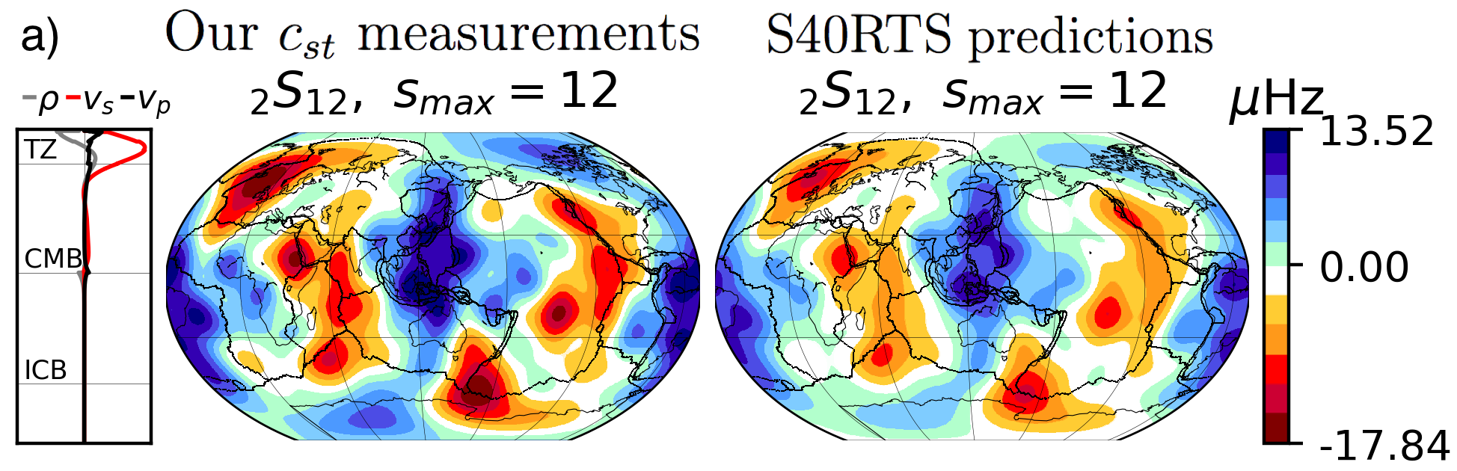
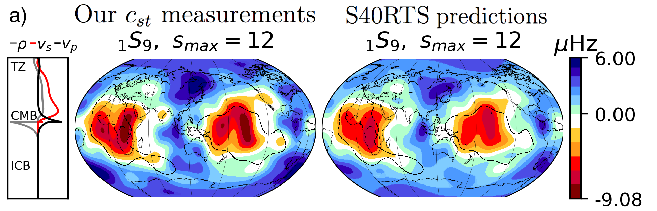
Splitting functions
F(θ,φ) = Σ c_{st} Y_{s}^{t}(θ,φ)
s=angular order
t=azimuthal order
Upper mantle
Lower mantle
Splitting function – 3D velocity & density
Splitting function – 3D velocity & density
Deuss et al, GJI, 2013

Slide 12
Splitting functions
F(θ,φ) = Σ c_{st} Y_{s}^{t}(θ,φ)
s=angular order
t=azimuthal order
Coefficients c_{st} depend on Earth structure
a
c_{st}=∫δm_{st}(r)K_{s}(r)dr
0
δm_{st}(r) are model parameters (v_{s}, v_{p}, ρ)
K_{s}(r) are the kernels
s=0 ‘center frequencies’ 1D structure
s > 0 ‘splitting function’ 3D structure

Slide 13
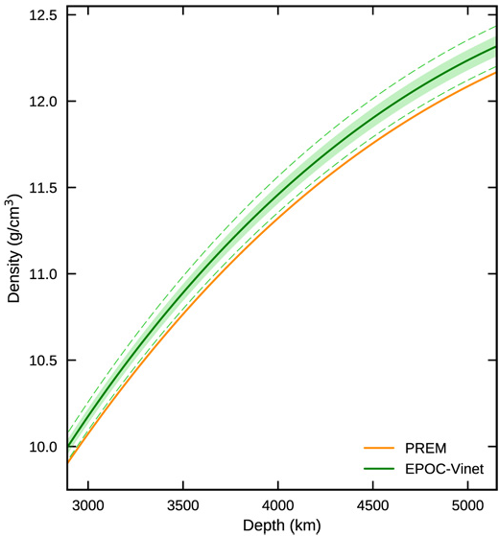
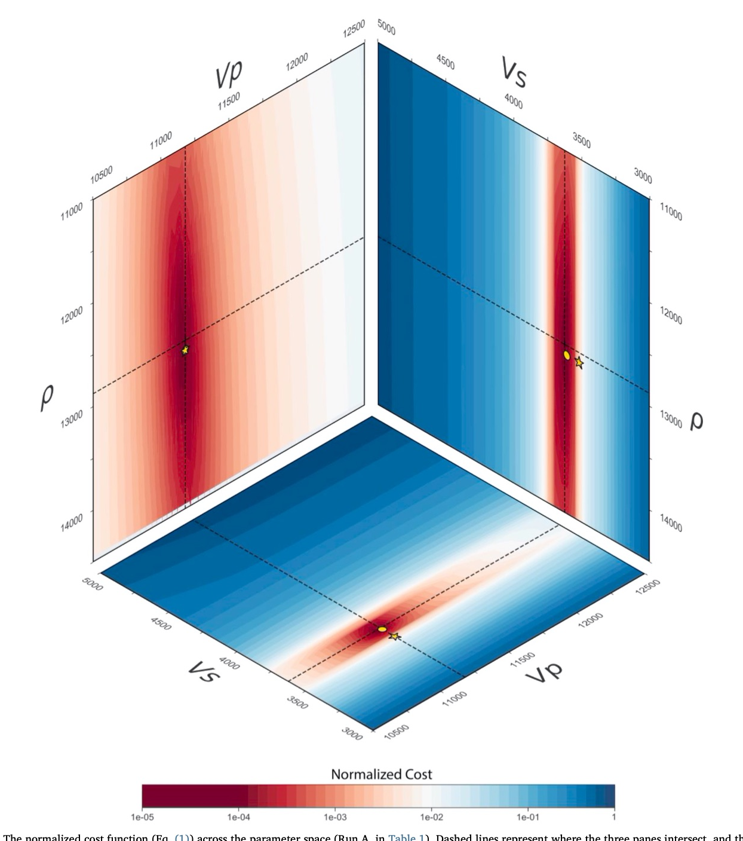
1D structure
Outer core is denser than PREM
(Irving et al, 2018)
Inner core is lighter than PREM
(Robson & Romanowicz, 2019)

Slide 14
Core Mantle Boundary Stoneley modes
Strong sensitivity to the Core Mantle Boundary
Difficult to observe, as almost no surface expression!
(Koelemeijer & Deuss, GJI, 2013)

Slide 15
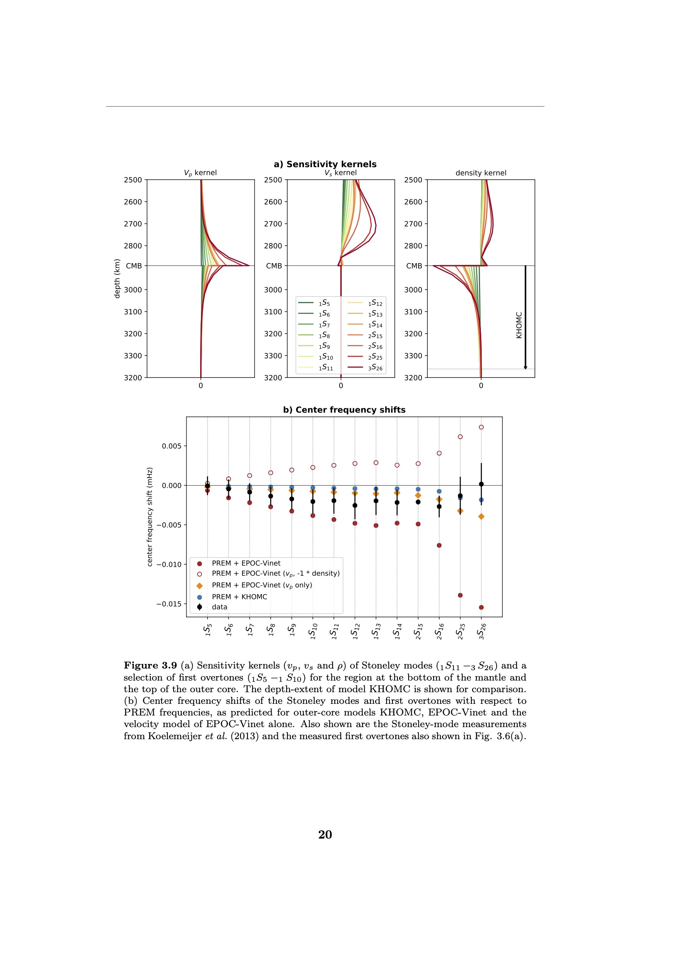
1D structure
Outer core density – center frequency shifts

Slide 16
1D structure
Normal mode spectra– outer core density

Slide 17
1D structure
Outer core is denser then PREM?
Inner core is lighter than PREM?

Slide 18
1D structure
Outer core is denser then PREM?
Inner core is lighter than PREM?

Slide 19
1D structure
Outer core is denser then PREM?
Inner core is lighter than PREM?

Slide 20
1D structure
Outer core is denser then PREM? 0.2% denser near the top
Inner core is lighter than PREM? 0.4% lighter

Slide 21
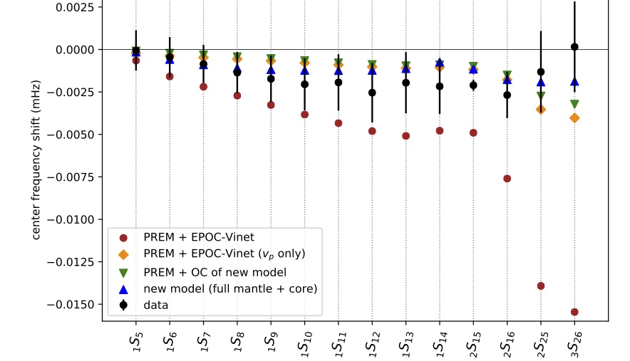
1D structure

Slide 22
1D structure

Slide 23
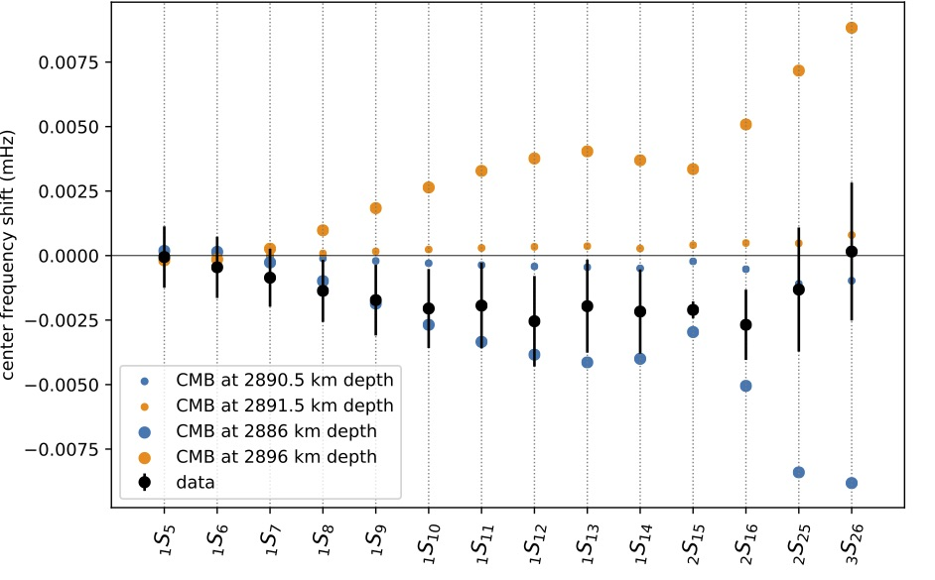
1D structure
CMB depth – 5km shift is already too much!

Slide 24
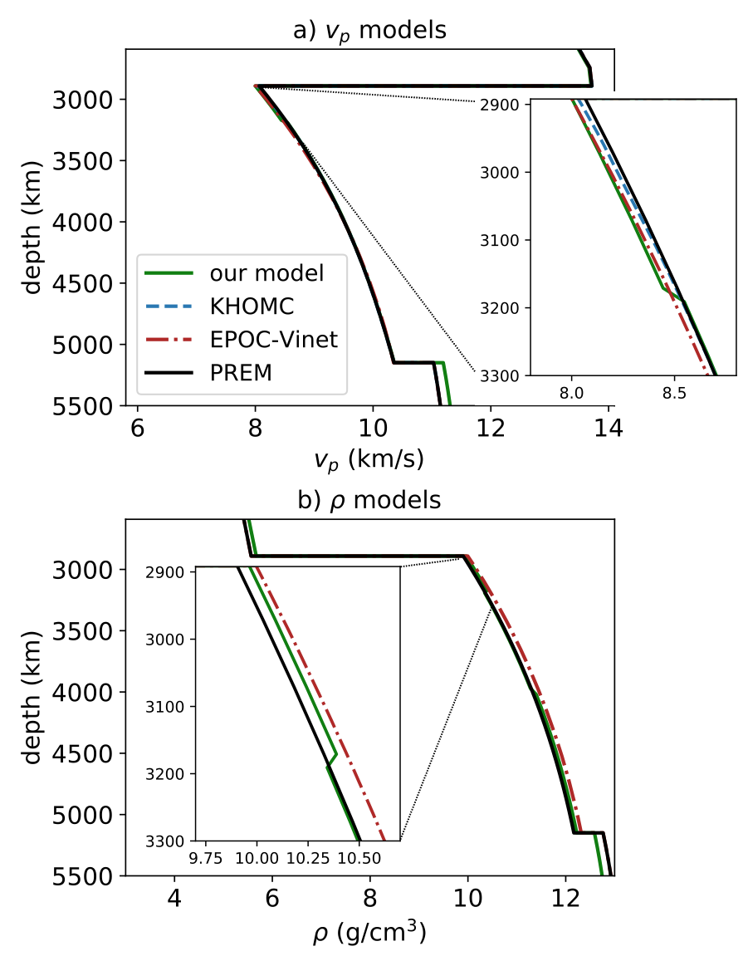
1D structure
Outer core is denser than PREM
(Irving et al, 2018)
Outer core is only denser at the top

Slide 25
1D density profile
Seismic tomography
Neutrino tomography
PREM, Dziewonski & Anderson (1981)
Donini et al (2019)

Slide 26
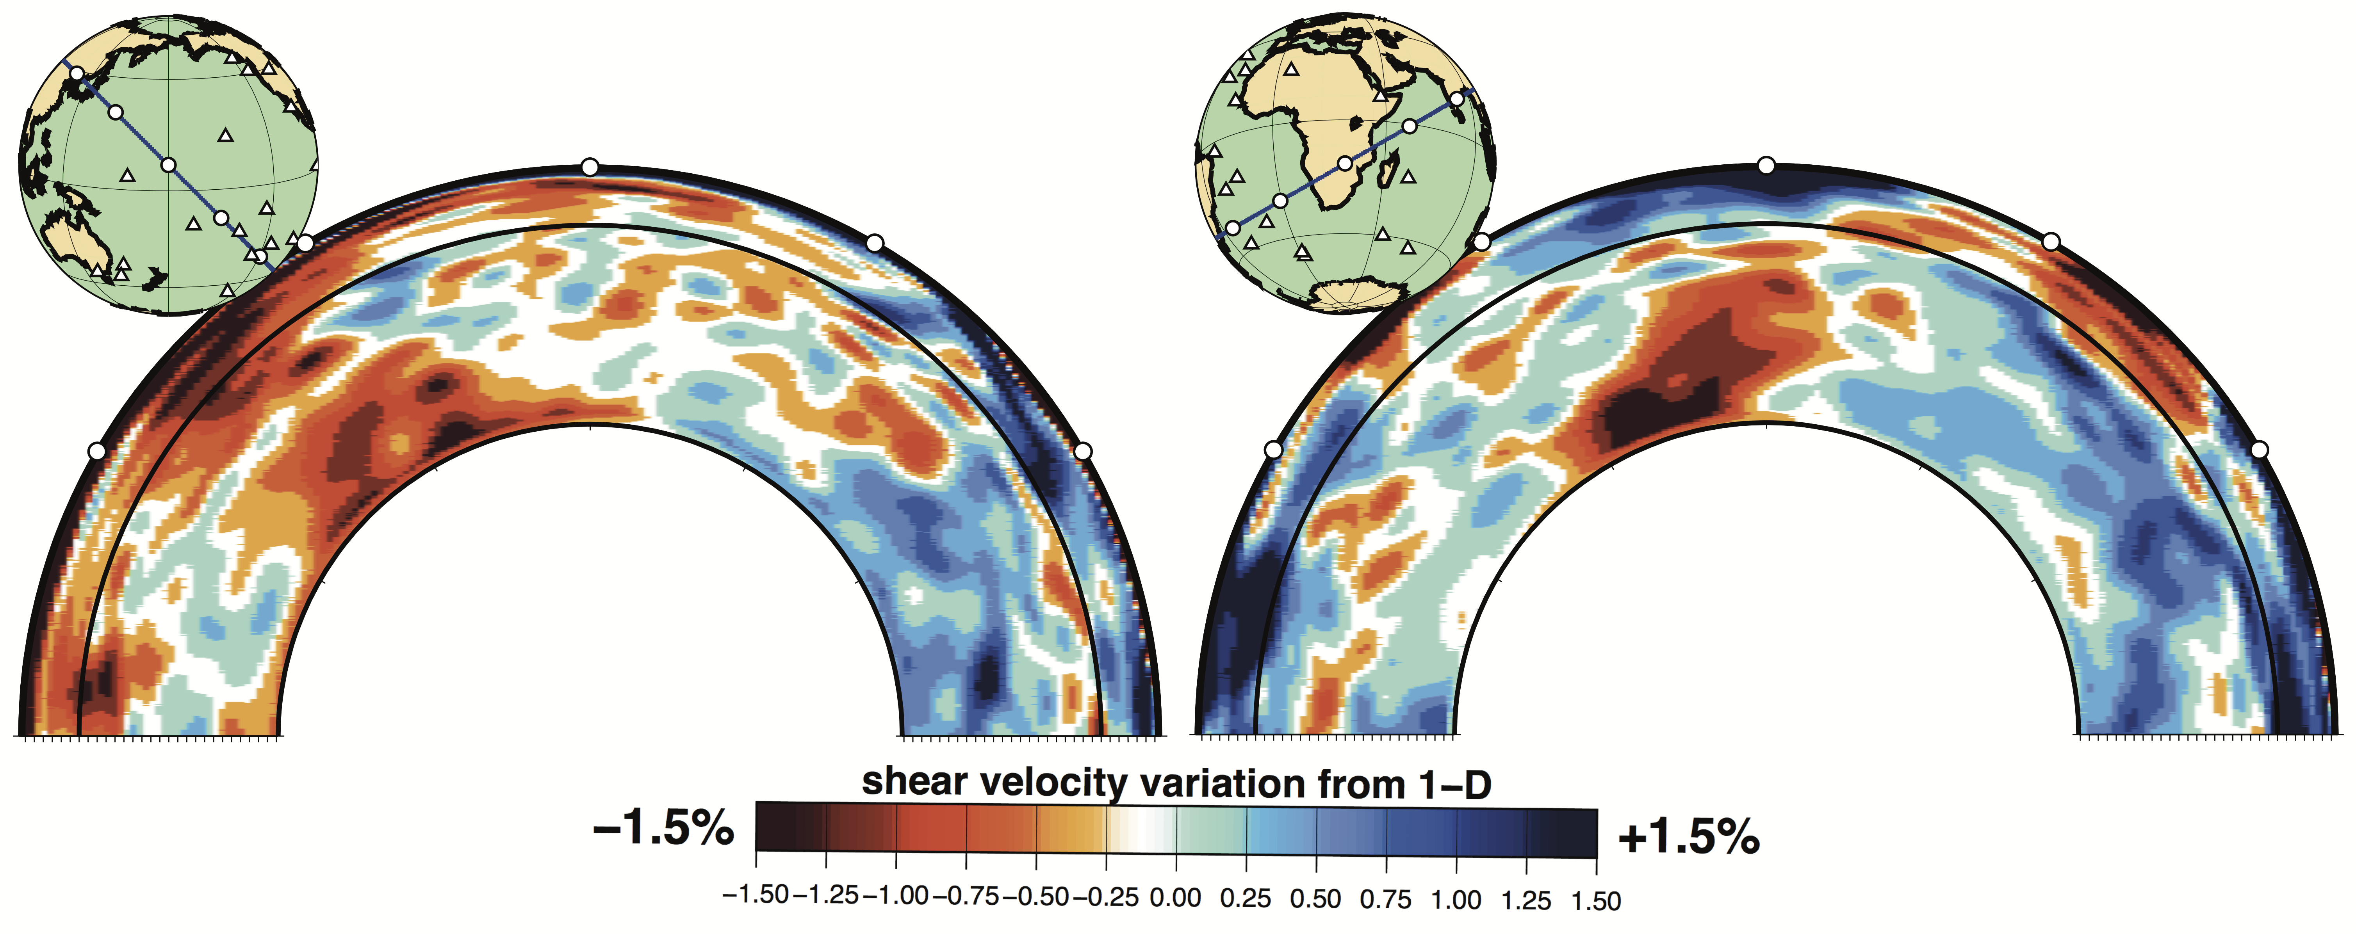
3D structure
Large Low Shear Velocity Provinces (LLSVPs):
Hot superplume or stable mantle anchor?
Model S40RTS
Ritsema, Deuss et al., 2011

Slide 27
LLSVP density – previous studies
Seismic normal modes
Tomographic models - LLSVPs are dense
Stoneley modes - LLSVPs are light
Geoid - LLSVPs are light
Tidal data - LLSVPs are dense
Ishii & Tromp (1999)
Trampert et al. (2004)
Mosca et al. (2012)
Koelemeijer et al.(2017)
Hager et al. (1985)
Lau et al. (2017)
Notes:
The problem is that studies have found conflicting results. Seismic normal mode studies using all modes find that the LLSVPs are dense, while the Stoneley modes, which are soecifically sensitive to the lowermost mantle, prefer LLSVPs to be light. The geoid also prefers light LLSVPs but tidal data prefers dense LLSVPs. Herem we are going to use the normal modes and I will show that when we make a model combining the Stoneley modes with all other modes, that we find that the LLSVPs are partly dense and partly light.

Slide 28
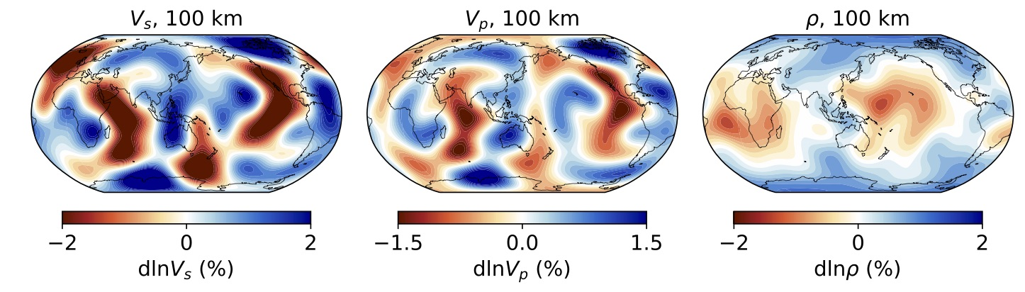
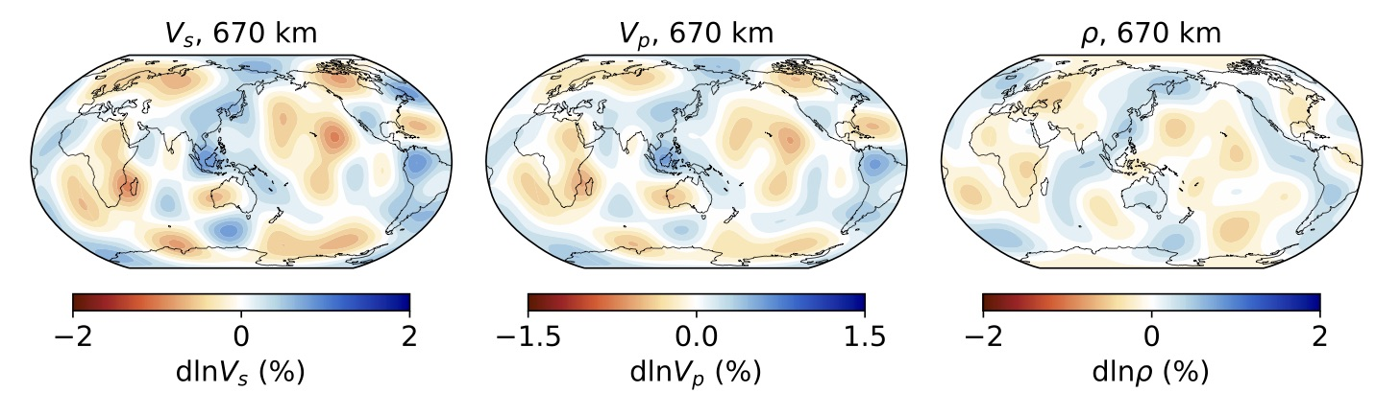
Density tomography
(Using Hamiltonian
Monte Carlo sampling)
Velocity
Density
Spreading ridges
Shields
Subducting slabs
van Tent, Gebraad, Fichtner, Trampert & Deuss, in prep, 2022

Slide 29
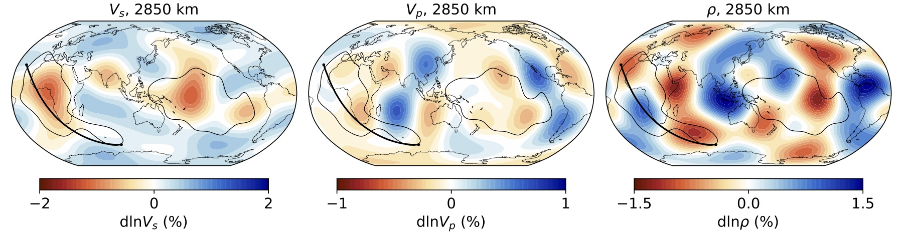
Density tomography
(Using Hamiltonian
Monte Carlo sampling)
Velocity
Density
Low velocity LLSVP’s
Light top
Dense base
van Tent, Gebraad, Fichtner, Trampert & Deuss, in prep, 2022

Slide 30
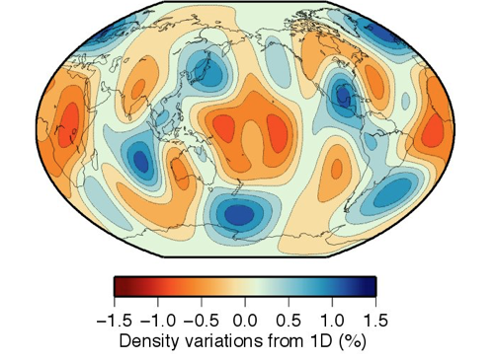
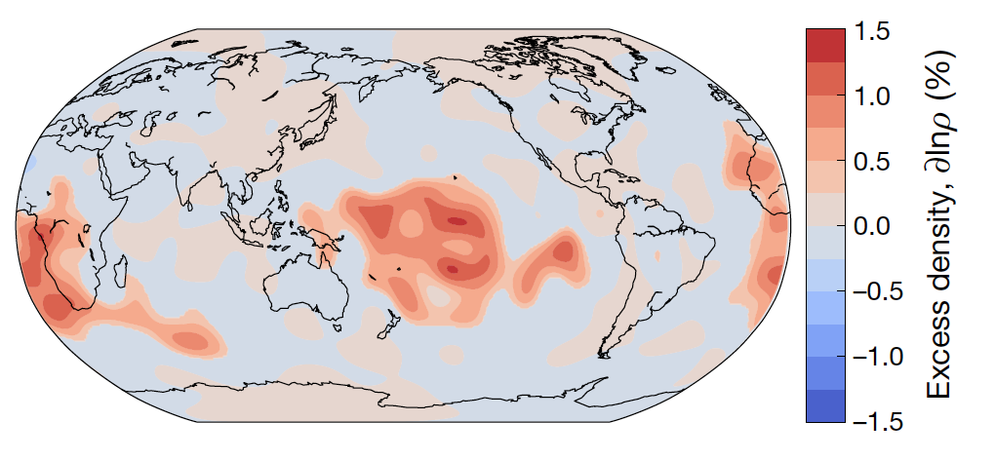
Comparing density models
Koelemeijer et al.
(2017)
Lau et al. (2017)

Slide 31
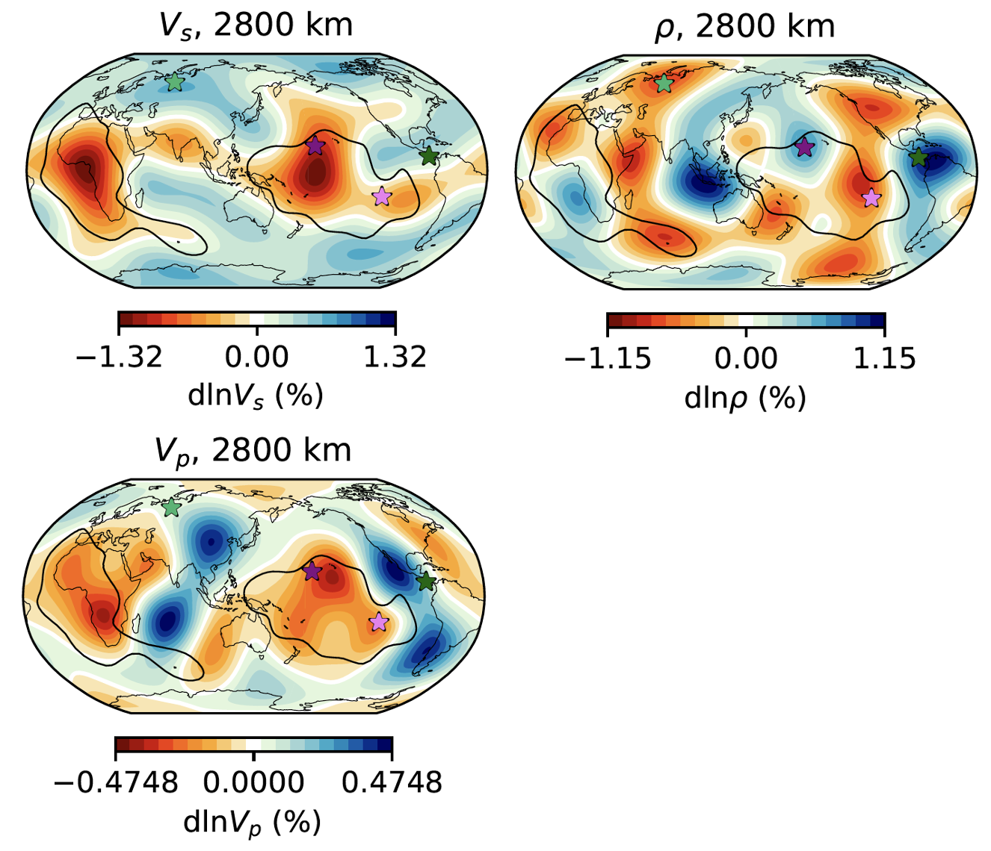
Thermochemical inversion
LLSVPs are hot
High density regions
are enriched in FeO
and SiO₂
In collaboration with
Ashim Rijal and Laura Cobden
Notes:
What can the velocity and density tell us about the temperature and compostion? We use a neural network to do a thermochemcial inversion, see for more details Ashim’s presentatio later today. We find that the whole LLSVPs are hot., bit the dens eand light regions. The dense regions, both inside and outside the LLSVPs, are enriched in iron and slso have a high SiO₂ content.

Slide 32
Synthesis - LLSVPs
Velocity
Density
The continental sized LLSVPs are devided into a dense base and a light top. They have a high temperature; their higher density is due to increased iron content, which makes them rather stable.

Slide 33
Conclusions
The outer core is 0.2% denser than PREM
The inner core is 0.4% lighter than PREM.
We find 1% denser regions at the base of otherwise light LLSVPs, reconciling apparently contradicting earlier constraints
The dense base of the LLSVP regions correspond to a change in composition with an increase in FeO and SiO₂, within overall high temperature LLSVPs

Slide 34

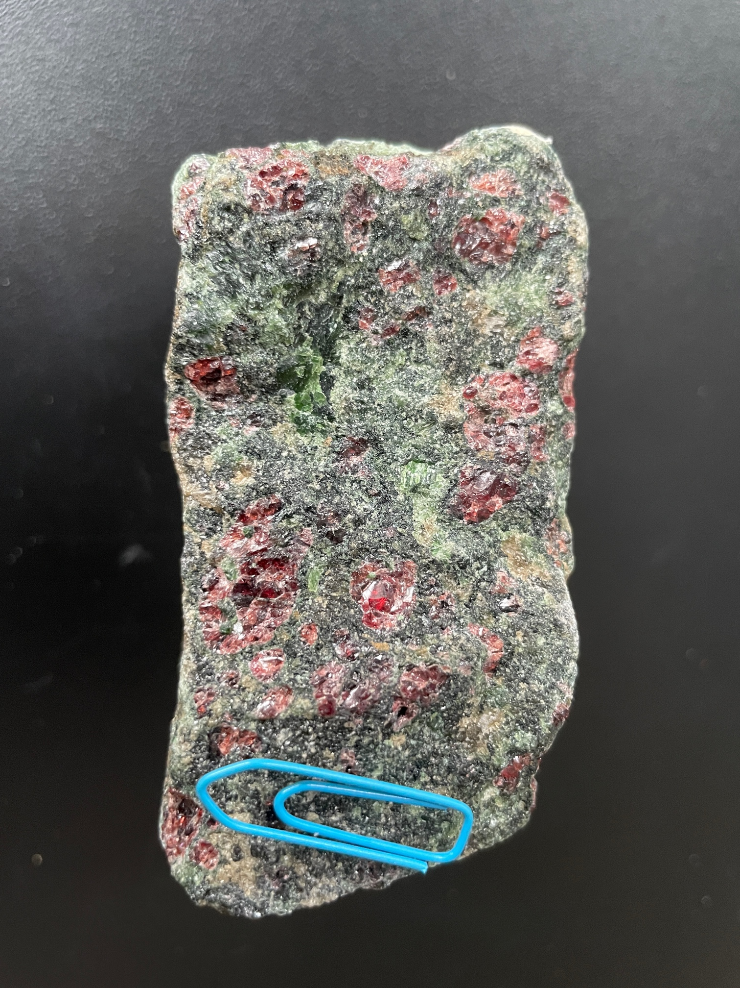
Tour de France – 5th stage
Do you want to know why the King of the Mountain polka-dot jersey in the Tour de France should be red-and-green instead of red-and-white?
https://www.geo-sports.org/2023/stage-5-mountain-jersey/

