Slide 1
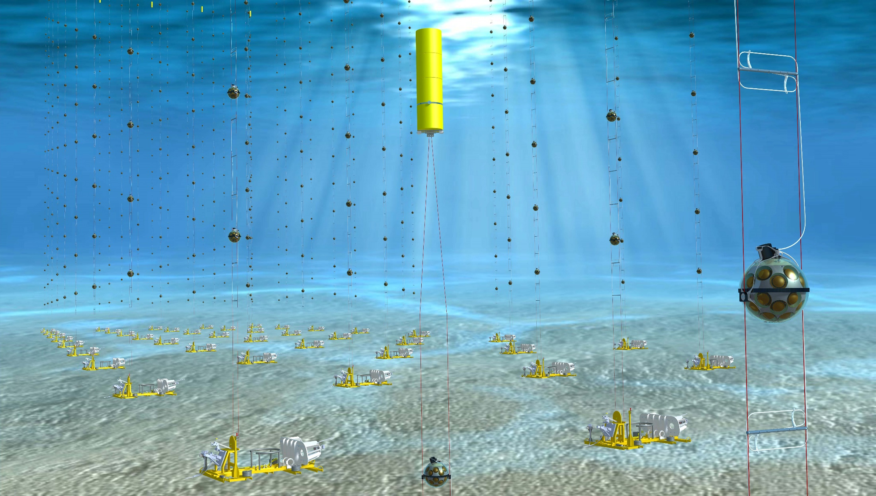
Computational and Statistical Aspects of Neutrino Oscillation Tomography
João Coelho
APC Laboratory
05 July 2023

Slide 2
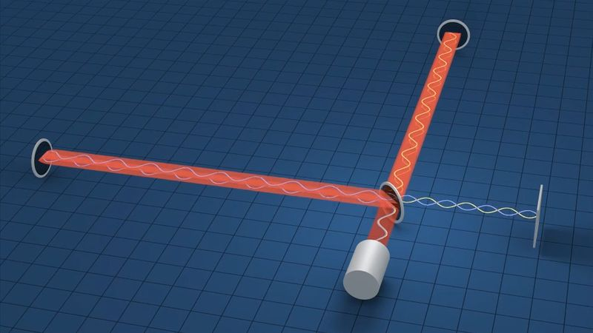
Some Numbers
Oscillation length: L/E ~ 500 km/GeV
Structures sensitive to oscillation > 100 km
Volume of the Earth: 10¹² km³
Number of objects with size ~(100 km)³: 10⁶
Yes, LIGO can measure 10⁻¹⁹ m with a 10⁻⁶ m wavelength. But they have 10²⁴ photons per second!
https://arxiv.org/abs/2211.02666

Slide 3
Neutrino Oscillations
Neutrinos are created in a superposition of mass states
Time evolution generates flavour oscillations
Quantum Mechanics
ν_{e}
ν_{μ}
ν_{τ}

Slide 4
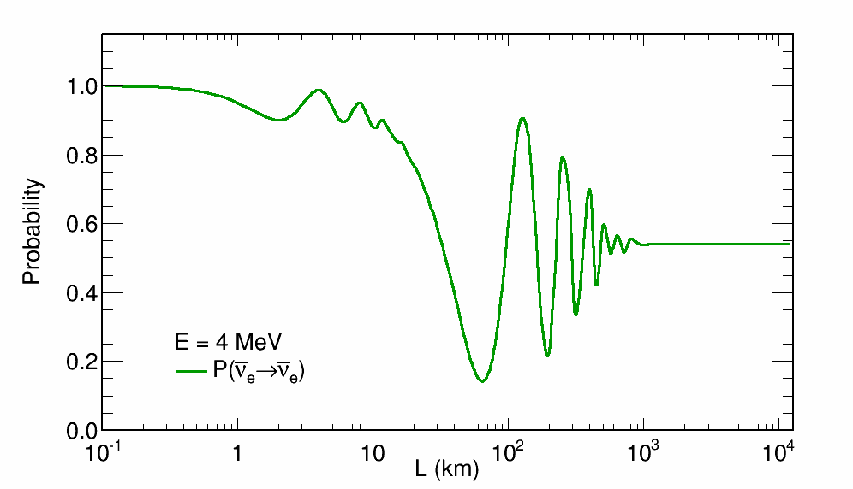
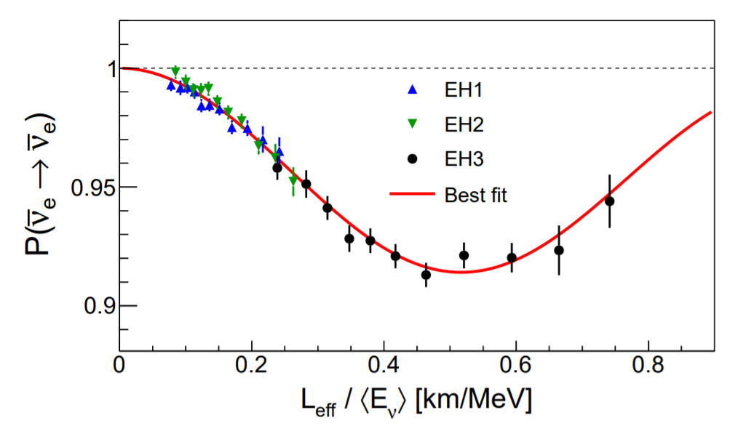
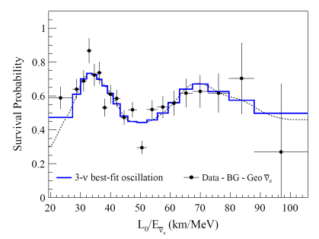
The Data: Reactor Neutrinos
Daya Bay
KamLAND

Slide 5
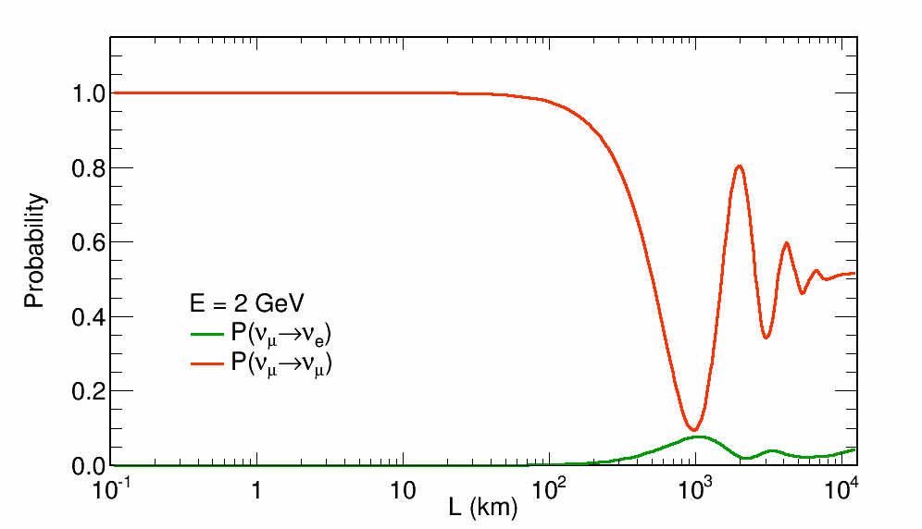
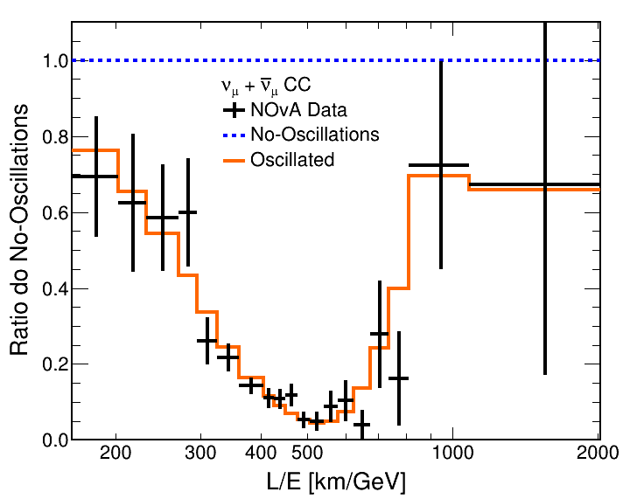
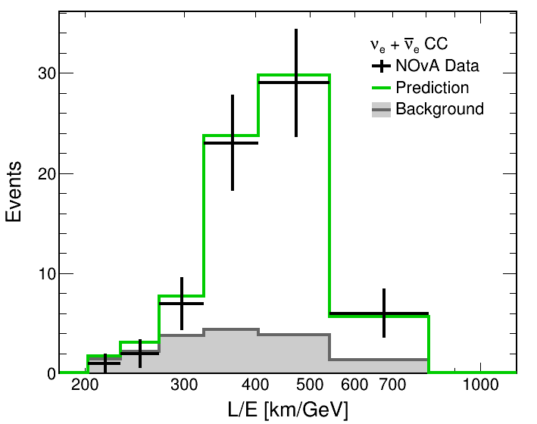
The Data: Accelerator Neutrinos
NOvA
T2K

Slide 6
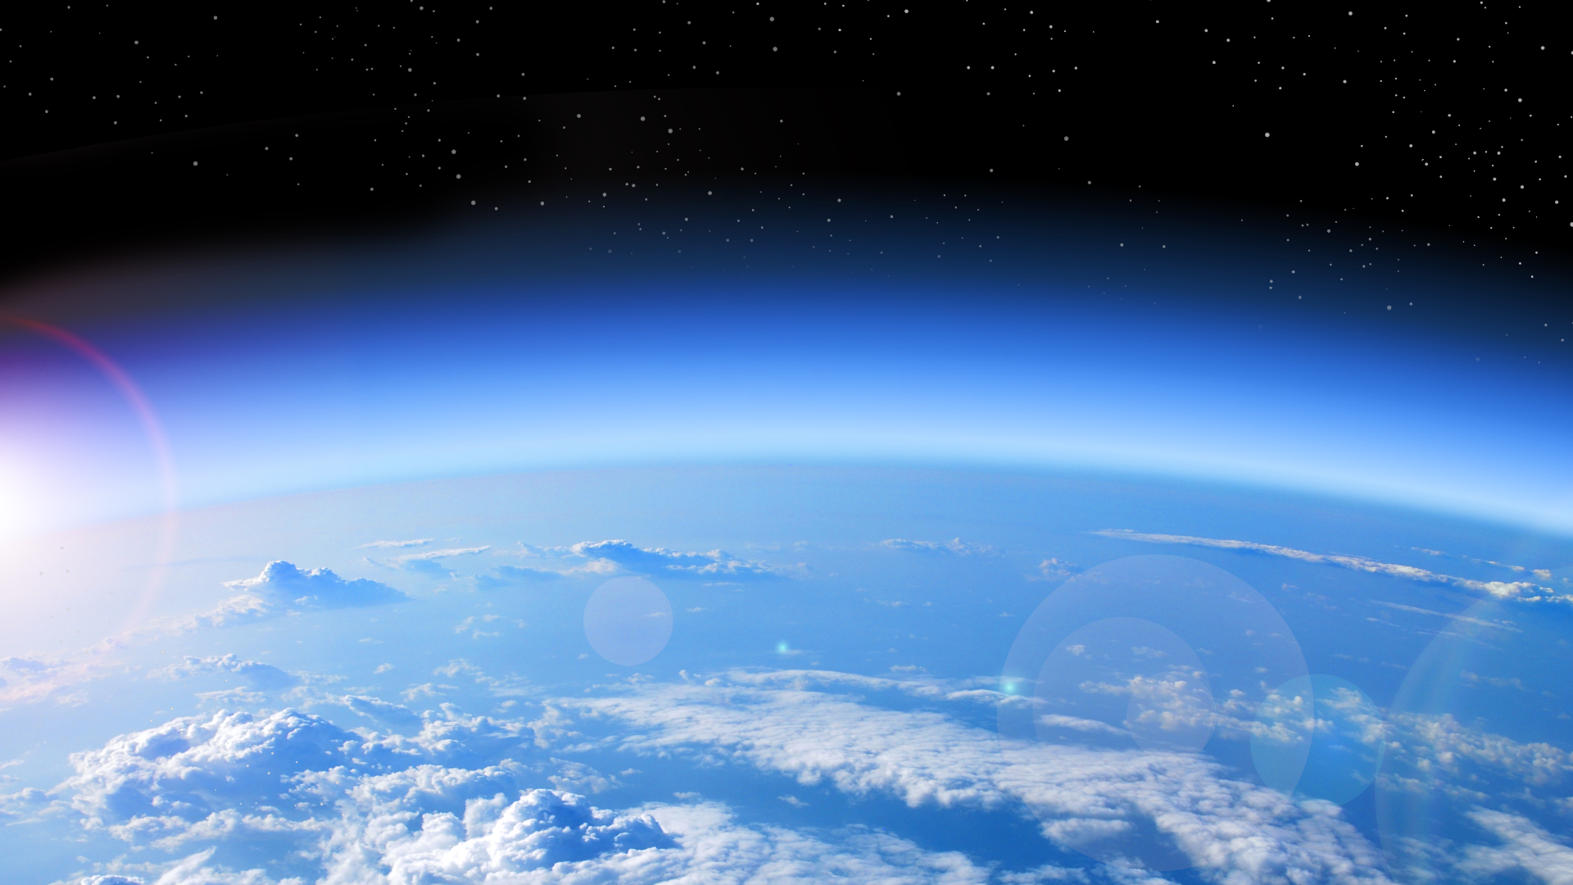
Atmospheric Neutrinos
Cosmic
Ray
π⁺
π⁻
μ⁻
μ⁺
e⁺
ν_{e}
e⁻
ν_{μ}
ν̅_{e}
ν̅_{μ}
ν̅_{μ}
ν_{μ}

Slide 7
Atmospheric Neutrinos

Slide 8
Looking Down for Neutrinos

Slide 9
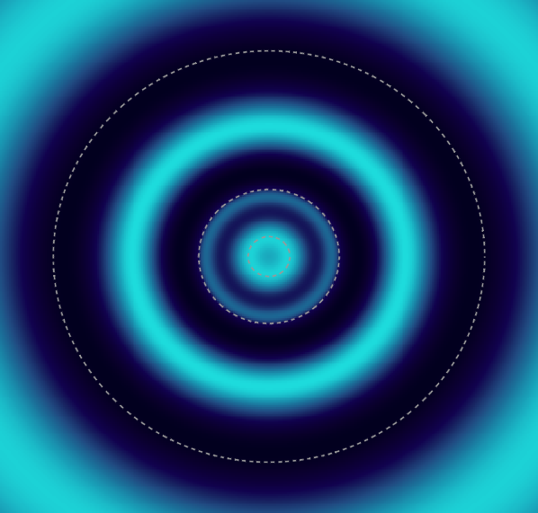
Looking Down for Neutrinos
Muon neutrinos at 4 GeV

Slide 10
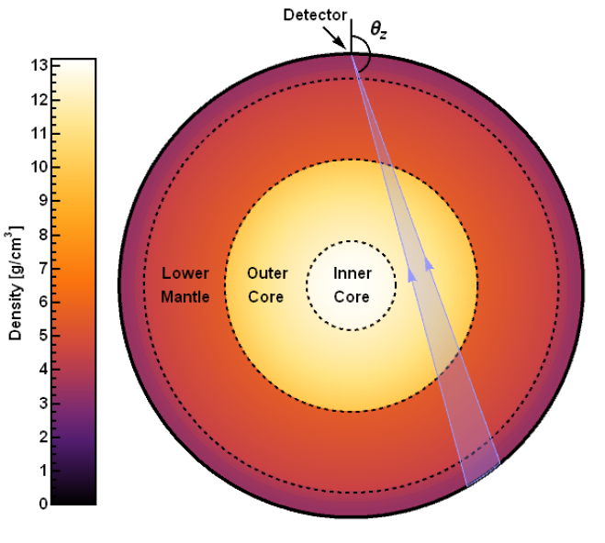
Looking Down for Neutrinos
Muon neutrinos at 4 GeV

Slide 11
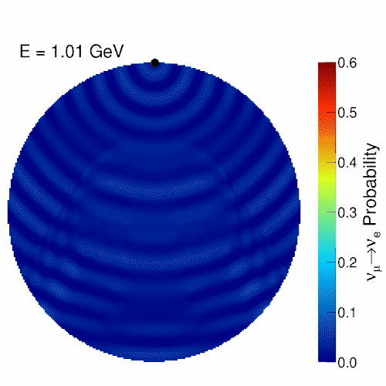
Atmospheric Neutrinos
Oscillations are resonant at certain energies
E_{res} ~ 7 GeV in Mantle
E_{res} ~ 3 GeV in Core
Nue appearance at the surface

Slide 12
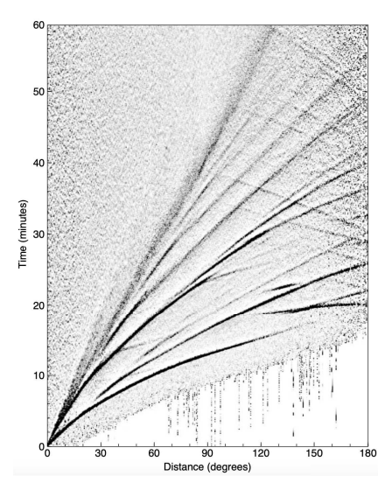
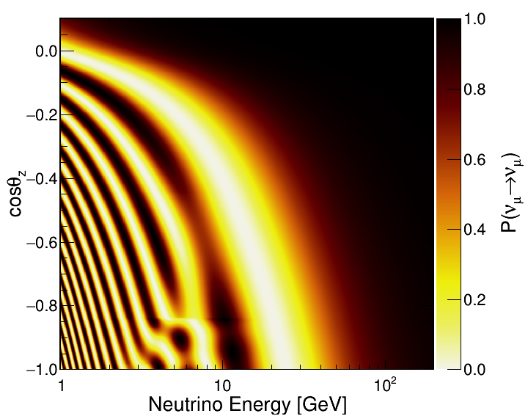
Time is Energy
Neutrino oscillograms are not so different from travel time curves
Seismic waves have many detectors. Neutrinos many sources.
The question is how do we go from these to an Earth model?
Source positions
Detector positions

Slide 13
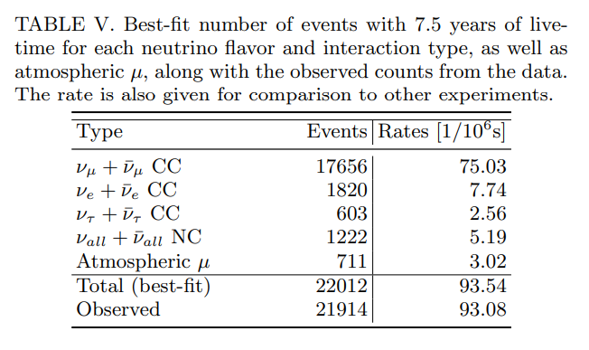
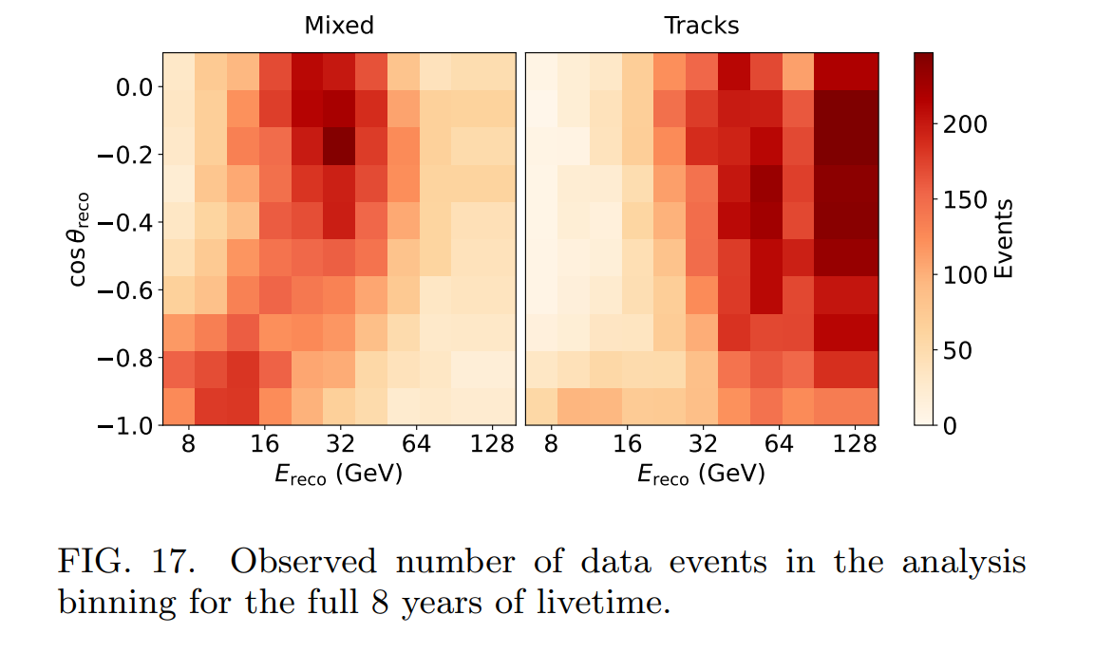
But Data is Hard
Forward problem: Generate prediction
Already computationally expensive
An inverse problem
We don’t usually do this!

Slide 14
Double Inversion?

Slide 15
Forward Pass 1

Slide 16
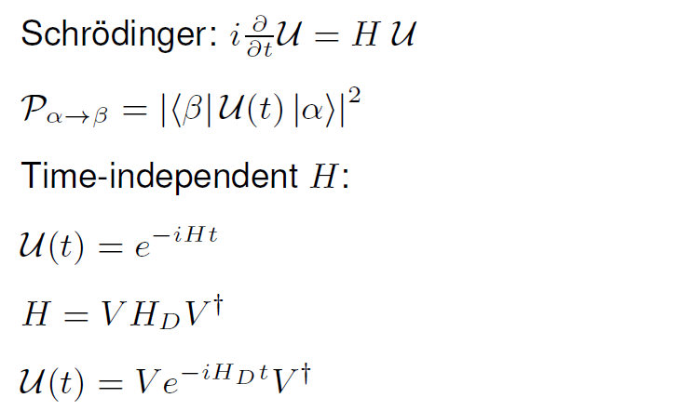
Quantum Evolution
Eigenvectors
Eigenvalues
Main problem
Easy to compute

Slide 17
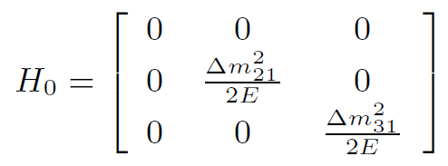
Neutrino Hamiltonian in Vacuum
PMNS Matrix = Vacuum Eigenvectors
Mass basis
Flavour basis
Easy to solve
Already know diagonalisation
(Eigenvectors and Eigenvalues)

Slide 18
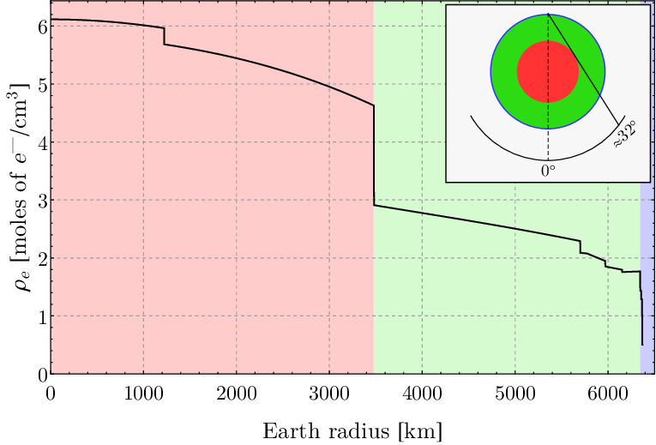
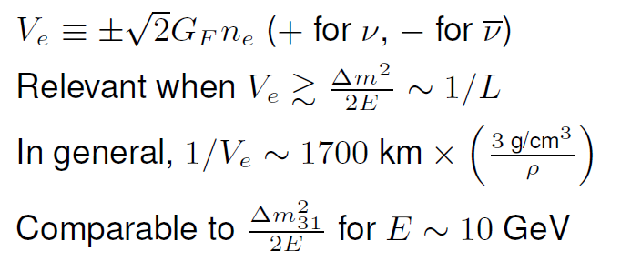
Neutrino Hamiltonian in Matter
Time Dependent

Slide 19
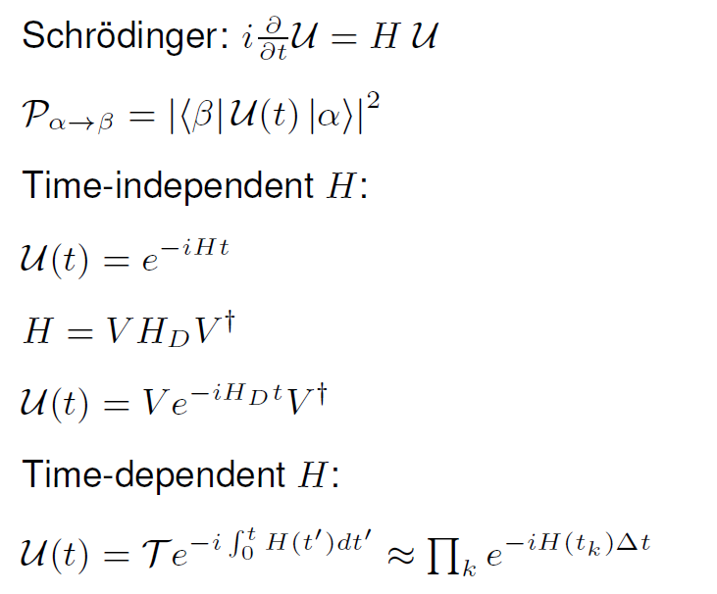
Quantum Evolution

Slide 20
Forward Pass 1
Trace neutrino path through the Earth
Break path into N segments of similar electron density
Compute neutrino evolution through each segment with constant density assumption

Slide 21
OscProb Package
Diagonalises Hamiltonian to obtain exact probabilities
Three step process:
Build Hamiltonian from parameters
Solve Hamiltonian
Fast algorithm from GLoBES for 3 neutrinos*
Propagate neutrino state
Repeat for each step of constant matter in neutrino path
PremModel class has built-in Earth layers model
For a 3D model with 1M bins: ~ 1 second?
Probably depends on IO scalability
https://github.com/joaoabcoelho/OscProb
† Up-going (42+2 layers)
*J. Kopp, Int. J. Mod. Phys. C, 19, 523 (2008)

Slide 22
Forward Pass 2

Slide 23
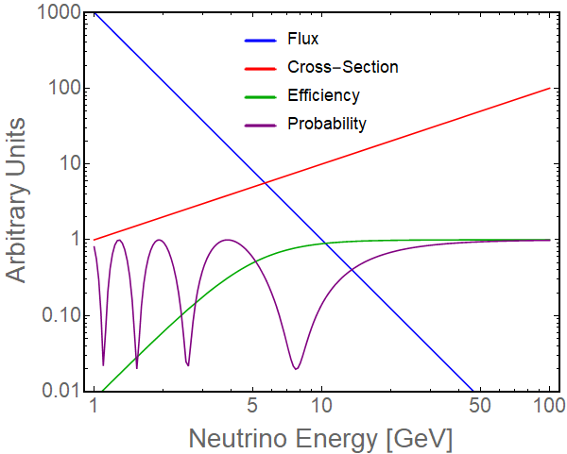
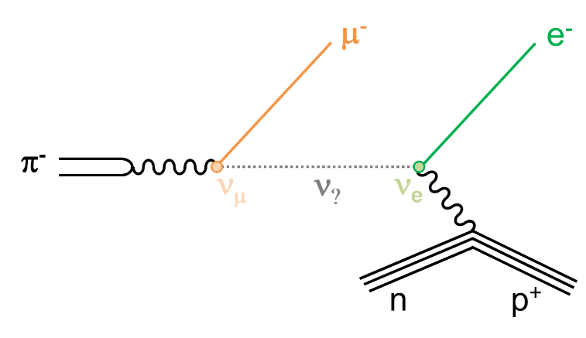
A Chain of Events
Neutrino rates are a product of source, propagation and detection
Rate = Flux × Oscillation Probability × Cross-Section × Efficiency
Lets go through a toy model
Efficiency
Flux
Oscil.
X-Section

Slide 24
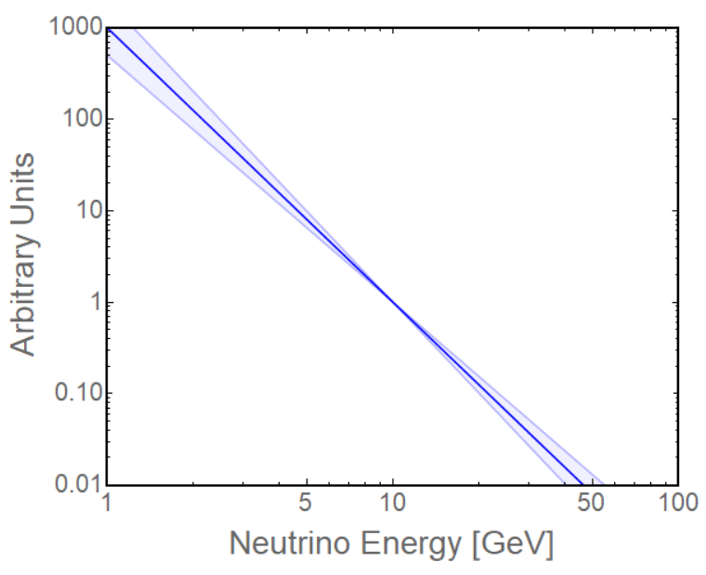
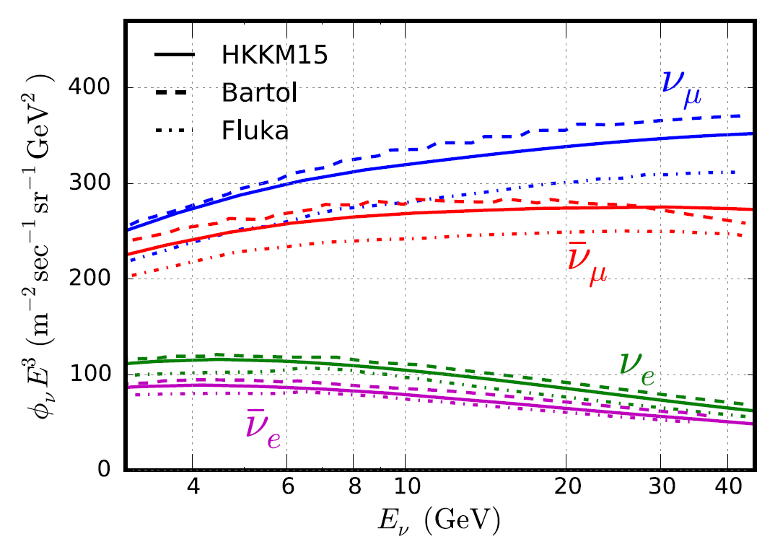
Neutrino Flux
Cosmic
Ray
Neutrino flux from cosmic rays hitting the atmosphere
Follows similar power law spectrum: φ α E⁻³
For our toy model, lets add an uncertainty φ α E^{-3±δγ}
π⁺
π⁻
ν_{μ}
μ⁻
ν̅_{μ}
μ⁺
e⁺
ν̅_{e}
e⁻
ν̅_{μ}
ν_{e}
ν_{μ}

Slide 25
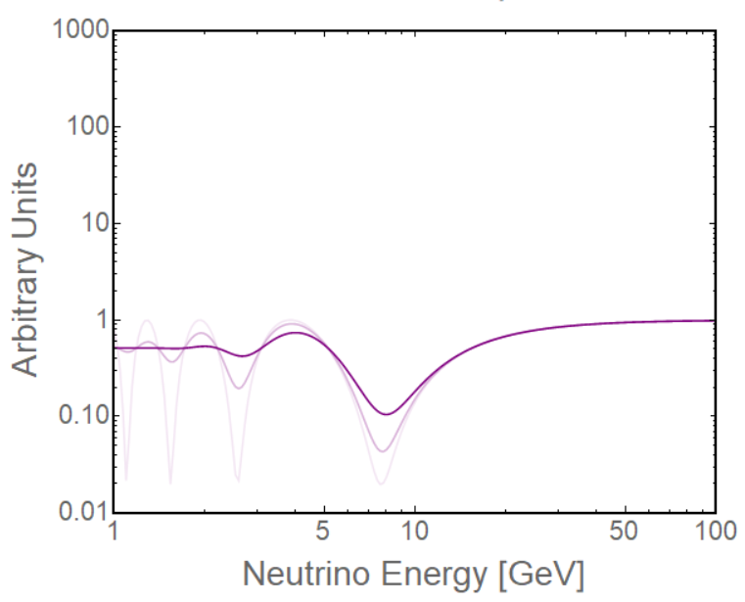
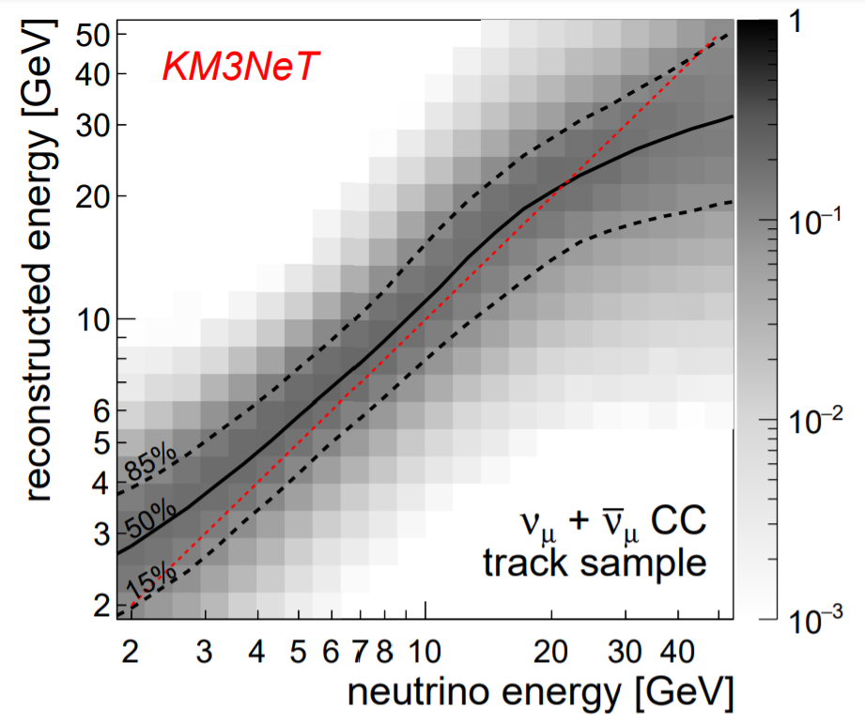
Oscillation & Resolution
Oscillations will be our main phenomena of interest
Energy resolution will degrade our ability to see fast oscillations
We will implement an energy resolution of 20% at the probability level
20%
10%
Perfect

Slide 26
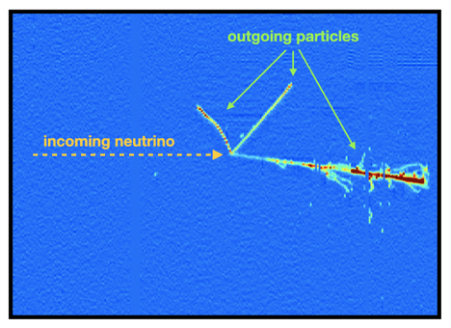
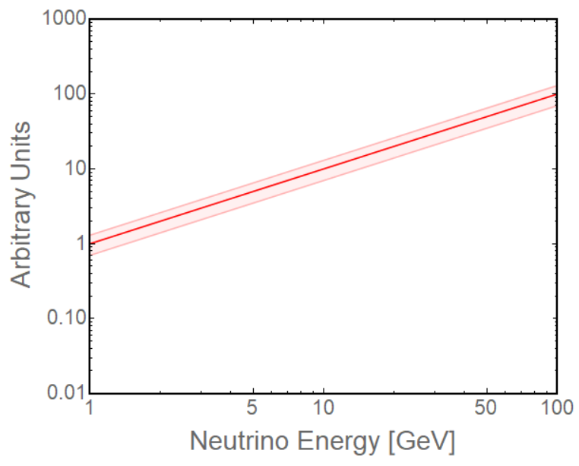
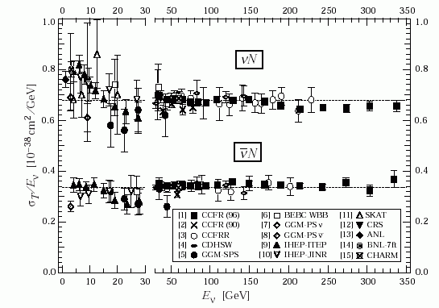
Neutrino X-Section
Interaction rate at detector is given by the x-section
At GeV energies, x-section is linear in energy: σ α E
For our toy model, lets add an uncertainty on the normalisation
ν/ν̅ ratio is ~2 due to detector being made of matter, not antimatter

Slide 27
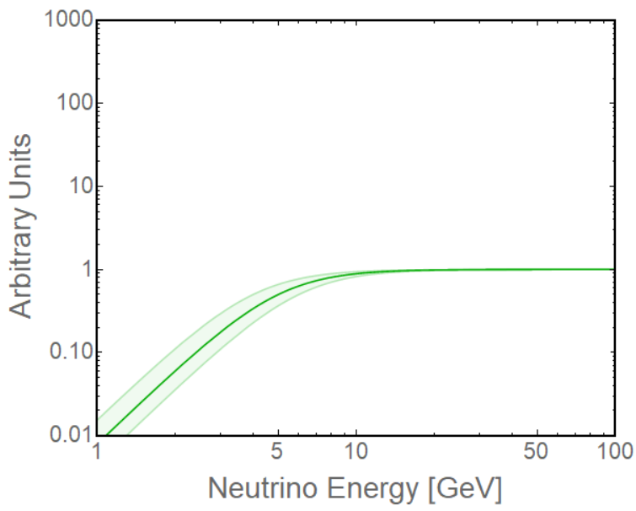
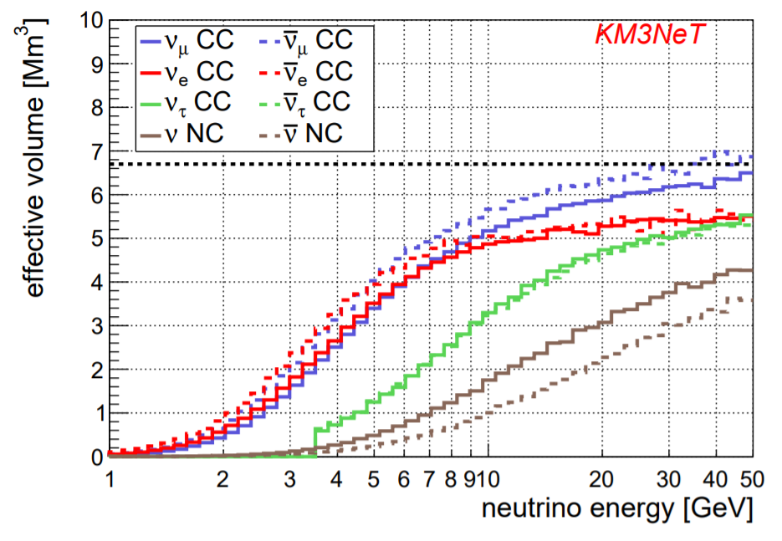
Detector Efficiency
Detector needs to see enough light to trigger/reconstruct a neutrino
More energy means more light. At low energies efficiency drops
For our toy model, lets add an uncertainty on how much light we see for a given neutrino energy, i.e. what’s the threshold
In KM3NeT, we usually talk about the effective volume or mass
Analogous to efficiency, but gives also number of target nuclei

Slide 28
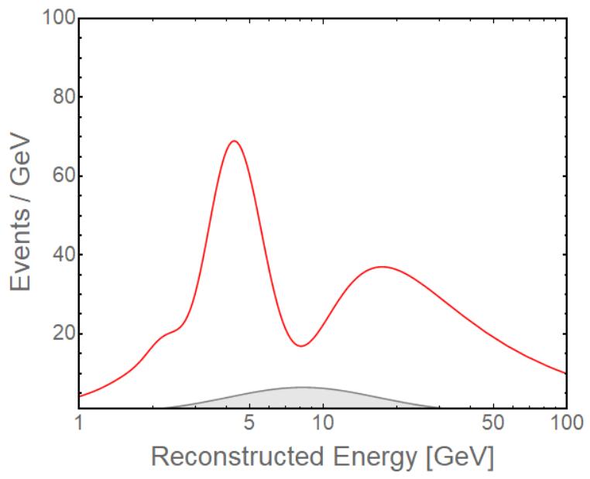
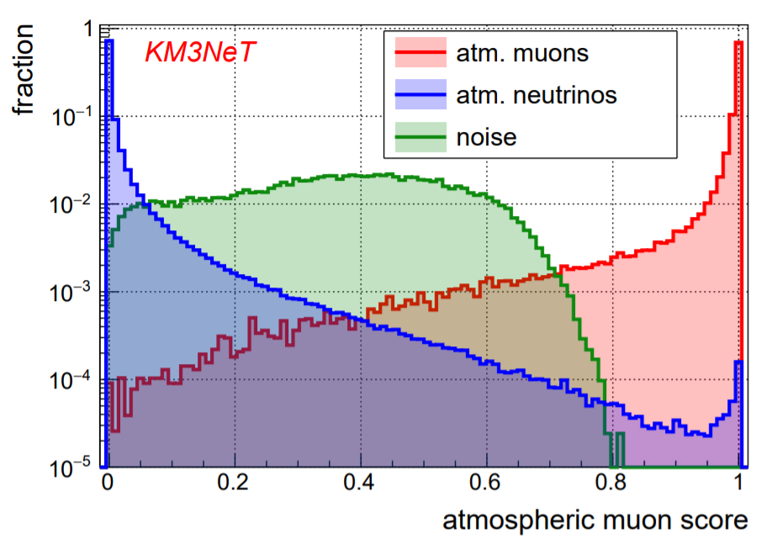
Background
We can now put it all together and we get an expected event rate
Typically we will also have background sources, e.g. cosmic muons
Lets model it as some small component added to our event rate
In this toy, we will assume background events do not oscillate
We often use machine learning to distinguish between signal and background, and reduce the bkgd. contamination
Neutrinos
Cosmic muons

Slide 29
Inversion

Slide 30
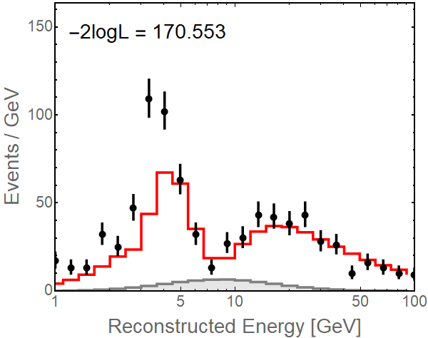
Lets look at some data
In general, our data doesn’t agree with our predictions
We quantify the disagreement by computing the likelihood of observing this data given the prediction we made
Relatively simple problem when we’re just counting events

Slide 31
Log Likelihood-Ratio
The natural choice is to use the likelihood P(data | prediction)
In general our metric is:
If data is distributed as a Gaussian:
For Poisson distributed data, this results in:
*
* Technically pred = best possible prediction, which may not be =data

Slide 32
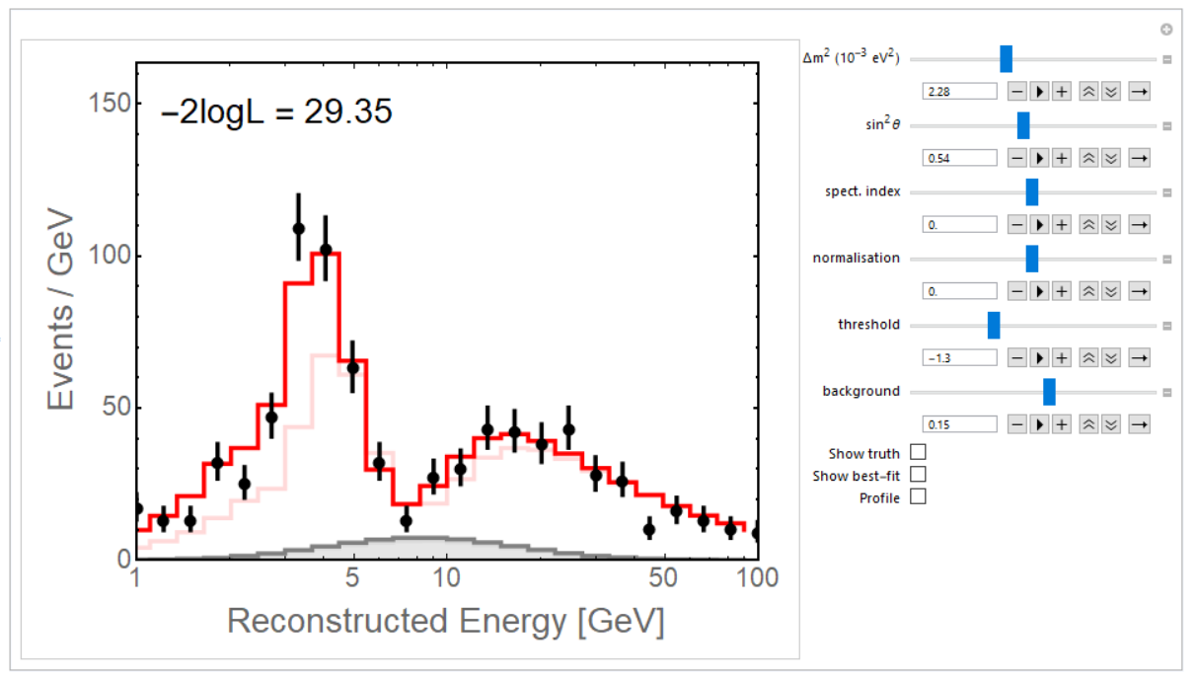
Now lets try to fix the prediction
We can play around with multiple parameters to minimize -2logL

Slide 33
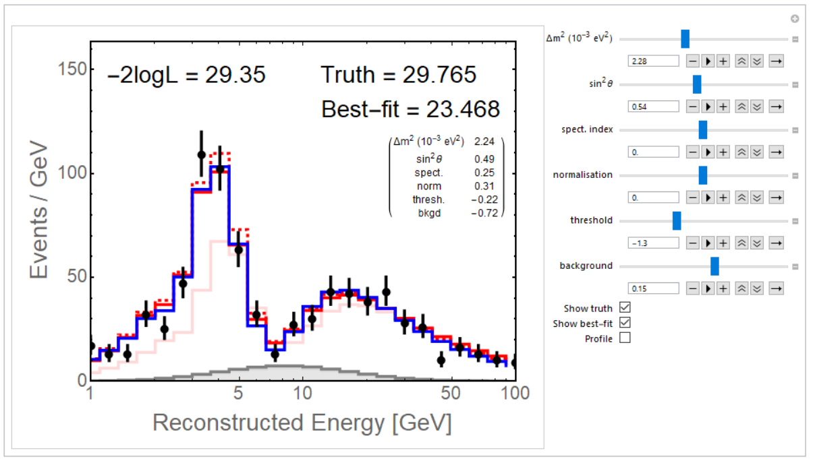
Now lets try to fix the prediction
In practice, we use gradient descent and fit all parameters
We can then build confidence regions around any parameter by considering what parameter values have -2ΔlogL < α

Slide 34
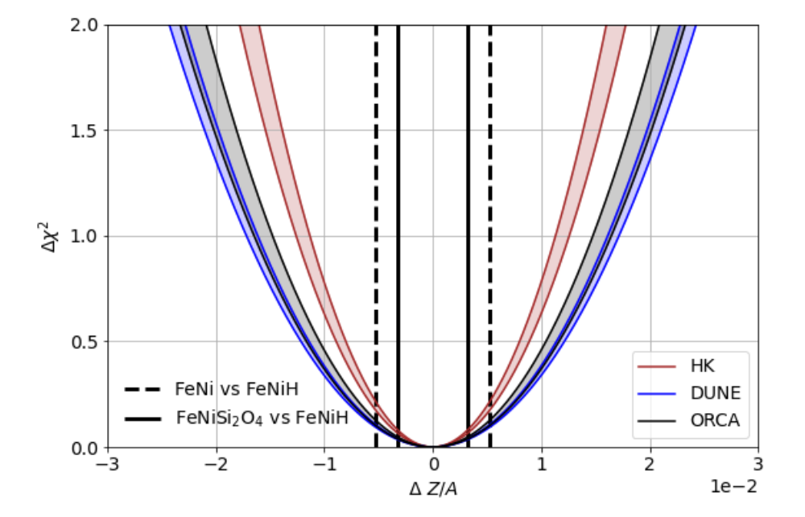
Now lets try to fix the prediction
In practice, we use gradient descent and fit all parameters
We can then build confidence regions around any parameter by considering what parameter values have -2ΔlogL < α
α = 1
68% CL

Slide 35
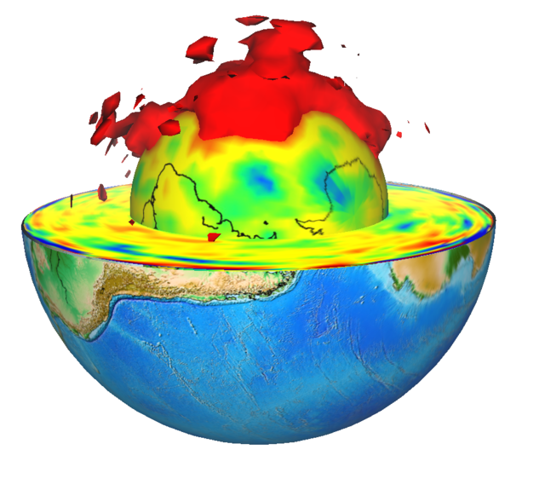
The Real Challenge
Fitting 1M parameters is on a par with some Machine Learning problems
Impossible to use 2nd order methods for gradient descent (Hessian too large)
Computing the gradient requires at least 1M forward predictions if we don’t have a differentiable simulation model
At least 1 sec per prediction, so ~ 300 cpu-hours per gradient
Without a Hessian, expect ~ 100 iterations to converge: O(cpu-years)
And all of this is somewhat optimistic. Ignoring many other bottlenecks
Of course, we can start with a
less ambitious model of the Earth

Slide 36
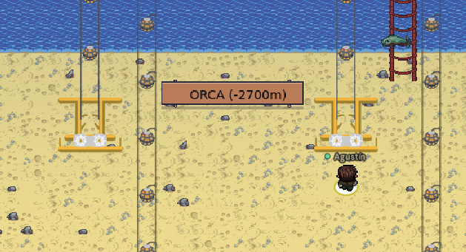
Thank you!

Slide 37
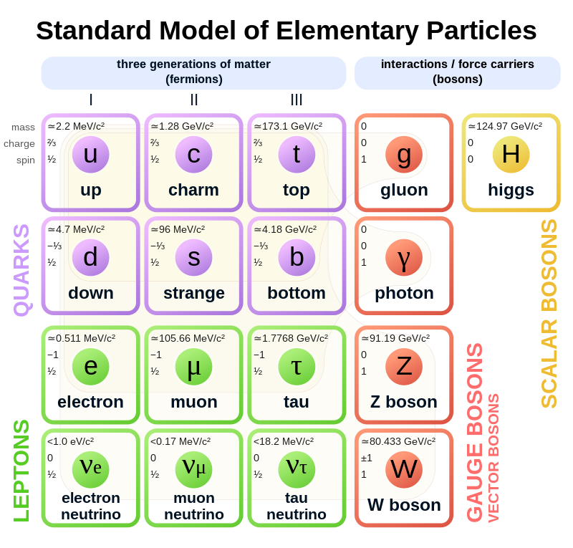
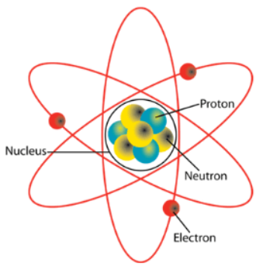
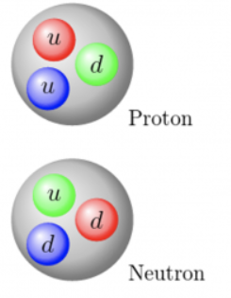
The Structure of the Universe

Slide 38
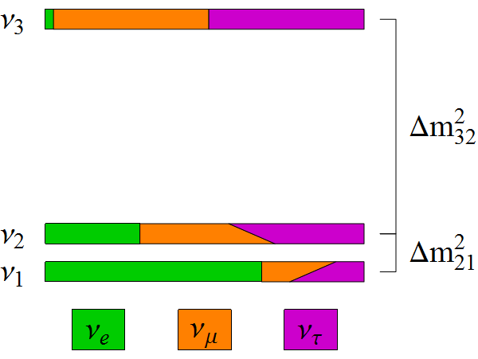
Neutrino Oscillations
There are 3 neutrinos, so things are a bit more complicated
Two independent differences in mass-squared (Δm²₂₁, Δm²₃₂)
3 mixing angles (θ₁₂, θ₁₃, θ₂₃) and 1 CPV phase δ_{CP}
sin²θ₁₃
~ sin²θ₂₃
~ sin²θ₁₂
cosδ_{CP}

Slide 39
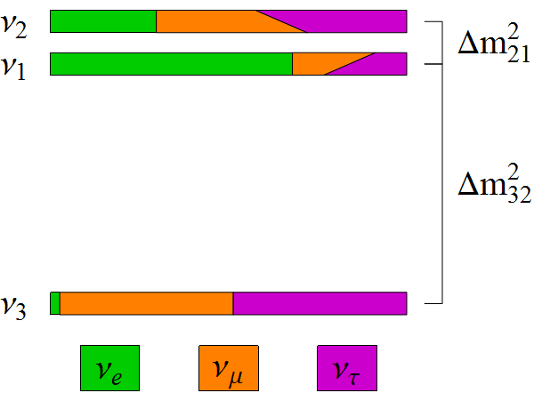
Missing Pieces
symmetries
Is θ₂₃ = π/4? Underlying symmetry?
Do neutrinos violate CP? (δ_{CP})
What is the mass ordering? (Mass Hierarchy)
Normal Hierarchy
Inverted Hierarchy
same?
Δm²₃₂ < 0 ?
(Δm²₃₁ < Δm²₃₂ ??)
JUNO
δ_{CP} ?

Slide 40
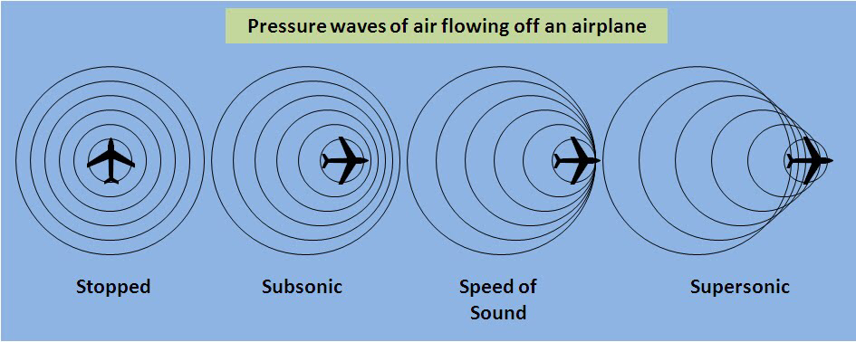
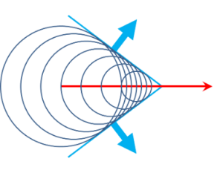
Cherenkov Radiation
γ
Muons and electrons can travel faster than light in water
Emit light shockwave
μ⁻
γ

Slide 41
Neutrino Example

Slide 42
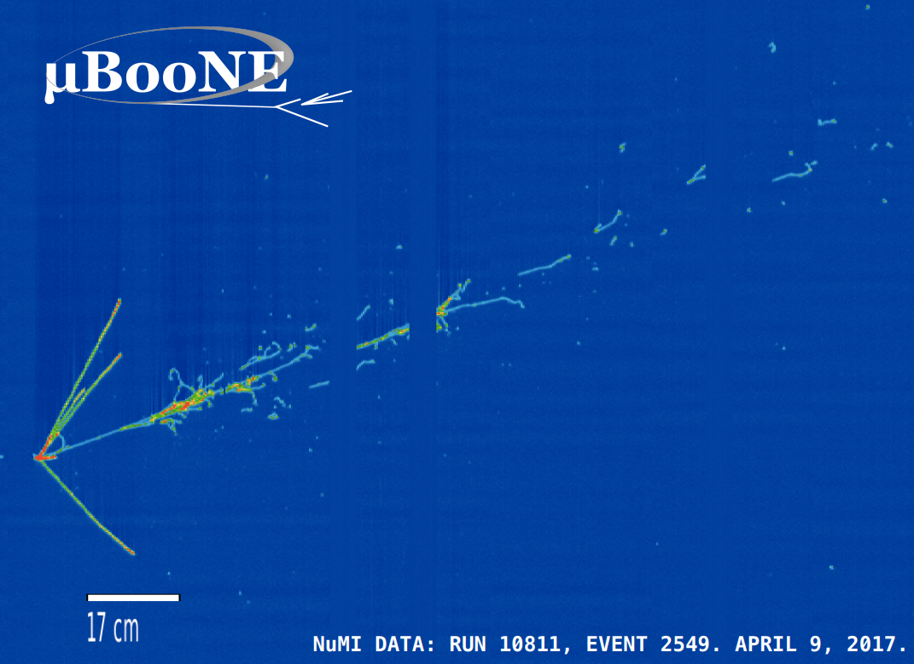
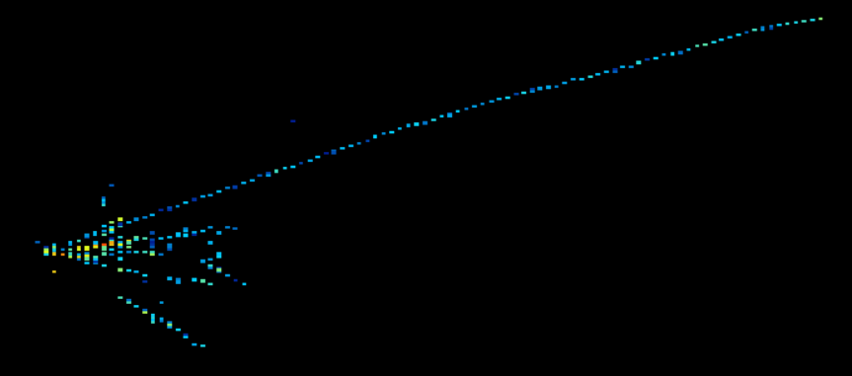
Neutrino Interactions
Electron
ν_{e}
Muon
ν_{μ}
NOvA

Slide 43
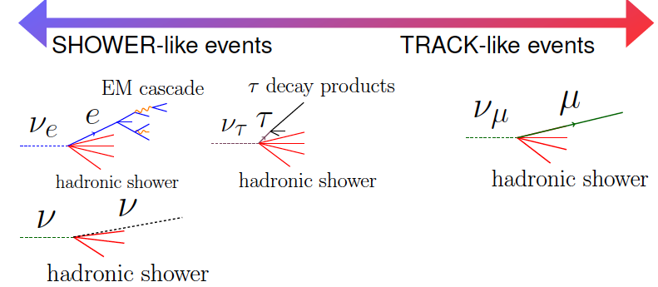
Measuring Neutrinos
Track-like
Shower-like

Slide 44
Example of L/E Plot
This exposure (300 kton-years) contains ~ 1200 neutrinos
In total we expect ~ 0.5 M neutrinos in ORCA in 10 years (70 Mton-years)

Slide 45
IceCube Response Function

