Slide 1
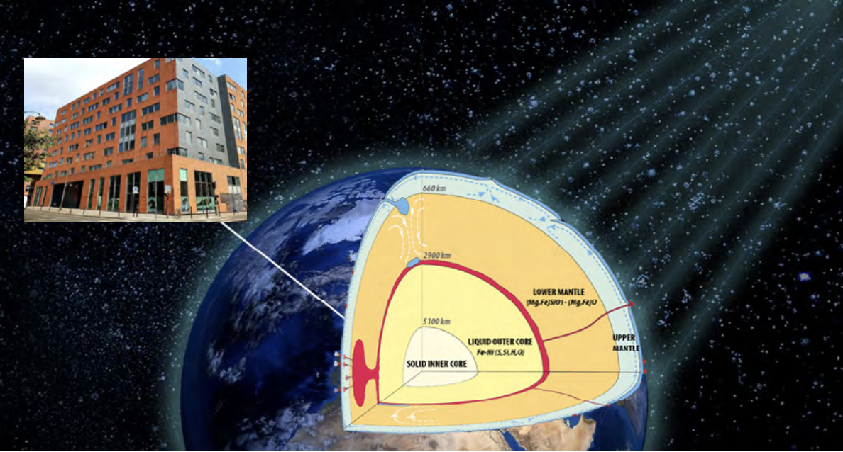
Welcome to MMTE
Nobuaki Fuji
July 4th, APC, UPC, Paris

Slide 2
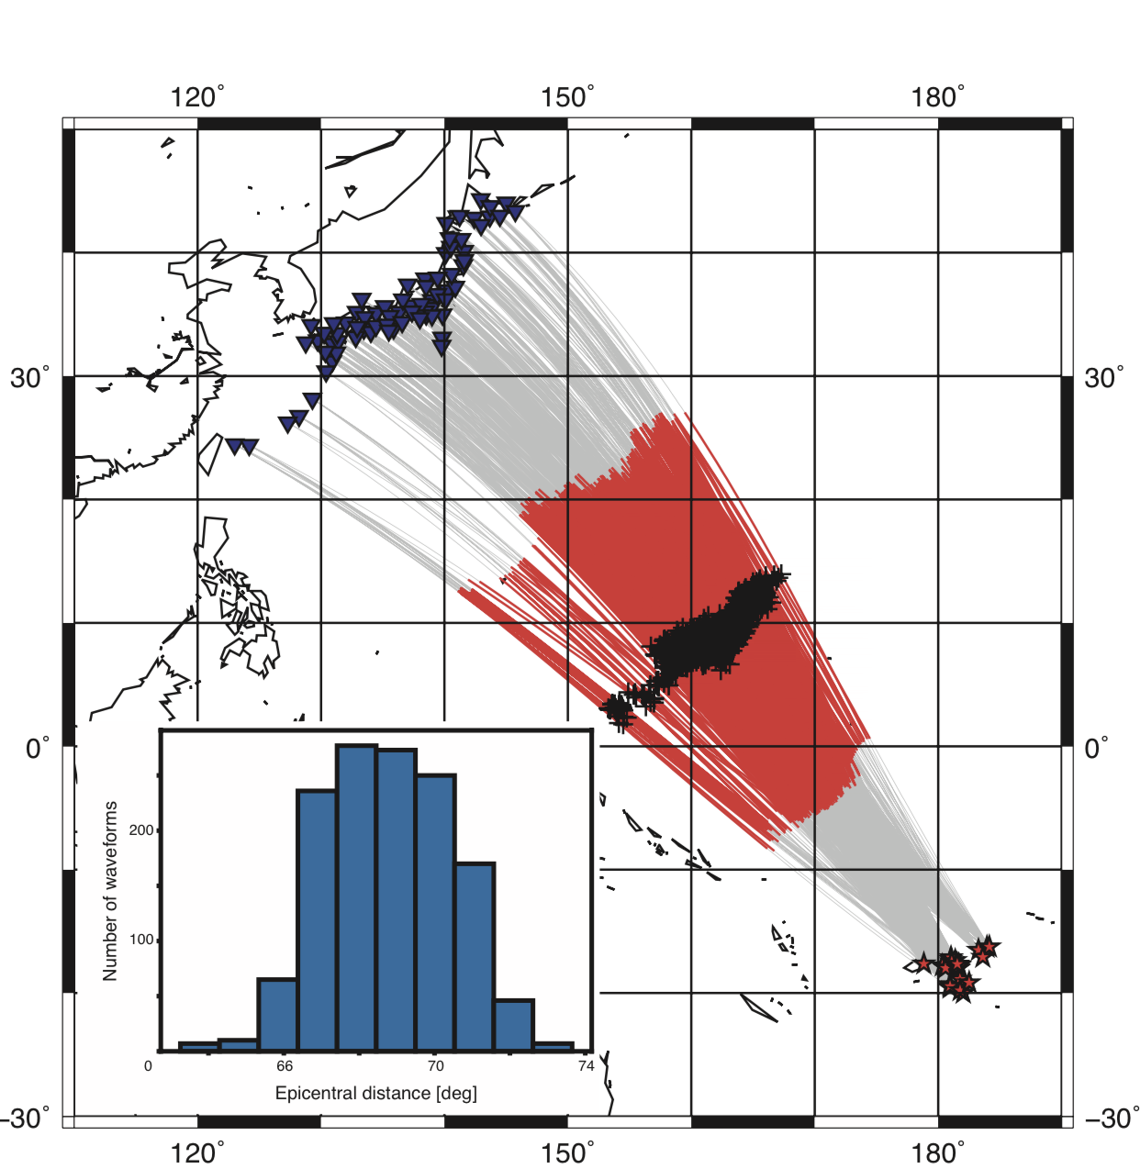
Caroline plume, at the edge of LLSVP
-an iron-rich pile from the bottom?
400 km above
400 km above
Core-mantle boundary
Core-mantle boundary
Waveform inversions for Vs and Q
Then another inversion to the temperature and iron contents
(Konishi et al. 2016; 2020; Deschamps et al. 2018)
Notes:
Who fed that plate on the top? Well, fortunately, we have done many waveform tomography studies of the bottom of the mantle beneath this region, combining with mineralogy we assume that there is a hot tiny plume rich in iron going up from the bottom of the mantle. The iron, however, will drop at 400 km above the core-mantle boundary since it is too heavy to go upper.

Slide 3
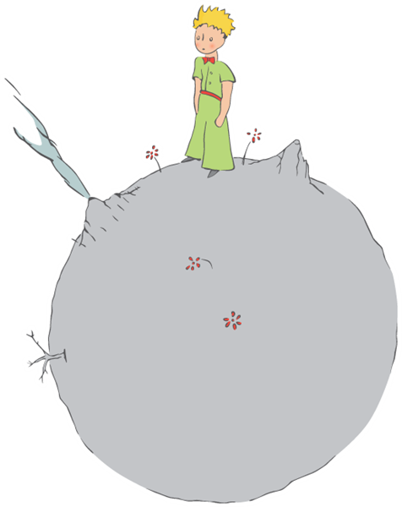
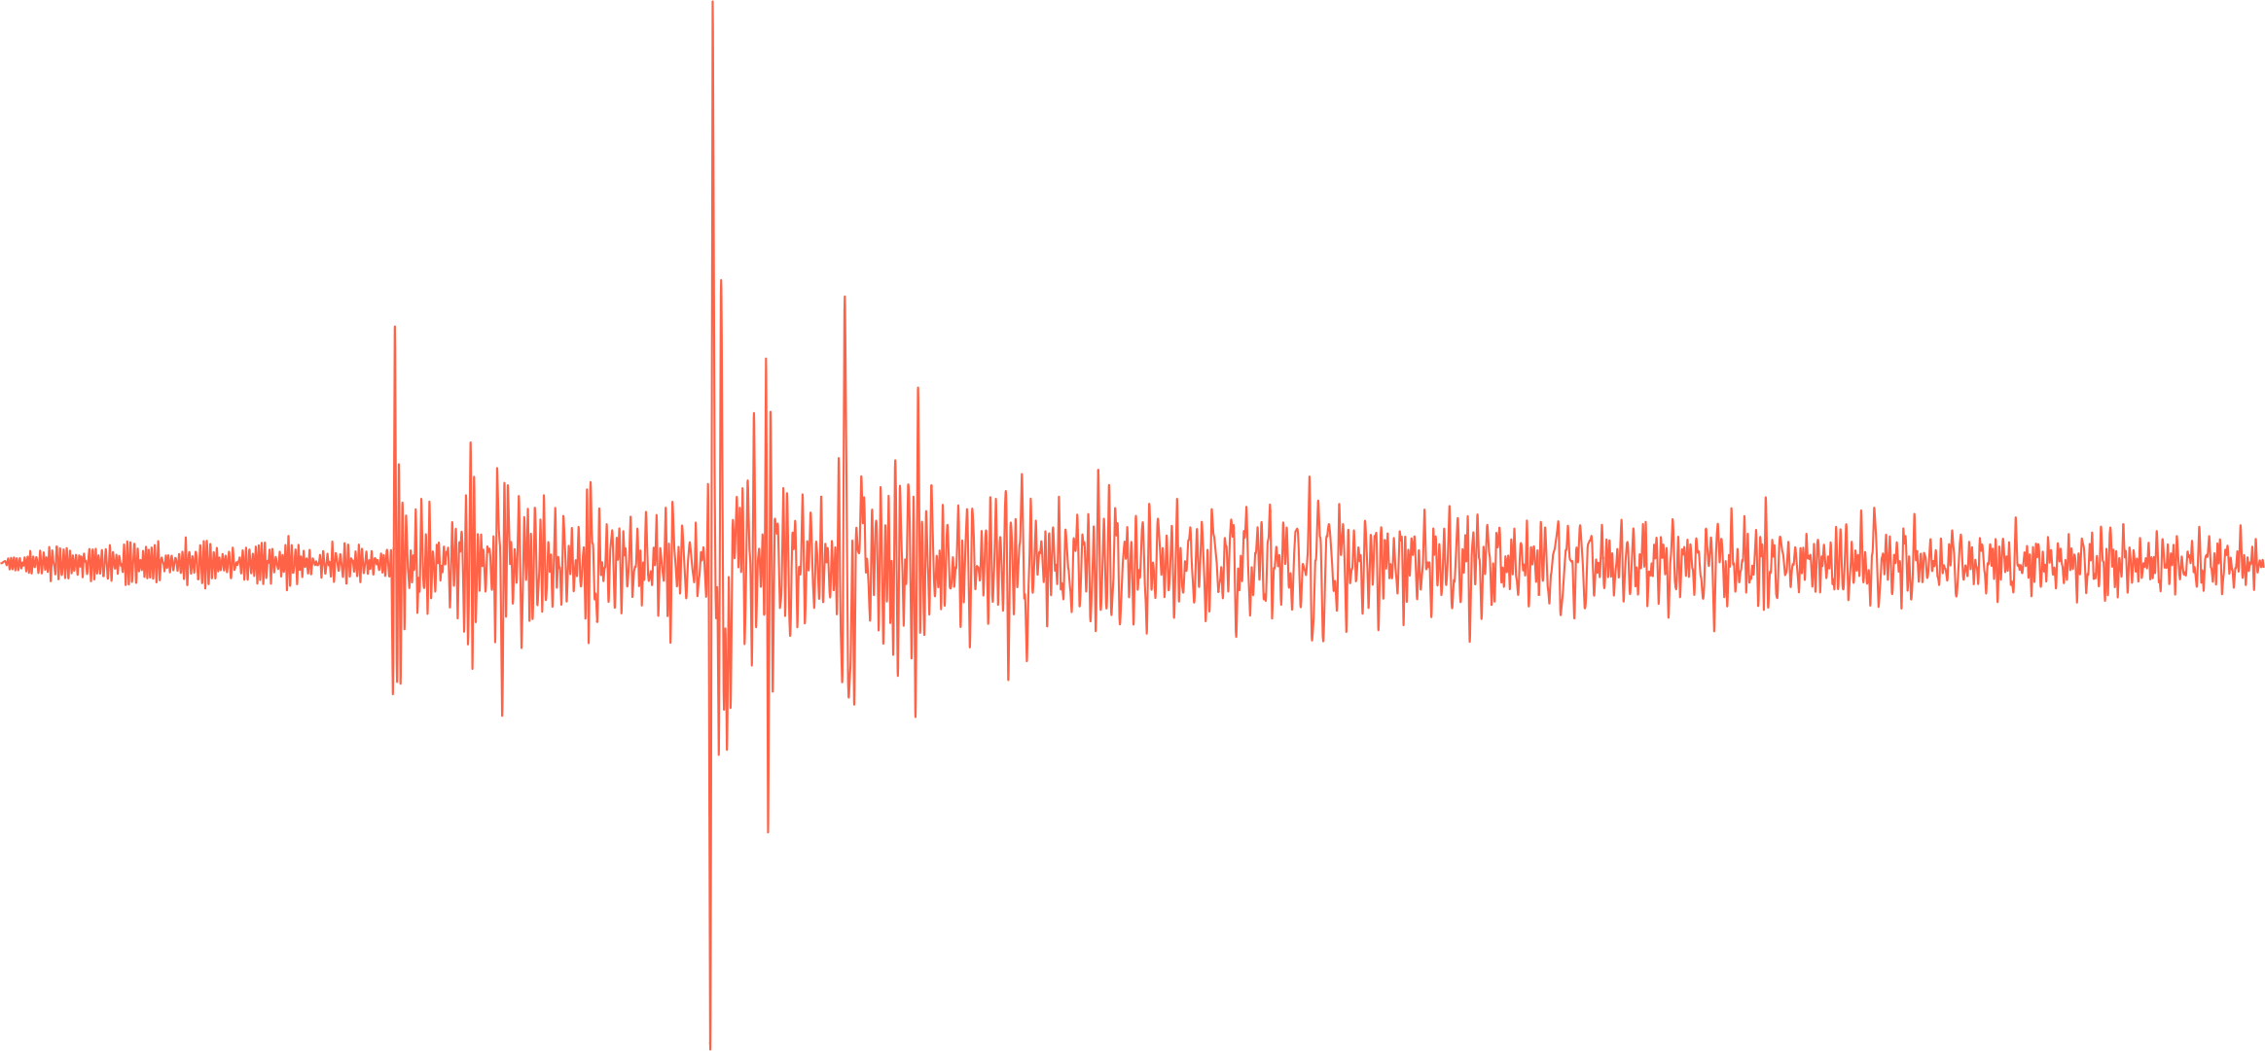
"What is essential is invisible to the eye"
data: what we perceive
what we want to know:
e.g. history of the Earth
de Saint-Exupéry 1943; Crameri & Tackely 2016; Fuji 2022 (habilitation)

Slide 4
How to work together?

