Slide 1




Beam-Based Alignment Tests
at FACET, ATF2, and Fermi
Andrea Latina
ATF3 – Flight Simulator meeting – 24 April 2023
(Based on LCWS2014 – Oct 8, 2014 – Belgrade)

Slide 2
Objectives
We proposed automated beam-steering methods to improve the linacs performance by correcting orbit, dispersion, and wakefields simultaneously.
Our technique is:
Model independent
Global
Automatic
Robust and rapid
We base our algorithms operate in two phases: automatic system identification, and BBA
It is a considerable step forward with respect to traditional alignment techniques.

Slide 3
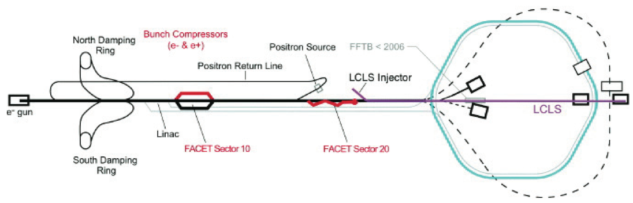
FACET @ SLAC
FACET (Facility for Advanced Accelerator Experimental Tests) is a new User Facility at SLAC National Accelerator Laboratory. Experiments apply for beam time to a scientific committee.
E = 1.19 to 20 GeV Linac, q up to 3.2 nC, 1.5 mm long bunches (injection)
The first User Run started in spring 2012 with 20 GeV, 3 nC electron beams.
The facility is designed to provide short (20 μm) bunches and small (20 μm wide) spot sizes.
BBA experiments:
DFS Sectors 04-10
WFS Sectors 02-04

Slide 4
Beam-based alignment
DFS simultaneously corrects the orbit, x_{i} , and minimizes the difference between the nominal and a dispersive trajectory, x_{ΔE,i}. This corresponds to minimizing:
which is equivalent to solving the system of equations:
with
and
It is a least-square problem that can be solved using an SVD.
The free parameter ω accounts for the relative weight of the orbit w.r.t. the dispersive term; β is a regularization parameter to modify the condition number of the system matrix.

Slide 5
Object-oriented approach
We propose to develop the new flight simulator following an object-oriented approach
Each machine is an “Interface”, and we can have several:
InterfaceATF2 (real machine)
InterfacePLACET (simulated machine with PLACET)
InterfaceRFT (simulated machine with RF-Track)
…
This backbone structure implements all the basic functionalities, in a high-level way:
GetBpms
GetCorrectors
SetCorrectors
ChangeBeamEnergy
ChangeBunchCharge
Python or Octave could provide this backbone, which would allow to pilot either the real machine or a simulation indifferently.
Then, we develop independent tools based on this Interface.

Slide 6
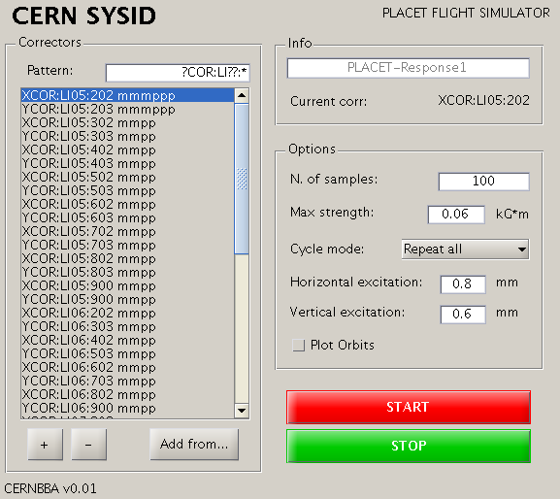
An almost automatic correction
We want to make our BBA algorithms as automatic as possible. Two tools have been developed. SYSID and BBA tools
The left-hand side panel shows the list of selected correctors, and displays how many iterations have been performed for each of them
The right-hand side panel allows to set the desired amplitude of the orbit oscillations excited to measure the trajectory response
The tool implements an adaptive scheme, that tunes the corrector strength to reach target amplitude according to the information from previous measurements.

Slide 7
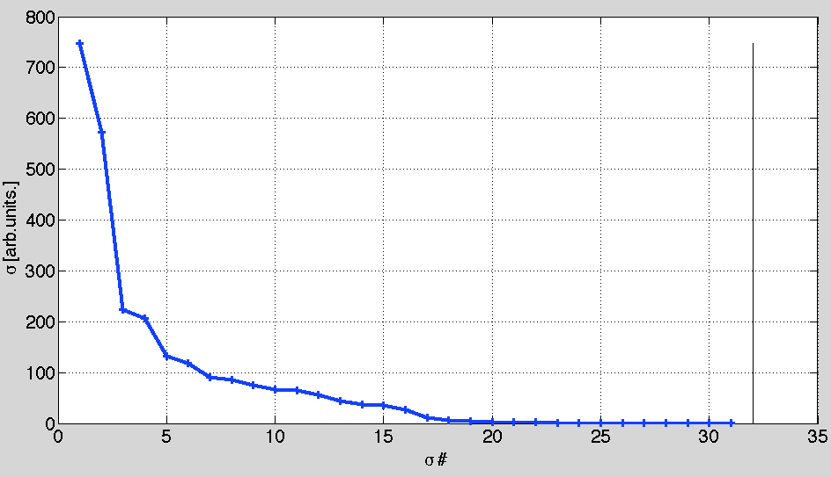
Response matrix
The response matrix might compromise the performance of BBA algorithms in several ways:
It can misrepresent the optics (computer model vs real machine)
It can be ill-conditioned: an ill-conditioned matrix leads to bad solutions of the system of equations
Very little information in the small singular values directions
If measured, it is affected by instrumentation noise: an inaccurate response matrix misrepresents the optics of the system and compromises BBA
We use an algorithm that measures the optics : System Identification (or SYSID)
The matrix needs to be conditioned (SVD cut, or beta parameter)
Very little information in the low sing. values directions -> huge corrector strength needed to make a small adjustment to correction -> ignore these directions.
Singular values of R
We can control this via the parameter β, or by zeroing the smallest singular values.

Slide 8
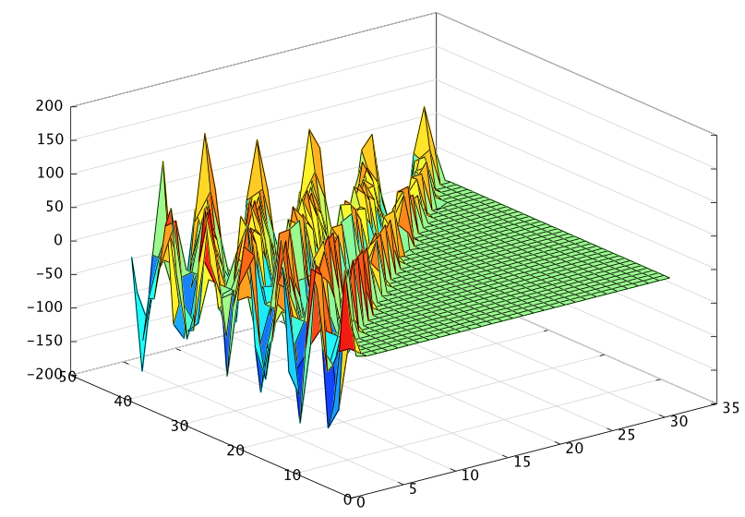
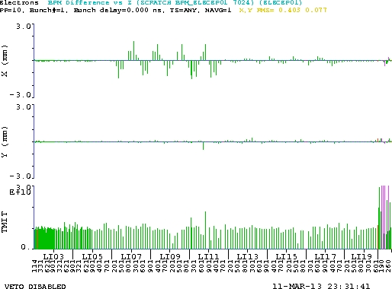
Results: SysID + orbit control
Focused on Sectors 04 through 08 (500 m of linac)
Used 52 correctors in total (1h15 acquisition time)
Measured orbit and dispersion (2h30 in total)
Applied Orbit and DFS
We excited a bump in X
Response matrix

Slide 9
An (almost) automatic correction
BBA tool
Large space of parameters have to be tuned to achieve best performance:
  Correction gain, g
  Weight of the DFS term, ω_{DFS}
  Weight of the WFS term, ω_{WFS}
  Regularization term of the global matrix, by means of:
    Cut off the smallest singular values, n_{SVD}, or
    Beta parameter, β

Slide 10
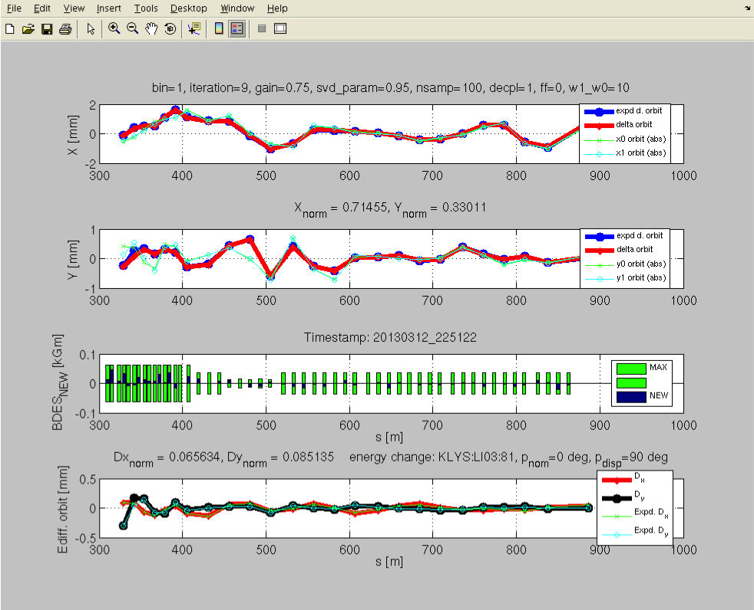

Slide 11
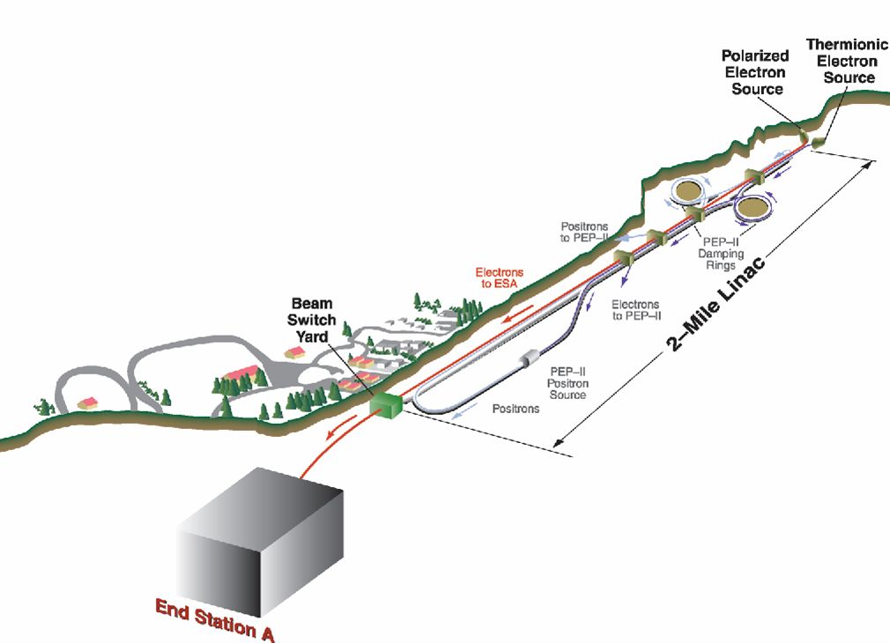
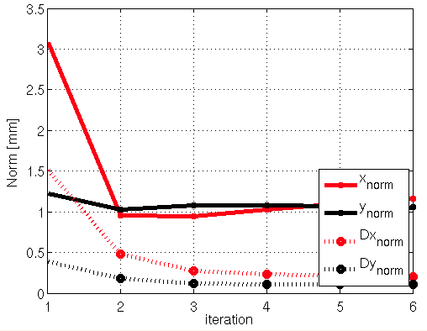
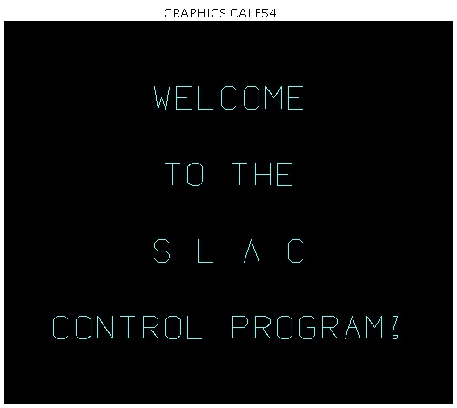

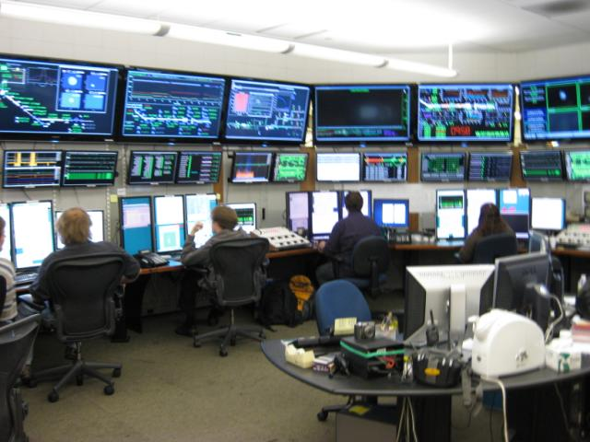
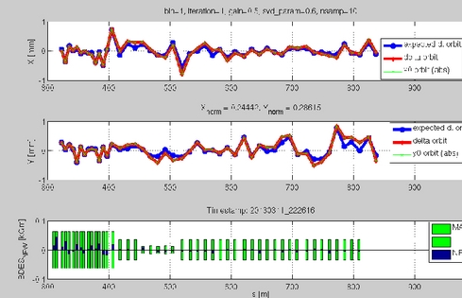
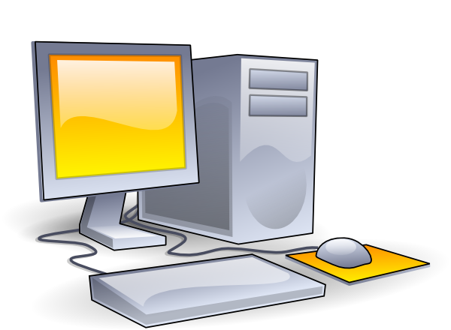
Flight Simulator
Extensive analysis of the space of parameters
Real Data
Simulated Data (PLACET)
SLC, SLAC Linac
SCP, SLAC Control Program
PLACET
x
Us trying to steer the beam
Our BBA routines (Matlab)

Slide 12
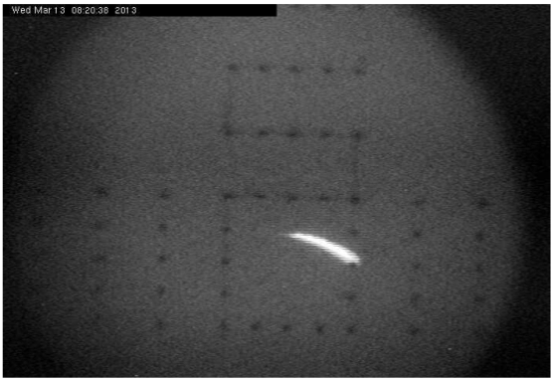
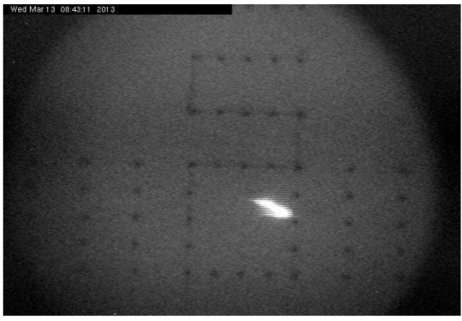
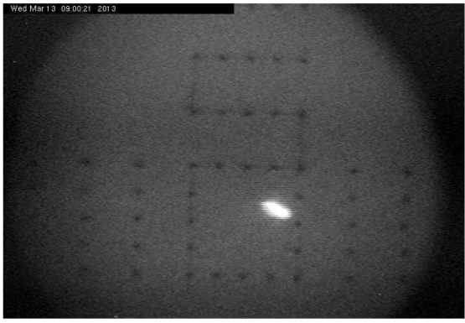
March 2013: DFS correction
LI04-LI10:
Incoming oscillation/dispersion is taken out and flattened; emittance in LI11 and emittance growth significantly reduced.
Emittance at LI11 (iteraton 1)
X: 43.2 x 10⁻⁵ m
Y: 27.82 x 10⁻⁵ m
Emittance at LI11 (iteration 4)
X: 3.71 x 10⁻⁵ m
Y: 0.87 x 10⁻⁵ m
S19 phos, PR185 :
Before correction
After 1 iteration
After 3 iterations

Slide 13
March 2014: WFS correction
LI02-LI04: Weight scan vs. emittance. We tried w = 4, 40, 160, 400 i.
Used 90% of the nominal charge to measure the wakes.
Vertical emittance measured in sector 04 (quad scan)
w = 0 initial vertical emittance: 0.56 / 1.10
w = 4, vertical emittance = 0.36 / 1.63
w = 40, vertical emittance = 0.12 / 1.16 (re-measured: 0.17 / 1.20)
w = 160, emittance not measurable
w = 400, emittance not measurable
From simulation, one expects something like
the black line in the plot:
Conclusion:
Emittance scan gives expected results
No time for measuring more points
Vertical emittance reduced
From 0.56 ± 0.05 x 10⁻⁵ m
to 0.15 ± 0.05 x 10⁻⁵ m, in few minutes.

Slide 14
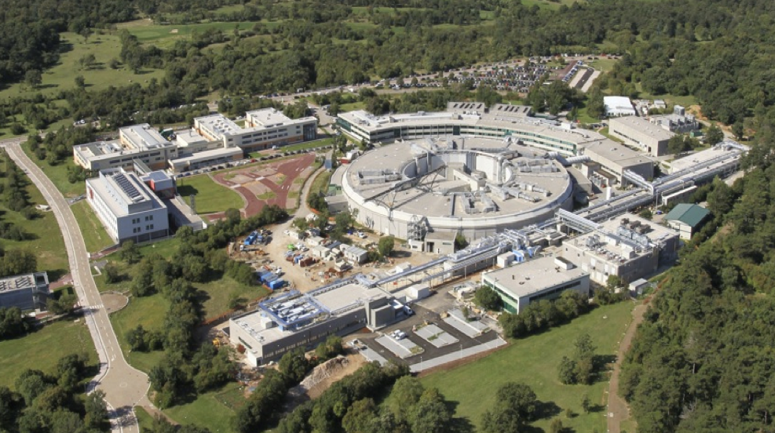
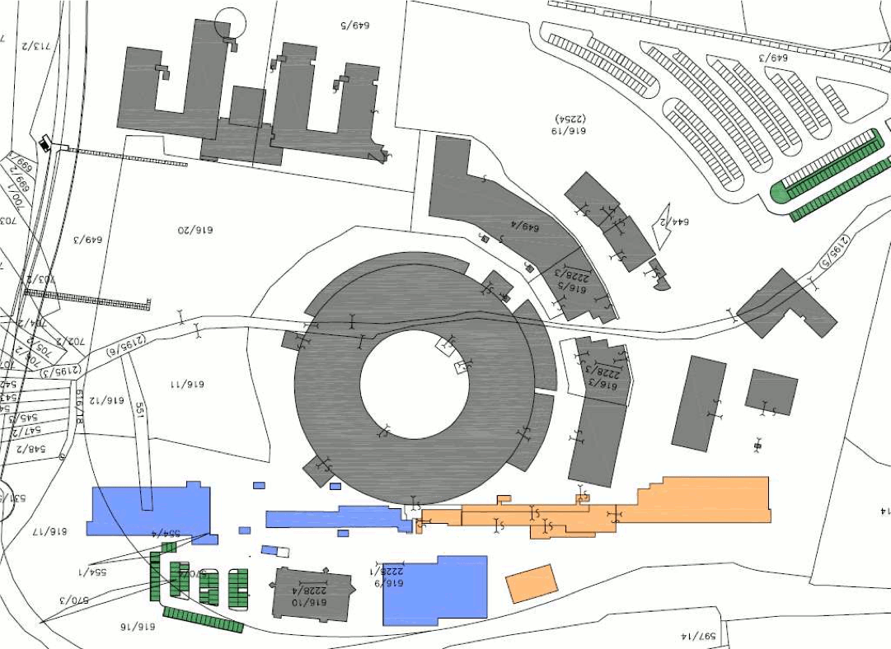
We used it at Fermi (Elettra)
Free Electron Laser for Multidisciplinary Investigations

Slide 15
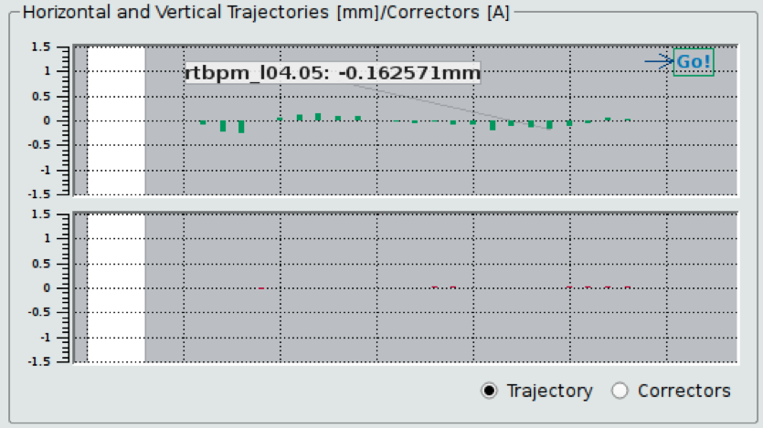
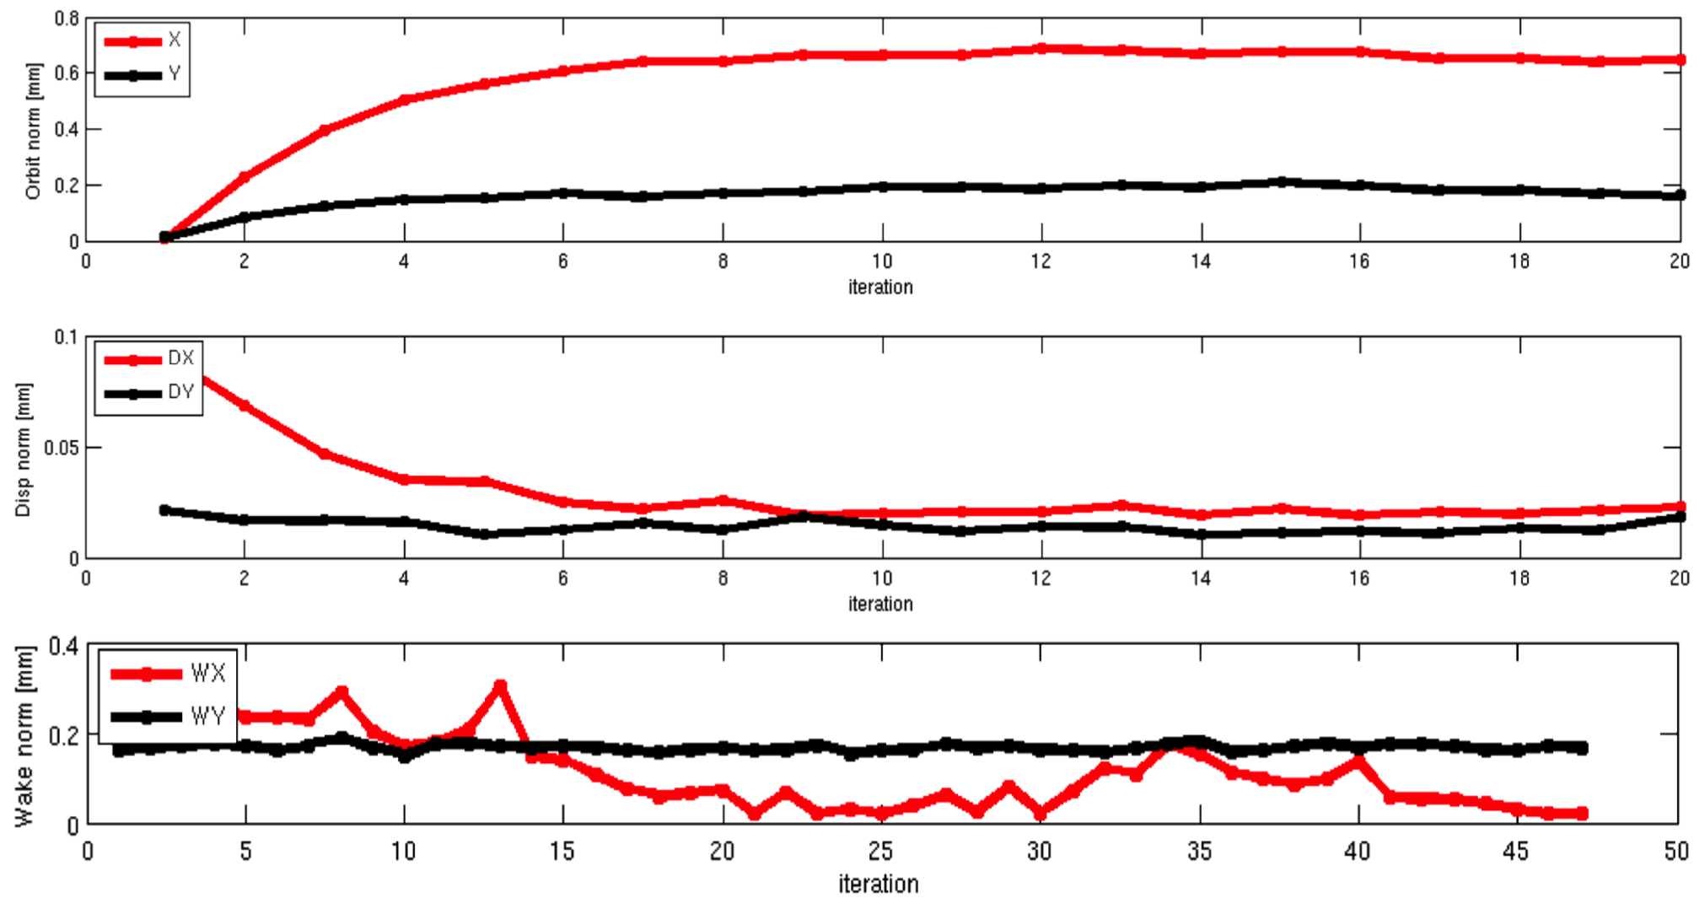
Tests of WFS at Fermi@Elettra
To test and scan the efficiency of WFS we decided to excite an even larger emittance in the horizontal plane only, passing from 2.8um to 4.5um with a bump in the horizontal plane only, at bpm_l04.02, from 0mm to 0.9mm offset.
We found the following, as function of the weight on the WFS:
H-Emittance before correction = 4.5um
H-Emittance after correction = 2.84um
Emittance is totally recovered in just few minutes.
With S. Di Mitri, G. Gaio, E. Ferrari (Elettra)
Charge-independent orbit
Orbit, Dispersion, Wakefield convergence (bottom plot)

Slide 16
Abstract Interfaces
macbe16641:Interfaces alatina$ ll
total 0
drwxr-xr-x 17 alatina staff 544 Apr 24 09:49 @InterfaceATF2
drwxr-xr-x 17 alatina staff 544 Apr 23 14:41 @InterfaceFacet
drwxr-xr-x 19 alatina staff 608 Apr 23 14:41 @InterfaceFermi
drwxr-xr-x 19 alatina staff 608 Apr 23 14:41 @InterfacePlacet
macbe16641:Interfaces alatina$

Slide 17
Interface: PLACET
MACBE17363:Interfaces alatina$ ls -l @InterfacePlacet/
total 1208
-rw-r--r-- 1 alatina staff 320 Apr 23 14:41 ChangeBunchCharge.m
-rw-r--r-- 1 alatina staff 1169 Apr 23 14:41 GetBpms.m
-rw-r--r-- 1 alatina staff 270 Apr 23 14:41 GetBpmsCorrs.m
-rw-r--r-- 1 alatina staff 141 Apr 23 14:41 GetCorrs.m
-rw-r--r-- 1 alatina staff 77 Apr 23 14:41 GetDescription.m
-rw-r--r-- 1 alatina staff 194 Apr 23 14:41 GetMachine.m
-rw-r--r-- 1 alatina staff 1199 Apr 23 14:41 InterfacePlacet.m
-rw-r--r-- 1 alatina staff 41 Apr 23 14:41 README
-rw-r--r-- 1 alatina staff 77 Apr 23 14:41 Restore.m
-rw-r--r-- 1 alatina staff 753 Apr 23 14:41 SetCorrs.m
-rw-r--r-- 1 alatina staff 290 Apr 23 14:41 SetKlystronPhase.m
-rw-r--r-- 1 alatina staff 82 Apr 23 14:41 SetSamples.m
-rw-r--r-- 1 alatina staff 814 Apr 23 14:41 VaryCorrs.m
-rw-r--r-- 1 alatina staff 97 Apr 23 14:41 display.m
-rw-r--r-- 1 alatina staff 346 Apr 23 14:41 loadobj.m
-rw-r--r-- 1 alatina staff 1169432 Apr 23 14:41 machine_status.mat
-rw-r--r-- 1 alatina staff 36 Apr 23 14:41 saveobj.m
MACBE17363:Interfaces alatina$
function desc = GetDescription(this)
desc = 'PLACET FLIGHT SIMULATOR';
end

Slide 18
Interface: FACET
MACBE17363:Interfaces alatina$ ls -l @InterfaceFacet/
total 1208
-rw-r--r-- 1 alatina staff 557 Apr 23 14:41 ChangeBunchCharge.m
-rw-r--r-- 1 alatina staff 179 Apr 23 14:41 GetBpms.m
-rw-r--r-- 1 alatina staff 385 Apr 23 14:41 GetBpmsCorrs.m
-rw-r--r-- 1 alatina staff 184 Apr 23 14:41 GetCorrs.m
-rw-r--r-- 1 alatina staff 70 Apr 23 14:41 GetDescription.m
-rw-r--r-- 1 alatina staff 404 Apr 23 14:41 GetMachine.m
-rw-r--r-- 1 alatina staff 251 Apr 23 14:41 InterfaceFacet.m
-rw-r--r-- 1 alatina staff 1465 Apr 23 14:41 Restore.m
-rw-r--r-- 1 alatina staff 1103 Apr 23 14:41 SetCorrs.m
-rw-r--r-- 1 alatina staff 169 Apr 23 14:41 SetKlystronPhase.m
-rw-r--r-- 1 alatina staff 85 Apr 23 14:41 SetSamples.m
-rw-r--r-- 1 alatina staff 1166 Apr 23 14:41 VaryCorrs.m
-rw-r--r-- 1 alatina staff 78 Apr 23 14:41 display.m
-rw-r--r-- 1 alatina staff 172 Apr 23 14:41 loadobj.m
-rw-r--r-- 1 alatina staff 36 Apr 23 14:41 saveobj.m
MACBE17363:Interfaces alatina$
function desc = GetDescription(this)
desc = 'FACET ONLINE BBA';
end

Slide 19
Interface: ATF2
MACBE17363:Interfaces alatina$ ls -l @InterfaceATF2/
total 60
-rw-r--r-- 1 alatina staff 1246 Apr 23 14:41 ChangeBunchCharge.m
-rw-r--r-- 1 alatina staff 885 Apr 23 14:41 ChangeEnergy.m
-rw-r--r-- 1 alatina staff 305 Apr 23 14:41 GetBpms.m
-rw-r--r-- 1 alatina staff 424 Apr 23 14:41 GetBpmsCorrs.m
-rw-r--r-- 1 alatina staff 195 Apr 23 14:41 GetCorrs.m
-rw-r--r-- 1 alatina staff 69 Apr 23 14:41 GetDescription.m
-rw-r--r-- 1 alatina staff 276 Apr 23 14:41 GetMachine.m
-rw-r--r-- 1 alatina staff 267 Apr 23 14:41 InterfaceATF2.m
-rw-r--r-- 1 alatina staff 1062 Apr 23 14:41 Restore.m
-rw-r--r-- 1 alatina staff 296 Apr 23 14:41 SetCorrs.m
-rw-r--r-- 1 alatina staff 107 Apr 23 14:41 SetSamples.m
-rw-r--r-- 1 alatina staff 586 Apr 23 14:41 VaryCorrs.m
-rw-r--r-- 1 alatina staff 77 Apr 23 14:41 display.m
-rw-r--r-- 1 alatina staff 171 Apr 23 14:41 loadobj.m
-rw-r--r-- 1 alatina staff 36 Apr 23 14:41 saveobj.m
MACBE17363:Interfaces alatina$
function desc = GetDescription(this)
desc = 'ATF2 ONLINE BBA';
end

Slide 20
New Interface
Python?
Avni, who used both, actually proposed to use Octave. Easier to program.
As for the flight simulator, I’d like to propose RF-Track, but we could start with resuming the PLACET simulation files.

