Slide 1
Building the Xe-Ar phase diagram from Molecular Simulation
Céline Houriez¹ and Jean-Marc Simon² + XXX the PhD student^{1,2}
1-Centre Thermodynamique des Procédés Fontainebleau, Ecole des Mines de Paris
2-Laboratoire Interdisciplinaire Carnot de Bourgogne (LICB)
UMR 6303 CNRS-Université de Bourgogne

Slide 2
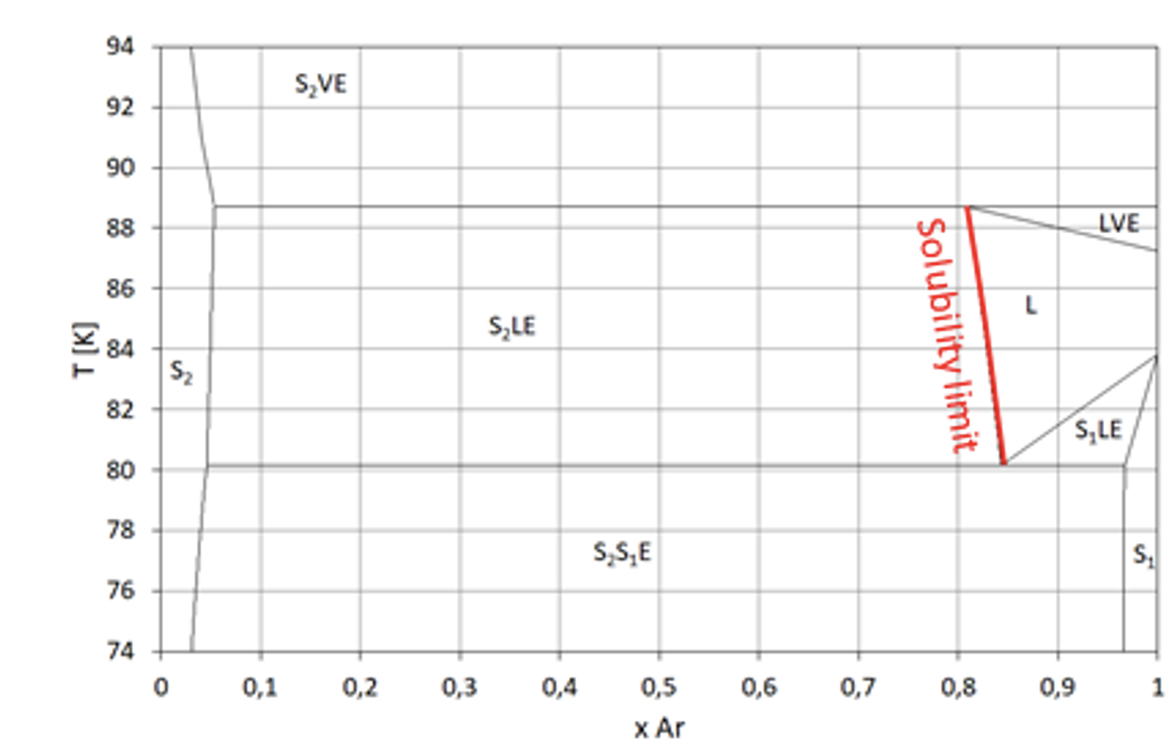
Objectives :
To use classical molecular simulation (Molecular dynamics and Monte-Carlo):
I- To build the Xe/Ar phase diagram
II- to calculate the thermodynamic, dynamic and structural properties
III-to investigate the thermodynamic and kinetic aspects of the mechanism of solid formation, liquefaction, stability of phase, …
WPA: Xe-Ar thermodynamics
WPA-1: Bibliographic research
WPA-2: Experimental study of Xe-Ar phase diagram
WPA-3: Molecular simulation
WPA-4: Development of the Equation of State (EoS)
Xe solubility in liquid Ar

Slide 3
Objectives :
To use classical molecular simulation (Molecular dynamics and Monte-Carlo):
I- To test accurate potential force field (dispersion repulsion forces, Van der Waals), polarisation ?
II- to compare the results with experiments
III-to build an accurate equation of state (EoS)
Monte Carlo => thermodynamics and structural properties
Advantage : statistically very efficient, direct access to phase equilibrium (Gibbs ensemble) DL Monte, …
Molecular dynamics => thermodynamics, structural properties and dynamics
Advantage : get access to dynamic processes Lammps, Gromacs, …
Simulation of 100 to 100000 atoms (few nm)

Slide 4
First simulations with Prof. P. Krüger University of Chiba in Japan
Extension of Kirkwood–Buff theory to solids and its application to the compressibility of fcc argon, M. Miyaji, B. Radola, J.-M. Simon, P. Krüger 154, 164506, J. Chem. Phys. (2021)
Thermodynamic Analysis of Ar_{x}Xe_{1-x} Solid Solutions Based on Kirkwood–Buff Theory, M. Miyaji, J.-M. Simon, P. Krüger, Physchem 2 191 (2022)

Slide 5
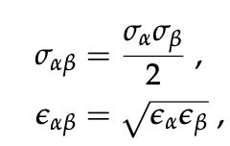
SIMULATIONS
- Use of DL Monte code, with interaction potential of Mie*:
Lorentz-Berthelot mixing rules
*Mick, J.R.; Soroush Barhaghi, M.; Jackman, B.; Rushaidat, K.; Schwiebert, L.; Potoff, J.J. Optimized Mie potentials for phase 300 equilibria: Application to noble gases and their mixtures with n-alkanes. J. Chem. Phys. 2015, 143, 114504.

Slide 6
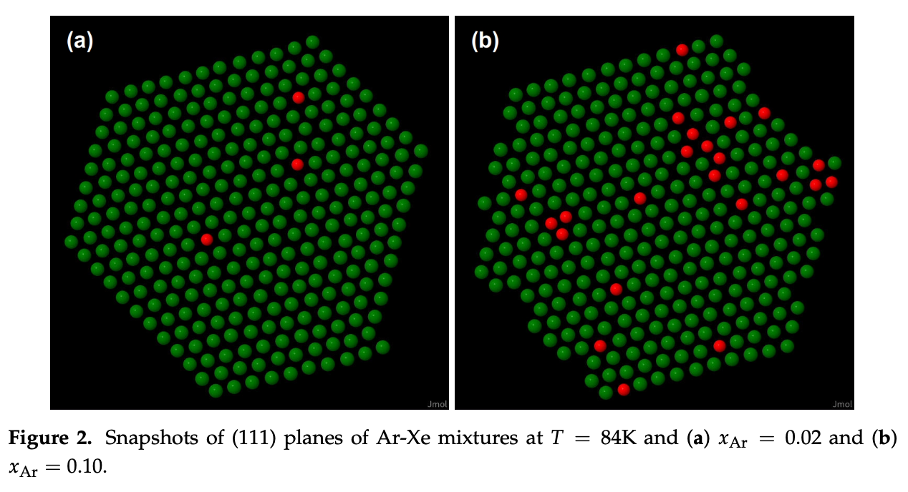
SIMULATIONS
- Use of DL Monte code, T = 84-86 K, 0=<X_{ar}<=0.1, P=1bar

Slide 7
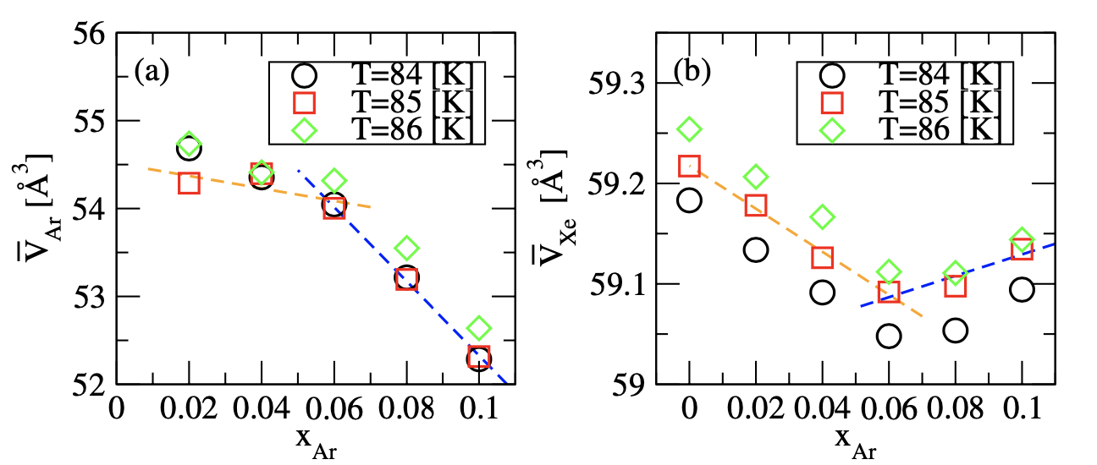
SIMULATION RESULTS
Partial molar volume 0.06

Slide 8
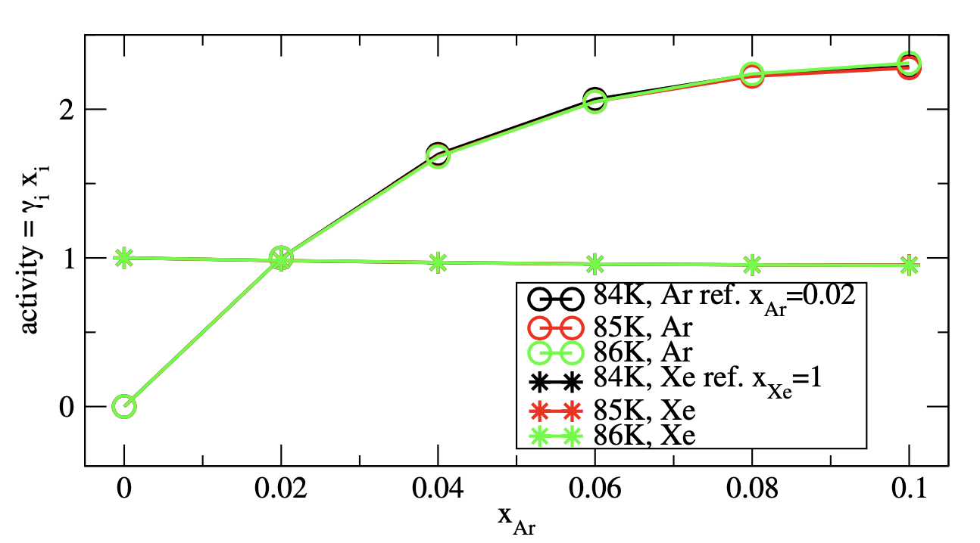
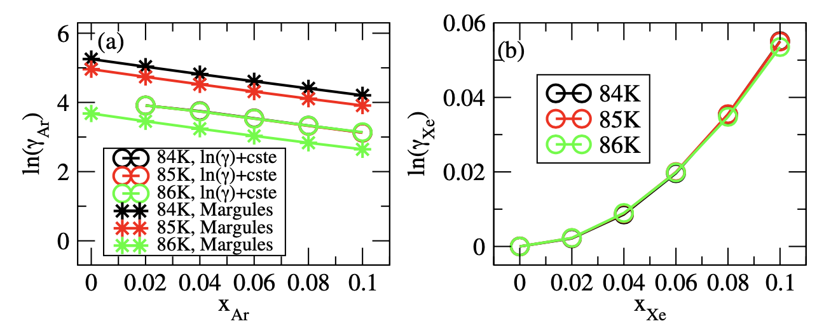
SIMULATION RESULTS

Slide 9
Margule’s equation

Slide 10
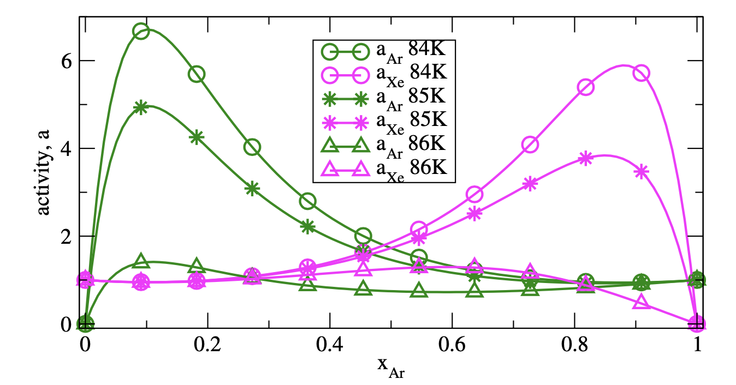
Activity from Margule’s equation
From Partial molar volume
=> x_{Ar}=0.06 (*)
o
x
*
o
x
*
o
x
*
Accuracy of the results and of the equation of state

