Slide 1
CTP
Phase equilibrium of noble gas mixtures at low T : Ar+Xe
KOM X-ArT 05 / 04 /2023

Slide 2
introduction
Mixtures of liquefied noble gasses can provide a suitable combination of scintillation and ionization properties for particle physics and medical imaging
The project X-ArT aims at studying xenon doped liquid argon for neutrinoless double beta decay search and TOF-PET
The temperature of LAr is lower than the Xe triple point temperature. This means that a Xe-rich solid phase will form if Xe concentration is higher than a certain value, knowns as solubility limit
The solubility limit depends on temperature and, slightly, on pressure
The solubility limit can be determined from the Ar+Xe phase diagram, as the composition of the liquid phase in equilibrium with the solid phase
Knowledge of Ar+Xe phase diagram is also important for loading operations and mixture recirculation for purification

Slide 3
Ar + Xe mixture: global phase diagram
Ar (1) + Xe (2) global phase equilibrium behavior:
predictions from the LJ-SLV-EoS (▬, ▬)

Slide 4
Ar + Xe mixture: global phase diagram
Ar (1) + Xe (2) global phase equilibrium behavior:
predictions from the LJ-SLV-EoS (▬, ▬, ▬), qualitative behaviors (▬)

Slide 5
Ar + Xe mixture: global phase diagram
Atmospheric pressure
Ar (1) + Xe (2) global phase equilibrium behavior:
predictions from the LJ-SLV-EoS (▬, ▬, ▬), qualitative behaviors (▬)

Slide 6
Ar + Xe mixture: T - x diagram @ atmospheric p

Slide 7
Ar + Xe mixture: T - x diagram @ atmospheric p

Slide 8
Ar + Xe mixture: T - x diagram @ atmospheric p
V

Slide 9
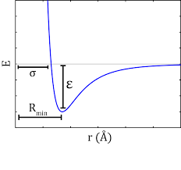
predictive model : SLV-LJ EoS
Hypothesis:
Ar + Xe behave like a mixture of LJ fluids
Commonly accepted!

Slide 10
predictive model : SLV-LJ EoS
ε₁₁ / ε₂₂
MC simulations from:
M.H. Lamm and C.K. Hall
AIChE J. 2001, 47, 1664
σ₁₁/ σ₂₂

Slide 11
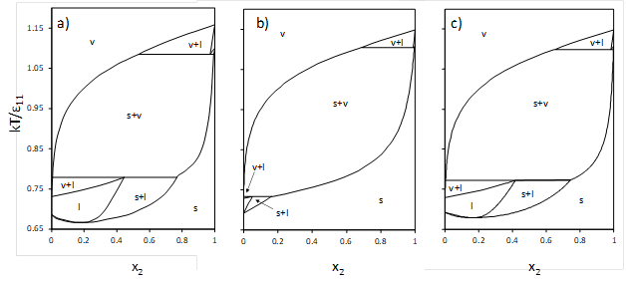
predictive model : SLV-LJ EoS
(a)
(b)
T-x phase diagram for Lennard-Jones binary mixtures with = 0.625 and = 0.9 at P* = 0.002. (a) MC simulation diagram; (b) LJ SLV-EoS with binary interaction parameters functions of and .

Slide 12
predictive model : SLV-LJ EoS
V
L+V
T-x phase diagram of Kr + Xe :
Comparison of SLV-LJ EoS and exp data
L
S+L
S

Slide 13
Ar + Xe mixture: literature data
Ref. | Kind | NP | Trange [K] | Prange [MPa] | x Xe [mol/mol]
[1] | VLE | 1 | 115.77 | 0.84487 | 0.1247
[2] | SLE | 10 | 82.32 – 83.38 |  | 0 – 0.284
[3] | SLE | 4 | 84 – 87.5 |  | 0.0414 – 0.0519
Ar + Xe phase equilibrium behavior: literature data
[1] Chui and Canfield, Trans. Farad. Soc., 1971, vol.67, pp.2933-2940
[2] Heastie and Lefebvre, Proc. Phys. Soc., 1960, vol.76, pp.180-184
[3] Yunker and Halsey Jr, J. Phys. Chem. 1960, vol. 64 pp.484–486.

Slide 14
Ar + Xe mixture: predictive model vs literature data
Ar + Xe temperature.vs.mole fraction diagram at 0.84487 MPa:
predictions from the LJ-SLV-EoS (▬) and VLE data (■)

Slide 15
Ar + Xe mixture: predictive model vs literature data
Ar + Xe temperature.vs.mole fraction diagram at 0.1 MPa:
predictions from the LJ-SLV-EoS (▬) and SLE data (■ , x)

Slide 16
Ar + Xe mixture: measurements
V
Pressure determined by the vapor phase
Vapor is almost pure Ar
L
L
Pressure determined by the amount of liquid in the cell
No vapor phase
S

Slide 17
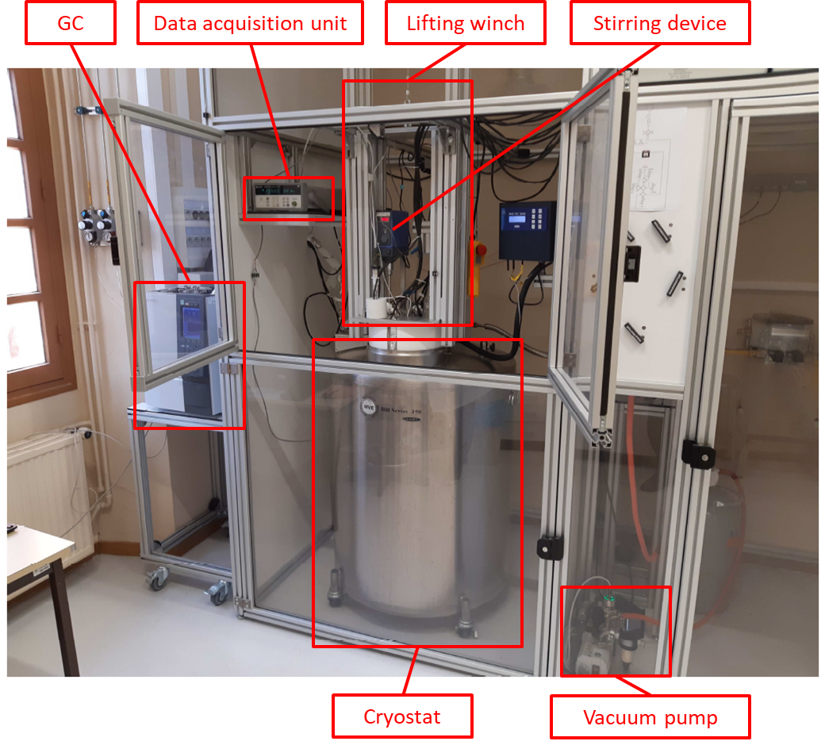
Ar + Xe mixture: measurements

Slide 18
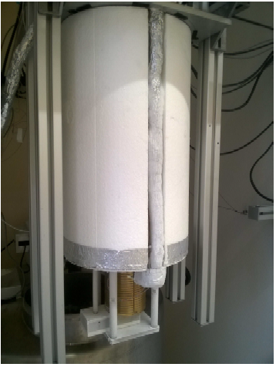
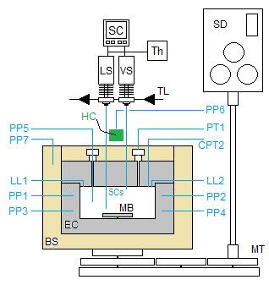
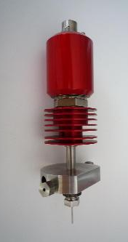
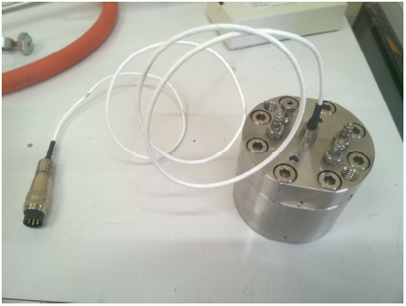
Ar + Xe mixture: measurements
BS: brass shell; CPT2: connection to the pressure transducer; EC: equilibrium cell; HC: heating cartridge; LLi: i^{th} loading line; LS: liquid ROLSI® sampler; MB: magnetic bar; MT: mechanic transmission; PPi: i^{th} platinum resistance thermometer probe; PT1: pressure transducer 1; SC: samplers control; SCs: sampling capillaries; SD: stirring device; Th: thermocouple; TL: transfer line; VS: vapor ROLSI® sampler.

Slide 19
progress
We are building a new experimental apparatus (operational in June-July)
Measurements will start in September, for a duration of 1 year
A post doc will be recruited for carrying out the measurements
Measurements and molecular simulation results will be used to improve the EoS

Slide 20
CTP
Visit us in Fontainebleau !

