Slide 1
DRD1
I. Laktineh

Slide 2
To start with :
This presentation is a selection of a few slides shown during the DRD1 preparation meetings.
They were produced essentially by Anna Colaleo, Leszek Ropelewski and Piotr Gasik.
Meetings are taking place almost on a weekly basis. Many exchanges and fruitful discussions.
DRD1 benefits largely from the very good experience of RD51 on MPGD.

Slide 3
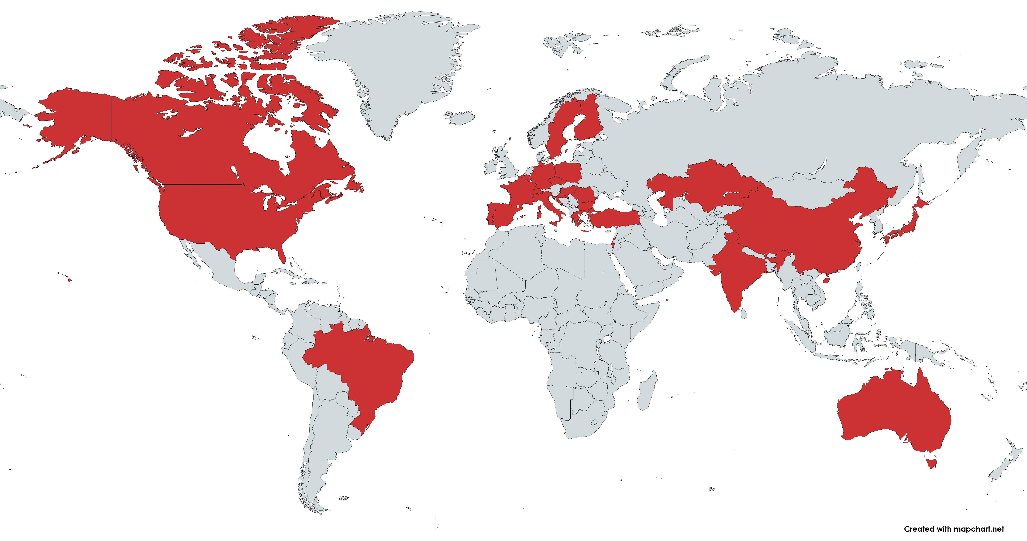
DRD1 Proposal: country maps
108 institutions in 4 continents expressed interest to join the DRD1 Collaboration

Slide 4
Scientific organization of DRD1: the pillars
The DRD1 Collaboration aims to promote the development, diffusion, and applications of gaseous detectors, following the General Strategic Recommendations* (GSR) outlined in the ECFA Detector R&D Roadmap Document.
The following pillars form the foundation of this Collaboration:
Community-Driven Collaboration: The Collaboration is driven by the community, providing a vital forum for exchanging ideas and establishing synergies to minimize duplicated efforts.
Recognition and Support for Young R&D Experts: The Collaboration will promote proper recognition and support for the careers of instrumentation R&D experts. This support will be facilitated through the member institutes and their interface with the scientific community and institutions.
Dynamic and Open R&D Environment: The Collaboration will strive to create and maintain an up-to-date, dynamic, and open R&D environment. This environment will support the development of necessary tools such as simulation and electronics, as well as the infrastructure required to undertake R&D on novel detectors and to validate their performances against the demanding specifications of future facilities and applications.

Slide 5
Scientific organization of DRD1: the pillars
The DRD1 Collaboration aims to promote the development, diffusion, and applications of gaseous detectors, following the General Strategic Recommendations* (GSR) outlined in the ECFA Detector R&D Roadmap Document.
The following pillars form the foundation of this Collaboration:
Global Network and Access to Facilities: Leveraging its worldwide international network, the DRD1 Collaboration will facilitate access to testing facilities and advanced engineering support, available at DRD1 research laboratories and institutes.
Support for "Blue-Sky" R&D: The Collaboration will actively support "Blue-sky” R&D, which can lead to breakthroughs driven by technology. Common resources will be allocated, leveraging the aforementioned R&D environment.
Efficient Resource Pooling: The Collaboration aims for the most efficient pooling of resources through joint projects that will undergo international review. It will promote and support research plans that attract long-term funding, enabling the community to effectively address future technical challenges. These efforts will also help to build strong relationships between institutes and industrial partners.
Increasing Research Potential: By adding critical mass to the needs of individual institutes, the Collaboration aims to reduce research costs and enhance potential and results.

Slide 6
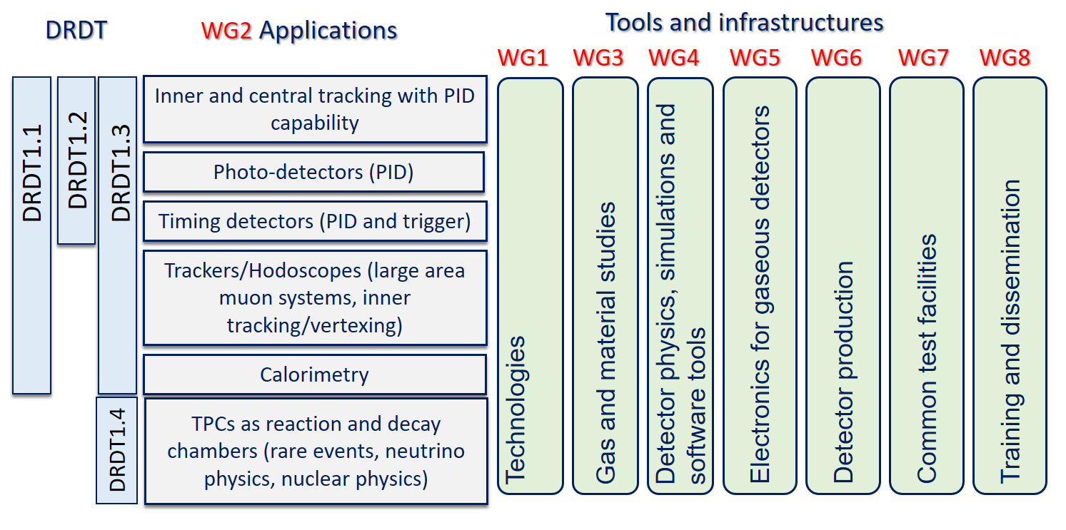
DRD1 Scientific organization: Working groups
Structure in Working Groups, forum for scientific discussions, coordinated by conveners:
aligned with the scientific program of the ECFA roadmap through the applications related to future facilities challenges, outlined by R&D Themes (DRDTs*), but also to the GSRs
Note: Applications Beyond HEP recently added

Slide 7
DRD1 scientific organization: Working groups
Working Groups are the core of the scientific collaboration
supporting the development of novel technologies and the consolidation of existing ones.
facilitating the exchange of ideas and foster synergies between institutes
playing a crucial role in identifying, guiding, and supporting strategic detector R&D directions, facilitating the establishment of joint projects between institutes
serving as a knowledge and technology hub for developing gaseous detector technologies:
Technological Aspects and Developments of New Detector Structures, Common Characterization and Physics Issue
Applications
Gas and material studies, and link to the novel technologies Detector Physics, Modelling and Simulation frameworks
Electronics for gaseous detectors
Production and Technology Transfer
Common Test Facilities and Infrastructures
Training and dissemination
WG will be recognized as a scientific reference for the community.

Slide 8
Organization of the collaboration activities
Following the indication of ECFA Detector Panel (*) two areas of Detector R&D :
”Blue-sky” R&D (competitive, short-term responsive grants, nationally organised)
Strategic R&D via DRD Collaborations (long-term strategic R&D lines, address the high-priority items defined in the Roadmap via the DRDTs)
Common projects
For low-TRL (blue sky) R&D, or other short term generic projects
Funding method:
Metabolism of each group
EU, National projects
DRD1 common fund
Work Packages
Strategic R&D targeting the priority programmes outlined in the updated European Strategy for Particle Physics.
Funding method:
Each institute asks its funding agency and controls the funds

Slide 9
Common projects
Common Projects (CP) support low TRL (blue-sky) R&D considered of interest by the collaboration, or generic projects (not related to experiments) that are vital for the community and require special backing:
Technology R&D projects towards developments of novel techniques, improvements of existing technologies, characterization methods and dedicated tools;
Development and optimization for novel applications;
Improvement of the technology transfer to industry.
This is a well-defined path (RD51 experience)
DRD1 Common Fund (details will be clearly defined in the MoU) supports CP with matching resources from participating Institutes.
a minimum number of participating Institutes to encourage collaborative effort between groups.
limited in time
limited funding support from the collaboration (example 20-30k/y)
➔ large number of groups in DRD1 ensures strong R&D
Reviewed by the DRD1 Collaboration

Slide 10
Strategic R&D = Work Package
Strategic R&Ds (according to ECFA Detector R&D Roadmap) organized in Work Packages
group activities of the Institutes with shared research interests around Applications with a focus on a specific task(s) devoted to a specific DRDT challenge, typically related to specific Detector Technologies and to the development of specific tool or infrastructure
Application
⇽ defined by ECFA R&D Roadmap
Tasks
focusing on challenges related to performance (precise timing, high rates performances, longevity …)
⇽ connection to ECFA DRDTs
Technological areas:
MPGD, RPC, Wire, LDC, TPC, …
R&D on Sensors, Electronics, Software Tools, Gas Properties studies;
Development of infrastructure and production techniques
Training
Work Package

Slide 11
Work Packages
WPs are organized and coordinated internally by participating Institutes:
It is required to be a member of DRD1 to contribute to a WP
should pursue implementation of the milestones and deliverables and execute the workplan outlined in the approved scientific proposal
funds are fully controlled and operated by participating Institutes.
A formal agreement between participating Institutes, DRD1 management, and the host lab (CERN) is being sorted out by CERN management
Work Packages take full advantage and contribute to the DRD1 scientific program, R&D environment, infrastructure, and R&D tools (electronics, software).
WP can be created at any time in the future
The strategic R&D will be in the focus of the DRDC* reviews.
Note: It is not required to be involved in a WP to be a member of DRD1

Slide 12
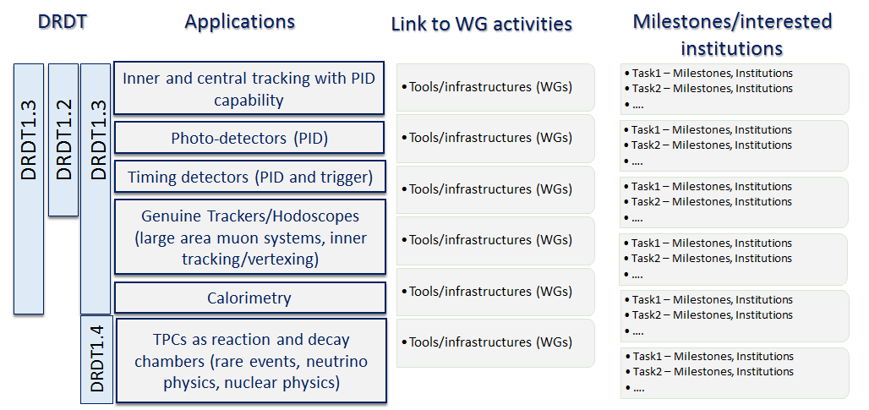
Work Packages

Slide 13
Work Packages
WP2: Drift Chambers, WP3: Straw Chambers, WP4: (Large Volume) Tracking TPCs
WP6
WP7
WP1
WP5
WP8

Slide 14
WP Coordinators
For the finalization of the DRD1 proposal, (incl. WP proposals) WP Coordinators have been established to initialize discussion within the community and organization of the first WPs
The list is not fixed, can be updated at any time. (Self-)nominations welcome
WP Coordinators should be involved in WP activities, eventually
WP1 (Trackers)
Atsuhiko Ochi
Gabriella Pugliese
Giulio Aielli
Mauro Iodice
Riccardo Farinelli
WP2 (Drift chambers)
Francesco Grancagnolo
WP3 (Straw tubes)
Peter Wintz
WP4 (Tracking TPCs)
Diego Gonzalez Diaz
Esther Ferrer Ribas
Francisco Ignacio Garcia Fuentes
Jochen Kaminski
Piotr Gasik
WP5 (Calorimeters)
Imad Laktineh
WP6 (Photodetectors)
Fulvio Tessarotto
Florian Brunbauer
Piotr Gasik
WP7 (Timing)
Diego Gonzalez Diaz
Florian Brunbauer
Imad Laktineh
Ingo Deppner
WP8 (Reaction/Decay TPCs)
Diego Gonzalez Diaz
Esther Ferrer Ribas
Francisco Ignacio Garcia Fuentes
Jochen Kaminski
Piotr Gasik
(WP9) (Beyond HEP) under discussion

Slide 15
DRD collaborations interplay and overlapping areas
Following people were chosen to act as DRD1 link person in other DRD area
DRD2 - liquid detectors - Diego Gonzales Diaz
DRD4 - photon and PID - Fulvio Tessarotto
DRD5 - quantum technologies- Florian Brunbauer
DRD6 - calorimetry - Imad Laktineh
DRD7 - electronics - Sorin Martoiu, Marco Bregant

Slide 16
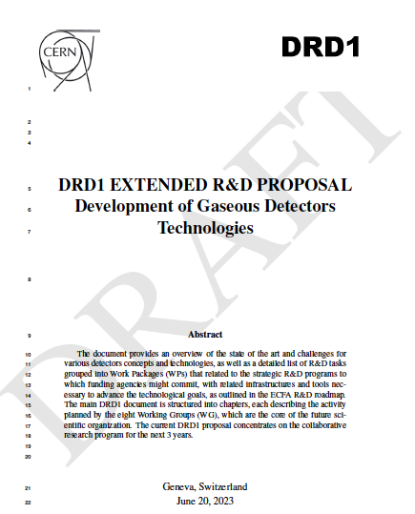
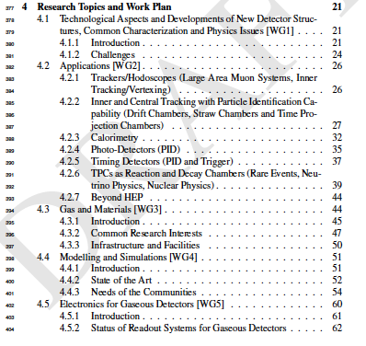
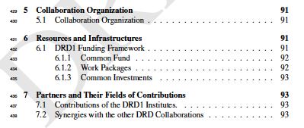
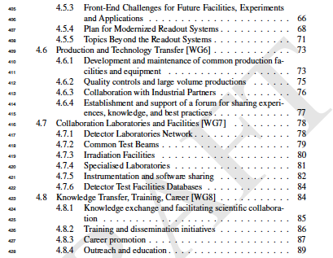
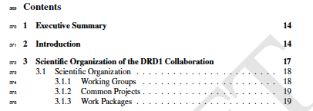
DRD1 Proposal
Research topics and Work plan
Collaboration organization
Resource and infrastructures
Executive summary
Scientific organization of DRD1 Collaboration

Slide 17
List of editors
Organization and collaborative aspects: A. Colaleo, E. Oliveri, L. Ropelewski, M. Titov
Research topics and Work plan
Paragraph 4.1 WG1 - Technologies: P.Colas, F. Resnati, P. Wintz, I. Deppner, M. Tytgat, L. Moleri
Paragraph 4.2 WG2 - Applications: F. Garcia, P. Gasik, F. Grancagnolo, D. Gonzalez Diaz, G. Aielli, G. Pugliese, R. Farinelli, I. Laktineh
Paragraph 4.3 WG3 - Gas and material studies: B. Mandelli, G. Morello, F. Renga, K. Dehmelt, S. Roth,
D. Piccolo, A. Pastore, B. A. Gonzalez
Paragraph 4.4 WG4 - Detector physics, simulations, and software tools: M.Abbrescia, M. Borysova,
P. Fonte, O. Sahin, P. Verwilligen, R. Veenhof
Paragraph 4.5 WG5 - Electronics for gaseous detectors H. Muller, J. Kaminski, M. Gouzevitch, R. Cardarelli, Sorin Martoiu, Marco Bregant, Michael Lupberger
Paragraph 4.6 WG6 - Detector production: R. De Oliveira, F. Jeanneau, A. Delbart, G. Iaselli,
I. Laktineh, G. Charles
Paragraph 4.7 WG7: Common test facilities: Y. Tsipolitis, E. Oliveri, R. Guida, G. Iaselli,
A. Ferretti
Paragraph 4.8 WG8:Training and dissemination: F. Brunbauer, M. Iodice, E. Baracchini, B. Liberti,
A. Paoloni

Slide 18
Conclusion
DRD1 intends to put together the big community of gaseous detectors . For the time being it seems to succeed.
Working groups forming the future collaboration are established
Common project will require a small participation of each group to have a common funds with a common projects in mind ( beam tests..etc) but also to allow a few ideas to be initiated.
Working packages are proposed and their contents are being discussed with the different groups to establish a list of milestones and deliverables fulfilling the ECFA road map
A full proposal is being finalized and will hopefully be ready by the end of July

