Slide 1
Introduction to CERN-DRD session
Réunion GDR DI2I, Subathec Nantes 10-12 Juil. 2023
D. Contardo IP2I

Slide 2
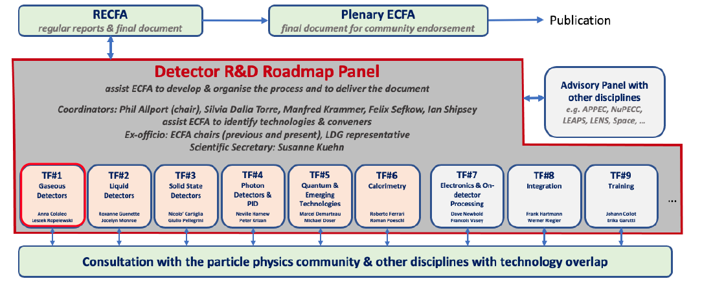
ECFA detector R&D roadmap (2021- following ESPP update of 2020)
establish what is needed when for strategic programs
9 Task Forces - wide consultation of the community and symposia
D. Contardo
J. Collot
6 areas mapping technologies and detector systems
3 transverse areas
R. Poeschl
10 General Recommendations:
GR4: international coordination and organization of R&D activities
GR6: establish long term strategic funding program
leading to on-going
implementation process
4

Slide 3
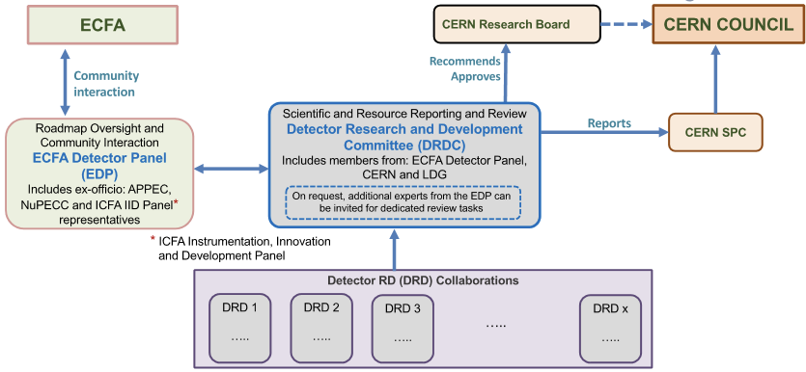
Proposal to form DRD international collaborations anchored at CERN
status similar to experiments with DRDC review committee and MoU agreements with FAs
D. Contardo co-chair
L. Serin expert member
EDP hosted at DESY : interface to experiments, vetting scope, goals & milestones, acting with expert members in DRDC
DRDC being formed
Chair T. Bergauer
DRDs areas as TFs in the roadmap
Coordination panel for training (TF9)
DRD8 still under discussion
DRD proposals to DRDC end-July 2023, collaborations active Jan. 2024, MoUs prepared/signed by FAs in 2024
DRD7 and DRD5 only LoI in July - full fledged proposals in fall
6

Slide 4
DRD proposal preparation started in January 2023
oversight by ECFA roadmap, convener-ship by roadmap TF and existing CERN-RD programs*
several French contributions in working groups (see following presentations)
relatively bottom-up approach with community asked to submit proposed contributions
  TF1/DRD1 Gaseous Detectors https://indico.cern.ch/event/1214405/
  TF2/DRD2 Liquid Detectors https://indico.cern.ch/event/1214404/
  TF3/DRD3 Solid State Detectors https://indico.cern.ch/event/1214410/
  TF4/DRD4 Photon Detectors and PID https://indico.cern.ch/event/1214407/
  TF5/DRD5 Quantum and Emerging Technologies** https://indico.cern.ch/event/1214411/
  TF6/DRD6 Calorimetry https://indico.cern.ch/event/1213733/
  TF7/DRD7 Electronics and On-detector Processing https://indico.cern.ch/event/1214423/
  TF8/DRD8 Integration https://indico.cern.ch/event/1214428/
  TF9/DRD9 Training https://indico.cern.ch/event/1214429/
* ex. current CERN RD programs end end-2023 and will be replaced by the new wider scope DRD collaborations:
RD51 (MPGDs) in TF1/DRD1, RD50 (radiation hard semiconductors) & RD42 (diamond) in TF3/DRD3, RD18 (crystals) in TF4/DRD4 and TF6/DRD6
** a white paper in preparation only accessible to people registered
7

Slide 5
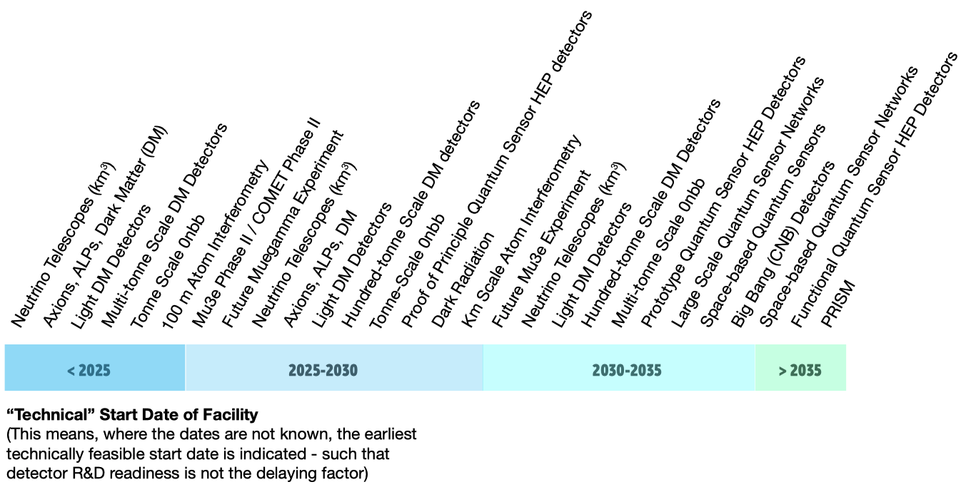
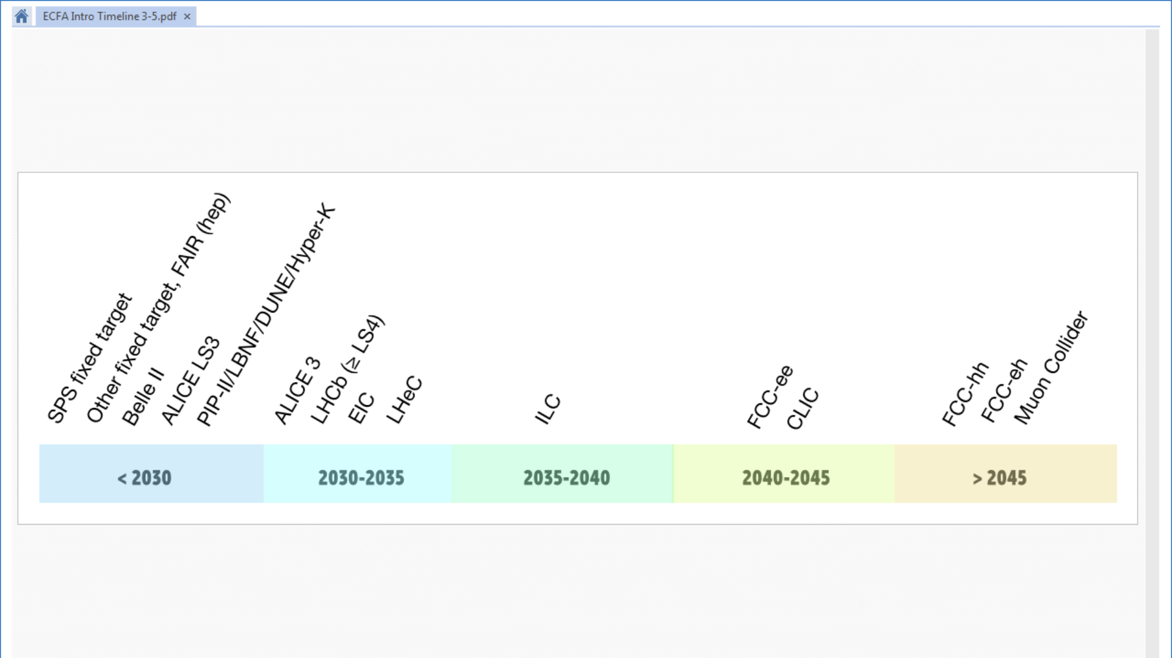
DRD proposals establish program of deliverables addressing roadmap strategic programs*
boundaries: when “blue sky” / low Technology Readiness Level integrate programs
when technical solutions are handled to specific program engineering design
    future experiments at large accelerator facilities
    future experiments at small accelerators,
    at nuclear reactors and/or with cosmic rays
Dark Matter, Neutrino, 0𝜈ββ mostly related to TF2 liquid detectors and TF5 quantum and emerging sensors
* Nuppec and APEC not part of strategic projects but invited to follow the process
DRD collaborations are open to contributions outside Europe and partnership with other fields
3

Slide 6
DRD proposals content
Public documents being circulated to the proponents contain
  Work Packages(deliverables) planning and list of institutes willing to contribute
  scale of human and funding resources required to achieve WP goals
  collaboration management, committees and working group organization
Confidential material on resources in support of programs will be submitted to the DRDC
  sum of resources (HR and funding) currently expected to be available
  sum of new strategic resources that could be considered by FAs (not engagements)
  initial money matrix of contributions per Funding Agencies
IN2P3 procédure vers les propositions de contributions aux DRD
Identifier par des Fiches Projets (format R&T usuel) les propositions de contributions aux Work Packages des DRDs – contacts :
  G. Charles (DRD1), A. Besson et M. Barbero (DRD3), M. Bongrand (DRD2/4), R. Poeschl (DRD6), J. Baudot et Frederic Druillole (DRD7), D. Contardo interface ECFA implementation panel
Validation non contraignante par les DU et les DAS pour soumission aux DRDs
Etape suivante: évaluation des propositions dans le contexte global des programmes des DRDs et préparation des priorités en vue des MoU
7

Slide 7
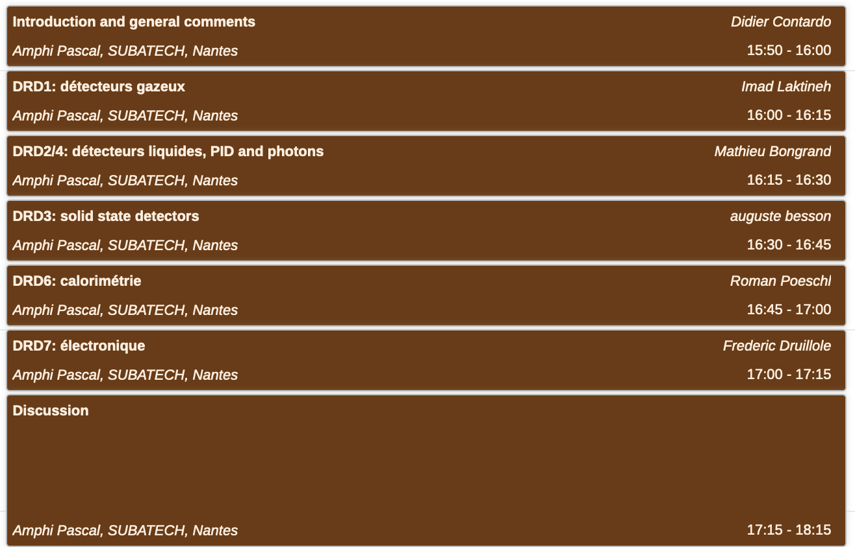
Agenda de la session
présentation du programme des DRDs et état des propositions françaises
6

Slide 8
Additional material
10

Slide 9


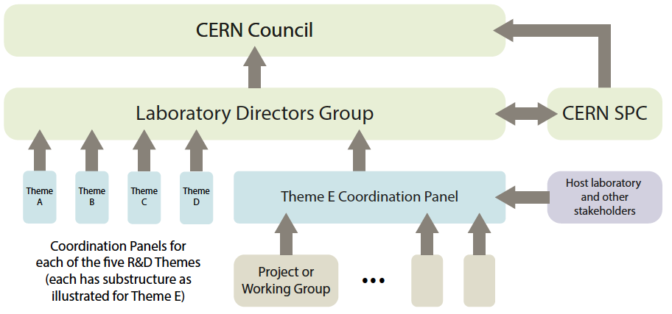

2020 Update of the European Strategy for Particle Physics Physics
under LDG, coordination formed
2021 Accelerator R&D roadmap
High-Field Magnets - Radiofrequency Structures - Muon Beams - Energy Recovery Linacs -
Plasma Acceleration
(Physics Briefing Book)
2021Detector R&D roadmap
2023 DRD collaboration
proposals
under ECFA, on-going this talk
US process : 2022 Snowmass symposium briefing book, P5 strategy update autumn 2023

Slide 10
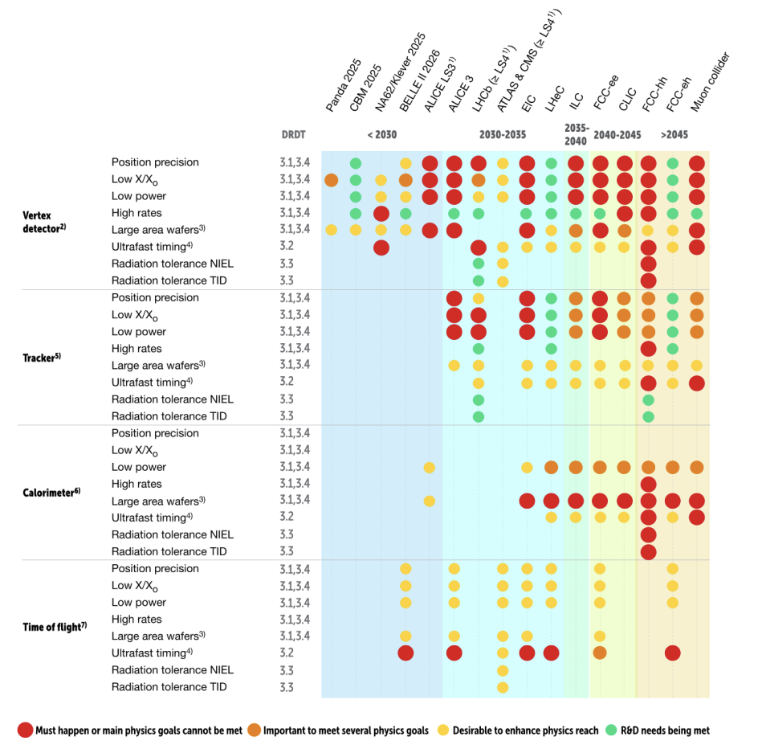
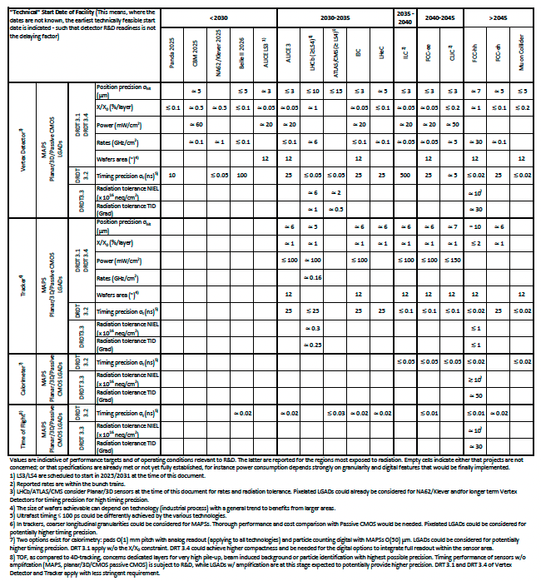
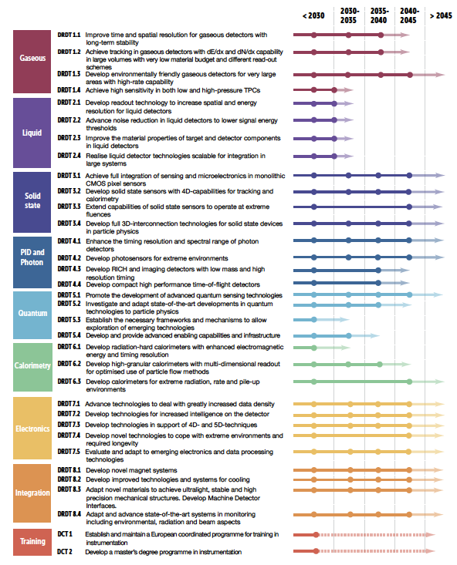
ECFA detector roadmap content ex. TF3 Solid State Detectors
ball park performance targets
needs/benefits for physics reach
detector R&D Themes
Systems and technology options
5

Slide 11
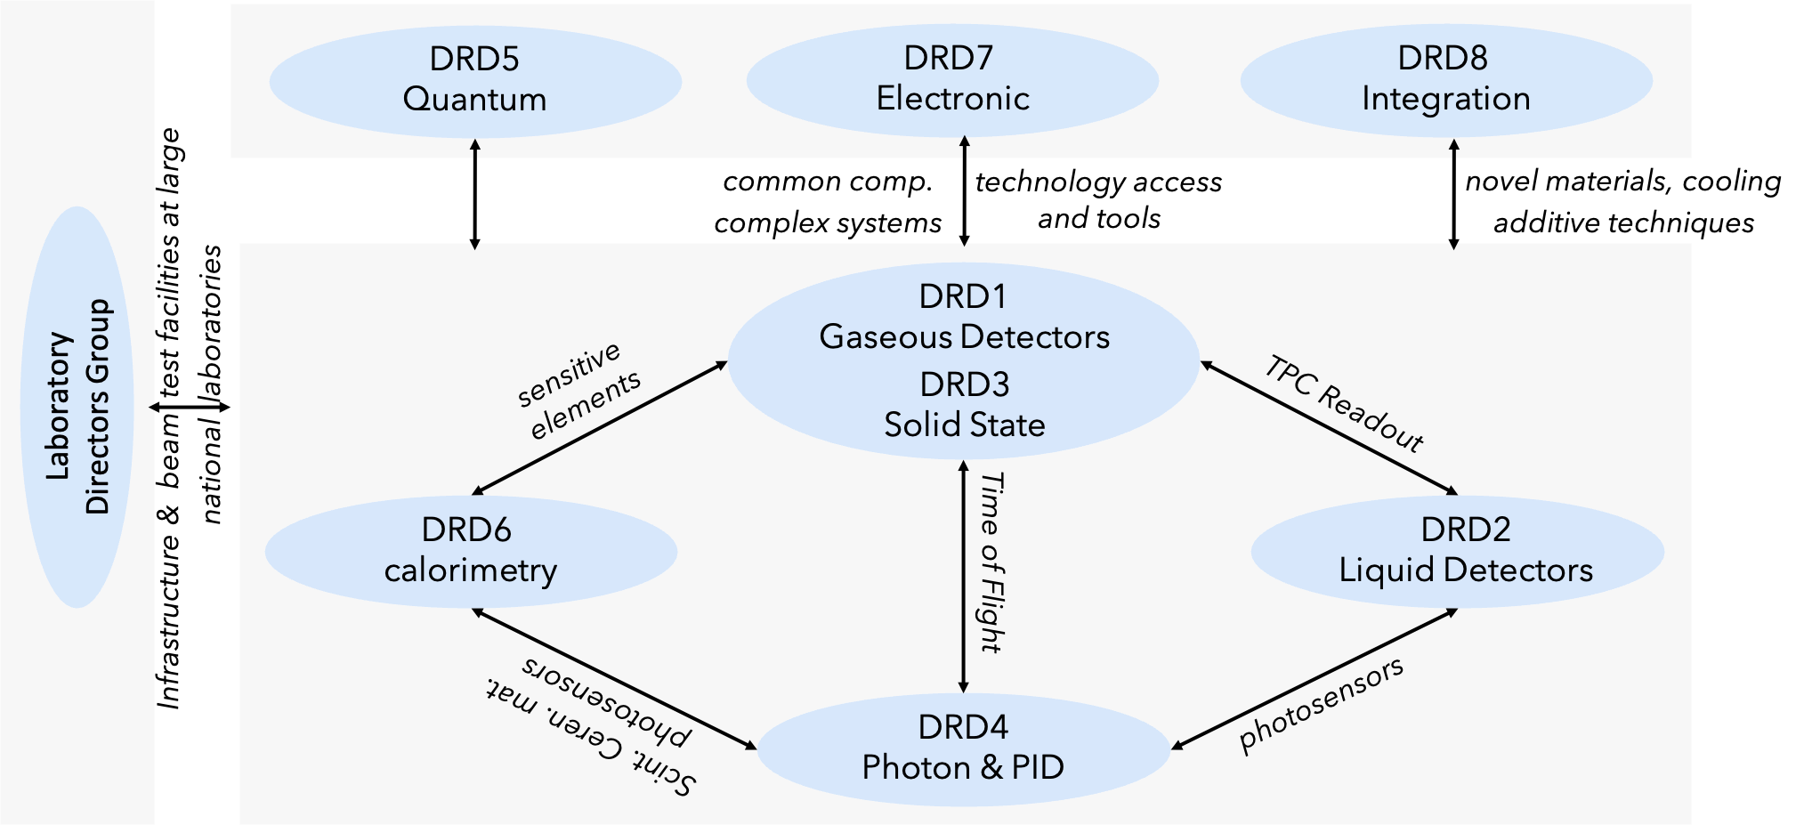
Interplay between DRDs
*
7
* LNF - Italy, STFC/Daresbury - UK, CIEMAT - DESY, Germany, STFC/RAL - UK , LNGS - Italy, F.CEA/Irfu – France, IJCLab – France, Nikhef - Netherlands, PSI - Switzerland

Slide 12
Future collider planning as of today
    préparation – construction - physics - ee, hh, μμ
3

Slide 13
Ballpark timelines for collider strategic programs, driving R&D plannings
”Blue sky” low Technology Readines Level continuous R&D process
DRD strategic R&D
Experiment design & system engineering
    Production
    and installation
Physics start
DRD collaborations active Jan. 2024
12 years
3 + 6 + 3 years
CLIC/FCC-ee
Muon Coll.
2037
2048
4 - 5 years
3 + 6 + 3 years
2028
2040
ILC/CCC
3 - 4 years
7 - 8 years
ALICE-3, LHCb-2, ATLAS/CMS, EIC, BELLE-3, stepping stones and also CEPC current planning
2027
2035
7

Slide 14
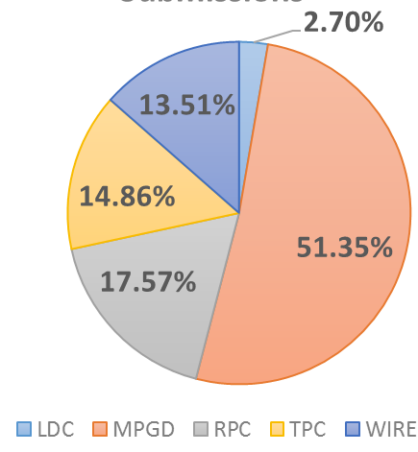
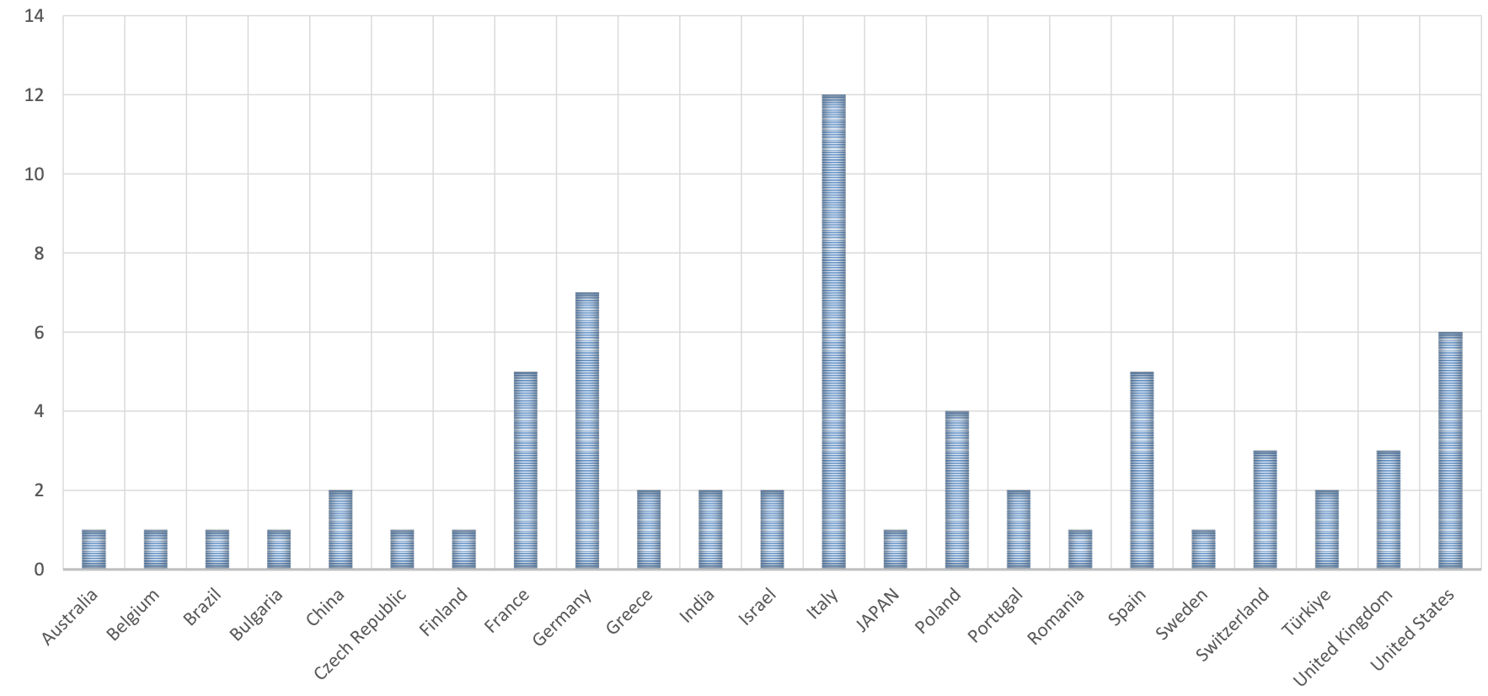
Mid-Mai status now proposal now being circulated to the proponents
DRD1 Gaseous Detectors program & community building status
conveners: Anna Colaleo, Leszek Ropelewski, 292 people registered
Organized in 8 working groups to develop the R&D program
  WG1 : technologies MPGDs, RPC, Wires, TPC, DCH
  WG2 : applications muon tracking and triggering, Central Tracking with PID, Photon Detection, ToF, High Granularity Calorimetry, TPC for rare event searches
  WG3 : gas and material studies
  WG5 : electronic components
  WG6 : detector production
  WG7 : common test facilities
  WG8 : training and dissemination
Detailed survey in each WG to assess community interests
  74 contributions presented at 1st community meeting
Planning of technology Work Packages (deliverable/milestones)
  on-going mapping of needs and aspirations of the community
Discussion of collaboration structure on-going
  proper arrangement of technology and transverse activities
DRD1 proposal draft at 2nd community meeting
Geographical distribution
Colors indicative of Technology areas versus transverse activities
6

Slide 15
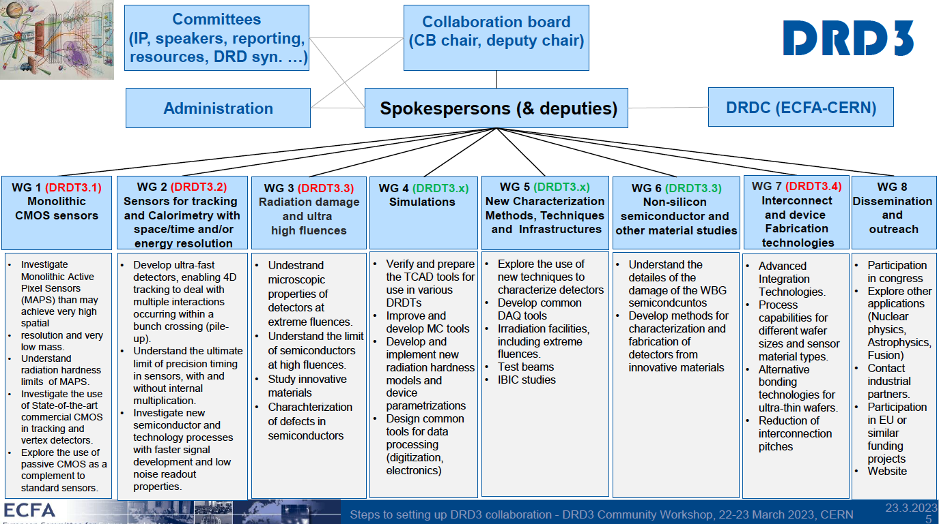
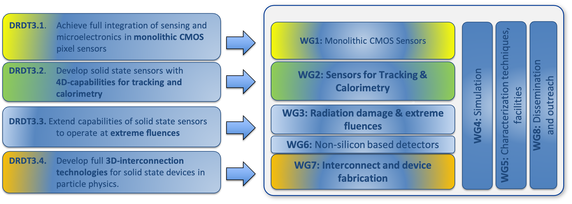
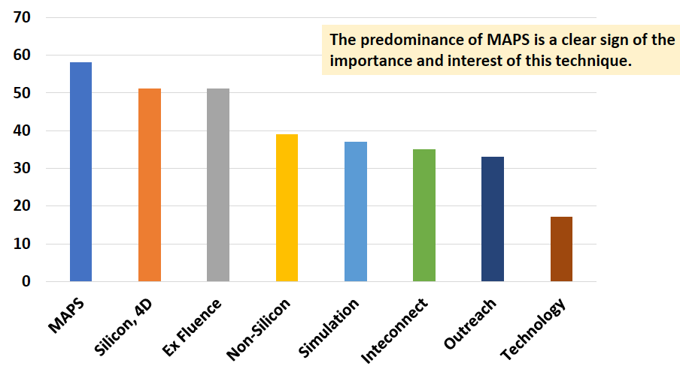
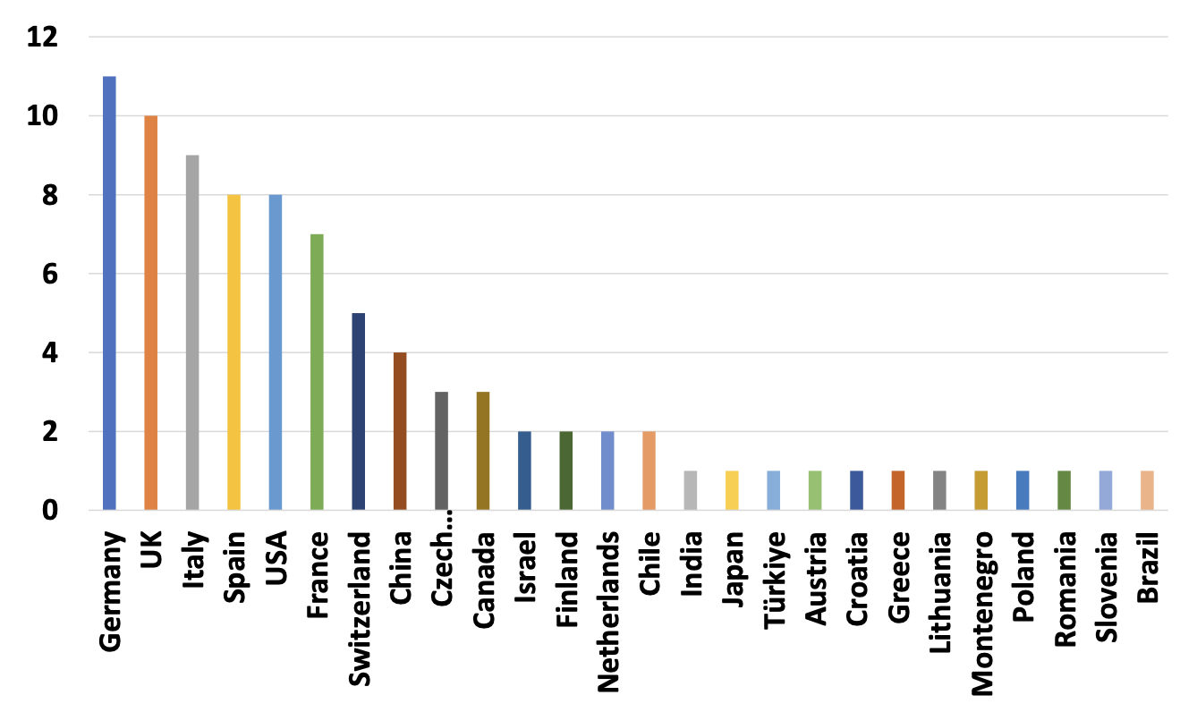
Mid-Mai status now proposal now being circulated to the proponents
DRD3 Solid State Detectors program & community building status
conveners: Nicolo Cartiglia, Giulio Pellegrini, 484 people registered
Organized in 8 working groups to develop the R&D program
  WG1 : Monolithic CMOS sensors
  WG2 : sensors for tracking and calorimetry (Hybrid, LGADs)
  WG3 : radiation damage and ultrahigh fluence
  WG5 : characterization techniques, facilities
  WG6 : non silicon based detectors
  WG7 : Interconnect and device fabrication
  WG8 : dissemination and outreach
Survey to assess community interests
  88 contributions presented at 1st community meeting
Planning of technology Work Packages (deliverable/milestones)
  on-going mapping of needs and aspirations of the community
DRD3 proposal draft beginning of June
Predominance of CMOS(MAPS)
Geographical distribution
6

Slide 16
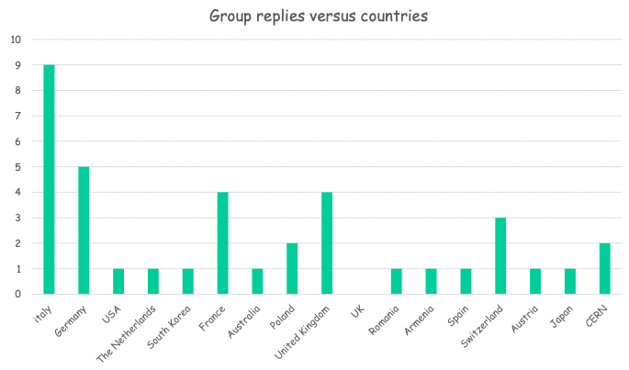
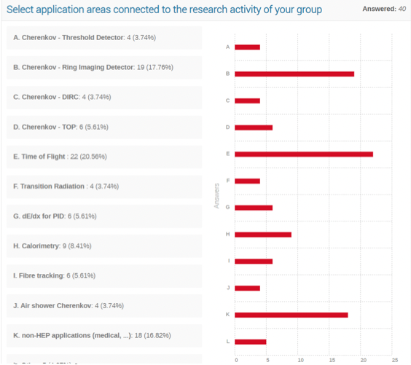
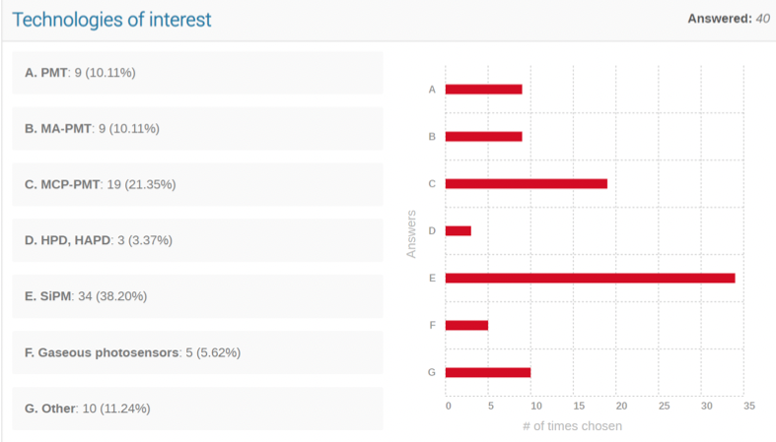
Mid-Mai status now proposal now being circulated to the proponents
DRD4 Photon Detectors and PID program & community building status
conveners: Peter Krizan, Christian Joram, 217 people registered
4 Technology areas identified in coordination meeting
  WG1 : photodetector (SiPM, SPADs, PMT/MCP-PMT, Gas)
  WG2 : particle ID (RICH/DIRC/TOP,TORCH/ToF)
  WG3 : technologies (radiators, optical elements, readout, cooling, software)
  WG4 : emerging technologies (novel materials and concepts…)
Survey to assess community interests
  40 contributions
Planning of technology Work Packages (deliverable/milestones)
  1st community meeting this week 16 – 17 May
DRD4 proposal draft end-June
WG2
WG1
6

Slide 17
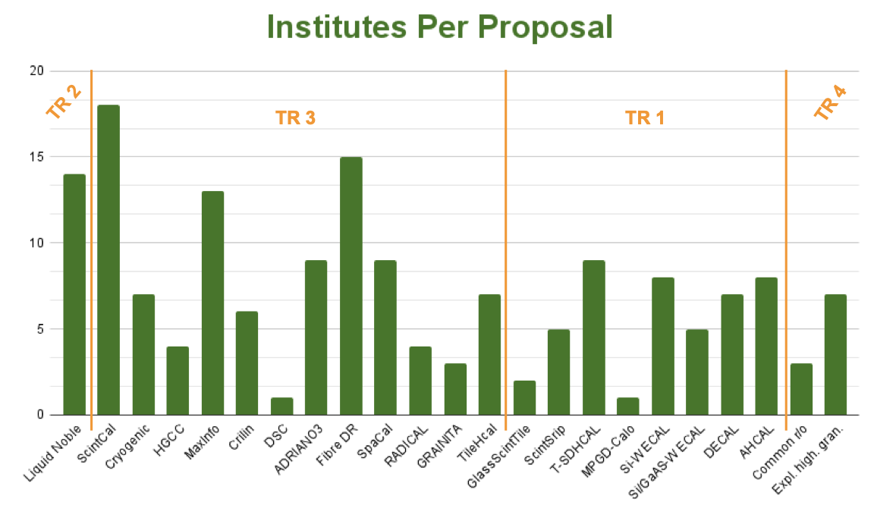
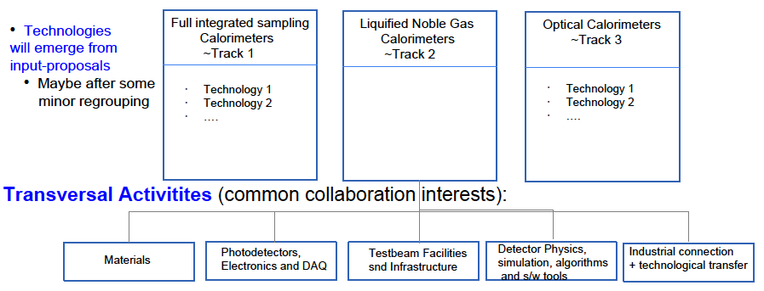
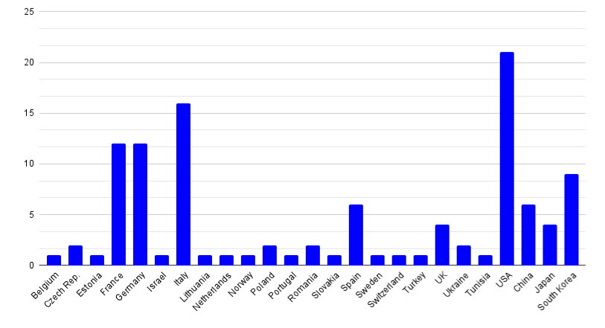
Mid-Mai status now proposal now being circulated to the proponents
DRD6 Calorimetry program & community building status
conveners: Roberto Ferrari, Roman Pöschl, 232 people registered
Organized in 4 working groups to develop the R&D program (1st community meeting)
  WG1 : full integrated sampling calorimeters
  WG2 : liquified Noble Gas calorimeters
  WG3 : optical calorimeters
  WG4 : transverse activities
Survey to assess community interests
  23 contributions, 110 institutes, presented at 2nd community meeting
Planning of technology Work Packages (deliverable/milestones)
  on-going mapping of needs and aspirations of the community
DRD6 proposal draft beginning of June
Institutes per proposal
WG2
WG3
WG1
WG4
Institutes per country
6

Slide 18
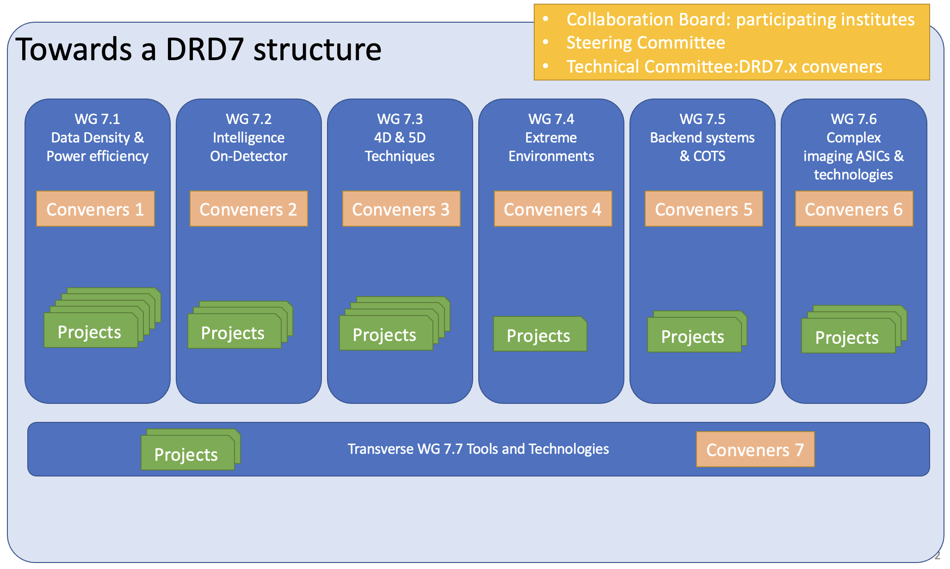
Mid-Mai status now proposal now being circulated to the proponents
DRD7 electronics and on-detector processing program & community building status
conveners: Francois Vasey, Dave Newbold, 183 people registered
Technology areas identified at 1st community workshop
  WG1 : data density and power efficiency
  WG2 : intelligence on the detector
  WG3 : 4D and 5D techniques
  WG4 : extreme environments
  WG5 : backend systems and cots
  WG6 : complex imaging ASICs and technologies
  WG7 : provision access to tools and technologies (vendors)
Interaction with other DRDs
  DRDs provide specification, planning, production and characterisation of prototypes with relevant RH and funding
  DRD7 review specifications and designs, develop and provision common IP, components, and subsystems, deliver common, generic, complete components / systems, when big or complex
      Work organisation proposal being investigated
        Tiered/platform structure of competences (with appropriate sharing of human resources with other DRDs)
Next steps
  May-June collect expressions of interest in specific projects, define common plans and interface to other DRDs
  July DRD7 LoI indicating broad scope, composition and resource needs scale
  September 2nd community workshop to discuss Work Packages
  December proposal submitted to DRDC including resources
organization proposal
6

Slide 19
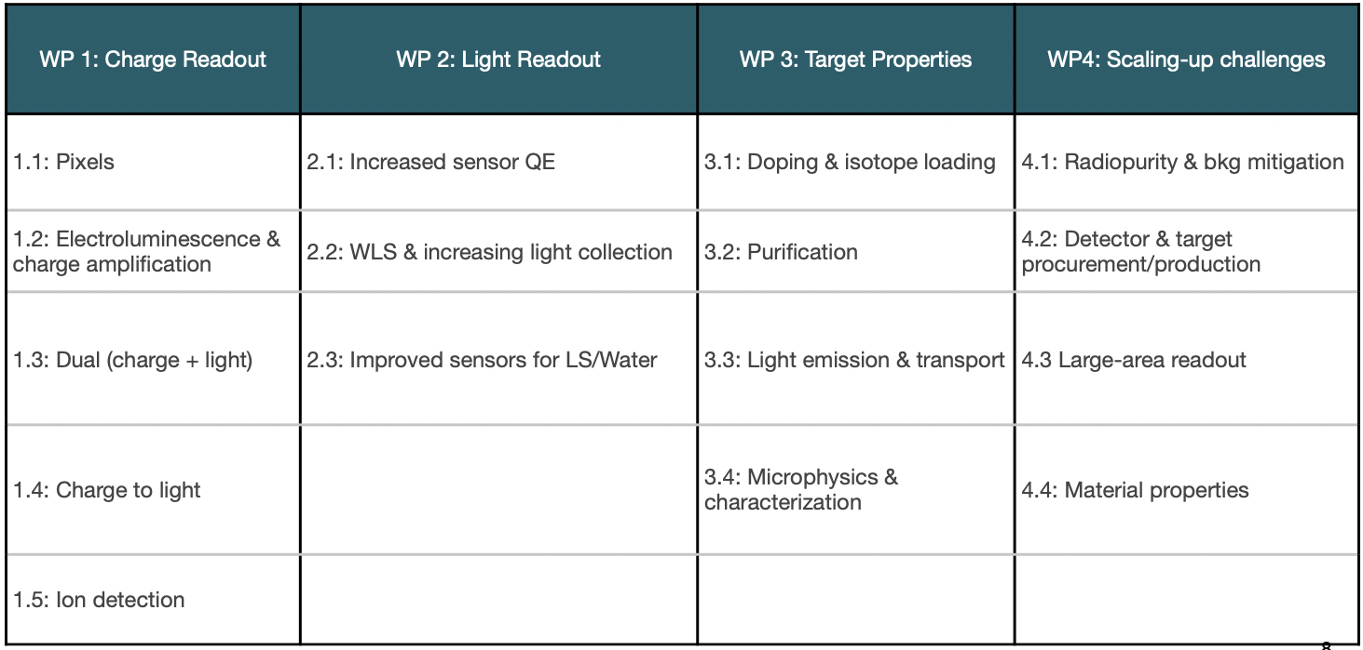
Mid-Mai status now proposal now being circulated to the proponents
DRD2 Liquid Detectors program & community building status
conveners: Roxanne Guenette, Jocelyn Rebecca Monroe, Ian Shipsey, 168 people registered
Technology areas identified in coordination meeting
  WG1 : charge readout
  WG2 : light readout
  WG3 : target properties
  WG4 : scaling-up
Planning of technology Work Packages
  1st community meeting
Survey to assess community interests and WP deliverables/milestones on-going
DRD2 proposal draft early-June
WG1
WG2
WG3
WG4
WPs
6

Slide 20
Mid-Mai status now proposal now being circulated to the proponents
DRD5 Quantum and emerging technologies program & community building status
conveners: Michael Doser, Marcel Demarteau, Ian Shipsey, 164 people registered
Proposal to organize WGs define in expert workshop Apr.
  WG1 : clocks, clock networks
  WG2 : kinetic detector
  WG3 : superconducting spin based sensors
  WG4 : optomechanical sensors
  WG5 : atoms, molecules, ions, interferometry
  WG6 : meta materials 0-1-2D materials
Next steps
  circulate minutes of workshop with seeds of Work Package
  circulate white paper to organise WGs
  July submit LoI to DRDC with initial projects and resource needs scale
  September 1st community meeting to tune WP proposal
  January 2024 submit proposal to DRDC
6

Slide 21
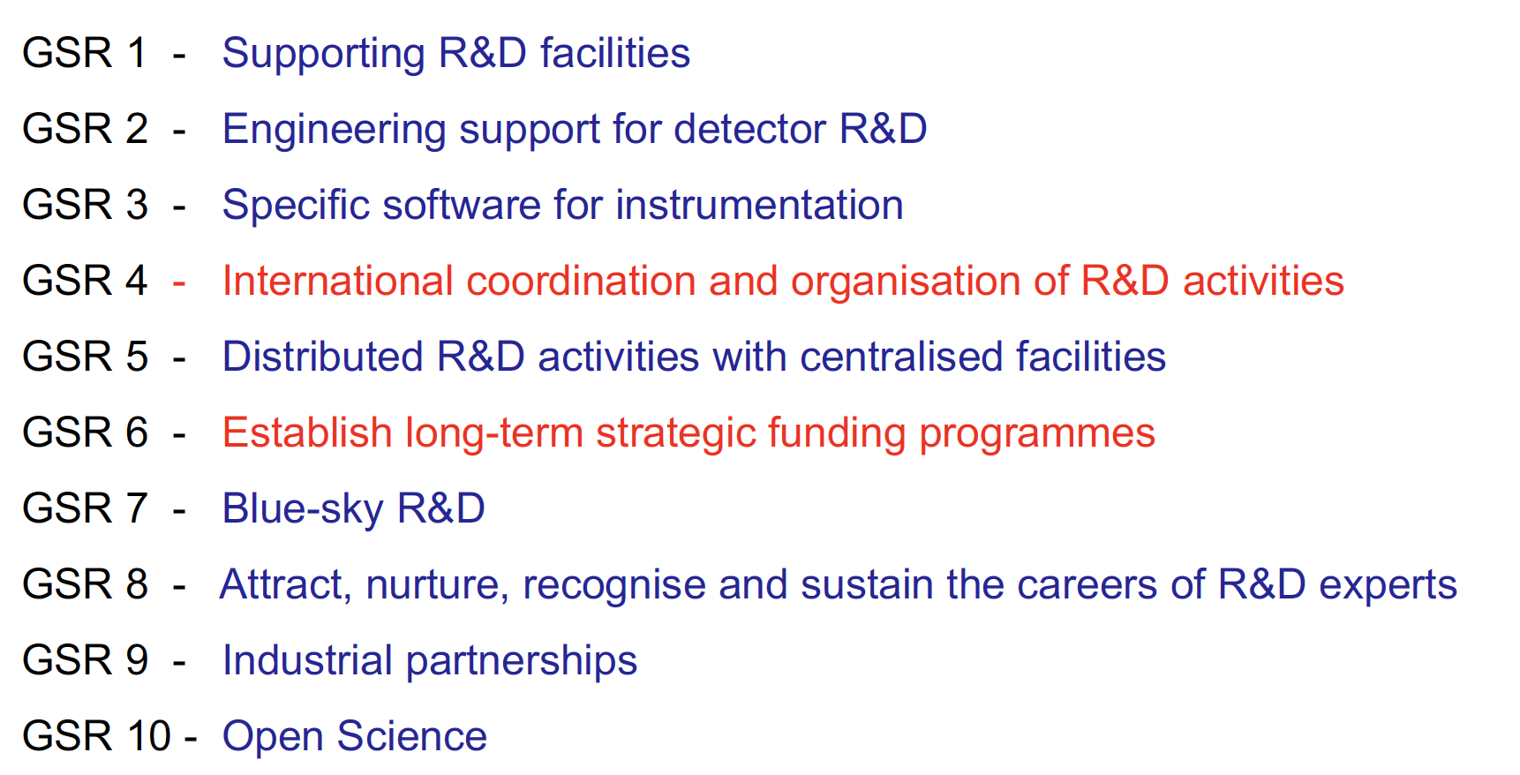
ECFA Detector R&D roadmap recommendations
11

Slide 22
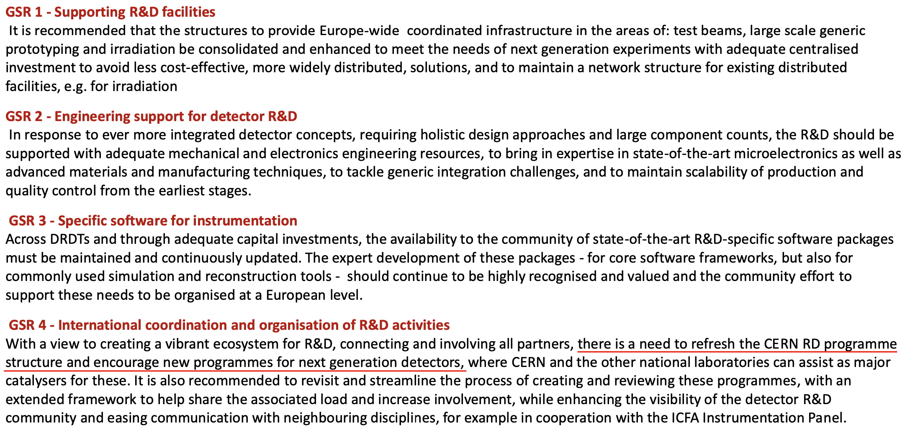
ECFA Detector R&D roadmap recommendations
11

Slide 23
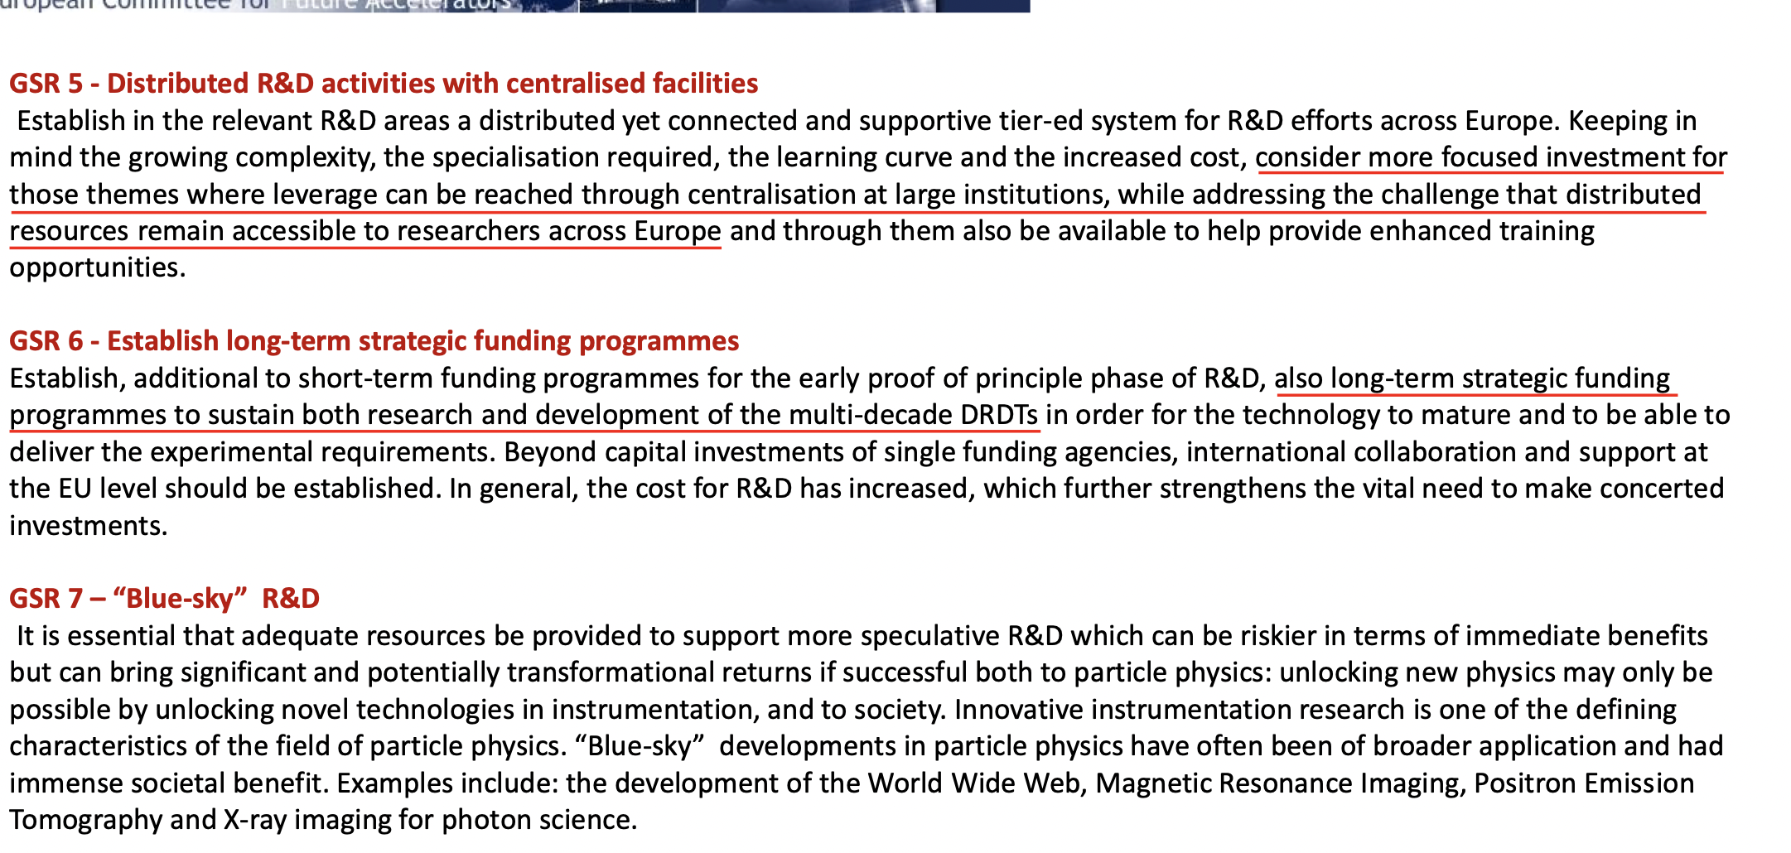
ECFA Detector R&D roadmap recommendations
11

Slide 24
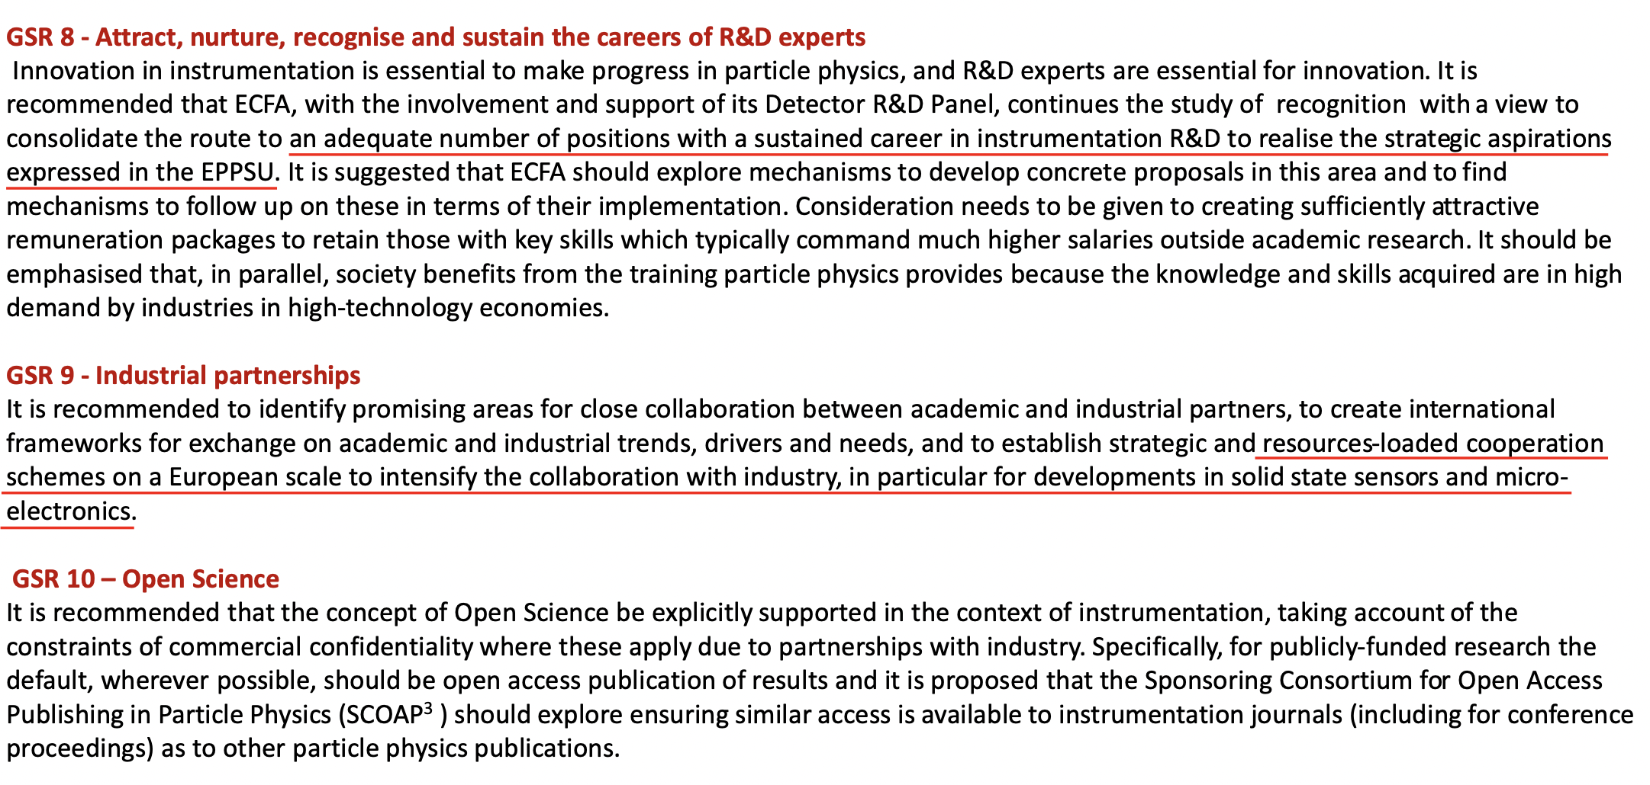
ECFA Detector R&D roadmap recommendations
11

Slide 25
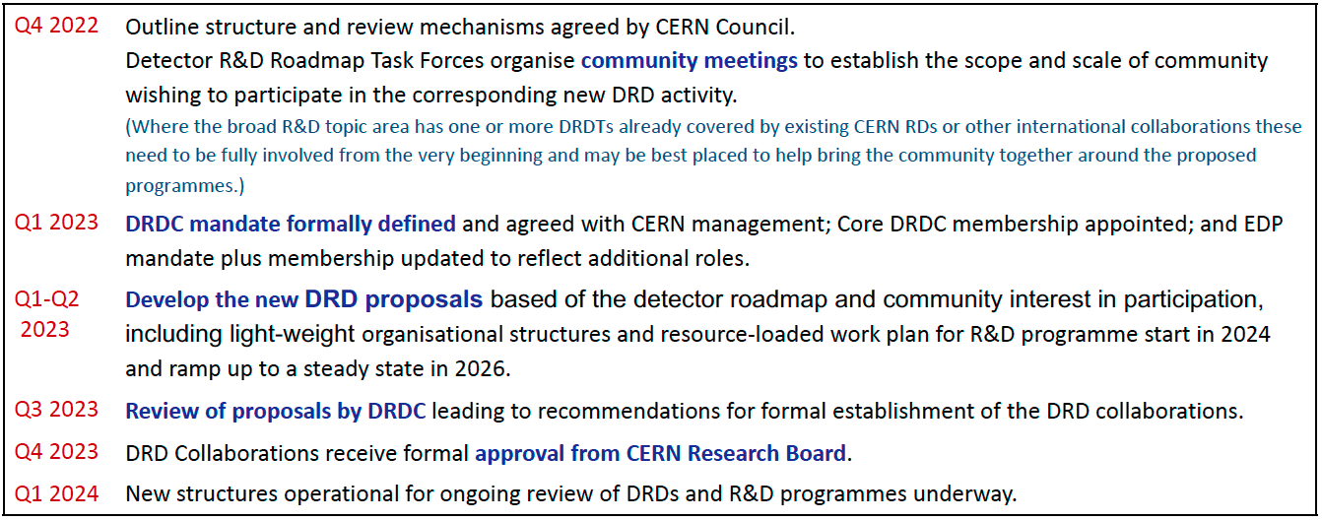
Overall process and timeline to form the DRD collaborations*
7
* Presentation of K. Jakobs at the SPSC on Sept. 27, 2022 (private communication)

Slide 26
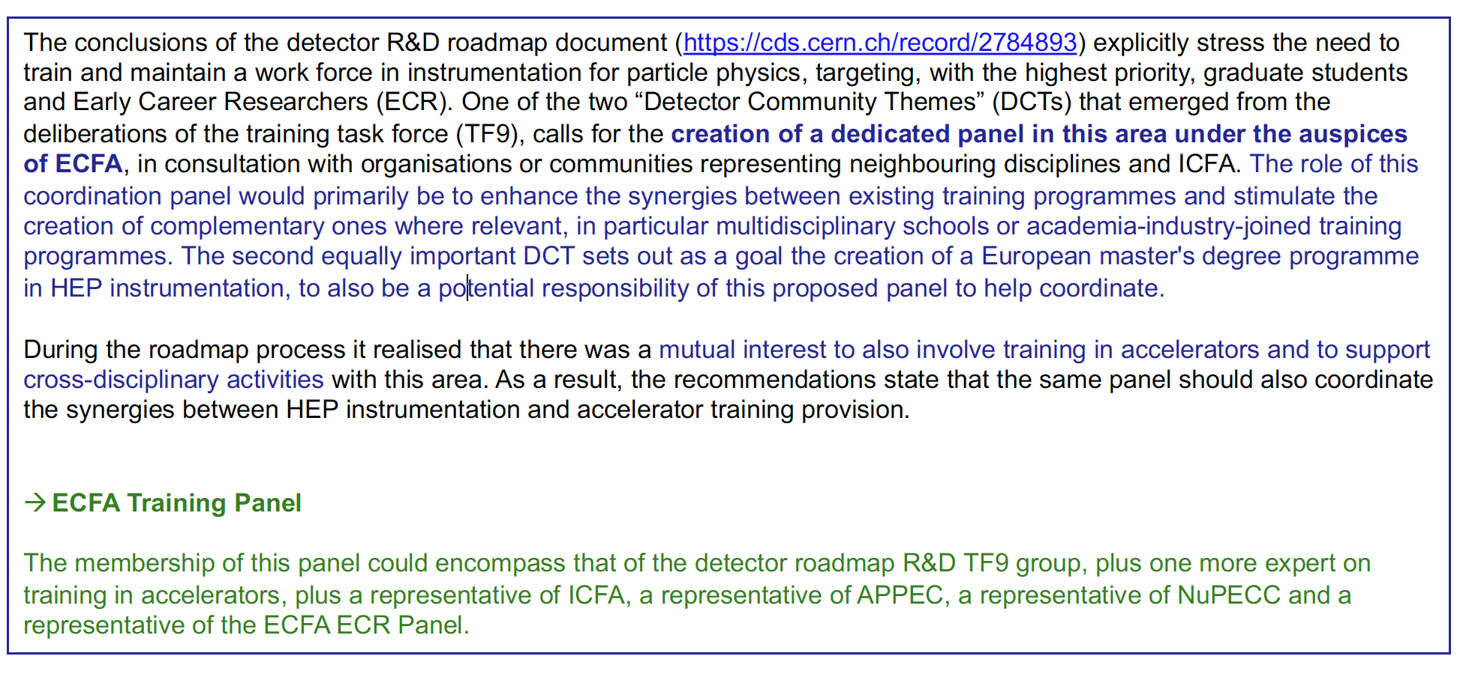
Plans for training (TF9)
* Presentation of K. Jakobs (ECFA Chair) at the SPSC on Sept. 27, 2022 (private communication)
12

Slide 27
Further references
DOE Basic Research Needs Study on High Energy Physics
CERN EP R&D program
AIDAINNOVA European Program (linking research infrastructures in detector development and testing)
Attract European Program (linking to industry on detection and imaging technologies)
ECFA EDP documents (input to ESPP, community survey…)
12

