Slide 1
Optical readout for gazeous detectors
Antoine Cools
Outline
Scintillation study and optical readout
Applications
Glass Micromegas

Slide 2
Outline
Scintillation study and optical readout
Optical readout overview
Argon/CF4 scintillation
Readout
Applications
Glass Micromegas

Slide 3
Optical readout overview
Gazeous detector
Large dimensions (several m²)
Not expensive
Radiation hard (10s year of LHC)
Compatible with magnetic field
Gas active medium low density
Optical readout
Use of camera (high granularity, large number of pixels, use of lens for large field of view)
Easy handling of the data (light intensity matrix)
Real-time imaging thanks to very low data processing and light integration approach

Slide 4
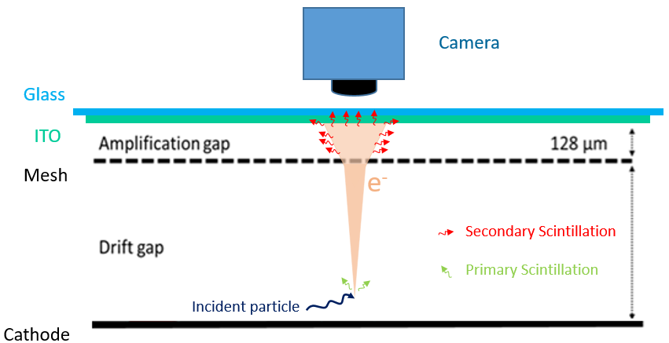
Optical readout overview

Slide 5
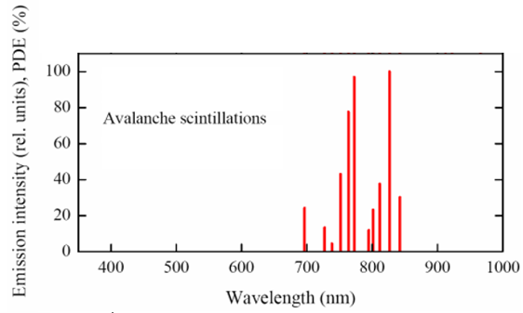
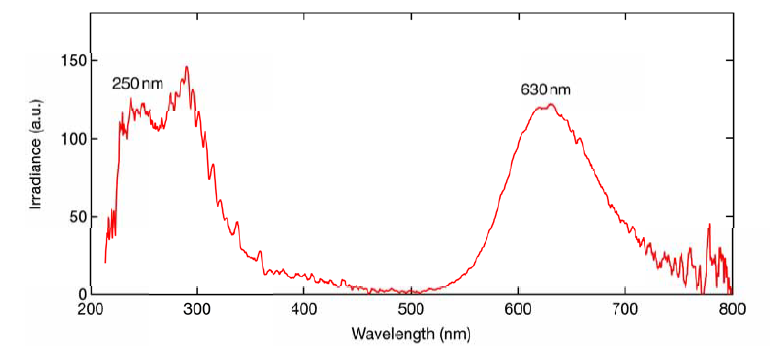
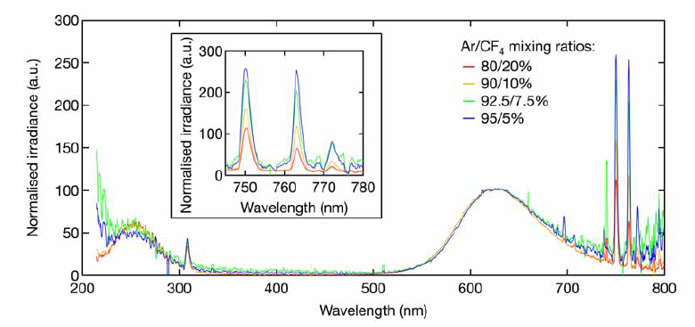
Argon/CF4 scintillation
Pure Ar
Pure CF4
F.M.F Fraga
F.M. Brunbauer

Slide 6
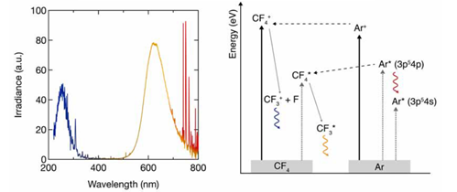
Argon/CF4 scintillation
F.M. Brunbauer
VIS : Electron impact : excited CF4* dissociates to CF3* which emits in VIS.
Dissociation of CF4* is not the only way to get CF3* :
Charge transfer processes : ionised Ar⁺ contributes to production of CF4⁺ towards CF3* production.
Ar + CF₄ → CF₃⁺ + F + Ar

Slide 7
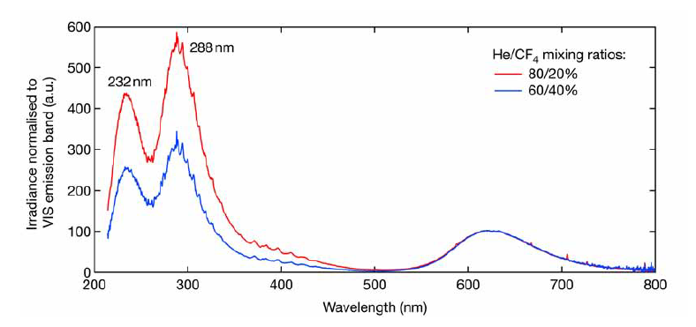
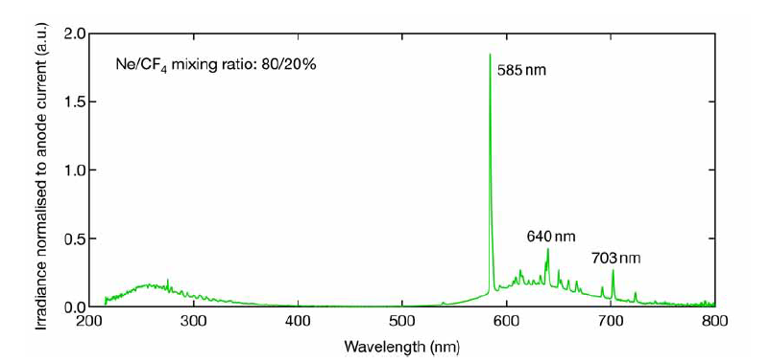
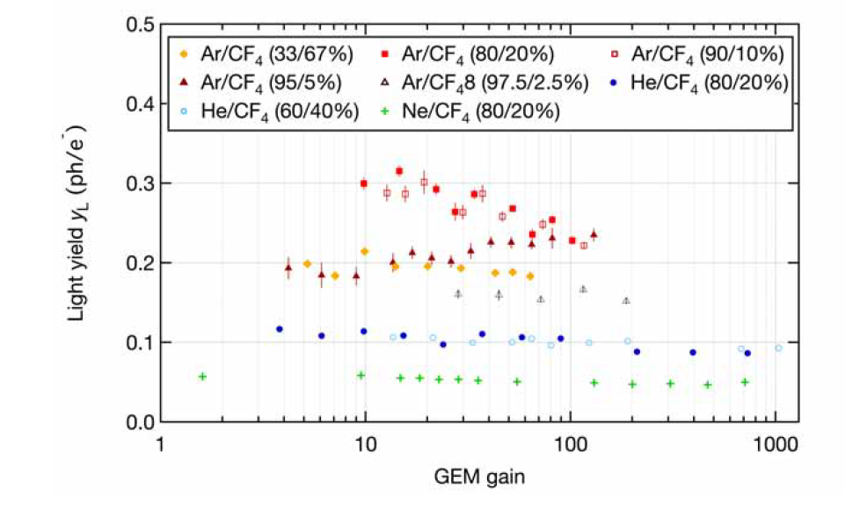
Other scintillating gas mixtures
F.M. Brunbauer
Light yield

Slide 8
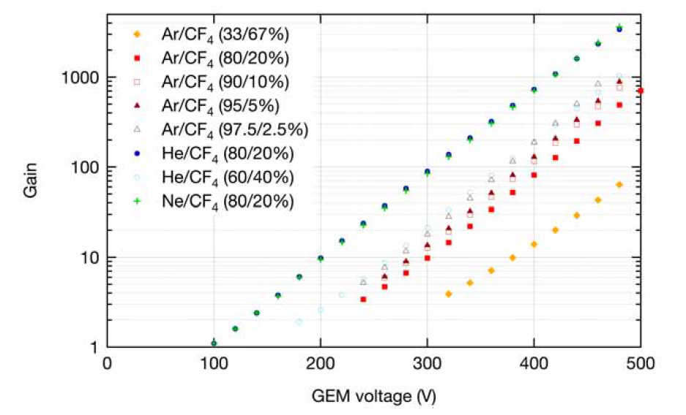
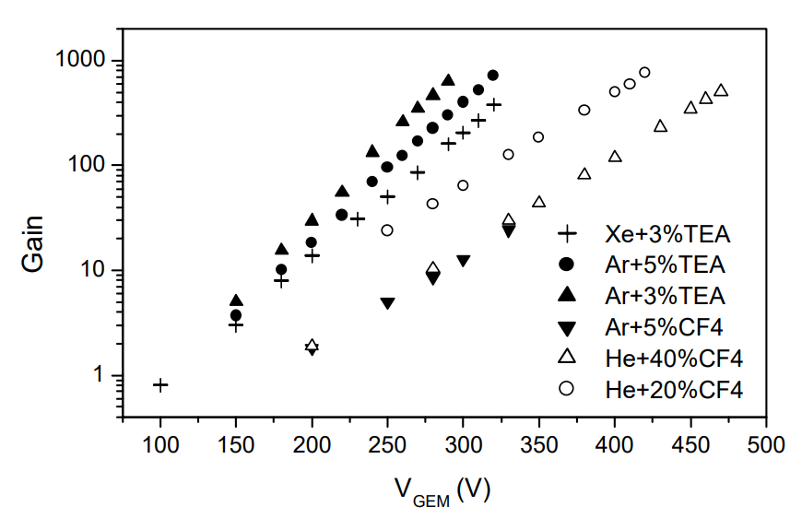
Gain
F.M. Brunbauer
F.M.F Fraga

Slide 9
Readout
PMT : High gain, fast response.
EMCCD (Electron Multiplying CCD) camera :
- High signal-to-noise ratio in low-light conditions
- Charge multiplication through impact ionisation
- Limited image resolution due to smaller pixels
CCD (Charges-Coupled Devices) camera :
- Large number of pixels
- Significant readout time (tens of Hz)
CMOS (Complementary Metal-Oxyde semiconductors) :
Very low noise : each pixel has a photosensitive region and an active amplifier.
- Shorter readout time
- Lower manufacturing cost than CDD sensors
- Rolling shutter effect : pixels are exposed alternatively

Slide 10
Readout
Hamamatsu CMOS camera
Readout noise
Pixels
Number Size
4096 x 2304 4.6 µm x 4.6 µm
Minimum exposure time
Mode Rate
Standard 1 µs/frame
Ultra quiet 200 ms/frame
Dark current
Cooling Sensor temperature Dark current
Air - 20 °C 0.016 e⁻ /pixels/s

Slide 11
Outline
Scintillation study and optical readout
Applications
Timeline
Optical GEMs
Optical TPCs
Glass Micromegas

Slide 12
Timeline
GEM scintillation with CF4
Light emission with TEA and TMEA
Dose imager for radiotherapy
Glass Micromegas
GEM invention
Optical TPCs
1990
2000
2010
2020
MICROMEGAS invention
Neutron imaging (He converter, low pressure)
Dark matter experiment OTPCs
Pressure and gain effect on light yield

Slide 13
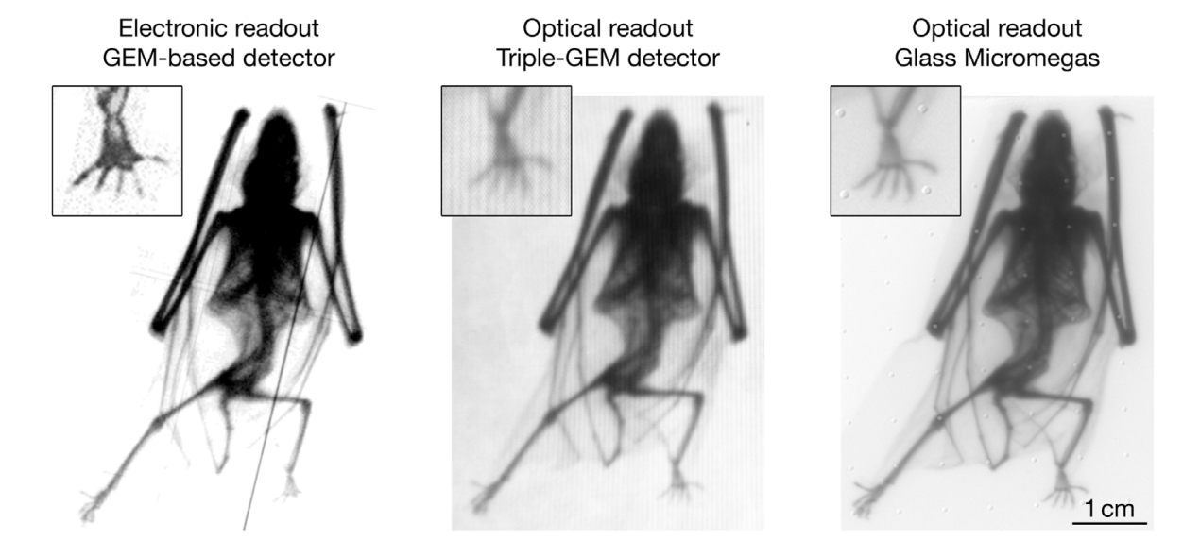
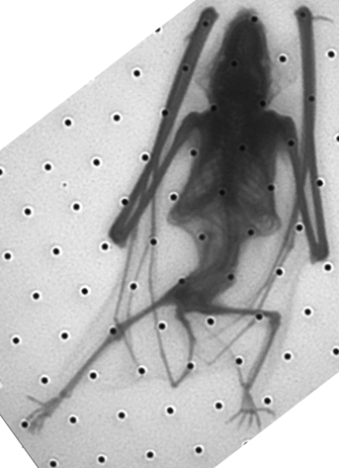
Radiography X
History of imaging with MPGDs
Glass Micromegas, Optical readout, deconvolution
https://doi.org/10.1016/j.nima.2019.163320

Slide 14
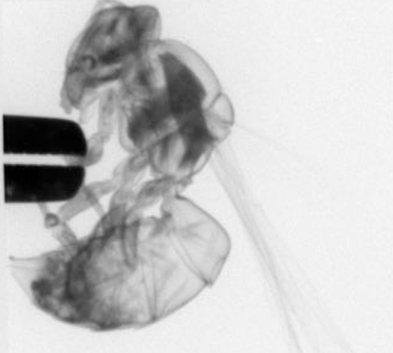
Optical GEM - Radiography X
10 Hz
σ = 351± 20 µm
F.M. Brunbauer
2018
σ = 280 µm
F. Takeshi
2019

Slide 15
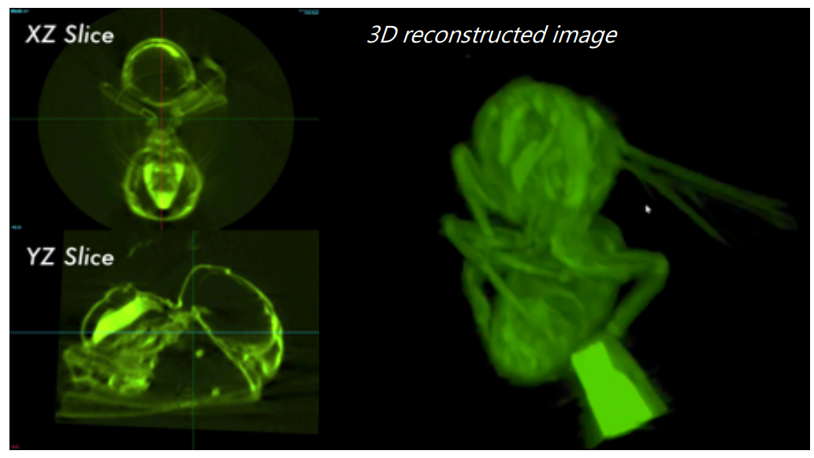
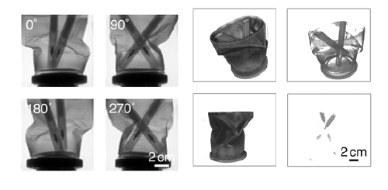
Optical GEM - Tomography X
F.M. Brunbauer
F. Takeshi
2019

Slide 16
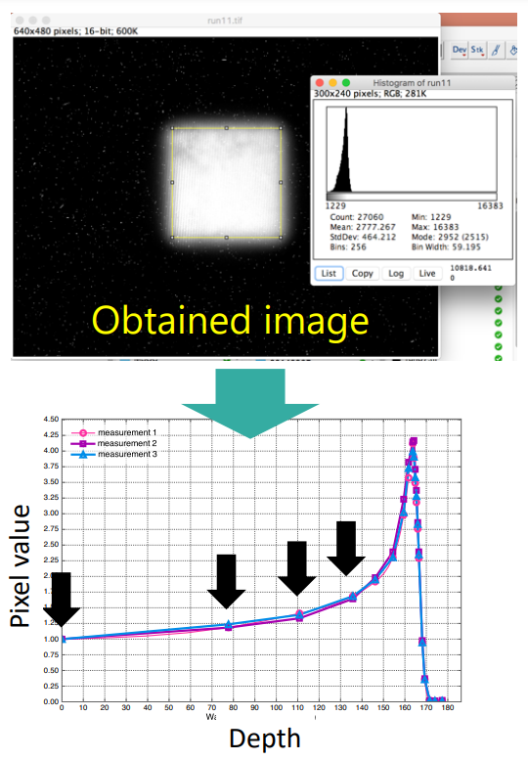
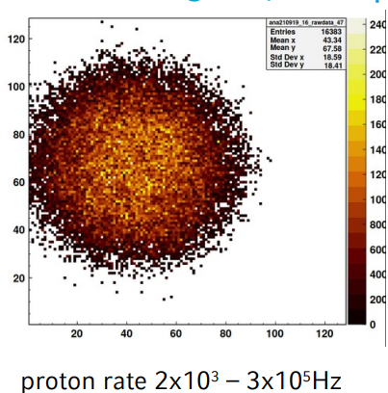
Dose imager for radiotherapy
Proton beam monitoring
F. Takeshi
J. Borteldt
2019
2020

Slide 17
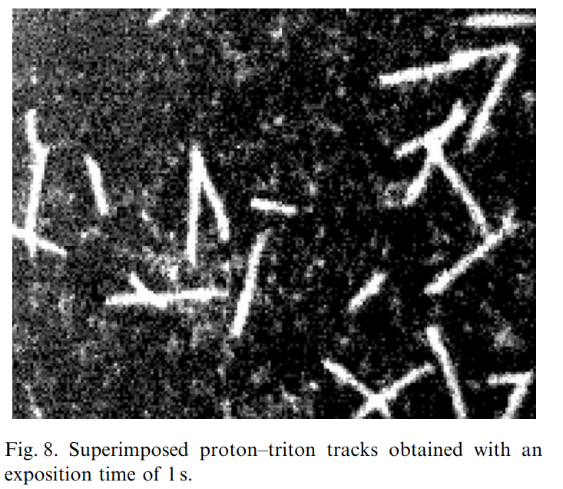
Optical TPC - 2D scintillation detector for thermal neutrons
F.M.F Fraga
2002

Slide 18
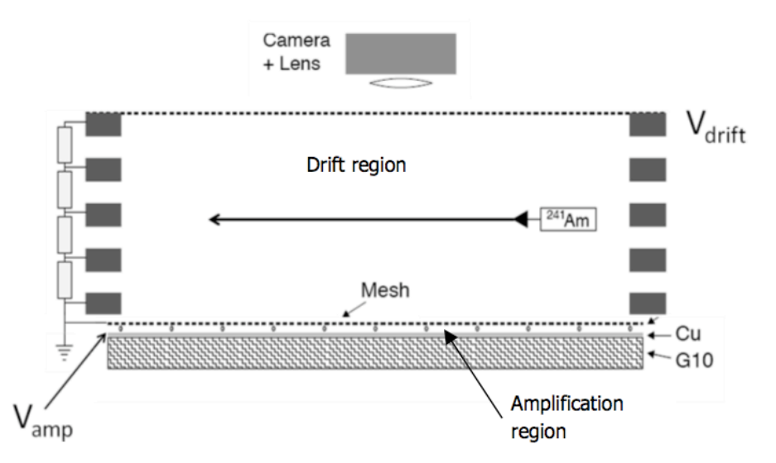
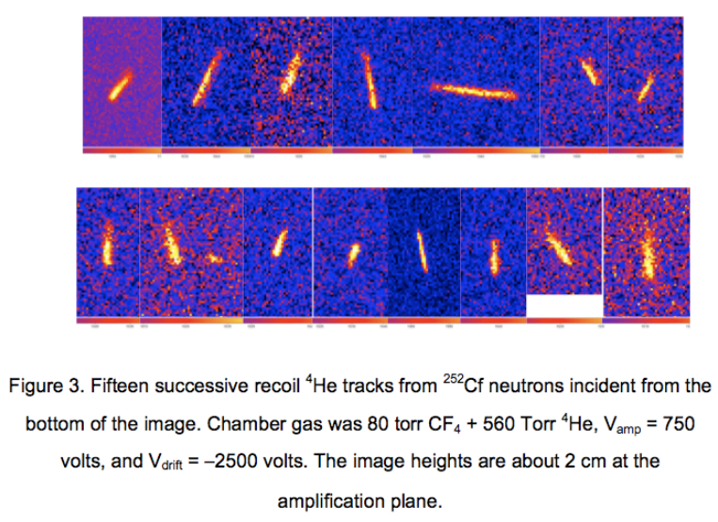
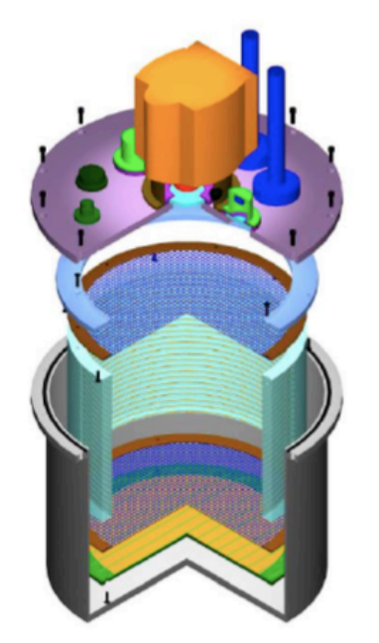
Optical TPC - 2D scintillation detector for thermal neutrons
20 cm
A. Roccaro
2009

Slide 19
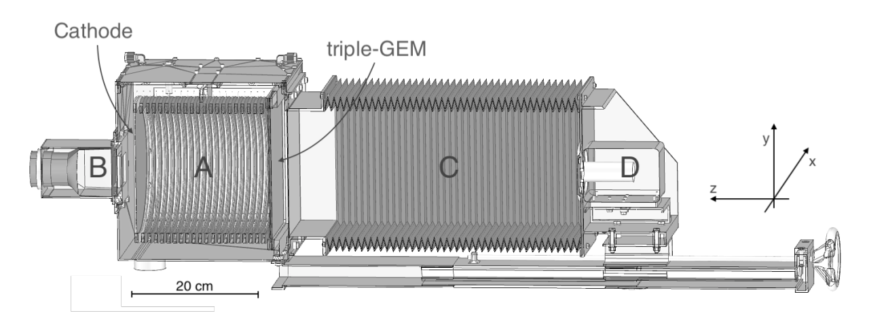
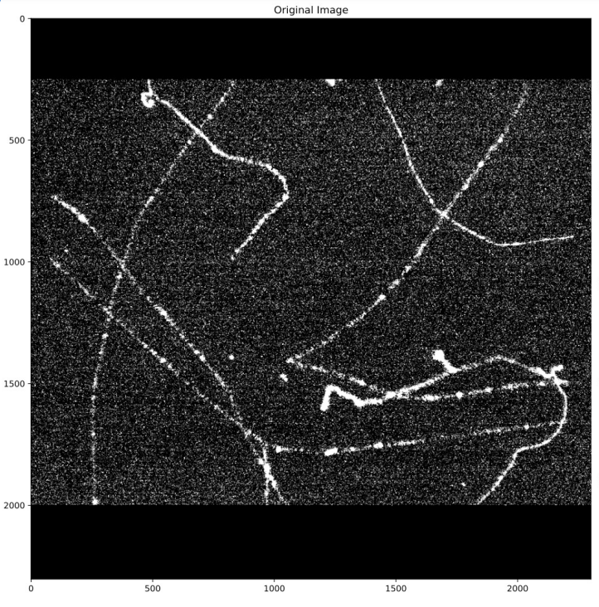
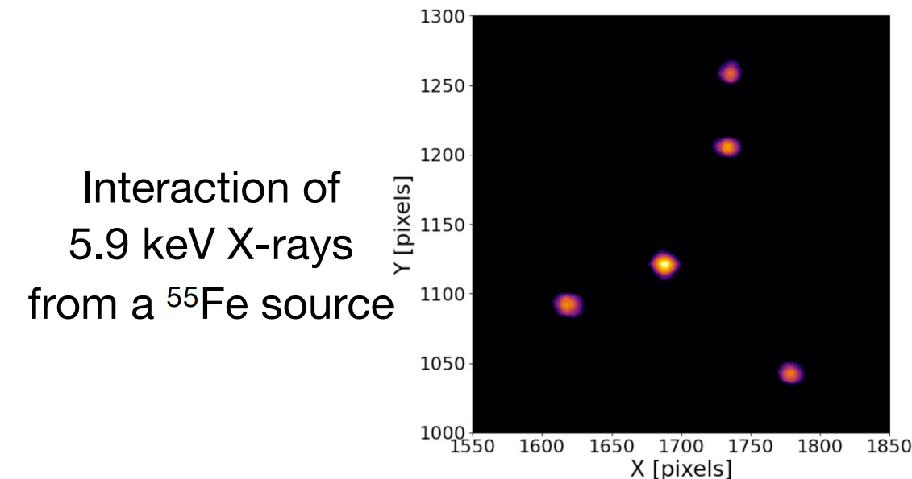
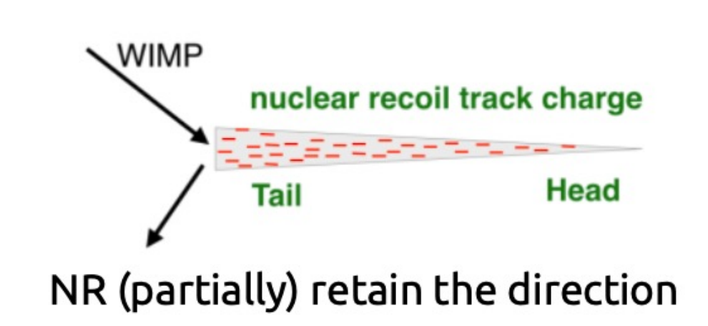
Optical TPC
CYGNO experiment
Camera
PMT
Drift gap
He + CF₄
F. Petrucci
MPGD conference 2022

Slide 20
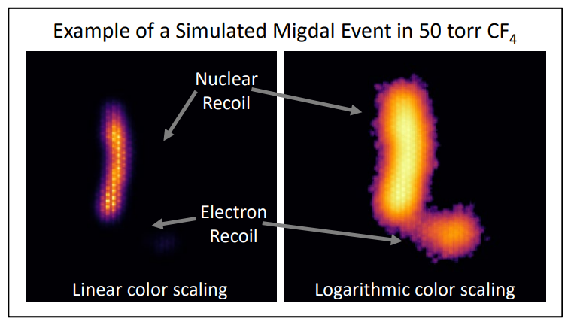
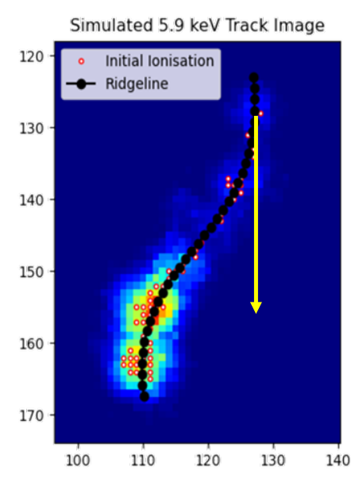
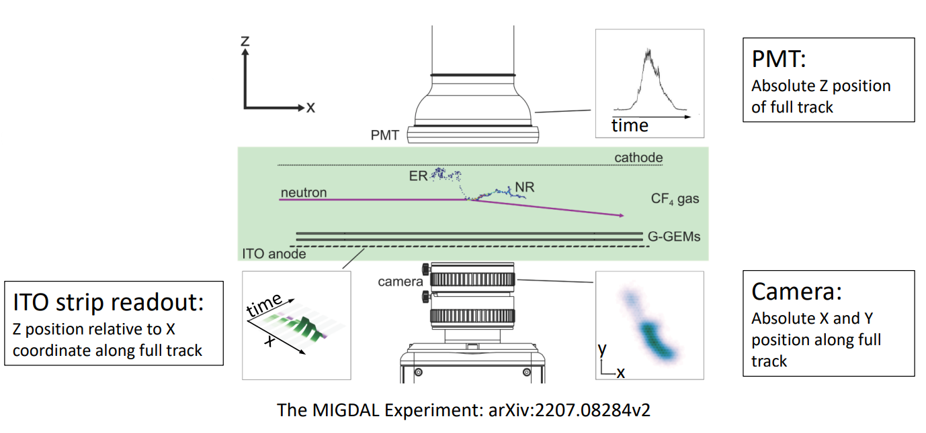
Optical TPC
Migdal experiment
Ar + CF₄
E. Tilly, MPGD conference 2022

Slide 21
Outline
Scintillation study and optical readout
Applications
Glass Micromegas
X-ray characterization
Activity measurement on tritiated cells
Neutron imaging

Slide 22
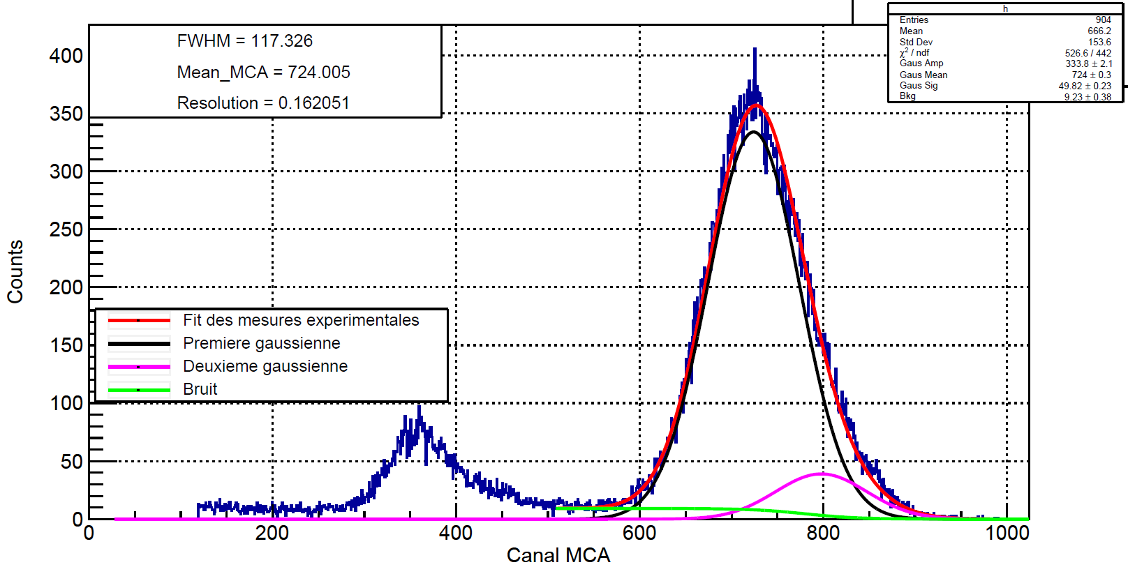
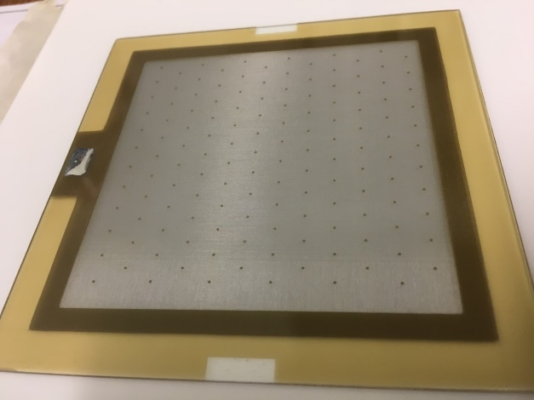
X-ray characterization
Performance of Micromegas on glass
Charge readout test in Argon+5%Iso:
- gain above 10⁴
- energy resolution (FWHM) reaches 16%
⁵⁵Fe energy spectrum – 5.9 keV
Coated glass with 150 nm of ITO (Indium Thin Oxide)
S. Aune, T. Benoit, M. Kebbiri
6 mm
Glass Micromegas
https://doi.org/10.1016/j.nima.2022.167910

Slide 23
X-ray characterization
X-ray radiography (20 kV) – Ar/CF₄(20%), CERN GDD
High gain: 1 min exposure time gives images with good contrast
6 mm
60 s exposure time bat radiography with simple background suppression and beam profile correction.
60 s full detector image with simple background suppression.

Slide 24
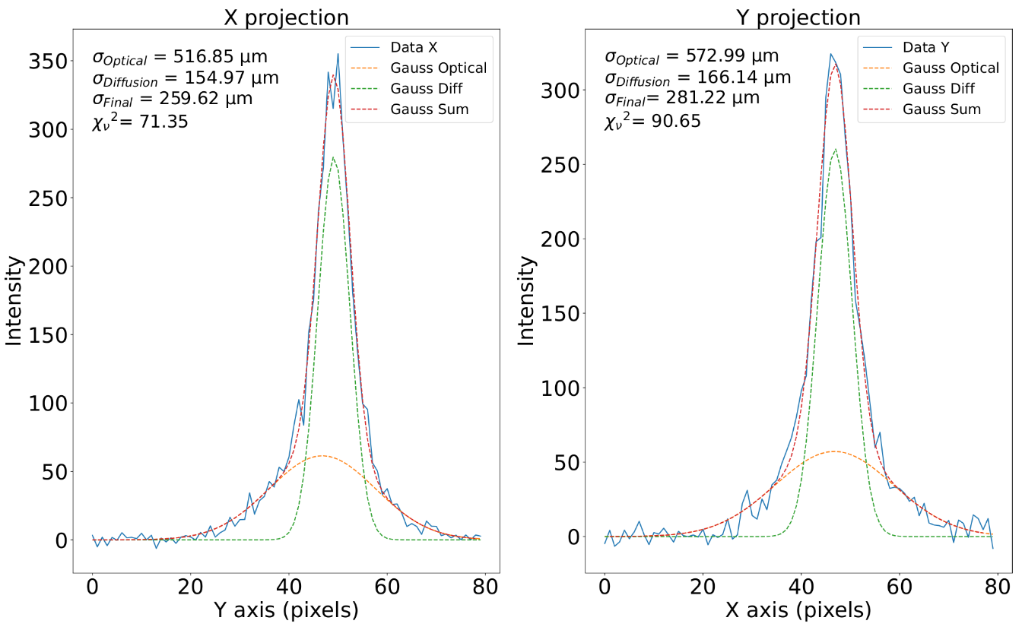
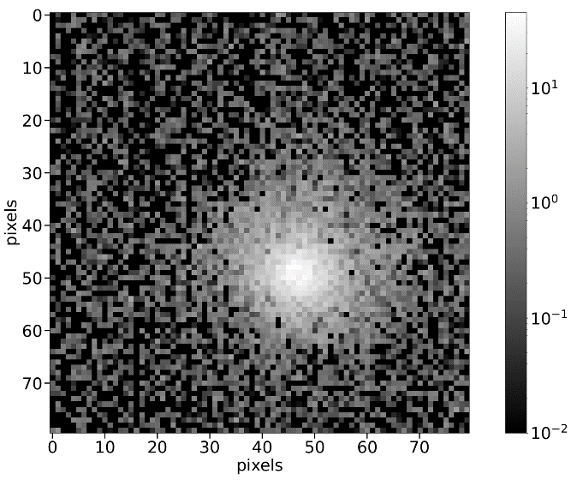
Soleil synchrotron
X-ray beam - 6keV - 50x50 µm
Goals
Measurement of Point Spread Function (PSF)
Spreading origins : diffusion and optics
https://doi.org/10.48550/arXiv.2303.17444
30 x 30 µm beam, Amplification
(Va=400 V, Vd=210 V)

Slide 25
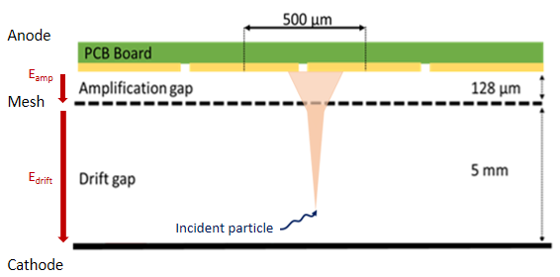
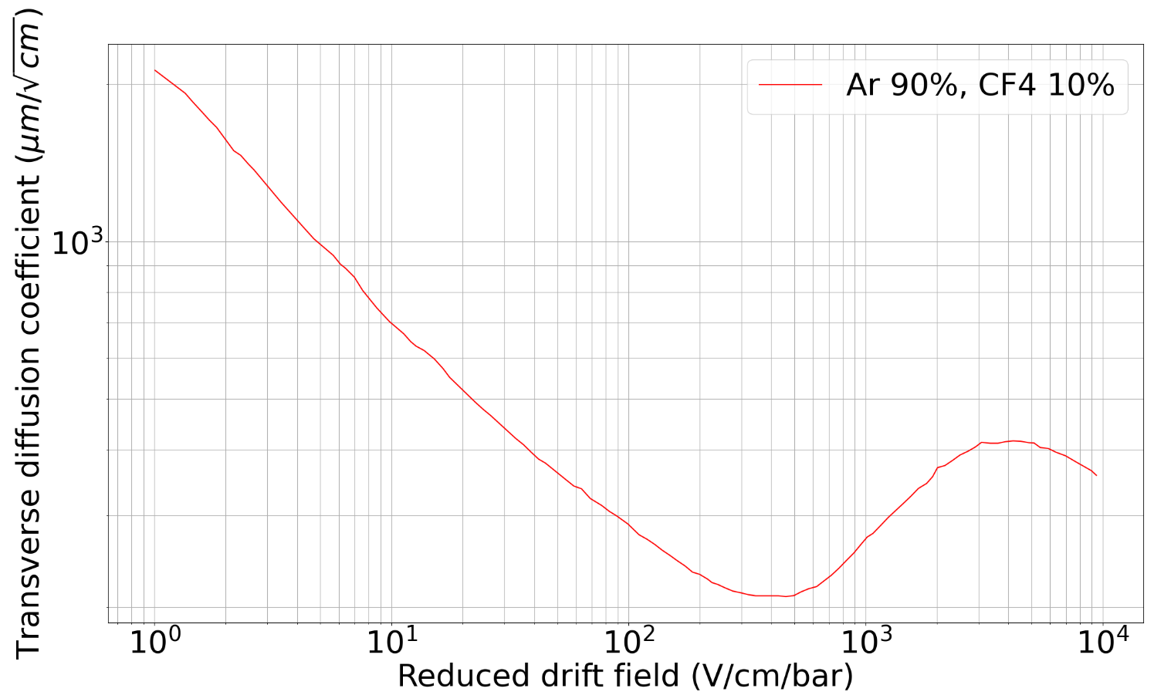
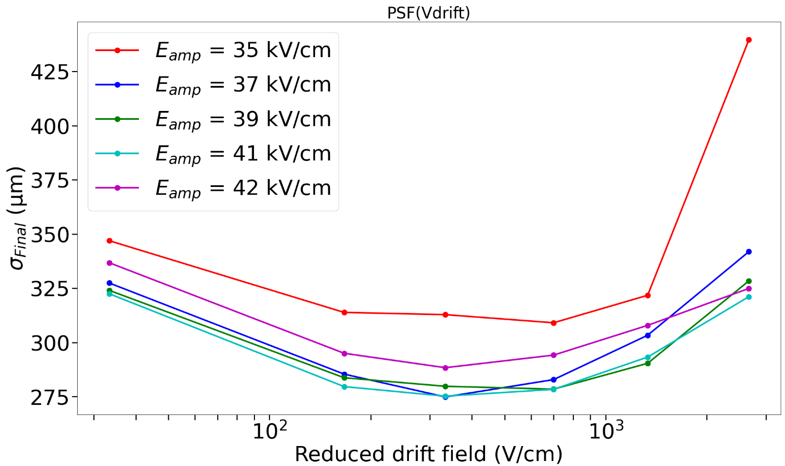
Soleil synchrotron
Diffusion
Signal spreading dependence on electric fields
σ = 280 µm
12/07/2023
GDR DI2I - Subatech
25

Slide 26
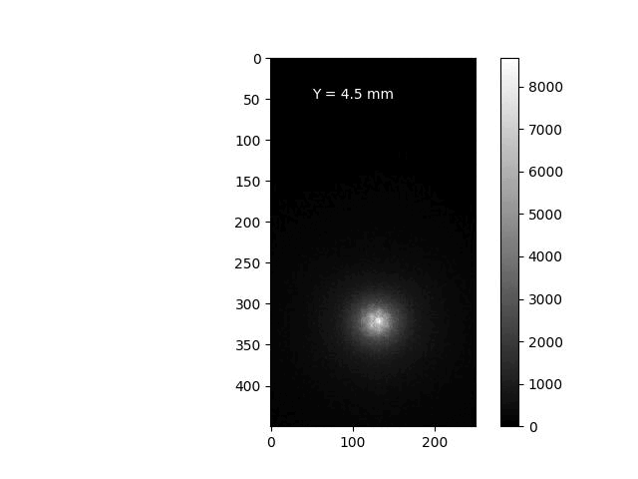
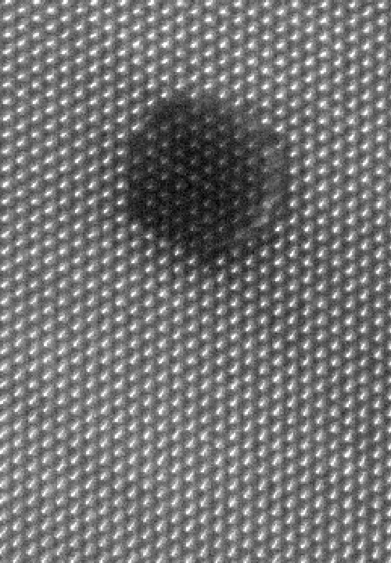
Soleil synchrotron
Goals
Micromegas mesh and pillar study
Glass Micromegas Beta mesh (Ambient light picture)
Glass Micromegas hexagonal mesh (50x50 µm x-ray beam)

Slide 27
Soleil synchrotron
Deconvolution
PSF
MTF : 800 µm
MTF : 281 µm

Slide 28
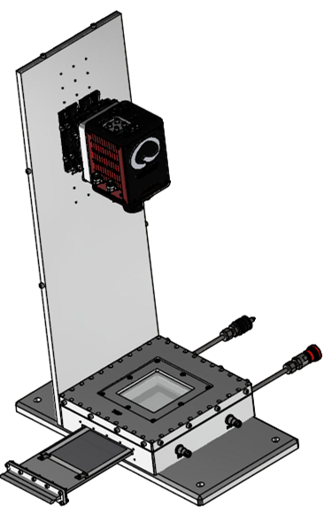
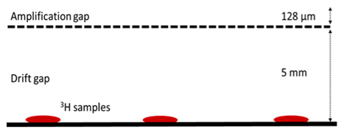
Activity measurement on tritiated cells
First deposit : tritiated glucose
Camera
Light cover
Glass
VIS light
ITO
Mesh
e⁻
β
Cathode
OPTIMED-BETA set-up scheme
Tritium deposits schema and picture
https://doi.org/10.1016/j.nima.2022.167910
Drug concentration ↔ sample activity (Bq)
Activity measurement limits and dynamic range → Activities: 0.1 Bq, 1 Bq and 10 Bq
12/07/2023
GDR DI2I - Subatech
28

Slide 29
Activity measurement on tritiated cells
Integration method :
Light intensity profile
All drops positions are well assessed
0.1 Bq drops are close to the background noise
Activity measurement (Bq) INTEGRATION
Reference | 0.09 | 1.76 | 9.8
Average | 0.086 | 0.84 | 11.74
σ | 0.026 | 0.18 | 1.28
Matching | 95% | 47% | 83%
*
12/07/2023
GDR DI2I - Subatech
720 frames of 5 s (60 min) added with simple background suppression - 20% of CF4
29

Slide 30
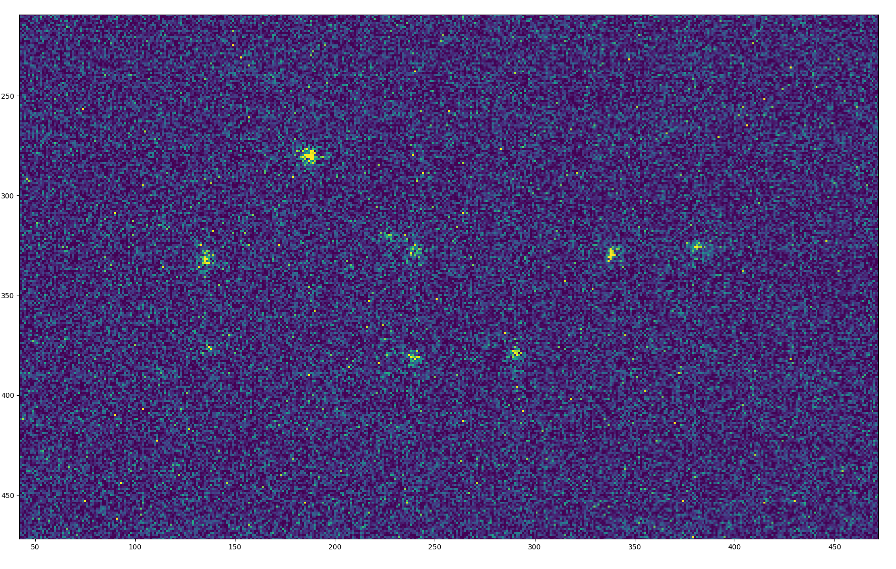
Activity measurement on tritiated cells
Clustering method :
200 ms frame with single beta events
12/07/2023
GDR DI2I - Subatech
30

Slide 31
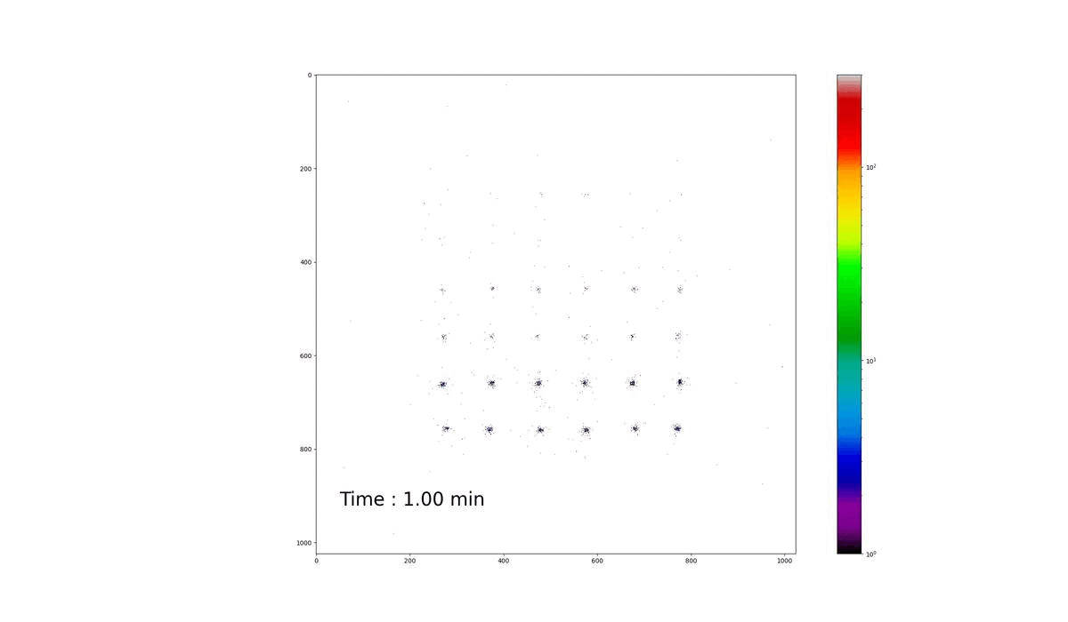
Activity measurement on tritiated cells
Clustering method :
Activity measurement (Bq) CLUSTERING
Reference | 0.09 | 1.76 | 9.8
Measurement | 0.108 | 0.85 | 5.13
σ | 0.014 | 0.088 | 0.38
Matching | 83% | 48% | 52%
12/07/2023
GDR DI2I - Subatech
31

Slide 32
Neutron imaging
Cathode : ¹⁰B₄C neutron-to-charge converter
Thermal neutrons absorbed by 2 µm thin ¹⁰B₄C layer
Conversion efficiency: 5%
(α or Li) fragments cause strong ionisation
Drawback: fragments long range in the gas (5 mm)
Acquisition modes:
Event-by-event: track reconstruction:
Potentially higher resolution (100 µm), better ɣ-to-n suppression
Integrated: real-time radiography:
Almost no data computation
12/07/2023
GDR DI2I - Subatech
32

Slide 33
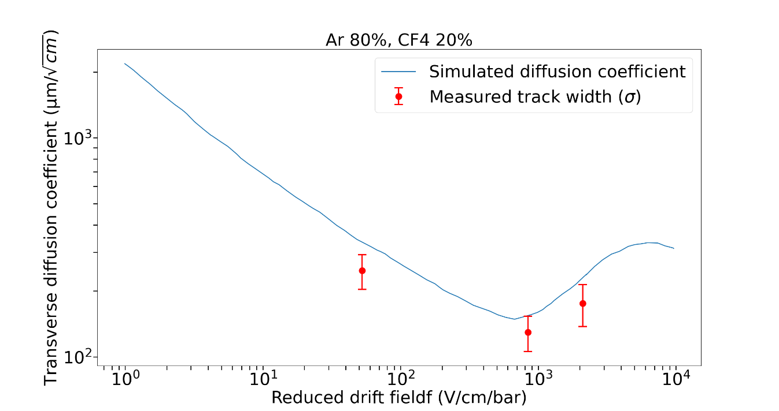
Neutron imaging
Neutron source (3 events/s on detector)
50 V/cm drift field
800 V/cm drift field
2000 V/cm drift field
Drift field affects the diffusion in the gas
Diffusion spreads the light
50 V/cm
2000 V/cm
800 V/cm
12/07/2023
GDR DI2I - Subatech
33
33

Slide 34
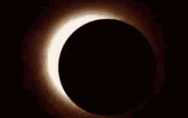
THANK YOU
A. Cools , S. Aune , F. Beau , F.M. Brunbauer , T. Benoit , E. Ferrer-Ribas , C. Malgorn , E. Oliveri , T. Papaevangelou , E.C. Pollacco , L. Ropelewski , A. Sari , F.J. Iguaz

Slide 35
BACK UP

Slide 36
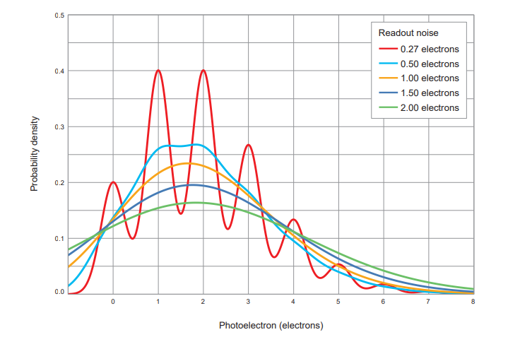
LIGHT DETECTION DEVICES
Hamamatsu CMOS camera
Readout noise
Photon number resolving
Pixels
Number Size
4096 x 2304 4.6 µm x 4.6 µm
Dark current
Cooling Sensor temperature Dark current
Air - 20 °C 0.016 e⁻ /pixels/s
Minimum exposure time
Mode Rate
Standard 1 µs/frame
Ultra quiet 100 ms/frame

Slide 37
Molecule labelling and tracking with tritium
Tumor heterogeneity: different cell types inside a tumor
Heterogeneity effect on drug targeting?
Develop more efficient drugs
Requires better detection sensibilities
Pharmaceutical needs at the cell level for drug development:
Assess the drug distribution among cells
At the cell level: Quantification of ³H concentration in single cell samples
37

Slide 38
LIGHT DETECTION
38

Slide 39
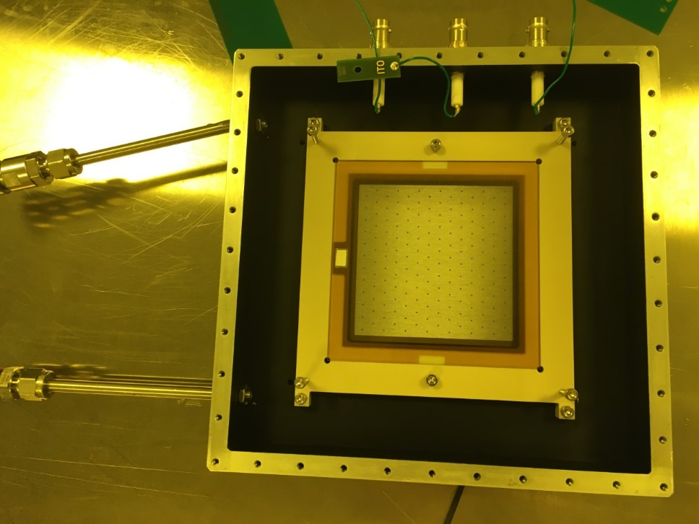
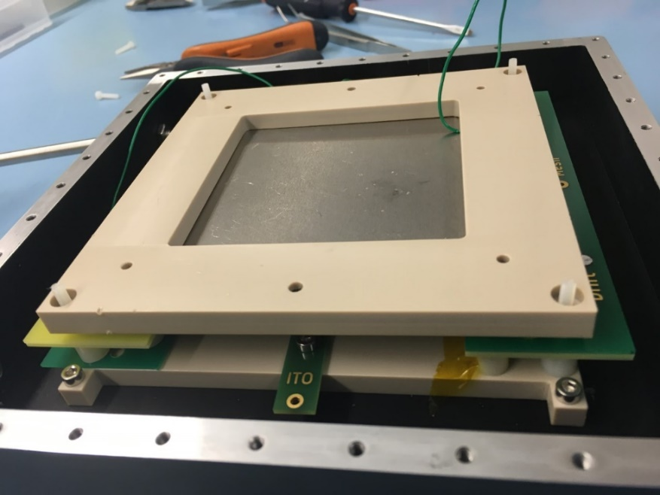
Neutron imaging
Experimental set-up
Camera
Light cover
Glass
VIS light
ITO
Mesh
e⁻
10 mm
Cathode
α & ⁷Li
B₄C
Slow neutron
Neutron source
OMNIS set-up schema
12/07/2023
GDR DI2I - Subatech
39

Slide 40
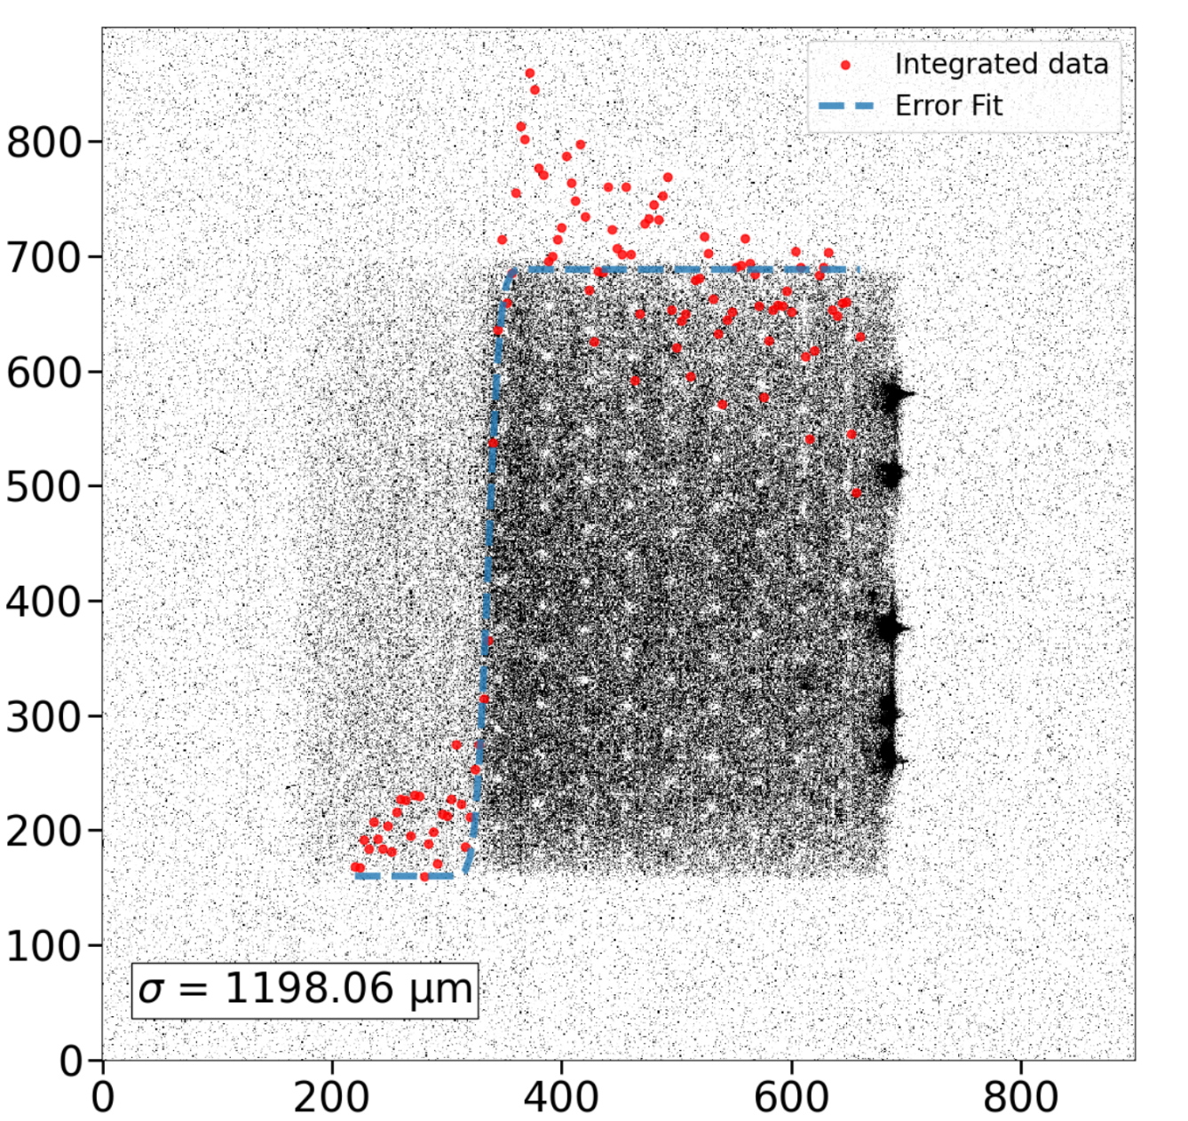
Neutron imaging
Neutron source (10 events/s on detector)
10 mm drift gap
250 µm drift gap
12/07/2023
GDR DI2I - Subatech
40

Slide 41
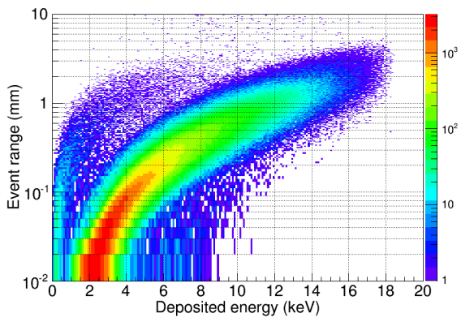
PRELIMINARY RESULTS WITH TRITIUM SAMPLES
β particle range in Ar-Isobutane gas mixture

Slide 42
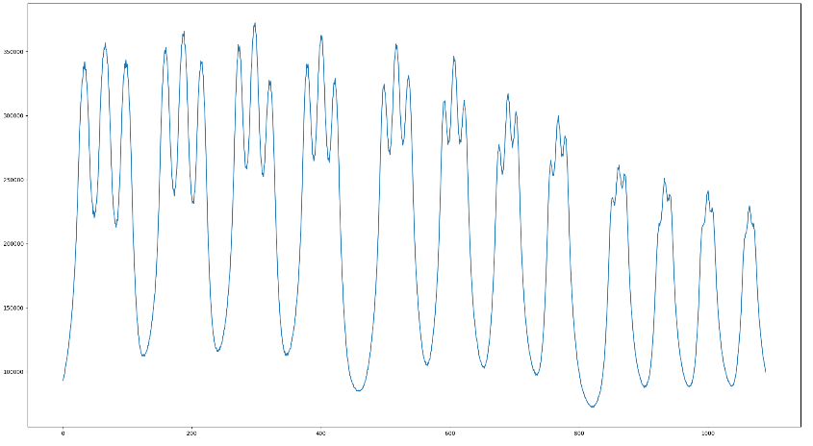
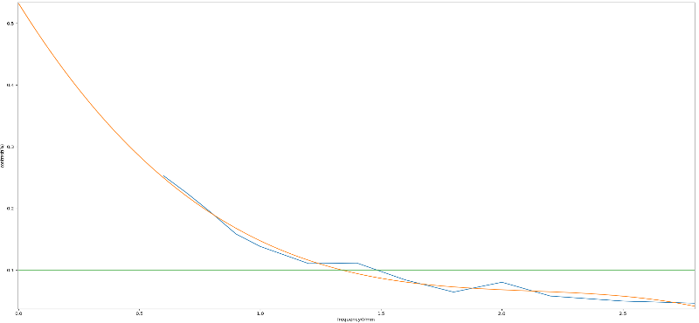
DETECTOR CHARACTERIZATION WITH X-RAYS
X-ray radiography
MTF measurement
60 sec exposure time lead target radiography with simple background suppression.

Slide 43
Beta spectrum : CF4 Overall activity : 76 Bq

Slide 46
2D scintillation detector for thermal neutrons
³H + CF₄
A. Morozov

Slide 48
Soleil beam test (June 2023)
Lens effects
Optical GEM and wavelength shifter
Beam collimator
Optical GEM
CMOS camera
Wavelength shifter GEM (pure Ar)
48

Slide 50
Production
Gain uniformity check
Production at CEA Bulk Lab
Light intensity
T. Benoit
Planarity check : Laser diffraction measurement
Vertical scale x1000
M. Vandenbroucke
50

Slide 51
51

