Slide 1
Scaling Properties of φ-Meson and Light Charged Hadron Production in Small and Large Systems at PHENIX
Rachid Nouicer, for the PHENIX Collaboration Brookhaven National Laboratory

Slide 2
Outline
Few selected results:
PHENIX established a comprehensive physics program to study φ-meson and light charged hadron production in Small (pAl, pAu, dAu, ³HeAu), and Large (CuAu, AuAu, UU) systems:
Identified light charged hadrons production in small and large systems:
Freeze-out temperature, ratios, and nuclear modification factors
φ-Meson production in small and large systems:
nuclear modification factors, comparison to symmetric systems, and elliptic flow
Summary
Rachid Nouicer
2
SQM 2024

Slide 3
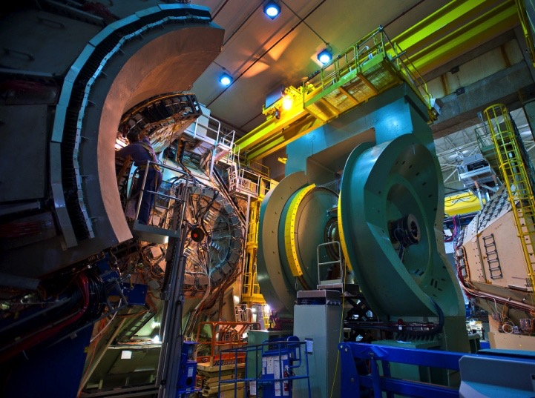
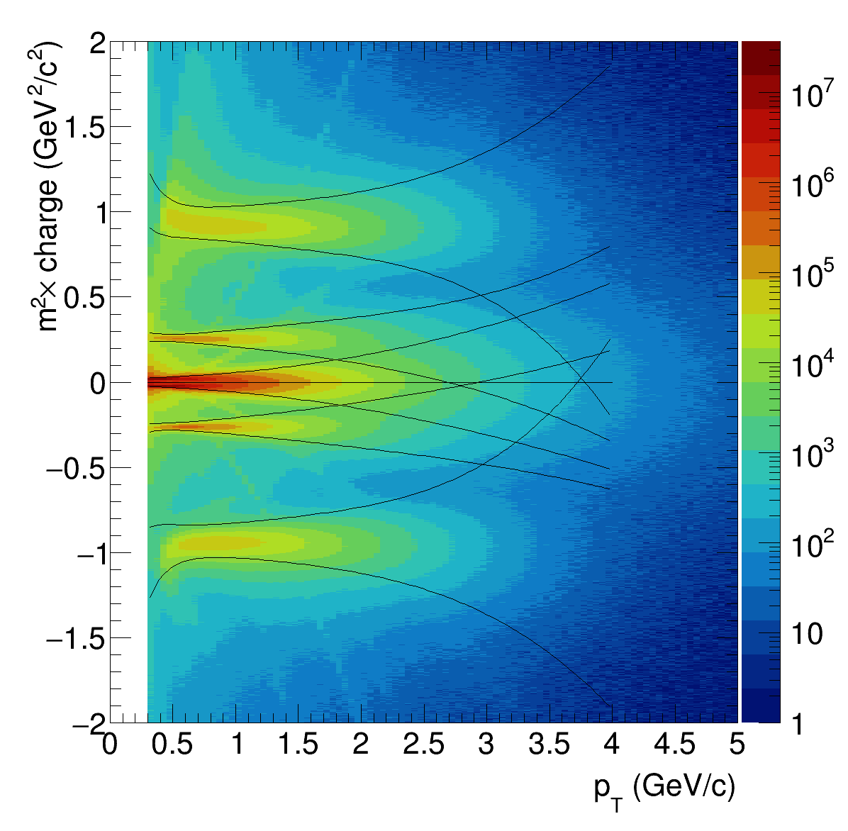
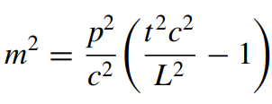
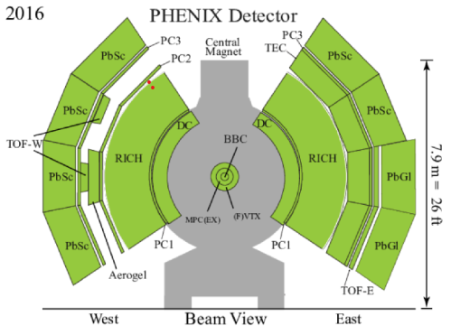
Charged Hadrons Identification in PHENIX
Charged hadrons are detected in the TOF and the DC. The squared mass of the tracks is determined by:
Run:1-16
p
PHENIX
K⁺
p: momentum (DC)
L: particle flight path length (vertex to TOF Det.)
t : time of flight measured in the TOF Det.
^{π+}
^{π-}
K⁻
p
Rachid Nouicer
3
SQM 2024

Slide 4
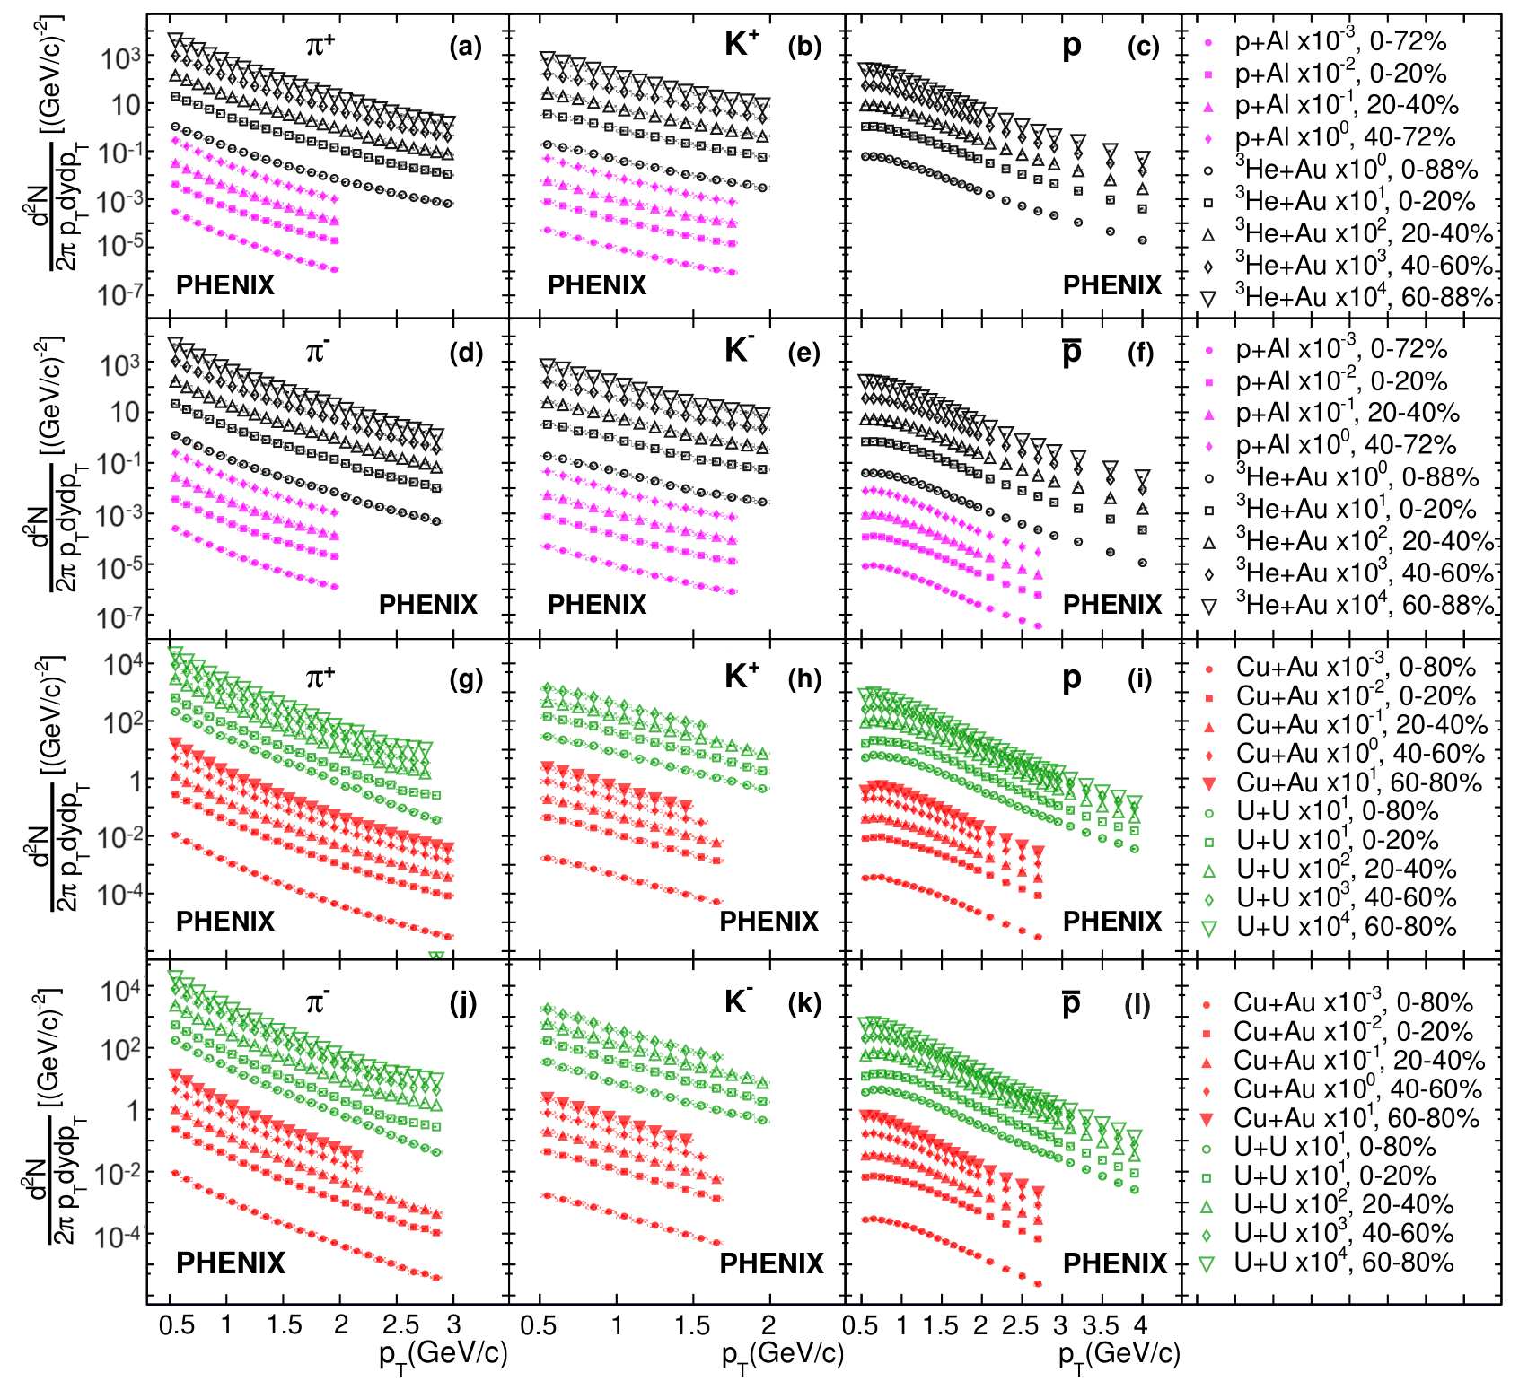
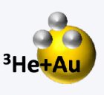
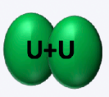
Invariant Transverse Momentum Spectra vs Centrality Classes
Heavy
p, K , and p invariant p_{T} spectra exhibit different shapes.
PRC 109, 054910 (2024)
Rachid Nouicer
4
SQM 2024

Slide 5
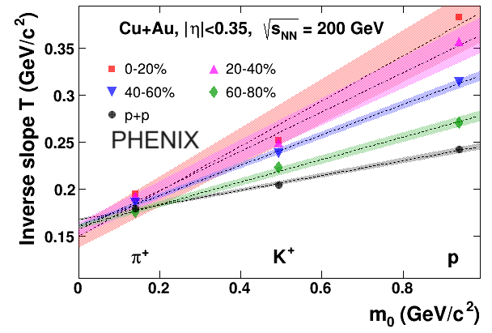
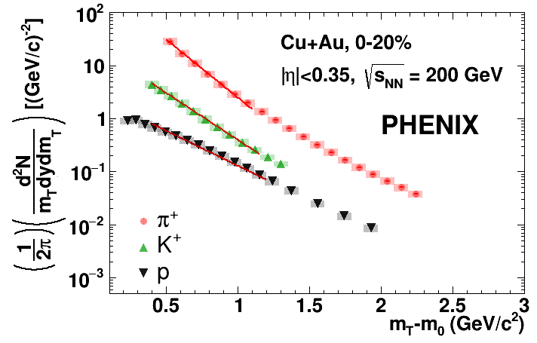
Transverse Mass Spectra
$$A=πr^{2}$$ g
π, K , and p spectra have different shapes
and in order to quantify these differences, we look at the transverse-mass spectra.
PRC 109, 054910 (2024)
Central
PRC 109, 054910 (2024)
Peripheral
p+p
The inverse slope parameter exhibits a dependence on the hadron mass!
Rachid Nouicer
5
SQM 2024

Slide 6
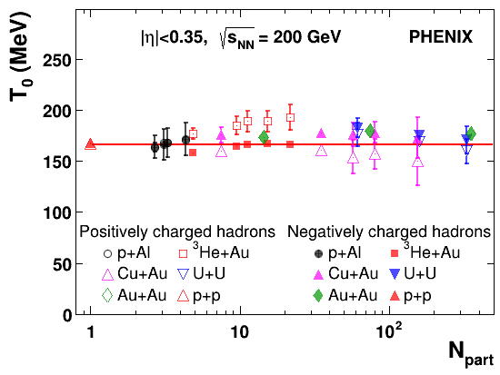
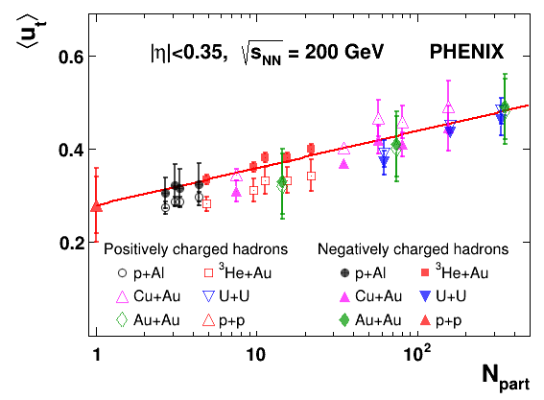
Freeze-out Temperature and Average Collective Velocity of all Particle Species
g
Can be interpreted as the freeze-out temperature
Average collective velocity for all particle species
PRC 109, 054910 (2024)
PRC 109, 054910 (2024)
The freeze-out temperature is approximately independent of centralities and collision system size within uncertainties!
Collective effects are more pronounced
in collisions characterized by large N_{part}
Rachid Nouicer
6
SQM 2024

Slide 7
p/π - Ratio in Small Collision Systems
Enhancement of baryon production in nucleus-nucleus collisions is considered
to be one of the signatures of QGP formation
Heavy
PRC 109, 054910 (2024)
In small collision systems (p+Al, ³He+Au), the values of p/π ratios in all centrality classes are similar to those measured in p+p collisions within uncertainties.
Rachid Nouicer
7
SQM 2024

Slide 8
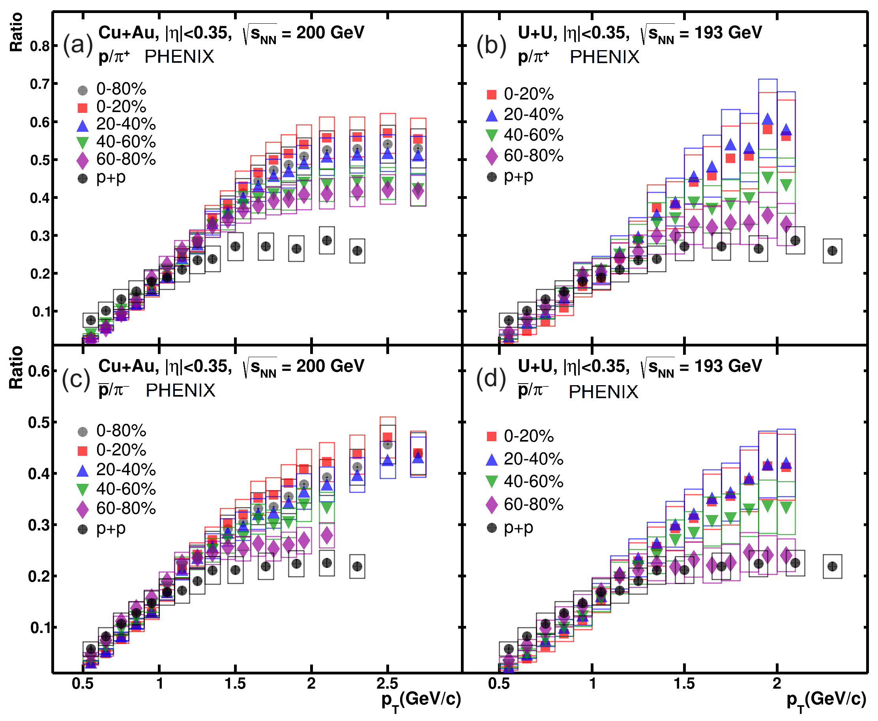
p/π - Ratio in Large Collision Systems
Enhancement of baryon production in nucleus-nucleus collisions is considered to be one of the signatures of QGP formation
In collision systems with large ⟨N_{part}⟩ values p/π ratios reach the values of ≈ 0.6, which is ≈2 times larger than (p/π) p+p.
PRC 109, 054910 (2024)
Rachid Nouicer
8
SQM 2024

Slide 9
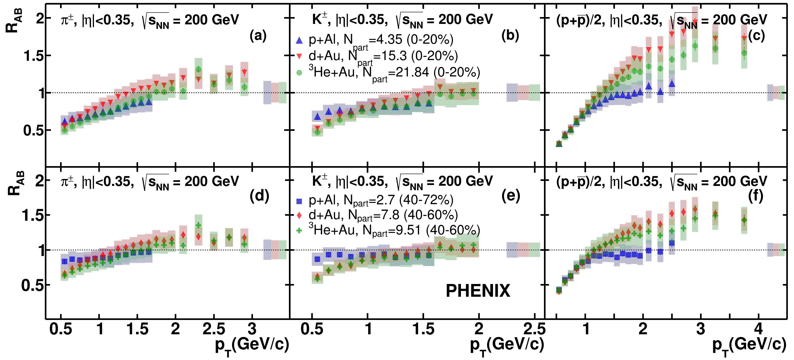
Nuclear Modification Factor in Small Collision Systems
Small Collision Systems
Comparisons of identified charged-hadron R_{AB} values as a function of p_{T} in central and peripheral
PRC 109, 054910 (2024)
Small systems
Central (0-20%)
Central (0-20%)
Central (0-20%)
R_{AB}(π, K) ~ 1
Peripheral collisions
Peripheral collisions
Peripheral collisions
Proton R_{AB} values in p+Al collisions at the intermediate p_{T} range (1.0 GeV/c < pT < 2.5 GeV/c) are equal to unity, while in d/³He+Au collisions proton R_{AB} is above unity → this difference btw p+Al and d/³He+Au might be caused by the size of the p+Al system being insufficient to observe an increase in proton production.
Rachid Nouicer
9
SQM 2024

Slide 10
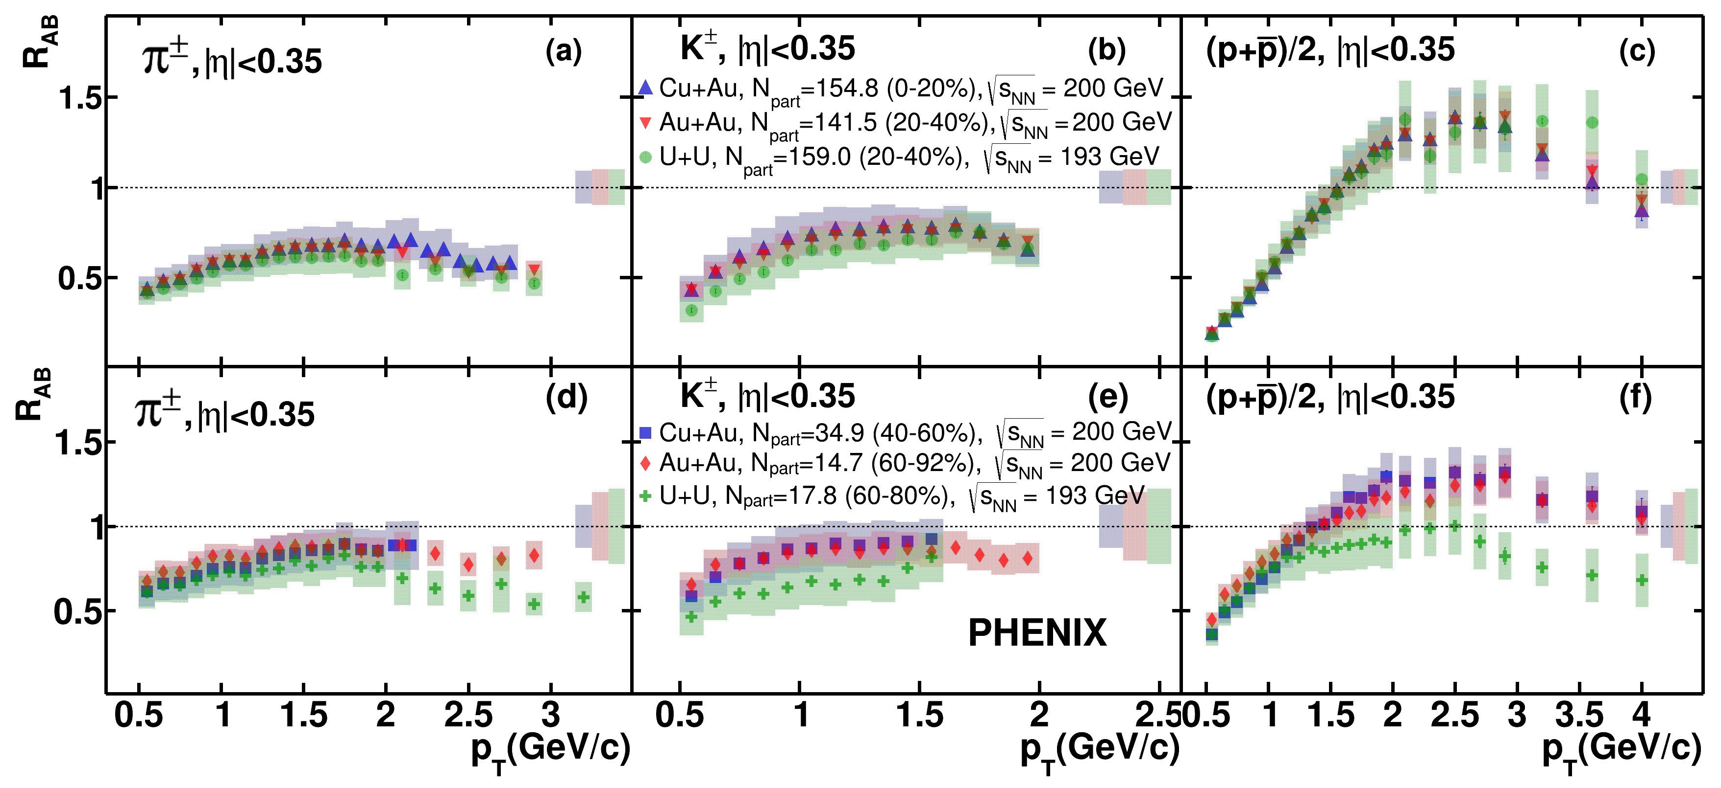
Nuclear Modification Factor in Large Collision Systems
Comparisons of identified charged-hadron R_{AB} values as a function of p_{T} in central and peripheral
PRC 109, 054910 (2024)
Large systems: Cu+Au,
Au+Au,
U+U
Central collisions
Central collisions
Central collisions
Central Collisions R_{AB}(π, K) < 1
Peripheral collisions
Peripheral collisions
Peripheral collisions
The R_{AB} values are found to be in agreement in collisions with different geometries, but with the same < N_{part}> values, indicating that identified charged-hadron production depends only on system size and not geometry.
Rachid Nouicer
10
SQM 2024

Slide 11
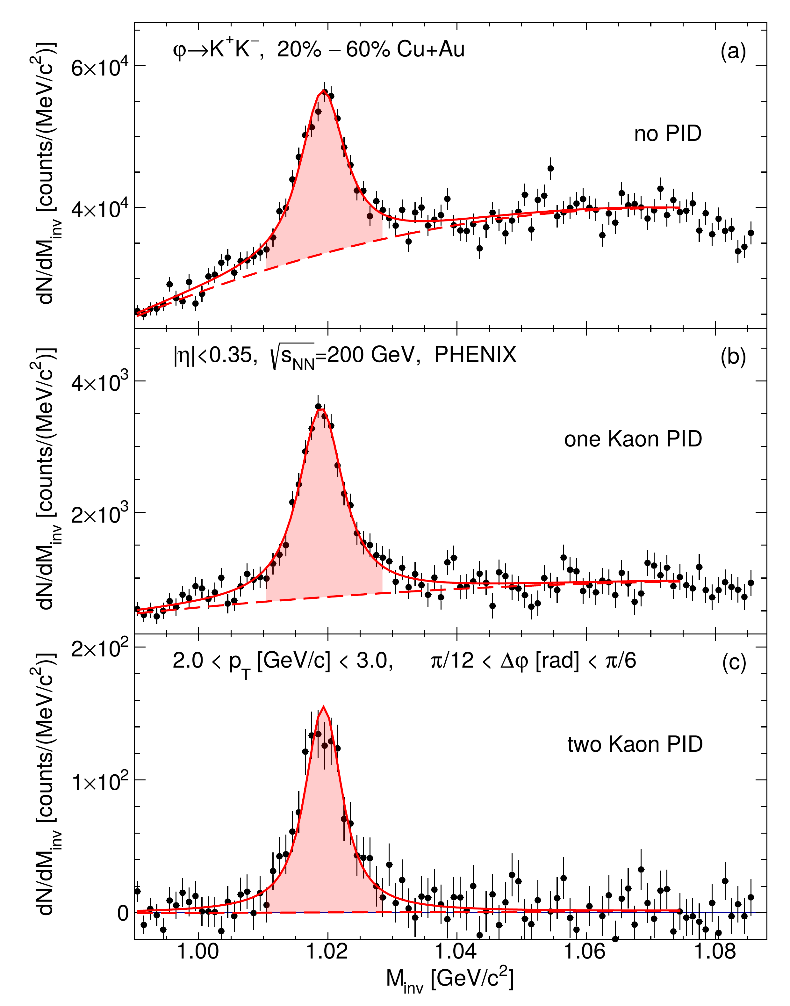
ϕ-Meson Production in Small and Large Collision Systems
PRC 107, 014907 (2023)
Heavy
In large systems (CuAu, Au+Au, and U+U): ϕ-meson production is an excellent probe for studying QGP - sensitive to several aspects of the collision, including modifications of strangeness production in bulk matter.
In small systems (p+Al, p+Au, d+Au, ³He+Au): ϕ-meson production is a good probe to study cold nuclear matter effects in order to disentangle hot nuclear (QGP related) and cold nuclear matter (modification of the production cross section in a nuclear target) effects exiting in A+B collisions.
ϕ → K⁺K⁻ with a branching ratio of 48.9 0.5 %
Rachid Nouicer
11
SQM 2024

Slide 12
ϕ-Meson Invariant Transverse Momentum Spectra
Small systems
Heavy
PRC 106, 014908 (2022)
Rachid Nouicer
12
SQM 2024

Slide 13
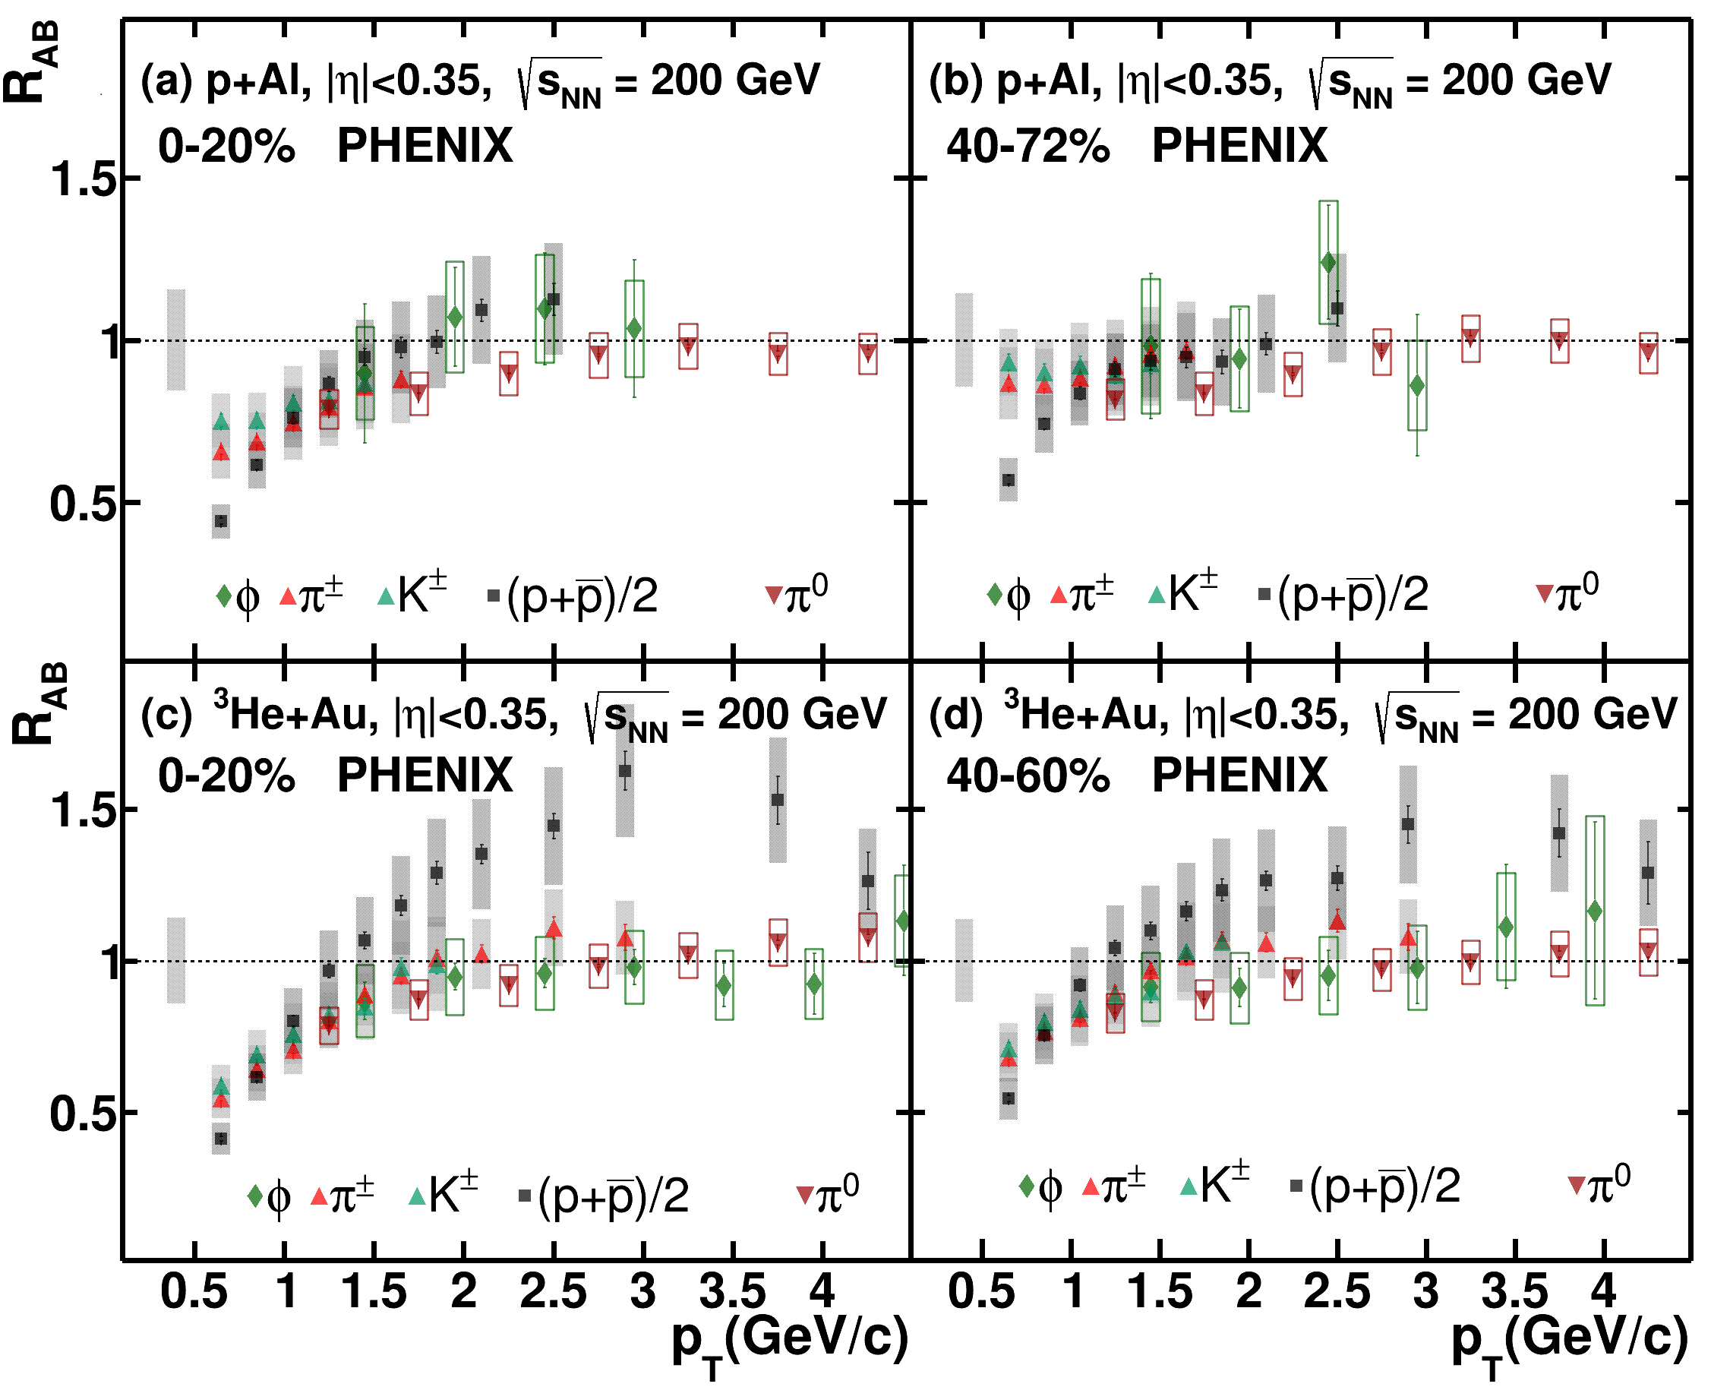
ϕ-Meson Nuclear Modification Factor in Small Systems
Small systems
Heavy
Central
Peripheral
PRC 109, 054910 (2024)
p+Al collision system: R_{AB} of protons and all mesons are in agreement within uncertainties, which shows zero enhancement in proton to φ-meson production.
³He+Au collision system: proton R_{AB} values are enhanced over all meson R_{AB} values.
Rachid Nouicer
13
SQM 2024

Slide 14
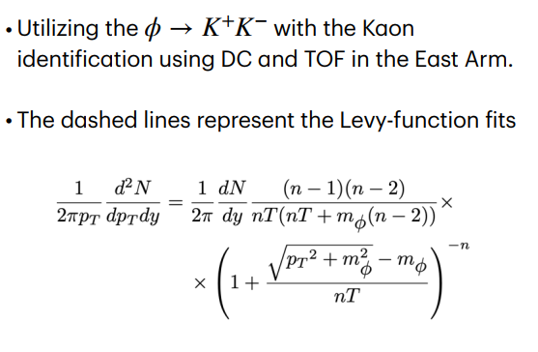
ϕ-Meson Invariant Transverse Momentum Spectra
Large systems
Heavy
PRC 107, 014907 (2023)
Rachid Nouicer
14
SQM 2024

Slide 15
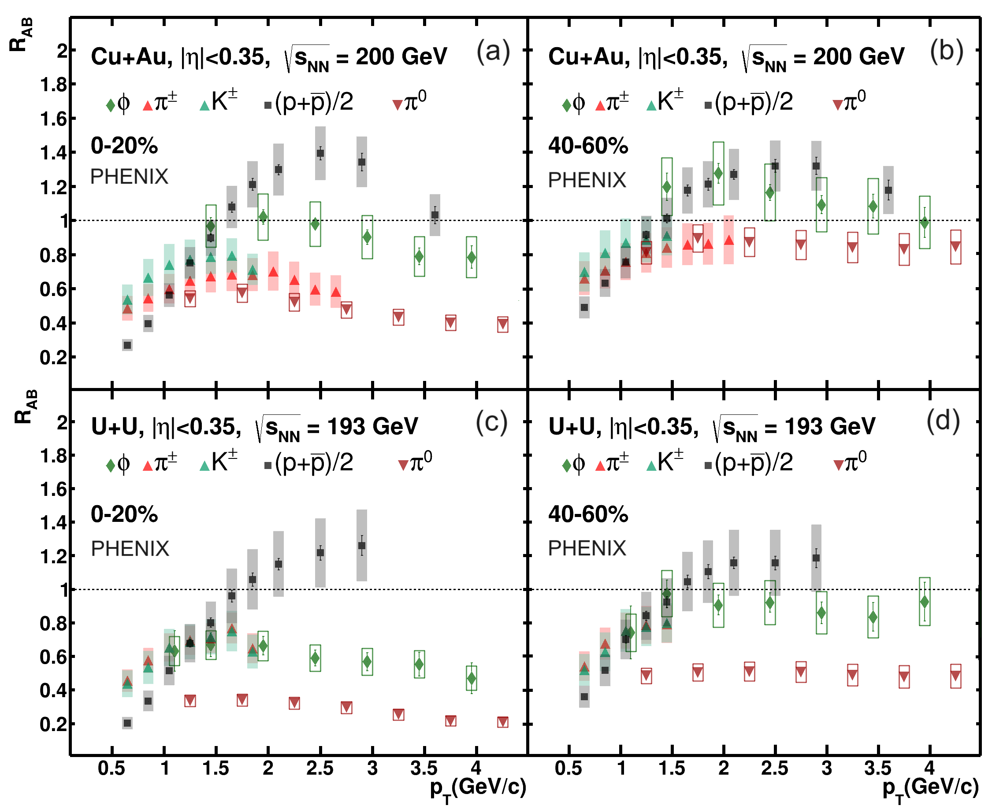
ϕ-Meson Nuclear Modification Factor in Large Systems
Heavy
Central
Peripheral
PRC 109, 054910 (2024)
Large systems
Observations:
1) in central collisions: proton R_{AB} values are enhanced over all meson R_{AB} values. m_{φ} =1019 MeV/c² is similar to m_{p}=938 MeV/c², therefore the enhancement of proton R_{AB} values over φ-meson R_{AB} values suggests differences in baryon versus meson production instead of a simple mass dependence.
2) in peripheral collisions: R_{AB} (proton) and R_{AB} (φ-meson) are in good agreement within uncertainties.
Rachid Nouicer
15
SQM 2024

Slide 16
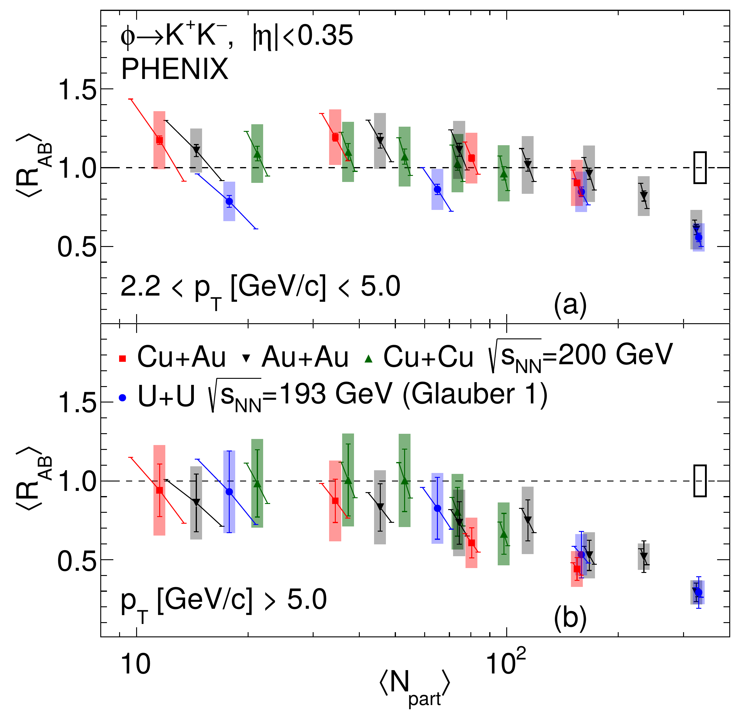
ϕ-Meson: Comparison with the Symmetric Systems
Heavy
In order to better understand the features of φ-meson production, the integrated nuclear modification factors <R_{AB}> for φ-mesons as a function of <N_{part}> for different collision systems: Cu+Au, Cu+Cu, Au+Au, and U+U collisions.
PRC 107, 014907 (2023)
Large systems
The <R_{AB}> values for φ-mesons vs. <Npart> obtained in the large collision systems are consistent within uncertainties
The obtained ⟨R_{AB}⟩ results suggest the scaling of φ-meson production with the average nuclear overlap size, regardless of the collision geometry
Rachid Nouicer
16
SQM 2024

Slide 17
Elliptic Flow v₂ of ϕ-Meson
Heavy
Large Systems: Cu+Au, U+U, and Au+Au
PRC 107, 014907 (2023)
The comparison of elliptic flow for φ-mesons in symmetric and asymmetric collision systems suggests that the v₂ values follow common empirical scaling with ε $N_{part}^{1/3}$
Rachid Nouicer
17
SQM 2024

Slide 18
Summary
Few bullets to remember from these measurements:
The freeze-out temperature (T₀) is approximately independent of centralities and collision system size
In small systems (p+Al, ³He+Au): p/π ratios in all centrality classes are similar to those measured in p+p
In large systems (Cu+Au, U+U), p/π ratios reach ≈ 2 times larger than (p/p) in p+p
φ-meson meson production in p+Al collision system: R_{AB} of protons and all mesons are in agreement within uncertainties, which shows zero enhancement in proton to φ-meson production.
Rachid Nouicer
18
SQM 2024

Slide 19
Thank you!
Auxiliaries Slides

Slide 20
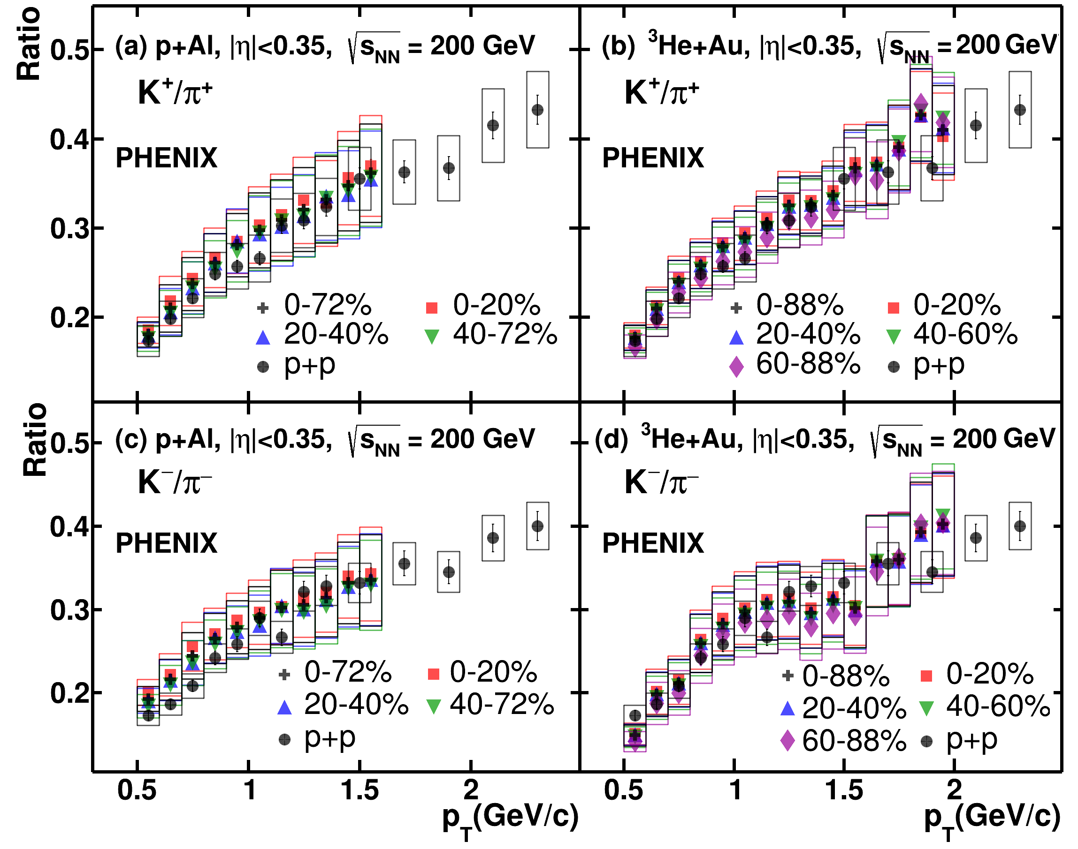
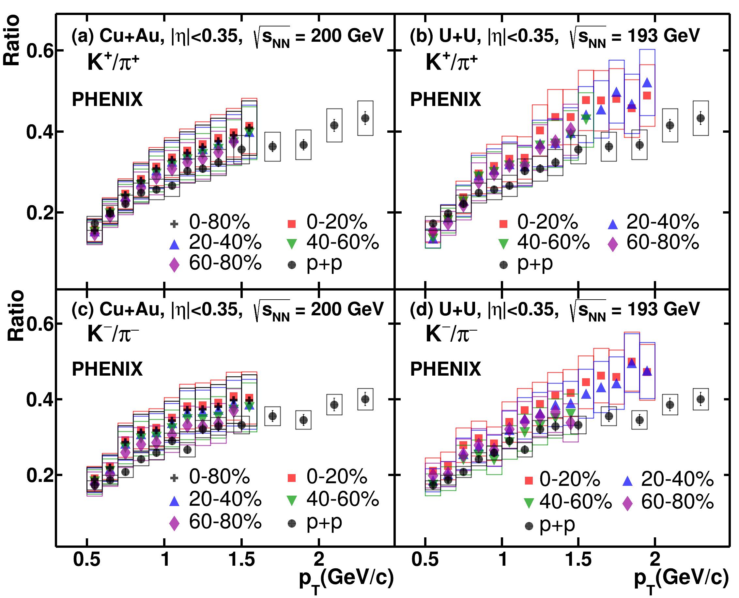
K/π Ratio in Small and Large Collision Systems
Heavy
PRC 109, 054910 (2024)
Rachid Nouicer
20
SQM20242023

Slide 21
PHENIX Collected and Enjoying Every Bit of RHIC Data
Heavy
Run | Species | Total particle energy [GeV/nucleon] | total delivered Luminosity [mb⁻¹]
I (2000) | Au+Au Au+Au | 56 130 | < 0.001 20
II (2001/2002) | Au+Au Au+Au p+p | 200 19.6 200 | 25.8 0.4 1.4x10⁻⁶
III (2003) | d+Au p+p | 200 200 | 73x10⁻³ 5.5x10⁻⁶
IV(2004) | Au+Au Au+Au p+p | 200 62.4 200 | 3.53x10⁻³ 67 7.1x10⁻⁶
V (2005) | Cu+Cu Cu+Cu Cu+Cu p+p p+p | 200 62.4 22.4 200 410 | 42.1x10⁻³ 1.5x10⁻³ 0.02x10⁻³ 29.5x10⁻⁶ 0.1x10⁻⁶
VI (2006) | p+p p+p | 200 62.4 | 88.6x10⁻⁶ 1.05x10⁻⁶
VII (2007) | Au+Au Au+Au | 200 9.2 | 7.25x10⁻³ Small
VIII ( 2008) | d+Au p+p Au+Au | 200 200 9.6 | 437x10⁻³ 38.4x10⁻⁶ Small
Run | Species | Total particle energy [GeV/nucleon] | Total delivered luminosity [mb⁻¹]
IX (2009) | p+p +p | 500 200 | 110x10⁻⁶ 114x10⁻⁶
X (2010) | Au+Au Au+Au Au+Au Au+Au Au+Au | 200 62.4 39 7.7 11.5 | 10.3x10⁻³ 544 206 4.23 7.8
XI (2011) | p+p Au+Au Au+Au Au+Au | 500 19.6 200 27 | 166x10⁻⁶ 33.2 9.79x10⁻³ 63.1
XII (2012) | p+p p+p U+U Cu+Au | 200 510 193 200 | 74x10⁻⁶ 283x10⁻⁶ 736 27x10⁻³
XIII (2013) | p+p | 510 | 1.04x10⁻⁹
XIV (2014) | Au+Au Au+Au ³He+Au | 14.6 200 200 | 44.2 43.9x10⁻³ 134x10⁻³
XV (2015) | p+p p+Au p+Al | 200 200 200 | 282x10⁻⁶ 1.27x10⁻⁶ 3.97x10⁻⁶
XVI (2016) | Au+Au d+Au d+Au d+Au d+Au | 200 200 62.4 19.6 39 | 52.2x10⁻³ 46.1x10⁻³ 44.0x10⁻³ 7.2x10⁻³ 19.5x10⁻³
Analyzing and publishing all these very interesting scientific data takes time, manpower, and resources. PHENIX Collaboration is on the right path to achieve these goals, and seek for a new discovery (ies) about the properties of QCD Matter at RHIC.
To maintain this momentum, Data and Analysis Preservation (DAP) is critical.
Rachid Nouicer
21
SQM 2024

