Slide 1
Critical Point Fluctuations in Heavy-Ion Collisions within Molecular Dynamics with Expansion
Volodymyr Kuznietsov
Based on: V.K., M.I. Gorenstein, V. Koch, V. Vovchenko, arXiv: 2404.00476 [nucl-th]

Slide 2
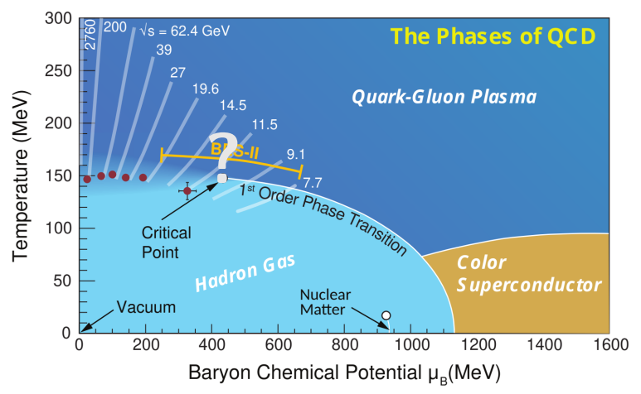
QCD PHASE DIAGRAM
Bzdak et al., Phys. Rept. 2020 & 2015 Long Range plan

Slide 3
Fluctuations as CP signature
[1] Non-critical baseline: Vovchenko, Koch, Shen, PRC 105, 014904 (2022)
[2] STAR data (BES-I): J. Adam et al., PRL 126, 092301 (2021)

Slide 4
Connection to the experiment
Experiment
Momentum space
Expanding in vacuum
Non-conserved particle numbers
Inhomogenous
Fluctuating volume
Theory
Coordinate and/or momentum space
In contact with the heat bath
Conserved charges
Uniform
Fixed volume
Here we study critical fluctuations in a microscopic approach
(MD)

Slide 5
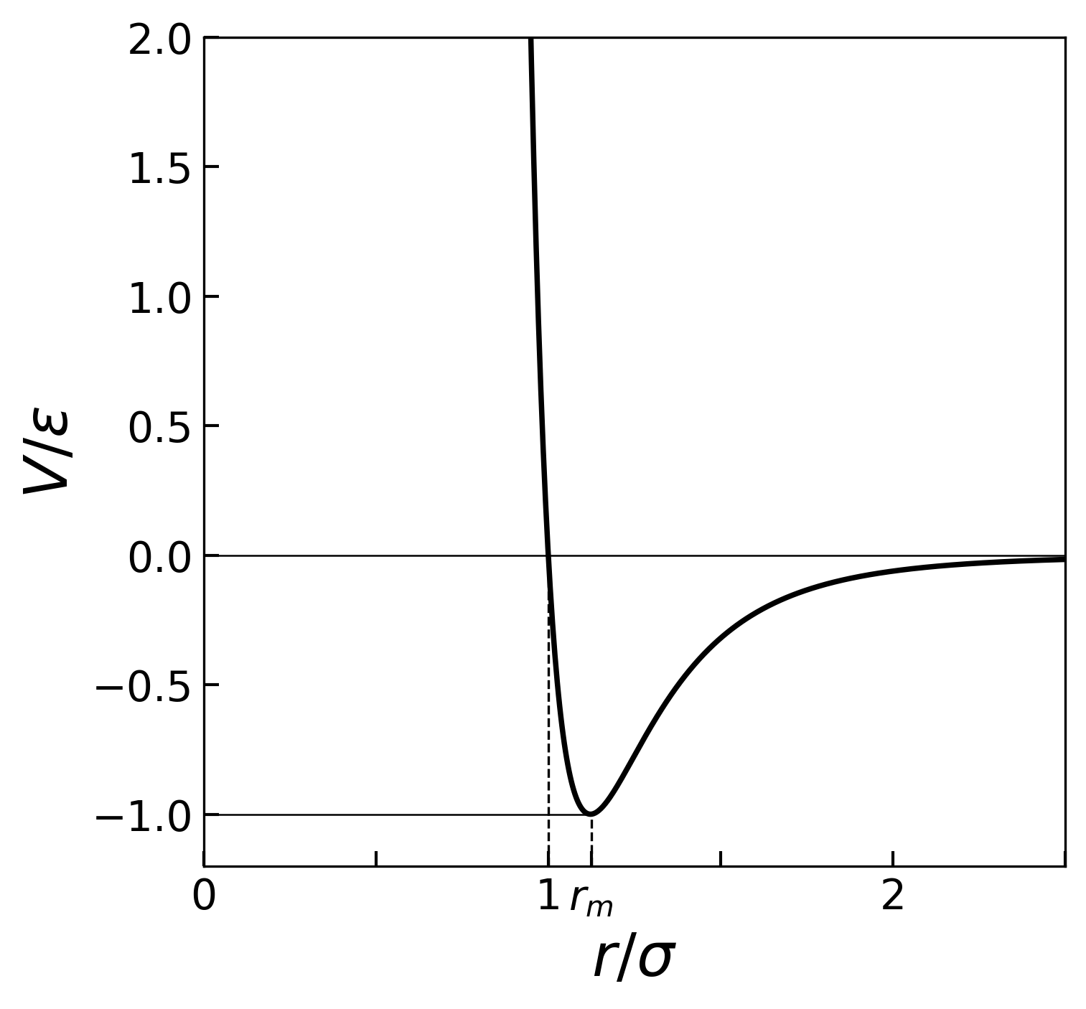
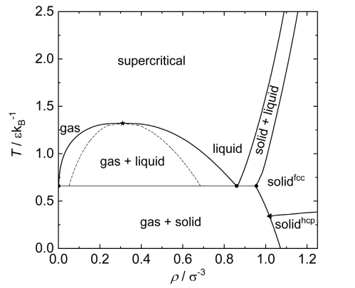
Lennard-Jones potential
The Lennard-Jones potential reads
$$V_{LJ}=4ε\left[{\left(σ/r\right)}^{6}\text{−}{\left(σ/r\right)}^{12}\right]$$
In reduced dimensionless variables it can be rewritten as
$${\tilde{V}}_{LJ}=4\left({\tilde{r}}^{−6}−{\tilde{r}}^{−12}\right)$$
where the reduced variables are use:
$$\tilde{r}=r/σ,$$
$$\tilde{t}=t\sqrt{ε/(mσ^{2})},$$
$${\tilde{V}}_{LJ}=V_{LJ}/ε$$
Advantages:
Well-studied system
The LJ fluid contains a critical point in the 3D-Ising universality class, same as QCD critical point.
Critical fluctuations are automatically projected on finite particle number statistics.

Slide 6
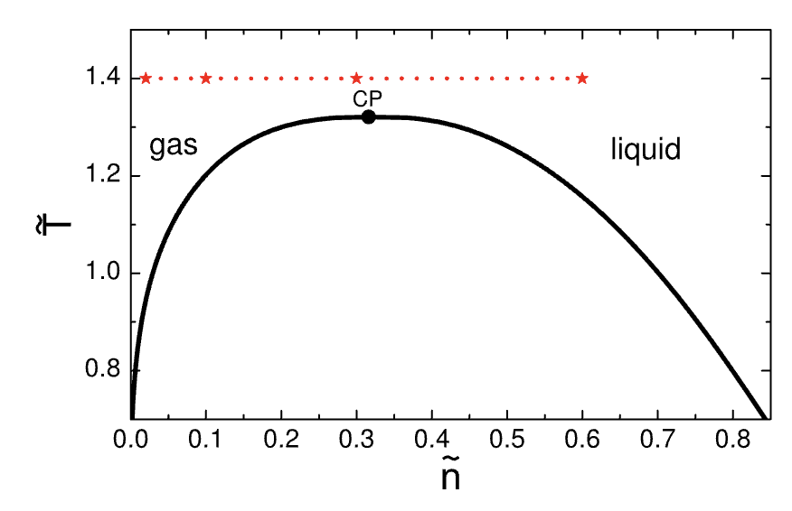
Simulation setup
$$m\frac{d^{2}{\vec{r}}_{i,j}}{d{\tilde{t}}^{2}}=−\vec{∇}V_{LJ}({\vec{r}}_{i,j})$$
Three points on the phase diagram, $\tilde{n}≈0.3n_{c}$, $\tilde{n}≈0.95n_{c}$, $\tilde{n}≈1.9n_{c}$ ($\tilde{T}≈1.9T_{c}$)
$N_{ev}=32 000$events at each density
Initialize each event with random initial coordinates and momenta
Run each event for long time ($\tilde{t}=100$) write snapshots to file at regular time intervals
Calculate observables as event-by-event (ensemble) or time average
The simulations are performed on PhysGPU cluster at UH. Code is available at:
https://github.com/vlvovch/lennard-jones-cuda

Slide 7
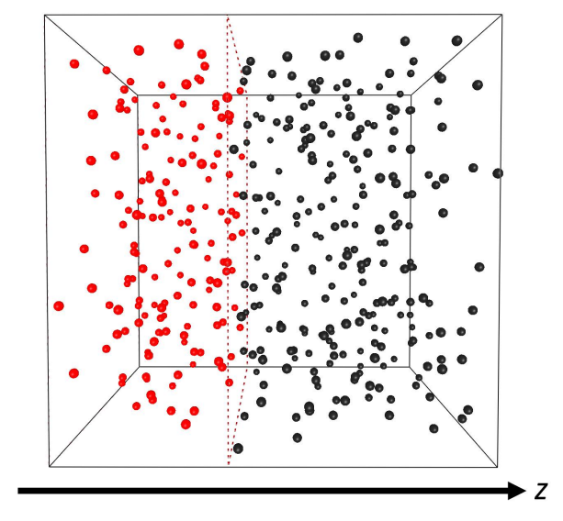
Observables and ergodicity
Time average
$${\left\langle A\right\rangle }_{τ}=\frac{1}{τ}\int_{{\tilde{t}}_{eq}}^{{\tilde{t}}_{eq}+τ}{ A(t)}dt$$
versus ensemble average:
$${\left\langle A\right\rangle }_{M}=\frac{1}{M}\sum_{i=0}^{M}{A_{i}}$$
Ergodic hypothesis:
$${\lim_{M→∞}\left\langle A\right\rangle }_{M}={\lim_{τ→∞}\left\langle A\right\rangle }_{τ}$$
Namely:
$$\left\langle N\right\rangle =\frac{1}{M}\sum_{i=0}^{M}{N_{i}(α)}, \tilde{ω}={\frac{1}{1−α}\frac{{\left\langle N\right\rangle }^{2}−\left\langle N^{2}\right\rangle }{\left\langle N\right\rangle }}^{ ∗}, α=\frac{\left\langle N\right\rangle }{N_{tot}}$$
V. A. Kuznietsov et al., PRC 105, 044903 (2022)
$^{∗}1/(1−α$) correction is related to the V. Vovchenko et al., Phys. Let. B, 2020

Slide 8
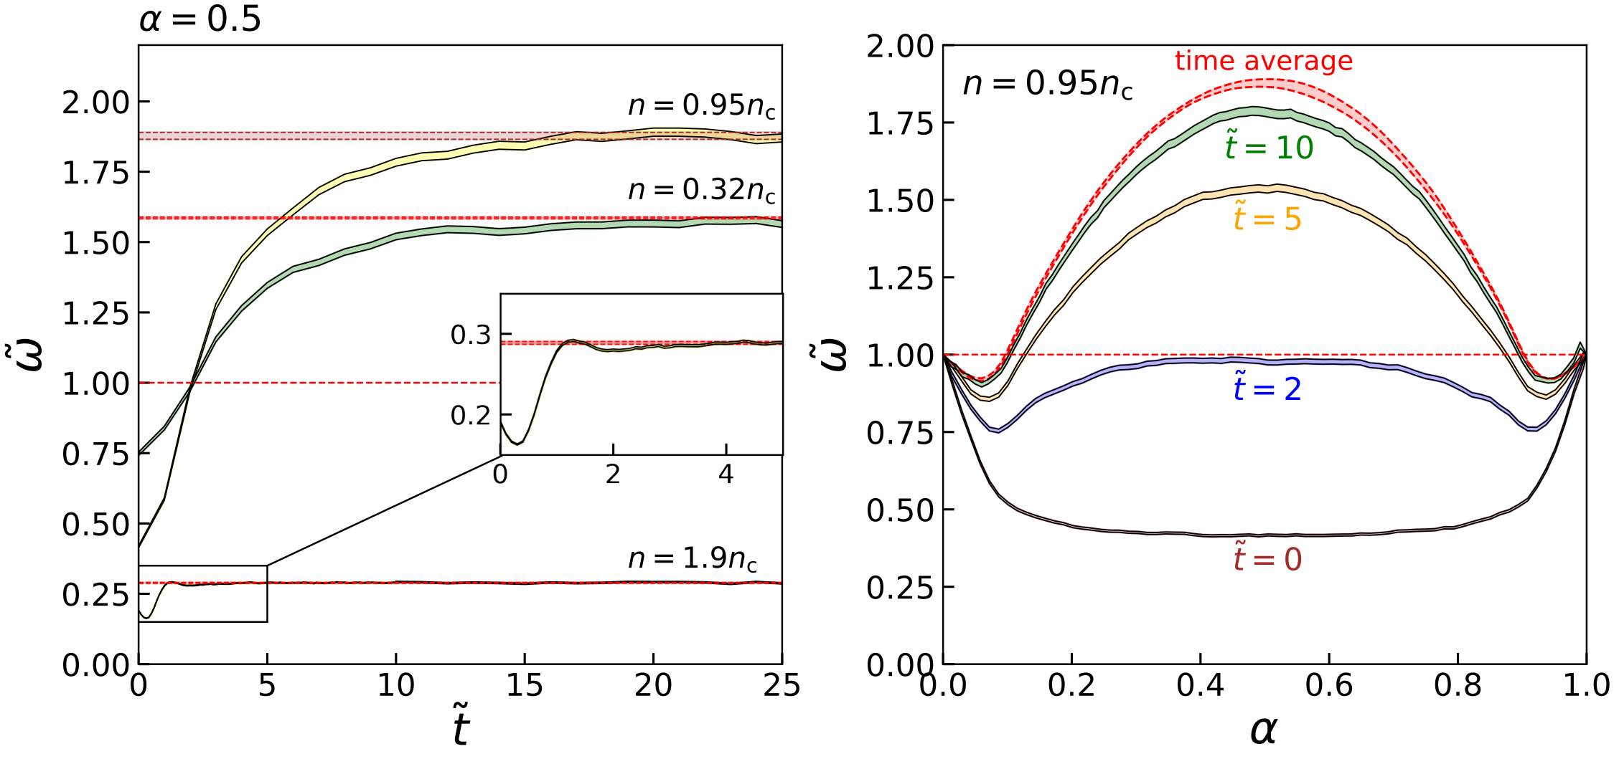
Time vs ensemble average, Equilibration
Ergodic hypothesis works
V.K., Gorenstein, Koch, Vovchenko, arXiv: 2404.00476 [nucl-th]

Slide 9
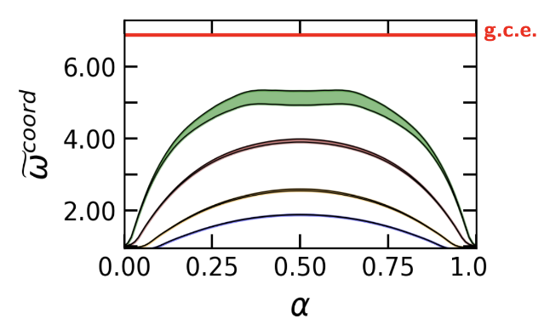
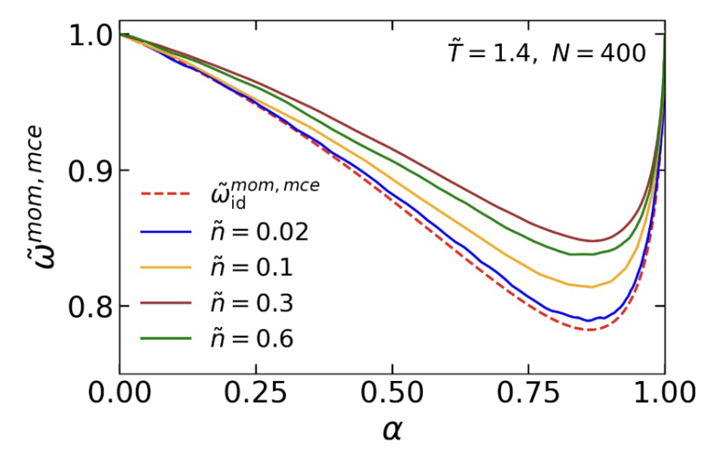
Previous results: time average in box
$$\tilde{ω}=\frac{1}{1−α}\frac{{\left\langle N\right\rangle }^{2}−\left\langle N^{2}\right\rangle }{\left\langle N\right\rangle }$$
Coordinate space
Momentum space
Large correlations in coordinate space Signal disappears in momentum space
V.K., Savchuk, Gorenstein, Koch, Vovchenko, PRC 105, 044903 (2022)

Slide 10
Experiment vs box
Heavy-ion simulation (UrQMD)
MD box simulation (LJ)

Slide 11
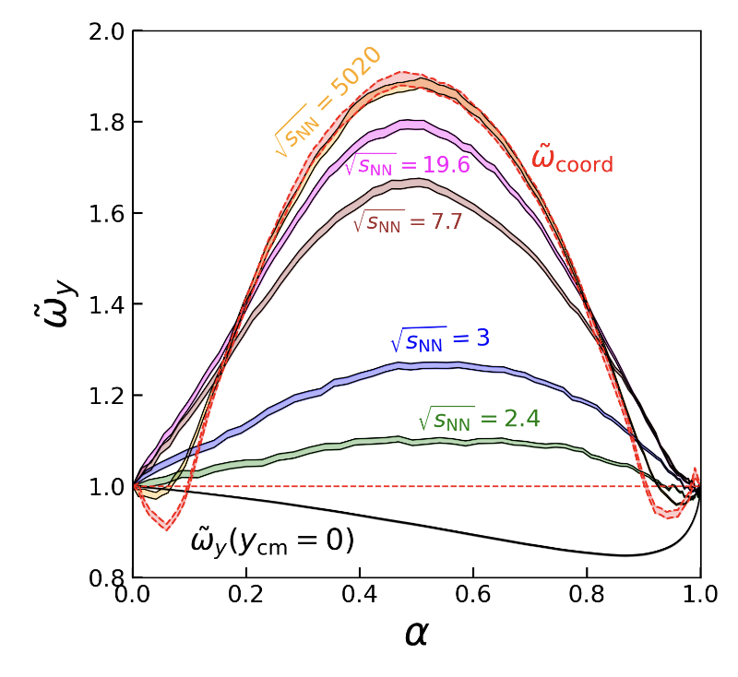
Adding Collective flow
We now add longitudinal flow (Bjorken-like) by boosting particles according
to the $z$-coordinates
Moment space (with flow)
$\tilde{y}={\tilde{y}}^{LJ}+\sqrt{\frac{T_{frz}}{m\tilde{T}}}κ\left(\frac{\tilde{z}}{\tilde{L}}−\frac{1}{2}\right)$,
$$κ={2y}_{cm}\sqrt{\frac{m\tilde{T}}{T_{frz}}}$$
Heavy-ion collision inspired parameters: $T_{frz}=150$MeV, $m=938$ MeV
Collective flow correlates momenta to coordinates and recovers correlations

Slide 12
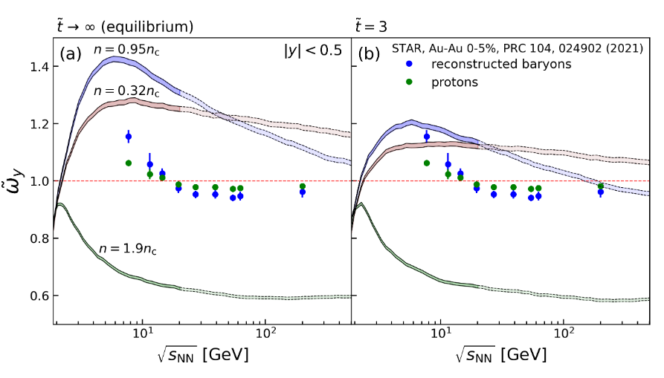
Fluctuations for constant rapidity cut
$α= α\left(\sqrt{s_{NN}}\right)=\frac{\left\langle N\right\rangle }{N_{tot}}$, $y_{cut}=0.5$ (experiment)
(Reconstructed STAR BES-I data was used, BES-II in future)
STAR data provided for the qualitative comparison
equilibrium finite time
Data: M. S. Abdallah et al. (STAR Collaboration), PRC 104, 024902 (2021)
1-$α$ correction based on hydro: Vovchenko, Koch, Shen, PRC105, 014904 (2022)

Slide 13
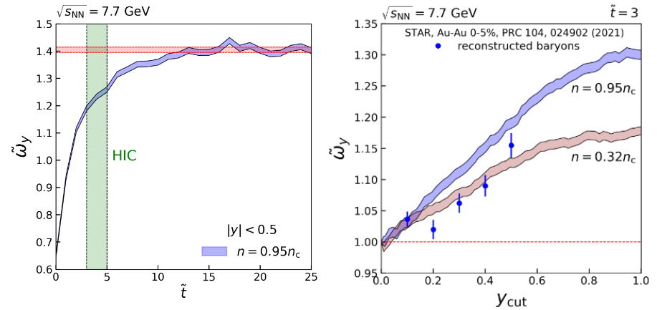
Fluctuations for constant rapidity cut
$τ: 7 −10$fm $→3−5$ at units of $\tilde{t}$
finite time
Data: M. S. Abdallah et al. (STAR Collaboration), PRC 104, 024902 (2021)
1-$α$ correction based on hydro: Vovchenko, Koch, Shen, PRC105, 014904 (2022)

Slide 14
Summary
Critical fluctuations are studied in a microscopic setup
Ergodic hypothesis is shown to work for 2nd-order fluctuations along the $\tilde{T}=1.4 \sim 1.06T_{c}$ isotherm, including the vicinity of the critical point
The collective flow effect allow us to see the enhancement of fluctuations in the momentum space
Fluctuations in experimental rapidity acceptance $\left|y\right|<0.5$ are studied. If critical point is close to freeze-out, the largest signal is observed at $\sqrt{s_{NN}}\sim 5$ GeV as interplay between longitudinal flow and number of protons in acceptance (system size).

Slide 15
outlook
Putting our study in the context of the BES II
Higher-order cumulants (need bigger statistics)
Study of the mixed phase
Implementing CP dynamics into the transport theory (UrQMD/SMASH)
Thank you for your time!
Questions?

Slide 16
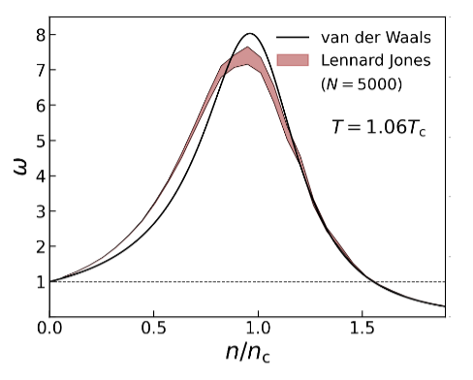
Fluctuations as CP signature
In GCE density cumulants shows singularity behavior in the critical point.
$$κ_{2 }\sim ε^{2}$$
$$\ln\left(Zᶢᶜᵉ\right)=ln⁡\left(\sum_{N=0}^{∞}{e^{μN}Z^{ce}(T,V,N)}\right)$$
$$κ_{n}=\frac{∂^{n}(ln⁡(Z^{ce}))}{{∂(μ_{N})}^{n}}$$
The real expression for$Zᶢᶜᵉ$ is unknown in QCD matter.

Slide 17
Momentum vs coordinate cuts

Slide 18
Sub-ensemble method: correction for global conservation
In the case of interacting system one can find
By definition in cumulants formalism
Finally, one can introduce the new measure
$κ_{1}=αVT^{3}χ_{1}$, $κ_{2}=α(1−α)$ $VT^{3}χ_{2}$
$ω^{coord}=$ $ω^{coord}/(1−α)$
${\tilde{ω}}^{coord}=\frac{κ_{2}}{κ_{1}}=(1−α)\frac{χ_{2}}{χ_{1}}$ $=(1−α)ω$
V. Vovchenko et al., Phys. Let. B, 2020

Slide 19
Reconstructed star data

Slide 20
Alpha dependence
$α= α\left(\sqrt{s_{NN}}\right)=\frac{\left\langle N\right\rangle }{N}$, $y_{cut}=0.5$ (experiment)

Slide 21
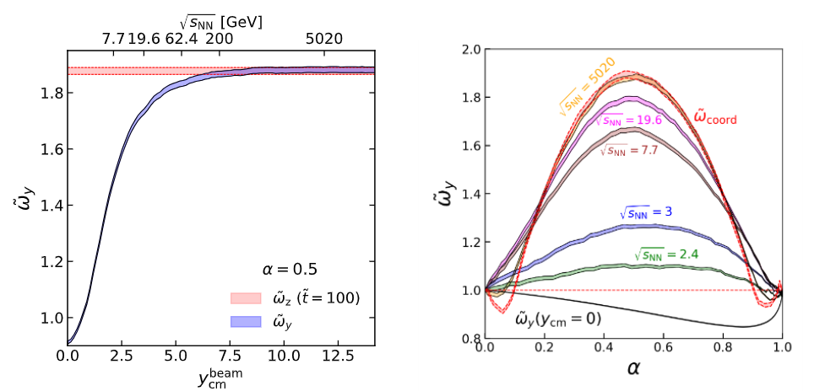
Fluctuations for constant alpha
$α=const=\frac{{\left\langle N\right\rangle }^{acc}}{N},$ $y_{cut}=y_{cut}(\sqrt{s_{NN}})$

