Slide 1
Evaluating results of the LISA Data Challenge 2a: sangria
Solano Felicio
Astrid Lamberts

Slide 2
The problem
How well do Global Fit outputs match simulation inputs?

Slide 3
Evaluating a Global Fit
Input data
LDC waveform
Pipeline 1
Pipeline 2
Pipeline 3
L2 output data
L2 output data
L2 output data
Match

Slide 4
The two UCB data sets
LDC simulation inputs (26 M)
Global Fit outputs (8.5 k)
Frequency
Amplitude
Sky localization
Frequency derivative
Inclination
Initial phase
Polarization
Frequency
Amplitude
Sky localization
Frequency derivative
Inclination
Initial phase

Slide 5
The Mahalanobis distance
Which inputs $x$ correspond to a given output $y$?
Dimensions: Latitude, longitude, frequency, frequency derivative, amplitude, inclination
Euclidean distance: $\sqrt{{\left(x−y\right)}^{T}(x−y) }$
Standardized Euclidean: $\sqrt{\sum_{i}{\frac{{\left(x_{i}−y_{i}\right)}^{2}}{σ_{i}^{2}}} }$
Mahalanobis: $d_{M}\left(x,y\right)=\sqrt{{\left(x−y\right)}^{T}Σ^{−1}(x−y)}$
Covariance matrix

Slide 6
Mahalanobis distance matching
The algorithm:
For all outputs $y$:
For all inputs $x$:
Compute $d_{M}\left(x,y\right)$;
Register the smallest five distances and the corresponding $(x,y)$;
Filter out distances greater than a threshold;
(Optional) For all remaining outputs $y$:
Select the input $x$ with the smallest $d_{M}\left(x,y\right)$ that is not already matched;
Match $y$ to $x$.

Slide 7
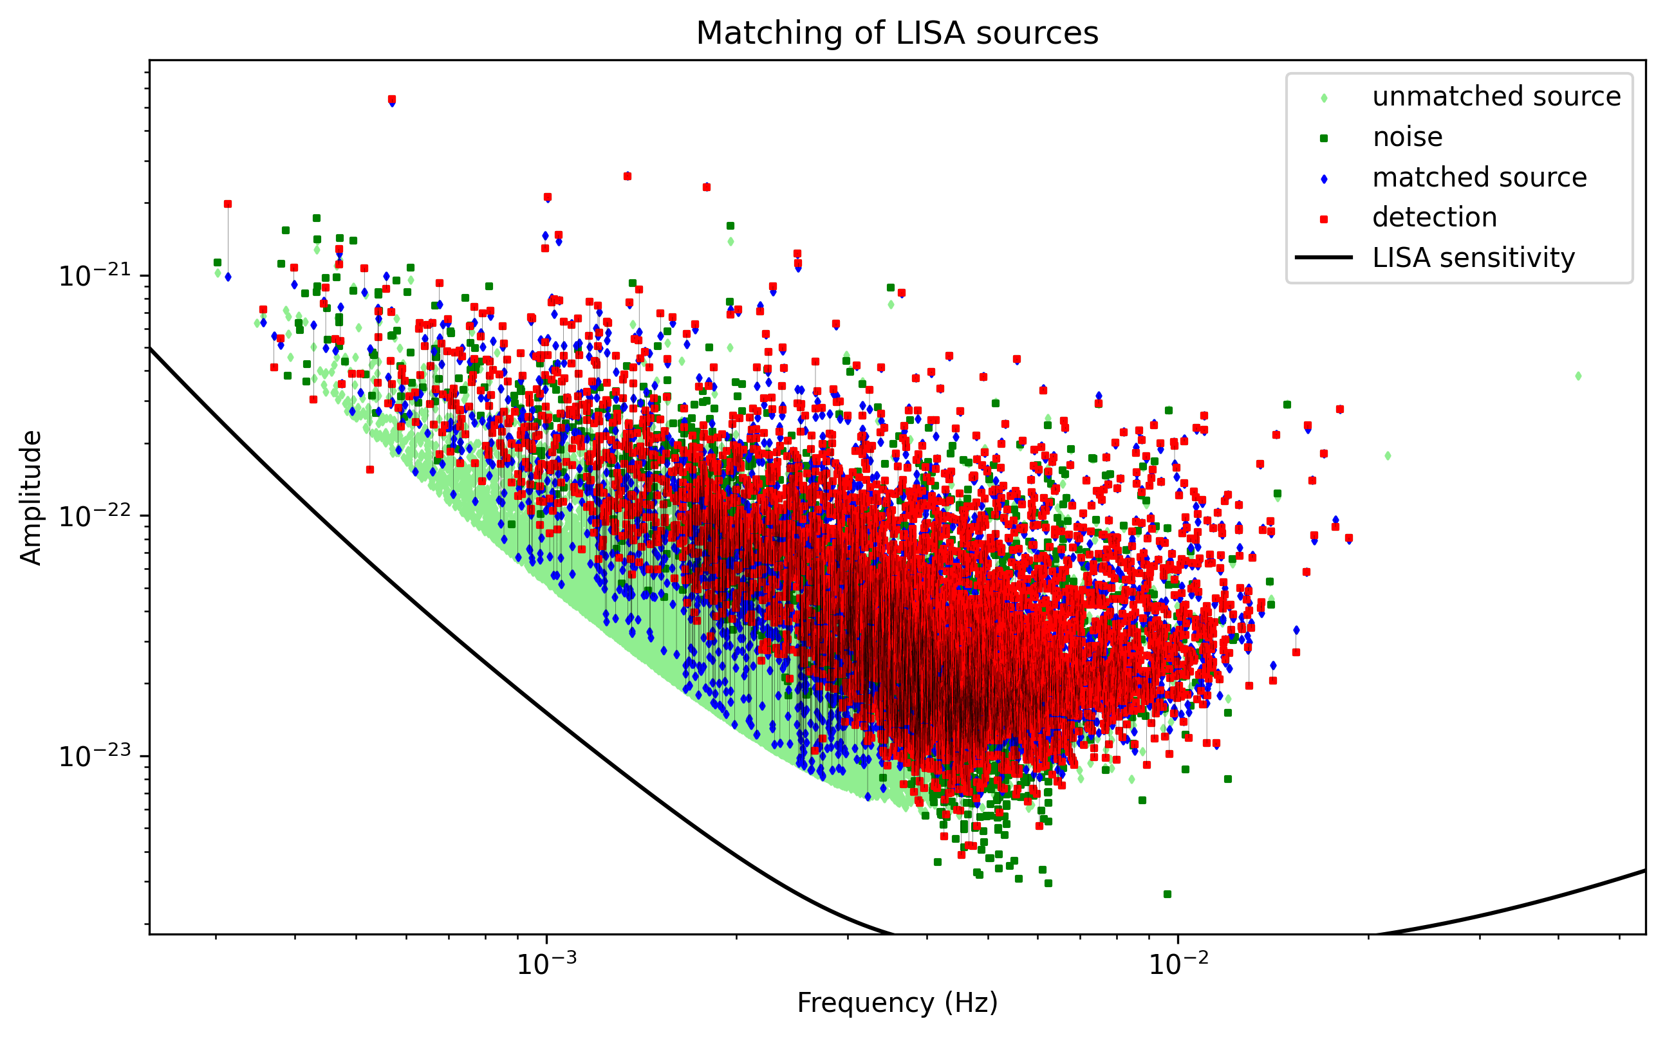
The MSFC-Montana Global Fit

Slide 8
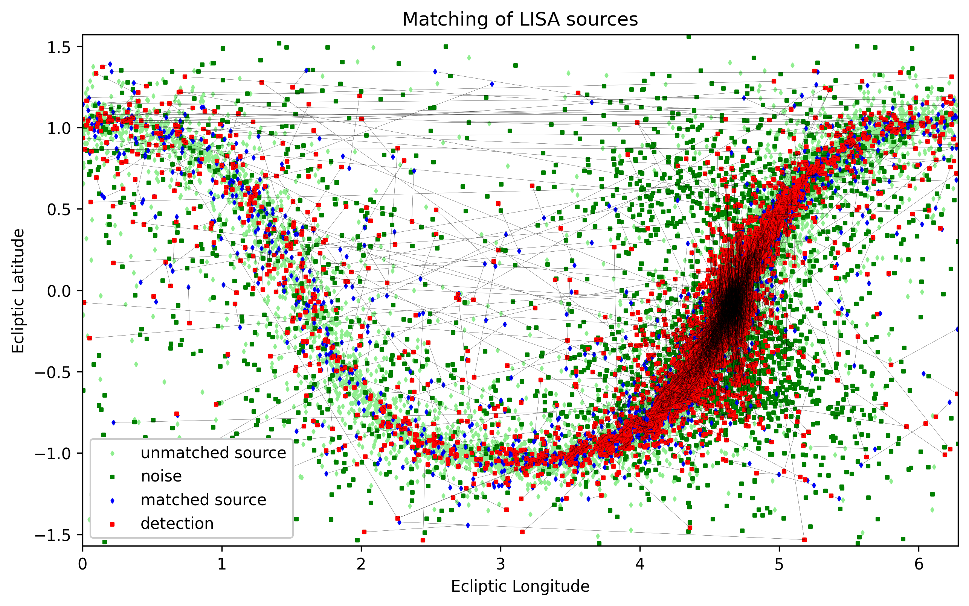
The MSFC-Montana Global Fit

Slide 9
High frequency sources

Slide 10
High frequency sources

Slide 11
100 highest SNR sources

Slide 12
100 highest SNR sources

Slide 13
How to verify correctness?
The Fellegi-Sunter model
Input data set $A$
Output data set $B$
Set of pairs $A×B=M∪U=M^{∗}∪U^{∗}$
True matches $M$, true non-matches $U$
Estimated matches $M^{∗}$, estimated non-matches $U^{∗}$

Slide 14
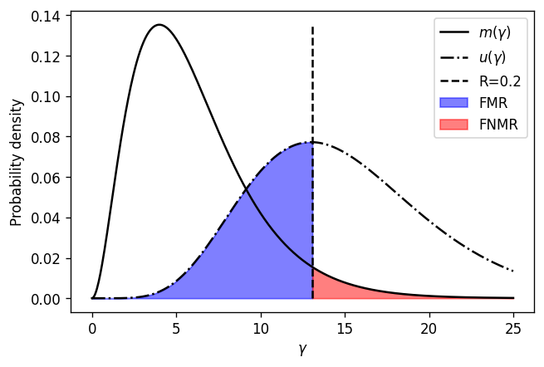
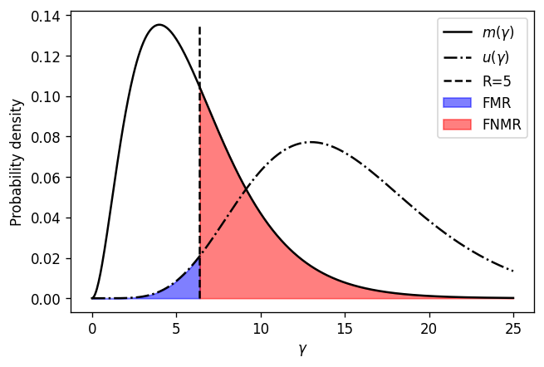
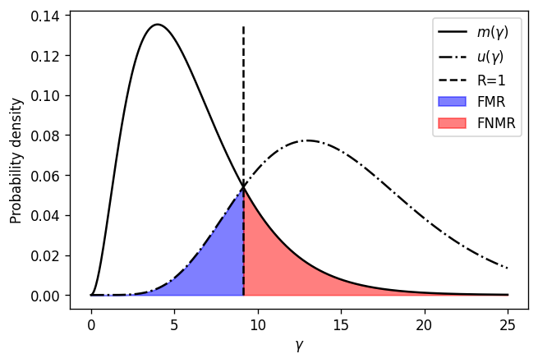
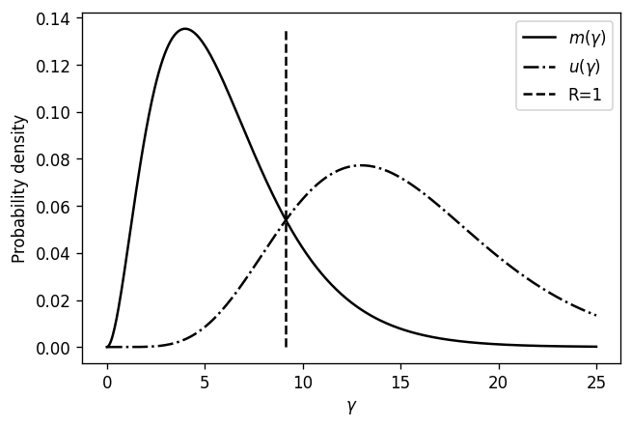
How to verify correctness?

Slide 15
The optimal threshold
Minimize the number of false matches + number of false non-matches
Iterate until convergence:
Minimization
Update $M^{∗}$ and $U^{∗}$

Slide 16
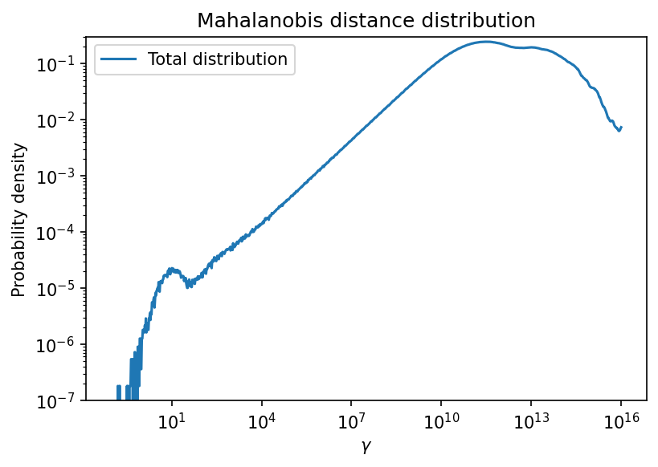
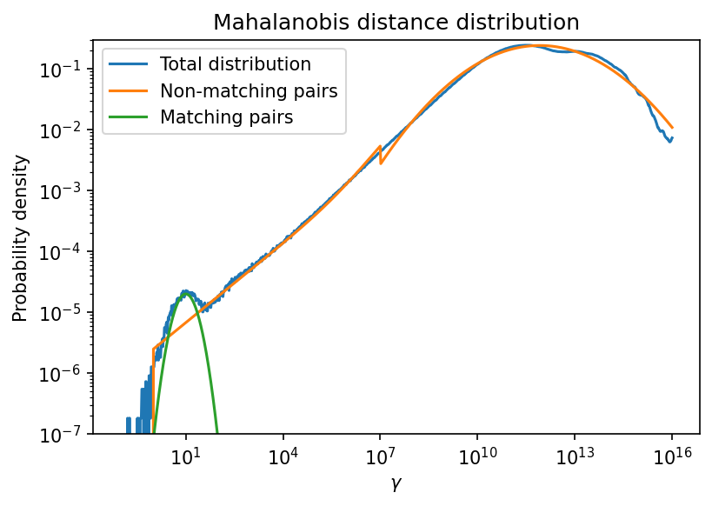
The MSFC-Montana Global Fit
Optimal threshold: 4.9
False Match Rate: 7e-6
False Non-Match Rate: 0.1
False matches: 2100
False non-matches: 500
Total estimated matches: 4900
Total number of outputs: 8500

Slide 17
Problems & questions
Problems with the matching method
Assumption: there is a right answer
Only appropriate for unimodal distributions
Little distinguishing power (comparison space too small?)
What is a good Global Fit? How to measure it?

