Slide 1
Combining catalogs with Bayesian meta-analysis
Towards LISA Catalogs, Nice, June 12-14
Avi Vajpeyi, Matt Edwards, Renate Meyer
The University of Auckland

Slide 2
Context
One of the topics we would like to discuss is how to combine the outputs of multiple global fit pipelines and construct a unique catalog. As the global fits will be producing parameter estimates for the signals, a question is how does one properly combine different parameter estimation runs that may be using different methods?
Nelson Christensen

Slide 3
Summary
Part 1: Bayesian toolbox
Bayesian meta-analysis
Example: NZ election polls
Bayesian model averaging
Example: Supernova signal reconstruction
Part 2: Combining LISA catalogs (L2→L3)
Goal of combining catalogs
Challenges of combining catalogs
Combining components:
Foreground
Background
Noise
Q

Slide 4
Meta-analysis
Formal statistical combination of results from individual independent studies, popular in medical studies.
Each study aims to measure the same thing, and each study has its own source of error.
Bayesian way to this is to build a hierarchical model where parameters could come from a common population distribution (prior).
For example, the Bayesian normal-normal random effects model, heterogeneity between studies captured by an additional variance component.

Slide 5
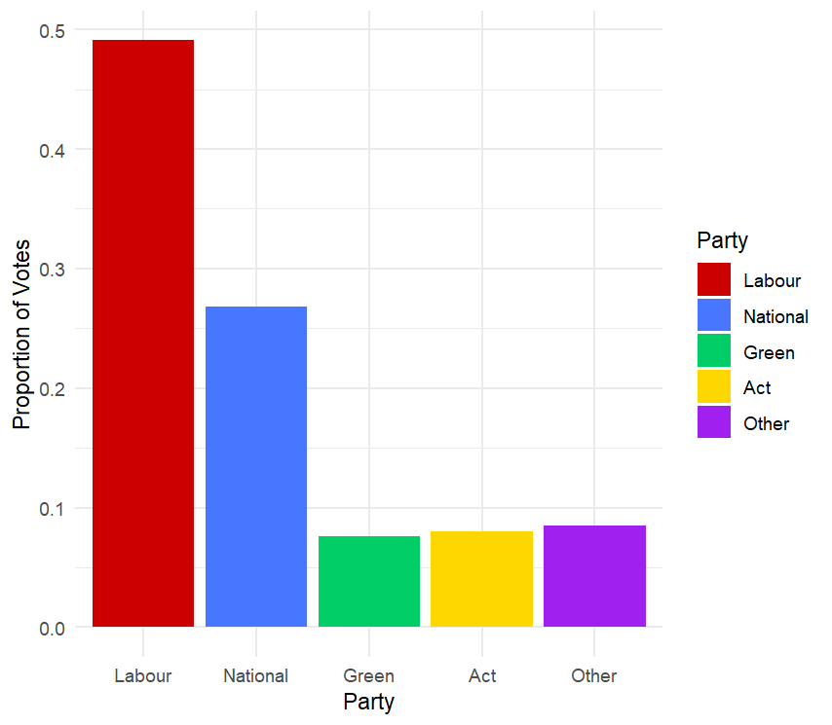
Example: 2020 NZ Election Polls
11 opinion polls leading into the 2020 NZ general election.
Each poll aimed to measure the proportion of the voting population who would vote for: Labour, National, Green, Act, Other.
Let be these population proportions respectively.
We can consider these as coming from the same population distribution (prior).

Slide 6
Example: 2020 NZ Election Polls
Multinomial likelihood
Dirichlet prior (population distribution)
Log Uniform hyperprior
Expectation of Dirichlet distribution
y⁽¹⁾
y⁽²⁾
…
y⁽¹¹⁾
θ
α

Slide 7
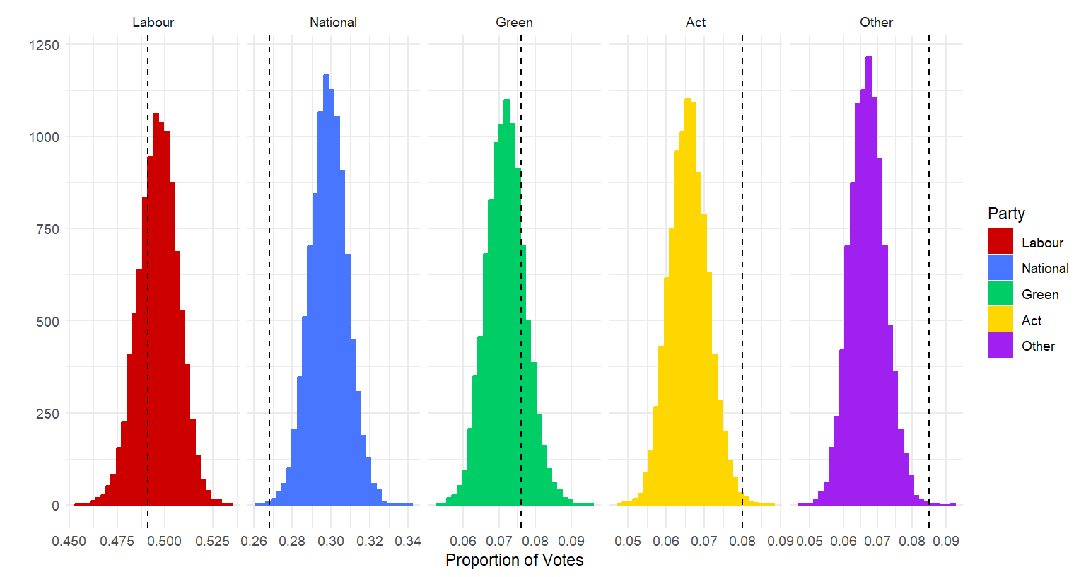
Example: 2020 NZ Election Polls

Slide 8
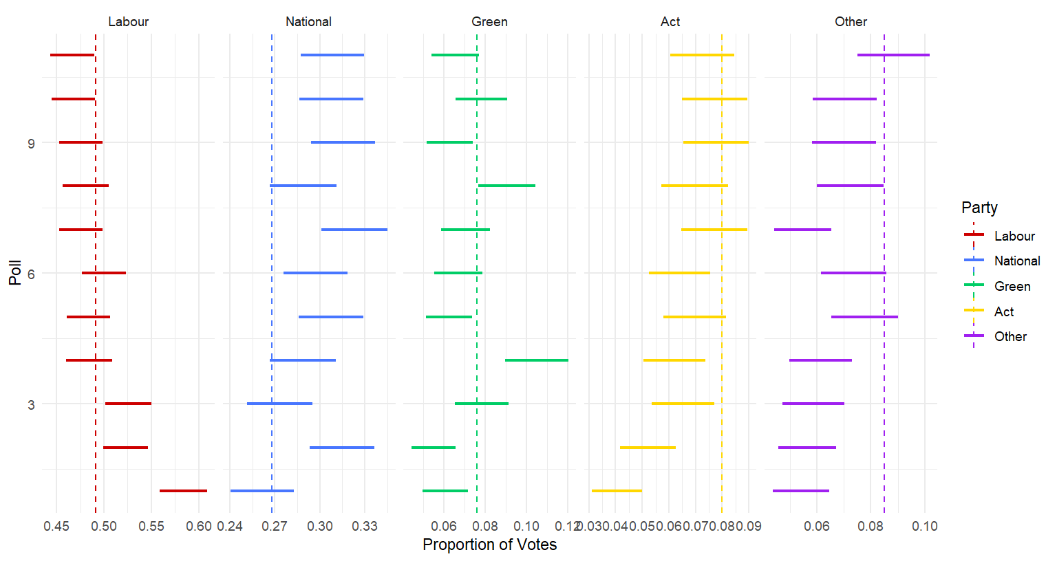
Example: 2020 NZ Election Polls

Slide 9
Bayesian model averaging
Bayesian model averaging (BMA) accounts for uncertainty in competing models.
Consider models with parameters .
Let be the quantity of interest.
Then is the average of the posterior distributions under each model considered, weighted by their posterior model probability, .
This requires computing the marginal likelihood for each competing model.
Generally provides better average predictive ability.

Slide 10
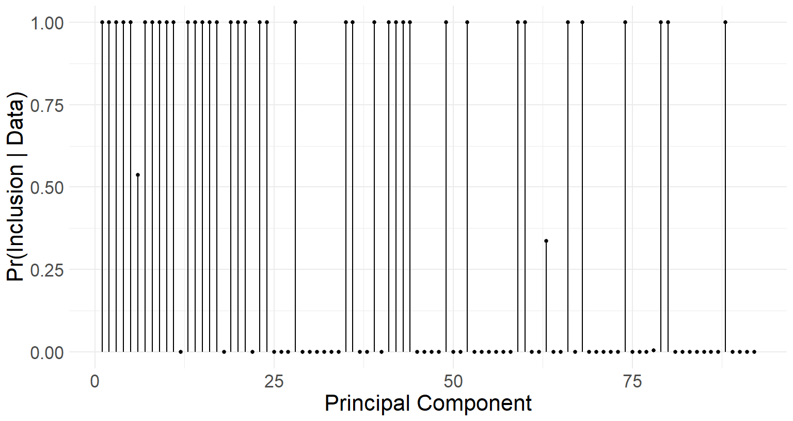
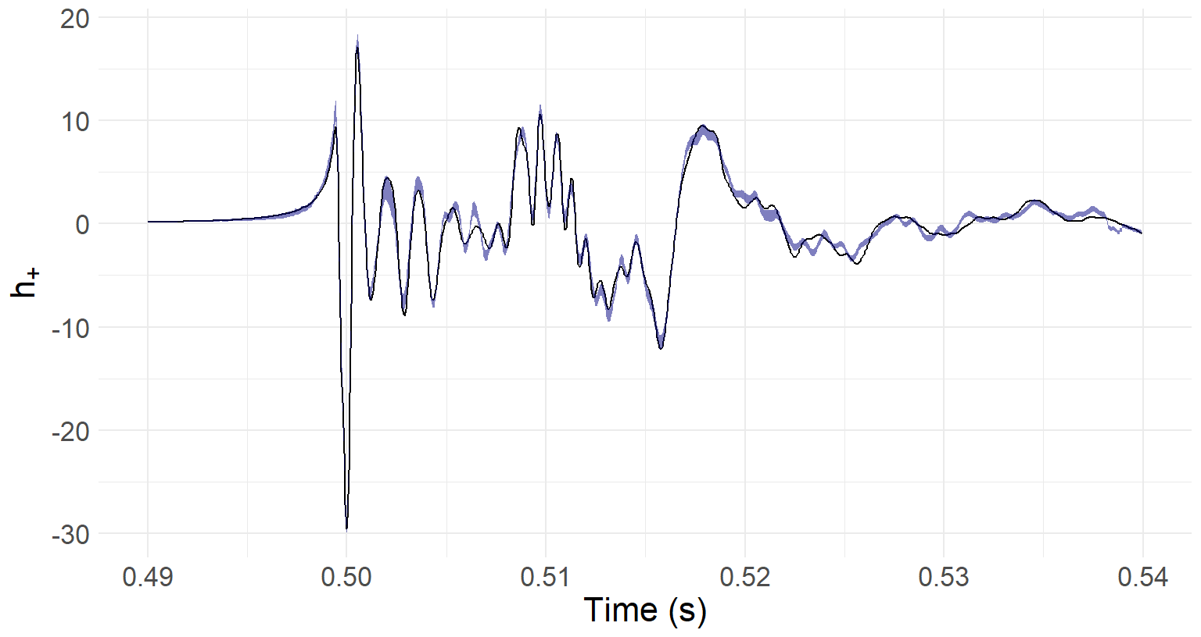
Example: Rotating core collapse signal reconstruction
Default signal reconstruction method uses principal component (PC) regression with first k PCs.
k often arbitrarily chosen to be 10.
Reconstruct signal using reversible jump MCMC and Bayesian model averaging. No evidence computations.
Specific PCs important, not just 1 to 10.

Slide 11
Some challenges
Although global fit pipelines will be independent, the data used by each pipeline will not be.
Exchangeability assumption of hierarchical model breaks down.
Bayesian hierarchical model does not use evidence. All models are considered equally relevant.
Becomes a problem if we have global fit catalogs of varying quality.
Model averaging catalogs could lose astrophysical interpretability.
Any alternatives?

Slide 12
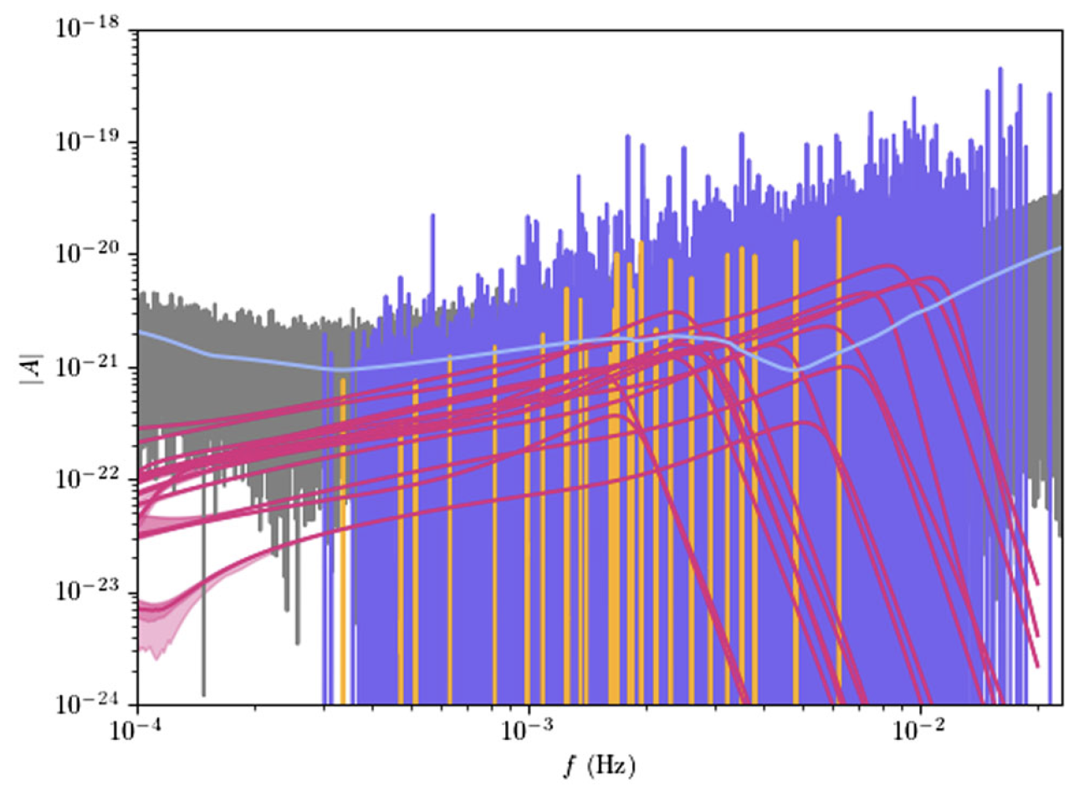
Combining LISA global fits
L2→L3
Residuals
Some questions:
What will L3 contain/
what do astronomers want
(in addition to galactic coordinates)
How can we find the same foreground signal in multiple L2 catalogs
Are they astrophysical signals?
How can we combine foreground signals?
What if catalogs use different models, priors, data conditioning?
parametric vs non-parametric models?
Does combining GW backgrounds even make sense?
How will the combined catalog satisfy:
data = foreground + background + noise
What is a good fit?
Verification binaries
Massive BH binaries
Ultra-compact binaries
Noise model
Example L2 output
Figure reference
Prototype global analysis of LISA data with multiple source types
Littenberg & Cornish, 2023

Slide 13
Combining LISA global fits
L2→L3
CATALOG 1
... N entries
What we may want
Table of foreground signals
Parameters
Rates
Table of background signals
Upper/lower limits
Indiv. signals (inflation, cosmic strings, etc)
Combined signal
Noise model
Best noise model estimation
Data = Foreground + Background + Noise
Challenges
L1 starting point the same, but…
Lots of differences!
DIFFERENT
CATALOG 2
... N entries
Figure reference
Stolen + adapted from Tyson’s slides
Towards LISA catalogs, 2023

Slide 14
Combining foreground signals: challenges
Similar, but different
Preprocessing:
Different sampling rate
FFT methods
‘glitch’ removal
noise estimation
Events found:
Astrophysical or not?
Different selection criteria
How can we identify as the same in another catalog?
Models used:
Models use different physics
Eg eccentricity vs precession
CATALOG
B
CATALOG
C
CATALOG
A

Slide 15
Combining foreground signals: a potential path
ASSUMPTIONS:
Same data, same model parameters
CATALOG A
Not
astrophysical
(ignored)
For each signal,
Astrophysical?
Present in other catalogs?
→ Combine* posteriors for signal
Signal A1 P(Θ|data)
Verification binaries:
Catalogs should have similar posteriors
Signal A2 P(Θ|data)
COMBINED
*need to be careful, can we “combine”
all posteriors?
CATALOG B
Combine if proximate
Verification 1
Combining method:
→ Bayesian model averaging/ hierarchical random effects model
Signal B1 P(Θ|data)
Signal 1 P(Θ|data)
Signal B2 P(Θ|data)
Signal 2 P(Θ|data)
“Astrophysical” check:
→ glitch VS signal
→ some metric like p-astro?
Signal B3 P(Θ|data)
Signal 3 P(Θ|data)

Slide 16
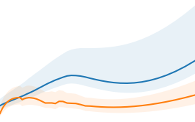
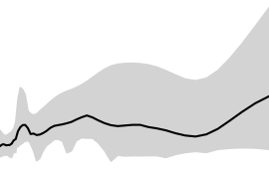
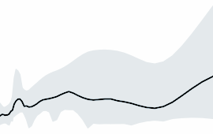
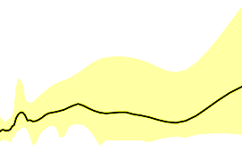
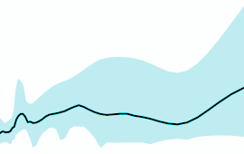
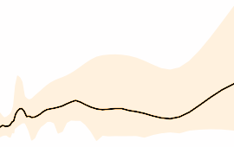
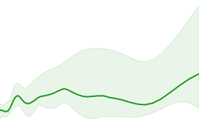
Combining background signals
If good fit* and astrophysical → combine*?
CATALOG A
COMBINED PREDICTION
INDIVIDUAL SIGNALS
Model A1 +
Model A2
Posterior-weighted
Model predictions
…
Inflation
Unresolvable CBC
?
Cosmic strings
CATALOG B
SUMMARY STATS
Non-parametric
Model
good fit*
How can we check ?
What if all models are bad?
combine*
Err…
Rates
Limits
…

Slide 17
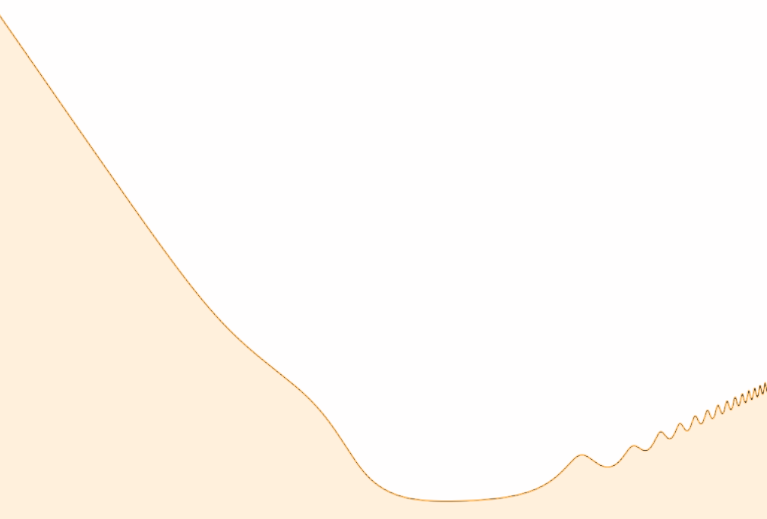
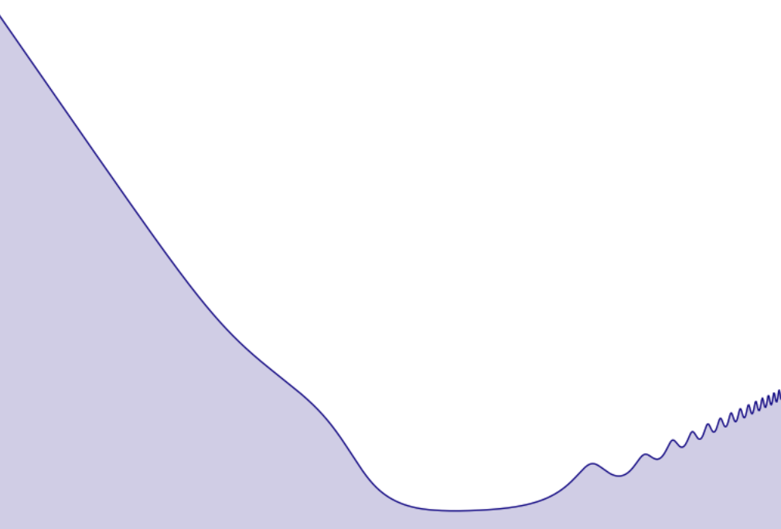
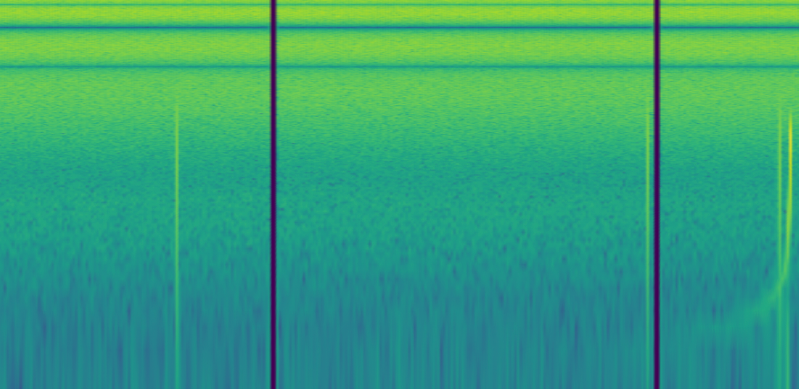
Combining noise estimate
NOISE A
Noise estimation may be dependant on GW signals
NOISE B
Can we combine noise estimates the same way as the GW background?
FOREGROUND
GW BACKGROUND
NOISE
LISA DATA
Verification 1
?
+
+
=
Signal 1 {pos, f}
Signal 2 {pos, f}
This requirement puts constraints on the combined noise estimate

Slide 18
Some questions:
1) What will L3 contain/
what do astronomers want
(in addition to galactic coordinates)
2) How can we find the same foreground signal in multiple L2 catalogs
Are they astrophysical signals?
3) How can we combine foreground/background/noise estimates?
What if catalogs use different models, priors, data conditioning?
4) Combining posteriors from parametric vs non-parametric models?
5) Will L2 use multiple waveforms?
6) Does combining GW backgrounds even make sense?
7) What is a good fit?
And more questions:
8) Can L3 be a mix of L3 + L2?
High SNR → L3 combined
Low SNR → references to L2 products
9) Do specs for L2 exist?
Will all L2 catalogs contain evidence for each signal?
10) Are there going to be simulation tests to calibrate the global fits?
Identify differences in global fit outputs
(Eg LVK search FARs vastly different)
11) Should we use models for L2→L3?
How do we decide which models to use?
12) Will the combined catalog satisfy:
data = foreground + background + noise
Can we ignore this?

Slide 19
Goals
Challenges
Combined global fit
Other astronomers wont care about different methods etc
They want 1 single answer from LISA
Eg number of objects, parameters, rates
Assuming that the community wants posterior samples
These are the signals
These are the estimates for the signals
What do we want to combine for the background?
Different data analysed
Sampling rate
FFT method, windowing
Cleaning/ conditioning
Different events found
Event significance?
Are events the same?
Different models used
Parametric vs nonparametric
Waveforms systematics (include HOM, etc)
Aligned vs non-aligned
Some models may not be considered
eg one global-fit will ignore cosmic-strings,
Another ignores EMRIs with f< some threshold
Different noise-estimations
Leads to different data analysed…
Could contribute to finding/losing signals

Slide 20
Things that need to be done to combine catalog:
Combine foreground signals (EMRIs, DCOs,...)
Assuming parametrically modeled signal analysis, and each
has an independent analysis
after/before the global-fit that provides an LnZ for the signal.
Is the signal astrophysical?
What if the ‘signal’ is actually from some noise artefact?
How can we reconcile if the signal is only present in 1 catalog and not the others?
Using LnZ signal vs LnZ noise? Some pastro metric?
Does the search pipeline have a false positive rate?
Assuming that they are astrophysical… (or someone gives us a ‘p-astro’)
[others are working on if a signal is a glitch or astrophysical]
Can we find the same signal in other catalogs?
How do we find the same signal in the other catalogs?
Using the same approach EM follow up folks use?
(search in same sky region, time)
Assuming we have an lnZ for each signal, and each model has the same parameters
Combined PE for signal
How should we combine PE for the signal?
Can we used some LnZ weighted importance sampling/mixing technique?
https://journals.aps.org/prd/pdf/10.1103/PhysRevD.101.064037 (Multiwaveform inference of gravitational waves)
GWTC3 paper (Section on “Waveform Systematics” – why LVK didnt use this)
—-
https://www.jstor.org/stable/20799887 (A Note on Bayesian Inference After Multiple Imputation)
https://journals.sagepub.com/doi/10.1177/1745691616658637 Increasing Transparency Through a Multiverse Analysis
https://arxiv.org/abs/1502.04206 Combining probability distributions: Extending the logarithmic pooling approach
https://arxiv.org/pdf/1803.01984.pdf Bayesian Predictive Synthesis with Outcome-Dependent Pools
https://www.sciencedirect.com/science/article/pii/S0378375817301702 Combining independent Bayesian posteriors into a confidence distribution, with application to estimating climate sensitivity
Bayesian model averaging (what are you interested in?)
Say 6/7 global fits find a SMBH
How do we combine 6 estimates → final parameters to describe SMBH
Missing parameter – ‘borrow strength’
Notes:
Bayesian model average
You can have different models
You combine all posteriors weighed by LnZ

Slide 21
Things that need to be done to combine catalog:
2) Combine GW background signals (cosmo, astro)
GW-Background sources:
Astro
Galactic foreground: white dwarf binaries
Hum of Stochastic DCOs (BBH, BNS, NSBH, binary stars)
Supernovae
(Non-axisymmetric) Pulsars/magnetars
Cosmological:
Cosmic strings
Inflation
First-order phase transitions
Challenges:
Parametric vs non-parametric signal models
Different number of models used:
Some catalogs may try to split up the GW background in individual signal components (eg power law model for strings, etc)
Data used for analysis different
Signal subtraction from previous stage will be different
Maybe data chunked/windowed differently
H_1 = alpha h_cosmicstrings + beta h_inflation + ….
H_2 = non-parametric
H_n = alpha_n h_inflation
—
Questions:
Combining samples from different models: Can we combine posterior model-predictions rather than the posterior itself? Will that still be useful?
Weigh each curve with a Bayesian model averaging
Treat each F as a different parameter and then combine them together

Slide 22
Bayesian normal-normal hierarchical model
Assume that we have estimates theta_i with standard deviations sigma_k from study k, i=1,...,K
\theta_k ~ N(mu_k, sigma_k) independent for k=1,...,K (Independence assumption is problematic for LISA applications as all global fits use the same data)
\mu_k ~ N(]mu, \tau) independent (random effects distribution)
\mu ~ p(\mu) (Usually noninformative)
\tau ~ p(\tau)
What about LnZ_i? – this does not use LnZ
(no, considers all models as equally relevant as well as results from each study as independent: points for discussion!)

