Slide 2
An overview of scientific publications
Historically: the scientific publication market is in the hands of learned societies
1665: foundation of the first scientific journal, Philosophical Transactions (Royal Society)
The purpose of scientific journals is to disseminate research work and contribute to debate between scientists

Slide 3
An overview of scientific publications
After the Second World War: proliferation of scientific journals
Commercial publishing houses enter this market by becoming owners or publishers of scientific journals e.g. Académie des Sciences-Elsevier agreement; Wiley
⇨2017: 100 000 journals

Slide 4
An overview of scientific publications
1990s: emergence of online journal platforms
1980s-1990s: concentration and emergence of an oligopolistic market:
➪ Reed-Elsevier, Springer Nature, Wiley-Blackwell, Taylor&Francis, Sage publish +50% of scientific articles worldwide
Linguistic concentration: English

Slide 5
An overview of scientific publications
The author and the reviewer are not remunerated by the publisher (remuneration in symbolic capital)
The author transfers all his rights to the publisher: the publisher becomes the new exclusive owner of the copyright
The publisher exploits its monopoly over the intellectual resource
For the researcher: “publish or perish”

Slide 6
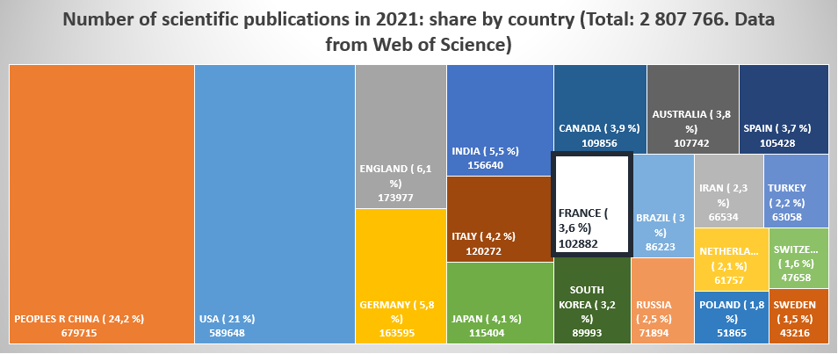
An overview of scientific publications

Slide 7
An overview of scientific publications
The three major publishers Elsevier,
SpringerNature and Wiley publish 48% of
French articles.
MDPI and Frontiers saw a vertiginous increase
in their publication rate between 2029 and 2021,
both internationally and in France.
Elsevier continues to lead the way, maintaining
its growth.

Slide 8
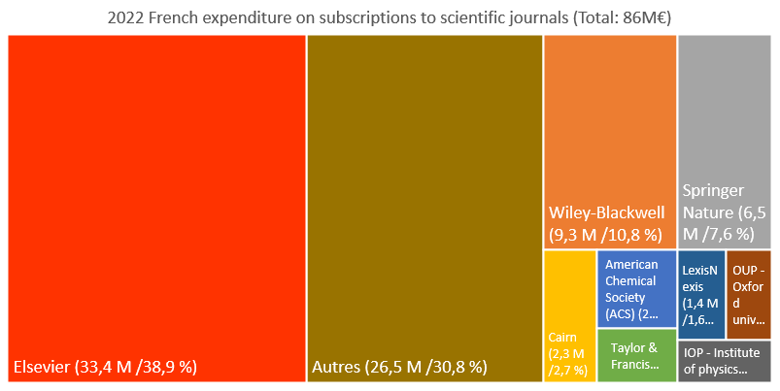
An overview of scientific publications

Slide 9
An overview of scientific publications
Scientific publications in physics worldwide: (WoS)
2021: 199 395 publications published by
Elsevier (commercial publisher)
MDPI (Open access publisher)
American Physical Society (learned society)
Springer Nature (commercial publisher)
Institute of Physics (learned society)
IEEE (learned society)
Wiley (commercial publisher)
AIP Publishing (learned society)
Royal Society of Chemistry (learned society)
American Chemical Society (learned society)

Slide 10
An overview of scientific publications
Scientific publications in physics at University of Strasbourg : (WoS)
2021: 384 publications published by
APS
Springer Nature
Elsevier
RSC
Wiley
MDPI
IOP
ACS
AIP Publishing
World Scientific

Slide 11
An overview of scientific publications
Open Access: the term "open access" applied to scientific publication refers to the removal or lowering of legal, financial and technical barriers to the dissemination of research results, so that they can be consulted and re-used
1991: arXiv a free distribution service and an open-access archive for 2,275,234 scholarly articles in the fields of physics, mathematics, computer science,…

Slide 12
An overview of scientific publications
New Open Access business models:
Article funding: payment of an Article Processing Charge by the author of the institution ⇨ the « hybrid journals » issue
Sponsoring, institutional partnership (« Diamond open access »), freemium (pay for additional service)
Ex: SciPost, SCOAP3
Agreements with publishers: read & publish, transformative agreement, subscribe to open
Ex : EDP Sciences

Slide 13
An overview of scientific publications
« Mega-journals » (Scientific Reports…)
New players: MDPI, Frontiers, Hindawi…
Journals « flipping » to open access
Diamond Open Access
Preprints servers
Predatory publishers

Slide 14
An overview of scientific publications
Predatory publishers: publishers who charge a fee for the publication of material without providing the publication services an author would expect such as peer review and editing. Claims of “quick peer review”, fake editorial boards, hidden charges, and fake Journal Impact Factors…
Useful tool: Think! Check! Submit!
Useful tool: Directory of Open Access Journal

