Slide 1
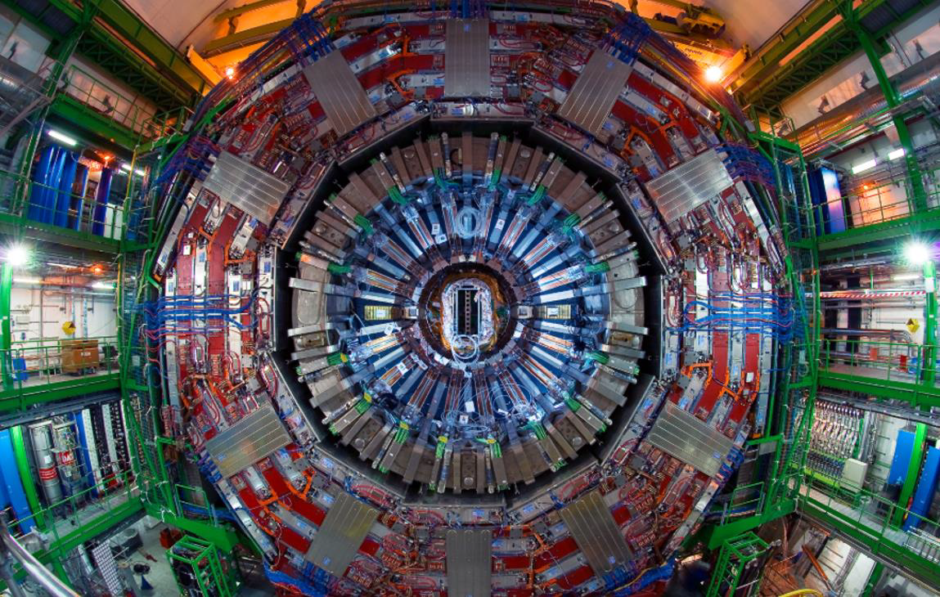





Searches for additional Higgs bosons at low mass with CMS
Suzanne GASCON-SHOTKIN
IP2I Lyon (IN2P3-CNRS)/Université Claude Bernard Lyon 1
on behalf of the CMS Collaboration
Rencontres de Moriond EW 2023
March 23, 2023 Hotel Planibel, LA THUILE (IT)

Slide 2
Outline
Three new CMS searches for additional low-mass Higgs bosons presented here for the first time!
All using full LHC Run 2 data!
  Exotic SM-like H₁₂₅→a₁a₁→μμbb or ττbb (12 GeV<m_{a1}<62.5 GeV)
  CMS-PAS-HIG-22-007 (includes CMS-PAS-HIG-21-021(μμbb) + combination) Motivated by significant BR in 2HDM + S models
  http://cds.cern.ch/record/2853298?ln=en
  SM-like H→γγ (70 GeV<m_{H}<110 GeV)
  CMS-PAS-HIG-20-002 Allowed in many BSM models http://cms-results.web.cern.ch/cms-results/public-results/preliminary-results/HIG-20-002/
  LFV SM (H₁₂₅) or SM-like Exotic X→eμ (110 GeV<m_{X}<160 GeV)
  CMS-PAS-HIG-22-002 Exotic case with m_{X}<2m_{W} motivated by potential constraints on Type III 2HDM
  http://cms-results.web.cern.ch/cms-results/public-results/preliminary-results/HIG-22-002/index.html
Conclusion and perspectives
Acknowledgements
Credit: CMS Low-Mass H→γγ team
2

Slide 3
Exotic SM-like H₁₂₅→a₁a₁→μμbb or ττbb (12 GeV<m_{a1}<62.5 GeV)
  http://cds.cern.ch/record/2853298?ln=en
CMS-PAS-HIG-22-007
Principal backgrounds: DY, ttbar, single t, dibosons
H→a₁a₁→μμbb (CMS-PAS-HIG-21-021)
  Exploit and
  with requirement on
  5 event categories based on jet p_{T}, b-tag scores,
  additional jet activity
  Data-driven background modeling
  Unbinned ML fit to m_{μμ} distribution
H→a₁a₁→ττbb with μτ_{h}, eτ_{h}, eμ channels
  Exploit DNNs with important discriminating variables: m_{bττ} , transverse mass (l , p_{Tmiss})
  (both smaller for signal), where ζ is bisector of directions of visible τ decay products transverse to beam (small for DY, large for ttbar),
  14 event categories based on 1,>1 b-jets, DNN
  Mostly data-driven background modeling
  Binned ML fit to m_{ττ} distribution
Transformed DNN
μτ_{h}

Slide 4
Exotic SM-like H₁₂₅→a₁a₁→μμbb or ττbb (12 GeV<m_{a1}<62.5 GeV)
  http://cds.cern.ch/record/2853298?ln=en
CMS-PAS-HIG-22-007
95% CL UL on B(H→a₁a₁→ττbb)
μτ_{h}
eτ_{h}
eμ
Only channel providing sensitivity down to m_{a1}=12 GeV
Most sensitive channel, limits as low as 1.4%
Notes:
Only the em channel provides sensitivity
to the 12 GeV mass point, as in this channel the baseline cut on the DR between the two t candidates
is the lowest.

Slide 5
Exotic SM-like H₁₂₅→a₁a₁→μμbb or ττbb (12 GeV<m_{a1}<62.5 GeV)
  http://cds.cern.ch/record/2853298?ln=en
CMS-PAS-HIG-22-007
95% CL UL on : B(H→a₁a₁→μμbb) B(H→a₁a₁→ττbb) B(H→a₁a₁→llbb) combination
={0.17-3.3} X 10⁻⁴ ={1.7-7.6} X 10⁻² ={0.7-7.7} X 10⁻²
(ATLAS={0.22-4} x 10⁻⁴)
CMS-PAS-HIG-21-021
Principal systematic uncertainties
Limits improved wrt expectation from lumi increase: Improvements to χ² method for μμbb and use of DNN for ττbb
First H₁₂₅→a₁a₁→μμ(ττ)bb results with Full Run 2!
Notes:
Combined fit (text)?
(***what mass range?) our limits slightly better than ATLAS (ref)
No excess of events wrt expected SM background yields. First combined with Full Run 2?***
depending on the pseudoscalar mass that varies between 12 and 62.5 GeV.

Slide 6
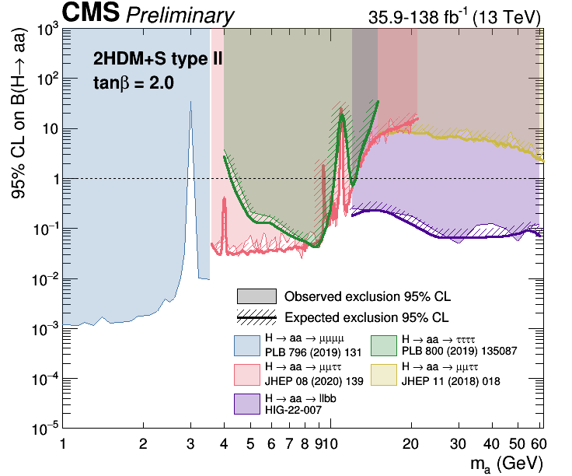
Exotic SM-like H₁₂₅→a₁a₁→μμbb or ττbb (12 GeV<m_{a1}<62.5 GeV)
  http://cds.cern.ch/record/2853298?ln=en
CMS-PAS-HIG-22-007
Interpretations in 2HDM +S : 95% CL UL on B(H→a₁a₁→llbb) with l = {μ,τ} in (tanβ, m_{a1}) plane
Type II : B(H→a₁a₁) >0.23 excluded @95% CL
https://twiki.cern.ch/twiki/bin/view/CMSPublic/Summary2HDMSRun2
Types III and IV: 95% UL on B(H→a₁a₁) : contours@16%: combined upper limit on H₁₂₅→BSM in Run 2 (Nature 607 (jul, 2022) 60–68)
Type III with tanβ=2.0: 95% UL on B(H→a₁a₁) between 0.07 and 0.01
Type IV with tanβ=0.6: 95% UL on B(H→a₁a₁) between 0.23 and 0.05

Slide 7
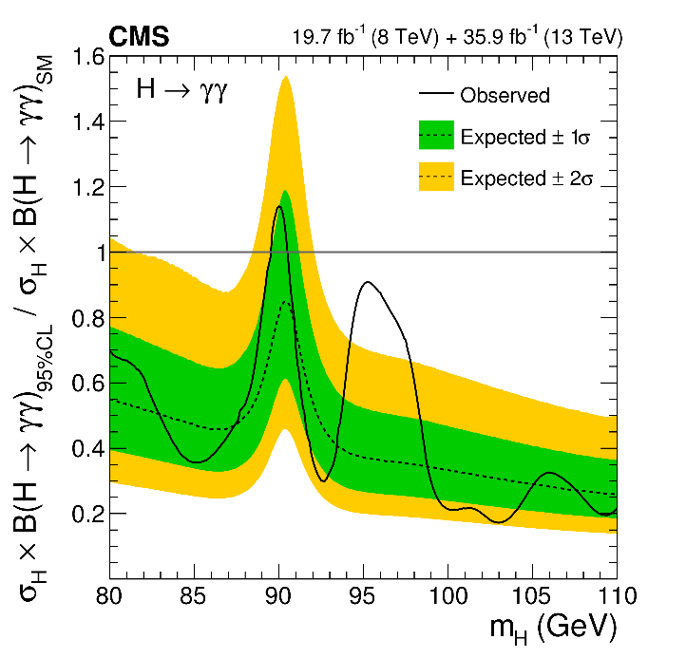
SM-like H→γγ (70 GeV<m_{H}<110 GeV)
CMS-PAS-HIG-20-002
  http://cms-results.web.cern.ch/cms-results/public-results/preliminary-results/HIG-20-002/
Search for narrow signal peak over smoothly-falling background (direct γγ , reducible γ + jet, jet+jet processes) except for relic Z→ee
Event reconstruction/selection, γ ID techniques (BDTs), signal and data-driven background modeling with discrete profiling method inherited from SM H→γγ analysis
Major changes wrt prior version (PLB 793 (2019) 320) (2012+2016 data):
  Kinematic event selection BDT (p_{T}/m_{γγ}, η , cos(φ₁−φ₂), both PhotonID BDT outputs, mass resolution wrt correct and incorrect vertices, vertex probability) reoptimized and events categorized for low-mass case
  Electron/relic Z→ee veto (based on pixel detector hits) reinforced with:
    Rejection of photon candidates also reconstructed as electrons
    Maximum value of ln (Σp_{T}²/GeV²)[tracks in chosen vertex] as function of p_{Tγγ}
  2017/18: Events with additional jets selected for class targeting VBF process
  2016: data reanalyzed with improved calibration
Major systematic uncertainties: per-photon energy resolution <20%, renormalization and factorization scales<14%, UE modeling <27%, PS<16%, JES corrections (VBF class) <16%.
PLB 793 (2019) 320

Slide 8
SM-like H→γγ (70 GeV<m_{H}<110 GeV)
CMS-PAS-HIG-20-002
  http://cms-results.web.cern.ch/cms-results/public-results/preliminary-results/HIG-20-002/
Observed and expected 95% CL UL on σ X B relative to SM-like expectation (production processes assumed in SM proportions)
Observed local p-values for 2016, 2017, 2018 and combination
Modest excess with ~2.9σ local (1.3σ global) significance at m_{γγ}=95.4 GeV, more data needed to conclude!
Observed absolute 95% CL UL on σ X B between 15-73 fb

Slide 9
SM-like H→γγ (70 GeV<m_{H}<110 GeV)
CMS-PAS-HIG-20-002
  http://cms-results.web.cern.ch/cms-results/public-results/preliminary-results/HIG-20-002/
Observed and expected 95% CL limits on σ X B by production process (integrated over all event classes)
100% production via gluon-induced processes (ggH, ttbarH in SM proportions)
100% production via fermion-induced processes (VBF, VH in SM proportions)
100% production via VBF
100% production via VH

Slide 10
SM-like H→γγ (70 GeV<m_{H}<110 GeV)
CMS-PAS-HIG-20-002
  http://cms-results.web.cern.ch/cms-results/public-results/preliminary-results/HIG-20-002/
‘Signal’ strengths μ fixing m_{H}=95.4 GeV
for the 11 event classes χ² compatibility probability: 68%
for the 3 years χ² compatibility probability: 6%
S/(S+B)-weighted m_{γγ} distribution with S+B fit for m_{H} =95.4 GeV
First search for new diphoton resonances in this mass range with full LHC Run 2 data!

Slide 11
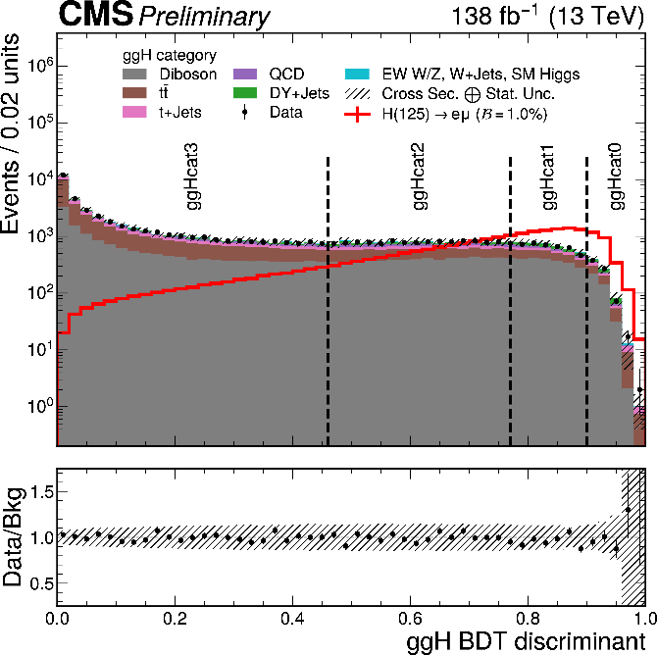
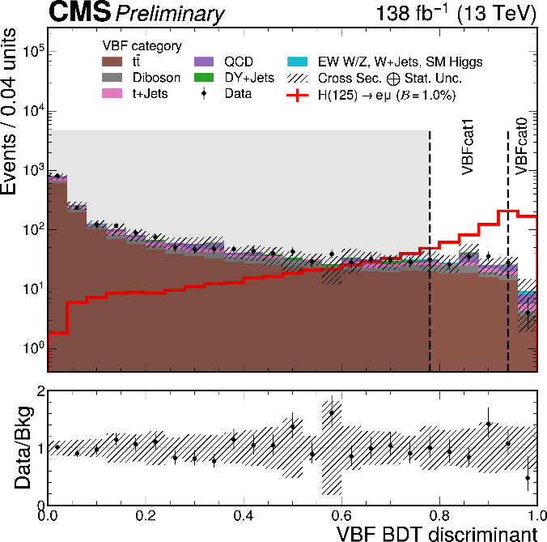
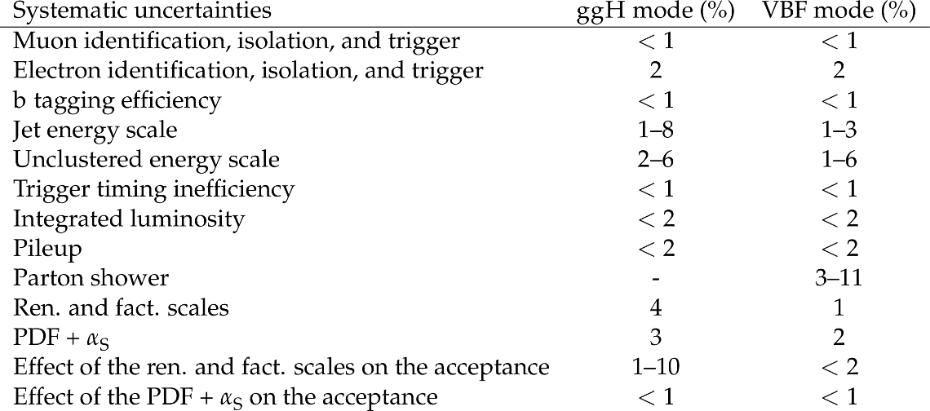
LFV SM (H₁₂₅) or SM-like Exotic X→eμ (110 GeV<m_{H}<160 GeV)
CMS-PAS-HIG-22-002
  http://cms-results.web.cern.ch/cms-results/public-results/preliminary-results/HIG-22-002/index.html
Targets ggH and VBF production modes
Principal backgrounds: ttbar or WW→leptons, DY with mis-id lepton
Exploit BDTs with important input variables: p_{Tmiss}, p_{T}-centrality,
p_{T}-balance ratio, jet-related variables, and Zeppenfeld variable for VBF:
4 ggH, 2 VBF categories based on BDT scores
Data-driven background modeling
ML fit to m_{eμ} distribution
ggH
VBF
Discarded
Principal systematic uncertainties

Slide 12
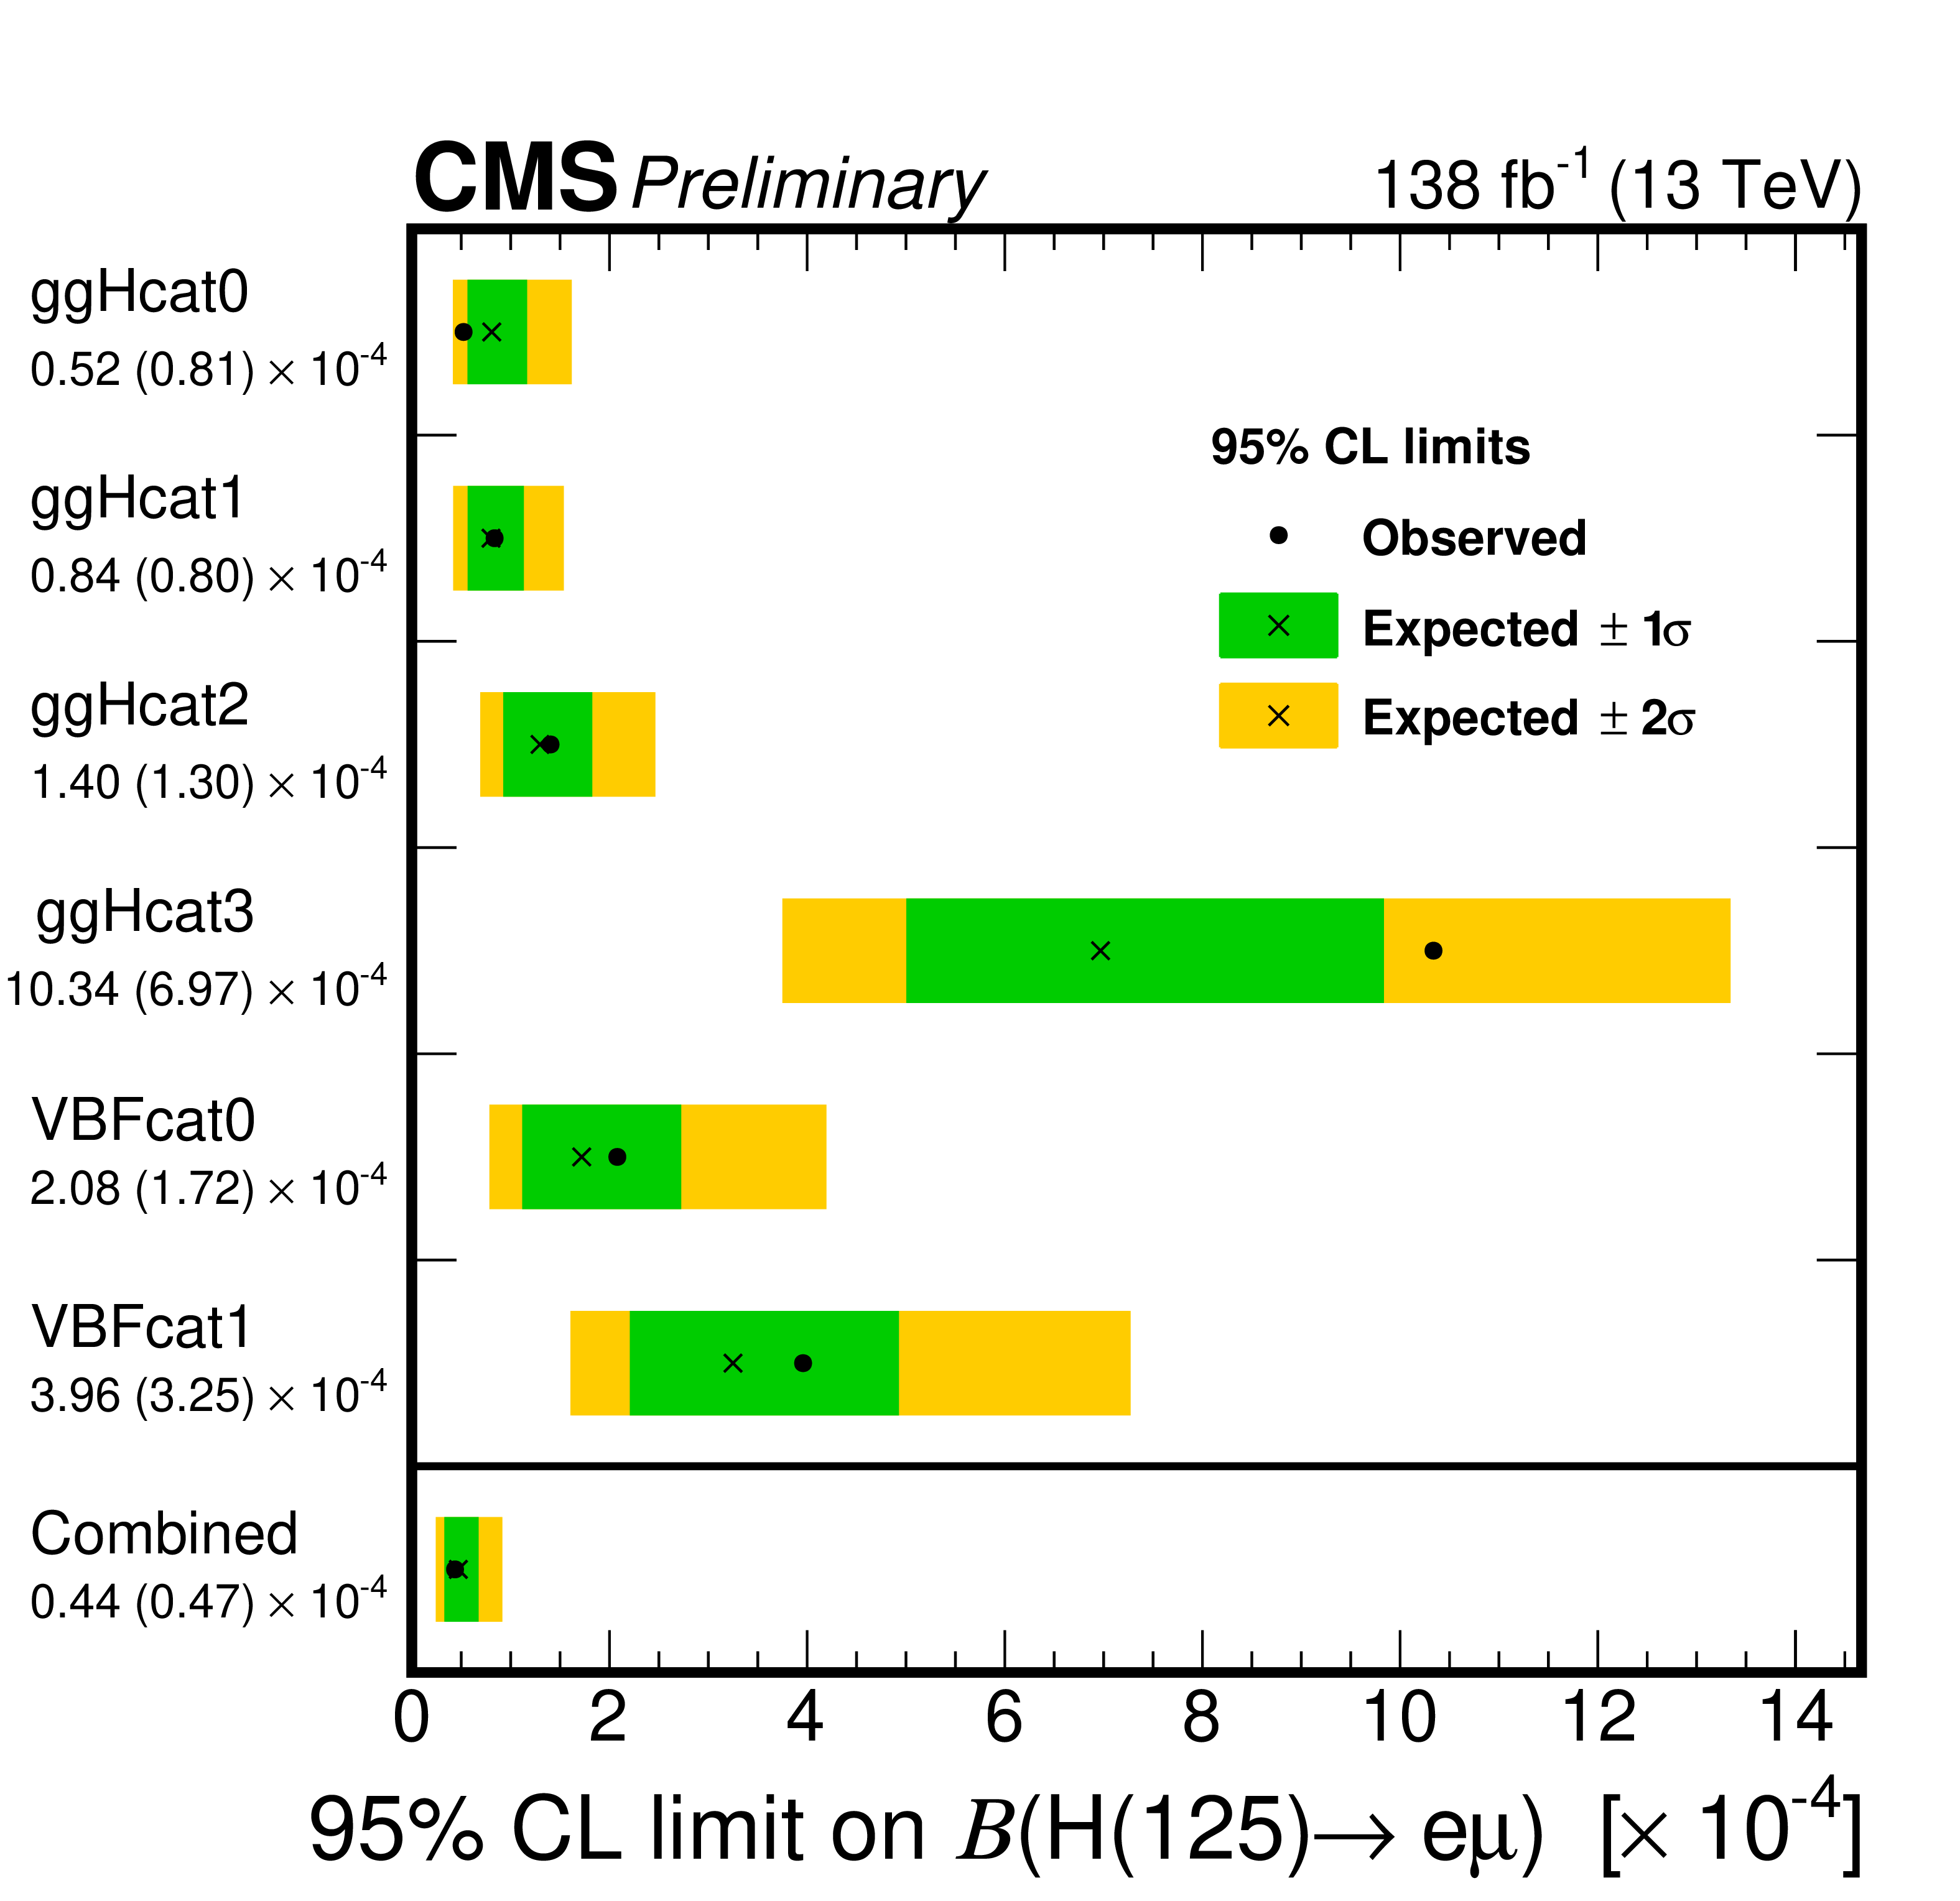
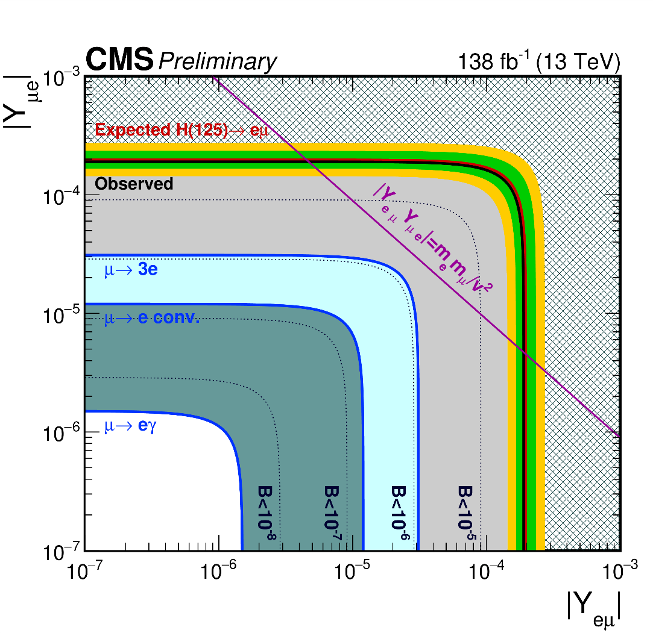
LFV SM (H₁₂₅) or SM-like Exotic X→eμ (110 GeV<m_{H}<160 GeV)
CMS-PAS-HIG-22-002
  http://cms-results.web.cern.ch/cms-results/public-results/preliminary-results/HIG-22-002/index.html
Excluded
Constraints on LFV Yukawa couplings: |Y_{eμ}|, |Y_{μe}|
Observed (expected) 95% CL UL: √ |Y_{eμ}|² + |Y_{me}|² < 1.9(2.0) x 10⁻⁴
Observed (expected) combined limit on B: 4.4(4.7) X 10⁻⁵ most stringent direct limit to-date!

Slide 13
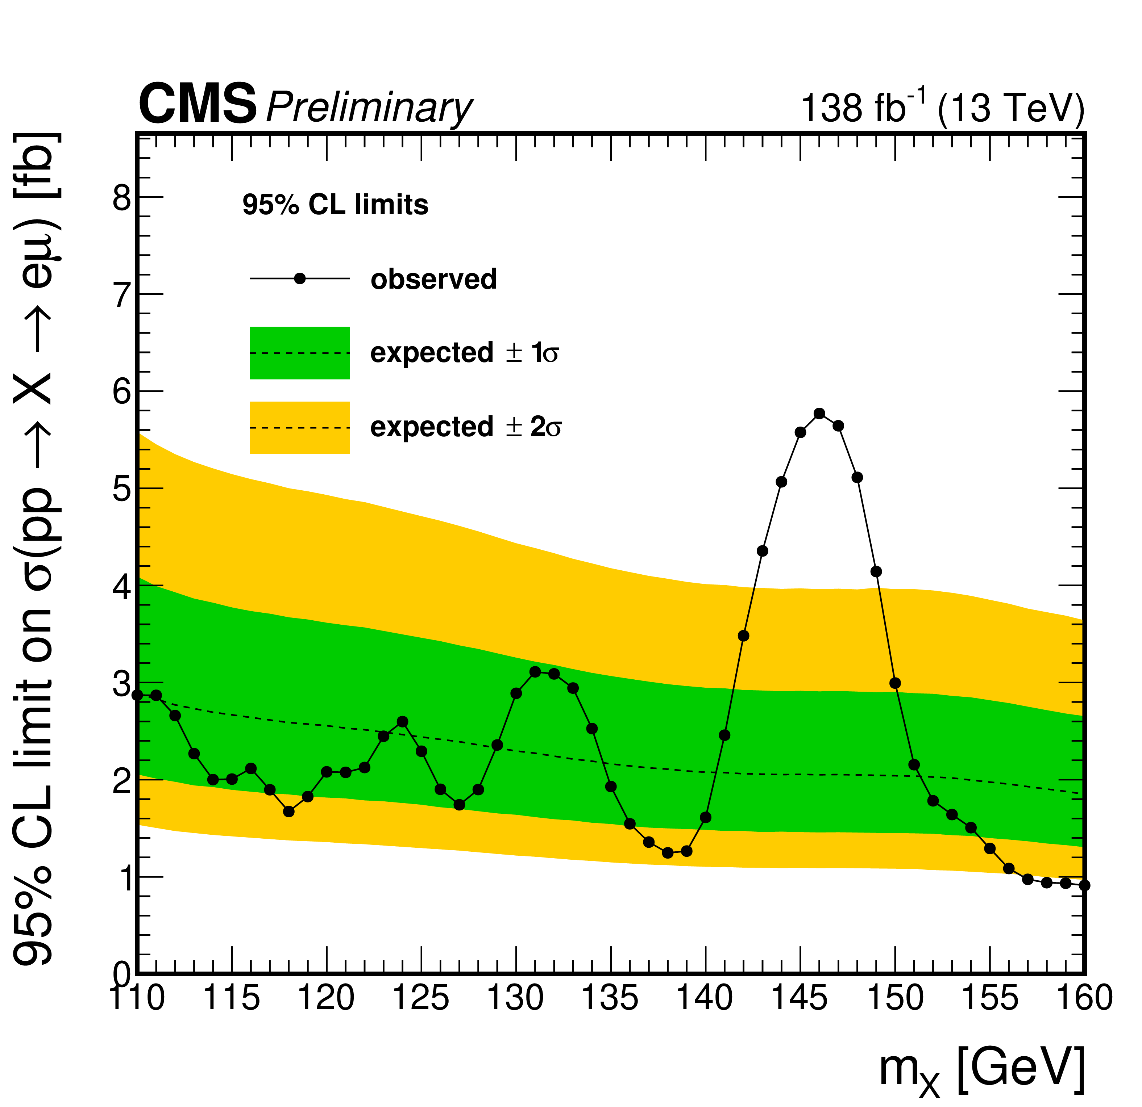
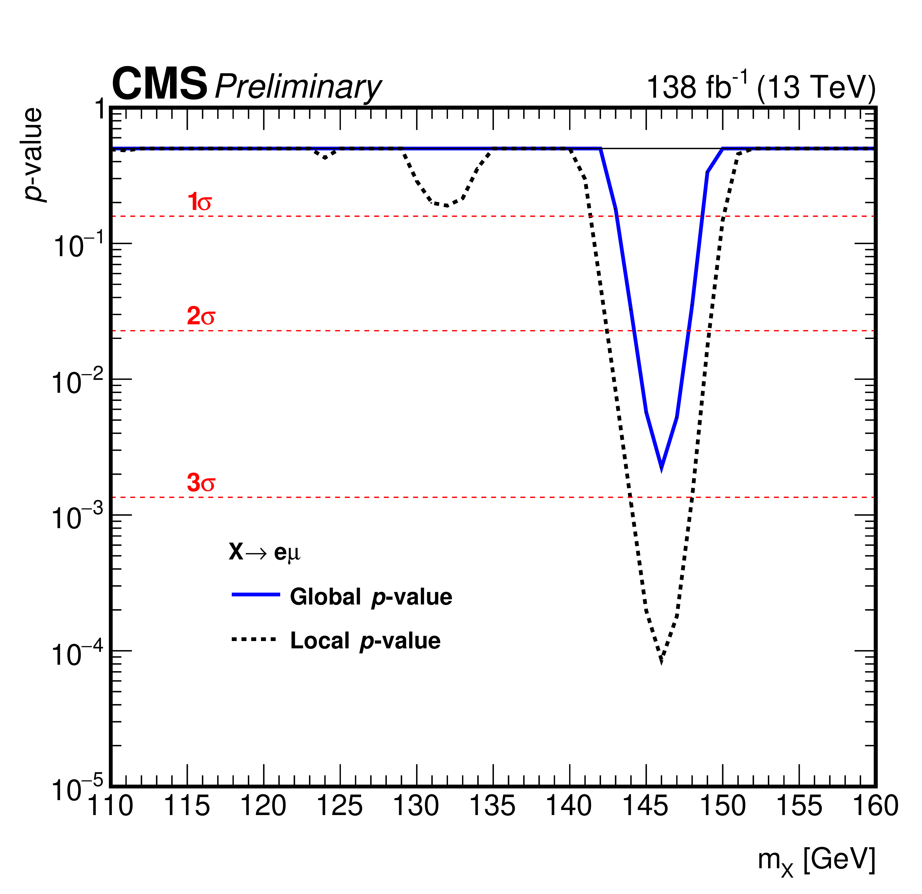
LFV SM (H₁₂₅) or SM-like Exotic X→eμ (110 GeV<m_{H}<160 GeV)
CMS-PAS-HIG-22-002
  http://cms-results.web.cern.ch/cms-results/public-results/preliminary-results/HIG-22-002/index.html
Observed & expected 95% CL UL on σ (pp→X→eμ)
Excess observed for m_{eμ}~146 GeV with global (2.8 σ) and local (3.8σ) significances
Not visible in ATLAS m_{eμ} spectrum (PLB 801 (2019) 135148), more data needed to conclude!

Slide 14
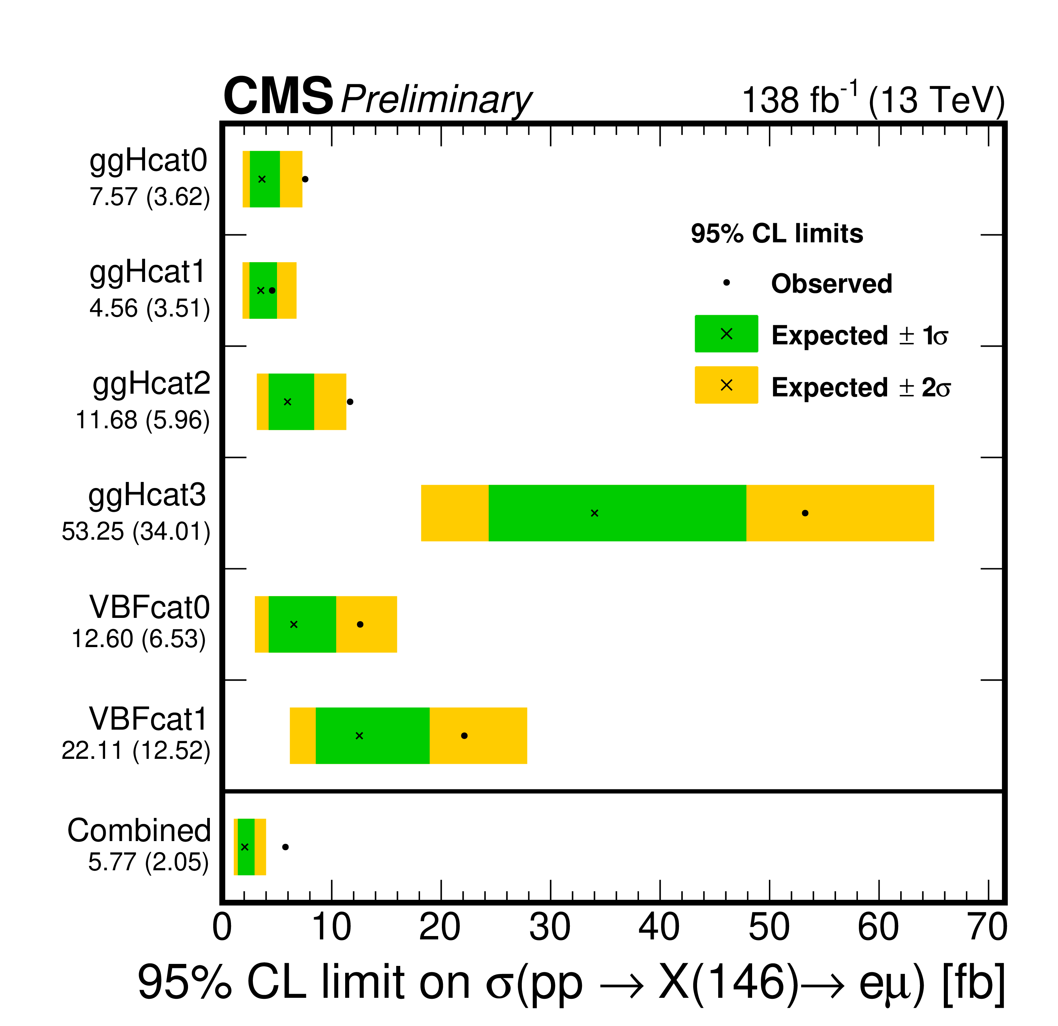
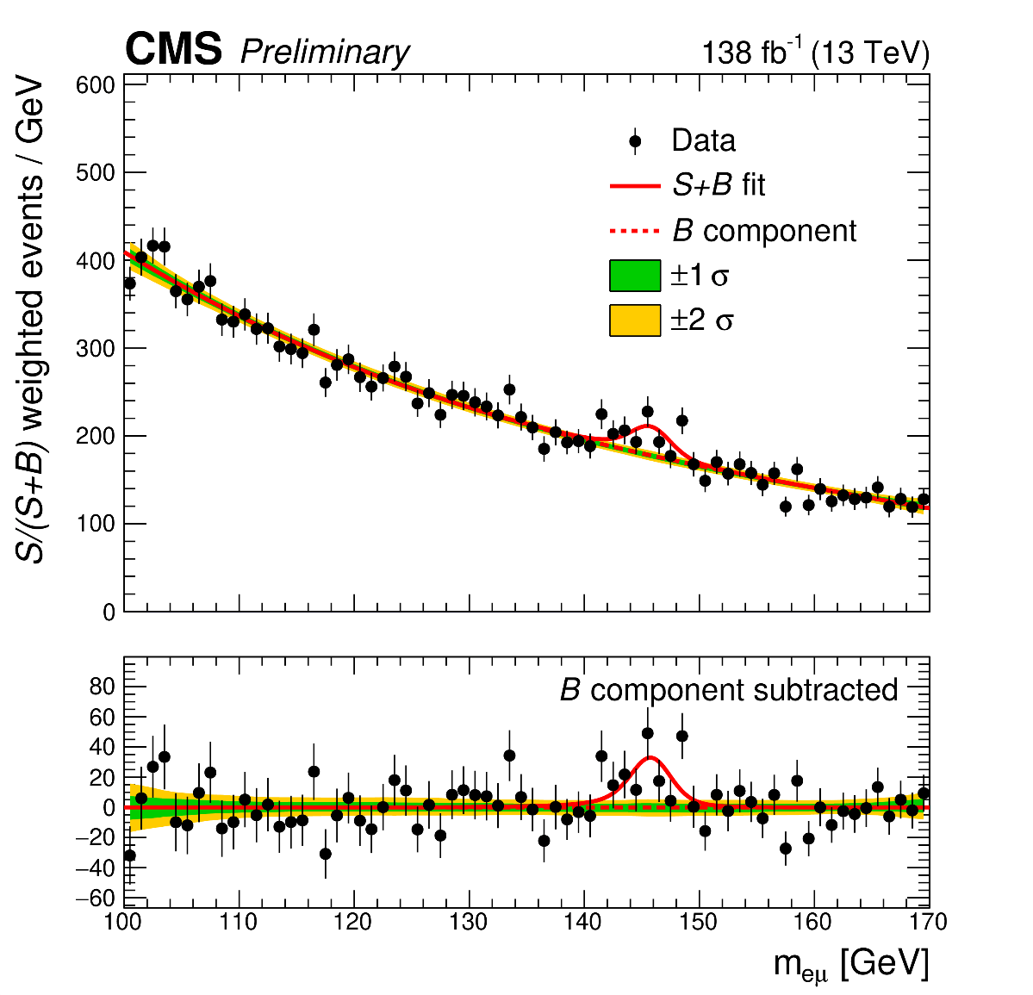
LFV SM (H₁₂₅) or SM-like Exotic X→eμ (110 GeV<m_{H}<160 GeV)
CMS-PAS-HIG-22-002
  http://cms-results.web.cern.ch/cms-results/public-results/preliminary-results/HIG-22-002/index.html
Observed (expected) 95% CL UL on σ (pp→X(146)→eμ) for each category and for their combination
S/(S+B)-weighted m_{eμ} distribution with S+B fit for m_{X} =146 GeV
First direct search for extra Higgs with m<2m_{W}

Slide 15
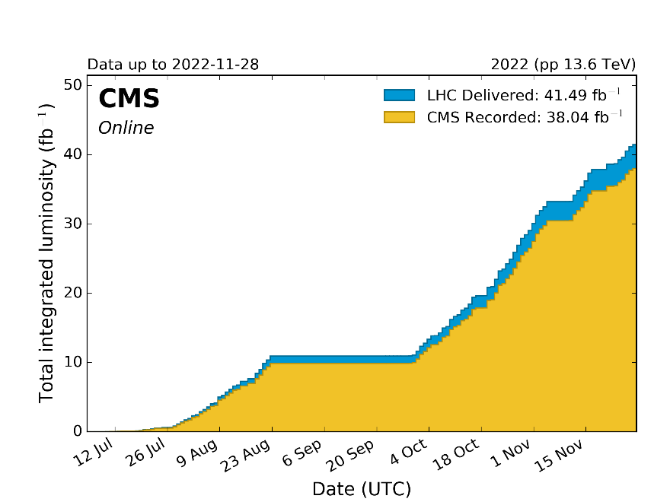
Conclusions and Perspectives
Presented three brand-new CMS searches for additional low-mass Higgs bosons using full LHC Run 2 data: No evidence for the existence of extra Higgs bosons has been found so far:
  Exotic SM-like H₁₂₅→a₁a₁→μμbb or ττbb (12 GeV<m_{a1}<62.5 GeV): First results with Full Run 2! Stringent limits set in context of Types II,III and IV 2HDM+S
  LFV SM (H₁₂₅) →eμ: Most stringent direct limit to-date: BR< 4.4X10⁻⁵
  LFV SM-like Exotic X→eμ (110 GeV<m_{X}<160 GeV): First direct search in regime m<2m_{W}. Excess at m_{eμ}∼146 GeV with 3.8σ local (2.8σ global) significance
  SM-like H→γγ (70 GeV<mH<110 GeV): Excess at m_{γγ}=95.4 GeV with 2.9σ local (1.3σ global) significance. First diphoton resonance search in this mass range with full LHC Run 2 data
  More (Run 3) data is needed to conclude on the nature of these excesses….and it’s on it’s way! (250fb⁻¹)
2022~2016
https://twiki.cern.ch/twiki/bin/view/CMSPublic/LumiPublicResults
15
https://hilumilhc.web.cern.ch/content/lhc-baseline

Slide 16
Acknowledgements
F. Canelli, P. Das, A. DeWit, L. Finco, K.W. Ho, M. Lethuillier, H. Mei, M. Pierini, M. A. Shahzad, J. Steggemann, J. Tao…
Thanks to the Moriond EW organization!

Slide 17
Backup

Slide 18
Exotic SM-like H₁₂₅→a₁a₁→μμbb or ττbb (12 GeV<m_{a1}<62.5 GeV)
CMS-PAS-HIG-22-007
μμbb category definitions
ττbb category definitions

Slide 19
Exotic SM-like H₁₂₅→a₁a₁→μμbb or ττbb (12 GeV<m_{a1}<62.5 GeV)
CMS-PAS-HIG-22-007
Post-fit m_{ττ} distributions, μτ_{h} final state
1 b-jet SR
Post-fit m_{ττ} distributions, μτ_{h} final state
at least 2 b-jets SR

Slide 20
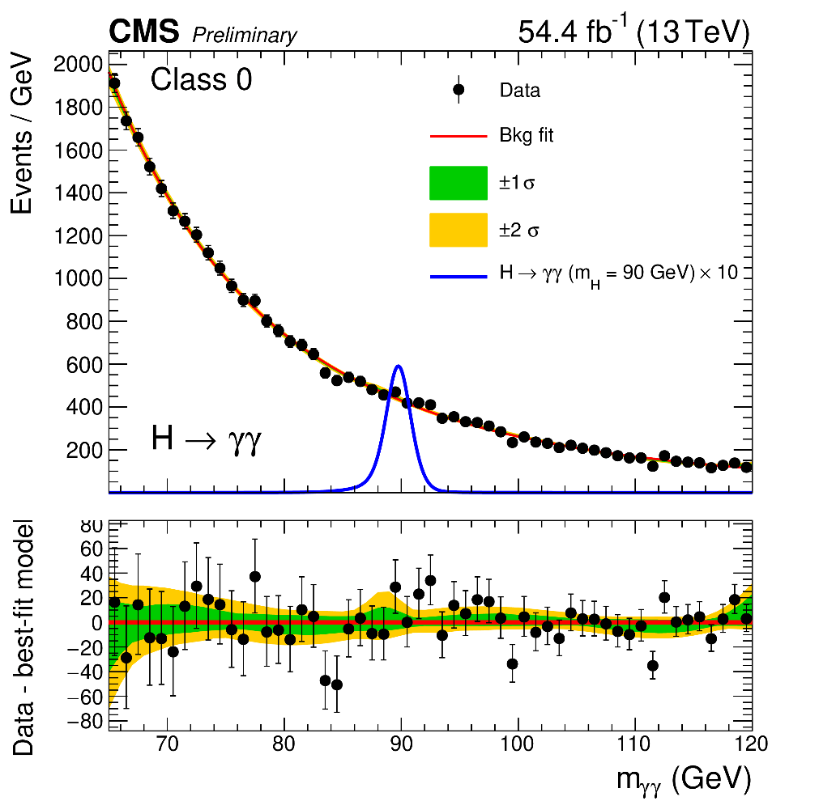
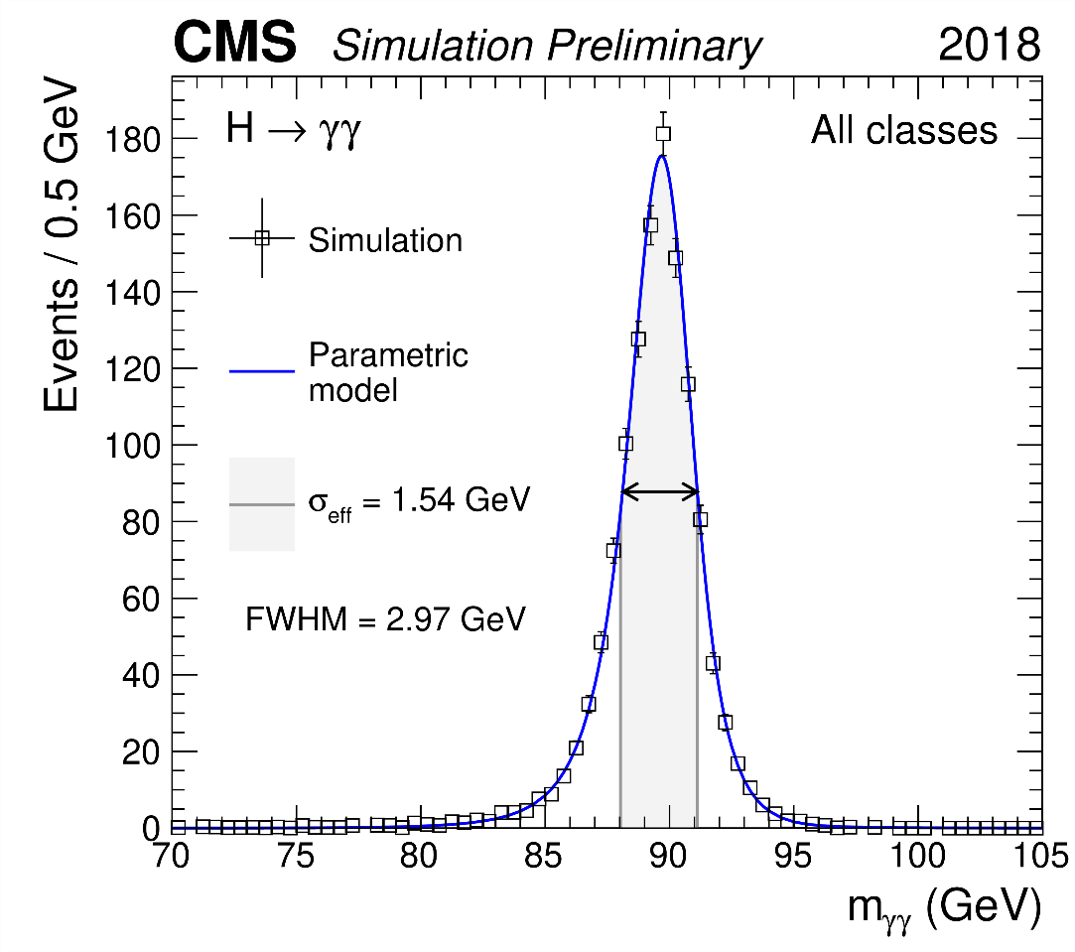
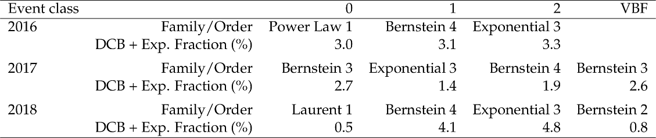
SM-like H→γγ (70 GeV<m_{H}<110 GeV)
CMS-PAS-HIG-20-002
  http://cms-results.web.cern.ch/cms-results/public-results/preliminary-results/HIG-20-002/
Signal modeling (sum of Gaussian functions), 2018
Background model fit, stat.uncertainties only, 2018
Families/orders of best-fit background functions with DCB+exponential fractions

Slide 21
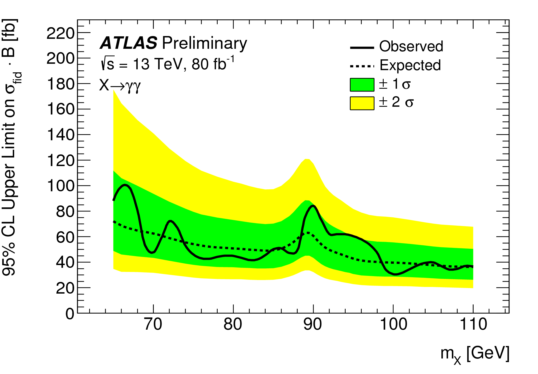
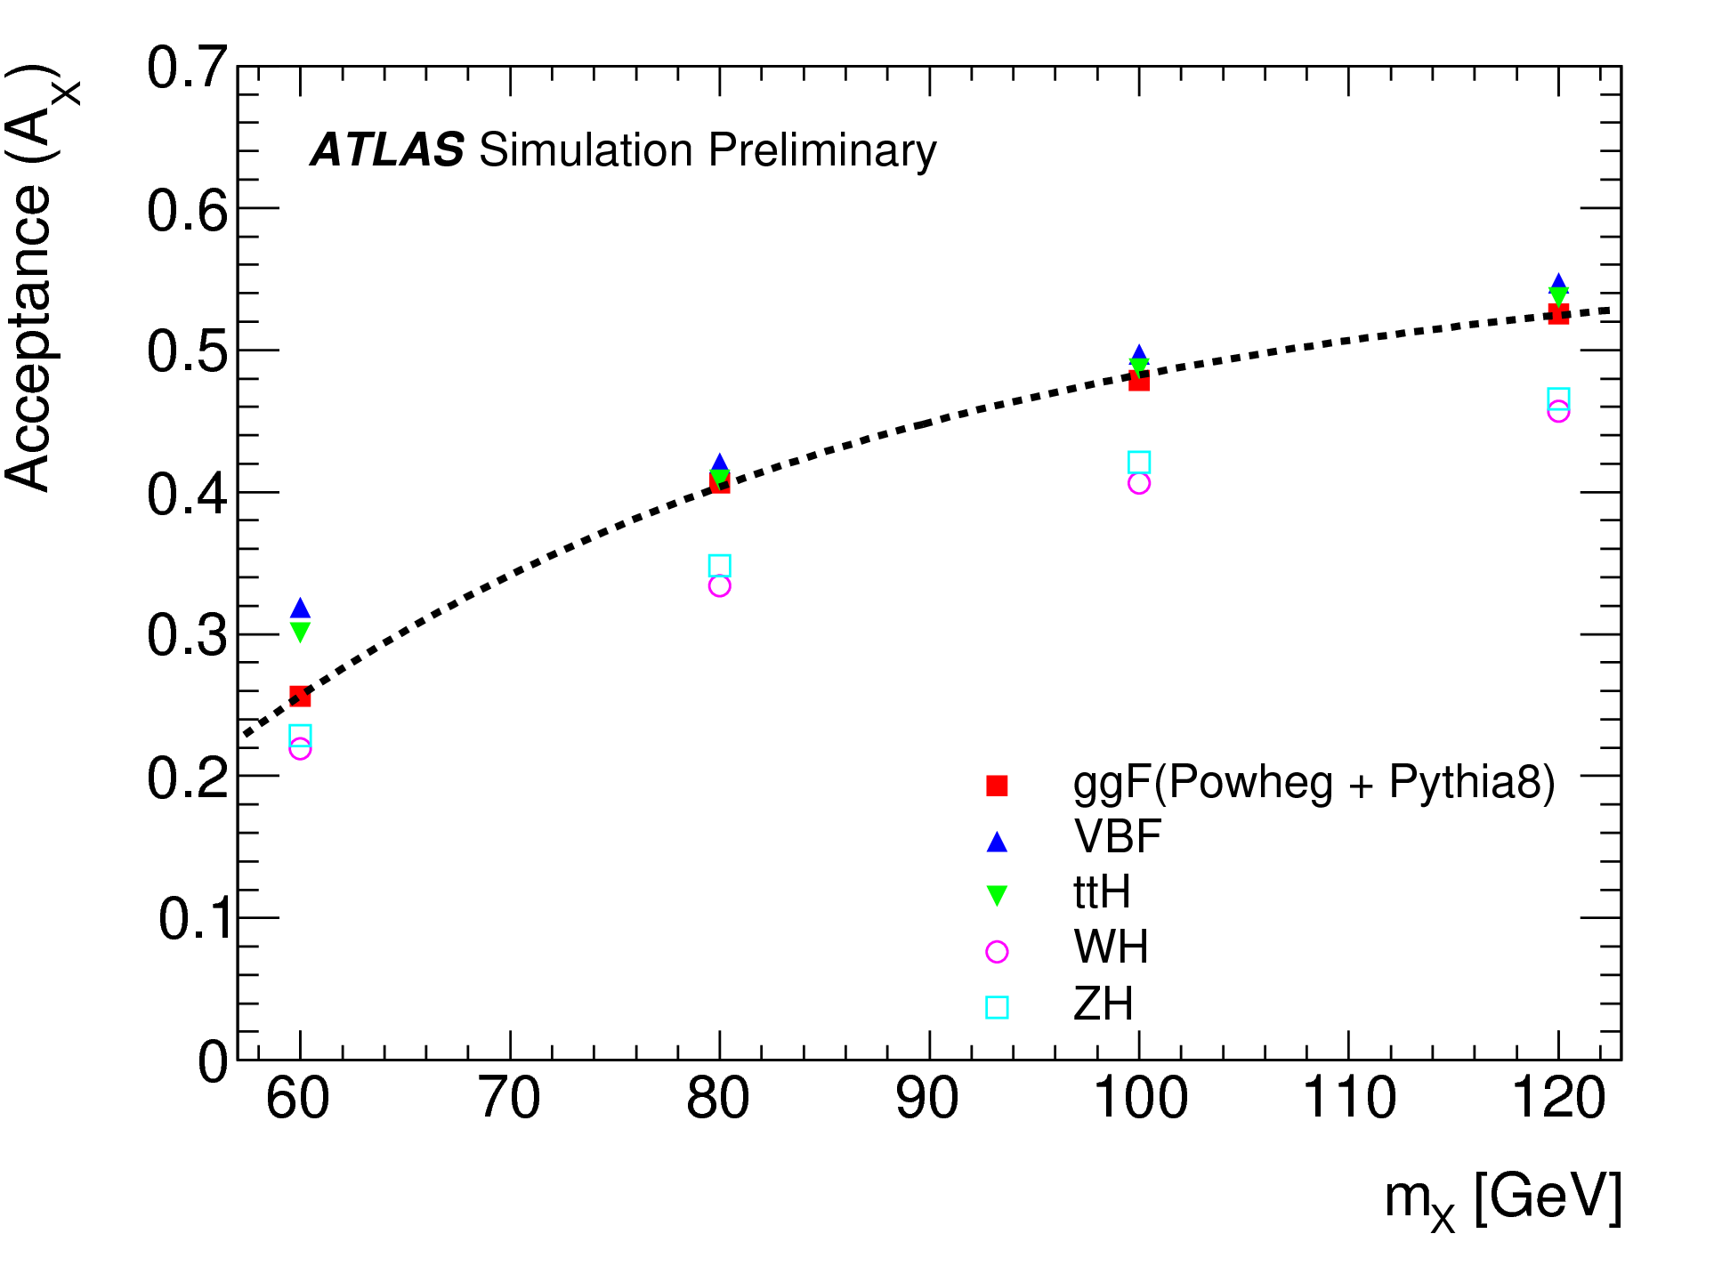
SM-like H→γγ (70 GeV<m_{H}<110 GeV)
CMS-PAS-HIG-20-002
  http://cms-results.web.cern.ch/cms-results/public-results/preliminary-results/HIG-20-002/
Most recent ATLAS results: ATLAS-CONF-2018-025
Limit on fiducial σXB

Slide 22
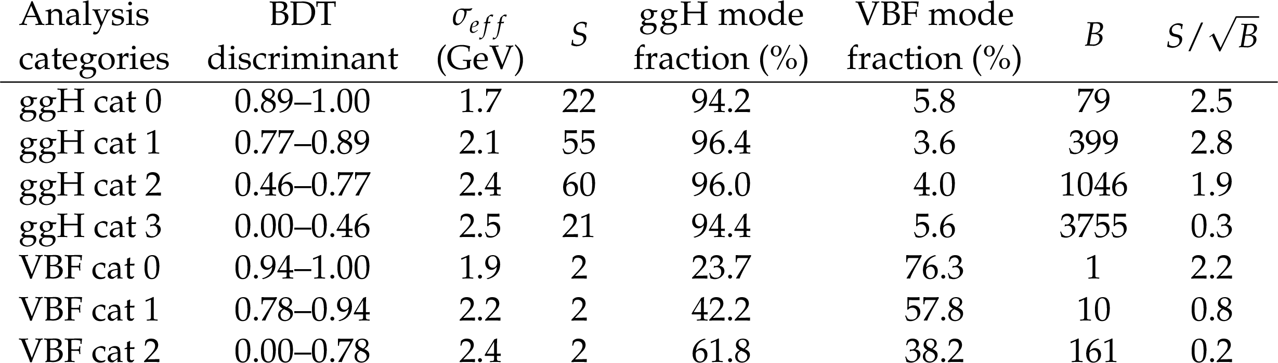
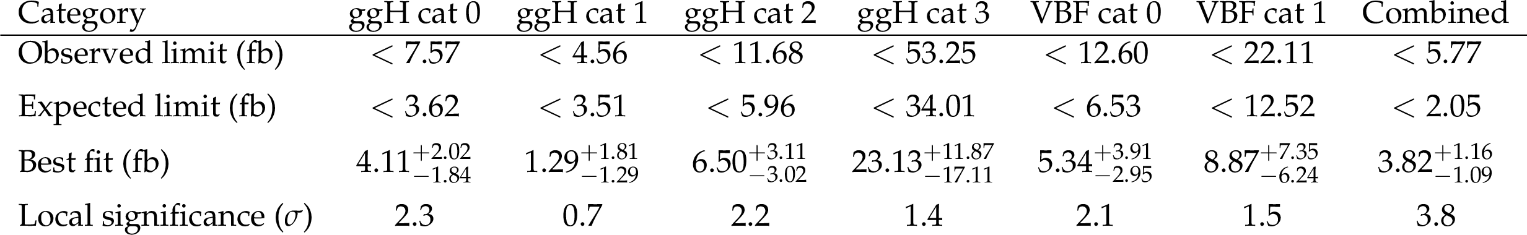
LFV SM (H₁₂₅) or SM-like Exotic X→eμ (110 GeV<m_{H}<160 GeV)
CMS-PAS-HIG-22-002
  http://cms-results.web.cern.ch/cms-results/public-results/preliminary-results/HIG-22-002/index.html
Category definitions and sensitivities
Observed (expected) limits on B by category: H₁₂₅ case
Observed (expected) limits, best fit and local significances by category: case X→eμ

Slide 23
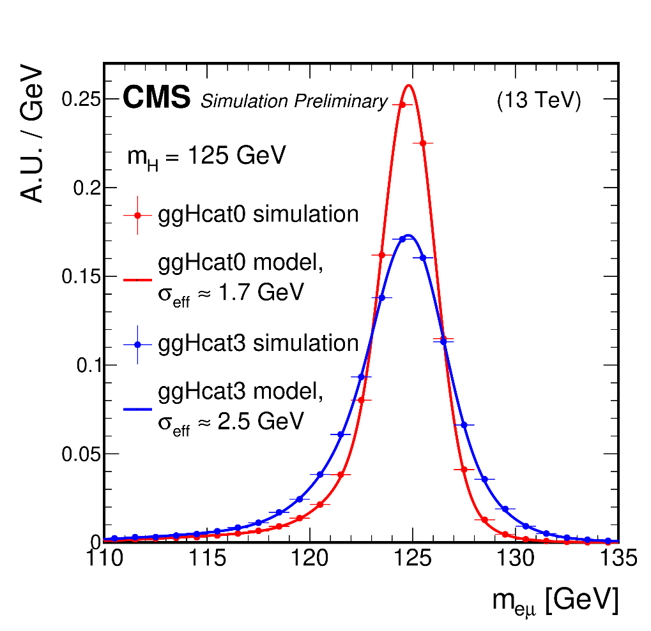
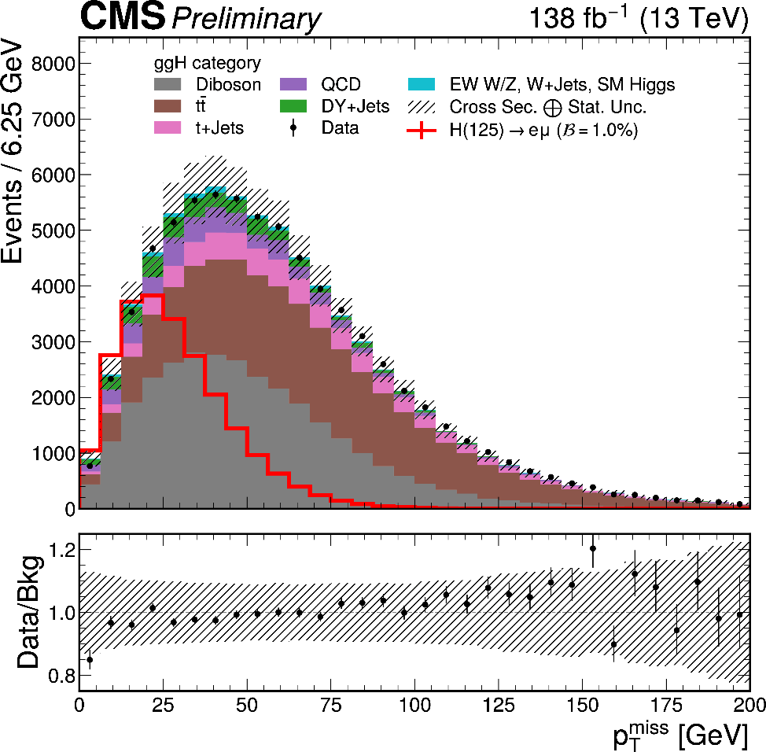
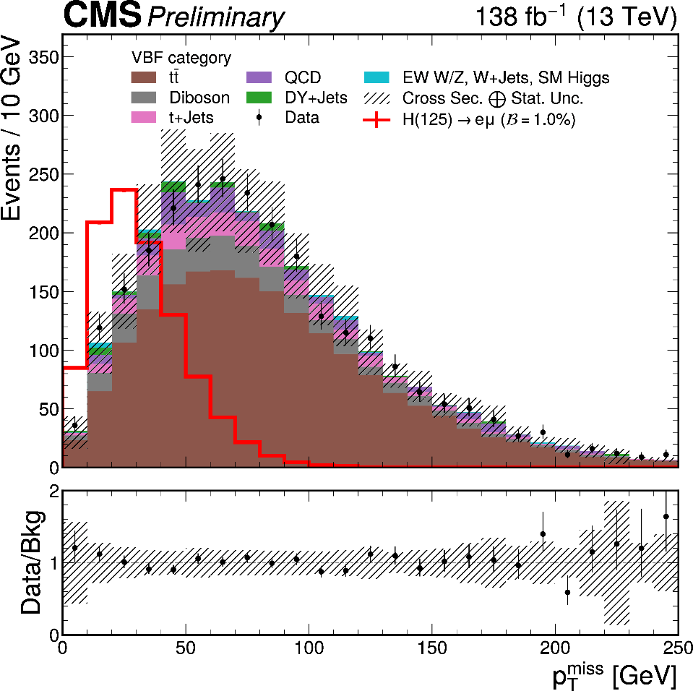
LFV SM (H₁₂₅) or SM-like Exotic X→eμ (110 GeV<m_{H}<160 GeV)
CMS-PAS-HIG-22-002
  http://cms-results.web.cern.ch/cms-results/public-results/preliminary-results/HIG-22-002/index.html
Signal modeling, ggH categories
P_{tmiss} distributions, ggH and VBF categories

