Slide 1
Vector Boson Scattering at the LHC: towards an EFT interpretation of the measurements
Eirini Kasimi, Iro Koletsou
20-21/09/2023
Ecole de gif, Annecy, France
Laboratoire d’Annecy de Physique des Particules

Slide 2
Theory part

Slide 3
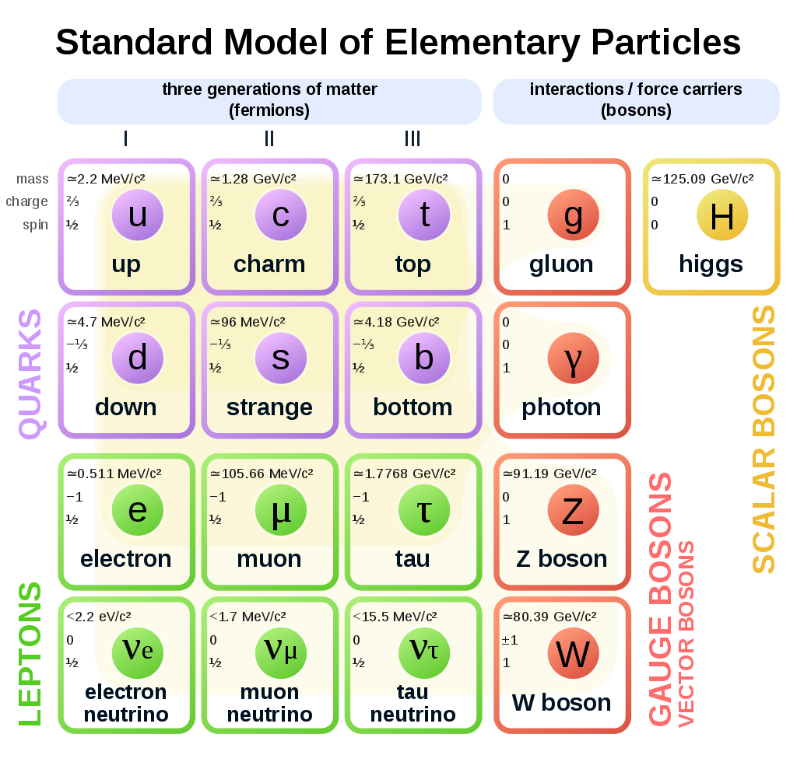
The Standard Model of Particle Physics
Standard Model is a highly successful quantum field theory that describes the fundamental particles and their interactions
Base on the symmetry group $SU\left(3\right)×SU\left(2\right)×U(1)$
$SU\left(3\right)$ group describes the strong interaction
$SU\left(2\right)×U(1)$ group describes the unified electroweak interaction
SM has limitations
Hierarchy problem
Incorporation of gravity
Dark matter – dark energy
Masses of neutrinos
Extensions to the SM
Electroweak symmetry breaking
Physics beyond the SM

Slide 4
Effective Field Theory: Overview (1)
There are two methods to look for physics beyond the Standard Model (BSM).
Look for new particles (model-dependent)
Look for new interactions of SM particles (model-independent)
We use the second method and we try to notice deviations in the tails of the distributions of some kinematical variables.

Slide 5
Effective Field Theory: Overview (2)
The Effective Field Theory (EFT) is the natural way to expand the SM such that the gauge symmetries are respected
The EFT provides a way to search for effects of BSM
Construction of an EFT Lagrangian:
SM: general theory of quark and lepton fields and their interactions with vector boson and the Higgs fields
Extend the theory: Add operators of higher dimension
The EFT Lagrangian can be expressed as:
Where: Λ is the scale of new physics
$O_{i}^{(6)} , O_{i}^{(8)}$ are the Lorentz and gauge invariant dimension-6 and dimension-8 operators
$c_{i}^{(6)} , c_{i}^{(8)}$are the dimensionless Wilson coefficients of the dimension-6 and 8 effective operators
Λ can be assumed as common to all the coefficients, the Wilson coefficients can be written as:
Energy scale of the interaction must be
E < Λ

Slide 6
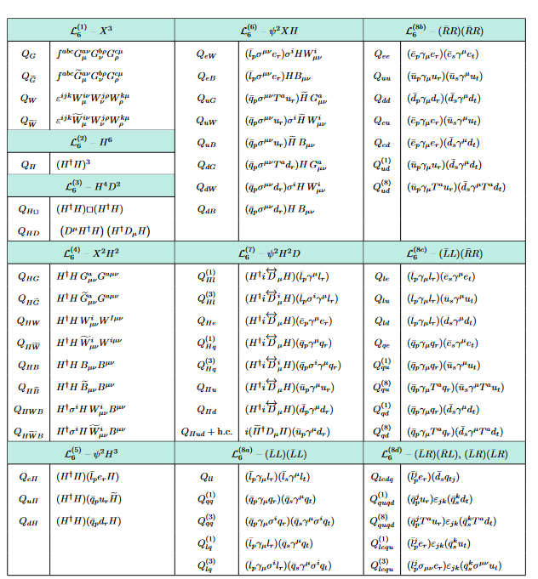
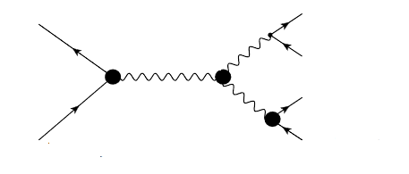
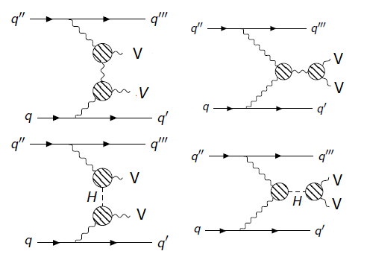
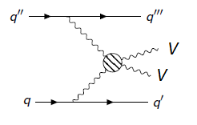
Effective Field Theory: dimension-6 operators
Dimension-6 operators are dominant in anomalous Triple Gauge Couplings (aTGCs)
After flavor symmetry assumptions, the Warsaw basis is used
minimal set of non-redundant dimension-6 operators
Includes bosonic, boson to fermion and four-fermion operators

Slide 7
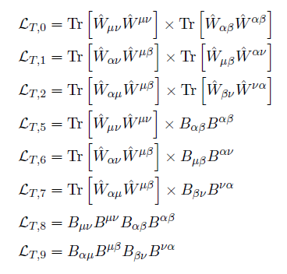
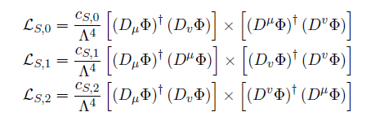
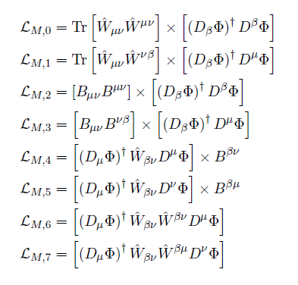
Effective Field Theory: dimension-8 operators
The dimension-8 operators are dominant in anomalous Quartic Gauge Couplings (aQGCs)
They are divided into three categories: Longitudinal (L_{S}), transverse (L_{T}) and mixed (L_{M})
Mixed operators
Scalar operators: Pure Higgs field
Tensor operators: field strength tensor

Slide 8
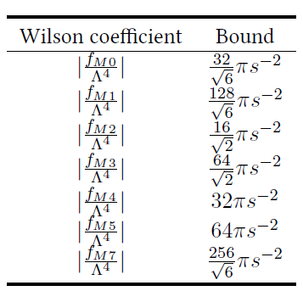
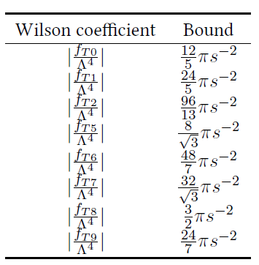
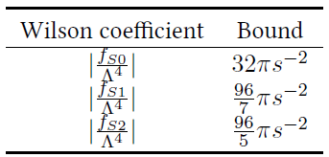
Effective Field Theory: Unitarity bounds
aTGCs/aQGC terms: disturb the cancellation between different contributions to the scattering amplitude of longitudinally polarized, massive electroweak gauge bosons
Cross section for the scattering of massive electroweak gauge bosons is rising with increasing centre-of-mass energy but it cannot exceed the physical upper bound
Range of validity of the specific EFT model: $E^{2}<Λ ≤ s^{U}$ , where $s^{U}≡ s^{U}(f_{i})$ is the unitarity bound
https://journals.aps.org/prd/abstract/10.1103/PhysRevD.101.113003

Slide 9
Effective Field Theory: Decomposition method
MC samples for the effect of higher dimension operators in many values of the coefficients
In order to avoid the production of large amounts of Monte Carlo samples, we will profit from the decomposition method
Full production
Interference term between SM-EFT
(Linear term)
Pure EFT contribution
(Quadratic term)
Interference term between EFT operators
(Cross term)
SM term

Slide 10
Hands on

Slide 11
An EFT reinterpretation analysis from scratch
1st step
Produce EFT samples and validate the decomposition method
2nd step
Find the most sensitive operators
3rd step
Build the analysis phase space using an analysis framework e.g., Rivet framework for truth level measurements
4th step
Use the outputs from the analysis framework as inputs to the fitting framework in order to compute the confidence intervals for the EFT parameters
All number and plots used in this tutorial come from this thesis:
https://ikee.lib.auth.gr/record/349124/files/thesis_kasimi-1.pdf

Slide 12
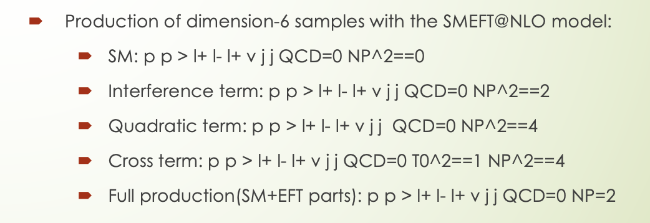
1st step: Production of EFT dimension-6 or 8 samples
production of the WZjj EWK process
Madgraph5_aMC@NLO generator for hard process
UFO models
Eboli-Garcia model for EFT dimension-8 operators at LO
SMEFTSim model for EFT dimension-6 operators at LO
SMEFT@NLO model for EFT dimension-6 operators at NLO (only the full production at NLO)
SmeftFR v3 model for both dimension-6 and dimension-8 operators (very preliminary)
Production of dimension-8 samples with the Eboli-Garcia model:
SM: p p > l+ l- l+ v j j QCD=0 T0==0
Interference term: p p > l+ l- l+ v j j QCD=0 T0^2==1
Quadratic term: p p > l+ l- l+ v j j QCD=0 T0^2==2
Cross term: p p > l+ l- l+ v j j QCD=0 T0^2==1 T1^2==1
Full production(SM+EFT parts): p p > l+ l- l+ v j j QCD=0 T0=1

Slide 13
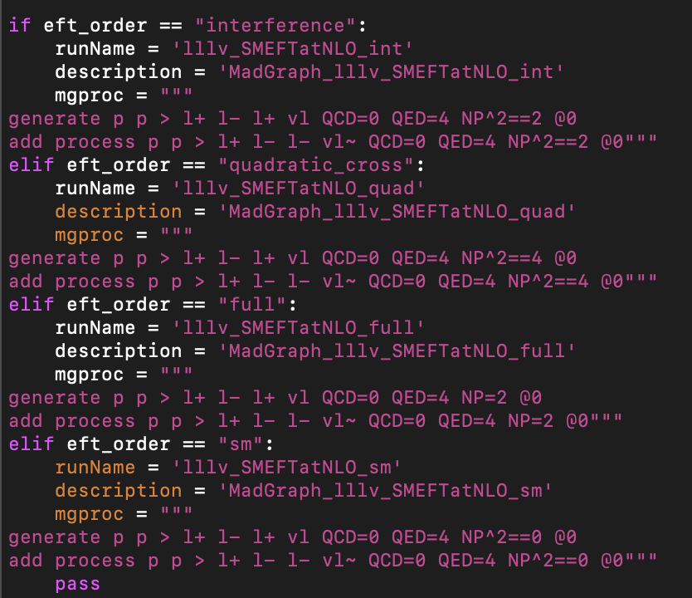
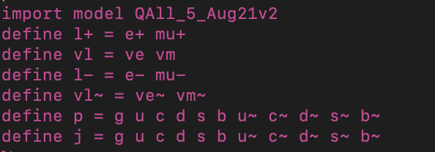
1st step: Building the JobOption
Eboli-Garcia model
SMEFT@NLO model

Slide 14
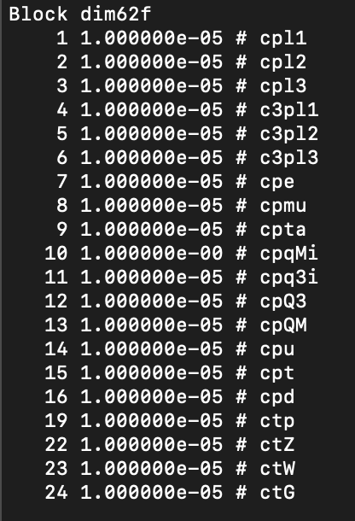
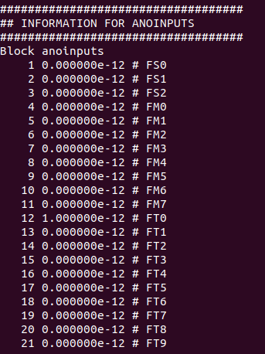
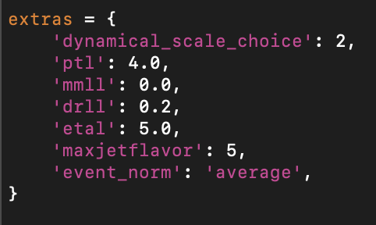
1st step: Building the JobOption (2)
SMEFT@NLO model
Eboli-Garcia model
Parameter card

Slide 15
1st step: Building the configuration file
Commands to run the configuration files:
setupATLAS
asetup 21.6.99,AthGeneration
Gen_tf.py --ecmEnergy=13000. --maxEvents=1 --firstEvent=1 --outputEVNTFile=EVNT.root --jobConfig=./

Slide 16
1st step: Validation of the decomposition method
In order to use the decomposition method to generate samples, we have to prove that the method works well even for coefficient values very far from the Standard Model
Validation of the decomposition method by comparing the full production with the sum of the decomposed samples
Arbitrary values
Good agreement between full and sum
Within the statistical error

Slide 17
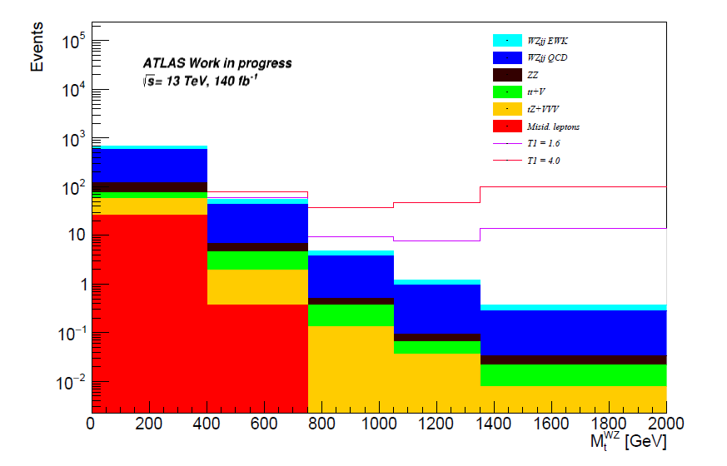
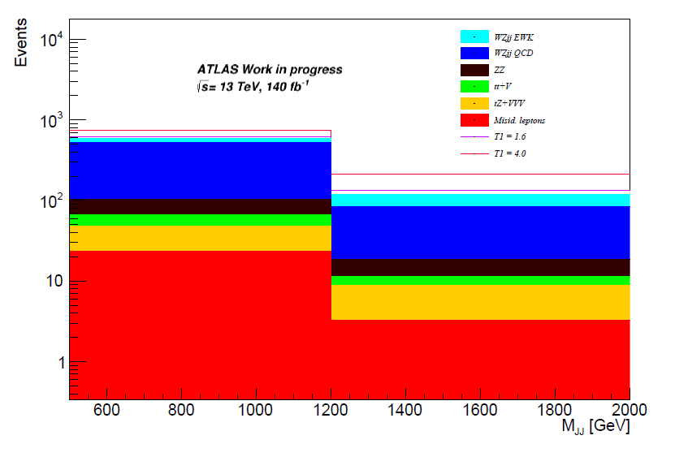
1st step: EFT contribution to kinematical variables

Slide 18
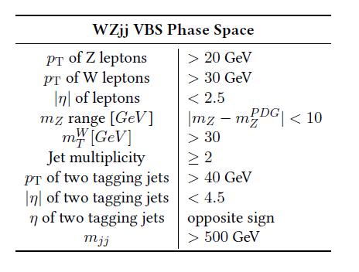
2nd step: Sensitive operatos
Effects of aTGCs/aQGCs on
the cross section measurement
The shape of the relevant kinematical distributions
Generate a Standard Model sample and full samples for some operators
3x the existing limits for the coefficients that have one and c=1 or 3 for those which have not a limit
In order to detect the effect of dimension-6 or dimension-8 operators on the SM cross section experimentally, the deviation from the SM has to be larger than the cross section error, which is of the order of 8-9% (for fullRun2 statistics)
Perform the study using the fiducial phase space
Both criteria have to be fulfilled in order to characterize an operator as “sensitive”

Slide 19
2nd step: Sensitive operators (2)
WZjj VBS production is mostly affected by the dimension-8 operators ideal ground for search for aQGCs
However, both WZjj EWK and WZjj-QCD are also affected by the dimension-6 operators search of aTGCs
MadGraph5_aMC@NLO 2.7.3 version and SMEFT@NLO model are used for the generation of LO for dimension-6 operators at parton level
MadGraph5_aMC@NLO 2.7.3 version and Eboli & Co model are used for the generation of LO events for dimension-8 operators at parton level
The generated process is: $p p> μ^{+}μ^{−}e^{+}ν_{e} j j$

Slide 20
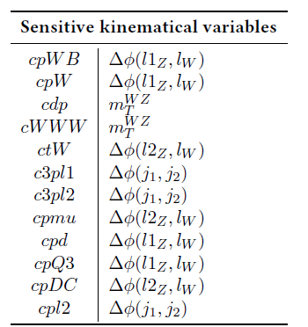
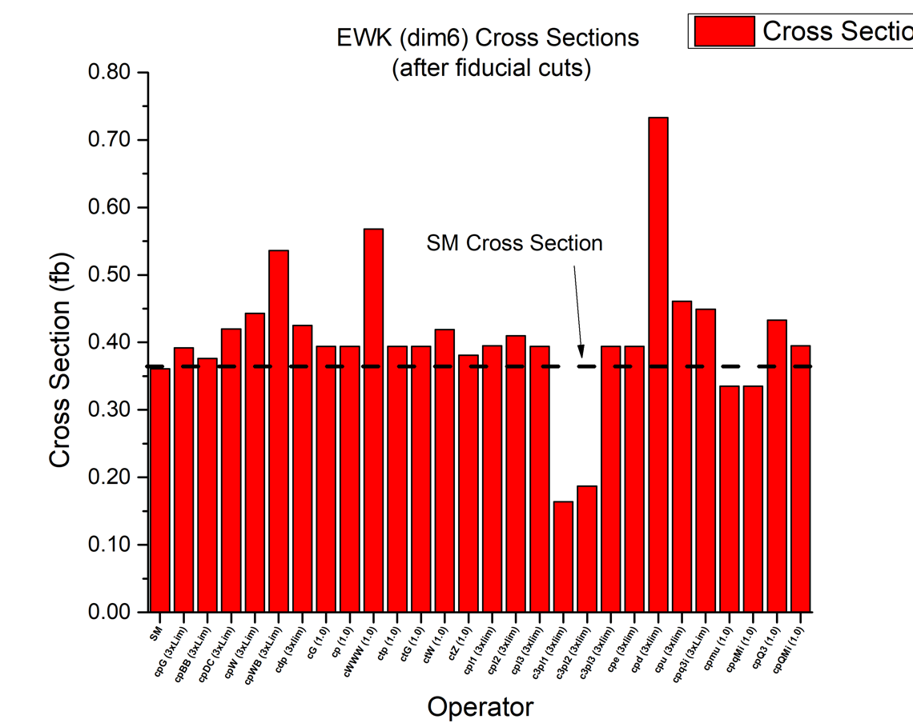
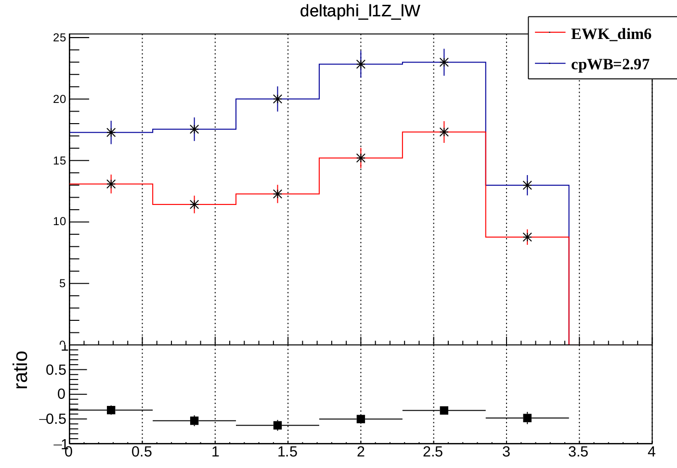
2nd step: Sensitive dimension-6 operators for EWK WZjj VBS case
The sensitive operators with either a positive or negative effect are:
cpWB (16% diff. from SM)
cpW (72% diff. from SM)
cdp (39% diff. from SM)
cWWW (31% diff. from SM)
ctW (15% diff. from SM)
c3pl1 (56% diff. from SM)
c3pl2 (57% diff. from SM)
cpmu (22% diff. from SM)
cpu (205% diff. from SM)
cpd (24% diff. from SM)
cpQ3 (23% diff. from SM)
Differences before the fiducial cuts
There are operators which have an effect to SM cross section after the WZjj VBS SR cuts (mjj>500GeV)
cpDC (16% diff. from SM)
cpl2 (13% diff. from SM)
Red: operators which do not have limits (maybe unphysical values)

Slide 21
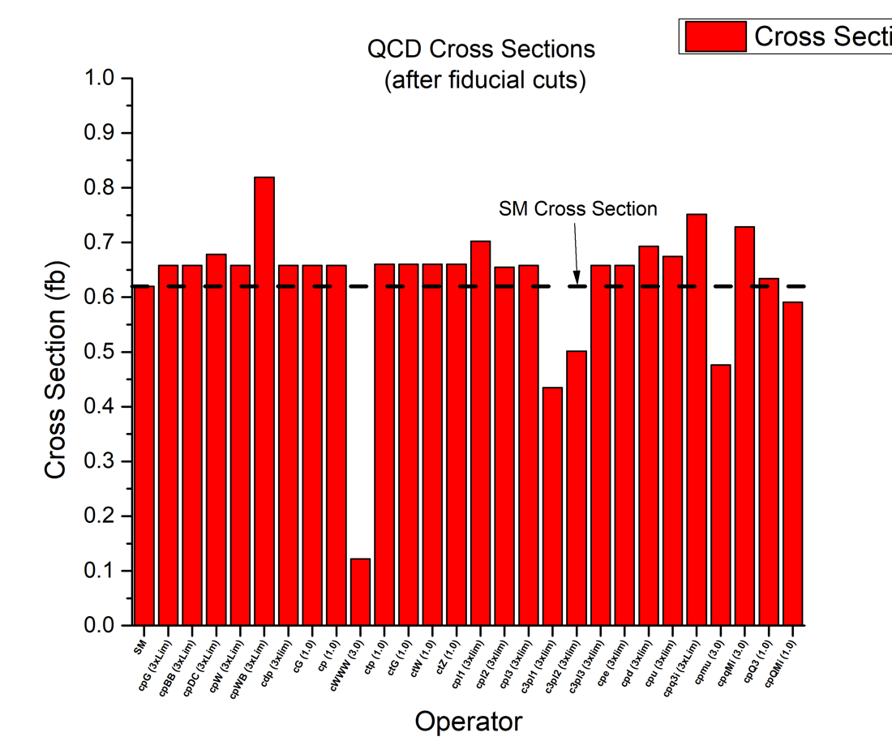
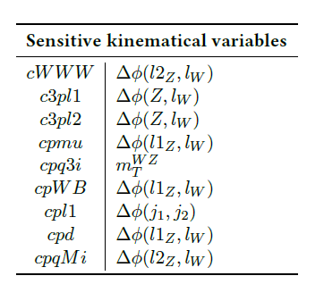
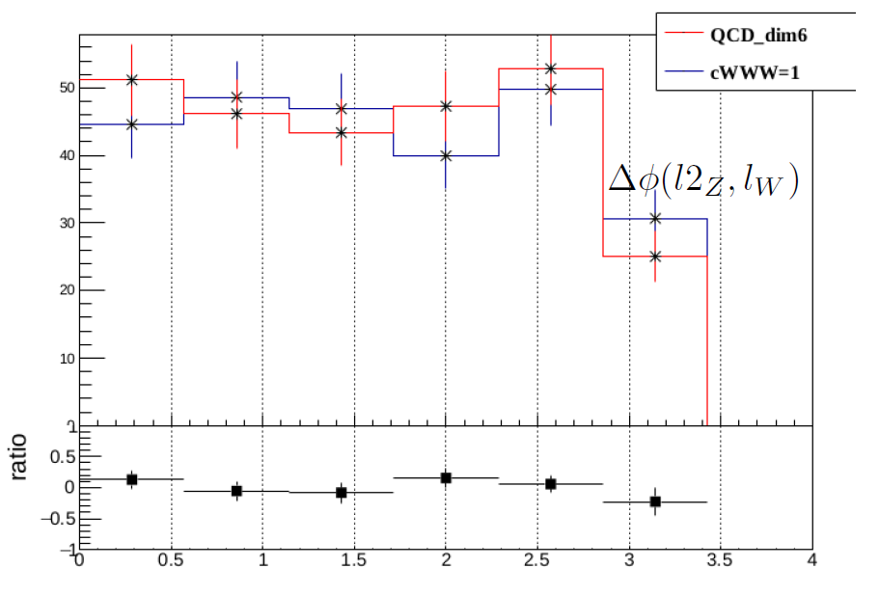
2nd step: Sensitive dimension-6 operators for QCD WZjj VBS case
The sensitive operators with either a positive or negative effect are:
cWWW (74% diff. from SM)
c3pl1 (31% diff. from SM)
c3pl2 (36% diff. from SM)
cpmu (20% diff. from SM)
cpq3i (21% diff. from SM)
Differences before the fiducial cuts
There are operators which have an effect to SM cross section after the WZjj VBS SR cuts (mjj>500GeV)
cpWB (31% diff. from SM)
cpl1 (13% diff. from SM)
cpd (11% diff. from SM)
cpqMi (46% diff. from SM)
Red: operators which do not have limits (maybe unphysical values)

Slide 22
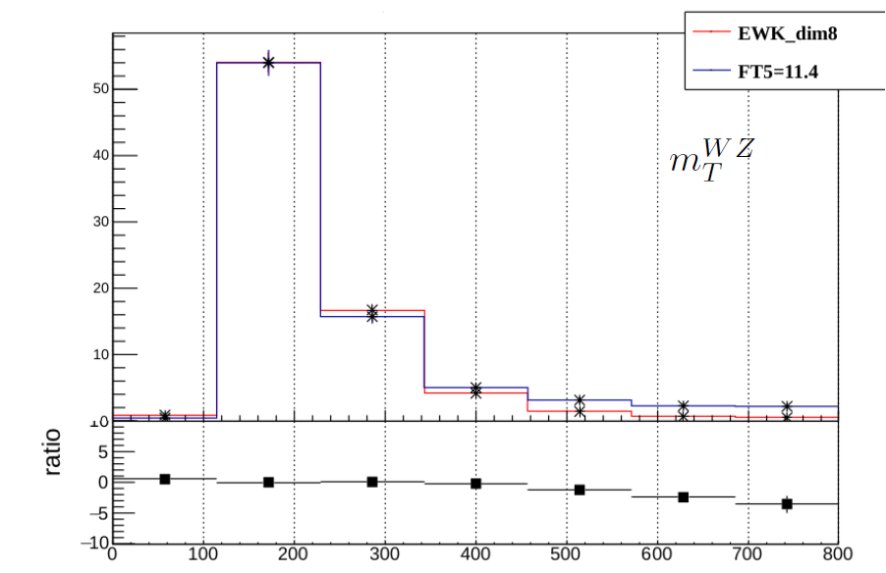
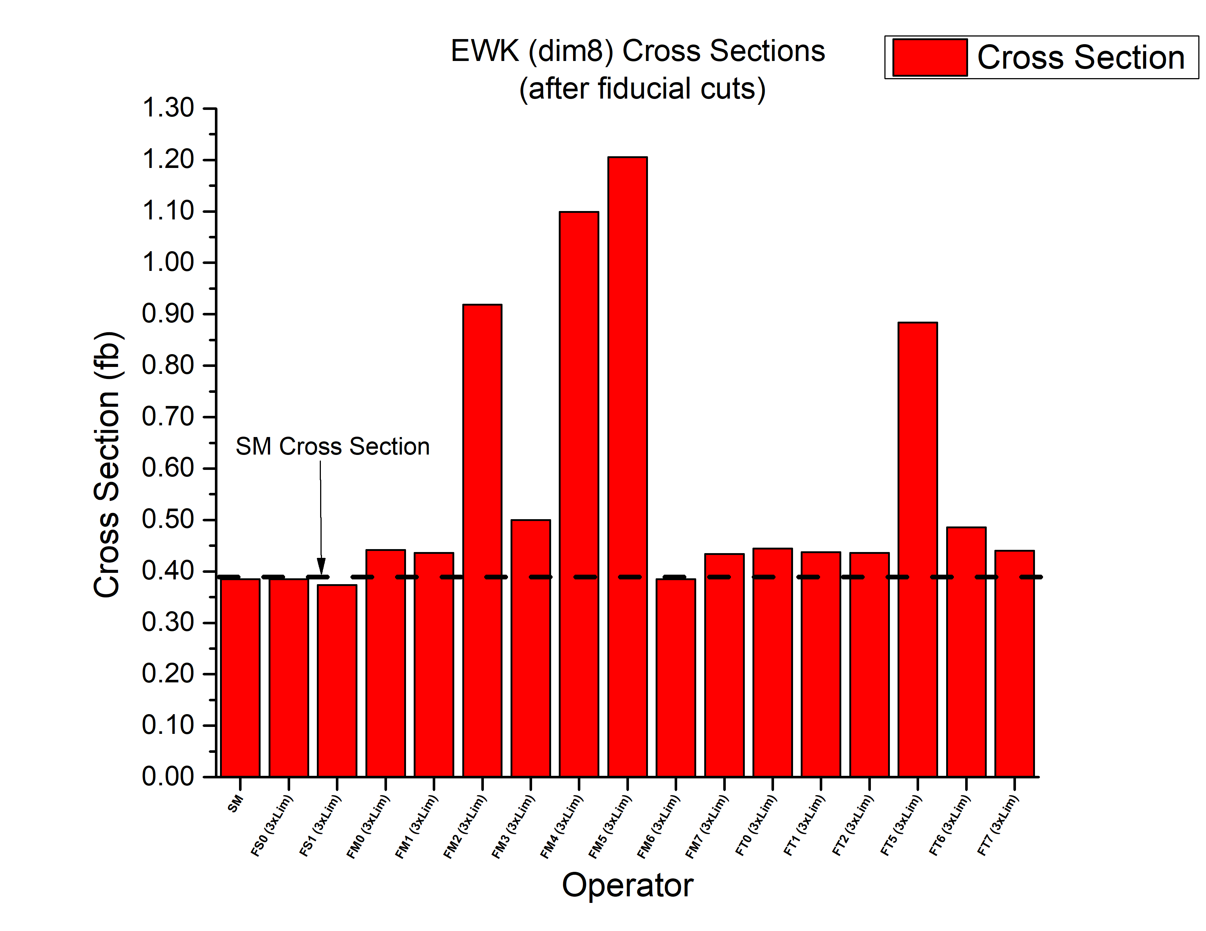
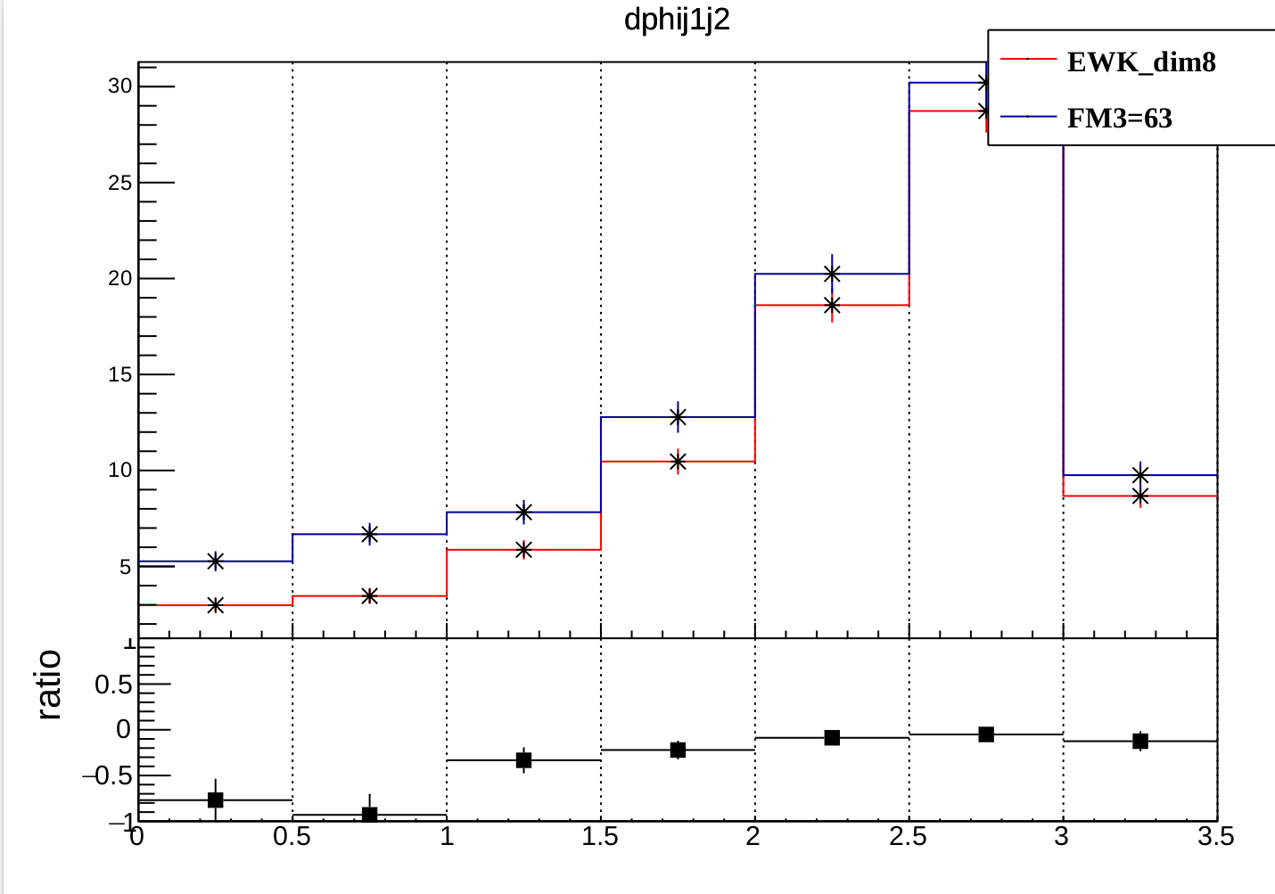
2nd step: Sensitive dimension-8 operators for EWK WZjj VBS case
For dim-8 operators, the effect of the operators on SM cross section cannot been showed without use the fiducial cuts. The sensitive operators are:
FM0 ( 15% diff from SM)
FM1 ( 13% diff from SM)
FM2 ( 139% diff from SM)
FM3 ( 30% diff from SM)
FM4 ( 185% diff from SM)
FM5 ( 213% diff from SM)
FM7 ( 13% diff from SM)
FT0 ( 16% diff from SM)
FT1 ( 14% diff from SM)
FT2 ( 13%diff from SM)
FT5 ( 129% diff from SM)
FT6 ( 26% diff from SM)
FT7 ( 15% diff from SM)
Red: operators which do not have limits (maybe unphysical values)
Most sensitive kinematical variables for all the operators: $m_{T}^{WZ}$ and $Δφ\left(j1,j2\right)$

Slide 23
1st and 2nd steps: Exercises
Download the folder gif_school from this link:
https://drive.google.com/file/d/1gAWEk_C7gEsqUXmudw7HjGxU6HYcFEaP/view?usp=sharing
Copy it in your home directory
Two folders: JOs_dim6 and JOs_dim8
Only JOs_dim6 today
1st task: find the most sensitive dimension-6 operators (only cross section comparison)
Generate the SM sample
Generate the full samples for the following operators:
cpDC (existing expected limits: [-0.43, 0.45])
cpWB (existing expected limits: [-1.09, 0.99])
cWWW (No existing limits)
c3pl1 (existing expected limits: [-0.33, 0.32])
c3pl2 (existing expected limits: [-0.33, 0.32])
cpq3i (existing expected limits: [-0.080, 0.052])
cpmu (No existing limits)
cpqMi (No existing limits)
cpW (existing expected limits: [-02.9, 1.6])
cdp (existing expected limits: [-4.9, 9.8])
Compare the cross section of the full sample with the SM cross section.
Are they have a difference of 8-9%?
Is your operator sensitive?
Don’t forget the instructions in Slide 19!!!!!

Slide 24
1st and 2nd steps: Exercises (2)
2nd task: validate the decomposition method
Generate the quadratic and interference terms for the previous sensitive operators
Add the SM, quadratic and interference cross sections and compare the sum with the full cross section
Try the same comparison using for the full and decomposed samples a ”crazy” parameter value
Are the sum and the full comparable?
Can we use the decomposition method for our studies?
In order the samples to be comparable, the parameter value must be the same for all of them!!!!
Can we use the decomposition method even for values very far from a “reasonable” value?

Slide 25
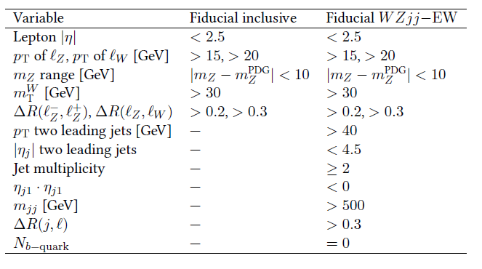
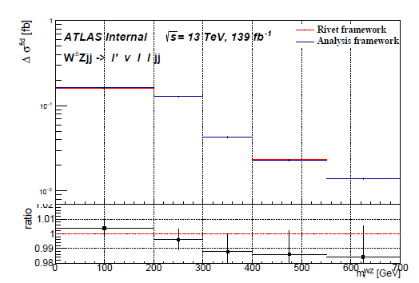
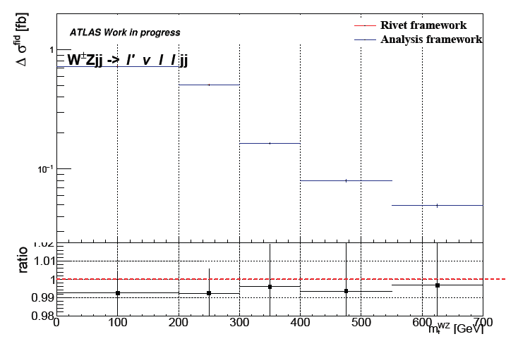
3rd step: Fiducial phase space and Rivet routine
Fiducial WZjj-EW phase space: subset of the fiducial inclusive phase space
Extra jet-related cuts are added
Selected to closely match the detector acceptance and the analysis selection
Rivet framework:
definition of the exact fiducial phase space of an analysis
make the results exploitable for interpretation studies
comparison between rivet framework and analysis framework
compare integrated cross sections:
𝑊𝑍 𝑗 𝑗_𝐸𝑊 process:
Rivet routine: 0.3705 𝑓𝑏
Analysis framework: 0.3697 𝑓𝑏
Difference: 0.2%
𝑊𝑍 𝑗 𝑗_QCD process:
Rivet routine: 1.5283 𝑓𝑏
Analysis framework: 1.5145 𝑓b
Difference: 0.9%
compare the differential distributions of some kinematical variables
𝑊𝑍 𝑗 𝑗-𝐸𝑊 process
𝑊𝑍 𝑗 𝑗-QCD process

Slide 26
4th step: Fitting framework
Use a fitting framework to perform the fit and to extract the confidence intervals for the coefficients of the sensitive operators
Many likelihood-based fitting frameworks in the market that can incorporate the EFT parametrization
EFTFun tool
TRExFitter
HistFactory
pyhf
In our examples, the EFTFun tool by Hannes Mildner is used
Not an open-source framework but just to see how a fitting framework works
Only available to those who have a CERN account

Slide 27
4th step: Statistical method used for the extraction of the truth level confidence intervals for the EFT parameters
The probability density function based on a multivariate Gaussian distribution is used in the reinterpretation of the unfolded measurements for the WZjj process.
predicted fiducial cross section
measured cross section
likelihood function
profile likelihood ratio
test statistics
Confidence intervals are derived using Wilks’ theorem, assuming that λ (fi) is χ2 distributed

Slide 28
4th step: Fitting procedure
Need for two configuration file
1st configuration file: Use it to run the main configuration file
2nd configuration file: this is the main configuration file
Add the central measurement values, most common in HEPdata format
Add the correlation of the measurement
Add the SM prediction
Add the theory uncertainties
The combination of correlation and correlated uncertainty serves the purpose of the covariance matrix

Slide 29
4th step: Fitting procedure (2)
2nd configuration file: this is the main configuration file
Add the experimental uncertainties of our measurement in a different way
Add the EFT templates for the interference, the quadratic and the cross terms
!!! We use either the combination of correlation and correlated uncertainty or this method to add the experimental uncertainties!!!
Interference terms
Quadratic terms
Cross terms

Slide 30
4th step: Procedure for the extraction of truth level limits for dimension-8 operators
Differential cross section distributions used for the extraction of the truth level limits
Used for combination with other channels
Easier to be used by theoreticians
Limits are extracted using seven different kinematical variables trying one kinematical variable at a time in order to define the most sensitive to dimension-8 operators
The binning used for each kinematical variable is the one used in the respective differential distribution which is guided by the minimum required statistics for each bin
Extraction of expected and observed 95% CL lower and upper limits on the aQGC for two different cases:
1) using one aQGC operator at a time setting all the other anomalous couplings to the SM value and
2) using simultaneously two aQGC operators of the same family and setting all the other anomalous couplings to SM value

Slide 31
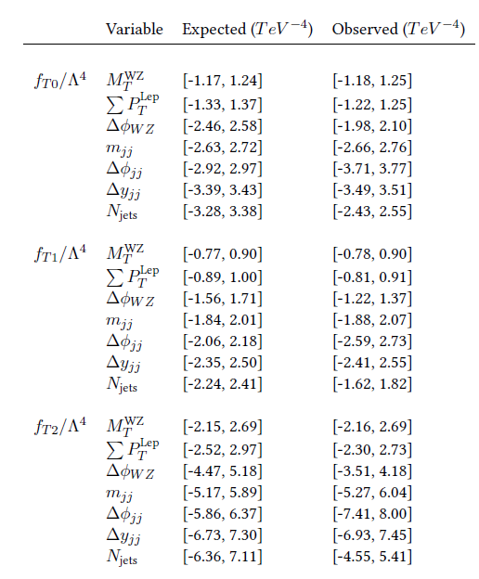
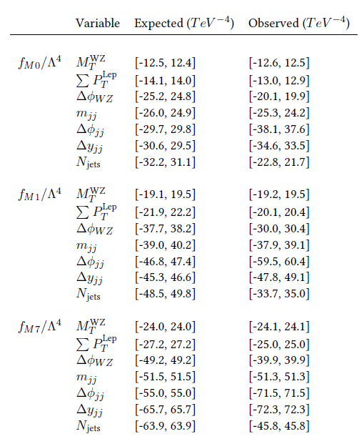
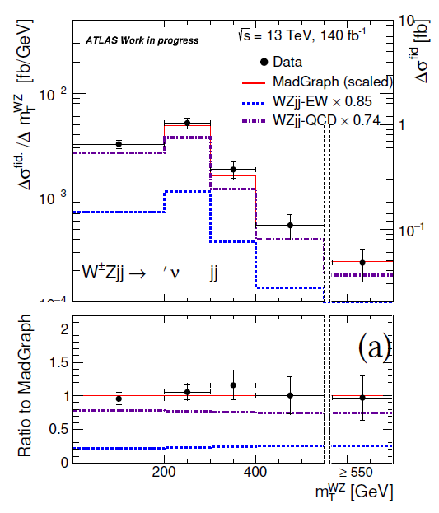
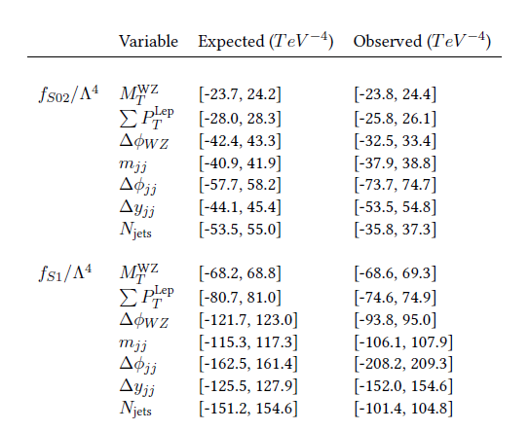
4th step: WZjj VBS production: Results for truth level limits
Expected and observed lower and upper 95% CL limits on the Wilson coefficients
Work in progress
Work in progress
Work in progress
The transverse mass of the diboson system
$M_{T}^{WZ}$ gives the best expected limits for all the operators
Input measurements: unfolded distributions

Slide 32
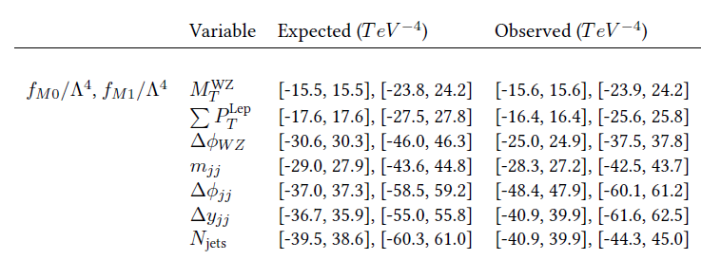
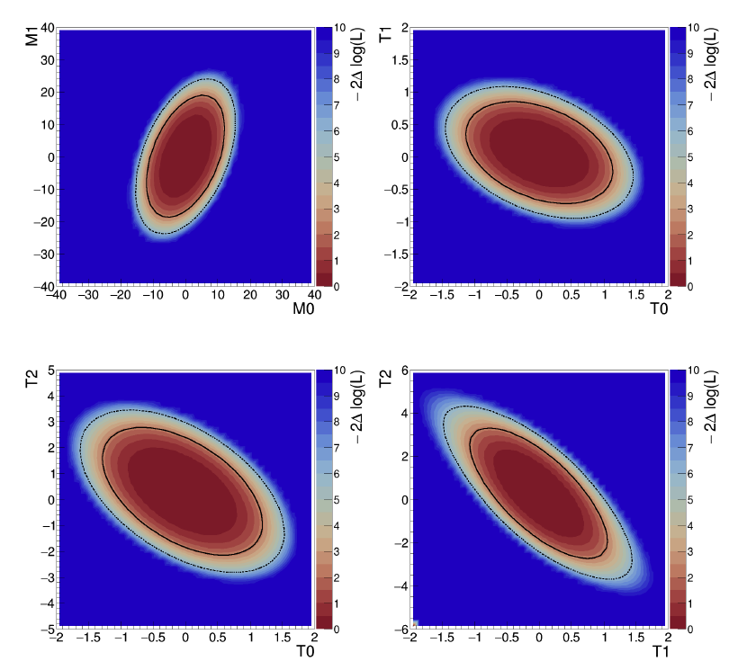
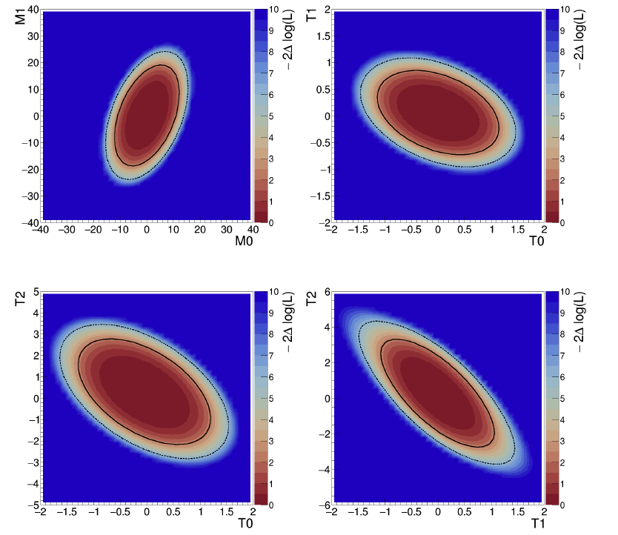
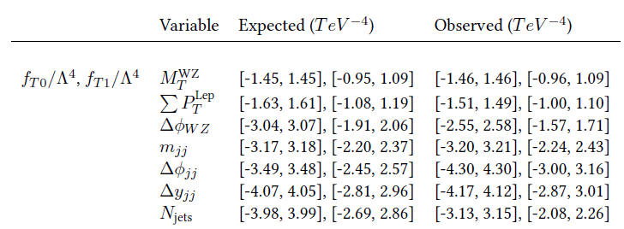
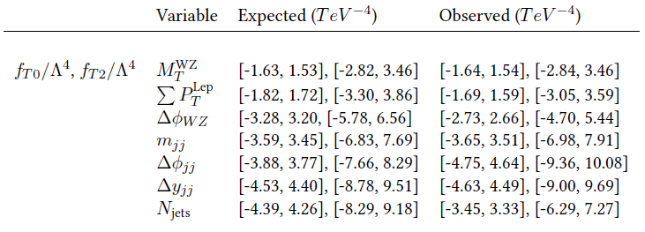
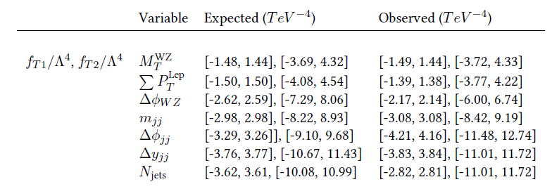
4th step: WZjj VBS production: 2-D truth level limits
Limits on aQGC Wilson coefficients are also derived fitting two parameters simultaneously
The $M_{T}^{WZ}$ gives the best expected limits
Work in progress
Work in progress
Work in progress
Work in progress
Work in progress
Work in progress
The limits for each operators are worse when extracted in pairs than when extracted one by one

Slide 33
4th step: Useful commands
Command to run the EFTFun tool:
In the main directory of EFTFun:
source setup.sh
./bin/eftfun.py -i configs/ecole_de_gif/Tutorial.cfg -m scan -p T0 -c all -o example (for observed limits)
./bin/eftfun.py -i configs/ecole_de_gif/Tutorial.cfg -m scan -p T0 -c all --asimov-o example (for expected limits)
Useful extra commands
Add a range in the corresponding operator: -r -2:2
Disable all the uncertainties except the statistical uncertainty: -d all
For two operators simultaneously:
./bin/eftfun.py -i configs/ ecole_de_gif/Tutorial.cfg -m scan -p M0,M1 -c all -r -40:40,-40:40 --asimov –o example
./bin/eftfun.py -i configs/ ecole_de_gif/Tutorial.cfg -m scan -p M0 -c T0,T1,T2,S02,S1 -r -40:40 --asimov -o example --conts2d
./bin/eftfun.py -i configs/ ecole_de_gif/Tutorial.cfg -m scan -p M1 -c T0,T1,T2,S02,S1 -r -40:40 --asimov -o example --conts2d

Slide 34
Exercises from 4th step
Go to the eft-fun folder in gif_school
1st task: Find the operator that give the best expected and observed limits
1st configuration file (Tutorial.cfg): Choose an operator to test
Available dimension-8 operators: T0, T1, T2, M0, M1, S1 and S02
2nd configuration file (Measurement_Tutorial.cfg): Add all the needed information in order to extract the limits
Add the measurement
Add the covariance matrix
Add the sm prediction
Add a relative flat uncertainty of 2% to all contributions
Add the interference term
Add the quadratic term
Don’t forget the instructions in Slide 30!!!!!
In this step, we will use only the MtWZ
See in Slide
Which is the operator that gives the “stricter” limits?
What do we mean with the term “stricter”? What means a limit close to zero?
What is the effect of a bigger flat uncertainty on the limits?

Slide 35
Exercises from 4th step (2)
2nd task: Find the kinematical variable that gives the ”stricter” limits for every operator
2nd configuration file (Measurement_Tutorial.cfg): Add all the needed information in order to extract the limits with different kinematical variable
Add the measurement
Add the covariance matrix
Add the sm prediction
Add a relative flat uncertainty of 2% to all contributions
Add the interference term
Add the quadratic term
3rd task: extract the limits using two operators simultaneously
2nd configuration file (Measurement_Tutorial.cfg): Add all the needed information in order to extract the limits with different kinematical variable
Add also a cross term
Which variable gives the stricter limits for every operator?
What does this mean?
Do we take the “stricter” limits for every operator using the same variable?
Don’t forget the instructions in Slide 30!!!!!
Using two operators simultaneously, are the limits “stricter”?
Why?

Slide 36
Exercises from 4th step (3)
HEPData
Root files
$m_{T}^{WZ}$
Data: data1.yaml
Covariance matrix: data2.yaml
$\sum{{pT}_{3l}}$
Data: data3.yaml
Covariance matrix: data4.yaml
$Δφ\left(Z,W\right)$
Data: data5.yaml
Covariance matrix: data6.yaml
Njets
Data: data7.yaml
Covariance matrix: data8.yaml
$m_{jj}$
Data: data9.yaml
Covariance matrix: data10.yaml
$\left|y_{j1}−y_{j2}\right|$
Data: data11.yaml
Covariance matrix: data12.yaml
$Δφ\left(j1,j2\right)$
Data: data13.yaml
Covariance matrix: data14.yaml
$m_{T}^{WZ}$
d02-x01-y01
$\sum{{pT}_{3l}}$
d03-x01-y01
$Δφ\left(Z,W\right)$
d04-x01-y01
Njets
d01-x01-y01
$m_{jj}$
d05-x01-y01
$\left|y_{j1}−y_{j2}\right|$
d06-x01-y01
$Δφ\left(j1,j2\right)$
d07-x01-y01

Slide 37
Future plans
Run2 WZ VBS analysis
Combination of aQGC EFT results combination among many diboson analyses
Run3 WZ diboson and VBS analyses
perform a complete study of both dimension-6 and dimension-8 operators using the new SmeftFR v3
machine learning approach to the EFT re-interpretation of the WZ diboson and VBS productions results appear very promising (next slide)
find a way to incorporate the NLO QCD and EWK effect
HL-LHC
WZ VBS polarization analysis

Slide 38
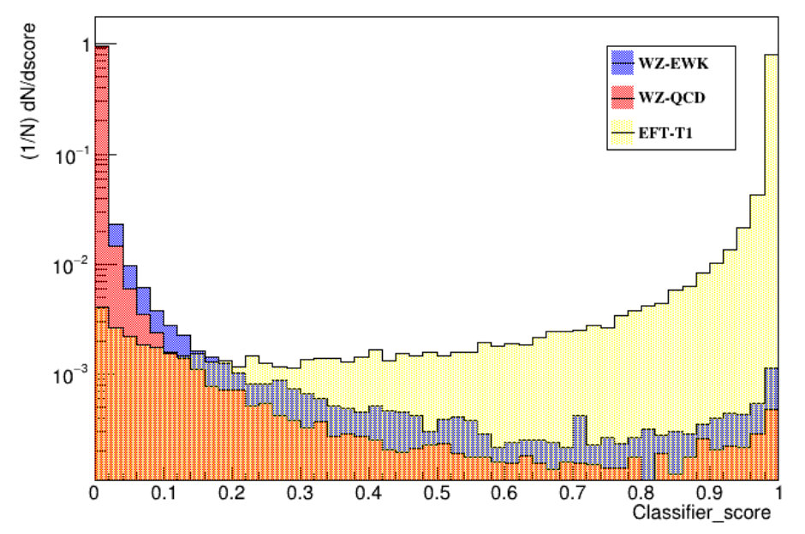
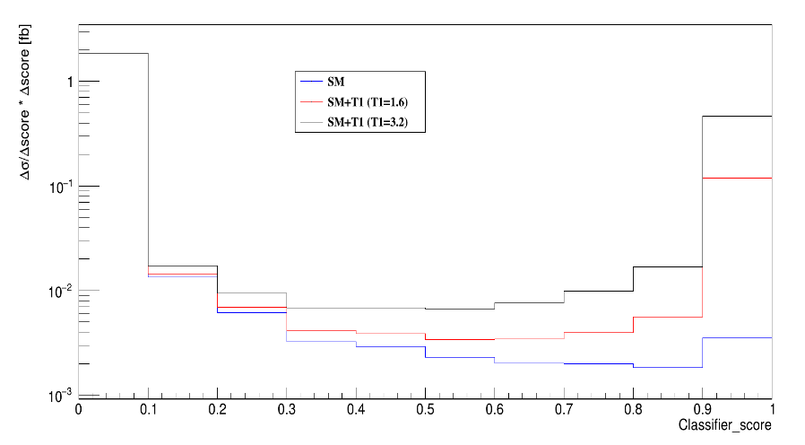
Μachine learning approach to the EFT re-interpretation of the WZ diboson and VBS productions

Slide 39
Extraction of reconstructed level limits for dimension-8 operators

Slide 40
Motivation
More difficult analysis than the truth level analysus BUT
Choose a better binning in order to have stricter limits
Two kinematical variables simultaneously
Multivariate variables like BDT scores and NN scores

Slide 41
WZjj VBS production: Procedure for the extraction of reconstructed level limits for dimension-8 operators
To maximally profit from the sensitive kinematical variables two variables relatively uncorrelated are selected. This template is created by binning two kinematical variables simultaneously.
Also a comparison between the limits derived using the two-variable fit template and the limits derived using only one kinematical variable is done
Extraction of expected and observed 95% CL lower and upper limits on the aQGC for two different cases:
1) using one aQGC operator at a time setting all the other anomalous couplings to the SM value and
2) using simultaneously two aQGC operators of the same family and setting all the other anomalous couplings to SM value

Slide 42
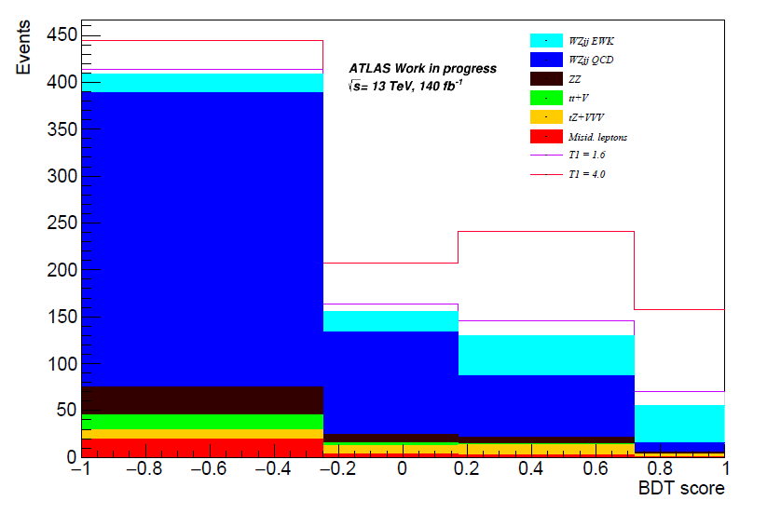
WZjj VBS production: Binning Optimization
After performing a binning optimization, the results for the optimized binnings are:
For the $M_{T}^{WZ}$and the $M_{jj}$the CMS binning will be used for comparison reasons, as the differences in the 95 % CL limits when using either the optimized binning or this binning are negligible.

Slide 43
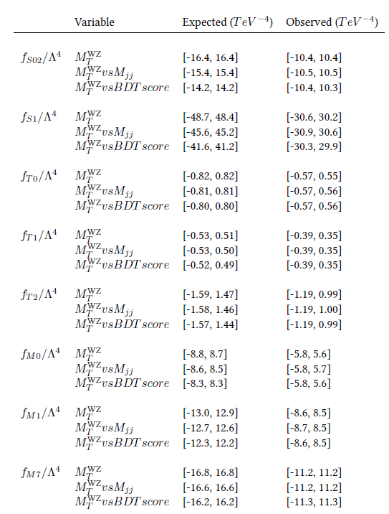
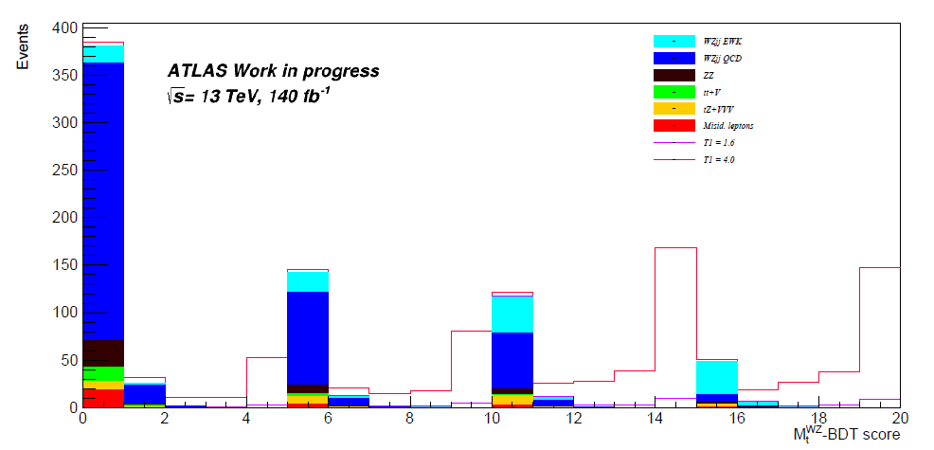
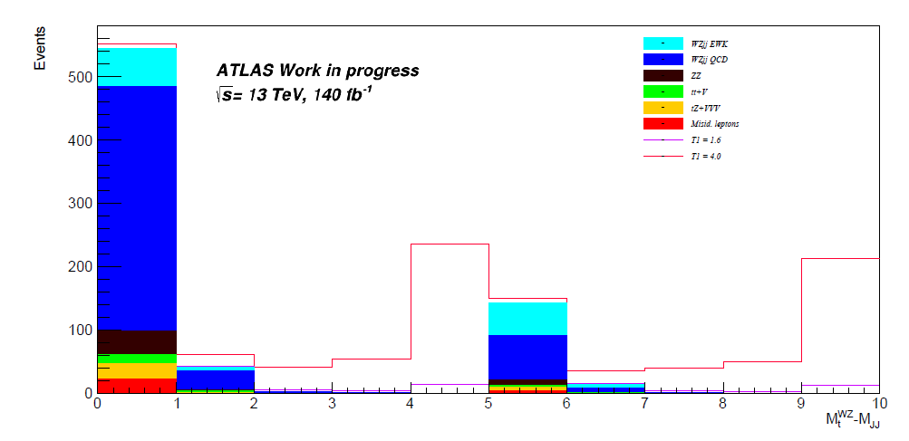
WZjj VBS production: Results for reconstructed level limits
Work in progress
Expected and observed lower and upper 95% CL limits on the Wilson coefficients
Extraction of the limits using
one dimensional distribution ($M_{T}^{WZ}$) in the fit
two-dimensional distributions ($M_{T}^{WZ}$- $M_{jj}$ and $M_{T}^{WZ}$- BDT score) in the fit
Create two-dimensional templates by binning two kinematic variables simultaneously
Create one dimension by ’unrolling’ the bin contents
The two-dimensional template
of the $M_{T}^{WZ}$ with the BDT score gives the best expected limits

Slide 44
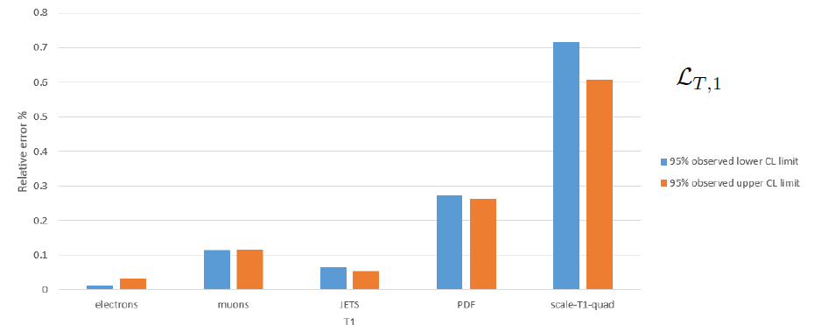
WZjj VBS production: Impact of the nuisance parameters on the 95% CL lower and upper expected limits
Impact of the nuisance parameters on the 95% CL observed limits for the Wilson coefficients of the L_{𝑇,1} operator. Only the nuisance parameters that have a visible effect are shown

Slide 45
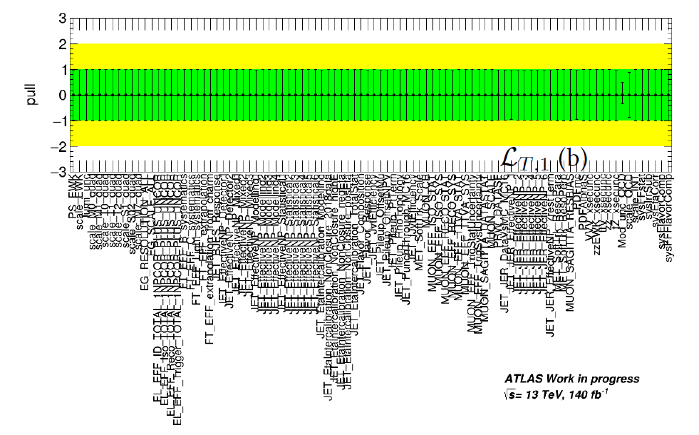
WZjj VBS production: Results for reconstructed level limits (2)
Expected fit
Example of the nuisance parameter pull distributions of the expected two-dimensional fit and of the fit on the data usingthe $M_{T}^{WZ}$- BDT score, for the L_{𝑇,1} operator
Fit on the data
Comparison of the profile likelihood ratio curves on the Wilson coefficients of the, L_{𝑇,1} operator for the expected fit and for the fit to the data using the two dimensional distributions of the $M_{T}^{WZ}$- BDT score when only statistical uncertainties are included (black curve) are included and when experimental and theoretical uncertainty nuisance parameters (red curve) are considered

Slide 46
WZjj VBS production: Clipping method
Evolution of the individual 95%C.L. expected and observed limits of the dimension-8 operators as a
function of the cut-off scale
EFT is not a complete model
the presence of non-zero aQGCs will violate tree-level unitarity at sufficiently high energy
The unitarity bounds show the range of validity of the EFT approach, where a contribution of an aQGC operator will not lead to unitarity violation at high energies.
More physical limits can be obtained using the clipping method by:
cutting the EFT integration at the unitarity limit and
keeping the SM predictions at invariant mass of parton level WZ, even above the unitarity limit

Slide 47
WZjj VBS production: Clipping method(2)

Slide 48
WZjj VBS production: 2-D reco level limits
Limits on aQGC Wilson coefficients are also derived fitting two parameters simultaneously
The two dimensional template of the $M_{T}^{WZ}$ with the BDT score gives the best expected and observed 95% C.L. limits
Work in progress

Slide 49
Backup

Slide 50
WZ diboson production: Comparison of SM_LO and SM_NLO and validation of the decomposition method
In order to see the effect of NLO QCD corrections to the LO, we compare the SM_LO production to the SM_NLO production(It will be used for setting a systematic uncertainty)
In order to use the decomposition method for our future samples, we have to prove that the method works well even for coefficient values very far from the Standard Model
For the Eta_Z, Mt_WZ, M_3leptons, deltaphi_l1Z_lW, deltaphi_l2Z_lW, deltaphi_Z_lW and delta_y, the k-factor seems to be almost flat and they can be used for setting a systematic uncertainty for the LO EFT distributions
Validation of the decomposition method by comparing the full production with the sum of the decomposed samples
Good agreement between full and sum
Within the statistical error
Arbitrary values

Slide 51
Binning Optimization (1)
Binned Profile-likelihood fits is heavily dependent on the binning of the histogram that is used in the fit.
The procedure to compute the optimal binning for the variables used in the Reco-level fits is as follows:
1. For a given number of bins, create a large number of variable binning options for the fit histogram, while requiring > 5 events in each bin for all Standard Model processes and the quadratic term of the L_{𝑇,1} operator, which is the most sensitive operator to the WZjj process.
2. The binning options are generated by splitting the initial histogram range in steps: In the first step, the range is split in 𝑛₁+1 bins. In the second step, each one of the 𝑛₁+1 bins is split in 𝑛₂+1 bins. The process continues for up to 4 steps, in which case the histogram will have 5 bins. The binning search performed in this optimization looks at 5-bin histograms, and the number of insertions at each step are: (𝑛₁ = 50, 𝑛₂ = 2, 𝑛₃ = 2, 𝑛₄ = 2).
3. Perform binned profile-likelihood fits for each binning option. The expected 95% C.L. value of the Wilson coefficient is computed using the quadratic EFT term for the L_{𝑇,1} operator.
4. The binning providing the best 95% C.L. for the Wilson coefficient is chosen as the optimized binning.

Slide 52
WZjj VBS production: Comparison of asymptotic and toys methods
Feldman-Cousins method uses pseudoexperiments (toys)
Pseudoexperiments are necessary in the extraction of the reco-level expected limits because the optimized binning used contains bins with low statistics. They have been chosen to have at least 5 events each of them.
Pseudoexperiments are very time consuming
The asymptotic method can be used for the extraction of the limits if the results of the two methods are comparable.
Probability function
Without using NPs
Using NPs
T1
T1

