Slide 1
Neutrino ASTROPHYSICS:
A WINDOW TO NEW PHYSICS
Maria Cristina Volpe
CNRS, Astroparticle and Cosmology Laboratory, Paris
LPNHE Seminar, 27th March 2023

Slide 2
OUTLINE
Neutrinos: from core-collapse supernovae to neutron star mergers
Theoretical aspects of flavor conversion in dense environments
Future observations and the upcoming discovery
of the diffuse supernova neutrino background
Conclusions
M.C. Volpe, «Neutrinos from dense: flavor mechanisms, theoretical approaches, observations, new directions »,
Review of Modern Physics, arXiv: 2301.11814

Slide 3
LPNHE Seminar, 27th March 2023

Slide 4
Super-Kamiokande
LPNHE Seminar, 27th March 2023

Slide 5
LPNHE Seminar, 27th March 2023

Slide 6
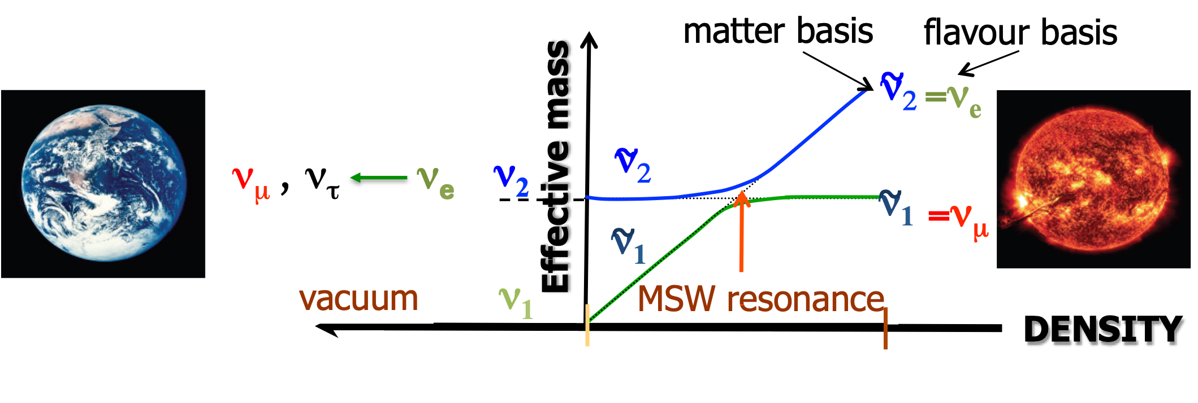
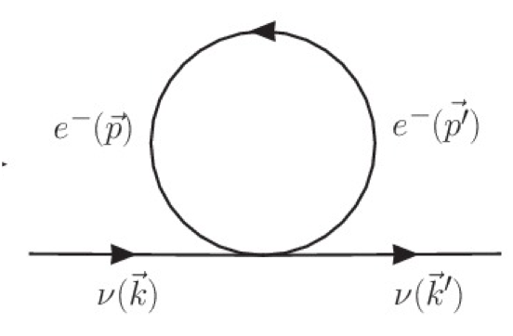
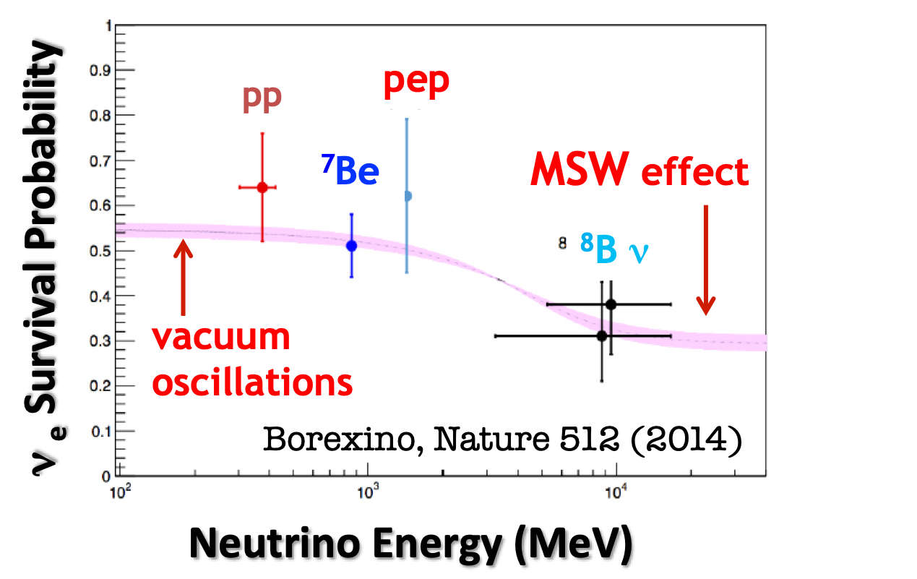
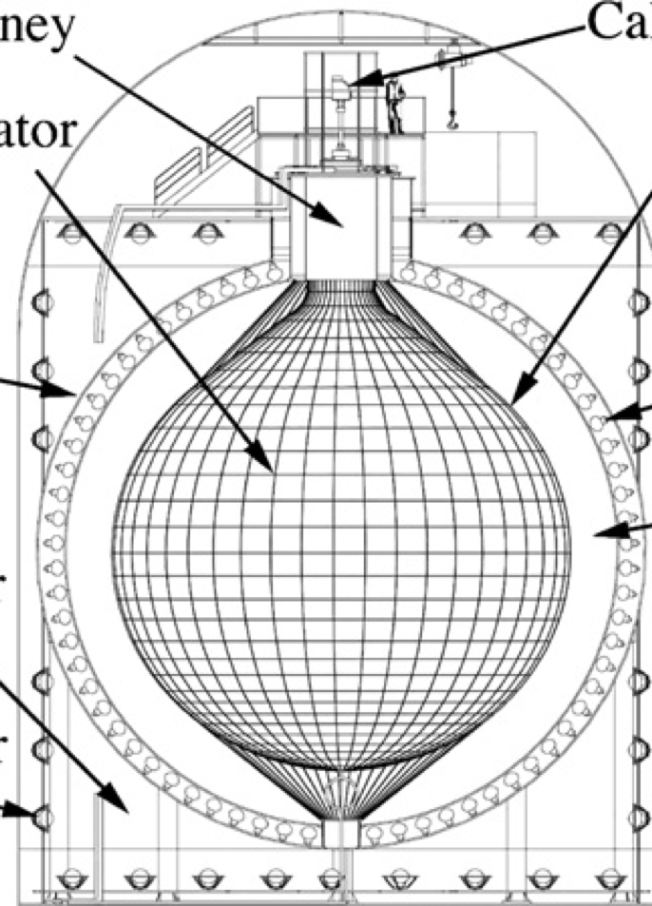
Mikheev-Smirnov-Wolfenstein (MSW) EFFECT
Wolfenstein, 1978; Mikheev and Smirnov, 1985
The neutrino-matter interaction term
responsible for the MSW effect
Established by experiments
Electron neutrinos adiabatically (efficiently)
convert into other flavors at the resonance location
SNO, PRL 87 (2001)
MSW occurs in supernovae, binary neutron
star mergers, Earth and early Universe
KamLAND,
PRL 90 (2003)
LPNHE Seminar, 27th March 2023

Slide 7
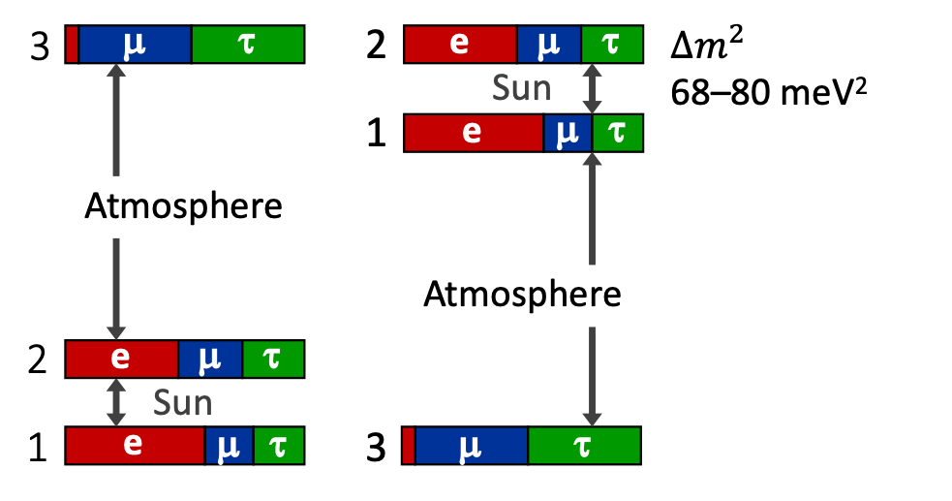
NEUTRINO VACUUM OSCILLATIONS and open QUESTIONS
Open questions :
>CP-violating phases ?
>mass ordering ?
>absolute mass values?
>Dirac or Majorana ?
>sterile neutrino ?
and
>electromagnetic properties?
>neutrino flavor in dense media?
….
Normal mass ordering
(NMO)
Inverted mass ordering
(IMO)
LPNHE Seminar, 27th March 2023

Slide 8
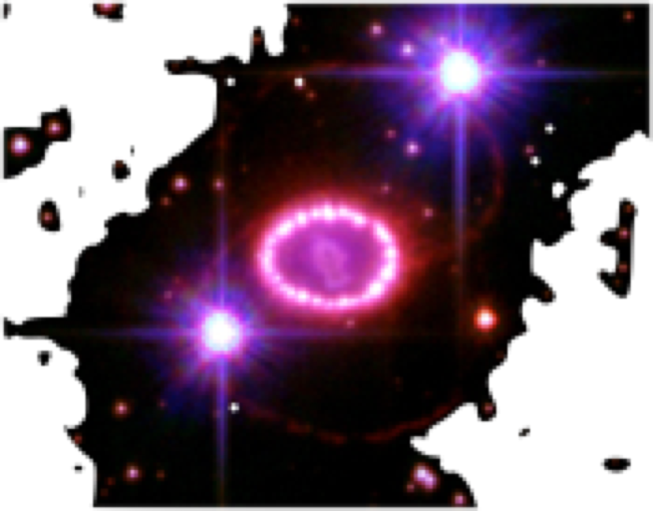
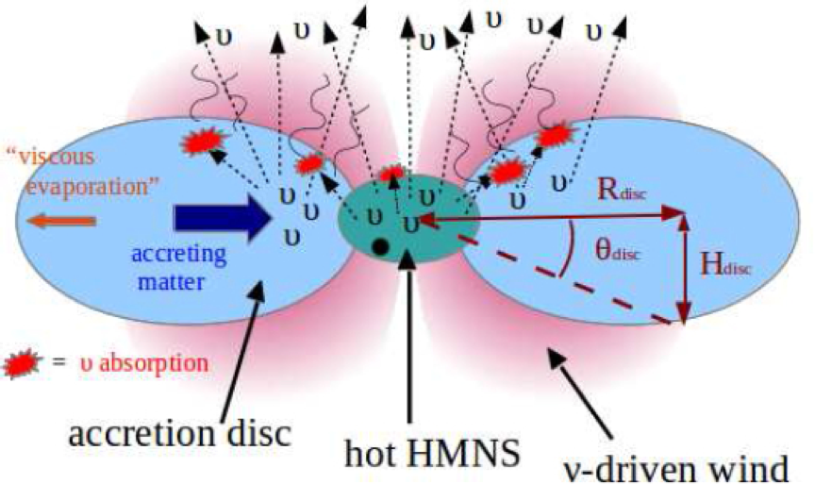
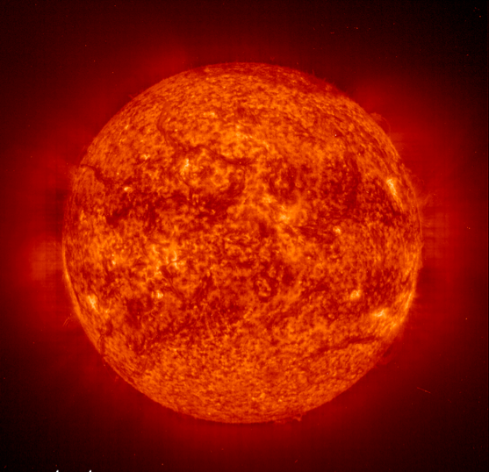
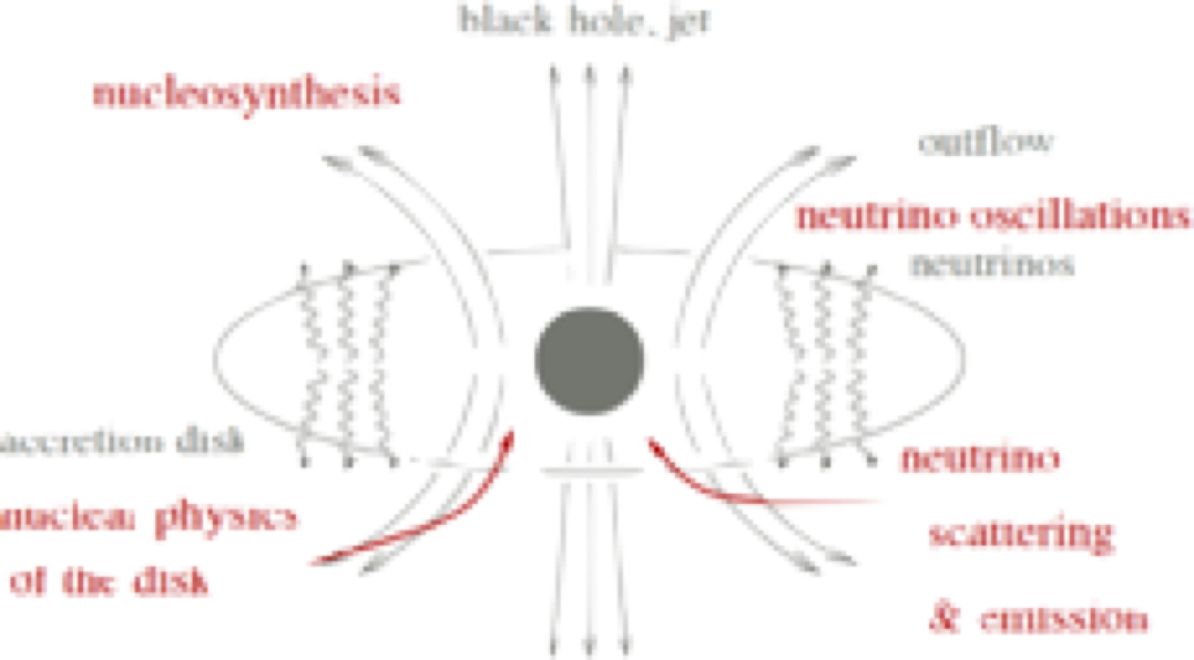
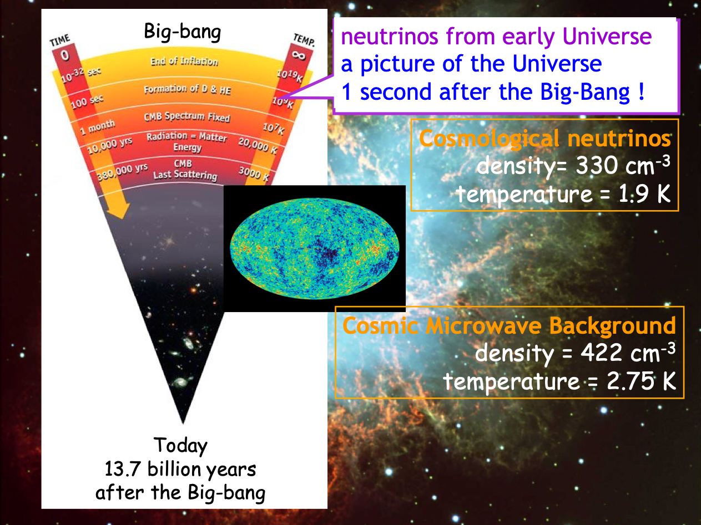
GW170817
SUN
SN1987A
BINARY MERGER REMNANTS
IMPORTANT SOURCES OF NEUTRINOS
ACCRETION DISKS AROUND BLACK HOLES
LPNHE Seminar, 27th March 2023

Slide 9
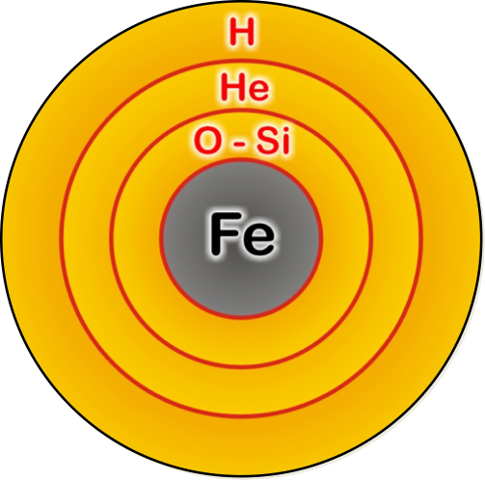
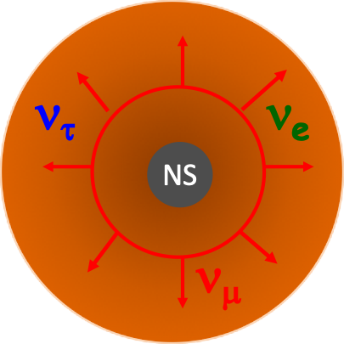
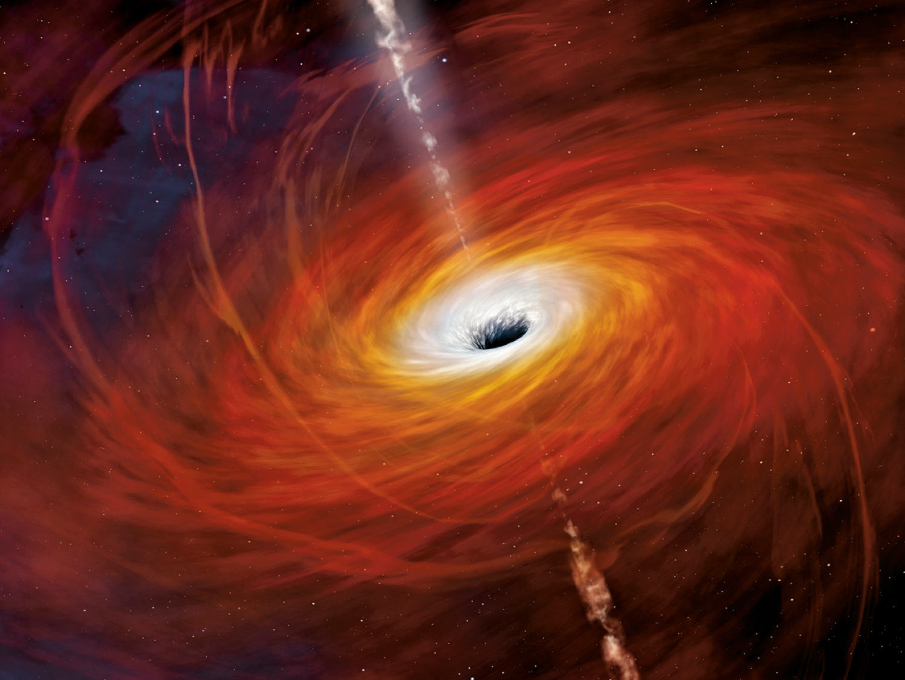
CORE-COLLAPSE SUPERNOVAE (SNe)
Massive stars with
8Msun<M< 10 Msun
O-Ne-Mg (electron-capture) SNe
M> 10 Msun
Iron CC supernovae
H
They include SNII, SN Ib (H shell lost),
SN Ic (H and He shell lost)
Gravitational binding energy taken away
by neutrinos.
NS
Colgate and White, 1966
Energy : 99 % neutrinos, 0.01% photons
about 1% explosion kinetic energy
Stellar death of massive stars due
to the core implosion.
Bounce of the neutron star forming,
launches a shock that ejects
the matter to make it unbound.
Colgate and Johnson, 1960
Hoyle and Fowler, 1960
Powerful sources of all flavor neutrinos,
during ten seconds’ burst
Neutrinos deposit energy behind
the shock triggering the explosion
(prompt explosion mechanism).
Colgate and White, 1966
LPNHE Seminar, 27th March 2023

Slide 10
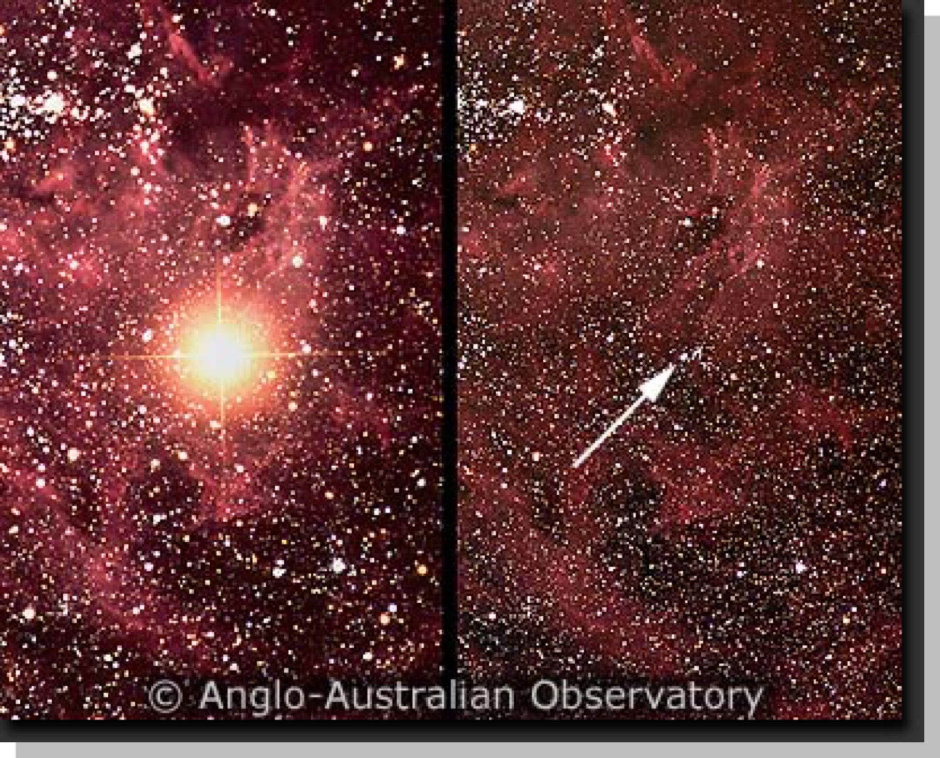
SN1987A NEUTRINO EVENTS
First observation of neutrinos from the death of a massive star.
Observed in all wavelengths.
24 events detected, plus 5 events in Mont Blanc (debated).
Kamiokande
7 s
Baksan
7 s
IMB
SN1987A
27 février 1987
Sanduleak 69⁰202
Mont Blanc
Time structure: exponential cooling versus double structure
Baksan fit to the data: luminosities too large…
Alexeyev et al, (Baksan Coll.), PLB 205 (1988)
SN1987A, Sanduleak 69⁰202 blue supergiant exploded,
Large Magellanic Cloud
kpc (163,000 light-years)
Consistent with a predicted time spread of about 10 s
Schmidt et al, 1992
LPNHE Seminar, 27th March 2023

Slide 11
SN1987A OBSERVATIONS
First observation of neutrinos from the death of a massive star.
Observed in all wavelengths.
24 events detected, plus 5 events in Mont Blanc (debated).
Bayesian analysis considering only cooling models
or accretion+cooling models.
Kamiokande
7 s
«We find two-component models
to be 100 more probable than
single-model component. »
Baksan
7 s
Loredo and Lamb, PLB 205 (1988)
IMB
Presence of the accretion phase confirmed
at 2-3 sigma by the analysis of Pagliaroli et al.
Mont Blanc
Pagliaroli, Vissani, Constantini, Ianni,
Astropart. Phys. 31 (2009)
Alexeyev et al, (Baksan Coll.), PLB 205 (1988)
Favoring the accretion+cooling model and rejecting the prompt model of supernova explosions
LPNHE Seminar, 27th March 2023

Slide 12
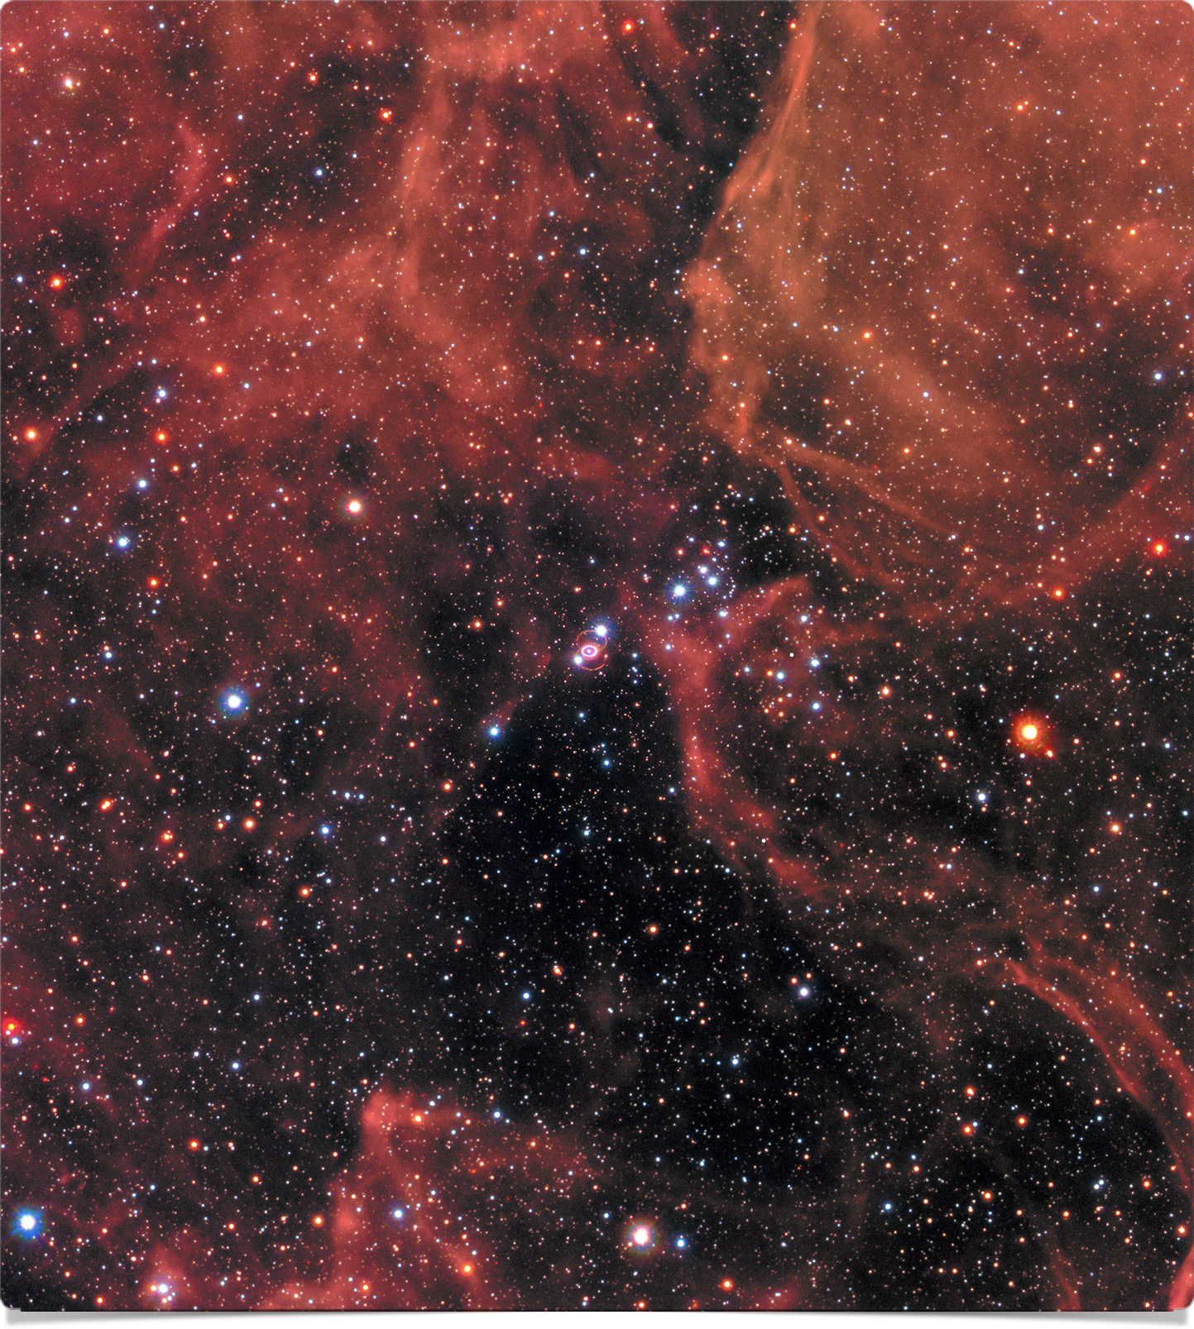
SN1987A OBSERVATIONS
SN1987A today
Hubble Space Telescope
The observation of ejecta asymmetries and the
presence of strong mixing in the ejecta gave
momentum to multidimensional supernova simulations.
After 30 years, there is finally indications for a compact
object remnant: a neutron star.
Hubble Space Telescope
Alp et al, 2018, Cigan et al, 2019, Page et al., Astroph. Journ. 898, 2020
LPNHE Seminar, 27th March 2023

Slide 13
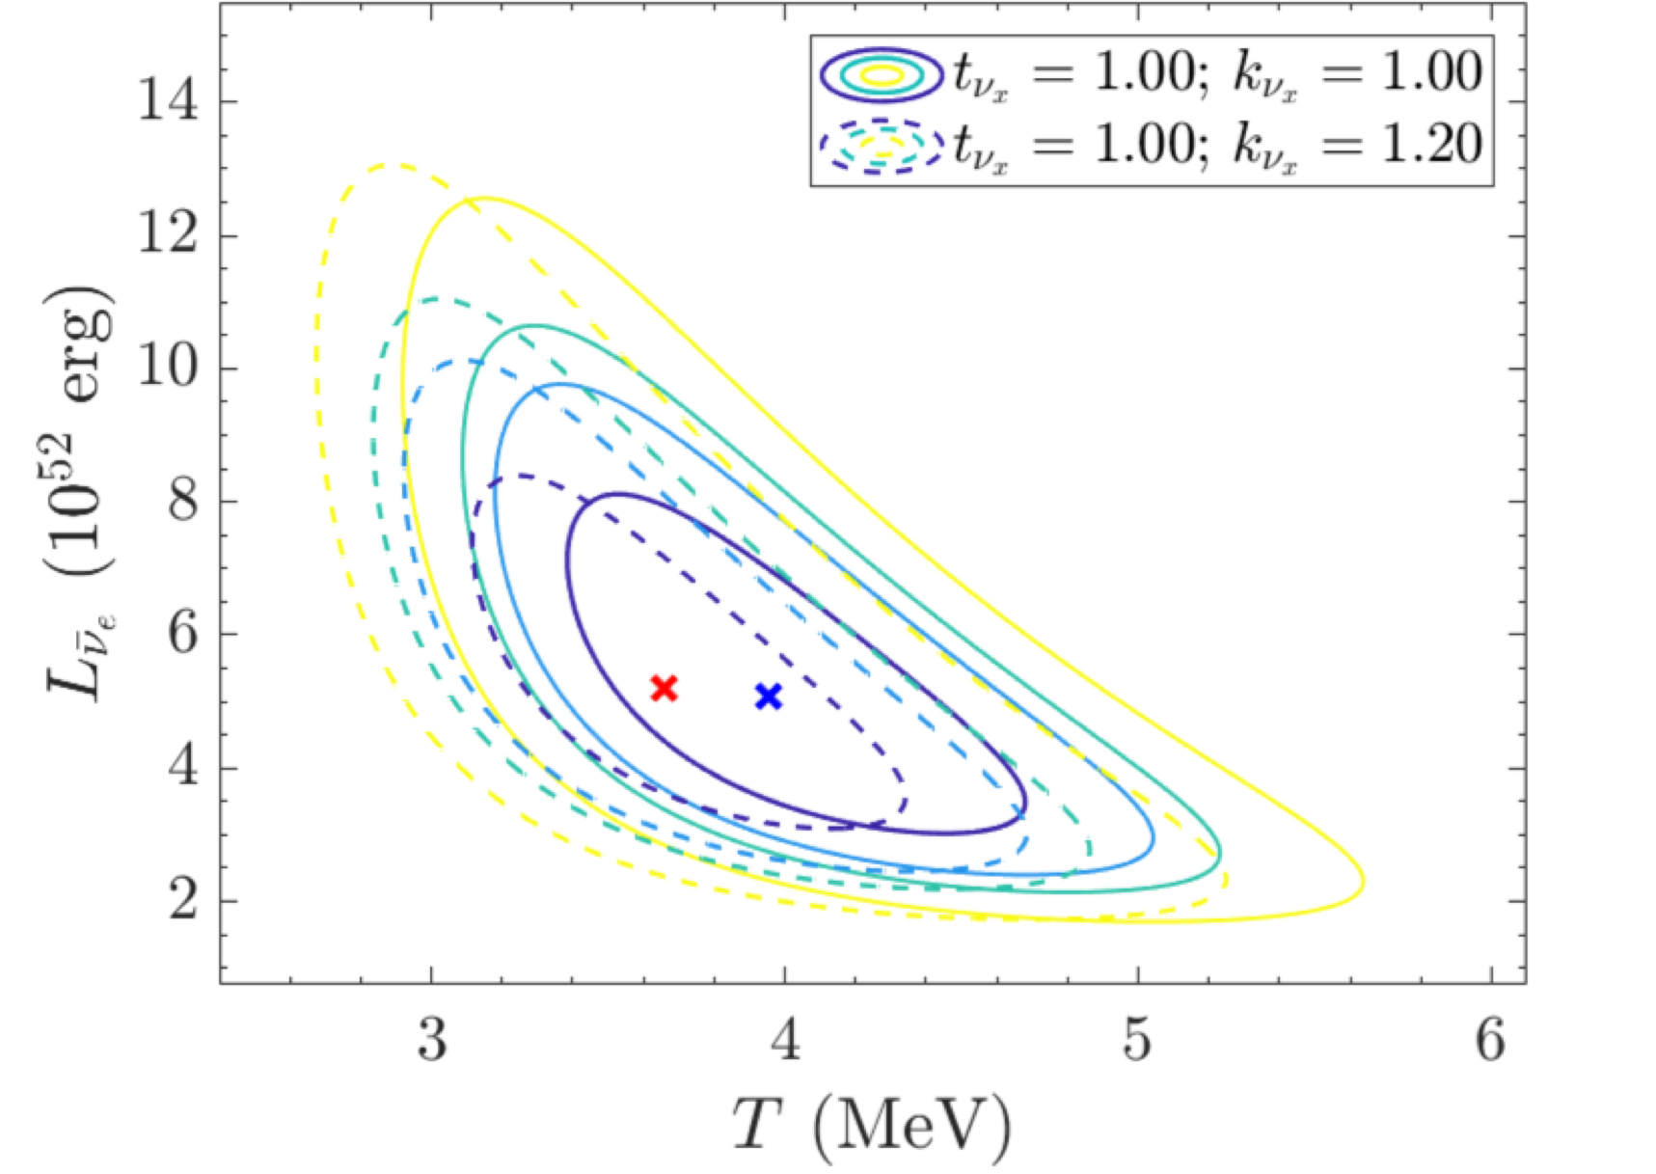
SN1987A and the MSW effect
First analysis found strong sensitivity,
Lunardini and Smirnov , Astrop. Phys. 2004
or indicated a conflict with average
neutrino energies from simulations.
Jegerlherer, Neubig, Raffelt, PRD 54, 1996
More recent found sensitivity at the level of
10%, from the spectral analysis
Vissani, J.Phys.G 42, 2015
Ivanez-Ballesteros and Volpe, 2023, in preparation
At the same level of several uncertainties in the analysis (energy thresholds, efficiencies, …)
LPNHE Seminar, 27th March 2023

Slide 14
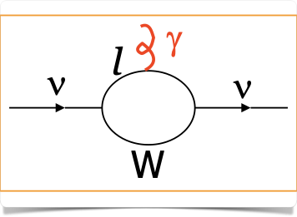
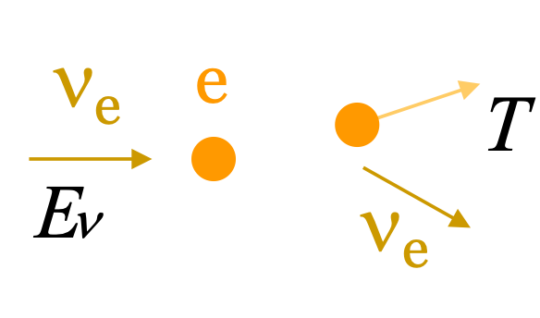
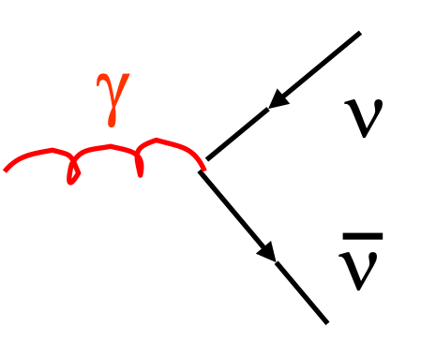
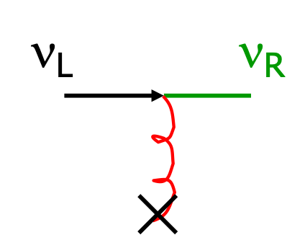
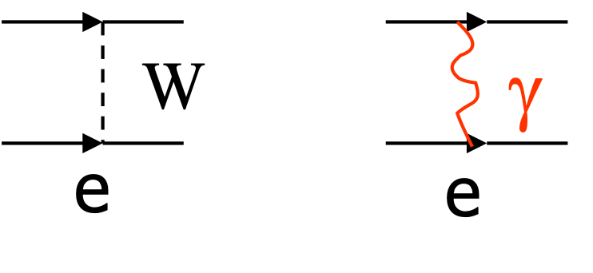
SN1987A: an incredible laboratory for particle physics
Neutrinos have electromagnetic properties from
effective one-photon couplings.
The most general vertex form, consistent with Lorentz
invariance includes
Effective one-photon coupling of
a neutrino with a photon
Magnetic form factor
Limits on the electron neutrino magnetic moment
Neutrino magnetic moment
from quantum loops
to
reactor, accelerator
experiments
SN1987A
Photon decay
Coupling to
magnetic fields
Lattimer and Cooperstein (1988),
Goldman et al. (1988), Notzold (1988),…
stellar cooling
See the review Giunti and Studenikin, RMP 87 (2015)
Numerous limits on non-standard properties,
particles and interactions
LPNHE Seminar, 27th March 2023

Slide 15
LPNHE Seminar, 27th March 2023

Slide 16
THEORETICAL DESCRIPTION OF NEUTRINO EVOLUTION
In astrophysical (and cosmological) environments,
neutrinos interact with the particles in the medium.
Standard Model charged- and neutral-current
interactions in the mean-field approximation.
One-body density matrix :
Diagonal elements are the expectation value of
the number operator :
The neutrino evolution equations in media
in the density matrix approach (Liouville
equation).
Non-diagonal elements account for the mixings
(flavor modification)
The full Liouville operator is 7-dimensional.
The full description employs the neutrino quantum
kinetic equations:
Same as the early univers (primordial nucleosynthesis).
LPNHE Seminar, 27th March 2023

Slide 17
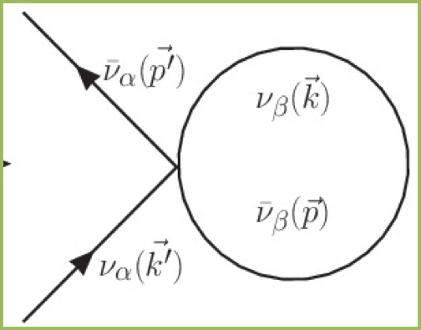
FLAVOR CONVERSION IN SUPERNOVAE
MSW effect
MSW
region
neutrinospheres
NS
shock wave
Shock wave effects
Schirato and Fuller,
hep-ph/0205390
Turbulence effects
Loreti et al, PRD 52 (1995)
Neutrino-neutrino interactions
Pantaleone, PLB287 (1992)
Volpe, Review of Modern Physics, arXiv: 2301.11814
LPNHE Seminar, 27th March 2023

Slide 18
THEORETICAL DESCRIPTION OF NEUTRINO EVOLUTION IN DENSE MEDIA
Neutrinos propagating in a dense astrophysical environments :
A weakly interacting many-body problem.
Volpe, «Neutrino quantum kinetic equations »,
Int. Journ. Of Modern Phys. E 24 (2015)
Density matrix
Non-standard interactions
Mass term in the flavor basis :
responsible for vacuum
oscillations
Wolfenstein weak potential that
produces MSW effect, together
with the vacuum term
limits for neutral solar-like matter
see e.g. Biggio et al, JHEP 0908 (2009)
Neutrino-neutrino interactions
The neutrino quantum kinetic equation solved numerically
For the early univers (epoch of primordial nucleosynthesis):
Froustey, Pitrou, Volpe, JCAP 12, 2020
LPNHE Seminar, 27th March 2023

Slide 19
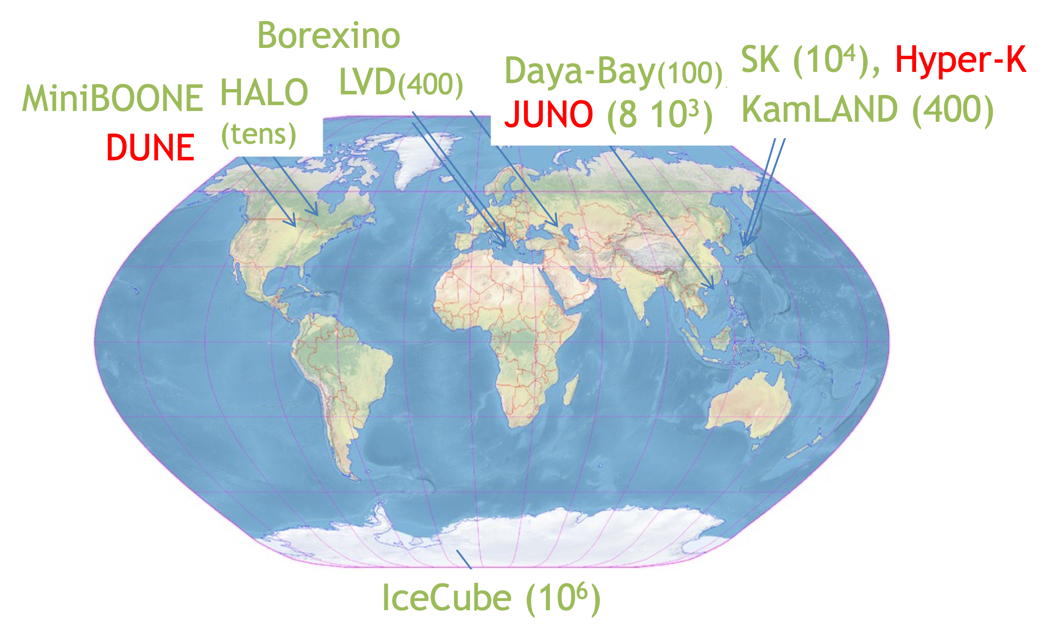
FROM NEXT SUPERNOVA
Sentivity to all flavors, time and energy signal
through scattering on protons, electrons, nuclei.
Expected events for a supernova in our galaxy (10 kpc)
Sensitivity to electron neutrinos from
neutrino-nucleus inelastic scattering
SN localization, cooling, M-R (compactness)
of the neutron star, explosion mechanism;
neutrino magnetic moment, mass ordering,
non-standard interactions, …
CP violation, Balantekin, Gava, Volpe,
PLB B662 (2008)
Scholberg, Supernova Early Warning
System (SNEWS), 1999; SNEWS 2.0, 2021
Crucial information on non-standard neutrino properties, particles, interactions, on explosion dynamics, star location and properties
LPNHE Seminar, 27th March 2023

Slide 20
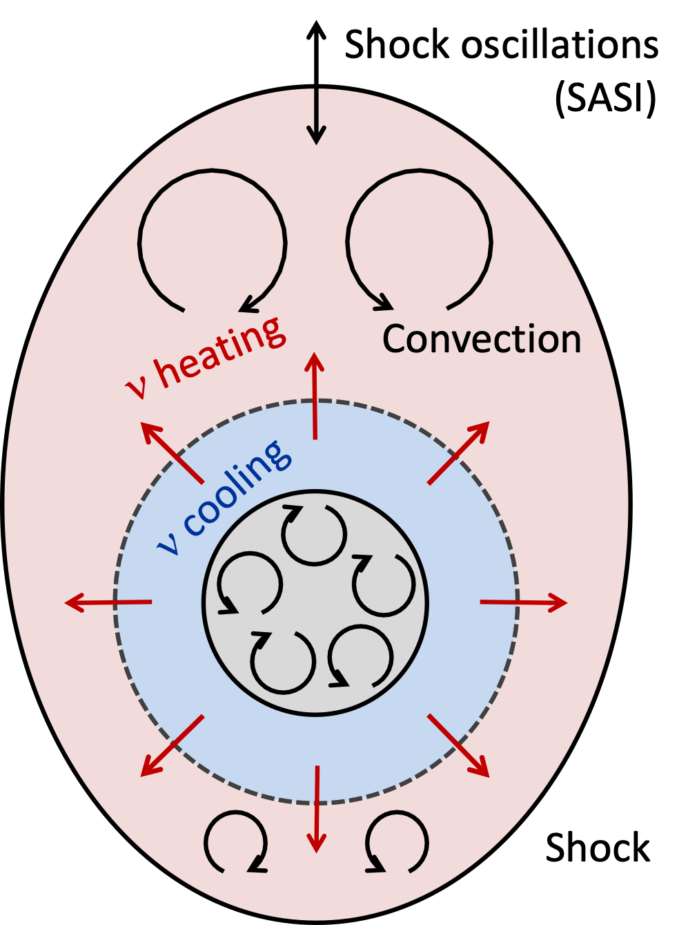
THE EXPLOSION MECHANISM?
2D and 3D simulations include convection, turbulence, neutrino heating and hydro instabilities (SASI).
The role of hydrodynamic instabilities
(SASI) debated.
Characteristic imprint of SASI
in neutrino signals
Janka 2017, Radice et al 2018, Bruenn et al, 2020,
Takiwaki et al, 2021, Tamborra et al, Astrophys.J.
792 (2014) (LESA)
Influence from flavor mechanisms small.
SASI IMPRINT: CONFIRM/REFUTE CURRENT SN EXPLOSION MODEL

Slide 21
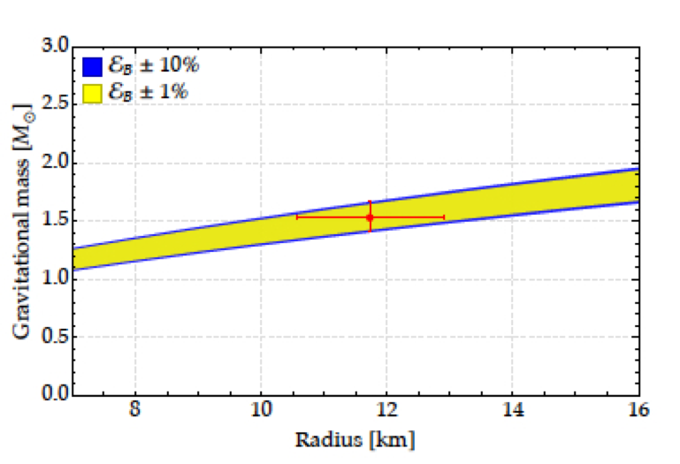
SUPERNOVA NEUTRINO TIME SIGNAL
Neutronization peak:
> time of core bounce
> only MSW effect operates
> non-standard properties, ex. decay or NSI
Neutronization
Accretion
Neutron star cooling
De Gouvea et al, PRD101, 2020; Das et al, JCAP
05, 2017; etc…
Cooling phase:
> it can be modified by non-standard
interactions
Total gravitational energy emitted in
neutrino luminosity:
> 11% (SK) and 3% (HK) precision (SN at 10 kpc)
> newly formed neutron star compactness
Different phases of the explosion
A star like SN1987A
Detection of each of these phases crucial
Gallo Rosso, Vissani, Volpe, JCAP 11, 2017, JCAP 04, 2018
LPNHE Seminar, 27th March 2023

Slide 22
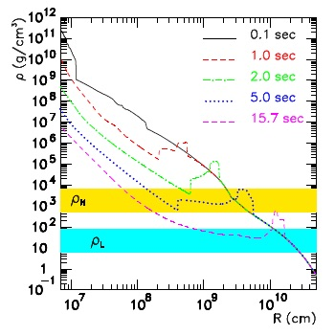
NEUTRINO MASS ORDERING
Time signal in Cherenkov and scintillator detectors of a supernova in our galaxy (10 kpc)
Presence of front and reverse shocks .
scintillator, Cherenkov detectors
Tomas et al, JCAP 09 (2004)
19 MeV
15 MeV
10 MeV
29 MeV
Inverted mass ordering
MSW resonance can be met multiple times.
Gava, Kneller, Volpe, McLaughlin, PRL 103 (2009)
Positron time signal from per unit tonne.
Prediction includes interactions and shock wave effects.
Picture of the shock wave passage in the MSW region. Similar for electron neutrinos in DUNE for NMO.
If the mass ordering determined by experiments, it will confirm/refute that we understand.
LPNHE Seminar, 27th March 2023

Slide 23
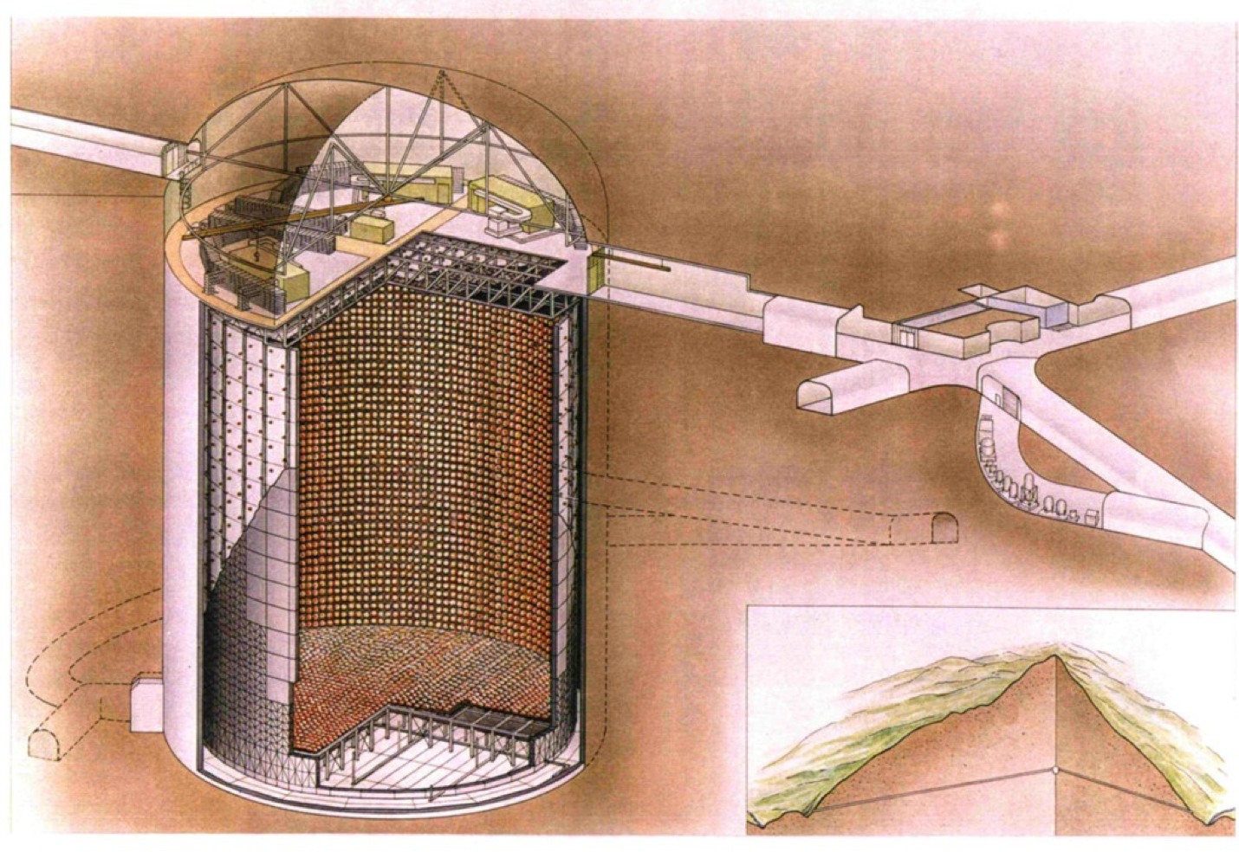
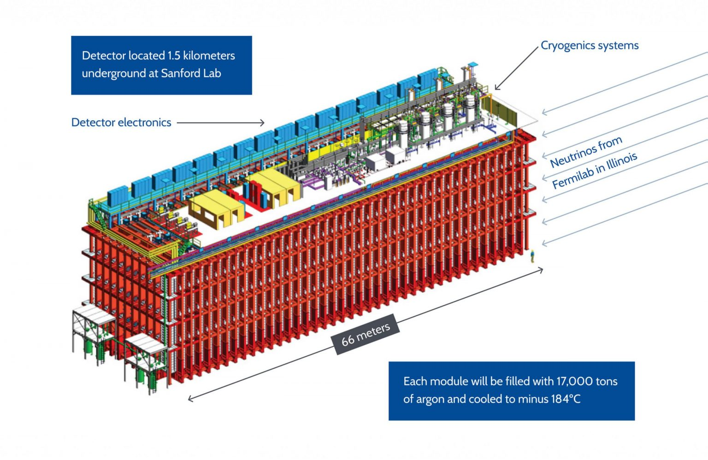
Super-Kamiokande
50 kton water (Japan)
Running (2020) + Gd
Hyper-Kamiokande
178 kton (FV) water (Japan)
Starting 2027
THE DISCOVERY OF THE
DIFFUSE SUPERNOVA NEUTRINO BACKGROUND (DSNB)
DUNE
40 kton
liquid argon
(US)
upcoming
JUNO
50 kton scintillator
(China)
running soon
LPNHE Seminar, 27th March 2023

Slide 25
STATUS on the DSNB
Flux upper limits from SKI-IV and SNO data
Abe et al, 2109.11174
SNO data, Aharmim et al, Astrophys. J. 2006
Peres and Lunardini,. JCAP 2008
The sensitivity of the combined analysis (90 % C.L.)
is on par with 4 predictions.
EXCESS (1.5 sigma) over BACKGROUND OBSERVED
Expected rates, 90% C.L. upper limits, best fit values (1 sig.)
and expected sensitivity from SK-I and SK-IV data
Abe et al, 2109.11174
LPNHE Seminar, 27th March 2023

Slide 26
DIFFUSE SUPERNOVA NEUTRINO BACKGROUND
The DSNB flux depends on the evolving core-collapse supernova
rate, the neutrino fluxes from a supernova, integrated over time
theoretical band
includes uncertainty
on supernova rate
and failed supernovae
redshifted neutrino energies
mass of the supernova progenitor
giving either a neutron star or a black hole
SK-limit
Priya and Lunardini JCAP 2017
There is a contribution from failed supernovae (black-hole):
hotter energy spectrum determines the relic flux tail
Lunardini, PRL 2009
dark energy and matter cosmic energy densities
DSNB detection window
LPNHE Seminar, 27th March 2023

Slide 27
CORE-COLLAPSE SUPERNOVA RATE
The cosmic core-collapse supernova rate history can be deduced from the cosmic star formation rate history.
is the number of stars with
progenitor mass
Salpeter Initial Mass Function (IMF)
Local SN rate uncertain by a factor of 2:
Yuksel et al, i Astrophys. J(2008)
ONE of the main UNCERTAINTIES
relevant for
the DSNB
below detection
threshold
LPNHE Seminar, 27th March 2023

Slide 28
DSNB IMPORTANT
Fraction of black-hole forming supernovae versus
neutron-star forming supernovae debated
Therefore the DSNB is sensitive to :
- the cosmic core-collapse supernova rate, the
fraction of failed supernovae, the EOS;
NS
BH
see e.g. Priya and Lunardini 2017,
Moller et al 2018, Kresse et al 2021,
Horiuchi et al 2021, …
- flavor conversion phenomena beyond MSW,
e.g. shock waves and self-interaction.
Event rates can be modified by 10-20 %.
Galais, Kneller, Gava, Volpe, PRD81, 2010
- non-standard neutrino properties such as
neutrino decay.
Ando 2003, Lisi et al 2004,
De Gouvea et al 2020,
Tabrizi et Horiuchi 2021,
Ivanez-Ballesteros and Volpe, 2022.
Kresse et al 2021
FOR ASTROPHYSICS AND PARTICLE PHYSICS
LPNHE Seminar, 27th March 2023

Slide 29
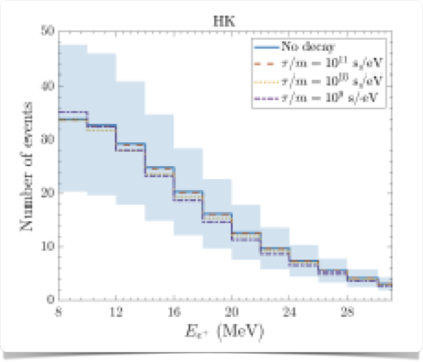
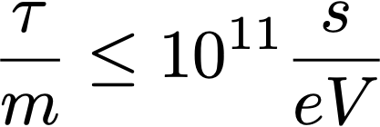
DSNB and NEUTRINO DECAY
The DSNB is sensitive to non-standard properties.
It has a unique sensitivity to neutrino non-radiative
two-body decay:
Hyper-Kamiokande
DSNB :
Normal mass
ordering and SH
a massless scalar particle
Ando et al, PLB 570 (2003) ; Fogli et al PRD70 (2004);
De Gouvea et al PRD 102 (2020); Tabrizi, Horiuchi,
JCAP 05 (2021).
Upper limits from Earth experiments,
solar neutrinos and cosmology (BBN and CMB).
Inverted
mass ordering
atmospheric exp.
decay observability
(rule of thumb)
Expected DSNB events (no decay) :
10 for SK-Gd (10 year), and DUNE (20 years),
10-40 for JUNO (20 years)
and a few hundreds for Hyper-Kamiokande (20 years).
Ivanez-Ballesteros and Volpe,
PRD107 (2023), arXiv:2209.12465
In case DSNB not observed, it could be
due to neutrino non-radiative two-body decay
LPNHE Seminar, 27th March 2023

Slide 30
Conclusions and Perspectives
Neutrino flavor evolution in dense environments, in particular core-collapse supernovae and
binary neutron star mergers still has to reveal mysteries. Neutrino self-interaction effects requires
further work, or gravitational field effects.
As for SN1987A, observation of a new (extra)galactic supernova would bring :
crucial evidence on the role of SASI,
key information on the supernova, on the neutron star and on
unknown neutrino properties.
Upcoming measurement of the diffuse supernova neutrino background important
for astrophysics and particle physics. It opens a new observational window.
LPNHE Seminar, 27th March 2023

