Slide 1
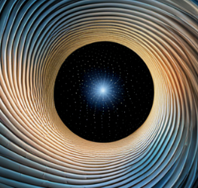
Mach’s Principle
-Hemansh Shah

Slide 2
The principle:
Basically, there exists no ‘space’ independent of the matter within it.
???
Let’s look at some history.

Slide 3
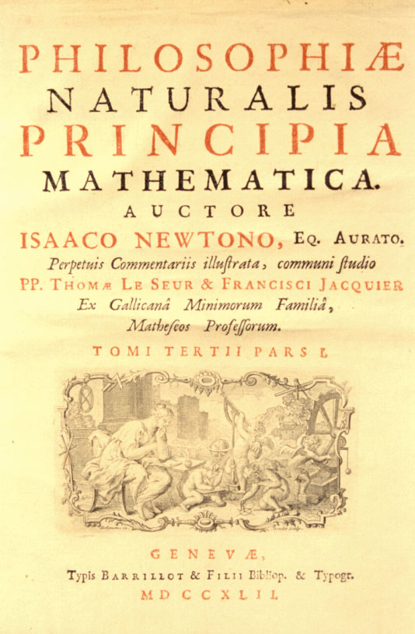
Newton in Principia:
Year: 1687
“Time, space, place, and motion, being words well known to everybody, I do not define. Yet, it is to be remarked that the vulgar conceive them only in their relation to sensible objects.”
……
“Absolute time, by itself, flows on uniformly, without regard to anything external.”
……
“Absolute space, without regard to anything external, always remains similar and immovable.”

Slide 4
Why so, Newton? : Newton’s bucket
Newton’s argument for the existence of absolute space was to consider a thought experiment with an observer and a bucket at rest relative to the observer.
If they are as a whole inertial, the water level in the bucket will be flat.
If they are, as a whole, rotating of accelerating, the water level will deform.
Hence, the absolute space…
vs

Slide 5
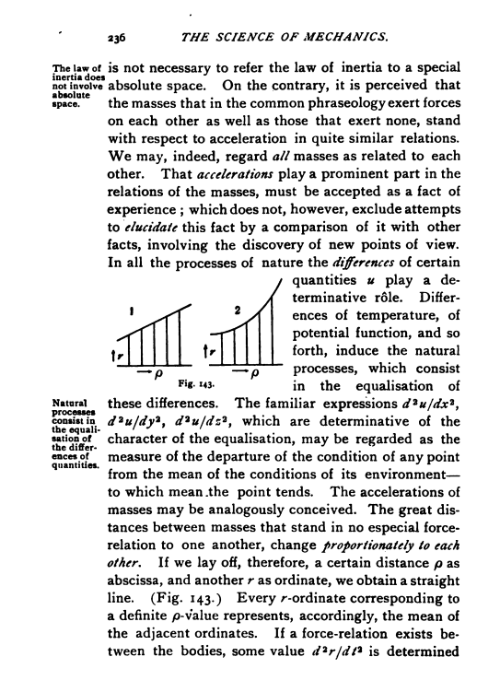
Mach in ‘The Science of Mechanics’:
Year: 1883
“Instead of referring a moving body to space or a system of coordinates, let us view directly its relation to the bodies in the universe, by which alone such a system of coordinates can be determined.”
…
“Instead of saying the velocity of a mass in space remains constant, we should say, the mean acceleration of a mass with respect to all the other masses is zero.”

Slide 6
Mach’s alternative:
Mach proposed a modified law for the motion of a particle of mass $μ$ acted upon by a force $\vec{f}$.
$$μ\frac{d^{2}}{dt^{2}}\frac{Σm_{i}\vec{r_{i}}}{Σm_{i}}=\vec{f}$$
where the sum is over all particles, $m_{i}$ are their masses and $\vec{r_{i}}$ are the position vector of our particle relative to them.
This allows Mach to circumvent the need for absolute space in Newton’s law $μ\ddot{\vec{r}}=f$, and works exactly the same given the net motion of all matter is defined “inertial”.

Slide 7
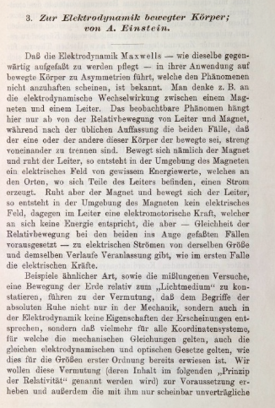
Einstein’s Special Relativity:
Year: 1905
Special Relativity provided a new theoretical understanding of the nature of space and time. Space and time were unified into one 4-D Minkowski space, and the principle of relativity was maintained as a change in velocity was now a ‘rotation’ in this 4-D space.
Special relativity is not a Machian theory. Objects move in uniform motion on a background spacetime, irrespective of the rest of the matter.

Slide 8
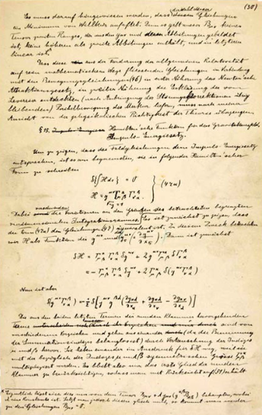
Einstein’s General Theory of Relativity:
Year: 1915
Real progress in the understanding and implementation of Mach’s principle was made with the General Theory of Relativity.
Mach’s principle was one of the key considerations of Einstein when making this theory. He hoped the theory would satisfy this principle.
However, Einstein dropped it later.
In general relativity, inertial objects still move uniformly through a ‘background space’.
However, a major change is that the motion of masses can indeed change the standard of rest.

Slide 9
A quick computation:
The matter surrounding the mass starts accelerating leftward, while the mass stays stationary.
A mass at rest, surrounded by a uniform sphere of matter, starts accelerating rightward.
$$a$$
Let’s compare!
?
$$m$$
$$a$$
$$≡$$
$$m$$
Mach’s principle
suggests
equivalency.

Slide 10
Case 1:
The mass experiences a leftward inertial backreaction of $ma$.
An external rightward force of $ma$ is needed to balance it out.
$$m$$
$$a$$

Slide 11
Case 2:
According to Newtonian gravitation, there is no force on the mass.
But such a force does arise in General Relativity. Exact computations are difficult, but if we neglect stresses and assume weak fields, we can use an approximation here, called
Gravito-electromagnetism.
(The approximation is gross here, but I can’t help it. In reality, such a sphere would have enormous stresses, affecting its gravity further.)
$$a$$
$$m$$

Slide 12
Gravito-electromagnetism:
Two fields: Gravitational field: $\vec{g}$
Gravitomagnetic field: $\vec{h}$
Force on a mass $m$ moving with velocity $\vec{v}$: $\vec{F}=m\left(\vec{g}+\vec{v}×4\vec{h}\right)$
Field equations, with matter density $ρ$ and mass flow $\vec{j}$:
$$\vec{∇}.\vec{g}=−4πGρ$$
$$\vec{∇}.\vec{h}=0$$
$$\vec{∇}×\vec{g}=−\frac{∂\vec{h}}{∂t}$$
$$∇×\vec{h}=−\frac{4πG}{c^{2}}\vec{j}+\frac{1}{c^{2}}\frac{∂\vec{g}}{∂t}$$

Slide 13
Case 2:
The accelerating matter creates an increasing circulating gravitomagnetic field, which creates a leftward gravitational field at the centre, with magnitude given by
$$g=\frac{πGρR^{2}}{c^{2}}a$$
Where $ρ$ is the density of matter and $R$ is the radius of the sphere.
$$a$$
$$m$$

Slide 14
Case 2:
$$a$$
$$g=\frac{πGρR^{2}}{c^{2}}a$$
The mass experiences a leftward gravitational backreaction of $mg$, which must be balanced by an equal external rightward force, since the mass stays stationary.
$$m$$

Slide 15
Equivalency?
If our universe were indeed a static homogenous sphere (somehow…),
we could say that Mach’s principle was valid if
$$g=a$$
$$i.e. \frac{πGρR^{2}}{c^{2}}=1$$
Of course, our universe isn’t, but the above equation will still be true very VERY roughly. Further, we can substitute: $R∼ct$, $t∼1/H$ to get an order of magnitude equation
$$\frac{πGρ}{H^{2}}∼1$$

Slide 16
General Relativity
Now, we do know that our universe is flat (upto our best measurements). So,
$$\frac{8πGρ}{3H^{2}}=1 (flat universe)$$
That’s impressive, but General Relativity is generally not Machian.
$G$ could as well have been any other value. The universe might have
been empty, but the solar system would not be different.
Einstein hence, later, abandoned Mach’s principle.
So, our universe seeming to obey the principle is just a coincidence?

Slide 17
It was an accident!
There are no accidents…

Slide 18
Mach’s principle today:
$G$ is a dynamical field.
The universe does not appear to rotate relative to local inertial frames.
Inertial mass is affected by global distribution of matter.
Local inertial frames are affected by cosmic motion.
$Ω=4πρGT^{2}$ is a definite number of order unity.
An isolated body in empty space has no inertia.

Slide 19
So what’s true?
What is?
Replacements have been proposed but none verified.
General Relativity is accurate.
Space has properties independent of the matter contained in it.
General Relativity is not an accurate description of the universe.
OR
General Relativity is correct, but there are some yet unknown boundary conditions.
General Relativity is accurate for our universe, but empty space solutions, etc. are somehow disallowed.

Slide 20
Thank you!!

