Slide 1
Air contamination in IBS vacuum systems
Prepared by Ieva Janušaitytė
2023-07-18

Slide 2
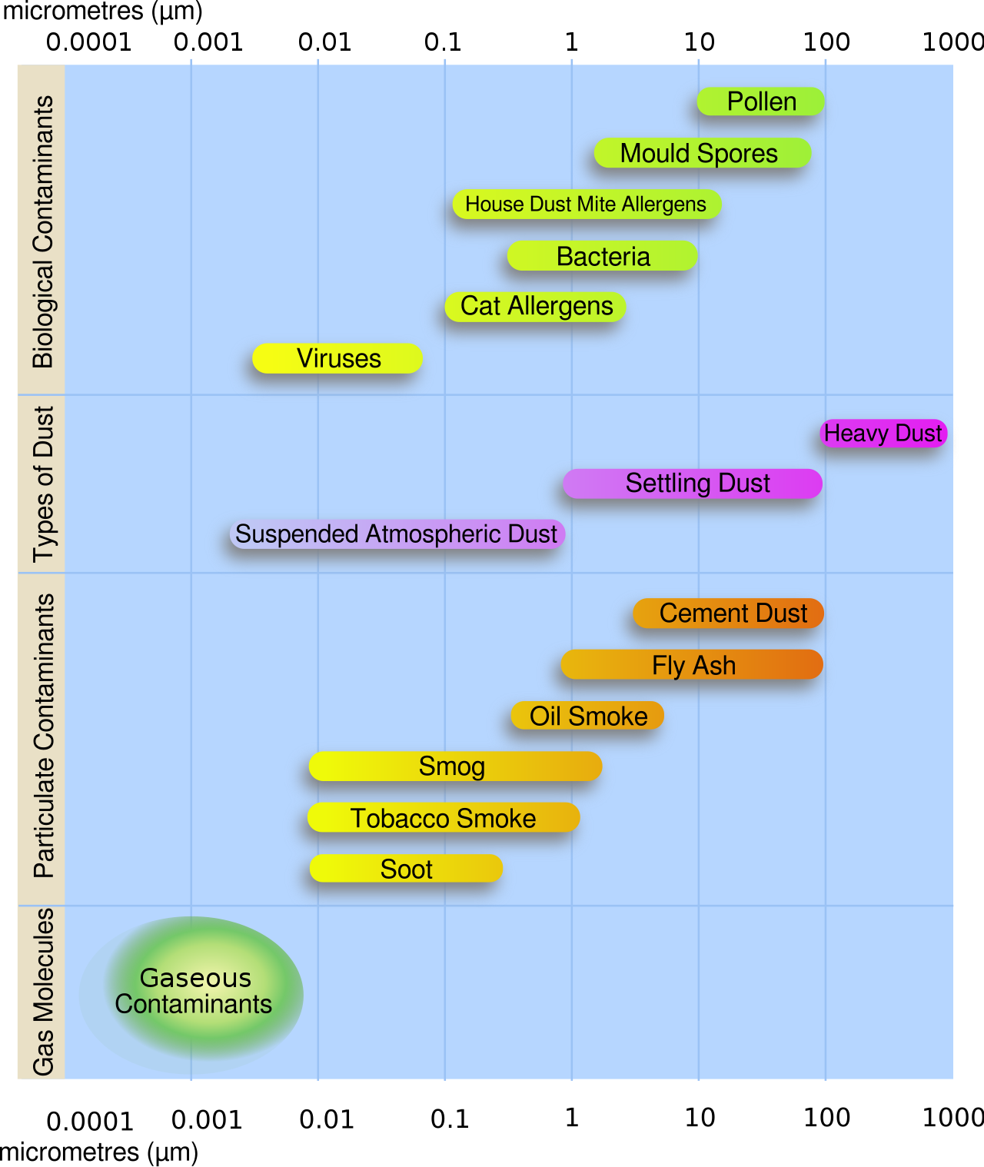
Dust and particulates
Cause problems:
Performance deterioration for components
Growth defects for thin films
Their origins:
Air pollution
Fabrication
Assembly (Humans, friction)
Operations (Friction, charging, aging)

Slide 3
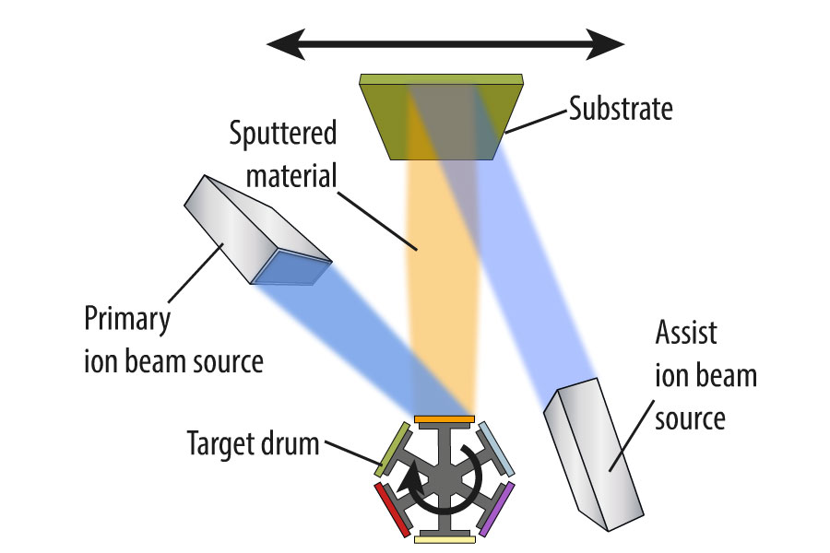

Slide 4
The challenge
How to create a particulate free vacuum system?
What are the main causes of air contamination in IBS systems?

Slide 5
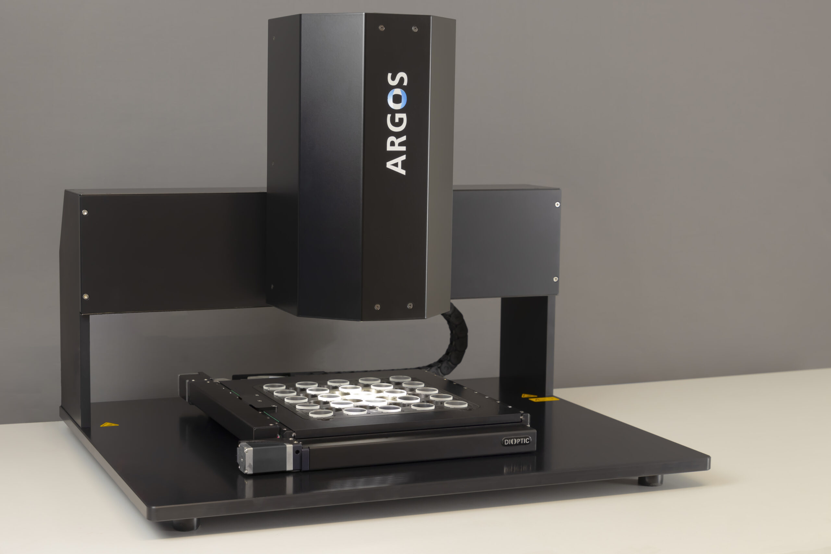
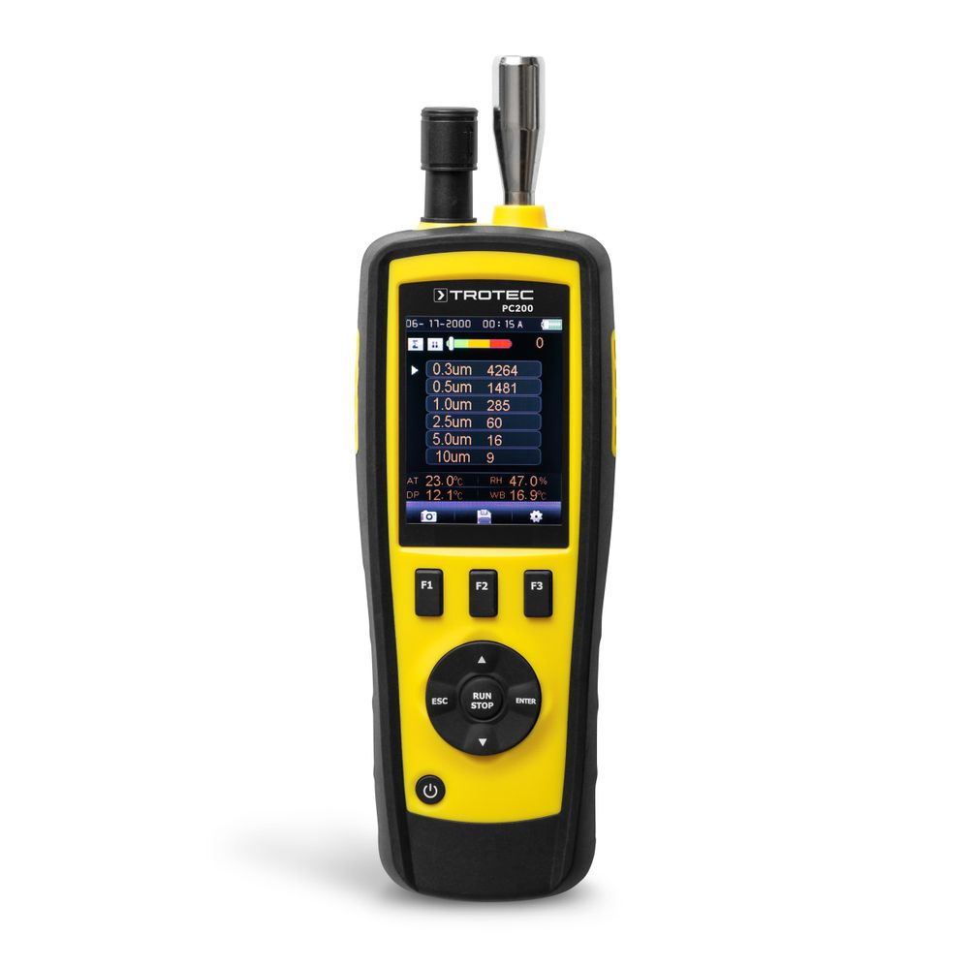
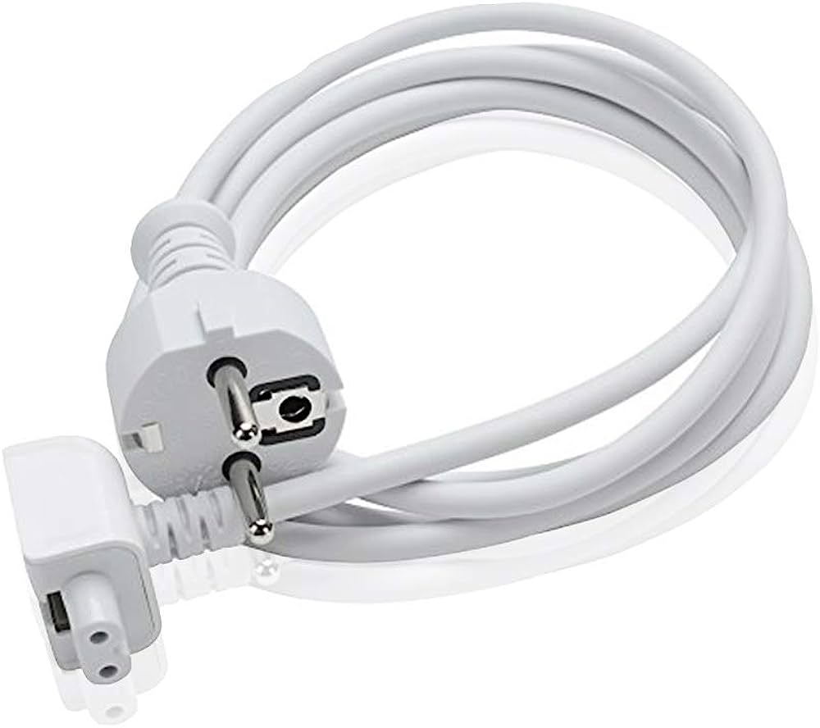
Methods for analysis
2. Leave lenses at the bottom of the vacuum chamber for overnight processes and check the surface quality.
2.5. Compare it to the thin film coatings’ surface quality.
Use particle counter after various processes.

Slide 6
Expected results
To examine the correlation between the amount of defects on surface and the density of airborne particles in the chamber.
To examine how air contamination levels depend on in the vacuum systems.
To identify the key factors leading to the deteriation of surface quality.

Slide 7
Literature sources
HOH, Peter D, 1984. Summary Abstract: Quantitative particulate contamination studies utilizing reduced turbulence pumping and venting. 1 April 1984. Vol. 2, no. 2, p. 198–199. DOI https://doi.org/10.1116/1.572722.
LILJE, Lutz, [no date]. Controlling Particulates and Dust in Vacuum Systems Online. [Accessed 17 July 2023]. Available from: https://arxiv.org/ftp/arxiv/papers/2006/2006.02820.pdf
MARTIGNAC, J, BONIN, B, HENRIOT, C, POUPEAU, J, KOLTCHAKIAN, I, KOCIC, D, HERBEAUX, Ch and MARX, J, [no date]. PARTICLE CONTAMINATION IN VACUUM SYSTEMS Online. [Accessed 17 July 2023]. Available from: https://accelconf.web.cern.ch/SRF95/papers/srf95c08.pdf
STRASSER, Gottfried, BADER, Hans-Peter and BADER, M E, 1990. Reduction of particle contamination by controlled venting and pumping of vacuum loadlocks. 1 November 1990. Vol. 8, no. 6, p. 4092–4097. DOI https://doi.org/10.1116/1.576445.

Slide 8
Pictures from
https://en.wikipedia.org/wiki/Particulates
https://www.scia-systems.com/products/ion-beam-sputtering
https://www.amazon.com/Extension-European-Standard-Macbook-17-inch/dp/B00FDLP6DC
https://www.dioptic.de/en/2021/03/15/argos-matrix-200-the-new-industry-standard-for-automated-surface-inspection/

Slide 9
QnA

