Slide 1
Anyons
Andjela Besir
University of Belgrade

Slide 2
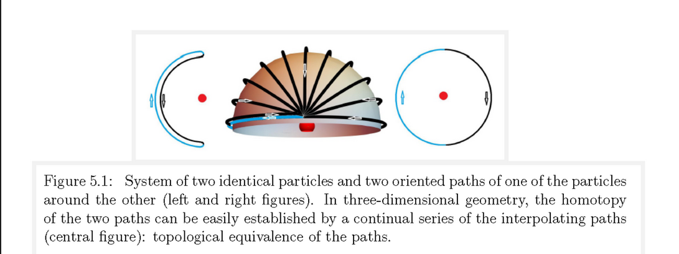

Permutational group Sn
In 3D : Double transposition of two particles ($π^{2})$ – rotation of one around the other – restores the original position
$π^{2}=1$
$$π=±1$$
Bosons and fermions

Slide 3
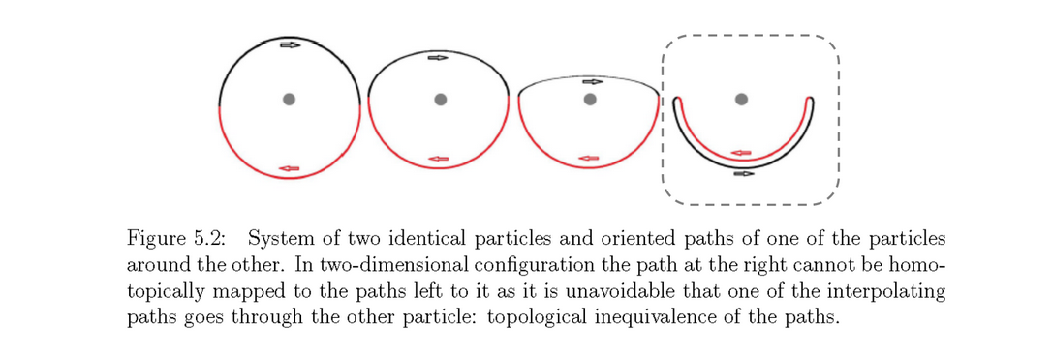
Braid group Bn
2D vs 3D – qualitative difference! Winding is well defined – trajectory of one particle around the other can not be homotopicaly squeezed to a point -> resulting state doesn’t have to be the same as starting one

Slide 4
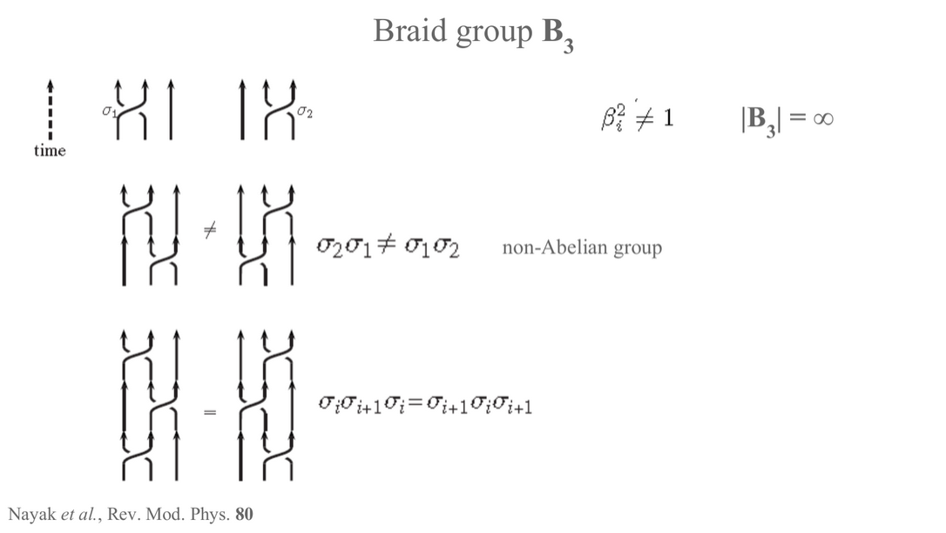

Slide 5
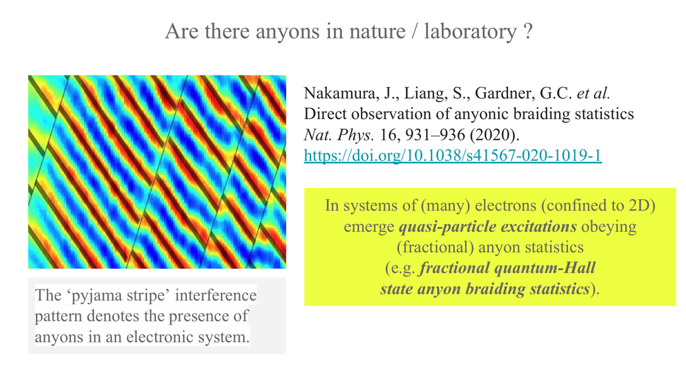

Slide 6
Thank you for your attention

