Slide 1
Shape Coexistence at A~100
Emmanuel, Didier, Freddy, Serge, Magda, Wolfram, Jérémie etc …

Slide 2
Shape coexistence in atomic nuclei is an universal phenomenon
It reflects the competition between a stable spherical shape and
the natural tendency of the nucleus to deform
Competition between spherical gap and residual interaction minimizing the potential energy of deformed configuration
Two microscopical configurations, with different shape, coexist at low excitation energy in the same nucleus
Which mechanism ?
Microscopical effect ?
Relevant excitation and coupling
Mean field ?
Which symmetries ?
An experimental view on shape coexistence in nuclei Progress in Particle and Nuclear Physics Volume 124, (2022), 103931 Paul E. Garrett, Magda Zielińska, Emmanuel Clément
Shape coexistence in atomic nuclei REVIEWS OF MODERN PHYSICS, VOLUME 83, (2011) Kris Heyde, John L. Wood
Notes:
2

Slide 3
J. P. Delaroche et al PHYSICAL REVIEW C 81, 014303 (2010)
The shape evolution can be smooth as the function of the nucleon number (monopole effect)
In some case, the interaction between nucleons causes a sudden re-arrangement of the entire nucleus when few nucleons are added or removed
It is a characteristic of the shape coexistence that the “other” shape doesn’t disappear but coexists/compete at very low excitation energy

Slide 4
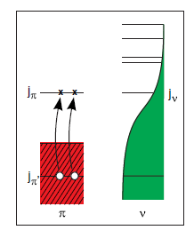
Microscopical effect
Kris Heyde and John L. Wood Rev. Mod. Phys. 83, 1467 (2011)
Gap
residual p-n energy
Pairing
The gap is not necessarily reduced but residual p-n interaction can overcomes the cost in energy

Slide 5
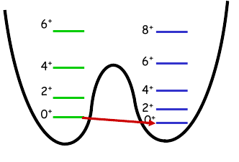
What can we measure experimentally ?
Establish the shape isomer : 0⁺₂
Collectivity in such nuclei : level scheme and B(E2) .
Shape (oblate - prolate ?) : Q₀
Wave function mixing ? : ρ²(E0)
Microscopical description : Laser spectroscopy of Odd-mass, transfer reaction C²S
Notes:
5

Slide 6
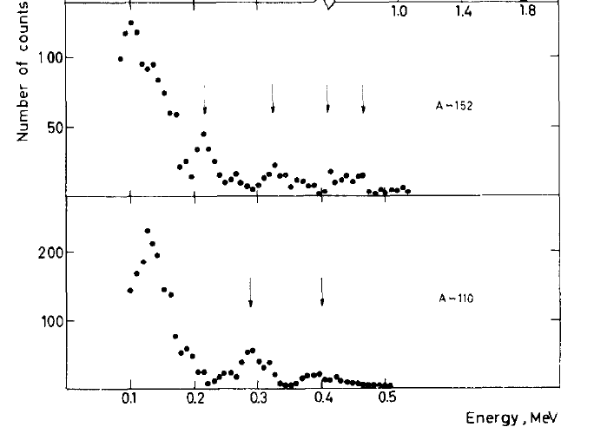
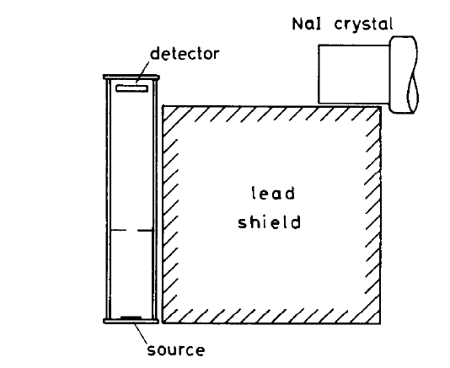
It has been established in the 60’s that elements with A~ 110 belong to a new island of stable deformation similar to the rare earth region
S. A. E. Johansson, Nucl. Phys. 64 (1965) 147

Slide 7
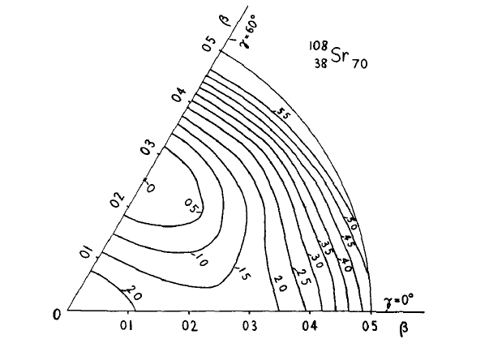
Semi-phenomenological theoretical approaches
Region for which the equilibrium shape is an axially symmetric oblate distribution
Transition from nearly spherical nuclei at N=50 to highly deformed nuclei at N=60-70
D. A Arseniev, A Sobiczewski,V G. Soloviev Nuclear Physics A139 (1969) 269--276

Slide 8
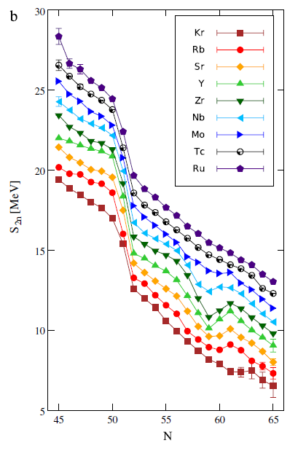
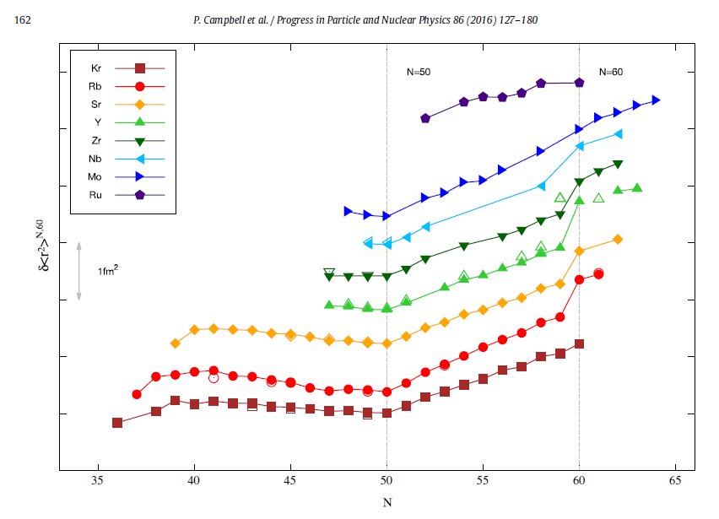
Ground states properties
The n-rich nuclei between Z=37 and Z=41 present at N=60 one of the most impressive deformation change in the nuclear chart
Localized within the Z degree of freedom
  → Point to a specific π−ν interaction

Slide 9
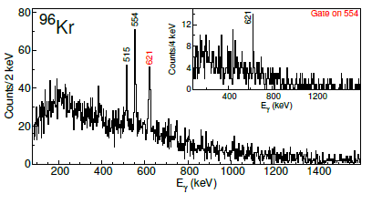
Excited states properties
First spectroscopy (GS and 2⁺₁) indicated a shape change from β ~0.1 to β~0.4
0⁺₂ states are indication of shape coexistence
→ Shape inversion ?
Kr isotopes behave differently : smooth 2⁺ change, delayed S_{2n} increase, no low lying 0⁺_{2,} sharp transition as function of Z
J. Dudouet et al. Phys. Rev. Lett. 118, 162501 (2017)
AGATA- VAMOS data

Slide 10
Excited states properties
Zr (Z=40)
Purnima Singh et al PRL121, 192501 (2018)
EXOGAM- VAMOS data

Slide 11
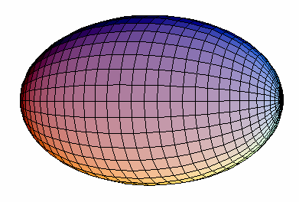
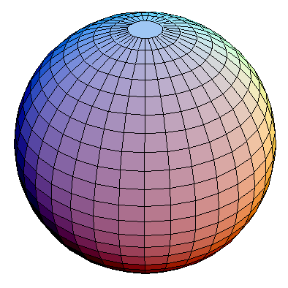
Shape Transition at N=60
What is the shape of the corresponding 2⁺ states ?
How are the different configurations connected ?
Coulomb excitation of RIB
185(50) mu
N=58
53(5) mu
N=60

Slide 12
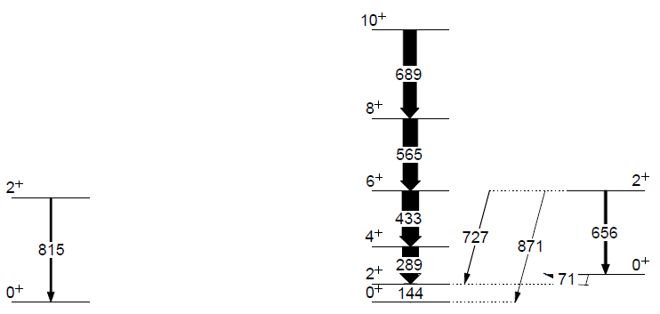
Shape Coexistence in ^{96,98}Sr
The 2⁺₁in ⁹⁶Sr is weakly deformed
The ground state band in ⁹⁸Sr has a large prolate deformation and the 2⁺₂ is similar to the ground state in ⁹⁶Sr
Shape coexistence in ⁹⁸Sr
Shape inversion at N=60
β > 0.4
|β| < 0.2
Q_{s} = -90(80) efm²
Q_{s} = -22 (31) efm²
Q_{s} = +3(24) efm²
Q_{s} = -130(23) efm²
B(E2↓) = 450 (110) e²fm⁴
Q_{s} = -213 (16) efm²
Q_{s} = -48 (25) efm²
⁹⁶Sr ; N=58
⁹⁸Sr ; N=60
E. C. et al, Phys.Rev.Lett. 116, 022701 (2016)

Slide 13
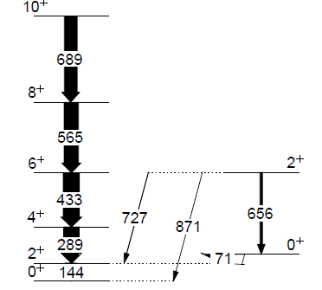
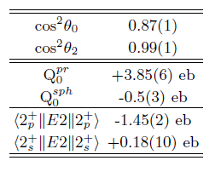
Shape Coexistence in ^{96,98}Sr
Shape coexistence in a two-state mixing model
The sharp transition is related to the very weak mixing between competing configurations in contrast to the N~Z cases in Kr and Hg isotopes
Perturbed states
Pure states
E. C. et al, Phys.Rev.Lett. 116, 022701 (2016)
E. C. et al. Phys. Rev. C 94, 054326 (2016)

Slide 14
Shape Transition at N=60
The sharp transition and magnitude of the deformation remain still a challenge for theories (> 100 theoretical papers since the 70’s)
HFB + the generator coordinate method (GCM)
the macroscopic-microscopic method
the shell model
the Monte Carlo shell model
the interacting boson model (IBM) approximation
the VAMPIR model
covariant density functional (DF) theory (PC-PK1).
⁹⁶Sr
h_{11/2}
0⁺₂ state created by (2p-2h/4p-4h) excitation across Z=40
g_{7/2}
s_{1/2}
Beyond N=60, g_{7/2} and h_{11/2} are populated, the π−ν interaction and the participates to the lowering 0⁺₂ state and to the high collectivity of 2⁺₁ state
d_{5/2}
g_{9/2}
50
40
ν
p_{1/2}
Proton g_{7/2}-g_{9/2} SO increased when neutron populate d_{5/2} → g_{7/2}
Reduction of spin orbit splitting induced by the tensor term
f_{5/2}
p_{3/2}
28
π
K. Sieja et al PRC 79, 064310 (2009)
A. Petrovici PRC 85, 034337 (2012)
T. Togashi et al, Phys.Rev.Lett. 117, 172502 (2016)

Slide 15
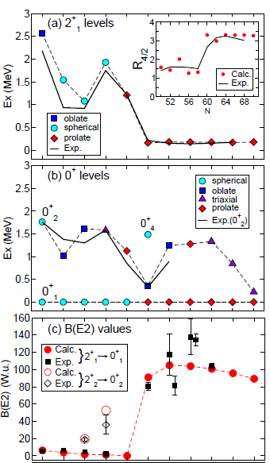
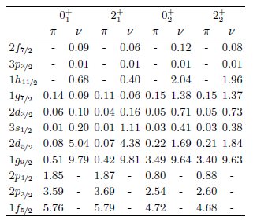
Collectivity around N=60
From a theoretical point of view
1h_{11/2}
1g_{7/2}
ll
1g_{7/2}
3s_{1/2}
ll
2d_{5/2}
2d_{5/2}
ll
ll
ll
1g_{9/2}
50
50
2p_{1/2}
40
1f_{5/2}
ll
ll
ll
2p_{3/2}
ll
ll
28
Tomoaki Togashi et al Phys. Rev. Lett., 117:172502, (2016)
The spherical 2⁺₁ is a simple neutron excitation
The 0⁺₂/2⁺₂ deformed configuration is a (2p-2h/4p-4h)π_{pf} → g_{9/2} excitation coupled to ν in the intruder h_{11/2}, g_{7/2} from the d_{5/2}
Zr
(It is an island of inversion …)

Slide 16
A~100 goes multiple shape coexistence
⁹⁵Sr(d,p)⁹⁶Sr → focusing on 0⁺ states → probing the ν[s1/2]² configuration
S. Cruz, et al PHYSICAL REVIEW C 100, 054321 (November 2019)
→⁹⁶Sr cannot be described in the spherical shell model
→ More spherical strength ν[s1/2]² in the 0⁺₂ than 0⁺₁
Strongly deformed should not be and is not populated (0⁺₃)
Much more complex structures suggest triple shapes coexistence
  Weakly triaxial ground state (as suggested by the coulex)
  Spherical 0⁺₂ highly mixed with the highly deformed 0⁺₃ (ρ²(E0)
These are not the main occupancy that are probed.
→Probing the “shape” of the 0⁺₂ and 0⁺₃ by coulex will be already a milestone for SPES !

Slide 17
⁹⁸Zr under the light of the (d,p) transfer in ⁹⁵Sr
Tomoaki Togashi et al Phys. Rev. Lett., 117:172502, (2016)
S. Cruz, et al PRC 100, 054321 (November 2019)
0⁺
2⁺
3⁺
4⁺
These are not the main occupancy to probe
Proton : Occupancy of the 1g_{9/2} from pf (depletion of pf)
Neutron : Depletion of d_{5/2} ? (3⁺ states not observed)
Increase of g_{7/2} ? : missing 4⁺ states
(4⁺₂ has consistently higher C²S than 4⁺₁: 4⁺₂ deformed ?)
Increase of h_{11/2} ? : search for 5⁺ states ….
→ Challenges of the high l-transfer in (d,p)

Slide 18
A~100 goes multiple shape coexistence
The B(E2) values indicate the coexistence of 3 different structures
“nearly » spherical 0⁺₁ ground state,
deformed 0⁺₂ state
well-deformed structure 0⁺₃ state.
⁹⁶Sr was proposed as weakly triaxial ground state , spherical 0⁺₂ highly mixed with the highly deformed 0⁺₃
A significant mixing between the well deformed and moderately deformed configurations from exp. B(E2)
Purnima Singh et al PRL121, 192501 (2018)
EXOGAM- VAMOS data. Coming soon AGATA –VAMOS data
⁹⁸Zr
Shape coexistence → Multiple shape coexistence with less caricatured shapes
Much more complex structures than a spherical to deformed transition
The structure of the three 0⁺ states requires some experimental clarifications at N=58
→Probing the “shape” of the 0⁺₂ and 0⁺₃ by coulex will be already a difficult milestone for SPES !

Slide 19
Shape Coexistence at N=60
Comparison between Ground and Excited state Quadrupole moments
Comparison with other Coulomb excitation measurement for even-even nuclei
Laser spectroscopy of odd-mass nuclei
Spectroscopic quadrupole moment replaced in the nucleus framework
Remove the Z and A dependences
But assume a certain level of axiality
T. W. Hagen et al. , Phys. Rev. C, 95:034302, (2017) EXOGAM-VAMOS data )
Adapted from N.J. Stone. Table of nuclear electric quadrupole moments. Atomic Data and Nuclear Data Tables, 111-112:1 – 28, 2016.
Amazing coherence of the experimental data
Z independence below and after N=59
A “Z” dependence is highlighted at N=59
Probing the effect of proton pair excitation coupled to the neutron intruder
Missing point (^{90,92}Rb, ^{90,92,94,97}Sr, ^{91-93, 95-98}Y, ^{92-94,96-99,100}Zr, ^{94-98,100}Nb, ⁹⁹⁻¹⁰¹Mo)
E. Clément et al, Phys. Scr. 92, 084002 (2017)

Slide 20
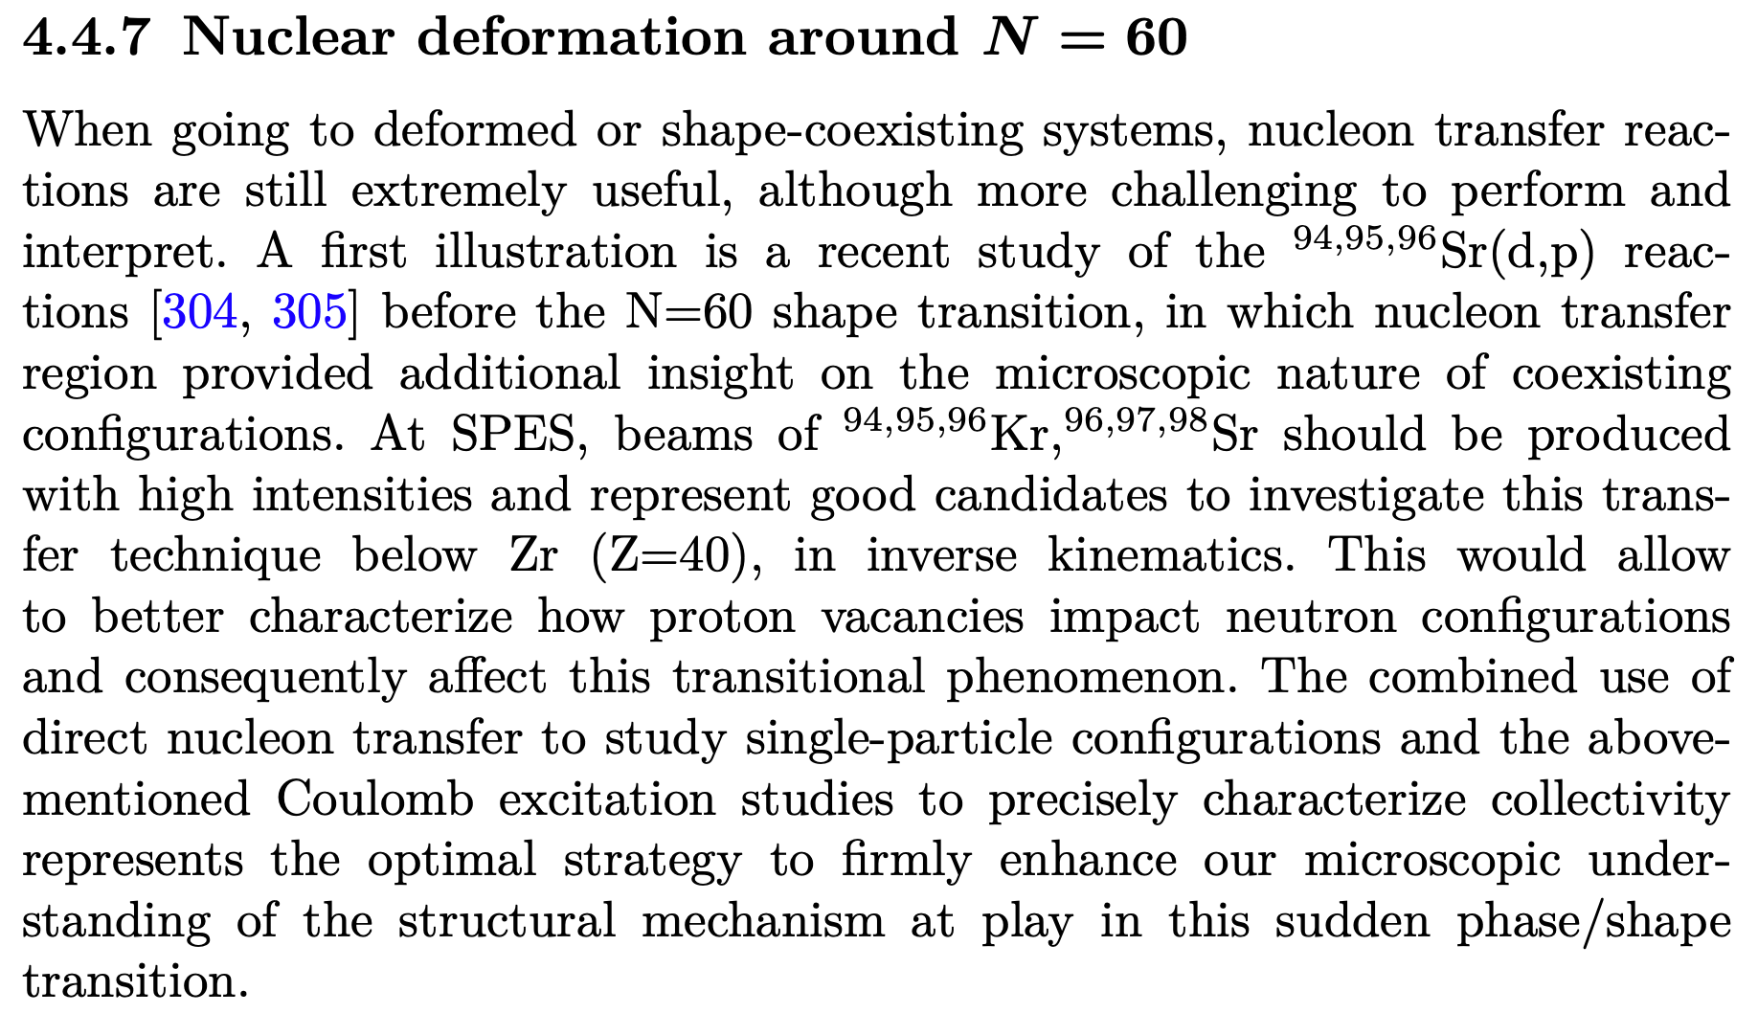
F. Flavigny et al PRL 118, 242501 (2017)
Shapes ?
Shape Coexistence ?
Delayed effect ?

Slide 21
⁹⁸Zr under the light of the heavy transfer transfer
2 proton stripping, see also alpha transfer
Last stable
From Kris Heyde, John L. Wood REVIEWS OF MODERN PHYSICS, VOLUME 83, (2011)

Slide 22
Pair transfer (neutron & proton)
Similarly to α-decay in the Po/Pb/Hg region : α-transfer
→ Connecting the 0⁺ _{def, sph, triax}
1h_{11/2}
1g_{7/2}
(p,t)
3s_{1/2}
1g_{7/2}
2d_{5/2}
2d_{5/2}
ll
ll
ll
⁹⁶Zr
⁹⁸Zr
¹⁰⁰Zr
1g_{9/2}
50
50
Z=40
2p_{1/2}
ll
40
1f_{5/2}
ll
ll
ll
(⁶Li,⁸B)
(t,p)
2p_{3/2}
ll
ll
|β| < 0.2
(⁷Li, t)
28
⁹⁴Sr
⁹⁶Sr
⁹⁸Sr
1h_{11/2}
1g_{7/2}
ll
1g_{7/2}
3s_{1/2}
(¹²C, ¹⁶O)
2d_{5/2}
2d_{5/2}
ll
ll
1g_{9/2}
ll
50
50
⁹⁴Kr
⁹⁶Kr
(t,p)
¹⁰⁰Kr
2p_{1/2}
40
1f_{5/2}
ll
ll
ll
2p_{3/2}
ll
ll
β > 0.4
N=60
28

Slide 23
Perspective at the sub-shell closure 40
Shape coexistence at Z=40, A=100
What happens at N=59 ?
  Studying the shape parameter of the N=59 nuclei would underline the contribution of the proton pair
Structure of the Kr
  Microscopical description of the delayed onset of deformation
  Shape coexisting structure ?
  Can we populate the deformed structure in ⁹⁶Kr from the ⁹⁸Sr deformed ground state ?
  Coherence of the β-decay chain from moderately deformed ⁹⁸Kr down to spherical ⁹⁸Zr via highly deformed ⁹⁸Sr ?
Structure of the multiple shape coexistence at N=58 (several 0⁺ excited)
Safe coulomb excitation at ~5 MeV/A of very intense (10⁷pps – 1 pnA) ⁹⁶Sr and ⁹⁸Zr beam to extract the shape parameters of the 0⁺₂ and 0⁺₃ states (would have been my dreaming experiment at SPIRAL2…)
Continue to probe the wave function decomposition
  The main mechanism π (pf→ g_{9/2}) and ν (d_{5/2}→ g_{7/2}; h_{11/2}) is not probed by C²S measurement

