Slide 1
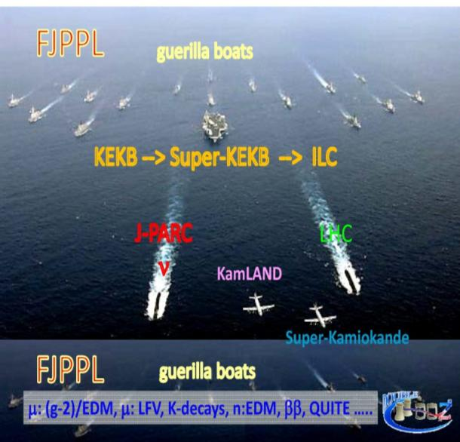
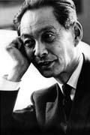
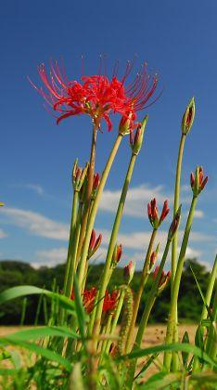
Shinichiro Tomonaga
Nobel Laureate
in Physics (1965)
“ Questioning :
Sprout of Science”
“Observing :
Stalk of Science”
“Solving the question :
Flower of Science”

