Slide 1



The FJPPL workshop 2010 @ LAPP, Annecy-Le-Vieux (France), June 15-17 2010
LHC-3
Superconducting Magnets
for the LHC Luminosity Upgrade
KEK : N. Kimura, A. Yamamoto, K. Tsuchiya, T. Ogitsu,
T. Nakamoto, K. Sasaki, Q. Xu, Y. Iwamoto**
Irfu/CEA : B. Baudouy, J. Rifflet, M. Durante, F. Rondeaux, S. Pietrowicz, A. Four
**JAEA, Tokai, Japan
KEK-CEA Superconducting Magnet Co-operation Program

Slide 2
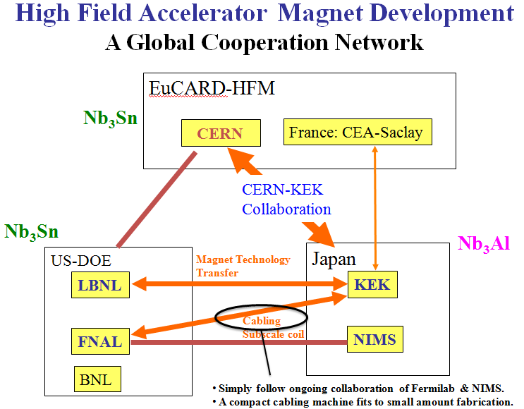
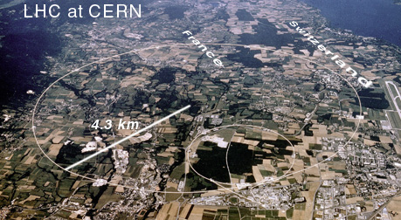
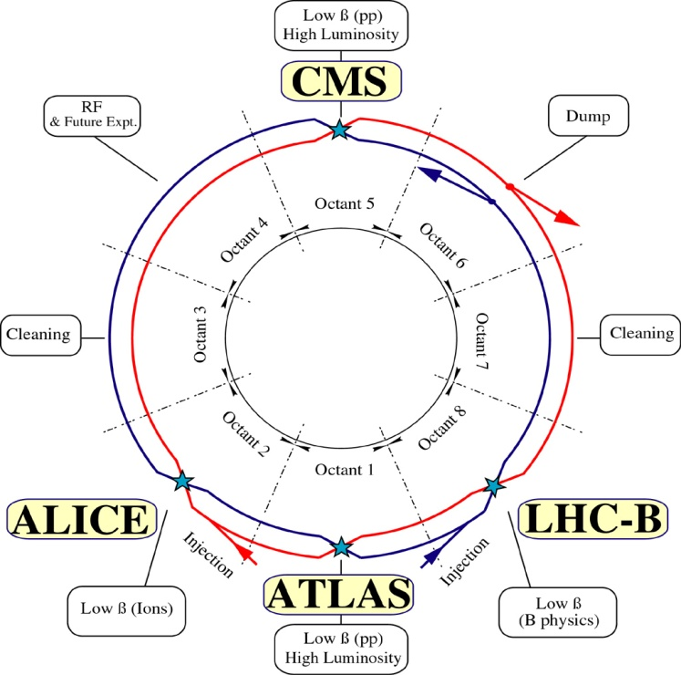
Background
For the LHC luminosity upgrade: Replacing the final focus system of the interaction regions with higher performance magnets
Increasing the magnetic field from 9 T (NbTi) to beyond 12 T using Nb₃Sn or Nb₃Al
Final goal is to construct of high field magnet with Nb₃Al or Nb3Sn cable. But higher heat loads!
Notes:
LHC pic; 1st object; design concept with pics;

Slide 3
Objectives
For the LHC luminosity upgrade, Cryogenic Science Center of KEK and SACM of Irfu/CEA have started a collaboration on :
Model coil to evaluate cable performance at 13 T
  A common coil magnet design using Nb₃Sn and Nb₃Al
Heat transfer through electrical insulation
  Measurement of the thermal performances in LHe
  Thermal conductivity measurement

Slide 4
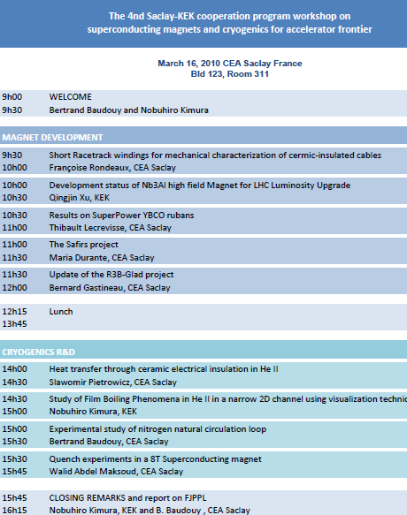
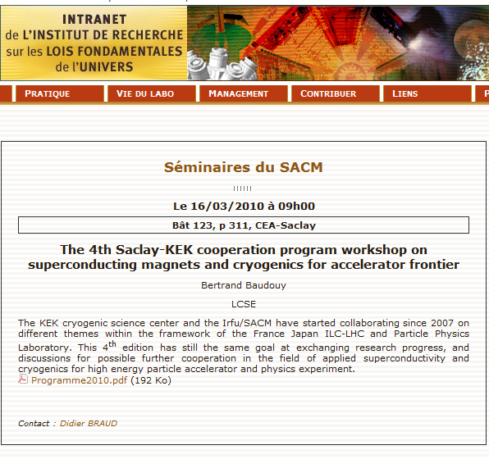
4th KEK-CEA Workshop
Notes:
LHC pic; 1st object; design concept with pics;

Slide 5
KEK-SACM/Irfu Exchanges
Nobuhiro Kimura @ Saclay
  Dec. 2009 Porous insulation tests in saturated He II
  March 2010 Porous insulation tests in pressurized He II
Sławomir Pietrowicz, Aurélien Four and Bertrand Baudouy @ KEK
  Oct. 2010 Porous insulation tests in supercritical He
Notes:
LHC pic; 1st object; design concept with pics;

Slide 6
Objectives
For the LHC luminosity upgrade, Cryogenic Science Center of KEK and SACM of Irfu/CEA have started a collaboration on :
Model coil to evaluate cable performance at 13 T
  A common coil magnet design using Nb₃Sn and Nb₃Al
Heat transfer through electrical insulation
  Measurement of the thermal performances in LHe
  Thermal conductivity measurement

Slide 7
Progress on the Nb₃Al coil
First Rutherford Nb₃Al cable strand successfully fabricated
The K3 & K4 cables should be achieved in 2010
The first Nb₃Al coil with K1 cable will be assembled and tested in JPY 2011
Radiation resistant resin of Cyanate Ester is being developed for the Nb₃Al coil impregnation (dry electrical insulation)
K1 cable (Cu ion-plating (<1 mm) + Cu electroplating (150 mm))
Number of strand: 28, Width: 13.96 mm, Thickness: 1.84 mm, Lay angle: 14.9 deg., Packing factor: 86.7 %

Slide 8
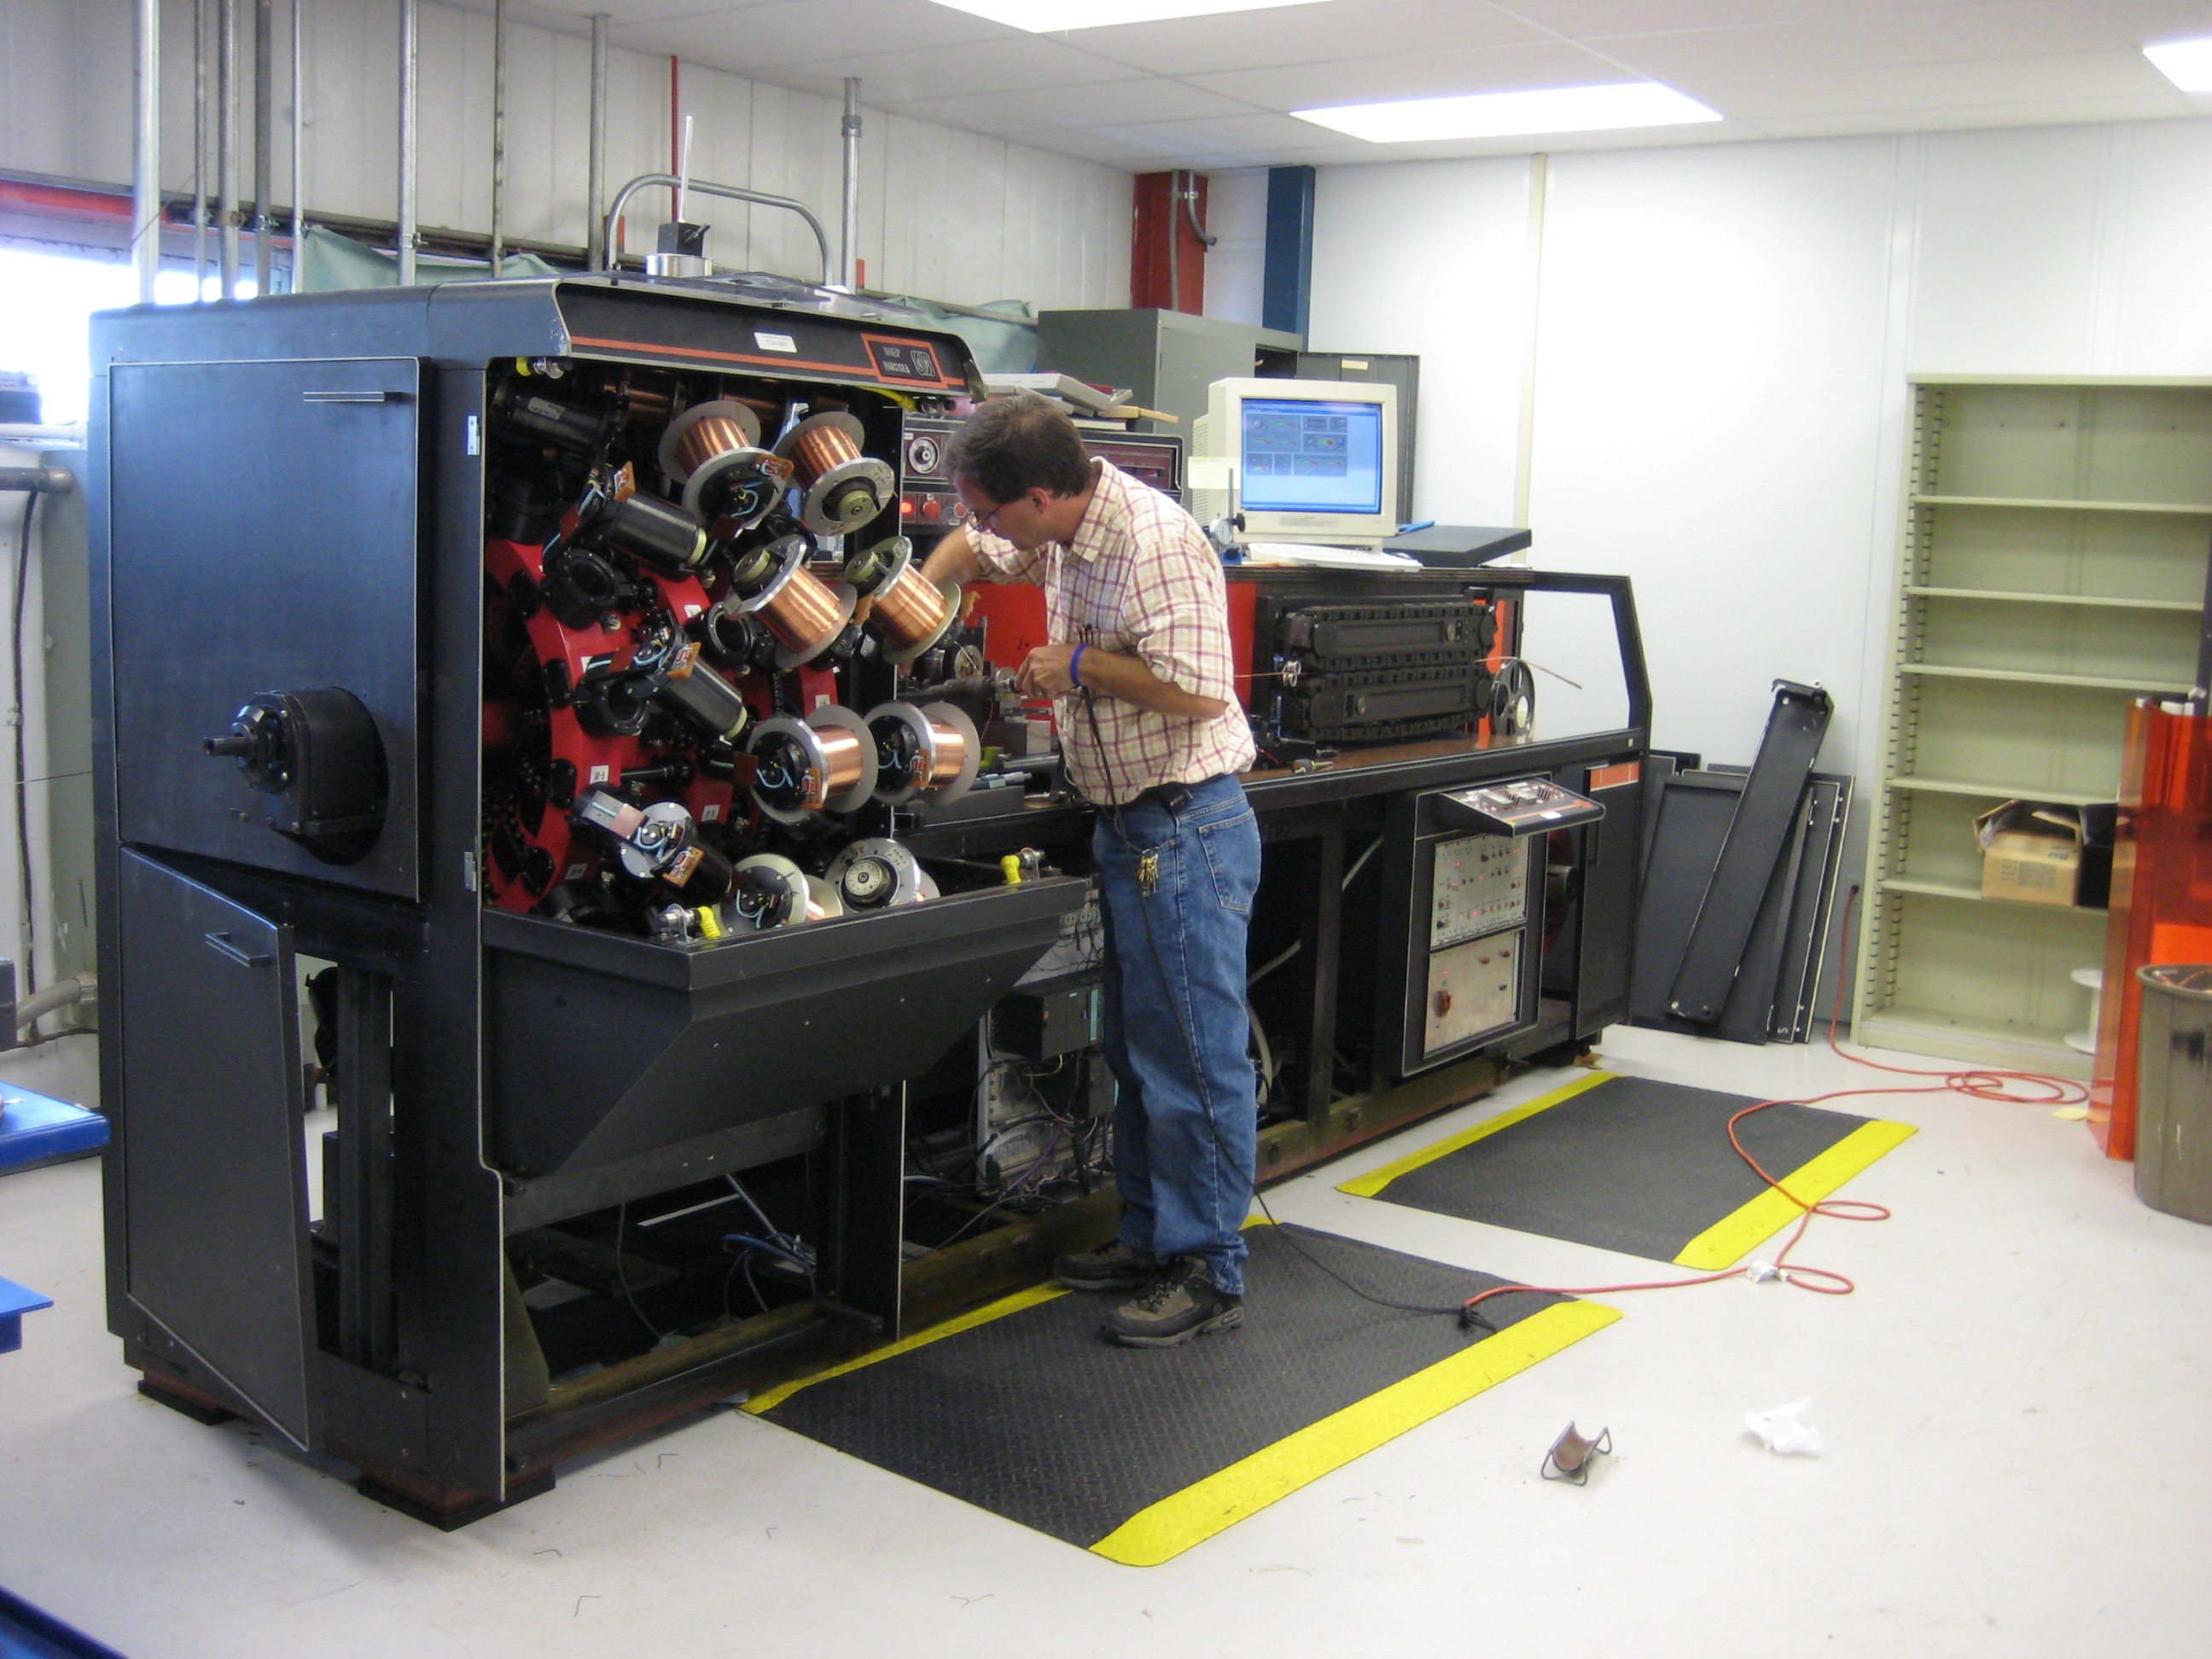
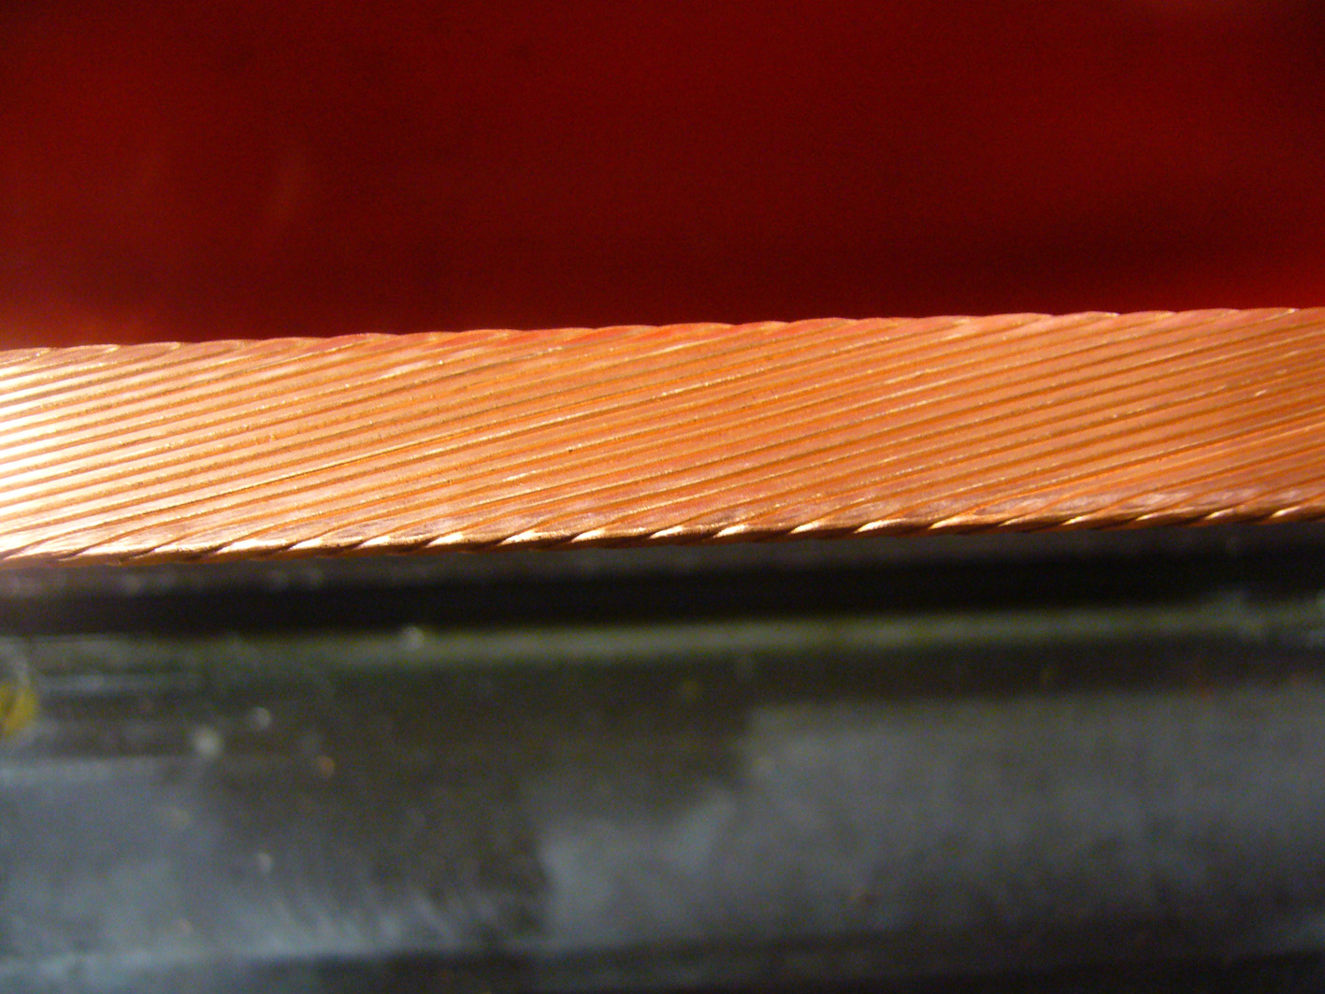
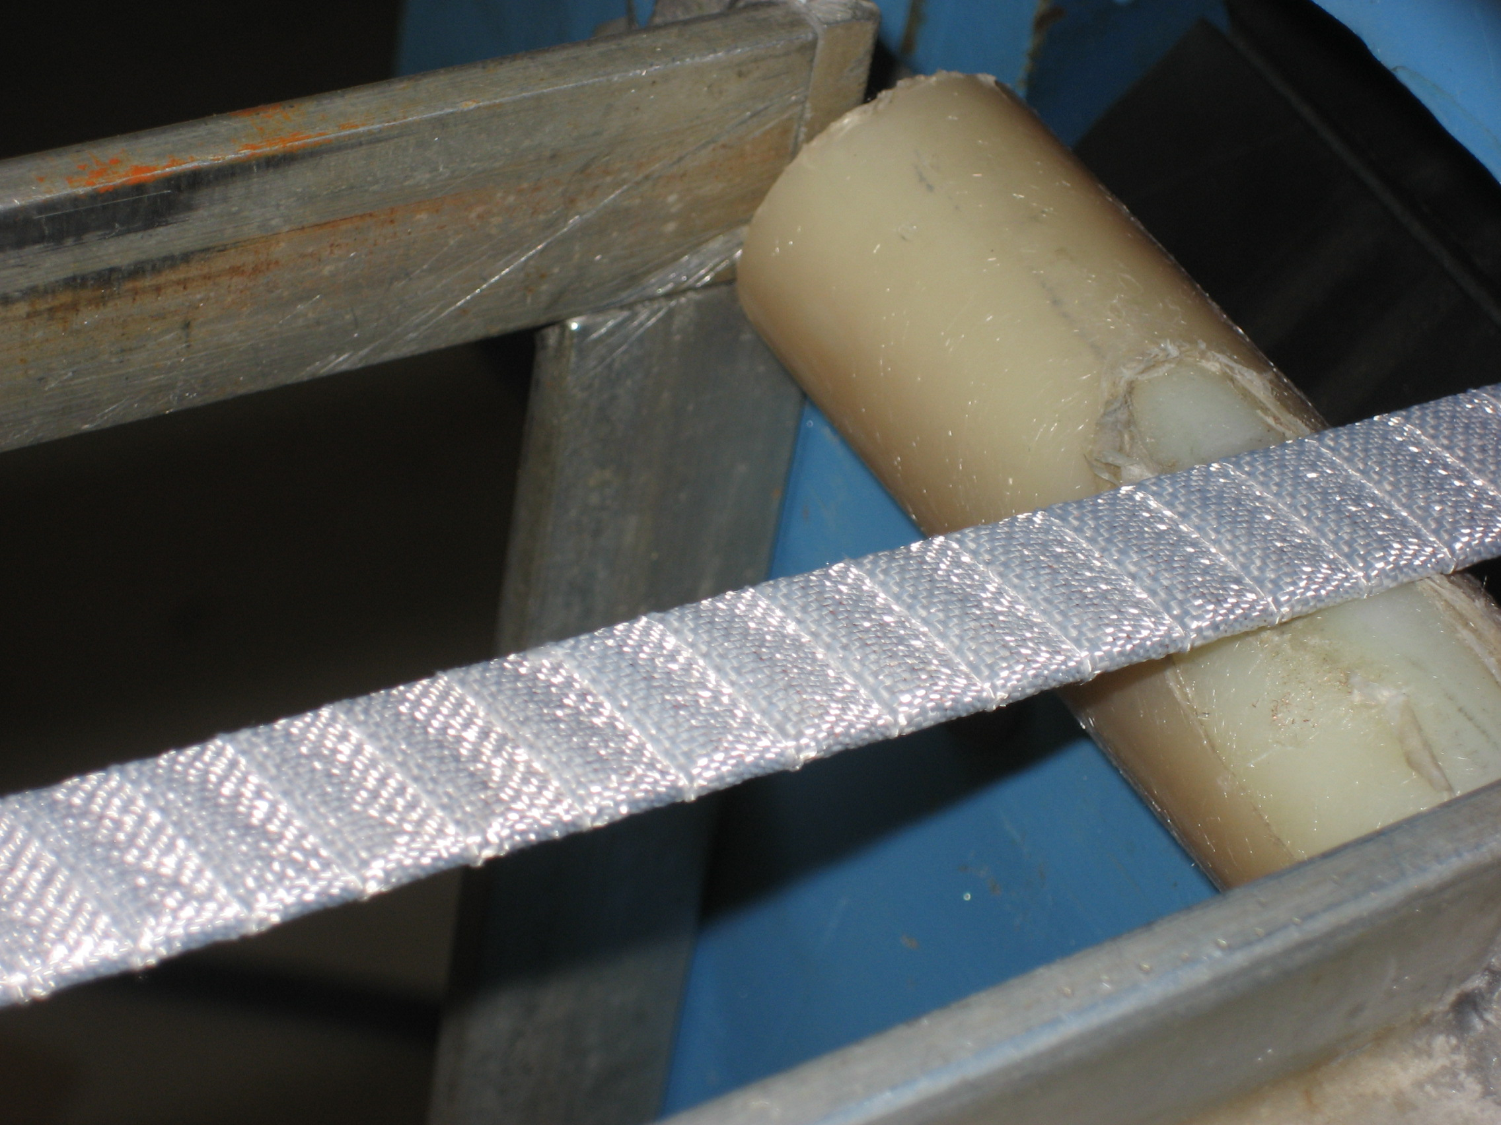
Cable Fabrication at Fermi Lab
Cabling with ceramic insulation completed in 2009
K1 cable (w/ 28 strands): 22 m
Long enough for Coil winding
K2 cable (w/ 27 strands): 9 m
Cabling machine
Cable without insulation
Cable with insulation

Slide 9
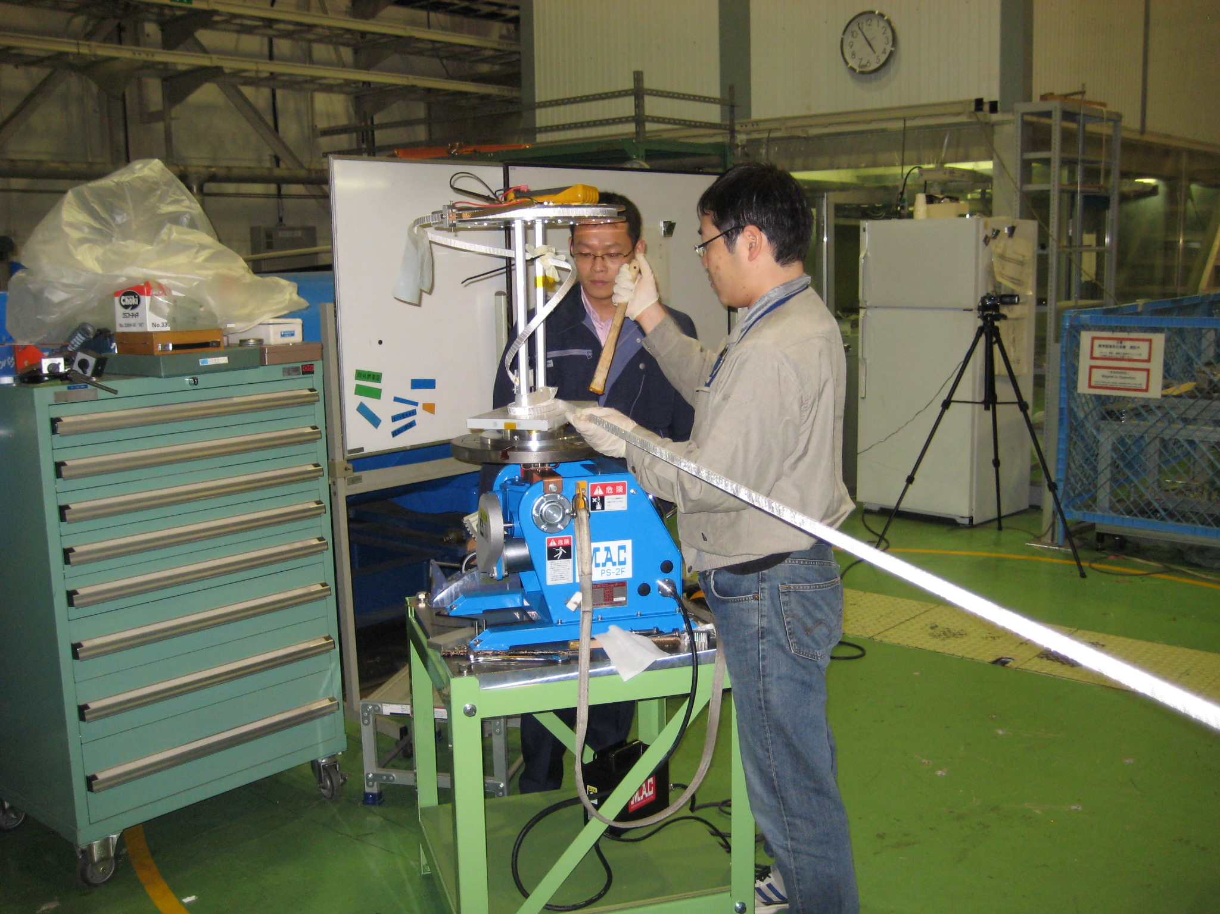
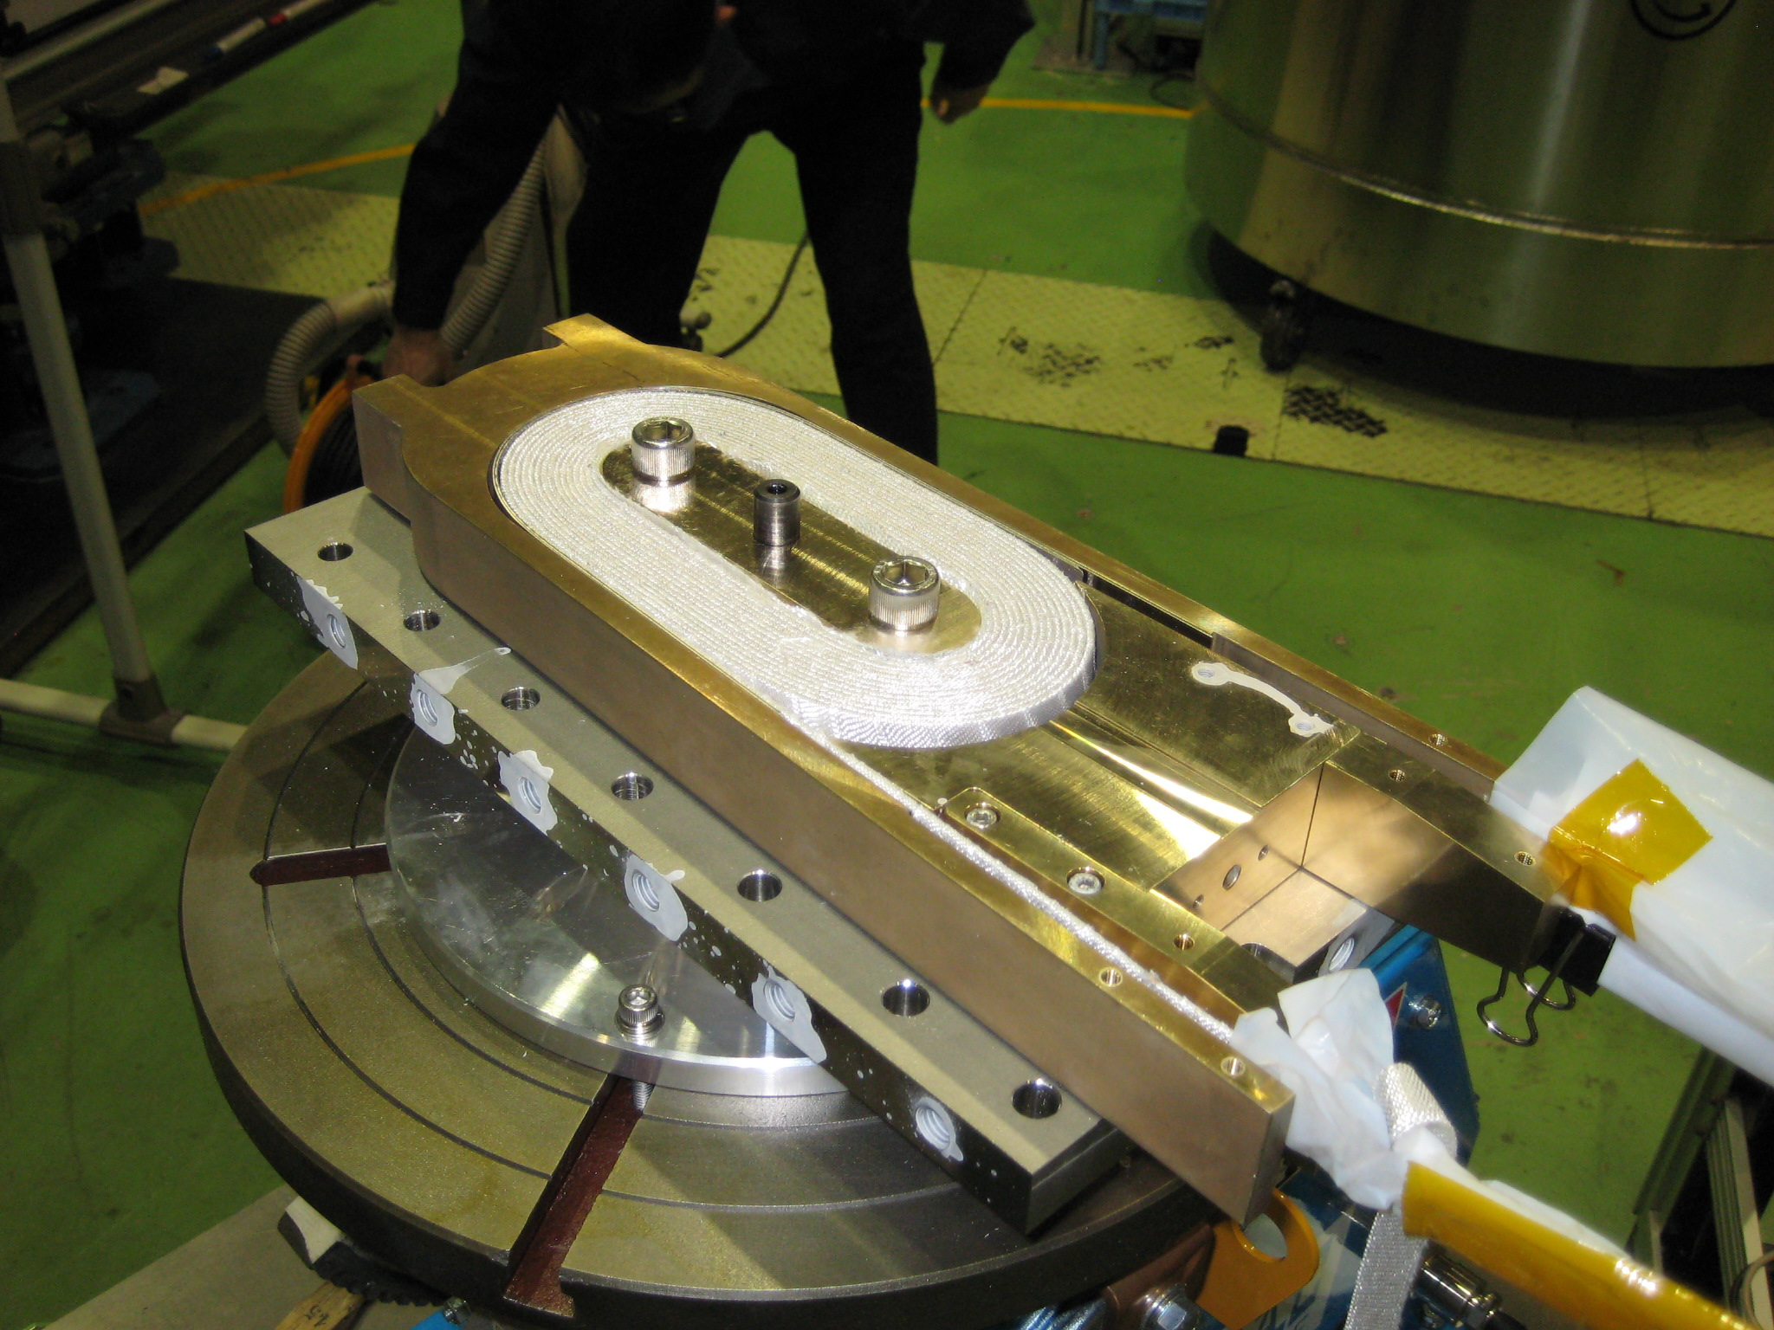
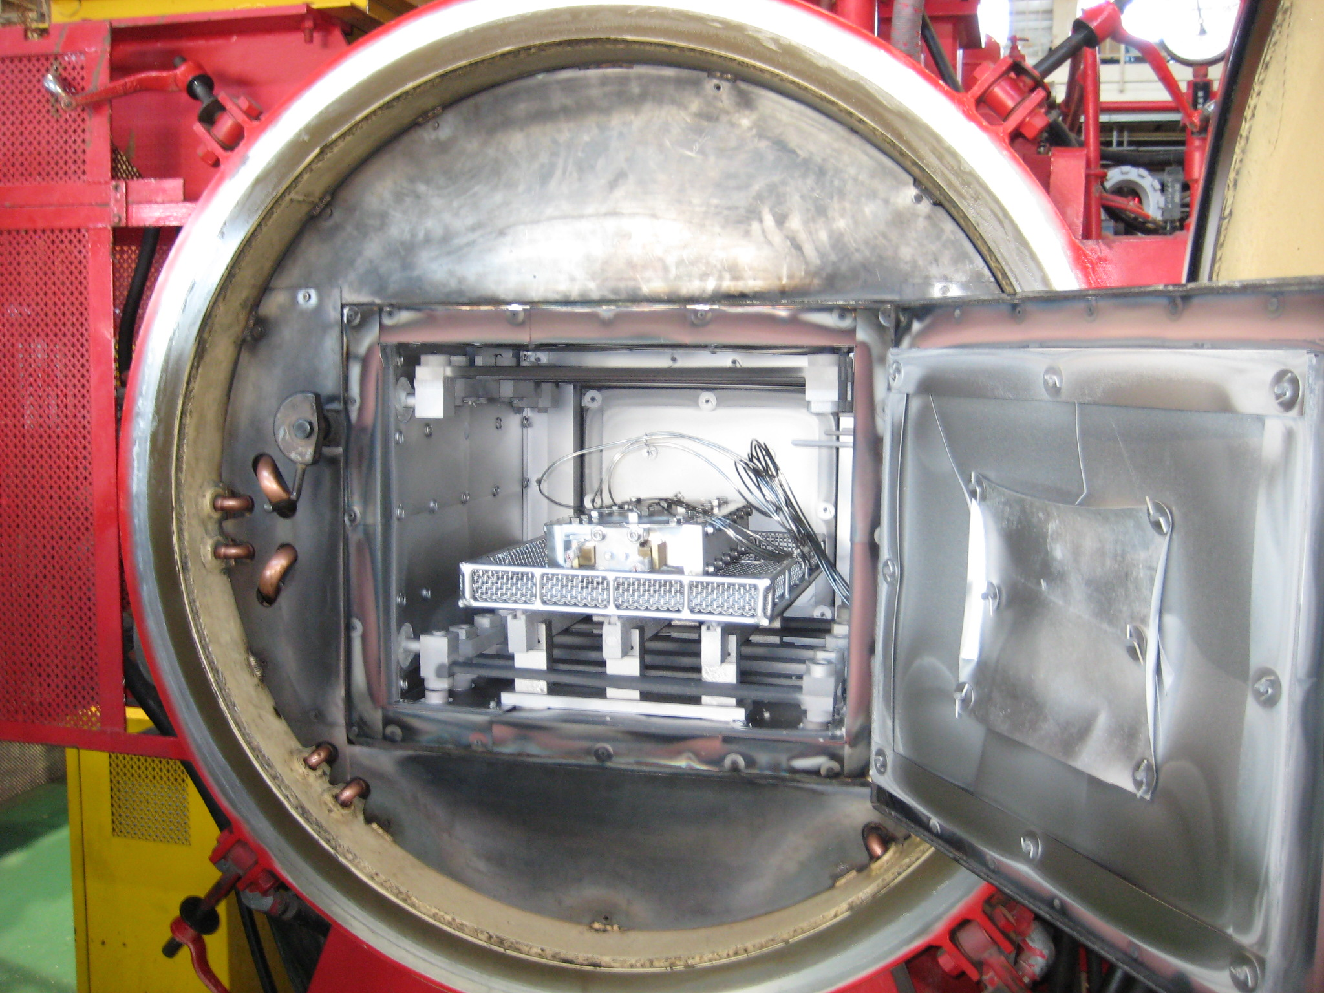
Practice Coil Fabrication at KEK
1st practice coil winding completed (LHC NbTi cable with alumina tape insulation)
Heat reaction at 800 ⁰C for 10 hours in a vacuum furnace was done to check uniformity of temperature. Vacuum impregnation to follow
2nd practice coil winding and 1st Nb₃Al coil winding under preparation
Practice coil winding
Practice coil winding
800 ℃ heat reaction

Slide 10
Objectives
For the LHC luminosity upgrade, Cryogenic Science Center of KEK and SACM of Irfu/CEA have started a collaboration on :
Model coil to evaluate cable performance at 13 T,
  A common coil magnet design using Nb₃Sn and Nb₃Al
Heat transfer through electrical insulation
  Measurement of the thermal performances
  Thermal conductivity measurement

Slide 11
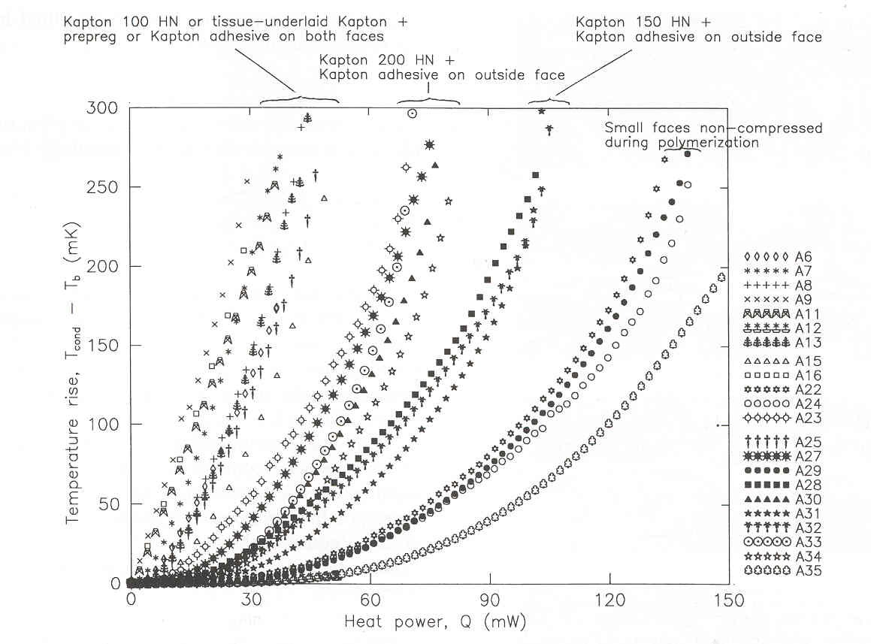
Heat transfer in accelerator magnets
“Beam losses” of LHC upgrade with Nb₃Sn Magnets
  50 to 80 mW/cm³ or 2 to 3 W/m (cable) → ΔT~ K with polyimide insulation
  Dry insulation for Nb₃Sn Magnets !
Development of “innovative” ceramic insulation
  Thermal treatment (insulation+Nb₃Sn, easier and less costly construction)
  Fiberglass + ceramic precursor (CEA patent)
  Higher heat transfer rate, larger He volume in the insulation (Cp) and heat exchange surface increase (matrix participation)
Courtesy of F. Rondeaux (CEA)
Courtesy of F. Rondeaux (CEA)

Slide 12
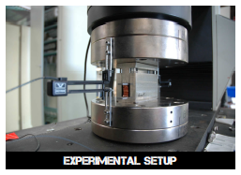
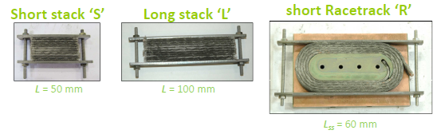
The porous ceramic insulation
 | Ceramic | Classic | Full Impregnation
Pore size (µm) | 100 | 10 to 100 | 0
Porosity (%) | 4.5 to 29 | 1 | 0
Conductivity (W/m.K) | 4 10⁻² | 10⁻² | 10⁻²
Mechanical characterization on mini Race track magnet up to 60 MPa (Irfu/Sacm)
  Race track magnet with the porous insulation under construction (SMC program in collaboration with CERN and RAL)
Courtesy of P. Manil (CEA)
Courtesy of F. Rondeaux (CEA)

Slide 13
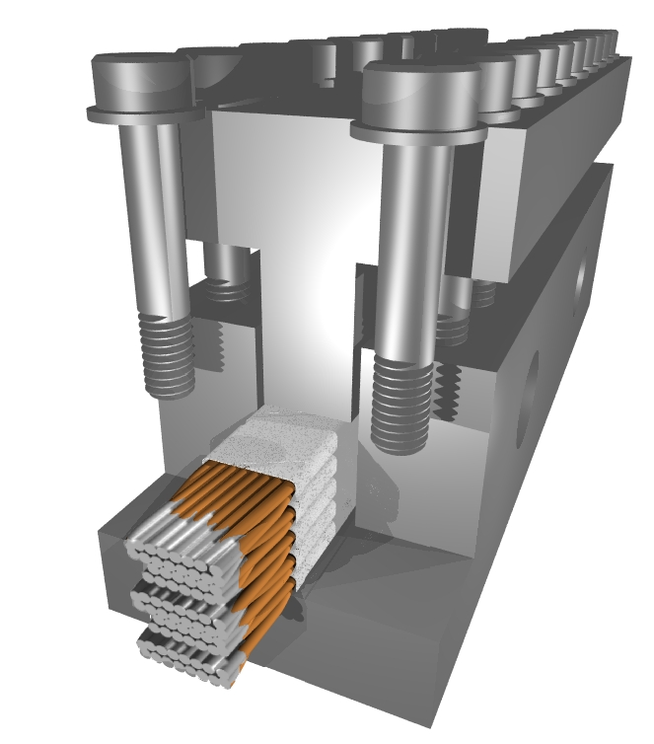
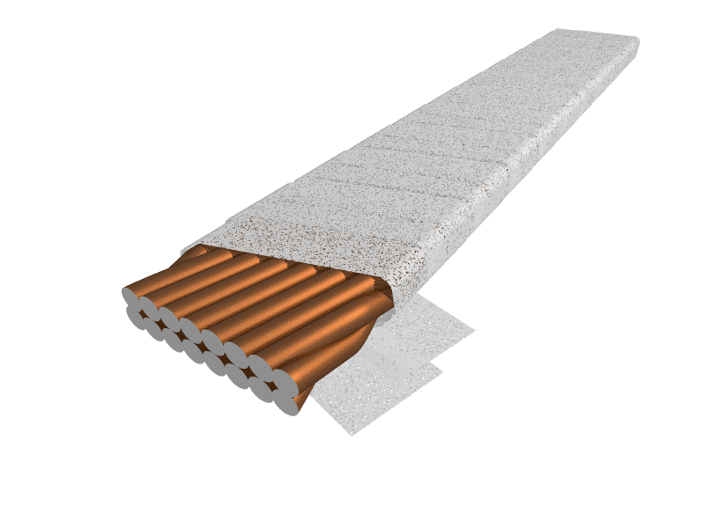
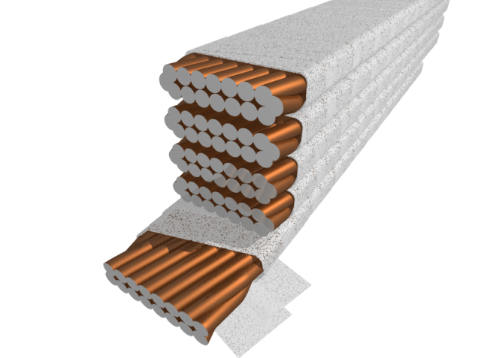
The Stack Experiment : A Common tool
Characterization of the thermal performance of the insulation
  “real cable” geometry (CuNi cable)
  Real electrical insulation
  Mechanical constraints (compression)
  Heat transfer configuration (Joule heating)

Slide 14
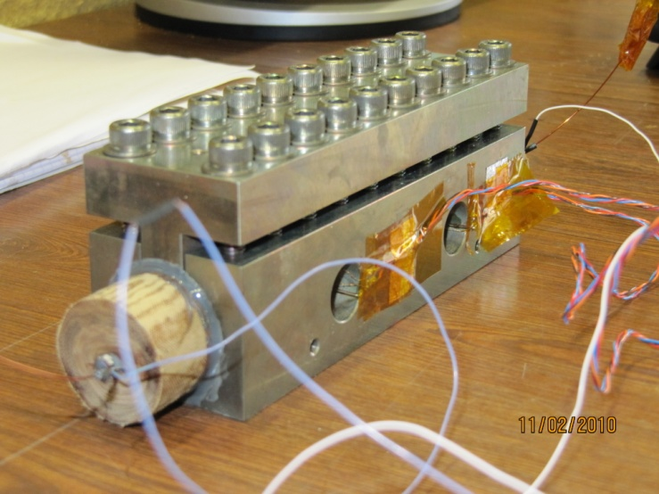
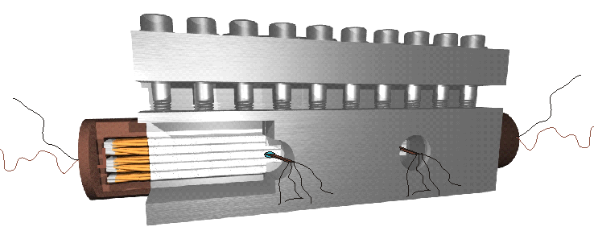
The Stack Experiment : A Common tool
Characterization of the thermal performance of the insulation
  Central cable instrumented with bare ship sensors

Slide 15
Heat transfer results
Samples tested in He II saturated and pressurized from 1.7 to 2.1 K
Samples tested in He I at atmospheric pressure
  10 and 20 Mpa compression
  Steady-State and transient
∆T <20 mK for the LHC upgrade
heat load
∆ T <5 mK for the current LHC
heat load
100 times more efficient than the
current LHC insulation!
∆T_{fully impregnated insulation} > ∆T_{current insulation} ∆T_{porous insulation}

Slide 16
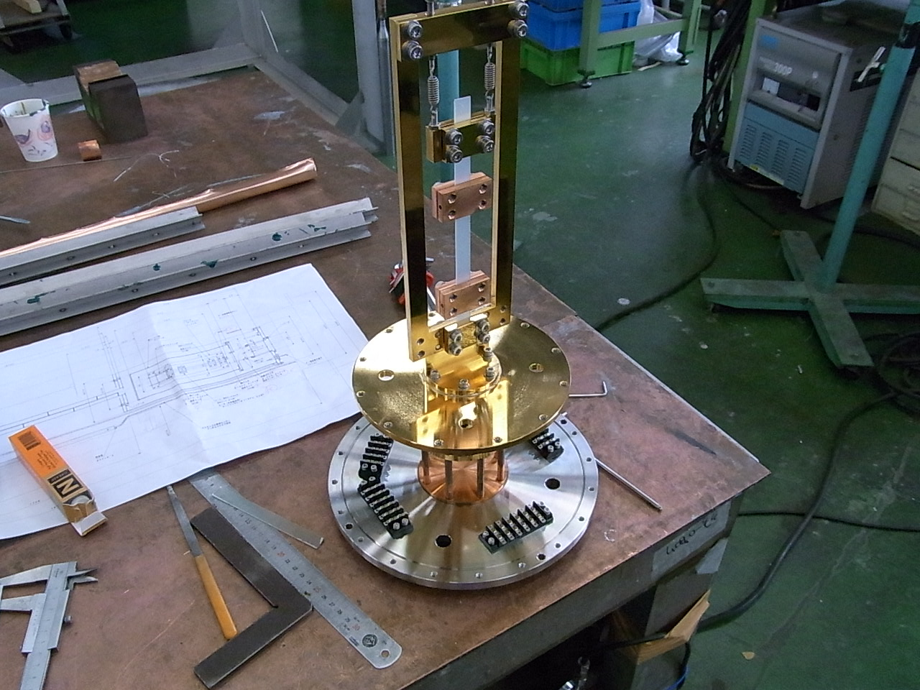
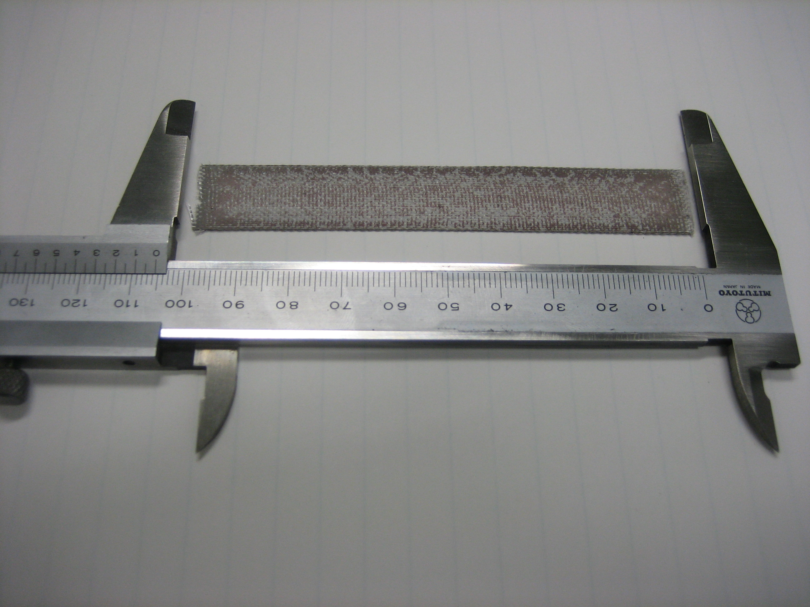
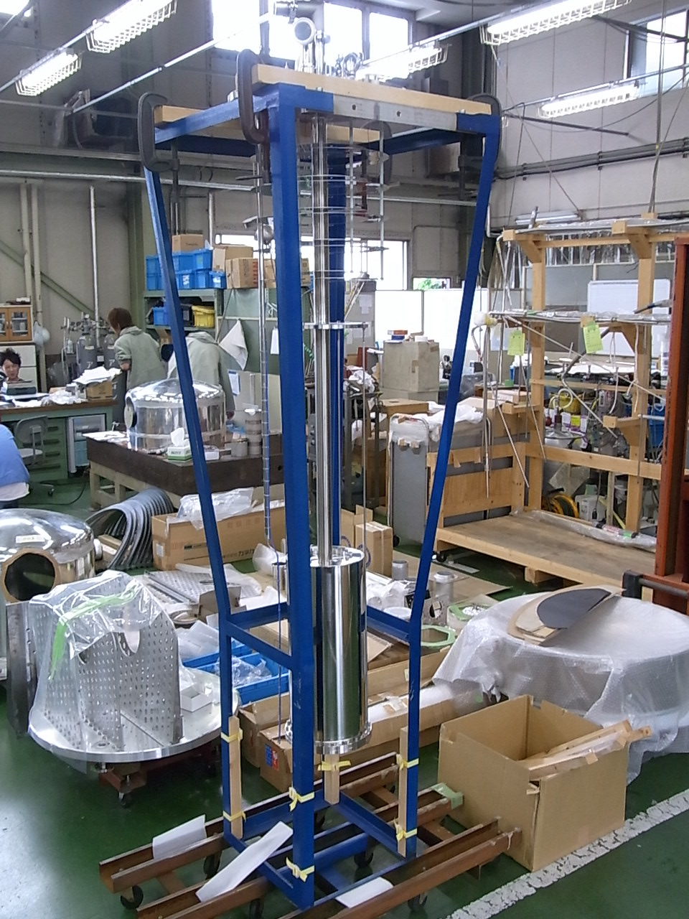
Thermal conductivity measurement
Construction of a thermal conductivity measurements rig at KEK
  The material will be measured from 1.8 K to 77 K
  Porous insulation constructed at SAC M/Irfu
  Cyanate Ester resin being developed for the Nb₃Al coil impregnation in KEK
Both materials have good radiation resistance
Porous insulation Sample
(Made by F. Rondeaux (CEA))
Apparatus of Thermal Conductivity
Measurement at KEK

Slide 17
Future work
Construction and tests of a the first race track coil in Nb₃Al
Construction and tests of a porous insulation sample at 50 MPa
Construction and tests of the Cyanate Ester resin sample
  Construction at Saclay and tests at Saclay and KEK
Measurement of the thermal conductivity of the ceramic insulation and Cyanate Ester resin (KEK and Saclay)
Publications
  2 papers (polyimide insulation)
  2 papers (porous insulation)

