Slide 1

EP-DT
Detector Technologies
R&D strategies for optimizing
the greenhouse gas consumption
at the CERN LHC experiments
R. Guida, B. Mandelli, G. Rigoletti
CERN EP-DT
French Days On Gaseous Detector Lyon, June 8th-9th, 2023

Slide 2
Outline
Greenhouse gases (GHGs) for particle detection
CERN Strategies for optimizing GHGs usage
  Results, new projects and plans
Conclusions

Slide 3
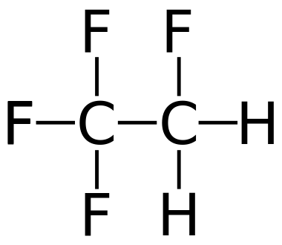
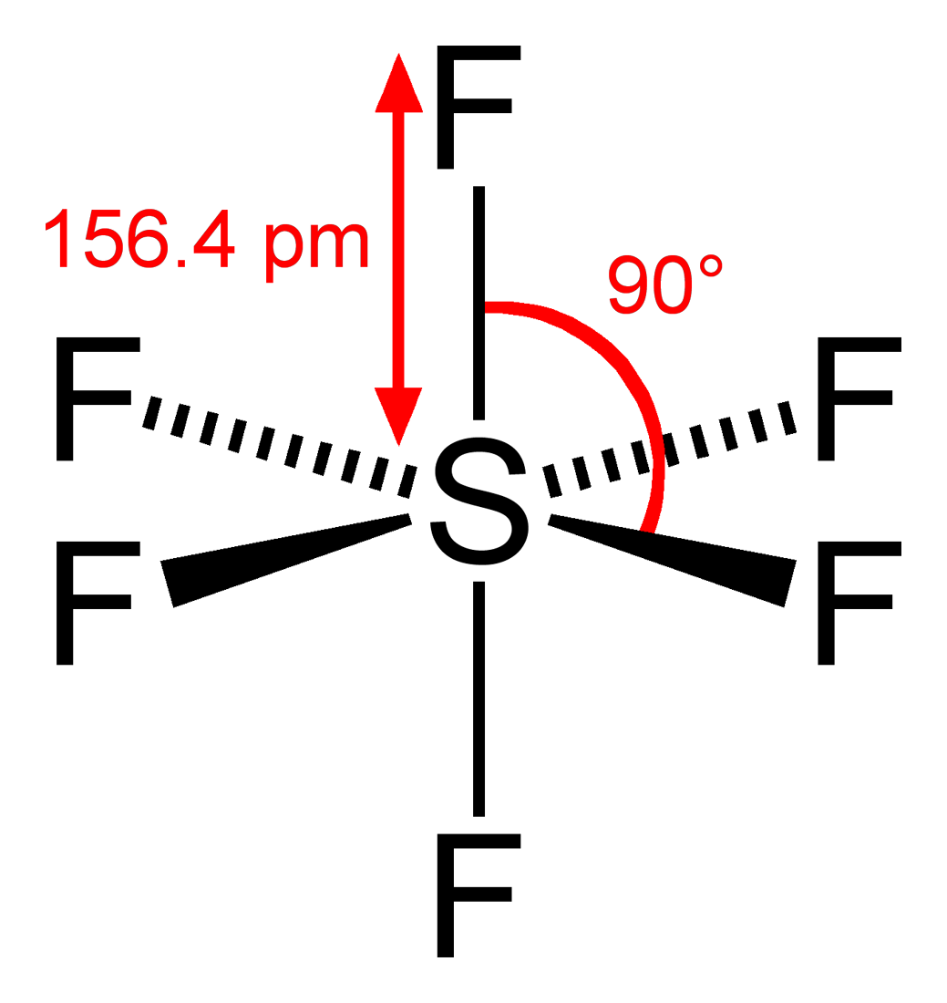
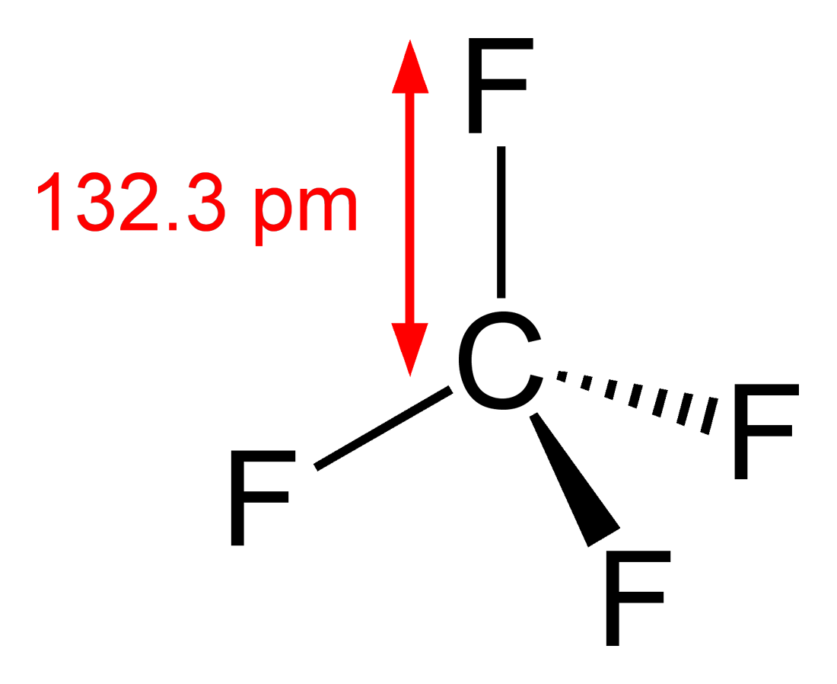
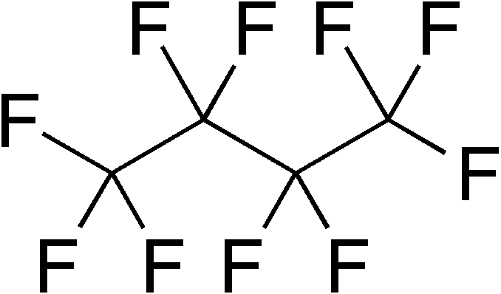
Gaseous detector systems at LHC
Very Large apparatus: detector volume from < 1 m³ up to several 100 m³
High mixture flow
Use of expensive and/or greenhouse gases
Operational costs issue
Optimization of gas usage: mandatory!
A lot of work already from the design phase
Nowadays increased attention on GHGs emissions: F-gas regulation aims in limiting emissions, GHGs availability, price, …
GHGs are used because needed to achieve specific detector performance and/or long-term stability
C2H2F4
GWP 1430
SF6
GWP 22800
CF4
GWP 7390
C4F10
GWP 8860
Containment of charge
Rate capability
limiting charge development
Cherenkov radiator
Resistive Plate Chamber (RPC)
Cherenkov detector (RICH)
Mitigation of aging phenomena
Time resolution
Cathode Strip Chamber (CSC)
Multi Wire Proportional Chamber (MWPC)
Gas Electron Multiplier (GEM)

Slide 4
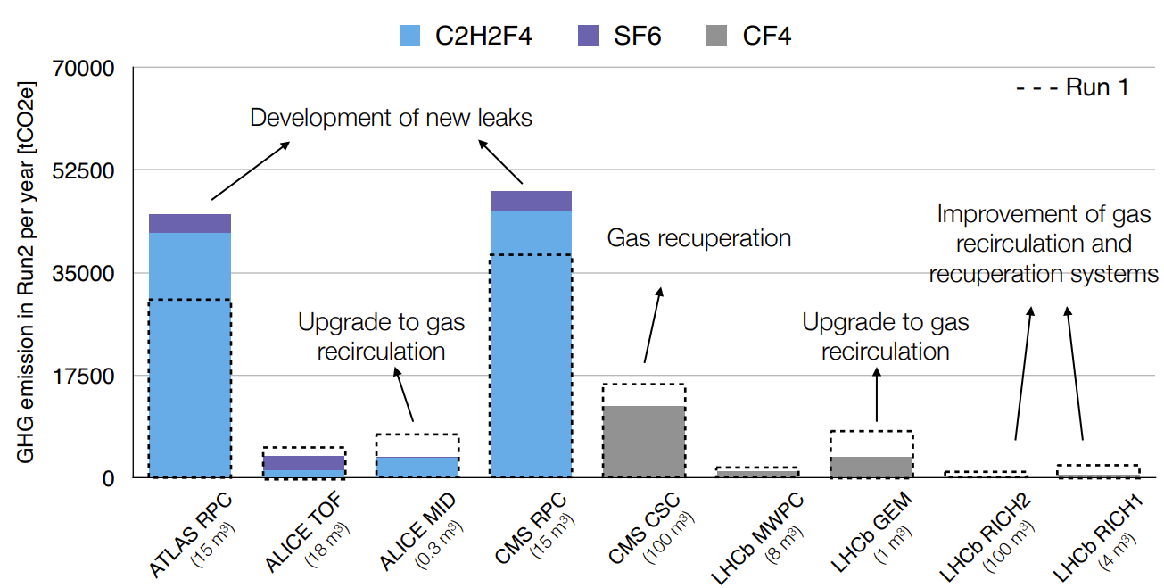
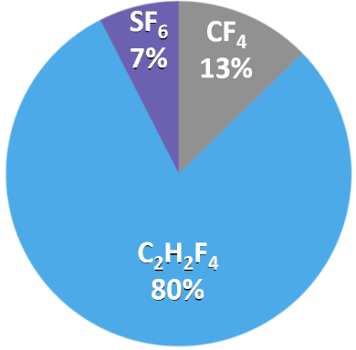
Gaseous detector systems at LHC
Of course, GHG usage in particle research is negligible wrt other activities.
However, GHG optimization is mandatory, and it can secure operation over the LHC run period and reduce costs.
-40% GHG emissions from Run 1 to Run 2 excluding ATLAS and CMS RPC systems
-25% GHG emissions from Run 2 to Run 3 excluding ATLAS and CMS RPC systems
New objective: -28% by 2024 wrt 2018 (Run2)

Slide 5
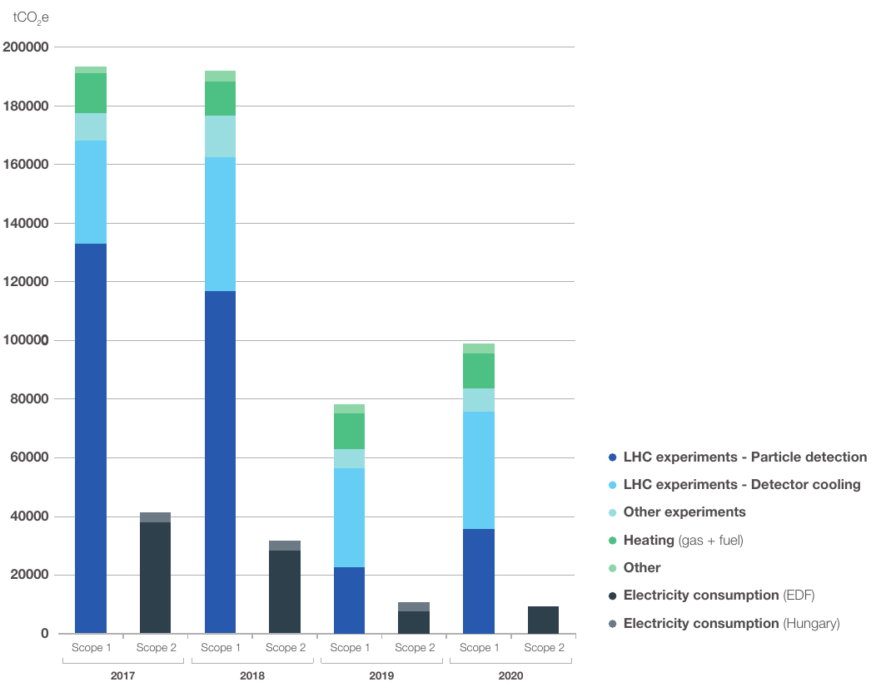
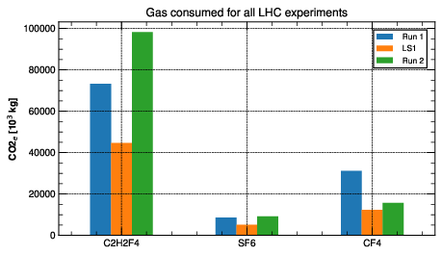


Greenhouse gas usage
CERN Environment Report 2019-2020
2021: CERN’s Year of Environmental Awareness.
CERN Environment workshop: 12 and 13 October 2022
Total CERN emissions during 1 year of Run 2 ~ 200 000 tCO2e
~ 50% from particle detectors → mostly due to leaks and operation
C₂H₂F₄/R-134a biggest contributor → leaks from RPC detector
CF₄ → due to operation of CSC and RICH systems
SF₆ → Related to RPCs as R-134a
Emissions from
particle detection
tCO_{2e}
2017
2018
2019
2020
R-134a
SF6
CF4
Run2
LS2

Slide 6
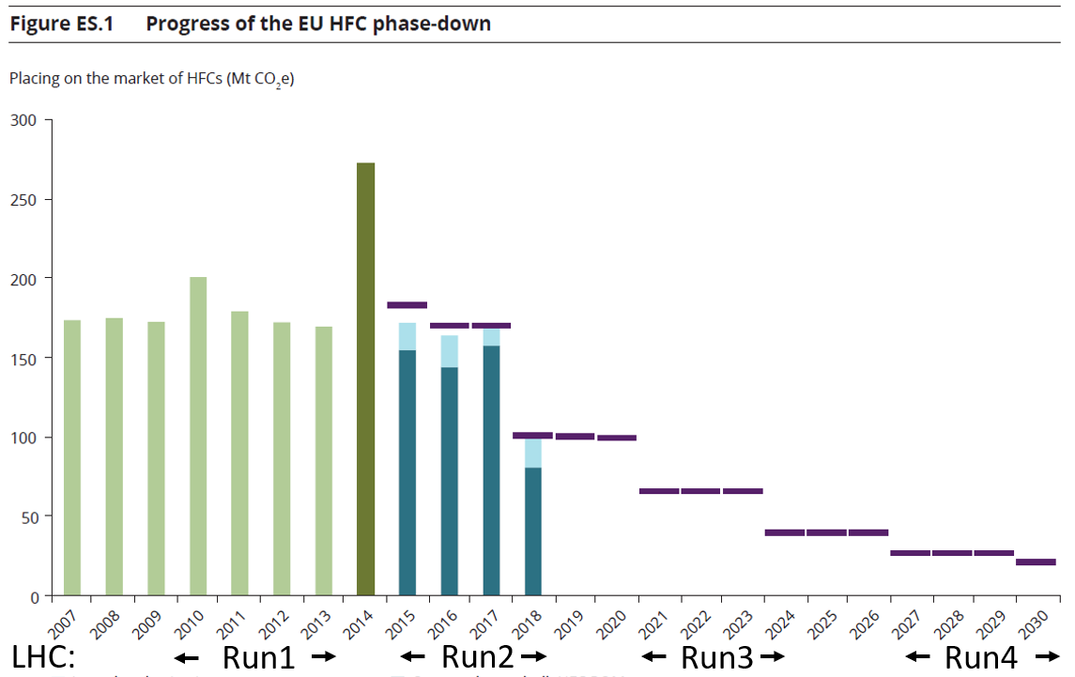
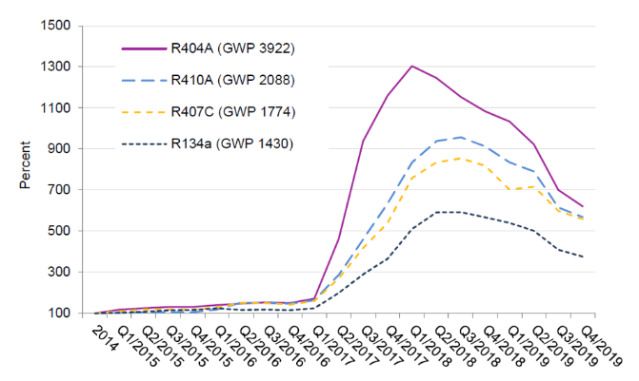
Greenhouse gas regulation
Due to the environmental risk, “F-gas regulations” started to appear. For example, the EU517/2014 is:
Limiting the total amount of the most important F-gases that can be sold from 2015 onwards. By 2030, it limits the use to 1/5 of 2014 sales.
Banning the use of F-gases in new equipment where less harmful alternatives are available.
Preventing emissions of F-gases from existing equipment by requiring checks, proper servicing and recovery of gases.
HFC phase down: effects on HFC availability and prices
Price fluctuations:
decrease due to industrial conversion to new low GWP gases
Reduction in availability over LHC operation
increase due to EU HFC phase-down/reduced availability
100%
93%
Today
63%
45%
31%
24%
21%
Today
Run3
Run4
Sources: European Environment Agency, Fluorinated greenhouse gases 2019 report
Öko Recherche report, March 2020 J. Kleinschmidt et al.
Goal: reduce F- gases consumption and emissions from particle detectors

Slide 7
GHG Optimization: CERN Strategies
How to reduce greenhouse gas usage
Optimization of current technologies
Gas Recuperation
Alternative Gases
Gas disposal
Gas recirculation
Membrane separation
Pressure swing
Particular attention to operation
Improved controls and monitoring
Cryogenic/cold separation
GHGs destruction
New eco-friendly gases, HFOs, …

Slide 8
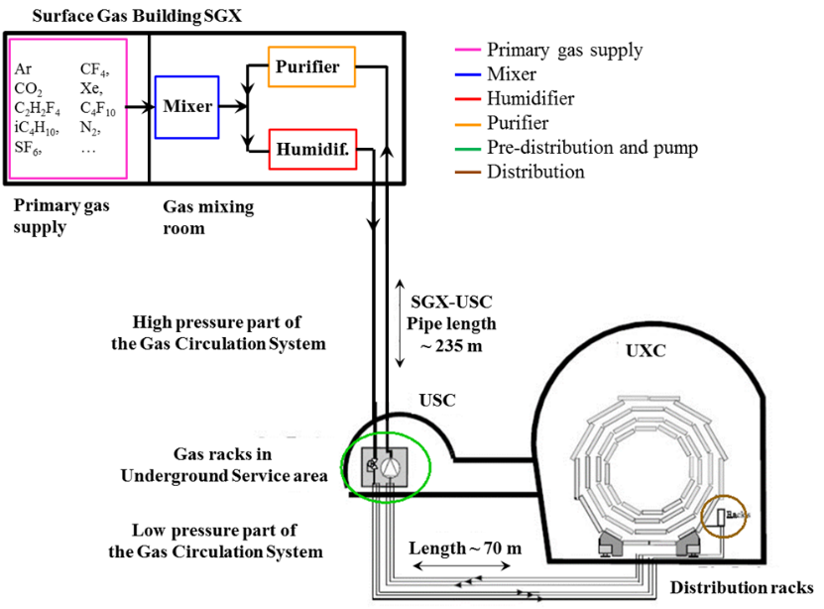
Gas mixture recirculation system
Gas systems extend from the surface building to service balcony on the experiment following a route few hundred meters long.
Primary gas supply point is located in surface building
Gas system distributed in three levels:
  Surface (SG)
  Gas Service room (USC)
  experimental cavern (UXC)
The gas systems were built according to a common standard allowing minimization of manpower and costs for maintenance and operation.
  Construction started early 2000
  Operational since 2005-2006
The CERN gas service team (EP-DT-FS, BE-ICS)

Slide 9
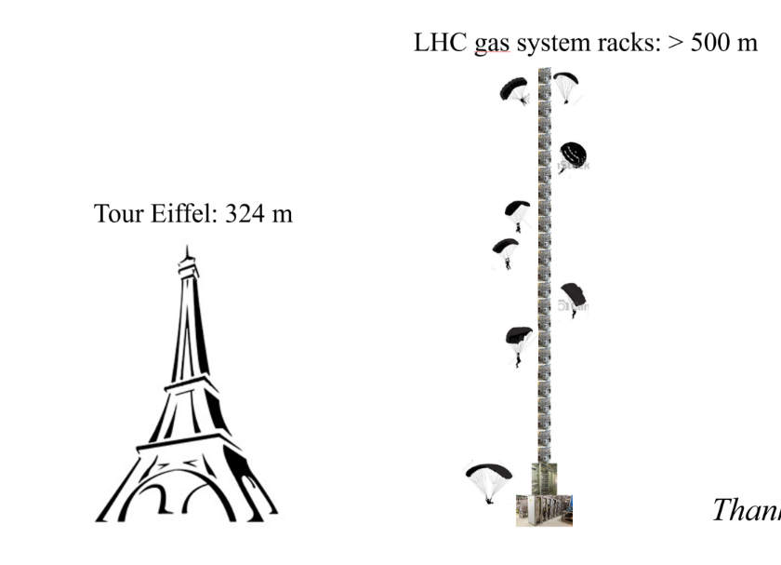
Gas mixture recirculation system
Reliability
  LHC experiments are operational 24/24 7/7
  Gas systems must be available all time
Automation
  Large and complex infrastructure
  Resources for operation
  Repeatability of conditions.
Stability
  Detector performance are strictly related with stable conditions (mixture composition, pressures, flows, …)
Few numbers:
Construction started in 2000
Operational since 2005-2006
30 gas systems detectors at the LHC experiments
300 Universal Euroracks → x2 height of Eiffel Tower
60 PLCs
150 MFCs
4000 flow meters in distribution racks
~ 70 gas analyzers and 6 gas chromatographers
Per gas system:
  ~ 2-3 km pipes
  > 1000 connectors and 500 welds
  ~ 40 Pressure sensors
  ~ 10 Regulation valves
  < 0.1 l/h leak rate

Slide 10
Gas mixture recirculation system
Gas systems (as detectors) are subject to severe requirements on material & gas for safe detector operation:
Mainly (if needed only) stainless steel pipe and components
Need to validate the gas system components (ageing test setup)
Documentation for QA and easy operation/maintenance follow up
Monitoring of gas system operation
Monitor of supply gases and mixture composition
Evaluation of operational cost
Flexible design to accommodate detector requirements/upgrades
Careful evaluation of
  resources for operation
  resources for maintenance activity
  Stability required
  Balance requirements vs safety (as much as possible)

Slide 11
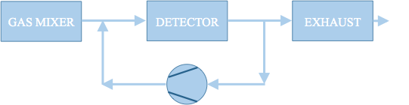
Optimization of current technologies
All gas systems are designed to recirculate the gas mixture: average 90% gas recirculation → 90% reduction of consumption
Advantages:
- Reduction of gas consumption
Disadvantages:
- Complex systems
- Constant monitoring (hardware and mixture composition)
- Use of gas purifying techniques
The remaining 10% is what we started to address from LS1. It is needed to compensate for:
  Leaks at detector: 85 % (mainly ATLAS and CMS RPC systems)
  15% N₂ intake (CMS-CSC, LHCb-RICH1, LHCb-RICH2)
Two remaining open mode systems upgraded to gas re-circulations from Run1 to Run2:
ALICE-MTR: from Run1 to Run2: 75% GHG reduction
LHCb-GEM: from Run1 to Run2: 90% GHG reduction
  → For both detector systems: Original investment largely paid back by gas cost saving during few years of operation
and laboratory setups:
2013: Development of "A portable gas recirculation unit" JINST 12 T10002
2020: Development of Gas recirculation systems for RPC detectors: from LHC experiments to laboratory set-ups - RPC2022

Slide 12
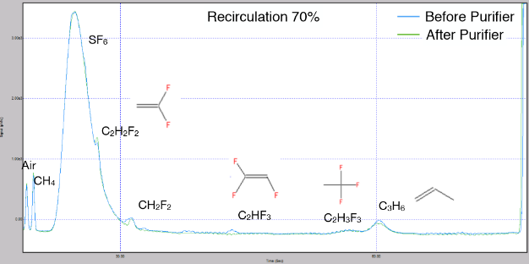
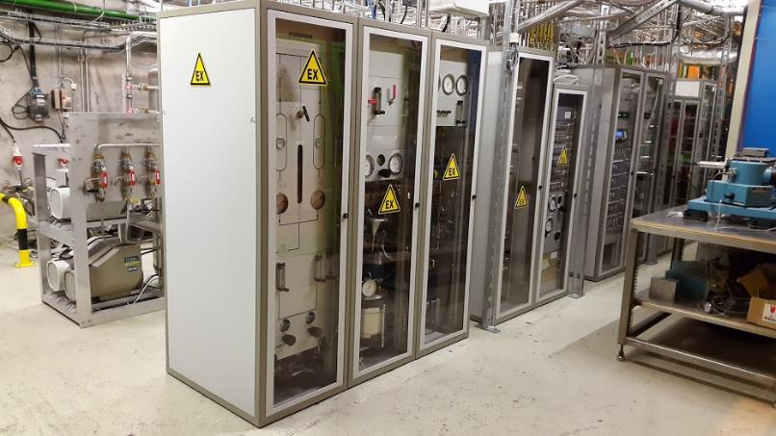
ALICE-Muon Trigger RPCs/MID
Mixture: C₂H₂F₄ 89.7%, SF₆ 0.3%, iC₄H₁₀ 10%
Detector volume: 300 liters (much smaller wrt ATLAS and CMS-RPC systems)
Therefore originally designed in open mode → upgraded to gas recirculation in 2015
From Run1 to Run2:
75% GHG reduction
Original investment already largely paid back by gas cost saving during operation
RPC operated in slightly different conditions (higher pulse charge):
→ Impurities due to fragmentation of main gas components are visible
Closely monitored
Detector performance are not affected by gas recirculation
More details in
Gas mixture monitoring for the RPC at LHC (RPC2018)

Slide 13
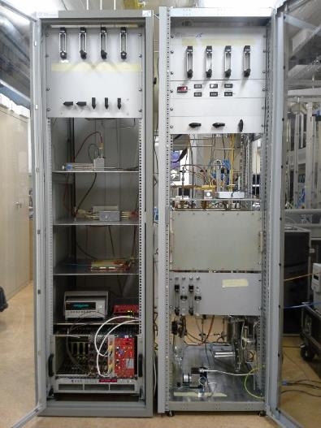
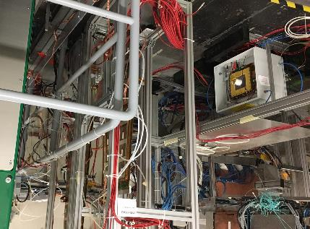
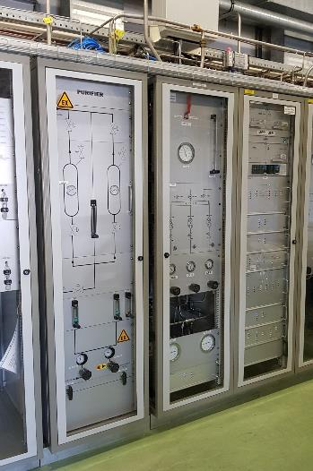
LHCb-GEM example
mixture: CF₄ 40%, Ar 45%, CO₂ 15%
Detector volume: ~ 50 liters (but very high flow needed by the detector)
→ R&D for operation of large GEM detector systems with gas recirculation
From Run1 to Run2:
90% GHG reduction
2013: Development of small gas recirculation systems for R&D
Started test in lab with radioactive source (GEM never operated in recirculation before)
2016-…:
Validation continued at CERN Gamma Irradiation Facility
2016-…:
LHCb-GEM upgraded to gas recirculation
Gas mixture purification studies
"A portable gas recirculation unit" JINST 12 T10002
Original investment already largely paid back by gas cost saving during operation
LHCb-GEM detector operation became more stable thanks to less frequent replacement of CF₄ cylinders

Slide 14
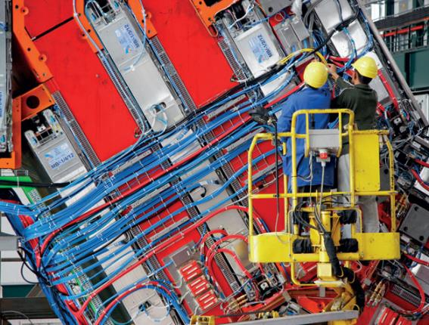
ATLAS and CMS RPC systems
Nowadays GHGs usage for particle detectors @ LHC is dominated by the large ATLAS and CMS RPC systems:
mixture recirculation is already almost at design level (85-90%) and today it is limited by leaks at detector level
Further optimization requires:
Fixing leaks at detector level
  Huge ongoing effort of RPC detector communities (ATLAS and CMS)
  but critical/fragile gas connectors are extremely difficult to access
  Good technical progress
Gas system upgrade to minimize any pressure/flow fluctuation
  Goal: new upgrades to cope with observed fragility of some detector components
  Positive effects already visible at end of Run2:
  Reduced leak developments at start-up
  Pressure regulation improved by 70%
Minimize impact of cavern ventilation (tests in collaboration with EN-CV)
Look for other external causes (vibrations, …)
Detector R&D to validate higher recirculation fraction
Tools to check detector and gas system tightness

Slide 15
Optimization strategies
Helps reducing gas emissions
Optimization of gas systems
Affects detector performances
Optimization strategy | Technical implementation | Goal | Examples
Gas recirculation | Mixture recirculation systems | Consumption reduction, detector performance | RPC, RICH, CSC, …
Flow, Pressure regulation | Automatic regulation, PID controllers | Detector stability, leak reduction | RICH detectors, RPC leaks
Software upgrades | Additional control features | Operation stability | All LHC gas systems during LS2 upgrades
Monitoring | HMI, Control panels, dashboards | Anomaly detection | Impurities intake, malfunctioning of gas component
Offline analysis | Data analysis | Deeper understanding of the dynamics | System startups, additional regulation valves when needed
Direct effects
Indirect effects

Slide 16
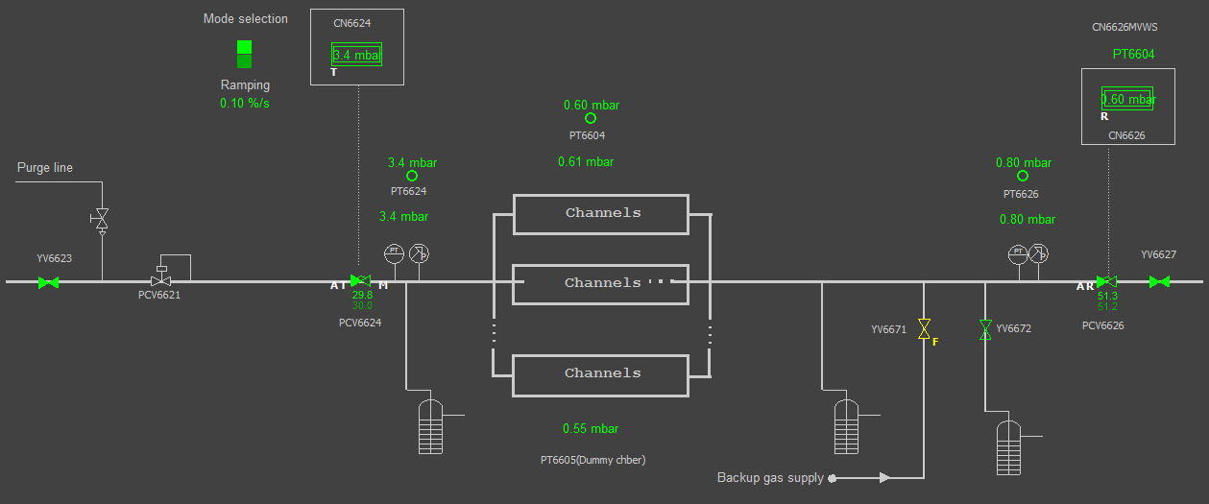
Examples: RPC Gas system upgrade
Goal: minimize any chamber pressure/flow fluctuation to cope with observed fragility of some detector components
from some 0.1 mbar to ~ 0.1 mbar: not an easy challenge
Example of upgrades on mixture distribution modules:
As slow as possible opening at input
New modules with regulation valves
New restart procedure
Additional regulation valves
Two sets of controls parameters (for start-up and run)
Pressure regulation by using Detector pressure or “reference/dummy chambers”

Slide 17
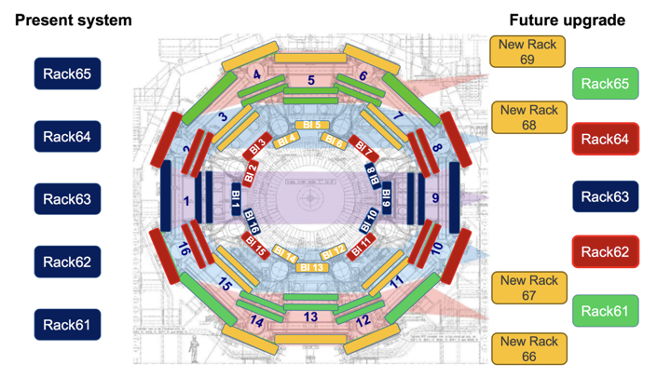
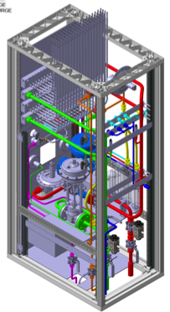
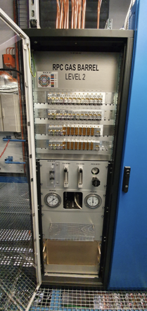
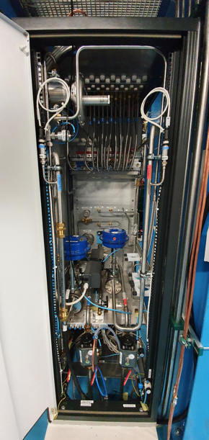
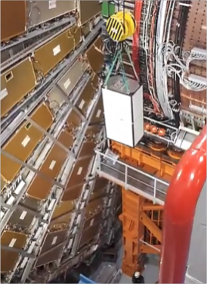
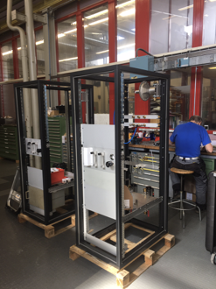
Examples: ATLAS – RPC gas system
4 New distribution racks (i.e., from 5 to 9 modules):
To minimize hydrostatic pressure effect
for the addition of new channels needed for upgrade
Upgrade of existing racks:
to minimize any chamber/flow fluctuation from some 0.1 to ~0.1 mbar
From design to installation:

Slide 18
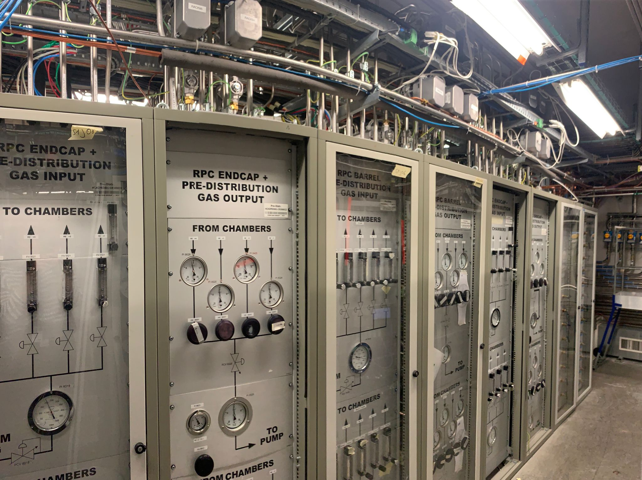
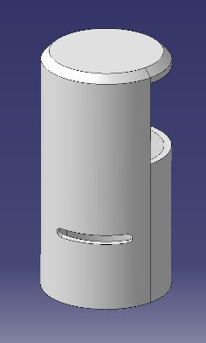
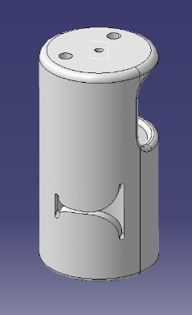
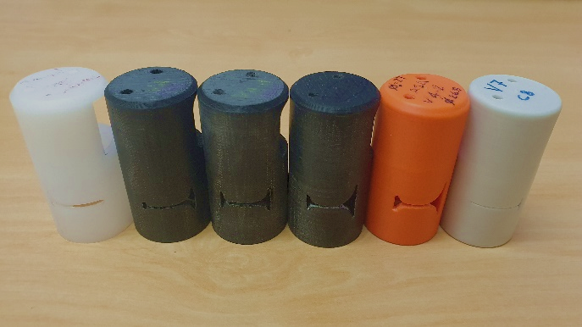
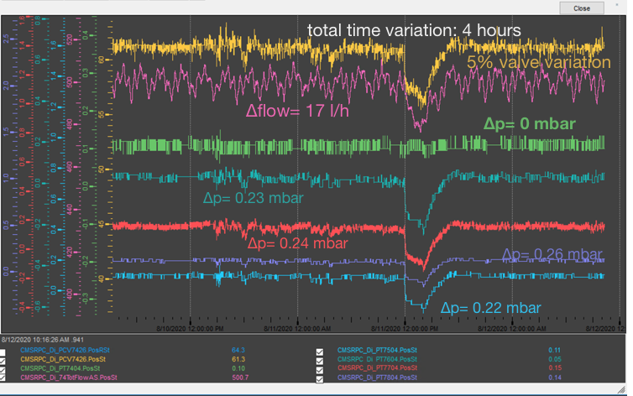
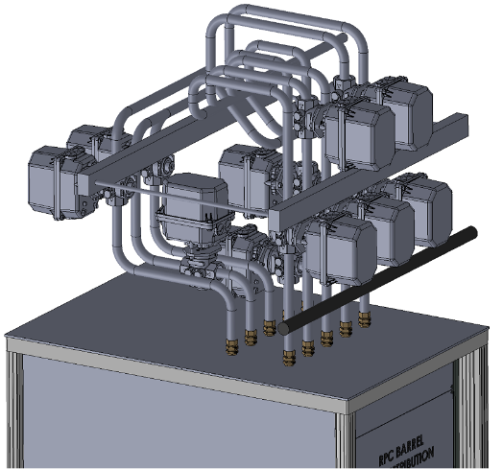
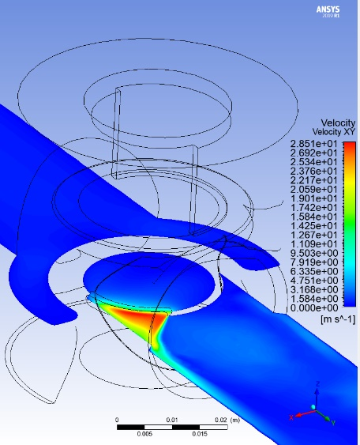
Examples: CMS – RPC gas system
Many tests performed in laboratory and at CMS
One valve selected: ECONEX
Valve seats specific for distribution module:
  Different in BARREL and ENDCAP
  R&D to improve/design seat shape
Valves installed
M. Busato
with valve

Slide 19
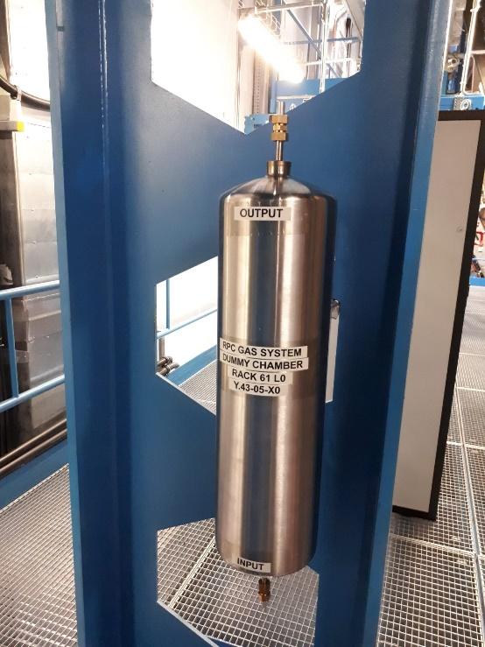
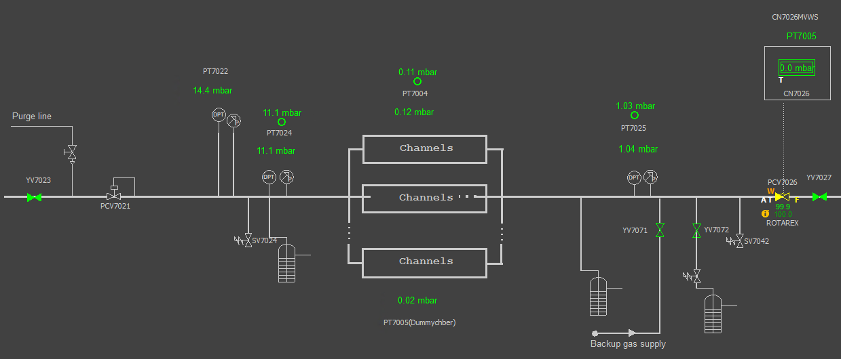
Examples: ATLAS and CMS – RPC gas systems
Detector pressure regulation was done using sensors at rack level:
Weight of hydrostatic column was not taken into account
Particularly critical during fill and emptying phases
Pressure sensors already present at detector level cannot be used due to risk of detector leak presence/development
Installation of volumes that simulates detectors (reference sensors/“dummy RPC”)
Extremely useful during detector filling after shutdown (when mixture hydrostatic pressure is changing significantly)
Minimize over-pressure at chamber level

Slide 20
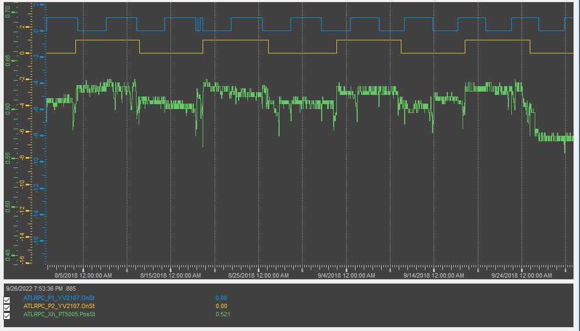
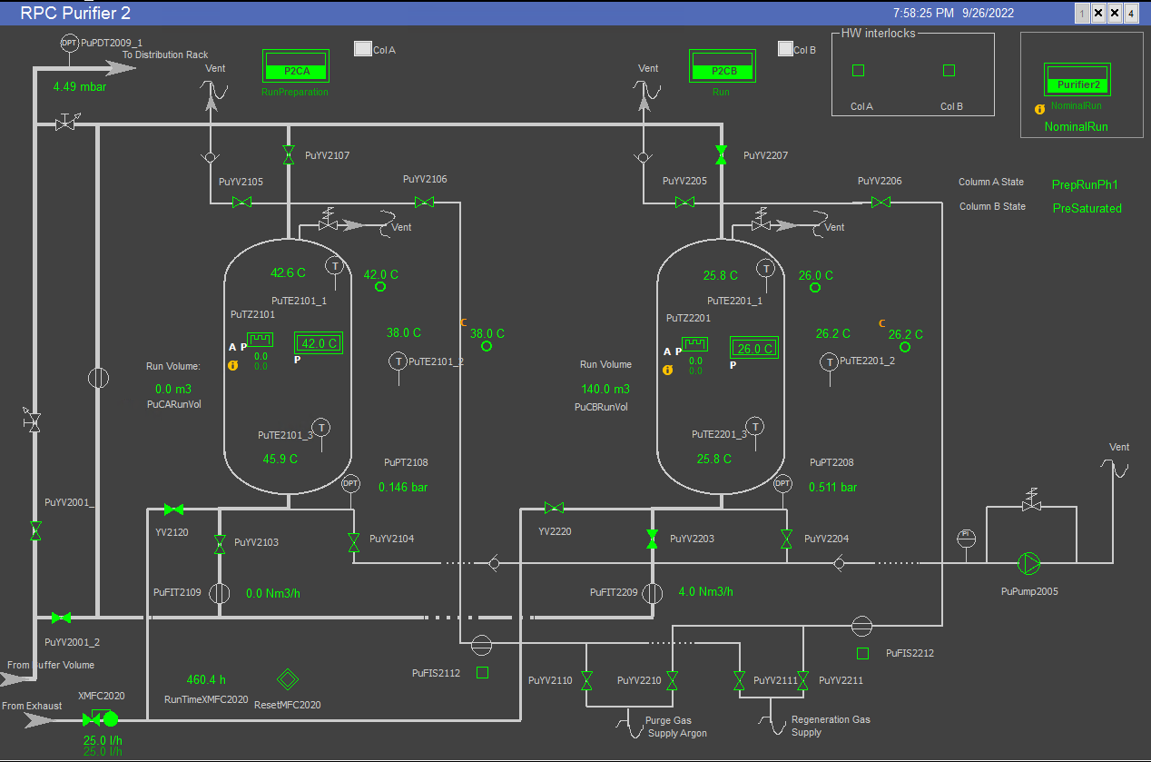
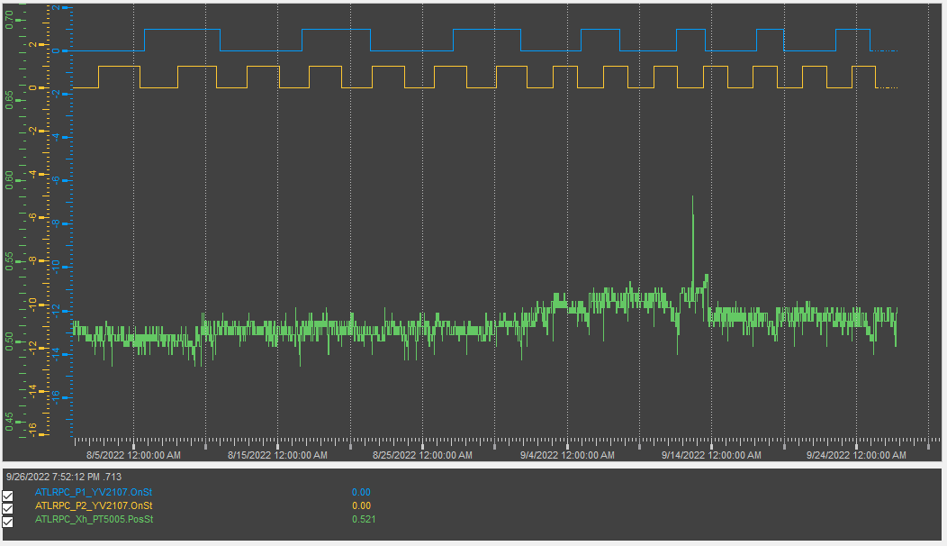
Examples: ATLAS and CMS – RPC gas systems
Upgrade of purifier modules
Smoother change to run conditions:
modification of preparation for run phases
Run2:
Δ high pressure buffer ~70 mbar
Run3:
Δ pressure buffer ~30 mbar

Slide 21
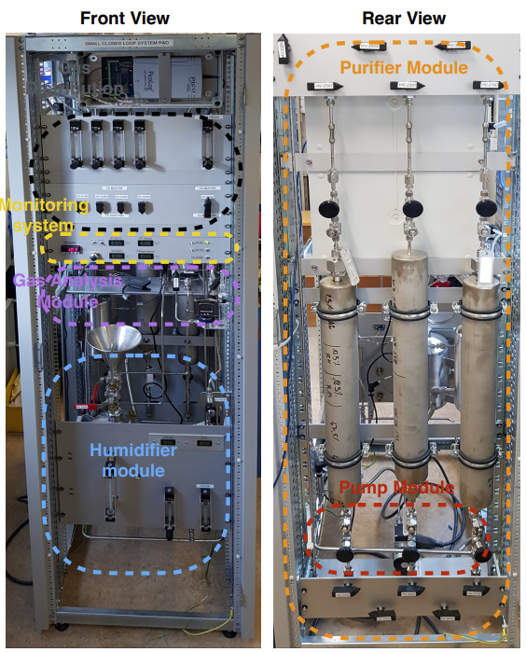
“Lab size” gas systems
Sometimes lab test are using relatively high gas quantity if compared with large LHC systems:
example from GIF++ tests (RPC, CSC, GEM), test beam activities (CALICE RPC-SDHCAL), EEE telescope, …
Development of Recirculation system for laboratory applications
2013: Development of "A portable gas recirculation unit" JINST 12 T10002
~10 detectors
~100-200 l/h
One single rack can contain the full system
Control system based on simple PLC
Monitoring system based on Grafana
Possible to have some parameters controlled remotely
Few sensors
Five gas systems already produced and in use
20-30 kCHF

Slide 22
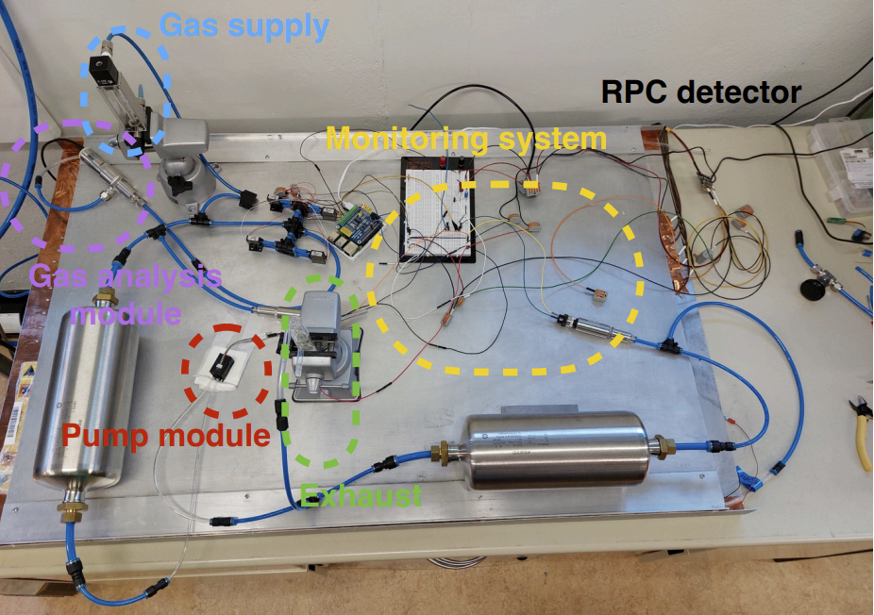
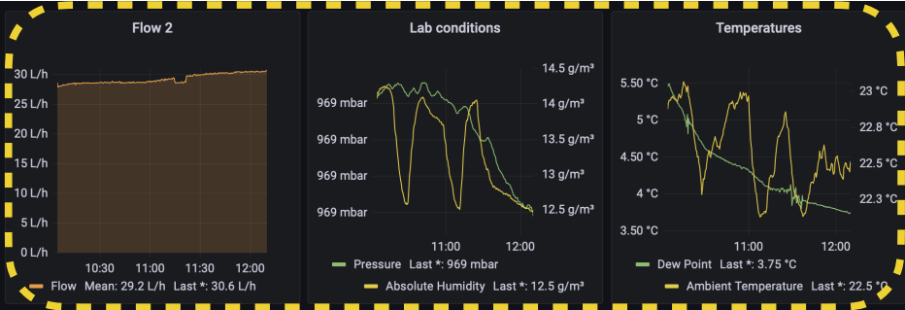
“Lab size” gas systems
Development of Recirculation system for ~1-2 detectors – 20-30 l/h
2019: Development of Gas recirculation systems for RPC detectors: from LHC experiments to laboratory set-ups - RPC2022
It should fit in a small box
Monitoring system based on RaspBerry PI and Grafana
Manual (optional remote) control
Limited number of electronic sensors
Very cheap components
1-2 kCHF

Slide 23
GHG Optimization Strategies
How to reduce greenhouse gas usage
Optimization of current technologies
Gas Recuperation
Alternative Gases
Gas disposal
Membrane separation
Pressure swing
Cryogenic/cold separation

Slide 24
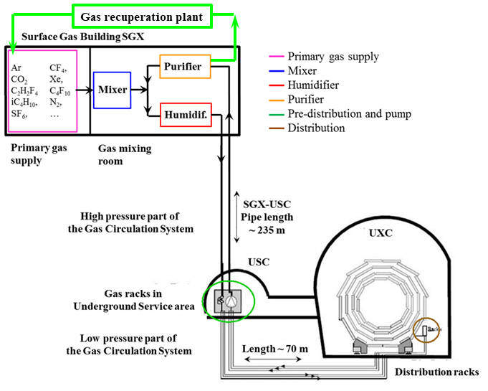
Gas systems and recuperation
Possibility to recuperate a single gas component from exhausted mixture
Many LHC gas systems already with gas recuperation
Advantages:
- Further reduction of gas consumption
Disadvantages:
- Higher level of complexity
- Dedicated R&D
- Gas mixture monitoring fundamental
Ongoing R&D aims in testing the feasibility for new recuperation systems:
  R134a for ALICE-RPC, ATLAS-RPC, CMS-RPC, ALICE-TOF
and substantial improvements of existing systems:
  CF₄ for CMS-CSC, LHCb-RICH2
  C₄F₁₀ for LHCb-RICH1
Recuperation will be effective only if leaks at detector level will be reduced
R134a recuperation can drastically decrease GHG consumption
R&D costs for first R134a recuperation system can be potentially paid back with one year of operation

Slide 25
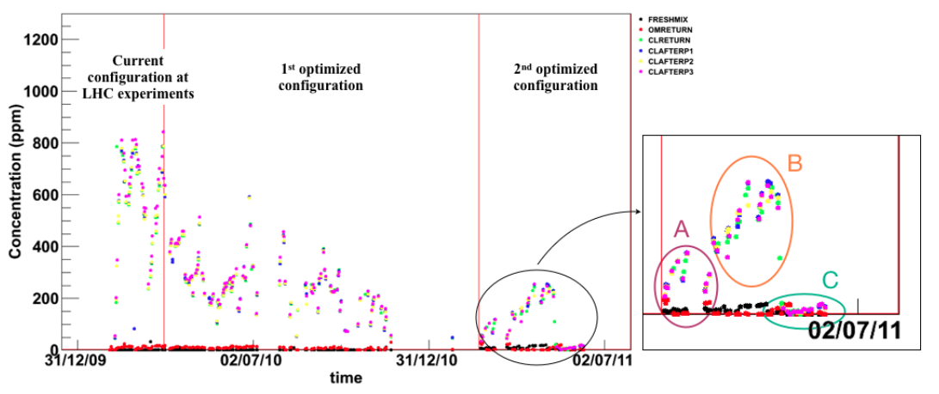
Beyond gas recirculation: why?
Not always the recirculation fraction can be increased easily: two examples
RPC Detector operation validated for ageing up to 90%
  What about recirculating more? Only short test performed in the past (2011) up to 97-99%
N2 intake by diffusion in CMS-CSC detector
https://pos.sissa.it/159/029/pdf
RPC: Gas recirculation and impurities in past test
Higher recirculation fraction:
97%
99%
94%

Slide 26
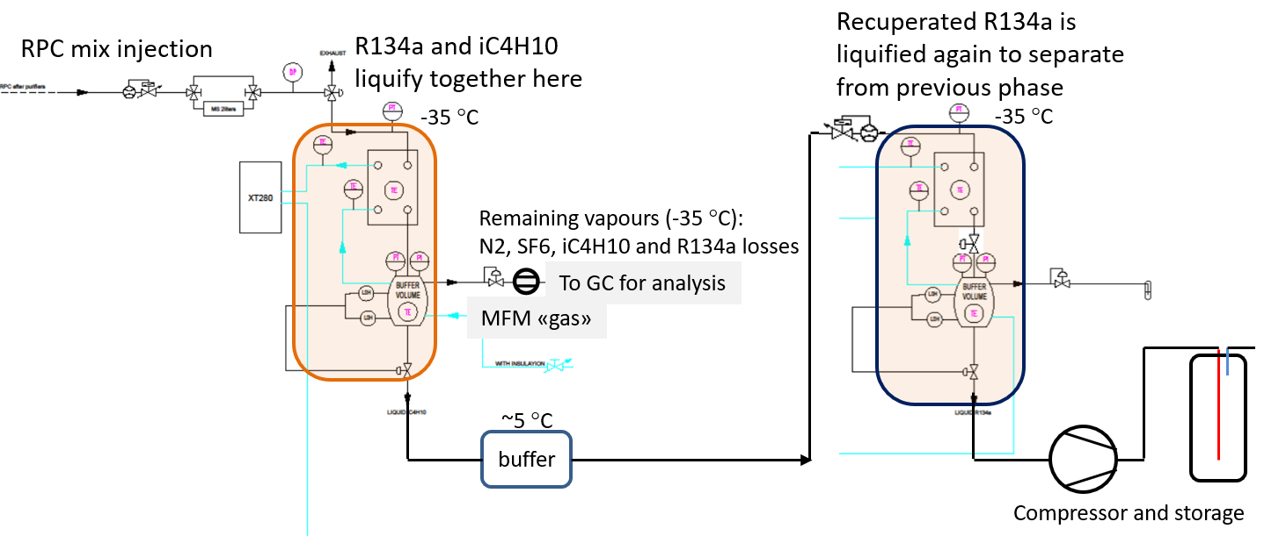
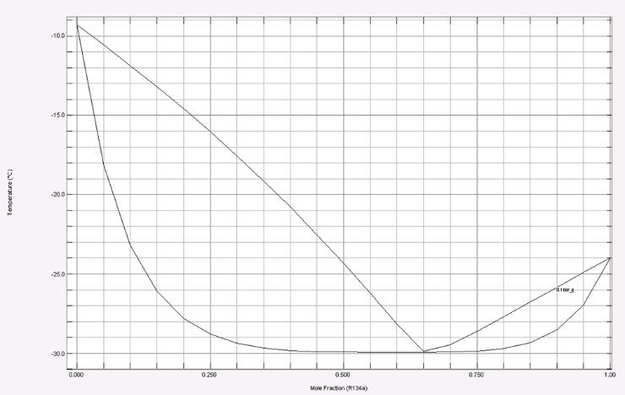
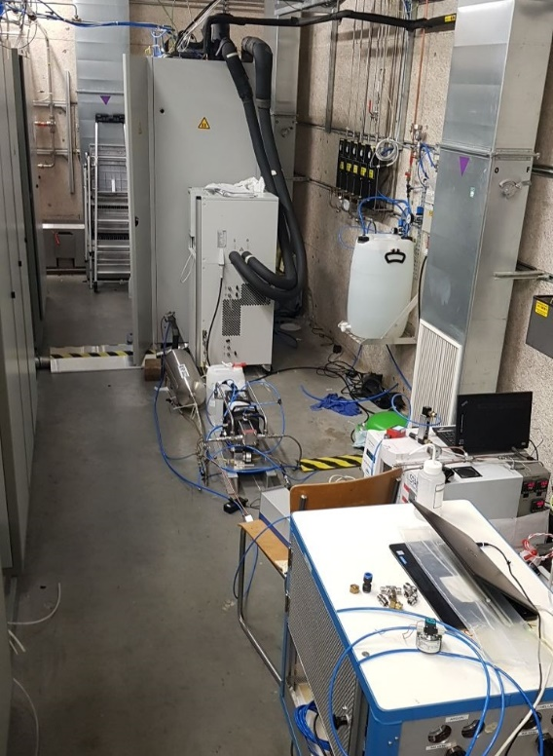
Gas Recuperation: the R134a case
2018: Prototype0 tested in ATLAS-RPC (100 nl/h)
encouraging results, air/N2 and iC4H10/SF6 removed
2019: Prototype0 moved to CMS
2020: test restarted at CMS with CMS-RPC
R134a/iC4H10 form an azeotrope
simple separation thanks to difference in boiling points is not possible
2022: Good R134a quality, ~80% recuperation efficiency (limit due to azeotrope)
2023: installation of new Prototype1 for continuous operation
R134a, iC₄H₁₀, SF₆, …
Starting point mixture
95% R134a - 5% iC4H10
input
Vapour composition curve
Cold separation
R134a/iC4H10 remaining mixture is totally liquefied and it is sent to buffer at 5 °C:
azeotropic mixture is slowly heats up
liquid is enriched of pure R134a
vapour of azeotrope which escapes from exhaust
RPC
chiller
compressor
GC/MS
IR
liquid composition curve
GC

Slide 27
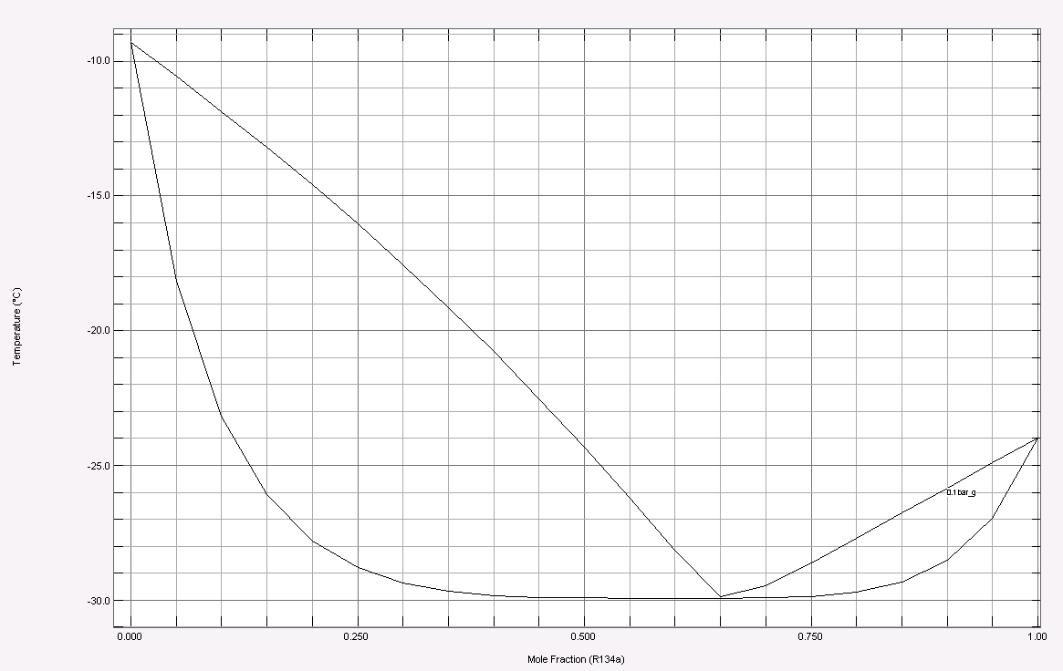
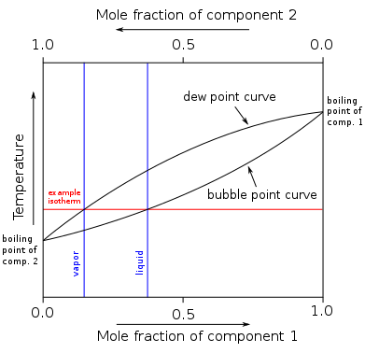
Gas Recuperation: the R134a case
Ideal mixture:
Two boiling termeratures (component1 and component2)
No other min/max for vapour and liquid curves
Azeotropic mixture:
In the boiling temperature vs composition plot is present a min or a max
iC₄H₁₀
«distillation» occours between
azeotrope and one of the two components
Separation efficiency cannot be 100%
R134a
azeotrope

Slide 28
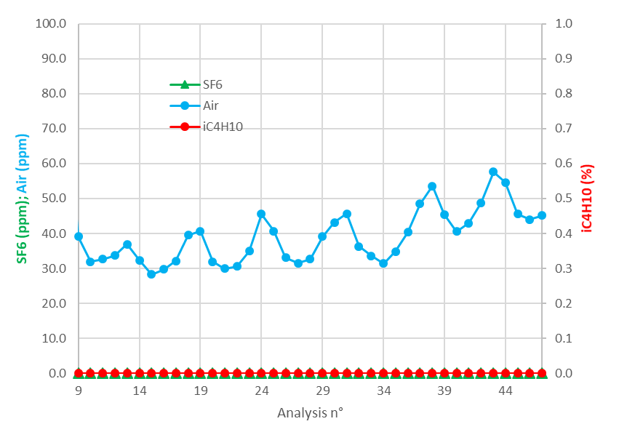
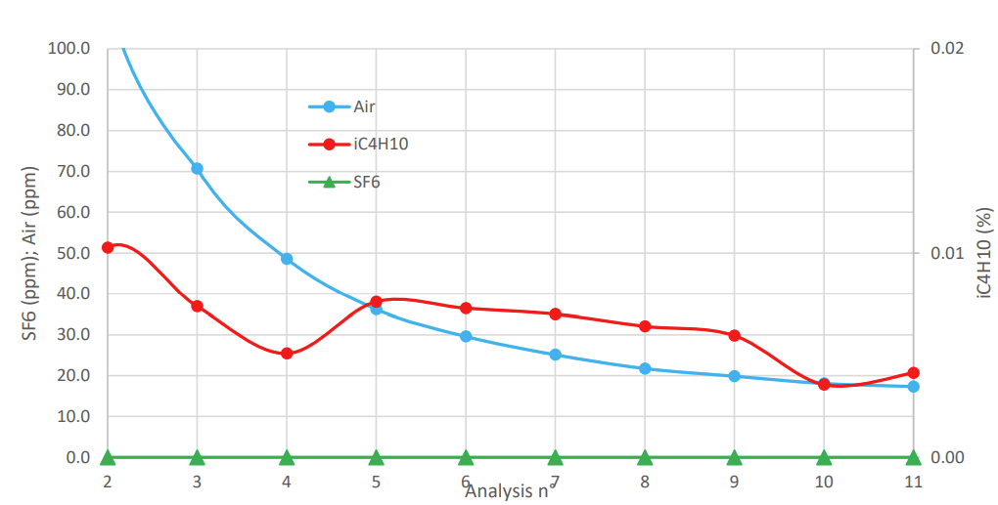
Gas Recuperation: the R134a case
Status (Master Thesis F. Cambiè, D. Burragato, M. Di Toma, M. Bruno, M.C. Arena)
collaboration with:
Chemistry department University of Pavia, Italy
Politecnico of Torino, Italy
GC analysis after test at 400 l/h mixture:
Analysis from “warm” buffer
Input flow tested up to 600 l/h
Good R134a quality with good recuperation efficiency (~80% limit due to azeotrope)
    Contaminants: air and SF6 (<100 ppm) and iC₄H₁₀ (close to detection limit in PPU)
Integration of compressor unit and storage of recuperated R134a completed
Tests still needed
Input flow up to 1000 l/h
Azeotrope can be a problem for high flow
Re-use of recuperated R134a in mixer: June 2023
Separation studies of possible RPC impurities: 2023
R&D for possible recuperation of SF6 (timescale to be defined)
GC analysis of recuperated R134a from storage bottle

Slide 29

Gas Recuperation: the R134a case
Installation completed -> Commissioning started last week
controls module
Chillers (-40 C & +10 C)
analysis modules
(gas chromatograph
and mass-spectrometer)
two cold trap separation modules
compressor
Storage and re-use

Slide 30


Gas Recuperation: the R134a case

Slide 31


Gas Recuperation: the CF4 case
CMS-CSC CF₄ recuperation plant
From Run1 to Run2
up to 44% GHG reduction
Problem:
Too high N₂ concentration for gas recirculation due to diffusion leak from detector components
Technical challenge:
First plant built for CF₄ warm adsorption
A completely non-standard system
Operation started in 2012. Several technical and resource problems → Average efficiency ~50-60%
R&D will either solve current limitations or convert the last module for cryogenic separation

Slide 32




CSC CF4 Recuperation Plant: recent R&D studies
Membrane module
Search and characterization of new membranes
    Membranes used in industry to recuperate CO2
    For different flow and with different sensitivity
Characterization of existing membranes to improve CF4 loss
    Impact of different permeate side pressures for Ar, CO2, O₂, N₂ extraction
    Impact of input flow fluctuations on the membrane efficiency
    Monitoring and fine tuning of membrane parameters
CF4 loss
for different membranes
CF4 adsorption module
CF4 recuperation wrt Argon extraction low pressure limit
Pressure-swing method
Timing/optimization of run parameters
    Example: Ar extraction low pressurelimit
Characterization of recuperated gas during full cycle
    GC analyses for recuperated and exhaust gas
CF4 recuperation efficiency increased to about 70%
and more studies still ongoing
improvements possible thanks to additional resources
Need of dedicated qualified personnel

Slide 33





Gas recuperation: monitoring quality of recuperated gas
Complexity of using a recuperated gas: mixture quality monitoring ensuring good composition and avoiding ageing
Quality of recuperated CF₄ is monitored: with GC analysis
Mixed injection of CF₄ 50% recuperated and 50% new
CO₂
Ar
Increased to about 95%
CF₄ New
CF₄ Recuperated
and with gas mixture monitoring: Single Wire Chambers
Normalized gain monitoring

Slide 34
GHG Optimization: CERN Strategies
How to reduce greenhouse gas usage
Optimization of current technologies
Gas Recuperation
Alternative Gases
Gas disposal
New eco-friendly gases, HFOs, …

Slide 35

Possible alternatives to GHG gases
R&D started long time ago

Slide 36




Possible alternatives to GHG gases
New eco-friendly liquids/gases have been developed for industrial applications as refrigerants and HV insulating medium…
→ many gases tested, but not straightforward for detector operation. Best options:
HFO-1234ze
(C3H2F4)
GWP 6
R134a (C2H2F4)
GWP 1430
HFO-1234yf
(C3H2F4)
GWP 4
flammable
?
CF3I
GWP 0.4
toxic
R14 (CF4)
GWP 5700
Very difficult challenge for already installed detectors where it is not possible to change of FEB electronics, HV system, etc
However, in any case to be considered
Long-term operation (to evaluate possible aging issues)
No flammability or toxicity of the gas mixture

Slide 37


Possible CF4 replacements
CF4 is used in different types of particle detectors to prevent aging, to enhance time resolution or because of its scintillation photon emission
CMS CSC studies
(K. Kuznetsova)
CF4 is a source of fluorine radicals to protect against anode ageing
  Now 10% CF4 in CSC gas mixture
Two possibile approaches to reduce GHG consumption (beyond the recirculation and recuperation systems)
  Decrease the CF4 concentration: preliminary results show that 5% could be safe for operation
  CF3I and HFO1234ze not best candidates
  Look for other alternatives to CF4 on-going
LHCb RICH studies
(S. Easo and O. Ullaland)
RICH detectors use either CF4 or C4F10
  Necessary for good refractive index
Replacement of C4F10 with C4H10
  Refractive index matches very well
  But C4H10 flammable
Replacement of CF4 with CO2
  Under investigation
Use of SiPM to reduce the chromatic error and increase the yield

Slide 38





Alternatives to SF6
10 F
7 F
6 F
3MTM NovecTM 5110
(CF₃C(O)CF(CF₃)₂ )
GWP <1 - Atm. lifetime 15 days
High boiling point: 27 C
Sensitive to UV radiation
Higher HV working point
3MTM NovecTM 4710
((CF₃)₂ CFCN)
GWP 2100 - Atm. lifetime 30 years
It may react with H2O
SF6
GWP 23900
3-4 F
8 F
3 F
Chemical inertness: extremely stable
Exceptionally long lived in the atmosphere
Excellent dielectric property
  SF6 x 2.5 than Air
Non-flammable and toxic
Gaseous form
No major reactions
  Ok with H2O, Cl and acids
>1.5% needed
No gain in GWP
toxic
AMOLEATM HFO-1224yd
(CF3-CF=CHCl)
GWP <1 - Atm. lifetime 20 days
CF3I
GWP 0.4
Atm. lifetime 6 days
C4F8O
GWP 8700
Atm. lifetime >3000 years
Presence of Cl (and recent worring experience at CMS to understood)

Slide 39





Not only detector performances….
Two factors identify the greenhouse gases and their effects on climate:
the radiative efficiency and lifetime in the atmosphere
The lower are the GWP and the lifetime, the easier is the creation of sub-products
HFO-1224yd
Degradation products:
TFA, CO2, HF, HCl
Do these sub-products have an impact on detector lifetime?
Three factors determine the atmospheric lifetime
Rain out
Water solubility
Oxidation
Reactivity with OH
Photolysis
UV absorbance
Hydrofluoric Acid (HF)
HFO produces much more HF than R134a in RPC detectors
Observation with ppm of HCFC:
Trifluoroacetic acid (TFA)
HFO1234ze is estimated to break down into TFA at less than 10%, whereas R-1234yf will break down into TFA at 100% (R134a at 21%)
TFA highly soluble: no formation of insoluble salts
Phytotoxic

Slide 40



Detector performances vs safety and long term operation
Safety:
Safety first for LHC operation. Due to gas leaks and currents design:
Gas mixture must not be flammable
Gas components should not have high toxicity levels
Performance:
RPC short and long term performance shouldn’t be affected
Good quenching gases required for high rate capability
Radiation-hard gases required to minimize impurities affecting long term performances
CF3COOH (TFA):
a serious environmental concern (?)
Tradeoff between flammability and GWP. Lowering GWP by:
Replacing F with Cl or H:
  Shortens atmospheric lifetime
  Increases flammability limit
Adding C=C bound:
  Increases reaction with O₂
GWP is related to Infrared absorption over time. Low-GWP gases have short atmospheric lifetimes:
Water solubility → Rain out
OH⁻ reactivity → Oxidation
UV absorbance → Photolysis
Presence of Chlorine:
a warning from CMS bad experience
Environment:
GWP represents the main environmental concern
Studies ongoing: UV, water, long term effects on detector

Slide 41




Long-term studies with HFO gas mixtures
RPC long-term operation with eco-friendly gas mixtures under high background radiation and possible ageing effects must be investigated
Creation of the ECOGAS@GIF++ collaboration: a joint effort between CERN Gas Team, ALICE, ATLAS, CMS, LHCb-SHIP RPC communities
Set-up at CERN Gamma Irradiation Facility (GIF++)
    12.2 TBq ¹³⁷Cs and H4 SPS beam line
Several RPCs under test from different experiments
Detector performance studies
    At different back-ground radiations
    For different gas mixtures and for different types of RPCs
Long-term performance studies
    Irradiation of RPCs to accumulate an equivalent charge of the HL-LHC Phase
    Fundamental for the validation of new eco-friendly gas mixtures
Three gas mixtures under study
    CO2 50-70% + HFO 45-25%
    with~5% iC4H10 and 1% SF6
¹³⁷Cs
STD gas mix
RPC detectors
LHCb-SHIP RPC
ECO2 gas mixture
ECO2 mix
EP-DT RPC
Results presented in RPC2022 workshop

Slide 42



ATLAS and CMS - RPC upgrade programs: new detectors & FEB
New detectors for Run3 (ATLAS-BIS/BI)
Mixtures from ECOGAS@GIF
collaboration:
Triplet (3 single gaps; 1 mm gas gap)
Very effective Faraday cage allowing to operate with low noise and trigger on 2/3 coincidence
New FEB with new chip:
  Low noise
  Allowing threshold as low as 1 fC
→ from 30 to 3 pC per photon count
      Increased rate capability (x10)
      Low ageing (÷10)
3 independent singlets providing 3D+time
Combined σ_{t} 160 ps
ABS=22
Std mix
< 𝑛𝑝 >= 𝑙og(1/(1 − 𝜖))
New detectors for Run3 (CMS-iRPC)
double gap (1.4 mm gas gap)
new FEB:
  PETIROC2C re-designed
  Threshold < 50 fC
  TDC σt 20 ps
  TDC and detector σt ~ 160 ps
    → position resolution of ~1.6 cm
From:
CERN EP Seminar: Summary of RPC workshop
RPC 2022 workshop: Overview:
Exploring the performance limits of the new generation of ATLAS RPCs
XVI Workshop on Resistive PlaCMS iRPC FEB development and validation

Slide 43


PFAS: “forever chemicals”
PFASs are defined as fluorinated substances that contain at least one fully fluorinated methyl or methylene carbon atom (without any H/Cl/Br/I atom attached to it), i.e. with a few noted exceptions, any chemical with at least a perfluorinated methyl group (–CF3) or a perfluorinated methylene group (–CF2–) is a PFAS
PFASs play a key economic role for companies such as DuPont, 3M, and W. L. Gore & Associates because they are used in emulsion polymerization to produce fluoropolymers. They have two main markets: a $1 billion annual market for use in stain repellents, and a $100 million annual market for use in polishes, paints, and coatings. In 2022, 3M announced that it will end PFAS production by 2025.
Bioaccumulation and biomagnification

Slide 44


Slide 45


Slide 46
Conclusions
GHGs usage in particle detectors
F-gas regulation
Due to the environmental risk, “F-gas regulations” started to limit the GHGs usage (EU case)
availability and price are today critical for old F-gases
Detector design
It is fundamental to look not only at detector performance but also at the infrastructure
New generation detectors should limit the risk of developing leaks
If detectors are tight, gas consumption can be limited thanks to gas recirculation and recuperation systems (useful not only for GHGs but also for any expensive gases)
Strategies for GHG usage optimization
Optimization of current technologies
Particular attention to gas system and detector operation
Gas systems upgrade beyond original design
Improved/higher gas recirculation

Slide 47

Conclusions
Gas recuperation plant
Gas recuperation will be effective only if leaks at detector level will be reduced
R&D costs for R134a recuperation system is well justified by running costs
R134a recuperation prototype0 is more complicated than expected but showed good performance:
  ~ 80% recuperation efficiency and good gas quality
Consolidation of existing plants (CF4, C4F10) ongoing:
  CMS-CSC-CF4 recuperation efficiency increased to 70%
  LHCb-RICH2-CF4 installed
  LHCb-RICH1-C4F10 design ongoing
New eco-gases
New low-GWP gases can easily break
  Sensitive to UV, humidity and oxidation
  HF, TFA sub-products are produced and their effects on long-term operation need to be evaluated
Missing cross-section to perform simulation studies
  Dedicated measurements needed
R-1234ze, NOVEC, … are currently the main fluorinated alternative but:
  For 2 mm gas gap RPC, the addition of a 4th mixture components (CO2, ?) is needed to maintain reasonable HV working point
  availability and price are still a matter of concern
  long term operation in high radiation environment to be studied
New generation detectors and electronics seems to be more compatible with new eco-friendly gases than old-generation 2 mm gas gap RPC
  Upgrades for LHC experiments (ATLAS and CMS RPC Phase2 upgrades)
Recuperation of R134a can drastically decrease GHG consumption

Slide 48
Conclusions
GHGs abatement/disposal
Commercial systems exist. Adopted when gases cannot be reused.
Heavy infrastructures required (CH4+O2 supply, Waste water treatment)
Since availability/price can become a real problem in the future it is better to optimize consumption
Destruction in external companies: more expensive than Gas abatement system.
Additional challenge: finding right profile for resources for R&D and new recuperation plants operation:
Chemist, industrial chemistry engineer, engineer, physicist
Short term contracts: trainee, technical (max doctoral)

Slide 49


Optimization of gas consumption
gas recuperation improvement:
CF₄: CMS-CSC
gas recirculation increased:
ALICE-RPC
LHCb-GEM
Today optimization challenge
gas recirculation:
ALICE-RPC
LHCb-GEM
run optimization:
LHCb-RICH1
LHCb-RICH2
gas recirculation for most detectors (gas systems design, 2000):
90% optimization => 90% reduction
gas recuperation:
CF₄: CMS-CSC
LHC-LS1
LHC-LS2

Slide 50
Spare Slides

Slide 51

GHG equivalent emissions
Run 2 emissions from F-gases ~ 130 000 tCO2e
Geneva emissions 2019 ~ 2 650 000 tCO2
Switzerland emissions 2018 ~ 39 637 007 tCO2e
CERN contribution ~ 5% of Geneva, 0.3 % of Switzerland GHG emissions
https://www.epa.gov/energy/greenhouse-gas-equivalencies-calculator

Slide 52

Gas systems for LHC experiments
Gas system for detector at LHC experiments:
  Very large apparatus
  Mixing the different gas components in the appropriate proportion
  Distributing the mixture to the individual chambers
Gas systems are made of several configurable functional modules (building blocks):
  Simplifies maintenance, operation, training of personnel, …
Three keywords for such a large infrastructure:
Reliability
  LHC experiments are operational 24/24 7/7
  Gas systems must be available all time
Automation
  Large and complex infrastructure
  Resources for operation
  Repeatability of conditions.
Stability
  Detector performance are strictly related with stable conditions (mixture composition, pressures, flows, …)
Distribution
Analysis
Exhaust & Pump
Humidifier
Purifier

Slide 53



Gas systems for LHC experiments
Gas systems extend from the surface building to the service balcony on the experiment following: a route few hundred meters long.
1 gas system = ~ 10 active modules
LHC gas systems = 30 systems =
= 300 modules
LHC gas systems modules > 500 m

Slide 54




Alternative Gases
New low GWP gases alternative to R134a are already available on the market and used by industry
It is not the first time this happens in particle detection:
~1995
?
R13B1
(CBrF₃)
ODP* 10
GWP 6900
R134a
(C₂H₂F₄)
ODP 0
GWP 1430
HFO1234yf
(C₃H₂F₄)
ODP 0
GWP 4
HFO1234ze
(C₃H₂F₄)
ODP 0
GWP 6
HFOs refrigerant properties are well known while studies of ionisation processes just started…
R&D studies are ongoing. Main constrain is coming from need of maintaining current infrastructures (HV cables, Front End electronics) very difficult to access for replacement.
More details on Thursday, Detectors for Future Facilities session:
“Performance studies of RPC detectors operated with new environmentally friendly gas mixtures in presence of LHC-like radiation background”
*The Ozone Depletion Potential (ODP)

Slide 55
GHG abatement system
In case all studies on recuperation will not bring to efficient recuperation plants, industrial system able to destroy GHGs avoiding their emission into the atmosphere have been considered
Abatement plants are employed when GHG are polluted and therefore not reusable.
Quite heavy infrastructure required:
CH₄/city gas + O₂ supply + N₂ supply
Waste water treatment
  PFC/HFC are converted in CO₂ + HF acid dissolved in water
  disposal of remaining waste/mud
Joint CMS and EP-DT gas team is studying the feasibility
Found also companies available to take PFC/HFC based mixture for disposal:
but extremely expensive

