Slide 1
Investigating Eco-Friendly Gas Mixtures for RPCs at the LHC
Gianluca Rigoletti, R. Guida, B. Mandelli
8/06/2023
Notes:
Potential gases

Slide 2
Outline
RPCs at LHC
  R-134a consumption
Alternative gases to R-134a
  R-1234ze as alternative to R-134a
  Addition of alternative, non fluorinated components
Addition of CO2 as a possible mitigation of R-134a consumption
  Muon beam + Gamma background tests
Alternative gases to SF6
Gas properties studies
Conclusions
Notes:
Meno punti

Slide 3
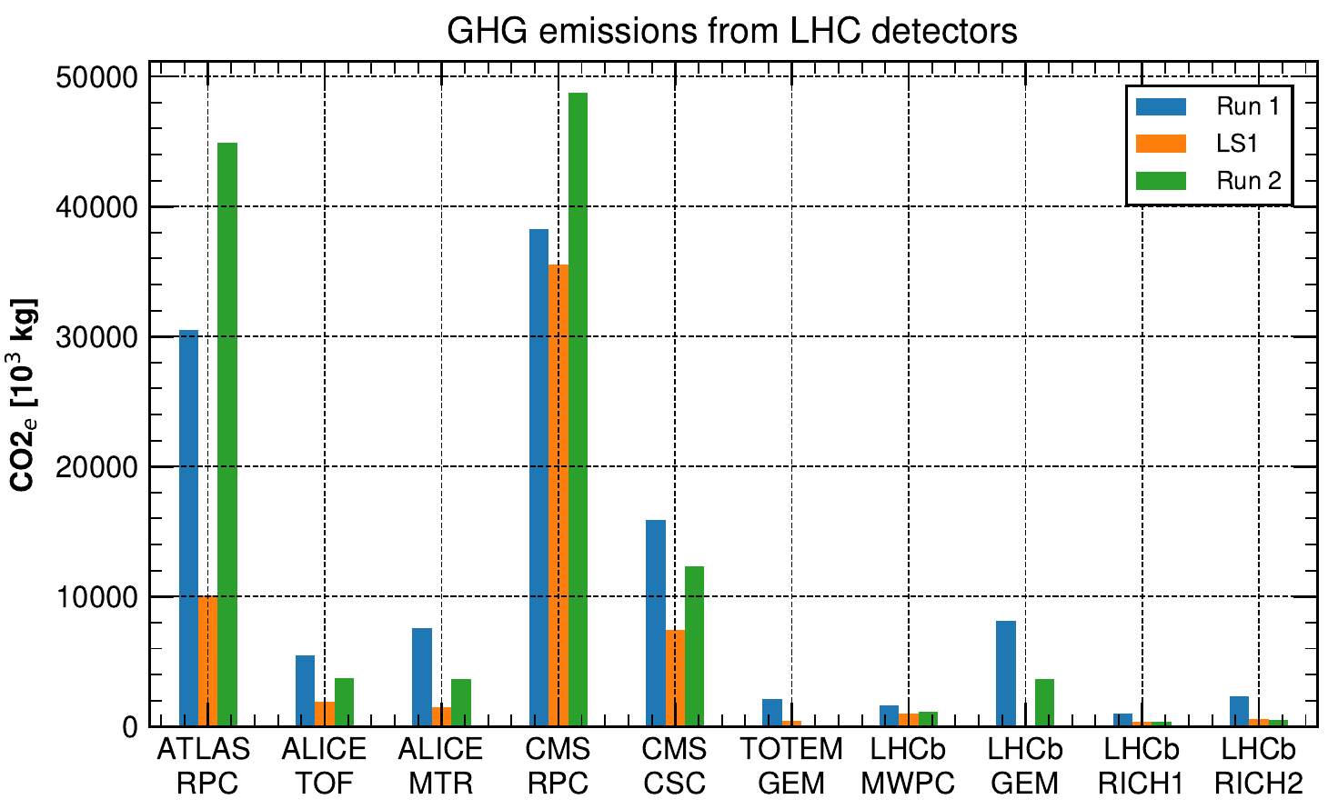
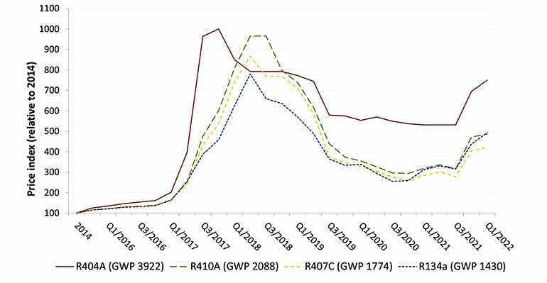


RPCs at LHC: R-134a consumption
RPCs at LHC are operated with 90-95% of R-134a (C2H2F4)
R-134a consumption during LHC Runs
Run 2: ~ 100 000 tCO2e/year emitted from R-134a consumption
Early Run 3 estimates: ~ 90 000 tCO2e/year of R-134a
Environmental + Economical factors
R-134a price increased of about 2.5 times w.r.t to 2015
Increase due to
HFC/EU phase down
Industrial conversion to new low-GWP gases
⇒ 3.5% of Geneva CO2e emissions (2019)
90 kT CO2e
⇒ 0.23% of Switzerland CO2e emissions (2018)
19 400 cars/year
11 000 homes’ energy use/year
Lockdown supply
chain slowdown
https://www.epa.gov/energy/greenhouse-gas-equivalencies-calculator

Slide 4
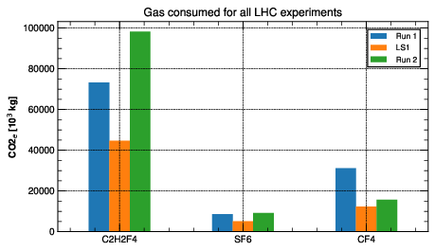

RPCs at LHC: SF6 consumption
SF6 used in glass and HPL RPCs
~ 7% in ALICE TOF, 0.3 % in ALICE, ATLAS, CMS RPCs
Mass consumption → 1% of total GHGs
CO2 equivalent emissions → 8% of total GHGs
SF6 has unique properties
Most potent GHG: GWP of 22800
Chemically stable, inert
Extremely high atmosphere lifetime: 3200 years
Excellent dielectric properties: high electronegativity
Not flammable
Not toxic
Good vapour pressure
Electrical industry is actively researching and developing alternatives to SF6
1 kg SF6
22800 kg CO2
5 cars / year
380 tree seedlings / 10 years
https://www.epa.gov/energy/greenhouse-gas-equivalencies-calculator

Slide 5
Goal of RPCs studies on alternative gases
Alternatives to/reduction of R-134a
Alternatives to SF6
Aging studies
HFO/R-1234ze as
main alternative
Non fluorinated gases
NovecTM 4710, 5110, C4F8O, CF3I, R-1224yd
RPC ECOGAS@GIF++ (AIDAInnova)
CO2 addition to the standard gas mixture
Goal:
Find a low-GWP gas mixture suitable for LHC-operation that requires no change in the current RPC systems (i.e. no change in electronics, HV, gas systems, etc.)
Studies on gas properties
Gas species qualification and quantification
UV absorption
Water solubility
HF and other acids production

Slide 6
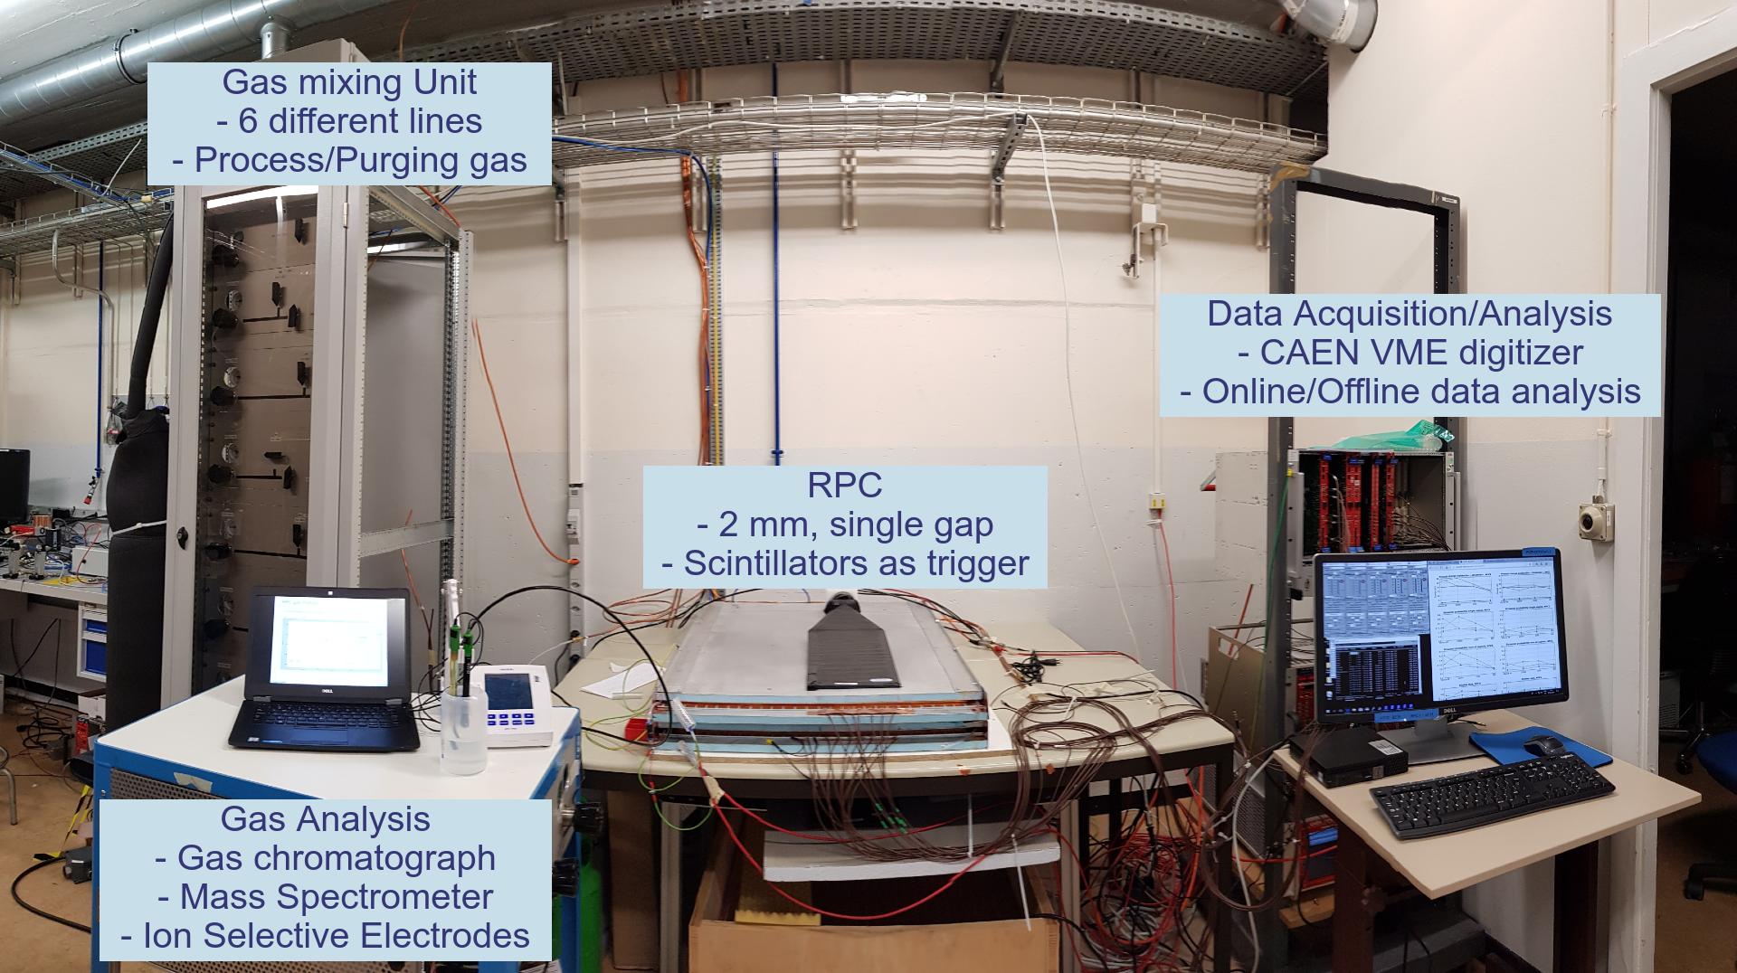
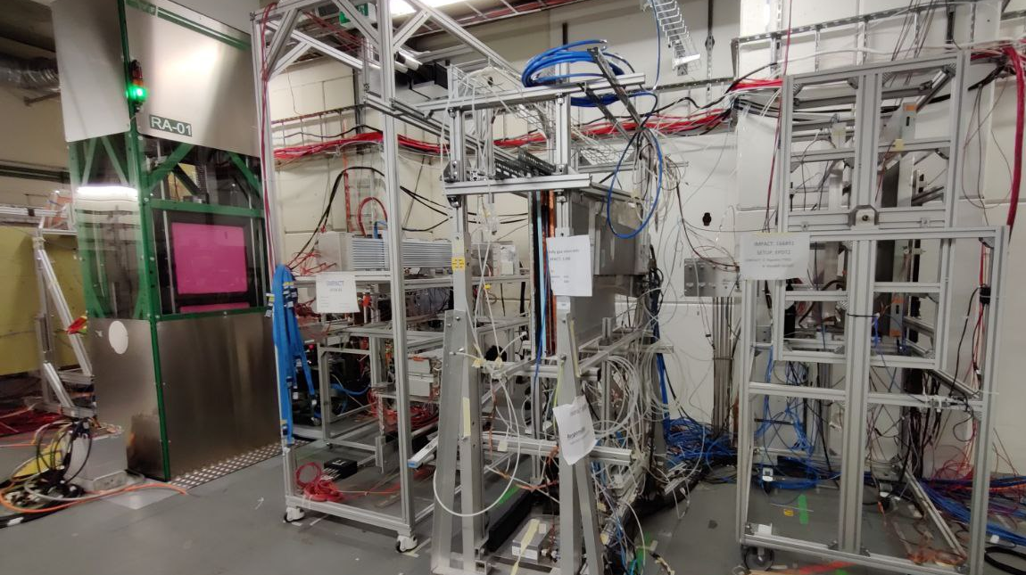
Experimental setup
Laboratory setup
Single gap, 2 mm electrodes + 2 mm 80x100 cm² gap HPL
Tests of new gases
Gas mixtures fine tuning: up to 6 components, 0.01% precision
Low rates, cosmic muons
Raw waveform analysis: efficiency, st. prob., cluster size, time resolution, prompt charge
GIF++ setup
Muon beam + ¹³⁷Cs gamma source
Gas mixtures validation:
  Muon beam at different background rates (ABS filters)
  Long term studies: currents stability
  Cosmic muons measurements
Muon beam
Gamma source
RPCs
Rotating RPC trolley

Slide 7
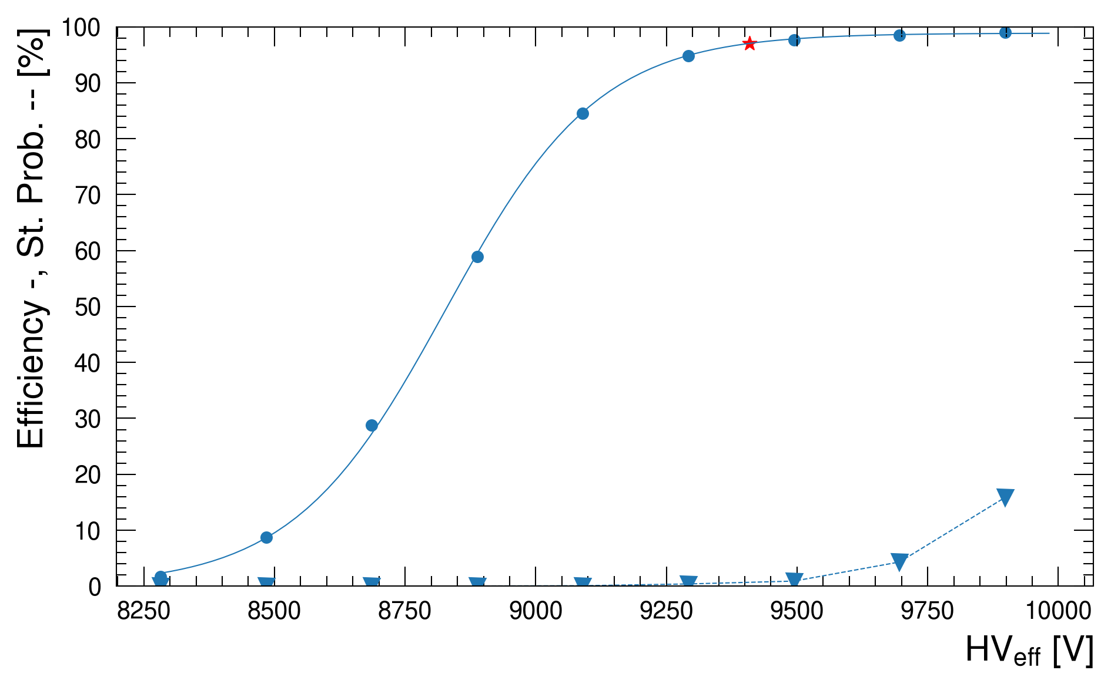
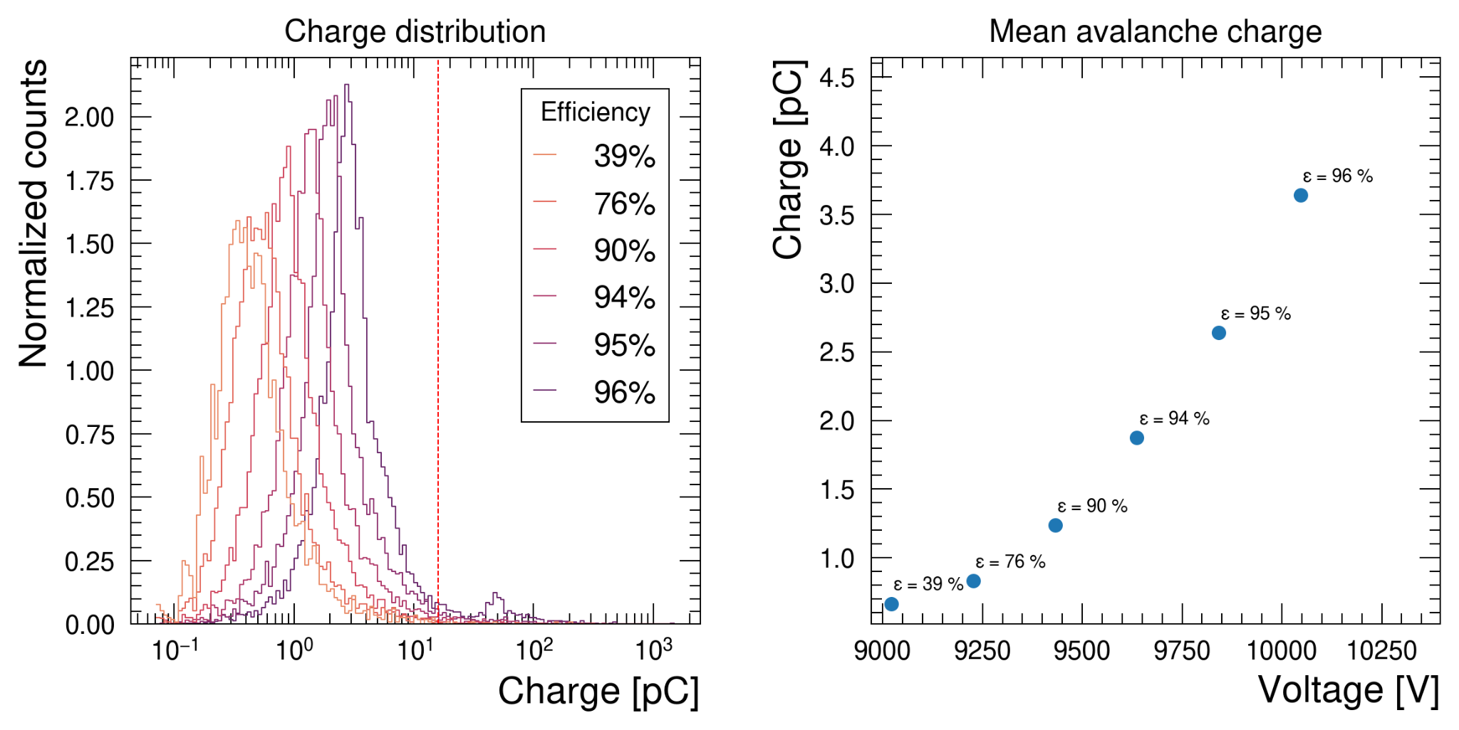
Data acquisition and analysis
Working point
Eff. max
Data acquisition
Raw waveform digitizing: efficiency, charge, shape, time analysis of signals
7 strips readout / RPC
2-3 RPC for result consistency
HV scans: ~ 10 HV points, 10⁴ waveforms for each HV point → O(10⁵-10⁶) waveforms analyzed per run
Efficiency
streamer
separation
10% st. prob.
Streamer variability
Data analysis
Efficiency fitting with sigmoid function
Working point definition: HV(95% of ε_{max} ) + 150 V
Avalanche / Streamer threshold: 10⁸ electrons ~ 16 pC
Efficiency-streamer separation: ΔV_{w.p} - ΔV_{10% st.prob.}, streamer variability: (w.p. ± 50V)
GIF++ tests: foremost parameters evaluated at working point for each ABS filter
  Tested up to 500-600 Hz/cm²

Slide 8
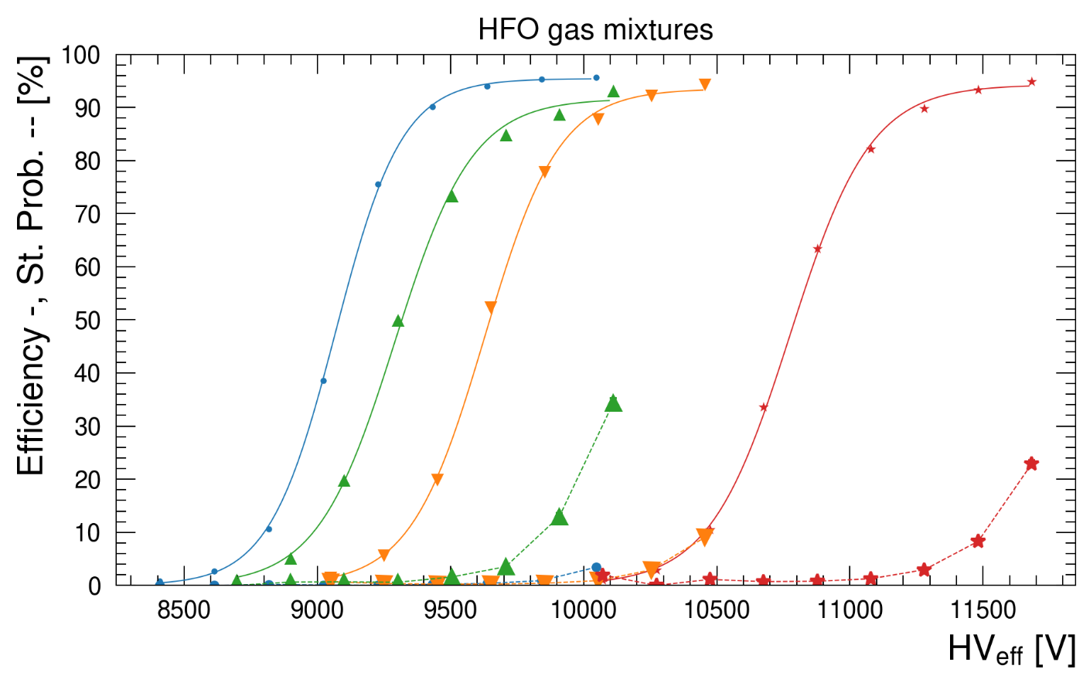
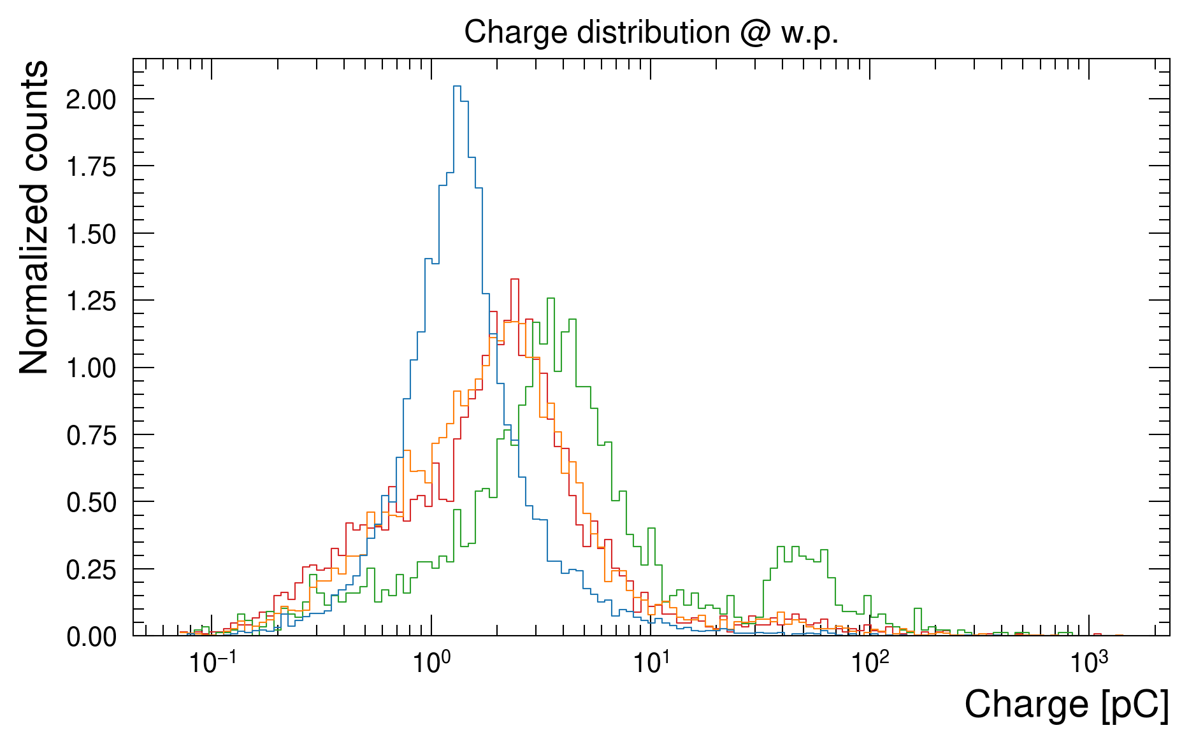
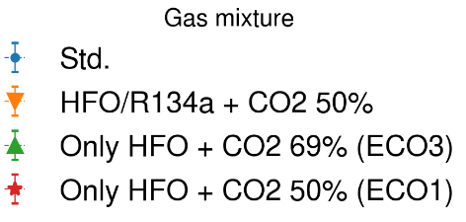
Alternative gases: R-1234ze
+2 kV
R-1234ze identified as possible replacement to R-134a
Extremely low GWP (~ 7)
Increasingly wider adoption in refrigerant industry
However, market price and availability not yet comparable to R-134a → Honeywell patented
Cannot replace 1:1 R-134a → w.p. too high → CO2/He required to lower w.p.
Long term effects still under investigation
R-1234ze performance with CO2 (+ R-134a) with cosmic muons
45% HFO + CO2 (ECO1) ⇒ w.p. too high (~11.6 kV)
25% HFO + CO2 (ECO3) ⇒ low GWP, high charge content → higher currents. Currently being tested by RPC ECOGAS collaboration
22% HFO + 22% R-134a + CO2 ⇒ higher GWP, lower charge content than HFO only. Possible compromise between performance and environment
45% HFO + CO2
25% HFO + CO2
22 %R-134a + 22% HFO + CO2

Slide 9
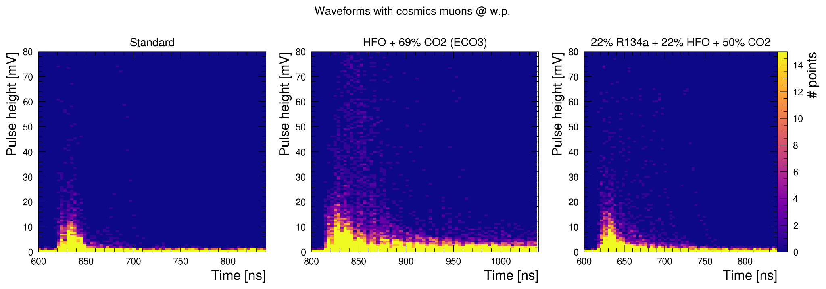
Waveforms of Std vs. HFO vs. HFO + R134a gas mixtures
HFO only → higher charge content:
bigger and longer signals
HFO + R-134a only: lower charge content and faster signals decay times

Slide 10
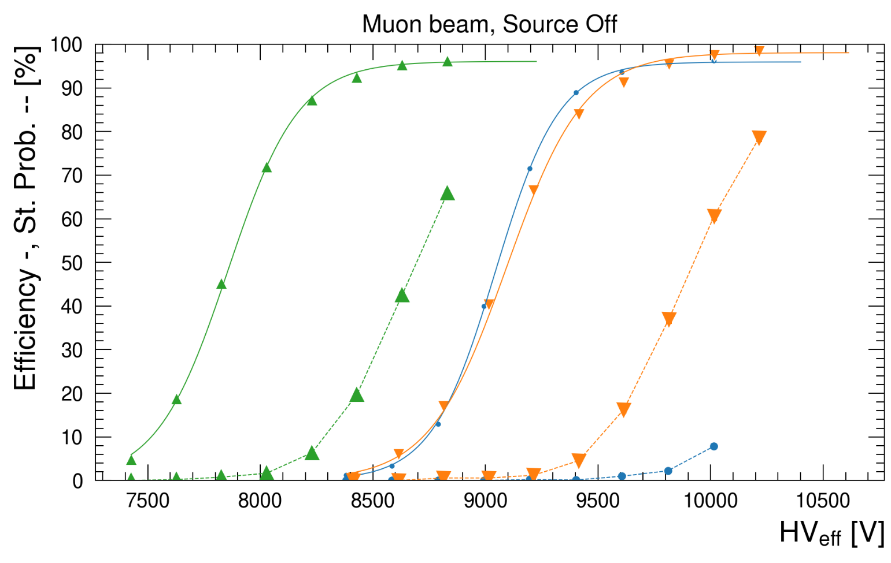
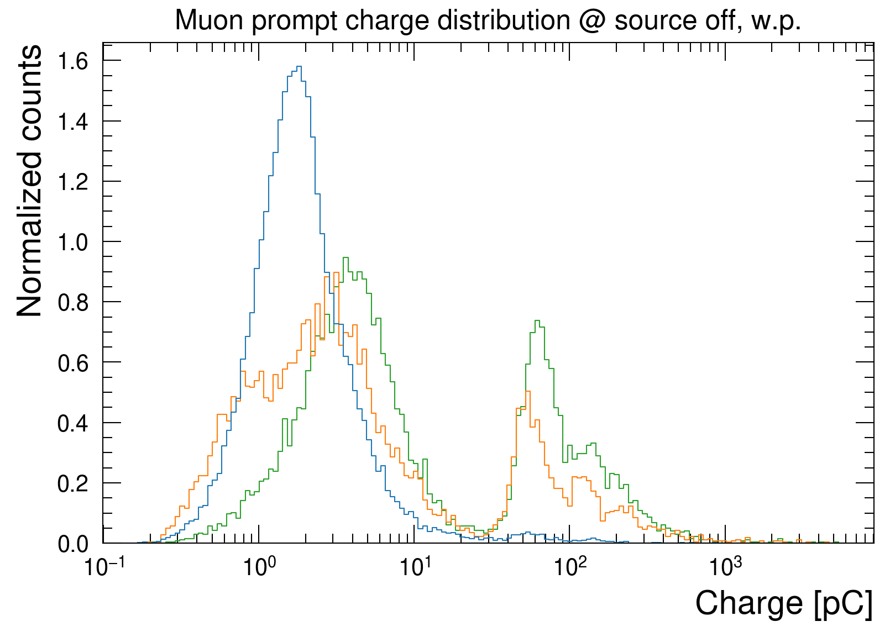
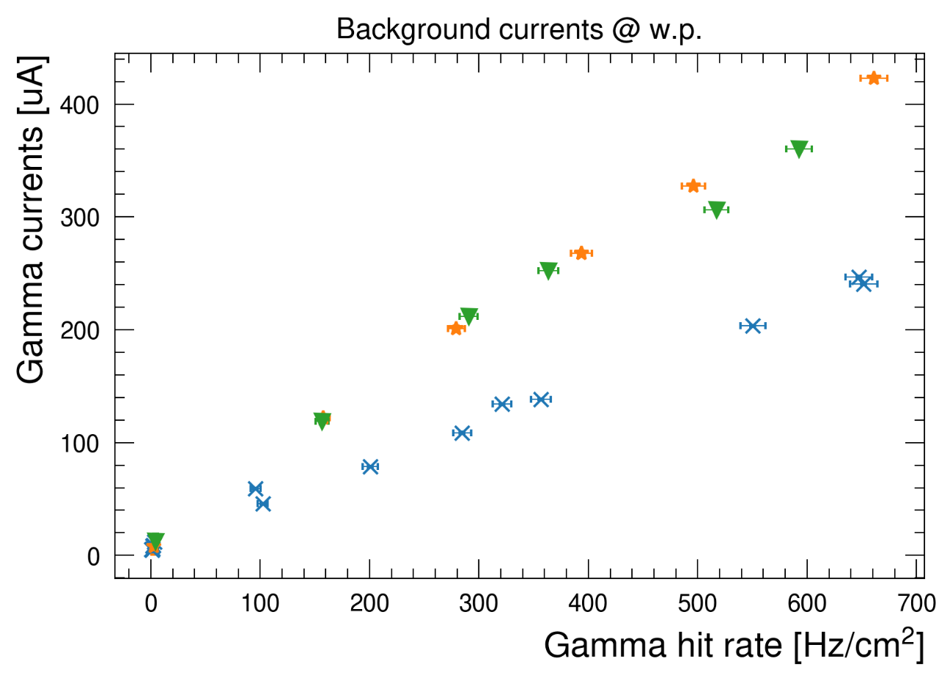
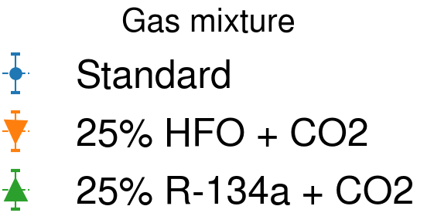
Difference between R-134a/CO2 and R-1234ze/CO2 mixtures
69% CO2, 5% i-C4H10, 1% SF6 + 25% <R-1234ze|R-134a> :
R-1234ze gas mixture have higher w.p than R-134a one
Similar st. prob. but higher st. prob. than std. gas mixture
R-1234ze brings a higher prompt charge content than R-134a
Gamma background currents of R-1234ze, R-134a ~ 2 times higher currents at 300 Hz/cm² than std. gas mixture → currents dominated by amount of CO2 in the gas mixture
1
-400 V
4
x2
3
2

Slide 11
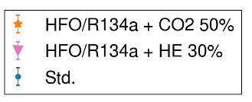
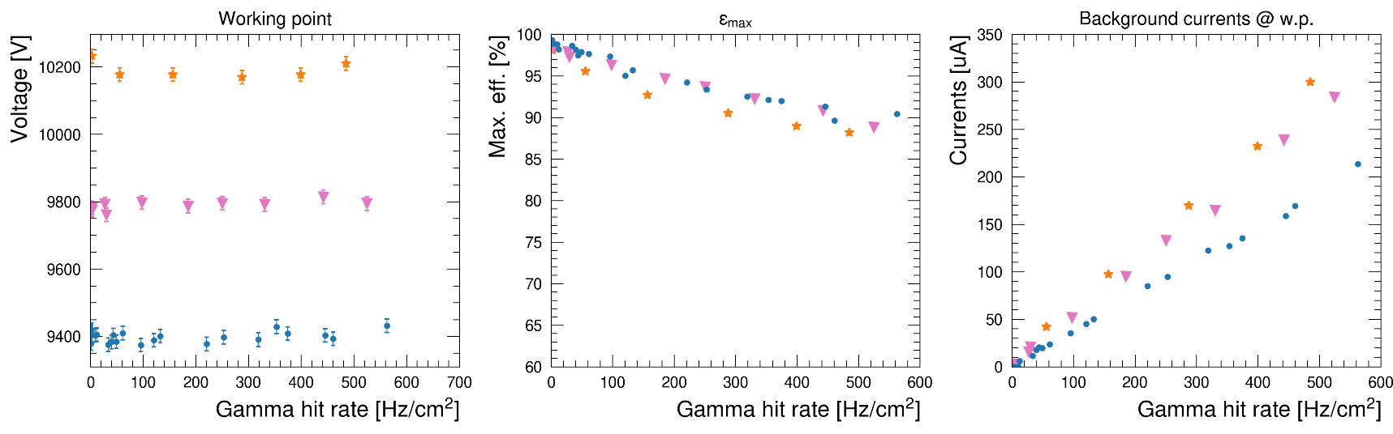
R-134a + R-1234ze + CO2/He gas mixtures @ GIF++
R-134a + R-1234ze: two gas mixtures at high rates (1 CO2 50%, 1 He 30%):
He gas mixture has lower working point than CO2 one
CO2 + R-1234ze gas mixtures have slightly higher efficiency drop (-2 %)
He gas mixture has slightly lower currents than CO2 equivalent
Muon beam + gamma background
Notes:
Togliere time resolution

Slide 12
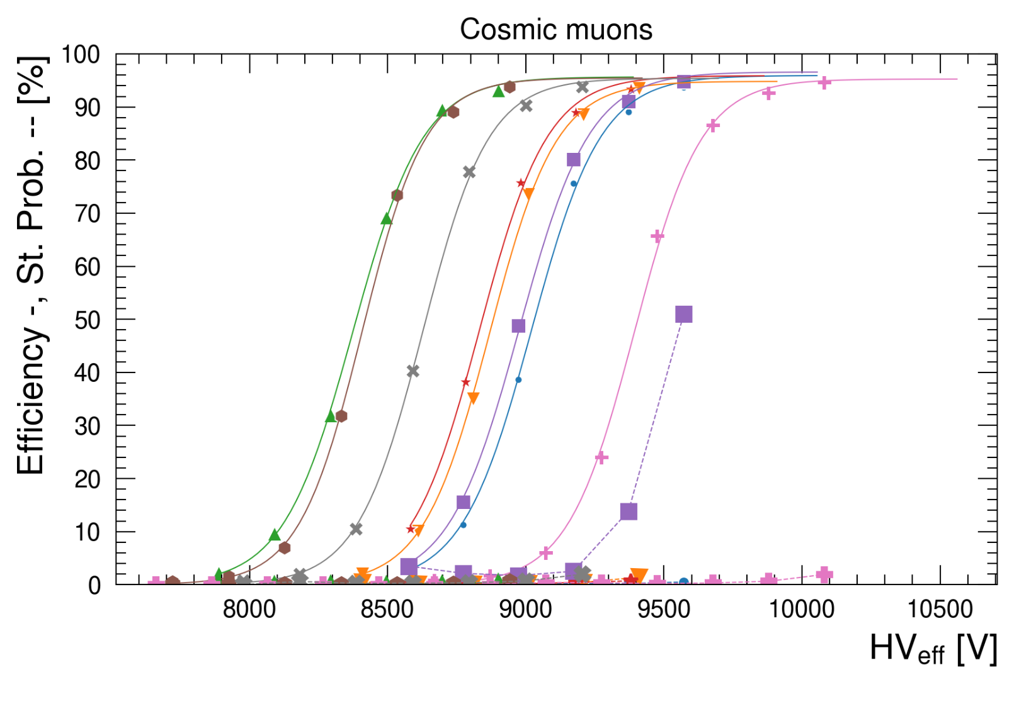
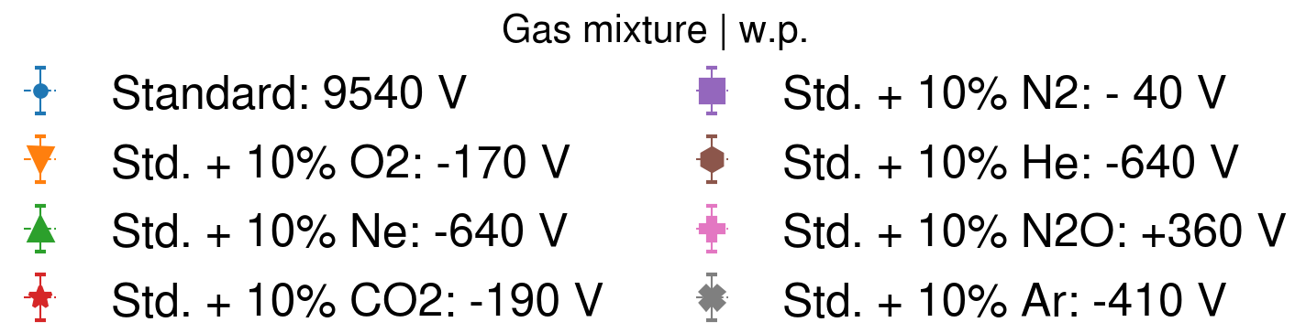
Alternative gases: reduction of R-134a consumption
Reduction of R-134a in the standard gas mixture by addition of a 4th, non-fluorinated gas
O2: good performance but highly reactive → lower flammability limit, higher currents due to oxidation reactions
Ne: good performance but no availability on the market
CO2: good performance → selected as main candidate for GIF++ tests
N2: high streamer contamination at low concentrations
He: good performance but problematic for PMTs in LHC caverns
N2O: discrete performance but increased working point of ~ 300 V
Ar: slightly high streamer probability

Slide 13
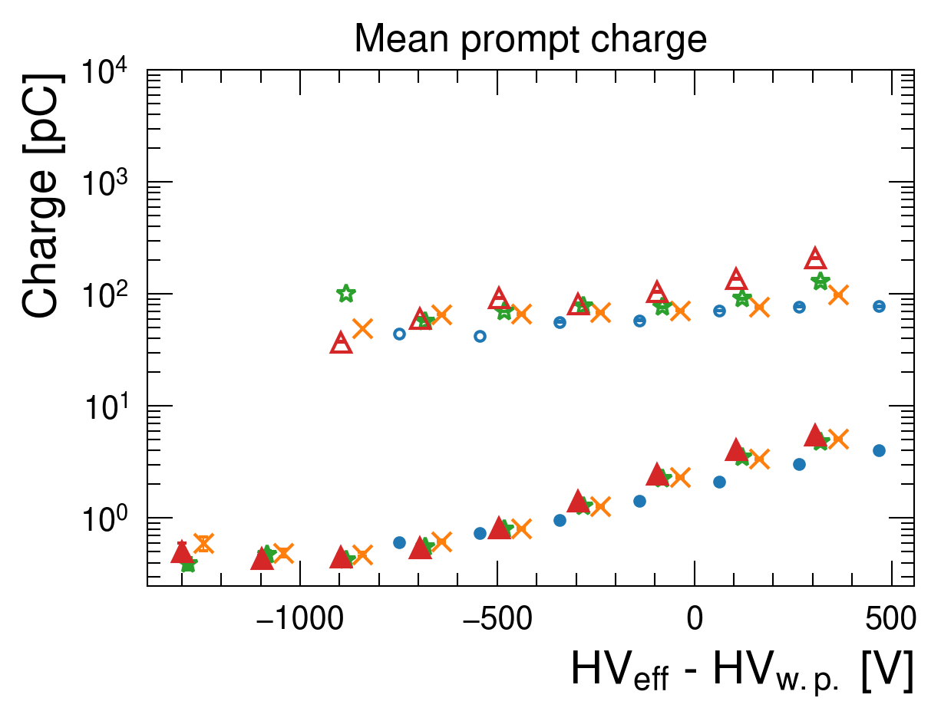
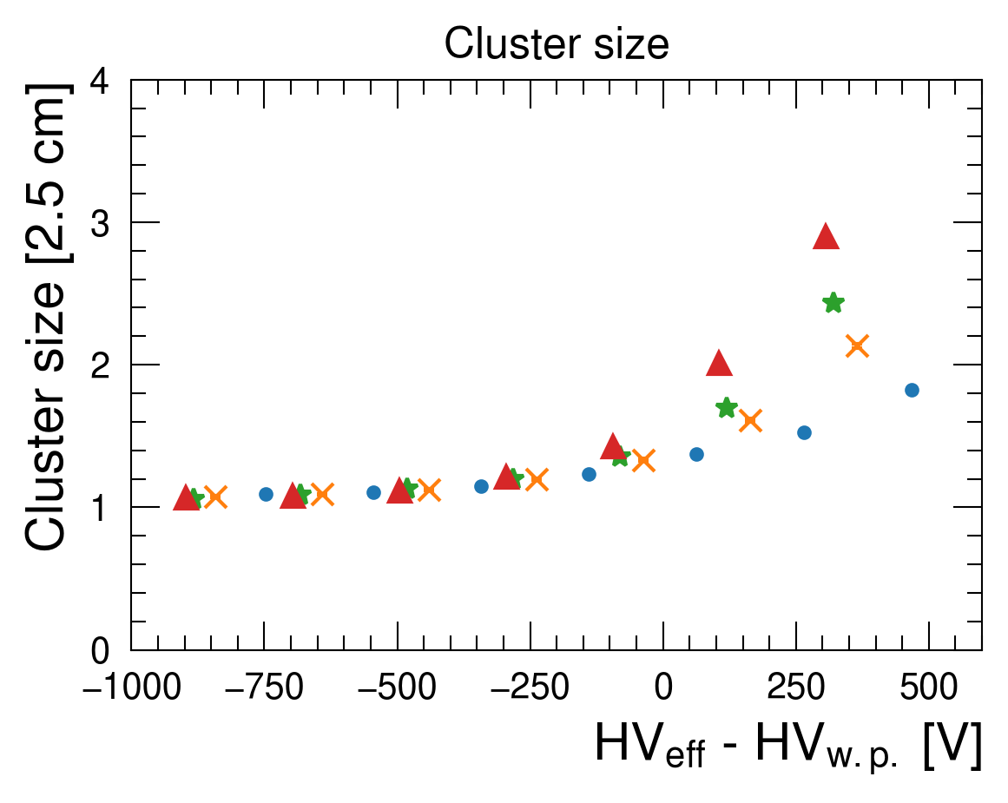
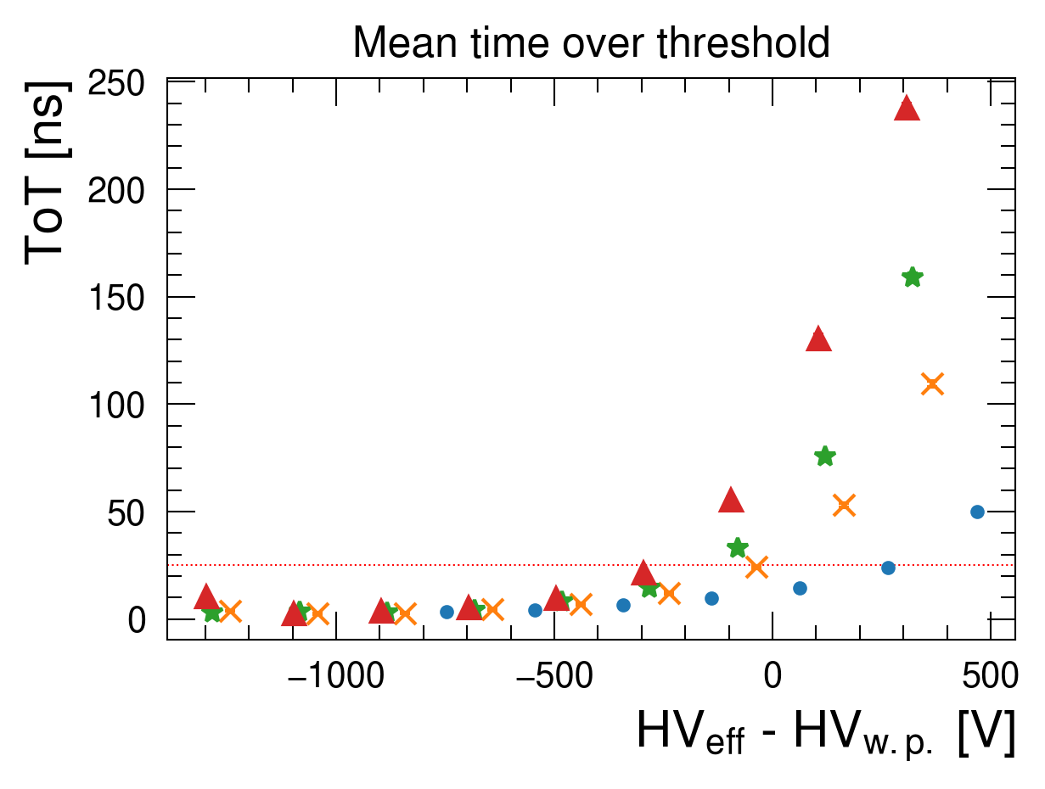
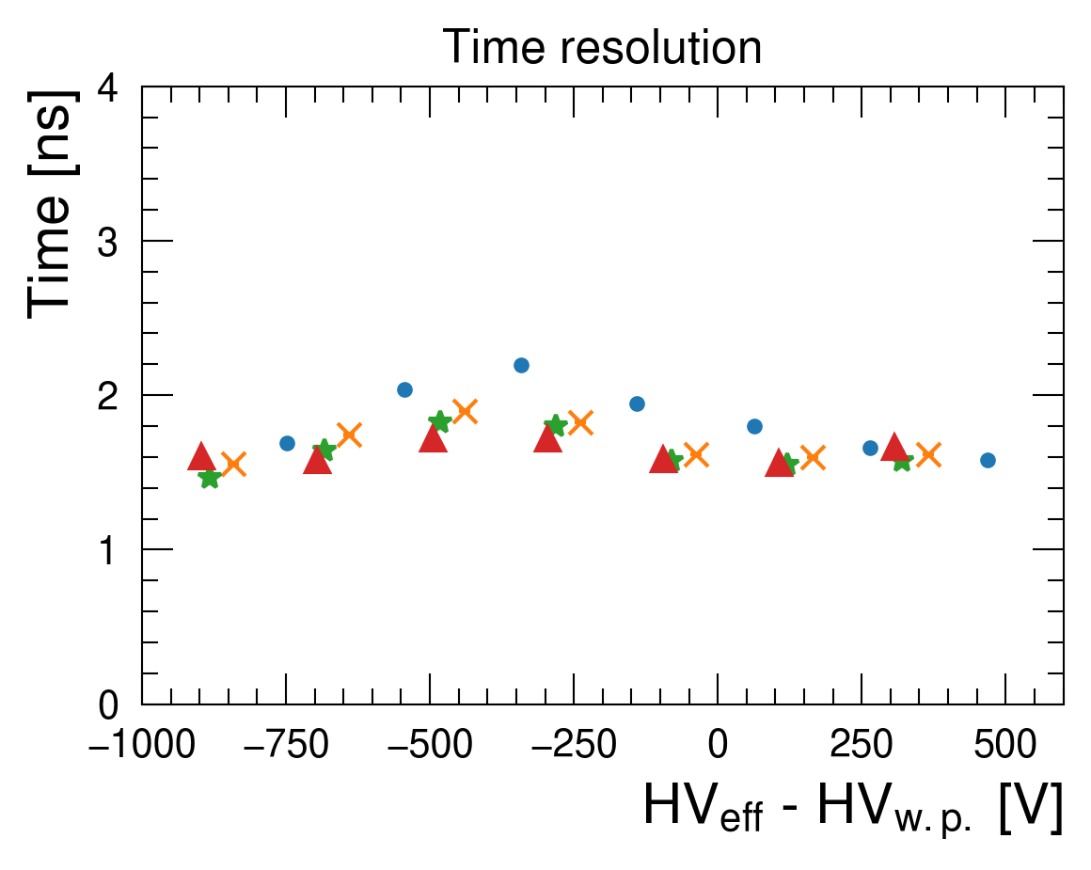
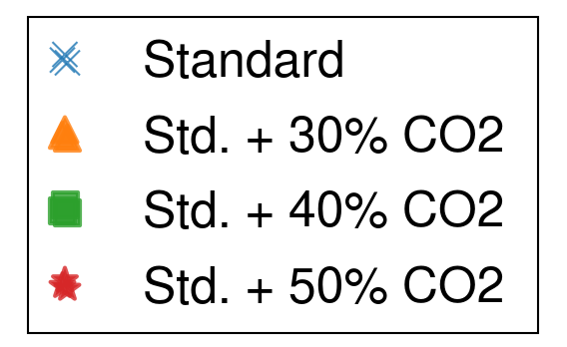
Addition of CO2 to the standard gas mixture
Addition of 30%, 40%, 50% of CO2 to gas mixture as mid-term solution to mitigate R-134a. Muon beam studies
Average prompt charge slightly increasing (+10-15%)
Cluster size increases with CO2 amount
Average signal times over threshold increase with CO2
Time resolution of CO2 gas mixtures is lower than std. one
CO2 increase
1
2
4
Adjustment of SF6 needed to further suppress streamers
CO2 increase
3

Slide 14
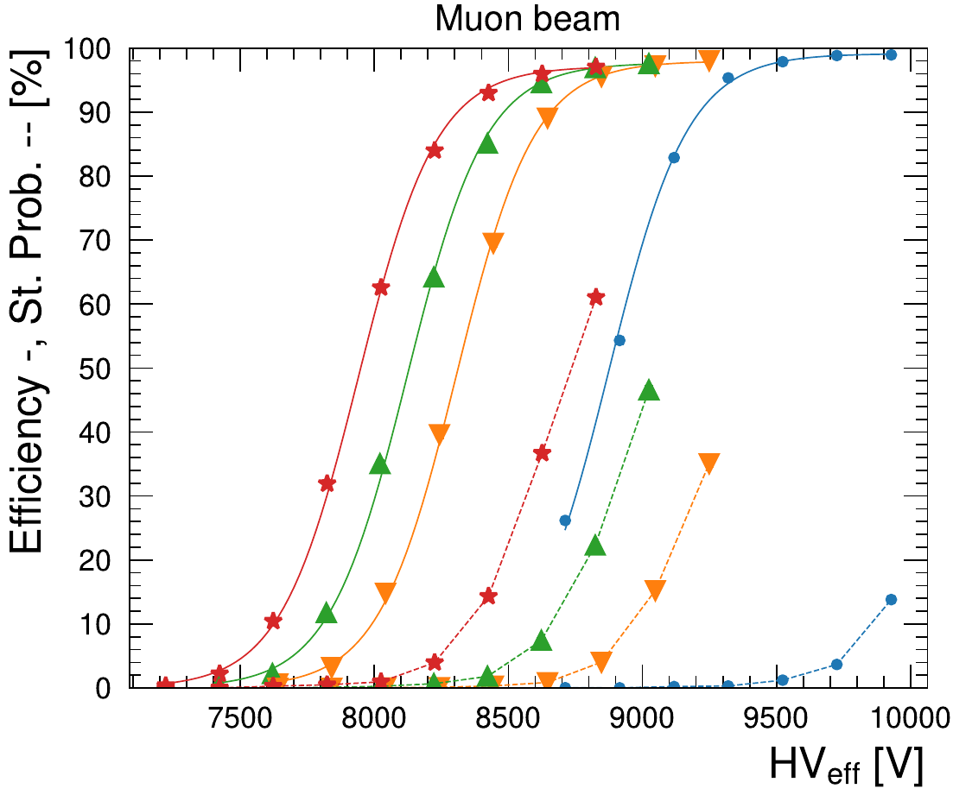
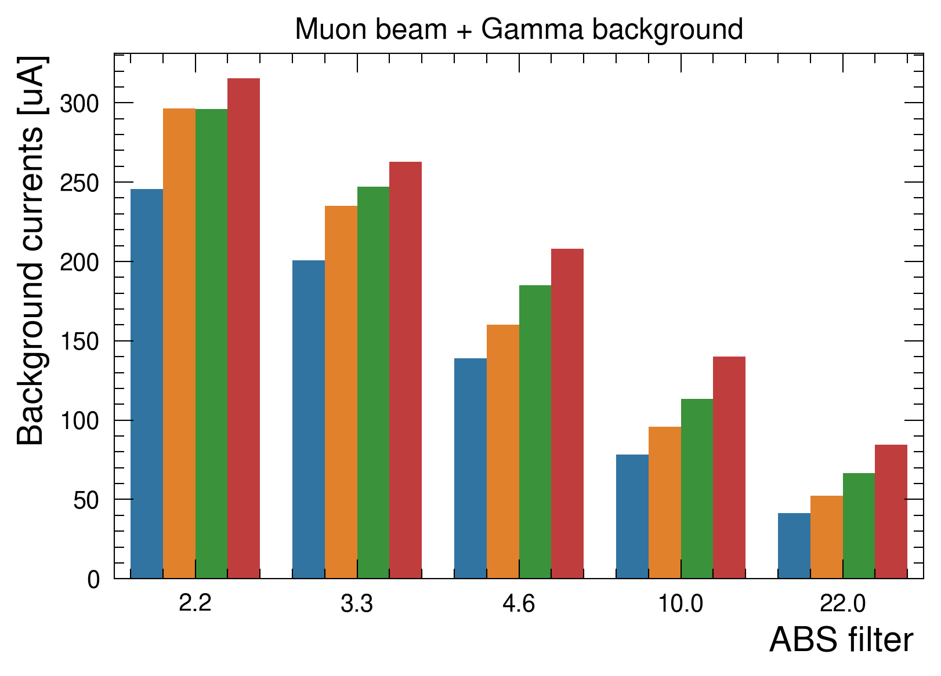
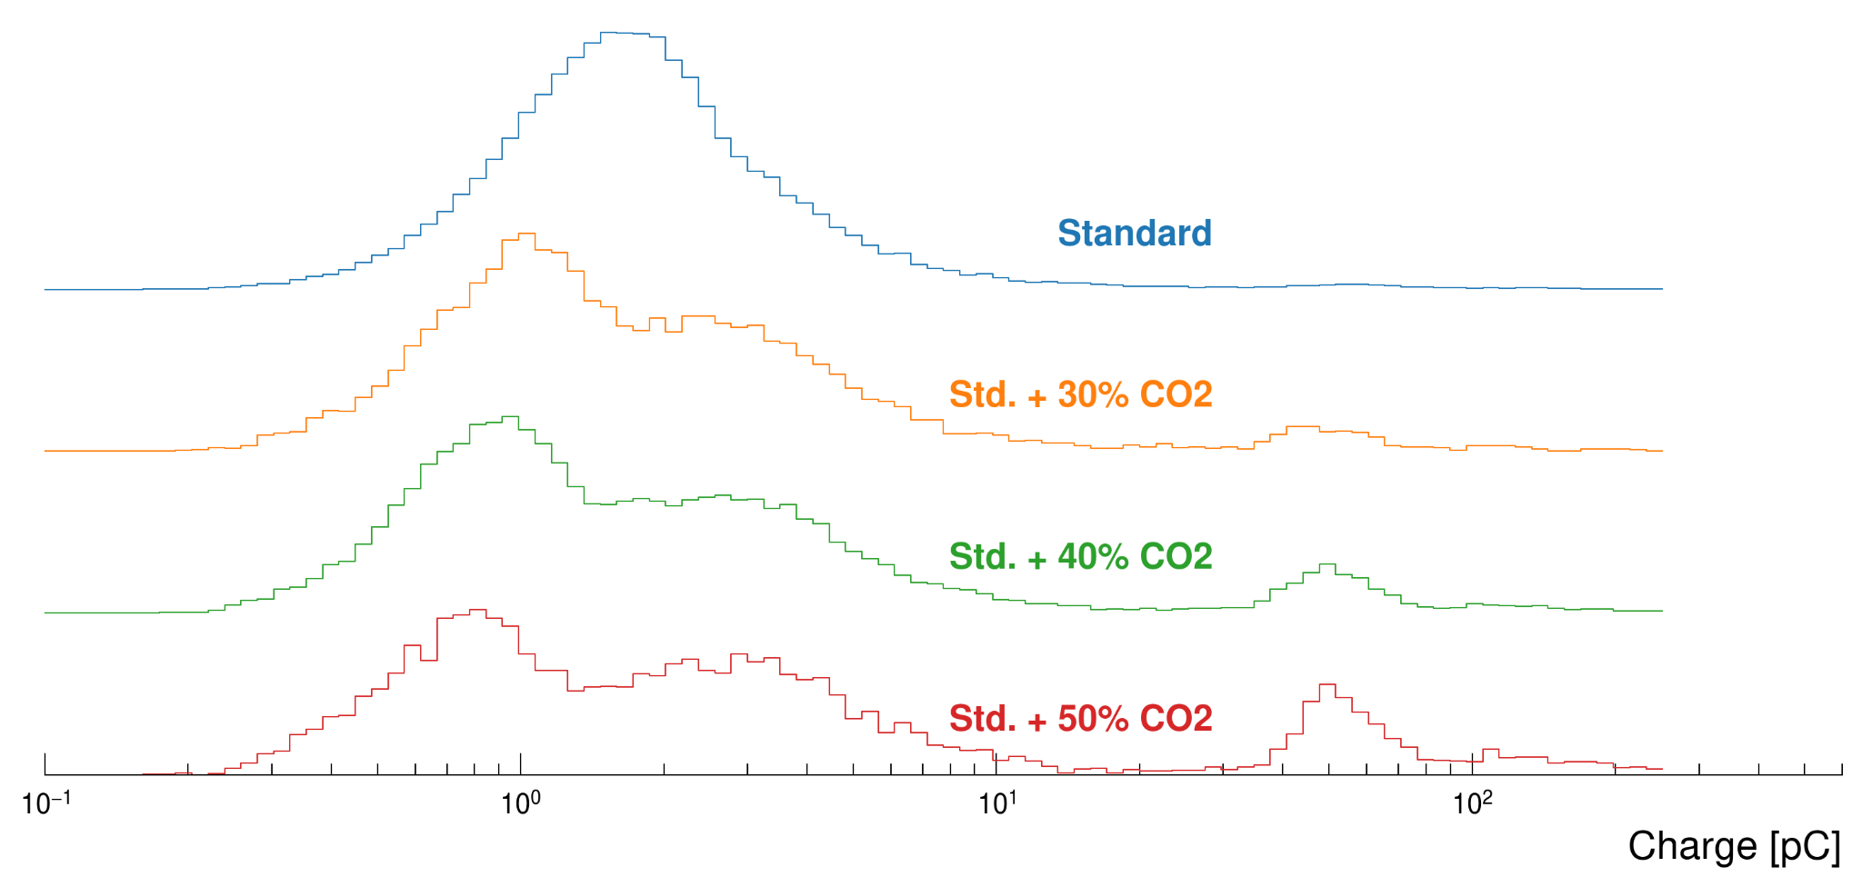
Mid-term solution to mitigate R-134a consumption
Studies on CO2 impact when added to the standard gas mixture: 30%, 40%, 50%
Tests performed with muon beam and gamma background
w.p. decreases of ~ 190 V / 10% CO2
GWP reduction of 30-50%
Current increase of +15-20% @ 500 Hz/cm2
Streamer fraction increases
Two avalanche populations when using CO2 and R-134a → under investigation
https://doi.org/10.1016/j.nima.2023.168088
CO2 increase
CO2 increase
Charge distribution @ w.p. (muon beam)
CO2 increase

Slide 15
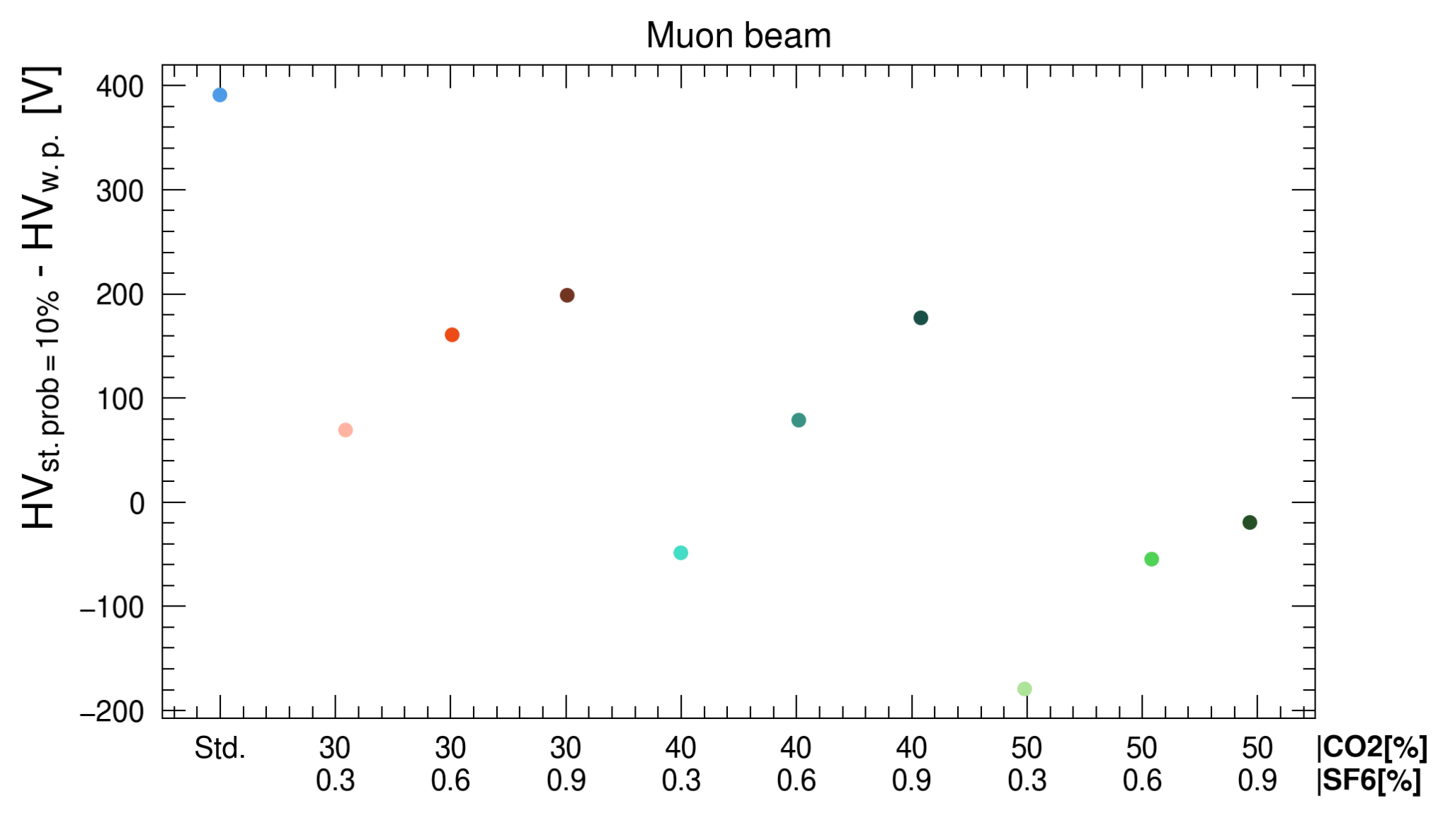
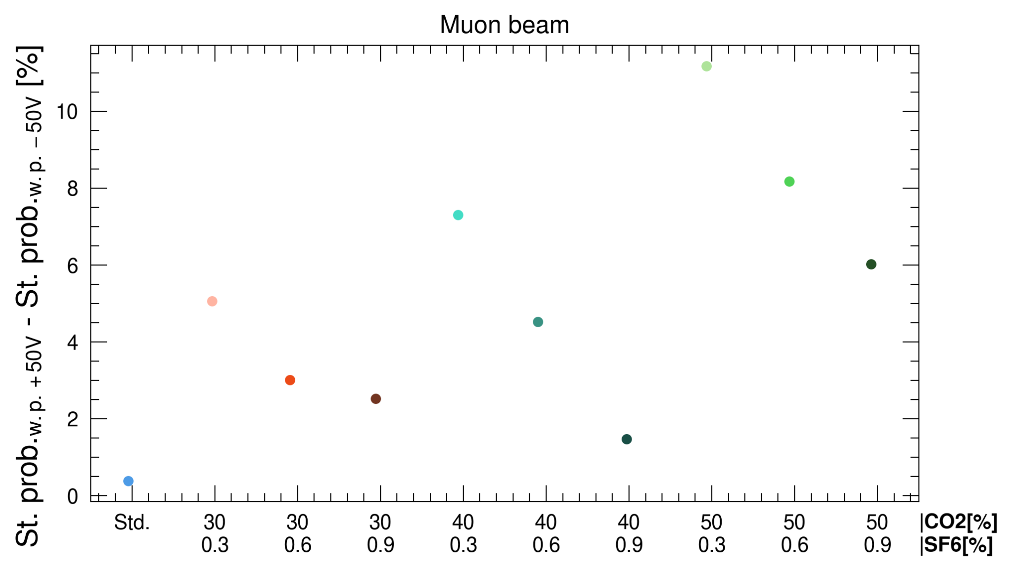
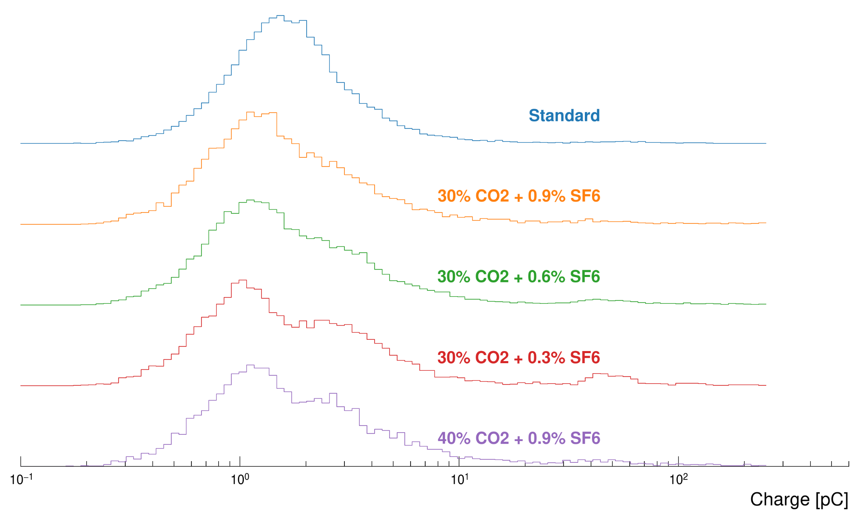
SF6 adjustment in CO2 + R-134a gas mixture
Efficiency - Streamer separation. Muon beam only
Combination (30%, 40%, 50%) CO2 x (0.3%, 0.6%, 0.9%) SF6
Higher efficiency-streamer separation for 30%/40% CO2 + 0.9% SF6 or 30% CO2 + 0.6% SF6 → selected gas mixtures
Lower variation of streamer probability for the same gas mixtures
SF6 increase
CO2 increase
Streamer variability. Muon beam only
Charge distribution @ w.p.
CO2 increase
SF6 increase

Slide 16
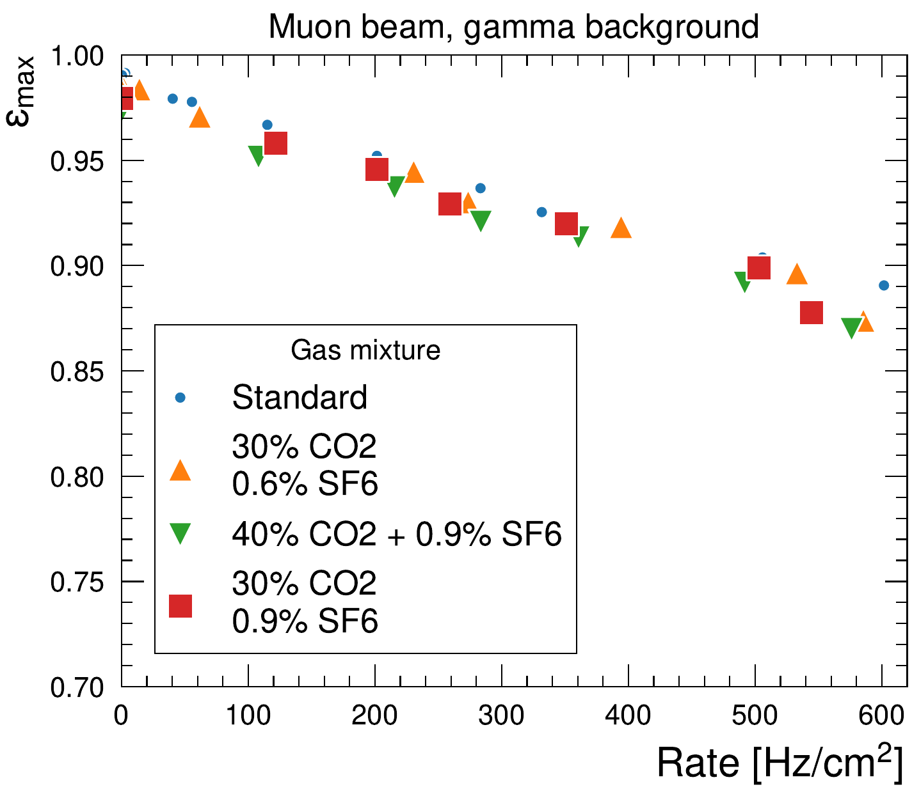
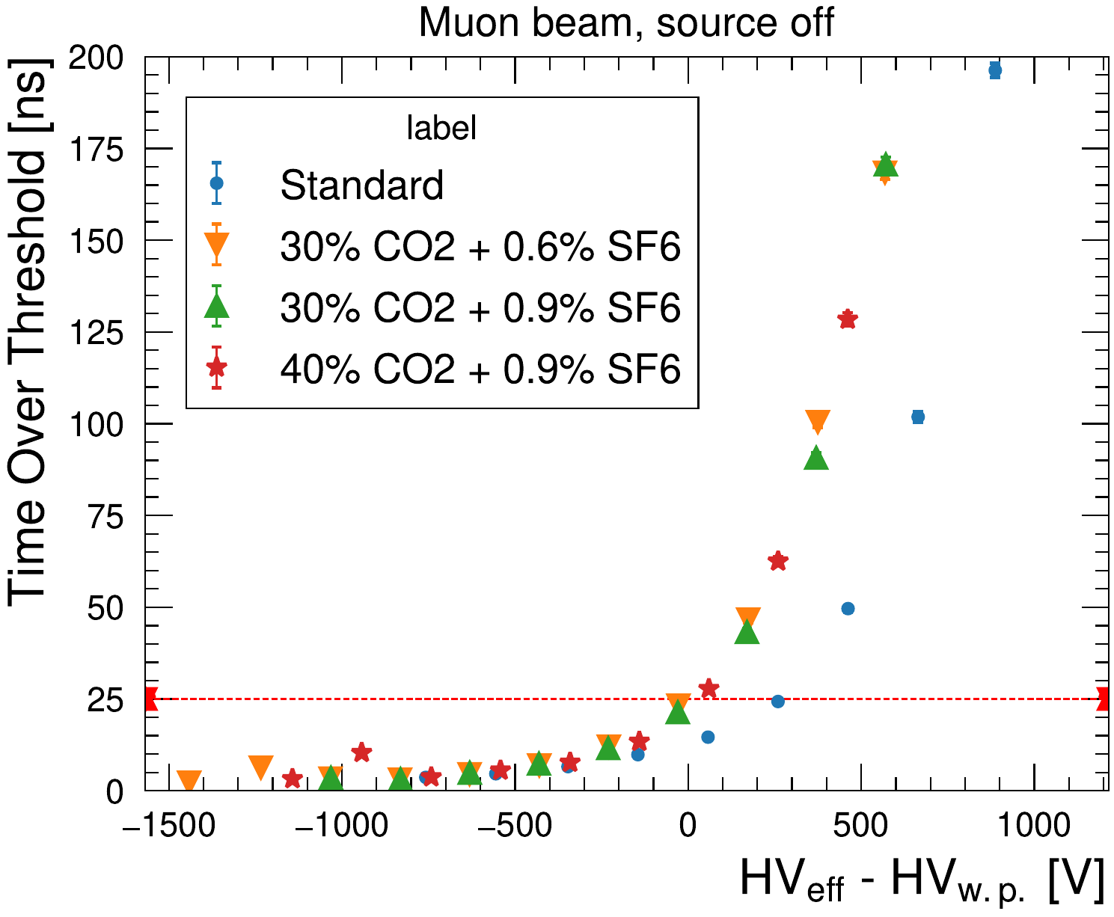
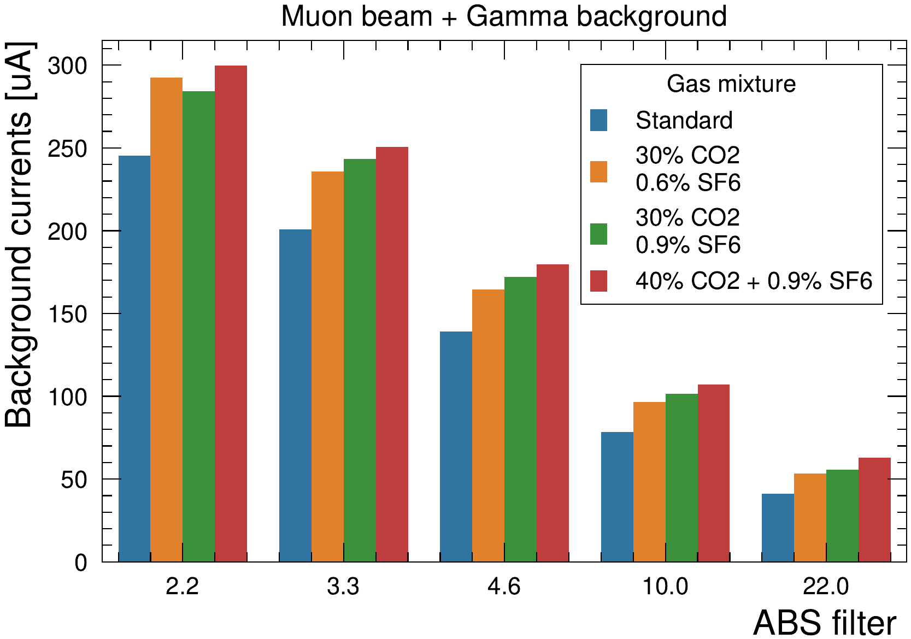
Selected CO2-based gas mixtures
Observed performance
Efficiency drop similar to std. gas mixture up to 500 Hz/cm²
Mean time over threshold below 25 ns for 30% CO2 gas mixtures
Currents at fixed ABS around 15-20% higher
Selected CO2/SF6 gas mixtures
30% CO2 + 0.6% SF6: overall good performance
30% CO2 + 0.9% SF6: best performance but higher SF6 consumption
40% CO2 + 0.9%: slightly worse performance (cluster size, ToT) but higher R-134a reduction
540-600 Hz/cm²
3
490-530 Hz/cm²
1
330-390 Hz/cm²
200-230 Hz/cm²
2
110-110 Hz/cm²

Slide 17
Alternatives to SF6

Slide 18
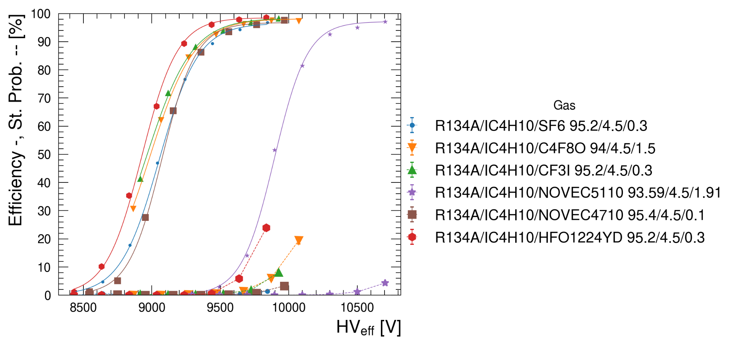
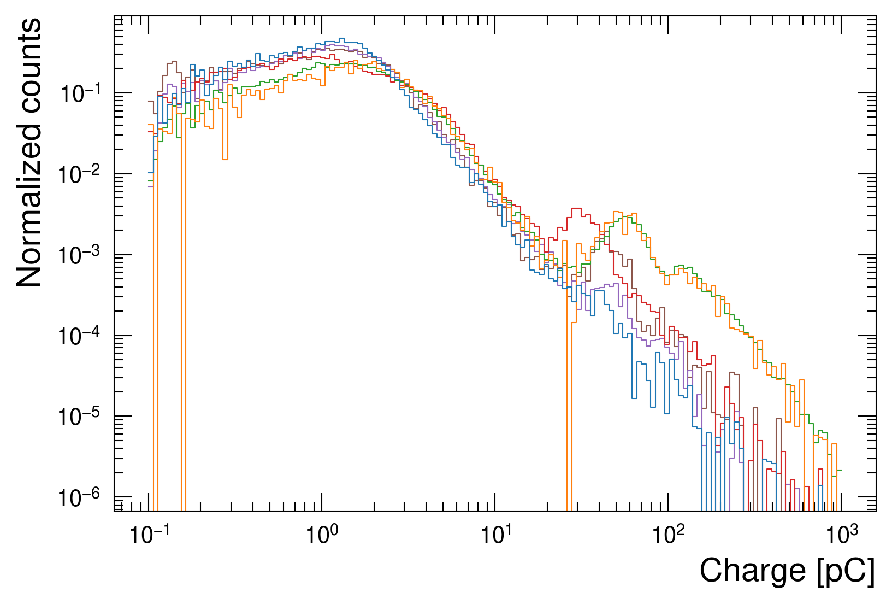
Alternatives to SF6: laboratories studies
SF6 in the standard gas mixture replaced with its alternative:
C4F8O → Discrete performance at 1.5%, high GWP (~8000)
CF3I → Good performance at 0.3% but mutagenic toxicity
Novec 5110 → Discrete performance at 2% but almost liquid
Novec 4710 → Excellent performance at 0.1% but it may react with water (under investigation) → selected for beam studies
Amolea 1224yd → Good performance at 0.3% → selected for beam studies
Charge distribution @ HV > w.p.
R-1224yd
R-1224yd
C4F8O
Novec 4710
Novec 5110
SF6 (standard)

Slide 19
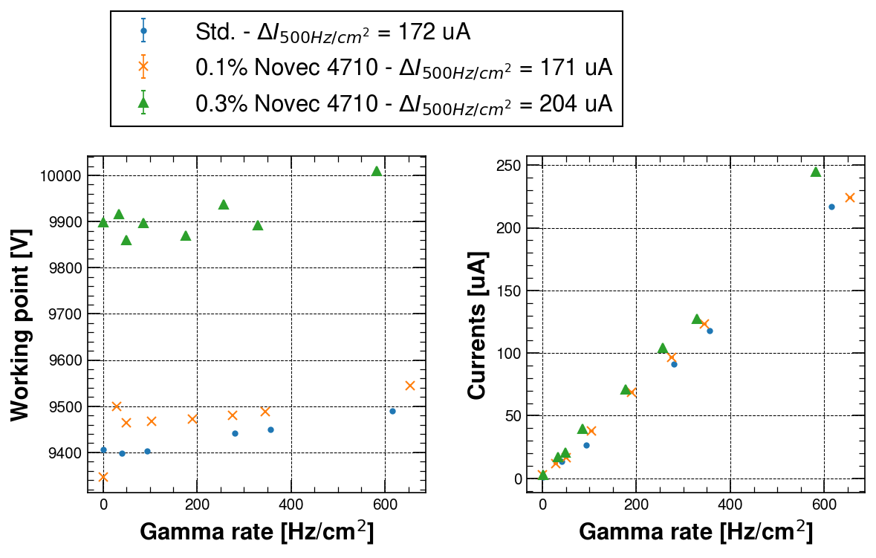
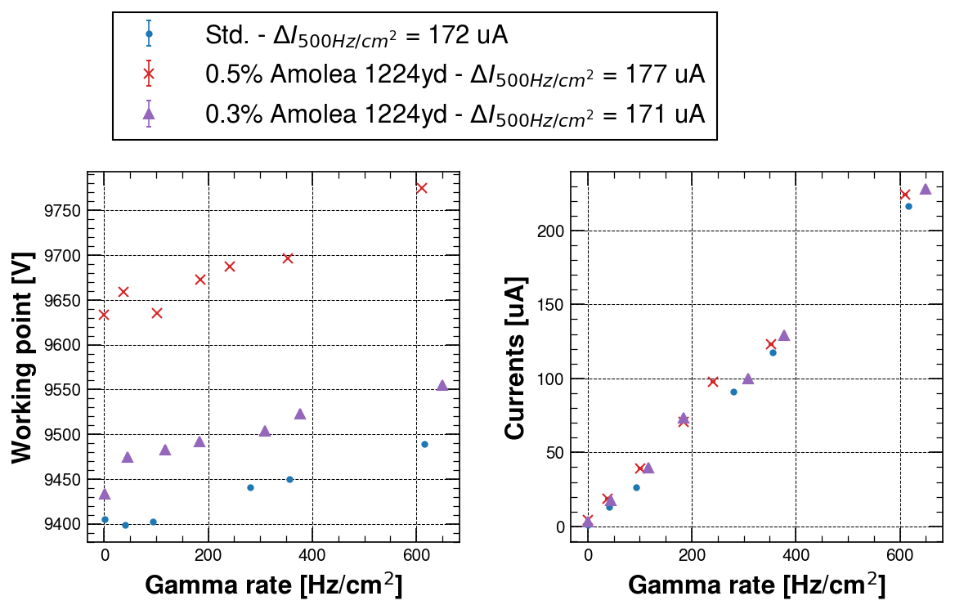
SF6 alternatives: GIF++ studies
Two selected gases: Novec 4710, Amolea 1224yd
Novec 4710 0.1%, 0.3%:
Working point similar to std. when used at 0.1%
Currents slightly lower for 0.1% → possibly saturated effects at 0.3%, under investigation
Amolea 1224yd 0.3%, 0.5%:
Working point similar to std. gas mixture at 0.3%
Currents at 0.3% and 0.5% similar to std. gas mixture
2
1
4
4
3
3
Notes:
Fix concentration of Amolea in plot

Slide 20
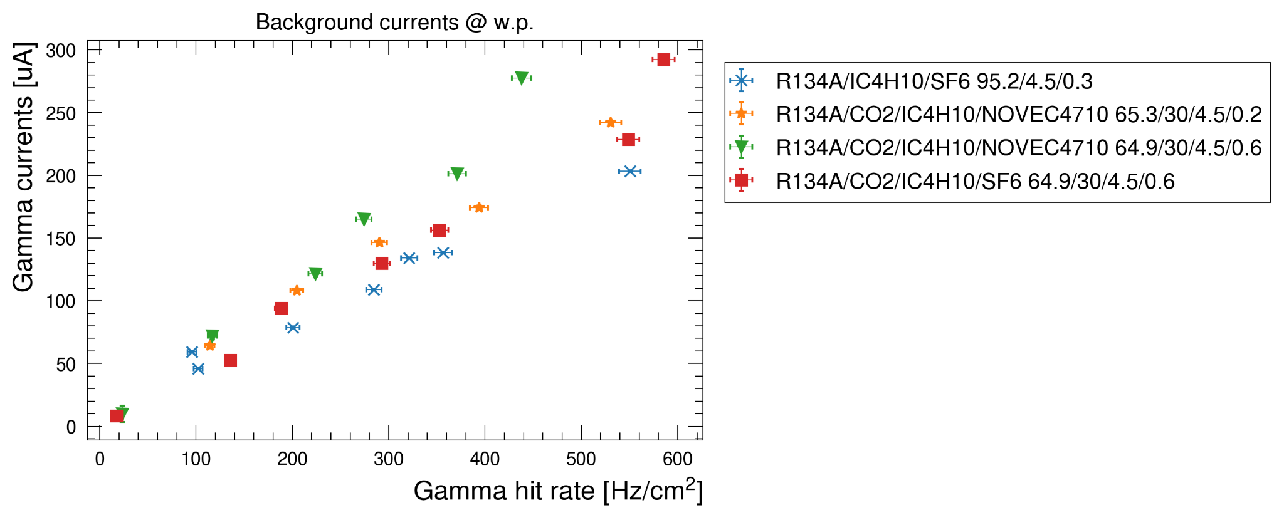
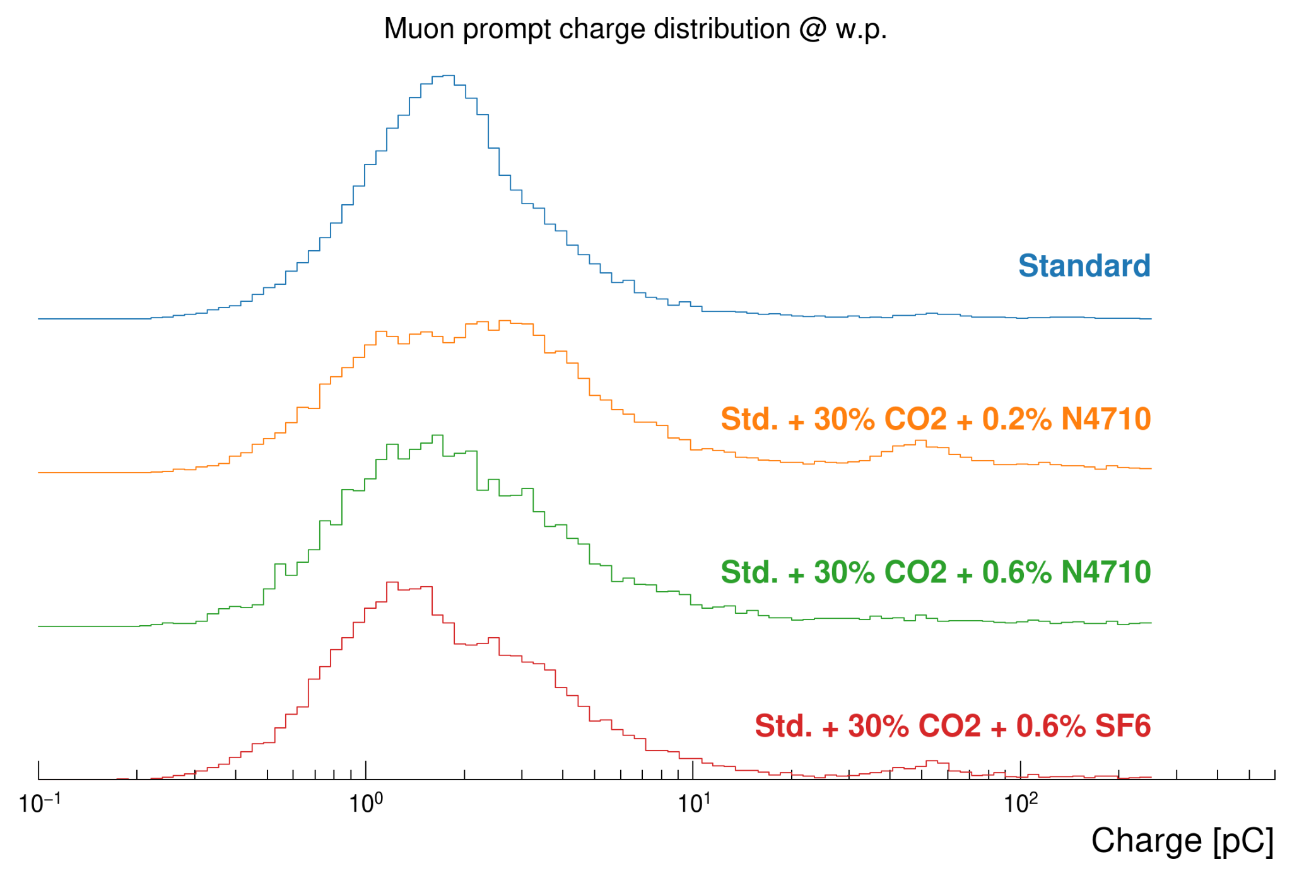
Novec 4710 with R-134a/CO2 gas mixtures
Novec 4710 + R-134a + CO2
30% CO2 + 0.2% N4710 and 30% CO2 + 0.6% SF6 have similar performance (w.p., prompt charge, background currents)
30% CO2 + 0.2% N4710: lower gamma background currents
30% CO2 + 0.6% N4710: lower mean prompt charge but higher background currents → under investigation

Slide 21
Gas Properties Studies

Slide 22
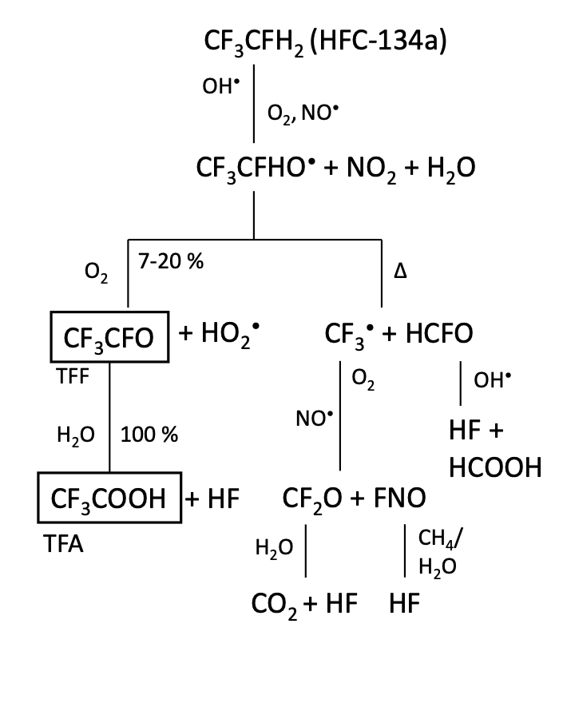
Gas properties and detector performance
Detectors requirements
Quenching gases to suppress photon-feedback effects
Radiation hard gases: ensure stability of the gas mixture
Eco-friendly gases have low GWP
Short atmospheric lifetime
Radiative efficiency
Short lived gases reacts in atmosphere in different ways
Rain out → dissolution in water
Atmospheric oxidation → OH- reactions
Photolysis → UV light
Low GWP gases molecules produce several subproducts in atmosphere
Some might be high-GWP gases or aggressive compounds
How is detector performance affected? → gas properties studies
Degradation products of R-134a
photolysis
hydrolysis

Slide 23
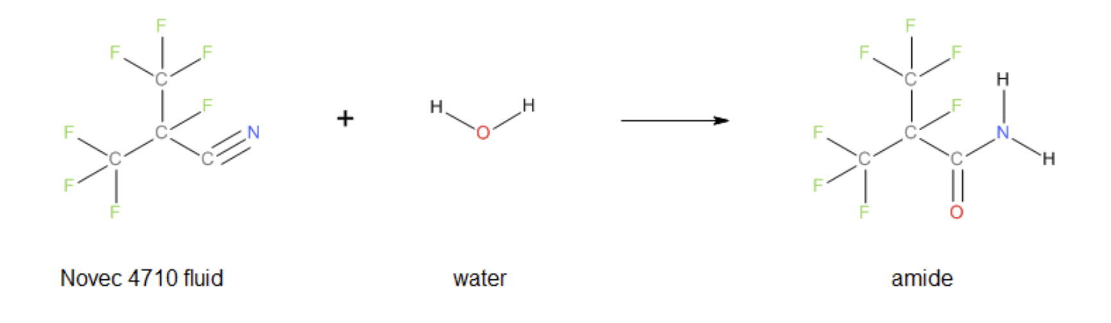
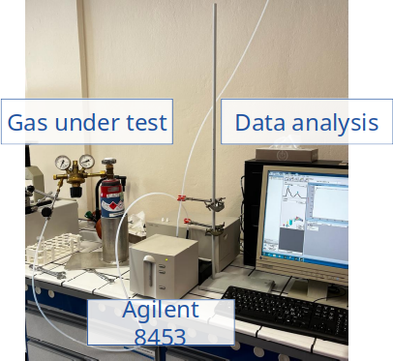
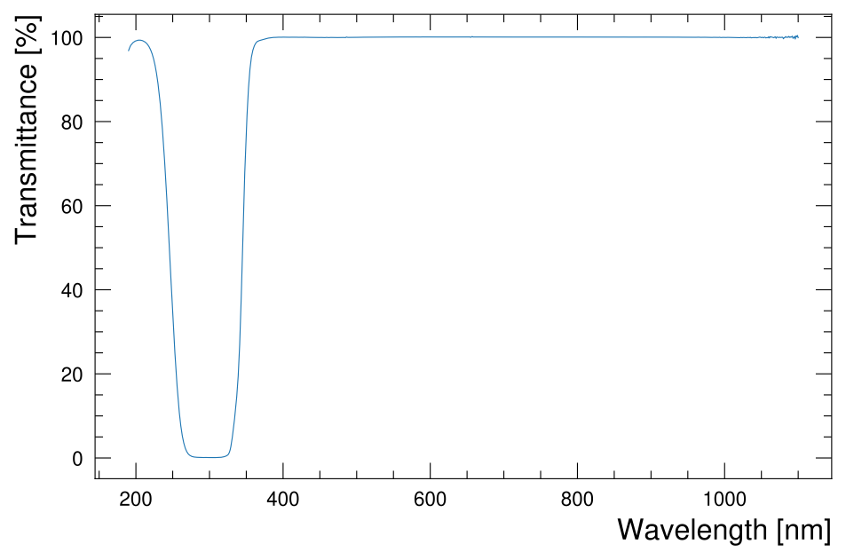
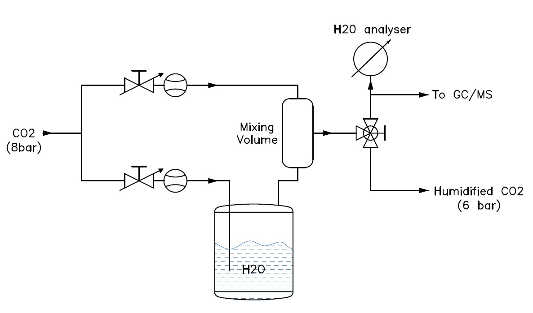
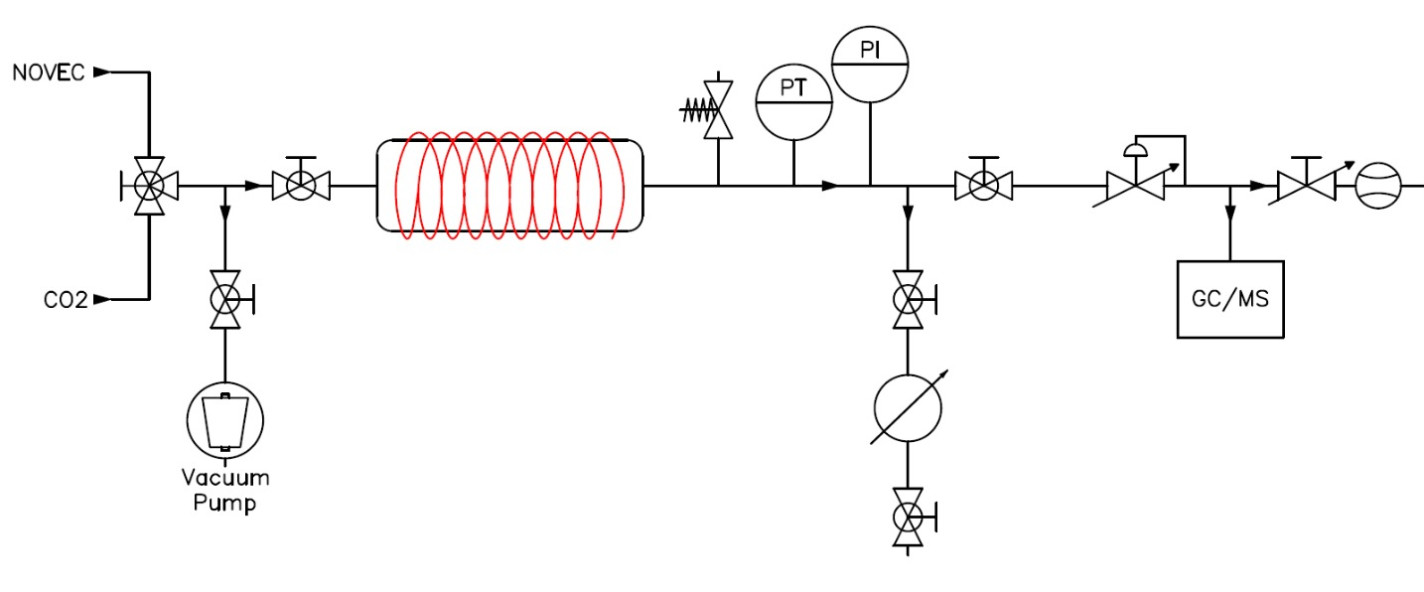
Hydrolysis and UV absorption tests
Hydrolysis processes happening when Novec 4710 is forced into aqueous media → persistent fluorinated amide production
HPL RPCs gas mixture have ~ 40% of Relative Humidity
Dedicated setup to characterize amide production
Sub products expected to be ppb
Solid products at ambient T, melting point 49 °C
Amide in gas phase at low concentrations at T > 60 °C
UV absorption tests
Required to understand stability of gases and their quenching properties
Agilent 8453 UV-visible spectroscopy system: 190-1100 nm range
Several gas tested: Novecs, HFO, N2, CO2, i-C4H10
Good agreement with 3M data
Wavelength absorption spectra in the range 100-190 nm required for RPCs
No commercially available instruments
Custom spectrometer costs >= 500 kCHF
Novec 4710 humidifier setup
Thanks to B. Teissandier for helping in the measurements and providing the instrument

Slide 24
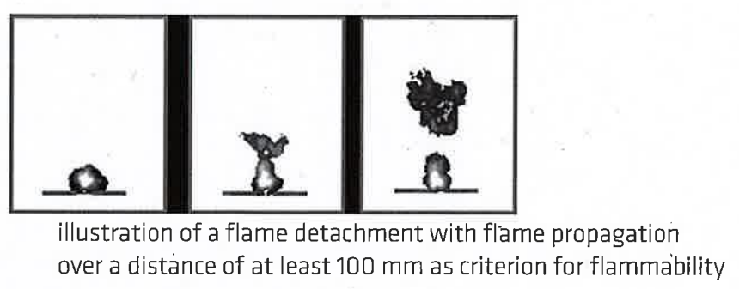
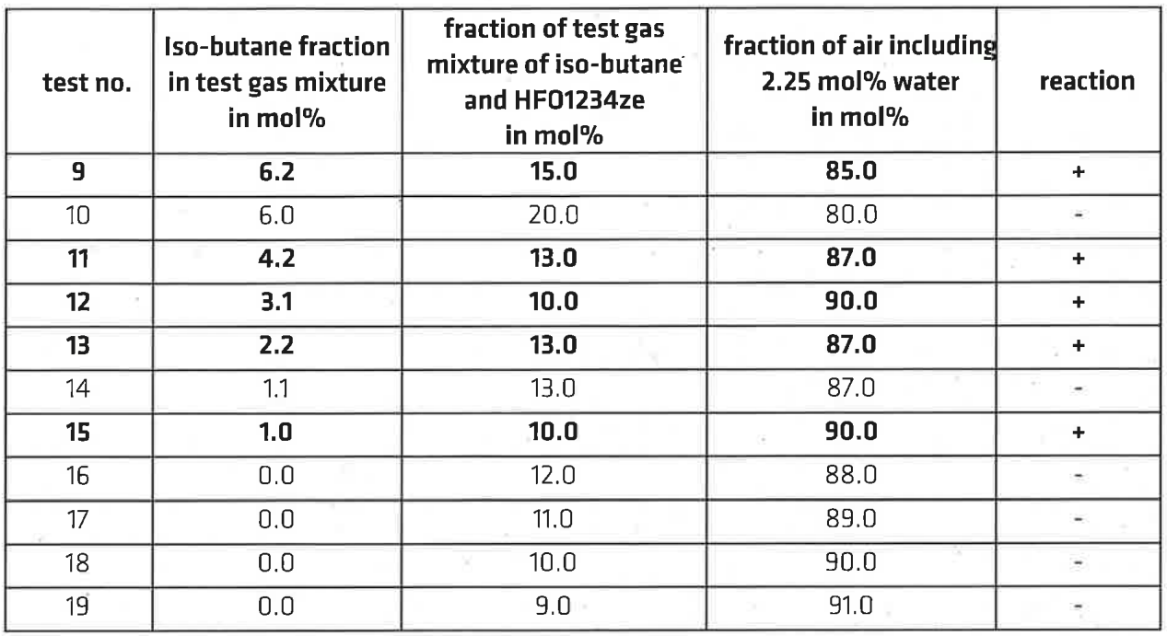
R-1234ze flammability tests
Safety concerning HFO usage
R-1234yf classified as mildly flammable → Focus on R-1234ze
R-1234ze + i-C4H10 + 40% RH flammability test conducted:
ISO 1056 standard flammability test (detachement + flame propagation criteria) performed by external company
Results
Mixture with 1% i-C4H10 + R-1234ze is flammable
Water vapour plays an important role
HFOs alone + i-C4H10 is flammable → Effects of the CO2 on the mixtures to be understood/checked
https://chemistry-europe.onlinelibrary.wiley.com/doi/full/10.1002/open.202000172
https://edms.cern.ch/document/2463340/1

Slide 25
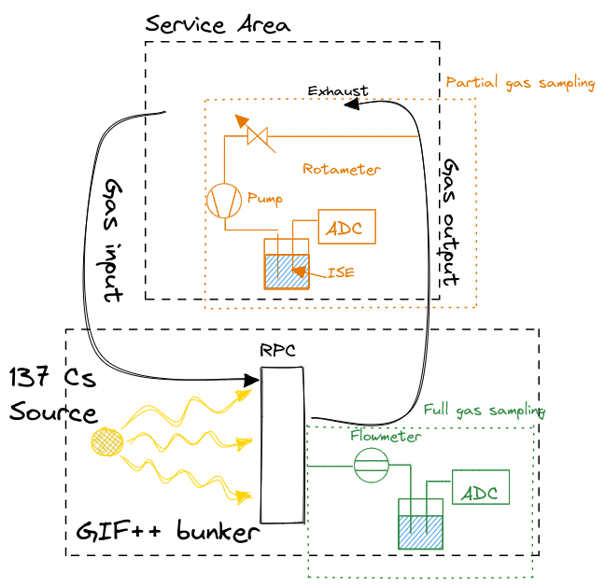
Impurities studies: setup and methodology development
R-134a and R-1234ze break under electric field and gamma irradiation → HF production → detector inner surface possible damage
Studies on HF production
Gas analyzed at the output of the detector irradiated and operated at working point with different gas mixtures
Ion Selective Electrode technique employed: gas is sampled into a F- capturing solution, the concentration of HF is measured
Setup and methodology development
Partial gas sampling or full gas sampling → Both have pros and cons
Optimization of the existing methods: increase the accuracy of measurement by improving parameter monitoring and measurements procedure
Tests on hardware components for optimal measurements: long lasting electrodes, mass flow meters, stirrers, etc.

Slide 26
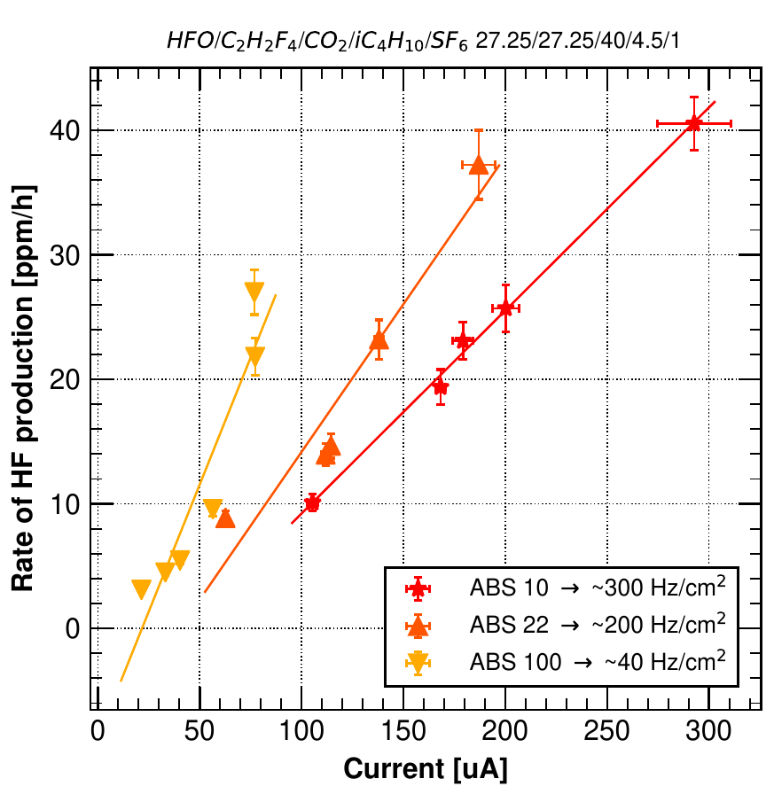
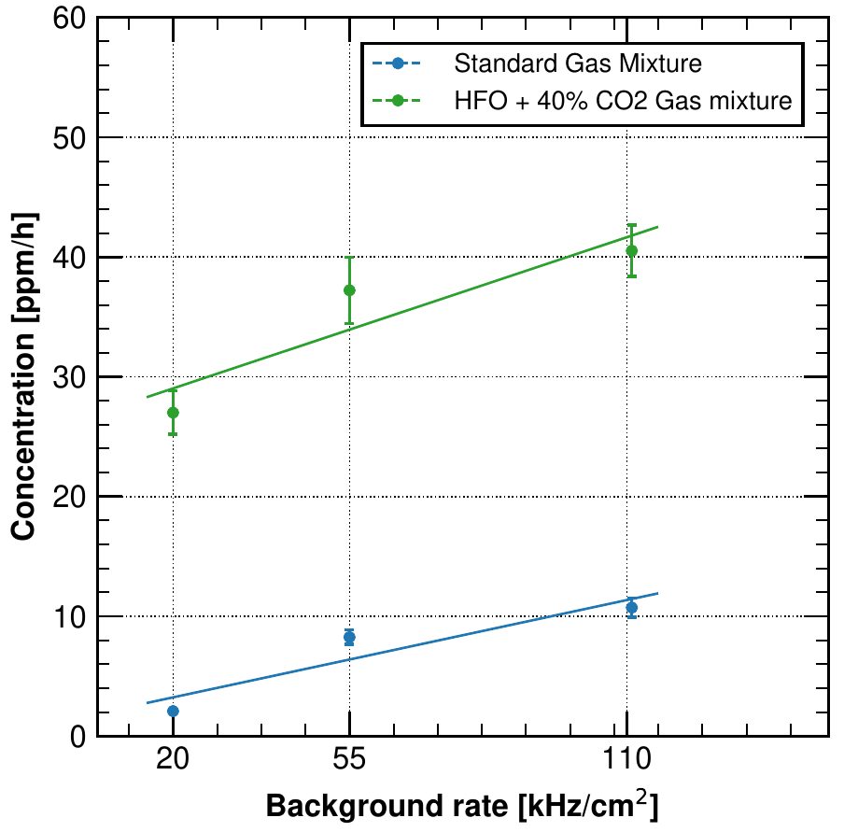


Impurities studies: HF measurements
R-134a/HFO + 40% CO2
Rate @ w.p.
2019 ⇒ Std., HFO + R-134a + 40% CO2
F- production does not depend only on the currents but also on the gap electric field
Tested R-1234ze gas mixture produced 4x more F- than std. gas mixture
2022 ⇒ Std, Std + CO2 (+1% SF6), HFO + R134a + 50% CO2
30% of CO2 in the standard gas mixture has the same F- production → F- production not proportional to R-134a
Using 1% SF6 to 30% CO2 + R-134a increases the F- production → under investigation
HFO + R134a + 50% CO2 produces 4x more F- than Std
Std. gas. mixture
1
R-134a/HFO + 40% CO2 gas mixture
2
F- [ppm/h]
F- [ppm/h]
4x F- production
Currents [uA]
Background rate [kHz/cm²]
4
4
3

Slide 27

Cross-section measurement for new gases
Collaboration CERN-ETHZ

Slide 28
Conclusions
Alternatives to R-134a
R-1234ze current main fluorinated alternative
Needs to be used with a 4th gas to keep “low” working point
SF6 concentration needs to be increased to ~ 1%
Market availability and price still a matter of concern
Still requires understanding of its effects on long term operation of RPC
Non fluorinated alternatives
Several gas tested: N2, N2O, O2, Ne, He, CO2, Ar
They cannot replace R-134a but mitigate its consumption
CO2 selected: availability, price, good performance, known effects on other detectors
Addition of CO2 to mitigate R-134a consumption
30%, 40%, 50% of CO2 added to the standard gas mixture: good performance but SF6 concentration needs to be increased
0.3%, 0.6%, 0.9% of SF6 tested for each CO2 concentration: few combinations selected
Foremost parameters of selected CO2 + SF6 gas mixture similar to standard gas mixture
  Only background currents found to be 15-20% higher probably due to avalanche mean prompt charge
30-40% CO2 + 0.6%-0.9% SF6 are promising short to mid-term gas mixtures for RPC @ LHC experiments

Slide 29
Conclusions
Alternatives to SF6
Several gases tested: only few are safe for LHC operation → Novec 4710, Cl-HFOs
Chlorine may represent an issue for gas systems and detectors: pollutants production not clear yet
Studies on gases properties
ISE measurements performed with different gas mixtures under gamma background: only qualitative measurements, non-linear behaviour of F- vs. gas mixture composition
Novec 4710 may react with water: ongoing studies to understand the amount of amide production
UV absorption: lower ranges required to compare with quenching properties of i-C4H10 (100-150 nm)
Cross-section measurement for new gases (HFO). Collaboration CERN-ETHZ

Slide 30
Thank you

Slide 31
Backup

Slide 32
GWP calculation
GWP for a single gas is well defined: it is a measure of how much energy the emissions of 1 ton of a gas will absorb over a given period of time, relative to the emissions of 1 ton of carbon dioxide (CO2)
Gas mixture is expressed in fractions of normal volume → proportional to number of moles → molecular weight
GWP of gas mixture: (ΣGWP_{i} * M_{i}*f_{i}) / M_{CO2,} where M is molecular mass and f the amount of the gas in the mixture
Example:
Suppose RPCs are operated with 1000 ln/h of CO2. After one year the tons of CO2 are:
1000 ln/h * 8760 h / 22.4 l/mol * 44 g/mol = 17.2 tons
Suppose RPCs are operated with 70% R-134a and 30% CO2. If we simply do the proportion we would get: 1430 * 0.7 + 1* 0.3 = 1001 of GWP → wrong estimation
After one year the equivalent tCO2e are:
CO2: 300 ln/h * 8760 h / 22.4 l/mol * 44 g/mol = 5.2 tons
R-134a: 300 ln/h * 8760 h / 22.4 l/mol * 102 g/mol * 1430 = 39.9 kTons
This results are because detectors and gas systems are operated using normal volume units and not mass of the gases
⇒ 39.9 ktCO2e ⇒ GWP_{e} = 39.9 ktons / 17.2 tons = 2320 GWP_{e}

Slide 33

Gamma charge per count
Charge [pC]
HV - HV_{w.p.}

Slide 34




Gas coefficients

