Slide 1
Recirculation/purification for muon tomography
Journées 2023 de l’atelier détecteurs gazeux
8 juin 2023
D. Attié, H. Gomez-Maluenda, P. Mas, S. Procureur

Slide 2
Summary
Muon tomography
Gaseous detectors developed for muon tomography at Irfu
CEA/Irfu muon tomography telescopes
WaTto: first Micromegas telescope outside
ScanPyramids: gas requirements
Studies for autonomy optimization
  Pipes
  Outgassing
  Recirculation
  Filtration

Slide 3
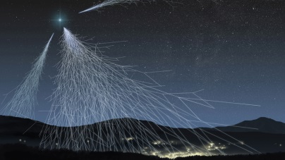
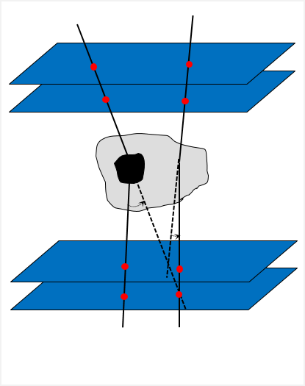
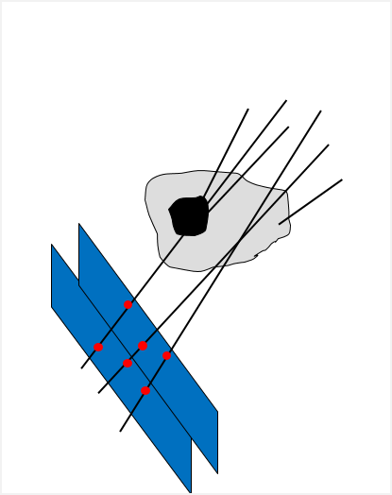
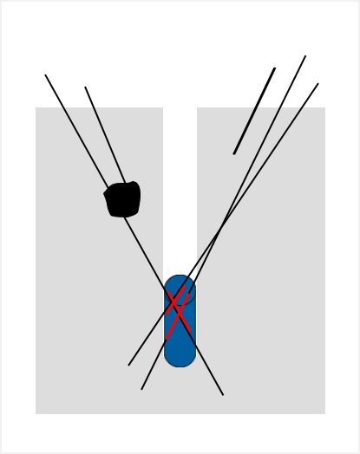
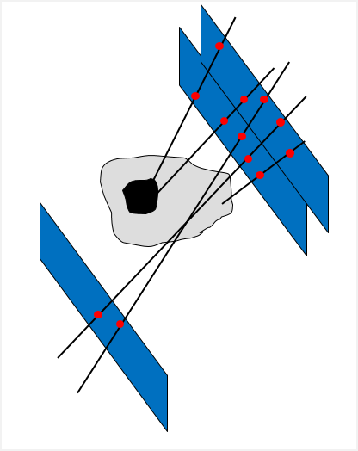
Muon Tomography
Muons produce in electromagnetic showers from cosmic-rays high atmosphere
  Flux: ~150/m²/s ~ cos²θ (maximal in zenith direction)
  Straight line propagation
  Natural, free and harmless radiation
  Mean energy ~4GeV
  Half-life : 2µs
Electromagnetic interaction with matter and can:
  Change trajectory
  Be stopped (decay)
Enable non-invasive and penetrating imaging (opacity map)
Different mode of muon tomography
  Deviation
  Transmission
  Absorption
Materiel | Thickness | θ (°) | P_{absorption}
Air | 100 m | 0.094 | 0.78%
Lead | 10 cm | 1.01 | 2.9%
Water | 1 m | 0.35 | 4.2%
Ground | 100 m |  | 99%
Deviation (3D)
Transmission (2D)
Absorption (2D)

Slide 4
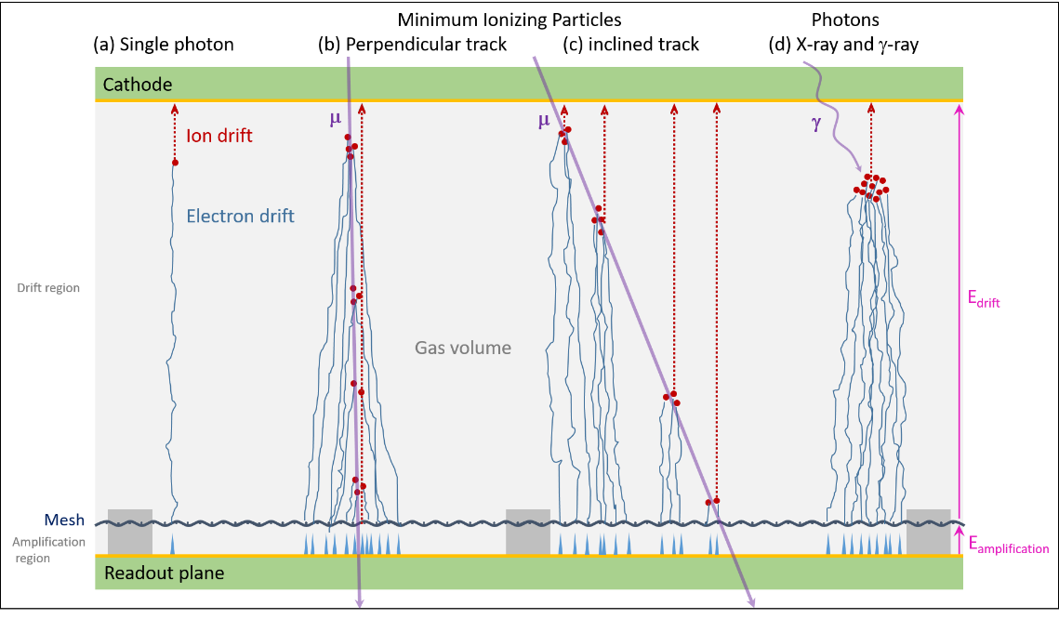
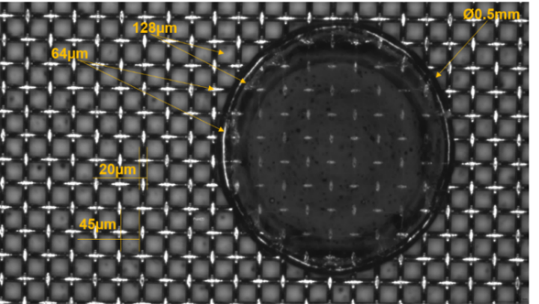
Micromegas Technology
Gaseous detector invented at CEA (1996)
  Defined by two regions
    Conversion region (few mm to few m): E_{drift} ~100 V/cm
    Amplification region (~100 μm): E_{amplication} ~ 50 kV/cm
  Bulk Micromegas (2005)
    Robust, large area
    Industrialized manufacturing (printed circuit processes)
Excellent performances for nuclear and particle physics
  Spatial resolution < 100 µm
  Time resolution < 10 ns
  High flux operation
Successful industrial transfer
  Started in 2012 with Elvia-PCB
  Production of 1250 m² for ATLAS/NSW
  ~ 100 resistive bulk Micromegas of 50x50 cm² for muon tomography
Pillar from bulk Micromegas

Slide 5
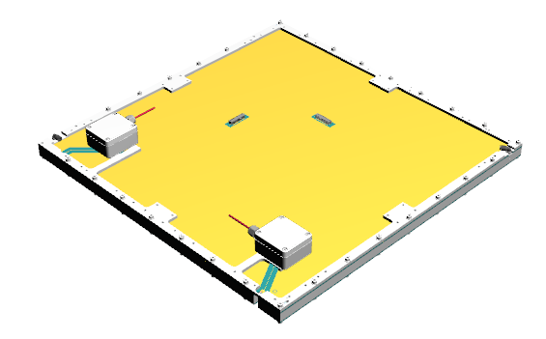
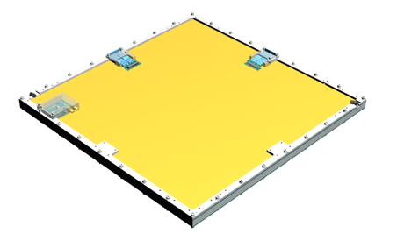
Gaseous detectors developed for muon tomography at Irfu
MultiGen detector principle:
  Bulk Micromegas with resistive strips
  2D readout (X & Y) with genetic multiplexing
  Each coordinate read out by 61 electronic channel
  PCB : 546×546 mm²
  Active area : 500×500 mm²
  Can be used in mosaic
Development since 2014: from prototype to serial
(ELVIA-PCB)
MultiGen v2
MultiGen v3-v4
MultiGen version | Multiplexing family | Number of strips (X/Y) | Strip pitch (μm) | Drift gap (mm) | Gap | Produced detector | Improvements
V1 | 17* | 1024 | 488 | 10 | 2014 | 7 | (*) Incomplete family: 13 missing strips
v2 | 17 | 1037 | 482 | 15 | 2015 | 42 | Families completed; grounding plane added
v3 | 17 | 1037 | 482 | 8-10 | 2017 | 50 | Connectors moved to sides; HV filter on PCB
v4 | 12 | 732 | 683 | 8 | 2019 | 52 | Number of family reduced to 12; higher resistivity

Slide 6
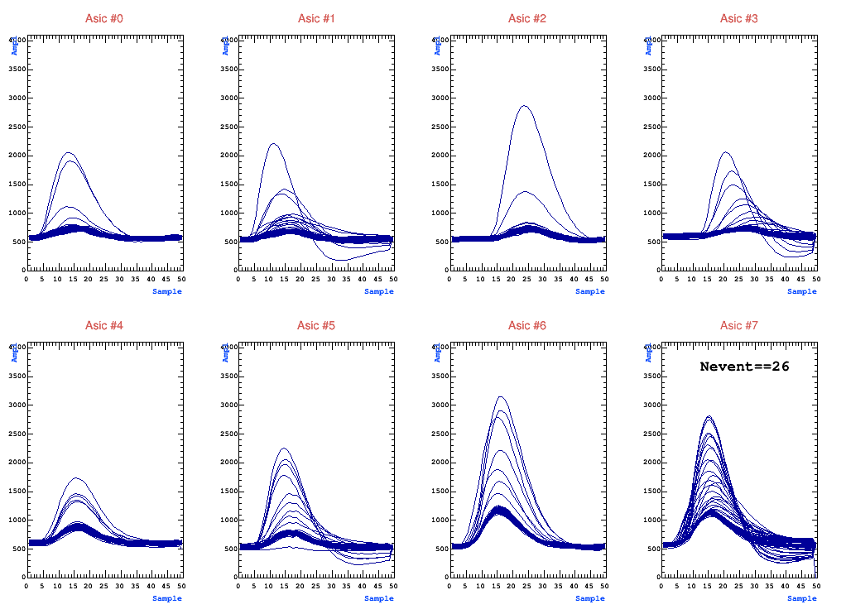
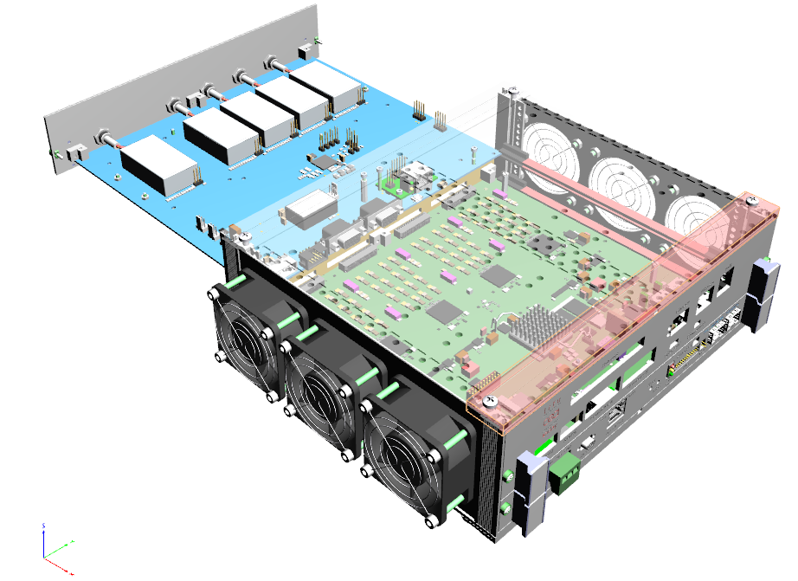
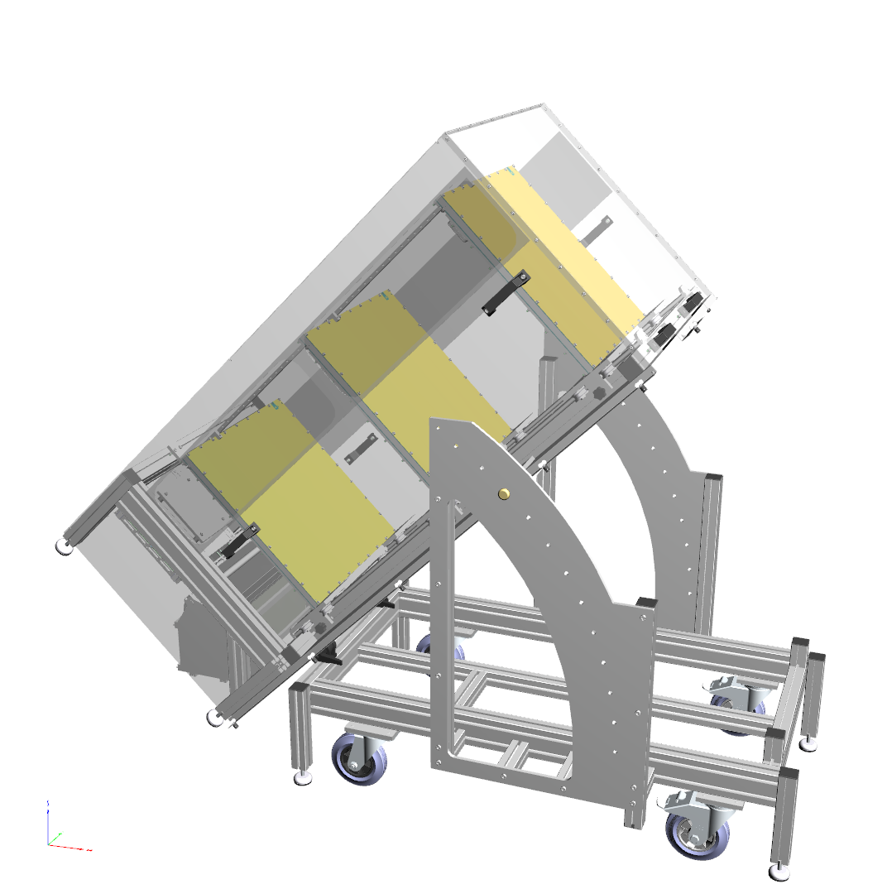
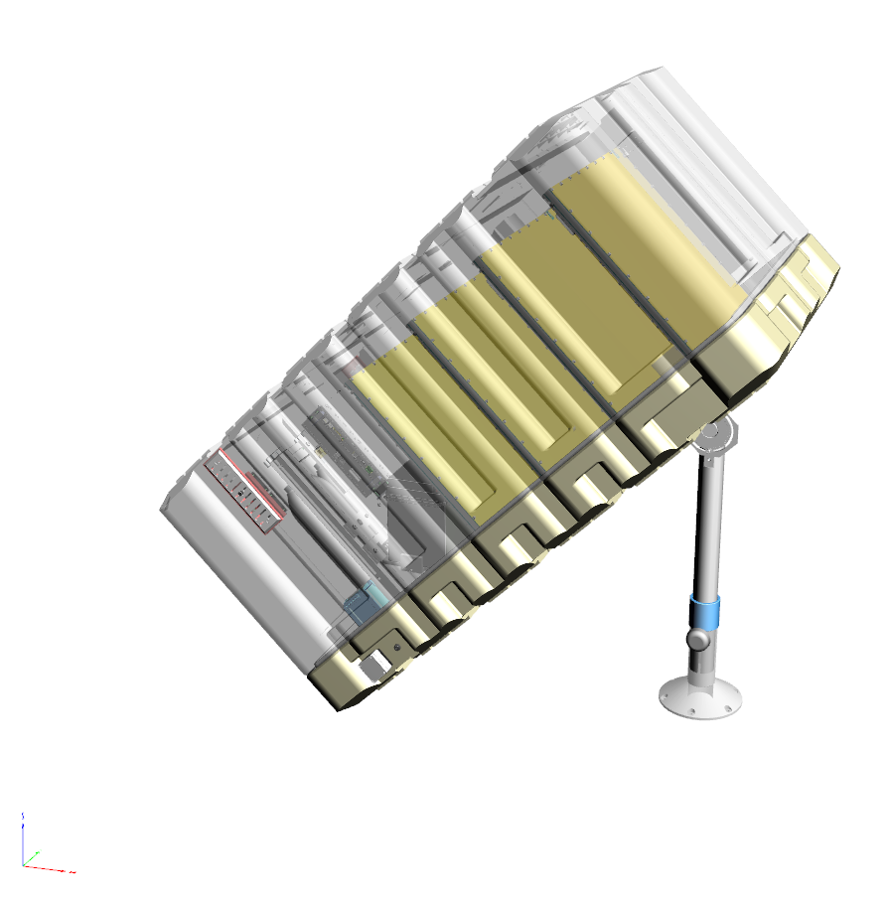
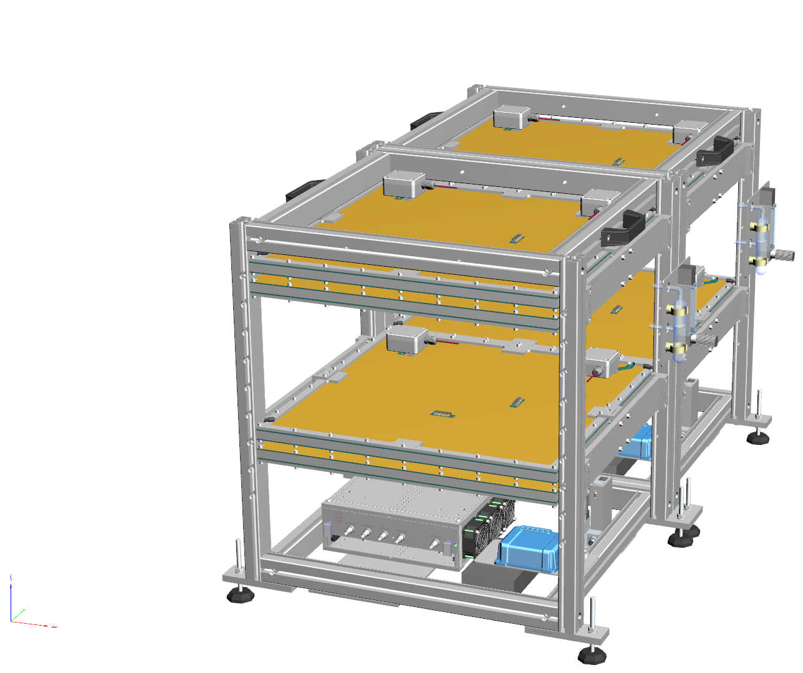
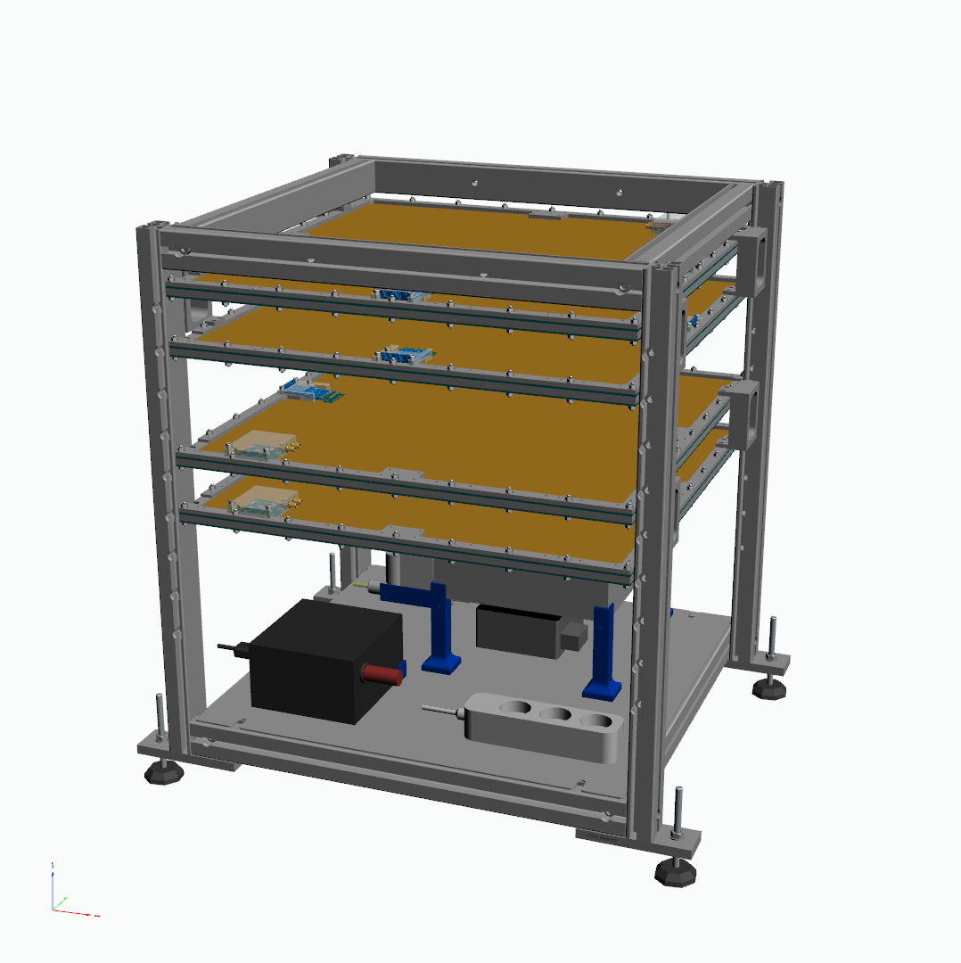
Muon Tomography Telescopes at Irfu
Evolution of the Irfu’s telescopes : ↗ compactness, transportability and automony
  2015: WatTo, ~200 kg
  2016: ScanPyramids (outdoor), ~130 kg
  2018: ScanPyramids (indoor) cube, ~45 kg
  2019: G2G3, EDF, …, cube optimized, ~45 kg
Electronic and control cards from Irfu :
  Front-End Unit (FEU) developed for Clas12
  Specific High-Voltage Power Supply (HVPS) card (v1: 2015, v2:2016, v3: 2022)
  allow to monitor and control flowmeter (v2) and sensor of gas properties (v3)
6U Rack
HVPS
FEU
8 ASICs Dream
2015
2016
2018
2019-today

Slide 7
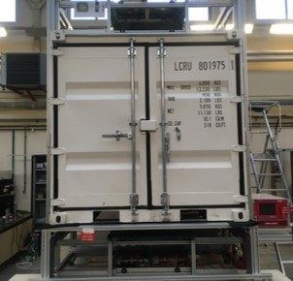
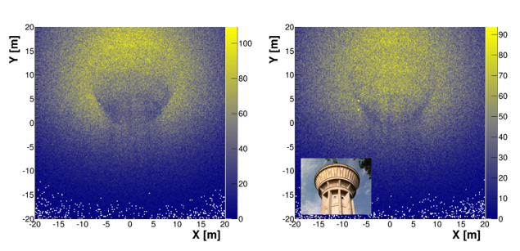

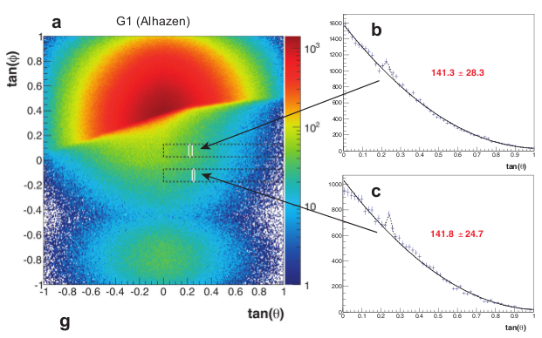
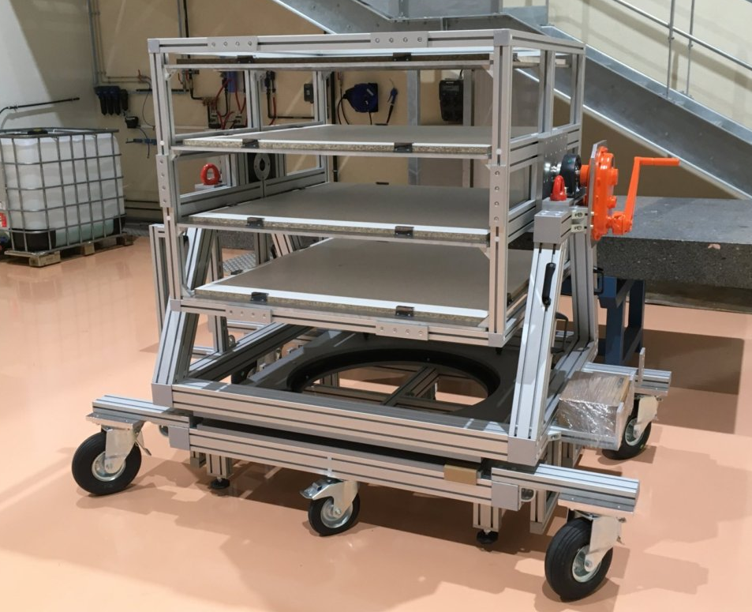
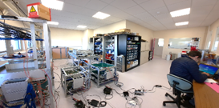
Some Project Highlights
M-Cube – Muon tomography with Multiplexed Micromegas (2014–2017) [Thèse S. Bouteille]
  Demonstrator of a scanner homeland security
  Detection of Nuclear Matter in smuggling in less than 4 minutes
WaTo – Water Tower (2015) [NIM A 834 (2016) 223 - 228]
  HD muography of the CEA/Saclay water tower
  1st Micromegas telescope outdoor
  1st transmission muography of a recognizable object
ScanPyramids (2016–2021)
  Three compact telescopes for Cheops Pyramid’s scan
  Discovery of a big void above the Grand Gallery [Nature 552 (2017) 386 -390]
  Discovery of a North Face Corridor [Nature Communication, 14, p. 1144. 2023]
Mimosa – Maison de l’Imagerie Muonique
Ouverte aux applications Sociétales
et Académiques (2016–…)
  Transportable telescopes
  Cosmic test bench of 1 m²
Common-lab with Iris-Instruments

Slide 8
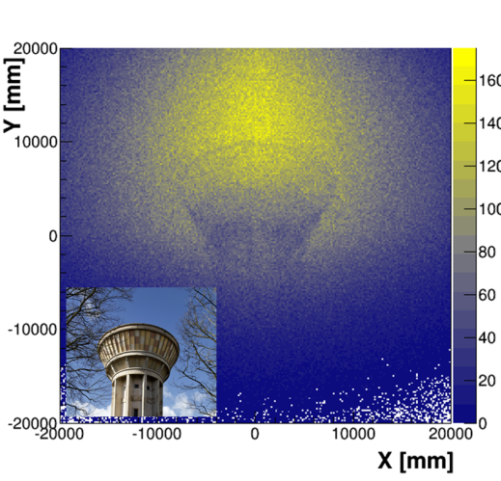
WatTo: First Micromegas Telescope Outside the Lab

Slide 9
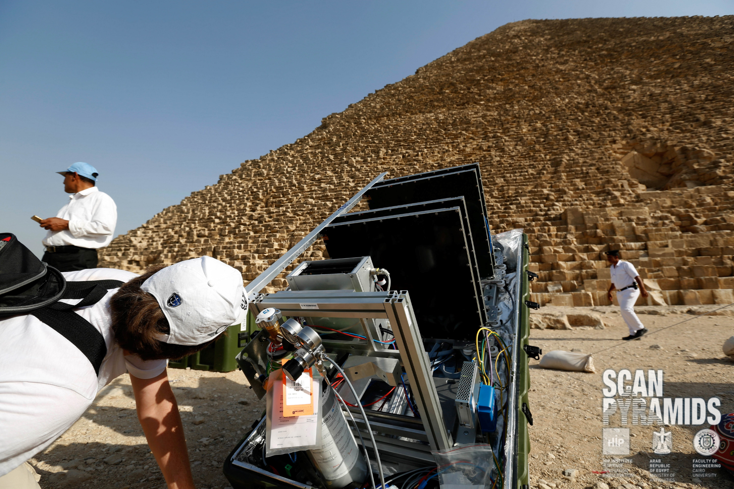
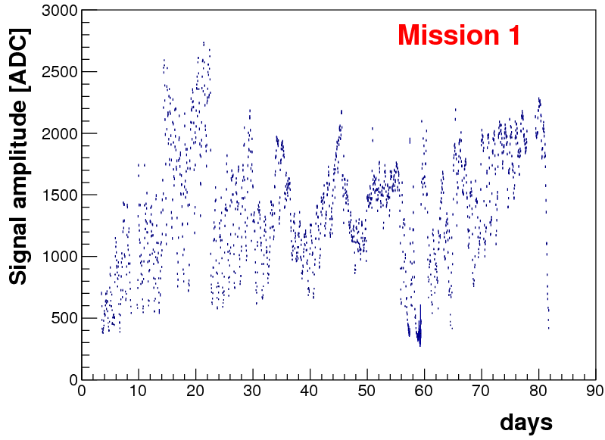
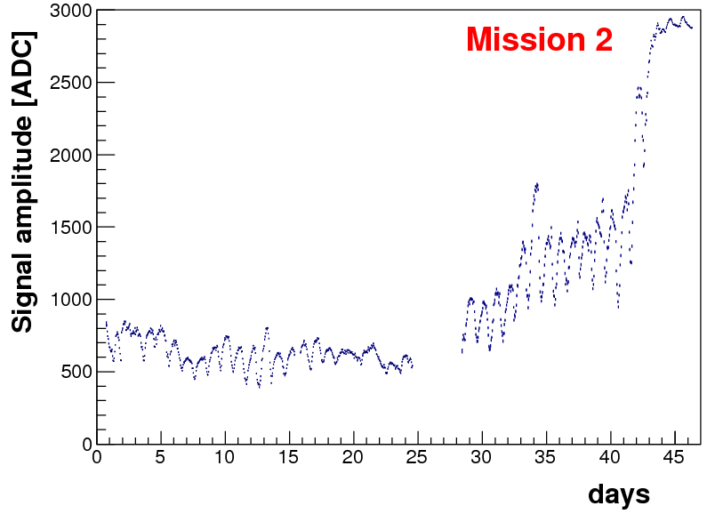
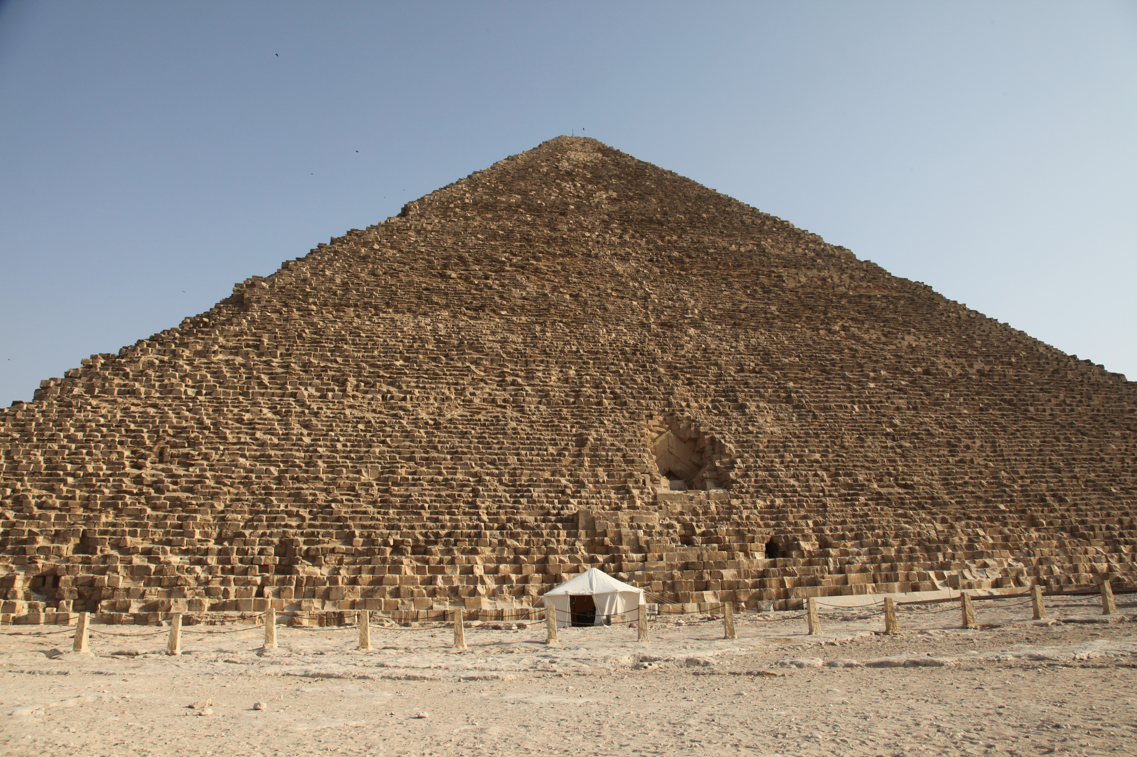
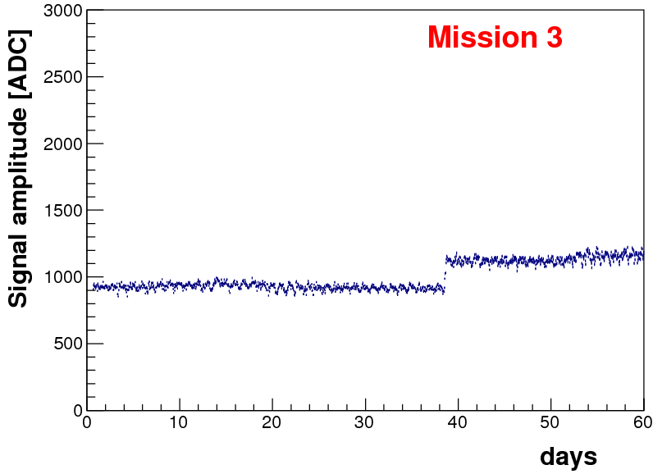
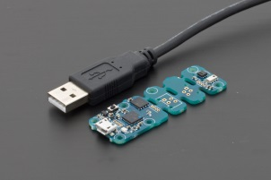
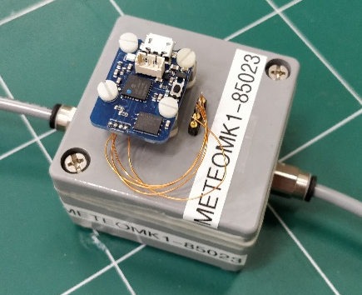
ScanPyramids: Gas Requirements
Need improvement for gas/gain stability:
  Flux: BronKhorst flowmeter (digital/analogic)
  Non-flammable mixture: Ar-CF₄-iC₄H₁₀ (95-3-2)
  Gain corrections in function of:
    Mission 1: outside temperature
    Mission 2: gas temperature
    Mission 3 and others: mean amplitude of signals
Environmental conditions
  Temperature/pressure/humidity sensor
    Mission 1: external
    Mission 2: external + internal
    Mission 3: external + internal
    Others: + O₂
Online monitoring and analysis
  Temperature/pressure
  Mean amplitude : [Patented]
Yocto-Meteo

Slide 10
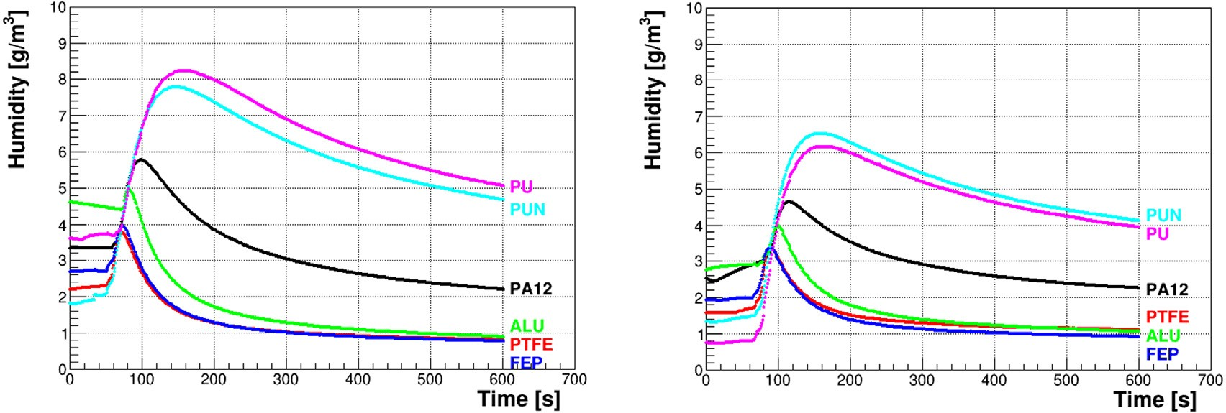
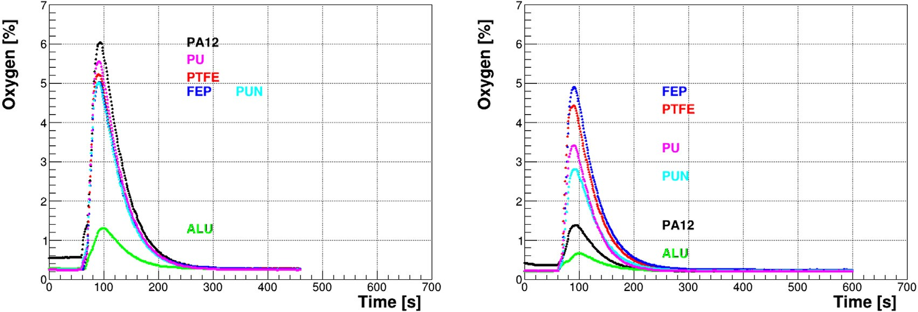
Studies for autonomy optimization: Pipes
List of flexible pipes studied (Ø6 mm, 1 m) :
  Polyurethane-based (PU, PUN)
  Polyamide (PA12)
  Polytetrafluoroethylene (PTFE)
  Perfluoro-ethylene propylene, Teflon (FEP)
  Aluminium (ALU)
Initially, one by one, flushed with:
  Pure Argon
  At 4 L/h during 15 minutes → (80×volume)
Then isolated:
  Legris gate 7910 06 00
  During 50 or 30 days
After outgassing:
  Vacuum and heated (1 week)
  Periodically flush with Argon
Then tested with low flow with Yocto sensors:
  Pure Argon at 0.5 L/h during 10 minutes
After 50 days in isolation
Before outgassing
After 30 days of isolation
After outgassing

Slide 11
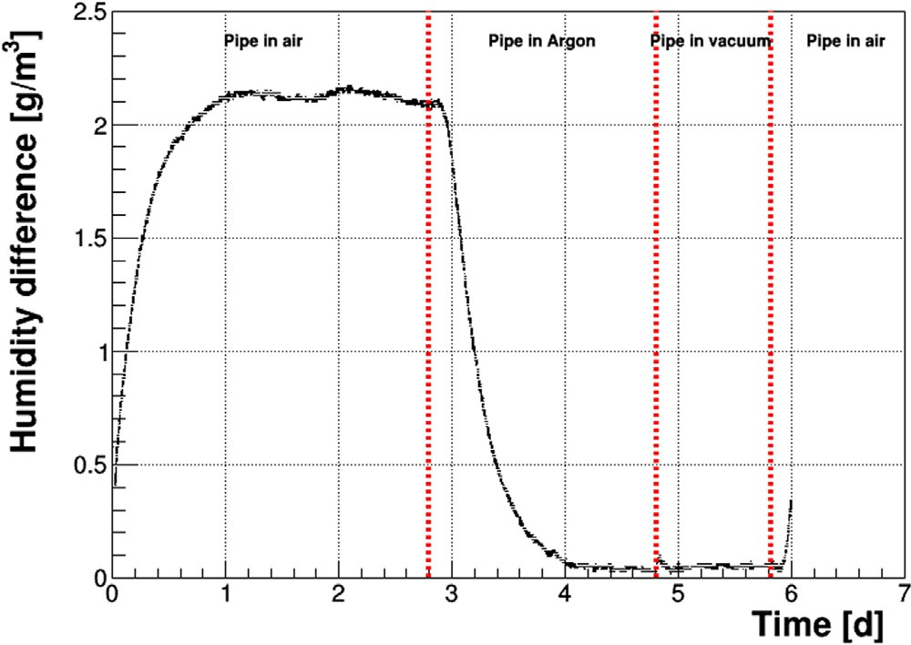
Studies for autonomy optimization: Pipes
Pipe of PU (Ø6 mm, 1 m) :
  15 mbar of overpressure
  10 L/h of Argon
Inside a chamber:
  Filled with air during 3 days
  Filled with Argon during 2 days
  Under vacuum during 1 day
  Filled again with air
Humidity difference measurements:
  Laboratory (28°C, humidity ~10 mg/L)
  Pipe volume
Permeation measurement of H₂0 and 0₂
  Material dependence
  Time scale t_{H20} = 30 × t₀₂
 | Permeation rate (µg/h/m)
Pipe | H₂0 | O₂
PU | 1150
PTFE | 20 | 90
Alu | 0,62 | 1,4

Slide 12
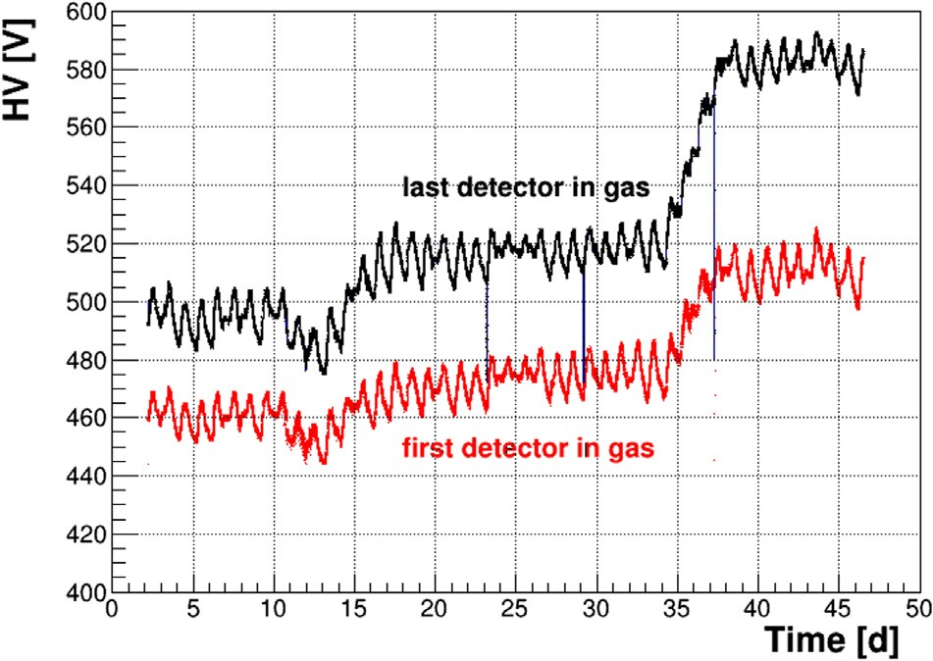
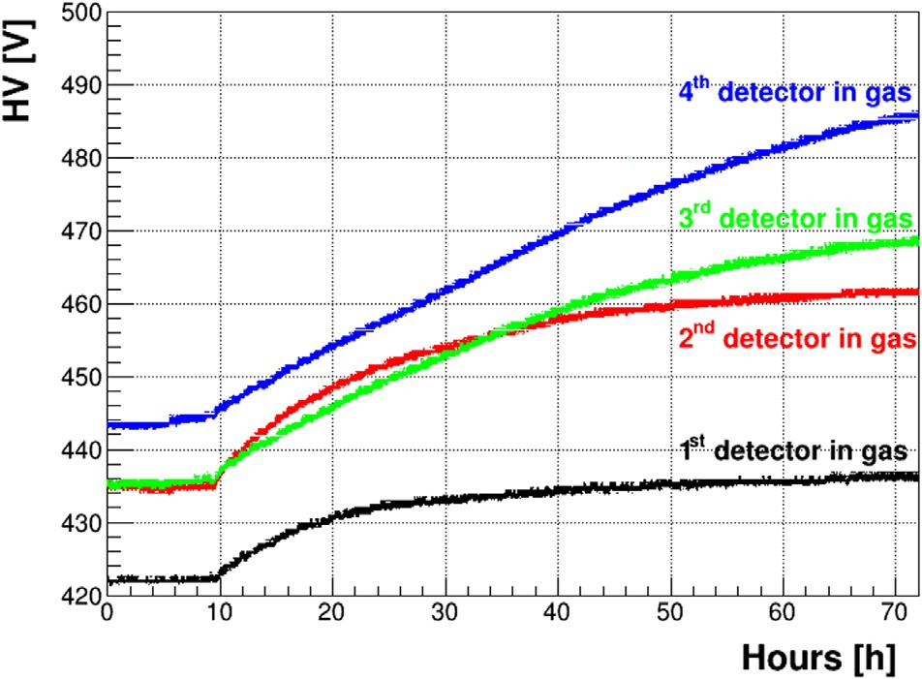
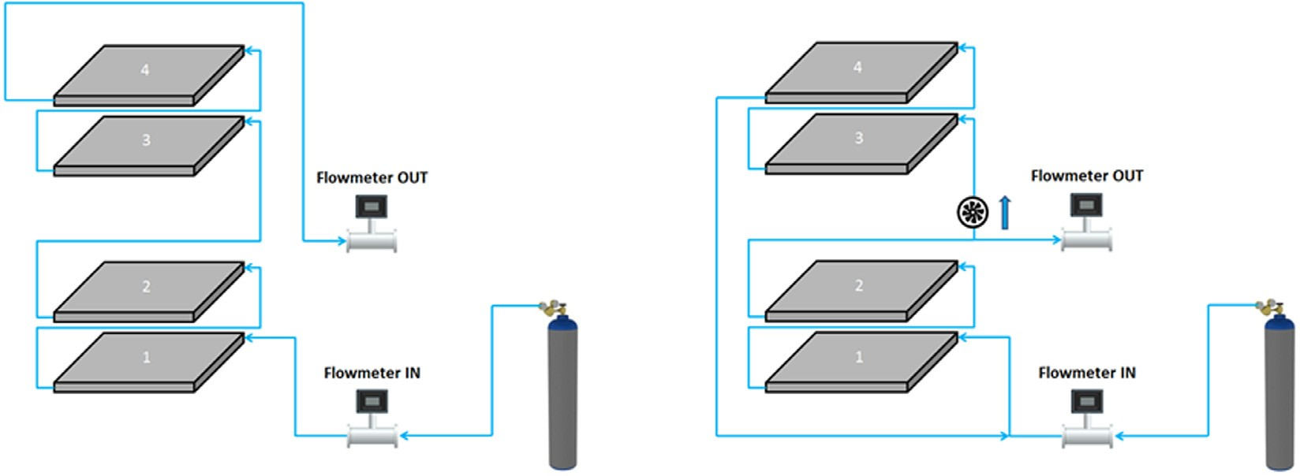
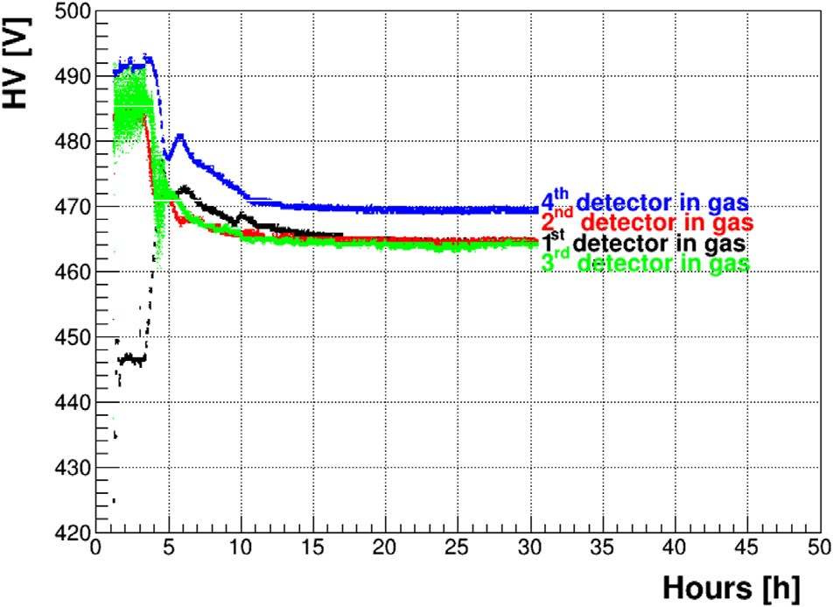
Studies for autonomy optimization: Recirculation
Detectors flushed in serial
  Gain: delta ~10% = f(flux)
  1.2 L/h
  B5 → 3 weeks of autonomy
Recirculation system:
  Input gas flow: 0.4 L/h
  Turbine or micro-pump (~5L/h)
  → Homogenize the gas
  → Balance the efficiencies
Egypt
Lab
Gas flow: 1.2 L/h
Before recirculation 0.4L/h
Labo
After recirculation 0.4 L/h

Slide 13
Studies for autonomy optimization: Filtration
Goal: insert filter(s) inside the recirculation loop
  H₂0
  0₂
Flow of the circulator:
  Adjustable
  Superior than the gas input flow (~5 L/h)
Absorber OFF
Absorber OFF
Humidité (g/m³)
Absorber ON
Time (days)

Slide 14
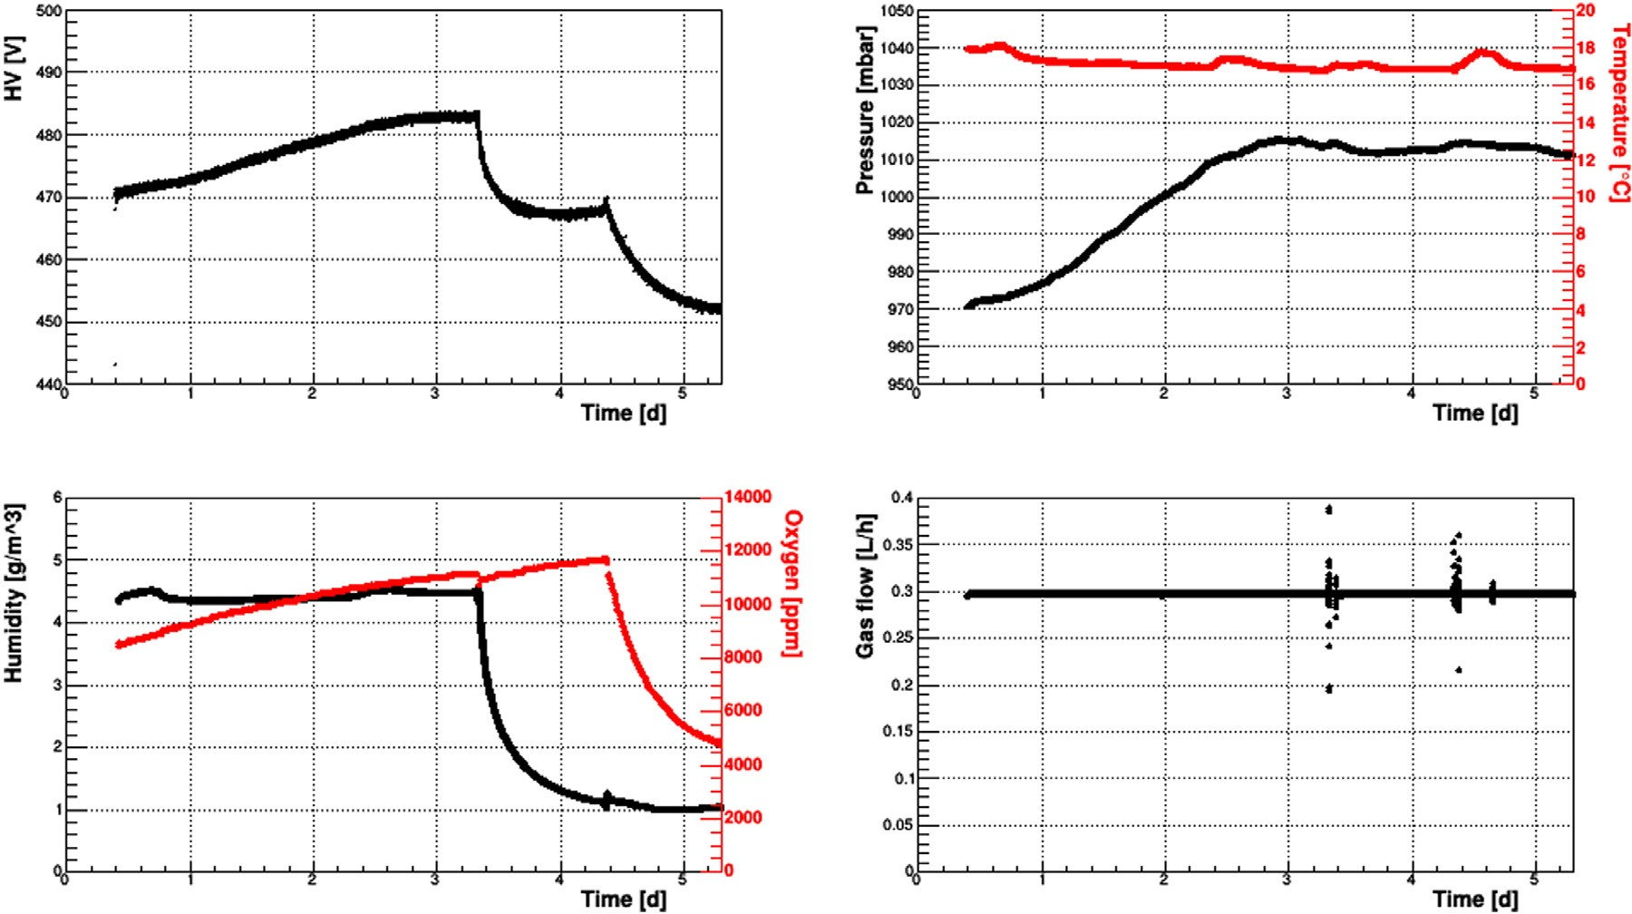
Studies for autonomy optimization: Filtration
Goal: insert filter(s) inside the recirculation loop
  H₂0
  0₂

Slide 15
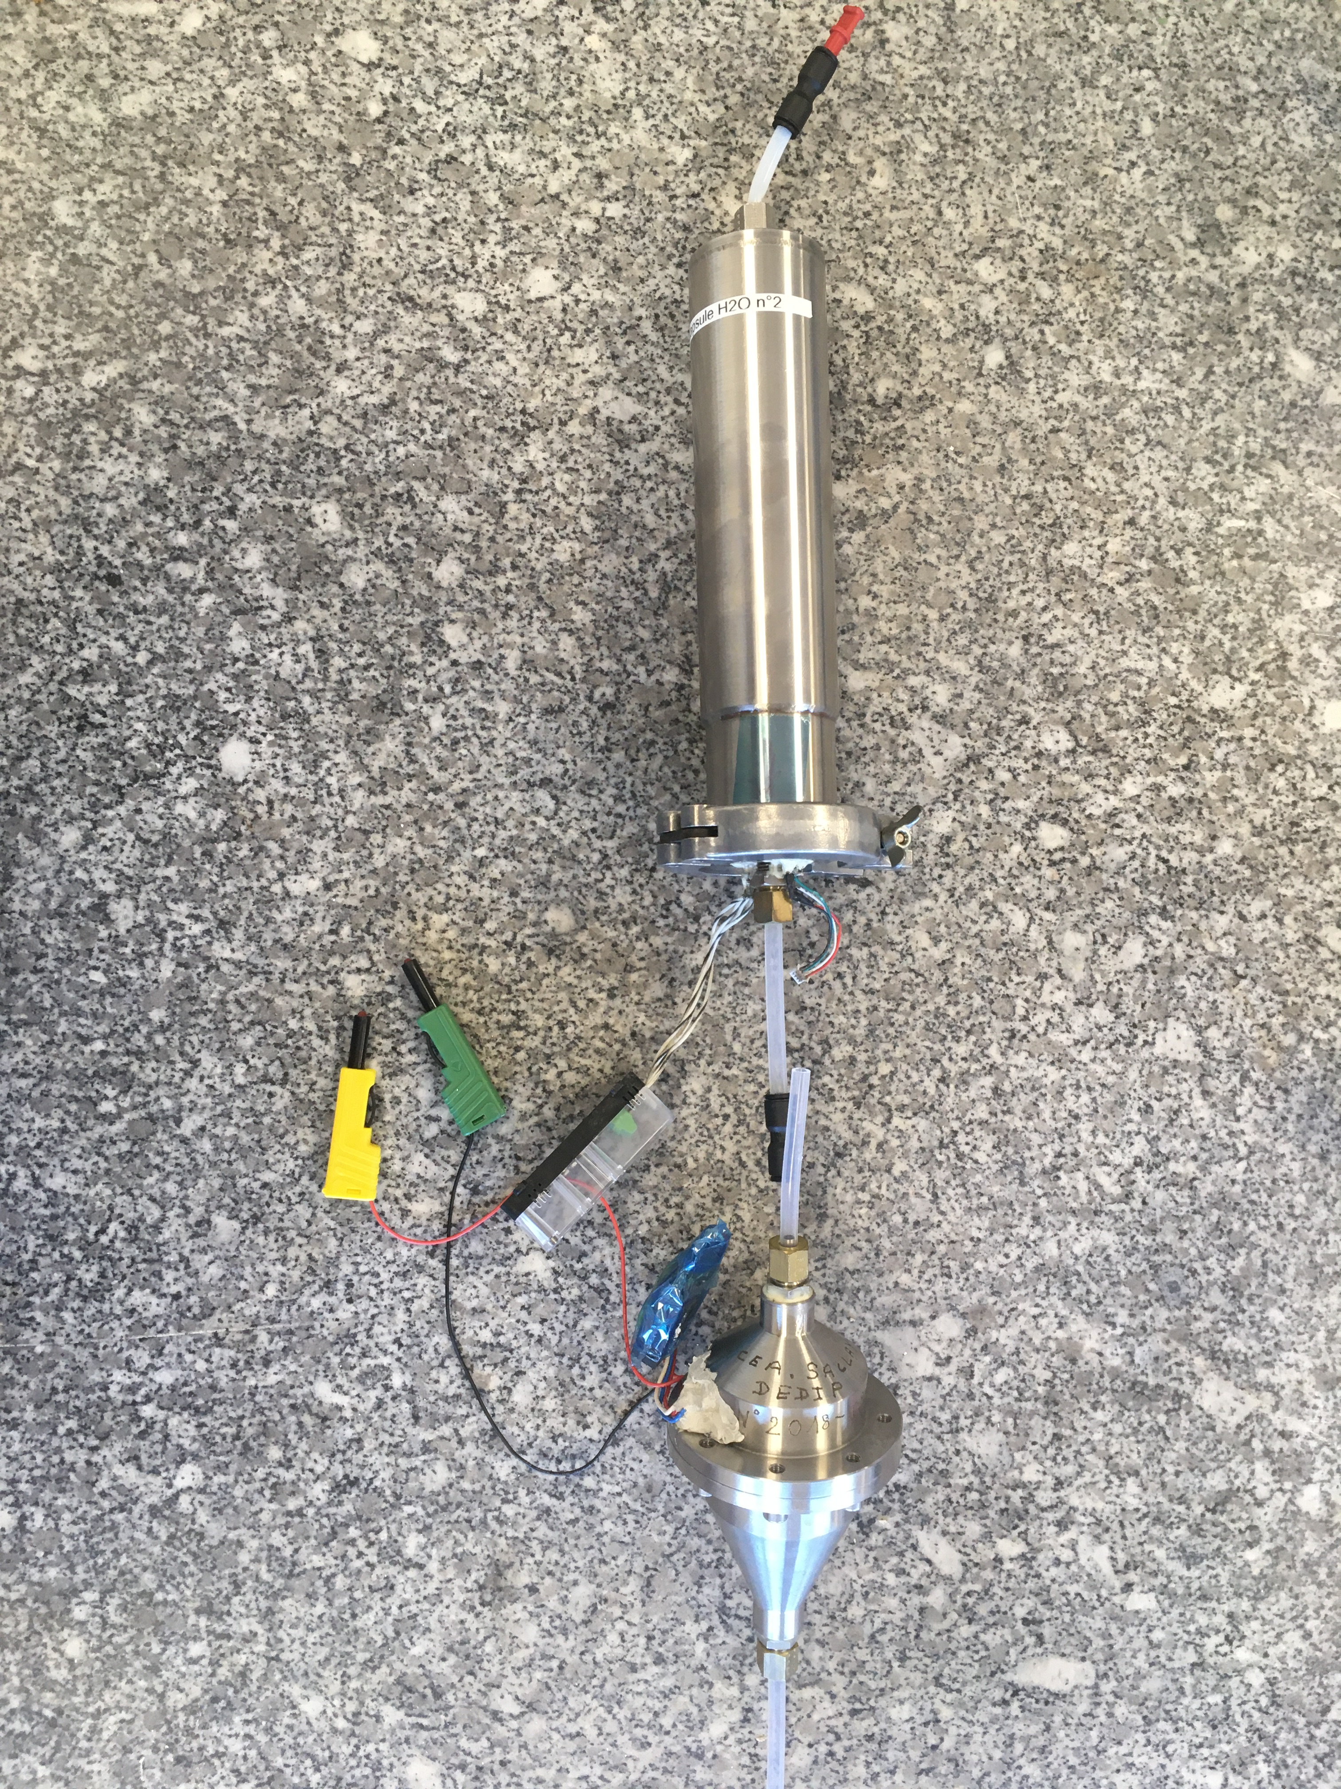
Recirculation System with Home Made Components
Previous recirculation system:
  MicroTurbine from Micronel in specific conic mechanical stainless steal
  Specific tube for sieves

Slide 16
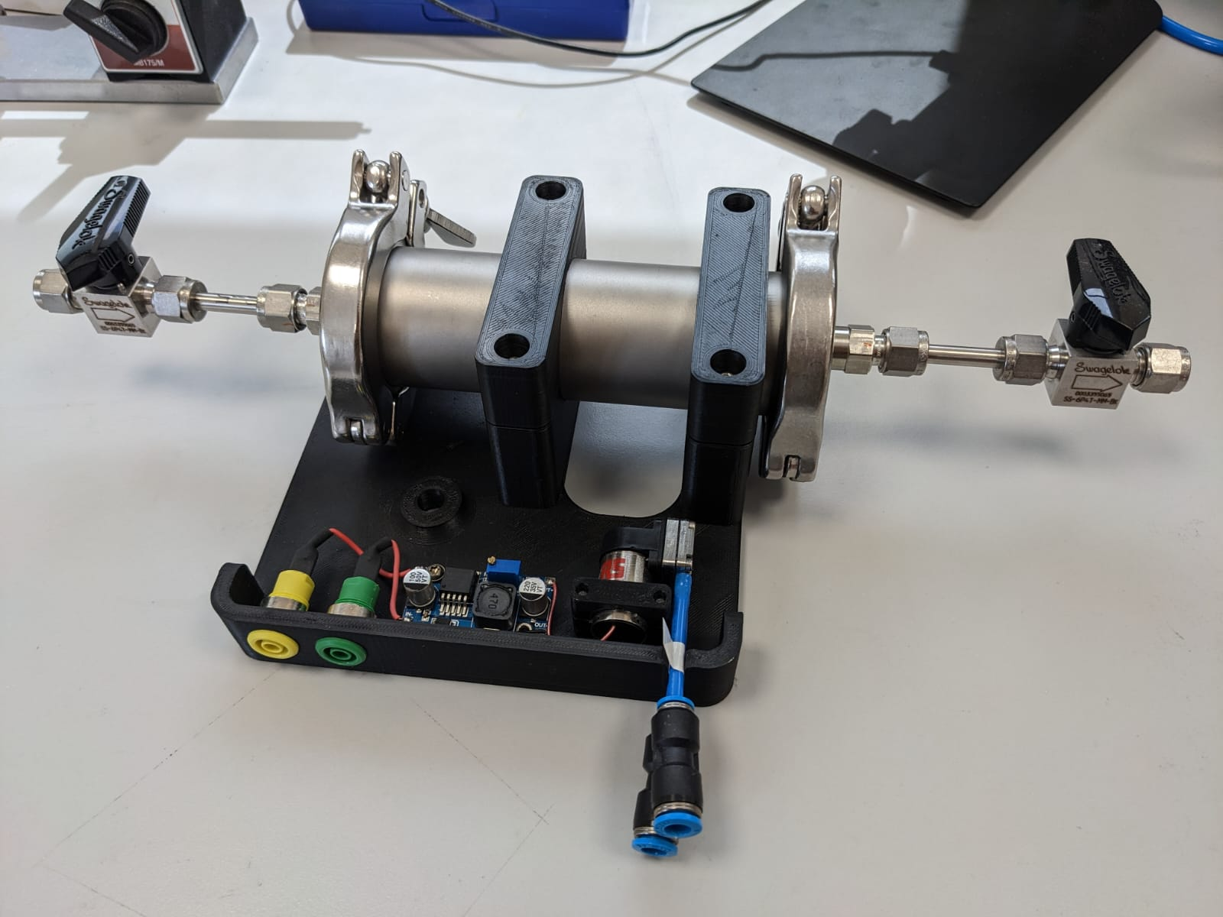
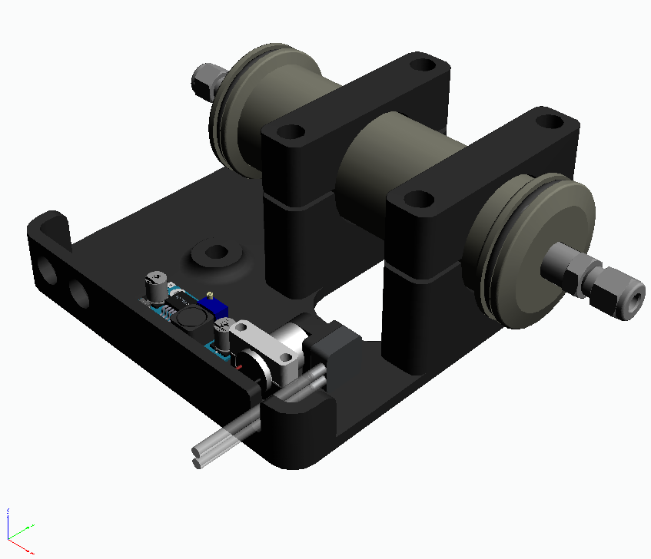
Recirculation System with Industrial Components
New recirculation system:
  Micro-pump from RS (2 have been tested during 14 months in continuous operation)
  Components from Pfeiffer’s catalogue

Slide 17
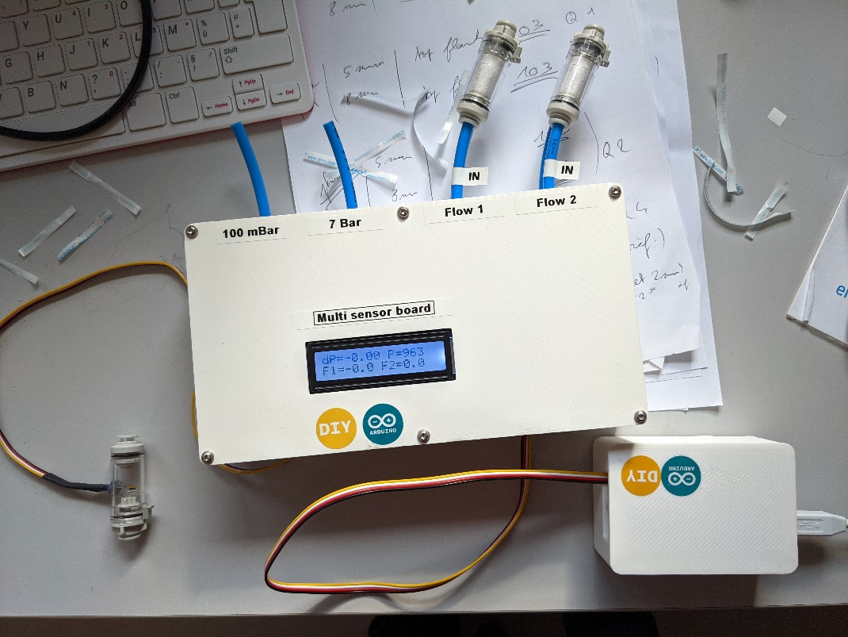
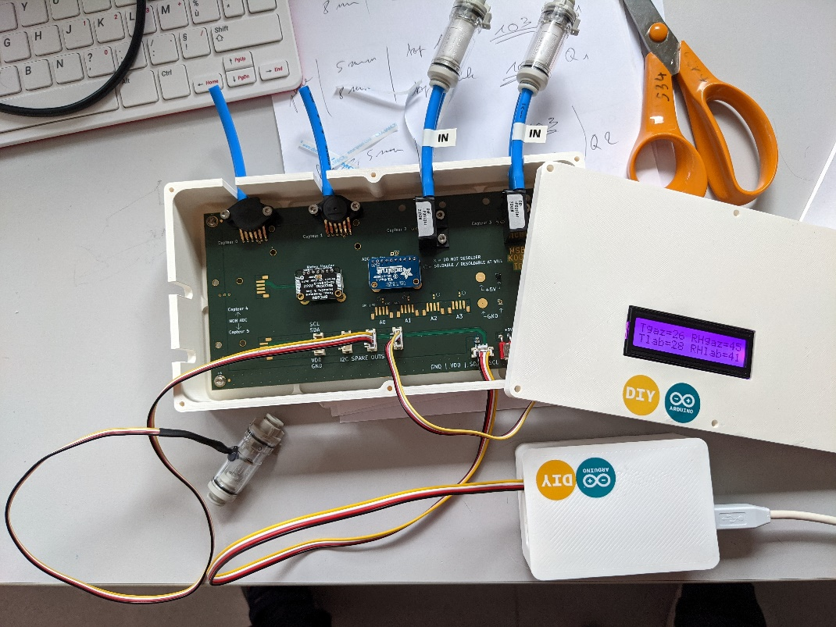
Specific card for Gas Sensors
Dedicated gas sensors:
T°C and RH% in gas
Absolute Pressure 0-7bar
Differential pressure 0-100mbar
2 x flowmeter 0-60L/h
Lab sensor: Pressure, T°C, RH%
4 x Ports I2C ports
ADC 16 bits 4 channels
Double power supply: Arduino or external power 5V, card for sensor

Slide 18
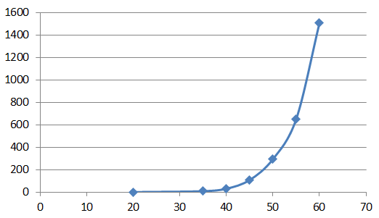
Conclusions
Gas leak ~10 mL/day without gluing
Large outgassing of water can be cured by heating/pumping
Large effect of CF4 on gas degradation (~1 V/h) → New ATLAS-NSW gas (Ar-CO2-i-C4H10/93-5-2)
  More stable
  Need higher operation voltage
Reduced gas flushing with current telescopes from 4L/h to 0.4 L/h without filtration
In very humid environment (inside Pyramid) up to 20 detectors (50 liters) and with filtration : 0.4 to 0.2 L/h
With standard detector (PCB, plastic pipe) very important :
  Choice of gas
  Choice of the pipe material
Add a filtration is a bonus but first the recirculation system is needed
Detector dark current has temperature dependence
I [nA]
T [°C]

