Slide 1

Bootstrability program
Solving (planar) N=4 SYM using
integrability + crossing symmetry
Ongoing work with Michelangelo, Andrea, Julius and Nika
EXACTC

Slide 2
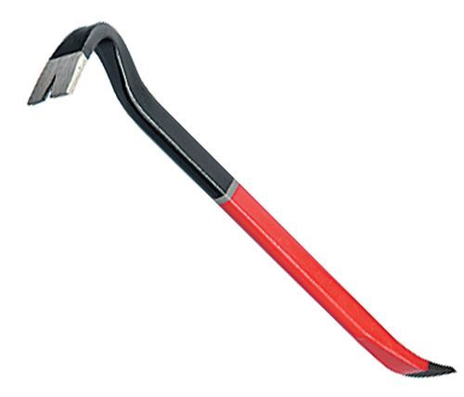

Tools to go beyond spectrum - basics
Integrability: SoV, Hexagons
Bootstrability = Integrability + Bootstrap

Slide 3
Is the spectrum of N=4 and its deformations sufficient to obtain non-spectral observables?
in combination with conformal symmetry

Slide 4
Bootstrability
Conformal bootstrap + integrability for N=4 Spectrum
`16 M. Picco, S. Ribault, and R. Santachiara
`20 Y. He, J. L. Jacobsen, and H. Saleur
A.Cavaglià, NG, J.Julius, M.Preti, N.Sokolova `21-`23

Slide 5
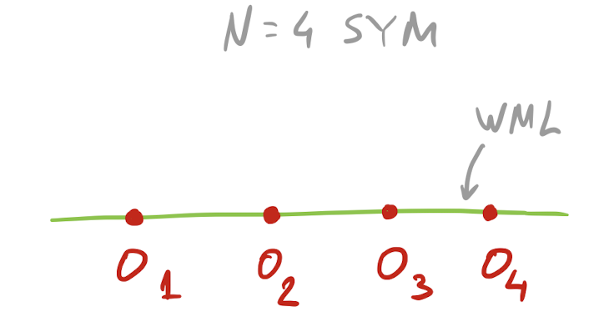
Concrete set-up
N. Drukker `12
D. Correa, J. Maldacena, and A. Sever `12
N. NG and F. Levkovich-Maslyuk `15
Know the spectrum of the defect CFT
All correlators are O(N^0)
No “double traces” problem
Price to pay: less symmetry, same number of operators
P. Liendo, C. Meneghelli, and V. Mitev `18
P. Ferrero and C. Meneghelli `21
P. Liendo and C. Meneghelli `16
L. Bianchi, G. Bliard, V. Forini, L. Griguolo, and D. Seminara `20

Slide 6
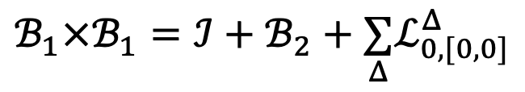



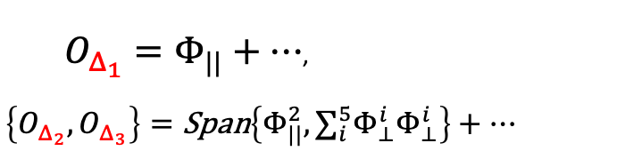
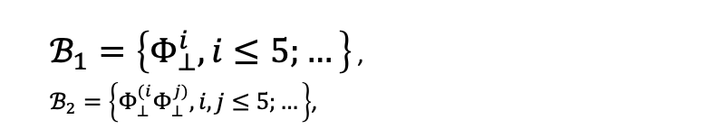
1/2 BPS Wilson line
$$t$$
$$W=\text{TrP}e^{∫dt\left(iA_{t}+Φ_{||}\right)}$$
[Maldacena, ’98]
16 preserved supercharges
Bosonic subgroup
$$OSp(2,2|4)$$
$$SO(1,2)×SO(3)×SO(5)$$
Superconformal defect where local operators reorganise in representations of the preserved superalgebra.
Protected 1/2 BPS multiplets
Non-protected long operators
$O_{Δ_{1}}=Φ_{||}+…$,
$$\left\{O_{Δ_{2}},O_{Δ_{3}}\right\}=\text{Span}\left\{Φ_{||}^{2},∑_{i}^{5}Φ_{⊥}^{i}Φ_{⊥}^{i}\right\}+…$$
$ℬ_{1}=\left\{Φ_{⊥}^{i},i≤5;…\right\}$ ,
$ℬ_{2}=\left\{Φ_{⊥}^{(i}Φ_{⊥}^{j)},i,j≤5;…\right\}$,
OPE e.g.
$$ℬ_{1}×ℬ_{1}=ℐ+ℬ_{2}+\underset{Δ}{∑}ℒ_{0,[0,0]}^{Δ}$$

Slide 7




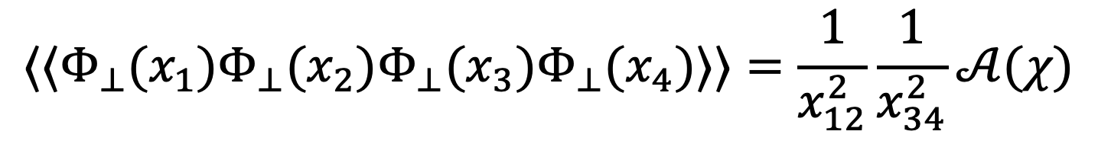




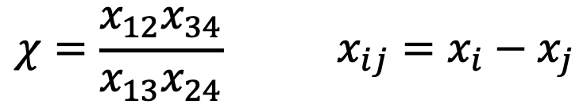







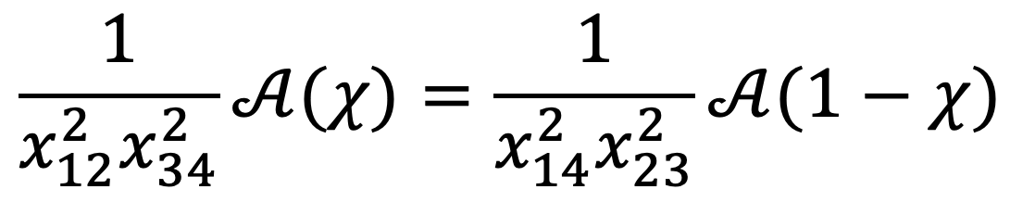


Simplest 4-point function
The simplest operator in $ℬ_{1}$:
$$Φ_{⊥}^{1}≡Φ_{⊥}$$
$$⟨⟨Φ_{⊥}(x_{1})Φ_{⊥}(x_{2})Φ_{⊥}(x_{3})Φ_{⊥}(x_{4})⟩⟩=\frac{1}{x_{12}^{2}}\frac{1}{x_{34}^{2}}𝒜(χ)$$
$$χ=\frac{x_{12}x_{34}}{x_{13}x_{24}} x_{ij}=x_{i}−x_{j}$$
With cross ratio and
Crossing equation:
$$=$$
$$x_{1}$$
$$x_{4}$$
$$=$$
$$x_{1}$$
$$x_{2}$$
$$x_{3}$$
$$x_{4}$$
$$x_{4}$$
$$x_{1}$$
$$x_{2}$$
$$x_{3}$$
$$x_{2}$$
$$x_{3}$$
$$\frac{1}{x_{12}^{2}x_{34}^{2}}𝒜(χ)=\frac{1}{x_{14}^{2}x_{23}^{2}}𝒜(1−χ)$$

Slide 8
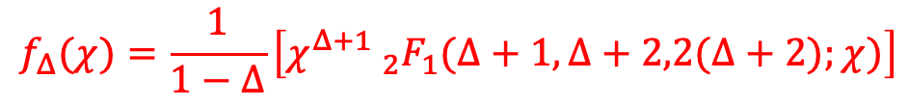

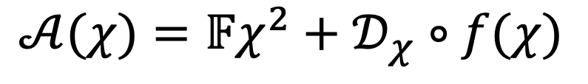

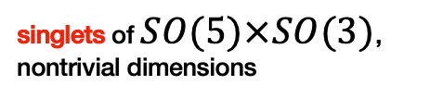
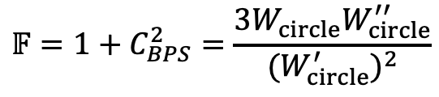

Constraints of superconformal symmetry
Studying the related topological sector
$$⟨W_{circle}⟩=\frac{2}{\sqrt{λ}}I_{1}(\sqrt{λ})$$
$$𝔽=1+C_{BPS}^{2}=\frac{3W_{circle}W_{circle}^{′′}}{(W_{circle}^{′})^{2}}$$
Known differential operator
reproduced by integrability
[Cavaglià, NG, Julius, Preti ’22]
$$𝒜(χ)=𝔽χ^{2}+𝒟_{χ}∘f(χ)$$
[Liendo Meneghelli Mitev ‘17]
Operator Product Expansion
$$f(χ)=f_{I}(χ)+C_{BPS}^{2}(λ)f_{ℬ_{2}}(χ)+∑_{Δ}C_{1,1,Δ}^{2}f_{Δ}(χ)$$
Superconformal blocks
$$f_{I}(χ)=χ$$
$$f_{ℬ_{2}}(χ)=χ\left(1− _{2}F_{1}(1,2,4;χ)\right)$$
singlets of $SO(5)×SO(3)$,
nontrivial dimensions
$$f_{Δ}(χ)=\frac{1}{1−Δ}\left[χ^{Δ+1} _{2}F_{1}(Δ+1,Δ+2,2(Δ+2);χ)\right]$$

Slide 9
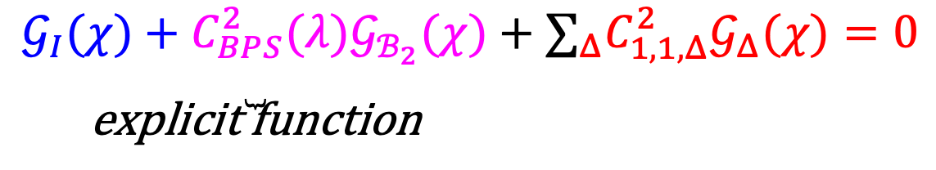
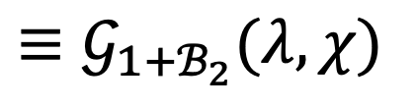
Constraints of conformal symmetry
The reduced correlator $f(χ)$ still obeys to the crossing equation
$$𝒢(χ)≡(1−χ)^{2}f(χ)+χ^{2}f(1−χ)=0$$
and rewriting it in terms of the OPE expansion we obtain
$$\underset{\text{explicit} \text{function}}{\underset{⏟}{𝒢_{I}(χ)+C_{BPS}^{2}(λ)𝒢_{ℬ_{2}}(χ)}}+∑_{Δ}C_{1,1,Δ}^{2}𝒢_{Δ}(χ)=0$$
$$≡𝒢_{1+ℬ_{2}}(λ,χ)$$
Existing results
[Liendo, Meneghelli, Mitev ’17]
Numerical bootstrap
Functional bootstrap at strong coupling
[Meneghelli Ferrero ’21]

Slide 10
Integrability for the spectrum

Slide 11
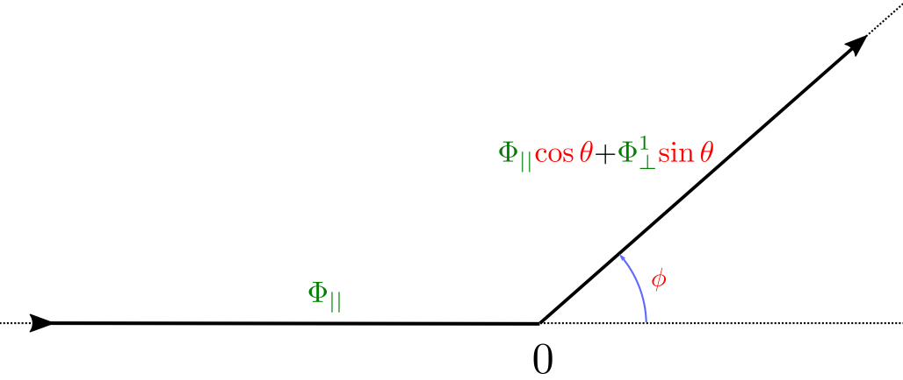
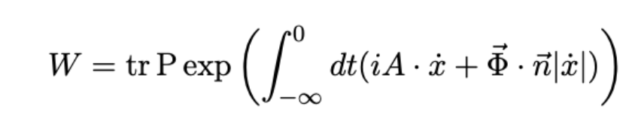
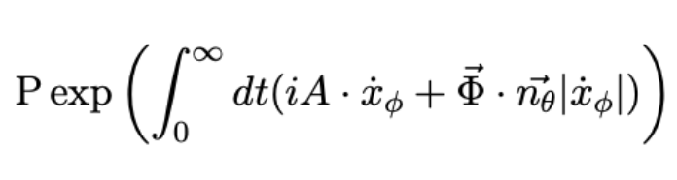

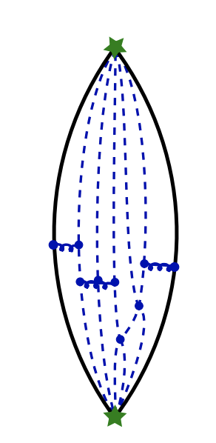


Integrability for the cusped Wilson line
$$O_{L}$$
$$O_{L}$$
Weak coupling
For “orthogonal” insertions: [Correa, Maldacena, Sever ’12] [Drukker ’12]
[Bonini, Griguolo, Preti, Seminara ’15] (wrapping terms)
For “parallel” insertions: [Correa, Leoni, Luque ’18] (1-loop, one sector)
Non-perturbative
For “orthogonal” insertions: [Correa Maldacena Sever ’12] [Drukker ’12] (TBA)
[NG,Levkovich-Maslyuk’15] (QSC)
For “parallel” insertions: [Cavaglià, NG, Levkovich-Maslyuk ’15] (ladder)
[Grabner, NG, Julius ’20] (general $θ,φ$)

Slide 12
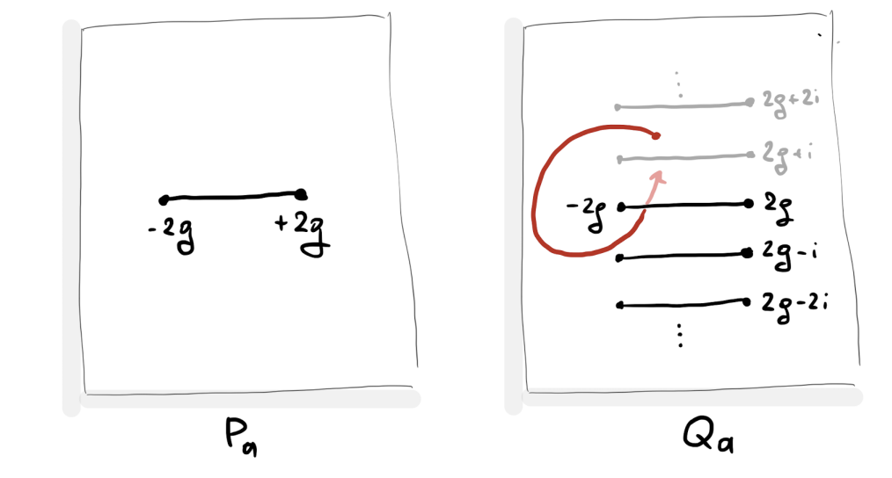

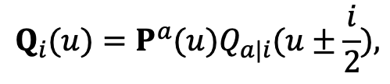
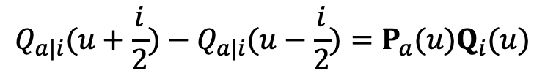
Crash course on QSC
Functional relations (algebra) + Analytic properties for Q-functions
QQ-relations
(reduction of PSU(2,2|4) system)
[NG, Kazakov, Leurent, Volin ’13]
$$Q_{a|i}(u+\frac{i}{2})−Q_{a|i}(u−\frac{i}{2})=P_{a}(u)Q_{i}(u)$$
$$Q_{i}(u)=P^{a}(u)Q_{a|i}(u±\frac{i}{2}),$$
$$(16π^{2}λ=g^{2})$$
Q-functions have cuts dictated by the ’t Hooft coupling

Slide 13
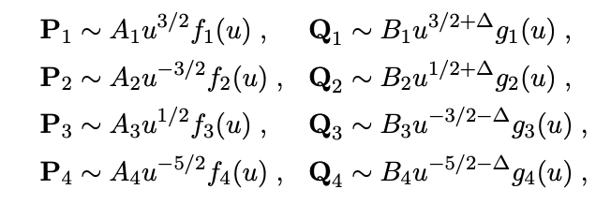
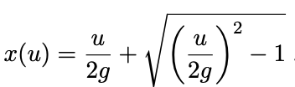
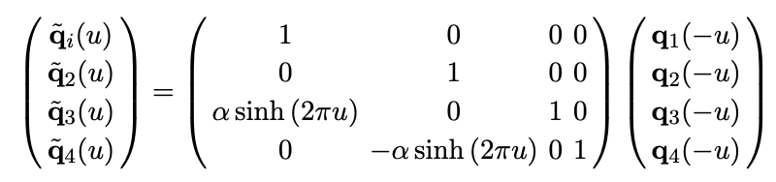


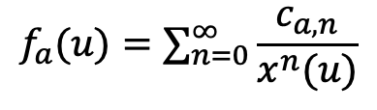
QSC for the straight line
parameters
$$g_{a}(u)≃1,u→∞$$
$$f_{a}(u)=∑_{n=0}^{∞}\frac{c_{a,n}}{x^{n}(u)}$$
With QQ-relations, we can get all Q-functions numerically in terms of $\left\{c_{a,n}\right\}$
Fix parameters numerically by imposing gluing across the cut (-2g, 2g)
[Julius, PhD Thesis]
[Cavaglià, NG, Julius, Preti ’21]
Many solutions! = Many states!
Weak coupling solutions are needed to find good starting points

Slide 14
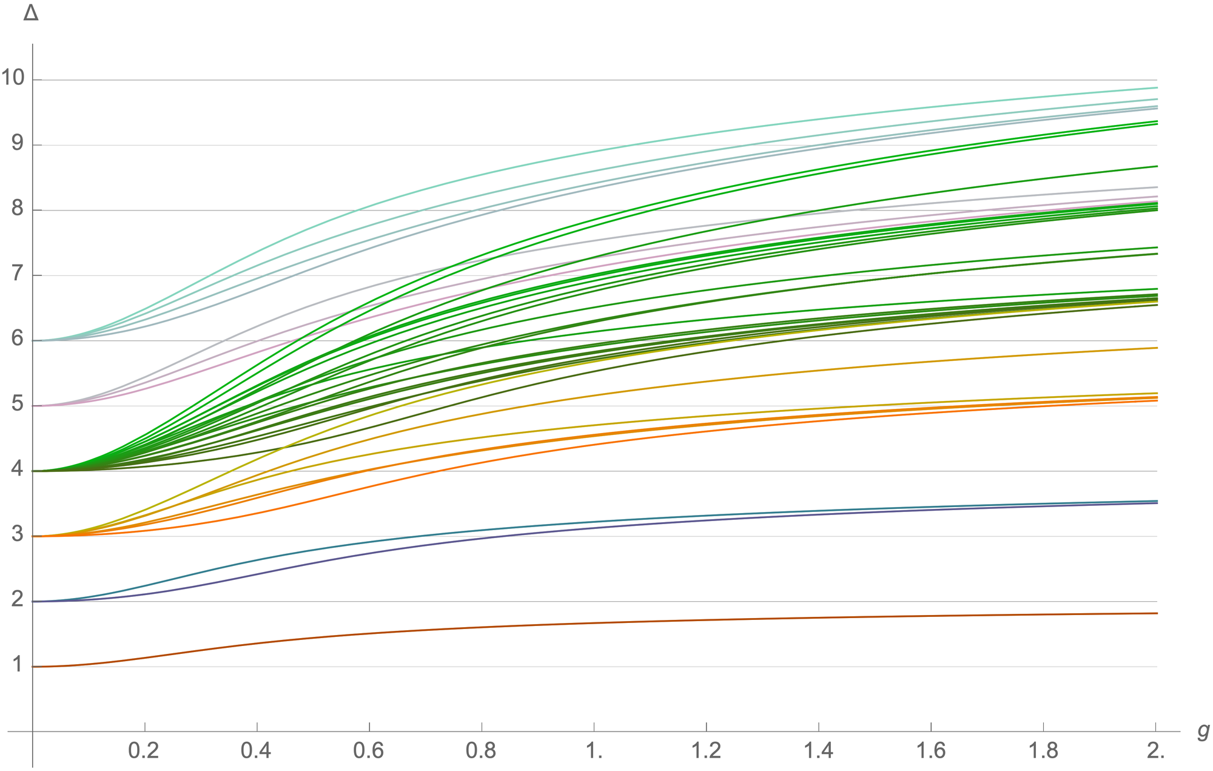
The spectrum
[Cavaglià, NG, Julius, Preti ’21]
[Grabner,NG,Julius ’20]
complete
[Julius, PhD Thesis]
complete

Slide 15
Bootstrapping OPE coefficients

Slide 16

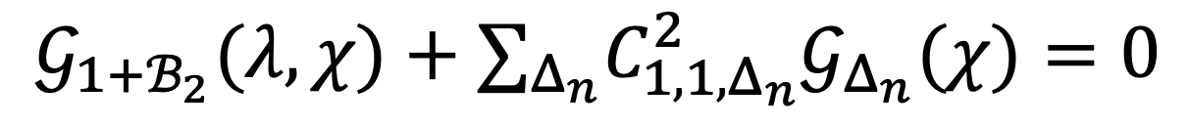
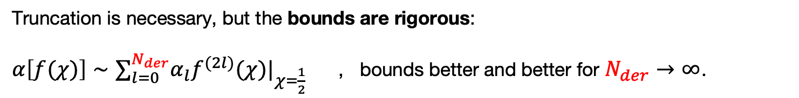
Bootstrability setup
The bootstrap equation obtained before is
$$𝒢_{1+ℬ_{2}}(λ,χ)+∑_{Δ_{n}}C_{1,1,Δ_{n}}^{2}𝒢_{Δ_{n}}(χ)=0$$
1D CFT is unitary $C_{1,1,Δ}^{2}≥0$
Now we have access to the spectrum!
General numerical bootstrap setup:
Given a linear functional $α$, impose how it acts on the crossing equation
Use inequalities to bound the allowed conformal data.
[El-Showk,Paulos,Poland,Rychkov,
Simmons-Duffin,Vichi ’12]
This can be done efficiently with Semi Definite Programming.
We use the powerful package SDPB
[Simmons-Duffin ’15]
Truncation is necessary, but the bounds are rigorous:
$α\left[f(χ)\right]∼∑_{l=0}^{N_{der}}α_{l}{f^{(2l)}(χ)|}_{χ=\frac{1}{2}}$ , bounds better and better for $N_{der}→∞$.

Slide 17
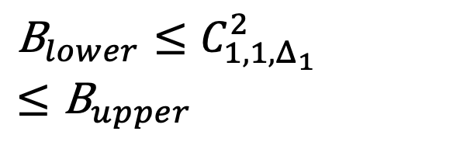
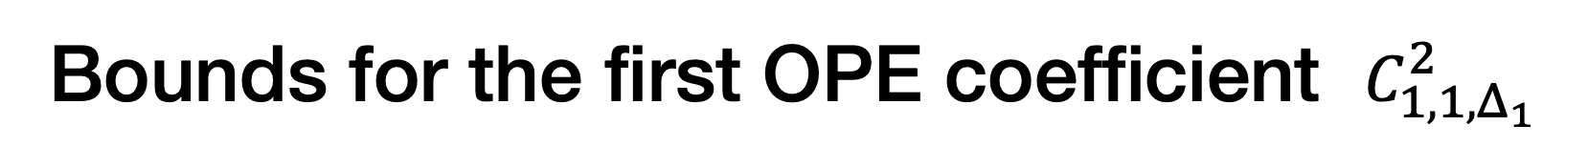
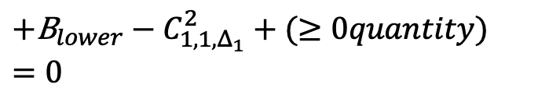

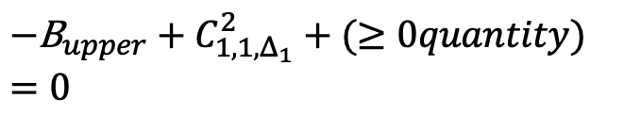

Bounds for the first OPE coefficient $C_{1,1,Δ_{1}}^{2}$
$$𝒢_{1+ℬ_{2}}(λ,χ)+C_{1,1,Δ_{1}}^{2}𝒢_{Δ_{1}}(χ)+∑_{n≥2}C_{1,1,Δ_{n}}^{2}𝒢_{Δ_{n}}(χ)=0$$
Using SDPB, find the functional such that
Lower bound
$α^{upper}[𝒢_{Δ_{1}}]=1$ ,
$α^{upper}[𝒢_{Δ}]≥0$ for $Δ≥Δ_{∗}≡Δ_{2}$
$α^{upper}[𝒢_{1+ℬ_{2}}]$ is maximal $≡−{\text{B}}_{upper}$
$α^{lower}[𝒢_{Δ_{1}}]=−1$ ,
$α^{lower}[𝒢_{Δ}]≥0$ for $Δ≥Δ_{∗}≡Δ_{2}$
$α^{lower}[𝒢_{1+ℬ_{2}}]$ is maximal $≡{\text{B}}_{lower}$
Upper bound
$$−{\text{B}}_{upper}+C_{1,1,Δ_{1}}^{2}+(≥0quantity)=0$$
$$+{\text{B}}_{lower}−C_{1,1,Δ_{1}}^{2}+(≥0quantity)=0$$
$${\text{B}}_{lower}≤C_{1,1,Δ_{1}}^{2}≤{\text{B}}_{upper}$$

Slide 18
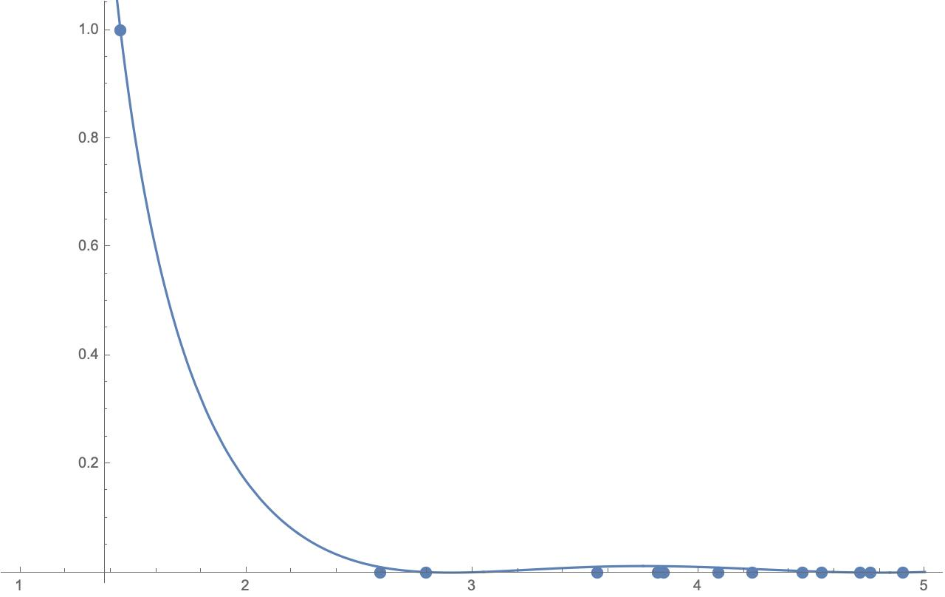
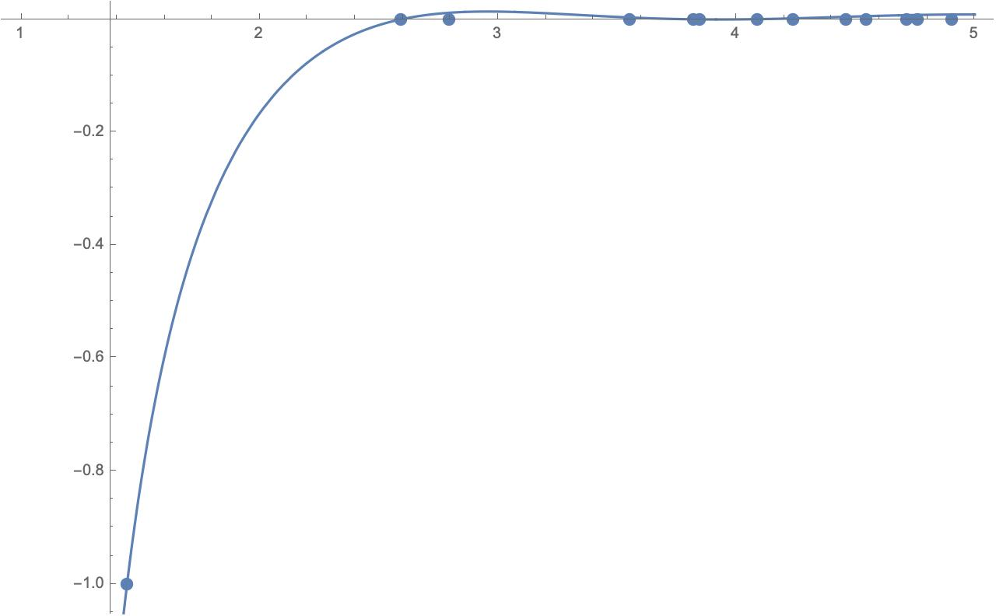






$$α^{upper}\left[𝒢_{Δ}\right]$$
The two functionals for coupling g=1/2, $N_{der}=20$
$$Δ$$
$$α^{lower}\left[𝒢_{Δ}\right]$$
$$Δ_{2}$$
$$Δ$$
$$Δ_{2}$$

Slide 19
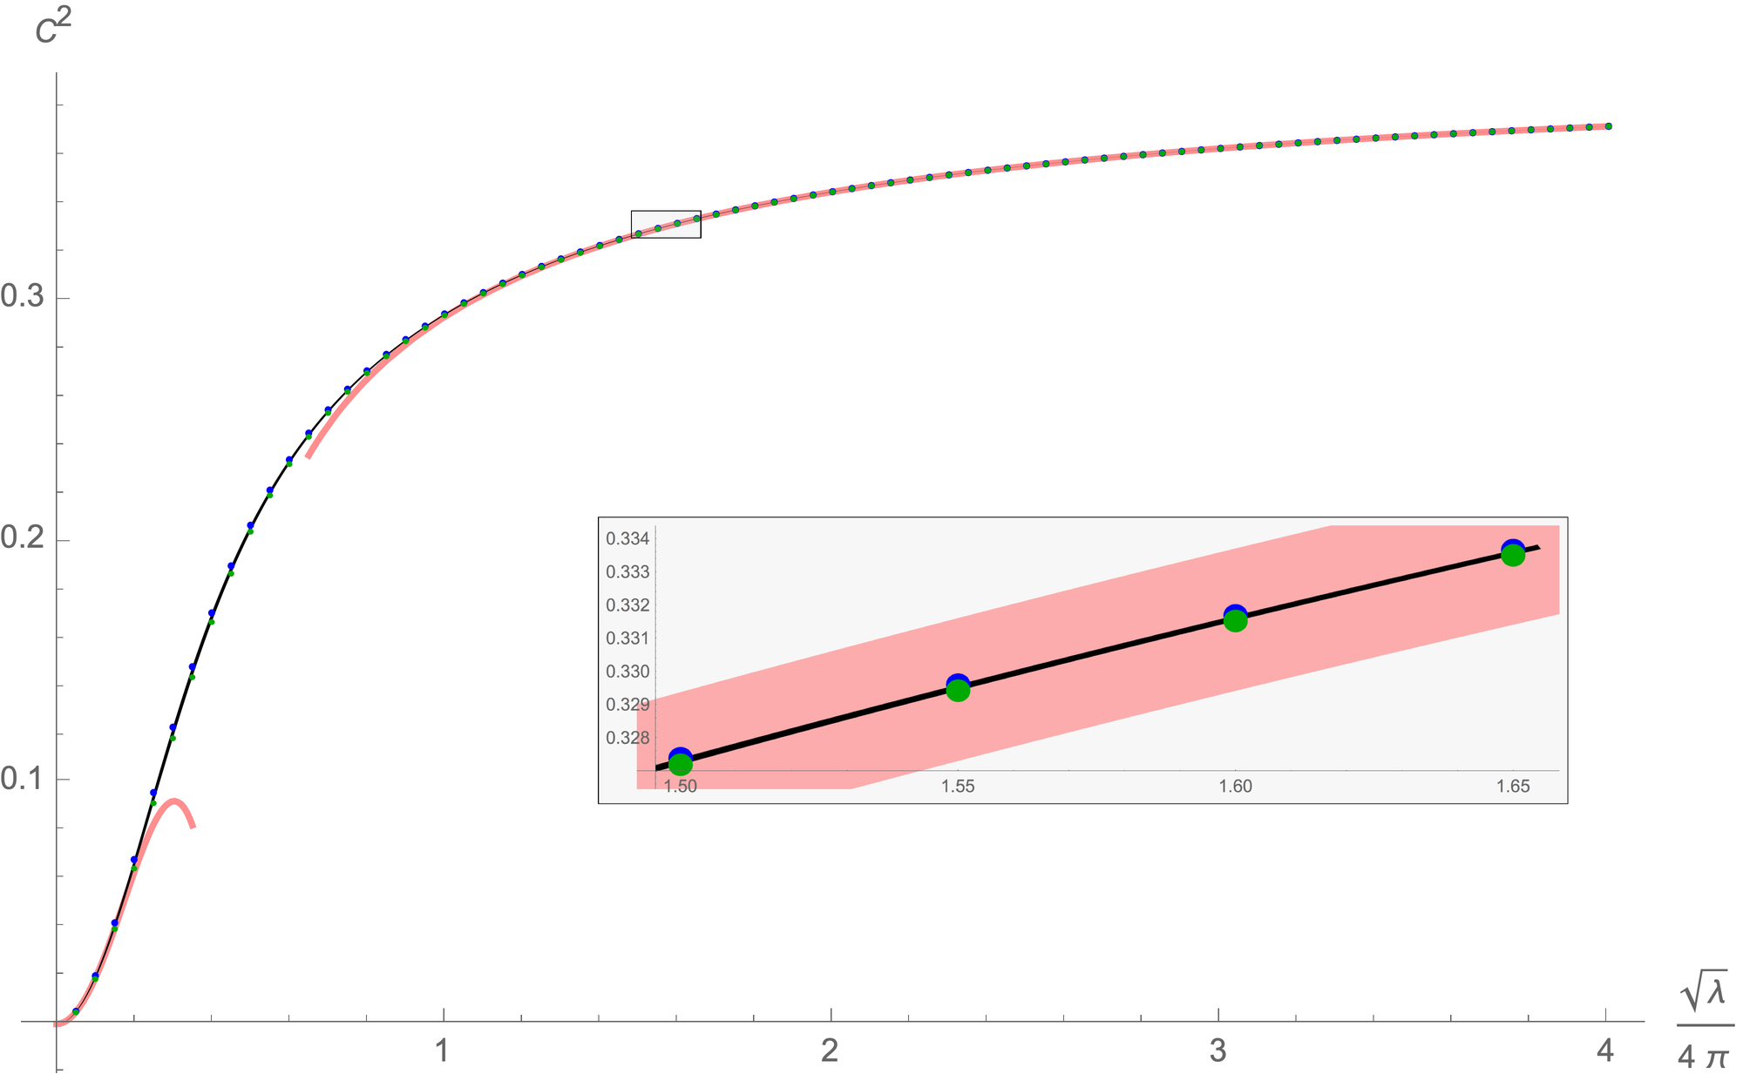
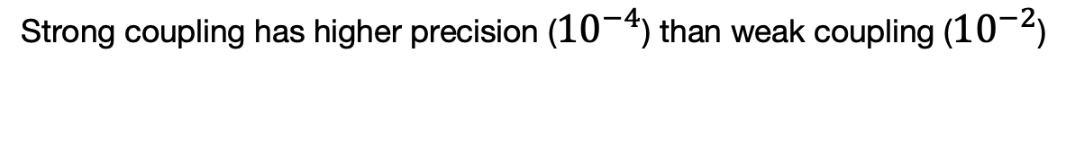
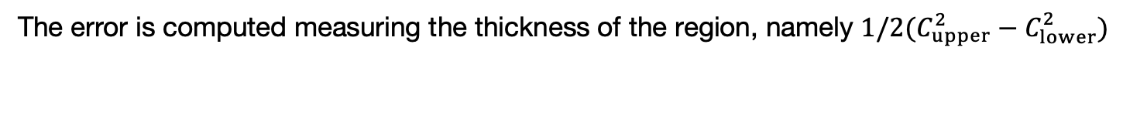
OPE coefficient $C_{1,1,Δ_{1}}^{2}$including only 2 states
[Cavaglià, NG, Julius, Preti ’21]
Strong coupling
[Ferrero Meneghelli ’21]
Strong coupling
[Ferrero Meneghelli ’21]
Weak coupling
[Kiryu Komatsu’18] ; [Cavaglià, NG, Julius, Preti ’22]
The error is computed measuring the thickness of the region, namely $1/2(C_{upper}^{2}−C_{lower}^{2})$
Strong coupling has higher precision (${10}^{−4}$) than weak coupling (${10}^{−2}$)

Slide 20
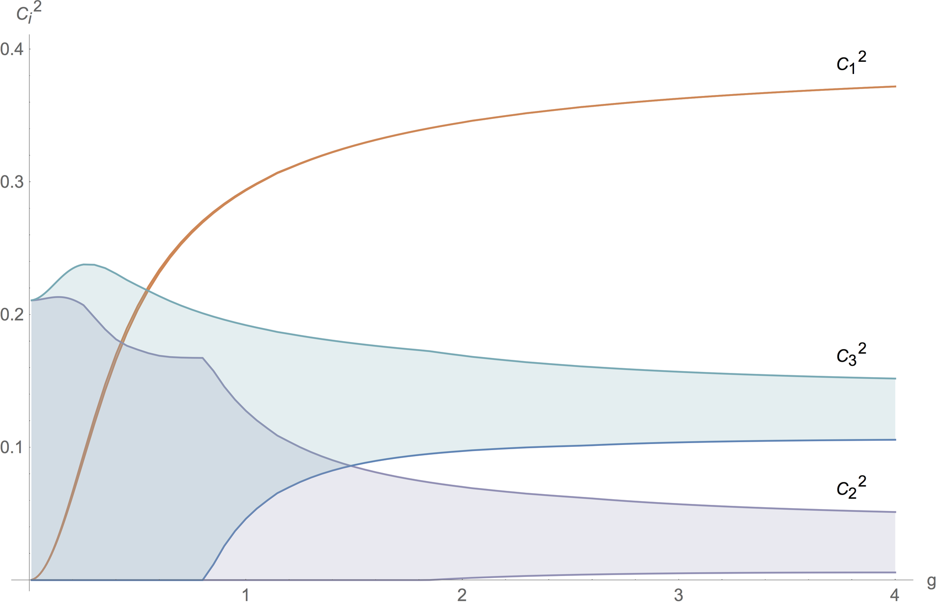

First 3 OPE coefficients including the first 10 states
[Cavaglià, NG, Julius, Preti ’22]
$$N_{der}=60$$
The error reduces from 16% to 75% depending on the coupling

Slide 21
Can we do better?

Slide 22
Integrated correlators

Slide 23
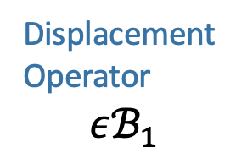
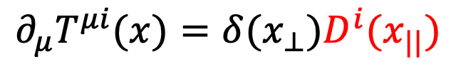
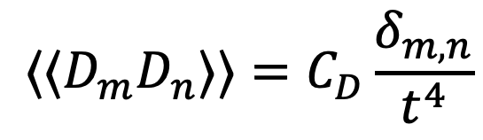

Line deformations
Defect breaks translation invariance
Displacement
Operator
$$εℬ_{1}$$
$$∂_{μ}T^{μi}(x)=δ(x_{⊥})D^{i}(x_{||})$$
$$δW$$
Correlation function of arbitrary operator in presence of the line deformation
$$⟨X⟩_{W+δW}=∫dt⟨⟨XD_{i}(t)⟩⟩δx^{i}(t)+𝒪(δx^{2})$$
The first non-trivial correlator is
$$⟨⟨D_{m}D_{n}⟩⟩=C_{D}\frac{δ_{m,n}}{t^{4}}$$
Fixed by conformal
symmetry

Slide 24

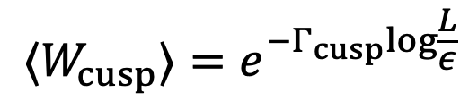
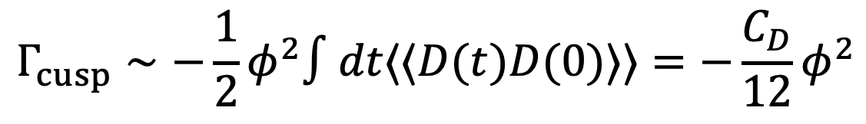
Line deformations
Defect breaks translation invariance
Displacement
Operator
$$εℬ_{1}$$
$$∂_{μ}T^{μi}(x)=δ(x_{⊥})D^{i}(x_{||})$$
Expectation value is divergent and contains the cusp anomaly
$$⟨W_{cusp}⟩=e^{−Γ_{cusp}log\frac{L}{ε}}$$
In the near BPS limit ($φ→0$), it is controlled by the displacement operator
$$Γ_{cusp}∼−\frac{1}{2}φ^{2}∫dt⟨⟨D(t)D(0)⟩⟩=−\frac{C_{D}}{12}φ^{2}$$

Slide 25

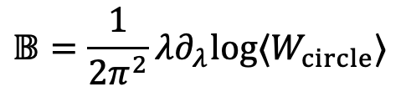
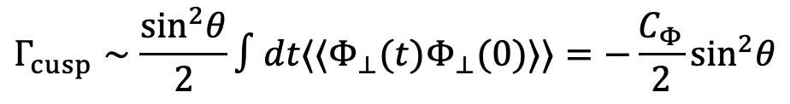
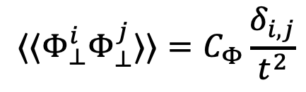



Line deformations
$$δn$$
$$⟨⟨Φ_{⊥}^{i}Φ_{⊥}^{j}⟩⟩=C_{Φ}\frac{δ_{i,j}}{t^{2}}$$
$$Γ_{cusp}∼\frac{\sin^{2}θ}{2}∫dt⟨⟨Φ_{⊥}(t)Φ_{⊥}(0)⟩⟩=−\frac{C_{Φ}}{2}\sin^{2}θ$$
The cusp anomalous dimension at order $\sin^{2}θ$ is computed exactly
$$Γ_{cusp}∼𝔹\sin^{2}θ$$
$$𝔹=\frac{1}{2π^{2}}λ∂_{λ}log⟨W_{circle}⟩$$
Bremsstrahlung
function
[Correa, Henn, Maldacena, Sever ’12]
$$C_{Φ}=2𝔹$$
$$∫dt⟨⟨Φ_{⊥}(t)Φ_{⊥}(0)⟩⟩=−2𝔹$$
Can we exploit the line deformations to obtain constraints for our four-point function?

Slide 26
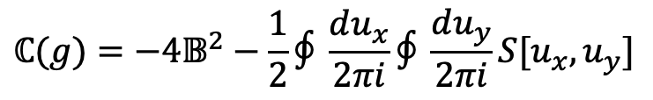
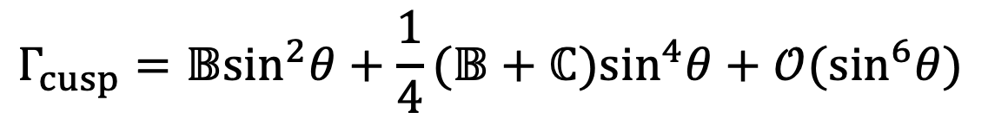
New integrated correlators
We can follow the same logic but expanding the cusp anomaly to the next order
$$Γ_{cusp}=𝔹\sin^{2}θ+\frac{1}{4}(𝔹+ℂ)\sin^{4}θ+𝒪(\sin^{6}θ)$$
[NG,Levkovich-Maslyuk’15]
Curvature
function
$$ℂ(g)=−4𝔹^{2}−\frac{1}{2}∮\frac{du_{x}}{2πi}∮\frac{du_{y}}{2πi}S[u_{x},u_{y}]$$
Solving the integrals running clockwise around the cut $[−2g,2g]$, we obtain
[Cavaglià, NG, Julius, Preti ’22]
$$ℂ=4g^{4}−\left(24ζ_{3}+\frac{16π^{2}}{3}\right)g^{6}+\left(\frac{64π^{2}ζ_{3}}{3}+360ζ_{5}+\frac{64π^{4}}{9}\right)g^{8}−\left(\frac{112π^{4}ζ_{3}}{5}+272π^{2}ζ_{5}+4816ζ_{7}+\frac{416π^{6}}{45}\right)g^{10}$$
$$+\left(\frac{3488π^{6}ζ_{3}}{135}+\frac{2192π^{4}ζ_{5}}{9}+\frac{9184π^{2}ζ_{7}}{3}+63504ζ_{9}+\frac{176π^{8}}{15}\right)g^{12}+O\left(g^{14}\right)$$
$$ℂ=\frac{\left(2π^{2}−3\right)g}{6π^{3}}+\frac{−24ζ_{3}+5−4π^{2}}{32π^{4}}+\frac{11+2π^{2}}{256π^{5}g}+\frac{96ζ_{3}+75+8π^{2}}{4096π^{6}g^{2}}+\frac{3\left(408ζ_{3}−240ζ_{5}+213+14π^{2}\right)}{65536π^{7}g^{3}}+\frac{3\left(315ζ_{3}−240ζ_{5}+149+6π^{2}\right)}{65536π^{8}g^{4}}+O\left(\frac{1}{g^{5}}\right)$$

Slide 27



New integrated correlators
[Cavaglià, NG, Julius, Preti ’22]
The four-point function $𝒜$ and the reduced correlator $f$ obey the following constraints
Constraint 1
Constraint 2
$$∫_{0}^{1}δ𝒜(χ)\frac{1+logχ}{χ^{2}}dχ=\frac{3ℂ−𝔹}{8𝔹^{2}}$$
$$∫_{0}^{1}\frac{δf(χ)}{χ}dχ=\frac{ℂ}{4𝔹^{2}}+𝔽−3$$
$$δ𝒜(χ)≡𝒜(χ)−𝒜_{weak}^{(0)}(χ),δf(χ)≡f(χ)−f_{weak}^{(0)}(χ)$$
Where and the zero-coupling values are
$$f_{weak}^{(0)}(χ)=2χ+\frac{χ}{χ−1},𝒜_{weak}^{(0)}(χ)=\frac{2(χ−1)χ+1}{(χ−1)^{2}}$$
We tested both at weak and strong coupling.
Recently a linear combination of them has been proven
A complete proof
[Drukker, Kong, Sakkas ’22]
[Cavaglià, NG, Julius, `22]
Huge impact on the Bootstrability output

Slide 28

Super tight bounds for structure constant
2 states from QSC
A.Cavaglià, NG, J.Julius, M.Preti, N.Sokolova `21

Slide 29

Super tight bounds for structure constant
10 states,
+curvature function
A.Cavaglià, NG, J.Julius, M.Preti, N.Sokolova `22

Slide 30

Super tight bounds for structure constant
10 states,
+curvature function
A.Cavaglià, NG, J.Julius, M.Preti, N.Sokolova `22

Slide 31

Super tight bounds for structure constant
Approaching precision
of the anomalous magnetic
dipole momentum of electron!
(only 2 digits away)
Only spectrum goes in, no extra localization data, this includes spectrum of deformed theory, which gives integrated correlators

Slide 32






[Cavaglià, NG, Julius, Preti ’22]
$$N_{der}=60\text{and} 140$$
$$𝒪(1/g^{4})$$
$$𝒪(g^{2})$$
$$𝒪(1/g^{0})$$
$$𝒪(g^{8})$$

Slide 33
Analytic Bootstrability

Slide 34
Strategy at weak coupling
The four-point function at weak coupling is known only up to order $g^{2}$
[Kiryu Komatsu’18]
Our strategy to compute higher orders is to formulate an ansatz in terms of Harmonic Polylogarithms (HPL) and then fix the coefficients using
Crossing equation
Conformal data matching
Integral relations
Uniform transcendentally
At order $g^{4}$ we obtain
[Cavaglià, NG, Julius, Preti ’22]
$$G_{weak}^{(2)}(x)=\frac{4(1−2x)}{(1−x)^{2}}[\frac{π^{2}}{3}(H_{2}−H_{1,0}+H_{1,1})−3ζ_{3}H_{1}+2(H_{1,2,1}−H_{1,1,2}−H_{2,0,0}−H_{1,1,0,0})$$
$$+\frac{(x−1)x+1}{2x−1}\left(2H_{2,1}−2H_{1,0,0}+(x−1)H_{1,1,0}−(x−2)H_{2,0}+xH_{3}+\frac{π^{2}}{3}(H_{1}−xH_{0})\right)$$
$$+\frac{(x^{3}+1)}{1−2x}H_{1,2}+H_{1,3}−H_{2,2}+2H_{3,0}+2H_{3,1}+H_{1,2,0}−H_{2,1,0}+x\frac{2π^{4}x−45((x−1)x+1)ζ_{3}}{15(2x−1)}]$$

Slide 35



OPE coefficients at weak coupling
As a bi-product we obtain several results for the structure constants of which the most interesting ones are the following
Classical dimension = 1
$$C_{1}^{2}(g)=2g^{2}−\left(24−\frac{4π^{2}}{3}\right)g^{4}+\left(320−16π^{2}+48ζ_{3}−\frac{76π^{4}}{45}\right)g^{6}$$
$$−\left(4480−\frac{832π^{2}}{3}+256ζ_{3}−\frac{224π^{4}}{15}+880ζ_{5}−\frac{64π^{6}}{45}\right)g^{8}+O(g^{10})$$
Classical dimension = 2
$$C_{2}^{2}=\frac{1}{10}+\frac{1}{150}\left(10π^{2}−75−9\sqrt{5}\right)g^{2}+O(g^{4})$$
$$C_{3}^{2}=\frac{1}{10}+\frac{1}{150}\left(10π^{2}−75+9\sqrt{5}\right)g^{2}+O(g^{4})$$
Classical dimension = 3
$$C_{6}^{2}=\frac{1}{14}+\frac{2}{7\sqrt{37}}+O(g^{2})C_{8}^{2}=\frac{1}{14}−\frac{2}{7\sqrt{37}}+O(g^{2})$$
[Cavaglià, NG, Julius, Preti ’22]

Slide 36
Multi-correlators

Slide 37








4 types of correlators

Slide 38








Extra spectra

Slide 39










BPS constants
We fix BPS structure constants from localization/integrability
Crossing equation takes the form

Slide 40






































Slide 41
















































[Chester, Landry, Liu, Poland Simons-Duffin, Su, Vichi `20]

Slide 42




Slide 43




Slide 44














Slide 45
Local operators?

Slide 46

[NG, Julius, N.Sokolova ‘23]
All 219 states with bare dimension <= 6
Improved performance at weak coupling,
allowing to start numeric
from perturbation theory (1 loop could be enough)
C++ code to generate more if needed
(https://github.com/julius-julius/qsc)
Merges with analytic bootstrap at strong coupling giving new predictions for structure constants
[LF Alday, T Hansen, JA Silva ‘23]
[LF Alday, T Hansen ‘23]

Slide 47
What’s next?
Non-protected multi-correlators With ~10 states, there are a lot of correlators!
Local operators - we gain a lot more symmetry (4D CFT) with a similar (smaller?) number of states.
We can also add data from deformations of N=4 (QSC known)
Get rid of SUSY and Unitarity – with known spectrum those are not crucial – could help to simplify the standard numerical bootstrap
See [Niarchos, Papageorgakis, Richmond, Stapleton, Woolley ‘23]

