Slide 1
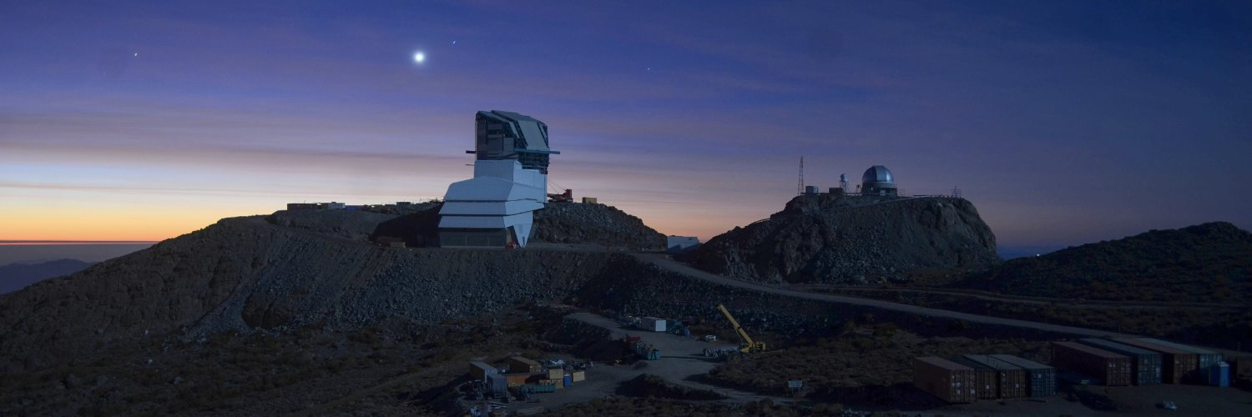
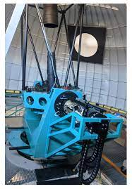
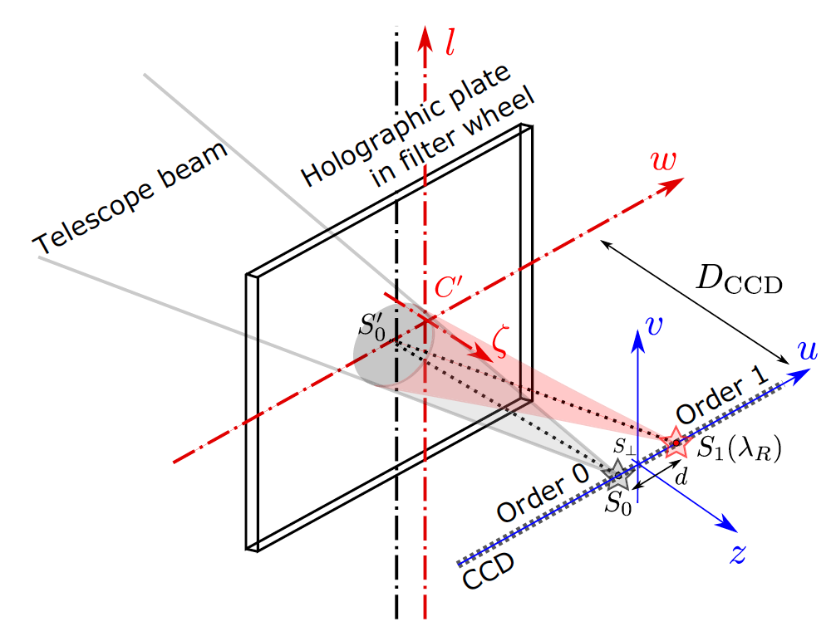
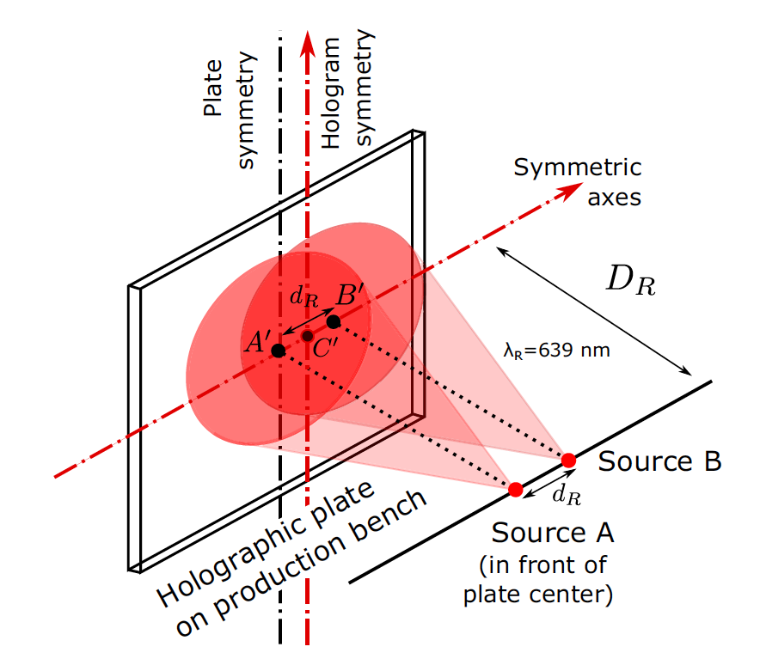
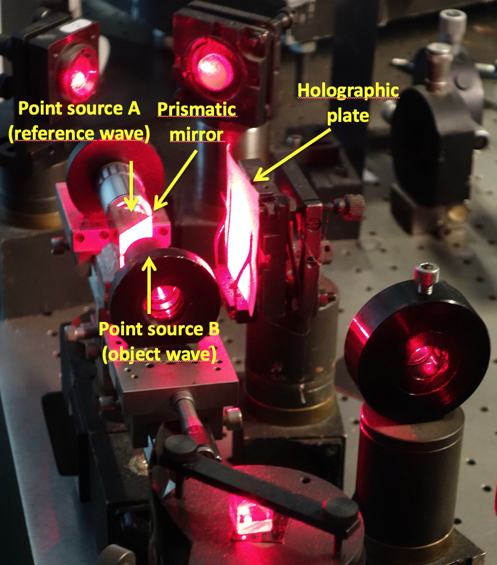
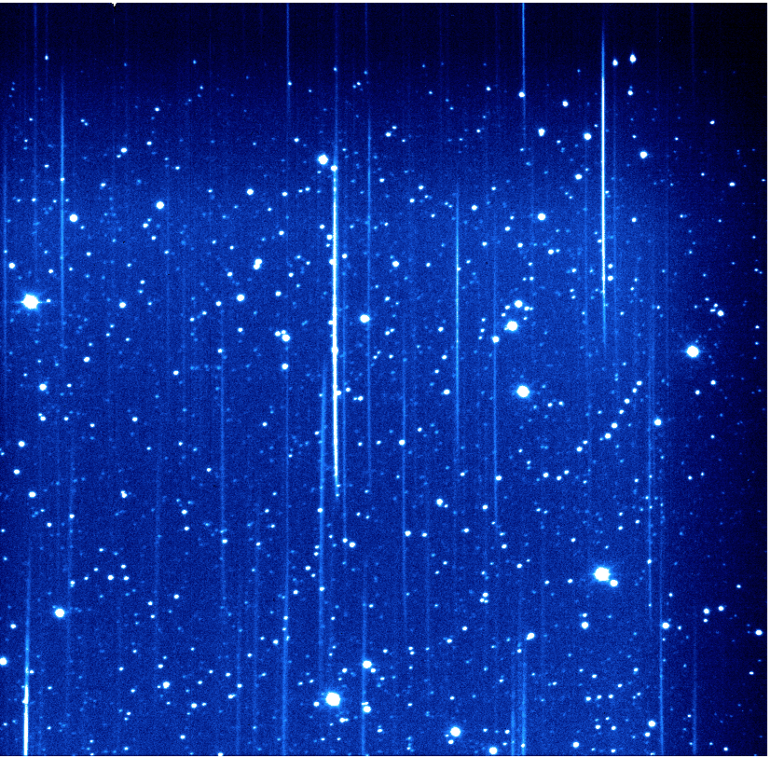
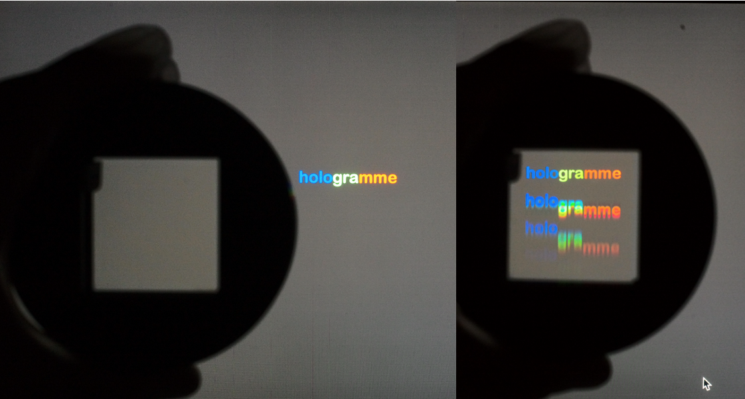
Main Telescope
Auxiliary Telescope
Le telescope auxiliaire (AuxTel)
D. Boutigny, S. Dagoret-Campagne, J. Chevalier, L. Le Guillou, M. Moniez, J. Neveu, M. Rodriguez-Monroy
+ Observing team (Patrick, Merlin, Tiago, Craig, Erik, Ioana, Alysha & others)
Rubin-LSST France, LPNHE, 30 nov. 2022
Use as disperser
Hologram recording
AuxTel
Notes:
Ne pas rentrer dans les détails

Slide 2
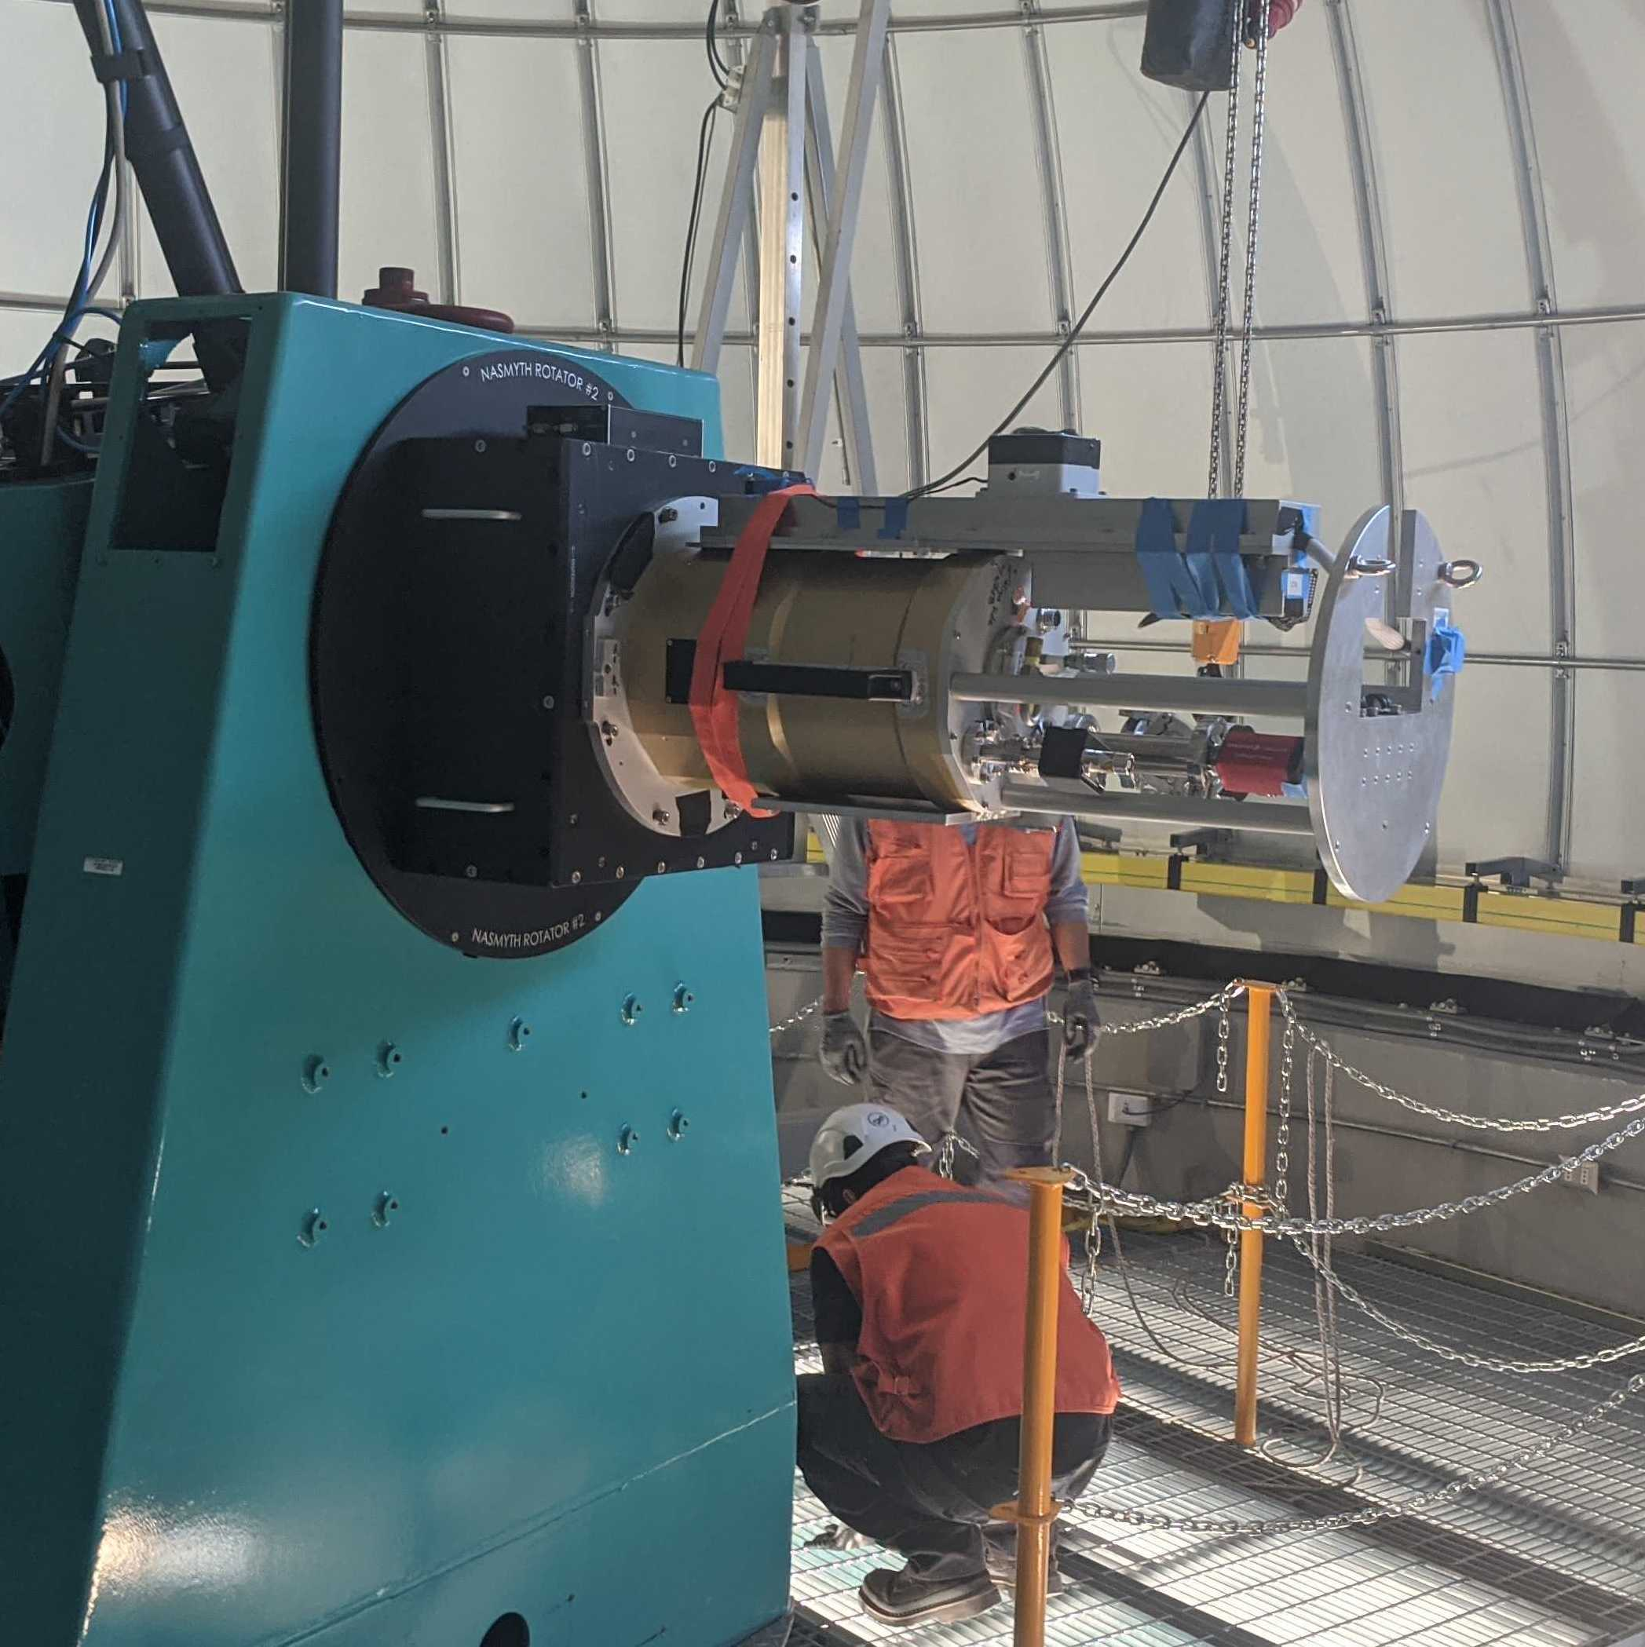
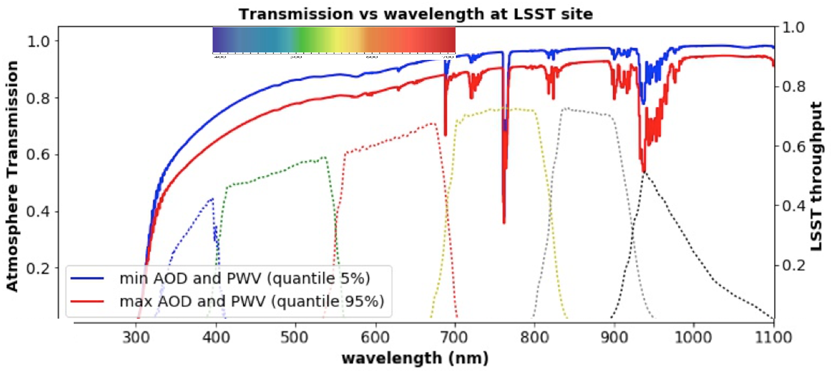
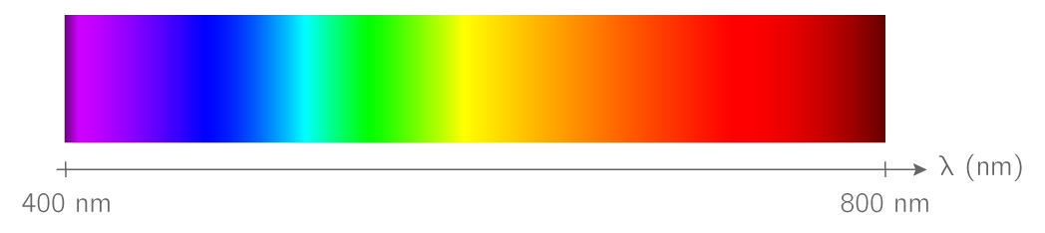
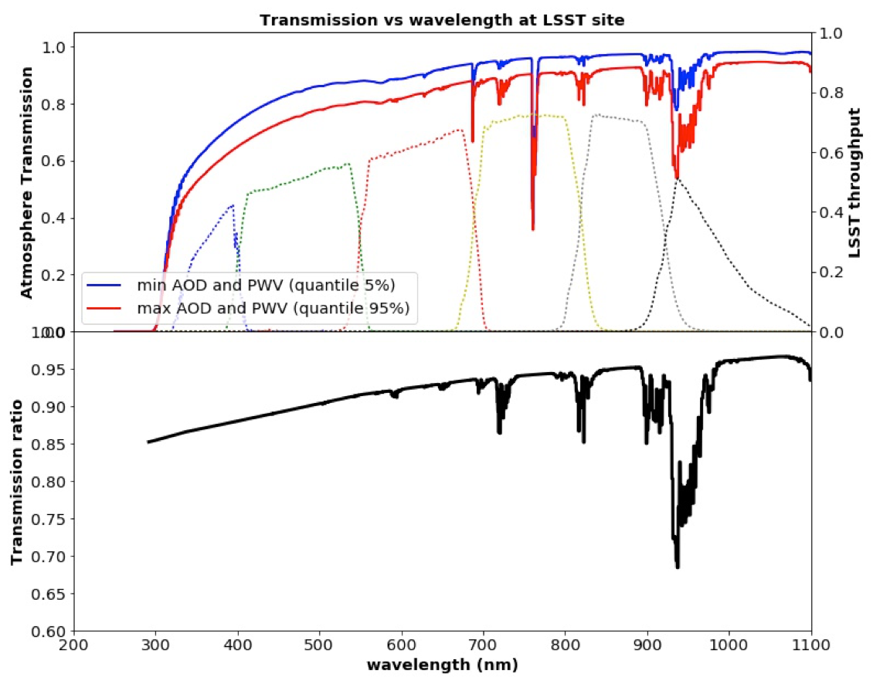
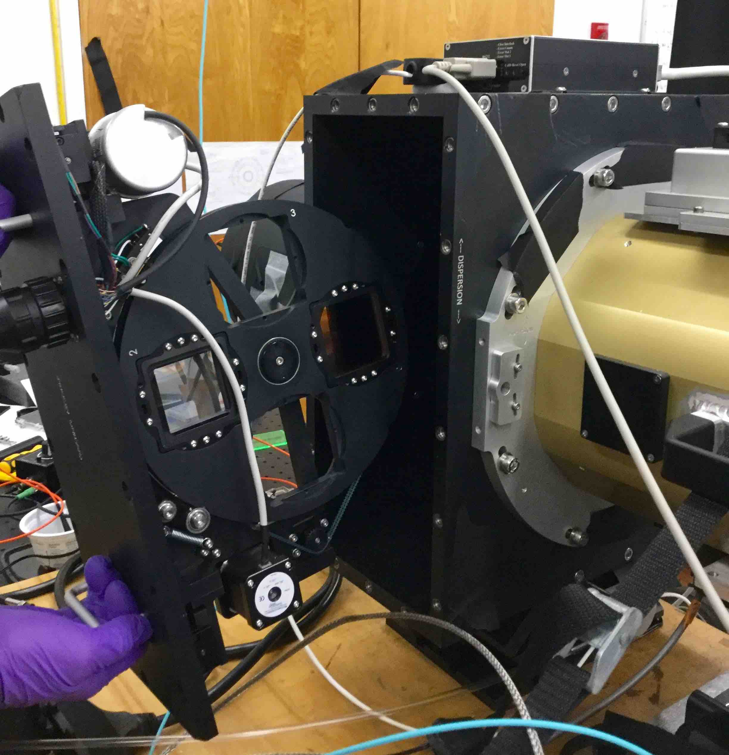
AuxTel spectrograph mission: measure the atmospheric transmission to derive the expected fluxes for each object under standard atmospheric conditions
Estimate colour corrections, as functions of the atmospheric conditions and of the object UGRIZY in every LSST field
Example below
- Constant airmass, constant O₂ and O₃. No cloud
- Change only : H₂O (PWV), Aerosols
AuxTel spectrometer
Aerosol/no aerosol
Wet/dry

Slide 3
Some facts about AuxTel
Telescope
- D = 1.20m, f/D = 18, f = 21.6m
- Depth of focus 1 arcsec (10 pixels) for 1.8mm change in distance (small aperture).
- Secondary mirror (M2) Obturation: 0.3m
Total collection area : S= 1.06 m² (taking into account M2 obturation)
Zero point : M(no filter nor dispersor) = 27.8 – 2.5 Log10(Flux in ADU/s)
Detector
- Plate scale: 105µm/arcsec -> about 10 pixels/arcsec.
Field of view : 6.3 Arcmin.
CCD gain ~ 1.1 -> 1.3 (from 2022/09/22) photoelectron/ADU
Light distribution
For a sky background of 20 mag/(‘’)² (~ full moon): expect 13 ADU/pixel/s
For a sky background of 22 mag/(‘’)² (~ new moon): expect 2 ADU/pixel/s
Saturation (no filter, no disperser, assuming seeing of 1’’): M_{sat}=13.35+2.5Log₁₀(Texp/30s)
Geometry
- Distance camera window-CCD : 63.85mm. Light beam diameter at this distance : 3.55mm
- Distance dispersor-CCD: ~ 191.4mm (tilted). beam diameter at this distance : 10.6mm
- Distance filter-CCD : 229mm (tilted)

Slide 4
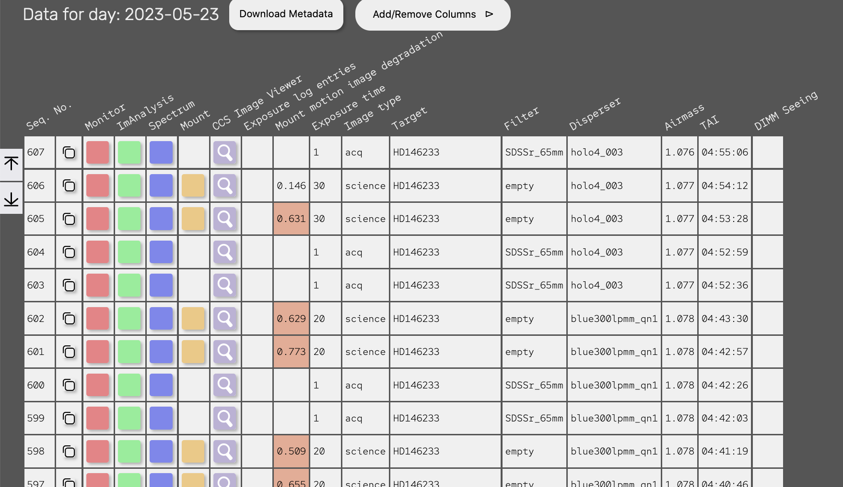
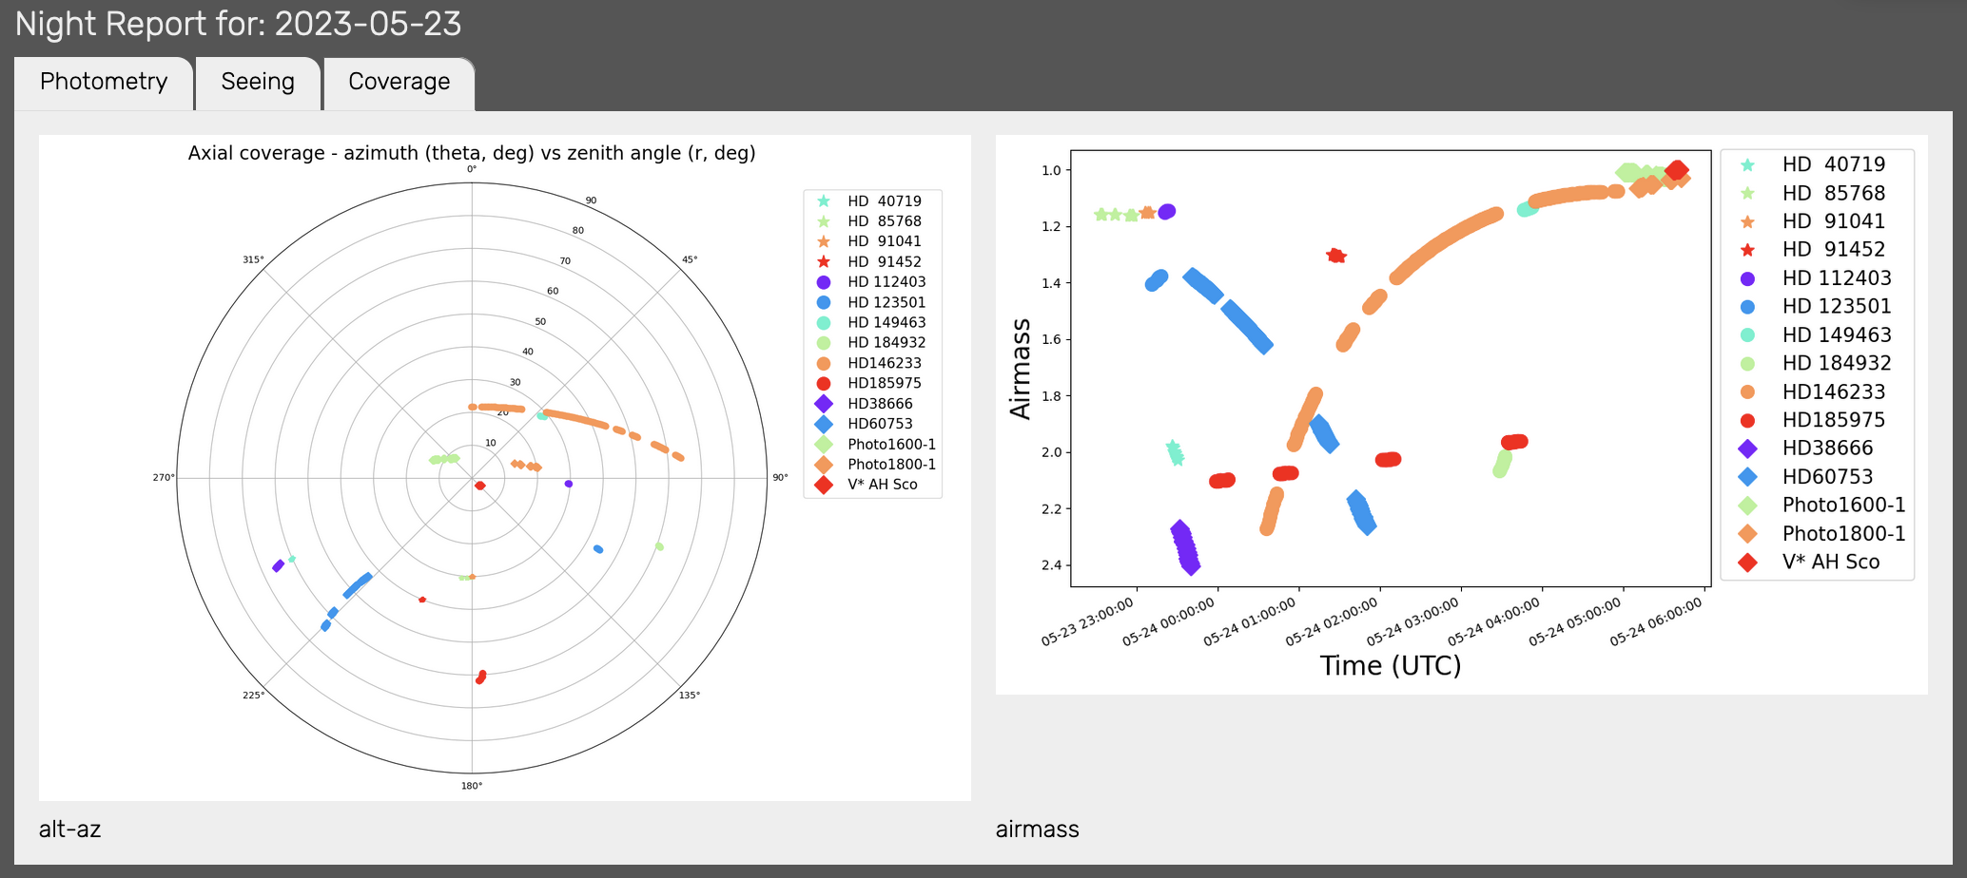
AuxTel observation ecosystem newcomers welcome
3000-4000 spectra taken since feb. 2021
One 3-night run per month (new moon)
Now two runs/month
One contact person for each run
Sometimes online participation
  From 2am (Paris-time)
Strategy updated (JIRA ticket) for each run
Data reduction -> Sylvie
Check (direct or the day after) with Rubin-TV
https://roundtable.lsst.codes/rubintv/summit/auxtel
Slack channels
  Run preparation: auxtel-operations
  Control room: summit-auxtel
  Data reduction: auxtel-computing
  Analysis: desc-pc-auxtel

Slide 5
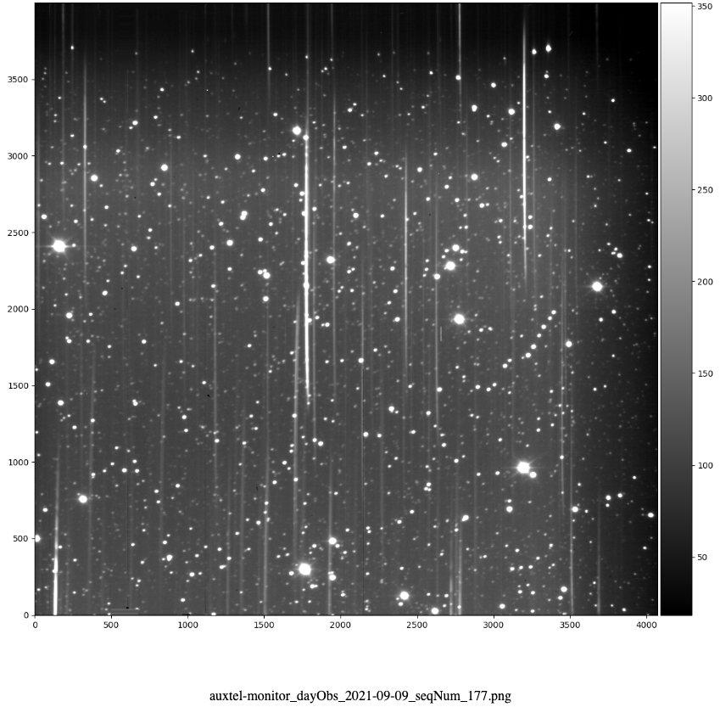
How does it look like?
hologram dispersion
Atmospheric dispersion (x20)

Slide 6
AuxTel: chantiers en cours
Image reduction
- Flat-fielding in spectroscopy : analysis -> Martin
- Hardware: flat-fielding in spectroscopy / mitigate impact of field stars : -> Marc
Spectrum Extraction
- Full understanding of order2/order1
- Understanding of telescope throughput
Atmospheric studies
  Fit of atmospheric parameters
  - Known –constant- atmospheric effects (not measured): Rayleigh
  - Variable atmospheric parameters : water, ozone, aerosols, clouds
  Estimated at airmass=1
Compensation of the color variations due to atmosphere (Discussion). Color changes induced by water vapor / aerosols

Slide 7
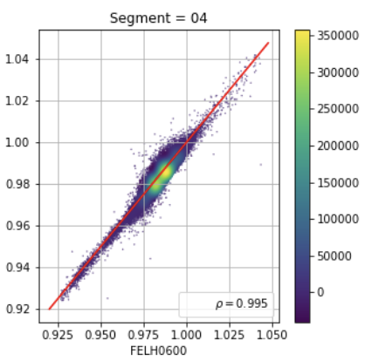
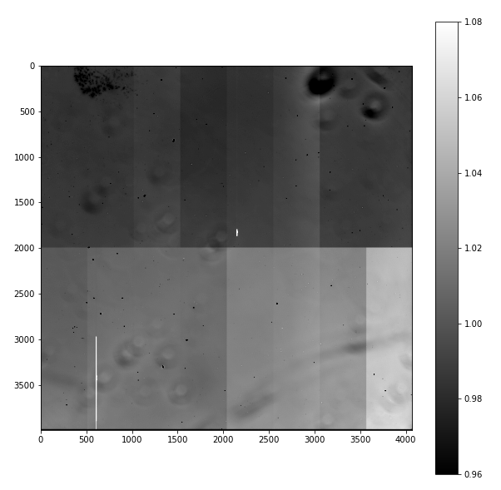
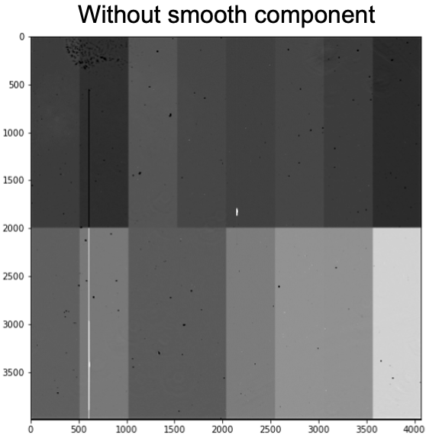

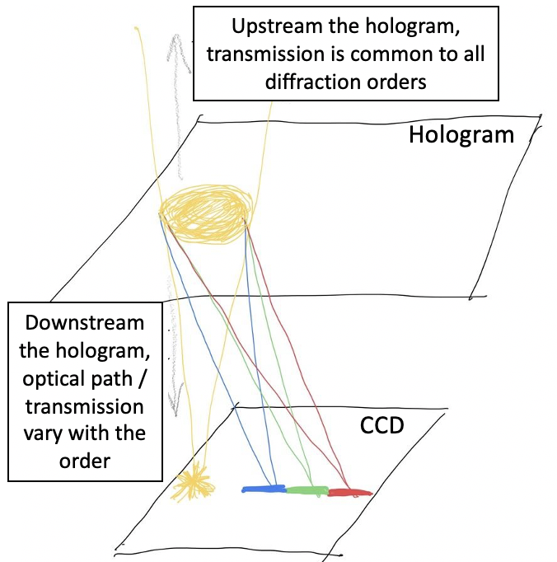
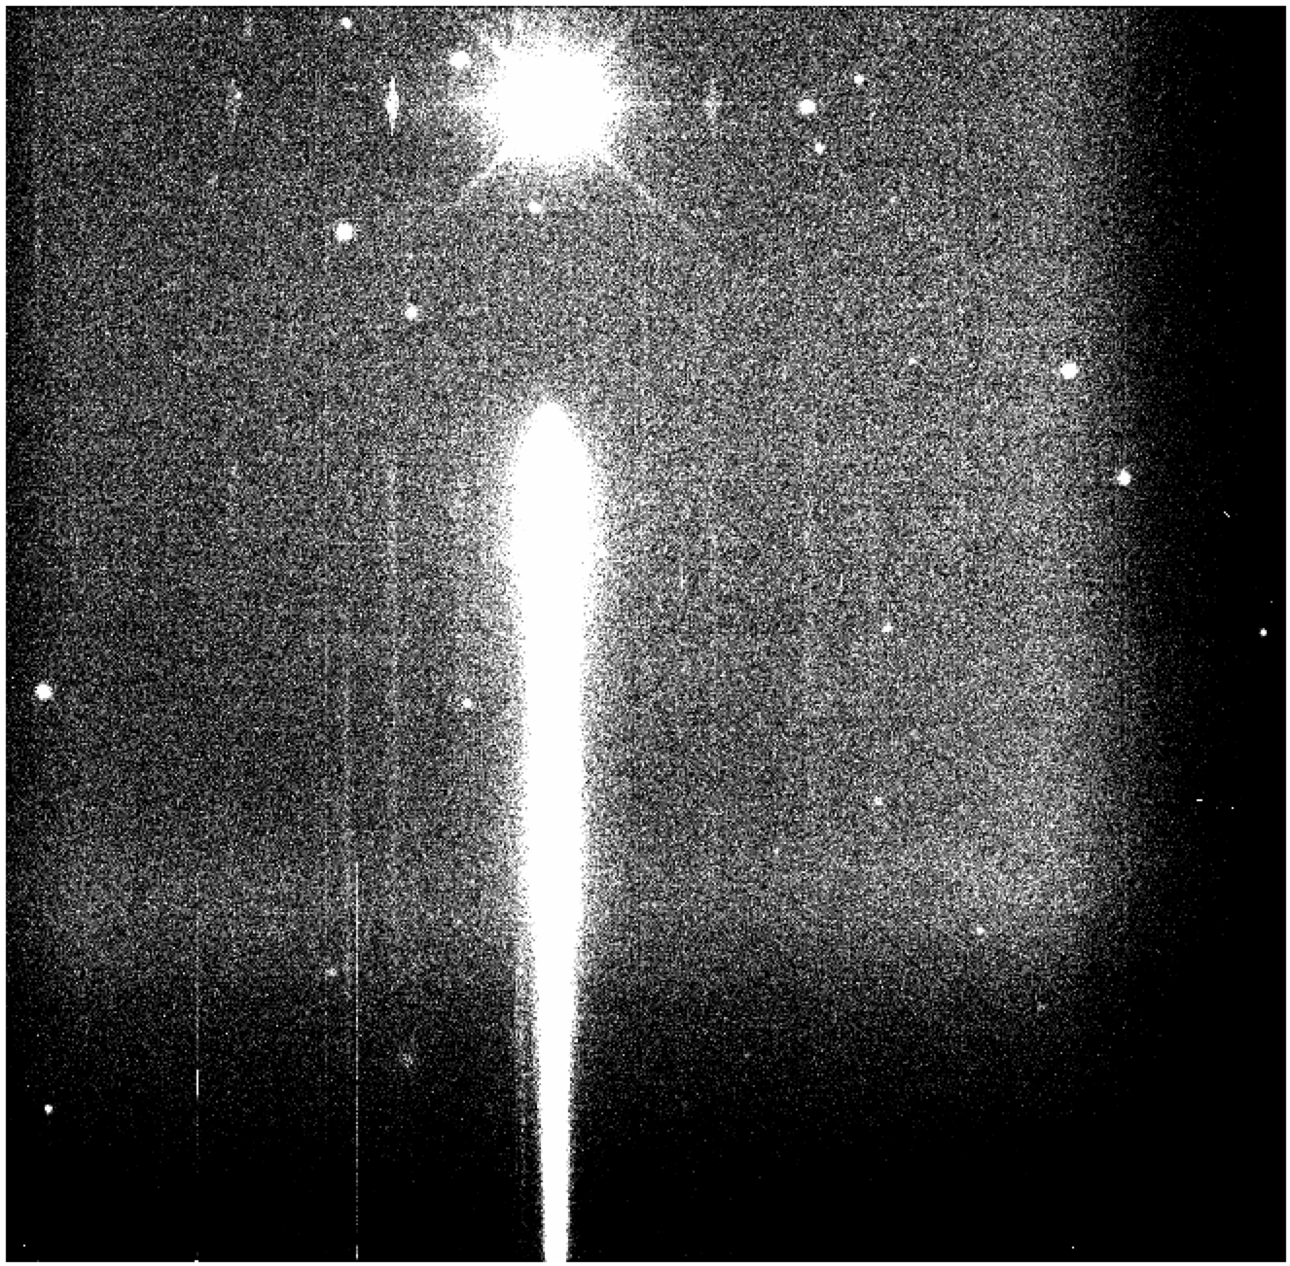
Flat-fielding in spectroscopy
Flat-fielding is not standard for spectroscopy
  Ultimately, the CBP will be the best tool
  In the meanwhile,we use approximations :
    Keep only fluctuations due to camera window + CCD (dust & pixel-to-pixel gain variations)
    spatial and wavelength efficiencies factorize
  A line of light to produce a special flat-field
Blue flat pixel value
Red flat pixel value
Normal flat FELH0600
flat after filtering slow variations due to upstream optics
Vignetting affects direct image but not spectrum

Slide 8
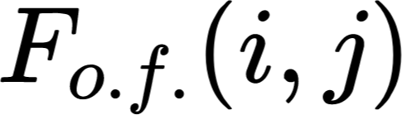
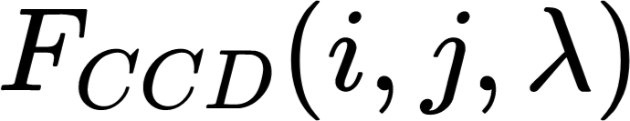
Factorization of the wavelength dependence
Idea:
Evaluate spatial correlation between flats with different filters
See if can factorize out the wavelength dependency on the flats:
  = out of focus artifacts (vignetting, dust on optical components) = slow pixel to pixel variation (real space) or low spatial frequency (Fourier space)
  = focused artifacts (dust on the CCD, pixel surface variations) = fast pixel to pixel variation or high spatial frequency
  We examine the hypothesis of
If ~ true, then we could preliminary use a single flat for spectra reduction
How can we test this?
  By examining the ratio of flat images at different wavelengths (with different filters)

Slide 9
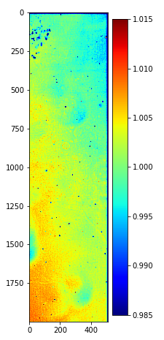
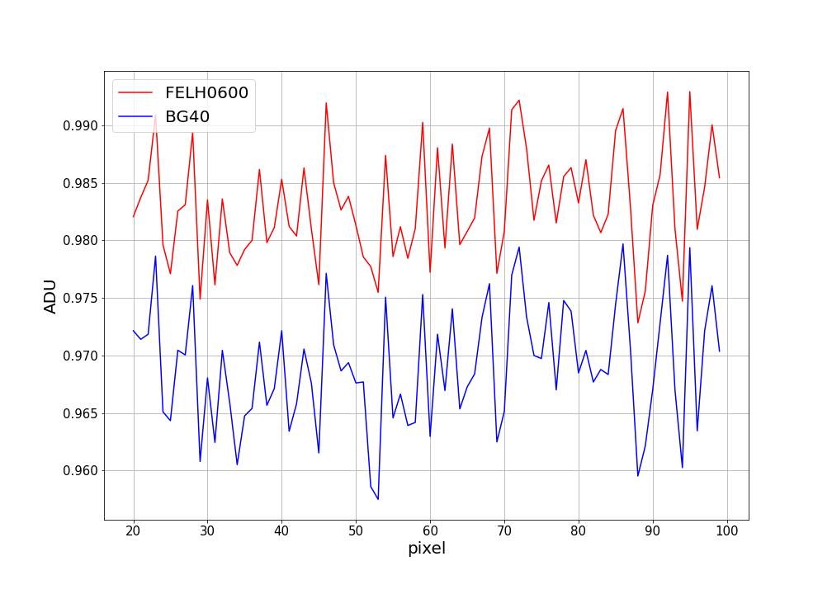
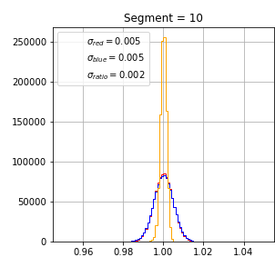
Factorization of the wavelength dependence: pixel correlation
⍴ = 0.96
Relative dispersion of ratio
ADU Relative dispersion

Slide 10
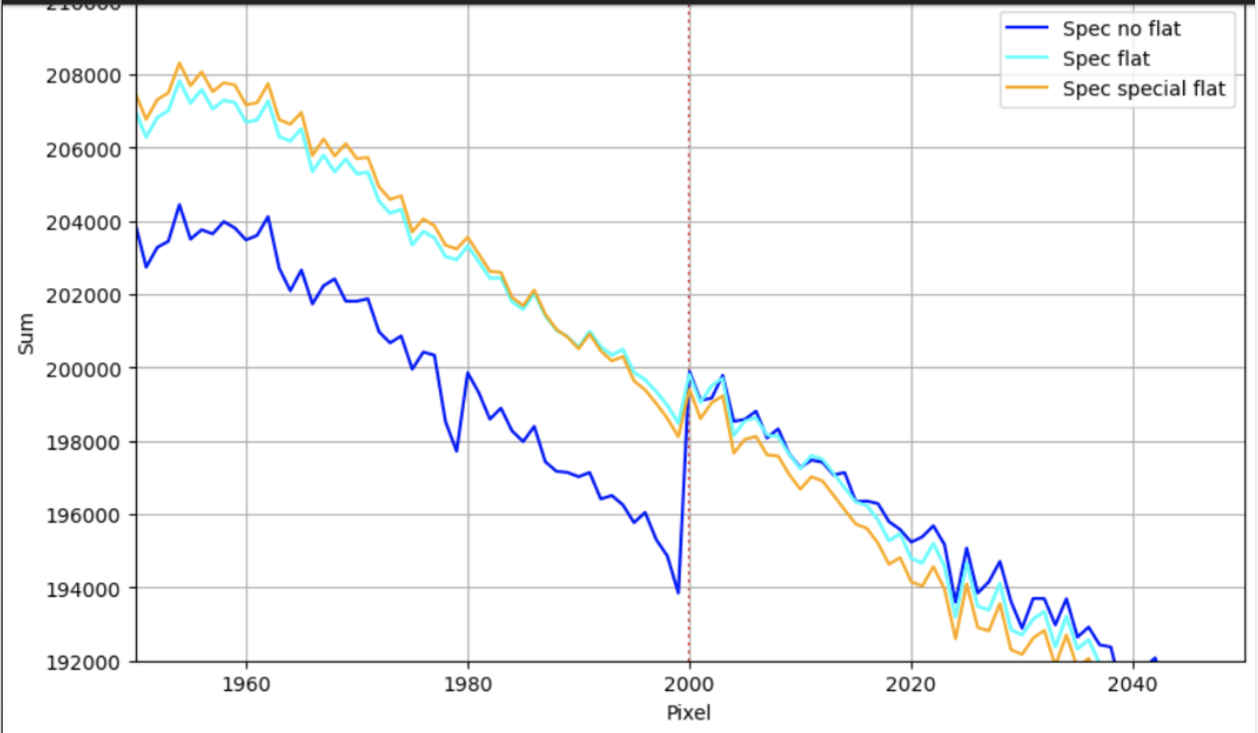
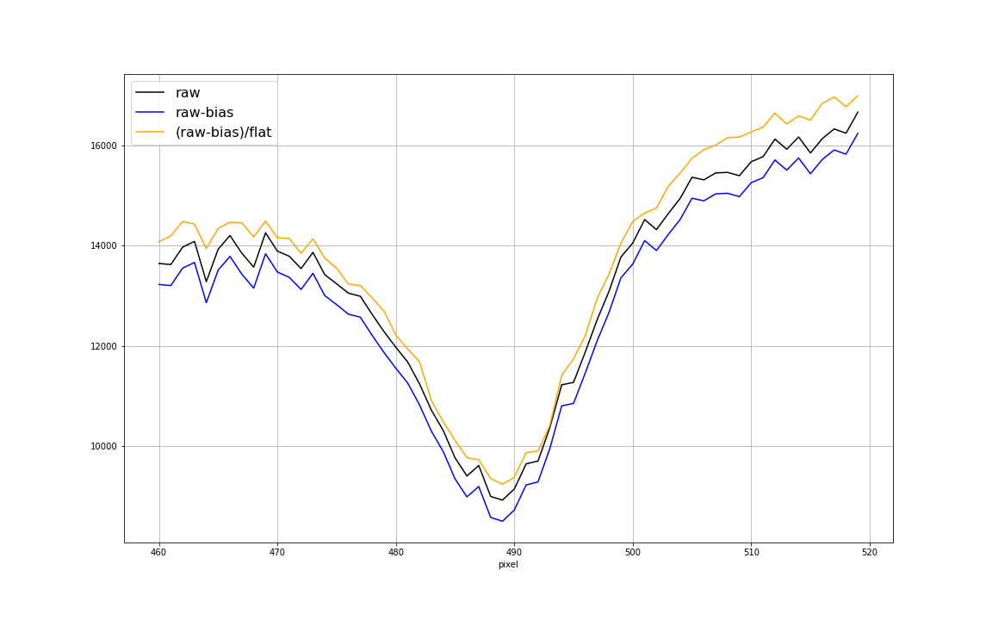
Flat-fielding in spectroscopy
Inter-register gap
Difference (normal flat) vs (special flat):
Visible on large-scale only
-> spots from upstream optics are out-of-focus and impacts only the direct light of a normal flat
Impact of flat-fielding on a segment of pixels on the crest of the spectrum (around a spectral line)
-> smaller pixel-to-pixel variations

Slide 11
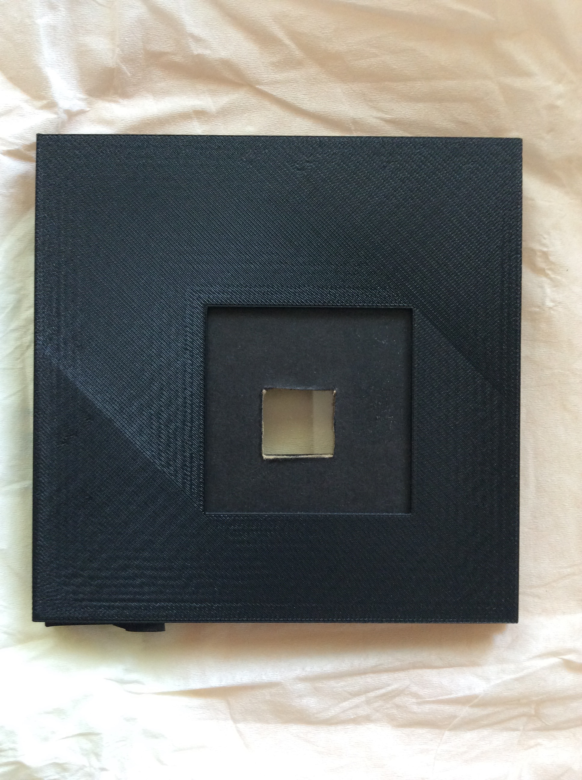
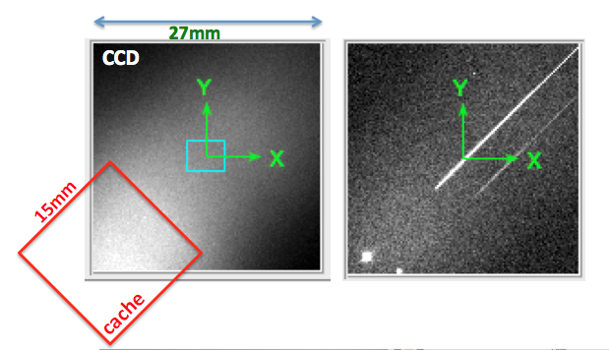
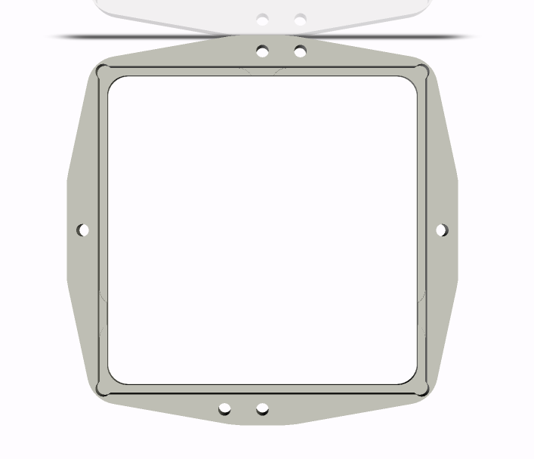
Hardware to mitigate field star contamination
Simple hardware to be installed in the filter wheel (less than 3cm distance to the hologram)
  For special flat-fielding: cylindrical lens
  To mitigate the field stars: collimator
  -> already (successfully) tested with the first hologram prototypes at CTIO and Pic du Midi
  -> reduces both sky background and 0th order field stars. The structure of the sky background (section orthogonal to the dispersion) remains invariant by translation along the dispersion axis with a squared collimator
window
65
62
17
15
No source
With source

Slide 12
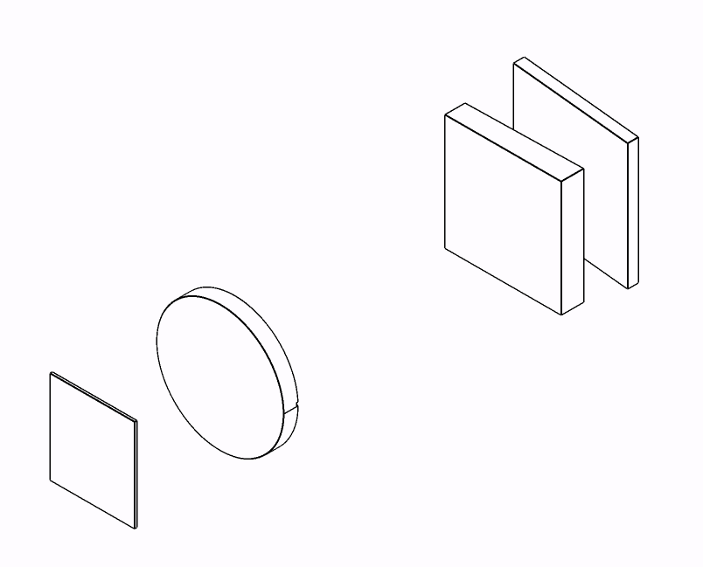
Optical setup
Disperser wheel
Filter wheel

Slide 13
Optical design
Cylindrical lens
Disperser
Filter

Slide 14
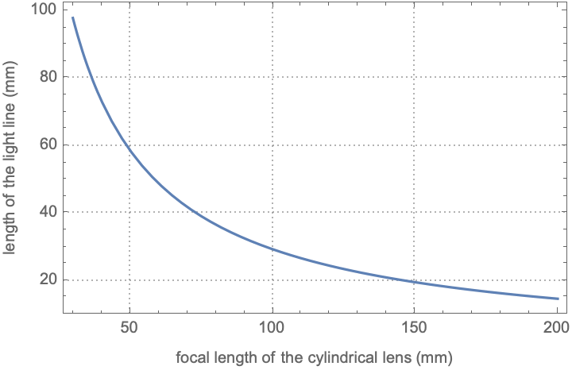
Optical design
Disperser
Filter

Slide 15
Optical design
Disperser
Filter
Light profile shape invariant with λ
-> Deviations are attributable to defects in the input window and the CCD

Slide 16
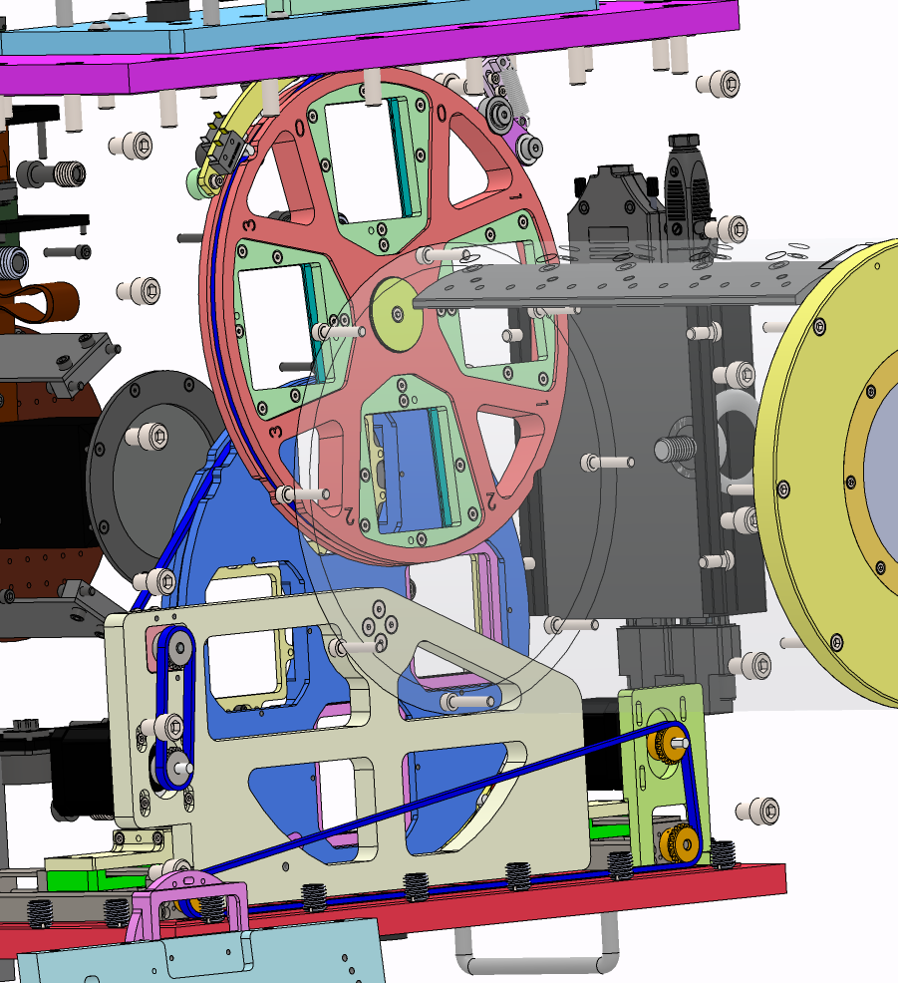
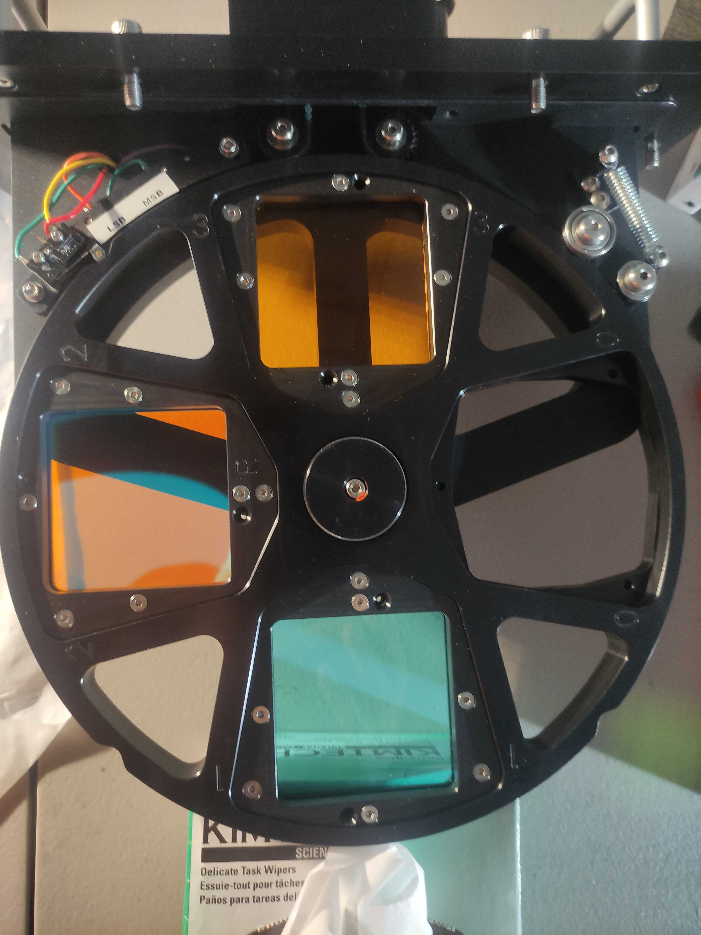
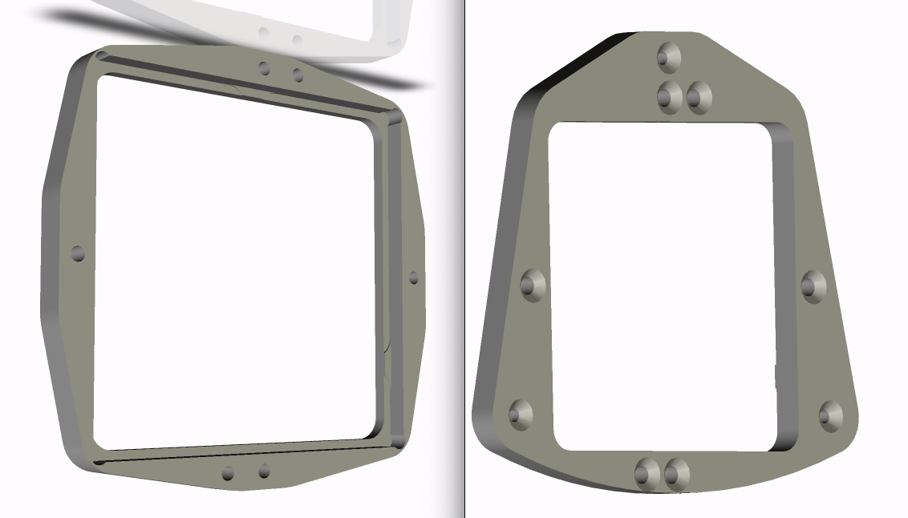
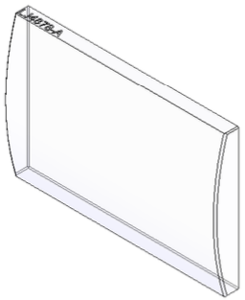
Frame conception
62
65
62

Slide 17
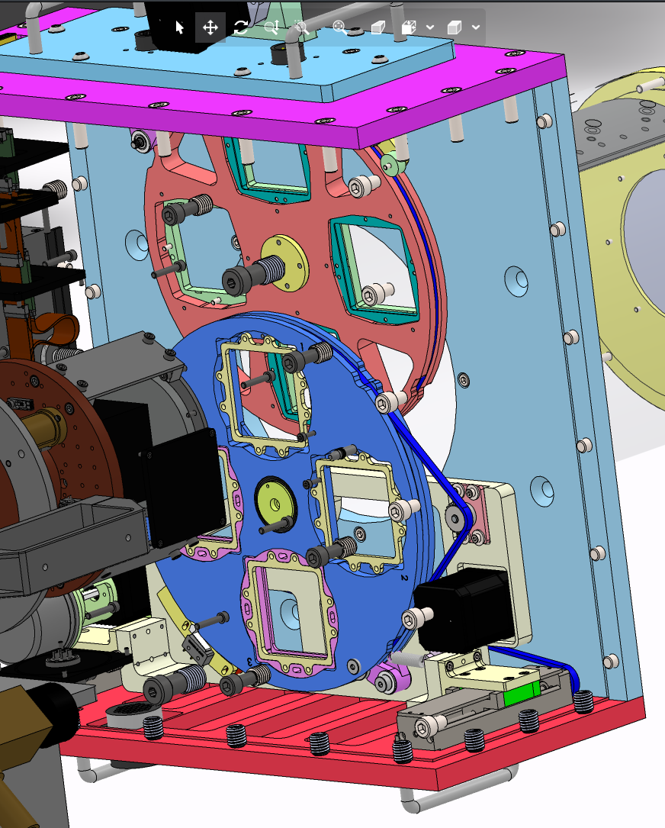
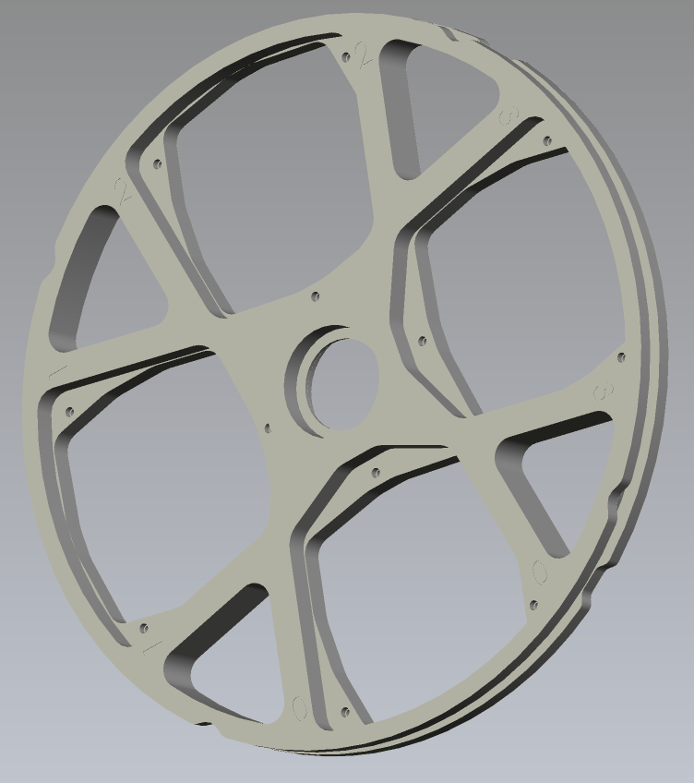

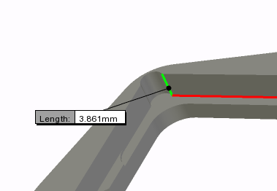
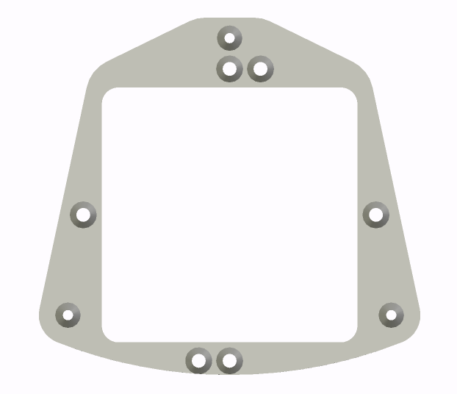
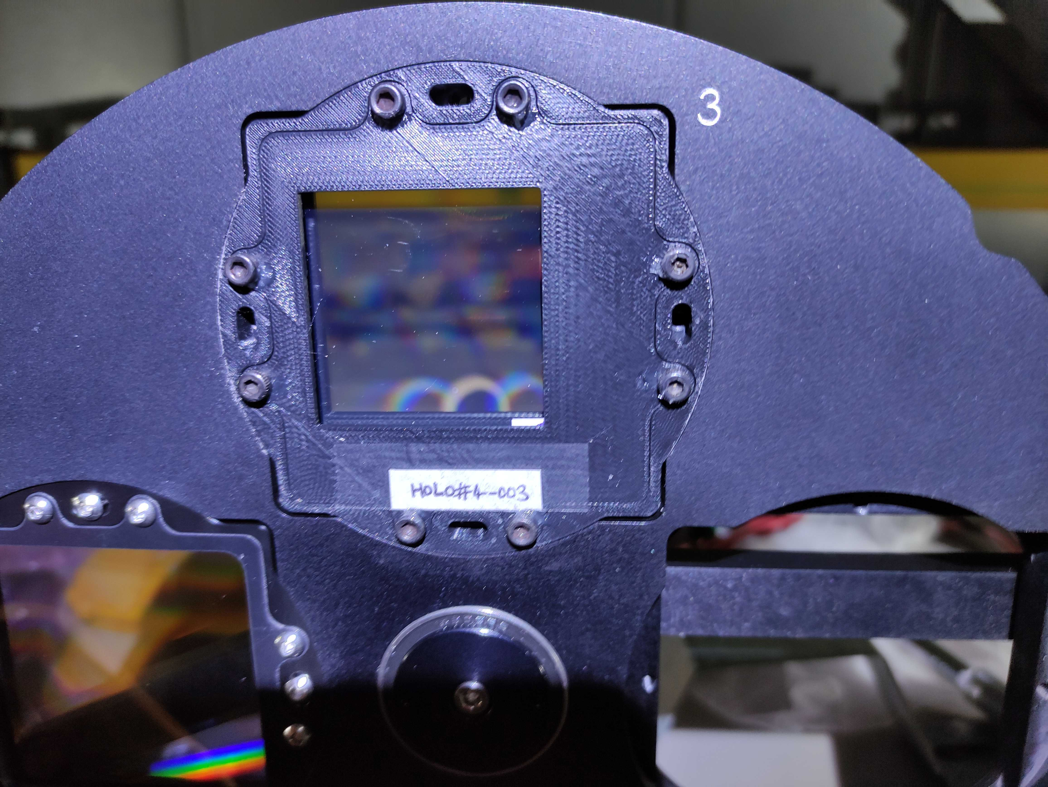
Frame conception for cylindrical lens
plane face behind (side of the detector)
Cylindrical lens
Edmund
17
window
65
62
2.5
15
dispersion
62
Frame center
15
light entrance
side

Slide 18
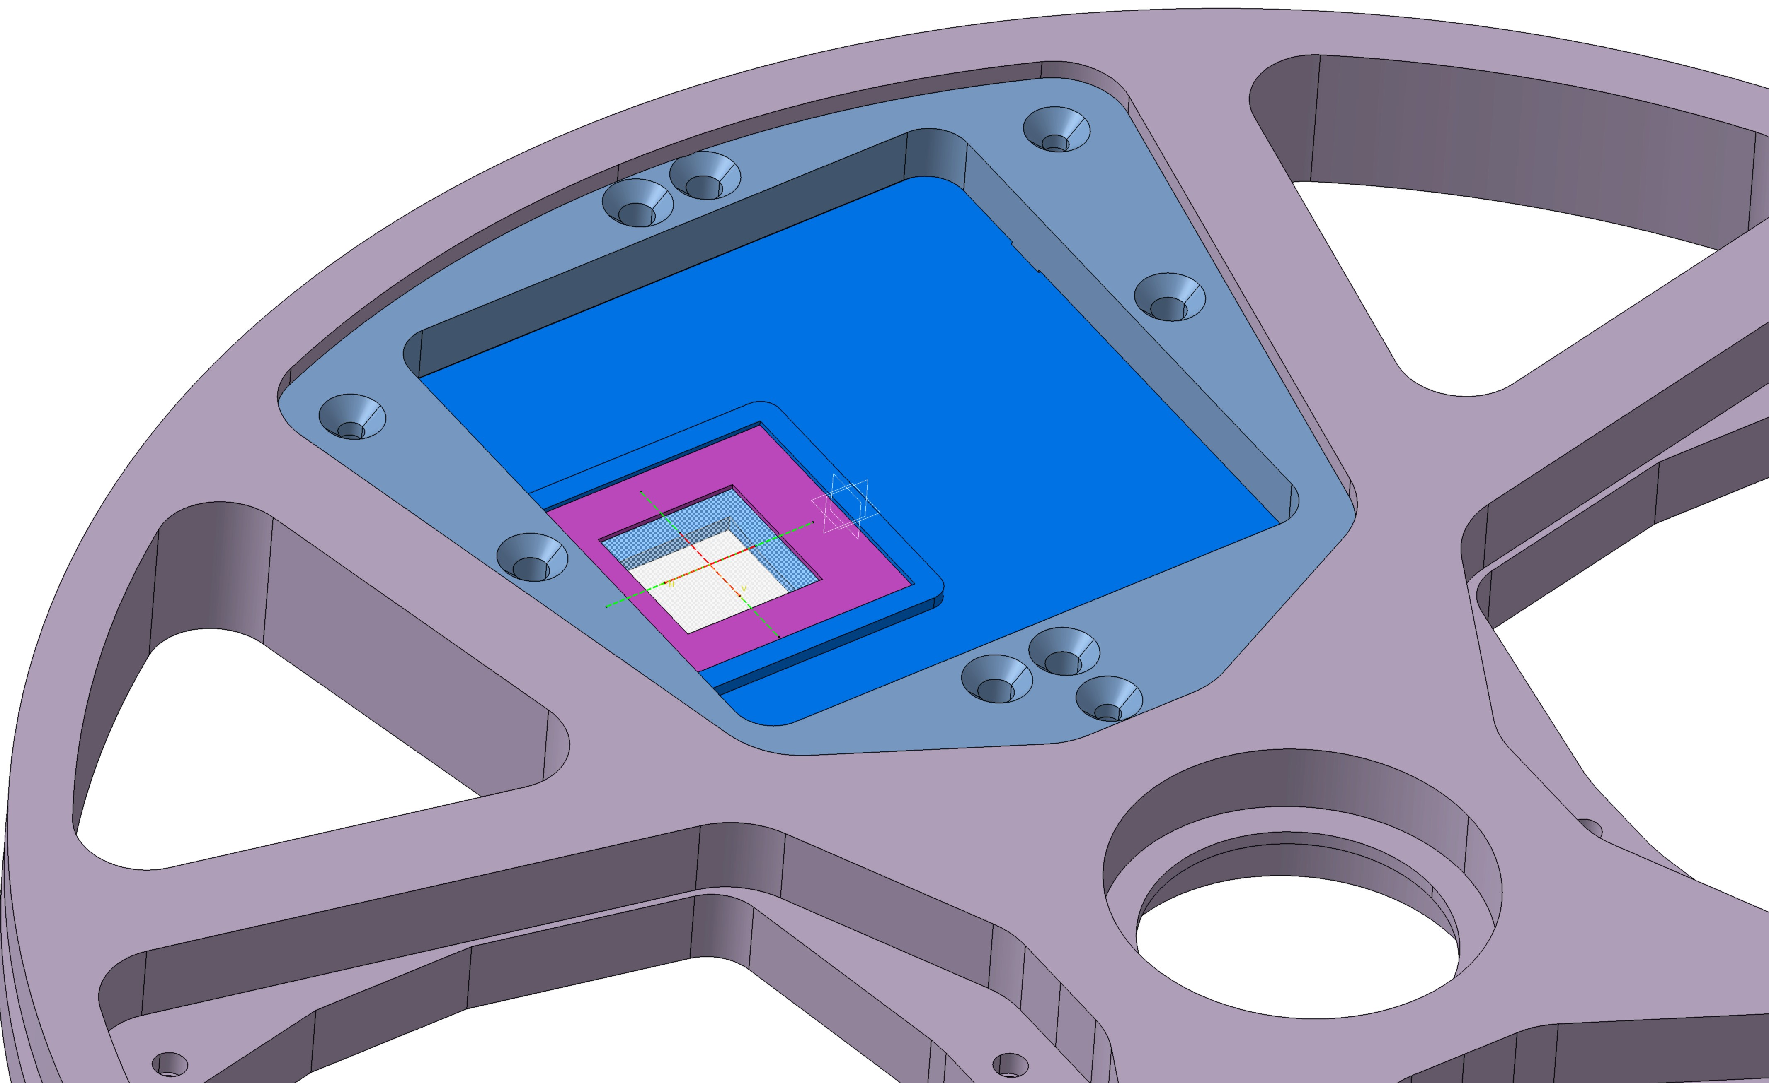
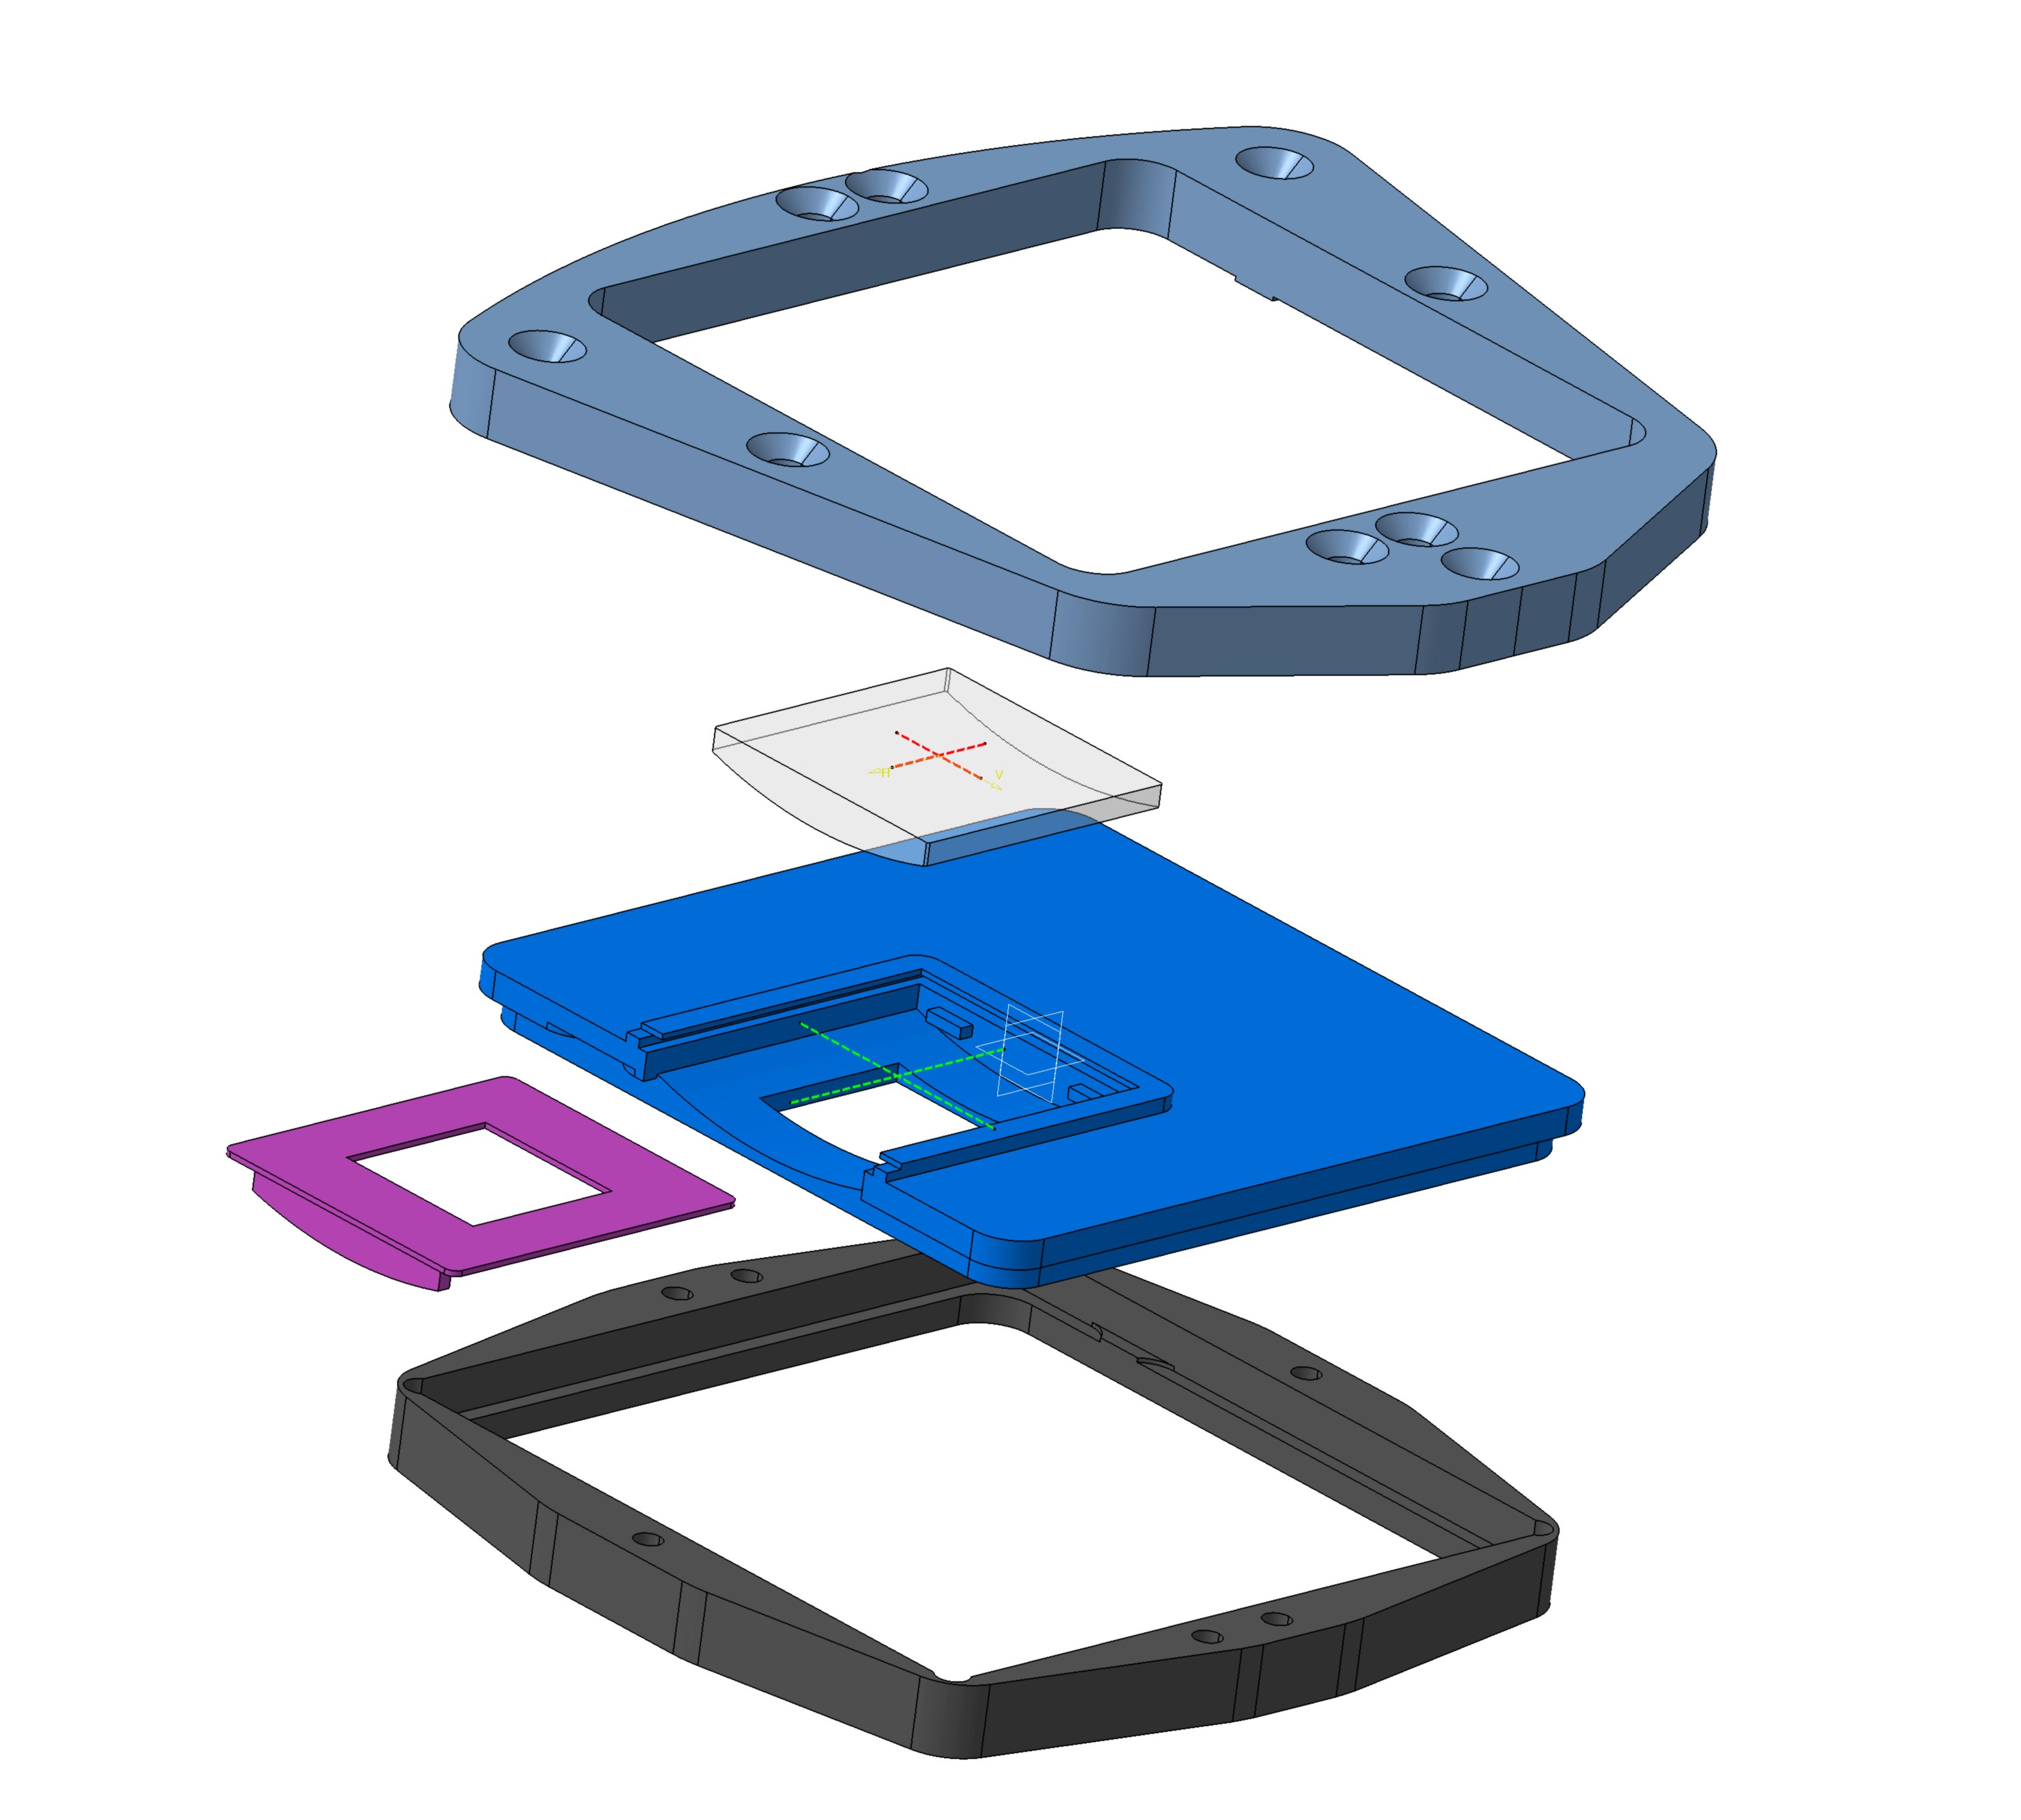
Frame conception

Slide 19
More hardware -> easier analysis for hologram and notch spectra…
Planning:
Cylindrical lens ordered (on the shelve)
Special frame to be inserted in the filter wheel produced with 3D-printer (as the hologram)
tests with these objects should take place on-site at the end of august/september

Slide 20
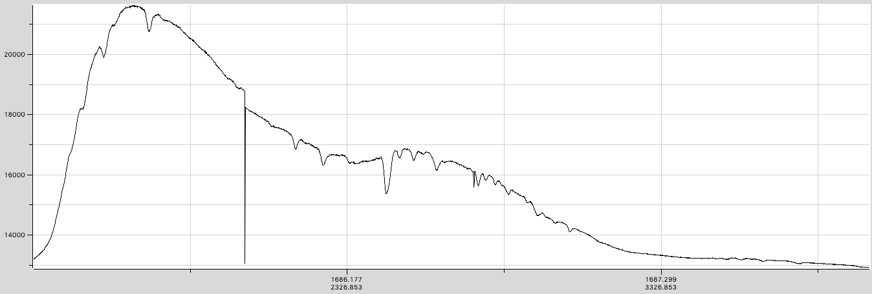
Spectroscopic reduction: état de l’art
SpecTractor operational tool for spectrum extraction
  Forward modelling, taking into account every instrumental effect:
    dispersion law, PSF(λ), focus, 1rst+2nd orders, atmospheric dispersion…
  Separation of 1^{rst} and 2nd diffraction orders now satisfactory
From RAW

Slide 21
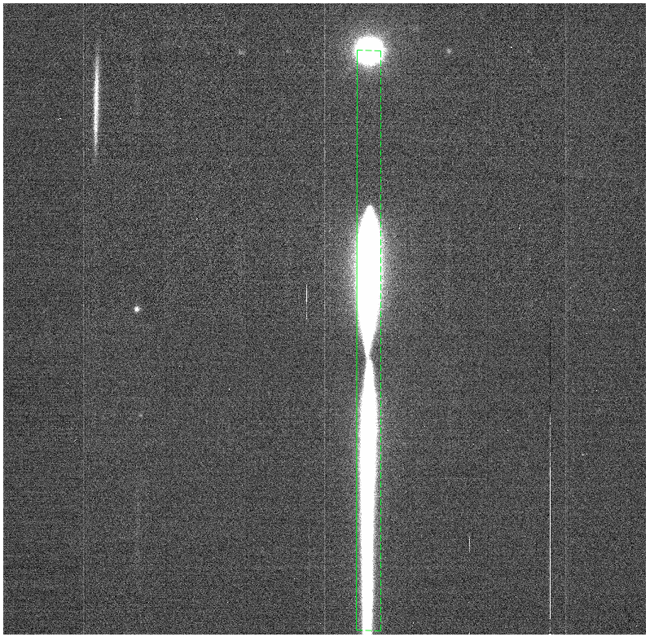
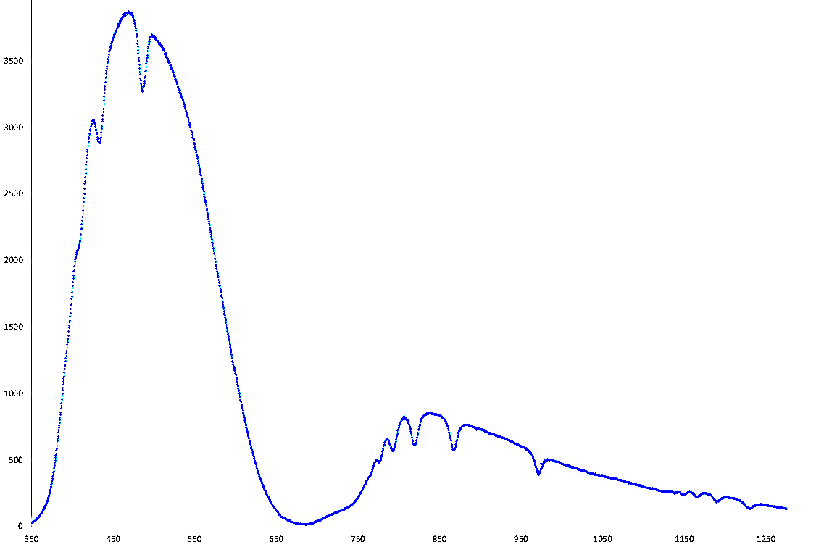
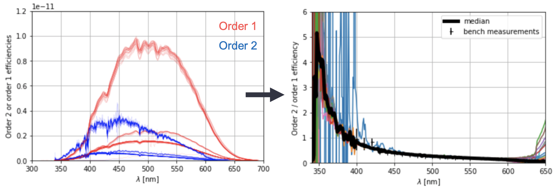
Determination of 2nd order/1rst order
Use spectra with blue filter (125)
Extract separately orders 1 and 2
Compute ratio
Order 1
Projection
Order 2

Slide 22
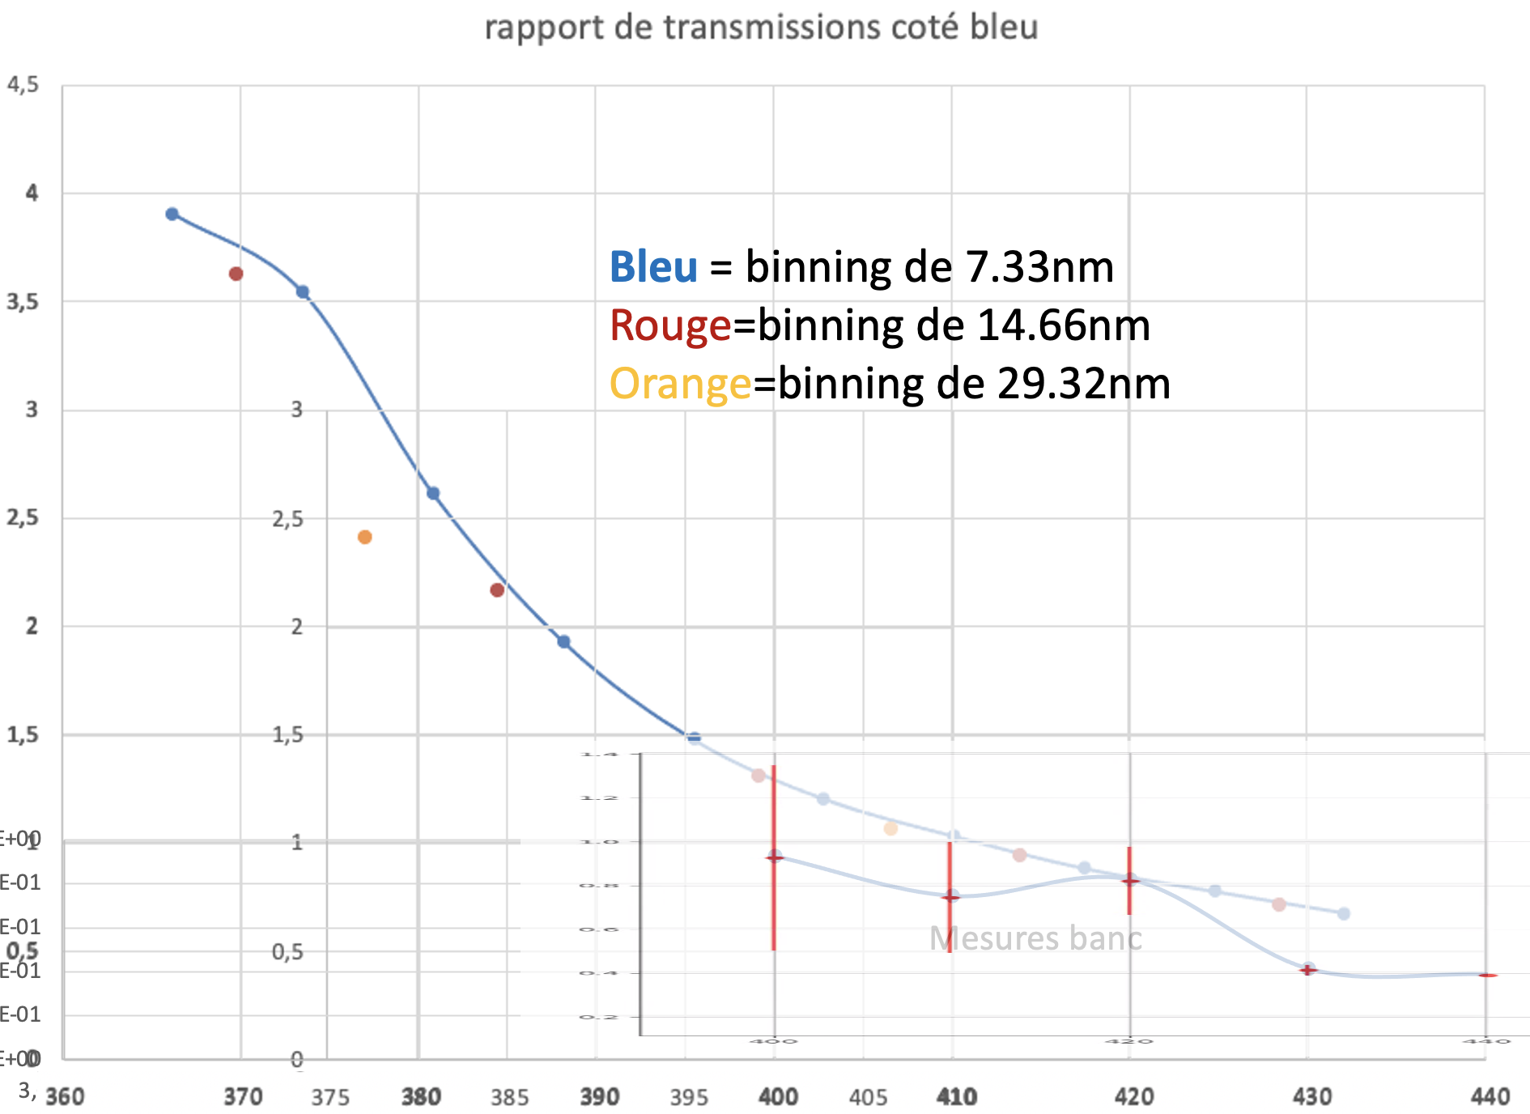
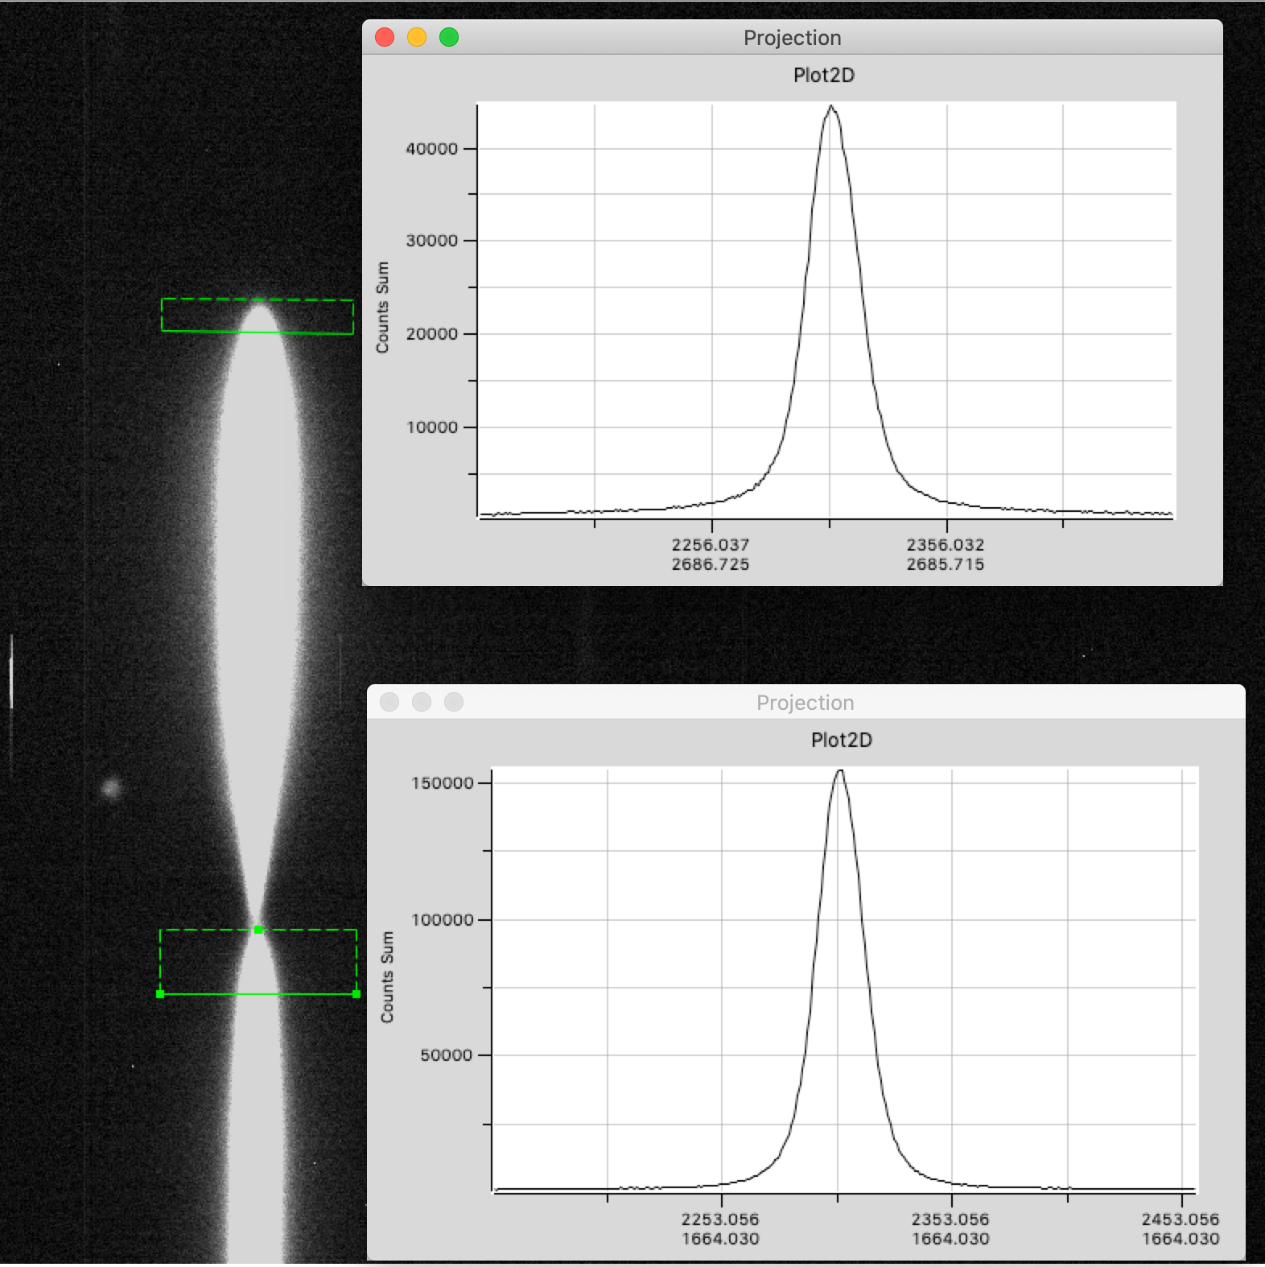
Rapport 2/1 avec Mu-Col en UV
Spectre image 2021110400553_postisrccd.fits : MuCol avec filtre BG40, z = 1.13, seeing = 1.3’’, FWHM spectre autour de 25 pixels.
Rapports flux boite2/boite1
Soustraction bandes latérales
Pas 149.85 traits/mm recalculé à partir de la raie Hγ (à 1 pixel près)
Relation exacte pixel - longueur d’onde
Positionnement précis
Pas de déflatage

Slide 23
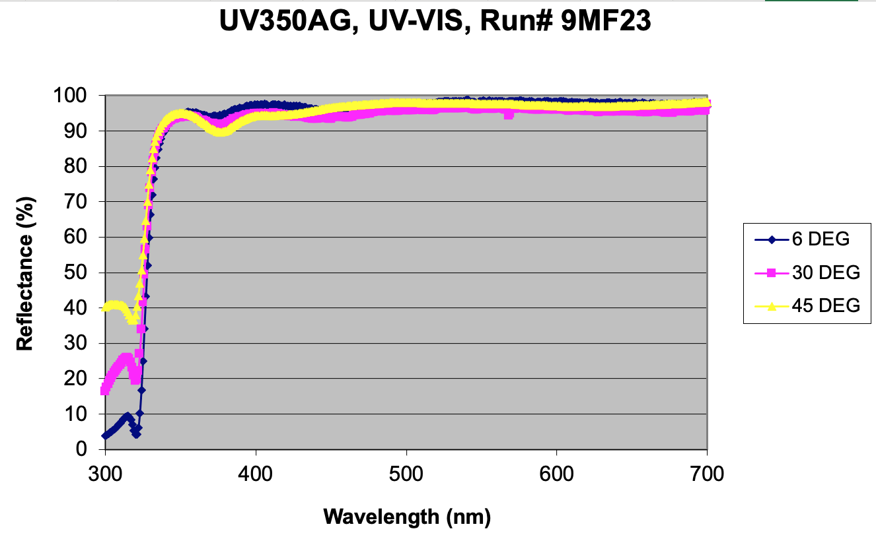




Ingredients of throughput
M2-M3 reflectivity vs λ (theoretical)
M1 reflectivity vs date (measured)
Loss at window entrance/exit
Hologram transmission
(measured/modelized)
CCD efficiency (measured)

Slide 24



Throughput is estimated with Bouguer lines technique (1729)
Example in band [485-515]nm (1rst order)
Series of instrumental magnitudes
- of the same source
- for various aimasses (here 1.23 - 2.1)
- during a period with stable atmosphere
Extrapolation of the line to airmass=0
-> get magnitude OUT OF ATMOSPHERE
-> compare with HST spectrum
-> deduce system throughput in the band
30 june 2022
Only end of night used
(low+stable absorption)
Several measurements duplicated
(and almost identical)
per airmass

Slide 25



Control tool : EQW(O₂) should depend only on airmass x pressure
EQW definition
After checking EQW(O₂), we will measure
EQW(H₂O_{(A)}) and EQW(H₂O_{(B)})
H₂O_{(A)}
H₂O_{(B)}

Slide 26




Color changes due to water vapor
PWV=1mm
2
4
3
6
5
8
7
9
Color variations follow: Scalar(PWV)xVector(type)

Slide 27

Color changes due to water vapor
Impact of PWV on colors
- mainly (i-z) and (z-y)
- described by Scalar(PWV)xVector(type)
- with type linked to (ugrizY)
Impact of aerosol on colors
- mainly (u-g) and (g-r)
- work in progress

Slide 28
COMPLEMENTS

Slide 29


Slide 30


Variability of the atmospheric transmission
(Stubbs et al. PASP, 119: 1163–1178, 2007)
Photometrists use photometric quality nights and narrow band filters
  No cloud
  Low humidity
  Low aerosols
LSST wants to use all nights with wide band filters
  Few clouds (grey absorption)
  Humidity (affects I & Z)
  Aerosol (affects U & G)
After correcting for Airmass:
O₂, O₃, rayleigh can be extracted
Then determine H₂O and aerosol

Slide 31
Spectrograph commissioning results
Objectives of the spectrograph commissioning:
Short term: characterize the spectrograph
- Geometry -> done
- Spectrograph resolution R > 200 within [342, 1100]nm : limited by the seeing (as expected); 2x better for the second order -> ex. H9 absorption line (@383nm) clearly visible. -> OK
- Software: SpecTractor⁽¹⁾ operational, constantly improving -> work in progress
- Checked the equivalent width (EQW) properties -> OK
- Telescope throughputs of 1rst and 2nd orders holographic disperser⁽²⁾ with Bouguer lines -> work in progress, near to end (needs one « ideal » photometric night to consolidate).
- + a faint V=11.3 standard gives « enough » signal in 30s for spectroscopy
Long term: Estimate colour corrections, as functions of the airmass, atmospheric conditions and the object UGRIZY in every LSST field -> work in progress (Martin Rodriguez-Monroy)
  Either with an atmospheric model established from the follow-up of standards throughout the night
    -> Check the predictivity of the model versus airmass AND versus azimuth
  And / or with simultaneous measurements near the LSST field (needs secondary standards and observation strategy to « follow » LSST)
    -> Rely on GAIA DR of spectra
(1) Paper in preparation (2) MNRAS 506, 5589–5605 (2021). 2nd paper in preparation.

Slide 32



Hologram for AuxTel
Goal : measure atmospheric parameters by extracting spectrum of standards
Constraints
  Easily switch imager / spectro.
  Incident beam perpendicular to CCD-plane
  Converging beam (not parallel)
Usual gratings:
  Strong defocus due to optical path variations with the diffraction angle
  Distorsion when used with a converging beam
Holographic grating:
  forced focus on the focal plane at all wavelengths: 0th and 1rst order at same focus
  No distorsion by design of hologram

Slide 33



Holographic element characterization
Geometry: 2 scans (wide and fine meshes); changing position of the 0 order star
Determination of the nominal zero order position (1750, 300) -> determined with
< 0.5 mm precision
Transmission is found constant within >1mm from nominal position
Good focus along the full λ [342-1100]nm scale -> one of the main improvements w/r Ronchi grating
Transmission efficiency -> up to 3x more than Ronchi (depending on λ)
Shows the dispersion direction if zero order is here

Slide 34




Estimating a lower limit of resolution, using narrow emission lines of
Planetary nebula Hen 2-113
-> lower limits on R=λ/Δλ (because extended object)
-> focus OK for all λ
star
star
R α 200
(seeing/object size limited)
star
star
star
Hologram, Texp=60s
R α 100
(seeing/object size limited)
spectrum from
le Bertre et al. 1989, A&A, 225, 417
H_{𝜸}
H_{𝞫}
OII
SIII
SIII
400
500
600
H⍺
700
CII
O₂
800
900
434 nm
656 nm
O₂
953 nm
486 nm
762 nm
907nm
967 nm
486 nm
656 nm
762 nm

Slide 35

Transmission efficiency model vs test-bench measurements
Transmissions:
Model (lines)
Data (points)
Caracteristic curve of holographic emulsion
λ=400nm
λ=639nm
λ=1000nm
UV transmissions measured on sky (Bouguer lines): in progress
Phase delay profile of holographic grating

Slide 36




Auxtel : First estimates of atmospheric parameters
Atmospheric absorption lines
EQW depends on atmosphere
O₂ atm. absorption lines
O₃ atm. absorption bands
H₂O atm. absorption bands
Stellar lines
EQW independent on atmosphere
Variation of EQW for atmospheric lines illustrates sensitivity to atmospheric parameters (EQW)
H_{γ}
H_{β}
H_{α}
H₂O
(720nm)
O₂
(760nm)
H₂O
(820nm)
data/simu(LibRadTran) for several hypothesis (PWV)
H₂O
H₂O
H₂O
EQW definition
  ‘’fit’’ H₂O :
  PWV ~ 3.2mm

Slide 37
Atmospheric studies
Objective of the AuxTel calibration:
Estimate colour corrections to vector (UGRIZY)_{LSST} for each object, as a function of
- the atmospheric parameters (airmass, PWV, τ_{VAOD} ) -> the baseline
- or the directly measured atmospheric transmission function
T_{atm}(λ, RA, Dec) synchroneously within the LSST field
What are the orders of magnitude of the corrections ?
From simulation: atmospheric fluctuations induce typically less than 10mmag (max. ~30mmag @ airmass=2 for cold stars) residual colour variations per airmass after removing grey common absorption
-> Correction precision δC needs to be such that:
0.010 x δC < wanted resolution
i.e. δC=50% for 5mmag / 10% for 1mmag

Slide 38

Characterizing the AuxTel throughput with Bouguer lines to measure separately order1 and order 2 transmissions versus λ
Spectrum extraction software (SpecTractor) needs the global throughput of the system for each diffraction order p:
T_{p}(λ) = τ(λ)_{telescope} . τ_{p}(λ)_{disperser} . ε_{CCD}(λ)
-> Obtained by the ratio of instrumental out-of-atmosphere flux to HST reference flux (as a function of λ)
If constant atmospheric conditions, instrumental magnitude@λ follows a Bouguer line in airmass z:
m_{p}(λ,z)_{instrumental} = m(λ)_{SED-HST} + A_{atm}(λ) . z + 2.5.Log[T_{p}(λ)]
At a given λ, extrapolating the line from the series of m_{p}(λ,z)_{instrumental} to z=0 airmass gives out-of-atmosphere instrumental magnitude and allows to deduce the throughput from:
m_{p}(λ,0)_{instrumental} = m(λ)_{SED-HST} + 2.5.Log[T_{p}(λ)]
Series of m_{p}(λ,z)_{instrumental}
λ
Slope depends on λ
Requirements
-> (at least) one photometric night (i.e. stable atmosphere) to obtain long series of spectra.
-> The same star needs to be measured during the same night in the widest airmass domain.
-> large # of measurements allows better determination of the slopes and of z=0 extrapolation.
Extrapolated m_{p}(λ,0)_{instrumental}
z

Slide 39



Measurement of Bouguer lines
Example of a
Bouguer line
HD142331 trajectory in airmass
Only end of night used
(low+stable absorption)
Instrumental magnitude vs airmass
Out of atm.
SED
Measured
spectra
Spectra integrated in bins of 30 nm width
Extrapolated out of atmosphere instrumental magnitudes in narrow [30nm] bandwidth
Notes:
The night is not photometric, however we convince ourself that the the second part of the night have lower absorption and seems for stable.
The we remains with few usable exposures to construct Bouguer lines.
Top right : this is and example of Bouguer line, but the chi2 per degree of fredoom is above 6.
Bottom right : this is the set of Bouger lines from which one can reconstruct the Throughputs.

Slide 40
Establishing correction procedures
We did predictions from simulations, based on parametrization with (z, PWV, VAOD). But O₃ , O₂ and cloud absorption (grey) can also be parameters.
The methods have to be systematically checked for every atmospheric situation:
  Predictability of the correction in (airmass, azimuth)
  Needs observation of CALSPEC standards through entire nights (to estimate atm. parameters) AND various fields in (airmass, azimuth) containing standards to test the prediction. « ronde des standards ».
Alternative: directly measure atm. transmission in the same direction than LSST, using secondary spectrophotometric standards measured out of atmosphere by GAIA.
We checked that spectra of stars as faint as M=10 are measurable in 30s with s/b>100

